Slide 1
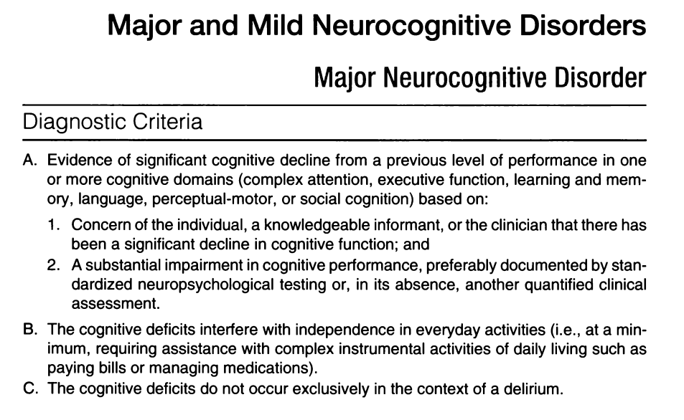
DSM-5

Slide 2
DSM-5

Slide 3
DSM-5

Slide 4
DSM-5

Slide 5
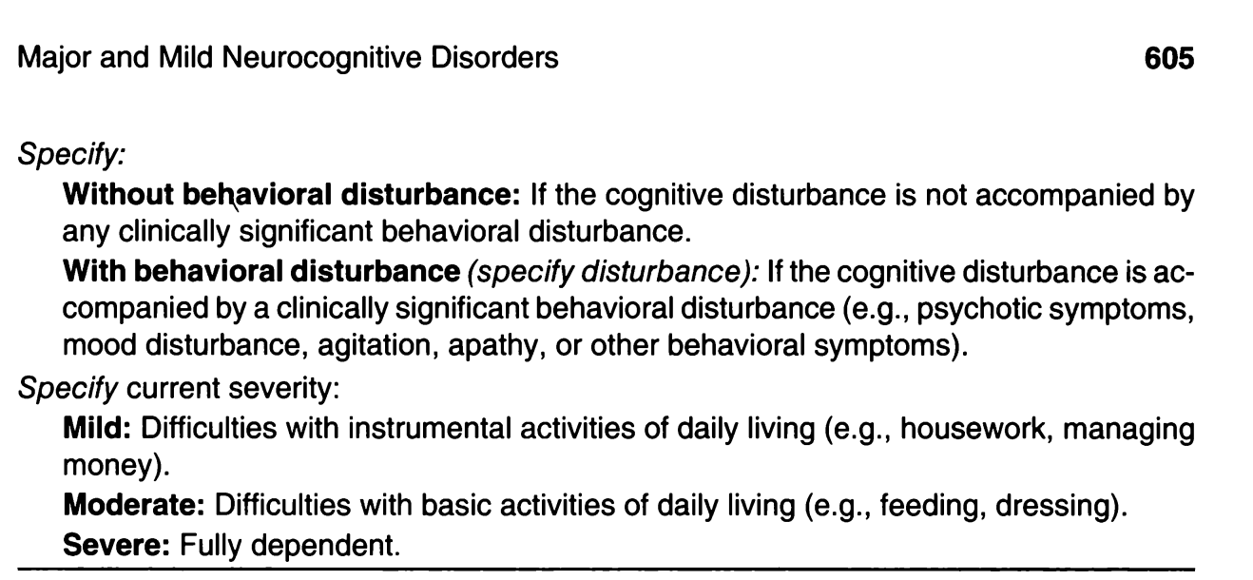

Slide 14
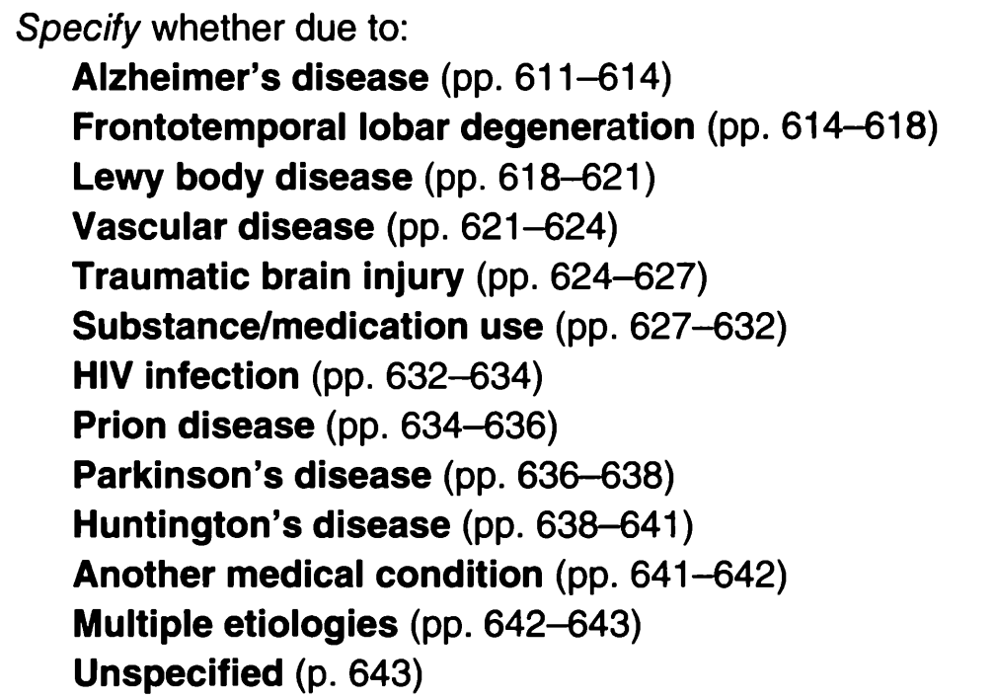

Slide 16
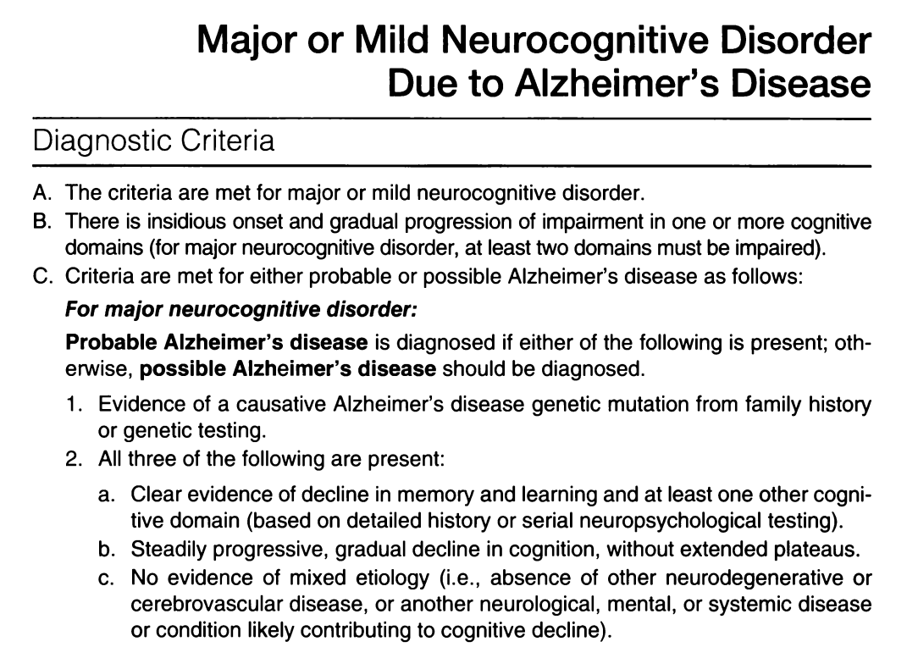

Slide 19
or

Slide 20
or

Slide 21
or

Slide 22
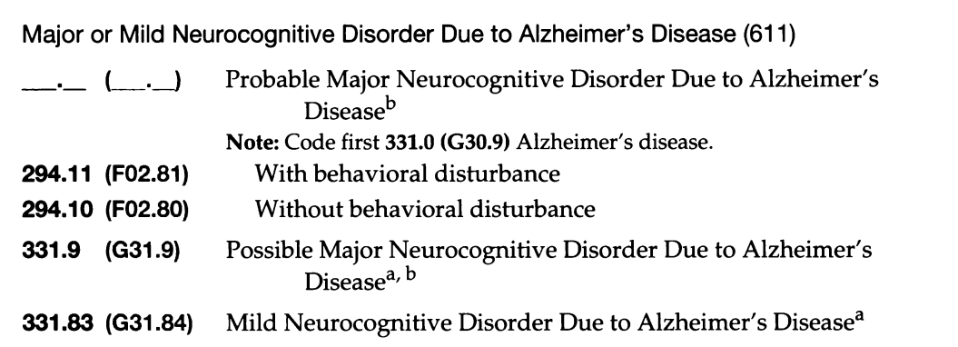

Slide 24
There are no objective biomedical tests to diagnose any mental illness.

Slide 25
There are no objective biomedical tests to diagnose any mental illness.
DSM defines symptom clusters, not medical diagnoses.

Slide 26
There are no objective biomedical tests to diagnose any mental illness.
DSM defines symptom clusters, not medical diagnoses.
Neurocognitive disorder is a symptom cluster.

Slide 27
There are no objective biomedical tests to diagnose any mental illness.
DSM defines symptom clusters, not medical diagnoses.
Neurocognitive disorder is a symptom cluster.
Alzheimer’s disease is a medical diagnosis.

Slide 28
There are no objective biomedical tests to diagnose any mental illness.
DSM defines symptom clusters, not medical diagnoses.
Neurocognitive disorder is a symptom cluster.
Alzheimer’s disease is a medical diagnosis.
Medications are approved for Alzheimer’s dementia not neurocognitive disorder.

Slide 29
There are no objective biomedical tests to diagnose any mental illness.
DSM defines symptom clusters, not medical diagnoses.
Neurocognitive disorder is a symptom cluster.
Alzheimer’s disease is a medical diagnosis.
Medications are approved for Alzheimer’s dementia not neurocognitive disorder.

Slide 30
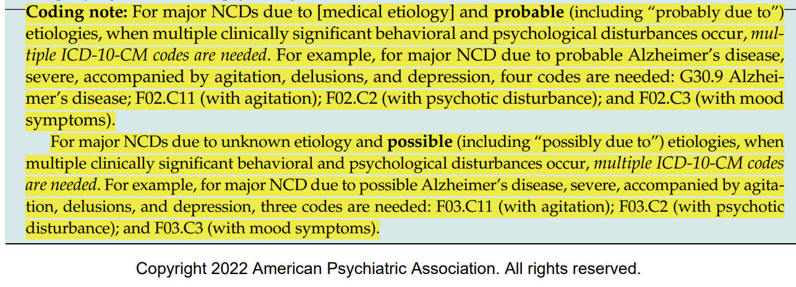
DSM-5-TR update

Slide 32
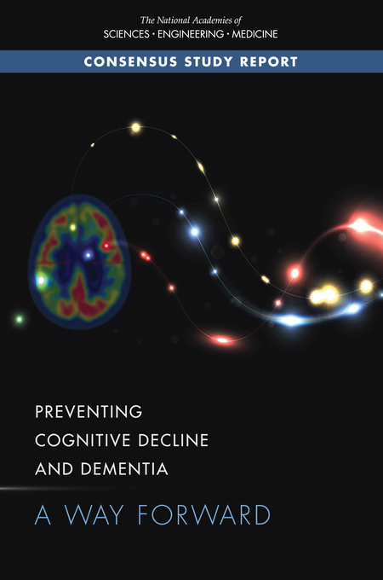
Not DSM-5
2017
Age-related cognitive decline (ARCD):
Deterioration in cognitive performance that can be a normal part of aging.
Sometimes referred to as cognitive aging.
National Academies of Sciences, Engineering, and Medicine; Health and Medicine Division; Board on Health Sciences Policy; Committee on Preventing Dementia and Cognitive Impairment. Preventing Cognitive Decline and Dementia: A Way Forward. Downey A, Stroud C, Landis S, Leshner AI, editors. Washington (DC): National Academies Press (US); 2017 Jun 22. PMID: 28650595.

Slide 33
Not DSM-5
2017
Age-related cognitive decline (ARCD):
Deterioration in cognitive performance that can be a normal part of aging.
Sometimes referred to as cognitive aging.
Mild cognitive impairment (MCI):
Cognitive impairment that has reached
a level of deterioration from normal cognitive function identifiable by individuals, family members, or clinicians, but without significant functional impairment in daily activities
Individuals may have mild functional impairments but can adapt to them.
~ “pre-dementia”

Slide 34
Not DSM-5
2017
Age-related cognitive decline (ARCD):
Deterioration in cognitive performance that can be a normal part of aging.
Sometimes referred to as cognitive aging.
Mild cognitive impairment (MCI):
Cognitive impairment that has reached
a level of deterioration from normal cognitive function identifiable by individuals, family members, or clinicians, but without significant functional impairment in daily activities
Individuals may have mild functional impairments but can adapt to them.
~ “pre-dementia”
MCI does not equal mild neurocognitive disorder.

Slide 35
Not DSM-5
~ DSM-5 Possible or Probable Mild / Major Neurocognitive Disorder Due to Alzheimer's Disease
2017
Alzheimer’s-type dementia:
Cognitive impairment severe enough that an individual can no longer function independently
May be due to Alzheimer’s disease (i.e., the abnormal buildup of amyloid and tau proteins in the brain)...
Or to “mixed” causes of dementia, such as Alzheimer’s disease combined with:
Lewy body dementia (alpha-synuclein)
Limbic-Predominant Age-Related TDP-43 Encephalopathy (LATE)
Cerebrovascular disease
National Academies of Sciences, Engineering, and Medicine; Health and Medicine Division; Board on Health Sciences Policy; Committee on Preventing Dementia and Cognitive Impairment. Preventing Cognitive Decline and Dementia: A Way Forward. Downey A, Stroud C, Landis S, Leshner AI, editors. Washington (DC): National Academies Press (US); 2017 Jun 22. PMID: 28650595.

Slide 36
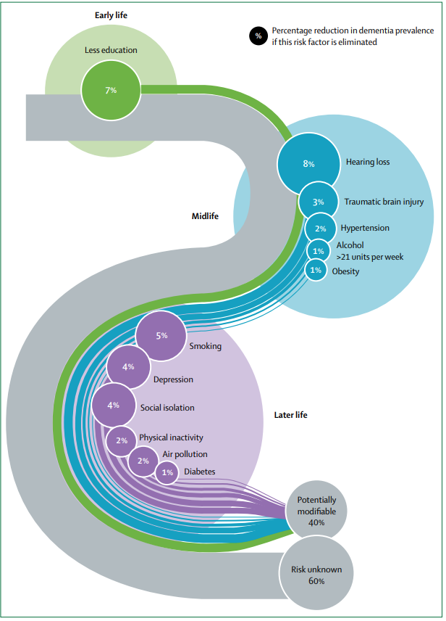
?
Modifying 12 risk factors might prevent or delay up to 40% of dementias.
Contributions to the risk and mitigation of dementia continue throughout life, so it is never too early.
?

Slide 37
?
45 – 65

Slide 38
45 – 65

Slide 39
Bilateral, untreated
45 – 65

Slide 40
?
65+

Slide 41
65+
Probably could decrease to 50% if you add healthy diet, sleep, and treatment of other mental disorders

Slide 42
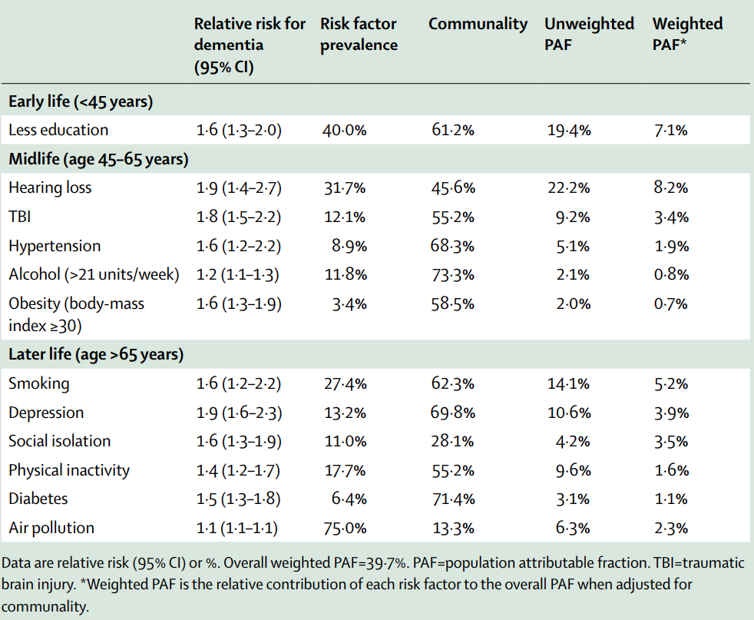
?

Slide 44
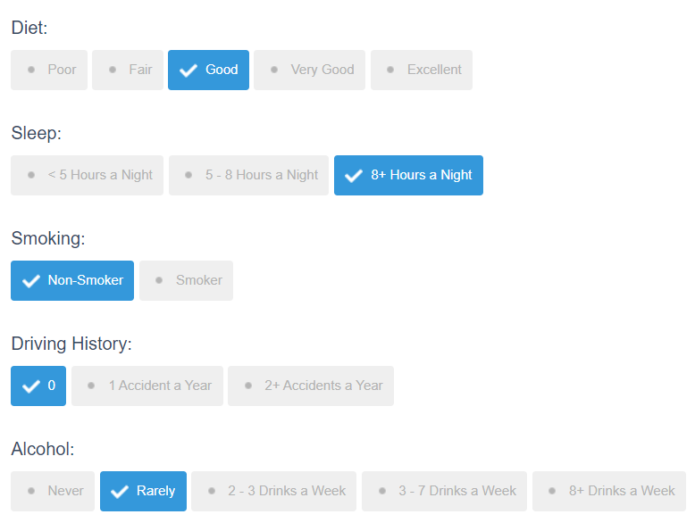
Your predicted future healthy years is 46.9 Years
Your predicted future unhealthy years is 2.3 Years (4.7 years if disabled by a cognitive disease)
Your predicted age at death is 97.2 Years (2072)
By exercising more you can increase your healthy life expectancy by 3.1 years.

Slide 45
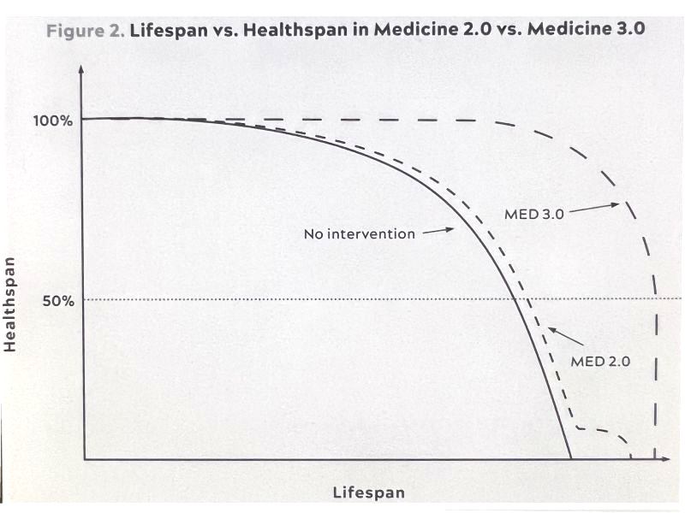
Peter Attia, Outlive

Slide 46
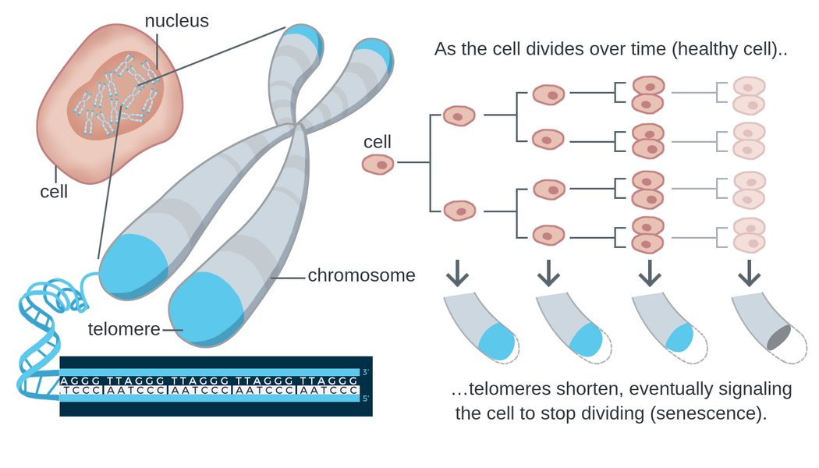
Telomere shortening is a biomarker of aging.
REVIEW article
Front. Psychiatry, 29 September 2020
Sec. Mood Disorders
https://doi.org/10.3389/fpsyt.2020.586083
This article is part of the Research Topic
Neurobiological Underpinnings of Bipolar Disorder and its Treatment
View all 6 Articles
Lithium and the Interplay Between Telomeres and Mitochondria in Bipolar Disorder
Mitochondrial dysfunction and telomere shortening have been implicated in both the pathophysiology of bipolar disorder and as targets of lithium treatment. Interestingly, it has in recent years become clear that these phenomena are intimately linked, partly through reactive oxygen species signaling and the subcellular translocation and non-canonical actions of telomerase reverse transcriptase. In this review, we integrate the current understanding of mitochondrial dysfunction, oxidative stress and telomere shortening in bipolar disorder with documented effects of lithium. Moreover, we propose that lithium’s mechanism of action is intimately connected with the interdependent regulation of mitochondrial bioenergetics and telomere maintenance.
Notes:
There are biomarkers that can estimate the biologic age of various organs, including the length of telomeres. Telomeres form protective caps at the ends of chromosomes.

Slide 47
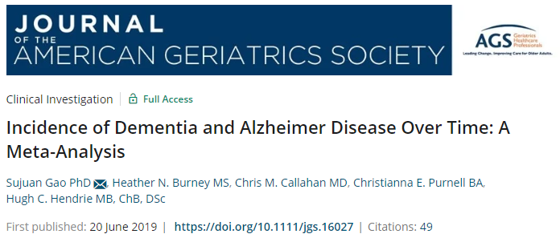
Incidence rates of dementia declined over the past four decades...
but AD incidence rates did not decline.
The decline was in vascular dementia.
?

Slide 48
Incidence rates of dementia declined over the past four decades...
but AD incidence rates did not decline.
The decline was in vascular dementia.

Slide 49
Antihypertensive treatment for hypertension is the only proven effective preventive medication for dementia.
?

Slide 50
Antihypertensive treatment for hypertension is the only proven effective preventive medication for dementia.

Slide 51
Antihypertensive treatment for hypertension is the only proven effective preventive medication for dementia.
Aim to maintain systolic BP of 130 mm Hg or less from around age 40 years
?

Slide 52
Antihypertensive treatment for hypertension is the only proven effective preventive medication for dementia.
Aim to maintain systolic BP of 130 mm Hg or less from around age 40 years

Slide 53
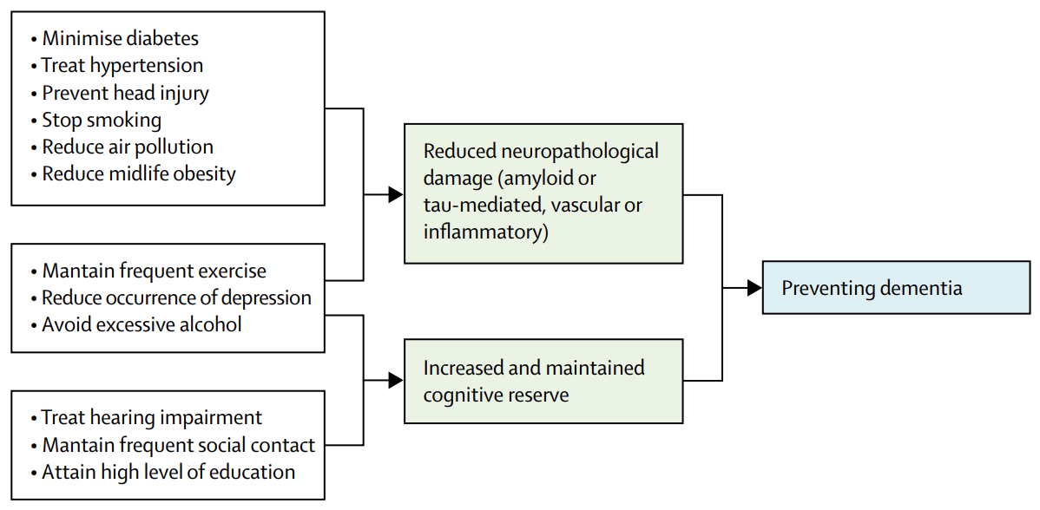
?

Slide 54
?

Slide 55
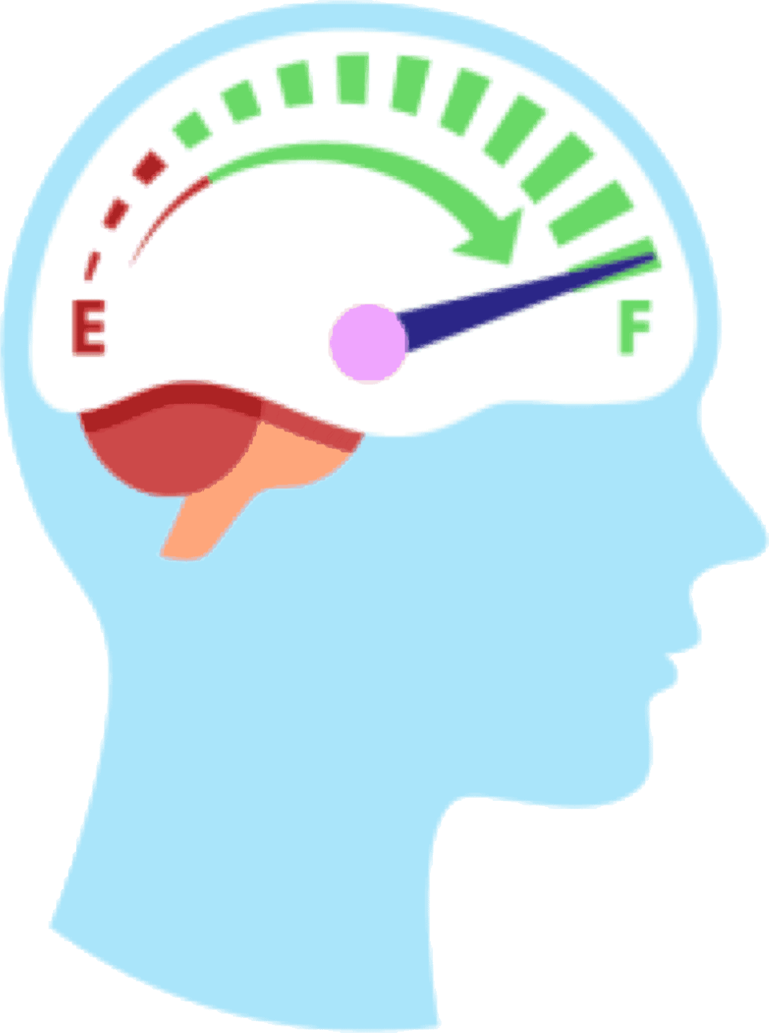
?

Slide 56
?

Slide 57
?

Slide 58
*

Slide 59
*
*All mental disorders reduce life span by about 10 years

Slide 60
Which individuals should be especially concerned with preventing Alzheimer’s-type dementia?

Slide 61
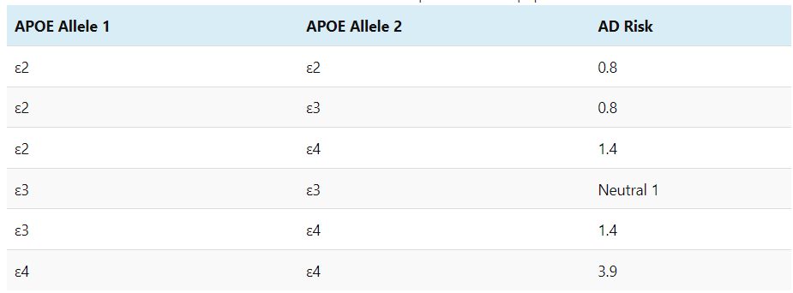
Which individuals should be especially concerned with preventing Alzheimer’s-type dementia?
apolipoprotein E (APOE)

Slide 62
Which individuals should be especially concerned with preventing Alzheimer’s-type dementia?
apolipoprotein E (APOE)
ε3 = neutral

Slide 63
Which individuals should be especially concerned with preventing Alzheimer’s-type dementia?
apolipoprotein E (APOE)
ε3 = neutral
ε2 = protective

Slide 64
Which individuals should be especially concerned with preventing Alzheimer’s-type dementia?
apolipoprotein E (APOE)
2-3%
ε3 = neutral
ε2 = protective
ε4 = bad

Slide 65
Which individuals should be especially concerned with preventing Alzheimer’s-type dementia?
The 2-3% with 2 copies of the APOE4 allele
2-3%
ε3 = neutral
ε2 = protective
ε4 = bad

Slide 66
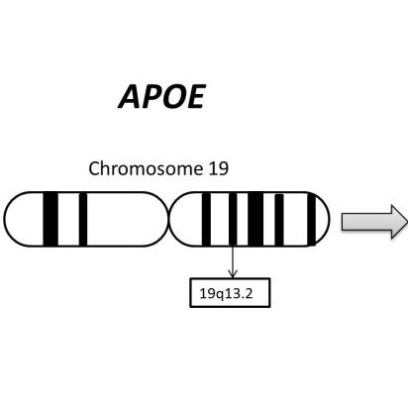
Apolipoprotein (apo) E
a key regulator of plasma lipid levels
regulator of amyloid beta (Aβ) deposition, aggregation and clearance
Protective effect on neurons
Neutral protective effect on neurons
Damaging effect on neurons, increased risk of Alzheimer’s

Slide 67
Apolipoprotein (apo) E genotypes
Protective effect on neurons
Highly associated with longevity
Neutral protective effect on neurons
The most common
Damaging effect on neurons, increased risk of Alzheimer’s
Less likely to live > 100

Slide 68
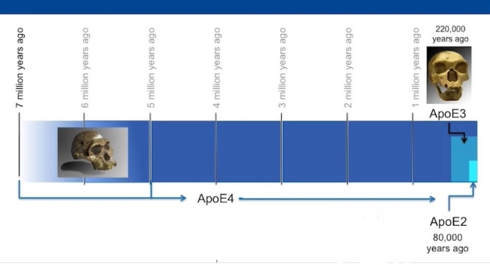
Which individuals should be especially concerned with preventing Alzheimer’s-type dementia?
The 2-3% with 2 copies of the APOE4 allele

Slide 69
Which individuals should be especially concerned with preventing Alzheimer’s-type dementia?
The 2-3% with 2 copies of the APOE4 allele

Slide 70
Which individuals should be especially concerned with preventing Alzheimer’s-type dementia?
The 2-3% with 2 copies of the APOE4 allele

Slide 71
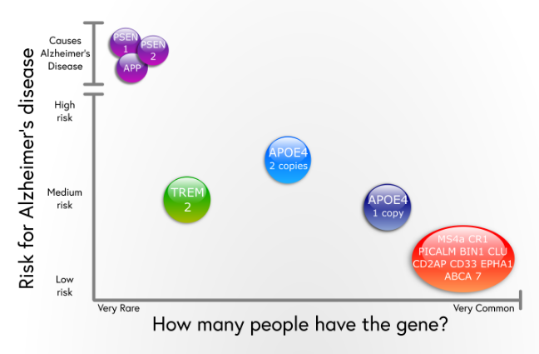
Which individuals should be especially concerned with preventing Alzheimer’s-type dementia?
The 2-3% with 2 copies of the APOE4 allele

Slide 72
Which individuals should be especially concerned with preventing Alzheimer’s-type dementia?
The 2-3% with 2 copies of the APOE4 allele

Slide 73
Which individuals should be especially concerned with preventing Alzheimer’s-type dementia?
The 2-3% with 2 copies of the APOE4 allele

Slide 74
Which individuals should be especially concerned with preventing Alzheimer’s-type dementia?
The 2-3% with 2 copies of the APOE4 allele
2-3%

Slide 75
Which individuals should be especially concerned with preventing Alzheimer’s-type dementia?
The 2-3% with 2 copies of the APOE4 allele
2-3%

Slide 76
Which individuals should be especially concerned with preventing Alzheimer’s-type dementia?
The 2-3% with 2 copies of the APOE4 allele
2-3%

Slide 77
Which individuals should be especially concerned with preventing Alzheimer’s-type dementia?
The 2-3% with 2 copies of the APOE4 allele
2-3%

Slide 78
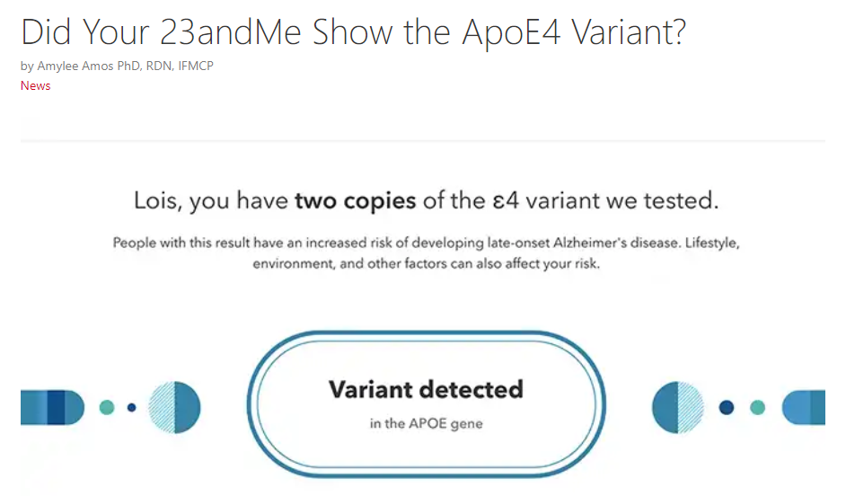

Slide 79
APOE4 wiki - all about what to do
https://wiki.apoe4.info

Slide 80
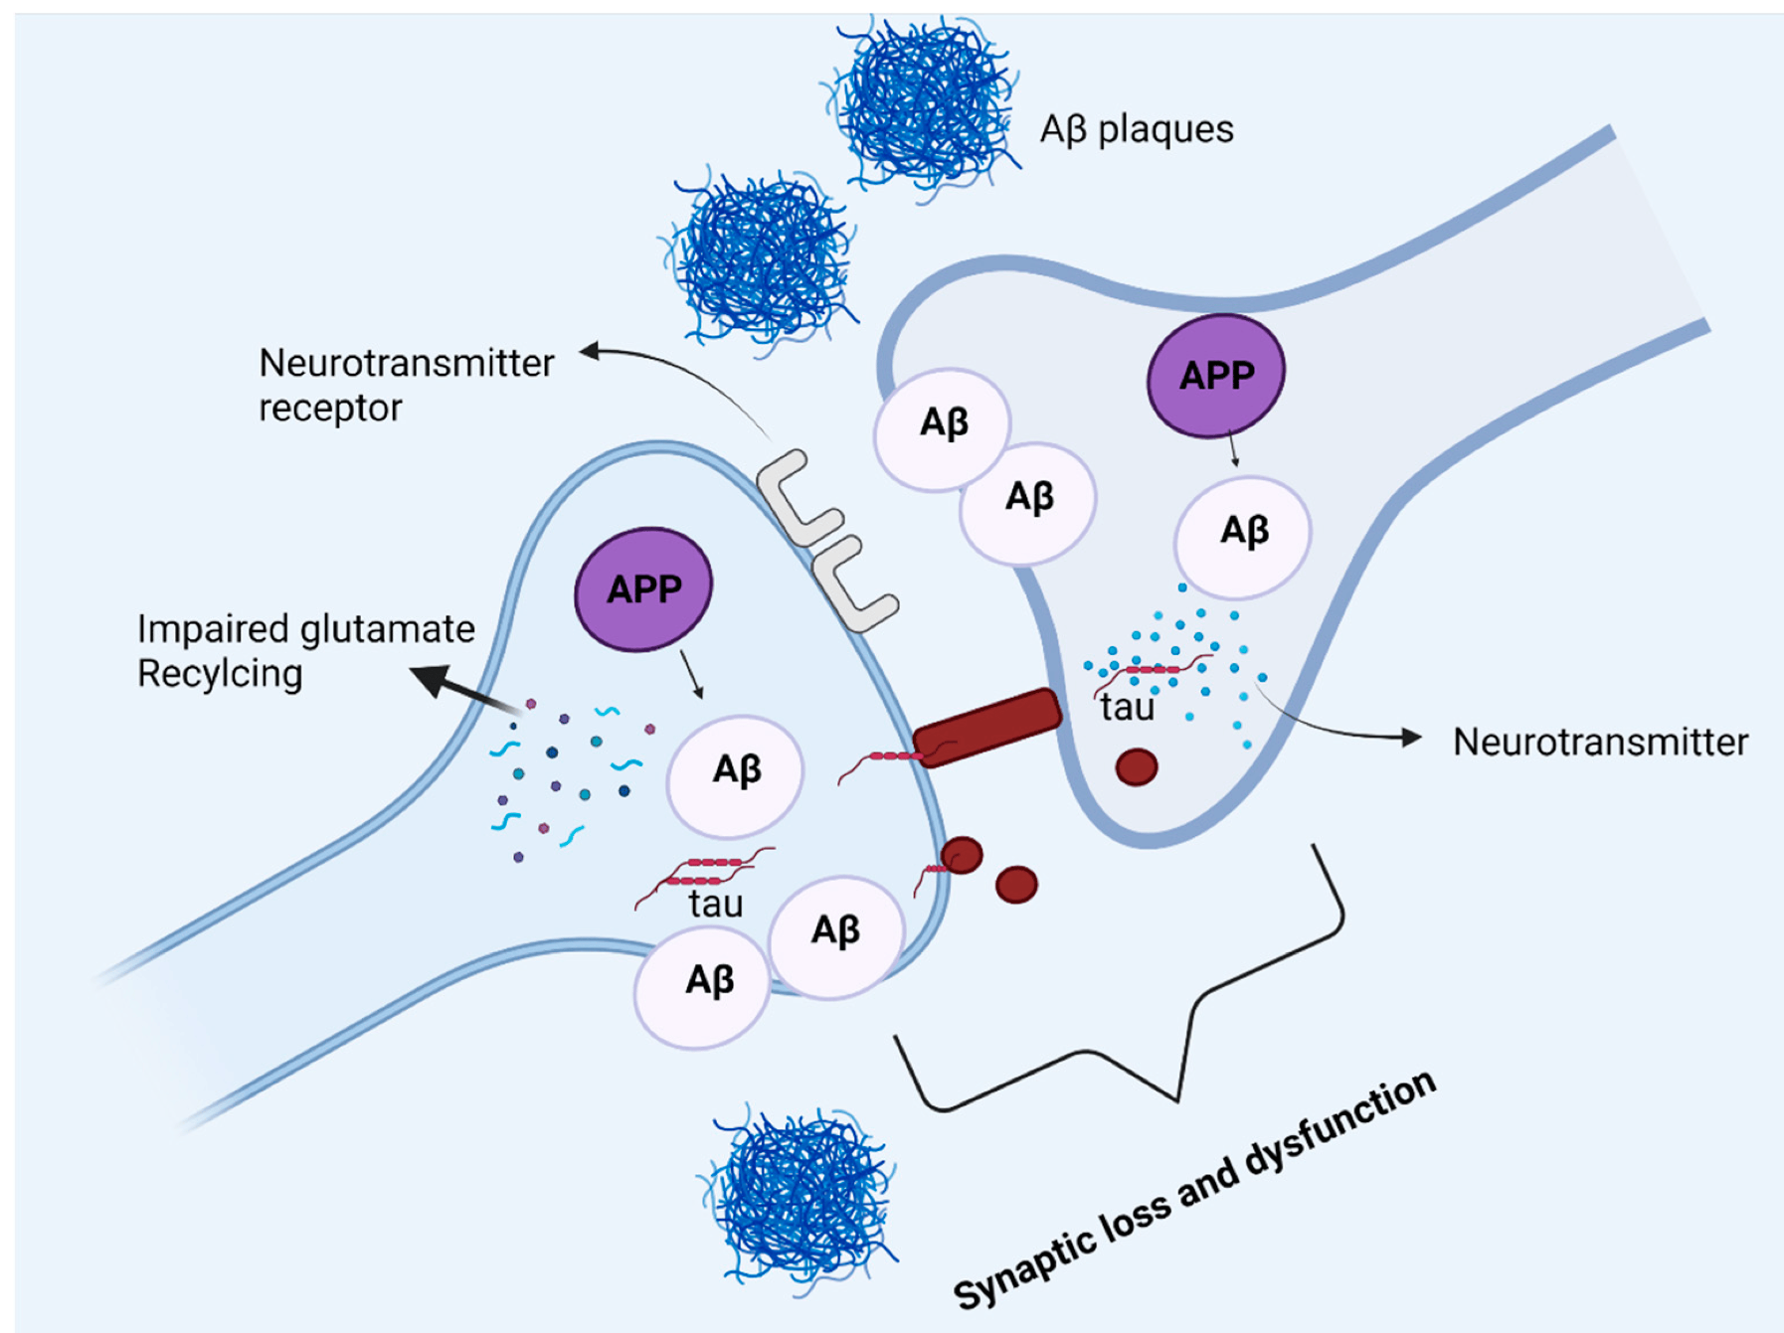
Alzheimer’s dementia is caused by plaques and tangles:
Sehar, U., Rawat, P., Reddy, A. P., Kopel, J., & Reddy, P. H. (2022). Amyloid beta in aging and Alzheimer’s disease. International journal of molecular sciences, 23(21), 12924.
Notes:
https://www.mdpi.com/1422-0067/23/21/12924
Figure 5. Amyloid beta and tau protein at the synapse. In Alzheimer’s disease, amyloid precursor protein is processed into amyloid beta peptides that accumulate inside and outside the neuronal cells and form plaques. The deposition of amyloid plaques in the vicinity of the synapse causes synaptic loss and dysfunction. Moreover, glutamate recycling is also dysregulated in the presence of pathological amyloid beta levels in neurons. The soluble, hyperphosphorylated tau protein can directly move across the plasma membrane, or by another mechanism where the formation of nanotubules helps the translocation of tau intracellularly. The synergetic pathology of Aβ and tau at synapse causes synaptic loss and dysfunction.

Slide 81
Alzheimer’s dementia is caused by plaques and tangles:
β-amyloid (Aβ) plaques
Sehar, U., Rawat, P., Reddy, A. P., Kopel, J., & Reddy, P. H. (2022). Amyloid beta in aging and Alzheimer’s disease. International journal of molecular sciences, 23(21), 12924.
Notes:
https://www.mdpi.com/1422-0067/23/21/12924
Figure 5. Amyloid beta and tau protein at the synapse. In Alzheimer’s disease, amyloid precursor protein is processed into amyloid beta peptides that accumulate inside and outside the neuronal cells and form plaques. The deposition of amyloid plaques in the vicinity of the synapse causes synaptic loss and dysfunction. Moreover, glutamate recycling is also dysregulated in the presence of pathological amyloid beta levels in neurons. The soluble, hyperphosphorylated tau protein can directly move across the plasma membrane, or by another mechanism where the formation of nanotubules helps the translocation of tau intracellularly. The synergetic pathology of Aβ and tau at synapse causes synaptic loss and dysfunction.

Slide 82
Alzheimer’s dementia is caused by plaques and tangles:
β-amyloid (Aβ) plaques
neurofibrillary tangles composed of tau protein
Sehar, U., Rawat, P., Reddy, A. P., Kopel, J., & Reddy, P. H. (2022). Amyloid beta in aging and Alzheimer’s disease. International journal of molecular sciences, 23(21), 12924.
Notes:
https://www.mdpi.com/1422-0067/23/21/12924
Figure 5. Amyloid beta and tau protein at the synapse. In Alzheimer’s disease, amyloid precursor protein is processed into amyloid beta peptides that accumulate inside and outside the neuronal cells and form plaques. The deposition of amyloid plaques in the vicinity of the synapse causes synaptic loss and dysfunction. Moreover, glutamate recycling is also dysregulated in the presence of pathological amyloid beta levels in neurons. The soluble, hyperphosphorylated tau protein can directly move across the plasma membrane, or by another mechanism where the formation of nanotubules helps the translocation of tau intracellularly. The synergetic pathology of Aβ and tau at synapse causes synaptic loss and dysfunction.

Slide 83
Alzheimer’s dementia is caused by plaques and tangles:
β-amyloid (Aβ) plaques
neurofibrillary tangles composed of tau protein
Sehar, U., Rawat, P., Reddy, A. P., Kopel, J., & Reddy, P. H. (2022). Amyloid beta in aging and Alzheimer’s disease. International journal of molecular sciences, 23(21), 12924.
Notes:
https://www.mdpi.com/1422-0067/23/21/12924
Figure 5. Amyloid beta and tau protein at the synapse. In Alzheimer’s disease, amyloid precursor protein is processed into amyloid beta peptides that accumulate inside and outside the neuronal cells and form plaques. The deposition of amyloid plaques in the vicinity of the synapse causes synaptic loss and dysfunction. Moreover, glutamate recycling is also dysregulated in the presence of pathological amyloid beta levels in neurons. The soluble, hyperphosphorylated tau protein can directly move across the plasma membrane, or by another mechanism where the formation of nanotubules helps the translocation of tau intracellularly. The synergetic pathology of Aβ and tau at synapse causes synaptic loss and dysfunction.

Slide 84
Alzheimer’s dementia is caused by plaques and tangles:
β-amyloid (Aβ) plaques
neurofibrillary tangles (NFTs) composed of tau protein
Sehar, U., Rawat, P., Reddy, A. P., Kopel, J., & Reddy, P. H. (2022). Amyloid beta in aging and Alzheimer’s disease. International journal of molecular sciences, 23(21), 12924.
Notes:
https://www.mdpi.com/1422-0067/23/21/12924
Figure 5. Amyloid beta and tau protein at the synapse. In Alzheimer’s disease, amyloid precursor protein is processed into amyloid beta peptides that accumulate inside and outside the neuronal cells and form plaques. The deposition of amyloid plaques in the vicinity of the synapse causes synaptic loss and dysfunction. Moreover, glutamate recycling is also dysregulated in the presence of pathological amyloid beta levels in neurons. The soluble, hyperphosphorylated tau protein can directly move across the plasma membrane, or by another mechanism where the formation of nanotubules helps the translocation of tau intracellularly. The synergetic pathology of Aβ and tau at synapse causes synaptic loss and dysfunction.

Slide 85
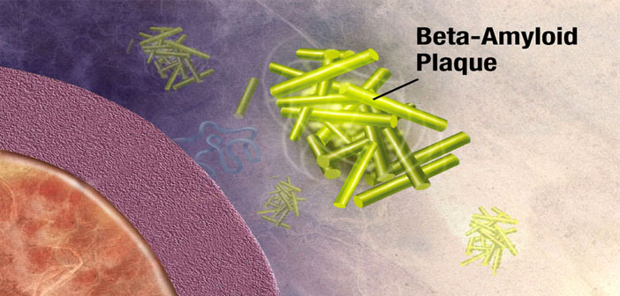
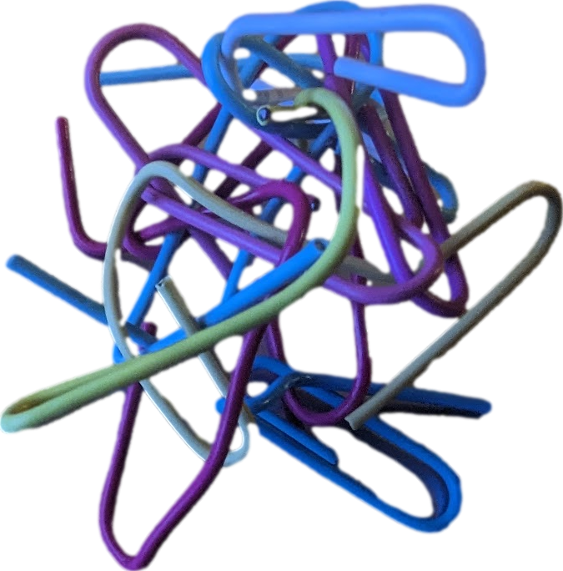

Slide 86
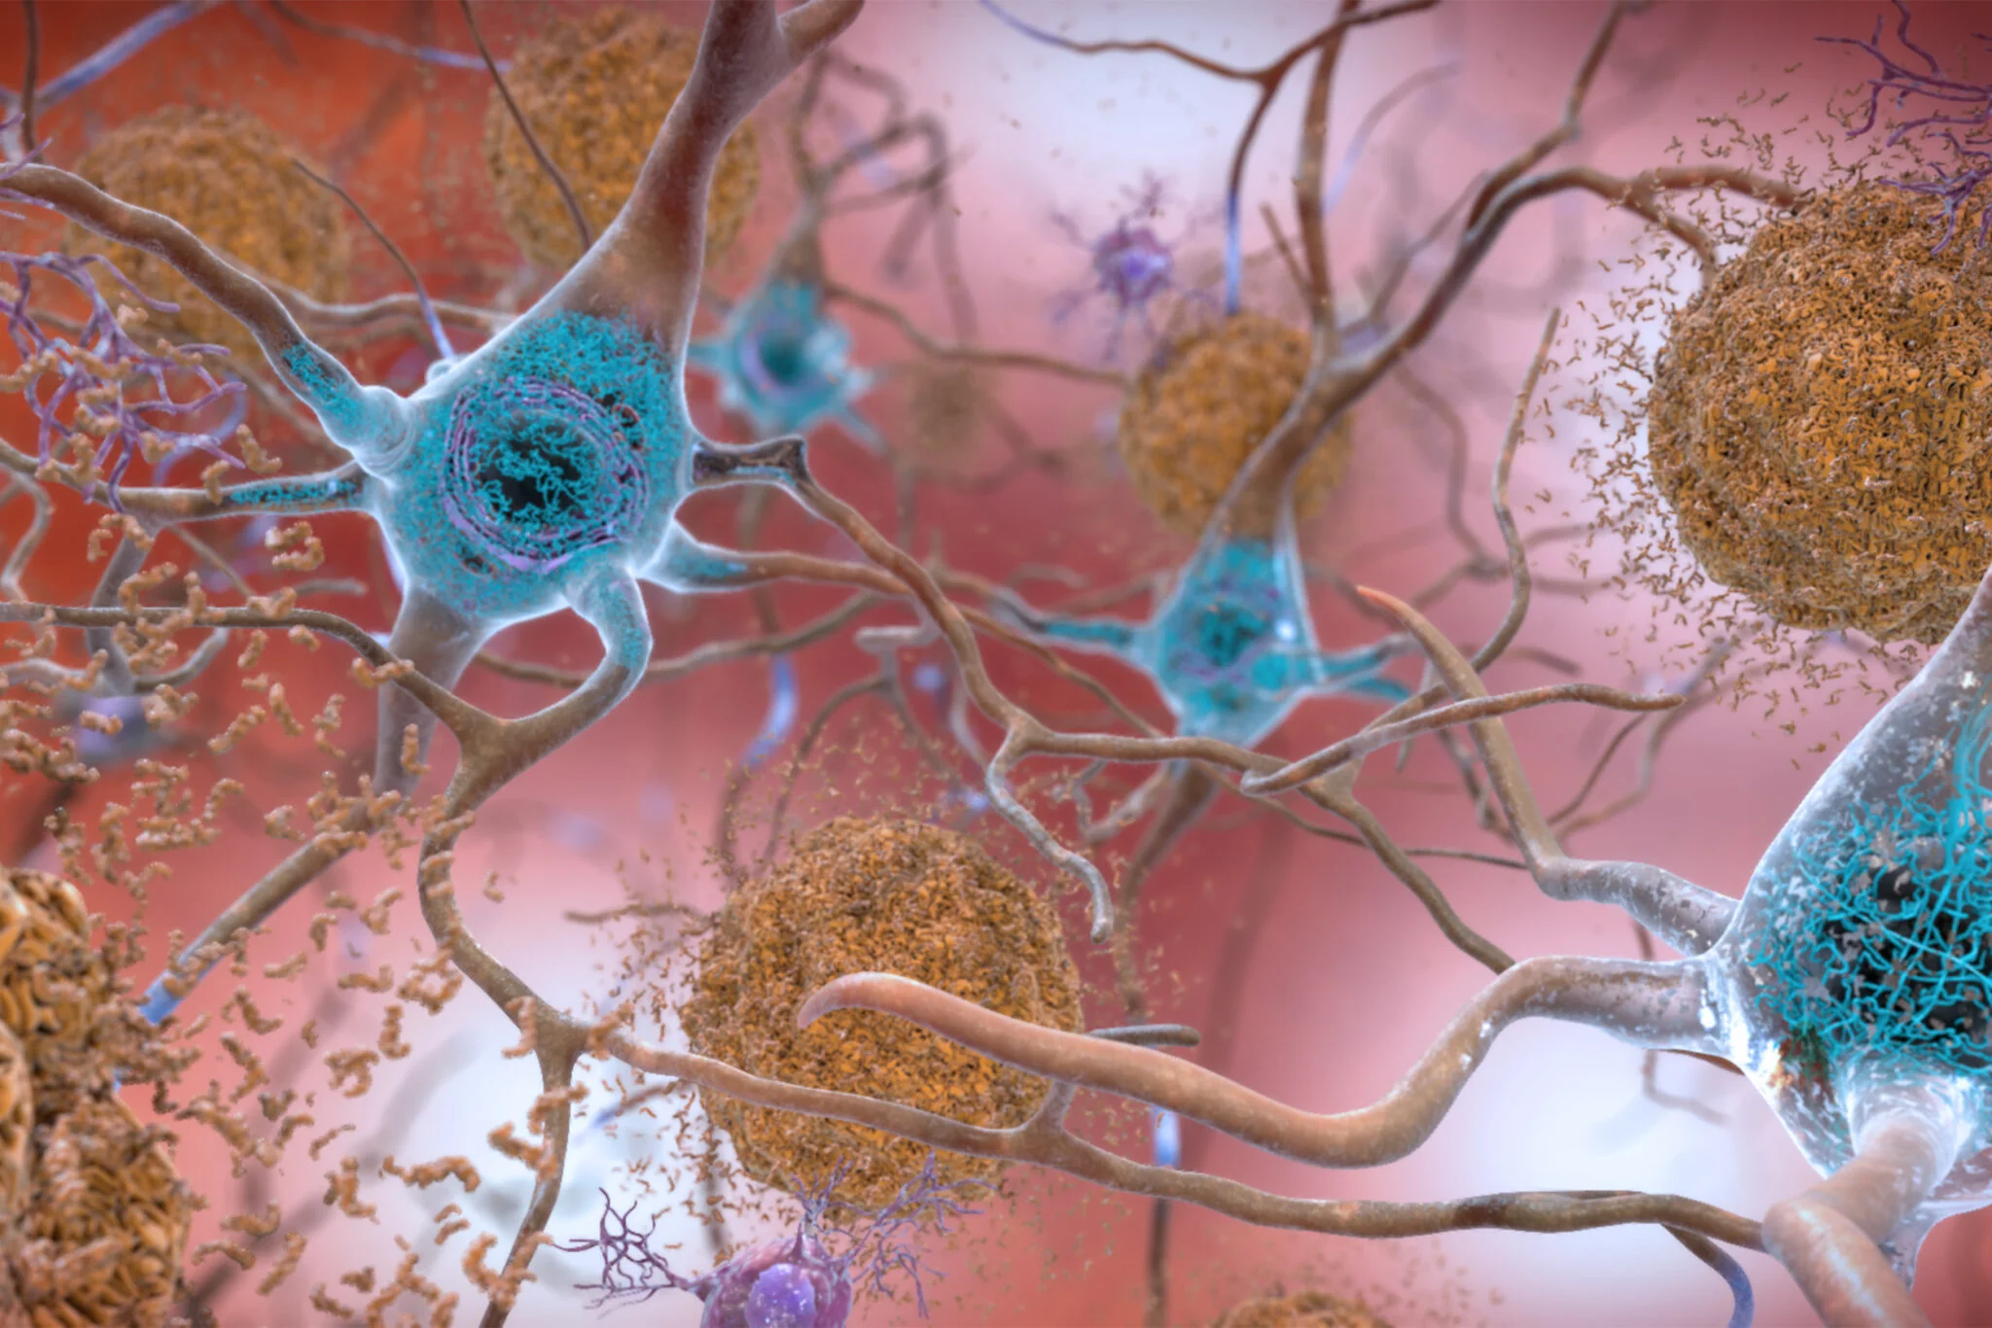
Amyloid = insoluble protein that can deposit in tissues
Amyloid β plaques
=
aggregates of misfolded proteins that form in the spaces between nerve cells

Slide 87
Amyloid = insoluble protein that can deposit in tissues
Amyloid β plaques
=
aggregates of misfolded proteins that form in the spaces between nerve cells

Slide 88
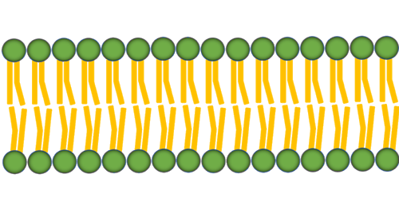
Amyloid β precursor protein (APP)
cell membrane receptor likely involved in neural stem cell development, neurite outgrowth and neurorepair.

Slide 89
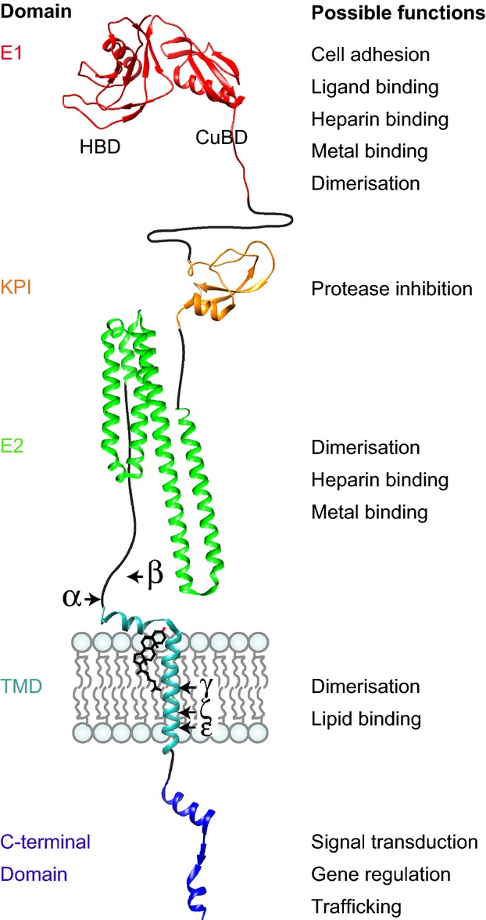
Amyloid β precursor protein (APP)
cell membrane receptor likely involved in neural stem cell development, neurite outgrowth and neurorepair.
=

Slide 90
Amyloid β precursor protein (APP)

Slide 91
What’s supposed to happen to it?
Amyloid β precursor protein (APP)

Slide 92
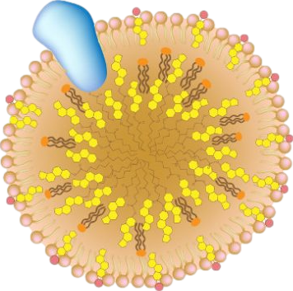
What’s supposed to happen to it?
lipoprotein
APOE = apolipoprotein E
ε2
the dominant lipid carrier in the brain, critical for Aβ catabolism
ε3
Amyloid β precursor protein (APP)

Slide 93
Apolipoprotein =
“A.P.O.”lipoprotein =
“A Part Of” a lipoprotein
What’s supposed to happen to it?
lipoprotein
APOE = apolipoprotein E
ε2
the dominant lipid carrier in the brain, critical for Aβ catabolism
ε3
Amyloid β precursor protein (APP)

Slide 94
Apolipoprotein =
“A.P.O.”lipoprotein =
“A Part Of” a lipoprotein
What’s supposed to happen to it?
lipoprotein
APOE = apolipoprotein E
ε2
the dominant lipid carrier in the brain, critical for Aβ catabolism
ε3
Amyloid β precursor protein (APP)
ε4
APOE4 = high risk gene for Alzheimer’s
ε4

Slide 95
Amyloid β precursor protein (APP)
Apolipoprotein =
“A.P.O.”lipoprotein =
“A Part Of” a lipoprotein
lipoprotein
APOE = apolipoprotein E
ε2
the dominant lipid carrier in the brain, critical for Aβ catabolism
ε3
Amyloid β plaques
ε4
APOE4 = high risk gene for Alzheimer’s
aggregates of misfolded proteins that form in the spaces between nerve cells
ε4

Slide 96
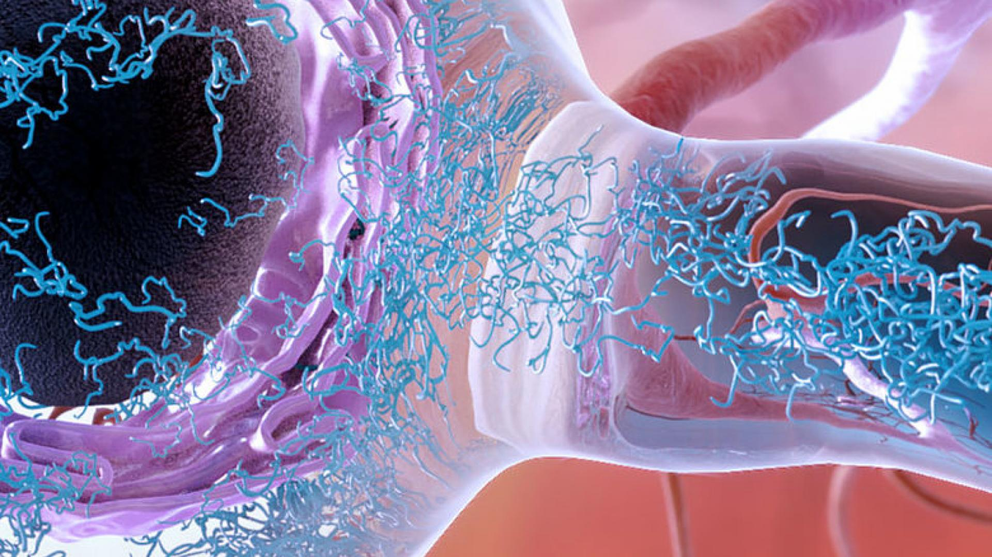
Tau protein accumulation within a neuron = neurofibrillary tangles (NFTs)
National Institute on Aging/National Institutes of Health

Slide 97
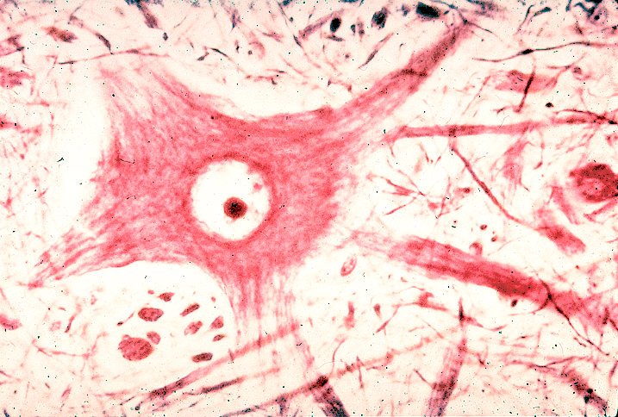
neurofibrillary tangles (NFTs) are composed of modified tau protein.
www1.udel.edu
neurofibrils not tangled
Notes:
https://www1.udel.edu/biology/Wags/histopage/colorpage/cne/cne.htm

Slide 98
neurofibrillary tangles (NFTs) are composed of modified tau protein.
www1.udel.edu
neurofibrils not tangled
neurofibrillary tangles
Notes:
https://www1.udel.edu/biology/Wags/histopage/colorpage/cne/cne.htm

Slide 99
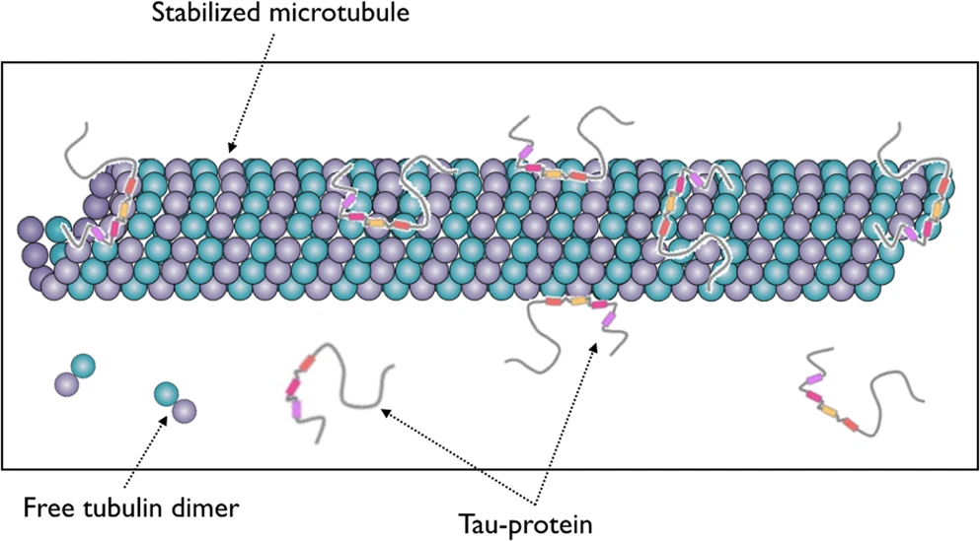
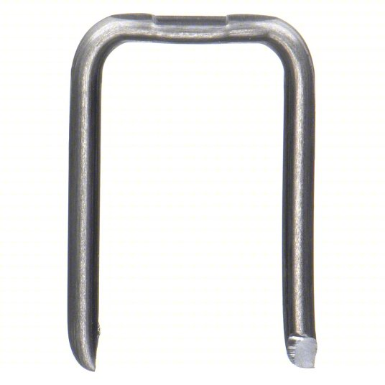
Tau's normal function is stabilizing microtubules inside of neurons
Neurofibrillary tangles
(made of tau protein)

Slide 100
Tau's normal function is stabilizing microtubules inside of neurons

Slide 101
Tau's normal function is stabilizing microtubules inside of neurons

Slide 102
Tau's normal function is stabilizing microtubules inside of neurons

Slide 103
Tau's normal function is stabilizing microtubules inside of neurons

Slide 104
Plaques and tangles
Neurofibrillary tangles
(made of tau protein)
Amyloid β plaques
→ neuronal death

Slide 105
25 biochemical pathways that can contribute to Alzheimer’s disease
brain aging
synaptic function
neural plasticity
neuronal apoptosis
mitochondrial function
deposition of amyloid or its precursor Aβ42
tau deposition
glutamatergic neuronal function
cholinergic neuronal function
adrenergic neuronal function
GABAergic neuronal function
JNK activation
the unfolded protein response
autophagy
insulin resistance
oxidative stress
genetic mutations
abnormal gene expressions
deficient cerebral microcirculation
impaired astrocyte function
21. Ca2+ release from the endoplasmic reticulum affecting the NMDAR and causing excitotoxicity. Locally excessive Ca2+ causes mitochondria to release free radicals, leading to peroxidation of unsaturated fatty acids in cell membranes and cell death of neurons, astrocytes, and endothelial cells
22. phosphoinositide kinase and phosphoCREB activation
23. release of β-catenin from the Wnt/β-catenin complex
24. microglial activation producing immune activation in the brain
25. systemic inflammation transmitted to and affecting the brain
Jeffrey Fessel, Prevention of Alzheimer's disease by treating mild cognitive impairment with combinations chosen from eight available drugs, Alzheimer's & Dementia: Translational Research & Clinical Interventions, Volume 5, 2019

Slide 106
25 biochemical pathways that can contribute to Alzheimer’s disease
brain aging
synaptic function
neural plasticity
neuronal apoptosis
mitochondrial function
deposition of amyloid or its precursor Aβ42
tau deposition
glutamatergic neuronal function
cholinergic neuronal function
adrenergic neuronal function
GABAergic neuronal function
JNK activation
the unfolded protein response
autophagy
insulin resistance
oxidative stress
genetic mutations
abnormal gene expressions
deficient cerebral microcirculation
impaired astrocyte function
21. Ca2+ release from the endoplasmic reticulum affecting the NMDAR and causing excitotoxicity. Locally excessive Ca2+ causes mitochondria to release free radicals, leading to peroxidation of unsaturated fatty acids in cell membranes and cell death of neurons, astrocytes, and endothelial cells
22. phosphoinositide kinase and phosphoCREB activation
23. release of β-catenin from the Wnt/β-catenin complex
24. microglial activation producing immune activation in the brain
25. systemic inflammation transmitted to and affecting the brain
Jeffrey Fessel, Prevention of Alzheimer's disease by treating mild cognitive impairment with combinations chosen from eight available drugs, Alzheimer's & Dementia: Translational Research & Clinical Interventions, Volume 5, 2019

Slide 107
25 biochemical pathways that can contribute to Alzheimer’s disease
brain aging
synaptic function
neural plasticity
neuronal apoptosis
mitochondrial function
deposition of amyloid or its precursor Aβ42
tau deposition
glutamatergic neuronal function
cholinergic neuronal function
adrenergic neuronal function
GABAergic neuronal function
JNK activation
the unfolded protein response
autophagy
insulin resistance
oxidative stress
genetic mutations
abnormal gene expressions
deficient cerebral microcirculation
impaired astrocyte function
21. Ca2+ release from the endoplasmic reticulum affecting the NMDAR and causing excitotoxicity. Locally excessive Ca2+ causes mitochondria to release free radicals, leading to peroxidation of unsaturated fatty acids in cell membranes and cell death of neurons, astrocytes, and endothelial cells
22. phosphoinositide kinase and phosphoCREB activation
23. release of β-catenin from the Wnt/β-catenin complex
24. microglial activation producing immune activation in the brain
25. systemic inflammation transmitted to and affecting the brain
Jeffrey Fessel, Prevention of Alzheimer's disease by treating mild cognitive impairment with combinations chosen from eight available drugs, Alzheimer's & Dementia: Translational Research & Clinical Interventions, Volume 5, 2019

Slide 108
25 biochemical pathways that can contribute to Alzheimer’s disease
brain aging
synaptic function
neural plasticity
neuronal apoptosis
mitochondrial function
deposition of amyloid or its precursor Aβ42
tau deposition
glutamatergic neuronal function
cholinergic neuronal function
adrenergic neuronal function
GABAergic neuronal function
JNK activation
the unfolded protein response
autophagy
insulin resistance
oxidative stress
genetic mutations
abnormal gene expressions
deficient cerebral microcirculation
impaired astrocyte function
21. Ca2+ release from the endoplasmic reticulum affecting the NMDAR and causing excitotoxicity. Locally excessive Ca2+ causes mitochondria to release free radicals, leading to peroxidation of unsaturated fatty acids in cell membranes and cell death of neurons, astrocytes, and endothelial cells
22. phosphoinositide kinase and phosphoCREB activation
23. release of β-catenin from the Wnt/β-catenin complex
24. microglial activation producing immune activation in the brain
25. systemic inflammation transmitted to and affecting the brain
Jeffrey Fessel, Prevention of Alzheimer's disease by treating mild cognitive impairment with combinations chosen from eight available drugs, Alzheimer's & Dementia: Translational Research & Clinical Interventions, Volume 5, 2019

Slide 109
25 biochemical pathways that can contribute to Alzheimer’s disease
brain aging
synaptic function
neural plasticity
neuronal apoptosis
mitochondrial function
deposition of amyloid or its precursor Aβ42
tau deposition
glutamatergic neuronal function
cholinergic neuronal function
adrenergic neuronal function
GABAergic neuronal function
JNK activation
the unfolded protein response
autophagy
insulin resistance
oxidative stress
genetic mutations
abnormal gene expressions
deficient cerebral microcirculation
impaired astrocyte function
21. Ca2+ release from the endoplasmic reticulum affecting the NMDAR and causing excitotoxicity. Locally excessive Ca2+ causes mitochondria to release free radicals, leading to peroxidation of unsaturated fatty acids in cell membranes and cell death of neurons, astrocytes, and endothelial cells
22. phosphoinositide kinase and phosphoCREB activation
23. release of β-catenin from the Wnt/β-catenin complex
24. microglial activation producing immune activation in the brain
25. systemic inflammation transmitted to and affecting the brain
Jeffrey Fessel, Prevention of Alzheimer's disease by treating mild cognitive impairment with combinations chosen from eight available drugs, Alzheimer's & Dementia: Translational Research & Clinical Interventions, Volume 5, 2019

Slide 110
25 biochemical pathways that can contribute to Alzheimer’s disease
brain aging
synaptic function
neural plasticity
neuronal apoptosis
mitochondrial function
deposition of amyloid or its precursor Aβ42
tau deposition
glutamatergic neuronal function
cholinergic neuronal function
adrenergic neuronal function
GABAergic neuronal function
JNK activation
the unfolded protein response
autophagy
insulin resistance
oxidative stress
genetic mutations
abnormal gene expressions
deficient cerebral microcirculation
impaired astrocyte function
21. Ca2+ release from the endoplasmic reticulum affecting the NMDAR and causing excitotoxicity. Locally excessive Ca2+ causes mitochondria to release free radicals, leading to peroxidation of unsaturated fatty acids in cell membranes and cell death of neurons, astrocytes, and endothelial cells
22. phosphoinositide kinase and phosphoCREB activation
23. release of β-catenin from the Wnt/β-catenin complex
24. microglial activation producing immune activation in the brain
25. systemic inflammation transmitted to and affecting the brain
Jeffrey Fessel, Prevention of Alzheimer's disease by treating mild cognitive impairment with combinations chosen from eight available drugs, Alzheimer's & Dementia: Translational Research & Clinical Interventions, Volume 5, 2019

Slide 111
25 biochemical pathways that can contribute to Alzheimer’s disease
brain aging
synaptic function
neural plasticity
neuronal apoptosis
mitochondrial function
deposition of amyloid or its precursor Aβ42
tau deposition
glutamatergic neuronal function
cholinergic neuronal function
adrenergic neuronal function
GABAergic neuronal function
JNK activation
the unfolded protein response
autophagy
insulin resistance
oxidative stress
genetic mutations
abnormal gene expressions
deficient cerebral microcirculation
impaired astrocyte function
21. Ca2+ release from the endoplasmic reticulum affecting the NMDAR and causing excitotoxicity. Locally excessive Ca2+ causes mitochondria to release free radicals, leading to peroxidation of unsaturated fatty acids in cell membranes and cell death of neurons, astrocytes, and endothelial cells
22. phosphoinositide kinase and phosphoCREB activation
23. release of β-catenin from the Wnt/β-catenin complex
24. microglial activation producing immune activation in the brain
25. systemic inflammation transmitted to and affecting the brain
memantine
Jeffrey Fessel, Prevention of Alzheimer's disease by treating mild cognitive impairment with combinations chosen from eight available drugs, Alzheimer's & Dementia: Translational Research & Clinical Interventions, Volume 5, 2019

Slide 112
25 biochemical pathways that can contribute to Alzheimer’s disease
brain aging
synaptic function
neural plasticity
neuronal apoptosis
mitochondrial function
deposition of amyloid or its precursor Aβ42
tau deposition
glutamatergic neuronal function
cholinergic neuronal function
adrenergic neuronal function
GABAergic neuronal function
JNK activation
the unfolded protein response
autophagy
insulin resistance
oxidative stress
genetic mutations
abnormal gene expressions
deficient cerebral microcirculation
impaired astrocyte function
21. Ca2+ release from the endoplasmic reticulum affecting the NMDAR and causing excitotoxicity. Locally excessive Ca2+ causes mitochondria to release free radicals, leading to peroxidation of unsaturated fatty acids in cell membranes and cell death of neurons, astrocytes, and endothelial cells
22. phosphoinositide kinase and phosphoCREB activation
23. release of β-catenin from the Wnt/β-catenin complex
24. microglial activation producing immune activation in the brain
25. systemic inflammation transmitted to and affecting the brain
memantine
donepezil
Jeffrey Fessel, Prevention of Alzheimer's disease by treating mild cognitive impairment with combinations chosen from eight available drugs, Alzheimer's & Dementia: Translational Research & Clinical Interventions, Volume 5, 2019

Slide 113
25 biochemical pathways that can contribute to Alzheimer’s disease
brain aging
synaptic function
neural plasticity
neuronal apoptosis
mitochondrial function
deposition of amyloid or its precursor Aβ42
tau deposition
glutamatergic neuronal function
cholinergic neuronal function
adrenergic neuronal function
GABAergic neuronal function
JNK activation
the unfolded protein response
autophagy
insulin resistance
oxidative stress
genetic mutations
abnormal gene expressions
deficient cerebral microcirculation
impaired astrocyte function
21. Ca2+ release from the endoplasmic reticulum affecting the NMDAR and causing excitotoxicity. Locally excessive Ca2+ causes mitochondria to release free radicals, leading to peroxidation of unsaturated fatty acids in cell membranes and cell death of neurons, astrocytes, and endothelial cells
22. phosphoinositide kinase and phosphoCREB activation
23. release of β-catenin from the Wnt/β-catenin complex
24. microglial activation producing immune activation in the brain
25. systemic inflammation transmitted to and affecting the brain
memantine
donepezil
Anticholinergic drug use is an independent risk factor for Alzheimer’s disease.
Jeffrey Fessel, Prevention of Alzheimer's disease by treating mild cognitive impairment with combinations chosen from eight available drugs, Alzheimer's & Dementia: Translational Research & Clinical Interventions, Volume 5, 2019

Slide 114
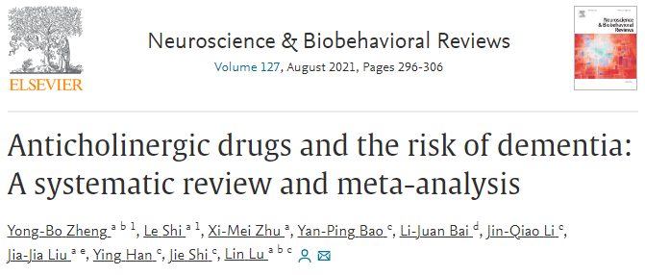
Anticholinergic drug use is an independent risk factor for all-cause dementia and Alzheimer’s disease.

Slide 115
Anticholinergic drug use is an independent risk factor for all-cause dementia and Alzheimer’s disease.
Heavier anticholinergic drug exposure is associated with a higher risk of dementia.

Slide 116
Anticholinergic drug use is an independent risk factor for all-cause dementia and Alzheimer’s disease.
Heavier anticholinergic drug exposure is associated with a higher risk of dementia.
Risk of dementia from some classes of anticholinergic drugs can be counterbalanced by therapeutic effects.

Slide 117
Anticholinergic drugs and dementia risk
Risk of dementia from some classes of anticholinergic drugs can be counterbalanced by therapeutic effects.
Yong-Bo Zheng, Le Shi, Xi-Mei Zhu, Yan-Ping Bao, Li-Juan Bai, Jin-Qiao Li, Jia-Jia Liu, Ying Han, Jie Shi, Lin Lu. Anticholinergic drugs and the risk of dementia: A systematic review and meta-analysis. Neuroscience & Biobehavioral Reviews. Volume 127, 2021

Slide 118
Anticholinergic drugs and dementia risk
positive effect
negative effect
Risk of dementia from some classes of anticholinergic drugs can be counterbalanced by therapeutic effects.
Yong-Bo Zheng, Le Shi, Xi-Mei Zhu, Yan-Ping Bao, Li-Juan Bai, Jin-Qiao Li, Jia-Jia Liu, Ying Han, Jie Shi, Lin Lu. Anticholinergic drugs and the risk of dementia: A systematic review and meta-analysis. Neuroscience & Biobehavioral Reviews. Volume 127, 2021

Slide 119
Anticholinergic drugs and dementia risk
positive effect
e.g., anticholinergic for Parkinson's or overactive bladder
negative effect
Risk of dementia from some classes of anticholinergic drugs can be counterbalanced by therapeutic effects.
Yong-Bo Zheng, Le Shi, Xi-Mei Zhu, Yan-Ping Bao, Li-Juan Bai, Jin-Qiao Li, Jia-Jia Liu, Ying Han, Jie Shi, Lin Lu. Anticholinergic drugs and the risk of dementia: A systematic review and meta-analysis. Neuroscience & Biobehavioral Reviews. Volume 127, 2021

Slide 120
Anticholinergic drugs and dementia risk
positive effect
e.g., anticholinergic for Parkinson's or overactive bladder
negative effect
Risk of dementia from some classes of anticholinergic drugs can be counterbalanced by therapeutic effects.
strong anticholinergic
better mood
Yong-Bo Zheng, Le Shi, Xi-Mei Zhu, Yan-Ping Bao, Li-Juan Bai, Jin-Qiao Li, Jia-Jia Liu, Ying Han, Jie Shi, Lin Lu. Anticholinergic drugs and the risk of dementia: A systematic review and meta-analysis. Neuroscience & Biobehavioral Reviews. Volume 127, 2021

Slide 121
Anticholinergic drugs and dementia risk
positive effect
e.g., anticholinergic for Parkinson's or overactive bladder
negative effect
Risk of dementia from some classes of anticholinergic drugs can be counterbalanced by therapeutic effects.
strong anticholinergic
better mood
e.g., strongly anticholinergic psychotropic
Yong-Bo Zheng, Le Shi, Xi-Mei Zhu, Yan-Ping Bao, Li-Juan Bai, Jin-Qiao Li, Jia-Jia Liu, Ying Han, Jie Shi, Lin Lu. Anticholinergic drugs and the risk of dementia: A systematic review and meta-analysis. Neuroscience & Biobehavioral Reviews. Volume 127, 2021

Slide 122
Anticholinergic drugs and dementia risk
positive effect
e.g., anticholinergic for Parkinson's or overactive bladder
negative effect
Risk of dementia from some classes of anticholinergic drugs can be counterbalanced by therapeutic effects.
strong anticholinergic
better mood
e.g., strongly anticholinergic psychotropic
weak anticholinergic
better mood
Yong-Bo Zheng, Le Shi, Xi-Mei Zhu, Yan-Ping Bao, Li-Juan Bai, Jin-Qiao Li, Jia-Jia Liu, Ying Han, Jie Shi, Lin Lu. Anticholinergic drugs and the risk of dementia: A systematic review and meta-analysis. Neuroscience & Biobehavioral Reviews. Volume 127, 2021

Slide 123
Anticholinergic drugs and dementia risk
positive effect
e.g., anticholinergic for Parkinson's or overactive bladder
negative effect
Risk of dementia from some classes of anticholinergic drugs can be counterbalanced by therapeutic effects.
strong anticholinergic
better mood
e.g., strongly anticholinergic psychotropic
weak anticholinergic
better mood
e.g., weakly anticholinergic psychotropic
Yong-Bo Zheng, Le Shi, Xi-Mei Zhu, Yan-Ping Bao, Li-Juan Bai, Jin-Qiao Li, Jia-Jia Liu, Ying Han, Jie Shi, Lin Lu. Anticholinergic drugs and the risk of dementia: A systematic review and meta-analysis. Neuroscience & Biobehavioral Reviews. Volume 127, 2021

Slide 124
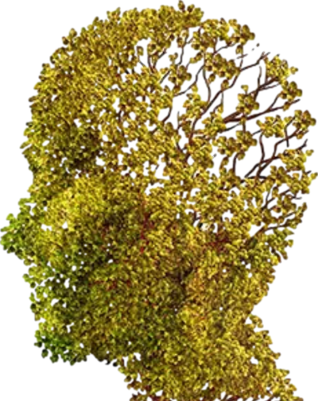
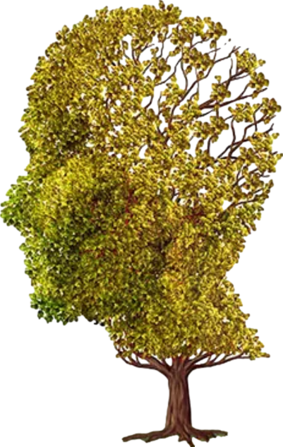
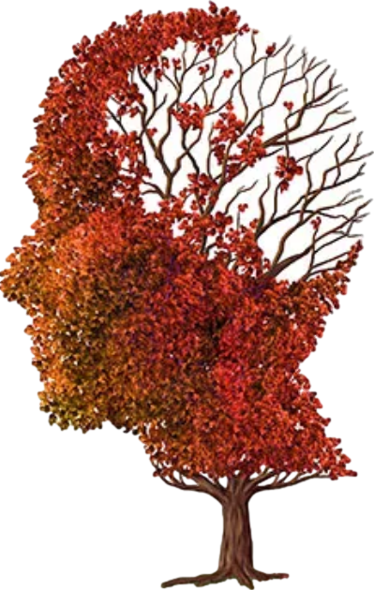
Association with dementia
decreased
increased
Benztropine (Cogentin)

Slide 125
Association with dementia
decreased
increased
Benztropine (Cogentin)
-
+
++
+++
anticholinergic:

Slide 126
Association with dementia
decreased
increased
Benztropine (Cogentin)
positive effect
negative effect
-
+
++
+++
anticholinergic:

Slide 127
Association with dementia
decreased
increased
Oxybutynin (Ditropan)

Slide 128
Association with dementia
decreased
increased
Oxybutynin (Ditropan)
-
+
++
+++
anticholinergic:

Slide 129
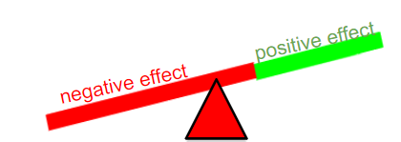
Association with dementia
decreased
increased
Oxybutynin (Ditropan)
-
+
++
+++
anticholinergic:

Slide 130
Association with dementia
decreased
increased
Amitriptyline (Elavil)

Slide 131
Association with dementia
decreased
increased
Amitriptyline (Elavil)
-
+
++
+++
anticholinergic:

Slide 132
Association with dementia
decreased
increased
Amitriptyline (Elavil)
-
+
++
+++
anticholinergic:

Slide 133
Association with dementia
decreased
increased
Chlorpromazine (Thorazine)

Slide 134
Association with dementia
decreased
increased
Chlorpromazine (Thorazine)
-
+
++
+++
anticholinergic:

Slide 135
Association with dementia
decreased
increased
Chlorpromazine (Thorazine)
strong anticholinergic
treatment of psychosis
-
+
++
+++
anticholinergic:

Slide 136
benztropine
not benign
oxybutynin
amitriptyline
chlorpromazine
Yong-Bo Zheng, Le Shi, Xi-Mei Zhu, Yan-Ping Bao, Li-Juan Bai, Jin-Qiao Li, Jia-Jia Liu, Ying Han, Jie Shi, Lin Lu. Anticholinergic drugs and the risk of dementia: A systematic review and meta-analysis,
Neuroscience & Biobehavioral Reviews. Volume 127, 2021

Slide 137
Association with dementia
decreased
increased
Paroxetine (Paxil)

Slide 138
Association with dementia
decreased
increased
Paroxetine (Paxil)
-
+
++
+++
anticholinergic:

Slide 139
Association with dementia
decreased
increased
Escitalopram (Lexapro)

Slide 140
Association with dementia
decreased
increased
Escitalopram (Lexapro)
-
+
++
+++
anticholinergic:

Slide 141
Association with dementia
decreased
increased
Mediterranean diet

Slide 142
Association with dementia
decreased
increased
Mediterranean diet
decreased risk of dementia
less accumulation of cerebral β-amyloid
less decrease brain volume over 3 years

Slide 143
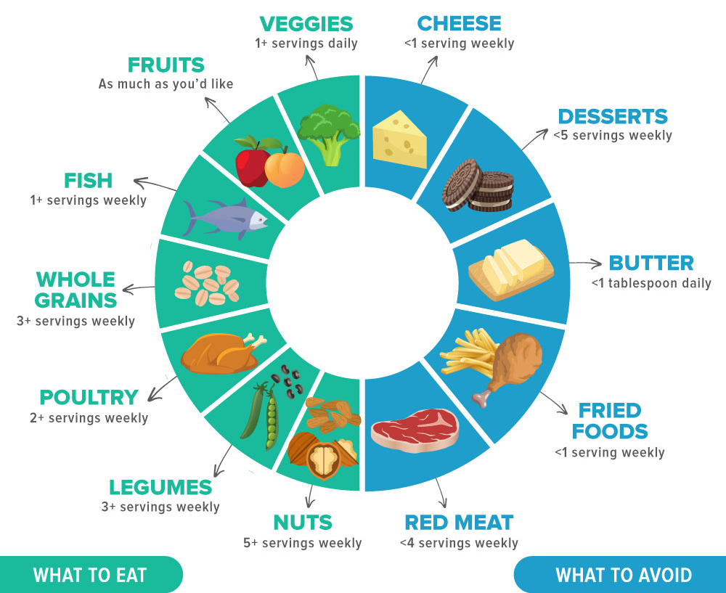
Association with dementia
decreased
increased
MIND diet
modified mediterranean diet by allocating separate categories for green leafy vegetables and berries, fruit not included, and less fish

Slide 144
Association with dementia
decreased
increased
MIND diet
modified mediterranean diet by allocating separate categories for green leafy vegetables and berries, fruit not included, and less fish
same or better decreased risk vs mediterranean diet

Slide 145
Association with dementia
decreased
increased
Among specific diets, the evidence is strongest for preventative roles of the Mediterranean diet and MIND diet (Beversdorf, Crosby, Shenker, 2023).

Slide 146
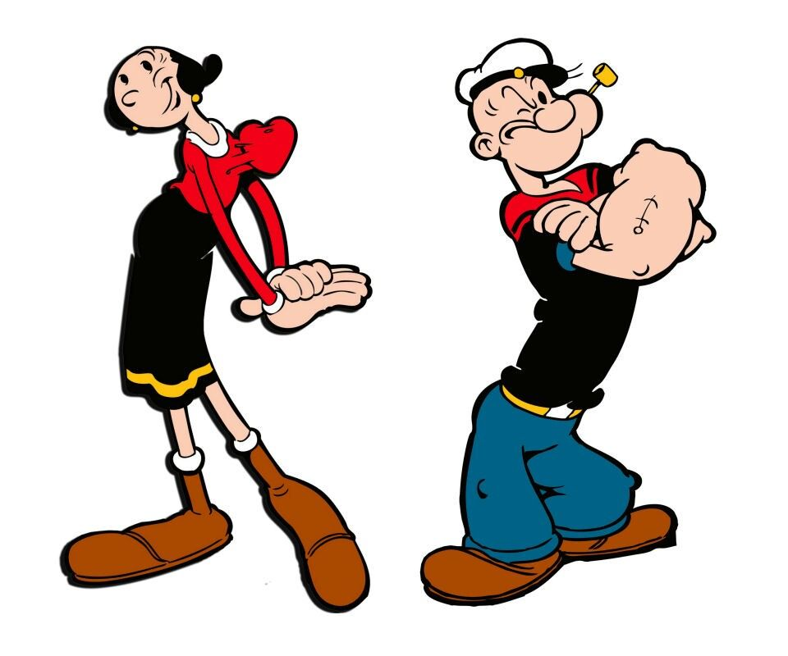
Association with dementia
decreased
increased
Olive Oil

Slide 147
Association with dementia
decreased
increased
Olive Oil
Associated with decreased risk of death from neurodegenerative diseases
Better cognitive outcomes with MCI patients

Slide 148
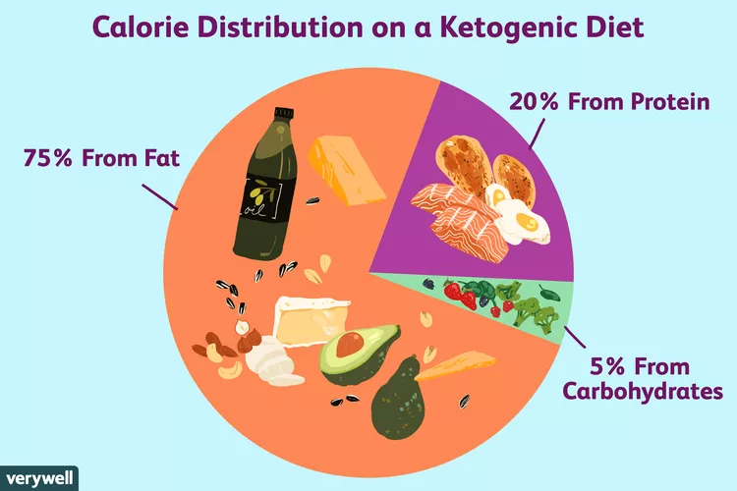
Association with dementia
decreased
increased
Ketogenic diet
increased
that’s not cake

Slide 149
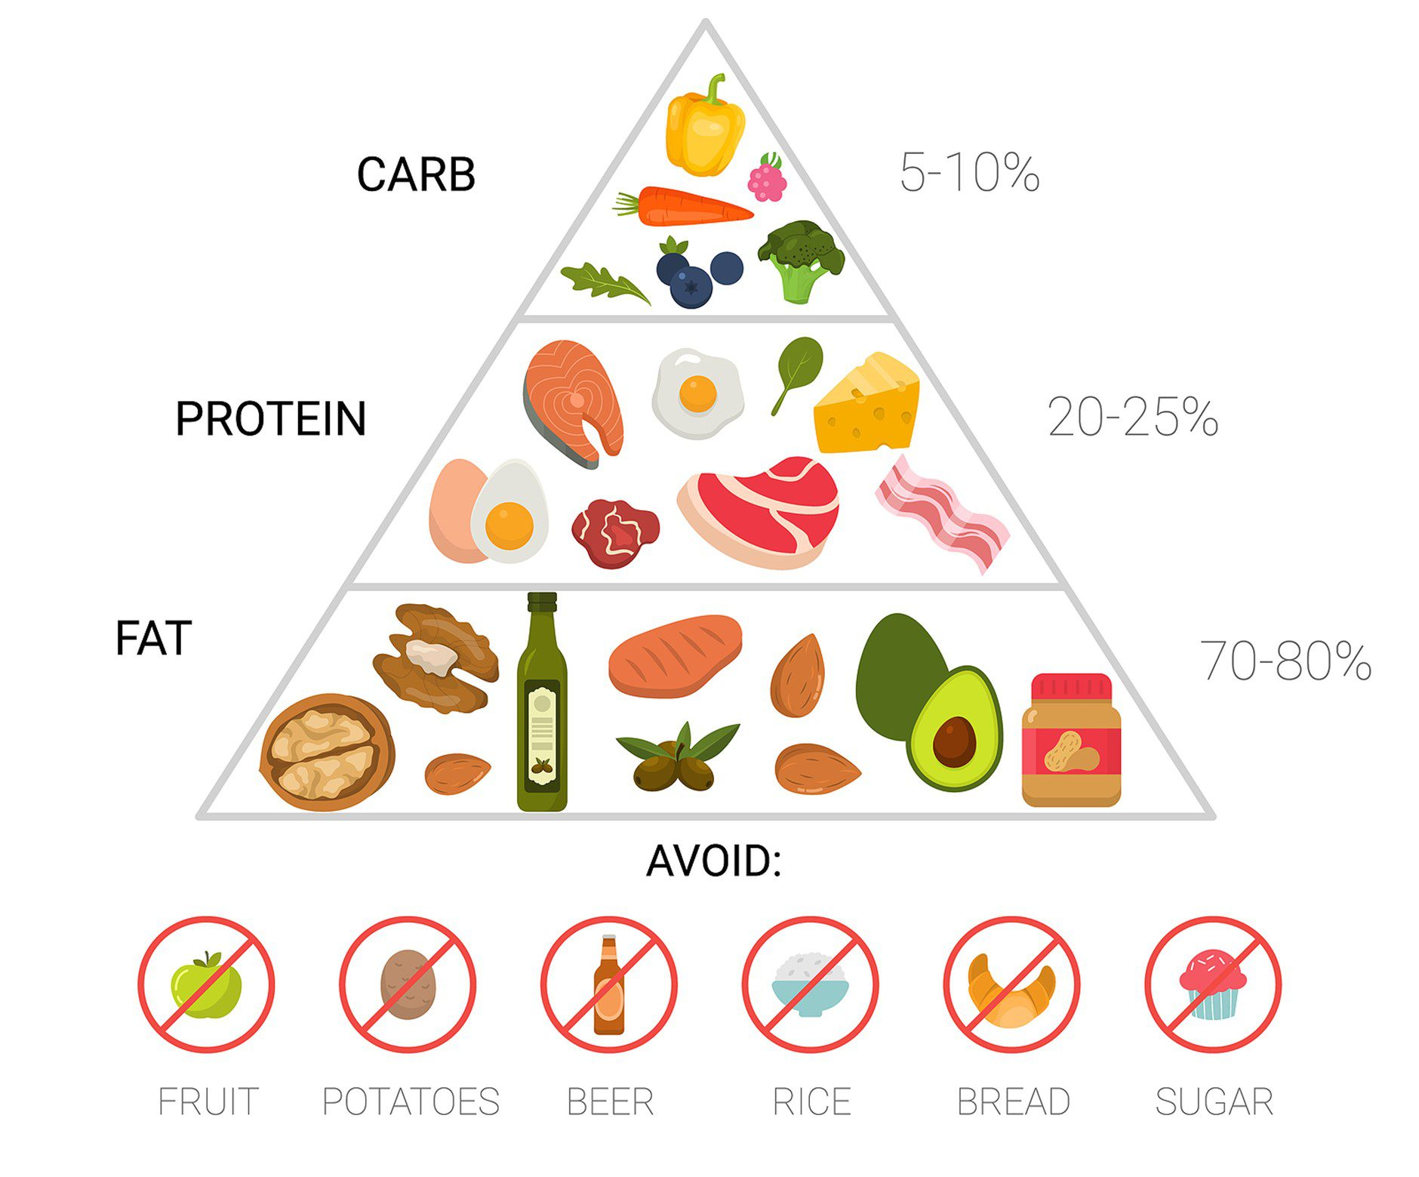
Association with dementia
decreased
increased
Ketogenic diet
increased
Intriguing data exists for ketogenic diet for treatment of dementia, but larger trials are needed (Beversdorf, Crosby & Shenker, 2023)
Allows brain to use ketones to switch away from obligatory processing of glucose

Slide 150
Association with dementia
decreased
increased
Postponing retirement

Slide 151
Association with dementia
decreased
increased
Postponing retirement

Slide 152
Association with dementia
decreased
increased
Sleeping six hours / night in 50s & 60s

Slide 153
Association with dementia
decreased
increased
Sleeping six hours / night or less in 50s & 60s
β-Amyloid accumulates in the brain after one night of sleep deprivation
Each additional hour of nighttime sleep was associated with a statistically significant reduction of Aβ

Slide 154
Association with dementia
decreased
increased
Japanese diet

Slide 155
Association with dementia
decreased
increased
Japanese diet

Slide 156
Association with dementia
decreased
increased
Standard American Diet

Slide 157
Association with dementia
decreased
increased
Standard American Diet

Slide 158
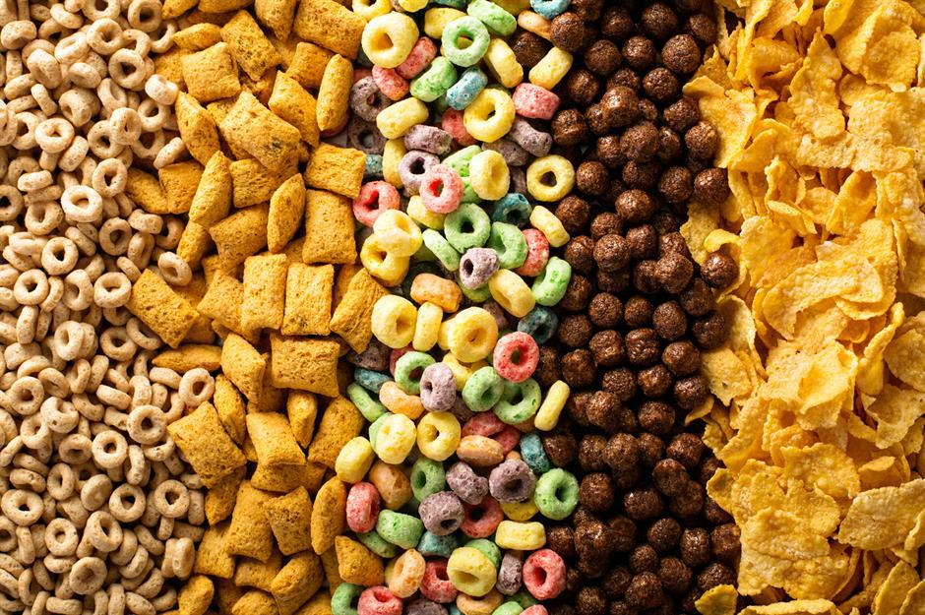
Association with dementia
decreased
increased
Ultra-processed
foods

Slide 159
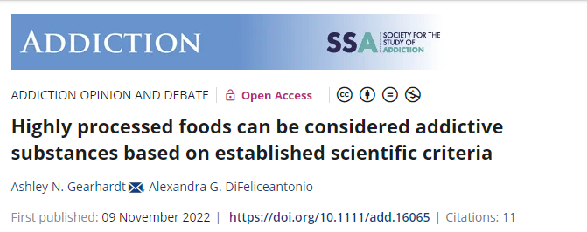
Association with dementia
decreased
increased
Ultra-processed food addiction is estimated to occur in 14% of adults and 12% of children worldwide.
(DiFeliceantonio, 2023)

Slide 160
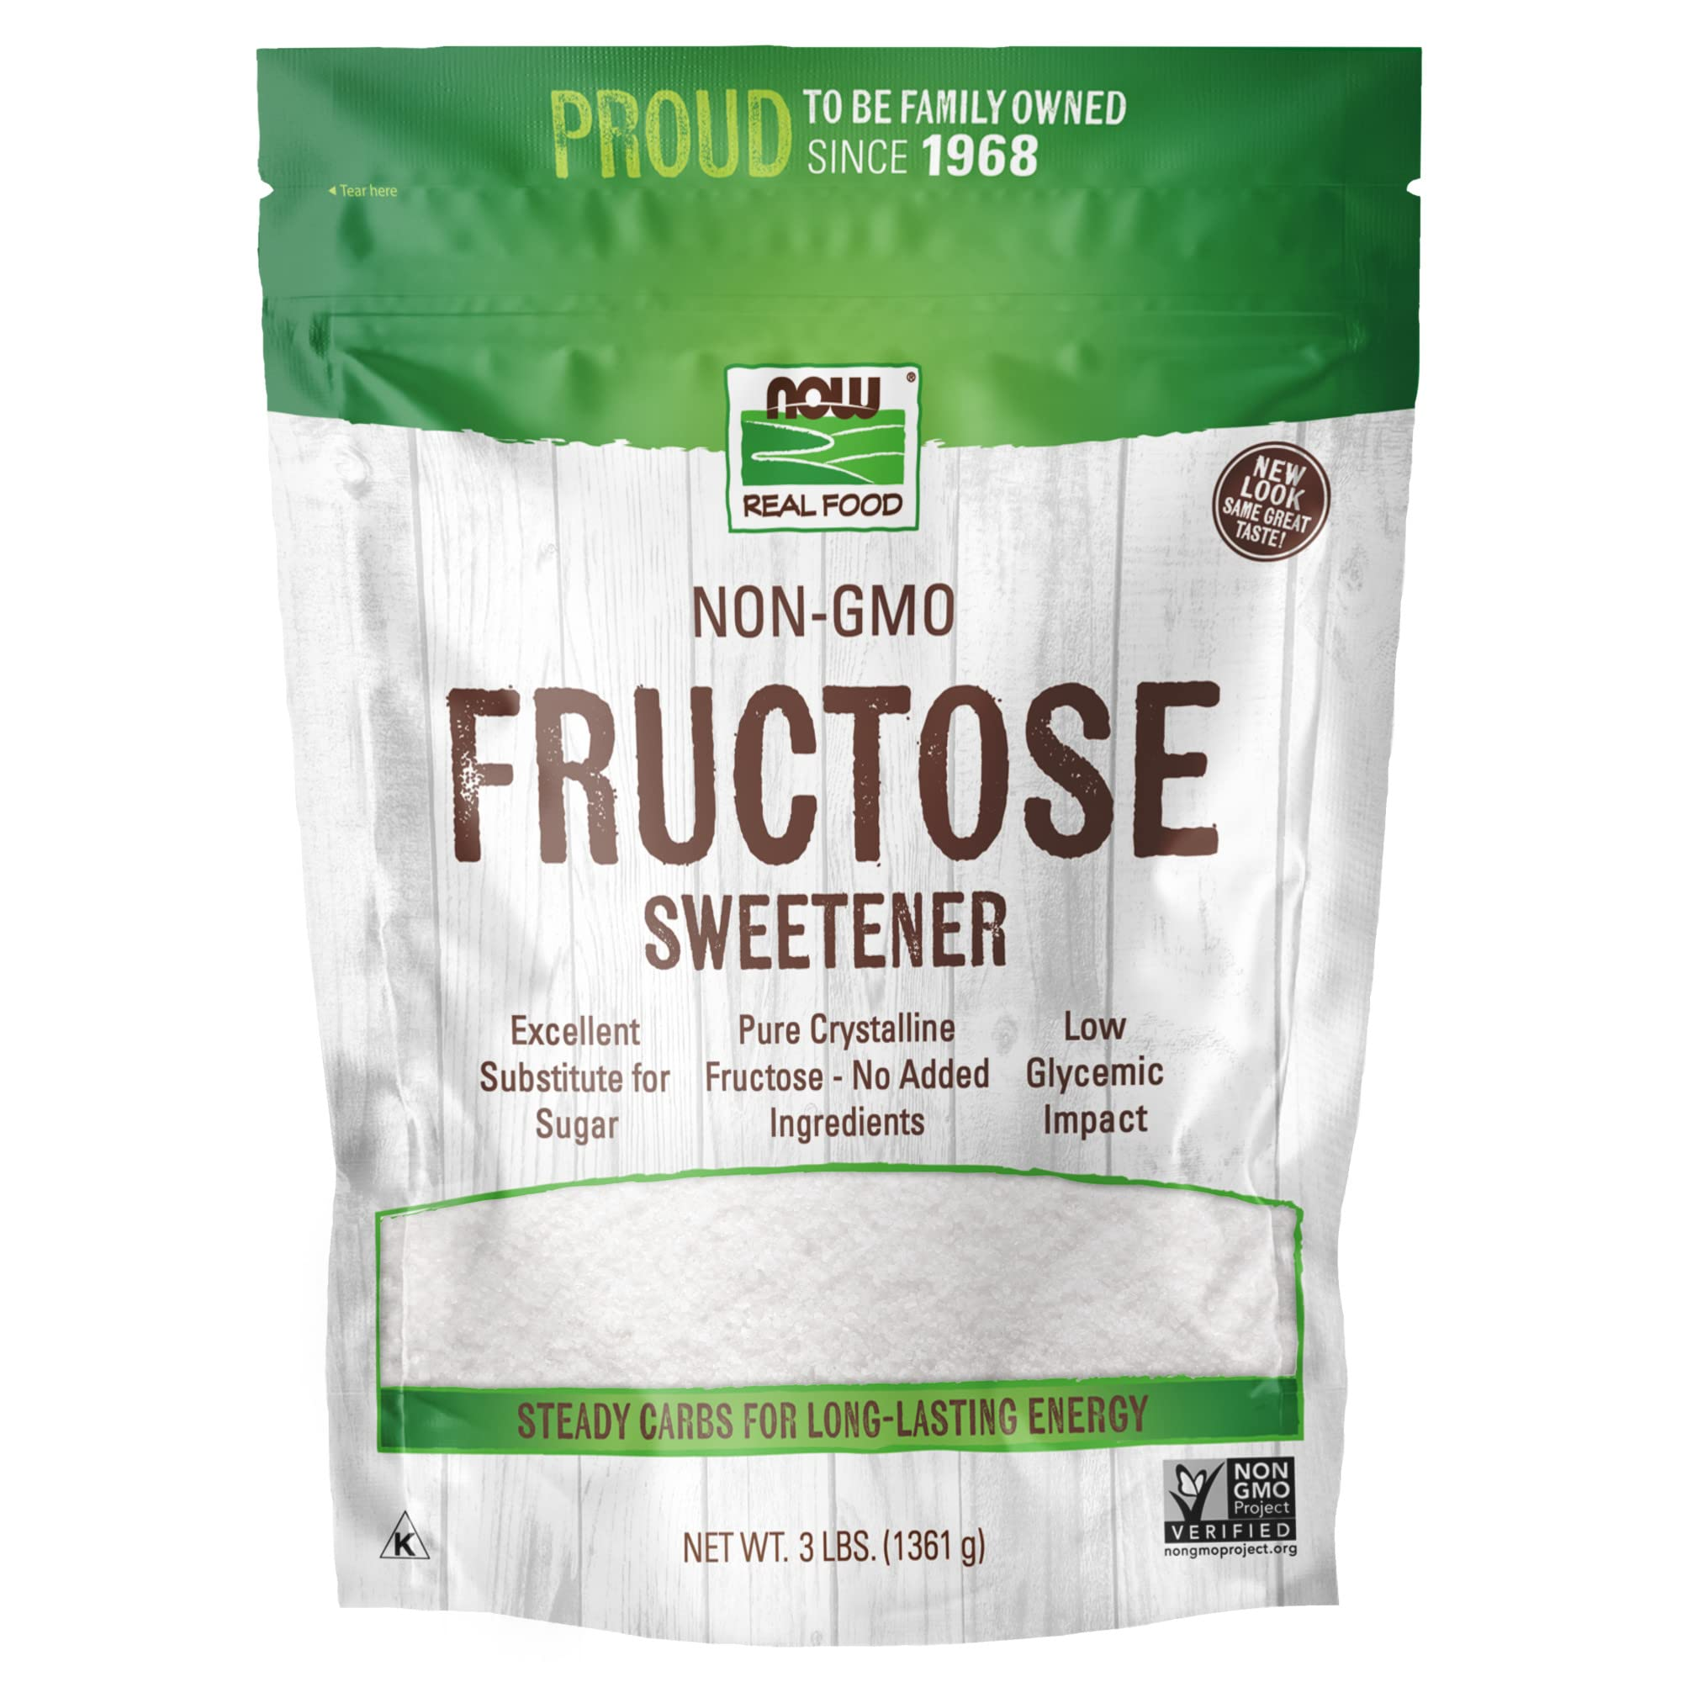
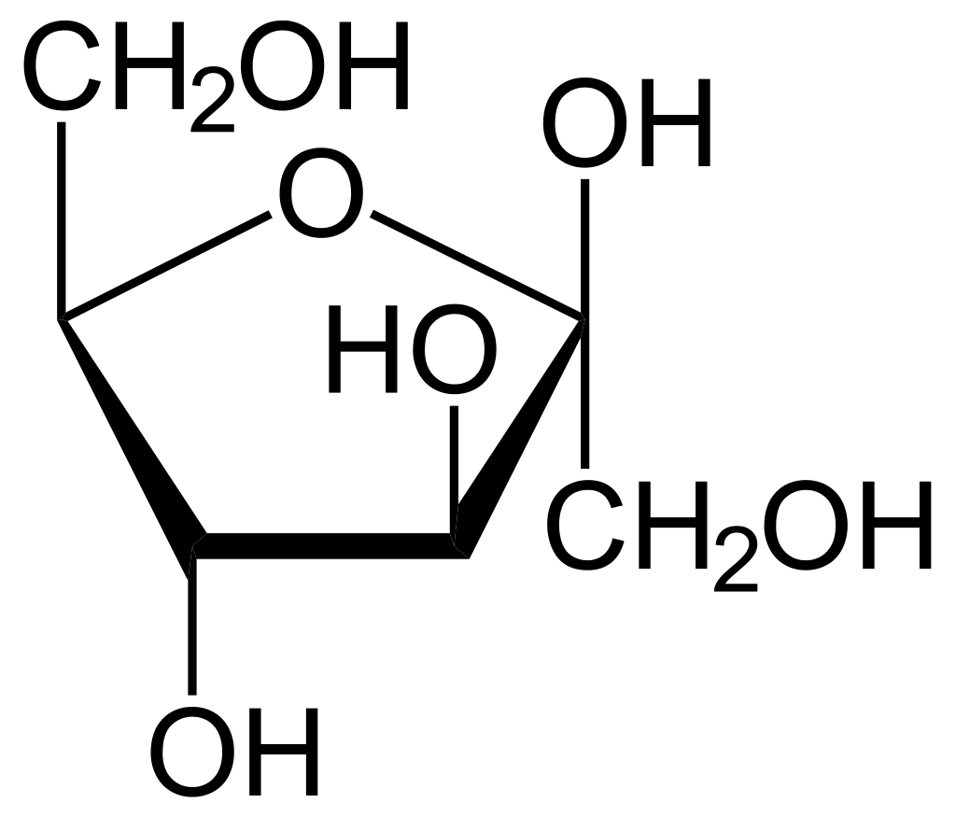
Association with dementia
decreased
increased
Fructose

Slide 161
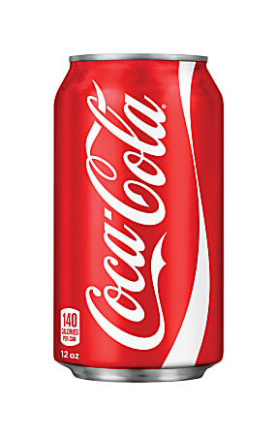
Association with dementia
decreased
increased
Fructose

Slide 162
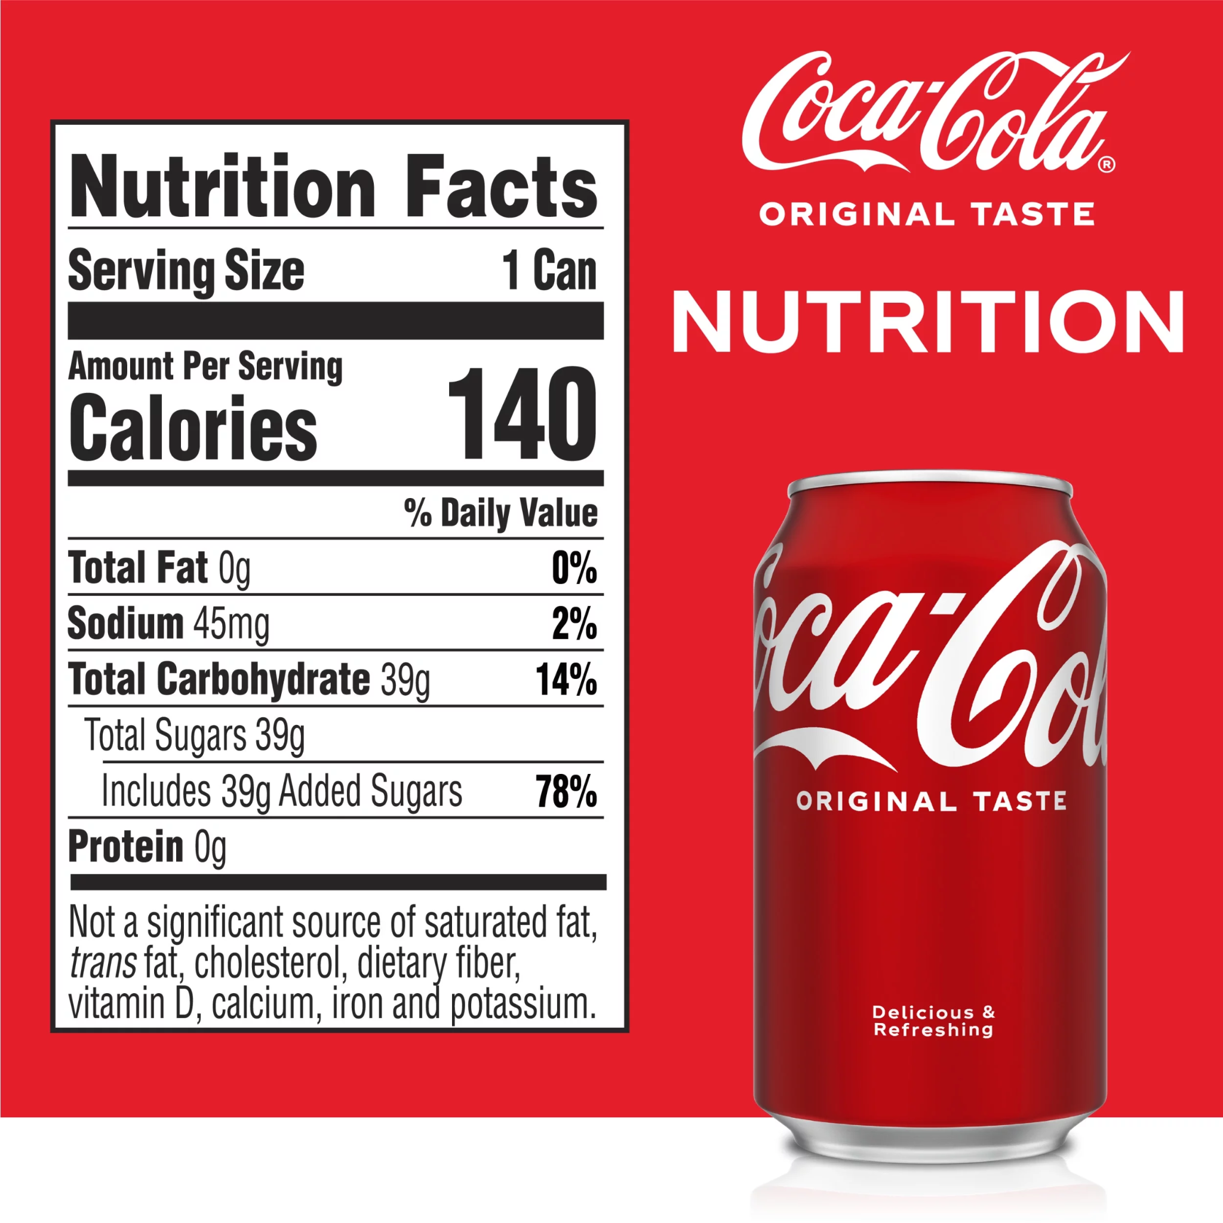
Association with dementia
decreased
increased
Higher consumption of sugar in beverage was associated with an increased risk of all dementia, hazard ratio of 2.80 (Miao et al, 2021).

Slide 163
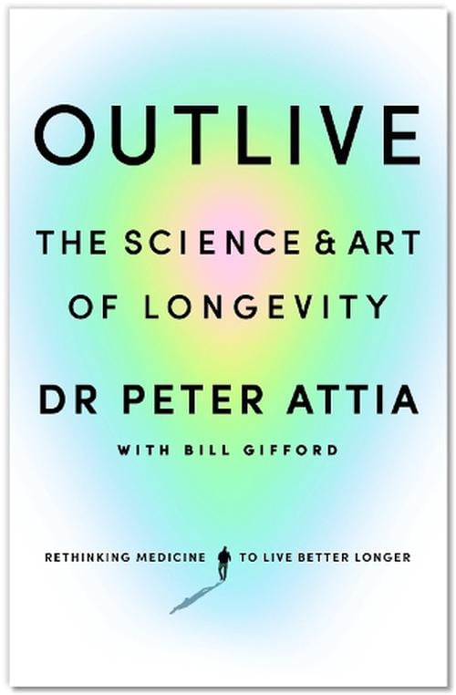
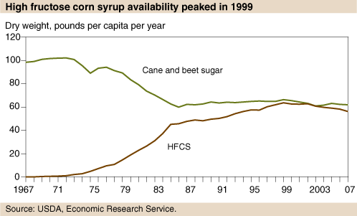
Peter Attia MD:
“We are swimming in a sea of fructose”.

Slide 164
Peter Attia MD:
“We are swimming in a sea of fructose”.
“If there is one type of food that I would eliminate from everyone’s diet if I could, it would be fructose-sweetened drinks (sodas, fruit juices)”.

Slide 165
Peter Attia MD:
“We are swimming in a sea of fructose”.
“If there is one type of food that I would eliminate from everyone’s diet if I could, it would be fructose-sweetened drinks (sodas, fruit juices)”.
Glucose and fructose are metabolized very differently at the cellular level.

Slide 166
Peter Attia MD:
“We are swimming in a sea of fructose”.
“If there is one type of food that I would eliminate from everyone’s diet if I could, it would be fructose-sweetened drinks (sodas, fruit juices)”.
Glucose and fructose are metabolized very differently at the cellular level.
When a cell breaks down glucose, it will almost instantly have more ATP.

Slide 167
Peter Attia MD:
“We are swimming in a sea of fructose”.
“If there is one type of food that I would eliminate from everyone’s diet if I could, it would be fructose-sweetened drinks (sodas, fruit juices)”.
Glucose and fructose are metabolized very differently at the cellular level.
When a cell breaks down glucose, it will almost instantly have more ATP.
But when we metabolize fructose, (ATP) levels inside the cell drop rapidly and dramatically.

Slide 168
Peter Attia MD:
“We are swimming in a sea of fructose”.
“If there is one type of food that I would eliminate from everyone’s diet if I could, it would be fructose-sweetened drinks (sodas, fruit juices)”.
Glucose and fructose are metabolized very differently at the cellular level.
When a cell breaks down glucose, it will almost instantly have more ATP.
But when we metabolize fructose, (ATP) levels inside the cell drop rapidly and dramatically.
Fructose basically tricks our metabolism into thinking that we are depleting energy—and need to take in still more food.

Slide 169
Association with dementia
decreased
increased
Coffee

Slide 170
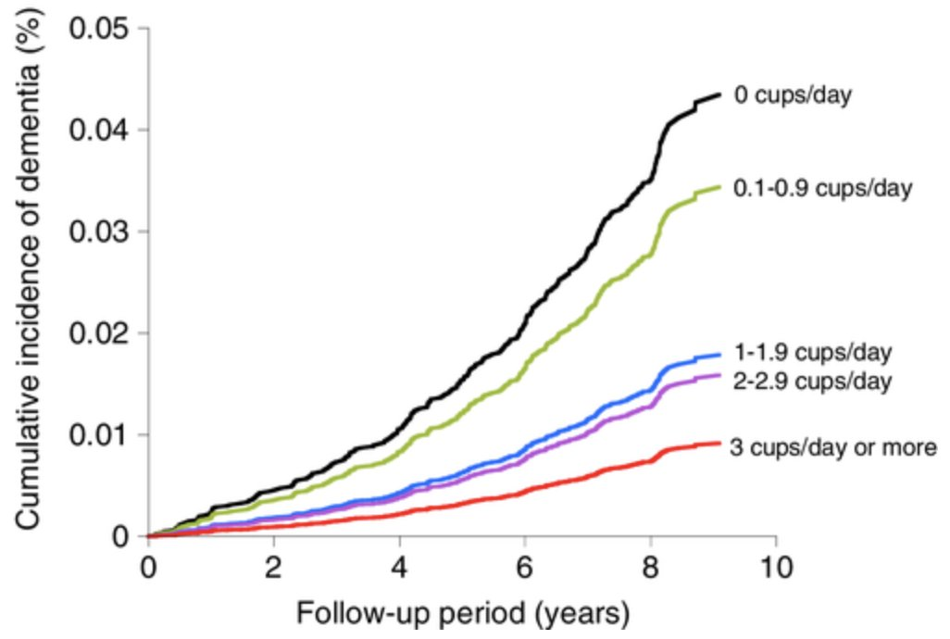
Association with dementia
decreased
increased
Coffee consumption of ≥3 cups/day was associated with a 50% reduction in dementia risk (Matsushita et al, 2021).

Slide 171
Association with dementia
decreased
increased
Tea

Slide 172
Association with dementia
decreased
increased
Tea

Slide 173
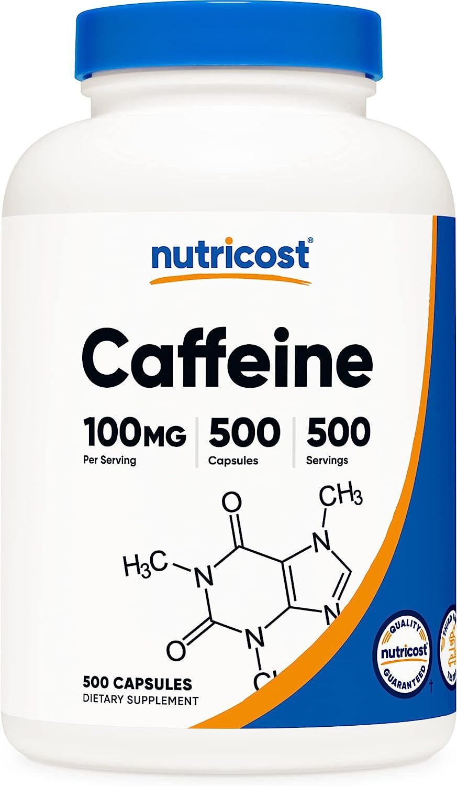
Association with dementia
decreased
increased
Caffeine

Slide 174
Association with dementia
decreased
increased
Caffeine
-
+
++
+++
anticholinergic:

Slide 175
Association with dementia
decreased
increased
Vitamin E

Slide 176
Association with dementia
decreased
increased
Vitamin E
Some Evidence Suggesting No Benefit
Moderate-strength evidence shows no benefit in cognitive performance for vitamin E in women.
In adults with MCI, low-strength evidence shows no benefit for vitamin E in incident CATD.
2017

Slide 177
Association with dementia
decreased
increased
Flavonoids

Slide 178
Association with dementia
decreased
increased
Flavonoids

Slide 179
Association with dementia
decreased
increased

Slide 180
Association with dementia
decreased
increased
-
+
++
+++
anticholinergic:

Slide 181
Peter Libby MD:
“Atherosclerosis probably would not occur in the absence of LDL concentrations in excess of physiological needs, 10 to 20 mg/dL”.

Slide 182
Peter Libby MD:
“Atherosclerosis probably would not occur in the absence of LDL concentrations in excess of physiological needs, 10 to 20 mg/dL”.
Peter Attia MD:
“You want apoB and LDL cholesterol as low as possible”.

Slide 183
Peter Libby MD:
“Atherosclerosis probably would not occur in the absence of LDL concentrations in excess of physiological needs, 10 to 20 mg/dL”.
Peter Attia MD:
“You want apoB and LDL cholesterol as low as possible”.
“I tend to start with rosuvastatin (Crestor) and only pivot from that if there I want to knock someone’s apoB concentration down to 20 or 30 mg/dL, about where it would be for a child”.

Slide 184
Peter Libby MD:
“Atherosclerosis probably would not occur in the absence of LDL concentrations in excess of physiological needs, 10 to 20 mg/dL”.
Peter Attia MD:
“You want apoB and LDL cholesterol as low as possible”.
“I tend to start with rosuvastatin (Crestor) and only pivot from that if there I want to knock someone’s apoB concentration down to 20 or 30 mg/dL, about where it would be for a child”.
“For people who can’t tolerate statins, I use bempedoic acid (Nexletol)”.

Slide 185
Association with dementia
decreased
increased
Tobacco

Slide 186
2017
somewhat controversial

Slide 187
Association with dementia
decreased
increased
Tobacco
The increased dementia risk is vascular, not Alzheimer’s.
Some evidence of poor cognitive outcomes among older adults who smoke tobacco and/or consume smokeless tobacco as compared to never-tobacco users (Singh et al, 2023).
No significant association between smoking and the onset of any dementia (Otuyama et al, 2019).
Earlier studies found an inverse association between smoking and Alzheimer's disease (Van Duijn & Hofman, 1991) and nicotine was proposed as a treatment for Alheimer’s ~2000.
Possibility of neuroprotective effect of nicotine counterbalancing neurotoxic effect of hydrocarbons.

Slide 188
Association with dementia
decreased
increased
Benzodiazepines

Slide 189
Association with dementia
decreased
increased
Benzodiazepines
There were studies showing an association of benzodiazepines and dementia, but more recent studies have cast doubt.
In a prospective follow-up study with 3434 patients, the risk of dementia actually went down as the dose exposure went up (Gray SL et al, 2016).
Another study with 616,256 patients found the same risk of dementia in people taking benzodiazepines as in those on antidepressants, suggesting that these meds are just a marker for another variable, like having a psychiatric disorder (Baek et al, 2020).
No association between benzos and dementia (n = 235,465, Osler & Jørgensen, 2020).
A systematic review of reviews suggested an association (Ferreira et al, 2021).

Slide 190
Association with dementia
decreased
increased
Low-dose aspirin

Slide 191
Association with dementia
decreased
increased
Low-dose aspirin / NSAIDs
Some Evidence Suggesting No Benefit
2017
-
+
++
+++
anticholinergic:

Slide 192
Association with dementia
decreased
increased
Prevagen
increased

Slide 193
Association with dementia
decreased
increased
Total
scam
Prevagen
increased
No evidence of benefit despite company’s claims.
The supposedly active ingredient in Prevagen is similar to calmodulin, a known factor in memory consolidation
Apoaequorin is likely hydrolysed by gut proteases and even if it escaped proteolysis would not readily cross the blood-brain barrier (Morrill et al, 2017).
“Predatory Marketing on Older Adults” (Stephanie Jones et al, 2021)

Slide 194
Association with dementia
decreased
increased
Intermittent fasting

Slide 195
Association with dementia
decreased
increased
Intermittent fasting
Not studies specifically for dementia prevention
Appears to slow aging process
Ketosis is healthy for neuronal mitochondria
Caloric restriction in general slows aging

Slide 196
Association with dementia
decreased
increased
Lithium

Slide 197
Association with dementia
decreased
increased
Lithium
Procognitive effects in patients with MCI and Alzheimer’s disease
Decreased CSF biomarkers for neurodegeneration
After 3 months of lithium treatment at low dose, a slowing of cognitive decline was observed in patients with Alzheimer’s disease
-
+
++
+++
anticholinergic:
Haussmann, R., Noppes, F., Brandt, M. D., Bauer, M., & Donix, M. (2021). Minireview: Lithium: a therapeutic option in Alzheimer’s disease and its prodromal stages?. Neuroscience Letters, 760, 136044. Chicago

Slide 198
Lithium - neuroprotection
Neuroprotective Effects of Lithium: Implications for the Treatment of Alzheimer’s Disease and Related Neurodegenerative Disorders O. V. Forlenza et al. ACS Chemical Neuroscience 2014.
Notes:
Other neurodegenerative diseases. +-Overlapping mechanisms with other neuroprotectants.

Slide 199
Lithium - neuroprotection
Neuroprotective Effects of Lithium: Implications for the Treatment of Alzheimer’s Disease and Related Neurodegenerative Disorders O. V. Forlenza et al. ACS Chemical Neuroscience 2014.
Notes:
Other neurodegenerative diseases. +-Overlapping mechanisms with other neuroprotectants.

Slide 200
Lithium - neuroprotection
Neuroprotective Effects of Lithium: Implications for the Treatment of Alzheimer’s Disease and Related Neurodegenerative Disorders O. V. Forlenza et al. ACS Chemical Neuroscience 2014.
Notes:
Other neurodegenerative diseases. +-Overlapping mechanisms with other neuroprotectants.

Slide 201
Lithium - neuroprotection
Neuroprotective Effects of Lithium: Implications for the Treatment of Alzheimer’s Disease and Related Neurodegenerative Disorders O. V. Forlenza et al. ACS Chemical Neuroscience 2014.
Notes:
Other neurodegenerative diseases. +-Overlapping mechanisms with other neuroprotectants.

Slide 202
Lithium - neuroprotection post-TBI
ACS Chem. Neurosci. 2014, 5, 6, 422–433 Publication Date:April 3, 2014 https://doi.org/10.1021/cn500040g

Slide 203
Lithium level 0.25 - 0.5
1 year
Improved cognition
Decrease in tau proteins
Forlenza OV, Diniz BS, Radanovic M, et al. Disease modifying properties of long-term lithium treatment for amnestic mild cognitive impairment: randomised controlled trial. Br J Psychiatry. 2011;198(5):351-356.
Notes:
Don’t worry, I’ll tell you about the other 9 neuroprotections…
Think about disease modifying… donepezil, and memantine don’t do this. neurofibrillary tangles composed of tau protein. 2 new antibody treatments that are disease modifying. Prevagen.

Slide 204
Lithium in drinking water
Higher lithium concentrations were associated with
Notes:
2021 meta-analysis - still appears to be true. Some studies showed fewer homicides.

Slide 205
Lithium in drinking water
Higher lithium concentrations were associated with
reduced suicide rates
Notes:
2021 meta-analysis - still appears to be true. Some studies showed fewer homicides.

Slide 206
Lithium in drinking water
Higher lithium concentrations were associated with
reduced suicide rates
reduced hospital admissions
Notes:
2021 meta-analysis - still appears to be true. Some studies showed fewer homicides.

Slide 207
Lithium in drinking water
Higher lithium concentrations were associated with
reduced suicide rates
reduced hospital admissions
reduced homicide rates
Notes:
2021 meta-analysis - still appears to be true. Some studies showed fewer homicides.

Slide 208
Lithium in drinking water
Higher lithium concentrations were associated with
reduced suicide rates
reduced hospital admissions
reduced homicide rates
reduced all-caused dementia
Notes:
2021 meta-analysis - still appears to be true. Some studies showed fewer homicides.

Slide 209
Bruce D. Lindsey, et al. Lithium in groundwater used for drinking-water supply in the United States,Science of The Total Environment,Volume 767, 2021.
Notes:
Amount of lithium in water around here is low. Many places have 10x more lithium in water, especially northern texas.

Slide 210
Lithium - anti-aging
Castillo-Quan et al., Lithium Promotes Longevity through GSK3/NRF2-Dependent Hormesis, Cell Reports (2016) http://dx.doi.org/10.1016
Notes:
Lithium may not only prevent aging of the brain, but aging throughout. It extended the lifespan and health span of yeast and fruit flies.

Slide 211
Accelerated aging in bipolar disorder
Bipolar disorder has been linked to accelerated aging mechanisms
Widespread gray matter decreases in older adults with bipolar disorder

Slide 212
Lithium - anti-aging (bipolar)
(Leukocytes of) lithium-treated bipolar patients had 35% longer telomeres than controls.
Lundberg M, Millischer V, Backlund L, Martinsson L, Stenvinkel P, Sellgren CM, Lavebratt C, Schalling M. Lithium and the Interplay Between Telomeres and Mitochondria in Bipolar Disorder. Front Psychiatry. 2020 Sep 29;11:586083.
Martinsson L, Wei Y, Xu D, Melas PA, Mathé AA, Schalling M, et al. Long-term lithium treatment in bipolar disorder is associated with longer leukocyte telomeres. Transl Psychiatry (2013) 3(5):e261. 10.1038/tp.2013.37
Notes:
The telomeres of people taking lithium were found to be 35% longer, which is theorized to represent a younger biologic age. Telomeres of WBCs were tested, so this is outside of the brain.

Slide 213
Lithium - cardioprotection
Lithium may protect cardiac structure and function in patients with bipolar disorder.
Reduction of CX3CL1 (chemokine associated with the pathogenesis of mood disorders and cardiovascular diseases) may mediate the cardioprotective effects of lithium.
Notes:
Otherwise lithium appears to be cardioprotective, which could be a general anti-aging effect.

Slide 214
Lithium - improved bone mineral density
Lithium regulates expression of osteoblastic- and osteoclastic-specific genes
Improved bone density
Fewer fractures

Slide 215
Lithium - anti-tumor effects
Much evidence shows lithium prevents the development of different cancers, including leukemia, melanoma, lung cancer, and pancreatic cancer.
Lithium prevents tumor metastasis
Lithium may increase cancer treatment efficacy while reducing side effects, suggesting that it can be used as an adjunctive therapy.
Yang C, Zhu B, Zhan M, Hua ZC. Lithium in Cancer Therapy: Friend or Foe? Cancers (Basel). 2023 Feb 8;15(4):1095.

Slide 216
Lithium - renal risk
Our analysis suggests no effect of stable lithium maintenance therapy (lithium levels in therapeutic range) on the rate of change in eGFR over time.
Our results therefore contradict the idea that long-term lithium therapy is associated with nephrotoxicity in the absence of episodes of acute intoxication.
Stefan Clos, Petra Rauchhaus, Alison Severn, Lynda Cochrane, Peter T Donnan, Long-term effect of lithium maintenance therapy on estimated glomerular filtration rate in patients with affective disorders: a population-based cohort study, The Lancet Psychiatry, Volume 2, Issue 12, 2015.

Slide 217
Lithium - renal risk
Maintenance treatment with lithium as practiced in modern care is associated with an chronic kidney disease (CKD).
However, use of lithium is not associated with an increased rate of end-stage CKD.
Kessing LV, Gerds TA, Feldt-Rasmussen B, Andersen PK, Licht RW. Use of Lithium and Anticonvulsants and the Rate of Chronic Kidney Disease: A Nationwide Population-Based Study. JAMA Psychiatry. 2015;72(12):1182–1191. doi:10.1001/jamapsychiatry.2015.1834

Slide 218
Lithium - weight gain?
Weight change with lithium was not clinically or statistically significant.
Weight change with lithium did not differ from placebo.
Gomes-da-Costa, et al. Lithium therapy and weight change in people with bipolar disorder: A systematic review and meta-analysis, Neuroscience & Biobehavioral Reviews, Volume 134, 2022.
Notes:
Batchelor, D.H. and Lowe, M.R. (1990), Reported neurotoxicity with the lithium/haloperidol combination and other neuroleptics—A literature review. Hum. Psychopharmacol. Clin. Exp., 5: 275-280. https://doi.org/10.1002/hup.470050323

Slide 219
U.S. dietary intake of lithium ~ 0.6 - 3.1 mg daily (Schrauzer, 2002).
Lithium orotate pills are available on Amazon as 1, 5, 10, and 20 mg equivalents.
Lithium orotate
Lithium carbonate
Lithium citrate
Notes:
This one of 1 mg elemental lithium. 1 mg would be a reasonable dose if you conceptualize the problem as lithium deficiency. The max OTC dose is 20x stronger than this.The ideal dose has not been defined.

Slide 220
Association with dementia
decreased
increased
Ω-3 Fatty Acids

Slide 221
Association with dementia
decreased
increased
Ω-3 Fatty Acids
Among specific dietary components, the evidence is strongest for a preventive role of omega-3 fatty acids (Beversdorf, Crosby, Shenker, 2023).

Slide 222
Association with dementia
decreased
increased
Speed processing training

Slide 223
Association with dementia
decreased
increased
Speed processing training
Double Decision (from BrainHQ), nearly halved dementia risk ten years after the training

Slide 224
Association with dementia
decreased
increased
vitamin B12
plus folic acid
(vitamin B9) supplementation
?

Slide 225
Association with dementia
decreased
increased
vitamin B12
plus folic acid
(vitamin B9) supplementation

Slide 226
Association with dementia
decreased
increased
2017
vitamin B12 + folic acid (vit B9)
Supplemental B vitamins (B6, B12, and folate) are of interest as possible interventions for preventing cognitive decline and dementia based on their ability to lower blood homocysteine levels, which, when elevated, are associated poor cognitive outcomes (Beydoun et al., 2014; IOM, 2015).

Slide 227
Association with dementia
decreased
increased
Estrogen / progesterone
supplementation

Slide 228
Association with dementia
decreased
increased
2017
Estrogen / progesterone supplementation
Some evidence suggesting detrimental effects on cognition
Low-strength evidence suggests that estrogen therapy may slightly increase the risk of probable MCI and Alzheimer’s type dementia

Slide 229
Association with dementia
decreased
increased
Diphenhydramine (Benadryl)

Slide 230
Association with dementia
decreased
increased
Diphenhydramine (Benadryl)
-
+
++
+++
anticholinergic:

Slide 231
Association with dementia
decreased
increased
Donepezil (Aricept)

Slide 232
Association with dementia
decreased
increased
Donepezil (Aricept)
Some evidence suggesting no benefit in mild cognitive impairment (MCI), i.e., does not appear to prevent dementia
2017
+
++
+++
anticholinergic:
cholinergic

Slide 233
Association with dementia
decreased
increased
Memantine (Namenda)

Slide 234
Association with dementia
decreased
increased
Memantine (Namenda)
No evidence for preventing dementia, but has not been tested much.
There is a prevention study ongoing
Theorized to possibly be useful for prevention in combination with certain other meds
-
+
++
+++
anticholinergic:

Slide 235
Association with dementia
decreased
increased
Omeprazole (Prilosec)

Slide 236
Association with dementia
decreased
increased
Omeprazole (Prilosec)
Use of a PPI for greater than 4.4 years was associated with 33% increased risk of dementia (Northuis et al, 2023).
Lansoprazole (Prevacid) was shown to inhibit Aβ degradation (Badiola et al, 2013).
H2-antihistamines, e.g., ranitidine (Zantac) and famotidine (Pepcid), have NOT been linked to dementia or cognitive decline.
-
+
++
+++
anticholinergic:

Slide 237
Association with dementia
decreased
increased
Ranitidine (Zantac)

Slide 238
Association with dementia
decreased
increased
Ranitidine (Zantac)
H2-antihistamines, e.g., ranitidine (Zantac) and famotidine (Pepcid), are slightly anticholinergic but have NOT been linked to dementia or cognitive decline.
-
+
++
+++
anticholinergic:

Slide 239
Association with dementia
decreased
increased
Metformin (Glucophage)

Slide 240
Association with dementia
decreased
increased
Metformin (Glucophage)
Prevents dementia in those with type 2 diabetes
In general population–unproven but possible due to enhanced mitochondrial function and decreased MCI-related gene (NDUFA2) expression
Appears to slow the aging process (large TAME trial ongoing)
-
+
++
+++
anticholinergic:

Slide 241
Association with dementia
decreased
increased
Singulair (Montelukast)

Slide 242
Association with dementia
decreased
increased
Singulair (Montelukast)
Leukotrienes have been implicated in the pathogenesis of brain aging and neurodegenerative diseases
Helpful in a rat model of mild cognitive impairment (Aigner et al, 2017)
-
+
++
+++
anticholinergic:

Slide 243
Association with dementia
decreased
increased
Taurine

Slide 244
Association with dementia
decreased
increased
Taurine
One of the most abundant amino acids in the body
Prevents dysfunction of mitochondria within brain cells
Blood taurine levels decline by 80% with aging.
Lower taurine levels may correlate with higher dementia risk.
My functional medicine PCP recommended I take 1 gram BID.

Slide 245
Association with dementia
decreased
increased
Magnesium

Slide 246
Association with dementia
decreased
increased
Magnesium
Dietary magnesium intake is related to larger brain volumes and lower white matter lesions, especially in women (Alateeq et al, 2023)
550 mg of magnesium daily is linked to one-year younger brain age by 55 years (vs 350 mg, which is close to the average daily intake)
My functional med doctor recommended 1 take one cap daily (144 mg). The bottle says 3 caps.

Slide 247
Association with dementia
decreased
increased
Resveratrol
(grape seed extract)

Slide 248
Association with dementia
decreased
increased
Resveratrol
Generalized anti-aging effects
Anti-amyloid effects

Slide 249
Association with dementia
decreased
increased
N-Acetylcysteine (NAC)

Slide 250
Association with dementia
decreased
increased
N-Acetylcysteine (NAC)
No studies have looked at prevention of cognitive decline in humans with NAC alone, but a nutraceutical formulation containing N-acetylcysteine has shown some pro-cognitive benefits in older
Good evidence for safety

Slide 251
Association with dementia
decreased
increased
Quetiapine (Seroquel)

Slide 252
Association with dementia
decreased
increased
Quetiapine (Seroquel)
weak anticholinergic
Anticholinergic but potentially protective for people who need it. Non-anticholinergic antipsychotics may be safer.
better mood
-
+
++
+++
anticholinergic:

Slide 253
Association with dementia
decreased
increased
Olanzapine (Zyprexa)

Slide 254
Association with dementia
decreased
increased
Olanzapine (Zyprexa)
metabolic and anticholinergic effects
psychiatric benefits
Has not been associated with dementia, but considering olanzapine’s anticholinergic + metabolic effects, we cannot conclude it is benign. Only use long-term if necessary.
-
+
++
+++
anticholinergic:

Slide 255
clozapine
M1-M4
“-pines”
olanzapine
quetiapine
asenapine
risperidone
paliperidone
ziprasidone
iloperidone
lurasidone
lumateperone
aripiprazole
brexpiprazole
cariprazine

Slide 256
Anticholinergic Burden Scale
3 Points (worst) | 2 points | 1 point (mild) | 0 points
Most TCAs Chlorpromazine (Thorazine) Diphenhydramine (Benadryl) Benztropine (Cogentin) Trihexyphenidyl (Artane) | Clozapine (Clozaril) Olanzapine (Zyprexa) Paroxetine (Paxil) Hydroxyzine (Vistaril) Carbamazepine (Tegretol) | Haloperidol (Haldol) Quetiapine (Seroquel) | Most SSRIs SNRIs Newer antidepressants Bupropion (Wellbutrin) Most SGAs Most benzos Most anticonvulsants

Slide 257
Hey ChatGPT, what are some drugs we may be able to repurpose for treatment / prevention of Alzheimer’s disease?

Slide 259
Metformin

Slide 260
Metformin
Losartan

Slide 261
Metformin
Losartan
Minocycline

Slide 262
Metformin
Losartan
Minocycline
Simvastatin

Slide 263
Metformin
Losartan
Minocycline
Simvastatin
Pioglitazone

Slide 264
Metformin
Losartan
Minocycline
Simvastatin
Pioglitazone
Candesartan

Slide 265
Metformin
Losartan
Minocycline
Simvastatin
Pioglitazone
Candesartan
Rapamycin

Slide 266
Metformin
Losartan
Minocycline
Simvastatin
Pioglitazone
Candesartan
Rapamycin
Lithium

Slide 267
Not surprising if no single drug prevents dementia, because there are approximately 25 pathways at fault.
Among 8 available drugs, combinations of nonoverlapping actions may have the potential to prevent MCI from progressing to AD.

Slide 268
Not surprising if no single drug prevents dementia, because there are approximately 25 pathways at fault.
Among 8 available drugs, combinations of nonoverlapping actions may have the potential to prevent MCI from progressing to AD.

Slide 269
Dantrolene
Not surprising if no single drug prevents dementia, because there are approximately 25 pathways at fault.
Among 8 available drugs, combinations of nonoverlapping actions may have the potential to prevent MCI from progressing to AD.

Slide 270
Dantrolene
Erythropoietin
Not surprising if no single drug prevents dementia, because there are approximately 25 pathways at fault.
Among 8 available drugs, combinations of nonoverlapping actions may have the potential to prevent MCI from progressing to AD.

Slide 271
Dantrolene
Erythropoietin
Memantine
Not surprising if no single drug prevents dementia, because there are approximately 25 pathways at fault.
Among 8 available drugs, combinations of nonoverlapping actions may have the potential to prevent MCI from progressing to AD.

Slide 272
Dantrolene
Erythropoietin
Memantine
Minocycline
Not surprising if no single drug prevents dementia, because there are approximately 25 pathways at fault.
Among 8 available drugs, combinations of nonoverlapping actions may have the potential to prevent MCI from progressing to AD.

Slide 273
Dantrolene
Erythropoietin
Memantine
Minocycline
Piracetam
Not surprising if no single drug prevents dementia, because there are approximately 25 pathways at fault.
Among 8 available drugs, combinations of nonoverlapping actions may have the potential to prevent MCI from progressing to AD.

Slide 274
Dantrolene
Erythropoietin
Memantine
Minocycline
Piracetam
Riluzole
Not surprising if no single drug prevents dementia, because there are approximately 25 pathways at fault.
Among 8 available drugs, combinations of nonoverlapping actions may have the potential to prevent MCI from progressing to AD.

Slide 275
Dantrolene
Erythropoietin
Memantine
Minocycline
Piracetam
Riluzole
Silymarin/
silybin
(milk thistle)
Not surprising if no single drug prevents dementia, because there are approximately 25 pathways at fault.
Among 8 available drugs, combinations of nonoverlapping actions may have the potential to prevent MCI from progressing to AD.

Slide 276
Dantrolene
Erythropoietin
Memantine
Minocycline
Piracetam
Riluzole
Silymarin/
silybin
(milk thistle)
Not surprising if no single drug prevents dementia, because there are approximately 25 pathways at fault.
Among 8 available drugs, combinations of nonoverlapping actions may have the potential to prevent MCI from progressing to AD.

Slide 277
Dantrolene
Erythropoietin
Lithium
Memantine
Minocycline
Piracetam
Riluzole
Silymarin/
silybin
(milk thistle)
16 of the 25 pathways
Not surprising if no single drug prevents dementia, because there are approximately 25 pathways at fault.
Among 8 available drugs, combinations of nonoverlapping actions may have the potential to prevent MCI from progressing to AD.

Slide 278
What’s the best theoretical combo?
Dantrolene
Erythropoietin
Lithium
Memantine
Minocycline
Piracetam
Riluzole
Silymarin/
silybin
(milk thistle)
16 of the 25 pathways
Not surprising if no single drug prevents dementia, because there are approximately 25 pathways at fault.
Among 8 available drugs, combinations of nonoverlapping actions may have the potential to prevent MCI from progressing to AD.

Slide 279
What’s the best theoretical combo?
Dantrolene
Erythropoietin
Lithium
Memantine
Minocycline
Piracetam
Riluzole
Silymarin/
silybin
(milk thistle)
16
+2
+4
Not surprising if no single drug prevents dementia, because there are approximately 25 pathways at fault.
Among 8 available drugs, combinations of nonoverlapping actions may have the potential to prevent MCI from progressing to AD.
= 22 of 25

Slide 280
What’s the best theoretical combo?
Dantrolene
Erythropoietin
Lithium
Memantine
Minocycline
Piracetam
Riluzole
Silymarin/
silybin
(milk thistle)
16
+5
CYP inHibitor, but rarely at clinically achievable concentrations
= 21 of 25

Slide 281
Theoretical combos:
Riluzole (5), minocycline (6), and piracetam (4) = 15 pathways
Lithium alone = 16 pathways
Lithium (16) and silymarin (+5) = 21 pathways
Lithium (16) memantine (+2) and minocycline (+4) = 22 pathways
Lithium and erythropoietin IM onceweekly
= 22 pathways
But does not prevent activation of JNK, which may
or may not be a serious disadvantage
Lithium, silymarin and dantrolene = 22 pathways
CYP inHibitor, but rarely at clinically achievable concentrations

Slide 282
Sirolimus
(rapamycin,
RAPAMUNE)
“Wrap a mice in
Zero limas”
2000
$200–$900
How many limas
do you want?
zero!
❖ immunosuppressant
❖ immunomodulator
❖ purported longevity
promotor
FDA-approved for:
❖ Kidney transplant rejection
prophylaxis
❖ Lymphangioleiomyomatosis
❖ Coating of coronary stents
aging
aging
aging
aging
aging
0.5
1
2 mg

Slide 283
Sirolimus
(rapamycin,
RAPAMUNE)
“Wrap a mice in
Zero limas”
mTOR inhibitor
mTOR = mammalian target of rapamycin
The mTOR pathway is a central regulator of mammalian metabolism and physiology.
Rapamycin was identified in Rapa Nui (Easter Island) made by a soil bacterium.
Similar mTOR inhibitors are referred to as “rapalogs”, for instance everolimus (Afinitor).
❖ immunosuppressant
❖ immunomodulator
❖ purported longevity
promotor
❖ Main FDA-approved
use is kidney transplant
rejection prophylaxis
“wrap a log”

Slide 284
Sirolimus
(rapamycin,
RAPAMUNE)
“Wrap a mice in
Zero limas”
mTOR inhibitor
Rapamycin makes mice live longer, and every other animal tested.
Rapamycin makes mice live longer, and every other animal tested.
It appears to be prevent all age-related diseases.
When dosed daily, sirolimus is an immunosuppressant to prevent kidney transplant rejection.
It has recently become recognized as an immunomodulator because at lower doses it enhances the immune response to vaccines in older individuals (Gammon et al, 2017).
❖ immunosuppressant
❖ immunomodulator
❖ purported longevity
promotor
❖ Main FDA-approved
use is kidney transplant
rejection prophylaxis

Slide 285
Sirolimus
(rapamycin,
RAPAMUNE)
“Wrap a mice in
Zero limas”
mTOR inhibitor
In animals, rapamycin is by far the most studied longevity intervention after calorie restriction.
It extends lifespan in animals (in the ballpark of 20%), healthspan, and delays onset of age-related diseases.
Transient treatment with rapamycin appears to slow aging long after drug discontinuation.
❖ immunosuppressant
❖ immunomodulator
❖ purported longevity
promotor
❖ Main FDA-approved
use is kidney transplant
rejection prophylaxis

Slide 286
Sirolimus
(rapamycin,
RAPAMUNE)
“Wrap a mice in
Zero limas”
mTOR inhibitor
The first large-scale placebo-controlled trial to determine the effects of rapamycin on human longevity (PEARL) is crowdfunded to start in 2021 for ages 50–80. Several biomarkers of aging will be tested at 6 months and 12 months.
❖ immunosuppressant
❖ immunomodulator
❖ purported longevity
promotor
❖ Main FDA-approved
use is kidney transplant
rejection prophylaxis

Slide 287
Sirolimus
(rapamycin,
RAPAMUNE)
“Wrap a mice in
Zero limas”
mTOR inhibitor
To promote longevity, rapamycin is taken on an intermittent/pulsatile schedule that inhibits mTOR1 but not mTOR2, and slows mTOR1 down rather than shutting it off.
Common side effects of rapamycin include stomatitis/mucositis/aphthous ulcers (canker sores) and finger/toenail abnormalities.
❖ immunosuppressant
❖ immunomodulator
❖ purported longevity
promotor
❖ Main FDA-approved
use is kidney transplant
rejection prophylaxis

Slide 288
Sirolimus
(rapamycin,
RAPAMUNE)
“Wrap a mice in
Zero limas”
mTOR inhibitor
Other potential side effects (not all applicable to intermittent dosing):
weight loss
leukopenia
anemia
thrombocytopenia
blood glucose elevation
edema
skin/subcutaneous bacterial infections
noninfectious interstitial pneumonitis (rare)
❖ immunosuppressant
❖ immunomodulator
❖ purported longevity
promotor
❖ Main FDA-approved
use is kidney transplant
rejection prophylaxis

Slide 289
Sirolimus
(rapamycin,
RAPAMUNE)
“Wrap a mice in
Zero limas”
mTOR inhibitor
However, in healthy elderly subjects side effects did not exceed placebo at 1 mg daily (Kraig et al, 2018).
However, in healthy elderly subjects side effects did not exceed placebo at 1 mg daily (Kraig et al, 2018).
In some studies, side effects were higher in the placebo group than in the rapamycin-treated group.
A failed suicide attempt (1 mg tabs #103) caused no effects except elevated blood lipids
❖ immunosuppressant
❖ immunomodulator
❖ purported longevity
promotor
❖ Main FDA-approved
use is kidney transplant
rejection prophylaxis

Slide 290
Sirolimus
(rapamycin,
RAPAMUNE)
“Wrap a mice in
Zero limas”
mTOR inhibitor
Sirolimus has several boxed warnings including “appropriate use” by physicians experienced in immunosuppressant management of renal (not liver or lung) transplant patients, risk of infection, and (theoretical) risk of malignancy.
The FDA warning of cancer risk is applied to all drugs marketed as immunosuppressants and does not appear to apply to sirolimus, which is felt to prevent cancer by enhancing the aging immune system.
In mice, rapamycin decreases progression of tobacco-induced lung cancer by 90% (Granville et al, 2007).
❖ immunosuppressant
❖ immunomodulator
❖ purported longevity
promotor
❖ Main FDA-approved
use is kidney transplant
rejection prophylaxis

Slide 291
Sirolimus
(rapamycin,
RAPAMUNE)
“Wrap a mice in
Zero limas”
Mikhail Blagosklonny MD, PhD, oncologist
2006 - The first to propose that rapamycin is a ready-to-use anti-aging drug and how to use it for longevity without additional trials
Aging is driven by hyperfunctional signal-transduction pathways including mTOR. Hyperfunctional cells drive age-related diseases.
“It is more dangerous not to use anti-aging drugs than to use them” (Aging, 10/4/2019).
“For healthy people, rapamycin may be safer than ice cream” (Twitter, 8/27/2020).
Ironically, his confidence in rapamycin may have result in his early demise related to ignoring what was thought to be a benign lung mass for 20 years.
❖ immunosuppressant
❖ immunomodulator
❖ purported longevity
promotor
❖ Main FDA-approved
use is kidney transplant
rejection prophylaxis

Slide 292
Sirolimus
(rapamycin,
RAPAMUNE)
“Wrap a mice in
Zero limas”
Rapamycin dosing
The dose for kidney transplant rejection prophylaxis is 1–6 mg daily with a max of 40 mg/day.
Use of rapamycin for longevity is experimental.
In rodents, the magnitude of life extension by rapamycin depends on peak blood level, so the optimal anti-aging dose may be a personalized maximum that does not cause side effects.
The four dosing arms of the PEARL study:
2.5 mg 3x/week
5 mg weekly
5 mg 2x/week
10 mg weekly
0.5
1
2 mg
❖ immunosuppressant
❖ immunomodulator
❖ purported longevity
promotor
❖ Main FDA-approved
use is kidney transplant
rejection prophylaxis

Slide 293
Sirolimus
(rapamycin,
RAPAMUNE)
“Wrap a mice in
Zero limas”
Peter Attia, MD:
2–6 mg every 5–7 days for 8-week cycles separated by 5 weeks without the medication
Rapamycin dosing
❖ immunosuppressant
❖ immunomodulator
❖ purported longevity
promotor
❖ Main FDA-approved
use is kidney transplant
rejection prophylaxis

Slide 294
Sirolimus
(rapamycin,
RAPAMUNE)
“Wrap a mice in
Zero limas”
New York has the only rapamycin-based anti-aging clinic.
A major focus of his practice is giving rapamycin to apoE4 carriers to prevent Alzheimer’s disease.
Dr Green also prescribes the tyrosine kinase inhibitor dasatinib [da SAT in ib] (Sprycel)—an expensive cancer drug—to remove senescent cells.
❖ immunosuppressant
❖ immunomodulator
❖ purported longevity
promotor
❖ Main FDA-approved
use is kidney transplant
rejection prophylaxis

Slide 295
(neurofibrillary tangles)

Slide 296
(neurofibrillary tangles)

Slide 297
(neurofibrillary tangles)

Slide 298
(neurofibrillary tangles)

Slide 299
(neurofibrillary tangles)

Slide 300
2017
Interventions once a diagnosis has been made
Cholinesterase inhibitors
have a useful, modest role in improving cognition and activities of daily living in patients with mild-to-moderate Alzheimer’s disease and
Memantine can be prescribed in combination or each drug used separately for moderate and severe Alzheimer’s disease.
These drugs are no longer remunerated in France because it is felt that they offer only a small benefit while shifting clinician’s attention from other interventions.
National Academies of Sciences, Engineering, and Medicine; Health and Medicine Division; Board on Health Sciences Policy; Committee on Preventing Dementia and Cognitive Impairment. Preventing Cognitive Decline and Dementia: A Way Forward. Downey A, Stroud C, Landis S, Leshner AI, editors. Washington (DC): National Academies Press (US); 2017 Jun 22. PMID: 28650595.

Slide 301
Lecanemab (LEQEMBI)
le CAHN ue mab / leh KEM bee
“Lickin’ β”
$26,500 yearly
Approved 2023 for mild Alzheimer’s disease
Monoclonal antibody against amyloid β peptides
Monoclonal antibody against amyloid β (beta) peptides
“Leqembi licks beta” out of the brain
200
500
mg

Slide 303
Anticholinergic Burden Scale
 | 3 Points (worst) | 2 points | 1 point (mild) | 0 points

Slide 304
Anticholinergic Burden Scale
 | 3 Points (worst) | 2 points | 1 point (mild) | 0 points
TCA Antidepressants

Slide 305
Anticholinergic Burden Scale
 | 3 Points (worst) | 2 points | 1 point (mild) | 0 points
TCA Antidepressants | Amitriptyline Clomipramine Doxepin ≥ 50 mg Imipramine Maprotiline Protriptyline Trimipramine

Slide 306
Anticholinergic Burden Scale
 | 3 Points (worst) | 2 points | 1 point (mild) | 0 points
TCA Antidepressants | Amitriptyline Clomipramine Doxepin ≥ 50 mg Imipramine Maprotiline Protriptyline Trimipramine | Desipramine Nortriptyline

Slide 307
Anticholinergic Burden Scale
 | 3 Points (worst) | 2 points | 1 point (mild) | 0 points
TCA Antidepressants | Amitriptyline Clomipramine Doxepin ≥ 50 mg Imipramine Maprotiline Protriptyline Trimipramine | Desipramine Nortriptyline | Amoxapine

Slide 308
Anticholinergic Burden Scale
 | 3 Points (worst) | 2 points | 1 point (mild) | 0 points
TCA Antidepressants | Amitriptyline Clomipramine Doxepin ≥ 50 mg Imipramine Maprotiline Protriptyline Trimipramine | Desipramine Doxepin ≤ 25 mg Nortriptyline | Amoxapine Doxepin ≤ 10 mg | Doxepin ≤ 6 mg

Slide 309
Anticholinergic Burden Scale
 | 3 Points (worst) | 2 points | 1 point (mild) | 0 points
TCA Antidepressants | Amitriptyline Clomipramine Doxepin ≥ 50 mg Imipramine Maprotiline Protriptyline Trimipramine | Desipramine Doxepin ≤ 25 mg Nortriptyline | Amoxapine Doxepin ≤ 10 mg | Doxepin ≤ 6 mg
Other Antidepressants

Slide 310
Anticholinergic Burden Scale
 | 3 Points (worst) | 2 points | 1 point (mild) | 0 points
TCA Antidepressants | Amitriptyline Clomipramine Doxepin ≥ 50 mg Imipramine Maprotiline Protriptyline Trimipramine | Desipramine Doxepin ≤ 25 mg Nortriptyline | Amoxapine Doxepin ≤ 10 mg | Doxepin ≤ 6 mg
Other Antidepressants | N/A

Slide 311
Anticholinergic Burden Scale
 | 3 Points (worst) | 2 points | 1 point (mild) | 0 points
TCA Antidepressants | Amitriptyline Clomipramine Doxepin ≥ 50 mg Imipramine Maprotiline Protriptyline Trimipramine | Desipramine Doxepin ≤ 25 mg Nortriptyline | Amoxapine Doxepin ≤ 10 mg | Doxepin ≤ 6 mg
Other Antidepressants | N/A | Paroxetine (Paxil)

Slide 312
Anticholinergic Burden Scale
 | 3 Points (worst) | 2 points | 1 point (mild) | 0 points
TCA Antidepressants | Amitriptyline Clomipramine Doxepin ≥ 50 mg Imipramine Maprotiline Protriptyline Trimipramine | Desipramine Doxepin ≤ 25 mg Nortriptyline | Amoxapine Doxepin ≤ 10 mg | Doxepin ≤ 6 mg
Other Antidepressants | N/A | Paroxetine (Paxil) | Citalopram (Celexa) Fluoxetine (Prozac) MAOIs Mirtazapine (Remeron)

Slide 313
Anticholinergic Burden Scale
 | 3 Points (worst) | 2 points | 1 point (mild) | 0 points
TCA Antidepressants | Amitriptyline Clomipramine Doxepin ≥ 50 mg Imipramine Maprotiline Protriptyline Trimipramine | Desipramine Doxepin ≤ 25 mg Nortriptyline | Amoxapine Doxepin ≤ 10 mg | Doxepin ≤ 6 mg
Other Antidepressants | N/A | Paroxetine (Paxil) | Citalopram (Celexa) Fluoxetine (Prozac) MAOIs Mirtazapine (Remeron) | SNRIs, Other SSRIs, Bupropion (Wellbutrin), Trazodone, Nefazodone, Vilazodone (Viibryd), Vortioxetine (Trintellix)

Slide 314
Anticholinergic Burden Scale
 | 3 Points (worst) | 2 points | 1 point (mild) | 0 points
TCA Antidepressants | Amitriptyline Clomipramine Doxepin ≥ 50 mg Imipramine Maprotiline Protriptyline Trimipramine | Desipramine Doxepin ≤ 25 mg Nortriptyline | Amoxapine Doxepin ≤ 10 mg | Doxepin ≤ 6 mg
Other Antidepressants | N/A | Paroxetine (Paxil) | Citalopram (Celexa) Fluoxetine (Prozac) MAOIs Mirtazapine (Remeron) | SNRIs, Other SSRIs, Bupropion (Wellbutrin), Trazodone, Nefazodone, Vilazodone (Viibryd), Vortioxetine (Trintellix)
Antipsychotics (and other D2 blockers)

Slide 315
Anticholinergic Burden Scale
 | 3 Points (worst) | 2 points | 1 point (mild) | 0 points
TCA Antidepressants | Amitriptyline Clomipramine Doxepin ≥ 50 mg Imipramine Maprotiline Protriptyline Trimipramine | Desipramine Doxepin ≤ 25 mg Nortriptyline | Amoxapine Doxepin ≤ 10 mg | Doxepin ≤ 6 mg
Other Antidepressants | N/A | Paroxetine (Paxil) | Citalopram (Celexa) Fluoxetine (Prozac) MAOIs Mirtazapine (Remeron) | SNRIs, Other SSRIs, Bupropion (Wellbutrin), Trazodone, Nefazodone, Vilazodone (Viibryd), Vortioxetine (Trintellix)
Antipsychotics (and other D2 blockers) | Low potency FGAs:
?

Slide 316
Anticholinergic Burden Scale
 | 3 Points (worst) | 2 points | 1 point (mild) | 0 points
TCA Antidepressants | Amitriptyline Clomipramine Doxepin ≥ 50 mg Imipramine Maprotiline Protriptyline Trimipramine | Desipramine Doxepin ≤ 25 mg Nortriptyline | Amoxapine Doxepin ≤ 10 mg | Doxepin ≤ 6 mg
Other Antidepressants | N/A | Paroxetine (Paxil) | Citalopram (Celexa) Fluoxetine (Prozac) MAOIs Mirtazapine (Remeron) | SNRIs, Other SSRIs, Bupropion (Wellbutrin), Trazodone, Nefazodone, Vilazodone (Viibryd), Vortioxetine (Trintellix)
Antipsychotics (and other D2 blockers) | Low potency FGAs:

Slide 317
Anticholinergic Burden Scale
 | 3 Points (worst) | 2 points | 1 point (mild) | 0 points
TCA Antidepressants | Amitriptyline Clomipramine Doxepin ≥ 50 mg Imipramine Maprotiline Protriptyline Trimipramine | Desipramine Doxepin ≤ 25 mg Nortriptyline | Amoxapine Doxepin ≤ 10 mg | Doxepin ≤ 6 mg
Other Antidepressants | N/A | Paroxetine (Paxil) | Citalopram (Celexa) Fluoxetine (Prozac) MAOIs Mirtazapine (Remeron) | SNRIs, Other SSRIs, Bupropion (Wellbutrin), Trazodone, Nefazodone, Vilazodone (Viibryd), Vortioxetine (Trintellix)
Antipsychotics (and other D2 blockers) | Low potency FGAs: Chlorpromazine (Thorazine) Promethazine (Phenergan) Thioridazine (Mellaril)

Slide 318
Anticholinergic Burden Scale
 | 3 Points (worst) | 2 points | 1 point (mild) | 0 points
TCA Antidepressants | Amitriptyline Clomipramine Doxepin ≥ 50 mg Imipramine Maprotiline Protriptyline Trimipramine | Desipramine Doxepin ≤ 25 mg Nortriptyline | Amoxapine Doxepin ≤ 10 mg | Doxepin ≤ 6 mg
Other Antidepressants | N/A | Paroxetine (Paxil) | Citalopram (Celexa) Fluoxetine (Prozac) MAOIs Mirtazapine (Remeron) | SNRIs, Other SSRIs, Bupropion (Wellbutrin), Trazodone, Nefazodone, Vilazodone (Viibryd), Vortioxetine (Trintellix)
Antipsychotics (and other D2 blockers) | Low potency FGAs: Chlorpromazine (Thorazine) Promethazine (Phenergan) Thioridazine (Mellaril) | Intermediate potency FGAs: Loxapine (Loxitane) Molindone (Moban) Perphenazine (Trilafon) SGAs: Clozapine (Clozaril) Olanzapine (Zyprexa)

Slide 319
Anticholinergic Burden Scale
 | 3 Points (worst) | 2 points | 1 point (mild) | 0 points
TCA Antidepressants | Amitriptyline Clomipramine Doxepin ≥ 50 mg Imipramine Maprotiline Protriptyline Trimipramine | Desipramine Doxepin ≤ 25 mg Nortriptyline | Amoxapine Doxepin ≤ 10 mg | Doxepin ≤ 6 mg
Other Antidepressants | N/A | Paroxetine (Paxil) | Citalopram (Celexa) Fluoxetine (Prozac) MAOIs Mirtazapine (Remeron) | SNRIs, Other SSRIs, Bupropion (Wellbutrin), Trazodone, Nefazodone, Vilazodone (Viibryd), Vortioxetine (Trintellix)
Antipsychotics (and other D2 blockers) | Low potency FGAs: Chlorpromazine (Thorazine) Promethazine (Phenergan) Thioridazine (Mellaril) | Intermediate potency FGAs: Loxapine (Loxitane) Molindone (Moban) Perphenazine (Trilafon) SGAs: Clozapine (Clozaril) Olanzapine (Zyprexa) | High potency FGAs:
?

Slide 320
Anticholinergic Burden Scale
 | 3 Points (worst) | 2 points | 1 point (mild) | 0 points
TCA Antidepressants | Amitriptyline Clomipramine Doxepin ≥ 50 mg Imipramine Maprotiline Protriptyline Trimipramine | Desipramine Doxepin ≤ 25 mg Nortriptyline | Amoxapine Doxepin ≤ 10 mg | Doxepin ≤ 6 mg
Other Antidepressants | N/A | Paroxetine (Paxil) | Citalopram (Celexa) Fluoxetine (Prozac) MAOIs Mirtazapine (Remeron) | SNRIs, Other SSRIs, Bupropion (Wellbutrin), Trazodone, Nefazodone, Vilazodone (Viibryd), Vortioxetine (Trintellix)
Antipsychotics (and other D2 blockers) | Low potency FGAs: Chlorpromazine (Thorazine) Promethazine (Phenergan) Thioridazine (Mellaril) | Intermediate potency FGAs: Loxapine (Loxitane) Molindone (Moban) Perphenazine (Trilafon) SGAs: Clozapine (Clozaril) Olanzapine (Zyprexa) | High potency FGAs: Fluphenazine (Prolixin) Haloperidol (Haldol) Pimozide (Orap) Prochlorperazine (Compazine) Thiothixene (Navane) Trifluoperazine (Stelazine) SGAs: Pimavanserin (Nuplazid) Quetiapine (Seroquel)

Slide 321
Anticholinergic Burden Scale
 | 3 Points (worst) | 2 points | 1 point (mild) | 0 points
TCA Antidepressants | Amitriptyline Clomipramine Doxepin ≥ 50 mg Imipramine Maprotiline Protriptyline Trimipramine | Desipramine Doxepin ≤ 25 mg Nortriptyline | Amoxapine Doxepin ≤ 10 mg | Doxepin ≤ 6 mg
Other Antidepressants | N/A | Paroxetine (Paxil) | Citalopram (Celexa) Fluoxetine (Prozac) MAOIs Mirtazapine (Remeron) | SNRIs, Other SSRIs, Bupropion (Wellbutrin), Trazodone, Nefazodone, Vilazodone (Viibryd), Vortioxetine (Trintellix)
Antipsychotics (and other D2 blockers) | Low potency FGAs: Chlorpromazine (Thorazine) Promethazine (Phenergan) Thioridazine (Mellaril) | Intermediate potency FGAs: Loxapine (Loxitane) Molindone (Moban) Perphenazine (Trilafon) SGAs: Clozapine (Clozaril) Olanzapine (Zyprexa) | High potency FGAs: Fluphenazine (Prolixin) Haloperidol (Haldol) Pimozide (Orap) Prochlorperazine (Compazine) Thiothixene (Navane) Trifluoperazine (Stelazine) SGAs: Pimavanserin (Nuplazid) Quetiapine (Seroquel) | SGAs: Aripiprazole (Abilify) Asenapine (Saphris) Brexpiprazole (Rexulti) Cariprazine (Vraylar) Iloperidone (Fanapt) Lurasidone (Latuda) Paliperidone (Invega) Risperidone (Risperdal) Ziprasidone (Geodon)

Slide 322
Anticholinergic Burden Scale
 | 3 Points (worst) | 2 points | 1 point (mild) | 0 points
Antihistamines

Slide 323
Anticholinergic Burden Scale
 | 3 Points (worst) | 2 points | 1 point (mild) | 0 points
Antihistamines | Cyproheptadine (Periactin) Diphenhydramine (Benadryl) Doxylamine (Unisom) Meclizine (Antivert) Hydroxyzine (Vistaril)

Slide 324
Anticholinergic Burden Scale
 | 3 Points (worst) | 2 points | 1 point (mild) | 0 points
Antihistamines | Cyproheptadine (Periactin) Diphenhydramine (Benadryl) Doxylamine (Unisom) Meclizine (Antivert) | Hydroxyzine (Vistaril) Chlorpheniramine (Chlor-Trimeton)

Slide 325
Anticholinergic Burden Scale
 | 3 Points (worst) | 2 points | 1 point (mild) | 0 points
Antihistamines | Cyproheptadine (Periactin) Diphenhydramine (Benadryl) Doxylamine (Unisom) Meclizine (Antivert) | Hydroxyzine (Vistaril) Chlorpheniramine (Chlor-Trimeton) | Cetirizine (Zyrtec) Famotidine (Pepcid) Fexofenadine (Allegra) Loratadine (Claritin) Ranitidine (Zantac)

Slide 326
Anticholinergic Burden Scale
 | 3 Points (worst) | 2 points | 1 point (mild) | 0 points
Antihistamines | Cyproheptadine (Periactin) Diphenhydramine (Benadryl) Doxylamine (Unisom) Meclizine (Antivert) | Hydroxyzine (Vistaril) Chlorpheniramine (Chlor-Trimeton) | Cetirizine (Zyrtec) Famotidine (Pepcid) Fexofenadine (Allegra) Loratadine (Claritin) Ranitidine (Zantac) | Levocetirizine (Xyzal)

Slide 327
Anticholinergic Burden Scale
 | 3 Points (worst) | 2 points | 1 point (mild) | 0 points
Antihistamines | Cyproheptadine (Periactin) Diphenhydramine (Benadryl) Doxylamine (Unisom) Meclizine (Antivert) | Hydroxyzine (Vistaril) Chlorpheniramine (Chlor-Trimeton) | Cetirizine (Zyrtec) Famotidine (Pepcid) Fexofenadine (Allegra) Loratadine (Claritin) Ranitidine (Zantac) | Levocetirizine (Xyzal)
Anticholinergics for OAB

Slide 328
Anticholinergic Burden Scale
 | 3 Points (worst) | 2 points | 1 point (mild) | 0 points
Antihistamines | Cyproheptadine (Periactin) Diphenhydramine (Benadryl) Doxylamine (Unisom) Meclizine (Antivert) | Hydroxyzine (Vistaril) Chlorpheniramine (Chlor-Trimeton) | Cetirizine (Zyrtec) Famotidine (Pepcid) Fexofenadine (Allegra) Loratadine (Claritin) Ranitidine (Zantac) | Levocetirizine (Xyzal)
Anticholinergics for OAB | Oxybutynin (Ditropan)
DITRO
“Ox’s booty in a
(ditro)pan”

Slide 329
Anticholinergic Burden Scale
 | 3 Points (worst) | 2 points | 1 point (mild) | 0 points
Antihistamines | Cyproheptadine (Periactin) Diphenhydramine (Benadryl) Doxylamine (Unisom) Meclizine (Antivert) | Hydroxyzine (Vistaril) Chlorpheniramine (Chlor-Trimeton) | Cetirizine (Zyrtec) Famotidine (Pepcid) Fexofenadine (Allegra) Loratadine (Claritin) Ranitidine (Zantac) | Levocetirizine (Xyzal)
Anticholinergics for OAB | Oxybutynin (Ditropan) | Tolterodine (Detrol)
DITRO
“Total rodent
Detrusor control”
“Ox’s booty in a
(ditro)pan”

Slide 330
Anticholinergic Burden Scale
 | 3 Points (worst) | 2 points | 1 point (mild) | 0 points
Antihistamines | Cyproheptadine (Periactin) Diphenhydramine (Benadryl) Doxylamine (Unisom) Meclizine (Antivert) | Hydroxyzine (Vistaril) Chlorpheniramine (Chlor-Trimeton) | Cetirizine (Zyrtec) Famotidine (Pepcid) Fexofenadine (Allegra) Loratadine (Claritin) Ranitidine (Zantac) | Levocetirizine (Xyzal)
Anticholinergics for OAB | Oxybutynin (Ditropan) | Tolterodine (Detrol) | Fesoterodine (Toviaz) Solifenacin (Vesicare)
DITRO
“Total rodent
Detrusor control”
“Ox’s booty in a
(ditro)pan”

Slide 331
Anticholinergic Burden Scale
 | 3 Points (worst) | 2 points | 1 point (mild) | 0 points
Antihistamines | Cyproheptadine (Periactin) Diphenhydramine (Benadryl) Doxylamine (Unisom) Meclizine (Antivert) | Hydroxyzine (Vistaril) Chlorpheniramine (Chlor-Trimeton) | Cetirizine (Zyrtec) Famotidine (Pepcid) Fexofenadine (Allegra) Loratadine (Claritin) Ranitidine (Zantac) | Levocetirizine (Xyzal)
Anticholinergics for OAB | Oxybutynin (Ditropan) | Tolterodine (Detrol) | Fesoterodine (Toviaz) Solifenacin (Vesicare) | Darifenacin (Enablex) Trospium (Sanctura)
DITRO
“Total rodent
Detrusor control”
“Ox’s booty in a
(ditro)pan”

Slide 332
Anticholinergic Burden Scale
 | 3 Points (worst) | 2 points | 1 point (mild) | 0 points
Antihistamines | Cyproheptadine (Periactin) Diphenhydramine (Benadryl) Doxylamine (Unisom) Meclizine (Antivert) | Hydroxyzine (Vistaril) Chlorpheniramine (Chlor-Trimeton) | Cetirizine (Zyrtec) Famotidine (Pepcid) Fexofenadine (Allegra) Loratadine (Claritin) Ranitidine (Zantac) | Levocetirizine (Xyzal)
Anticholinergics for OAB | Oxybutynin (Ditropan) | Tolterodine (Detrol) | Fesoterodine (Toviaz) Solifenacin (Vesicare) | Darifenacin (Enablex) Trospium (Sanctura)
Other Anticholinergics

Slide 333
Anticholinergic Burden Scale
 | 3 Points (worst) | 2 points | 1 point (mild) | 0 points
Antihistamines | Cyproheptadine (Periactin) Diphenhydramine (Benadryl) Doxylamine (Unisom) Meclizine (Antivert) | Hydroxyzine (Vistaril) Chlorpheniramine (Chlor-Trimeton) | Cetirizine (Zyrtec) Famotidine (Pepcid) Fexofenadine (Allegra) Loratadine (Claritin) Ranitidine (Zantac) | Levocetirizine (Xyzal)
Anticholinergics for OAB | Oxybutynin (Ditropan) | Tolterodine (Detrol) | Fesoterodine (Toviaz) Solifenacin (Vesicare) | Darifenacin (Enablex) Trospium (Sanctura)
Other Anticholinergics | Atropine (injected) Benztropine (Cogentin) Dicyclomine (Bentyl) Hyoscyamine (Levsin) Scopolamine (Transderm Scōp) Trihexyphenidyl (Artane)

Slide 334
Anticholinergic Burden Scale
 | 3 Points (worst) | 2 points | 1 point (mild) | 0 points
Antihistamines | Cyproheptadine (Periactin) Diphenhydramine (Benadryl) Doxylamine (Unisom) Meclizine (Antivert) | Hydroxyzine (Vistaril) Chlorpheniramine (Chlor-Trimeton) | Cetirizine (Zyrtec) Famotidine (Pepcid) Fexofenadine (Allegra) Loratadine (Claritin) Ranitidine (Zantac) | Levocetirizine (Xyzal)
Anticholinergics for OAB | Oxybutynin (Ditropan) | Tolterodine (Detrol) | Fesoterodine (Toviaz) Solifenacin (Vesicare) | Darifenacin (Enablex) Trospium (Sanctura)
Other Anticholinergics | Atropine (injected) Benztropine (Cogentin) Dicyclomine (Bentyl) Hyoscyamine (Levsin) Scopolamine (Transderm Scōp) Trihexyphenidyl (Artane) | Amantadine (Symmetrel) Atropine eye drops

Slide 335
Anticholinergic Burden Scale
 | 3 Points (worst) | 2 points | 1 point (mild) | 0 points
Antihistamines | Cyproheptadine (Periactin) Diphenhydramine (Benadryl) Doxylamine (Unisom) Meclizine (Antivert) | Hydroxyzine (Vistaril) Chlorpheniramine (Chlor-Trimeton) | Cetirizine (Zyrtec) Famotidine (Pepcid) Fexofenadine (Allegra) Loratadine (Claritin) Ranitidine (Zantac) | Levocetirizine (Xyzal)
Anticholinergics for OAB | Oxybutynin (Ditropan) | Tolterodine (Detrol) | Fesoterodine (Toviaz) Solifenacin (Vesicare) | Darifenacin (Enablex) Trospium (Sanctura)
Other Anticholinergics | Atropine (injected) Benztropine (Cogentin) Dicyclomine (Bentyl) Hyoscyamine (Levsin) Scopolamine (Transderm Scōp) Trihexyphenidyl (Artane) | Amantadine (Symmetrel) Atropine eye drops | Ipratropium inhaler (Atrovent) Note that ipratropium is like an inhaled form of atropine (the strongest anticholinergic)

Slide 336
Anticholinergic Burden Scale
 | 3 Points (worst) | 2 points | 1 point (mild) | 0 points
Antihistamines | Cyproheptadine (Periactin) Diphenhydramine (Benadryl) Doxylamine (Unisom) Meclizine (Antivert) | Hydroxyzine (Vistaril) Chlorpheniramine (Chlor-Trimeton) | Cetirizine (Zyrtec) Famotidine (Pepcid) Fexofenadine (Allegra) Loratadine (Claritin) Ranitidine (Zantac) | Levocetirizine (Xyzal)
Anticholinergics for OAB | Oxybutynin (Ditropan) | Tolterodine (Detrol) | Fesoterodine (Toviaz) Solifenacin (Vesicare) | Darifenacin (Enablex) Trospium (Sanctura)
Other Anticholinergics | Atropine (injected) Benztropine (Cogentin) Dicyclomine (Bentyl) Hyoscyamine (Levsin) Scopolamine (Transderm Scōp) Trihexyphenidyl (Artane) | Amantadine (Symmetrel) Atropine eye drops | Ipratropium inhaler (Atrovent) Note that ipratropium is like an inhaled form of atropine (the strongest anticholinergic) | Glycopyrrolate (Robinul)* *Strong anticholinergic but does not cross blood-brain barrier; Therefore it causes constipation but not cognitive problems.

Slide 337
Anticholinergic Burden Scale
 | 3 Points (worst) | 2 points | 1 point (mild) | 0 points
Antihistamines | Cyproheptadine (Periactin) Diphenhydramine (Benadryl) Doxylamine (Unisom) Meclizine (Antivert) | Hydroxyzine (Vistaril) Chlorpheniramine (Chlor-Trimeton) | Cetirizine (Zyrtec) Famotidine (Pepcid) Fexofenadine (Allegra) Loratadine (Claritin) Ranitidine (Zantac) | Levocetirizine (Xyzal)
Anticholinergics for OAB | Oxybutynin (Ditropan) | Tolterodine (Detrol) | Fesoterodine (Toviaz) Solifenacin (Vesicare) | Darifenacin (Enablex) Trospium (Sanctura)
Other Anticholinergics | Atropine (injected) Benztropine (Cogentin) Dicyclomine (Bentyl) Hyoscyamine (Levsin) Scopolamine (Transderm Scōp) Trihexyphenidyl (Artane) | Amantadine (Symmetrel) Atropine eye drops | Ipratropium inhaler (Atrovent) Note that ipratropium is like an inhaled form of atropine (the strongest anticholinergic) | Glycopyrrolate (Robinul)* *Strong anticholinergic but does not cross blood-brain barrier; Therefore it causes constipation but not cognitive problems.
Muscle relaxants

Slide 338
Anticholinergic Burden Scale
 | 3 Points (worst) | 2 points | 1 point (mild) | 0 points
Antihistamines | Cyproheptadine (Periactin) Diphenhydramine (Benadryl) Doxylamine (Unisom) Meclizine (Antivert) | Hydroxyzine (Vistaril) Chlorpheniramine (Chlor-Trimeton) | Cetirizine (Zyrtec) Famotidine (Pepcid) Fexofenadine (Allegra) Loratadine (Claritin) Ranitidine (Zantac) | Levocetirizine (Xyzal)
Anticholinergics for OAB | Oxybutynin (Ditropan) | Tolterodine (Detrol) | Fesoterodine (Toviaz) Solifenacin (Vesicare) | Darifenacin (Enablex) Trospium (Sanctura)
Other Anticholinergics | Atropine (injected) Benztropine (Cogentin) Dicyclomine (Bentyl) Hyoscyamine (Levsin) Scopolamine (Transderm Scōp) Trihexyphenidyl (Artane) | Amantadine (Symmetrel) Atropine eye drops | Ipratropium inhaler (Atrovent) Note that ipratropium is like an inhaled form of atropine (the strongest anticholinergic) | Glycopyrrolate (Robinul)* *Strong anticholinergic but does not cross blood-brain barrier; Therefore it causes constipation but not cognitive problems.
Muscle relaxants | Carisoprodol (Soma) Orphenadrine (Norflex)

Slide 339
Anticholinergic Burden Scale
 | 3 Points (worst) | 2 points | 1 point (mild) | 0 points
Antihistamines | Cyproheptadine (Periactin) Diphenhydramine (Benadryl) Doxylamine (Unisom) Meclizine (Antivert) | Hydroxyzine (Vistaril) Chlorpheniramine (Chlor-Trimeton) | Cetirizine (Zyrtec) Famotidine (Pepcid) Fexofenadine (Allegra) Loratadine (Claritin) Ranitidine (Zantac) | Levocetirizine (Xyzal)
Anticholinergics for OAB | Oxybutynin (Ditropan) | Tolterodine (Detrol) | Fesoterodine (Toviaz) Solifenacin (Vesicare) | Darifenacin (Enablex) Trospium (Sanctura)
Other Anticholinergics | Atropine (injected) Benztropine (Cogentin) Dicyclomine (Bentyl) Hyoscyamine (Levsin) Scopolamine (Transderm Scōp) Trihexyphenidyl (Artane) | Amantadine (Symmetrel) Atropine eye drops | Ipratropium inhaler (Atrovent) Note that ipratropium is like an inhaled form of atropine (the strongest anticholinergic) | Glycopyrrolate (Robinul)* *Strong anticholinergic but does not cross blood-brain barrier; Therefore it causes constipation but not cognitive problems.
Muscle relaxants | Carisoprodol (Soma) Orphenadrine (Norflex) | Cyclobenzaprine (Flexeril) Baclofen (Lioresal)

Slide 340
Anticholinergic Burden Scale
 | 3 Points (worst) | 2 points | 1 point (mild) | 0 points
Antihistamines | Cyproheptadine (Periactin) Diphenhydramine (Benadryl) Doxylamine (Unisom) Meclizine (Antivert) | Hydroxyzine (Vistaril) Chlorpheniramine (Chlor-Trimeton) | Cetirizine (Zyrtec) Famotidine (Pepcid) Fexofenadine (Allegra) Loratadine (Claritin) Ranitidine (Zantac) | Levocetirizine (Xyzal)
Anticholinergics for OAB | Oxybutynin (Ditropan) | Tolterodine (Detrol) | Fesoterodine (Toviaz) Solifenacin (Vesicare) | Darifenacin (Enablex) Trospium (Sanctura)
Other Anticholinergics | Atropine (injected) Benztropine (Cogentin) Dicyclomine (Bentyl) Hyoscyamine (Levsin) Scopolamine (Transderm Scōp) Trihexyphenidyl (Artane) | Amantadine (Symmetrel) Atropine eye drops | Ipratropium inhaler (Atrovent) Note that ipratropium is like an inhaled form of atropine (the strongest anticholinergic) | Glycopyrrolate (Robinul)* *Strong anticholinergic but does not cross blood-brain barrier; Therefore it causes constipation but not cognitive problems.
Muscle relaxants | Carisoprodol (Soma) Orphenadrine (Norflex) | Cyclobenzaprine (Flexeril) Baclofen (Lioresal) | Methocarbamol (Robaxin)

Slide 341
Anticholinergic Burden Scale
 | 3 Points (worst) | 2 points | 1 point (mild) | 0 points
Antihistamines | Cyproheptadine (Periactin) Diphenhydramine (Benadryl) Doxylamine (Unisom) Meclizine (Antivert) | Hydroxyzine (Vistaril) Chlorpheniramine (Chlor-Trimeton) | Cetirizine (Zyrtec) Famotidine (Pepcid) Fexofenadine (Allegra) Loratadine (Claritin) Ranitidine (Zantac) | Levocetirizine (Xyzal)
Anticholinergics for OAB | Oxybutynin (Ditropan) | Tolterodine (Detrol) | Fesoterodine (Toviaz) Solifenacin (Vesicare) | Darifenacin (Enablex) Trospium (Sanctura)
Other Anticholinergics | Atropine (injected) Benztropine (Cogentin) Dicyclomine (Bentyl) Hyoscyamine (Levsin) Scopolamine (Transderm Scōp) Trihexyphenidyl (Artane) | Amantadine (Symmetrel) Atropine eye drops | Ipratropium inhaler (Atrovent) Note that ipratropium is like an inhaled form of atropine (the strongest anticholinergic) | Glycopyrrolate (Robinul)* *Strong anticholinergic but does not cross blood-brain barrier; Therefore it causes constipation but not cognitive problems.
Muscle relaxants | Carisoprodol (Soma) Orphenadrine (Norflex) | Cyclobenzaprine (Flexeril) Baclofen (Lioresal) | Methocarbamol (Robaxin) | Metaxalone (Skelaxin) Tizanidine (Zanaflex)

Slide 342
Anticholinergic Burden Scale
 | 3 Points (worst) | 2 points | 1 point (mild) | 0 points
Antihistamines | Cyproheptadine (Periactin) Diphenhydramine (Benadryl) Doxylamine (Unisom) Meclizine (Antivert) | Hydroxyzine (Vistaril) Chlorpheniramine (Chlor-Trimeton) | Cetirizine (Zyrtec) Famotidine (Pepcid) Fexofenadine (Allegra) Loratadine (Claritin) Ranitidine (Zantac) | Levocetirizine (Xyzal)
Anticholinergics for OAB | Oxybutynin (Ditropan) | Tolterodine (Detrol) | Fesoterodine (Toviaz) Solifenacin (Vesicare) | Darifenacin (Enablex) Trospium (Sanctura)
Other Anticholinergics | Atropine (injected) Benztropine (Cogentin) Dicyclomine (Bentyl) Hyoscyamine (Levsin) Scopolamine (Transderm Scōp) Trihexyphenidyl (Artane) | Amantadine (Symmetrel) Atropine eye drops | Ipratropium inhaler (Atrovent) Note that ipratropium is like an inhaled form of atropine (the strongest anticholinergic) | Glycopyrrolate (Robinul)* *Strong anticholinergic but does not cross blood-brain barrier; Therefore it causes constipation but not cognitive problems.
Muscle relaxants | Carisoprodol (Soma) Orphenadrine (Norflex) | Cyclobenzaprine (Flexeril) Baclofen (Lioresal) | Methocarbamol (Robaxin) | Metaxalone (Skelaxin) Tizanidine (Zanaflex)
Mood stabilizers & Antiepileptics

Slide 343
Anticholinergic Burden Scale
 | 3 Points (worst) | 2 points | 1 point (mild) | 0 points
Antihistamines | Cyproheptadine (Periactin) Diphenhydramine (Benadryl) Doxylamine (Unisom) Meclizine (Antivert) | Hydroxyzine (Vistaril) Chlorpheniramine (Chlor-Trimeton) | Cetirizine (Zyrtec) Famotidine (Pepcid) Fexofenadine (Allegra) Loratadine (Claritin) Ranitidine (Zantac) | Levocetirizine (Xyzal)
Anticholinergics for OAB | Oxybutynin (Ditropan) | Tolterodine (Detrol) | Fesoterodine (Toviaz) Solifenacin (Vesicare) | Darifenacin (Enablex) Trospium (Sanctura)
Other Anticholinergics | Atropine (injected) Benztropine (Cogentin) Dicyclomine (Bentyl) Hyoscyamine (Levsin) Scopolamine (Transderm Scōp) Trihexyphenidyl (Artane) | Amantadine (Symmetrel) Atropine eye drops | Ipratropium inhaler (Atrovent) Note that ipratropium is like an inhaled form of atropine (the strongest anticholinergic) | Glycopyrrolate (Robinul)* *Strong anticholinergic but does not cross blood-brain barrier; Therefore it causes constipation but not cognitive problems.
Muscle relaxants | Carisoprodol (Soma) Orphenadrine (Norflex) | Cyclobenzaprine (Flexeril) Baclofen (Lioresal) | Methocarbamol (Robaxin) | Metaxalone (Skelaxin) Tizanidine (Zanaflex)
Mood stabilizers & Antiepileptics | N/A

Slide 344
Anticholinergic Burden Scale
 | 3 Points (worst) | 2 points | 1 point (mild) | 0 points
Antihistamines | Cyproheptadine (Periactin) Diphenhydramine (Benadryl) Doxylamine (Unisom) Meclizine (Antivert) | Hydroxyzine (Vistaril) Chlorpheniramine (Chlor-Trimeton) | Cetirizine (Zyrtec) Famotidine (Pepcid) Fexofenadine (Allegra) Loratadine (Claritin) Ranitidine (Zantac) | Levocetirizine (Xyzal)
Anticholinergics for OAB | Oxybutynin (Ditropan) | Tolterodine (Detrol) | Fesoterodine (Toviaz) Solifenacin (Vesicare) | Darifenacin (Enablex) Trospium (Sanctura)
Other Anticholinergics | Atropine (injected) Benztropine (Cogentin) Dicyclomine (Bentyl) Hyoscyamine (Levsin) Scopolamine (Transderm Scōp) Trihexyphenidyl (Artane) | Amantadine (Symmetrel) Atropine eye drops | Ipratropium inhaler (Atrovent) Note that ipratropium is like an inhaled form of atropine (the strongest anticholinergic) | Glycopyrrolate (Robinul)* *Strong anticholinergic but does not cross blood-brain barrier; Therefore it causes constipation but not cognitive problems.
Muscle relaxants | Carisoprodol (Soma) Orphenadrine (Norflex) | Cyclobenzaprine (Flexeril) Baclofen (Lioresal) | Methocarbamol (Robaxin) | Metaxalone (Skelaxin) Tizanidine (Zanaflex)
Mood stabilizers & Antiepileptics | N/A | Carbamazepine (Tegretol)

Slide 345
Anticholinergic Burden Scale
 | 3 Points (worst) | 2 points | 1 point (mild) | 0 points
Antihistamines | Cyproheptadine (Periactin) Diphenhydramine (Benadryl) Doxylamine (Unisom) Meclizine (Antivert) | Hydroxyzine (Vistaril) Chlorpheniramine (Chlor-Trimeton) | Cetirizine (Zyrtec) Famotidine (Pepcid) Fexofenadine (Allegra) Loratadine (Claritin) Ranitidine (Zantac) | Levocetirizine (Xyzal)
Anticholinergics for OAB | Oxybutynin (Ditropan) | Tolterodine (Detrol) | Fesoterodine (Toviaz) Solifenacin (Vesicare) | Darifenacin (Enablex) Trospium (Sanctura)
Other Anticholinergics | Atropine (injected) Benztropine (Cogentin) Dicyclomine (Bentyl) Hyoscyamine (Levsin) Scopolamine (Transderm Scōp) Trihexyphenidyl (Artane) | Amantadine (Symmetrel) Atropine eye drops | Ipratropium inhaler (Atrovent) Note that ipratropium is like an inhaled form of atropine (the strongest anticholinergic) | Glycopyrrolate (Robinul)* *Strong anticholinergic but does not cross blood-brain barrier; Therefore it causes constipation but not cognitive problems.
Muscle relaxants | Carisoprodol (Soma) Orphenadrine (Norflex) | Cyclobenzaprine (Flexeril) Baclofen (Lioresal) | Methocarbamol (Robaxin) | Metaxalone (Skelaxin) Tizanidine (Zanaflex)
Mood stabilizers & Antiepileptics | N/A | Carbamazepine (Tegretol) | Oxcarbazepine (Trileptal)

Slide 346
Anticholinergic Burden Scale
 | 3 Points (worst) | 2 points | 1 point (mild) | 0 points
Antihistamines | Cyproheptadine (Periactin) Diphenhydramine (Benadryl) Doxylamine (Unisom) Meclizine (Antivert) | Hydroxyzine (Vistaril) Chlorpheniramine (Chlor-Trimeton) | Cetirizine (Zyrtec) Famotidine (Pepcid) Fexofenadine (Allegra) Loratadine (Claritin) Ranitidine (Zantac) | Levocetirizine (Xyzal)
Anticholinergics for OAB | Oxybutynin (Ditropan) | Tolterodine (Detrol) | Fesoterodine (Toviaz) Solifenacin (Vesicare) | Darifenacin (Enablex) Trospium (Sanctura)
Other Anticholinergics | Atropine (injected) Benztropine (Cogentin) Dicyclomine (Bentyl) Hyoscyamine (Levsin) Scopolamine (Transderm Scōp) Trihexyphenidyl (Artane) | Amantadine (Symmetrel) Atropine eye drops | Ipratropium inhaler (Atrovent) Note that ipratropium is like an inhaled form of atropine (the strongest anticholinergic) | Glycopyrrolate (Robinul)* *Strong anticholinergic but does not cross blood-brain barrier; Therefore it causes constipation but not cognitive problems.
Muscle relaxants | Carisoprodol (Soma) Orphenadrine (Norflex) | Cyclobenzaprine (Flexeril) Baclofen (Lioresal) | Methocarbamol (Robaxin) | Metaxalone (Skelaxin) Tizanidine (Zanaflex)
Mood stabilizers & Antiepileptics | N/A | Carbamazepine (Tegretol) | Oxcarbazepine (Trileptal) Diazepam (Valium) Temazepam (Restoril)

Slide 347
Anticholinergic Burden Scale
 | 3 Points (worst) | 2 points | 1 point (mild) | 0 points
Antihistamines | Cyproheptadine (Periactin) Diphenhydramine (Benadryl) Doxylamine (Unisom) Meclizine (Antivert) | Hydroxyzine (Vistaril) Chlorpheniramine (Chlor-Trimeton) | Cetirizine (Zyrtec) Famotidine (Pepcid) Fexofenadine (Allegra) Loratadine (Claritin) Ranitidine (Zantac) | Levocetirizine (Xyzal)
Anticholinergics for OAB | Oxybutynin (Ditropan) | Tolterodine (Detrol) | Fesoterodine (Toviaz) Solifenacin (Vesicare) | Darifenacin (Enablex) Trospium (Sanctura)
Other Anticholinergics | Atropine (injected) Benztropine (Cogentin) Dicyclomine (Bentyl) Hyoscyamine (Levsin) Scopolamine (Transderm Scōp) Trihexyphenidyl (Artane) | Amantadine (Symmetrel) Atropine eye drops | Ipratropium inhaler (Atrovent) Note that ipratropium is like an inhaled form of atropine (the strongest anticholinergic) | Glycopyrrolate (Robinul)* *Strong anticholinergic but does not cross blood-brain barrier; Therefore it causes constipation but not cognitive problems.
Muscle relaxants | Carisoprodol (Soma) Orphenadrine (Norflex) | Cyclobenzaprine (Flexeril) Baclofen (Lioresal) | Methocarbamol (Robaxin) | Metaxalone (Skelaxin) Tizanidine (Zanaflex)
Mood stabilizers & Antiepileptics | N/A | Carbamazepine (Tegretol) | Oxcarbazepine (Trileptal) Diazepam (Valium) Temazepam (Restoril) | Other anticonvulsants Other benzos Lithium

