Slide 1
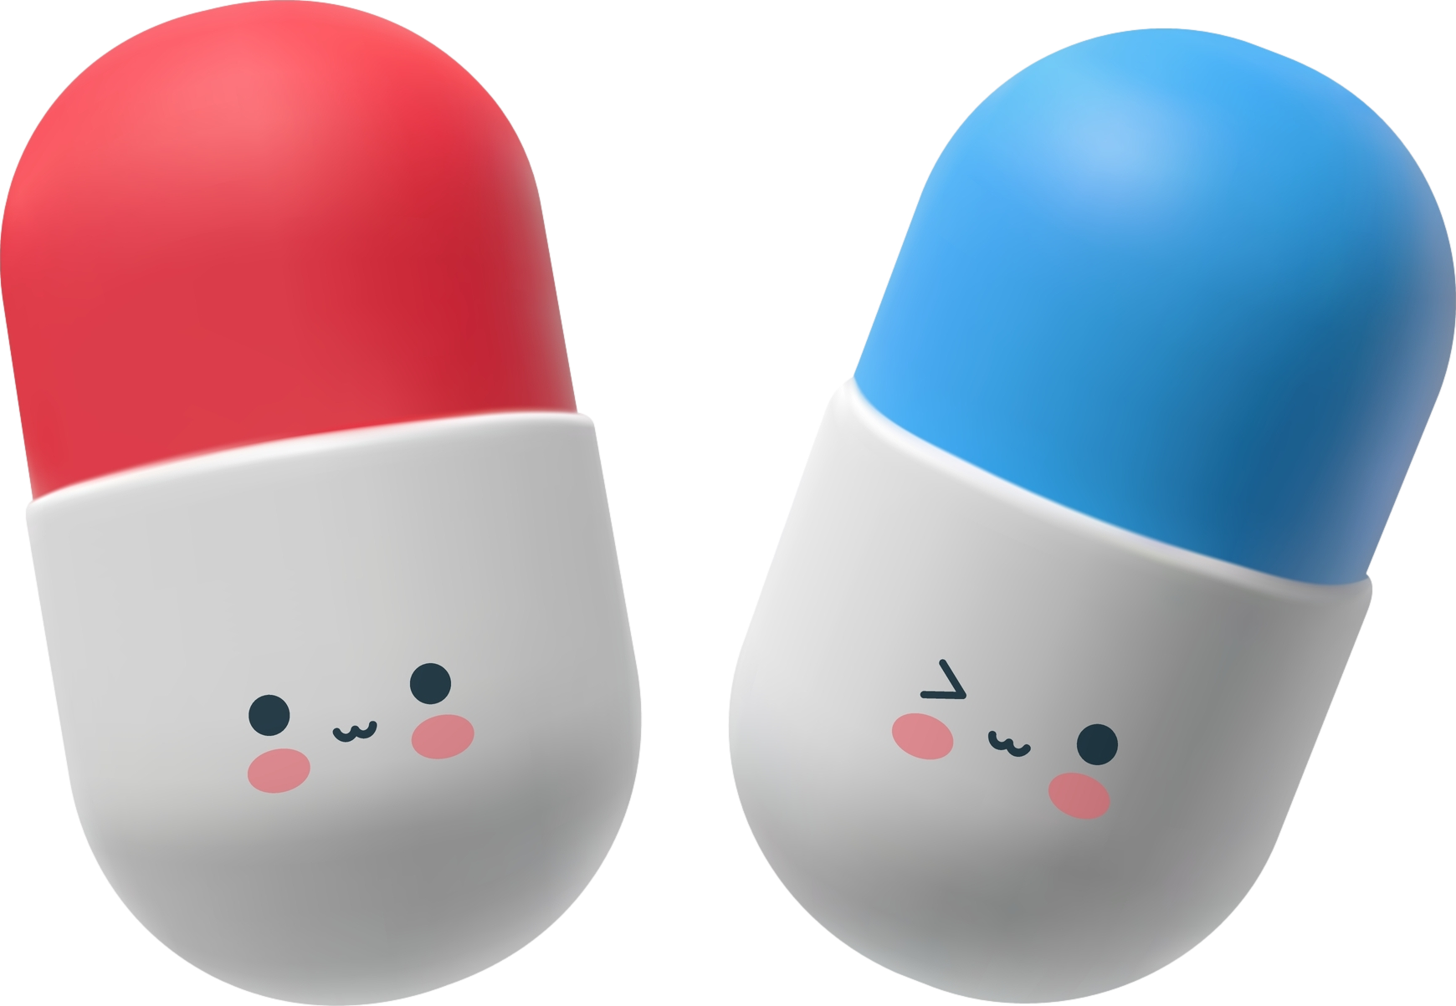
Antidepressants Jason Cafer, MD

Slide 2
Neurotransmission
is the foundation of psychopharmacology.
Enzyme
Stahl’s Essential Psychopharmacology

Slide 3
Neurotransmission
is the foundation of psychopharmacology.
Enzyme
Stahl’s Essential Psychopharmacology

Slide 4
neurotransmitter
Neurotransmission
is the foundation of psychopharmacology.
Enzyme
Stahl’s Essential Psychopharmacology

Slide 5
neurotransmitter
first messenger
Neurotransmission
is the foundation of psychopharmacology.
Enzyme
Stahl’s Essential Psychopharmacology

Slide 6
neurotransmitter
first messenger
Neurotransmission
is the foundation of psychopharmacology.
neuron cell membrane
Enzyme
Stahl’s Essential Psychopharmacology

Slide 7
neurotransmitter
first messenger
Neurotransmission
is the foundation of psychopharmacology.
remember #7
neuron cell membrane
Enzyme
Stahl’s Essential Psychopharmacology

Slide 8
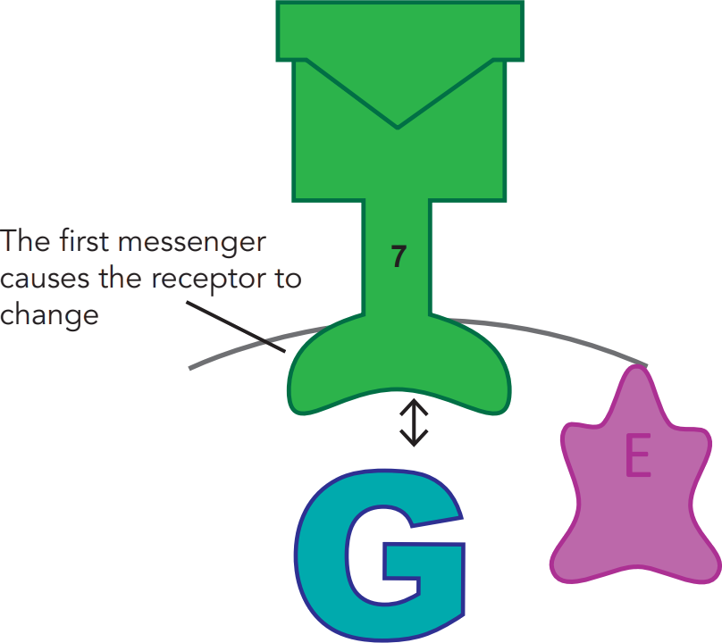
Binding can start a signal transduction cascade
neurotransmitter
receptor
Stahl’s Essential Psychopharmacology

Slide 9
Binding can start a signal transduction cascade
neurotransmitter
receptor
Stahl’s Essential Psychopharmacology

Slide 10
Binding can start a signal transduction cascade
neurotransmitter
receptor
Stahl’s Essential Psychopharmacology

Slide 11
Binding can start a signal transduction cascade
neurotransmitter
receptor
Stahl’s Essential Psychopharmacology

Slide 12
Binding can start a signal transduction cascade
neurotransmitter
receptor
Stahl’s Essential Psychopharmacology

Slide 13
Binding can start a signal transduction cascade
e.g., serotonin
neurotransmitter
receptor
Stahl’s Essential Psychopharmacology

Slide 14
Most serotonin receptors are linked to G-proteins
neurotransmitter
receptor
receptor
Stahl’s Essential Psychopharmacology

Slide 15
Second messenger starts signal transduction cascade
neurotransmitter
receptor
enzyme synthesizes second messenger
Stahl’s Essential Psychopharmacology

Slide 16
Second messenger starts signal transduction cascade
neurotransmitter
receptor
Stahl’s Essential Psychopharmacology

Slide 17
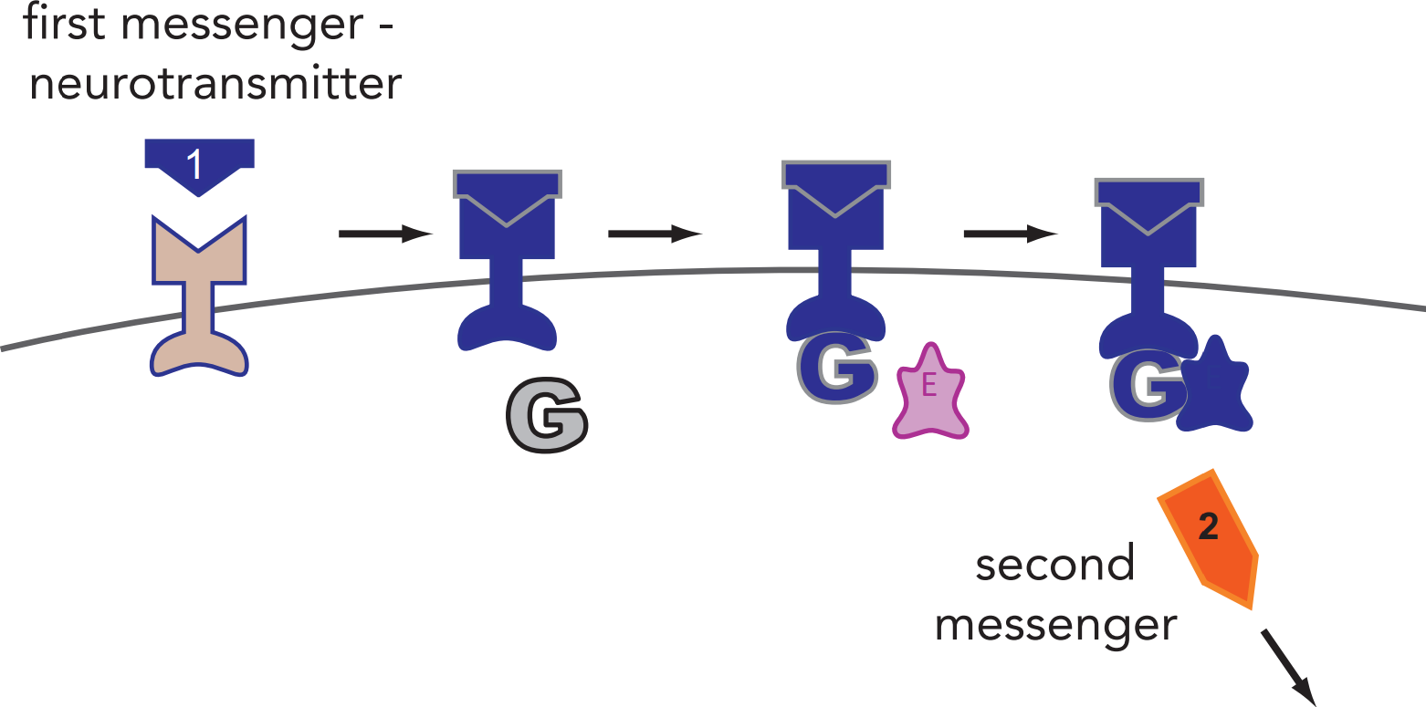
cAMP
Stahl’s Essential Psychopharmacology

Slide 18
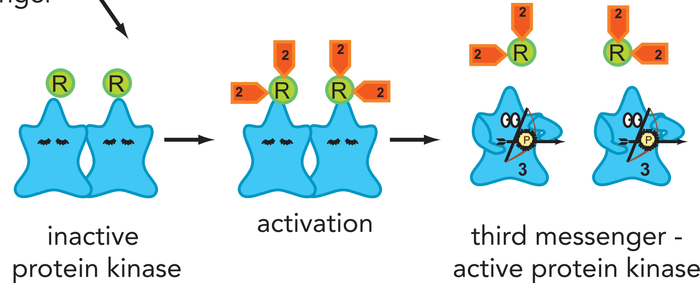
2nd messenger activates 3rd messenger
cAMP
Stahl’s Essential Psychopharmacology

Slide 19
2nd messenger activates 3rd messenger
cAMP
Stahl’s Essential Psychopharmacology

Slide 20
2nd messenger activates 3rd messenger
cAMP
Stahl’s Essential Psychopharmacology

Slide 21
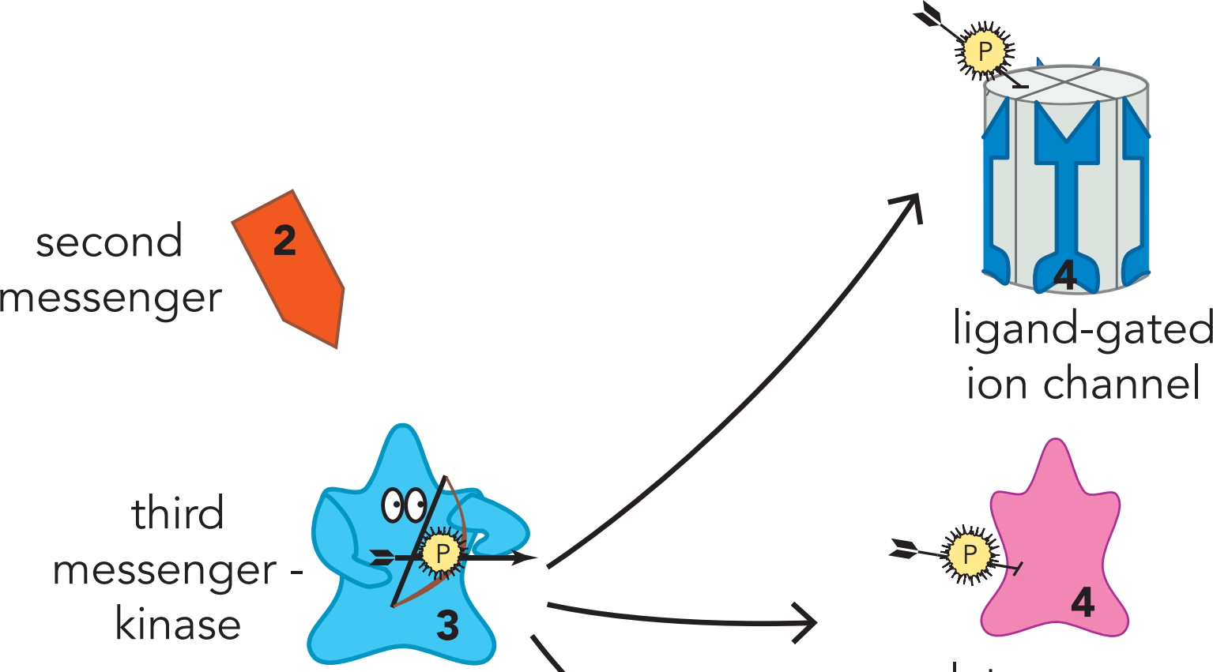
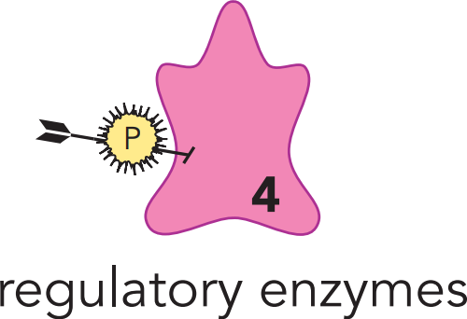
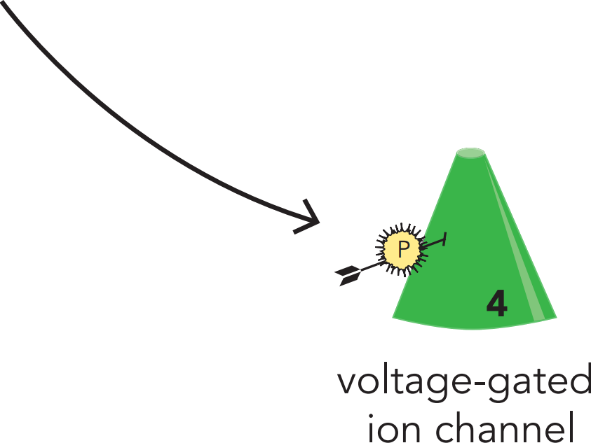
3rd messenger activates 4th messengers
Stahl’s Essential Psychopharmacology

Slide 22
3rd messenger activates 4th messengers
Stahl’s Essential Psychopharmacology

Slide 23
3rd messenger activates 4th messengers
Stahl’s Essential Psychopharmacology

Slide 24
3rd messenger activates 4th messengers
Stahl’s Essential Psychopharmacology

Slide 25
A 4th messenger can be a transcription factor
Stahl’s Essential Psychopharmacology

Slide 26
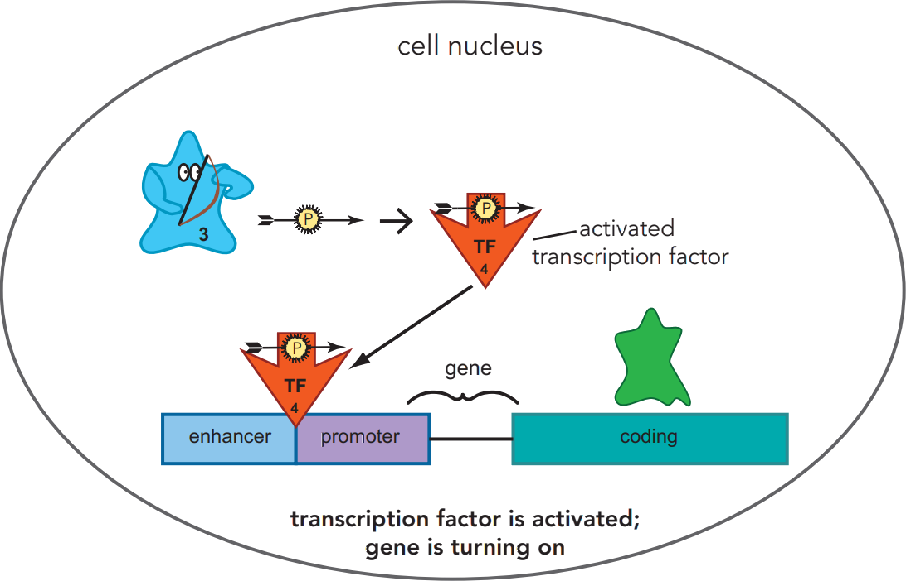
4th messenger activates a gene
Stahl’s Essential Psychopharmacology

Slide 27
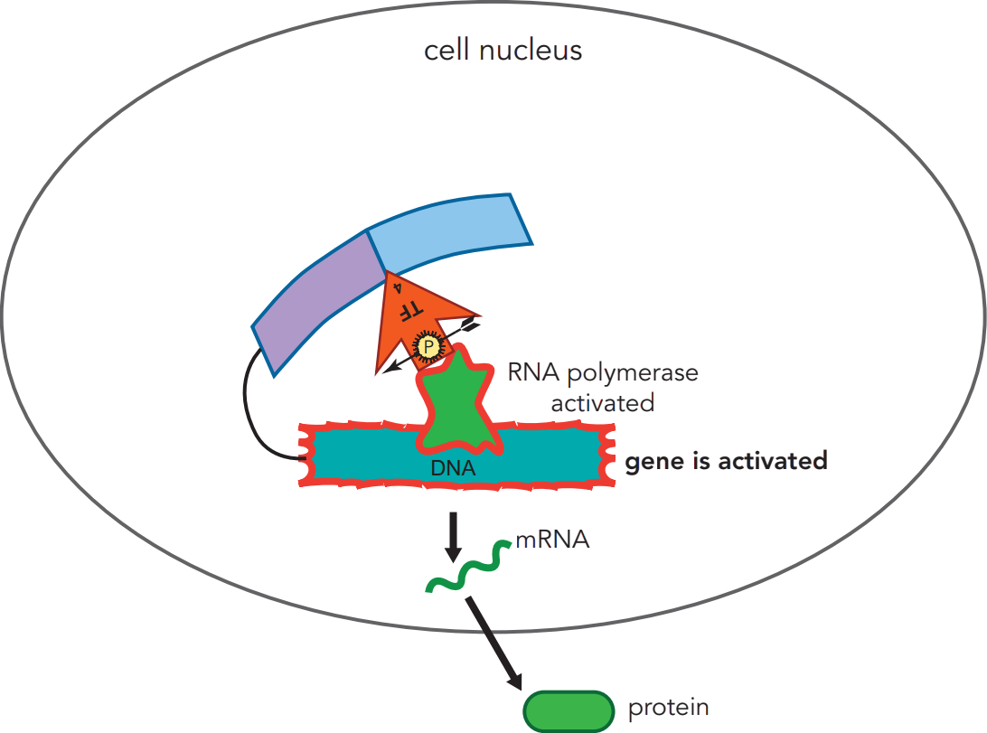
Transcription
transcription
translation
(5th messenger, early gene product)
Stahl’s Essential Psychopharmacology
5

Slide 28
Translation
transcription
translation
(5th messenger, early gene product)
Stahl’s Essential Psychopharmacology
5

Slide 29
Early gene product is 5th messenger
transcription
translation
(5th messenger, early gene product)
Stahl’s Essential Psychopharmacology
5

Slide 30
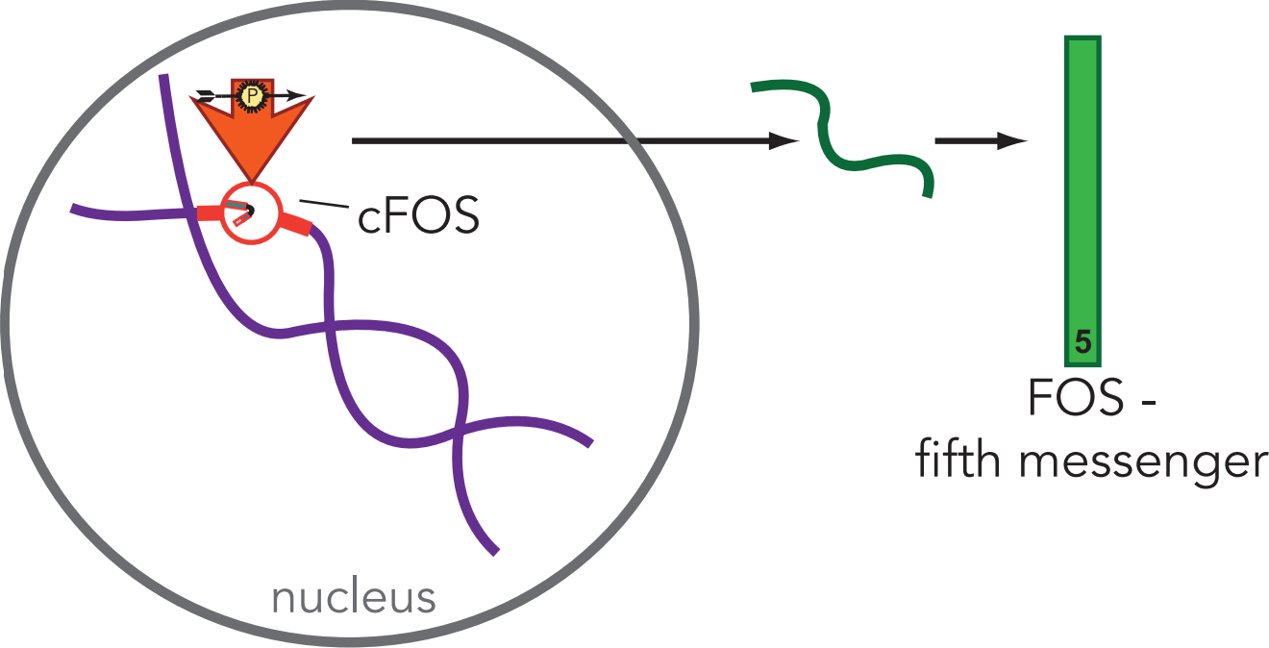
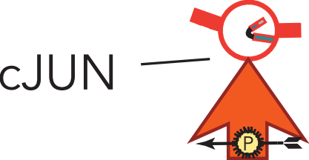
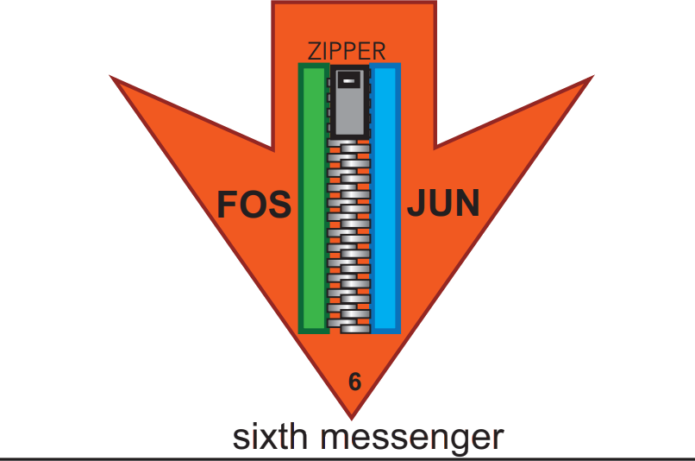
6th messenger is another transcription factor
Stahl’s Essential Psychopharmacology

Slide 31
6th messenger is another transcription factor
Stahl’s Essential Psychopharmacology

Slide 32
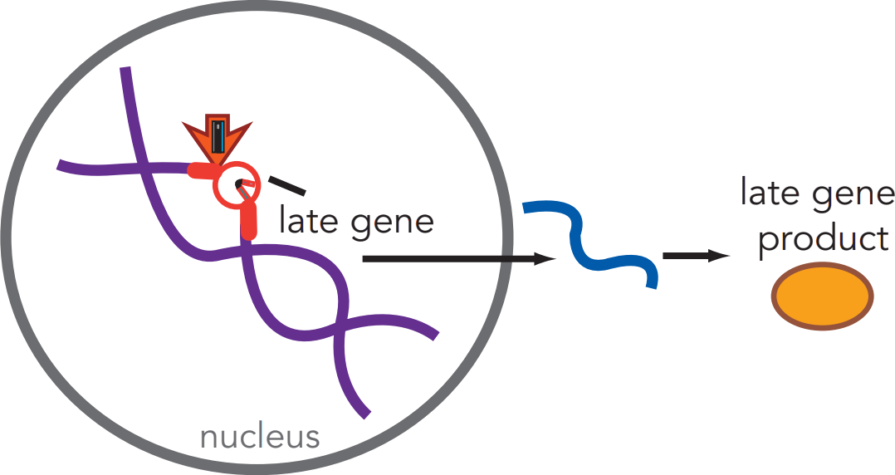
7th messenger is a late gene product
7
Stahl’s Essential Psychopharmacology

Slide 33
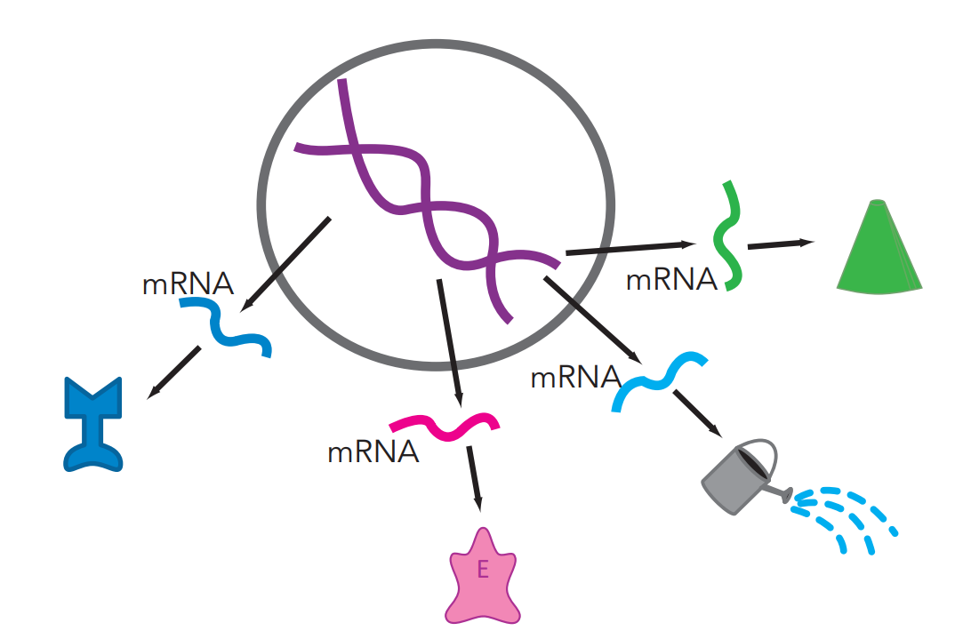
Examples of 7th messengers
7
an ion channel
7
a receptor
7
a neurotrophic growth factor
7
Stahl’s Essential Psychopharmacology
an enzyme

Slide 34
Examples of 7th messengers / Late gene products
7
an ion channel
7
a receptor
7
a neurotrophic growth factor
7
Stahl’s Essential Psychopharmacology
an enzyme

Slide 35
Examples of 7th messengers / Late gene products
7
an ion channel
7
a receptor
7
a neurotrophic growth factor
7
Stahl’s Essential Psychopharmacology
an enzyme

Slide 36
Examples of 7th messengers / Late gene products
7
an ion channel
7
a receptor
7
a neurotrophic growth factor
7
Stahl’s Essential Psychopharmacology
an enzyme

Slide 37
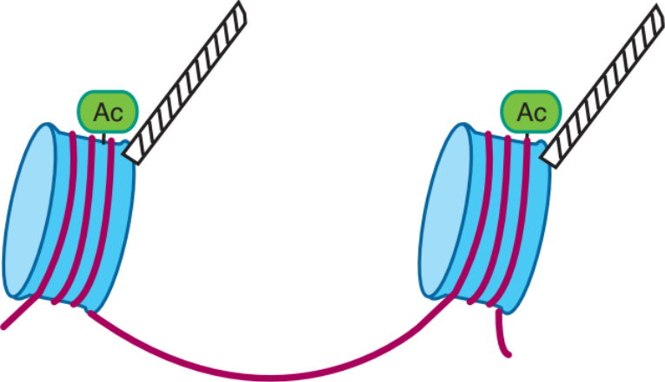
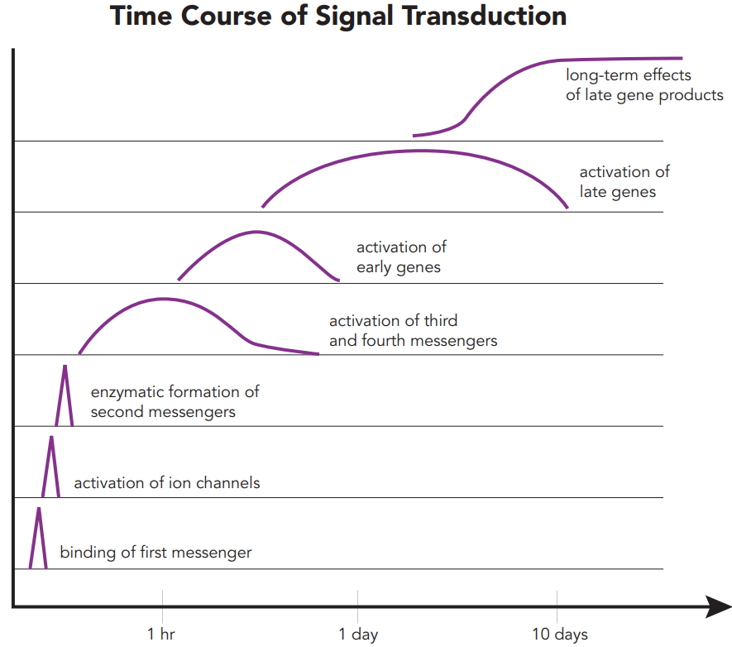
Signal transduction cascade
--> synthesis of new proteins which can alter the neuron’s functions

Slide 38
Signal transduction cascade
intracellular “downstream” effects
--> synthesis of new proteins which can alter the neuron’s functions

Slide 39
Signal transduction cascade
intracellular “downstream” effects
--> synthesis of new proteins which can alter the neuron’s functions
Downstream effects can be long-lasting, e.g.,

Slide 40
Signal transduction cascade
intracellular “downstream” effects
--> synthesis of new proteins which can alter the neuron’s functions
Downstream effects can be long-lasting, e.g.,
Synaptogenesis

Slide 41
Signal transduction cascade
intracellular “downstream” effects
--> synthesis of new proteins which can alter the neuron’s functions
Downstream effects can be long-lasting, e.g.,
Synaptogenesis
Neurogenesis

Slide 42
Signal transduction cascade
intracellular “downstream” effects
--> synthesis of new proteins which can alter the neuron’s functions
Downstream effects can be long-lasting, e.g.,
Synaptogenesis
Neurogenesis
Epigenetic changes

Slide 43
Signal transduction cascade
intracellular “downstream” effects
--> synthesis of new proteins which can alter the neuron’s functions
Downstream effects can be long-lasting, e.g.,
Synaptogenesis
Neurogenesis
Epigenetic changes

Slide 44
Chemical neurotransmission
neurotransmitter
first messenger
remember #7 =
neuron cell membrane
Enzyme
Stahl’s Essential Psychopharmacology

Slide 45
Chemical neurotransmission
neurotransmitter
first messenger
remember #7 = seventh messenger
(late gene product)
neuron cell membrane
Enzyme
Stahl’s Essential Psychopharmacology

Slide 46
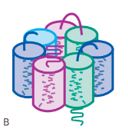
7-trans-membrane receptors
neurotransmitter
neuron cell membrane
Also 7-trans-
membrane region
Enzyme
Stahl’s Essential Psychopharmacology

Slide 47
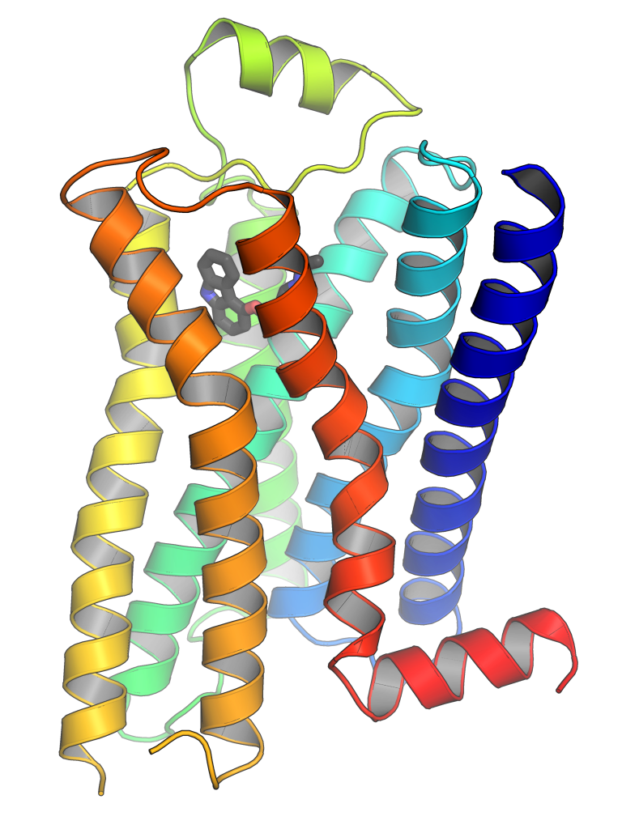
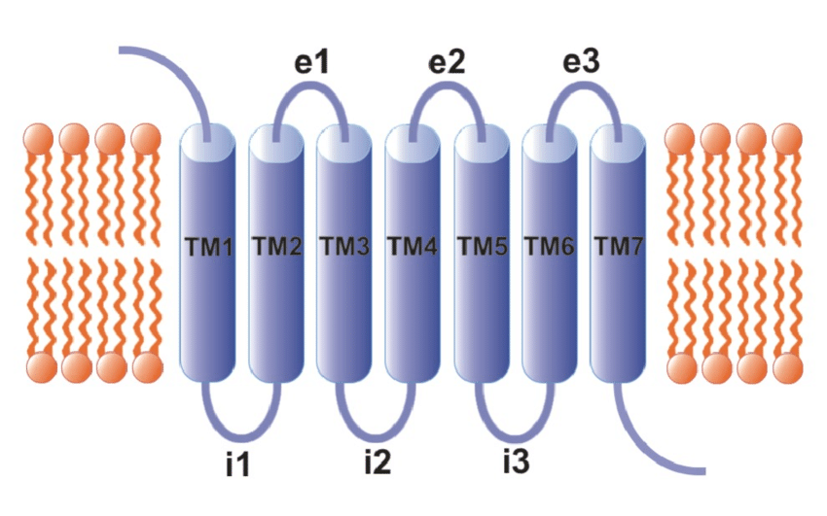
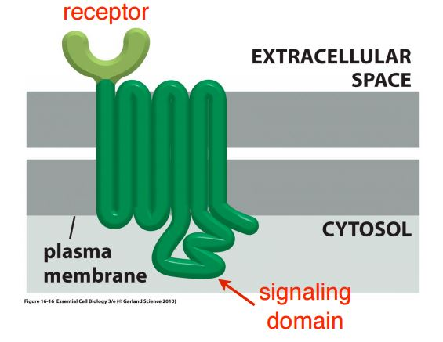
7-trans-membrane receptors
neurotransmitter
neuron cell membrane
Also 7-trans-
membrane region
Enzyme

Slide 48
7-trans-membrane receptors
neurotransmitter
neuron cell membrane
Also 7-trans-
membrane region
Enzyme

Slide 49
Chemical neurotransmission
neurotransmitter
neuron cell membrane
Neurotransmission can alter the target neuron
Enzyme

Slide 50
Chemical neurotransmission
neurotransmitter
neuron cell membrane
Neurotransmission can alter the target neuron
in a profound and enduring manner.
Enzyme

Slide 51
Chemical neurotransmission
neurotransmitter
neuron cell membrane
Neurotransmission can alter the target neuron
in a profound and enduring manner.
The presynaptic genome is talking to the postsynaptic genome.
Enzyme

Slide 52
Chemical neurotransmission
neurotransmitter
neuron cell membrane
Neurotransmission can alter the target neuron
in a profound and enduring manner.
The presynaptic genome is talking to the postsynaptic genome.
All treatments for depression affect gene expression in the brain.
Enzyme

Slide 53
Chemical neurotransmission
neurotransmitter
neuron cell membrane
Neurotransmission can alter the target neuron
in a profound and enduring manner.
The presynaptic genome is talking to the postsynaptic genome.
All treatments for depression affect gene expression in the brain.
Enzyme

Slide 54
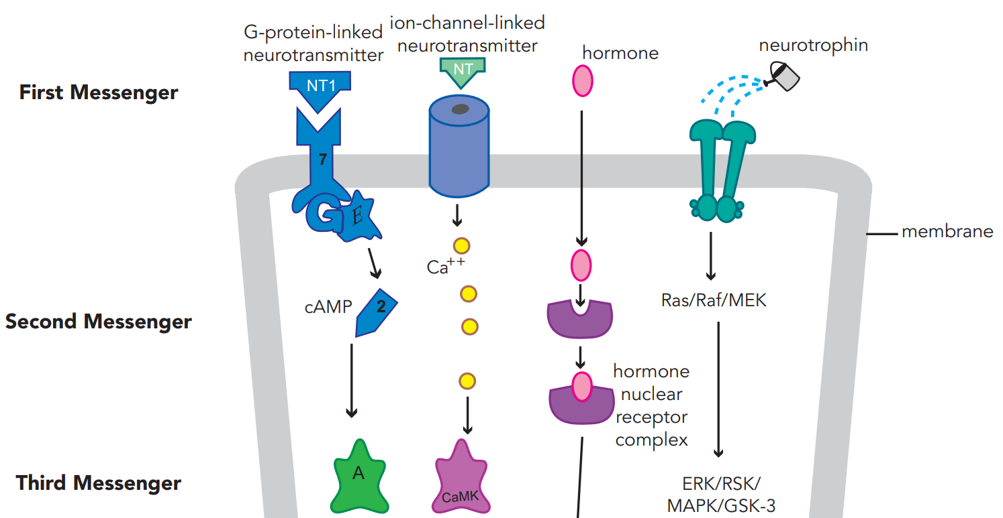
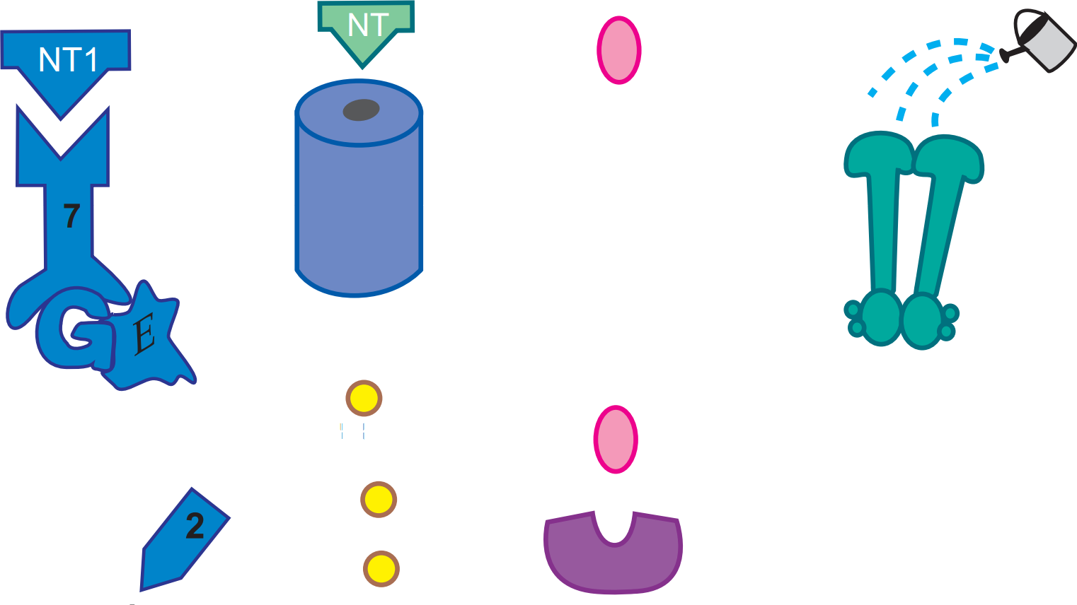
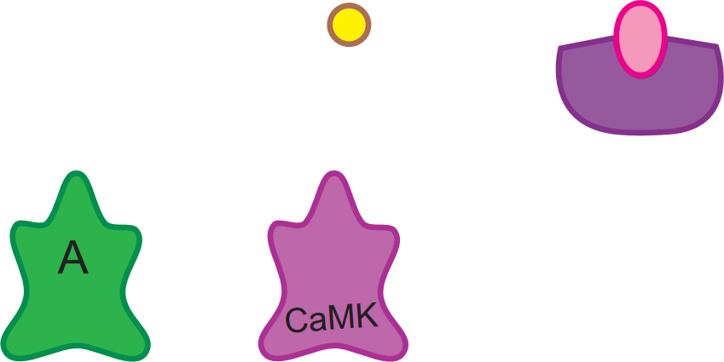
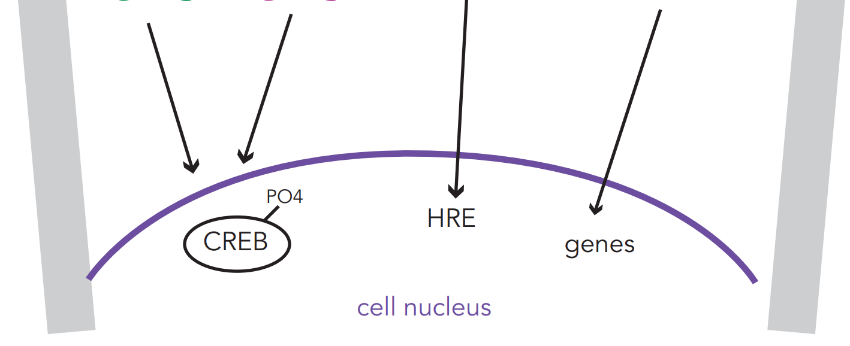
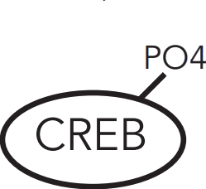
4 of the most
important signal
transduction
cascades
neurotransmitter
cAMP = cyclic adenosine monophosphate
downstream effects
A = protein kinase A
CaMK = calcium/calmodulin kinase
CREB = cAMP response element-binding protein (phosphorylated)
genes (related to synaptogenesis
and neuronal survival)
HRE = hormone-response element
gene activation
cell nucleus

Slide 55
4 of the most
important signal
transduction
cascades
Most
serotonin
receptors
neurotransmitter
cAMP = cyclic adenosine monophosphate
downstream effects
A = protein kinase A
CaMK = calcium/calmodulin kinase
CREB = cAMP response element-binding protein (phosphorylated)
genes (related to synaptogenesis
and neuronal survival)
HRE = hormone-response element
gene activation
cell nucleus

Slide 56
4 of the most
important signal
transduction
cascades
1 type
of
sero-
tonin
receptor
neurotransmitter
cAMP = cyclic adenosine monophosphate
downstream effects
A = protein kinase A
CaMK = calcium/calmodulin kinase
CREB = cAMP response element-binding protein (phosphorylated)
genes (related to synaptogenesis
and neuronal survival)
HRE = hormone-response element
gene activation
cell nucleus

Slide 57
4 of the most
important signal
transduction
cascades
neurotransmitter
cAMP = cyclic adenosine monophosphate
downstream effects
A = protein kinase A
CaMK = calcium/calmodulin kinase
CREB = cAMP response element-binding protein (phosphorylated)
genes (related to synaptogenesis
and neuronal survival)
HRE = hormone-response element
gene activation
cell nucleus

Slide 58
4 of the most
important signal
transduction
cascades
neurotransmitter
cAMP = cyclic adenosine monophosphate
downstream effects
A = protein kinase A
CaMK = calcium/calmodulin kinase
CREB = cAMP response element-binding protein (phosphorylated)
genes (related to synaptogenesis
and neuronal survival)
HRE = hormone-response element
gene activation
cell nucleus
Notes:
cAMP-response element binding protein (CREB)

Slide 59
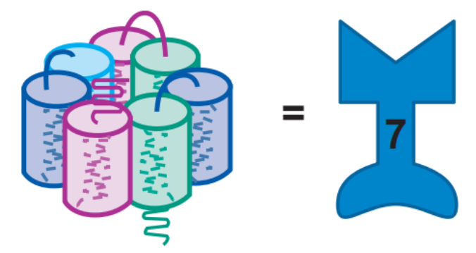
The Five Targets of Psychotropic Drugs
Stahl’s Essential Psychopharmacology

Slide 60
The Five Targets of Psychotropic Drugs
G-protein linked receptor
Stahl’s Essential Psychopharmacology

Slide 61
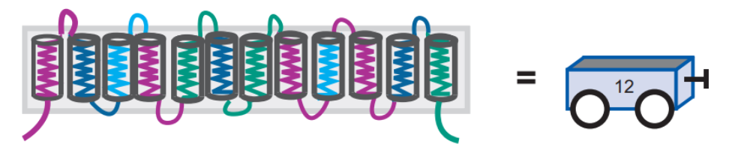
The Five Targets of Psychotropic Drugs
G-protein linked receptor
Stahl’s Essential Psychopharmacology

Slide 62
The Five Targets of Psychotropic Drugs
G-protein linked receptor
Transporter
(reuptake inhibitors)
Stahl’s Essential Psychopharmacology

Slide 63
The Five Targets of Psychotropic Drugs
G-protein linked receptor
Transporter
(reuptake inhibitors)
Stahl’s Essential Psychopharmacology

Slide 64
The Five Targets of Psychotropic Drugs
G-protein linked receptor
Transporter
(reuptake inhibitors)
Ligand-gated ion channel
Stahl’s Essential Psychopharmacology

Slide 65
The Five Targets of Psychotropic Drugs
G-protein linked receptor
Transporter
(reuptake inhibitors)
Ligand-gated ion channel
Stahl’s Essential Psychopharmacology

Slide 66
The Five Targets of Psychotropic Drugs
G-protein linked receptor
Voltage-gated ion channel
Transporter
(reuptake inhibitors)
Ligand-gated ion channel
Stahl’s Essential Psychopharmacology

Slide 67
The Five Targets of Psychotropic Drugs
G-protein linked receptor
Voltage-gated ion channel
Transporter
(reuptake inhibitors)
Ligand-gated ion channel
Stahl’s Essential Psychopharmacology

Slide 68
The Five Targets of Psychotropic Drugs
G-protein linked receptor
Voltage-gated ion channel
Transporter
(reuptake inhibitors)
Enzyme
Ligand-gated ion channel
Stahl’s Essential Psychopharmacology

Slide 69
The Five Targets of Psychotropic Drugs
G-protein linked receptor
Voltage-gated ion channel
Transporter
(reuptake inhibitors)
Enzyme
Ligand-gated ion channel
Stahl’s Essential Psychopharmacology

Slide 70
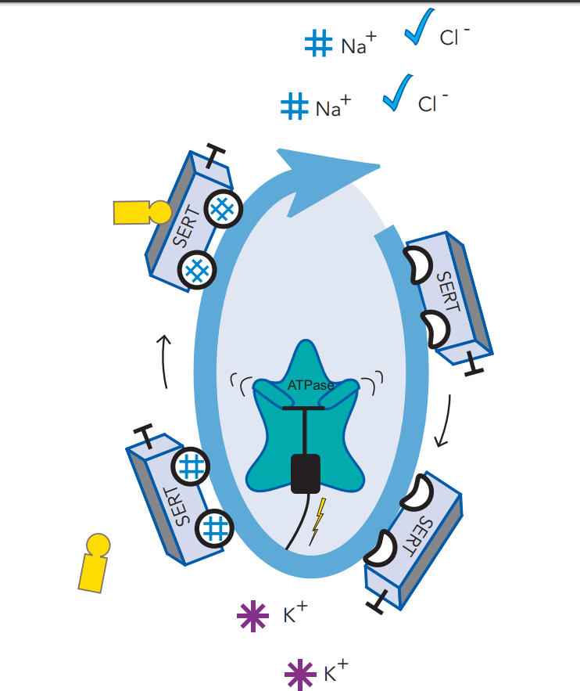
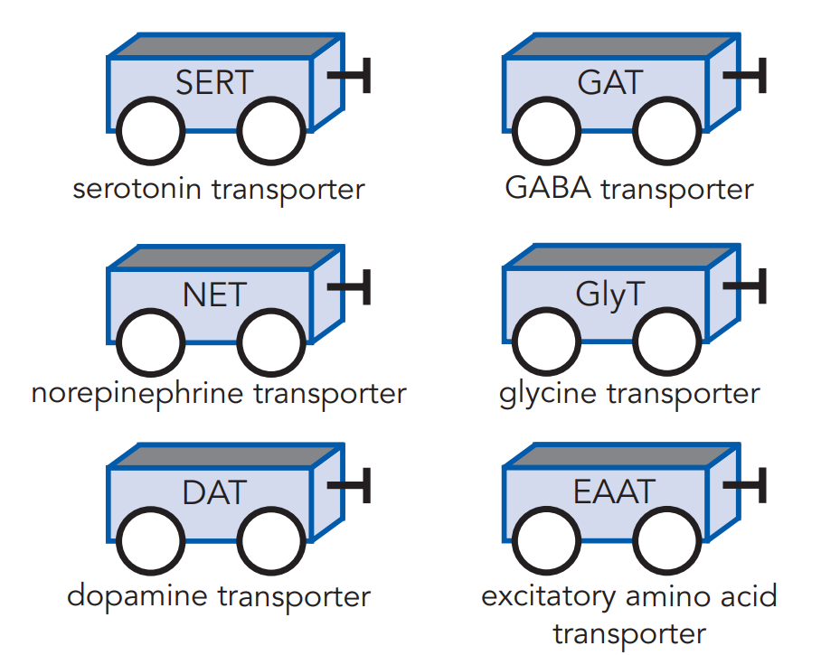
Transporters = reuptake pumps

Slide 71
Transporters = reuptake pumps
= what’s blocked by a reuptake inhibitor

Slide 72
Transporters = reuptake pumps
= what’s blocked by a reuptake inhibitor

Slide 73
Transporters = reuptake pumps
This is the target of serotonin reuptake inhibitors

Slide 74
Serotonin transporter (SERT) blocker
Stahl’s Essential Psychopharmacology

Slide 75
Serotonin transporter (SERT)
Serotonin transporter (SERT) blocker
Stahl’s Essential Psychopharmacology

Slide 76
Serotonin transporter (SERT)
Serotonin transporter (SERT) blocker
Stahl’s Essential Psychopharmacology

Slide 77
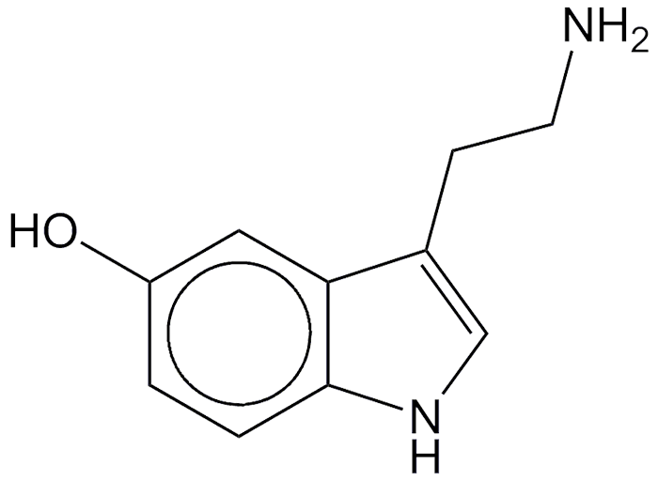
Serotonin transporter (SERT)
Serotonin transporter (SERT) blocker
Stahl’s Essential Psychopharmacology

Slide 78
Serotonin transporter (SERT)
Serotonin transporter (SERT) blocker
Stahl’s Essential Psychopharmacology

Slide 79
Serotonin transporter (SERT)
Stahl’s Essential Psychopharmacology

Slide 80
Serotonin transporter (SERT)
Stahl’s Essential Psychopharmacology

Slide 81
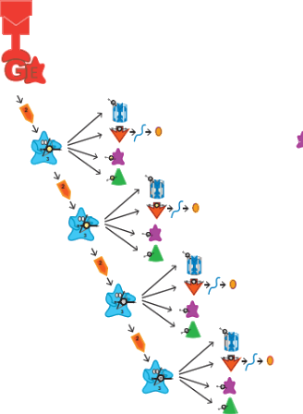
Serotonin transporter (SERT)
Stahl’s Essential Psychopharmacology

Slide 82
Serotonin transporter (SERT)
Stahl’s Essential Psychopharmacology

Slide 83
Serotonin transporter (SERT)
Stahl’s Essential Psychopharmacology

Slide 84
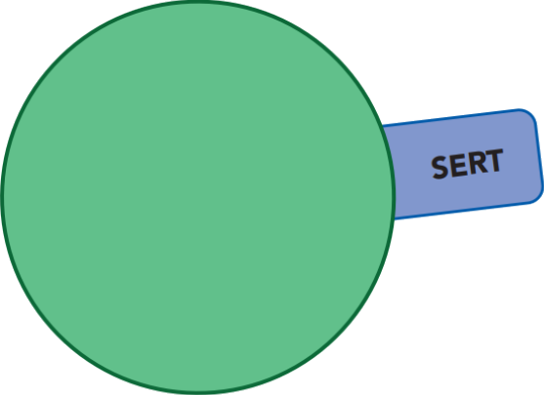
Serotonin transporter (SERT)
Stahl’s Essential Psychopharmacology

Slide 85
Serotonin transporter (SERT)
Stahl’s Essential Psychopharmacology

Slide 86
Serotonin transporter (SERT)
Stahl’s Essential Psychopharmacology

Slide 87
Serotonin transporter (SERT)
Stahl’s Essential Psychopharmacology

Slide 88
Serotonin transporter (SERT)
Stahl’s Essential Psychopharmacology

Slide 89
Serotonin transporter (SERT)
Stahl’s Essential Psychopharmacology

Slide 90
Serotonin transporter (SERT)
Stahl’s Essential Psychopharmacology

Slide 91
Serotonin transporter (SERT)
Stahl’s Essential Psychopharmacology

Slide 92
Serotonin transporter (SERT)
Stahl’s Essential Psychopharmacology

Slide 93
Serotonin transporter (SERT)
Stahl’s Essential Psychopharmacology

Slide 94
Serotonin transporter (SERT)
Stahl’s Essential Psychopharmacology

Slide 95
Serotonin transporter (SERT)
Stahl’s Essential Psychopharmacology

Slide 96
Serotonin transporter (SERT)
Stahl’s Essential Psychopharmacology

Slide 97
Serotonin transporter (SERT)
Stahl’s Essential Psychopharmacology

Slide 98
Serotonin transporter (SERT)
Stahl’s Essential Psychopharmacology

Slide 99
Serotonin transporter (SERT)
Stahl’s Essential Psychopharmacology

Slide 100
Serotonin transporter (SERT)
Serotonin reuptake inhibitor (SRI)
Stahl’s Essential Psychopharmacology

Slide 101
Serotonin = 5-hydroxytryptamine = 5-HT
=
Stahl’s Essential Psychopharmacology

Slide 102
Serotonin = 5-hydroxytryptamine = 5-HT
=

Slide 103
Serotonin = 5-hydroxytryptamine = 5-HT
=

Slide 104
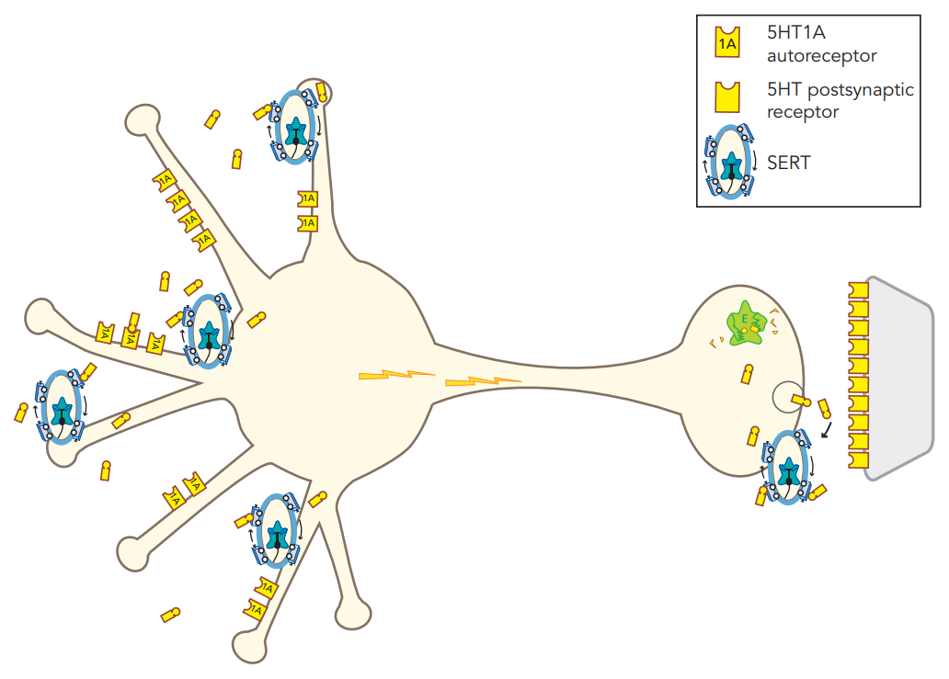
Monoamine hypothesis of depression - “low serotonin”
Low serotonin (5HT) at somatodendritic areas
5HT receptor
serotonin neuron
Low serotonin (5HT) in the synapse
serotonin transporter (SERT)
Stahl’s Essential Psychopharmacology

Slide 105
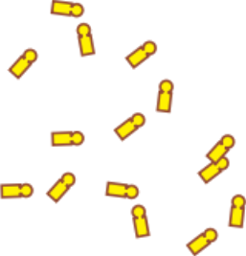
Monoamine hypothesis of depression - “low serotonin”
Low serotonin (5HT) at somatodendritic areas
5HT receptor
serotonin neuron
Low serotonin (5HT) in the synapse
serotonin transporter (SERT)
Stahl’s Essential Psychopharmacology

Slide 106
Monoamine hypothesis of depression - “low serotonin”
Low serotonin (5HT) at somatodendritic areas
5HT receptor
serotonin neuron
Low serotonin (5HT) in the synapse
serotonin transporter (SERT)

Slide 107
Neurotransmitter receptor hypothesis of depression
Upregulated presynaptic 5HT_{1A} autoreceptors
serotonin neuron

Slide 108
Neurotransmitter receptor hypothesis of depression
Upregulated presynaptic 5HT_{1A} autoreceptors
serotonin neuron
low number of signals

Slide 109
Neurotransmitter receptor hypothesis of depression
Upregulated presynaptic 5HT_{1A} autoreceptors
low serotonin in synapse
serotonin neuron
low number of signals

Slide 110
Neurotransmitter receptor hypothesis of depression
Upregulated presynaptic 5HT_{1A} autoreceptors
serotonin neuron
Upregulated postsynaptic 5HT receptors
low number of signals

Slide 111
SSRI

Slide 112
SSRI

Slide 113
SSRI

Slide 114
SSRI

Slide 115
SSRI

Slide 116
SSRI

Slide 117
SSRI

Slide 118
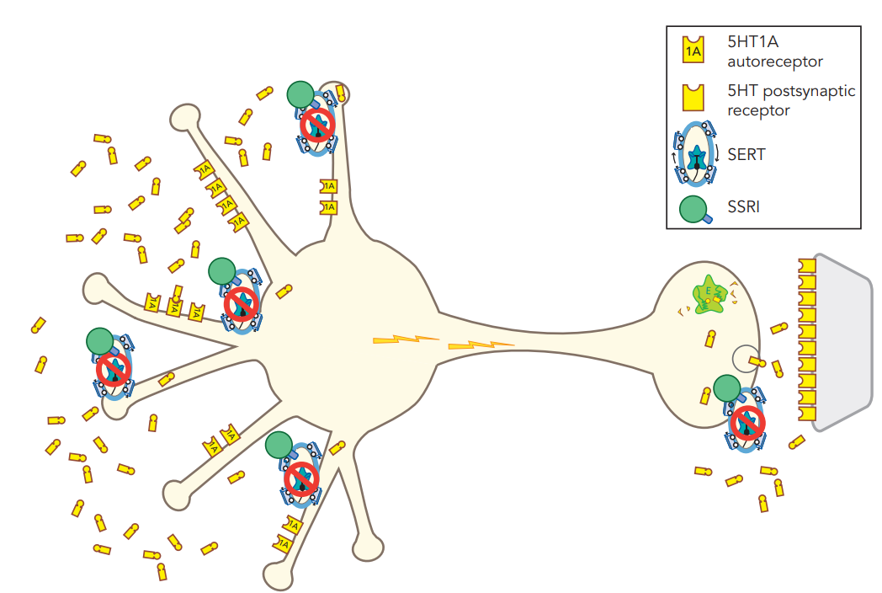
SSRI

Slide 119
SSRI

Slide 120
SSRI mechanism - immediate effects
serotonin neuron

Slide 121
SSRI mechanism - immediate effects
serotonin neuron
SRI blocks SERT at axon terminal

Slide 122
SSRI mechanism - immediate effects
SRI blocks SERT on dendrites
serotonin neuron
SRI blocks SERT at axon terminal

Slide 123
SSRI mechanism - immediate effects
SRI blocks SERT on dendrites
More 5HT in somatodendritic area.
serotonin neuron
SRI blocks SERT at axon terminal

Slide 124
SSRI mechanism - immediate effects
These are 5HT1A autoreceptors
SRI blocks SERT on dendrites
serotonin neuron
SRI blocks SERT at axon terminal

Slide 125
SSRI mechanism - immediate effects
SRI blocks SERT on dendrites
Binding to 5HT1A autoreceptors...
serotonin neuron
SRI blocks SERT at axon terminal

Slide 126
SSRI mechanism - immediate effects
SRI blocks SERT on dendrites
Binding to 5HT1A autoreceptors...
inhibits firing
serotonin neuron
SRI blocks SERT at axon terminal

Slide 127
SSRI mechanism - immediate effects
SRI blocks SERT on dendrites
Binding to 5HT1A autoreceptors...
inhibits firing
serotonin neuron
so, still low number of signals...
SRI blocks SERT at axon terminal

Slide 128
SSRI mechanism - immediate effects
SRI blocks SERT on dendrites
Binding to 5HT1A autoreceptors...
inhibits firing
serotonin neuron
so, still low number of signals...
despite SSRI
SRI blocks SERT at axon terminal

Slide 129
SSRI mechanism - immediate effects
SRI blocks SERT on dendrites
Binding to 5HT1A autoreceptors...
inhibits firing
serotonin neuron
so, not much more 5HT in axon terminal
so, still low number of signals...
despite SSRI
SRI blocks SERT at axon terminal

Slide 130
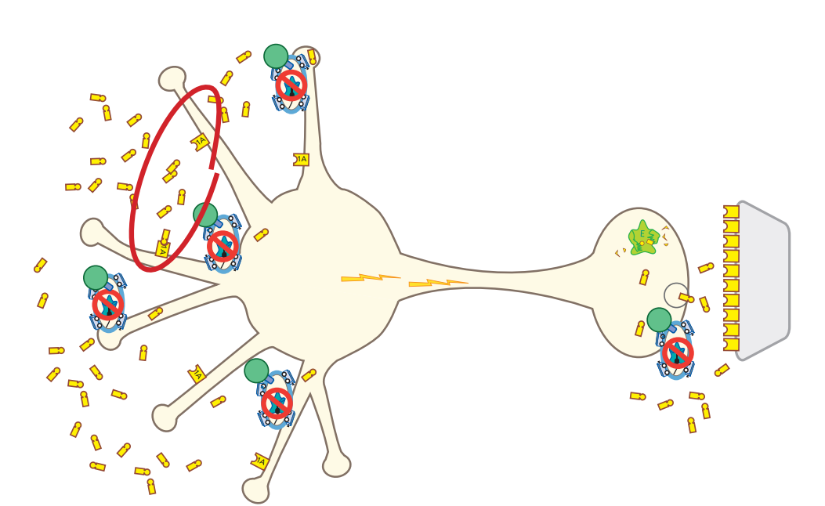
SSRI mechanism - delayed effects
serotonin neuron

Slide 131
SSRI mechanism - immediate effects
serotonin neuron

Slide 132
SSRI mechanism - delayed effects
serotonin neuron

Slide 133
SSRI mechanism - immediate effects
serotonin neuron

Slide 134
SSRI mechanism - delayed effects
serotonin neuron

Slide 135
SSRI mechanism - immediate effects
serotonin neuron

Slide 136
SSRI mechanism - delayed effects
serotonin neuron

Slide 137
SSRI mechanism - immediate effects
serotonin neuron

Slide 138
SSRI mechanism - delayed effects
serotonin neuron

Slide 139
SSRI mechanism - delayed effects
5HT1A autoreceptors downregulate
(due to increased 5HT)
serotonin neuron

Slide 140
SSRI mechanism - delayed effects
5HT1A autoreceptors downregulate
(due to increased 5HT)
serotonin neuron
Increased neuronal impulse flow

Slide 141
SSRI mechanism - delayed effects
5HT1A autoreceptors downregulate
(due to increased 5HT)
serotonin neuron
Increased neuronal impulse flow

Slide 142
SSRI mechanism - delayed effects
5HT1A autoreceptors downregulate
(due to increased 5HT)
serotonin neuron
Increased neuronal impulse flow

Slide 143
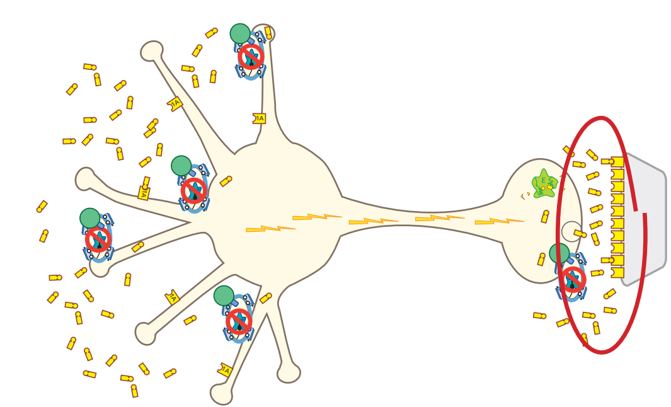
SSRI mechanism - result of delayed effects
Delay = time it takes for 5HT1A autoreceptors to downregulate
serotonin neuron

Slide 144
SSRI mechanism - result of delayed effects
Increased release of 5HT from axon
serotonin neuron

Slide 145
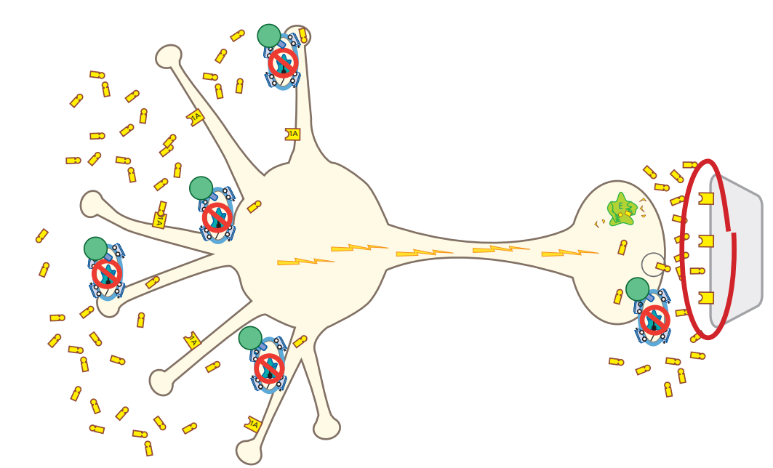
SSRI mechanism - result of delayed effects
The increase of 5HT at the axon causes...
serotonin neuron

Slide 146
SSRI mechanism - result of delayed effects
serotonin neuron

Slide 147
SSRI mechanism - result of delayed effects
serotonin neuron

Slide 148
SSRI mechanism - result of delayed effects
serotonin neuron

Slide 149
SSRI mechanism - result of delayed effects
serotonin neuron

Slide 150
SSRI mechanism - result of delayed effects
serotonin neuron

Slide 151
SSRI mechanism - result of delayed effects
serotonin neuron

Slide 152
SSRI mechanism - result of delayed effects
serotonin neuron

Slide 153
SSRI mechanism - result of delayed effects
serotonin neuron

Slide 154
SSRI mechanism - result of delayed effects
The increase of 5HT at the axon causes postsynaptic receptors to downregulate/
desensitize
serotonin neuron

Slide 155
SSRI mechanism - result of delayed effects
The increase of 5HT at the axon causes postsynaptic receptors to downregulate/
desensitize
→ therapeutic effects
serotonin neuron

Slide 156
SSRI mechanism - result of delayed effects
The increase of 5HT at the axon causes postsynaptic receptors to downregulate/
desensitize
→ therapeutic effects
→ tolerance to side effects
serotonin neuron

Slide 157
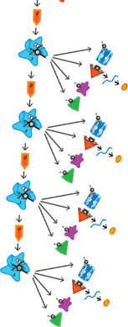
SSRI mechanism - result of delayed effects
serotonin neuron

Slide 158
SSRI mechanism - result of delayed effects
serotonin neuron

Slide 159
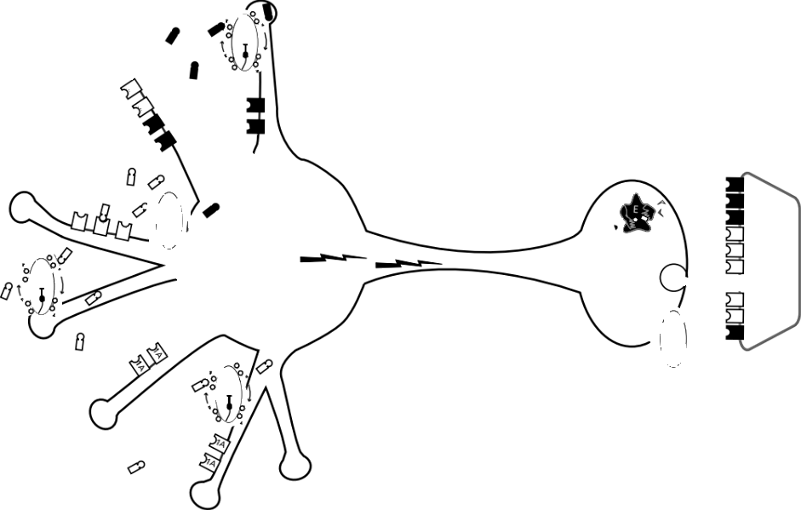
Serotonin (5HT) receptor subtypes
Note that these postsynaptic 5HT receptors are on a non-serotonin neuron (e.g., GABA interneuron)
serotonin neuron
serotonin neuron

Slide 160
Serotonin (5HT) receptor subtypes
Note that these postsynaptic 5HT receptors are on a non-serotonin neuron (e.g., GABA interneuron)
serotonin neuron
serotonin neuron
and the post-synaptic neuron won’t have all receptor subtypes

Slide 161
Serotonin (5HT) receptor subtypes
5HT1A “negative feedback” receptors
serotonin neuron
serotonin neuron

Slide 162
Serotonin (5HT) receptor subtypes
5HT1A “negative feedback” receptors
serotonin neuron
serotonin neuron
inhibitory

Slide 163
Serotonin (5HT) receptor subtypes
Inhibitory / negative feedback receptors

Slide 164
Serotonin (5HT) receptor subtypes
Inhibitory / negative feedback receptors
serotonin neuron

Slide 165
Serotonin (5HT) receptor subtypes
Inhibitory / negative feedback receptors
serotonin neuron

Slide 166
Serotonin (5HT) receptor subtypes
Inhibitory / negative feedback receptors
serotonin neuron

Slide 167
Serotonin (5HT) receptor subtypes
Inhibitory / negative feedback receptors
serotonin neuron

Slide 168
Serotonin (5HT) receptor subtypes
Inhibitory / negative feedback receptors
serotonin neuron

Slide 169
Serotonin (5HT) receptor subtypes
Inhibitory / negative feedback receptors
serotonin neuron

Slide 170
Serotonin (5HT) receptor subtypes
Inhibitory / negative feedback receptors
serotonin neuron

Slide 171
Serotonin (5HT) receptor subtypes
Inhibitory / negative feedback receptors

Slide 172
Serotonin (5HT) receptor subtypes

Slide 173
Serotonin (5HT) receptor subtypes
“Feed-forward” / excitatory receptors

Slide 174
Serotonin (5HT) receptor subtypes
“Feed-forward” / excitatory receptors
serotonin neuron

Slide 175
Serotonin (5HT) receptor subtypes
“Feed-forward” / excitatory receptors
serotonin neuron

Slide 176
Serotonin (5HT) receptor subtypes
“Feed-forward” / excitatory receptors
serotonin neuron

Slide 177
Serotonin (5HT) receptor subtypes
“Feed-forward” / excitatory receptors
serotonin neuron

Slide 178
Serotonin (5HT) receptor subtypes
“Feed-forward” / excitatory receptors
serotonin neuron

Slide 179
Serotonin (5HT) receptor subtypes
“Feed-forward” / excitatory receptors
serotonin neuron

Slide 180
Serotonin (5HT) receptor subtypes
“Feed-forward” / excitatory receptors
serotonin neuron

Slide 181
Serotonin (5HT) receptor subtypes
“Feed-forward” / excitatory receptors
serotonin neuron

Slide 182
Serotonin (5HT) receptor subtypes
“Feed-forward” / excitatory receptors
serotonin neuron

Slide 183
Serotonin (5HT) receptor subtypes
5HT3 receptors are ligand-gated ion channels
serotonin neuron
serotonin neuron

Slide 184
Serotonin (5HT) receptor subtypes
Other than 5HT3, serotonin receptors are G-protein linked
5HT3 receptors are ligand-gated ion channels
serotonin neuron
serotonin neuron

Slide 185
Serotonin (5HT) receptor subtypes
serotonin neuron
serotonin neuron
serotonin transmission regulates other neurotransmitters in downstream circuits

Slide 186
Serotonin (5HT) receptor subtypes
serotonin neuron
serotonin neuron
serotonin transmission regulates other neurotransmitters in downstream circuits

Slide 187
Serotonin (5HT) receptor subtypes
serotonin neuron
serotonin neuron
serotonin transmission regulates other neurotransmitters in downstream circuits

Slide 188
Serotonin (5HT) receptor subtypes
serotonin neuron
serotonin neuron
serotonin transmission regulates other neurotransmitters in downstream circuits

Slide 189
Serotonin (5HT) receptor subtypes
serotonin neuron
serotonin neuron
serotonin transmission regulates other neurotransmitters in downstream circuits

Slide 190
Serotonin (5HT) receptor subtypes
serotonin neuron
serotonin neuron
serotonin transmission regulates other neurotransmitters in downstream circuits

Slide 191
Serotonin (5HT) receptor subtypes
serotonin neuron
serotonin neuron
serotonin transmission regulates other neurotransmitters in downstream circuits

Slide 192
Serotonin (5HT) receptor subtypes
serotonin neuron
serotonin neuron
serotonin transmission regulates other neurotransmitters in downstream circuits

Slide 193
Serotonin (5HT) receptor subtypes
serotonin neuron
serotonin neuron
serotonin transmission regulates other neurotransmitters in downstream circuits

Slide 194
Serotonin (5HT) receptor subtypes
serotonin neuron
serotonin neuron
serotonin transmission regulates other neurotransmitters in downstream circuits

Slide 195
By “downstream” we’re not referring to cascade inside the cell...
serotonin transmission regulates other neurotransmitters in downstream circuits

Slide 196
By “downstream” we’re not referring to cascade inside the cell...
now we’re talking neural circuits
serotonin transmission regulates other neurotransmitters in downstream circuits

Slide 197
5HT1A

Slide 198
5HT1A Stimulation Increases Release of

Slide 199
5HT1A Stimulation Increases Release of Norepinephrine

Slide 200
5HT1A Stimulation Increases Release of Norepinephrine Dopamine

Slide 201
5HT1A Stimulation Increases Release of Norepinephrine Dopamine and Acetylcholine

Slide 202
5HT1A
5HT1A Stimulation Increases Release of Norepinephrine Dopamine and Acetylcholine

Slide 203
5HT1A
5HT1A Stimulation Increases Release of Norepinephrine Dopamine and Acetylcholine

Slide 204
5HT1A
5HT1A Stimulation Increases Release of Norepinephrine Dopamine and Acetylcholine

Slide 205
5HT1A
5HT1A Stimulation Increases Release of Norepinephrine Dopamine and Acetylcholine
serotonin transmission regulates other neurotransmitters in downstream circuits

Slide 206
5HT1A Stimulation Increases Release of Norepinephrine Dopamine and Acetylcholine
serotonin transmission regulates other neurotransmitters in downstream circuits

Slide 207
5HT1A Stimulation Increases Release of Norepinephrine Dopamine and Acetylcholine
serotonin transmission regulates other neurotransmitters in downstream circuits
5HT1A receptors are on GABA interneurons

Slide 208
5HT1A Stimulation Increases Release of Norepinephrine Dopamine and Acetylcholine
serotonin transmission regulates other neurotransmitters in downstream circuits
5HT1A receptors are on GABA interneurons

Slide 209
5HT1A Stimulation Increases Release of Norepinephrine Dopamine and Acetylcholine
serotonin transmission regulates other neurotransmitters in downstream circuits
5HT1A receptors are on GABA interneurons

Slide 210
5HT1A Stimulation Increases Release of Norepinephrine Dopamine and Acetylcholine
serotonin transmission regulates other neurotransmitters in downstream circuits
5HT1A receptors are on GABA interneurons

Slide 211
5HT1A Stimulation Increases Release of Norepinephrine Dopamine and Acetylcholine
serotonin transmission regulates other neurotransmitters in downstream circuits
5HT1A receptors are on GABA interneurons

Slide 212
5HT1A Stimulation Increases Release of Norepinephrine Dopamine and Acetylcholine
serotonin transmission regulates other neurotransmitters in downstream circuits
5HT1A receptors are on GABA interneurons

Slide 213
5HT1A Stimulation Increases Release of Norepinephrine Dopamine and Acetylcholine
serotonin transmission regulates other neurotransmitters in downstream circuits
5HT1A receptors are on GABA interneurons

Slide 214
5HT1A Stimulation Increases Release of Norepinephrine Dopamine and Acetylcholine
serotonin transmission regulates other neurotransmitters in downstream circuits
5HT1A receptors are on GABA interneurons

Slide 215
5HT1A Stimulation Increases Release of Norepinephrine Dopamine and Acetylcholine
serotonin transmission regulates other neurotransmitters in downstream circuits
5HT1A receptors are on GABA interneurons

Slide 216
Those were 5HT-1A receptors...
serotonin transmission regulates other neurotransmitters in downstream circuits

Slide 217
Those were 5HT-1A receptors...
serotonin transmission regulates other neurotransmitters in downstream circuits

Slide 218
Those were 5HT-1A receptors...
now some examples with other serotonin receptor subtypes...
serotonin transmission regulates other neurotransmitters in downstream circuits

Slide 219
Those were 5HT-1A receptors...
now some examples with other serotonin receptor subtypes...
Don’t worry about the specifics.
serotonin transmission regulates other neurotransmitters in downstream circuits

Slide 220
Here’s 5HT-1B
serotonin transmission regulates other neurotransmitters in downstream circuits

Slide 221
Here’s 5HT-1B
serotonin transmission regulates other neurotransmitters in downstream circuits

Slide 222
Here’s 5HT-1B
serotonin transmission regulates other neurotransmitters in downstream circuits

Slide 223
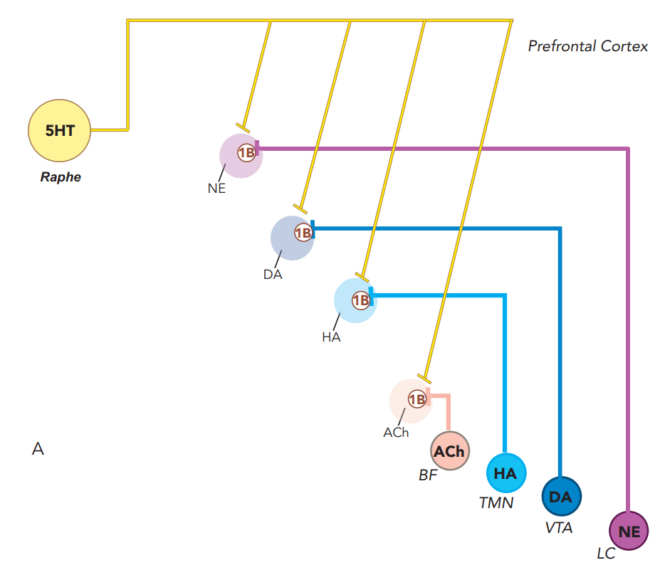
5HT1B Presynaptic Regulation of NE DA HA & Acetylcholine in the Prefrontal Cortex
serotonin transmission regulates other neurotransmitters in downstream circuits

Slide 224
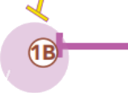
5HT1B Presynaptic Regulation of NE DA HA & Acetylcholine in the Prefrontal Cortex
serotonin transmission regulates other neurotransmitters in downstream circuits
Presynaptic

Slide 225
Here’s 5HT-2A
serotonin transmission regulates other neurotransmitters in downstream circuits

Slide 226
Here’s 5HT-2A
serotonin transmission regulates other neurotransmitters in downstream circuits

Slide 227
Here’s 5HT-2A
serotonin transmission regulates other neurotransmitters in downstream circuits

Slide 228
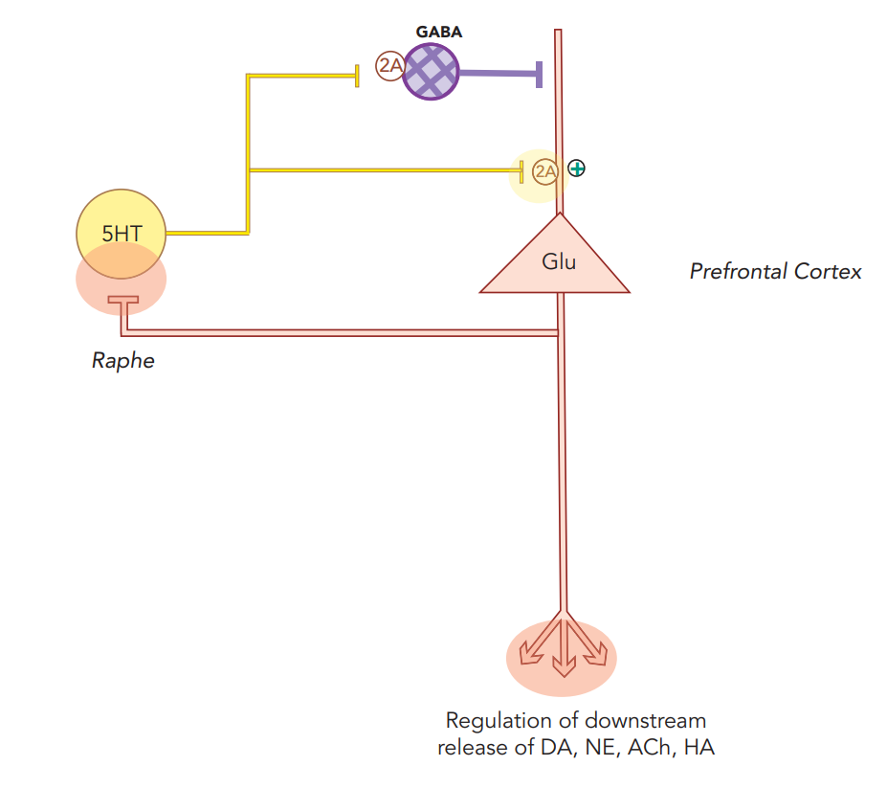
5HT2A Receptors Regulate Glutamate Release – But It’s Complicated
serotonin transmission regulates other neurotransmitters in downstream circuits

Slide 229
Here’s 5HT-2C
serotonin transmission regulates other neurotransmitters in downstream circuits

Slide 230
Here’s 5HT-2C
serotonin transmission regulates other neurotransmitters in downstream circuits

Slide 231
Here’s 5HT-2C
serotonin transmission regulates other neurotransmitters in downstream circuits

Slide 232
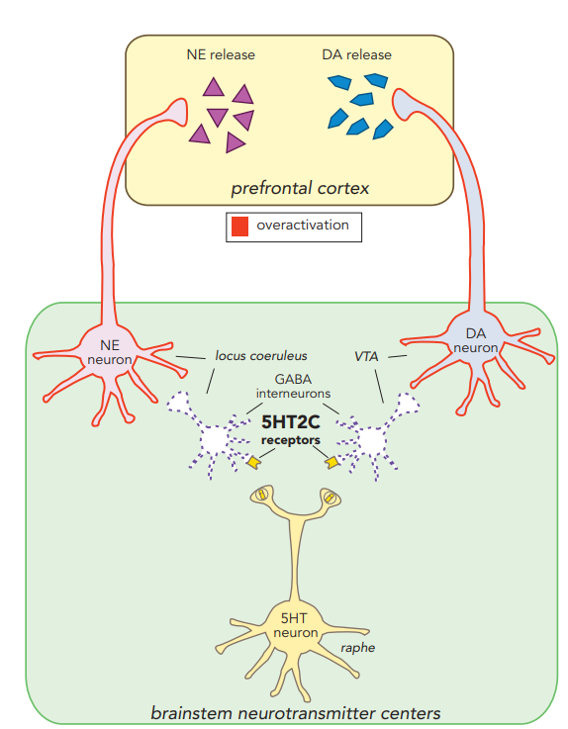
5HT-2C

Slide 233
Here’s 5HT-3
serotonin transmission regulates other neurotransmitters in downstream circuits

Slide 234
Here’s 5HT-3
serotonin transmission regulates other neurotransmitters in downstream circuits

Slide 235
Here’s 5HT-3
serotonin transmission regulates other neurotransmitters in downstream circuits

Slide 236
5HT3 Stimulation inhibits release of NE and acetylcholine
These 5HT3 receptors are on GABA interneurons
serotonin transmission regulates other neurotransmitters in downstream circuits
Stahl’s Essential Psychopharmacology

Slide 237
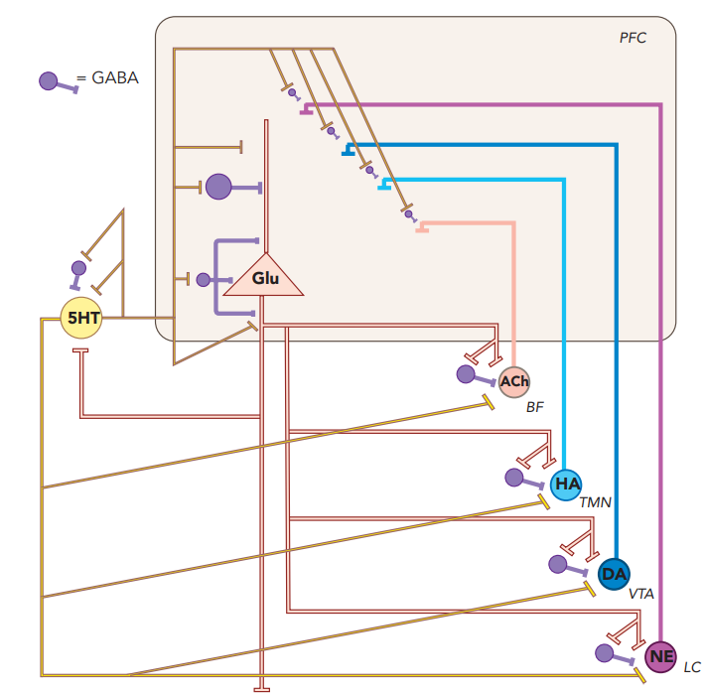
Serotonin (5HT) Interacts in a Neuronal Network to Regulate All Major Neurotransmitter Systems
serotonin transmission regulates other neurotransmitters in downstream circuits

Slide 238
Serotonin (5HT) Interacts in a Neuronal Network to Regulate All Major Neurotransmitter Systems
Interneurons are (inhibitory)
GABA neurons

Slide 239
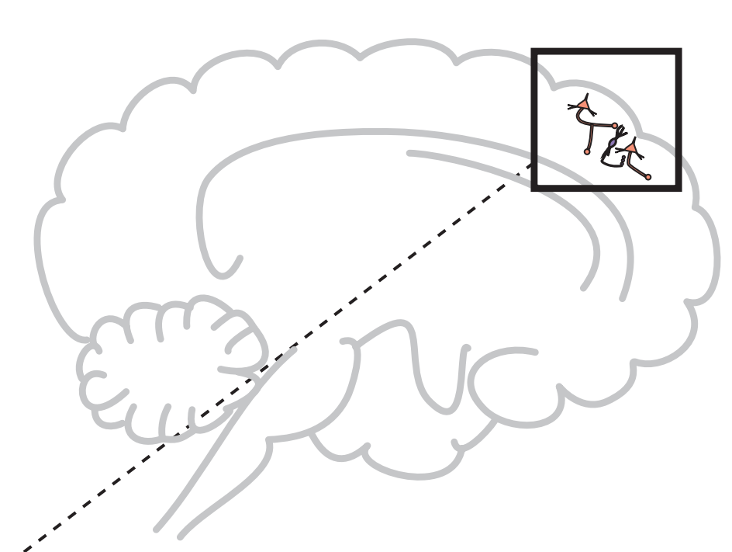
Glutamate pathways
Glutamate (pyramidal neurons)
Pyramidal neurons constitute the large majority of nerve cells in the cerebral cortex

Slide 240
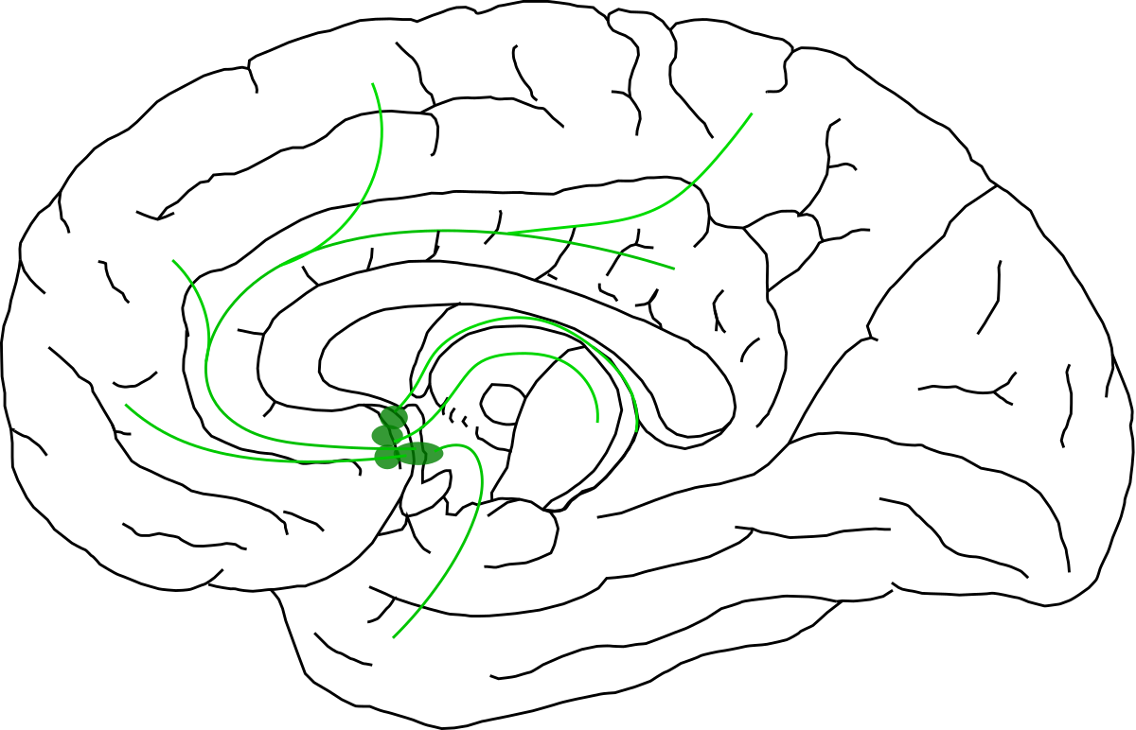
Acetylcholine pathways
acetylcholine (basal forebrain)

Slide 241
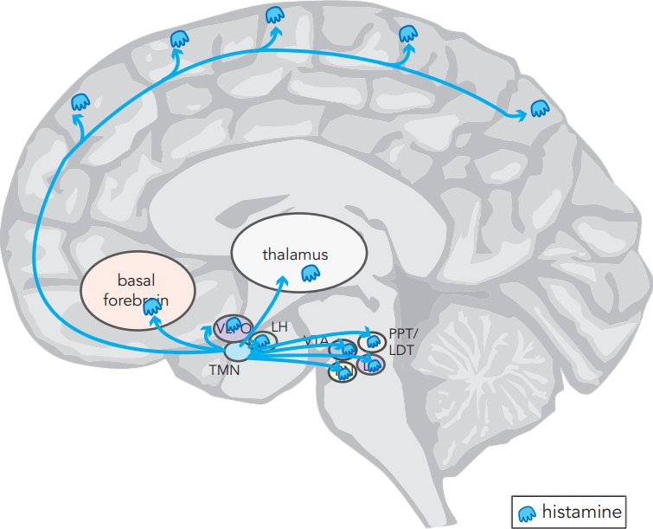
Histamine pathways
histamine
(tuberomammillary nucleus)

Slide 242
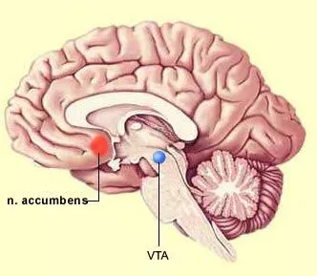
Dopamine pathways
dopamine (ventral tegmental area)

Slide 243
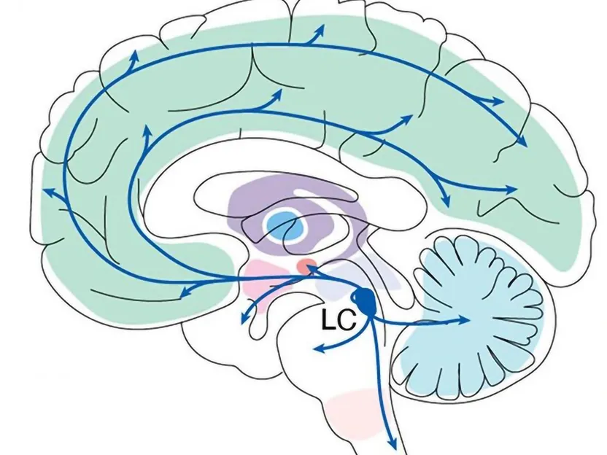
Norepinephrine pathways
norepinephrine (locus coeruleus)

Slide 244
Serotonin (5HT)
serotonin (raphe nucleus)
glutamate (pyramidal neurons)
acetylcholine (basal forebrain)
histamine
(tuberomammillary nucleus)
dopamine
(ventral tegmental area)
norepinephrine (locus coeruleus)

Slide 245
Serotonin (5HT) Interacts
serotonin (raphe nucleus)
glutamate (pyramidal neurons)
acetylcholine (basal forebrain)
histamine
(tuberomammillary nucleus)
dopamine
(ventral tegmental area)
norepinephrine (locus coeruleus)

Slide 246
Serotonin (5HT) Interacts in a Neuronal Network
serotonin (raphe nucleus)
glutamate (pyramidal neurons)
acetylcholine (basal forebrain)
histamine
(tuberomammillary nucleus)
dopamine
(ventral tegmental area)
norepinephrine (locus coeruleus)

Slide 247
Serotonin (5HT) Interacts in a Neuronal Network to Regulate
serotonin (raphe nucleus)
glutamate (pyramidal neurons)
acetylcholine (basal forebrain)
histamine
(tuberomammillary nucleus)
dopamine
(ventral tegmental area)
norepinephrine (locus coeruleus)

Slide 248
Serotonin (5HT) Interacts in a Neuronal Network to Regulate All Major Neurotransmitter Systems
serotonin (raphe nucleus)
glutamate (pyramidal neurons)
acetylcholine (basal forebrain)
histamine
(tuberomammillary nucleus)
dopamine
(ventral tegmental area)
norepinephrine (locus coeruleus)

Slide 249
Serotonin (5HT) Interacts in a Neuronal Network to Regulate All Major Neurotransmitter Systems
transcription factor
epigenetic changes
neurogenesis / synaptogenesis

Slide 250
Serotonin (5HT) Interacts in a Neuronal Network to Regulate All Major Neurotransmitter Systems
Intracellular
transcription factor
epigenetic changes
neurogenesis / synaptogenesis

Slide 251
Serotonin (5HT) Interacts in a Neuronal Network to Regulate All Major Neurotransmitter Systems
Intracellular downstream
transcription factor
epigenetic changes
neurogenesis / synaptogenesis

Slide 252
Serotonin (5HT) Interacts in a Neuronal Network to Regulate All Major Neurotransmitter Systems
Intracellular downstream effects
transcription factor
epigenetic changes
neurogenesis / synaptogenesis

Slide 253
Serotonin (5HT) Interacts in a Neuronal Network to Regulate All Major Neurotransmitter Systems
Intracellular downstream effects
transcription factor
epigenetic changes
neurogenesis / synaptogenesis

Slide 254
Serotonin (5HT) Interacts in a Neuronal Network to Regulate All Major Neurotransmitter Systems
Intracellular downstream effects
transcription factor
epigenetic changes
neurogenesis / synaptogenesis

Slide 255
Serotonin (5HT) Interacts in a Neuronal Network to Regulate All Major Neurotransmitter Systems
Intracellular downstream effects
transcription factor
epigenetic changes
neurogenesis / synaptogenesis

Slide 256
Let’s block some serotonin (5-HT) transporters!
Stahl’s Essential Psychopharmacology

Slide 257
SSRIs
CYP
CYP
escitalopram
LEXAPRO
sertraline
ZOLOFT
fluoxetine
PROZAC
CYP
CYP
citalopram
CELEXA
paroxetine
PAXIL
fluvoxamine
LUVOX

Slide 258
SSRIs
CYP
CYP
escitalopram
LEXAPRO
sertraline
ZOLOFT
fluoxetine
PROZAC
CYP
CYP
citalopram
CELEXA
paroxetine
PAXIL
fluvoxamine
LUVOX

Slide 259
SSRIs
CYP
CYP
escitalopram
LEXAPRO
sertraline
ZOLOFT
fluoxetine
PROZAC
not entirely selective for serotonin
CYP
CYP
citalopram
CELEXA
paroxetine
PAXIL
fluvoxamine
LUVOX

Slide 260
SSRIs
CYP
CYP
escitalopram
LEXAPRO
sertraline
ZOLOFT
fluoxetine
PROZAC
CYP inHibitors
CYP
CYP
citalopram
CELEXA
paroxetine
PAXIL
fluvoxamine
LUVOX

Slide 261
SSRIs
CYP
CYP
escitalopram
LEXAPRO
sertraline
ZOLOFT
fluoxetine
PROZAC
No antidepressants are inDucers
CYP
CYP
citalopram
CELEXA
paroxetine
PAXIL
fluvoxamine
LUVOX

Slide 262
SSRIs
CYP
CYP
escitalopram
LEXAPRO
sertraline
ZOLOFT
fluoxetine
PROZAC
Off-target
(side) effects
CYP
CYP
citalopram
CELEXA
paroxetine
PAXIL
fluvoxamine
LUVOX

Slide 263
SSRIs
CYP
CYP
escitalopram
LEXAPRO
sertraline
ZOLOFT
fluoxetine
PROZAC
risk of QT prolongation
CYP
CYP
citalopram
CELEXA
paroxetine
PAXIL
fluvoxamine
LUVOX

Slide 264
SSRIs
CYP
CYP
escitalopram
LEXAPRO
sertraline
ZOLOFT
fluoxetine
PROZAC
potential therapeutic effects
CYP
CYP
citalopram
CELEXA
paroxetine
PAXIL
fluvoxamine
LUVOX

Slide 265
SSRIs
escitalopram

Slide 266
Escitalopram (LEXAPRO)
ess sit AL o pram / LEX a pro
“Lexus Pram”
#26
2002
$3–$98
❖ Antidepressant
❖ Selective serotonin
reuptake inhibitor (SSRI)
EXAPRO
SSRI
5
10
20
mg
“Pram” is the British word for baby carriage.

Slide 267
Escitalopram: SSRI
escitalopram
LEXAPRO

Slide 268
Escitalopram: SSRI
escitalopram
LEXAPRO
Serotonin reuptake inhibitor

Slide 269
Escitalopram: SSRI
escitalopram
LEXAPRO
Antidepressant and anxiolytic effects, sexual dysfunction
Serotonin reuptake inhibitor

Slide 270
Escitalopram: SSRI
escitalopram
LEXAPRO
Antidepressant and anxiolytic effects, sexual dysfunction
Serotonin reuptake inhibitor

Slide 271
Escitalopram: SSRI
sensitive substrate
(CYP2C19)
escitalopram
LEXAPRO
Antidepressant and anxiolytic effects, sexual dysfunction
Serotonin reuptake inhibitor

Slide 272
Escitalopram: SSRI
not a CYP inHibitor
sensitive substrate
(CYP2C19)
escitalopram
LEXAPRO
Antidepressant and anxiolytic effects, sexual dysfunction
Serotonin reuptake inhibitor

Slide 273
Escitalopram: SSRI
not a CYP inHibitor - MAJOR ADVANTAGE OVER THE OTHER SSRIs
sensitive substrate
(CYP2C19)
escitalopram
LEXAPRO
Antidepressant and anxiolytic effects, sexual dysfunction
Serotonin reuptake inhibitor

Slide 274
Escitalopram: SSRI
not a CYP inHibitor - MAJOR ADVANTAGE OVER THE OTHER SSRIs
sensitive substrate
(CYP2C19)
escitalopram
LEXAPRO
Antidepressant and anxiolytic effects, sexual dysfunction
Serotonin reuptake inhibitor
not a CYP inDucer
(no antidepressants are)

Slide 275
Escitalopram: SSRI
not a CYP inHibitor - MAJOR ADVANTAGE OVER THE OTHER SSRIs
sensitive substrate
(CYP2C19)
no off-target effects - slightly fewer side effects
escitalopram
LEXAPRO
Antidepressant and anxiolytic effects, sexual dysfunction
Serotonin reuptake inhibitor
not a CYP inDucer
(no antidepressants are)

Slide 276
Escitalopram: SSRI
not a CYP inHibitor - MAJOR ADVANTAGE OVER THE OTHER SSRIs
sensitive substrate
(CYP2C19)
no off-target effects - slightly fewer side effects
escitalopram
LEXAPRO
Antidepressant and anxiolytic effects, sexual dysfunction
Serotonin reuptake inhibitor
not a CYP inDucer
(no antidepressants are)

Slide 277
Escitalopram: SSRI
sensitive substrate
(CYP2C19)
CYP2C19
PPI
omeprazole
PRILOSEC

Slide 278
Escitalopram: SSRI
sensitive substrate
(CYP2C19)
CYP2C19
PPI
omeprazole
PRILOSEC

Slide 279
Escitalopram: SSRI
Serum levels of escitalopram increased by 90%
CYP2C19
sensitive substrate
(CYP2C19)
PPI
omeprazole
PRILOSEC

Slide 280
Escitalopram (LEXAPRO)
sensitive substrate
(CYP2C19)
not a CYP inHibitor
no off-target effects
escitalopram
LEXAPRO
Antidepressant and anxiolytic effects, sexual dysfunction
Serotonin reuptake inhibitor
not a CYP inDucer
(no antidepressants are)

Slide 281
Escitalopram (LEXAPRO)
The only pure SSRI
sensitive substrate
(CYP2C19)
not a CYP inHibitor
no off-target effects
escitalopram
LEXAPRO
Antidepressant and anxiolytic effects, sexual dysfunction
Serotonin reuptake inhibitor
not a CYP inDucer
(no antidepressants are)

Slide 282
Escitalopram (LEXAPRO)
The only pure SSRI
1st-line SSRI (or sertraline)
sensitive substrate
(CYP2C19)
not a CYP inHibitor
no off-target effects
escitalopram
LEXAPRO
Antidepressant and anxiolytic effects, sexual dysfunction
Serotonin reuptake inhibitor
not a CYP inDucer
(no antidepressants are)

Slide 283
Escitalopram (LEXAPRO)
The only pure SSRI
1st-line SSRI (or sertraline)
Does not inHibit CYP enzymes
sensitive substrate
(CYP2C19)
not a CYP inHibitor
no off-target effects
escitalopram
LEXAPRO
Antidepressant and anxiolytic effects, sexual dysfunction
Serotonin reuptake inhibitor
not a CYP inDucer
(no antidepressants are)

Slide 284
Escitalopram (LEXAPRO)
The only pure SSRI
1st-line SSRI (or sertraline)
Does not inHibit CYP enzymes
Slightly fewer side effects
sensitive substrate
(CYP2C19)
not a CYP inHibitor
no off-target effects
escitalopram
LEXAPRO
Antidepressant and anxiolytic effects, sexual dysfunction
Serotonin reuptake inhibitor
not a CYP inDucer
(no antidepressants are)

Slide 285
Escitalopram (LEXAPRO)
The only pure SSRI
1st-line SSRI (or sertraline)
Does not inHibit CYP enzymes
Slightly fewer side effects
The “pure” form of citalopram (Celexa)...
sensitive substrate
(CYP2C19)
not a CYP inHibitor
no off-target effects
escitalopram
LEXAPRO
Antidepressant and anxiolytic effects, sexual dysfunction
Serotonin reuptake inhibitor
not a CYP inDucer
(no antidepressants are)

Slide 286
SSRIs
escitalopram

Slide 287
SSRIs
escitalopram
citalopram

Slide 288
Citalopram (CELEXA)
si TAL o pram / SEL ex a
“Sell Lexus Pram”
#21
1998
$2–$35
❖ Antidepressant
❖ Selective serotonin
reuptake inhibitor (SSRI)
ELEXA
The right-handed enantiomer (R-citalopram) is ineffective and causes QT interval prolongation.
SSRI
QT prolongation
10
20
40
mg
QT prolongation

Slide 289
Citalopram (CELEXA)
si TAL o pram / SEL ex a
“Sell Lexus Pram”
#21
1998
$2–$35
❖ Antidepressant
❖ Selective serotonin
reuptake inhibitor (SSRI)
ELEXA
The right-handed enantiomer (R-citalopram) is ineffective and causes QT interval prolongation.
SSRI
QT prolongation
10
20
40
mg
QT prolongation

Slide 290
Citalopram (CELEXA)
si TAL o pram / SEL ex a
“Sell Lexus Pram”
#21
1998
$2–$35
❖ Antidepressant
❖ Selective serotonin
reuptake inhibitor (SSRI)
ELEXA
The right-handed enantiomer (R-citalopram) is ineffective and causes QT interval prolongation.
SSRI
QT prolongation
10
20
40
mg
QT prolongation

Slide 291
Citalopram: SSRI
S-citalopram
R-citalopram

Slide 292
Citalopram: SSRI
“Lexapro”
S-citalopram
R-citalopram

Slide 293
Citalopram: SSRI
“Bad citalopram”
S-citalopram
R-citalopram
R-citalopram

Slide 294
Citalopram: SSRI
50%
50%
S-citalopram
R-citalopram

Slide 295
Citalopram: SSRI
“Bad citalopram”
S-citalopram
R-citalopram
R-citalopram
“Lexapro”

Slide 296
Citalopram: SSRI
“Bad citalopram”
May interfere with S-citaloprams ability
to inhibit SERT
S-citalopram
R-citalopram
R-citalopram
“Lexapro”

Slide 297
Citalopram: SSRI
Anti-
histamine
(mild)
“Bad citalopram”
May interfere with S-citaloprams ability
to inhibit SERT
S-citalopram
R-citalopram
R-citalopram
“Lexapro”

Slide 298
Citalopram: SSRI
possible sedation, weight gain
Anti-
histamine
(mild)
“Bad citalopram”
May interfere with S-citaloprams ability
to inhibit SERT
S-citalopram
R-citalopram
R-citalopram
“Lexapro”

Slide 299
Citalopram: SSRI
possible sedation, weight gain
Anti-
histamine
(mild)
“Bad citalopram”
May interfere with S-citaloprams ability
to inhibit SERT
S-citalopram
R-citalopram
R-citalopram
“Lexapro”
inhibitor of rapid delayed rectifier (IKr) potassium channels

Slide 300
Citalopram: SSRI
possible sedation, weight gain
Anti-
histamine
(mild)
“Bad citalopram”
May interfere with S-citaloprams ability
to inhibit SERT
S-citalopram
R-citalopram
R-citalopram
“Lexapro”
inhibitor of rapid delayed rectifier (IKr) potassium channels
QT prolongation

Slide 301
Citalopram (Celexa)
possible sedation, weight gain
Anti-
histamine
(mild)
“Bad citalopram”
May interfere with S-citaloprams ability
to inhibit SERT
S-citalopram
R-citalopram
R-citalopram
“Lexapro”
“Bad Lexapro”
inhibitor of rapid delayed rectifier (IKr) potassium channels
QT prolongation

Slide 302
Citalopram (Celexa)
Choose escitalopram (Lexapro) instead
possible sedation, weight gain
Anti-
histamine
(mild)
“Bad citalopram”
May interfere with S-citaloprams ability
to inhibit SERT
S-citalopram
R-citalopram
R-citalopram
“Lexapro”
“Bad Lexapro”
inhibitor of rapid delayed rectifier (IKr) potassium channels
QT prolongation

Slide 303
Citalopram (Celexa)
Choose escitalopram (Lexapro) instead
If changing, go from citalopram 40 mg to escitalopram 20 mg
possible sedation, weight gain
Anti-
histamine
(mild)
S-citalopram
R-citalopram
R-citalopram
“Lexapro”
“Bad Lexapro”
inhibitor of rapid delayed rectifier (IKr) potassium channels
QT prolongation

Slide 304
Citalopram (Celexa)
Choose escitalopram (Lexapro) instead
If changing, go from citalopram 40 mg to escitalopram 20 mg
possible sedation, weight gain
Anti-
histamine
(mild)
S-citalopram
R-citalopram
R-citalopram
“Lexapro”
“Bad Lexapro”
inhibitor of rapid delayed rectifier (IKr) potassium channels
QT prolongation

Slide 305
Citalopram (Celexa)
Choose escitalopram (Lexapro) instead
If changing, go from citalopram 40 mg to escitalopram 20 mg
20 mg
20 mg
S-citalopram
R-citalopram
R-citalopram
“Lexapro”
“Bad Lexapro”

Slide 306
Citalopram (Celexa)
Choose escitalopram (Lexapro) instead
If changing, go from citalopram 40 mg to escitalopram 20 mg
20 mg
20 mg
S-citalopram
R-citalopram
R-citalopram
R-citalopram
“Lexapro”
“Bad Lexapro”

Slide 307
Citalopram (Celexa)
Choose escitalopram (Lexapro) instead
If changing, go from citalopram 40 mg to escitalopram 20 mg
20 mg
20 mg
S-citalopram
“Lexapro”

Slide 308
Citalopram (Celexa)
Choose escitalopram (Lexapro) instead
If changing, go from citalopram 40 mg to escitalopram 20 mg
20 mg
20 mg
S-citalopram
“Lexapro”

Slide 309
Citalopram (Celexa)
Choose escitalopram (Lexapro) instead
If changing, go from citalopram 40 mg to escitalopram 20 mg
20 mg
20 mg
S-citalopram
“Lexapro”

Slide 310
Citalopram (Celexa)
Choose escitalopram (Lexapro) instead
If changing, go from citalopram 40 mg to escitalopram 20 mg
20 mg
S-citalopram
“Lexapro”

Slide 311
SSRIs
escitalopram
citalopram

Slide 312
SSRIs
escitalopram
citalopram
fluoxetine

Slide 313
Fluoxetine (PROZAC)
flu OX e teen / PRO zak
“Prolonged sack of the Flustered ox”
#29
1987
$2–$36
❖ Antidepressant
❖ Selective serotonin
reuptake inhibitor (SSRI)
SSRI
The “fluffers” - infamous inHibitors of CYP enzymes:
❖ Fluvoxamine (Luvox)
❖ Fluoxetine (Prozac)
❖ Fluconazole (Diflucan)
10
20
40
mg
“Prolonged” refers to Prozac’s prolonged presence in the body, with half-life of 1 week.

Slide 314
Fluoxetine (PROZAC)
flu OX e teen / PRO zak
“Prolonged sack of the Flustered ox”
#29
1987
$2–$36
❖ Antidepressant
❖ Selective serotonin
reuptake inhibitor (SSRI)
SSRI
The “fluffers” - infamous inHibitors of CYP enzymes:
❖ Fluvoxamine (Luvox)
❖ Fluoxetine (Prozac)
❖ Fluconazole (Diflucan)
10
20
40
mg
“Prolonged” refers to Prozac’s prolonged presence in the body, with half-life of 1 week.

Slide 315
What’s the major difference between escitalopram...
escitalopram
LEXAPRO

Slide 316
What’s the major difference between escitalopram and fluoxetine?
escitalopram
LEXAPRO
fluoxetine
PROZAC

Slide 317
“activating”
“activating”
escitalopram
LEXAPRO
fluoxetine
PROZAC

Slide 318
Stahl’s Essential Psychopharmacology

Slide 319
CYP
“fluffer”
inHibitor
fluoxetine
PROZAC

Slide 320
CYP
not
“fluffer”
inHibitor
fluoxetine
PROZAC

Slide 321
Fluoxetine: SSRI
CYP
fluoxetine
PROZAC

Slide 322
Fluoxetine: SSRI
CYP
fluoxetine
PROZAC
Serotonin reuptake inhibitor

Slide 323
Fluoxetine: SSRI
CYP
fluoxetine
PROZAC
Antidepressant and anxiolytic effects, sexual dysfunction
Serotonin reuptake inhibitor

Slide 324
Fluoxetine: SSRI
“fluffer” inHibitor
CYP
fluoxetine
PROZAC
Antidepressant and anxiolytic effects, sexual dysfunction
Serotonin reuptake inhibitor

Slide 325
Fluoxetine: SSRI
“fluffer” inHibitor
markedly increases serum levels of other medications
CYP
fluoxetine
PROZAC
Antidepressant and anxiolytic effects, sexual dysfunction
Serotonin reuptake inhibitor

Slide 326
Fluoxetine: SSRI
“fluffer” inHibitor
markedly increases serum levels of other medications
CYP
Norepinephrine reuptake inhibitor
fluoxetine
PROZAC
Antidepressant and anxiolytic effects, sexual dysfunction
Serotonin reuptake inhibitor

Slide 327
Fluoxetine: SSRI
“fluffer” inHibitor
markedly increases serum levels of other medications
CYP
“activating” effects (at very high doses, if at all)
Norepinephrine reuptake inhibitor
fluoxetine
PROZAC
Antidepressant and anxiolytic effects, sexual dysfunction
Serotonin reuptake inhibitor

Slide 328
Fluoxetine: SSRI
“fluffer” inHibitor
markedly increases serum levels of other medications
CYP
5HT2C antagonist
“activating” effects (at very high doses, if at all)
Norepinephrine reuptake inhibitor
fluoxetine
PROZAC
Antidepressant and anxiolytic effects, sexual dysfunction
Serotonin reuptake inhibitor

Slide 329
Fluoxetine: SSRI
“fluffer” inHibitor
markedly increases serum levels of other medications
CYP
5HT2C antagonist
“activating” effects (at very high doses, if at all)
Norepinephrine reuptake inhibitor
about these things sticking off the Stahl balls...
fluoxetine
PROZAC
Antidepressant and anxiolytic effects, sexual dysfunction
Serotonin reuptake inhibitor

Slide 330
The agonist spectrum
e.g., no serotonin
antagonist = “blocker”
keeps the neurotransmitter (e.g., serotonin) from exerting an effect

Slide 331
The agonist spectrum
e.g., no serotonin
antagonist = “blocker”
keeps the neurotransmitter (e.g., serotonin) from exerting an effect

Slide 332
The agonist spectrum

Slide 333
The agonist spectrum
e.g., serotonin

Slide 334
The agonist spectrum
partial agonist = “stabilizer”

Slide 335
The agonist spectrum
partial agonist = “stabilizer”
causes a relative increase or decrease in activity depending on how much neurotransmitter is around

Slide 336
Fluoxetine: SSRI
“fluffer” inHibitor
markedly increases serum levels of other medications
CYP
5HT2C antagonist
“activating” effects (at very high doses, if at all)
Norepinephrine reuptake inhibitor
fluoxetine
PROZAC
Antidepressant and anxiolytic effects, sexual dysfunction
Serotonin reuptake inhibitor

Slide 337
Fluoxetine: SSRI
“fluffer” inHibitor
markedly increases serum levels of other medications
CYP
blocks serotonin from binding 5HT2C receptors
5HT2C antagonist
“activating” effects (at very high doses, if at all)
Norepinephrine reuptake inhibitor
fluoxetine
PROZAC
Antidepressant and anxiolytic effects, sexual dysfunction
Serotonin reuptake inhibitor

Slide 338
Fluoxetine: SSRI
“fluffer” inHibitor
markedly increases serum levels of other medications
CYP
blocks serotonin from binding 5HT2C receptors
5HT2C antagonist
“activating” effects (at very high doses, if at all)
Norepinephrine reuptake inhibitor
disinhibition of norepinephrine and dopamine
fluoxetine
PROZAC
Antidepressant and anxiolytic effects, sexual dysfunction
Serotonin reuptake inhibitor

Slide 339
Fluoxetine: SSRI
disinhibition of norepinephrine and dopamine

Slide 340
Fluoxetine: SSRI
disinhibition of norepinephrine and dopamine
potentially “activating”

Slide 341
Fluoxetine (Prozac)
“fluffer” inHibitor
markedly increases serum levels of other medications
CYP
5HT2C antagonist
“activating” effects (at very high doses, if at all)
Norepinephrine reuptake inhibitor
potentially “activating”
disinhibition of norepinephrine and dopamine
fluoxetine
PROZAC
Anti-
depressant and anxiolytic effects, sexual dysfunction
Serotonin reuptake inhibitor

Slide 342
Fluoxetine (Prozac)
“Fluffer” inHibitor
“fluffer” inHibitor
markedly increases serum levels of other medications
CYP
5HT2C antagonist
“activating” effects (at very high doses, if at all)
Norepinephrine reuptake inhibitor
potentially “activating”
disinhibition of norepinephrine and dopamine
fluoxetine
PROZAC
Anti-
depressant and anxiolytic effects, sexual dysfunction
Serotonin reuptake inhibitor

Slide 343
Fluoxetine (Prozac)
“Fluffer” inHibitor
Only start it if you know the interactions
“fluffer” inHibitor
markedly increases serum levels of other medications
CYP
5HT2C antagonist
“activating” effects (at very high doses, if at all)
Norepinephrine reuptake inhibitor
potentially “activating”
disinhibition of norepinephrine and dopamine
fluoxetine
PROZAC
Anti-
depressant and anxiolytic effects, sexual dysfunction
Serotonin reuptake inhibitor

Slide 344
Fluoxetine (Prozac)
“Fluffer” inHibitor
Only start it if you know the interactions
Run an interaction check if you encounter it
“fluffer” inHibitor
markedly increases serum levels of other medications
CYP
5HT2C antagonist
“activating” effects (at very high doses, if at all)
Norepinephrine reuptake inhibitor
potentially “activating”
fluoxetine
PROZAC
Anti-
depressant and anxiolytic effects, sexual dysfunction
Serotonin reuptake inhibitor

Slide 345
Fluoxetine (Prozac)
“Fluffer” inHibitor
Only start it if you know the interactions
Run an interaction check if you encounter it
Long half-life
“fluffer” inHibitor
markedly increases serum levels of other medications
CYP
5HT2C antagonist
“activating” effects (at very high doses, if at all)
Norepinephrine reuptake inhibitor
potentially “activating”
fluoxetine
PROZAC
Anti-
depressant and anxiolytic effects, sexual dysfunction
Serotonin reuptake inhibitor

Slide 346
Fluoxetine (Prozac)
“Fluffer” inHibitor
Only start it if you know the interactions
Run an interaction check if you encounter it
Long half-life
The best at not causing serotonin withdrawal symptoms
“fluffer” inHibitor
markedly increases serum levels of other medications
CYP
5HT2C antagonist
“activating” effects (at very high doses, if at all)
Norepinephrine reuptake inhibitor
potentially “activating”
fluoxetine
PROZAC
Anti-
depressant and anxiolytic effects, sexual dysfunction
Serotonin reuptake inhibitor

Slide 347
Fluoxetine (Prozac)
“Fluffer” inHibitor
Only start it if you know the interactions
Run an interaction check if you encounter it
Long half-life
The best at not causing serotonin withdrawal symptoms
Reputation as “activating”
“fluffer” inHibitor
markedly increases serum levels of other medications
CYP
5HT2C antagonist
“activating” effects (at very high doses, if at all)
Norepinephrine reuptake inhibitor
potentially “activating”
fluoxetine
PROZAC
Anti-
depressant and anxiolytic effects, sexual dysfunction
Serotonin reuptake inhibitor

Slide 348
SSRIs
escitalopram
citalopram
fluoxetine

Slide 349
SSRIs
escitalopram
citalopram
fluoxetine
sertraline

Slide 350
Sertraline (ZOLOFT)
SER tra leen / ZOE loft
“So Soft (on the) Shirt Line”
#14
1991
$3–$49
❖ Antidepressant
❖ Selective serotonin
reuptake inhibitor (SSRI)
SSRI
25
50
100
mg
Sertraline is the preferred antidepressant for pregnancy and breastfeeding.

Slide 351
Sertraline: SSRI
sertraline
ZOLOFT

Slide 352
Sertraline: SSRI
sertraline
ZOLOFT
Serotonin reuptake inhibitor

Slide 353
Sertraline: SSRI
Antidepressant and anxiolytic effects, sexual dysfunction
sertraline
ZOLOFT
Serotonin reuptake inhibitor

Slide 354
Sertraline: SSRI
CYP inHibitor (weak)
Antidepressant and anxiolytic effects, sexual dysfunction
sertraline
ZOLOFT
Serotonin reuptake inhibitor

Slide 355
Sertraline: SSRI
increased levels
of 2D6 substrates
(at high dose)
CYP inHibitor (weak)
Antidepressant and anxiolytic effects, sexual dysfunction
sertraline
ZOLOFT
Serotonin reuptake inhibitor

Slide 356
Sertraline: SSRI
increased levels
of 2D6 substrates
(at high dose)
minor sensitive substrate (CYP2B6 & CYP2C19)
CYP inHibitor (weak)
Antidepressant and anxiolytic effects, sexual dysfunction
sertraline
ZOLOFT
Serotonin reuptake inhibitor

Slide 357
Sertraline: SSRI
increased levels
of 2D6 substrates
(at high dose)
minor sensitive substrate (CYP2B6 & CYP2C19)
CYP inHibitor (weak)
Dopamine reuptake inhibitor
Antidepressant and anxiolytic effects, sexual dysfunction
sertraline
ZOLOFT
Serotonin reuptake inhibitor

Slide 358
Sertraline: SSRI
increased levels
of 2D6 substrates
(at high dose)
may improve energy, motivation, and concentration
(in theory)
minor sensitive substrate (CYP2B6 & CYP2C19)
CYP inHibitor (weak)
Dopamine reuptake inhibitor
Antidepressant and anxiolytic effects, sexual dysfunction
sertraline
ZOLOFT
Serotonin reuptake inhibitor

Slide 359
Sertraline: SSRI
increased levels
of 2D6 substrates
(at high dose)
may improve energy, motivation, and concentration
(in theory)
minor sensitive substrate (CYP2B6 & CYP2C19)
CYP inHibitor (weak)
Dopamine reuptake inhibitor
Antidepressant and anxiolytic effects, sexual dysfunction
sertraline
ZOLOFT
binds sigma-1 receptors
Serotonin reuptake inhibitor

Slide 360
Sertraline: SSRI
increased levels
of 2D6 substrates
(at high dose)
may improve energy, motivation, and concentration
(in theory)
minor sensitive substrate (CYP2B6 & CYP2C19)
CYP inHibitor (weak)
Dopamine reuptake inhibitor
Antidepressant and anxiolytic effects, sexual dysfunction
sertraline
ZOLOFT
anxiolytic actions and may be beneficial in psychotic depression
(in theory)
binds sigma-1 receptors
Serotonin reuptake inhibitor

Slide 361
Sertraline (ZOLOFT)
may improve energy, motivation, and concentration
(in theory)
Dopamine reuptake inhibitor
Antidepressant and anxiolytic effects, sexual dysfunction
sertraline
ZOLOFT
anxiolytic actions and may be beneficial in psychotic depression
(in theory)
binds sigma-1 receptors
Serotonin reuptake inhibitor

Slide 362
Sertraline (ZOLOFT)
Reasonable 1st-line SSRI
may improve energy, motivation, and concentration
(in theory)
Dopamine reuptake inhibitor
Antidepressant and anxiolytic effects, sexual dysfunction
sertraline
ZOLOFT
anxiolytic actions and may be beneficial in psychotic depression
(in theory)
binds sigma-1 receptors
Serotonin reuptake inhibitor

Slide 363
Sertraline (ZOLOFT)
Reasonable 1st-line SSRI
More GI side effects (e.g., diarrhea)
“so-soft”
may improve energy, motivation, and concentration
(in theory)
Dopamine reuptake inhibitor
Antidepressant and anxiolytic effects, sexual dysfunction
sertraline
ZOLOFT
anxiolytic actions and may be beneficial in psychotic depression
(in theory)
binds sigma-1 receptors
Serotonin reuptake inhibitor

Slide 364
Escitalopram vs Sertraline
escitalopram
LEXAPRO
sertraline
ZOLOFT

Slide 365
Escitalopram vs Sertraline
The two first-line SSRIs
escitalopram
LEXAPRO
sertraline
ZOLOFT

Slide 366
Escitalopram vs Sertraline
The two first-line SSRIs
Clinically significant differences are minimal
escitalopram
LEXAPRO
sertraline
ZOLOFT

Slide 367
SSRIs
escitalopram
citalopram
fluoxetine
sertraline

Slide 368
SSRIs
escitalopram
citalopram
fluoxetine
sertraline
paroxetine

Slide 369
Paroxetine (PAXIL)
par OX e tine / PAX il
“Pear rocks a teen (Paxil Rose)”
#64
1992
IR $3–$37
ER $55–$140
❖ Antidepressant
❖ Selective serotonin reuptake
inhibitor (SSRI)
Among SSRIs, Paxil has a relatively short half-life of 21 hours.
SSRI
short
ER 12.5
25
37.5
mg
10
20
30
40
mg
Axl Rose (Guns N' Roses)

Slide 370
Paroxetine: SSRI
CYP
paroxetine
PAXIL

Slide 371
Paroxetine: SSRI
CYP
paroxetine
PAXIL
Serotonin reuptake inhibitor

Slide 372
Paroxetine: SSRI
CYP
Antidepressant and anxiolytic effects, sexual dysfunction
paroxetine
PAXIL
Serotonin reuptake inhibitor

Slide 373
Paroxetine: SSRI
CYP
inHibitor
(strong)
CYP
Antidepressant and anxiolytic effects, sexual dysfunction
paroxetine
PAXIL
Serotonin reuptake inhibitor

Slide 374
Paroxetine: SSRI
CYP
inHibitor
(strong)
increases levels of CYP2D6 substrates
CYP
Antidepressant and anxiolytic effects, sexual dysfunction
paroxetine
PAXIL
Serotonin reuptake inhibitor

Slide 375
Paroxetine: SSRI
CYP
inHibitor
(strong)
increases levels of CYP2D6 substrates
CYP
anticholinergic (mild)
constipation,
dry mouth,
impaired cognition
Antidepressant and anxiolytic effects, sexual dysfunction
paroxetine
PAXIL
Serotonin reuptake inhibitor

Slide 376
Paroxetine: SSRI
CYP
inHibitor
(strong)
increases levels of CYP2D6 substrates
CYP
Norepinephrine reuptake inhibitor (weak)
anticholinergic (mild)
constipation,
dry mouth,
impaired cognition
Antidepressant and anxiolytic effects, sexual dysfunction
paroxetine
PAXIL
Serotonin reuptake inhibitor

Slide 377
Paroxetine: SSRI
CYP
inHibitor
(strong)
increases levels of CYP2D6 substrates
CYP
Norepinephrine reuptake inhibitor (weak)
anticholinergic (mild)
activating in theory (but has mythological “calming” reputation)
constipation,
dry mouth,
impaired cognition
Antidepressant and anxiolytic effects, sexual dysfunction
paroxetine
PAXIL
Serotonin reuptake inhibitor

Slide 378
Paroxetine: SSRI
CYP
inHibitor
(strong)
increases levels of CYP2D6 substrates
CYP
Norepinephrine reuptake inhibitor (weak)
anticholinergic (mild)
activating in theory (but has mythological “calming” reputation)
constipation,
dry mouth,
impaired cognition
Antidepressant and anxiolytic effects, sexual dysfunction
paroxetine
PAXIL
Inhibitor of nitric oxide synthase
Serotonin reuptake inhibitor

Slide 379
Paroxetine: SSRI
CYP
inHibitor
(strong)
increases levels of CYP2D6 substrates
CYP
Norepinephrine reuptake inhibitor (weak)
anticholinergic (mild)
activating in theory (but has mythological “calming” reputation)
constipation,
dry mouth,
impaired cognition
Antidepressant and anxiolytic effects, sexual dysfunction
paroxetine
PAXIL
Inhibitor of nitric oxide synthase
Serotonin reuptake inhibitor
sexual dysfunction

Slide 380
Paroxetine (PAXIL)
CYP
inHibitor
(strong)
increases levels of CYP2D6 substrates
CYP
Norepinephrine reuptake inhibitor (weak)
anticholinergic (mild)
activating in theory (but has mythological “calming” reputation)
constipation,
dry mouth,
impaired cognition
Antidepressant and anxiolytic effects, sexual dysfunction
paroxetine
PAXIL
Inhibitor of nitric oxide synthase
Serotonin reuptake inhibitor
sexual dysfunction

Slide 381
Paroxetine (PAXIL)
Most sexual side effects
CYP
inHibitor
(strong)
increases levels of CYP2D6 substrates
CYP
Norepinephrine reuptake inhibitor (weak)
anticholinergic (mild)
activating in theory (but has mythological “calming” reputation)
constipation,
dry mouth,
impaired cognition
Antidepressant and anxiolytic effects, sexual dysfunction
paroxetine
PAXIL
Inhibitor of nitric oxide synthase
Serotonin reuptake inhibitor
sexual dysfunction

Slide 382
Paroxetine (PAXIL)
Most sexual side effects
Most teratogenicity concerns
CYP
inHibitor
(strong)
increases levels of CYP2D6 substrates
CYP
Norepinephrine reuptake inhibitor (weak)
anticholinergic (mild)
activating in theory (but has mythological “calming” reputation)
constipation,
dry mouth,
impaired cognition
Antidepressant and anxiolytic effects, sexual dysfunction
paroxetine
PAXIL
Inhibitor of nitric oxide synthase
Serotonin reuptake inhibitor
sexual dysfunction

Slide 383
Paroxetine (PAXIL)
Most sexual side effects
Most teratogenicity concerns
Most anticholinergic effects
CYP
inHibitor
(strong)
increases levels of CYP2D6 substrates
CYP
Norepinephrine reuptake inhibitor (weak)
anticholinergic (mild)
activating in theory (but has mythological “calming” reputation)
constipation,
dry mouth,
impaired cognition
Antidepressant and anxiolytic effects, sexual dysfunction
paroxetine
PAXIL
Inhibitor of nitric oxide synthase
Serotonin reuptake inhibitor
sexual dysfunction

Slide 384
Paroxetine (PAXIL)
Most sexual side effects
Most teratogenicity concerns
Most anticholinergic effects
Short half-life, worse 5-HT withdrawal
CYP
inHibitor
(strong)
increases levels of CYP2D6 substrates
CYP
Norepinephrine reuptake inhibitor (weak)
anticholinergic (mild)
activating in theory (but has mythological “calming” reputation)
constipation,
dry mouth,
impaired cognition
Antidepressant and anxiolytic effects, sexual dysfunction
paroxetine
PAXIL
Inhibitor of nitric oxide synthase
Serotonin reuptake inhibitor
sexual dysfunction

Slide 385
Paroxetine (PAXIL)
Most sexual side effects
Most teratogenicity concerns
Most anticholinergic effects
Short half-life, worse 5-HT withdrawal
“More calming” reputation is mythology
CYP
inHibitor
(strong)
increases levels of CYP2D6 substrates
CYP
Norepinephrine reuptake inhibitor (weak)
anticholinergic (mild)
activating in theory (but has mythological “calming” reputation)
constipation,
dry mouth,
impaired cognition
Antidepressant and anxiolytic effects, sexual dysfunction
paroxetine
PAXIL
Inhibitor of nitric oxide synthase
Serotonin reuptake inhibitor
sexual dysfunction

Slide 386
Paroxetine (PAXIL)
Most sexual side effects
Most teratogenicity concerns
Most anticholinergic effects
Short half-life, worse 5-HT withdrawal
“More calming” reputation is mythology
Don’t start it
CYP
inHibitor
(strong)
increases levels of CYP2D6 substrates
CYP
Norepinephrine reuptake inhibitor (weak)
anticholinergic (mild)
activating in theory (but has mythological “calming” reputation)
constipation,
dry mouth,
impaired cognition
Antidepressant and anxiolytic effects, sexual dysfunction
paroxetine
PAXIL
Inhibitor of nitric oxide synthase
Serotonin reuptake inhibitor
sexual dysfunction

Slide 387
Serotonin Discontinuation Syndrome
“withdrawal” if an antidepressant is stopped abruptly
Paroxetine (Paxil)
Paresthesias (pins-and-needles tingling)
Lightheadedness
Nausea
Fatigue
Irritability

Slide 388
SSRIs
escitalopram
citalopram
fluoxetine
sertraline
paroxetine

Slide 389
SSRIs
escitalopram
citalopram
fluoxetine
sertraline
paroxetine
fluvoxamine

Slide 390
Fluvoxamine (LUVOX)
flu VOX a meen / LU vox
“Glove-ox”
*
1996
$20–$120
❖ Selective serotonin
reuptake inhibitor (SSRI)
❖ OCD medication
❖ Potent CYP inHibitor
For maintenance, Luvox is dosed BID because it has the shortest half-life among SSRIs (15 hr).
SSRI
short
25
50
100
mg

Slide 391
Fluvoxamine (LUVOX)
flu VOX a meen / LU vox
“Glove-ox”
*
1996
$20–$120
❖ Selective serotonin
reuptake inhibitor (SSRI)
❖ OCD medication
❖ Potent CYP inHibitor
For maintenance, Luvox is dosed BID because it has the shortest half-life among SSRIs (15 hr).
SSRI
short
25
50
100
mg

Slide 392
Fluvoxamine: SSRI
CYP
fluvoxamine
LUVOX

Slide 393
Fluvoxamine: SSRI
CYP
fluvoxamine
LUVOX
Serotonin reuptake inhibitor

Slide 394
Fluvoxamine: SSRI
CYP
Antidepressant and anxiolytic effects, sexual dysfunction
fluvoxamine
LUVOX
Serotonin reuptake inhibitor

Slide 395
Fluvoxamine: SSRI
CYP
“fluffer” inHibitor
Antidepressant and anxiolytic effects, sexual dysfunction
fluvoxamine
LUVOX
Serotonin reuptake inhibitor

Slide 396
Fluvoxamine: SSRI
CYP
“fluffer” inHibitor
markedly increases serum levels of CYP1A2
CYP2C19
CYP3A4
substrates
Antidepressant and anxiolytic effects, sexual dysfunction
fluvoxamine
LUVOX
Serotonin reuptake inhibitor

Slide 397
Fluvoxamine: SSRI
CYP
“fluffer” inHibitor
markedly increases serum levels of CYP1A2
CYP2C19
CYP3A4
substrates
Antidepressant and anxiolytic effects, sexual dysfunction
fluvoxamine
LUVOX
binds sigma-1 receptors
Serotonin reuptake inhibitor

Slide 398
Fluvoxamine: SSRI
CYP
“fluffer” inHibitor
markedly increases serum levels of CYP1A2
CYP2C19
CYP3A4
substrates
Antidepressant and anxiolytic effects, sexual dysfunction
fluvoxamine
LUVOX
anxiolytic actions and theoretically beneficial in psychotic depression
binds sigma-1 receptors
Serotonin reuptake inhibitor

Slide 399
Fluvoxamine (LUVOX)
CYP
“fluffer” inHibitor
markedly increases serum levels of CYP1A2
CYP2C19
CYP3A4
substrates
Antidepressant and anxiolytic effects, sexual dysfunction
fluvoxamine
LUVOX
anxiolytic actions and theoretically beneficial in psychotic depression
binds sigma-1 receptors
Serotonin reuptake inhibitor

Slide 400
Fluvoxamine (LUVOX)
FDA-approved for OCD, not depression
CYP
“fluffer” inHibitor
markedly increases serum levels of CYP1A2
CYP2C19
CYP3A4
substrates
Antidepressant and anxiolytic effects, sexual dysfunction
fluvoxamine
LUVOX
anxiolytic actions and theoretically beneficial in psychotic depression
binds sigma-1 receptors
Serotonin reuptake inhibitor

Slide 401
Fluvoxamine (LUVOX)
FDA-approved for OCD, not depression
“Fluffer” inHibitor
CYP
“fluffer” inHibitor
markedly increases serum levels of CYP1A2
CYP2C19
CYP3A4
substrates
Antidepressant and anxiolytic effects, sexual dysfunction
fluvoxamine
LUVOX
anxiolytic actions and theoretically beneficial in psychotic depression
binds sigma-1 receptors
Serotonin reuptake inhibitor

Slide 402
Fluvoxamine (LUVOX)
FDA-approved for OCD, not depression
“Fluffer” inHibitor
Don’t prescribe it unless you know the interactions!!
CYP
“fluffer” inHibitor
markedly increases serum levels of CYP1A2
CYP2C19
CYP3A4
substrates
Antidepressant and anxiolytic effects, sexual dysfunction
fluvoxamine
LUVOX
anxiolytic actions and theoretically beneficial in psychotic depression
binds sigma-1 receptors
Serotonin reuptake inhibitor

Slide 403
Fluvoxamine (LUVOX)
FDA-approved for OCD, not depression
“Fluffer” inHibitor
Don’t prescribe it unless you know the interactions!!
Run an interaction check!!
CYP
“fluffer” inHibitor
markedly increases serum levels of CYP1A2
CYP2C19
CYP3A4
substrates
Antidepressant and anxiolytic effects, sexual dysfunction
fluvoxamine
LUVOX
anxiolytic actions and theoretically beneficial in psychotic depression
binds sigma-1 receptors
Serotonin reuptake inhibitor

Slide 404
Fluvoxamine (LUVOX)
FDA-approved for OCD, not depression
“Fluffer” inHibitor
Don’t prescribe it unless you know the interactions!!
Run an interaction check!!
CYP
“fluffer” inHibitor
markedly increases serum levels of CYP1A2
CYP2C19
CYP3A4
substrates
Antidepressant and anxiolytic effects, sexual dysfunction
fluvoxamine
LUVOX
anxiolytic actions and theoretically beneficial in psychotic depression
binds sigma-1 receptors
Serotonin reuptake inhibitor

Slide 405
Fluvoxamine (LUVOX)
FDA-approved for OCD, not depression
“Fluffer” inHibitor
Don’t prescribe it unless you know the interactions!!
Run an interaction check!!
Shortest half-life of SSRIs
CYP
“fluffer” inHibitor
markedly increases serum levels of CYP1A2
CYP2C19
CYP3A4
substrates
Antidepressant and anxiolytic effects, sexual dysfunction
fluvoxamine
LUVOX
anxiolytic actions and theoretically beneficial in psychotic depression
binds sigma-1 receptors
Serotonin reuptake inhibitor

Slide 406
Fluvoxamine (LUVOX)
FDA-approved for OCD, not depression
“Fluffer” inHibitor
Don’t prescribe it unless you know the interactions!!
Run an interaction check!!
Shortest half-life of SSRIs
BID dosing
CYP
“fluffer” inHibitor
markedly increases serum levels of CYP1A2
CYP2C19
CYP3A4
substrates
Antidepressant and anxiolytic effects, sexual dysfunction
fluvoxamine
LUVOX
anxiolytic actions and theoretically beneficial in psychotic depression
binds sigma-1 receptors
Serotonin reuptake inhibitor

Slide 407
Fluvoxamine (LUVOX)
FDA-approved for OCD, not depression
“Fluffer” inHibitor
Don’t prescribe it unless you know the interactions!!
Run an interaction check!!
Shortest half-life of SSRIs
BID dosing
5HT withdrawal
CYP
“fluffer” inHibitor
markedly increases serum levels of CYP1A2
CYP2C19
CYP3A4
substrates
Antidepressant and anxiolytic effects, sexual dysfunction
fluvoxamine
LUVOX
anxiolytic actions and theoretically beneficial in psychotic depression
binds sigma-1 receptors
Serotonin reuptake inhibitor

Slide 408
Serotonin Discontinuation Syndrome
Fluvoxamine (Luvox)
Lightheadedness
Paresthesias
Nausea
Fatigue
Irritability

Slide 409
SSRIs
CYP
CYP
escitalopram
LEXAPRO
sertraline
ZOLOFT
fluoxetine
PROZAC
CYP
CYP
citalopram
CELEXA
paroxetine
PAXIL
fluvoxamine
LUVOX

Slide 410
SSRIs
CYP
CYP
escitalopram
LEXAPRO
sertraline
ZOLOFT
fluoxetine
PROZAC
CYP
CYP
citalopram
CELEXA
paroxetine
PAXIL
fluvoxamine
LUVOX

Slide 411
SSRIs
CYP
CYP
escitalopram
LEXAPRO
sertraline
ZOLOFT
fluoxetine
PROZAC
not entirely selective for serotonin
CYP
CYP
citalopram
CELEXA
paroxetine
PAXIL
fluvoxamine
LUVOX

Slide 412
SSRIs
CYP
CYP
escitalopram
LEXAPRO
sertraline
ZOLOFT
fluoxetine
PROZAC
CYP inHibitors
CYP
CYP
citalopram
CELEXA
paroxetine
PAXIL
fluvoxamine
LUVOX

Slide 413
SSRIs
CYP
CYP
escitalopram
LEXAPRO
sertraline
ZOLOFT
fluoxetine
PROZAC
No antidepressants are inDucers
CYP
CYP
citalopram
CELEXA
paroxetine
PAXIL
fluvoxamine
LUVOX

Slide 414
SSRIs
CYP
CYP
escitalopram
LEXAPRO
sertraline
ZOLOFT
fluoxetine
PROZAC
side effects
CYP
CYP
citalopram
CELEXA
paroxetine
PAXIL
fluvoxamine
LUVOX

Slide 415
SSRIs
CYP
CYP
escitalopram
LEXAPRO
sertraline
ZOLOFT
fluoxetine
PROZAC
risk of QT prolongation
CYP
CYP
citalopram
CELEXA
paroxetine
PAXIL
fluvoxamine
LUVOX

Slide 416
SSRIs
CYP
CYP
escitalopram
LEXAPRO
sertraline
ZOLOFT
fluoxetine
PROZAC
potential therapeutic effects
CYP
CYP
citalopram
CELEXA
paroxetine
PAXIL
fluvoxamine
LUVOX

Slide 417
...and these 3 are first-line for OCD
CYP
CYP
escitalopram
LEXAPRO
sertraline
ZOLOFT
fluoxetine
PROZAC
CYP
CYP
citalopram
CELEXA
paroxetine
PAXIL
fluvoxamine
LUVOX

Slide 418
Norepinephrine (NE)

Slide 419
Norepinephrine (NE)
CYP
CYP
escitalopram
LEXAPRO
sertraline
ZOLOFT
fluoxetine
PROZAC
CYP
CYP
citalopram
CELEXA
paroxetine
PAXIL
fluvoxamine
LUVOX

Slide 420
CYP
Norepinephrine (NE)
These 2 SSRIs could be called SNRIs.
fluoxetine
PROZAC
CYP
paroxetine
PAXIL

Slide 421
Norepinephrine (NE)

Slide 422
Norepinephrine (NE)

Slide 423
Norepinephrine (NE)

Slide 424
Norepinephrine (NE)

Slide 425
Norepinephrine (NE)
alpha-1 adrenergic receptors

Slide 426
Norepinephrine (NE)
alpha-2 adrenergic receptors

Slide 427
Norepinephrine (NE)
beta adrenergic receptors

Slide 428
SSRIs
SERT
SERT
Stahl’s Essential Psychopharmacology

Slide 429
Serotonin and norepinephrine reuptake inhibitors (SNRIs)
SERT
SERT
SERT
NET
NET
NET
Stahl’s Essential Psychopharmacology

Slide 430
Serotonin and norepinephrine reuptake inhibitor (SNRI)

Slide 431
Serotonin and norepinephrine reuptake inhibitor (SNRI)

Slide 432
Serotonin and norepinephrine reuptake inhibitor (SNRI)
SERT
NET
5HT
NE
5HT

Slide 433
Serotonin and norepinephrine reuptake inhibitor (SNRI)
SERT
NET
5HT
NE
5HT

Slide 434
Serotonin and norepinephrine reuptake inhibitor (SNRI)
SERT
NET
5HT
NE
5HT

Slide 435
Serotonin and norepinephrine reuptake inhibitor (SNRI)
SERT
NET
5HT
NE
5HT

Slide 436
Serotonin & Norepinephrine Reuptake Inhibitors (SNRIs)
CYP
venlafaxine
EFFEXOR
duloxetine
CYMBALTA
levomilnacipran
FETZIMA
desvenlafaxine
PRISTIQ

Slide 437
Serotonin & Norepinephrine Reuptake Inhibitors (SNRIs)
CYP
venlafaxine
EFFEXOR
duloxetine
CYMBALTA
levomilnacipran
FETZIMA
desvenlafaxine
PRISTIQ

Slide 438
Serotonin & Norepinephrine Reuptake Inhibitors (SNRIs)
CYP
venlafaxine
EFFEXOR
duloxetine
CYMBALTA
levomilnacipran
FETZIMA
desvenlafaxine
PRISTIQ

Slide 439
Serotonin & Norepinephrine Reuptake Inhibitors (SNRIs)
CYP
venlafaxine
EFFEXOR
duloxetine
CYMBALTA
levomilnacipran
FETZIMA
desvenlafaxine
PRISTIQ

Slide 440
Serotonin & Norepinephrine Reuptake Inhibitors (SNRIs)
CYP
venlafaxine
EFFEXOR
duloxetine
CYMBALTA
levomilnacipran
FETZIMA
desvenlafaxine
PRISTIQ

Slide 441
SSRIs
escitalopram
citalopram
fluoxetine
sertraline
paroxetine
fluvoxamine
SNRIs

Slide 442
SSRIs
escitalopram
citalopram
fluoxetine
sertraline
paroxetine
fluvoxamine
SNRIs
venlafaxine

Slide 443
Venlafaxine (EFFEXOR)
ven la FAX ine / e FEX er
“Vanilla faxing (eFax’er)”
#51
1995
$6–$105
❖ Antidepressant
❖ Serotonin-norepinephrine
reuptake inhibitor (SNRI)
❖ 5-HT > NE
I’m depressed.
Must fax for help.
80’s rapper Vanilla Ice
+
SNRI
XR
37.5
75
150
mg
possible BP elevation

Slide 444
SNRI: Venlafaxine
EFFEXOR
Venlafaxine and desvenlafaxine

Slide 445
SNRI: Venlafaxine
serotonin reuptake inhibitor
EFFEXOR
Venlafaxine and desvenlafaxine

Slide 446
SNRI: Venlafaxine
serotonin reuptake inhibitor
antidepressant and anxiolytic effects, sexual dysfunction
EFFEXOR
Venlafaxine and desvenlafaxine

Slide 447
SNRI: Venlafaxine
serotonin reuptake inhibitor
antidepressant and anxiolytic effects, sexual dysfunction
EFFEXOR
norepinephrine reuptake inhibitor
Venlafaxine and desvenlafaxine

Slide 448
SNRI: Venlafaxine
serotonin reuptake inhibitor
antidepressant and anxiolytic effects, sexual dysfunction
EFFEXOR
antidepressant and anxiolytic effects, potentially activating, benefits in chronic pain, ameliorates sexual dysfunction
norepinephrine reuptake inhibitor
Venlafaxine and desvenlafaxine

Slide 449
SNRI: Venlafaxine
serotonin reuptake inhibitor
antidepressant and anxiolytic effects, sexual dysfunction
Effexor XR
EFFEXOR
37.5
mg
75
mg
150
mg
antidepressant and anxiolytic effects, potentially activating, benefits in chronic pain, ameliorates sexual dysfunction
norepinephrine reuptake inhibitor
“SSRI” “SSRI” SNRI
Venlafaxine and desvenlafaxine

Slide 450
SNRI: Venlafaxine
not an inHibitor
serotonin reuptake inhibitor
antidepressant and anxiolytic effects, sexual dysfunction
EFFEXOR
antidepressant and anxiolytic effects, potentially activating, benefits in chronic pain, ameliorates sexual dysfunction
norepinephrine reuptake inhibitor
Venlafaxine and desvenlafaxine

Slide 451
SNRI: Venlafaxine
not an inHibitor
serotonin reuptake inhibitor
antidepressant and anxiolytic effects, sexual dysfunction
EFFEXOR
antidepressant and anxiolytic effects, potentially activating, benefits in chronic pain, ameliorates sexual dysfunction
norepinephrine reuptake inhibitor
not an inDucer
(no antidepressants are)
Venlafaxine and desvenlafaxine

Slide 452
SNRI: Venlafaxine
not a sensitive substrate
not an inHibitor
serotonin reuptake inhibitor
antidepressant and anxiolytic effects, sexual dysfunction
EFFEXOR
antidepressant and anxiolytic effects, potentially activating, benefits in chronic pain, ameliorates sexual dysfunction
norepinephrine reuptake inhibitor
not an inDucer
(no antidepressants are)
Venlafaxine and desvenlafaxine

Slide 453
SNRI: Venlafaxine
Venlafaxine (EFFEXOR)
not a sensitive substrate
not an inHibitor
serotonin reuptake inhibitor
antidepressant and anxiolytic effects, sexual dysfunction
EFFEXOR
antidepressant and anxiolytic effects, potentially activating, benefits in chronic pain, ameliorates sexual dysfunction
norepinephrine reuptake inhibitor
not an inDucer
(no antidepressants are)
Venlafaxine and desvenlafaxine

Slide 454
SNRI: Venlafaxine
Venlafaxine (EFFEXOR)
1st line option for severe melancholic depression (or mirtazapine)
not a sensitive substrate
not an inHibitor
serotonin reuptake inhibitor
antidepressant and anxiolytic effects, sexual dysfunction
EFFEXOR
antidepressant and anxiolytic effects, potentially activating, benefits in chronic pain, ameliorates sexual dysfunction
norepinephrine reuptake inhibitor
not an inDucer
(no antidepressants are)
Venlafaxine and desvenlafaxine

Slide 455
SNRI: Venlafaxine
Venlafaxine (EFFEXOR)
1st line option for severe melancholic depression (or mirtazapine)
More likely than duloxetine to elevate blood pressure
not a sensitive substrate
not an inHibitor
serotonin reuptake inhibitor
antidepressant and anxiolytic effects, sexual dysfunction
EFFEXOR
antidepressant and anxiolytic effects, potentially activating, benefits in chronic pain, ameliorates sexual dysfunction
norepinephrine reuptake inhibitor
not an inDucer
(no antidepressants are)
Venlafaxine and desvenlafaxine

Slide 456
SNRI: Venlafaxine
Venlafaxine (EFFEXOR)
1st line option for severe melancholic depression (or mirtazapine)
More likely than duloxetine to elevate blood pressure
Short half-life
not a sensitive substrate
not an inHibitor
serotonin reuptake inhibitor
antidepressant and anxiolytic effects, sexual dysfunction
EFFEXOR
antidepressant and anxiolytic effects, potentially activating, benefits in chronic pain, ameliorates sexual dysfunction
norepinephrine reuptake inhibitor
not an inDucer
(no antidepressants are)
Venlafaxine and desvenlafaxine

Slide 457
SNRI: Venlafaxine
Venlafaxine (EFFEXOR)
1st line option for severe melancholic depression (or mirtazapine)
More likely than duloxetine to elevate blood pressure
Short half-life
Serotonin withdrawal symptoms can be problematic
not a sensitive substrate
not an inHibitor
serotonin reuptake inhibitor
antidepressant and anxiolytic effects, sexual dysfunction
EFFEXOR
antidepressant and anxiolytic effects, potentially activating, benefits in chronic pain, ameliorates sexual dysfunction
norepinephrine reuptake inhibitor
not an inDucer
(no antidepressants are)
Venlafaxine and desvenlafaxine

Slide 458
SNRI: Venlafaxine
Venlafaxine (EFFEXOR)
1st line option for severe melancholic depression (or mirtazapine)
More likely than duloxetine to elevate blood pressure
Short half-life
Serotonin withdrawal symptoms can be problematic
Always use XL formulation
not a sensitive substrate
not an inHibitor
serotonin reuptake inhibitor
antidepressant and anxiolytic effects, sexual dysfunction
EFFEXOR
antidepressant and anxiolytic effects, potentially activating, benefits in chronic pain, ameliorates sexual dysfunction
norepinephrine reuptake inhibitor
not an inDucer
(no antidepressants are)
Venlafaxine and desvenlafaxine

Slide 459
SNRI: Venlafaxine
Venlafaxine (EFFEXOR)
1st line option for severe melancholic depression (or mirtazapine)
More likely than duloxetine to elevate blood pressure
Short half-life
Serotonin withdrawal symptoms can be problematic
Always use XL formulation
Venlafaxine IR very poorly tolerated - “Side Effexor”...
not a sensitive substrate
not an inHibitor
serotonin reuptake inhibitor
antidepressant and anxiolytic effects, sexual dysfunction
EFFEXOR
antidepressant and anxiolytic effects, potentially activating, benefits in chronic pain, ameliorates sexual dysfunction
norepinephrine reuptake inhibitor
not an inDucer
(no antidepressants are)
Venlafaxine and desvenlafaxine

Slide 460
SNRI: Venlafaxine
Venlafaxine (EFFEXOR)
1st line option for severe melancholic depression (or mirtazapine)
More likely than duloxetine to elevate blood pressure
Short half-life
Serotonin withdrawal symptoms can be problematic
Always use XL formulation
Venlafaxine IR very poorly tolerated - “Side Effexor”...
even in bariatric patients (absorption no different between IR & XR)
not a sensitive substrate
not an inHibitor
serotonin reuptake inhibitor
antidepressant and anxiolytic effects, sexual dysfunction
EFFEXOR
antidepressant and anxiolytic effects, potentially activating, benefits in chronic pain, ameliorates sexual dysfunction
norepinephrine reuptake inhibitor
not an inDucer
(no antidepressants are)
Venlafaxine and desvenlafaxine

Slide 461
Serotonin Discontinuation Syndrome
Venlafaxine (Effexor)
Paresthesias
Lightheadedness
Nausea
Fatigue
Irritability

Slide 462
SSRIs
escitalopram
citalopram
fluoxetine
sertraline
paroxetine
fluvoxamine
SNRIs
venlafaxine

Slide 463
SSRIs
escitalopram
citalopram
fluoxetine
sertraline
paroxetine
fluvoxamine
SNRIs
venlafaxine
desvenlafaxine

Slide 464
Desvenlafaxine (PRISTIQ)
des ven la FAX ine / Pris TIQ
“Desk faxing Pressed steak”
#272
2007
$33–$274
❖ Antidepressant
❖ Serotonin-norepinephrine
reuptake inhibitor (SNRI)
❖ 5-HT > NE
I’m (de)pressed
You have to
press a steak
before you can
fax it.
+
SNRI
Unnecessarily
expensive desk—
generic but still more expensive than Effexor XR
25
50
100
mg

Slide 465
SNRI: Venlafaxine
Active parent drug

Slide 466
SNRI: Venlafaxine
2D6
EFFEXOR
PRISTIQ
Active parent drug
Active metabolite
Active metabolite
Venlafaxine and desvenlafaxine

Slide 467
SNRI: Venlafaxine
2D6
EFFEXOR
PRISTIQ
Active parent drug
Active metabolite
Active metabolite
Venlafaxine and desvenlafaxine

Slide 468
SSRIs
escitalopram
citalopram
fluoxetine
sertraline
paroxetine
fluvoxamine
SNRIs
venlafaxine
desvenlafaxine

Slide 469
SSRIs
escitalopram
citalopram
fluoxetine
sertraline
paroxetine
fluvoxamine
SNRIs
venlafaxine
desvenlafaxine
duloxetine

Slide 470
Duloxetine (CYMBALTA)
du LOX e tine / cym BAL ta
“Dueling Cymbals”
#48
2004
$6–$166
❖ Antidepressant
❖ Serotonin-norepinephrine
reuptake inhibitor (SNRI)
❖ 5-HT > NE
Cymbal duel
+
SNRI
20
30
40
60
mg
Rare risk of liver damage

Slide 471
SNRI: Duloxetine
CYP
duloxetine
CYMBALTA

Slide 472
SNRI: Duloxetine
CYP
serotonin reuptake inhibitor
duloxetine
CYMBALTA

Slide 473
SNRI: Duloxetine
CYP
antidepressant and anxiolytic effects, sexual dysfunction
serotonin reuptake inhibitor
duloxetine
CYMBALTA

Slide 474
SNRI: Duloxetine
CYP
antidepressant and anxiolytic effects, sexual dysfunction
serotonin reuptake inhibitor
duloxetine
CYMBALTA
norepinephrine reuptake inhibitor

Slide 475
SNRI: Duloxetine
CYP
antidepressant and anxiolytic effects, sexual dysfunction
serotonin reuptake inhibitor
duloxetine
CYMBALTA
antidepressant and anxiolytic effects, potentially activating, benefits in chronic pain, ameliorates sexual dysfunction
norepinephrine reuptake inhibitor

Slide 476
SNRI: Duloxetine
CYP
CYP
inHibitor
(moderate)
antidepressant and anxiolytic effects, sexual dysfunction
serotonin reuptake inhibitor
duloxetine
CYMBALTA
antidepressant and anxiolytic effects, potentially activating, benefits in chronic pain, ameliorates sexual dysfunction
norepinephrine reuptake inhibitor

Slide 477
SNRI: Duloxetine
CYP
CYP
inHibitor
(moderate)
increases levels of CYP2D6 substrates
antidepressant and anxiolytic effects, sexual dysfunction
serotonin reuptake inhibitor
duloxetine
CYMBALTA
antidepressant and anxiolytic effects, potentially activating, benefits in chronic pain, ameliorates sexual dysfunction
norepinephrine reuptake inhibitor

Slide 478
SNRI: Duloxetine
sensitive substrate (CYP1A2, CYP2D6)
CYP
CYP
inHibitor
(moderate)
increases levels of CYP2D6 substrates
antidepressant and anxiolytic effects, sexual dysfunction
serotonin reuptake inhibitor
duloxetine
CYMBALTA
antidepressant and anxiolytic effects, potentially activating, benefits in chronic pain, ameliorates sexual dysfunction
norepinephrine reuptake inhibitor

Slide 479
Duloxetine (CYMBALTA)
sensitive substrate (CYP1A2, CYP2D6)
CYP
CYP
inHibitor
(moderate)
increases levels of CYP2D6 substrates
antidepressant and anxiolytic effects, sexual dysfunction
serotonin reuptake inhibitor
duloxetine
CYMBALTA
antidepressant and anxiolytic effects, potentially activating, benefits in chronic pain, ameliorates sexual dysfunction
norepinephrine reuptake inhibitor

Slide 480
Duloxetine (CYMBALTA)
Serotonin withdrawal less of an issue than with venlafaxine
sensitive substrate (CYP1A2, CYP2D6)
CYP
CYP
inHibitor
(moderate)
increases levels of CYP2D6 substrates
antidepressant and anxiolytic effects, sexual dysfunction
serotonin reuptake inhibitor
duloxetine
CYMBALTA
antidepressant and anxiolytic effects, potentially activating, benefits in chronic pain, ameliorates sexual dysfunction
norepinephrine reuptake inhibitor

Slide 481
Duloxetine (CYMBALTA)
Serotonin withdrawal less of an issue than with venlafaxine
Lower incidence of BP elevation than venlafaxine
sensitive substrate (CYP1A2, CYP2D6)
CYP
CYP
inHibitor
(moderate)
increases levels of CYP2D6 substrates
antidepressant and anxiolytic effects, sexual dysfunction
serotonin reuptake inhibitor
duloxetine
CYMBALTA
antidepressant and anxiolytic effects, potentially activating, benefits in chronic pain, ameliorates sexual dysfunction
norepinephrine reuptake inhibitor

Slide 482
Duloxetine (CYMBALTA)
Serotonin withdrawal less of an issue than with venlafaxine
Lower incidence of BP elevation than venlafaxine
Liver toxicity is a potential rare idiosyncratic reaction
sensitive substrate (CYP1A2, CYP2D6)
CYP
CYP
inHibitor
(moderate)
increases levels of CYP2D6 substrates
antidepressant and anxiolytic effects, sexual dysfunction
serotonin reuptake inhibitor
duloxetine
CYMBALTA
antidepressant and anxiolytic effects, potentially activating, benefits in chronic pain, ameliorates sexual dysfunction
norepinephrine reuptake inhibitor

Slide 483
Duloxetine (CYMBALTA)
Serotonin withdrawal less of an issue than with venlafaxine
Lower incidence of BP elevation than venlafaxine
Liver toxicity is a potential rare idiosyncratic reaction
More drug-drug interactions than venlafaxine
sensitive substrate (CYP1A2, CYP2D6)
CYP
CYP
inHibitor
(moderate)
increases levels of CYP2D6 substrates
antidepressant and anxiolytic effects, sexual dysfunction
serotonin reuptake inhibitor
duloxetine
CYMBALTA
antidepressant and anxiolytic effects, potentially activating, benefits in chronic pain, ameliorates sexual dysfunction
norepinephrine reuptake inhibitor

Slide 484
Duloxetine (CYMBALTA)
Serotonin withdrawal less of an issue than with venlafaxine
Lower incidence of BP elevation than venlafaxine
Liver toxicity is a potential rare idiosyncratic reaction
More drug-drug interactions than venlafaxine
Basically a toss-up between duloxetine and venlafaxine XR as a first-line SNRI
sensitive substrate (CYP1A2, CYP2D6)
CYP
CYP
inHibitor
(moderate)
increases levels of CYP2D6 substrates
antidepressant and anxiolytic effects, sexual dysfunction
serotonin reuptake inhibitor
duloxetine
CYMBALTA
antidepressant and anxiolytic effects, potentially activating, benefits in chronic pain, ameliorates sexual dysfunction
norepinephrine reuptake inhibitor

Slide 485
SSRIs
escitalopram
citalopram
fluoxetine
sertraline
paroxetine
fluvoxamine
SNRIs
venlafaxine
desvenlafaxine
duloxetine

Slide 486
SSRIs
escitalopram
citalopram
fluoxetine
sertraline
paroxetine
fluvoxamine
SNRIs
venlafaxine
desvenlafaxine
duloxetine
levomilnacipran

Slide 487
Levomilnacipran (FETZIMA)
LEE voe mil NA si pran / fet ZEE ma
“Leave Milhouse with a Zima Fetish”
2013
$394–$484
Now that’s stimulating!
❖ Antidepressant
❖ Serotonin-norepinephrine
reuptake inhibitor (SNRI)
❖ NE >> 5-HT
+
SNRI
20
40
80
120
mg
Zima was a clear malt beverage available 1993–2008.

Slide 488
(SAVELLA)
FDA-approved for fibromyalgia
Milnacipran and levomilnacipran FETZIMA and SAVELLA

Slide 489
(SAVELLA)
Milnacipran and levomilnacipran FETZIMA and SAVELLA

Slide 490
(SAVELLA)
FETZIMA
Milnacipran and levomilnacipran FETZIMA and SAVELLA

Slide 491
(SAVELLA)
FETZIMA
FDA-approved for fibromyalgia
FDA-approved for depression
Milnacipran and levomilnacipran FETZIMA and SAVELLA

Slide 492
SNRIs: Milnacipran & Levomilnacipran
(SAVELLA)
FETZIMA
Stronger NE inhibitor
FDA-approved for fibromyalgia
FDA-approved for depression
Milnacipran and levomilnacipran FETZIMA and SAVELLA

Slide 493
SSRIs
CYP
CYP
escitalopram
LEXAPRO
sertraline
ZOLOFT
fluoxetine
PROZAC
CYP
CYP
citalopram
CELEXA
paroxetine
PAXIL
fluvoxamine
LUVOX

Slide 494
SNRIs
CYP
venlafaxine
EFFEXOR
duloxetine
CYMBALTA
levomilnacipran
FETZIMA
desvenlafaxine
PRISTIQ

Slide 495
SNRIs
CYP
venlafaxine
EFFEXOR
duloxetine
CYMBALTA
levomilnacipran
FETZIMA
desvenlafaxine
PRISTIQ

Slide 496
Serotonin and norepinephrine reuptake inhibitor (SNRI)
SERT
NET
5HT
NE
5HT

Slide 497
Norepinephrine reuptake inhibitors (NRIs)
NET
NE

Slide 498
SSRIs
escitalopram
citalopram
fluoxetine
sertraline
paroxetine
fluvoxamine
SNRIs
venlafaxine
desvenlafaxine
duloxetine
levomilnacipran
NDRI

Slide 499
SSRIs
escitalopram
citalopram
fluoxetine
sertraline
paroxetine
fluvoxamine
SNRIs
venlafaxine
desvenlafaxine
duloxetine
levomilnacipran
NDRI
bupropion

Slide 500
Bupropion (WELLBUTRIN)
bu PRO pi on / wel BYU trin
“Boop ropin’ Well booty”
#28
1985
XL $12–$109 (#30)
SR $9–$76 (#60)
❖ Antidepressant
❖ Norepinephrine-dopamine
reuptake inhibitor (NDRI)
Betty Boop is slender, and bupropion may cause weight loss.
NE
DA
SR:
100
150
200
mg
XL:
150
300
mg

Slide 501
Bupropion: Norepinephrine and dopamine reuptake inhibitor (NDRI)
CYP
Bupropion
WELLBUTRIN

Slide 502
Bupropion: Norepinephrine and dopamine reuptake inhibitor (NDRI)
CYP
dopamine reuptake
inhibitor
weak
Bupropion
WELLBUTRIN

Slide 503
Bupropion: Norepinephrine and dopamine reuptake inhibitor (NDRI)
CYP
dopamine reuptake
inhibitor
insignificant at usual doses
weak
Bupropion
WELLBUTRIN

Slide 504
Bupropion: Norepinephrine and dopamine reuptake inhibitor (NDRI)
CYP
dopamine reuptake
inhibitor
insignificant at usual doses
can spike DA in nucleus accumbens (i.e., get you high) at supra-therapeutic dose
weak
Bupropion
WELLBUTRIN

Slide 505
Bupropion: Norepinephrine and dopamine reuptake inhibitor (NDRI)
CYP
dopamine reuptake
inhibitor
insignificant at usual doses
can spike DA in nucleus accumbens (i.e., get you high) at supra-therapeutic dose
weak
Bupropion
WELLBUTRIN
Norepinephrine reuptake inhibitor

Slide 506
Bupropion: Norepinephrine and dopamine reuptake inhibitor (NDRI)
CYP
dopamine reuptake
inhibitor
insignificant at usual doses
can spike DA in nucleus accumbens (i.e., get you high) at supra-therapeutic dose
weak
Bupropion
WELLBUTRIN
Antidepressant effects, improvement of ADHD symptoms, appetite suppression, improved sexual dysfunction, seizures at high dose, delayed anxiolytic effects
Norepinephrine reuptake inhibitor

Slide 507
Bupropion: Norepinephrine and dopamine reuptake inhibitor (NDRI)
CYP
dopamine reuptake
inhibitor
insignificant at usual doses
can spike DA in nucleus accumbens (i.e., get you high) at supra-therapeutic dose
weak
Bupropion
WELLBUTRIN
Antidepressant effects, improvement of ADHD symptoms, appetite suppression, improved sexual dysfunction, seizures at high dose, delayed anxiolytic effects
Norepinephrine reuptake inhibitor
indirectly increases DA in prefrontal cortex, which improves ADHD

Slide 508
Bupropion: Norepinephrine and dopamine reuptake inhibitor (NDRI)
CYP
inHibitor
(mod/strong)
CYP
dopamine reuptake
inhibitor
insignificant at usual doses
can spike DA in nucleus accumbens (i.e., get you high) at supra-therapeutic dose
weak
Bupropion
WELLBUTRIN
Antidepressant effects, improvement of ADHD symptoms, appetite suppression, improved sexual dysfunction, seizures at high dose, delayed anxiolytic effects
Norepinephrine reuptake inhibitor
indirectly increases DA in prefrontal cortex, which improves ADHD

Slide 509
Bupropion: Norepinephrine and dopamine reuptake inhibitor (NDRI)
CYP
inHibitor
(mod/strong)
increases levels of CYP2D6 substrates
CYP
dopamine reuptake
inhibitor
insignificant at usual doses
can spike DA in nucleus accumbens (i.e., get you high) at supra-therapeutic dose
weak
Bupropion
WELLBUTRIN
Antidepressant effects, improvement of ADHD symptoms, appetite suppression, improved sexual dysfunction, seizures at high dose, delayed anxiolytic effects
Norepinephrine reuptake inhibitor
indirectly increases DA in prefrontal cortex, which improves ADHD

Slide 510
Bupropion: Norepinephrine and dopamine reuptake inhibitor (NDRI)
CYP
inHibitor
(mod/strong)
increases levels of CYP2D6 substrates
CYP
Strategically combined with dextromethorphan (DXM) to inHibit its metabolism to “bad dextro”
dopamine reuptake
inhibitor
insignificant at usual doses
can spike DA in nucleus accumbens (i.e., get you high) at supra-therapeutic dose
weak
Bupropion
WELLBUTRIN
Antidepressant effects, improvement of ADHD symptoms, appetite suppression, improved sexual dysfunction, seizures at high dose, delayed anxiolytic effects
Norepinephrine reuptake inhibitor
indirectly increases DA in prefrontal cortex, which improves ADHD

Slide 511
Bupropion: Norepinephrine and dopamine reuptake inhibitor (NDRI)
CYP
inHibitor
(mod/strong)
increases levels of CYP2D6 substrates
CYP
Strategically combined with dextromethorphan (DXM) to inHibit its metabolism to “bad dextro”
dopamine reuptake
inhibitor
sensitive substrate (CYP2B6)
insignificant at usual doses
can spike DA in nucleus accumbens (i.e., get you high) at supra-therapeutic dose
weak
Bupropion
WELLBUTRIN
Antidepressant effects, improvement of ADHD symptoms, appetite suppression, improved sexual dysfunction, seizures at high dose, delayed anxiolytic effects
Norepinephrine reuptake inhibitor
indirectly increases DA in prefrontal cortex, which improves ADHD

Slide 512
Bupropion (Wellbutrin)
CYP
inHibitor
(mod/strong)
increases levels of CYP2D6 substrates
CYP
dopamine reuptake
inhibitor
sensitive substrate (CYP2B6)
insignificant at usual doses
weak
Bupropion
WELLBUTRIN
Norepinephrine reuptake inhibitor
Indirectly increases DA in prefrontal cortex, which improves ADHD

Slide 513
Bupropion (Wellbutrin)
inHibitor --> check interactions
CYP
inHibitor
(mod/strong)
increases levels of CYP2D6 substrates
CYP
dopamine reuptake
inhibitor
sensitive substrate (CYP2B6)
insignificant at usual doses
weak
Bupropion
WELLBUTRIN
Norepinephrine reuptake inhibitor
Indirectly increases DA in prefrontal cortex, which improves ADHD

Slide 514
Bupropion (Wellbutrin)
inHibitor --> check interactions
No serotonin so no sexual side effects
CYP
inHibitor
(mod/strong)
increases levels of CYP2D6 substrates
CYP
dopamine reuptake
inhibitor
sensitive substrate (CYP2B6)
insignificant at usual doses
weak
Bupropion
WELLBUTRIN
Norepinephrine reuptake inhibitor
Indirectly increases DA in prefrontal cortex, which improves ADHD

Slide 515
Bupropion (Wellbutrin)
inHibitor --> check interactions
No serotonin so no sexual side effects
Can combine with SSRI to ameliorate sexual dysfunction
CYP
inHibitor
(mod/strong)
increases levels of CYP2D6 substrates
CYP
dopamine reuptake
inhibitor
sensitive substrate (CYP2B6)
insignificant at usual doses
weak
Bupropion
WELLBUTRIN
Norepinephrine reuptake inhibitor
Indirectly increases DA in prefrontal cortex, which improves ADHD

Slide 516
Bupropion (Wellbutrin)
inHibitor --> check interactions
No serotonin so no sexual side effects
Can combine with SSRI to ameliorate sexual dysfunction
Approved for smoking cessation
CYP
inHibitor
(mod/strong)
increases levels of CYP2D6 substrates
CYP
dopamine reuptake
inhibitor
sensitive substrate (CYP2B6)
insignificant at usual doses
weak
Bupropion
WELLBUTRIN
Norepinephrine reuptake inhibitor
Indirectly increases DA in prefrontal cortex, which improves ADHD

Slide 517
Bupropion (Wellbutrin)
inHibitor --> check interactions
No serotonin so no sexual side effects
Can combine with SSRI to ameliorate sexual dysfunction
Approved for smoking cessation
Off-label for ADHD
CYP
inHibitor
(mod/strong)
increases levels of CYP2D6 substrates
CYP
dopamine reuptake
inhibitor
sensitive substrate (CYP2B6)
insignificant at usual doses
weak
Bupropion
WELLBUTRIN
Norepinephrine reuptake inhibitor
Indirectly increases DA in prefrontal cortex, which improves ADHD

Slide 518
Bupropion (Wellbutrin)
inHibitor --> check interactions
No serotonin so no sexual side effects
Can combine with SSRI to ameliorate sexual dysfunction
Approved for smoking cessation
Off-label for ADHD
Lowers seizure threshold at high dose
CYP
inHibitor
(mod/strong)
increases levels of CYP2D6 substrates
CYP
dopamine reuptake
inhibitor
sensitive substrate (CYP2B6)
insignificant at usual doses
weak
Bupropion
WELLBUTRIN
Norepinephrine reuptake inhibitor
Indirectly increases DA in prefrontal cortex, which improves ADHD

Slide 519
Bupropion (Wellbutrin)
inHibitor --> check interactions
No serotonin so no sexual side effects
Can combine with SSRI to ameliorate sexual dysfunction
Approved for smoking cessation
Off-label for ADHD
Lowers seizure threshold at high dose
Minimal seizure risk with XL formulation
CYP
inHibitor
(mod/strong)
increases levels of CYP2D6 substrates
CYP
dopamine reuptake
inhibitor
sensitive substrate (CYP2B6)
insignificant at usual doses
weak
Bupropion
WELLBUTRIN
Norepinephrine reuptake inhibitor
Indirectly increases DA in prefrontal cortex, which improves ADHD

Slide 520
Bupropion (Wellbutrin)
inHibitor --> check interactions
No serotonin so no sexual side effects
Can combine with SSRI to ameliorate sexual dysfunction
Approved for smoking cessation
Off-label for ADHD
Lowers seizure threshold at high dose
Minimal seizure risk with XL formulation
CYP
inHibitor
(mod/strong)
increases levels of CYP2D6 substrates
CYP
dopamine reuptake
inhibitor
sensitive substrate (CYP2B6)
insignificant at usual doses
weak
Bupropion
WELLBUTRIN
Norepinephrine reuptake inhibitor
Indirectly increases DA in prefrontal cortex, which improves ADHD

Slide 521
Bupropion is a NDRI that is essentially an NRI at usual doses

Slide 522
Bupropion is a NDRI that is essentially an NRI at usual doses
NRIs increase NE in prefrontal cortex (obviously)

Slide 523
Bupropion is a NDRI that is essentially an NRI at usual doses
NRIs increase NE in prefrontal cortex (obviously)
NE

Slide 524
Bupropion is a NDRI that is essentially an NRI at usual doses
NRIs increase NE in prefrontal cortex (obviously)
NE
neuron
NE

Slide 525
Bupropion is a NDRI that is essentially an NRI at usual doses
NRIs increase NE in prefrontal cortex (obviously)
post-
synaptic
neuron
NE
neuron
NE

Slide 526
Bupropion is a NDRI that is essentially an NRI at usual doses
NRIs increase NE in prefrontal cortex (obviously)
post-
synaptic
neuron
NE
neuron
NE

Slide 527
Bupropion is a NDRI that is essentially an NRI at usual doses
NRIs increase NE in prefrontal cortex (obviously)
post-
synaptic
neuron
NE
neuron
NE
DA neuron

Slide 528
Bupropion is a NDRI that is essentially an NRI at usual doses
NRIs increase NE in prefrontal cortex (obviously)
post-
synaptic
neuron
NE
neuron
NE
DA
DA neuron

Slide 529
Bupropion is a NDRI that is essentially an NRI at usual doses
NRIs increase NE in prefrontal cortex (obviously)
post-
synaptic
neuron
NE
neuron
NE
DA
No DA transporters in the cerebral cortex
DA neuron

Slide 530
Bupropion is a NDRI that is essentially an NRI at usual doses
NRIs increase NE in prefrontal cortex (obviously)
DA
No DA transporters in the cerebral cortex

Slide 531
Bupropion is a NDRI that is essentially an NRI at usual doses
NRIs increase NE in prefrontal cortex (obviously)
DA removed from synapse by NE transporter (NET)
DA
No DA transporters in the cerebral cortex

Slide 532
Bupropion is a NDRI that is essentially an NRI at usual doses
NRIs increase NE in prefrontal cortex (obviously)
DA removed from synapse by NE transporter (NET)
--> DA goes into the NE neuron
DA
No DA transporters in the cerebral cortex

Slide 533
Bupropion is a NDRI that is essentially an NRI at usual doses
NRIs increase NE in prefrontal cortex (obviously)
DA removed from synapse by NE transporter (NET)
--> DA goes into the NE neuron
By blocking NET, the NRI increases DA in prefrontal cortex
DA
No DA transporters in the cerebral cortex

Slide 534
Bupropion is a NDRI that is essentially an NRI at usual doses
NRIs increase NE in prefrontal cortex (obviously)
DA removed from synapse by NE transporter (NET)
--> DA goes into the NE neuron
By blocking NET, the NRI increases DA in prefrontal cortex
Nucleus accumbens has DATs, so NRIs do not spike DA there
DA
No DA transporters in the cerebral cortex

Slide 535
Bupropion compared to ADHD medications
CYP
Bupropion
WELLBUTRIN

Slide 536
Bupropion compared to ADHD medications
CYP
Bupropion
WELLBUTRIN
Atomoxetine
STRATTERA

Slide 537
Bupropion compared to ADHD medications
CYP
Bupropion
WELLBUTRIN
Atomoxetine
STRATTERA
Methylphenidate
RITALIN

Slide 538
Bupropion compared to ADHD medications
CYP
Bupropion
WELLBUTRIN
Atomoxetine
STRATTERA
Methylphenidate
RITALIN

Slide 539
Bupropion compared to ADHD medications
CYP
Bupropion
WELLBUTRIN
Atomoxetine
STRATTERA
Methylphenidate
RITALIN
NDRI

Slide 540
Bupropion compared to ADHD medications
CYP
Bupropion
WELLBUTRIN
Atomoxetine
STRATTERA
Methylphenidate
RITALIN
NDRI
DNRI

Slide 541
Bupropion compared to ADHD medications
CYP
Bupropion
WELLBUTRIN
Atomoxetine
STRATTERA
Methylphenidate
RITALIN
NDRI
DNRI

Slide 542
Bupropion compared to ADHD medications
CYP
Bupropion
WELLBUTRIN
Atomoxetine
STRATTERA
Methylphenidate
RITALIN
NDRI
NRI
DNRI

Slide 543
Bupropion compared to ADHD medications
CYP
Indirectly increases DA in the prefrontal cortex
Bupropion
WELLBUTRIN
Atomoxetine
STRATTERA
Methylphenidate
RITALIN
NDRI
NRI

Slide 544
Bupropion compared to ADHD medications
CYP
Indirectly increases DA in the prefrontal cortex
DIRECTLY increases DA in the nucleus accumbens
Bupropion
WELLBUTRIN
Atomoxetine
STRATTERA
Methylphenidate
RITALIN
NDRI
NRI
DNRI

Slide 545
Bupropion compared to ADHD medications
Schedule II
controlled substance
Schedule II
controlled substance
CYP
Indirectly increases DA in the prefrontal cortex
DIRECTLY increases DA in the nucleus accumbens
Bupropion
WELLBUTRIN
Atomoxetine
STRATTERA
Methylphenidate
RITALIN
NDRI
NRI
DNRI

Slide 546
Bupropion compared to ADHD medications
non-controlled
Schedule II
controlled substance
non-controlled
non-controlled
CYP
Indirectly increases DA in the prefrontal cortex
DIRECTLY increases DA in the nucleus accumbens
Bupropion
WELLBUTRIN
Atomoxetine
STRATTERA
Methylphenidate
RITALIN
NDRI
NRI
DNRI

Slide 547
SSRIs
CYP
CYP
escitalopram
LEXAPRO
sertraline
ZOLOFT
fluoxetine
PROZAC
CYP
CYP
citalopram
CELEXA
paroxetine
PAXIL
fluvoxamine
LUVOX

Slide 548
SNRIs
CYP
venlafaxine
EFFEXOR
duloxetine
CYMBALTA
levomilnacipran
FETZIMA
desvenlafaxine
PRISTIQ

Slide 549
Not antidepressants
CYP
Bupropion
WELLBUTRIN
Atomoxetine
STRATTERA
Methylphenidate
RITALIN
NDRI
NRI
DNRI

Slide 550
SSRIs
escitalopram
citalopram
fluoxetine
sertraline
paroxetine
fluvoxamine
SNRIs
venlafaxine
desvenlafaxine
duloxetine
levomilnacipran
NDRI
bupropion
TCAs

Slide 551
Tricyclic Antidepressants
Amitriptyline
ELAVIL
Nortriptyline
PAMELOR
Serotonergic;
Tertiary amine
Noradrenergic; Secondary amine
metabolized to
Imipramine
TOFRANIL
Desipramine
NORPRAMIN
Serotonergic;
Tertiary amine
Noradrenergic; Secondary amine
metabolized to

Slide 552
Tricyclic Antidepressants
Amitriptyline
ELAVIL
Nortriptyline
PAMELOR
Serotonergic;
Tertiary amine
Noradrenergic; Secondary amine
metabolized to
Imipramine
TOFRANIL
Desipramine
NORPRAMIN
Serotonergic;
Tertiary amine
Noradrenergic; Secondary amine
metabolized to

Slide 553
Block 5HT2A: Amitriptyline, Nortriptyline, Amoxapine, Clomipramine, Doxepin, Maprotiline, Imipramine,
5HT2C inverse agonists: amitriptyline and nortriptyline
5HT2C antagonists: fluoxetine, mirtazapine, nefazodone, trazodone
Tricyclic antidepressants (TCAs)
*
*Gillman: clomipramine and imipramine (but not other TCAs) can cause severe serotonin toxicity in combo with MAOI

Slide 554
Block 5HT2A: Amitriptyline, Nortriptyline, Amoxapine, Clomipramine, Doxepin, Maprotiline, Imipramine,
5HT2C inverse agonists: amitriptyline and nortriptyline
5HT2C antagonists: fluoxetine, mirtazapine, nefazodone, trazodone
Tricyclic antidepressants (TCAs)
*
nortriptyline
desipramine
*Gillman: clomipramine and imipramine (but not other TCAs) can cause severe serotonin toxicity in combo with MAOI

Slide 555
Block 5HT2A: Amitriptyline, Nortriptyline, Amoxapine, Clomipramine, Doxepin, Maprotiline, Imipramine,
5HT2C inverse agonists: amitriptyline and nortriptyline
5HT2C antagonists: fluoxetine, mirtazapine, nefazodone, trazodone
Tricyclic antidepressants (TCAs)
*
nortriptyline
desipramine
clomipramine
doxepin
*Gillman: clomipramine and imipramine (but not other TCAs) can cause severe serotonin toxicity in combo with MAOI

Slide 556
Block 5HT2A: Amitriptyline, Nortriptyline, Amoxapine, Clomipramine, Doxepin, Maprotiline, Imipramine,
5HT2C inverse agonists: amitriptyline and nortriptyline
5HT2C antagonists: fluoxetine, mirtazapine, nefazodone, trazodone
Tricyclic antidepressants (TCAs)
*
nortriptyline
desipramine
clomipramine
doxepin
amitriptyline
imipramine
*Gillman: clomipramine and imipramine (but not other TCAs) can cause severe serotonin toxicity in combo with MAOI

Slide 557
Block 5HT2A: Amitriptyline, Nortriptyline, Amoxapine, Clomipramine, Doxepin, Maprotiline, Imipramine,
5HT2C inverse agonists: amitriptyline and nortriptyline
5HT2C antagonists: fluoxetine, mirtazapine, nefazodone, trazodone
Tricyclic antidepressants (TCAs)
*
nortriptyline
desipramine
clomipramine
doxepin
amitriptyline
imipramine
*Gillman: clomipramine and imipramine (but not other TCAs) can cause severe serotonin toxicity in combo with MAOI

Slide 558
Block 5HT2A: Amitriptyline, Nortriptyline, Amoxapine, Clomipramine, Doxepin, Maprotiline, Imipramine,
5HT2C inverse agonists: amitriptyline and nortriptyline
5HT2C antagonists: fluoxetine, mirtazapine, nefazodone, trazodone
Tricyclic antidepressants (TCAs)
*
nortriptyline
desipramine
clomipramine
doxepin
amitriptyline
imipramine
*Gillman: clomipramine and imipramine (but not other TCAs) can cause severe serotonin toxicity in combo with MAOI

Slide 559
Block 5HT2A: Amitriptyline, Nortriptyline, Amoxapine, Clomipramine, Doxepin, Maprotiline, Imipramine,
5HT2C inverse agonists: amitriptyline and nortriptyline
5HT2C antagonists: fluoxetine, mirtazapine, nefazodone, trazodone
Tricyclic antidepressants (TCAs)
*
nortriptyline
desipramine
clomipramine
doxepin
amitriptyline
imipramine
*Gillman: clomipramine and imipramine (but not other TCAs) can cause severe serotonin toxicity in combo with MAOI

Slide 560
Block 5HT2A: Amitriptyline, Nortriptyline, Amoxapine, Clomipramine, Doxepin, Maprotiline, Imipramine,
5HT2C inverse agonists: amitriptyline and nortriptyline
5HT2C antagonists: fluoxetine, mirtazapine, nefazodone, trazodone
Tricyclic antidepressants (TCAs)
*
nortriptyline
desipramine
clomipramine
doxepin
amitriptyline
imipramine
*Gillman: clomipramine and imipramine (but not other TCAs) can cause severe serotonin toxicity in combo with MAOI

Slide 561
Block 5HT2A: Amitriptyline, Nortriptyline, Amoxapine, Clomipramine, Doxepin, Maprotiline, Imipramine,
5HT2C inverse agonists: amitriptyline and nortriptyline
5HT2C antagonists: fluoxetine, mirtazapine, nefazodone, trazodone
Tricyclic antidepressants (TCAs)
*
nortriptyline
desipramine
clomipramine
doxepin
amitriptyline
imipramine
*Gillman: clomipramine and imipramine (but not other TCAs) can cause severe serotonin toxicity in combo with MAOI

Slide 562
Block 5HT2A: Amitriptyline, Nortriptyline, Amoxapine, Clomipramine, Doxepin, Maprotiline, Imipramine,
5HT2C inverse agonists: amitriptyline and nortriptyline
5HT2C antagonists: fluoxetine, mirtazapine, nefazodone, trazodone
Tricyclic antidepressants (TCAs)
*
nortriptyline
desipramine
clomipramine
doxepin
amitriptyline
imipramine
*Gillman: clomipramine and imipramine (but not other TCAs) can cause severe serotonin toxicity in combo with MAOI

Slide 563
Block 5HT2A: Amitriptyline, Nortriptyline, Amoxapine, Clomipramine, Doxepin, Maprotiline, Imipramine,
5HT2C inverse agonists: amitriptyline and nortriptyline
5HT2C antagonists: fluoxetine, mirtazapine, nefazodone, trazodone
Tricyclic antidepressants (TCAs)
*
nortriptyline
desipramine
clomipramine
doxepin
amitriptyline
imipramine
*Gillman: clomipramine and imipramine (but not other TCAs) can cause severe serotonin toxicity in combo with MAOI

Slide 564
Block 5HT2A: Amitriptyline, Nortriptyline, Amoxapine, Clomipramine, Doxepin, Maprotiline, Imipramine,
5HT2C inverse agonists: amitriptyline and nortriptyline
5HT2C antagonists: fluoxetine, mirtazapine, nefazodone, trazodone
Tricyclic antidepressants (TCAs)
sensitive substrates
(CYP2D6, CYP2C19)
*
nortriptyline
desipramine
clomipramine
doxepin
amitriptyline
imipramine
*Gillman: clomipramine and imipramine (but not other TCAs) can cause severe serotonin toxicity in combo with MAOI

Slide 565
Amitriptyline (ELAVIL)
am i TRIP ta leen / EL a vil
“Am I trippin’ (off the) Elevator?”
#88
1961
$4–$16
❖ Tricyclic Antidepressant (TCA)
❖ Serotonin and norepinephrine
reuptake inhibitor (SNRI)
❖ 5-HT₂ receptor antagonist
❖ 5-HT > NE
Amitriptyline
is highly anticholinergic
TCA
“Mad as a
hatter”
10 mg
25
50
75
100
150
Risk of falls for the elderly

Slide 566
Amitriptyline (Elavil) - TCA
Some tricyclics have equal or greater potency for SERT inhibition (e.g., clomipramine); others are more selective for NET inhibition (e.g., desipramine, maprotiline, 335 STAHL’S ESSENTIAL PSYCHOPHARMACOLOGY 5HT2C 5HT2A Na+ sodium channel blocker A B C TCA SERT H1 NET α1 M1 H1 Na+ sodium channel blocker SERT H1 NET α1 M1 H1 Na+ sodium channel blocker H1 NET α1 M1 H1 Figure 7-67 Icons of tricyclic antidepressants (TCAs). All tricyclic antidepressants block reuptake of norepinephrine and are antagonists at histamine 1 (H1), α1-adrenergic, and muscarinic cholinergic receptors; they also block voltagesensitive sodium channels (A, B, and C). Some TCAs are also potent inhibitors of the serotonin reuptake pump (A, C), and some may additionally be antagonists at serotonin 2A and 2C receptors (C). nortriptyline, protriptyline) (Figure 7-67B). Most, however, block both serotonin and norepinephrine reuptake to some extent (Figure 7-67A). In addition, some TCAs have antagonist actions at 5HT2A and 5HT2C receptors, which could contribute to the therapeutic profile of those tricyclics that have such pharmacological actions (Figure 7-67C). The major limitation to the TCAs has never been their efficacy: these are quite effective agents. The problem with drugs in this class is the fact that all of them share at least four other unwanted pharmacological actions, namely, blockade of muscarinic cholinergic receptors, H1 histamine receptors, α1-adrenergic receptors, and voltagesensitive sodium channels (Figure 7-67). As already discussed, blockade of H1 receptors causes sedation and may cause weight gain (see Chapter 5 and Figure 5-13A). Blockade of muscarinic cholinergic receptors, also known as anticholinergic actions, causes dry mouth, blurred vision, urinary retention, and constipation (Figure 5-8). Blockade of α1-adrenergic receptors may be therapeutic but also causes orthostatic hypotension and dizziness (Figure 5-13B). Tricyclic antidepressants also weakly block voltage-sensitive sodium channels in the heart and brain at therapeutic doses; in overdose, this action is thought to be the cause of coma and seizures due to central nervous system actions, and cardiac arrhythmias and cardiac arrest and death due to peripheral cardiac actions (Figure 7-68). The lethal dose of a TCA is only about a 30-day supply of drug. For this reason, it has been said that each time you are giving the patient a 1-month’s prescription for a TCA, you are handing them a loaded gun. Obviously, this is often not a good idea in the treatment of a disorder associated with so much suicide; thus, TCAs have largely fallen out of favor except for patients who fail to respond to the various first-line drugs for depression discussed up to this point in this chapter. Monoamine Oxidase Inhibitors (MAOIs) The first clinically effective drugs for depression ever discovered were inhibitors of the enzyme monoamine oxidase (MAO). They were found by accident when an anti-tuberculosis drug was observed to help depression that coexisted in some of the patients who had tuberculosis. This anti-tuberculosis drug, iproniazid, was eventually found to work in depression by inhibiting the enzyme MAO. However, inhibition of MAO was unrelated to its anti-tubercular actions. Although best known as powerful drugs to treat depression, the monoamine oxidase inhibitors (MAOIs) are also highly effective therapeutic agents for certain anxiety disorders such as panic disorder and social anxiety disorder. MAOIs

Slide 567
Amitriptyline (Elavil) - TCA
NE reuptake inhibitor
Some tricyclics have equal or greater potency for SERT inhibition (e.g., clomipramine); others are more selective for NET inhibition (e.g., desipramine, maprotiline, 335 STAHL’S ESSENTIAL PSYCHOPHARMACOLOGY 5HT2C 5HT2A Na+ sodium channel blocker A B C TCA SERT H1 NET α1 M1 H1 Na+ sodium channel blocker SERT H1 NET α1 M1 H1 Na+ sodium channel blocker H1 NET α1 M1 H1 Figure 7-67 Icons of tricyclic antidepressants (TCAs). All tricyclic antidepressants block reuptake of norepinephrine and are antagonists at histamine 1 (H1), α1-adrenergic, and muscarinic cholinergic receptors; they also block voltagesensitive sodium channels (A, B, and C). Some TCAs are also potent inhibitors of the serotonin reuptake pump (A, C), and some may additionally be antagonists at serotonin 2A and 2C receptors (C). nortriptyline, protriptyline) (Figure 7-67B). Most, however, block both serotonin and norepinephrine reuptake to some extent (Figure 7-67A). In addition, some TCAs have antagonist actions at 5HT2A and 5HT2C receptors, which could contribute to the therapeutic profile of those tricyclics that have such pharmacological actions (Figure 7-67C). The major limitation to the TCAs has never been their efficacy: these are quite effective agents. The problem with drugs in this class is the fact that all of them share at least four other unwanted pharmacological actions, namely, blockade of muscarinic cholinergic receptors, H1 histamine receptors, α1-adrenergic receptors, and voltagesensitive sodium channels (Figure 7-67). As already discussed, blockade of H1 receptors causes sedation and may cause weight gain (see Chapter 5 and Figure 5-13A). Blockade of muscarinic cholinergic receptors, also known as anticholinergic actions, causes dry mouth, blurred vision, urinary retention, and constipation (Figure 5-8). Blockade of α1-adrenergic receptors may be therapeutic but also causes orthostatic hypotension and dizziness (Figure 5-13B). Tricyclic antidepressants also weakly block voltage-sensitive sodium channels in the heart and brain at therapeutic doses; in overdose, this action is thought to be the cause of coma and seizures due to central nervous system actions, and cardiac arrhythmias and cardiac arrest and death due to peripheral cardiac actions (Figure 7-68). The lethal dose of a TCA is only about a 30-day supply of drug. For this reason, it has been said that each time you are giving the patient a 1-month’s prescription for a TCA, you are handing them a loaded gun. Obviously, this is often not a good idea in the treatment of a disorder associated with so much suicide; thus, TCAs have largely fallen out of favor except for patients who fail to respond to the various first-line drugs for depression discussed up to this point in this chapter. Monoamine Oxidase Inhibitors (MAOIs) The first clinically effective drugs for depression ever discovered were inhibitors of the enzyme monoamine oxidase (MAO). They were found by accident when an anti-tuberculosis drug was observed to help depression that coexisted in some of the patients who had tuberculosis. This anti-tuberculosis drug, iproniazid, was eventually found to work in depression by inhibiting the enzyme MAO. However, inhibition of MAO was unrelated to its anti-tubercular actions. Although best known as powerful drugs to treat depression, the monoamine oxidase inhibitors (MAOIs) are also highly effective therapeutic agents for certain anxiety disorders such as panic disorder and social anxiety disorder. MAOIs

Slide 568
Amitriptyline (Elavil) - TCA
stimulant effects, improvement of ADHD, amelioration of sexual side effects, BP elevation
NE reuptake inhibitor
Some tricyclics have equal or greater potency for SERT inhibition (e.g., clomipramine); others are more selective for NET inhibition (e.g., desipramine, maprotiline, 335 STAHL’S ESSENTIAL PSYCHOPHARMACOLOGY 5HT2C 5HT2A Na+ sodium channel blocker A B C TCA SERT H1 NET α1 M1 H1 Na+ sodium channel blocker SERT H1 NET α1 M1 H1 Na+ sodium channel blocker H1 NET α1 M1 H1 Figure 7-67 Icons of tricyclic antidepressants (TCAs). All tricyclic antidepressants block reuptake of norepinephrine and are antagonists at histamine 1 (H1), α1-adrenergic, and muscarinic cholinergic receptors; they also block voltagesensitive sodium channels (A, B, and C). Some TCAs are also potent inhibitors of the serotonin reuptake pump (A, C), and some may additionally be antagonists at serotonin 2A and 2C receptors (C). nortriptyline, protriptyline) (Figure 7-67B). Most, however, block both serotonin and norepinephrine reuptake to some extent (Figure 7-67A). In addition, some TCAs have antagonist actions at 5HT2A and 5HT2C receptors, which could contribute to the therapeutic profile of those tricyclics that have such pharmacological actions (Figure 7-67C). The major limitation to the TCAs has never been their efficacy: these are quite effective agents. The problem with drugs in this class is the fact that all of them share at least four other unwanted pharmacological actions, namely, blockade of muscarinic cholinergic receptors, H1 histamine receptors, α1-adrenergic receptors, and voltagesensitive sodium channels (Figure 7-67). As already discussed, blockade of H1 receptors causes sedation and may cause weight gain (see Chapter 5 and Figure 5-13A). Blockade of muscarinic cholinergic receptors, also known as anticholinergic actions, causes dry mouth, blurred vision, urinary retention, and constipation (Figure 5-8). Blockade of α1-adrenergic receptors may be therapeutic but also causes orthostatic hypotension and dizziness (Figure 5-13B). Tricyclic antidepressants also weakly block voltage-sensitive sodium channels in the heart and brain at therapeutic doses; in overdose, this action is thought to be the cause of coma and seizures due to central nervous system actions, and cardiac arrhythmias and cardiac arrest and death due to peripheral cardiac actions (Figure 7-68). The lethal dose of a TCA is only about a 30-day supply of drug. For this reason, it has been said that each time you are giving the patient a 1-month’s prescription for a TCA, you are handing them a loaded gun. Obviously, this is often not a good idea in the treatment of a disorder associated with so much suicide; thus, TCAs have largely fallen out of favor except for patients who fail to respond to the various first-line drugs for depression discussed up to this point in this chapter. Monoamine Oxidase Inhibitors (MAOIs) The first clinically effective drugs for depression ever discovered were inhibitors of the enzyme monoamine oxidase (MAO). They were found by accident when an anti-tuberculosis drug was observed to help depression that coexisted in some of the patients who had tuberculosis. This anti-tuberculosis drug, iproniazid, was eventually found to work in depression by inhibiting the enzyme MAO. However, inhibition of MAO was unrelated to its anti-tubercular actions. Although best known as powerful drugs to treat depression, the monoamine oxidase inhibitors (MAOIs) are also highly effective therapeutic agents for certain anxiety disorders such as panic disorder and social anxiety disorder. MAOIs

Slide 569
Amitriptyline (Elavil) - TCA
SRI
clomipramine
imipramine
stimulant effects, improvement of ADHD, amelioration of sexual side effects, BP elevation
NE reuptake inhibitor
Some tricyclics have equal or greater potency for SERT inhibition (e.g., clomipramine); others are more selective for NET inhibition (e.g., desipramine, maprotiline, 335 STAHL’S ESSENTIAL PSYCHOPHARMACOLOGY 5HT2C 5HT2A Na+ sodium channel blocker A B C TCA SERT H1 NET α1 M1 H1 Na+ sodium channel blocker SERT H1 NET α1 M1 H1 Na+ sodium channel blocker H1 NET α1 M1 H1 Figure 7-67 Icons of tricyclic antidepressants (TCAs). All tricyclic antidepressants block reuptake of norepinephrine and are antagonists at histamine 1 (H1), α1-adrenergic, and muscarinic cholinergic receptors; they also block voltagesensitive sodium channels (A, B, and C). Some TCAs are also potent inhibitors of the serotonin reuptake pump (A, C), and some may additionally be antagonists at serotonin 2A and 2C receptors (C). nortriptyline, protriptyline) (Figure 7-67B). Most, however, block both serotonin and norepinephrine reuptake to some extent (Figure 7-67A). In addition, some TCAs have antagonist actions at 5HT2A and 5HT2C receptors, which could contribute to the therapeutic profile of those tricyclics that have such pharmacological actions (Figure 7-67C). The major limitation to the TCAs has never been their efficacy: these are quite effective agents. The problem with drugs in this class is the fact that all of them share at least four other unwanted pharmacological actions, namely, blockade of muscarinic cholinergic receptors, H1 histamine receptors, α1-adrenergic receptors, and voltagesensitive sodium channels (Figure 7-67). As already discussed, blockade of H1 receptors causes sedation and may cause weight gain (see Chapter 5 and Figure 5-13A). Blockade of muscarinic cholinergic receptors, also known as anticholinergic actions, causes dry mouth, blurred vision, urinary retention, and constipation (Figure 5-8). Blockade of α1-adrenergic receptors may be therapeutic but also causes orthostatic hypotension and dizziness (Figure 5-13B). Tricyclic antidepressants also weakly block voltage-sensitive sodium channels in the heart and brain at therapeutic doses; in overdose, this action is thought to be the cause of coma and seizures due to central nervous system actions, and cardiac arrhythmias and cardiac arrest and death due to peripheral cardiac actions (Figure 7-68). The lethal dose of a TCA is only about a 30-day supply of drug. For this reason, it has been said that each time you are giving the patient a 1-month’s prescription for a TCA, you are handing them a loaded gun. Obviously, this is often not a good idea in the treatment of a disorder associated with so much suicide; thus, TCAs have largely fallen out of favor except for patients who fail to respond to the various first-line drugs for depression discussed up to this point in this chapter. Monoamine Oxidase Inhibitors (MAOIs) The first clinically effective drugs for depression ever discovered were inhibitors of the enzyme monoamine oxidase (MAO). They were found by accident when an anti-tuberculosis drug was observed to help depression that coexisted in some of the patients who had tuberculosis. This anti-tuberculosis drug, iproniazid, was eventually found to work in depression by inhibiting the enzyme MAO. However, inhibition of MAO was unrelated to its anti-tubercular actions. Although best known as powerful drugs to treat depression, the monoamine oxidase inhibitors (MAOIs) are also highly effective therapeutic agents for certain anxiety disorders such as panic disorder and social anxiety disorder. MAOIs

Slide 570
Amitriptyline (Elavil) - TCA
antidepressant effects, sexual dysfunction
SRI
clomipramine
imipramine
stimulant effects, improvement of ADHD, amelioration of sexual side effects, BP elevation
NE reuptake inhibitor
Some tricyclics have equal or greater potency for SERT inhibition (e.g., clomipramine); others are more selective for NET inhibition (e.g., desipramine, maprotiline, 335 STAHL’S ESSENTIAL PSYCHOPHARMACOLOGY 5HT2C 5HT2A Na+ sodium channel blocker A B C TCA SERT H1 NET α1 M1 H1 Na+ sodium channel blocker SERT H1 NET α1 M1 H1 Na+ sodium channel blocker H1 NET α1 M1 H1 Figure 7-67 Icons of tricyclic antidepressants (TCAs). All tricyclic antidepressants block reuptake of norepinephrine and are antagonists at histamine 1 (H1), α1-adrenergic, and muscarinic cholinergic receptors; they also block voltagesensitive sodium channels (A, B, and C). Some TCAs are also potent inhibitors of the serotonin reuptake pump (A, C), and some may additionally be antagonists at serotonin 2A and 2C receptors (C). nortriptyline, protriptyline) (Figure 7-67B). Most, however, block both serotonin and norepinephrine reuptake to some extent (Figure 7-67A). In addition, some TCAs have antagonist actions at 5HT2A and 5HT2C receptors, which could contribute to the therapeutic profile of those tricyclics that have such pharmacological actions (Figure 7-67C). The major limitation to the TCAs has never been their efficacy: these are quite effective agents. The problem with drugs in this class is the fact that all of them share at least four other unwanted pharmacological actions, namely, blockade of muscarinic cholinergic receptors, H1 histamine receptors, α1-adrenergic receptors, and voltagesensitive sodium channels (Figure 7-67). As already discussed, blockade of H1 receptors causes sedation and may cause weight gain (see Chapter 5 and Figure 5-13A). Blockade of muscarinic cholinergic receptors, also known as anticholinergic actions, causes dry mouth, blurred vision, urinary retention, and constipation (Figure 5-8). Blockade of α1-adrenergic receptors may be therapeutic but also causes orthostatic hypotension and dizziness (Figure 5-13B). Tricyclic antidepressants also weakly block voltage-sensitive sodium channels in the heart and brain at therapeutic doses; in overdose, this action is thought to be the cause of coma and seizures due to central nervous system actions, and cardiac arrhythmias and cardiac arrest and death due to peripheral cardiac actions (Figure 7-68). The lethal dose of a TCA is only about a 30-day supply of drug. For this reason, it has been said that each time you are giving the patient a 1-month’s prescription for a TCA, you are handing them a loaded gun. Obviously, this is often not a good idea in the treatment of a disorder associated with so much suicide; thus, TCAs have largely fallen out of favor except for patients who fail to respond to the various first-line drugs for depression discussed up to this point in this chapter. Monoamine Oxidase Inhibitors (MAOIs) The first clinically effective drugs for depression ever discovered were inhibitors of the enzyme monoamine oxidase (MAO). They were found by accident when an anti-tuberculosis drug was observed to help depression that coexisted in some of the patients who had tuberculosis. This anti-tuberculosis drug, iproniazid, was eventually found to work in depression by inhibiting the enzyme MAO. However, inhibition of MAO was unrelated to its anti-tubercular actions. Although best known as powerful drugs to treat depression, the monoamine oxidase inhibitors (MAOIs) are also highly effective therapeutic agents for certain anxiety disorders such as panic disorder and social anxiety disorder. MAOIs

Slide 571
Amitriptyline (Elavil) - TCA
sensitive substrate
(CYP2D6, CYP2C19)
antidepressant effects, sexual dysfunction
SRI
clomipramine
imipramine
stimulant effects, improvement of ADHD, amelioration of sexual side effects, BP elevation
NE reuptake inhibitor
Some tricyclics have equal or greater potency for SERT inhibition (e.g., clomipramine); others are more selective for NET inhibition (e.g., desipramine, maprotiline, 335 STAHL’S ESSENTIAL PSYCHOPHARMACOLOGY 5HT2C 5HT2A Na+ sodium channel blocker A B C TCA SERT H1 NET α1 M1 H1 Na+ sodium channel blocker SERT H1 NET α1 M1 H1 Na+ sodium channel blocker H1 NET α1 M1 H1 Figure 7-67 Icons of tricyclic antidepressants (TCAs). All tricyclic antidepressants block reuptake of norepinephrine and are antagonists at histamine 1 (H1), α1-adrenergic, and muscarinic cholinergic receptors; they also block voltagesensitive sodium channels (A, B, and C). Some TCAs are also potent inhibitors of the serotonin reuptake pump (A, C), and some may additionally be antagonists at serotonin 2A and 2C receptors (C). nortriptyline, protriptyline) (Figure 7-67B). Most, however, block both serotonin and norepinephrine reuptake to some extent (Figure 7-67A). In addition, some TCAs have antagonist actions at 5HT2A and 5HT2C receptors, which could contribute to the therapeutic profile of those tricyclics that have such pharmacological actions (Figure 7-67C). The major limitation to the TCAs has never been their efficacy: these are quite effective agents. The problem with drugs in this class is the fact that all of them share at least four other unwanted pharmacological actions, namely, blockade of muscarinic cholinergic receptors, H1 histamine receptors, α1-adrenergic receptors, and voltagesensitive sodium channels (Figure 7-67). As already discussed, blockade of H1 receptors causes sedation and may cause weight gain (see Chapter 5 and Figure 5-13A). Blockade of muscarinic cholinergic receptors, also known as anticholinergic actions, causes dry mouth, blurred vision, urinary retention, and constipation (Figure 5-8). Blockade of α1-adrenergic receptors may be therapeutic but also causes orthostatic hypotension and dizziness (Figure 5-13B). Tricyclic antidepressants also weakly block voltage-sensitive sodium channels in the heart and brain at therapeutic doses; in overdose, this action is thought to be the cause of coma and seizures due to central nervous system actions, and cardiac arrhythmias and cardiac arrest and death due to peripheral cardiac actions (Figure 7-68). The lethal dose of a TCA is only about a 30-day supply of drug. For this reason, it has been said that each time you are giving the patient a 1-month’s prescription for a TCA, you are handing them a loaded gun. Obviously, this is often not a good idea in the treatment of a disorder associated with so much suicide; thus, TCAs have largely fallen out of favor except for patients who fail to respond to the various first-line drugs for depression discussed up to this point in this chapter. Monoamine Oxidase Inhibitors (MAOIs) The first clinically effective drugs for depression ever discovered were inhibitors of the enzyme monoamine oxidase (MAO). They were found by accident when an anti-tuberculosis drug was observed to help depression that coexisted in some of the patients who had tuberculosis. This anti-tuberculosis drug, iproniazid, was eventually found to work in depression by inhibiting the enzyme MAO. However, inhibition of MAO was unrelated to its anti-tubercular actions. Although best known as powerful drugs to treat depression, the monoamine oxidase inhibitors (MAOIs) are also highly effective therapeutic agents for certain anxiety disorders such as panic disorder and social anxiety disorder. MAOIs

Slide 572
Amitriptyline (Elavil) - TCA
sensitive substrate
(CYP2D6, CYP2C19)
antidepressant effects, sexual dysfunction
SRI
clomipramine
imipramine
stimulant effects, improvement of ADHD, amelioration of sexual side effects, BP elevation
anticholinergic
(antimuscarinic)
NE reuptake inhibitor
Some tricyclics have equal or greater potency for SERT inhibition (e.g., clomipramine); others are more selective for NET inhibition (e.g., desipramine, maprotiline, 335 STAHL’S ESSENTIAL PSYCHOPHARMACOLOGY 5HT2C 5HT2A Na+ sodium channel blocker A B C TCA SERT H1 NET α1 M1 H1 Na+ sodium channel blocker SERT H1 NET α1 M1 H1 Na+ sodium channel blocker H1 NET α1 M1 H1 Figure 7-67 Icons of tricyclic antidepressants (TCAs). All tricyclic antidepressants block reuptake of norepinephrine and are antagonists at histamine 1 (H1), α1-adrenergic, and muscarinic cholinergic receptors; they also block voltagesensitive sodium channels (A, B, and C). Some TCAs are also potent inhibitors of the serotonin reuptake pump (A, C), and some may additionally be antagonists at serotonin 2A and 2C receptors (C). nortriptyline, protriptyline) (Figure 7-67B). Most, however, block both serotonin and norepinephrine reuptake to some extent (Figure 7-67A). In addition, some TCAs have antagonist actions at 5HT2A and 5HT2C receptors, which could contribute to the therapeutic profile of those tricyclics that have such pharmacological actions (Figure 7-67C). The major limitation to the TCAs has never been their efficacy: these are quite effective agents. The problem with drugs in this class is the fact that all of them share at least four other unwanted pharmacological actions, namely, blockade of muscarinic cholinergic receptors, H1 histamine receptors, α1-adrenergic receptors, and voltagesensitive sodium channels (Figure 7-67). As already discussed, blockade of H1 receptors causes sedation and may cause weight gain (see Chapter 5 and Figure 5-13A). Blockade of muscarinic cholinergic receptors, also known as anticholinergic actions, causes dry mouth, blurred vision, urinary retention, and constipation (Figure 5-8). Blockade of α1-adrenergic receptors may be therapeutic but also causes orthostatic hypotension and dizziness (Figure 5-13B). Tricyclic antidepressants also weakly block voltage-sensitive sodium channels in the heart and brain at therapeutic doses; in overdose, this action is thought to be the cause of coma and seizures due to central nervous system actions, and cardiac arrhythmias and cardiac arrest and death due to peripheral cardiac actions (Figure 7-68). The lethal dose of a TCA is only about a 30-day supply of drug. For this reason, it has been said that each time you are giving the patient a 1-month’s prescription for a TCA, you are handing them a loaded gun. Obviously, this is often not a good idea in the treatment of a disorder associated with so much suicide; thus, TCAs have largely fallen out of favor except for patients who fail to respond to the various first-line drugs for depression discussed up to this point in this chapter. Monoamine Oxidase Inhibitors (MAOIs) The first clinically effective drugs for depression ever discovered were inhibitors of the enzyme monoamine oxidase (MAO). They were found by accident when an anti-tuberculosis drug was observed to help depression that coexisted in some of the patients who had tuberculosis. This anti-tuberculosis drug, iproniazid, was eventually found to work in depression by inhibiting the enzyme MAO. However, inhibition of MAO was unrelated to its anti-tubercular actions. Although best known as powerful drugs to treat depression, the monoamine oxidase inhibitors (MAOIs) are also highly effective therapeutic agents for certain anxiety disorders such as panic disorder and social anxiety disorder. MAOIs

Slide 573
Amitriptyline (Elavil) - TCA
sensitive substrate
(CYP2D6, CYP2C19)
antidepressant effects, sexual dysfunction
SRI
clomipramine
imipramine
dry mouth, blurred vision, urinary retention, constipation, cognitive impairment, delirium
stimulant effects, improvement of ADHD, amelioration of sexual side effects, BP elevation
anticholinergic
(antimuscarinic)
NE reuptake inhibitor
Some tricyclics have equal or greater potency for SERT inhibition (e.g., clomipramine); others are more selective for NET inhibition (e.g., desipramine, maprotiline, 335 STAHL’S ESSENTIAL PSYCHOPHARMACOLOGY 5HT2C 5HT2A Na+ sodium channel blocker A B C TCA SERT H1 NET α1 M1 H1 Na+ sodium channel blocker SERT H1 NET α1 M1 H1 Na+ sodium channel blocker H1 NET α1 M1 H1 Figure 7-67 Icons of tricyclic antidepressants (TCAs). All tricyclic antidepressants block reuptake of norepinephrine and are antagonists at histamine 1 (H1), α1-adrenergic, and muscarinic cholinergic receptors; they also block voltagesensitive sodium channels (A, B, and C). Some TCAs are also potent inhibitors of the serotonin reuptake pump (A, C), and some may additionally be antagonists at serotonin 2A and 2C receptors (C). nortriptyline, protriptyline) (Figure 7-67B). Most, however, block both serotonin and norepinephrine reuptake to some extent (Figure 7-67A). In addition, some TCAs have antagonist actions at 5HT2A and 5HT2C receptors, which could contribute to the therapeutic profile of those tricyclics that have such pharmacological actions (Figure 7-67C). The major limitation to the TCAs has never been their efficacy: these are quite effective agents. The problem with drugs in this class is the fact that all of them share at least four other unwanted pharmacological actions, namely, blockade of muscarinic cholinergic receptors, H1 histamine receptors, α1-adrenergic receptors, and voltagesensitive sodium channels (Figure 7-67). As already discussed, blockade of H1 receptors causes sedation and may cause weight gain (see Chapter 5 and Figure 5-13A). Blockade of muscarinic cholinergic receptors, also known as anticholinergic actions, causes dry mouth, blurred vision, urinary retention, and constipation (Figure 5-8). Blockade of α1-adrenergic receptors may be therapeutic but also causes orthostatic hypotension and dizziness (Figure 5-13B). Tricyclic antidepressants also weakly block voltage-sensitive sodium channels in the heart and brain at therapeutic doses; in overdose, this action is thought to be the cause of coma and seizures due to central nervous system actions, and cardiac arrhythmias and cardiac arrest and death due to peripheral cardiac actions (Figure 7-68). The lethal dose of a TCA is only about a 30-day supply of drug. For this reason, it has been said that each time you are giving the patient a 1-month’s prescription for a TCA, you are handing them a loaded gun. Obviously, this is often not a good idea in the treatment of a disorder associated with so much suicide; thus, TCAs have largely fallen out of favor except for patients who fail to respond to the various first-line drugs for depression discussed up to this point in this chapter. Monoamine Oxidase Inhibitors (MAOIs) The first clinically effective drugs for depression ever discovered were inhibitors of the enzyme monoamine oxidase (MAO). They were found by accident when an anti-tuberculosis drug was observed to help depression that coexisted in some of the patients who had tuberculosis. This anti-tuberculosis drug, iproniazid, was eventually found to work in depression by inhibiting the enzyme MAO. However, inhibition of MAO was unrelated to its anti-tubercular actions. Although best known as powerful drugs to treat depression, the monoamine oxidase inhibitors (MAOIs) are also highly effective therapeutic agents for certain anxiety disorders such as panic disorder and social anxiety disorder. MAOIs

Slide 574
Amitriptyline (Elavil) - TCA
Alpha1 adrenergic antagonist
sensitive substrate
(CYP2D6, CYP2C19)
antidepressant effects, sexual dysfunction
SRI
clomipramine
imipramine
dry mouth, blurred vision, urinary retention, constipation, cognitive impairment, delirium
stimulant effects, improvement of ADHD, amelioration of sexual side effects, BP elevation
anticholinergic
(antimuscarinic)
NE reuptake inhibitor
Some tricyclics have equal or greater potency for SERT inhibition (e.g., clomipramine); others are more selective for NET inhibition (e.g., desipramine, maprotiline, 335 STAHL’S ESSENTIAL PSYCHOPHARMACOLOGY 5HT2C 5HT2A Na+ sodium channel blocker A B C TCA SERT H1 NET α1 M1 H1 Na+ sodium channel blocker SERT H1 NET α1 M1 H1 Na+ sodium channel blocker H1 NET α1 M1 H1 Figure 7-67 Icons of tricyclic antidepressants (TCAs). All tricyclic antidepressants block reuptake of norepinephrine and are antagonists at histamine 1 (H1), α1-adrenergic, and muscarinic cholinergic receptors; they also block voltagesensitive sodium channels (A, B, and C). Some TCAs are also potent inhibitors of the serotonin reuptake pump (A, C), and some may additionally be antagonists at serotonin 2A and 2C receptors (C). nortriptyline, protriptyline) (Figure 7-67B). Most, however, block both serotonin and norepinephrine reuptake to some extent (Figure 7-67A). In addition, some TCAs have antagonist actions at 5HT2A and 5HT2C receptors, which could contribute to the therapeutic profile of those tricyclics that have such pharmacological actions (Figure 7-67C). The major limitation to the TCAs has never been their efficacy: these are quite effective agents. The problem with drugs in this class is the fact that all of them share at least four other unwanted pharmacological actions, namely, blockade of muscarinic cholinergic receptors, H1 histamine receptors, α1-adrenergic receptors, and voltagesensitive sodium channels (Figure 7-67). As already discussed, blockade of H1 receptors causes sedation and may cause weight gain (see Chapter 5 and Figure 5-13A). Blockade of muscarinic cholinergic receptors, also known as anticholinergic actions, causes dry mouth, blurred vision, urinary retention, and constipation (Figure 5-8). Blockade of α1-adrenergic receptors may be therapeutic but also causes orthostatic hypotension and dizziness (Figure 5-13B). Tricyclic antidepressants also weakly block voltage-sensitive sodium channels in the heart and brain at therapeutic doses; in overdose, this action is thought to be the cause of coma and seizures due to central nervous system actions, and cardiac arrhythmias and cardiac arrest and death due to peripheral cardiac actions (Figure 7-68). The lethal dose of a TCA is only about a 30-day supply of drug. For this reason, it has been said that each time you are giving the patient a 1-month’s prescription for a TCA, you are handing them a loaded gun. Obviously, this is often not a good idea in the treatment of a disorder associated with so much suicide; thus, TCAs have largely fallen out of favor except for patients who fail to respond to the various first-line drugs for depression discussed up to this point in this chapter. Monoamine Oxidase Inhibitors (MAOIs) The first clinically effective drugs for depression ever discovered were inhibitors of the enzyme monoamine oxidase (MAO). They were found by accident when an anti-tuberculosis drug was observed to help depression that coexisted in some of the patients who had tuberculosis. This anti-tuberculosis drug, iproniazid, was eventually found to work in depression by inhibiting the enzyme MAO. However, inhibition of MAO was unrelated to its anti-tubercular actions. Although best known as powerful drugs to treat depression, the monoamine oxidase inhibitors (MAOIs) are also highly effective therapeutic agents for certain anxiety disorders such as panic disorder and social anxiety disorder. MAOIs

Slide 575
Amitriptyline (Elavil) - TCA
Orthostatic hypotension
(like prazosin)
Alpha1 adrenergic antagonist
sensitive substrate
(CYP2D6, CYP2C19)
antidepressant effects, sexual dysfunction
SRI
clomipramine
imipramine
dry mouth, blurred vision, urinary retention, constipation, cognitive impairment, delirium
stimulant effects, improvement of ADHD, amelioration of sexual side effects, BP elevation
anticholinergic
(antimuscarinic)
NE reuptake inhibitor
Some tricyclics have equal or greater potency for SERT inhibition (e.g., clomipramine); others are more selective for NET inhibition (e.g., desipramine, maprotiline, 335 STAHL’S ESSENTIAL PSYCHOPHARMACOLOGY 5HT2C 5HT2A Na+ sodium channel blocker A B C TCA SERT H1 NET α1 M1 H1 Na+ sodium channel blocker SERT H1 NET α1 M1 H1 Na+ sodium channel blocker H1 NET α1 M1 H1 Figure 7-67 Icons of tricyclic antidepressants (TCAs). All tricyclic antidepressants block reuptake of norepinephrine and are antagonists at histamine 1 (H1), α1-adrenergic, and muscarinic cholinergic receptors; they also block voltagesensitive sodium channels (A, B, and C). Some TCAs are also potent inhibitors of the serotonin reuptake pump (A, C), and some may additionally be antagonists at serotonin 2A and 2C receptors (C). nortriptyline, protriptyline) (Figure 7-67B). Most, however, block both serotonin and norepinephrine reuptake to some extent (Figure 7-67A). In addition, some TCAs have antagonist actions at 5HT2A and 5HT2C receptors, which could contribute to the therapeutic profile of those tricyclics that have such pharmacological actions (Figure 7-67C). The major limitation to the TCAs has never been their efficacy: these are quite effective agents. The problem with drugs in this class is the fact that all of them share at least four other unwanted pharmacological actions, namely, blockade of muscarinic cholinergic receptors, H1 histamine receptors, α1-adrenergic receptors, and voltagesensitive sodium channels (Figure 7-67). As already discussed, blockade of H1 receptors causes sedation and may cause weight gain (see Chapter 5 and Figure 5-13A). Blockade of muscarinic cholinergic receptors, also known as anticholinergic actions, causes dry mouth, blurred vision, urinary retention, and constipation (Figure 5-8). Blockade of α1-adrenergic receptors may be therapeutic but also causes orthostatic hypotension and dizziness (Figure 5-13B). Tricyclic antidepressants also weakly block voltage-sensitive sodium channels in the heart and brain at therapeutic doses; in overdose, this action is thought to be the cause of coma and seizures due to central nervous system actions, and cardiac arrhythmias and cardiac arrest and death due to peripheral cardiac actions (Figure 7-68). The lethal dose of a TCA is only about a 30-day supply of drug. For this reason, it has been said that each time you are giving the patient a 1-month’s prescription for a TCA, you are handing them a loaded gun. Obviously, this is often not a good idea in the treatment of a disorder associated with so much suicide; thus, TCAs have largely fallen out of favor except for patients who fail to respond to the various first-line drugs for depression discussed up to this point in this chapter. Monoamine Oxidase Inhibitors (MAOIs) The first clinically effective drugs for depression ever discovered were inhibitors of the enzyme monoamine oxidase (MAO). They were found by accident when an anti-tuberculosis drug was observed to help depression that coexisted in some of the patients who had tuberculosis. This anti-tuberculosis drug, iproniazid, was eventually found to work in depression by inhibiting the enzyme MAO. However, inhibition of MAO was unrelated to its anti-tubercular actions. Although best known as powerful drugs to treat depression, the monoamine oxidase inhibitors (MAOIs) are also highly effective therapeutic agents for certain anxiety disorders such as panic disorder and social anxiety disorder. MAOIs

Slide 576
Amitriptyline (Elavil) - TCA
antihistamine
Orthostatic hypotension
(like prazosin)
Alpha1 adrenergic antagonist
sensitive substrate
(CYP2D6, CYP2C19)
antidepressant effects, sexual dysfunction
SRI
clomipramine
imipramine
dry mouth, blurred vision, urinary retention, constipation, cognitive impairment, delirium
stimulant effects, improvement of ADHD, amelioration of sexual side effects, BP elevation
anticholinergic
(antimuscarinic)
NE reuptake inhibitor
Some tricyclics have equal or greater potency for SERT inhibition (e.g., clomipramine); others are more selective for NET inhibition (e.g., desipramine, maprotiline, 335 STAHL’S ESSENTIAL PSYCHOPHARMACOLOGY 5HT2C 5HT2A Na+ sodium channel blocker A B C TCA SERT H1 NET α1 M1 H1 Na+ sodium channel blocker SERT H1 NET α1 M1 H1 Na+ sodium channel blocker H1 NET α1 M1 H1 Figure 7-67 Icons of tricyclic antidepressants (TCAs). All tricyclic antidepressants block reuptake of norepinephrine and are antagonists at histamine 1 (H1), α1-adrenergic, and muscarinic cholinergic receptors; they also block voltagesensitive sodium channels (A, B, and C). Some TCAs are also potent inhibitors of the serotonin reuptake pump (A, C), and some may additionally be antagonists at serotonin 2A and 2C receptors (C). nortriptyline, protriptyline) (Figure 7-67B). Most, however, block both serotonin and norepinephrine reuptake to some extent (Figure 7-67A). In addition, some TCAs have antagonist actions at 5HT2A and 5HT2C receptors, which could contribute to the therapeutic profile of those tricyclics that have such pharmacological actions (Figure 7-67C). The major limitation to the TCAs has never been their efficacy: these are quite effective agents. The problem with drugs in this class is the fact that all of them share at least four other unwanted pharmacological actions, namely, blockade of muscarinic cholinergic receptors, H1 histamine receptors, α1-adrenergic receptors, and voltagesensitive sodium channels (Figure 7-67). As already discussed, blockade of H1 receptors causes sedation and may cause weight gain (see Chapter 5 and Figure 5-13A). Blockade of muscarinic cholinergic receptors, also known as anticholinergic actions, causes dry mouth, blurred vision, urinary retention, and constipation (Figure 5-8). Blockade of α1-adrenergic receptors may be therapeutic but also causes orthostatic hypotension and dizziness (Figure 5-13B). Tricyclic antidepressants also weakly block voltage-sensitive sodium channels in the heart and brain at therapeutic doses; in overdose, this action is thought to be the cause of coma and seizures due to central nervous system actions, and cardiac arrhythmias and cardiac arrest and death due to peripheral cardiac actions (Figure 7-68). The lethal dose of a TCA is only about a 30-day supply of drug. For this reason, it has been said that each time you are giving the patient a 1-month’s prescription for a TCA, you are handing them a loaded gun. Obviously, this is often not a good idea in the treatment of a disorder associated with so much suicide; thus, TCAs have largely fallen out of favor except for patients who fail to respond to the various first-line drugs for depression discussed up to this point in this chapter. Monoamine Oxidase Inhibitors (MAOIs) The first clinically effective drugs for depression ever discovered were inhibitors of the enzyme monoamine oxidase (MAO). They were found by accident when an anti-tuberculosis drug was observed to help depression that coexisted in some of the patients who had tuberculosis. This anti-tuberculosis drug, iproniazid, was eventually found to work in depression by inhibiting the enzyme MAO. However, inhibition of MAO was unrelated to its anti-tubercular actions. Although best known as powerful drugs to treat depression, the monoamine oxidase inhibitors (MAOIs) are also highly effective therapeutic agents for certain anxiety disorders such as panic disorder and social anxiety disorder. MAOIs

Slide 577
Amitriptyline (Elavil) - TCA
weight gain, sedation
antihistamine
Orthostatic hypotension
(like prazosin)
Alpha1 adrenergic antagonist
sensitive substrate
(CYP2D6, CYP2C19)
antidepressant effects, sexual dysfunction
SRI
clomipramine
imipramine
dry mouth, blurred vision, urinary retention, constipation, cognitive impairment, delirium
stimulant effects, improvement of ADHD, amelioration of sexual side effects, BP elevation
anticholinergic
(antimuscarinic)
NE reuptake inhibitor
Some tricyclics have equal or greater potency for SERT inhibition (e.g., clomipramine); others are more selective for NET inhibition (e.g., desipramine, maprotiline, 335 STAHL’S ESSENTIAL PSYCHOPHARMACOLOGY 5HT2C 5HT2A Na+ sodium channel blocker A B C TCA SERT H1 NET α1 M1 H1 Na+ sodium channel blocker SERT H1 NET α1 M1 H1 Na+ sodium channel blocker H1 NET α1 M1 H1 Figure 7-67 Icons of tricyclic antidepressants (TCAs). All tricyclic antidepressants block reuptake of norepinephrine and are antagonists at histamine 1 (H1), α1-adrenergic, and muscarinic cholinergic receptors; they also block voltagesensitive sodium channels (A, B, and C). Some TCAs are also potent inhibitors of the serotonin reuptake pump (A, C), and some may additionally be antagonists at serotonin 2A and 2C receptors (C). nortriptyline, protriptyline) (Figure 7-67B). Most, however, block both serotonin and norepinephrine reuptake to some extent (Figure 7-67A). In addition, some TCAs have antagonist actions at 5HT2A and 5HT2C receptors, which could contribute to the therapeutic profile of those tricyclics that have such pharmacological actions (Figure 7-67C). The major limitation to the TCAs has never been their efficacy: these are quite effective agents. The problem with drugs in this class is the fact that all of them share at least four other unwanted pharmacological actions, namely, blockade of muscarinic cholinergic receptors, H1 histamine receptors, α1-adrenergic receptors, and voltagesensitive sodium channels (Figure 7-67). As already discussed, blockade of H1 receptors causes sedation and may cause weight gain (see Chapter 5 and Figure 5-13A). Blockade of muscarinic cholinergic receptors, also known as anticholinergic actions, causes dry mouth, blurred vision, urinary retention, and constipation (Figure 5-8). Blockade of α1-adrenergic receptors may be therapeutic but also causes orthostatic hypotension and dizziness (Figure 5-13B). Tricyclic antidepressants also weakly block voltage-sensitive sodium channels in the heart and brain at therapeutic doses; in overdose, this action is thought to be the cause of coma and seizures due to central nervous system actions, and cardiac arrhythmias and cardiac arrest and death due to peripheral cardiac actions (Figure 7-68). The lethal dose of a TCA is only about a 30-day supply of drug. For this reason, it has been said that each time you are giving the patient a 1-month’s prescription for a TCA, you are handing them a loaded gun. Obviously, this is often not a good idea in the treatment of a disorder associated with so much suicide; thus, TCAs have largely fallen out of favor except for patients who fail to respond to the various first-line drugs for depression discussed up to this point in this chapter. Monoamine Oxidase Inhibitors (MAOIs) The first clinically effective drugs for depression ever discovered were inhibitors of the enzyme monoamine oxidase (MAO). They were found by accident when an anti-tuberculosis drug was observed to help depression that coexisted in some of the patients who had tuberculosis. This anti-tuberculosis drug, iproniazid, was eventually found to work in depression by inhibiting the enzyme MAO. However, inhibition of MAO was unrelated to its anti-tubercular actions. Although best known as powerful drugs to treat depression, the monoamine oxidase inhibitors (MAOIs) are also highly effective therapeutic agents for certain anxiety disorders such as panic disorder and social anxiety disorder. MAOIs

Slide 578
Amitriptyline (Elavil) - TCA
weight gain, sedation
voltage-sensitive
antihistamine
Orthostatic hypotension
(like prazosin)
Alpha1 adrenergic antagonist
sensitive substrate
(CYP2D6, CYP2C19)
antidepressant effects, sexual dysfunction
SRI
clomipramine
imipramine
dry mouth, blurred vision, urinary retention, constipation, cognitive impairment, delirium
stimulant effects, improvement of ADHD, amelioration of sexual side effects, BP elevation
anticholinergic
(antimuscarinic)
NE reuptake inhibitor
Some tricyclics have equal or greater potency for SERT inhibition (e.g., clomipramine); others are more selective for NET inhibition (e.g., desipramine, maprotiline, 335 STAHL’S ESSENTIAL PSYCHOPHARMACOLOGY 5HT2C 5HT2A Na+ sodium channel blocker A B C TCA SERT H1 NET α1 M1 H1 Na+ sodium channel blocker SERT H1 NET α1 M1 H1 Na+ sodium channel blocker H1 NET α1 M1 H1 Figure 7-67 Icons of tricyclic antidepressants (TCAs). All tricyclic antidepressants block reuptake of norepinephrine and are antagonists at histamine 1 (H1), α1-adrenergic, and muscarinic cholinergic receptors; they also block voltagesensitive sodium channels (A, B, and C). Some TCAs are also potent inhibitors of the serotonin reuptake pump (A, C), and some may additionally be antagonists at serotonin 2A and 2C receptors (C). nortriptyline, protriptyline) (Figure 7-67B). Most, however, block both serotonin and norepinephrine reuptake to some extent (Figure 7-67A). In addition, some TCAs have antagonist actions at 5HT2A and 5HT2C receptors, which could contribute to the therapeutic profile of those tricyclics that have such pharmacological actions (Figure 7-67C). The major limitation to the TCAs has never been their efficacy: these are quite effective agents. The problem with drugs in this class is the fact that all of them share at least four other unwanted pharmacological actions, namely, blockade of muscarinic cholinergic receptors, H1 histamine receptors, α1-adrenergic receptors, and voltagesensitive sodium channels (Figure 7-67). As already discussed, blockade of H1 receptors causes sedation and may cause weight gain (see Chapter 5 and Figure 5-13A). Blockade of muscarinic cholinergic receptors, also known as anticholinergic actions, causes dry mouth, blurred vision, urinary retention, and constipation (Figure 5-8). Blockade of α1-adrenergic receptors may be therapeutic but also causes orthostatic hypotension and dizziness (Figure 5-13B). Tricyclic antidepressants also weakly block voltage-sensitive sodium channels in the heart and brain at therapeutic doses; in overdose, this action is thought to be the cause of coma and seizures due to central nervous system actions, and cardiac arrhythmias and cardiac arrest and death due to peripheral cardiac actions (Figure 7-68). The lethal dose of a TCA is only about a 30-day supply of drug. For this reason, it has been said that each time you are giving the patient a 1-month’s prescription for a TCA, you are handing them a loaded gun. Obviously, this is often not a good idea in the treatment of a disorder associated with so much suicide; thus, TCAs have largely fallen out of favor except for patients who fail to respond to the various first-line drugs for depression discussed up to this point in this chapter. Monoamine Oxidase Inhibitors (MAOIs) The first clinically effective drugs for depression ever discovered were inhibitors of the enzyme monoamine oxidase (MAO). They were found by accident when an anti-tuberculosis drug was observed to help depression that coexisted in some of the patients who had tuberculosis. This anti-tuberculosis drug, iproniazid, was eventually found to work in depression by inhibiting the enzyme MAO. However, inhibition of MAO was unrelated to its anti-tubercular actions. Although best known as powerful drugs to treat depression, the monoamine oxidase inhibitors (MAOIs) are also highly effective therapeutic agents for certain anxiety disorders such as panic disorder and social anxiety disorder. MAOIs

Slide 579
Amitriptyline (Elavil) - TCA
weight gain, sedation
voltage-sensitive
Overdose toxicity: arrhythmia, seizure, coma
antihistamine
Orthostatic hypotension
(like prazosin)
Alpha1 adrenergic antagonist
sensitive substrate
(CYP2D6, CYP2C19)
antidepressant effects, sexual dysfunction
SRI
clomipramine
imipramine
dry mouth, blurred vision, urinary retention, constipation, cognitive impairment, delirium
stimulant effects, improvement of ADHD, amelioration of sexual side effects, BP elevation
anticholinergic
(antimuscarinic)
NE reuptake inhibitor
Some tricyclics have equal or greater potency for SERT inhibition (e.g., clomipramine); others are more selective for NET inhibition (e.g., desipramine, maprotiline, 335 STAHL’S ESSENTIAL PSYCHOPHARMACOLOGY 5HT2C 5HT2A Na+ sodium channel blocker A B C TCA SERT H1 NET α1 M1 H1 Na+ sodium channel blocker SERT H1 NET α1 M1 H1 Na+ sodium channel blocker H1 NET α1 M1 H1 Figure 7-67 Icons of tricyclic antidepressants (TCAs). All tricyclic antidepressants block reuptake of norepinephrine and are antagonists at histamine 1 (H1), α1-adrenergic, and muscarinic cholinergic receptors; they also block voltagesensitive sodium channels (A, B, and C). Some TCAs are also potent inhibitors of the serotonin reuptake pump (A, C), and some may additionally be antagonists at serotonin 2A and 2C receptors (C). nortriptyline, protriptyline) (Figure 7-67B). Most, however, block both serotonin and norepinephrine reuptake to some extent (Figure 7-67A). In addition, some TCAs have antagonist actions at 5HT2A and 5HT2C receptors, which could contribute to the therapeutic profile of those tricyclics that have such pharmacological actions (Figure 7-67C). The major limitation to the TCAs has never been their efficacy: these are quite effective agents. The problem with drugs in this class is the fact that all of them share at least four other unwanted pharmacological actions, namely, blockade of muscarinic cholinergic receptors, H1 histamine receptors, α1-adrenergic receptors, and voltagesensitive sodium channels (Figure 7-67). As already discussed, blockade of H1 receptors causes sedation and may cause weight gain (see Chapter 5 and Figure 5-13A). Blockade of muscarinic cholinergic receptors, also known as anticholinergic actions, causes dry mouth, blurred vision, urinary retention, and constipation (Figure 5-8). Blockade of α1-adrenergic receptors may be therapeutic but also causes orthostatic hypotension and dizziness (Figure 5-13B). Tricyclic antidepressants also weakly block voltage-sensitive sodium channels in the heart and brain at therapeutic doses; in overdose, this action is thought to be the cause of coma and seizures due to central nervous system actions, and cardiac arrhythmias and cardiac arrest and death due to peripheral cardiac actions (Figure 7-68). The lethal dose of a TCA is only about a 30-day supply of drug. For this reason, it has been said that each time you are giving the patient a 1-month’s prescription for a TCA, you are handing them a loaded gun. Obviously, this is often not a good idea in the treatment of a disorder associated with so much suicide; thus, TCAs have largely fallen out of favor except for patients who fail to respond to the various first-line drugs for depression discussed up to this point in this chapter. Monoamine Oxidase Inhibitors (MAOIs) The first clinically effective drugs for depression ever discovered were inhibitors of the enzyme monoamine oxidase (MAO). They were found by accident when an anti-tuberculosis drug was observed to help depression that coexisted in some of the patients who had tuberculosis. This anti-tuberculosis drug, iproniazid, was eventually found to work in depression by inhibiting the enzyme MAO. However, inhibition of MAO was unrelated to its anti-tubercular actions. Although best known as powerful drugs to treat depression, the monoamine oxidase inhibitors (MAOIs) are also highly effective therapeutic agents for certain anxiety disorders such as panic disorder and social anxiety disorder. MAOIs

Slide 580
Amitriptyline (Elavil) - TCA
weight gain, sedation
voltage-sensitive
Overdose toxicity: arrhythmia, seizure, coma
antihistamine
Orthostatic hypotension
(like prazosin)
Alpha1 adrenergic antagonist
sensitive substrate
(CYP2D6, CYP2C19)
antagonist
most
antidepressant effects, sexual dysfunction
SRI
clomipramine
imipramine
dry mouth, blurred vision, urinary retention, constipation, cognitive impairment, delirium
stimulant effects, improvement of ADHD, amelioration of sexual side effects, BP elevation
anticholinergic
(antimuscarinic)
NE reuptake inhibitor
Some tricyclics have equal or greater potency for SERT inhibition (e.g., clomipramine); others are more selective for NET inhibition (e.g., desipramine, maprotiline, 335 STAHL’S ESSENTIAL PSYCHOPHARMACOLOGY 5HT2C 5HT2A Na+ sodium channel blocker A B C TCA SERT H1 NET α1 M1 H1 Na+ sodium channel blocker SERT H1 NET α1 M1 H1 Na+ sodium channel blocker H1 NET α1 M1 H1 Figure 7-67 Icons of tricyclic antidepressants (TCAs). All tricyclic antidepressants block reuptake of norepinephrine and are antagonists at histamine 1 (H1), α1-adrenergic, and muscarinic cholinergic receptors; they also block voltagesensitive sodium channels (A, B, and C). Some TCAs are also potent inhibitors of the serotonin reuptake pump (A, C), and some may additionally be antagonists at serotonin 2A and 2C receptors (C). nortriptyline, protriptyline) (Figure 7-67B). Most, however, block both serotonin and norepinephrine reuptake to some extent (Figure 7-67A). In addition, some TCAs have antagonist actions at 5HT2A and 5HT2C receptors, which could contribute to the therapeutic profile of those tricyclics that have such pharmacological actions (Figure 7-67C). The major limitation to the TCAs has never been their efficacy: these are quite effective agents. The problem with drugs in this class is the fact that all of them share at least four other unwanted pharmacological actions, namely, blockade of muscarinic cholinergic receptors, H1 histamine receptors, α1-adrenergic receptors, and voltagesensitive sodium channels (Figure 7-67). As already discussed, blockade of H1 receptors causes sedation and may cause weight gain (see Chapter 5 and Figure 5-13A). Blockade of muscarinic cholinergic receptors, also known as anticholinergic actions, causes dry mouth, blurred vision, urinary retention, and constipation (Figure 5-8). Blockade of α1-adrenergic receptors may be therapeutic but also causes orthostatic hypotension and dizziness (Figure 5-13B). Tricyclic antidepressants also weakly block voltage-sensitive sodium channels in the heart and brain at therapeutic doses; in overdose, this action is thought to be the cause of coma and seizures due to central nervous system actions, and cardiac arrhythmias and cardiac arrest and death due to peripheral cardiac actions (Figure 7-68). The lethal dose of a TCA is only about a 30-day supply of drug. For this reason, it has been said that each time you are giving the patient a 1-month’s prescription for a TCA, you are handing them a loaded gun. Obviously, this is often not a good idea in the treatment of a disorder associated with so much suicide; thus, TCAs have largely fallen out of favor except for patients who fail to respond to the various first-line drugs for depression discussed up to this point in this chapter. Monoamine Oxidase Inhibitors (MAOIs) The first clinically effective drugs for depression ever discovered were inhibitors of the enzyme monoamine oxidase (MAO). They were found by accident when an anti-tuberculosis drug was observed to help depression that coexisted in some of the patients who had tuberculosis. This anti-tuberculosis drug, iproniazid, was eventually found to work in depression by inhibiting the enzyme MAO. However, inhibition of MAO was unrelated to its anti-tubercular actions. Although best known as powerful drugs to treat depression, the monoamine oxidase inhibitors (MAOIs) are also highly effective therapeutic agents for certain anxiety disorders such as panic disorder and social anxiety disorder. MAOIs

Slide 581
Amitriptyline (Elavil) - TCA
weight gain, sedation
voltage-sensitive
Overdose toxicity: arrhythmia, seizure, coma
antihistamine
Orthostatic hypotension
(like prazosin)
Alpha1 adrenergic antagonist
sensitive substrate
(CYP2D6, CYP2C19)
Antidepressant effects (like 2nd-gen antipsychotics)
antagonist
most
antidepressant effects, sexual dysfunction
SRI
clomipramine
imipramine
dry mouth, blurred vision, urinary retention, constipation, cognitive impairment, delirium
stimulant effects, improvement of ADHD, amelioration of sexual side effects, BP elevation
anticholinergic
(antimuscarinic)
NE reuptake inhibitor
Some tricyclics have equal or greater potency for SERT inhibition (e.g., clomipramine); others are more selective for NET inhibition (e.g., desipramine, maprotiline, 335 STAHL’S ESSENTIAL PSYCHOPHARMACOLOGY 5HT2C 5HT2A Na+ sodium channel blocker A B C TCA SERT H1 NET α1 M1 H1 Na+ sodium channel blocker SERT H1 NET α1 M1 H1 Na+ sodium channel blocker H1 NET α1 M1 H1 Figure 7-67 Icons of tricyclic antidepressants (TCAs). All tricyclic antidepressants block reuptake of norepinephrine and are antagonists at histamine 1 (H1), α1-adrenergic, and muscarinic cholinergic receptors; they also block voltagesensitive sodium channels (A, B, and C). Some TCAs are also potent inhibitors of the serotonin reuptake pump (A, C), and some may additionally be antagonists at serotonin 2A and 2C receptors (C). nortriptyline, protriptyline) (Figure 7-67B). Most, however, block both serotonin and norepinephrine reuptake to some extent (Figure 7-67A). In addition, some TCAs have antagonist actions at 5HT2A and 5HT2C receptors, which could contribute to the therapeutic profile of those tricyclics that have such pharmacological actions (Figure 7-67C). The major limitation to the TCAs has never been their efficacy: these are quite effective agents. The problem with drugs in this class is the fact that all of them share at least four other unwanted pharmacological actions, namely, blockade of muscarinic cholinergic receptors, H1 histamine receptors, α1-adrenergic receptors, and voltagesensitive sodium channels (Figure 7-67). As already discussed, blockade of H1 receptors causes sedation and may cause weight gain (see Chapter 5 and Figure 5-13A). Blockade of muscarinic cholinergic receptors, also known as anticholinergic actions, causes dry mouth, blurred vision, urinary retention, and constipation (Figure 5-8). Blockade of α1-adrenergic receptors may be therapeutic but also causes orthostatic hypotension and dizziness (Figure 5-13B). Tricyclic antidepressants also weakly block voltage-sensitive sodium channels in the heart and brain at therapeutic doses; in overdose, this action is thought to be the cause of coma and seizures due to central nervous system actions, and cardiac arrhythmias and cardiac arrest and death due to peripheral cardiac actions (Figure 7-68). The lethal dose of a TCA is only about a 30-day supply of drug. For this reason, it has been said that each time you are giving the patient a 1-month’s prescription for a TCA, you are handing them a loaded gun. Obviously, this is often not a good idea in the treatment of a disorder associated with so much suicide; thus, TCAs have largely fallen out of favor except for patients who fail to respond to the various first-line drugs for depression discussed up to this point in this chapter. Monoamine Oxidase Inhibitors (MAOIs) The first clinically effective drugs for depression ever discovered were inhibitors of the enzyme monoamine oxidase (MAO). They were found by accident when an anti-tuberculosis drug was observed to help depression that coexisted in some of the patients who had tuberculosis. This anti-tuberculosis drug, iproniazid, was eventually found to work in depression by inhibiting the enzyme MAO. However, inhibition of MAO was unrelated to its anti-tubercular actions. Although best known as powerful drugs to treat depression, the monoamine oxidase inhibitors (MAOIs) are also highly effective therapeutic agents for certain anxiety disorders such as panic disorder and social anxiety disorder. MAOIs

Slide 582
Amitriptyline (Elavil) - TCA
weight gain, sedation
voltage-sensitive
Overdose toxicity: arrhythmia, seizure, coma
antihistamine
Orthostatic hypotension
(like prazosin)
Alpha1 adrenergic antagonist
sensitive substrate
(CYP2D6, CYP2C19)
Antidepressant effects (like 2nd-gen antipsychotics)
antagonist
most
antidepressant effects, sexual dysfunction
SRI
clomipramine
imipramine
inverse agonist
amitriptyline
nortriptyline
dry mouth, blurred vision, urinary retention, constipation, cognitive impairment, delirium
stimulant effects, improvement of ADHD, amelioration of sexual side effects, BP elevation
anticholinergic
(antimuscarinic)
NE reuptake inhibitor
Some tricyclics have equal or greater potency for SERT inhibition (e.g., clomipramine); others are more selective for NET inhibition (e.g., desipramine, maprotiline, 335 STAHL’S ESSENTIAL PSYCHOPHARMACOLOGY 5HT2C 5HT2A Na+ sodium channel blocker A B C TCA SERT H1 NET α1 M1 H1 Na+ sodium channel blocker SERT H1 NET α1 M1 H1 Na+ sodium channel blocker H1 NET α1 M1 H1 Figure 7-67 Icons of tricyclic antidepressants (TCAs). All tricyclic antidepressants block reuptake of norepinephrine and are antagonists at histamine 1 (H1), α1-adrenergic, and muscarinic cholinergic receptors; they also block voltagesensitive sodium channels (A, B, and C). Some TCAs are also potent inhibitors of the serotonin reuptake pump (A, C), and some may additionally be antagonists at serotonin 2A and 2C receptors (C). nortriptyline, protriptyline) (Figure 7-67B). Most, however, block both serotonin and norepinephrine reuptake to some extent (Figure 7-67A). In addition, some TCAs have antagonist actions at 5HT2A and 5HT2C receptors, which could contribute to the therapeutic profile of those tricyclics that have such pharmacological actions (Figure 7-67C). The major limitation to the TCAs has never been their efficacy: these are quite effective agents. The problem with drugs in this class is the fact that all of them share at least four other unwanted pharmacological actions, namely, blockade of muscarinic cholinergic receptors, H1 histamine receptors, α1-adrenergic receptors, and voltagesensitive sodium channels (Figure 7-67). As already discussed, blockade of H1 receptors causes sedation and may cause weight gain (see Chapter 5 and Figure 5-13A). Blockade of muscarinic cholinergic receptors, also known as anticholinergic actions, causes dry mouth, blurred vision, urinary retention, and constipation (Figure 5-8). Blockade of α1-adrenergic receptors may be therapeutic but also causes orthostatic hypotension and dizziness (Figure 5-13B). Tricyclic antidepressants also weakly block voltage-sensitive sodium channels in the heart and brain at therapeutic doses; in overdose, this action is thought to be the cause of coma and seizures due to central nervous system actions, and cardiac arrhythmias and cardiac arrest and death due to peripheral cardiac actions (Figure 7-68). The lethal dose of a TCA is only about a 30-day supply of drug. For this reason, it has been said that each time you are giving the patient a 1-month’s prescription for a TCA, you are handing them a loaded gun. Obviously, this is often not a good idea in the treatment of a disorder associated with so much suicide; thus, TCAs have largely fallen out of favor except for patients who fail to respond to the various first-line drugs for depression discussed up to this point in this chapter. Monoamine Oxidase Inhibitors (MAOIs) The first clinically effective drugs for depression ever discovered were inhibitors of the enzyme monoamine oxidase (MAO). They were found by accident when an anti-tuberculosis drug was observed to help depression that coexisted in some of the patients who had tuberculosis. This anti-tuberculosis drug, iproniazid, was eventually found to work in depression by inhibiting the enzyme MAO. However, inhibition of MAO was unrelated to its anti-tubercular actions. Although best known as powerful drugs to treat depression, the monoamine oxidase inhibitors (MAOIs) are also highly effective therapeutic agents for certain anxiety disorders such as panic disorder and social anxiety disorder. MAOIs

Slide 583
Amitriptyline (Elavil) - TCA
weight gain, sedation
voltage-sensitive
Overdose toxicity: arrhythmia, seizure, coma
antihistamine
Orthostatic hypotension
(like prazosin)
Alpha1 adrenergic antagonist
sensitive substrate
(CYP2D6, CYP2C19)
Antidepressant effects (like 2nd-gen antipsychotics)
antagonist
most
antidepressant effects, sexual dysfunction
SRI
clomipramine
imipramine
Possible antidepressant effects, disinhibition of NE and DA
inverse agonist
amitriptyline
nortriptyline
dry mouth, blurred vision, urinary retention, constipation, cognitive impairment, delirium
stimulant effects, improvement of ADHD, amelioration of sexual side effects, BP elevation
anticholinergic
(antimuscarinic)
NE reuptake inhibitor
Some tricyclics have equal or greater potency for SERT inhibition (e.g., clomipramine); others are more selective for NET inhibition (e.g., desipramine, maprotiline, 335 STAHL’S ESSENTIAL PSYCHOPHARMACOLOGY 5HT2C 5HT2A Na+ sodium channel blocker A B C TCA SERT H1 NET α1 M1 H1 Na+ sodium channel blocker SERT H1 NET α1 M1 H1 Na+ sodium channel blocker H1 NET α1 M1 H1 Figure 7-67 Icons of tricyclic antidepressants (TCAs). All tricyclic antidepressants block reuptake of norepinephrine and are antagonists at histamine 1 (H1), α1-adrenergic, and muscarinic cholinergic receptors; they also block voltagesensitive sodium channels (A, B, and C). Some TCAs are also potent inhibitors of the serotonin reuptake pump (A, C), and some may additionally be antagonists at serotonin 2A and 2C receptors (C). nortriptyline, protriptyline) (Figure 7-67B). Most, however, block both serotonin and norepinephrine reuptake to some extent (Figure 7-67A). In addition, some TCAs have antagonist actions at 5HT2A and 5HT2C receptors, which could contribute to the therapeutic profile of those tricyclics that have such pharmacological actions (Figure 7-67C). The major limitation to the TCAs has never been their efficacy: these are quite effective agents. The problem with drugs in this class is the fact that all of them share at least four other unwanted pharmacological actions, namely, blockade of muscarinic cholinergic receptors, H1 histamine receptors, α1-adrenergic receptors, and voltagesensitive sodium channels (Figure 7-67). As already discussed, blockade of H1 receptors causes sedation and may cause weight gain (see Chapter 5 and Figure 5-13A). Blockade of muscarinic cholinergic receptors, also known as anticholinergic actions, causes dry mouth, blurred vision, urinary retention, and constipation (Figure 5-8). Blockade of α1-adrenergic receptors may be therapeutic but also causes orthostatic hypotension and dizziness (Figure 5-13B). Tricyclic antidepressants also weakly block voltage-sensitive sodium channels in the heart and brain at therapeutic doses; in overdose, this action is thought to be the cause of coma and seizures due to central nervous system actions, and cardiac arrhythmias and cardiac arrest and death due to peripheral cardiac actions (Figure 7-68). The lethal dose of a TCA is only about a 30-day supply of drug. For this reason, it has been said that each time you are giving the patient a 1-month’s prescription for a TCA, you are handing them a loaded gun. Obviously, this is often not a good idea in the treatment of a disorder associated with so much suicide; thus, TCAs have largely fallen out of favor except for patients who fail to respond to the various first-line drugs for depression discussed up to this point in this chapter. Monoamine Oxidase Inhibitors (MAOIs) The first clinically effective drugs for depression ever discovered were inhibitors of the enzyme monoamine oxidase (MAO). They were found by accident when an anti-tuberculosis drug was observed to help depression that coexisted in some of the patients who had tuberculosis. This anti-tuberculosis drug, iproniazid, was eventually found to work in depression by inhibiting the enzyme MAO. However, inhibition of MAO was unrelated to its anti-tubercular actions. Although best known as powerful drugs to treat depression, the monoamine oxidase inhibitors (MAOIs) are also highly effective therapeutic agents for certain anxiety disorders such as panic disorder and social anxiety disorder. MAOIs

Slide 584
Doxepin (SINEQUAN)
DOX e pin / SIN e qwan
“Box pin”
#239
1969
$10–$21 caps
$450–$550 tabs
❖ Tricyclic Antidepressant (TCA)
❖ NE & 5-HT reuptake inhibitor
❖ 5-HT₂ receptor antagonist
❖ Antihistamine (sedating)
TCA
10
25
50
75
100
150
3
6
mg
$$$$
$

Slide 588
Just an antihistamine at low dose

Slide 589
Tricyclic antidepressants (TCAs)
Amitriptyline
ELAVIL

Slide 590
Tricyclic antidepressants (TCAs)
sensitive substrate
(levels increased by inHibitors of CYP2D6, CYP2C19)
Amitriptyline
ELAVIL

Slide 591
Pharmacokinetic interaction
sensitive substrate
(levels increased by inHibitors of CYP2D6, CYP2C19)
CYP
Amitriptyline
ELAVIL
fluoxetine
PROZAC

Slide 592
Pharmacokinetic interaction
“fluffer” inHibitor
sensitive substrate
(levels increased by inHibitors of CYP2D6, CYP2C19)
CYP
Amitriptyline
ELAVIL
fluoxetine
PROZAC

Slide 593
Pharmacokinetic interaction
Increased levels of CYP2D6
and CYP2C19 substrates
sensitive substrate
(levels increased by inHibitors of CYP2D6, CYP2C19)
“fluffer” inHibitor
CYP
Amitriptyline
ELAVIL
fluoxetine
PROZAC

Slide 594
Pharmacokinetic interaction
Increased levels of CYP2D6
and CYP2C19 substrates
sensitive substrate
(levels increased by inHibitors of CYP2D6, CYP2C19)
“fluffer” inHibitor
CYP
Amitriptyline
ELAVIL
fluoxetine
PROZAC

Slide 595
Pharmacokinetic interaction
Increased levels of CYP2D6
and CYP2C19 substrates
sensitive substrate
(levels increased by inHibitors of CYP2D6, CYP2C19)
“fluffer” inHibitor
CYP
Amitriptyline
ELAVIL
fluoxetine
PROZAC

Slide 596
Pharmacokinetic interaction
Increased levels of CYP2D6
and CYP2C19 substrates
sensitive substrate
(levels increased by inHibitors of CYP2D6, CYP2C19)
“fluffer” inHibitor
CYP
Amitriptyline
ELAVIL
fluoxetine
PROZAC

Slide 597
Pharmacokinetic interaction
Increased levels of CYP2D6
and CYP2C19 substrates
sensitive substrate
(levels increased by inHibitors of CYP2D6, CYP2C19)
“fluffer” inHibitor
CYP
Amitriptyline
ELAVIL
fluoxetine
PROZAC

Slide 598
Pharmacokinetic interaction
Increased levels of CYP2D6
and CYP2C19 substrates
sensitive substrate
(levels increased by inHibitors of CYP2D6, CYP2C19)
“fluffer” inHibitor
CYP
Amitriptyline
ELAVIL
fluoxetine
PROZAC

Slide 599
Pharmacodynamic interaction?
CYP
Amitriptyline
ELAVIL
fluoxetine
PROZAC

Slide 600
Pharmacodynamic interaction
CYP
Amitriptyline
ELAVIL
fluoxetine
PROZAC

Slide 601
Pharmacodynamic interaction
Looks like a lot of serotonin
CYP
Amitriptyline
ELAVIL
fluoxetine
PROZAC

Slide 602
Pharmacodynamic interaction
Looks like a lot of serotonin
therapeutic duplication
CYP
Amitriptyline
ELAVIL
fluoxetine
PROZAC

Slide 603
Pharmacodynamic interaction
Looks like a lot of serotonin
therapeutic duplication
possibility for mild serotonergic toxicity (side effects)
CYP
Amitriptyline
ELAVIL
fluoxetine
PROZAC

Slide 604
Pharmacodynamic interaction
Looks like a lot of serotonin
therapeutic duplication
possibility for mild serotonergic toxicity (side effects)
no risk of life-threatening serotonin toxicity
CYP
Amitriptyline
ELAVIL
fluoxetine
PROZAC

Slide 605
Pharmacodynamic interaction
Looks like a lot of serotonin
therapeutic duplication
possibility for mild serotonergic toxicity (side effects)
no risk of life-threatening serotonin toxicity
that only occurs if one of the meds is a MAOI
CYP
Amitriptyline
ELAVIL
fluoxetine
PROZAC

Slide 606
Serotonin Toxicity - don’t say “serotonin syndrome”
“Twitchy frog”
Dilated pupils
5-HT
Agitation
Sweating
Hyperreflexia
Fever

Slide 607
Serotonin toxicity - don’t say “serotonin syndrome”
5-HT
MDMA
azapine
Gillman, P. K. (2011). CNS toxicity involving methylene blue: the exemplar for understanding and predicting drug interactions that precipitate serotonin toxicity. Journal of psychopharmacology, 25(3), 429-436.

Slide 608
Serotonin toxicity - don’t say “serotonin syndrome”
5-HT
MDMA
azapine
Gillman, P. K. (2011). CNS toxicity involving methylene blue: the exemplar for understanding and predicting drug interactions that precipitate serotonin toxicity. Journal of psychopharmacology, 25(3), 429-436.

Slide 609
Serotonin toxicity - don’t say “serotonin syndrome”
5-HT
MDMA
azapine
Gillman, P. K. (2011). CNS toxicity involving methylene blue: the exemplar for understanding and predicting drug interactions that precipitate serotonin toxicity. Journal of psychopharmacology, 25(3), 429-436.

Slide 610
Serotonin toxicity - don’t say “serotonin syndrome”
5-HT
MDMA
azapine
Gillman, P. K. (2011). CNS toxicity involving methylene blue: the exemplar for understanding and predicting drug interactions that precipitate serotonin toxicity. Journal of psychopharmacology, 25(3), 429-436.

Slide 611
Serotonin toxicity - don’t say “serotonin syndrome”
5-HT
MDMA
azapine
Gillman, P. K. (2011). CNS toxicity involving methylene blue: the exemplar for understanding and predicting drug interactions that precipitate serotonin toxicity. Journal of psychopharmacology, 25(3), 429-436.

Slide 612
Serotonin toxicity - don’t say “serotonin syndrome”
For life-threatening serotonin toxicity, other serotonergic effects don’t count.
MDMA
azapine
Gillman, P. K. (2011). CNS toxicity involving methylene blue: the exemplar for understanding and predicting drug interactions that precipitate serotonin toxicity. Journal of psychopharmacology, 25(3), 429-436.

Slide 613
Serotonin toxicity - don’t say “serotonin syndrome”
For life-threatening serotonin toxicity, other serotonergic effects don’t count.
It has to be
an overload
of actual
serotonin.
MDMA
azapine
Gillman, P. K. (2011). CNS toxicity involving methylene blue: the exemplar for understanding and predicting drug interactions that precipitate serotonin toxicity. Journal of psychopharmacology, 25(3), 429-436.

Slide 614
Serotonin toxicity - don’t say “serotonin syndrome”
For life-threatening serotonin toxicity, other serotonergic effects don’t count.
It has to be an overload
of actual serotonin.
MDMA
azapine
Gillman, P. K. (2011). CNS toxicity involving methylene blue: the exemplar for understanding and predicting drug interactions that precipitate serotonin toxicity. Journal of psychopharmacology, 25(3), 429-436.

Slide 615
Serotonin toxicity - don’t say “serotonin syndrome”
For life-threatening serotonin toxicity, other serotonergic effects don’t count.
It has to be an overload
of actual serotonin.
MDMA
azapine
Gillman, P. K. (2011). CNS toxicity involving methylene blue: the exemplar for understanding and predicting drug interactions that precipitate serotonin toxicity. Journal of psychopharmacology, 25(3), 429-436.

Slide 616
Serotonin toxicity - don’t say “serotonin syndrome”
For life-threatening serotonin toxicity, other serotonergic effects don’t count.
It has to be an overload
of actual serotonin.
MDMA
azapine
Gillman, P. K. (2011). CNS toxicity involving methylene blue: the exemplar for understanding and predicting drug interactions that precipitate serotonin toxicity. Journal of psychopharmacology, 25(3), 429-436.

Slide 617
Serotonin toxicity - don’t say “serotonin syndrome”
For life-threatening serotonin toxicity, other serotonergic effects don’t count.
It has to be an overload
of actual serotonin.
MDMA
azapine
Gillman, P. K. (2011). CNS toxicity involving methylene blue: the exemplar for understanding and predicting drug interactions that precipitate serotonin toxicity. Journal of psychopharmacology, 25(3), 429-436.

Slide 618
Serotonin toxicity - don’t say “serotonin syndrome”
For life-threatening serotonin toxicity, other serotonergic effects don’t count.
It has to be an overload
of actual serotonin.
MDMA
azapine
Gillman, P. K. (2011). CNS toxicity involving methylene blue: the exemplar for understanding and predicting drug interactions that precipitate serotonin toxicity. Journal of psychopharmacology, 25(3), 429-436.

Slide 619
Serotonin toxicity - don’t say “serotonin syndrome”
For life-threatening serotonin toxicity, other serotonergic effects don’t count.
It has to be an overload
of actual serotonin.
MDMA
azapine
Gillman, P. K. (2011). CNS toxicity involving methylene blue: the exemplar for understanding and predicting drug interactions that precipitate serotonin toxicity. Journal of psychopharmacology, 25(3), 429-436.

Slide 620
Serotonin toxicity - don’t say “serotonin syndrome”
For life-threatening serotonin toxicity, other serotonergic effects don’t count.
It has to be an overload
of actual serotonin.
MDMA
azapine
Gillman, P. K. (2011). CNS toxicity involving methylene blue: the exemplar for understanding and predicting drug interactions that precipitate serotonin toxicity. Journal of psychopharmacology, 25(3), 429-436.

Slide 621
Serotonin toxicity - don’t say “serotonin syndrome”
For life-threatening serotonin toxicity, other serotonergic effects don’t count.
It has to be an overload
of actual serotonin.
MDMA
azapine
Gillman, P. K. (2011). CNS toxicity involving methylene blue: the exemplar for understanding and predicting drug interactions that precipitate serotonin toxicity. Journal of psychopharmacology, 25(3), 429-436.

Slide 622
Serotonin toxicity - don’t say “serotonin syndrome”
For life-threatening serotonin toxicity, other serotonergic effects don’t count.
It has to be an overload
of actual serotonin.
MDMA
azapine
Gillman, P. K. (2011). CNS toxicity involving methylene blue: the exemplar for understanding and predicting drug interactions that precipitate serotonin toxicity. Journal of psychopharmacology, 25(3), 429-436.

Slide 623
Serotonin toxicity - don’t say “serotonin syndrome”
For life-threatening serotonin toxicity, other serotonergic effects don’t count.
It has to be an overload
of actual serotonin.
MDMA
azapine
Gillman, P. K. (2011). CNS toxicity involving methylene blue: the exemplar for understanding and predicting drug interactions that precipitate serotonin toxicity. Journal of psychopharmacology, 25(3), 429-436.

Slide 624
Serotonin toxicity - don’t say “serotonin syndrome”
For life-threatening serotonin toxicity, other serotonergic effects don’t count.
It has to be an overload
of actual serotonin.
MDMA
azapine
Gillman, P. K. (2011). CNS toxicity involving methylene blue: the exemplar for understanding and predicting drug interactions that precipitate serotonin toxicity. Journal of psychopharmacology, 25(3), 429-436.

Slide 625
Hunter criteria for serotonin toxicity:
Potent serotonergic agent plus any of the following:
5-HT
Gillman, P. K. (2011). CNS toxicity involving methylene blue: the exemplar for understanding and predicting drug interactions that precipitate serotonin toxicity. Journal of psychopharmacology, 25(3), 429-436.

Slide 626
SSRIs
escitalopram
citalopram
fluoxetine
sertraline
paroxetine
fluvoxamine
SNRIs
venlafaxine
desvenlafaxine
duloxetine
levomilnacipran
NDRI
bupropion
TCAs
MAOIs

Slide 627
Monoamine Oxidase Inhibitors (MAOIs)
“Chairman Mao”
❖ Antidepressants
❖ Parkinson’s disease medications
Monoamine Oxidase (MAO) is the enzyme that breaks down the monoamine neurotransmitters:
Serotonin (5-HT)
Norepinephrine (NE)
Dopamine (DA)

Slide 628
Monoamine Oxidase Inhibitors (MAOIs)
Very serious dynamic interactions with serotonergic medications and tyramine-rich foods
*

Slide 629
Isocarboxazid (MARPLAN)
eye so kar BOX a zid / MAR plan
“Ice box Mars plan”
1959
$262–$286
To Mars is the plan,
to escape depression.
❖ Monoamine Oxidase Inhibitor
– Irreversible MAOI
– MAO-A & MAO-B
– 5-HT > NE > DA
Must not eat:
aged cheese
cured meats
MAOI
fava beans
soy sauce, sauerkraut
wine
10
mg
Unpasteurized beer
(Bottled beer is usually OK,
draught beer often not OK).

Slide 630
Isocarboxazid (MARPLAN)
eye so kar BOX a zid / MAR plan
“Ice box Mars plan”
1959
$262–$286
To Mars is the plan,
to escape depression.
❖ Monoamine Oxidase Inhibitor
– Irreversible MAOI
– MAO-A & MAO-B
– 5-HT > NE > DA
Must not eat:
aged cheese
cured meats
MAOI
fava beans
soy sauce, sauerkraut
wine
10
mg
Unpasteurized beer
(Bottled beer is usually OK,
draught beer often not OK).

Slide 631
“TIP”
The following information applies to all of
the non-selective MAO inhibitors used for
treatment of depression —”TIP”
► Tranylcypromine (PARNATE)
► Isocarboxazid (MARPLAN)
► Phenelzine (NARDIL)
Must not eat:
aged cheese
cured meats
fava beans
soy sauce, sauerkraut
wine
Unpasteurized beer
(Bottled beer is usually OK,
draught beer often not OK).
Tyramine—“tire rim”
Tyramine accumulates, causing hypertensive crisis.

Slide 632
“TIP”
The following information applies to all of
the non-selective MAO inhibitors used for
treatment of depression —”TIP”
► Tranylcypromine (PARNATE)
► Isocarboxazid (MARPLAN)
► Phenelzine (NARDIL)
Must not eat:
aged cheese
cured meats
fava beans
soy sauce, sauerkraut
wine
Unpasteurized beer
(Bottled beer is usually OK,
draught beer often not OK).
Tyramine—“tire rim”
Tyramine accumulates, causing hypertensive crisis.

Slide 633
Phenelzine (NARDIL)
FEN el zeen / NAR dil
“Gnarly Funnel”
1961
$25–$86
❖ Monoamine Oxidase Inhibitor
– Irreversible MAOI
– MAO-A & MAO-B
– 5-HT > NE > DA
How could I be depressed with this (g)narly phunnel?
MAOI
15 mg

Slide 634
How neurotransmitters are terminated

Slide 635
How neurotransmitters are terminated
Serotonin:

Slide 636
How neurotransmitters are terminated
Serotonin:

Slide 637
How neurotransmitters are terminated
Serotonin:

Slide 638
How neurotransmitters are terminated
Serotonin:

Slide 639
How neurotransmitters are terminated
Serotonin:
Block SERT + MAOI for serotonin toxicity

Slide 640
MAOIs for depression inhibit both A & B
High 5-HT
High NE
High DA

Slide 641
MAOIs
MAO
A
MAO
B
MAO
A
MAO
B
phenelzine
NARDIL
tranylcypromine
PARNATE
escitalopram
LEXAPRO
MAO
A
MAO
B
MAO
B
MAO
A
isocarboxazid
MARPLAN
selegiline
EMSAM

Slide 642
MAOIs
MAO
A
MAO
B
MAO
A
MAO
B
phenelzine
NARDIL
tranylcypromine
PARNATE
escitalopram
LEXAPRO
MAO
A
MAO
B
MAO
B
MAO
A
isocarboxazid
MARPLAN
selegiline
EMSAM

Slide 643
MAOIs
MAO
A
MAO
B
MAO
A
MAO
B
phenelzine
NARDIL
tranylcypromine
PARNATE
escitalopram
LEXAPRO
Not true, you’d die of serotonin toxicity
MAO
A
MAO
B
MAO
B
MAO
A
isocarboxazid
MARPLAN
selegiline
EMSAM

Slide 644
MAOIs
MAO
A
MAO
B
MAO
A
MAO
B
phenelzine
NARDIL
tranylcypromine
PARNATE
MAO
A
MAO
B
MAO
B
MAO
A
isocarboxazid
MARPLAN
selegiline
EMSAM
Transdermal patch

Slide 645
MAOIs
MAO
A
MAO
B
MAO
A
MAO
B
phenelzine
NARDIL
tranylcypromine
PARNATE
Only blocks MAO-A at high dose
MAO
A
MAO
B
MAO
B
MAO
A
isocarboxazid
MARPLAN
selegiline
EMSAM
Transdermal patch

Slide 646
MAOIs
MAO
A
MAO
B
MAO
A
MAO
B
phenelzine
NARDIL
tranylcypromine
PARNATE
Only blocks MAO-A at high dose
Sensitive CYP2B6 substrate
MAO
A
MAO
B
MAO
B
MAO
A
isocarboxazid
MARPLAN
selegiline
EMSAM
Transdermal patch

Slide 647
SSRIs
escitalopram
citalopram
fluoxetine
sertraline
paroxetine
fluvoxamine
SNRIs
venlafaxine
desvenlafaxine
duloxetine
levomilnacipran
NDRI
bupropion
TCAs
MAOIs
Atypical antidepressants

Slide 648
SSRIs
escitalopram
citalopram
fluoxetine
sertraline
paroxetine
fluvoxamine
SNRIs
venlafaxine
desvenlafaxine
duloxetine
levomilnacipran
NDRI
bupropion
TCAs
MAOIs
Atypical antidepressants
mirtazapine

Slide 649
Mirtazapine (REMERON)
mir TAZ ah peen / rim er ON
“Mr Taz zapping (R.E.M.-a’roni)”
#128
1996
$9–$52
❖ Noradrenergic and Specific
Serotonergic Antidepressant
(NaSSA)
– Alpha-2 antagonist
– 5-HT₂ antagonist
– 5-HT₃ antagonist
Taz is too depressed to sleep or eat
NaSSA
7.5
15
30
45
mg
R.E.M.-a’roni
Eating and sleeping well on Remeron

Slide 650
Mirtazapine: Noradrenergic and specific serotonergic antidepressant (NaSSA)
mirtazapine
REMERON

Slide 651
Mirtazapine: Noradrenergic and specific serotonergic antidepressant (NaSSA)
First line for severe melancholic depression (or venlafaxine)
mirtazapine
REMERON

Slide 652
Mirtazapine: Noradrenergic and specific serotonergic antidepressant (NaSSA)
First line for severe melancholic depression (or venlafaxine)
Works faster than others
mirtazapine
REMERON

Slide 653
Mirtazapine: Noradrenergic and specific serotonergic antidepressant (NaSSA)
First line for severe melancholic depression (or venlafaxine)
Works faster than others
Stimulates appetite
mirtazapine
REMERON

Slide 654
Mirtazapine: Noradrenergic and specific serotonergic antidepressant (NaSSA)
First line for severe melancholic depression (or venlafaxine)
Works faster than others
Stimulates appetite
Great for sleep
mirtazapine
REMERON

Slide 655
Mirtazapine: Noradrenergic and specific serotonergic antidepressant (NaSSA)
First line for severe melancholic depression (or venlafaxine)
Works faster than others
Stimulates appetite
Great for sleep
Suitable for older adults
mirtazapine
REMERON

Slide 656
Mirtazapine: Noradrenergic and specific serotonergic antidepressant (NaSSA)
First line for severe melancholic depression (or venlafaxine)
Works faster than others
Stimulates appetite
Great for sleep
Suitable for older adults
Not an SRI
mirtazapine
REMERON

Slide 657
Mirtazapine: Noradrenergic and specific serotonergic antidepressant (NaSSA)
First line for severe melancholic depression (or venlafaxine)
Works faster than others
Stimulates appetite
Great for sleep
Suitable for older adults
Not an SRI
Best choice for depressed patient who is not sleeping or eating well
mirtazapine
REMERON

Slide 658
Mirtazapine: Noradrenergic and specific serotonergic antidepressant (NaSSA)
mirtazapine
REMERON
not an SRI
Stahl’s Essential Psychopharmacology

Slide 659
Mirtazapine: Noradrenergic and specific serotonergic antidepressant (NaSSA)
antagonist
mirtazapine
REMERON
not an SRI
Stahl’s Essential Psychopharmacology

Slide 660
Mirtazapine: Noradrenergic and specific serotonergic antidepressant (NaSSA)
antagonist
primary therapeutic action
mirtazapine
REMERON
not an SRI
Stahl’s Essential Psychopharmacology

Slide 661
Mirtazapine: Noradrenergic and specific serotonergic antidepressant (NaSSA)
antagonist
primary therapeutic action
(opposite of clonidine)
mirtazapine
REMERON
not an SRI
Stahl’s Essential Psychopharmacology

Slide 662
Mirtazapine: Noradrenergic and specific serotonergic antidepressant (NaSSA)
not an inHibitor
antagonist
primary therapeutic action
(opposite of clonidine)
mirtazapine
REMERON
Stahl’s Essential Psychopharmacology

Slide 663
Mirtazapine: Noradrenergic and specific serotonergic antidepressant (NaSSA)
not an inHibitor
antagonist
primary therapeutic action
(opposite of clonidine)
mirtazapine
REMERON
not an inDucer (no antidepressants are)
Stahl’s Essential Psychopharmacology

Slide 664
Mirtazapine: Noradrenergic and specific serotonergic antidepressant (NaSSA)
not an inHibitor
antagonist
primary therapeutic action
(opposite of clonidine)
not a susceptible substrate
mirtazapine
REMERON
not an inDucer (no antidepressants are)
Stahl’s Essential Psychopharmacology

Slide 665
Mirtazapine: Noradrenergic and specific serotonergic antidepressant (NaSSA)
not an inHibitor
antagonist
primary therapeutic action
(opposite of clonidine)
not a susceptible substrate
antihistamine
mirtazapine
REMERON
not an inDucer (no antidepressants are)
Stahl’s Essential Psychopharmacology

Slide 666
Mirtazapine: Noradrenergic and specific serotonergic antidepressant (NaSSA)
not an inHibitor
antagonist
primary therapeutic action
(opposite of clonidine)
not a susceptible substrate
antihistamine
sedation, weight gain
mirtazapine
REMERON
not an inDucer (no antidepressants are)
Stahl’s Essential Psychopharmacology

Slide 667
Mirtazapine: Noradrenergic and specific serotonergic antidepressant (NaSSA)
not an inHibitor
antagonist
primary therapeutic action
(opposite of clonidine)
not a susceptible substrate
antihistamine
sedation, weight gain
mirtazapine
REMERON
antagonist
not an inDucer (no antidepressants are)
Stahl’s Essential Psychopharmacology

Slide 668
Mirtazapine: Noradrenergic and specific serotonergic antidepressant (NaSSA)
not an inHibitor
antagonist
primary therapeutic action
(opposite of clonidine)
not a susceptible substrate
antihistamine
sedation, weight gain
mirtazapine
REMERON
antidepressant effect (like SGAs)
antagonist
not an inDucer (no antidepressants are)

Slide 669
Mirtazapine: Noradrenergic and specific serotonergic antidepressant (NaSSA)
not an inHibitor
antagonist
primary therapeutic action
(opposite of clonidine)
not a susceptible substrate
antihistamine
sedation, weight gain
mirtazapine
REMERON
antidepressant effect (like SGAs)
antagonist
antagonist
not an inDucer (no antidepressants are)

Slide 670
Mirtazapine: Noradrenergic and specific serotonergic antidepressant (NaSSA)
not an inHibitor
antagonist
primary therapeutic action
(opposite of clonidine)
not a susceptible substrate
antihistamine
sedation, weight gain
mirtazapine
REMERON
antidepressant effect (like SGAs)
antagonist
possible antidepressant effects
antagonist
not an inDucer (no antidepressants are)

Slide 671
Mirtazapine: Noradrenergic and specific serotonergic antidepressant (NaSSA)
not an inHibitor
antagonist
primary therapeutic action
(opposite of clonidine)
not a susceptible substrate
antihistamine
sedation, weight gain
mirtazapine
REMERON
antidepressant effect (like SGAs)
antagonist
possible antidepressant effects
antagonist
antagonist
not an inDucer (no antidepressants are)

Slide 672
Mirtazapine: Noradrenergic and specific serotonergic antidepressant (NaSSA)
not an inHibitor
antagonist
primary therapeutic action
(opposite of clonidine)
not a susceptible substrate
antihistamine
sedation, weight gain
mirtazapine
REMERON
antidepressant effect (like SGAs)
antagonist
possible antidepressant effects
antagonist
possible antidepressant effects
antagonist
not an inDucer (no antidepressants are)

Slide 673
Mirtazapine: Noradrenergic and specific serotonergic antidepressant (NaSSA)
not an inHibitor
antagonist
primary therapeutic action
(opposite of clonidine)
Can precipitate hypertensive crisis when added to a stable clonidine regimen.
not a susceptible substrate
antihistamine
sedation, weight gain
mirtazapine
REMERON
antidepressant effect (like SGAs)
antagonist
possible antidepressant effects
antagonist
possible antidepressant effects
antagonist
not an inDucer (no antidepressants are)

Slide 674
SSRIs
escitalopram
citalopram
fluoxetine
sertraline
paroxetine
fluvoxamine
SNRIs
venlafaxine
desvenlafaxine
duloxetine
levomilnacipran
NDRI
bupropion
TCAs
MAOIs
Atypical antidepressants
mirtazapine

Slide 675
SSRIs
escitalopram
citalopram
fluoxetine
sertraline
paroxetine
fluvoxamine
SNRIs
venlafaxine
desvenlafaxine
duloxetine
levomilnacipran
NDRI
bupropion
TCAs
MAOIs
Atypical antidepressants
mirtazapine
trazodone

Slide 676
Trazodone (DESYREL)
TRA zo dohn / DES zi rel
“Trays o’ bone / Dizzy reel”
#24
1981
$3–$18
“Trays of bone” make you sleepy
❖ Antidepressant/sleep medication
❖ Serotonin antagonist and
reuptake inhibitor (SARI)
– 5-HT₂ antagonist
– 5-HT_{1A} agonist
*
SARI (sorry),
I fell asleep.
SARI
50
100
150
300
mg
Risk of prolonged
“boner”
Mouth “dry as
a bone”

Slide 677
trazodone
nefazodone

Slide 678
trazodone
nefazodone

Slide 679
trazodone
nefazodone

Slide 680
trazodone
nefazodone

Slide 681
trazodone
nefazodone

Slide 682
trazodone
nefazodone

Slide 683
trazodone
nefazodone

Slide 684
Trazodone - Serotonin antagonist/reuptake inhibitor (SARI)
Stahl’s Essential Psychopharmacology

Slide 685
Trazodone - Serotonin antagonist/reuptake inhibitor (SARI)
not an inHibitor
Stahl’s Essential Psychopharmacology

Slide 686
Trazodone - Serotonin antagonist/reuptake inhibitor (SARI)
not an inHibitor
not a sensitive substrate
Stahl’s Essential Psychopharmacology

Slide 687
Trazodone - Serotonin antagonist/reuptake inhibitor (SARI)
not an inHibitor
not a sensitive substrate
Serotonin reuptake inhibitor (weak)
Stahl’s Essential Psychopharmacology

Slide 688
Trazodone - Serotonin antagonist/reuptake inhibitor (SARI)
not an inHibitor
not a sensitive substrate
antihistamine
Serotonin reuptake inhibitor (weak)
Stahl’s Essential Psychopharmacology

Slide 689
Trazodone - Serotonin antagonist/reuptake inhibitor (SARI)
antagonist
not an inHibitor
not a sensitive substrate
antihistamine
Serotonin reuptake inhibitor (weak)
Stahl’s Essential Psychopharmacology

Slide 690
Trazodone - Serotonin antagonist/reuptake inhibitor (SARI)
antagonist
partial agonist
(like buspirone)
not an inHibitor
not a sensitive substrate
antihistamine
Serotonin reuptake inhibitor (weak)
Stahl’s Essential Psychopharmacology

Slide 691
Trazodone - Serotonin antagonist/reuptake inhibitor (SARI)
antagonist
partial agonist
(like buspirone)
not an inHibitor
not a sensitive substrate
antagonist
(potent)
antidepressant effect (like SGAs)
antihistamine
Serotonin reuptake inhibitor (weak)
Stahl’s Essential Psychopharmacology

Slide 692
Trazodone - Serotonin antagonist/reuptake inhibitor (SARI)
antagonist
partial agonist
(like buspirone)
not an inHibitor
not a sensitive substrate
antagonist
(potent)
antidepressant effect (like SGAs)
antihistamine
Serotonin reuptake inhibitor (weak)
antagonist
Possible pro-cognitive and antidepressant actions
Stahl’s Essential Psychopharmacology

Slide 693
Trazodone - Serotonin antagonist/reuptake inhibitor (SARI)
antagonist
partial agonist
(like buspirone)
not an inHibitor
not a sensitive substrate
antagonist
(potent)
antidepressant effect (like SGAs)
antihistamine
Serotonin reuptake inhibitor (weak)
antagonist
Possible pro-cognitive and antidepressant actions
antagonist
unknown effect (like viloxazine)
Stahl’s Essential Psychopharmacology

Slide 694
Trazodone - Serotonin antagonist/reuptake inhibitor (SARI)
antagonist
partial agonist
(like buspirone)
not an inHibitor
not a sensitive substrate
antagonist
(potent)
antidepressant effect (like SGAs)
antihistamine
Serotonin reuptake inhibitor (weak)
antagonist
Possible pro-cognitive and antidepressant actions
antagonist
unknown effect (like viloxazine)
antagonist
possible antidepressant effects
Stahl’s Essential Psychopharmacology

Slide 695
Trazodone - Serotonin antagonist/reuptake inhibitor (SARI)
antagonist
partial agonist
(like buspirone)
not an inHibitor
not a sensitive substrate
antagonist
(potent)
antidepressant effect (like SGAs)
antihistamine
Serotonin reuptake inhibitor (weak)
antagonist
Possible pro-cognitive and antidepressant actions
antagonist
unknown effect (like viloxazine)
antagonist
possible antidepressant effects
antagonist
possible pro-cognitive and antidepressant actions
Stahl’s Essential Psychopharmacology

Slide 696
Trazodone - Serotonin antagonist/reuptake inhibitor (SARI)
antagonist
partial agonist
(like buspirone)
not an inHibitor
not a sensitive substrate
antagonist
(potent)
antidepressant effect (like SGAs)
antihistamine
Serotonin reuptake inhibitor (weak)
antagonist
Possible pro-cognitive and antidepressant actions
antagonist
Receptor affinity (K_{i}) = drug concentration required to occupy 50% of the receptor.
unknown effect (like viloxazine)
antagonist
possible antidepressant effects
antagonist
possible pro-cognitive and antidepressant actions
Stahl’s Essential Psychopharmacology

Slide 697
Trazodone - Serotonin antagonist/reuptake inhibitor (SARI)
antagonist
partial agonist
(like buspirone)
not an inHibitor
not a sensitive substrate
antagonist
(potent)
antidepressant effect (like SGAs)
antihistamine
Serotonin reuptake inhibitor (weak)
antagonist
Possible pro-cognitive and antidepressant actions
antagonist
Receptor affinity (K_{i}) = drug concentration required to occupy 50% of the receptor.
Lower Ki means
higher affinity.
unknown effect (like viloxazine)
antagonist
possible antidepressant effects
antagonist
possible pro-cognitive and antidepressant actions
Stahl’s Essential Psychopharmacology

Slide 698
Trazodone - Serotonin antagonist/reuptake inhibitor (SARI)
antagonist
partial agonist
(like buspirone)
not an inHibitor
not a sensitive substrate
antagonist
(potent)
antidepressant effect (like SGAs)
antihistamine
Higher Ki means lower affinity
Serotonin reuptake inhibitor (weak)
antagonist
Possible pro-cognitive and antidepressant actions
antagonist
Lower Ki means
higher affinity.
unknown effect (like viloxazine)
antagonist
possible antidepressant effects
antagonist
possible pro-cognitive and antidepressant actions
Stahl’s Essential Psychopharmacology

Slide 700
SSRIs
escitalopram
citalopram
fluoxetine
sertraline
paroxetine
fluvoxamine
SNRIs
venlafaxine
desvenlafaxine
duloxetine
levomilnacipran
NDRI
bupropion
TCAs
MAOIs
Atypical antidepressants
mirtazapine
trazodone

Slide 701
SSRIs
escitalopram
citalopram
fluoxetine
sertraline
paroxetine
fluvoxamine
SNRIs
venlafaxine
desvenlafaxine
duloxetine
levomilnacipran
NDRI
bupropion
TCAs
MAOIs
Atypical antidepressants
mirtazapine
trazodone
nefazodone

Slide 702
Nefazodone (SERZONE)
nef FAH zoe dohn / SARE zone
“Nefarious Sear zone”
1994
$79–$173
❖ Antidepressant
❖ Serotonin antagonist and
reuptake inhibitor (SARI)
– 5-HT₂ antagonist
– 5-HT_{1A} agonist
Rare risk of “searing” the liver
SARI
50
100
150
200
250
mg

Slide 703
Nefazodone: Serotonin antagonist/reuptake inhibitor (SARI)
CYP
CYP3A4 inHibitor
SERZONE

Slide 704
SSRIs
escitalopram
citalopram
fluoxetine
sertraline
paroxetine
fluvoxamine
SNRIs
venlafaxine
desvenlafaxine
duloxetine
levomilnacipran
NDRI
bupropion
TCAs
MAOIs
Atypical antidepressants
mirtazapine
trazodone
nefazodone

Slide 705
SSRIs
escitalopram
citalopram
fluoxetine
sertraline
paroxetine
fluvoxamine
SNRIs
venlafaxine
desvenlafaxine
duloxetine
levomilnacipran
NDRI
bupropion
TCAs
MAOIs
Atypical antidepressants
mirtazapine
trazodone
nefazodone
vilazodone

Slide 706
Vilazodone (VIIBRYD)
vil AZ o dohn / VY brid
“(what that) Vile lazer done
(to that) Virile hybrid”
#278
2011
$276–$343
❖ Antidepressant
❖ Serotonin Modulator
and Stimulator (SMS)
– 5-HT reuptake
inhibitor (SRI)
– 5-HT_{1A} partial
agonist
I’m depressed!
SMS
I’m just fine !
10
20
40
mg

Slide 707
Serotonin partial agonist reuptake inhibitor (SPARI)
vilazodone
5HT1A autoreceptors desensitize/ downregulate
serotonin neuron

Slide 708
Serotonin partial agonist reuptake inhibitor (SPARI)
vilazodone
downregulation of postsynaptic 5HT receptors
serotonin neuron
5HT1A partial agonism may lead to downstream enhancement of dopamine release, which may mitigate sexual dysfunction.

Slide 709
Serotonin partial agonist reuptake inhibitor (SPARI)
5HT1A receptor partial agonist
sensitive substrate (CYP3A4)
anxiolytic actions and may mitigate sexual dysfunction
(principal mechanism of buspirone)
Antidepressant and anxiolytic effects, sexual dysfunction
vilazodone
VIIBRYD
Serotonin reuptake inhibitor

Slide 710
Serotonin partial agonist reuptake inhibitor (SPARI)
5HT1A receptor partial agonist
sensitive substrate (CYP3A4)
anxiolytic actions and may mitigate sexual dysfunction
(principal mechanism of buspirone)
Antidepressant and anxiolytic effects, sexual dysfunction
vilazodone
VIIBRYD
Serotonin reuptake inhibitor

Slide 711
SSRIs
escitalopram
citalopram
fluoxetine
sertraline
paroxetine
fluvoxamine
SNRIs
venlafaxine
desvenlafaxine
duloxetine
levomilnacipran
NDRI
bupropion
TCAs
MAOIs
Atypical antidepressants
mirtazapine
trazodone
nefazodone
vilazodone

Slide 712
SSRIs
escitalopram
citalopram
fluoxetine
sertraline
paroxetine
fluvoxamine
SNRIs
venlafaxine
desvenlafaxine
duloxetine
levomilnacipran
NDRI
bupropion
TCAs
MAOIs
Atypical antidepressants
mirtazapine
trazodone
nefazodone
vilazodone
vortioxetine

Slide 713
Vortioxetine (TRINTELLIX)
vor tye OX e teen / trin TELL ix
“Trent’s Vortex”
#260
2013
$357–$462
❖ Multimodal antidepressant
❖ Serotonin modulator
and stimulator (SMS)
- 5-HT reuptake inhibitor
- 5-HT_{1A} partial agonist
- 5-HT₃ antagonist
Trying to learn all of these serotonergic mechanisms
is making me nauseous!
“serotonergic vortex” of nausea
Long half-life of 3 days
SMS
Trent Reznor (Nine Inch Nails)
5
10
20
mg
Guitar
pick- shaped tablets
“Fight the fog (machine)
of depression” (cognitive benefits)

Slide 714
Vortioxetine (TRINTELLIX)
vor tye OX e teen / trin TELL ix
“Trent’s Vortex”
#260
2013
$357–$462
❖ Multimodal antidepressant
❖ Serotonin modulator
and stimulator (SMS)
- 5-HT reuptake inhibitor
- 5-HT_{1A} partial agonist
- 5-HT₃ antagonist
Trying to learn all of these serotonergic mechanisms
is making me nauseous!
“serotonergic vortex” of nausea
Long half-life of 3 days
SMS
Trent Reznor (Nine Inch Nails)
5
10
20
mg
Guitar
pick- shaped tablets
“Fight the fog (machine)
of depression” (cognitive benefits)

Slide 715
Vortioxetine (TRINTELLIX)
vor tye OX e teen / trin TELL ix
“Trent’s Vortex”
#260
2013
$357–$462
❖ Multimodal antidepressant
❖ Serotonin modulator
and stimulator (SMS)
- 5-HT reuptake inhibitor
- 5-HT_{1A} partial agonist
- 5-HT₃ antagonist
Trying to learn all of these serotonergic mechanisms
is making me nauseous!
“serotonergic vortex” of nausea
Long half-life of 3 days
SMS
Trent Reznor (Nine Inch Nails)
5
10
20
mg
Guitar
pick- shaped tablets
“Fight the fog (machine)
of depression” (cognitive benefits)

Slide 716
Vortioxetine (TRINTELLIX)
vor tye OX e teen / trin TELL ix
“Trent’s Vortex”
#260
2013
$357–$462
❖ Multimodal antidepressant
❖ Serotonin modulator
and stimulator (SMS)
- 5-HT reuptake inhibitor
- 5-HT_{1A} partial agonist
- 5-HT₃ antagonist
Trying to learn all of these serotonergic mechanisms
is making me nauseous!
“serotonergic vortex” of nausea
Long half-life of 3 days
SMS
Trent Reznor (Nine Inch Nails)
5
10
20
mg
Guitar
pick- shaped tablets
“Fight the fog (machine)
of depression” (cognitive benefits)

Slide 717
Vortioxetine (TRINTELLIX)
vor tye OX e teen / trin TELL ix
“Trent’s Vortex”
#260
2013
$357–$462
❖ Multimodal antidepressant
❖ Serotonin modulator
and stimulator (SMS)
- 5-HT reuptake inhibitor
- 5-HT_{1A} partial agonist
- 5-HT₃ antagonist
Trying to learn all of these serotonergic mechanisms
is making me nauseous!
“serotonergic vortex” of nausea
Long half-life of 3 days
SMS
Trent Reznor (Nine Inch Nails)
5
10
20
mg
Guitar
pick- shaped tablets
“Fight the fog (machine)
of depression” (cognitive benefits)

Slide 718
Vortioxetine (TRINTELLIX)
vor tye OX e teen / trin TELL ix
“Trent’s Vortex”
#260
2013
$357–$462
❖ Multimodal antidepressant
❖ Serotonin modulator
and stimulator (SMS)
- 5-HT reuptake inhibitor
- 5-HT_{1A} partial agonist
- 5-HT₃ antagonist
Trying to learn all of these serotonergic mechanisms
is making me nauseous!
“serotonergic vortex” of nausea
Long half-life of 3 days
SMS
Trent Reznor (Nine Inch Nails)
5
10
20
mg
Guitar
pick- shaped tablets
“Fight the fog (machine)
of depression” (cognitive benefits)

Slide 719
Vortioxetine: Serotonin modulator and stimulator (SMS)
not an inHibitor
partial agonist
(like buspirone)
weak partial agonist to antagonist
susceptible substrate (CYP2D6)
weak partial agonist to antagonist
Serotonin reuptake inhibitor
Vortioxetine
TRINTELLIX
antagonist
not an inDucer (no antidepressants are)
antagonist
possible pro-cognitive and antidepressant actions

Slide 720
Vortioxetine: Serotonin modulator and stimulator (SMS)
not an inHibitor
partial agonist
(like buspirone)
weak partial agonist to antagonist
susceptible substrate (CYP2D6)
nausea
weak partial agonist to antagonist
Serotonin reuptake inhibitor
Vortioxetine
TRINTELLIX
antagonist
not an inDucer (no antidepressants are)
antagonist
possible pro-cognitive and antidepressant actions

Slide 721
Vortioxetine: Serotonin modulator and stimulator (SMS)
not an inHibitor
partial agonist
(like buspirone)
weak partial agonist to antagonist
susceptible substrate (CYP2D6)
nausea
weak partial agonist to antagonist
Serotonin reuptake inhibitor
Vortioxetine
TRINTELLIX
Amelioration of nausea (same mechanism as ondansetron)
not an inDucer (no antidepressants are)
antagonist
antagonist
possible pro-cognitive and antidepressant actions

Slide 722
Vortioxetine: Serotonin modulator and stimulator (SMS)
not an inHibitor
partial agonist
(like buspirone)
weak partial agonist to antagonist
susceptible substrate (CYP2D6)
nausea
weak partial agonist to antagonist
Serotonin reuptake inhibitor
Vortioxetine
TRINTELLIX
Amelioration of nausea (same mechanism as ondansetron)
not an inDucer (no antidepressants are)
antagonist
antagonist
possible pro-cognitive and antidepressant actions

Slide 723
Vortioxetine: Serotonin modulator and stimulator (SMS)
not an inHibitor
partial agonist
(like buspirone)
weak partial agonist to antagonist
susceptible substrate (CYP2D6)
nausea
weak partial agonist to antagonist
Serotonin reuptake inhibitor
Vortioxetine
TRINTELLIX
Amelioration of nausea (same mechanism as ondansetron)
not an inDucer (no antidepressants are)
antagonist
antagonist
possible pro-cognitive and antidepressant actions

Slide 724
SSRIs
CYP
CYP
escitalopram
LEXAPRO
sertraline
ZOLOFT
fluoxetine
PROZAC
CYP
CYP
citalopram
CELEXA
paroxetine
PAXIL
fluvoxamine
LUVOX

Slide 725
SNRIs
CYP
venlafaxine
EFFEXOR
duloxetine
CYMBALTA
levomilnacipran
FETZIMA
desvenlafaxine
PRISTIQ

Slide 726
Not antidepressants
CYP
Bupropion
WELLBUTRIN
Atomoxetine
STRATTERA
Methylphenidate
RITALIN
NDRI
NRI
DNRI

Slide 727
Block 5HT2A: Amitriptyline, Nortriptyline, Amoxapine, Clomipramine, Doxepin, Maprotiline, Imipramine,
5HT2C inverse agonists: amitriptyline and nortriptyline
5HT2C antagonists: fluoxetine, mirtazapine, nefazodone, trazodone
Tricyclic antidepressants (TCAs)
Essentially NRIs with off-target effects
*
nortriptyline
desipramine
clomipramine
doxepin
amitriptyline
imipramine
*Gillman: clomipramine and imipramine (but not other TCAs) can cause severe serotonin toxicity in combo with MAOI

Slide 728
Block 5HT2A: Amitriptyline, Nortriptyline, Amoxapine, Clomipramine, Doxepin, Maprotiline, Imipramine,
5HT2C inverse agonists: amitriptyline and nortriptyline
5HT2C antagonists: fluoxetine, mirtazapine, nefazodone, trazodone
Tricyclic antidepressants (TCAs)
Essentially NRIs with off-target effects
Essentially SNRIs with off-target effects
*
nortriptyline
desipramine
clomipramine
doxepin
amitriptyline
imipramine
*Gillman: clomipramine and imipramine (but not other TCAs) can cause severe serotonin toxicity in combo with MAOI

Slide 729
Block 5HT2A: Amitriptyline, Nortriptyline, Amoxapine, Clomipramine, Doxepin, Maprotiline, Imipramine,
5HT2C inverse agonists: amitriptyline and nortriptyline
5HT2C antagonists: fluoxetine, mirtazapine, nefazodone, trazodone
Tricyclic antidepressants (TCAs)
Essentially NRIs with off-target effects
Essentially atypical antidepressants with off-target effects
Essentially SNRIs with off-target effects
*
nortriptyline
desipramine
clomipramine
doxepin
amitriptyline
imipramine
*Gillman: clomipramine and imipramine (but not other TCAs) can cause severe serotonin toxicity in combo with MAOI

Slide 730
MAOIs
MAO
A
MAO
B
MAO
A
MAO
B
phenelzine
NARDIL
tranylcypromine
PARNATE
MAO
A
MAO
B
MAO
B
MAO
A
isocarboxazid
MARPLAN
selegiline
EMSAM

Slide 731
Atypical antidepressants
mirtazapine
REMERON
CYP
Vortioxetine
TRINTELLIX
vilazodone
VIIBRYD
SERZONE

Slide 732
Atypical antidepressants
mirtazapine
REMERON
CYP
Vortioxetine
TRINTELLIX
vilazodone
VIIBRYD
SERZONE

Slide 733
Atypical antidepressants
mirtazapine
REMERON
CYP
Vortioxetine
TRINTELLIX
vilazodone
VIIBRYD
SERZONE

Slide 734
Atypical antidepressants
mirtazapine
REMERON
CYP
Vortioxetine
TRINTELLIX
vilazodone
VIIBRYD
SERZONE

Slide 735
Atypical antidepressants
mirtazapine
REMERON
CYP
Vortioxetine
TRINTELLIX
vilazodone
VIIBRYD
SERZONE

Slide 736
Atypical antidepressants
mirtazapine
REMERON
CYP
Vortioxetine
TRINTELLIX
vilazodone
VIIBRYD
SERZONE

Slide 737
Atypical antidepressants
mirtazapine
REMERON
CYP
Vortioxetine
TRINTELLIX
vilazodone
VIIBRYD
SERZONE

Slide 738
Atypical antidepressants
mirtazapine
REMERON
CYP
Vortioxetine
TRINTELLIX
vilazodone
VIIBRYD
SERZONE

Slide 739
Atypical antidepressants
mirtazapine
REMERON
CYP
Vortioxetine
TRINTELLIX
vilazodone
VIIBRYD
SERZONE

Slide 740
Atypical antidepressants
mirtazapine
REMERON
CYP
Vortioxetine
TRINTELLIX
vilazodone
VIIBRYD
SERZONE

Slide 741
Atypical antidepressants
mirtazapine
REMERON
CYP
Vortioxetine
TRINTELLIX
vilazodone
VIIBRYD
SERZONE

Slide 742
Atypical antidepressants
mirtazapine
REMERON
CYP
Vortioxetine
TRINTELLIX
vilazodone
VIIBRYD
SERZONE

Slide 743
Atypical antidepressants
mirtazapine
REMERON
CYP
Vortioxetine
TRINTELLIX
vilazodone
VIIBRYD
SERZONE

Slide 744
Atypical antidepressants
mirtazapine
REMERON
CYP
Vortioxetine
TRINTELLIX
vilazodone
VIIBRYD
SERZONE

Slide 745
Atypical antidepressants
mirtazapine
REMERON
CYP
Vortioxetine
TRINTELLIX
vilazodone
VIIBRYD
SERZONE

Slide 746
Neuromodulators
antagonist
NMDA antagonist
Rapid antidepressant effects;
dissociation
Dextromethorphan
DXM
SPRAVATO
agonist (potent)
Rapid antidepressant effects; hallucinogenic effects (opposite mechanism of second-generation antipsychotics)
Off-target: Valvular heart disease when chronically administered (like fenfluramine)
Psilocybin
agonist

