Slide 1
inHibitor
Notes:
***CUE PIC*** Our symbol for an inhibitor

Slide 2
The 2 Actions
inHibitor
inDucer
Notes:
The 2 actions are
inHibition and inDuction
(up and down)

Slide 3
inHibition
inDuction
High &
Hurried
Down &
Delayed

Slide 4
inHibition
inDuction
High &
Hurried
Down &
Delayed
carbamazepine

Slide 5
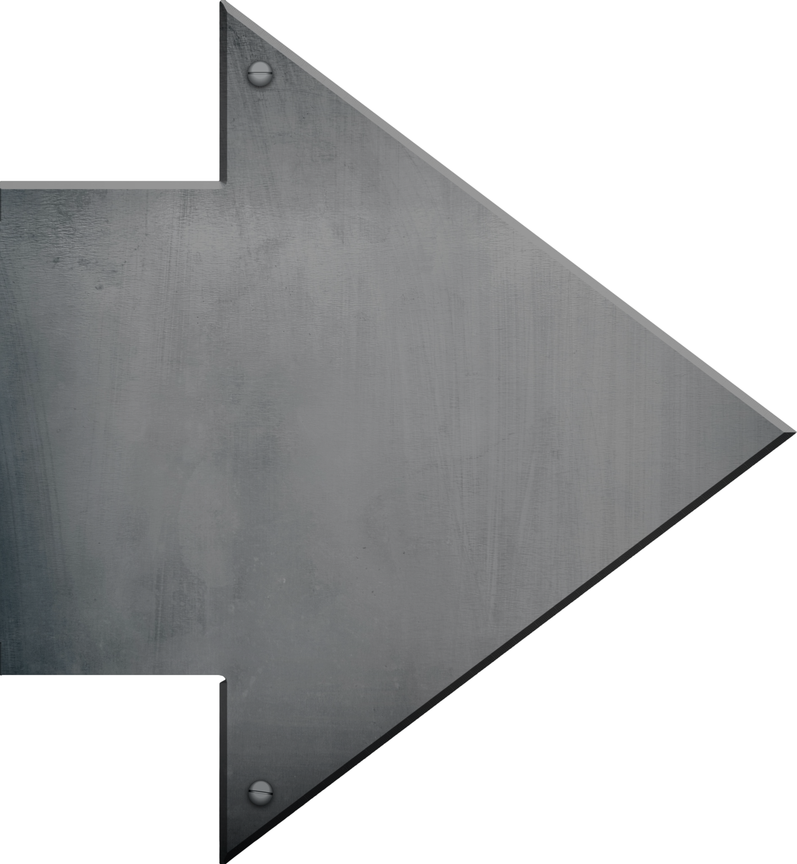
inHibition
inDuction
High &
Hurried
Down &
Delayed
carbamazepine
“shredder” inDucer of UGT, CYP, and P-gp enzymes

Slide 6
Carbamazepine (TEGRETOL)
kahr buh MAZ uh peen / TEG ra tal
“Tiger tail (in the) Car Maze”
Notes:
This mnemonic accomplishes everything I’m going for when designing a mascot. The mnemonic phrase that pairs trade name with the generic-- TIGER TAIL

Slide 7
Carbamazepine (TEGRETOL)
kahr buh MAZ uh peen / TEG ra tal
“Tiger tail (in the) Car Maze”
Notes:
In the CAR MAZE

Slide 8
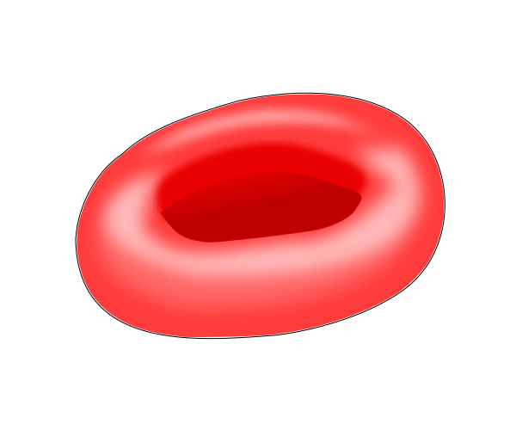
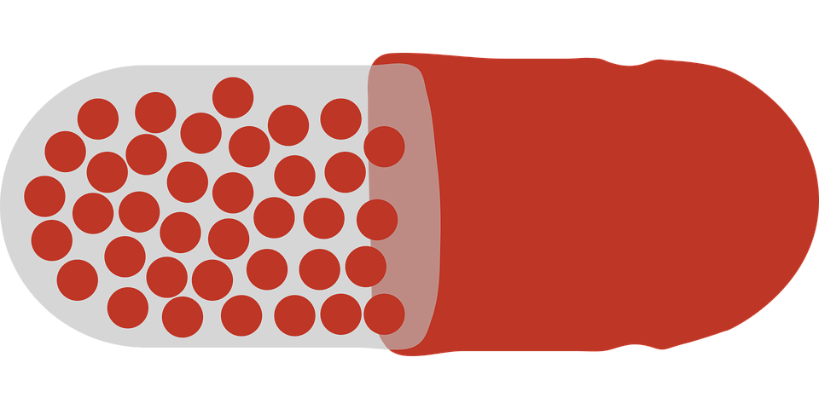
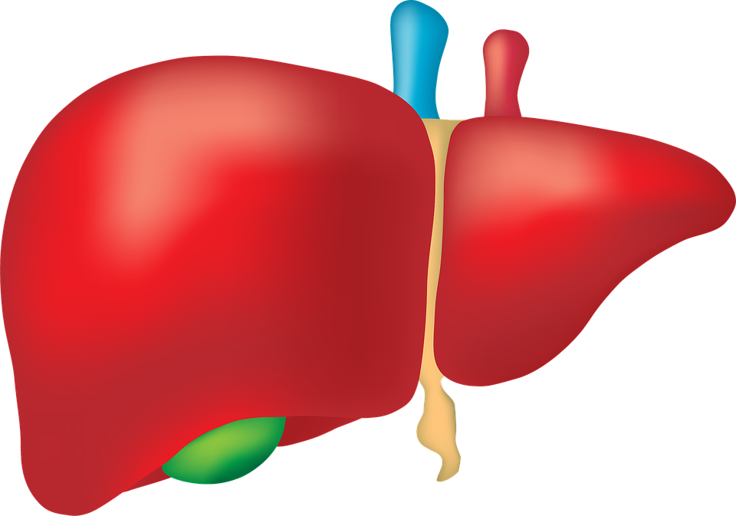
Risks of CBZ:
hyponatremia
Carbamazepine
(TEGRETOL)
“Tiger tail (in the)
Car Maze”
terato-
genicity
aplastic anemia
(rare)
Na⁺ Na⁺
decreased bone mineral density
agranulo-
cytosis (rare)
reduced levels of many medications
hepatotoxicity
Notes:
And its a Shredder Inducer, reducing serum levels of countless medications

Slide 9
Carbamazepine (TEGRETOL)
inDuction
Autoinduction of CYP3A4
Down and Delayed
Carbamazepine “eats its own tail”
inducing its own metabolism
Notes:
By stimulating production of 3A4 enzymes that metabolize it

Slide 10
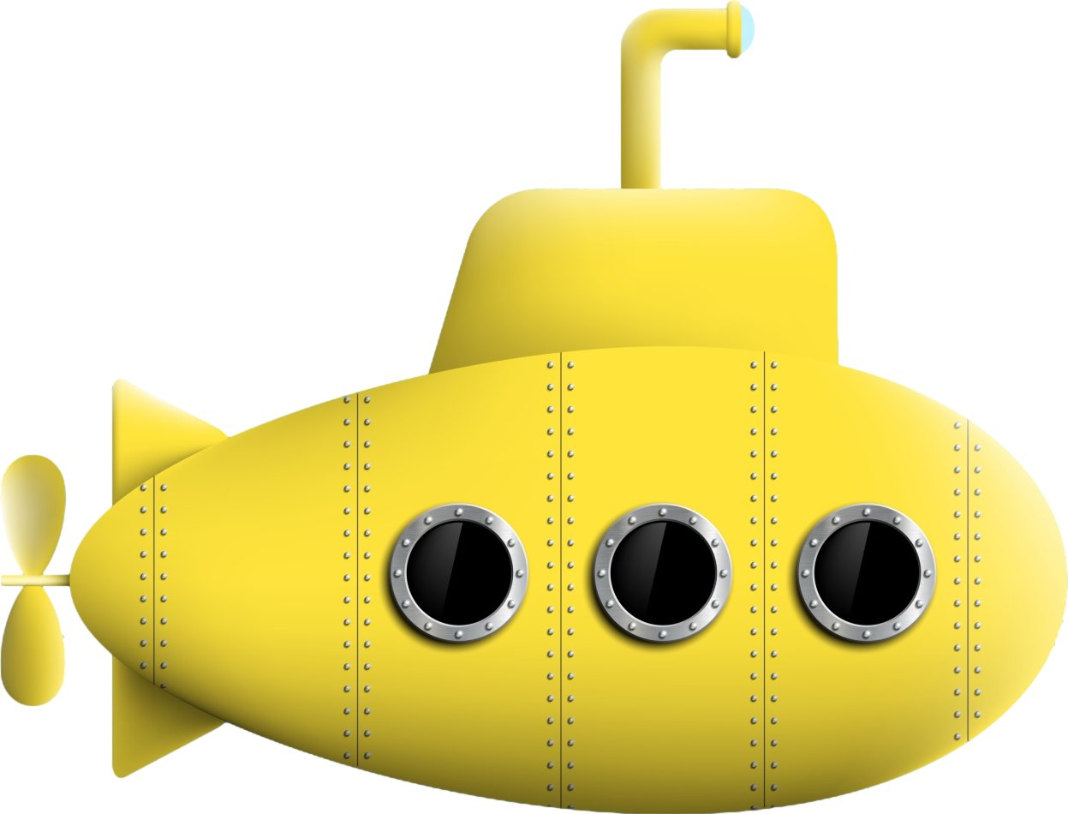
Enzyme inDuction
Enzyme inDuction causes decreased levels of “victim” drug (substrate).
D for Down and Delayed
(2–4 weeks)
inDucer
substrate
Notes:
inDuction is “Down and Delayed”,
causing a gradual decrease
of the victim drug
due to increased enzyme production.

Slide 11
Enzyme inDuction
Down and Delayed
inDucer, e.g.,
carbamazepine
Wait for liver to unregulate production of metabolic enzymes
substrate, e.g.,
quetiapine (Seroquel)
)
6-fold
decrease
Notes:
In our example, a patient is taking lurasidone.
The doctor adds carbamazepine for mood stabilization.
Nothing is noticeable for a couple of weeks, but the liver is ramping up enzyme production.
After a couple of weeks, lurasidone stops working, and the patient’s mood destabilizes.
The prescriber may have no idea why things went poorly.

Slide 12
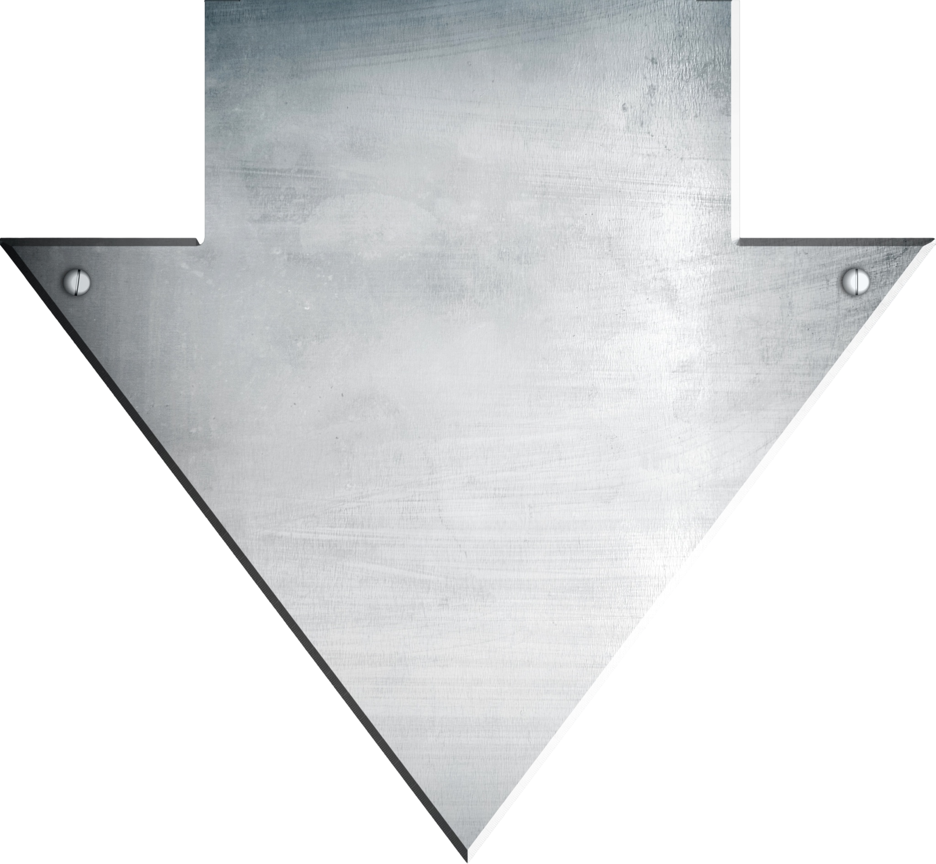
“Shredder” inDucers
barb
carbamazepine
phenobarbital / primidone (also a barbiturate)
phenytoin
rifampin
“Carb and Barb”

Slide 13
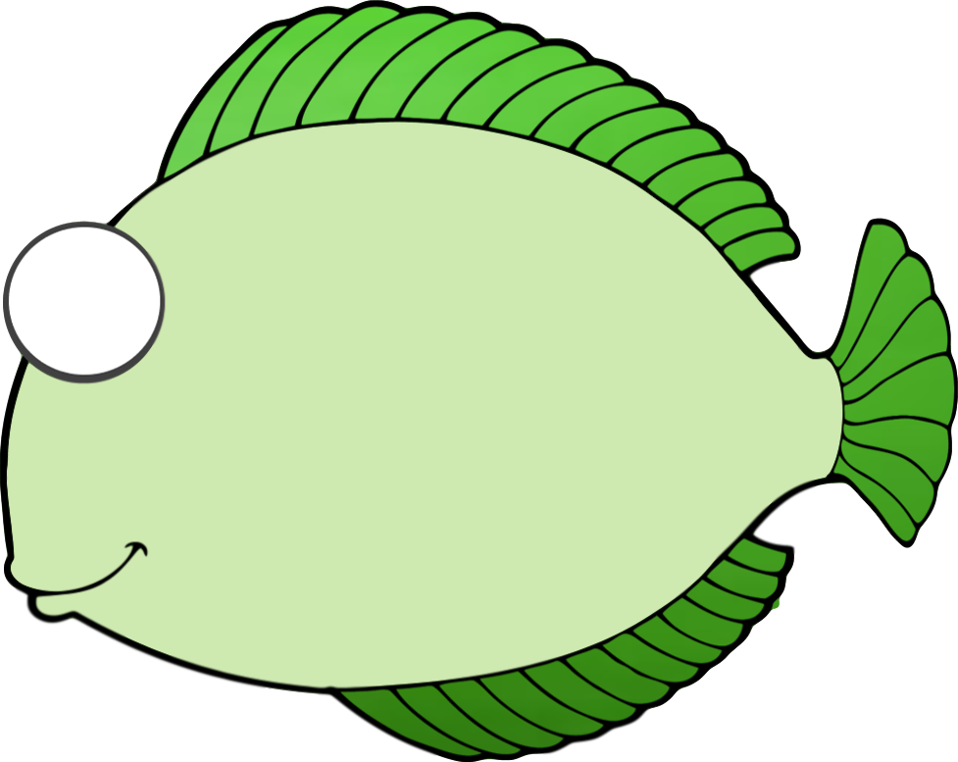
Interaction mnemonics
CYP3A4
“3 A’s For
(fishing)”
inDuction
3A4
Down and Delayed
inducer
3A4
substrate
Notes:
Anvils
drop
the blood levels
of fish

Slide 14
Interaction mnemonics
CYP3A4
“3 A’s For
(fishing)”
inDuction
Down and Delayed
Carbamazepine
(Tegretol)
“Tiger tail”
3A4
substrate
Notes:
“Tiger Tail”
is
an anvil

Slide 15
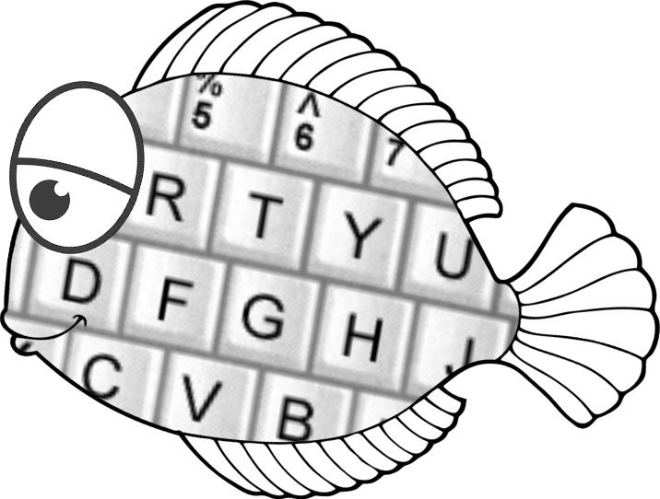
Interaction mnemonics
CYP3A4
“3 A’s For
(fishing)”
inDuction
Down and Delayed
Carbamazepine
(Tegretol)
“Tiger tail”
Quetiapine (Seroquel)
“Quit typing!”
6-fold decrease!
Notes:
Which decreases
“Quit Typing, Sera!”
6-fold

Slide 16
Interaction mnemonics
CYP3A4
“3 A’s For
(fishing)”
inDuction
Down and Delayed
Carbamazepine
(Tegretol)
“Tiger tail”
Lumateperone
(Caplyta)
“‘Luminated
Cap lighter”
20-fold decrease
of a $1,800 drug!
Notes:
“Cap Lighter”
levels decrease 95%...
That’s an $1,800 drug
made useless…and many psychiatrists
are unaware of this effect.

Slide 17
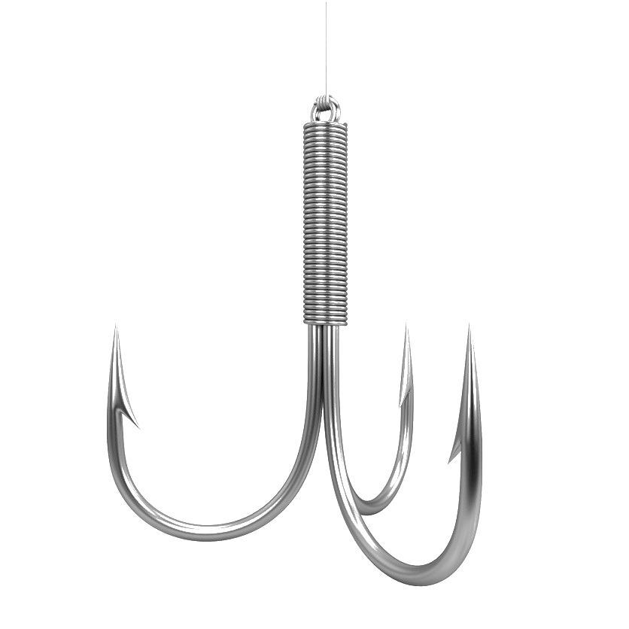
PHARMACOKINETIC INTERACTIONS 3 of 3
INDUCERS | INHIBITORS | SUBSTRATES
3A4 inducers Carbamazepine Modafinil Phenobarbital Phenytoin Rifampin St John’s Wort | 3A4 inhibitors Protease Inhibitors (HIV) Clarithromycin Diltiazem Fluvoxamine Grapefruit juice Ketoconazole Itraconazole Nefazodone Verapamil | 3A4 substrates Immuno- suppressants Progestins Alprazolam Aripiprazole Brexpiprazole Buprenorphine Buspirone Carbamazepine Cariprazine Chlordiazepoxide Clonazepam Fentanyl Flibanserin
UGT inducers Carbamazepine Estrogens Phenobarbital Phenytoin Rifampin | UGT inhibitors Valproate | UGT substrates Lamotrigine Lumateperone
Lemborexant
Lumateperone
Lurasidone
Pimavanserin
Pimozide
Quetiapine
Sildenafil
Simvastatin
Suvorexant
Tadalafil
Valbenazine
Vilazodone
Notes:
3 A’s for Fishing

Slide 18
PHARMACOKINETIC INTERACTIONS 3 of 3
INDUCERS | INHIBITORS | SUBSTRATES
3A4 inducers Carbamazepine Modafinil Phenobarbital Phenytoin Rifampin St John’s Wort | 3A4 inhibitors Protease Inhibitors (HIV) Clarithromycin Diltiazem Fluvoxamine Grapefruit juice Ketoconazole Itraconazole Nefazodone Verapamil | 3A4 substrates Immuno- suppressants Progestins Alprazolam Aripiprazole Brexpiprazole Buprenorphine Buspirone Carbamazepine Cariprazine Chlordiazepoxide Clonazepam Fentanyl Flibanserin
UGT inducers Carbamazepine Estrogens Phenobarbital Phenytoin Rifampin | UGT inhibitors Valproate | UGT substrates Lamotrigine Lumateperone
Lemborexant
Lumateperone
Lurasidone
Pimavanserin
Pimozide
Quetiapine
Sildenafil
Simvastatin
Suvorexant
Tadalafil
Valbenazine
Vilazodone
Notes:
Tegretol is a potent anvil

Slide 19
PHARMACOKINETIC INTERACTIONS 3 of 3
INDUCERS | INHIBITORS | SUBSTRATES
3A4 inducers Carbamazepine Modafinil Phenobarbital Phenytoin Rifampin St John’s Wort | 3A4 inhibitors Protease Inhibitors (HIV) Clarithromycin Diltiazem Fluvoxamine Grapefruit juice Ketoconazole Itraconazole Nefazodone Verapamil | 3A4 substrates Immuno- suppressants Progestins Alprazolam Aripiprazole Brexpiprazole Buprenorphine Buspirone Carbamazepine Cariprazine Chlordiazepoxide Clonazepam Fentanyl Flibanserin
UGT inducers Carbamazepine Estrogens Phenobarbital Phenytoin Rifampin | UGT inhibitors Valproate | UGT substrates Lamotrigine Lumateperone
Lemborexant
Lumateperone
Lurasidone
Pimavanserin
Pimozide
Quetiapine
Sildenafil
Simvastatin
Suvorexant
Tadalafil
Valbenazine
Vilazodone
LUVOX
Notes:
Luvox a bobber of intermediate potency

Slide 20
PHARMACOKINETIC INTERACTIONS 3 of 3
INDUCERS | INHIBITORS | SUBSTRATES
3A4 inducers Carbamazepine Modafinil Phenobarbital Phenytoin Rifampin St John’s Wort | 3A4 inhibitors Protease Inhibitors (HIV) Clarithromycin Diltiazem Fluvoxamine Grapefruit juice Ketoconazole Itraconazole Nefazodone Verapamil | 3A4 substrates Immuno- suppressants Progestins Alprazolam Aripiprazole Brexpiprazole Buprenorphine Buspirone Carbamazepine Cariprazine Chlordiazepoxide Clonazepam Fentanyl Flibanserin
UGT inducers Carbamazepine Estrogens Phenobarbital Phenytoin Rifampin | UGT inhibitors Valproate | UGT substrates Lamotrigine Lumateperone
Lemborexant
Lumateperone
Lurasidone
Pimavanserin
Pimozide
Quetiapine
Sildenafil
Simvastatin
Suvorexant
Tadalafil
Valbenazine
Vilazodone
LUVOX
PLENTY
OF
FISH
Notes:
And there are plenty of fish

Slide 21
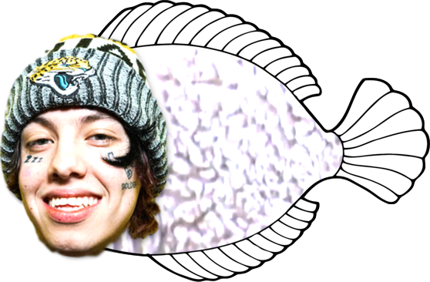
PHARMACOKINETIC INTERACTIONS 3 of 3
INDUCERS | INHIBITORS | SUBSTRATES
3A4 inducers Carbamazepine Modafinil Phenobarbital Phenytoin Rifampin St John’s Wort | 3A4 inhibitors Protease Inhibitors (HIV) Clarithromycin Diltiazem Fluvoxamine Grapefruit juice Ketoconazole Itraconazole Nefazodone Verapamil | 3A4 substrates Immuno- suppressants Progestins Alprazolam Aripiprazole Brexpiprazole Buprenorphine Buspirone Carbamazepine Cariprazine Chlordiazepoxide Clonazepam Fentanyl Flibanserin
UGT inducers Carbamazepine Estrogens Phenobarbital Phenytoin Rifampin | UGT inhibitors Valproate | UGT substrates Lamotrigine Lumateperone
Lemborexant
Lumateperone
Lurasidone
Pimavanserin
Pimozide
Quetiapine
Sildenafil
Simvastatin
Suvorexant
Tadalafil
Valbenazine
Vilazodone
LUVOX
PLENTY
OF
FISH
Notes:
Over

Slide 22
PHARMACOKINETIC INTERACTIONS 3 of 3
INDUCERS | INHIBITORS | SUBSTRATES
3A4 inducers Carbamazepine Modafinil Phenobarbital Phenytoin Rifampin St John’s Wort | 3A4 inhibitors Protease Inhibitors (HIV) Clarithromycin Diltiazem Fluvoxamine Grapefruit juice Ketoconazole Itraconazole Nefazodone Verapamil | 3A4 substrates Immuno- suppressants Progestins Alprazolam Aripiprazole Brexpiprazole Buprenorphine Buspirone Carbamazepine Cariprazine Chlordiazepoxide Clonazepam Fentanyl Flibanserin
UGT inducers Carbamazepine Estrogens Phenobarbital Phenytoin Rifampin | UGT inhibitors Valproate | UGT substrates Lamotrigine Lumateperone
Lemborexant
Lumateperone
Lurasidone
Pimavanserin
Pimozide
Quetiapine
Sildenafil
Simvastatin
Suvorexant
Tadalafil
Valbenazine
Vilazodone
LUVOX
PLENTY
OF
FISH
Notes:
half

Slide 23
PHARMACOKINETIC INTERACTIONS 3 of 3
INDUCERS | INHIBITORS | SUBSTRATES
3A4 inducers Carbamazepine Modafinil Phenobarbital Phenytoin Rifampin St John’s Wort | 3A4 inhibitors Protease Inhibitors (HIV) Clarithromycin Diltiazem Fluvoxamine Grapefruit juice Ketoconazole Itraconazole Nefazodone Verapamil | 3A4 substrates Immuno- suppressants Progestins Alprazolam Aripiprazole Brexpiprazole Buprenorphine Buspirone Carbamazepine Cariprazine Chlordiazepoxide Clonazepam Fentanyl Flibanserin
UGT inducers Carbamazepine Estrogens Phenobarbital Phenytoin Rifampin | UGT inhibitors Valproate | UGT substrates Lamotrigine Lumateperone
Lemborexant
Lumateperone
Lurasidone
Pimavanserin
Pimozide
Quetiapine
Sildenafil
Simvastatin
Suvorexant
Tadalafil
Valbenazine
Vilazodone
LUVOX
PLENTY
OF
FISH
Notes:
of

Slide 24
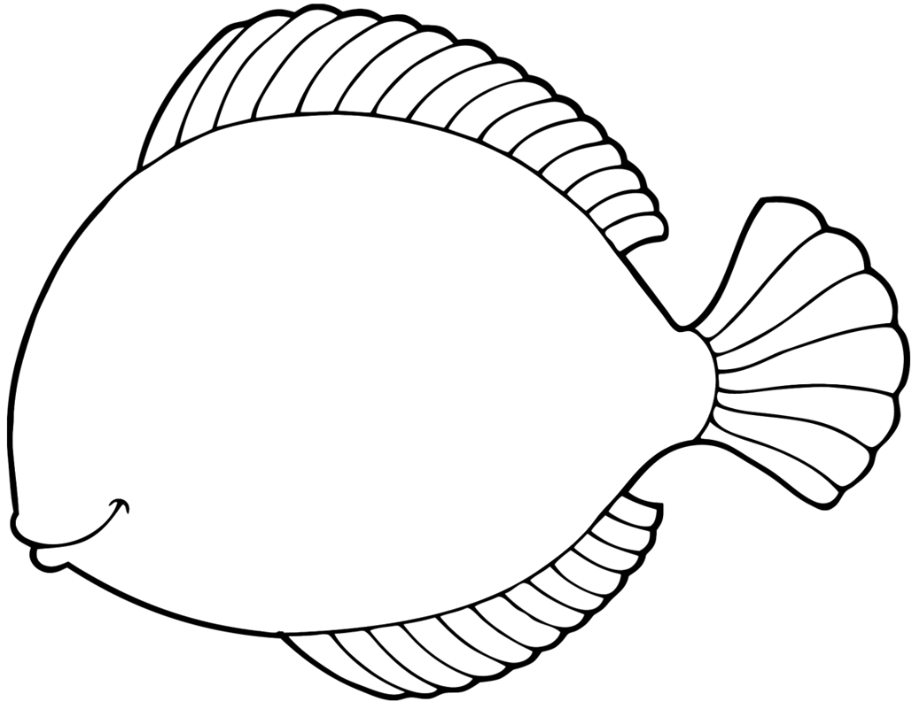
PHARMACOKINETIC INTERACTIONS 3 of 3
INDUCERS | INHIBITORS | SUBSTRATES
3A4 inducers Carbamazepine Modafinil Phenobarbital Phenytoin Rifampin St John’s Wort | 3A4 inhibitors Protease Inhibitors (HIV) Clarithromycin Diltiazem Fluvoxamine Grapefruit juice Ketoconazole Itraconazole Nefazodone Verapamil | 3A4 substrates Immuno- suppressants Progestins Alprazolam Aripiprazole Brexpiprazole Buprenorphine Buspirone Carbamazepine Cariprazine Chlordiazepoxide Clonazepam Fentanyl Flibanserin
UGT inducers Carbamazepine Estrogens Phenobarbital Phenytoin Rifampin | UGT inhibitors Valproate | UGT substrates Lamotrigine Lumateperone
Lemborexant
Lumateperone
Lurasidone
Pimavanserin
Pimozide
Quetiapine
Sildenafil
Simvastatin
Suvorexant
Tadalafil
Valbenazine
Vilazodone
LUVOX
PLENTY
OF
FISH
Notes:
prescription

Slide 25
PHARMACOKINETIC INTERACTIONS 3 of 3
INDUCERS | INHIBITORS | SUBSTRATES
3A4 inducers Carbamazepine Modafinil Phenobarbital Phenytoin Rifampin St John’s Wort | 3A4 inhibitors Protease Inhibitors (HIV) Clarithromycin Diltiazem Fluvoxamine Grapefruit juice Ketoconazole Itraconazole Nefazodone Verapamil | 3A4 substrates Immuno- suppressants Progestins Alprazolam Aripiprazole Brexpiprazole Buprenorphine Buspirone Carbamazepine Cariprazine Chlordiazepoxide Clonazepam Fentanyl Flibanserin
UGT inducers Carbamazepine Estrogens Phenobarbital Phenytoin Rifampin | UGT inhibitors Valproate | UGT substrates Lamotrigine Lumateperone
Lemborexant
Lumateperone
Lurasidone
Pimavanserin
Pimozide
Quetiapine
Sildenafil
Simvastatin
Suvorexant
Tadalafil
Valbenazine
Vilazodone
LUVOX
PLENTY
OF
FISH
Notes:
drugs

Slide 26
PHARMACOKINETIC INTERACTIONS 3 of 3
INDUCERS | INHIBITORS | SUBSTRATES
3A4 inducers Carbamazepine Modafinil Phenobarbital Phenytoin Rifampin St John’s Wort | 3A4 inhibitors Protease Inhibitors (HIV) Clarithromycin Diltiazem Fluvoxamine Grapefruit juice Ketoconazole Itraconazole Nefazodone Verapamil | 3A4 substrates Immuno- suppressants Progestins Alprazolam Aripiprazole Brexpiprazole Buprenorphine Buspirone Carbamazepine Cariprazine Chlordiazepoxide Clonazepam Fentanyl Flibanserin
UGT inducers Carbamazepine Estrogens Phenobarbital Phenytoin Rifampin | UGT inhibitors Valproate | UGT substrates Lamotrigine Lumateperone
Lemborexant
Lumateperone
Lurasidone
Pimavanserin
Pimozide
Quetiapine
Sildenafil
Simvastatin
Suvorexant
Tadalafil
Valbenazine
Vilazodone
LUVOX
*
PLENTY
OF
FISH
Notes:
are

Slide 27
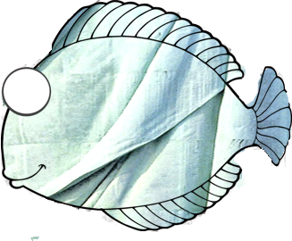
PHARMACOKINETIC INTERACTIONS 3 of 3
INDUCERS | INHIBITORS | SUBSTRATES
3A4 inducers Carbamazepine Modafinil Phenobarbital Phenytoin Rifampin St John’s Wort | 3A4 inhibitors Protease Inhibitors (HIV) Clarithromycin Diltiazem Fluvoxamine Grapefruit juice Ketoconazole Itraconazole Nefazodone Verapamil | 3A4 substrates Immuno- suppressants Progestins Alprazolam Aripiprazole Brexpiprazole Buprenorphine Buspirone Carbamazepine Cariprazine Chlordiazepoxide Clonazepam Fentanyl Flibanserin
UGT inducers Carbamazepine Estrogens Phenobarbital Phenytoin Rifampin | UGT inhibitors Valproate | UGT substrates Lamotrigine Lumateperone
Lemborexant
Lumateperone
Lurasidone
Pimavanserin
Pimozide
Quetiapine
Sildenafil
Simvastatin
Suvorexant
Tadalafil
Valbenazine
Vilazodone
LUVOX
PLENTY
OF
FISH
Notes:
broken

Slide 28
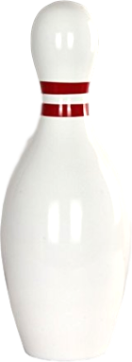
PHARMACOKINETIC INTERACTIONS 3 of 3
INDUCERS | INHIBITORS | SUBSTRATES
3A4 inducers Carbamazepine Modafinil Phenobarbital Phenytoin Rifampin St John’s Wort | 3A4 inhibitors Protease Inhibitors (HIV) Clarithromycin Diltiazem Fluvoxamine Grapefruit juice Ketoconazole Itraconazole Nefazodone Verapamil | 3A4 substrates Immuno- suppressants Progestins Alprazolam Aripiprazole Brexpiprazole Buprenorphine Buspirone Carbamazepine Cariprazine Chlordiazepoxide Clonazepam Fentanyl Flibanserin
UGT inducers Carbamazepine Estrogens Phenobarbital Phenytoin Rifampin | UGT inhibitors Valproate | UGT substrates Lamotrigine Lumateperone
Lemborexant
Lumateperone
Lurasidone
Pimavanserin
Pimozide
Quetiapine
Sildenafil
Simvastatin
Suvorexant
Tadalafil
Valbenazine
Vilazodone
LUVOX
PLENTY
OF
FISH
Notes:
down

Slide 29
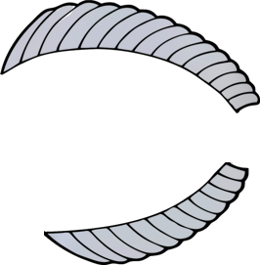
PHARMACOKINETIC INTERACTIONS 3 of 3
INDUCERS | INHIBITORS | SUBSTRATES
3A4 inducers Carbamazepine Modafinil Phenobarbital Phenytoin Rifampin St John’s Wort | 3A4 inhibitors Protease Inhibitors (HIV) Clarithromycin Diltiazem Fluvoxamine Grapefruit juice Ketoconazole Itraconazole Nefazodone Verapamil | 3A4 substrates Immuno- suppressants Progestins Alprazolam Aripiprazole Brexpiprazole Buprenorphine Buspirone Carbamazepine Cariprazine Chlordiazepoxide Clonazepam Fentanyl Flibanserin
UGT inducers Carbamazepine Estrogens Phenobarbital Phenytoin Rifampin | UGT inhibitors Valproate | UGT substrates Lamotrigine Lumateperone
Lemborexant
Lumateperone
Lurasidone
Pimavanserin
Pimozide
Quetiapine
Sildenafil
Simvastatin
Suvorexant
Tadalafil
Valbenazine
Vilazodone
LUVOX
PLENTY
OF
FISH
Notes:
through

Slide 30
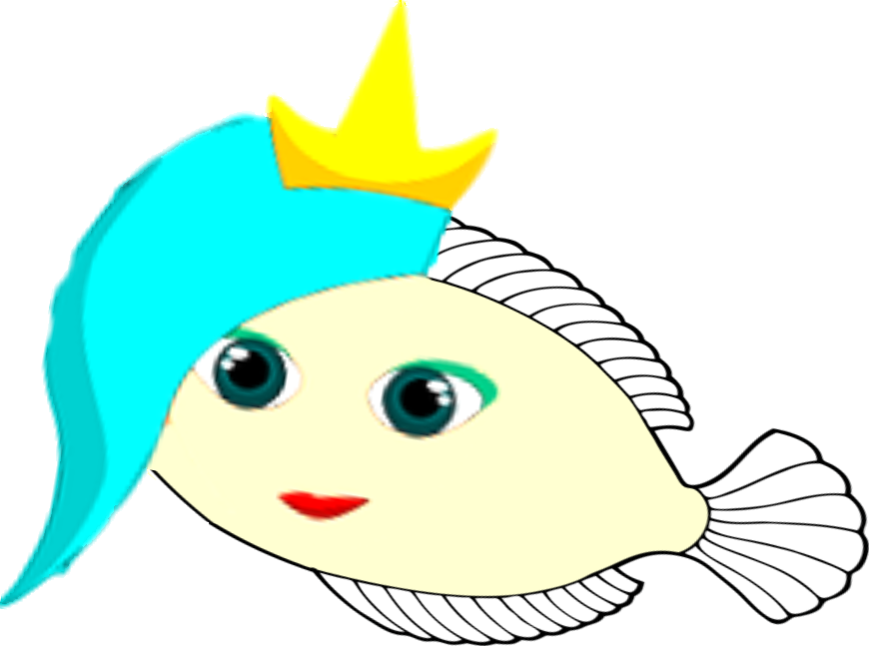
PHARMACOKINETIC INTERACTIONS 3 of 3
INDUCERS | INHIBITORS | SUBSTRATES
3A4 inducers Carbamazepine Modafinil Phenobarbital Phenytoin Rifampin St John’s Wort | 3A4 inhibitors Protease Inhibitors (HIV) Clarithromycin Diltiazem Fluvoxamine Grapefruit juice Ketoconazole Itraconazole Nefazodone Verapamil | 3A4 substrates Immuno- suppressants Progestins Alprazolam Aripiprazole Brexpiprazole Buprenorphine Buspirone Carbamazepine Cariprazine Chlordiazepoxide Clonazepam Fentanyl Flibanserin
UGT inducers Carbamazepine Estrogens Phenobarbital Phenytoin Rifampin | UGT inhibitors Valproate | UGT substrates Lamotrigine Lumateperone
Lemborexant
Lumateperone
Lurasidone
Pimavanserin
Pimozide
Quetiapine
Sildenafil
Simvastatin
Suvorexant
Tadalafil
Valbenazine
Vilazodone
LUVOX
PLENTY
OF
FISH
Notes:
3A4.

Slide 31
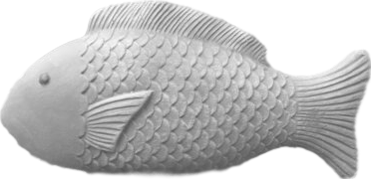
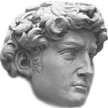
PHARMACOKINETIC INTERACTIONS 3 of 3
INDUCERS | INHIBITORS | SUBSTRATES
3A4 inducers Carbamazepine Modafinil Phenobarbital Phenytoin Rifampin St John’s Wort | 3A4 inhibitors Protease Inhibitors (HIV) Clarithromycin Diltiazem Fluvoxamine Grapefruit juice Ketoconazole Itraconazole Nefazodone Verapamil | 3A4 substrates Immuno- suppressants Progestins Alprazolam Aripiprazole Brexpiprazole Buprenorphine Buspirone Carbamazepine Cariprazine Chlordiazepoxide Clonazepam Fentanyl Flibanserin
UGT inducers Carbamazepine Estrogens Phenobarbital Phenytoin Rifampin | UGT inhibitors Valproate | UGT substrates Lamotrigine Lumateperone
Lemborexant
Lumateperone
Lurasidone
Pimavanserin
Pimozide
Quetiapine
Sildenafil
Simvastatin
Suvorexant
Tadalafil
Valbenazine
Vilazodone
LUVOX
PLENTY
OF
FISH
Notes:
...

Slide 32
PHARMACOKINETIC INTERACTIONS 3 of 3
INDUCERS | INHIBITORS | SUBSTRATES
3A4 inducers Carbamazepine Modafinil Phenobarbital Phenytoin Rifampin St John’s Wort | 3A4 inhibitors Protease Inhibitors (HIV) Clarithromycin Diltiazem Fluvoxamine Grapefruit juice Ketoconazole Itraconazole Nefazodone Verapamil | 3A4 substrates Immuno- suppressants Progestins Alprazolam Aripiprazole Brexpiprazole Buprenorphine Buspirone Carbamazepine Cariprazine Chlordiazepoxide Clonazepam Fentanyl Flibanserin
UGT inducers Carbamazepine Estrogens Phenobarbital Phenytoin Rifampin | UGT inhibitors Valproate | UGT substrates Lamotrigine Lumateperone
Lemborexant
Lumateperone
Lurasidone
Pimavanserin
Pimozide
Quetiapine
Sildenafil
Simvastatin
Suvorexant
Tadalafil
Valbenazine
Vilazodone
LUVOX
PLENTY
OF
FISH
Notes:
...

Slide 33
PHARMACOKINETIC INTERACTIONS 3 of 3
INDUCERS | INHIBITORS | SUBSTRATES
3A4 inducers Carbamazepine Modafinil Phenobarbital Phenytoin Rifampin St John’s Wort | 3A4 inhibitors Protease Inhibitors (HIV) Clarithromycin Diltiazem Fluvoxamine Grapefruit juice Ketoconazole Itraconazole Nefazodone Verapamil | 3A4 substrates Immuno- suppressants Progestins Alprazolam Aripiprazole Brexpiprazole Buprenorphine Buspirone Carbamazepine Cariprazine Chlordiazepoxide Clonazepam Fentanyl Flibanserin
UGT inducers Carbamazepine Estrogens Phenobarbital Phenytoin Rifampin | UGT inhibitors Valproate | UGT substrates Lamotrigine Lumateperone
Lemborexant
Lumateperone
Lurasidone
Pimavanserin
Pimozide
Quetiapine
Sildenafil
Simvastatin
Suvorexant
Tadalafil
Valbenazine
Vilazodone
LUVOX
PLENTY
OF
FISH
Notes:
...

Slide 34
PHARMACOKINETIC INTERACTIONS 3 of 3
INDUCERS | INHIBITORS | SUBSTRATES
3A4 inducers Carbamazepine Modafinil Phenobarbital Phenytoin Rifampin St John’s Wort | 3A4 inhibitors Protease Inhibitors (HIV) Clarithromycin Diltiazem Fluvoxamine Grapefruit juice Ketoconazole Itraconazole Nefazodone Verapamil | 3A4 substrates Immuno- suppressants Progestins Alprazolam Aripiprazole Brexpiprazole Buprenorphine Buspirone Carbamazepine Cariprazine Chlordiazepoxide Clonazepam Fentanyl Flibanserin
UGT inducers Carbamazepine Estrogens Phenobarbital Phenytoin Rifampin | UGT inhibitors Valproate | UGT substrates Lamotrigine Lumateperone
Lemborexant
Lumateperone
Lurasidone
Pimavanserin
Pimozide
Quetiapine
Sildenafil
Simvastatin
Suvorexant
Tadalafil
Valbenazine
Vilazodone
LUVOX
PLENTY
OF
FISH
Notes:
3A4

Slide 35
PHARMACOKINETIC INTERACTIONS 3 of 3
INDUCERS | INHIBITORS | SUBSTRATES
3A4 inducers Carbamazepine Modafinil Phenobarbital Phenytoin Rifampin St John’s Wort | 3A4 inhibitors Protease Inhibitors (HIV) Clarithromycin Diltiazem Fluvoxamine Grapefruit juice Ketoconazole Itraconazole Nefazodone Verapamil | 3A4 substrates Immuno- suppressants Progestins Alprazolam Aripiprazole Brexpiprazole Buprenorphine Buspirone Carbamazepine Cariprazine Chlordiazepoxide Clonazepam Fentanyl Flibanserin
UGT inducers Carbamazepine Estrogens Phenobarbital Phenytoin Rifampin | UGT inhibitors Valproate | UGT substrates Lamotrigine Lumateperone
Lemborexant
Lumateperone
Lurasidone
Pimavanserin
Pimozide
Quetiapine
Sildenafil
Simvastatin
Suvorexant
Tadalafil
Valbenazine
Vilazodone
LUVOX
PLENTY
OF
FISH
Notes:
is

Slide 36
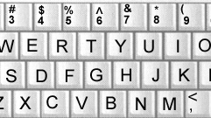
PHARMACOKINETIC INTERACTIONS 3 of 3
INDUCERS | INHIBITORS | SUBSTRATES
3A4 inducers Carbamazepine Modafinil Phenobarbital Phenytoin Rifampin St John’s Wort | 3A4 inhibitors Protease Inhibitors (HIV) Clarithromycin Diltiazem Fluvoxamine Grapefruit juice Ketoconazole Itraconazole Nefazodone Verapamil | 3A4 substrates Immuno- suppressants Progestins Alprazolam Aripiprazole Brexpiprazole Buprenorphine Buspirone Carbamazepine Cariprazine Chlordiazepoxide Clonazepam Fentanyl Flibanserin
UGT inducers Carbamazepine Estrogens Phenobarbital Phenytoin Rifampin | UGT inhibitors Valproate | UGT substrates Lamotrigine Lumateperone
Lemborexant
Lumateperone
Lurasidone
Pimavanserin
Pimozide
Quetiapine
Sildenafil
Simvastatin
Suvorexant
Tadalafil
Valbenazine
Vilazodone
LUVOX
PLENTY
OF
FISH
Notes:
the

Slide 37
PHARMACOKINETIC INTERACTIONS 3 of 3
INDUCERS | INHIBITORS | SUBSTRATES
3A4 inducers Carbamazepine Modafinil Phenobarbital Phenytoin Rifampin St John’s Wort | 3A4 inhibitors Protease Inhibitors (HIV) Clarithromycin Diltiazem Fluvoxamine Grapefruit juice Ketoconazole Itraconazole Nefazodone Verapamil | 3A4 substrates Immuno- suppressants Progestins Alprazolam Aripiprazole Brexpiprazole Buprenorphine Buspirone Carbamazepine Cariprazine Chlordiazepoxide Clonazepam Fentanyl Flibanserin
UGT inducers Carbamazepine Estrogens Phenobarbital Phenytoin Rifampin | UGT inhibitors Valproate | UGT substrates Lamotrigine Lumateperone
Lemborexant
Lumateperone
Lurasidone
Pimavanserin
Pimozide
Quetiapine
Sildenafil
Simvastatin
Suvorexant
Tadalafil
Valbenazine
Vilazodone
LUVOX
PLENTY
OF
FISH
Notes:
workhorse

Slide 38
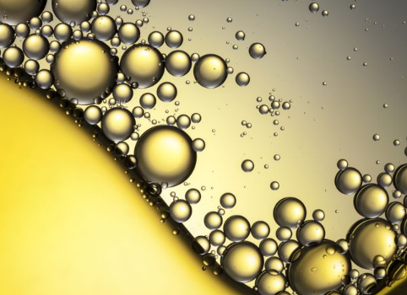
PHARMACOKINETIC INTERACTIONS 3 of 3
INDUCERS | INHIBITORS | SUBSTRATES
3A4 inducers Carbamazepine Modafinil Phenobarbital Phenytoin Rifampin St John’s Wort | 3A4 inhibitors Protease Inhibitors (HIV) Clarithromycin Diltiazem Fluvoxamine Grapefruit juice Ketoconazole Itraconazole Nefazodone Verapamil | 3A4 substrates Immuno- suppressants Progestins Alprazolam Aripiprazole Brexpiprazole Buprenorphine Buspirone Carbamazepine Cariprazine Chlordiazepoxide Clonazepam Fentanyl Flibanserin
UGT inducers Carbamazepine Estrogens Phenobarbital Phenytoin Rifampin | UGT inhibitors Valproate | UGT substrates Lamotrigine Lumateperone
Lemborexant
Lumateperone
Lurasidone
Pimavanserin
Pimozide
Quetiapine
Sildenafil
Simvastatin
Suvorexant
Tadalafil
Valbenazine
Vilazodone
LUVOX
PLENTY
OF
FISH
Notes:
of

Slide 39
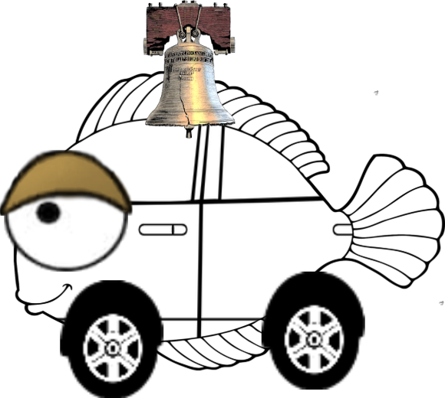
PHARMACOKINETIC INTERACTIONS 3 of 3
INDUCERS | INHIBITORS | SUBSTRATES
3A4 inducers Carbamazepine Modafinil Phenobarbital Phenytoin Rifampin St John’s Wort | 3A4 inhibitors Protease Inhibitors (HIV) Clarithromycin Diltiazem Fluvoxamine Grapefruit juice Ketoconazole Itraconazole Nefazodone Verapamil | 3A4 substrates Immuno- suppressants Progestins Alprazolam Aripiprazole Brexpiprazole Buprenorphine Buspirone Carbamazepine Cariprazine Chlordiazepoxide Clonazepam Fentanyl Flibanserin
UGT inducers Carbamazepine Estrogens Phenobarbital Phenytoin Rifampin | UGT inhibitors Valproate | UGT substrates Lamotrigine Lumateperone
Lemborexant
Lumateperone
Lurasidone
Pimavanserin
Pimozide
Quetiapine
Sildenafil
Simvastatin
Suvorexant
Tadalafil
Valbenazine
Vilazodone
LUVOX
PLENTY
OF
FISH
Notes:
cytochrome

Slide 40
PHARMACOKINETIC INTERACTIONS 3 of 3
INDUCERS | INHIBITORS | SUBSTRATES
3A4 inducers Carbamazepine Modafinil Phenobarbital Phenytoin Rifampin St John’s Wort | 3A4 inhibitors Protease Inhibitors (HIV) Clarithromycin Diltiazem Fluvoxamine Grapefruit juice Ketoconazole Itraconazole Nefazodone Verapamil | 3A4 substrates Immuno- suppressants Progestins Alprazolam Aripiprazole Brexpiprazole Buprenorphine Buspirone Carbamazepine Cariprazine Chlordiazepoxide Clonazepam Fentanyl Flibanserin
UGT inducers Carbamazepine Estrogens Phenobarbital Phenytoin Rifampin | UGT inhibitors Valproate | UGT substrates Lamotrigine Lumateperone
Lemborexant
Lumateperone
Lurasidone
Pimavanserin
Pimozide
Quetiapine
Sildenafil
Simvastatin
Suvorexant
Tadalafil
Valbenazine
Vilazodone
LUVOX
PLENTY
OF
FISH
Notes:
p450

Slide 41
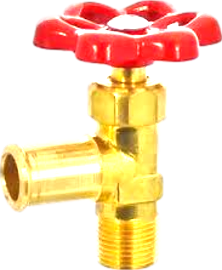
PHARMACOKINETIC INTERACTIONS 3 of 3
INDUCERS | INHIBITORS | SUBSTRATES
3A4 inducers Carbamazepine Modafinil Phenobarbital Phenytoin Rifampin St John’s Wort | 3A4 inhibitors Protease Inhibitors (HIV) Clarithromycin Diltiazem Fluvoxamine Grapefruit juice Ketoconazole Itraconazole Nefazodone Verapamil | 3A4 substrates Immuno- suppressants Progestins Alprazolam Aripiprazole Brexpiprazole Buprenorphine Buspirone Carbamazepine Cariprazine Chlordiazepoxide Clonazepam Fentanyl Flibanserin
UGT inducers Carbamazepine Estrogens Phenobarbital Phenytoin Rifampin | UGT inhibitors Valproate | UGT substrates Lamotrigine Lumateperone
Lemborexant
Lumateperone
Lurasidone
Pimavanserin
Pimozide
Quetiapine
Sildenafil
Simvastatin
Suvorexant
Tadalafil
Valbenazine
Vilazodone
LUVOX
PLENTY
OF
FISH
Notes:
metabolism

Slide 42
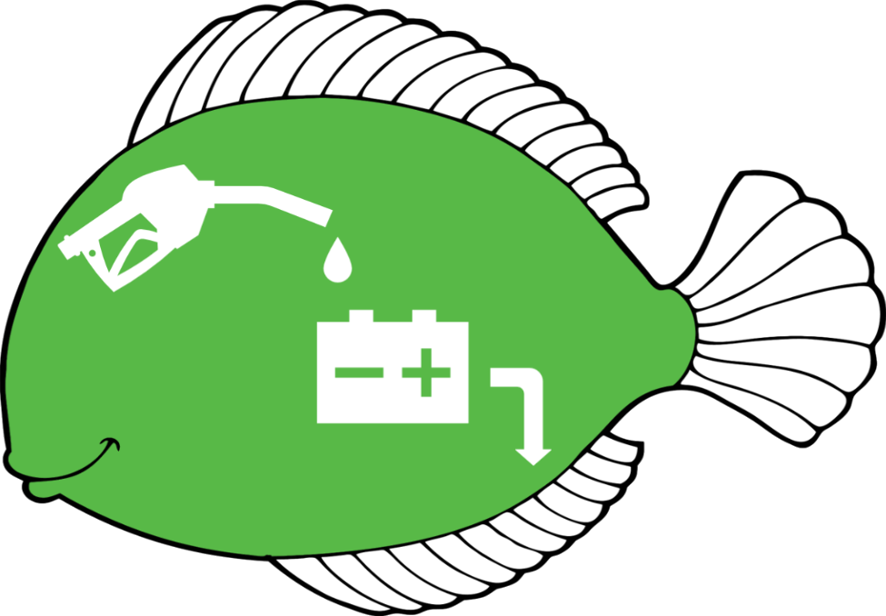
PHARMACOKINETIC INTERACTIONS 3 of 3
INDUCERS | INHIBITORS | SUBSTRATES
3A4 inducers Carbamazepine Modafinil Phenobarbital Phenytoin Rifampin St John’s Wort | 3A4 inhibitors Protease Inhibitors (HIV) Clarithromycin Diltiazem Fluvoxamine Grapefruit juice Ketoconazole Itraconazole Nefazodone Verapamil | 3A4 substrates Immuno- suppressants Progestins Alprazolam Aripiprazole Brexpiprazole Buprenorphine Buspirone Carbamazepine Cariprazine Chlordiazepoxide Clonazepam Fentanyl Flibanserin
UGT inducers Carbamazepine Estrogens Phenobarbital Phenytoin Rifampin | UGT inhibitors Valproate | UGT substrates Lamotrigine Lumateperone
Lemborexant
Lumateperone
Lurasidone
Pimavanserin
Pimozide
Quetiapine
Sildenafil
Simvastatin
Suvorexant
Tadalafil
Valbenazine
Vilazodone
LUVOX
PLENTY
OF
FISH
Notes:
accounting

Slide 43
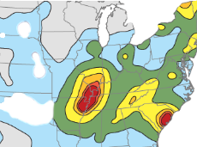
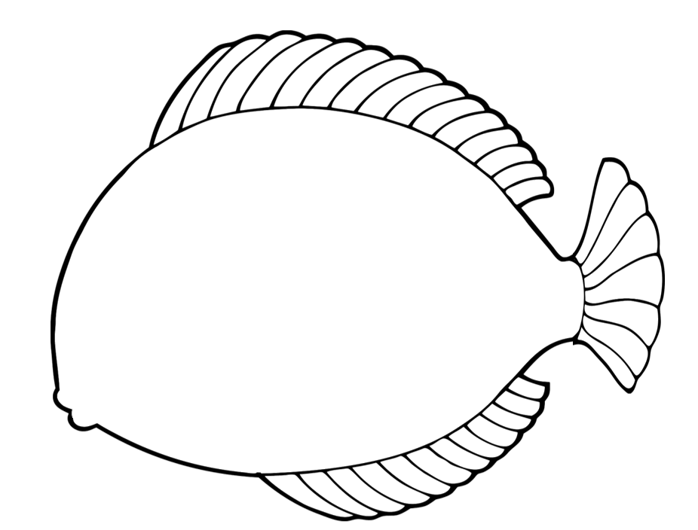
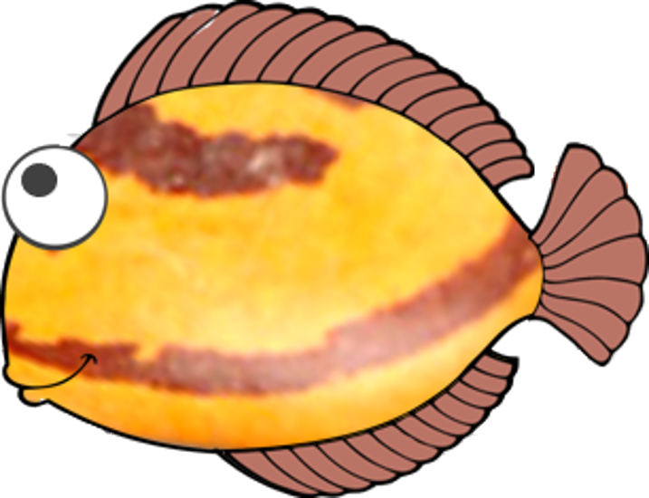
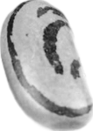
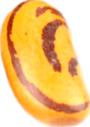
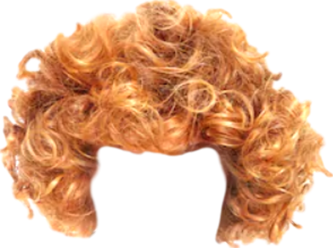
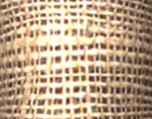
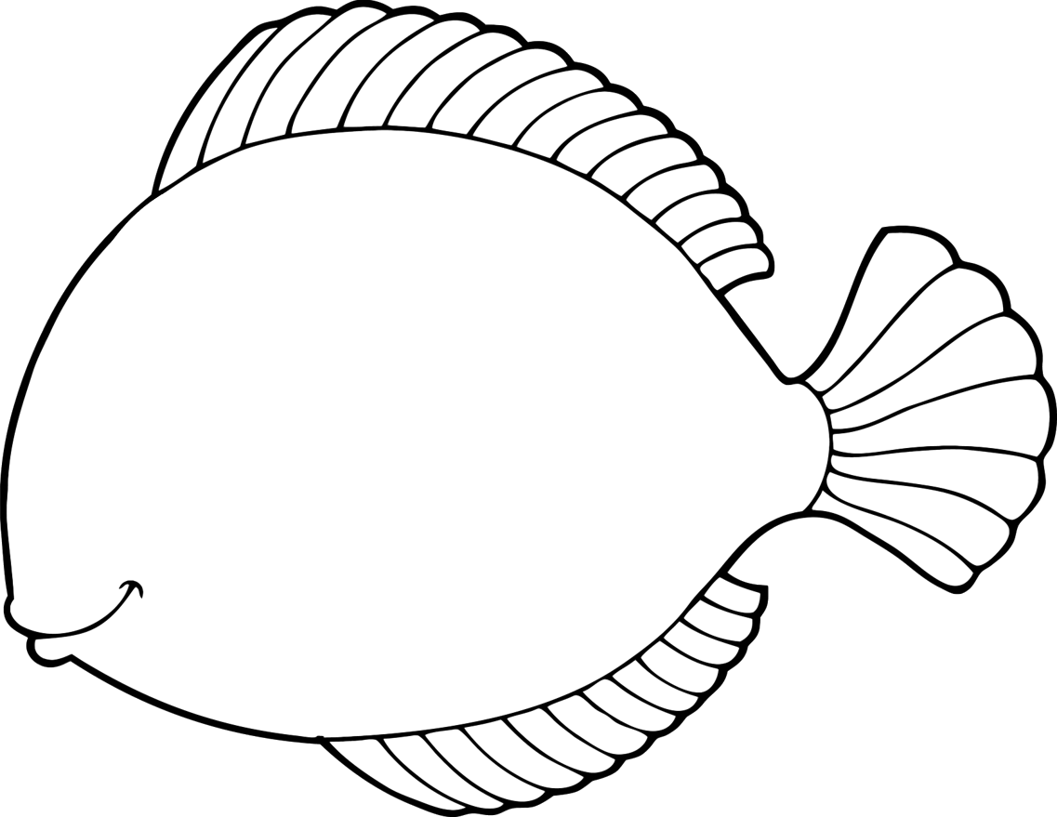
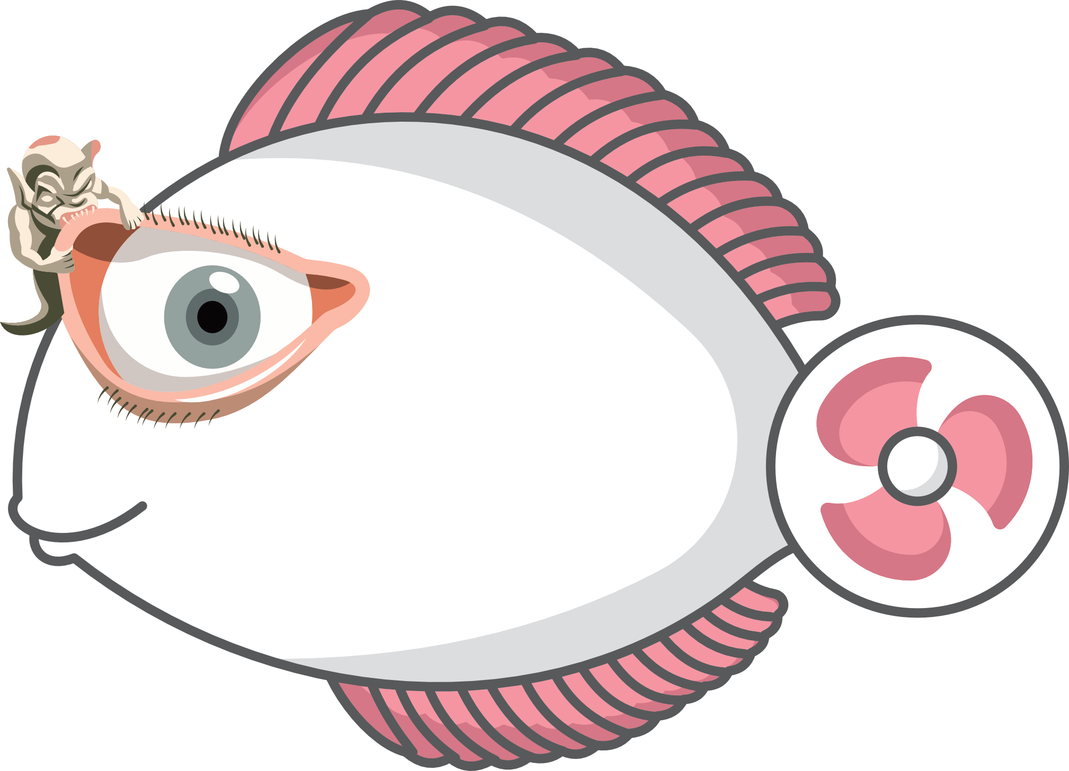
PHARMACOKINETIC INTERACTIONS 3 of 3
INDUCERS | INHIBITORS | SUBSTRATES
3A4 inducers Carbamazepine Modafinil Phenobarbital Phenytoin Rifampin St John’s Wort | 3A4 inhibitors Protease Inhibitors (HIV) Clarithromycin Diltiazem Fluvoxamine Grapefruit juice Ketoconazole Itraconazole Nefazodone Verapamil | 3A4 substrates
UGT inducers Carbamazepine Estrogens Phenobarbital Phenytoin Rifampin | UGT inhibitors Valproate | UGT substrates Lamotrigine Lumateperone
LUVOX
PLENTY
OF
FISH
Notes:
for

Slide 44
PHARMACOKINETIC INTERACTIONS 3 of 3
INDUCERS | INHIBITORS | SUBSTRATES
3A4 inducers Carbamazepine Modafinil Phenobarbital Phenytoin Rifampin St John’s Wort | 3A4 inhibitors Protease Inhibitors (HIV) Clarithromycin Diltiazem Fluvoxamine Grapefruit juice Ketoconazole Itraconazole Nefazodone Verapamil | 3A4 substrates
UGT inducers Carbamazepine Estrogens Phenobarbital Phenytoin Rifampin | UGT inhibitors Valproate | UGT substrates Lamotrigine Lumateperone
LUVOX
PLENTY
OF
FISH
Notes:
30% of

Slide 45
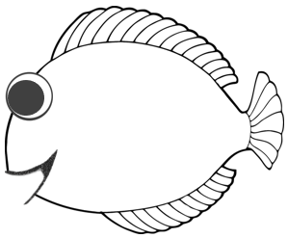
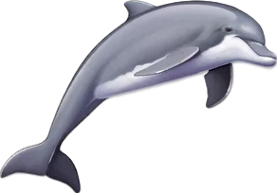
PHARMACOKINETIC INTERACTIONS 3 of 3
INDUCERS | INHIBITORS | SUBSTRATES
3A4 inducers Carbamazepine Modafinil Phenobarbital Phenytoin Rifampin St John’s Wort | 3A4 inhibitors Protease Inhibitors (HIV) Clarithromycin Diltiazem Fluvoxamine Grapefruit juice Ketoconazole Itraconazole Nefazodone Verapamil | 3A4 substrates
UGT inducers Carbamazepine Estrogens Phenobarbital Phenytoin Rifampin | UGT inhibitors Valproate | UGT substrates Lamotrigine Lumateperone
LUVOX
PLENTY
OF
FISH
Notes:
hepatic

Slide 46
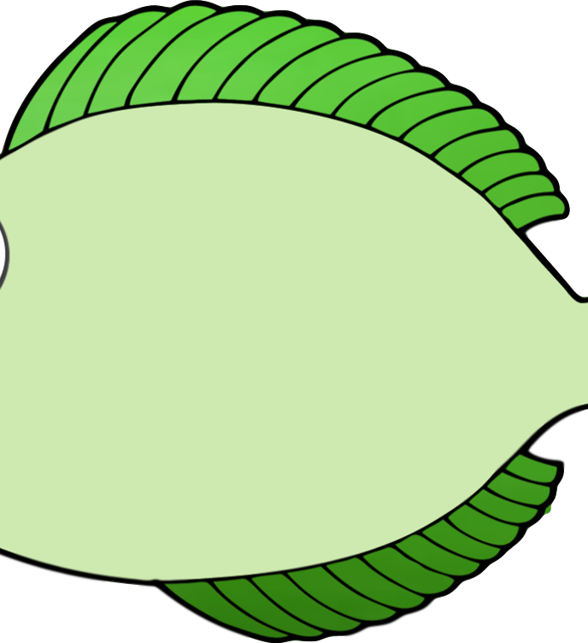
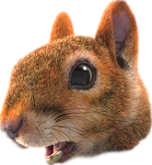
PHARMACOKINETIC INTERACTIONS 3 of 3
INDUCERS | INHIBITORS | SUBSTRATES
3A4 inducers Carbamazepine Modafinil Phenobarbital Phenytoin Rifampin St John’s Wort | 3A4 inhibitors Protease Inhibitors (HIV) Clarithromycin Diltiazem Fluvoxamine Grapefruit juice Ketoconazole Itraconazole Nefazodone Verapamil | 3A4 substrates
UGT inducers Carbamazepine Estrogens Phenobarbital Phenytoin Rifampin | UGT inhibitors Valproate | UGT substrates Lamotrigine Lumateperone
LUVOX
PLENTY
OF
FISH
Notes:
CYP activity

Slide 47
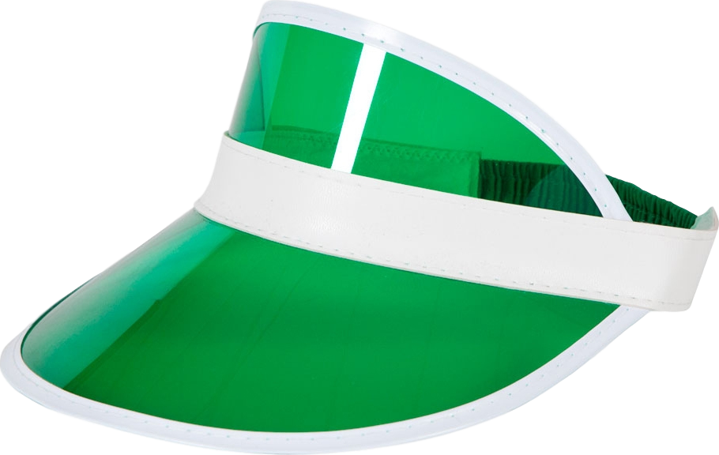
PHARMACOKINETIC INTERACTIONS 3 of 3
INDUCERS | INHIBITORS | SUBSTRATES
3A4 inducers Carbamazepine Modafinil Phenobarbital Phenytoin Rifampin St John’s Wort | 3A4 inhibitors Protease Inhibitors (HIV) Clarithromycin Diltiazem Fluvoxamine Grapefruit juice Ketoconazole Itraconazole Nefazodone Verapamil | 3A4 substrates
UGT inducers Carbamazepine Estrogens Phenobarbital Phenytoin Rifampin | UGT inhibitors Valproate | UGT substrates Lamotrigine Lumateperone
LUVOX
PLENTY
OF
FISH
Notes:
and 70%

Slide 48
PHARMACOKINETIC INTERACTIONS 3 of 3
INDUCERS | INHIBITORS | SUBSTRATES
3A4 inducers Carbamazepine Modafinil Phenobarbital Phenytoin Rifampin St John’s Wort | 3A4 inhibitors Protease Inhibitors (HIV) Clarithromycin Diltiazem Fluvoxamine Grapefruit juice Ketoconazole Itraconazole Nefazodone Verapamil | 3A4 substrates
UGT inducers Carbamazepine Estrogens Phenobarbital Phenytoin Rifampin | UGT inhibitors Valproate | UGT substrates Lamotrigine Lumateperone
LUVOX
PLENTY
OF
FISH
Notes:
of CYP activity in the gut.

Slide 49
PHARMACOKINETIC INTERACTIONS 3 of 3
INDUCERS | INHIBITORS | SUBSTRATES
3A4 inducers Carbamazepine Modafinil Phenobarbital Phenytoin Rifampin St John’s Wort | 3A4 inhibitors Protease Inhibitors (HIV) Clarithromycin Diltiazem Fluvoxamine Grapefruit juice Ketoconazole Itraconazole Nefazodone Verapamil | 3A4 substrates Immuno- suppressants Progestins Alprazolam Aripiprazole Brexpiprazole Buprenorphine Buspirone Carbamazepine Cariprazine Chlordiazepoxide Clonazepam Fentanyl Flibanserin
UGT inducers Carbamazepine Estrogens Phenobarbital Phenytoin Rifampin | UGT inhibitors Valproate | UGT substrates Lamotrigine Lumateperone
Lemborexant
Lumateperone
Lurasidone
Pimavanserin
Pimozide
Quetiapine
Sildenafil
Simvastatin
Suvorexant
Tadalafil
Valbenazine
Vilazodone
Notes:
Time to shave some sheep

Slide 50
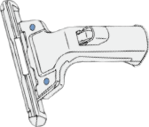
PHARMACOKINETIC INTERACTIONS 3 of 3
INDUCERS | INHIBITORS | SUBSTRATES
3A4 inducers Carbamazepine Modafinil Phenobarbital Phenytoin Rifampin St John’s Wort | 3A4 inhibitors Protease Inhibitors (HIV) Clarithromycin Diltiazem Fluvoxamine Grapefruit juice Ketoconazole Itraconazole Nefazodone Verapamil | 3A4 substrates Immuno- suppressants Progestins Alprazolam Aripiprazole Brexpiprazole Buprenorphine Buspirone Carbamazepine Cariprazine Chlordiazepoxide Clonazepam Fentanyl Flibanserin
UGT inducers Carbamazepine Estrogens Phenobarbital Phenytoin Rifampin | UGT inhibitors Valproate | UGT substrates Lamotrigine Lumateperone
Lemborexant
Lumateperone
Lurasidone
Pimavanserin
Pimozide
Quetiapine
Sildenafil
Simvastatin
Suvorexant
Tadalafil
Valbenazine
Vilazodone
Notes:
Tegretol is a razor

Slide 51
PHARMACOKINETIC INTERACTIONS 3 of 3
INDUCERS | INHIBITORS | SUBSTRATES
3A4 inducers Carbamazepine Modafinil Phenobarbital Phenytoin Rifampin St John’s Wort | 3A4 inhibitors Protease Inhibitors (HIV) Clarithromycin Diltiazem Fluvoxamine Grapefruit juice Ketoconazole Itraconazole Nefazodone Verapamil | 3A4 substrates Immuno- suppressants Progestins Alprazolam Aripiprazole Brexpiprazole Buprenorphine Buspirone Carbamazepine Cariprazine Chlordiazepoxide Clonazepam Fentanyl Flibanserin
UGT inducers Carbamazepine Estrogens Phenobarbital Phenytoin Rifampin | UGT inhibitors Valproate | UGT substrates Lamotrigine (LAMICTAL) Lumateperone
Lemborexant
Lumateperone
Lurasidone
Pimavanserin
Pimozide
Quetiapine
Sildenafil
Simvastatin
Suvorexant
Tadalafil
Valbenazine
Vilazodone
Notes:
Lamictal is a lamb

Slide 52
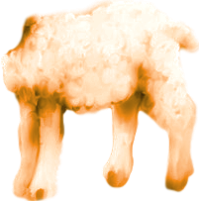
PHARMACOKINETIC INTERACTIONS 3 of 3
INDUCERS | INHIBITORS | SUBSTRATES
3A4 inducers Carbamazepine Modafinil Phenobarbital Phenytoin Rifampin St John’s Wort | 3A4 inhibitors Protease Inhibitors (HIV) Clarithromycin Diltiazem Fluvoxamine Grapefruit juice Ketoconazole Itraconazole Nefazodone Verapamil | 3A4 substrates Immuno- suppressants Progestins Alprazolam Aripiprazole Brexpiprazole Buprenorphine Buspirone Carbamazepine Cariprazine Chlordiazepoxide Clonazepam Fentanyl Flibanserin
UGT inducers Carbamazepine Estrogens Phenobarbital Phenytoin Rifampin | UGT inhibitors Valproate | UGT substrates Lamotrigine Lumateperone (CAPLYTA)
Lemborexant
Lumateperone
Lurasidone
Pimavanserin
Pimozide
Quetiapine
Sildenafil
Simvastatin
Suvorexant
Tadalafil
Valbenazine
Vilazodone
Notes:
And so is the antipsychotic lumateperone, trade name CAPLYTA, which will be on our Top 10

Slide 53
PHARMACOKINETIC INTERACTIONS 3 of 3
INDUCERS | INHIBITORS | SUBSTRATES
3A4 inducers Carbamazepine Modafinil Phenobarbital Phenytoin Rifampin St John’s Wort |  | 3A4 substrates Immuno- suppressants Progestins Alprazolam Aripiprazole Brexpiprazole Buprenorphine Buspirone Carbamazepine Cariprazine Chlordiazepoxide Clonazepam Fentanyl Flibanserin
UGT inducers Carbamazepine Estrogens Phenobarbital Phenytoin Rifampin |  | UGT substrates Lamotrigine Lumateperone (CAPLYTA)
Lemborexant
Lumateperone
Lurasidone
Pimavanserin
Pimozide
Quetiapine
Sildenafil
Simvastatin
Suvorexant
Tadalafil
Valbenazine
Vilazodone
Notes:
Caplyta - “Luminated Cap Lighter” - is a highly susceptible substrate when combined with Tegretol, which inDuces both enzymes responsible for metabolising it, taking serum levels of lumateperone down, down, down.

