Slide 1
Medication for Bipolar Depression
Jason Cafer MD
Notes:
Next

Slide 2
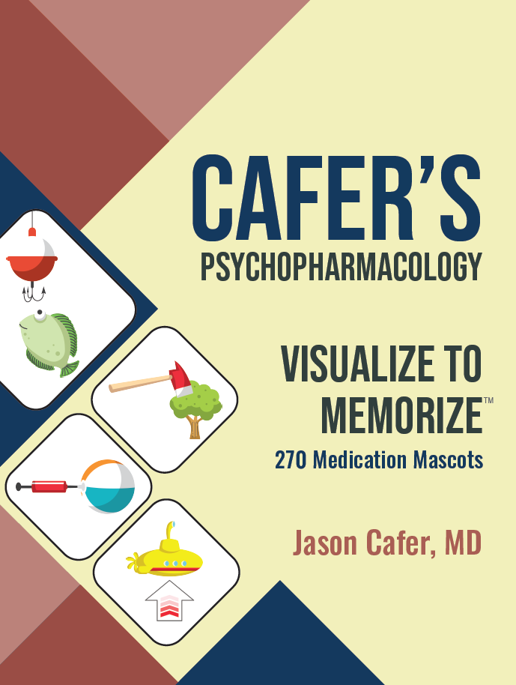
Jason Cafer MD
Conflict of interest statement
No relevant financial or other interests in any pharmaceutical or other products pertaining to this educational activity with the exception of:
Owner of CaferMed Publishing
Notes:
And also a link for a single-click download of my psychopharmacology mnemonics book that also serves as a prescriber guide for most anything that crosses the blood-brain barrier.

Slide 3
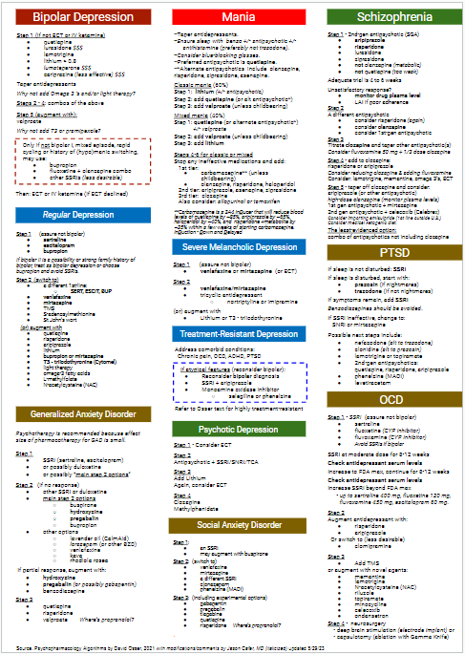
Algorithms
Psychopharmacology Algorithms
(Harvard, David N. Osser, 2021)
Notes:
And concerning evidence base, this was the main source I used in formulating my recommendations. I’ll refer to them as the Harvard algorithms. They’re helpful but complicated, even for psychiatrists.

Slide 4
Mood disorders
Some patients treated for Major Depression Disorder actually have Bipolar Disorder.
Terao, T. (2021). Neglected but not negligible aspects of antidepressants and their availability in bipolar depression. Brain and Behavior, 11, e2308. https://doi.org/10.1002/brb3.2308
Notes:
How bipolar is my patient’s affective disorder?

Slide 5
Antidepressants for Bipolar Disorder
Antidepressants are ineffective in bipolar disorder, slightly inferior to placebo in large STEP-BD trial.
They cause rapid cyclers to be depressed more often.
There are 6 medications effective for bipolar depression.
https://www.psychiatrictimes.com/view/case-against-antidepressants-bipolar-depression-findings-step-bd
Notes:
#1 - antidepressants in bipolar don’t work. In STEP-BD they were slightly inferior to placebo. #2 - They cause rapid cyclers to be depressed more often. #3 - there are 6 FDA approved medications that are effective in bipolar depression.

Slide 6
Antidepressants for Bipolar Disorder
Mania is likely to be antidepressant-induced and not attributable to the expected course of illness in one-third of treatment-refractory bipolar patients.
Altshuler LL, Post RM, Leverich GS, Mikalauskas K, Rosoff A, Ackerman L. Antidepressant-induced mania and cycle acceleration: a controversy revisited. Am J Psychiatry. 1995 Aug;152(8):1130-8. doi: 10.1176/ajp.152.8.1130. PMID: 7625459.
Notes:
For those with antidepressant-induced manic symptoms, continuation of the antidepressant is also certainly a bad idea, and most psychiatrists recognize this.

Slide 7
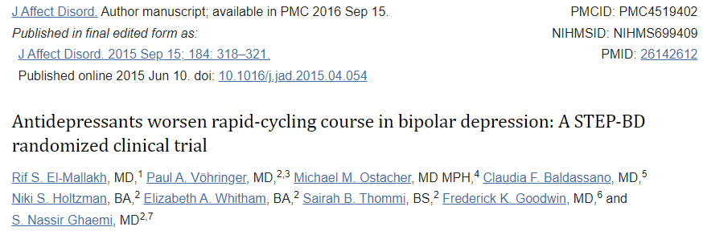
Antidepressants for Bipolar Disorder
Despite preselection for good antidepressant response and concurrent mood stabilizer treatment, antidepressant continuation in rapid-cycling was associated with worsened maintenance outcomes, especially for depressive morbidity, versus antidepressant discontinuation.
Notes:
To reiterate, the problem with antidepressants in bipolar is not necessary manic switch. For rapid cyclers, there are more depressive cycles.

Slide 8
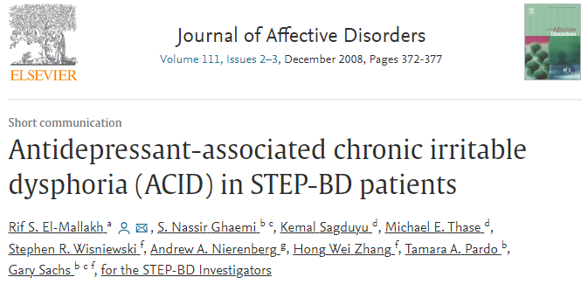
Antidepressants for Bipolar Disorder
Some bipolar patients on chronic antidepressant treatment experience a triad of:
dysphoria
irritability
middle insomnia
This study does not support the existence of ACID as an independent phenomenon.
Rather, ACID appears to be part of a broader spectrum of antidepressant treatment-emergent affective switches.
El-Mallakh RH, Ghaemi SN, Sagduyu K, et al. Antidepressant-associated chronic irritable dysphoria (ACID) in STEP-BD patients. J Affect Disord. 2008;111;372-377.
Notes:
ACID Syndrome does not seem to exist as an independent phenomenon. But for those with a history of manic switching, patients on antidepressants may develop a triad of
Chronic dysphoria, irritability and middle insomnia.

Slide 9
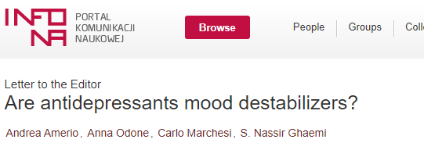
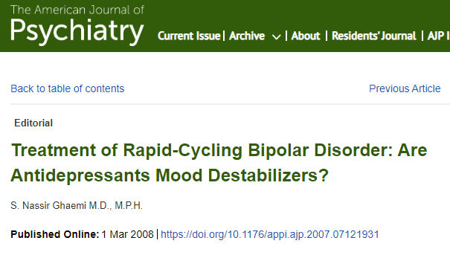
Antidepressants for Bipolar Disorder
Notes:
Antidepressants have an undeserved good reputation. “Mood elevators” may be a better term.

Slide 10
Antidepressants for Bipolar Disorder
In STEP-BD the most important risk factor for recurrence of depression was residual subthreshold mood elevation.
Subthreshold mood elevation = why a depressed bipolar patient may resist stopping an antidepressant that isn’t working.
It did make them feel better but now they are feeling worse because of it.
Notes:
STEP-BD [read slide]...Mood elevation sounds good, but it results in more depression in bipolar. If not for that, subthreshold mood elevation might be the ideal mental state. This is why a depressed bipolar patient may resist stopping an antidepressant that isn’t working. It did make them feel better but now they are feeling worse because of it.

Slide 11
Antidepressants for Bipolar Disorder
Recommendation:
For bipolar patients who are depressed, antidepressants should be tapered off.
For bipolar patients on an antidepressant with long-term stability, may continue it because it is not a mood destabilizer for that individual.
Notes:
My recommendation, consistent with tx guidelines…[read] because every brain is different and the antidepressant is not a mood destabilizer for that individual.

Slide 12
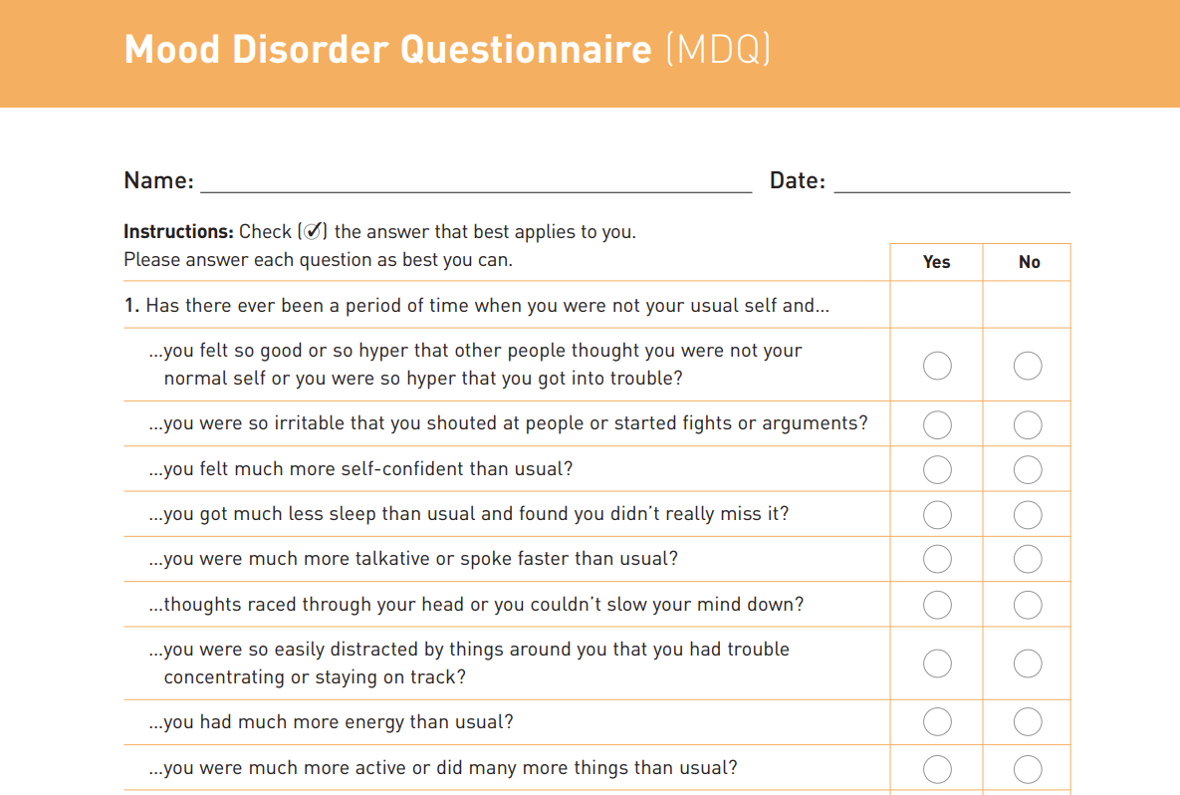
“Invincible”
“Super powers”

Slide 13
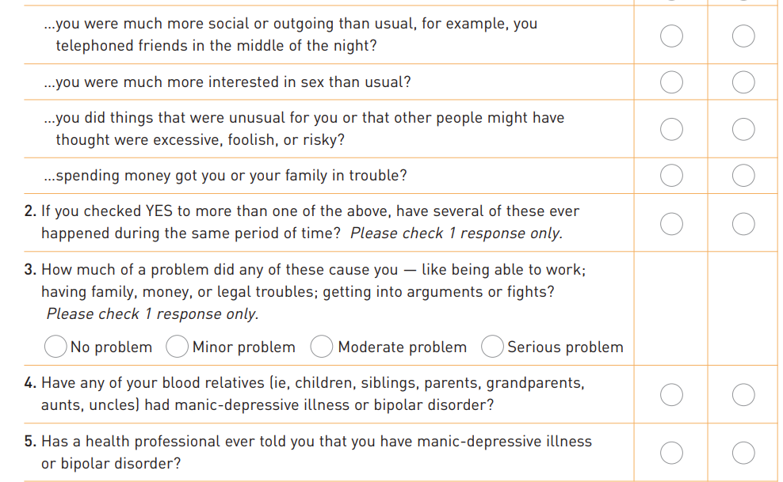

Slide 14
Mood disorders
If I don’t have an MDQ handy...
Have you, or anyone in your family, been suspected of having bipolar disorder?
Have you ever been in an elevated mood state--I can explain what that is?
Has there ever been a time, lasting at least a few days where you were
not your usual self,
in an intense way, maybe “high on life” or extremely irritable,
maybe having lots of big thoughts
maybe talking more than usual,
not needing to sleep as much,
or possibly feeling invincible?
Then clarify:
did you do anything risky or outrageous?
do you know what caused the elevated mood state?
Terao, T. (2021). Neglected but not negligible aspects of antidepressants and their availability in bipolar depression. Brain and Behavior, 11, e2308. https://doi.org/10.1002/brb3.2308
Notes:
How bipolar is my patient’s affective disorder?

Slide 15
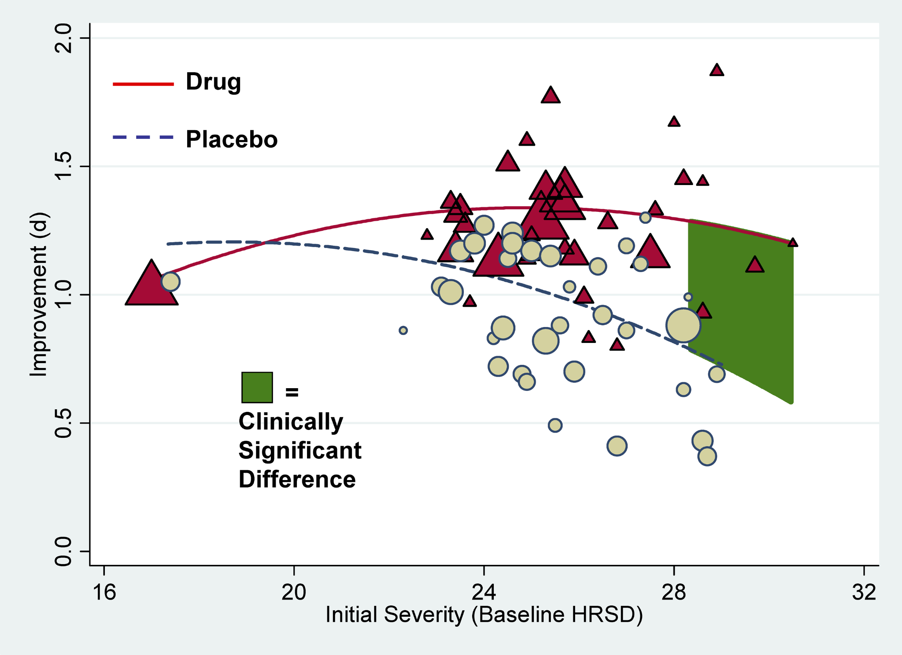
Antidepressants for Major Depression
Meta-analyses of antidepressant medications have reported only modest benefits over placebo treatment.
When unpublished trial data are included, the benefit falls below accepted criteria for clinical significance when initial severity of depression is below 28 on Hamilton Rating Scale of Depression (HRSD).
The response to placebo in these trials was exceptionally large, duplicating more than 80% of the improvement observed in the drug groups.
Kirsch I, Deacon BJ, Huedo-Medina TB, Scoboria A, Moore TJ, et al. (2008) Initial Severity and Antidepressant Benefits: A Meta-Analysis of Data Submitted to the Food and Drug Administration. PLOS Medicine 5(2): e45. https://doi.org/10.1371/journal.pmed.0050045
Notes:
This is MDD, not Bipolar.

Slide 16
Mood disorders
My perspective:
Antidepressants are ineffective and potentially harmful in bipolar disorder.
Manic switch is not the only problem - antidepressants increase frequency of depressive episodes in some individuals with bipolar disorder.
4.4% of population is bipolar (a lot of people)
Some patients diagnosed with MDD are actually bipolar.
When in doubt, where is the harm in treating presumptive MDD as latent bipolar disorder or unspecified mood disorder?
I would not prescribe an antidepressant to a young person with
a 1st degree relative with bipolar disorder and
depressive episode characteristic of a bipolar disorder (excessive sleeping)
Notes:
Lithium would have stronger placebo response than omega 3’s.

Slide 17
Depression
Unipolar
Bipolar
Psychotic
severe
melancholic
treatment-
resistant
with comorbidity
without comorbidity
Melancholia -
both prominent loss of pleasure and reactivity to usually pleasurable stimuli and additional somatic manifestations, including psychomotor agitation or retardation, weight loss, diurnal variation (worse in morning), and excessive guilt.
Notes:
I’m not going to present the algorithms today, but will do a drive-by of the algorithms as a “Psychiatrist Version” for anyone who wants to download the presentation…. OK-- antiDEPRESSANTS are NOT helpful in bipolar depression so you need more than antiDEPRESSANTS in your toolbox.

Slide 18
Bipolar Depression
Only if not bipolar I, mixed episode, rapid cycling or history of (hypo)manic switching, may use:
bupropion
fluoxetine + olanzapine combo
other SSRIs (less desirable)
Step 1 (if not ECT or IV ketamine)
lamotrigine
lithium > 0.8
quetiapine
lurasidone $$$
lumateperone $$$
cariprazine (less effective) $$$
Taper antidepressants
Why not add Omega 3 ‘s and/or light therapy?
Steps 2 - 4: combos of the above
Step 5 (augment with):
valproate
Why not add T3 or pramipexole?
Then: ECT or IV ketamine (if ECT declined)

Slide 19
Evidence-based 1st-line treatments for bipolar depression
 |  | Pro | Con | Dose
Quetiapine (SEROQUEL) | 2nd-gen antipsychotic | Evidence for preventing mania and depression. | Sedation, weight gain, DM | 50 mg PO HS x 1 100 mg HS x 1 200 mg HS x 1 then 300 mg HS = target = max
Lurasidone (LATUDA) | 2nd-gen antipsychotic | Weight neutral, larger effect size (NNT = 5) | Sedation, risk of tardive dyskinesia, still $$$$ | Start 20 mg, Max ~80 mg (FDA max 120 mg) with food
Lumateperone (CAPLYTA) | 2nd-gen antipsychotic | Minimal reported side effects other than sedation | New, expensive | 42 mg is the only dose
Cariprazine (VRAYLAR) | 2nd-gen antipsychotic | Less sedating that other 2nd-gen antipsychotics | Akathisia, smaller effect size (NNT = 7) | 1.5 mg x 14 days, then 3 mg if needed
Lamotrigine (LAMICTAL) | Mood stabilizer | Minimal if any side effects | 5-week titration needed due to risk of Stevens-Johnson. Does not prevent mania. | 25 mg x 2 wk 50 mg x 2 wk 100 mg x 1 wk then may increase to 200 mg
Lithium >0.8 | Mood stabilizer | Anti-suicide and neuroprotective effects | Potentially for serious toxicity. | Start 300-450 mg BID and target 0.8 if monotherapy, possibly 0.6 as adjunct.

Slide 20
Evidence-based 1st-line treatments for bipolar depression
 |  | Pro | Con | Dose
Quetiapine (SEROQUEL) | 2nd-gen antipsychotic | Evidence for preventing mania and depression. | Sedation, weight gain, DM | 50 mg PO HS x 1 100 mg HS x 1 200 mg HS x 1 then 300 mg HS = target = max
Lurasidone (LATUDA) | 2nd-gen antipsychotic | Weight neutral, larger effect size (NNT = 5) | Sedation, risk of tardive dyskinesia, still $$$$ | Start 20 mg, Max ~80 mg (FDA max 120 mg) with food
Lumateperone (CAPLYTA) | 2nd-gen antipsychotic | Minimal reported side effects other than sedation | New, expensive | 42 mg is the only dose
Cariprazine (VRAYLAR) | 2nd-gen antipsychotic | Less sedating that other 2nd-gen antipsychotics | Akathisia, smaller effect size (NNT = 7) | 1.5 mg x 14 days, then 3 mg if needed
Lamotrigine (LAMICTAL) | Mood stabilizer | Minimal if any side effects | 5-week titration needed due to risk of Stevens-Johnson. Does not prevent mania. | 25 mg x 2 wk 50 mg x 2 wk 100 mg x 1 wk then may increase to 200 mg
Lithium >0.8 | Mood stabilizer | Anti-suicide and neuroprotective effects | Potentially for serious toxicity. | Start 300-450 mg BID and target 0.8 if monotherapy, possibly 0.6 as adjunct.

Slide 21
Evidence-based 1st-line treatments for bipolar depression
 |  | Pro | Con | Dose
Quetiapine (SEROQUEL) | 2nd-gen antipsychotic | Evidence for preventing mania and depression. | Sedation, weight gain, DM | 50 mg PO HS x 1 100 mg HS x 1 200 mg HS x 1 then 300 mg HS = target = max
Lurasidone (LATUDA) | 2nd-gen antipsychotic | Weight neutral, larger effect size (NNT = 5) | Sedation, risk of tardive dyskinesia, still $$$$ | Start 20 mg, Max ~80 mg (FDA max 120 mg) with food
Lumateperone (CAPLYTA) | 2nd-gen antipsychotic | Minimal reported side effects other than sedation | New, expensive | 42 mg is the only dose
Cariprazine (VRAYLAR) | 2nd-gen antipsychotic | Less sedating that other 2nd-gen antipsychotics | Akathisia, smaller effect size (NNT = 7) | 1.5 mg x 14 days, then 3 mg if needed
Lamotrigine (LAMICTAL) | Mood stabilizer | Minimal if any side effects | 5-week titration needed due to risk of Stevens-Johnson. Does not prevent mania. | 25 mg x 2 wk 50 mg x 2 wk 100 mg x 1 wk then may increase to 200 mg
Lithium >0.8 | Mood stabilizer | Anti-suicide and neuroprotective effects | Potentially for serious toxicity. | Start 300-450 mg BID and target 0.8 if monotherapy, possibly 0.6 as adjunct.

Slide 22
Evidence-based 1st-line treatments for bipolar depression
 |  | Pro | Con | Dose
Quetiapine (SEROQUEL) | 2nd-gen antipsychotic | Evidence for preventing mania and depression. | Sedation, weight gain, DM | 50 mg PO HS x 1 100 mg HS x 1 200 mg HS x 1 then 300 mg HS = target = max
Lurasidone (LATUDA) | 2nd-gen antipsychotic | Weight neutral, larger effect size (NNT = 5) | Sedation, risk of tardive dyskinesia, still $$$$ | Start 20 mg, Max ~80 mg (FDA max 120 mg) with food
Lumateperone (CAPLYTA) | 2nd-gen antipsychotic | Minimal reported side effects other than sedation | New, expensive | 42 mg is the only dose
Cariprazine (VRAYLAR) | 2nd-gen antipsychotic | Less sedating that other 2nd-gen antipsychotics | Akathisia, smaller effect size (NNT = 7) | 1.5 mg x 14 days, then 3 mg if needed
Lamotrigine (LAMICTAL) | Mood stabilizer | Minimal if any side effects | 5-week titration needed due to risk of Stevens-Johnson. Does not prevent mania. | 25 mg x 2 wk 50 mg x 2 wk 100 mg x 1 wk then may increase to 200 mg
Lithium >0.8 | Mood stabilizer | Anti-suicide and neuroprotective effects | Potentially for serious toxicity. | Start 300-450 mg BID and target 0.8 if monotherapy, possibly 0.6 as adjunct.

Slide 23
Evidence-based 1st-line treatments for bipolar depression
 |  | Pro | Con | Dose
Quetiapine (SEROQUEL) | 2nd-gen antipsychotic | Evidence for preventing mania and depression. | Sedation, weight gain, DM | 50 mg PO HS x 1 100 mg HS x 1 200 mg HS x 1 then 300 mg HS = target = max
Lurasidone (LATUDA) | 2nd-gen antipsychotic | Weight neutral, larger effect size (NNT = 5) | Sedation, risk of tardive dyskinesia, still $$$$ | Start 20 mg, Max ~80 mg (FDA max 120 mg) with food
Lumateperone (CAPLYTA) | 2nd-gen antipsychotic | Minimal reported side effects other than sedation | New, expensive | 42 mg is the only dose
Cariprazine (VRAYLAR) | 2nd-gen antipsychotic | Less sedating that other 2nd-gen antipsychotics | Akathisia, smaller effect size (NNT = 7) | 1.5 mg x 14 days, then 3 mg if needed
Lamotrigine (LAMICTAL) | Mood stabilizer | Minimal if any side effects | 5-week titration needed due to risk of Stevens-Johnson. Does not prevent mania. | 25 mg x 2 wk 50 mg x 2 wk 100 mg x 1 wk then may increase to 200 mg
Lithium >0.8 | Mood stabilizer | Anti-suicide and neuroprotective effects | Potentially for serious toxicity. | Start 300-450 mg BID and target 0.8 if monotherapy, possibly 0.6 as adjunct.

Slide 24
Evidence-based 1st-line treatments for bipolar depression
 |  | Pro | Con | Dose
Quetiapine (SEROQUEL) | 2nd-gen antipsychotic | Evidence for preventing mania and depression. | Sedation, weight gain, DM | 50 mg PO HS x 1 100 mg HS x 1 200 mg HS x 1 then 300 mg HS = target = max
Lurasidone (LATUDA) | 2nd-gen antipsychotic | Weight neutral, larger effect size (NNT = 5) | Sedation, risk of tardive dyskinesia, still $$$$ | Start 20 mg, Max ~80 mg (FDA max 120 mg) with food
Lumateperone (CAPLYTA) | 2nd-gen antipsychotic | Minimal reported side effects other than sedation | New, expensive | 42 mg is the only dose
Cariprazine (VRAYLAR) | 2nd-gen antipsychotic | Less sedating that other 2nd-gen antipsychotics | Akathisia, smaller effect size (NNT = 7) | 1.5 mg x 14 days, then 3 mg if needed
Lamotrigine (LAMICTAL) | Mood stabilizer | Minimal if any side effects | 5-week titration needed due to risk of Stevens-Johnson. Does not prevent mania. | 25 mg x 2 wk 50 mg x 2 wk 100 mg x 1 wk then may increase to 200 mg
Lithium >0.8 | Mood stabilizer | Anti-suicide and neuroprotective effects | Potentially for serious toxicity. | Start 300-450 mg BID and target 0.8 if monotherapy, possibly 0.6 as adjunct.

Slide 25
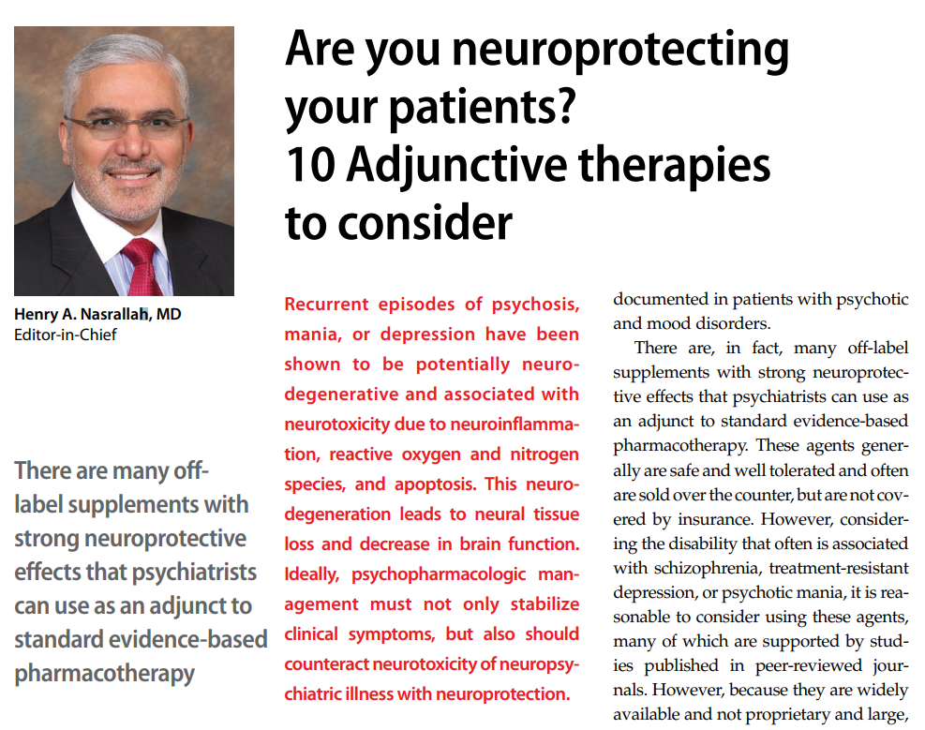
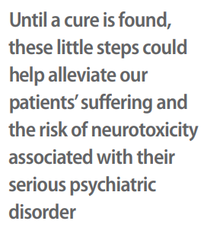
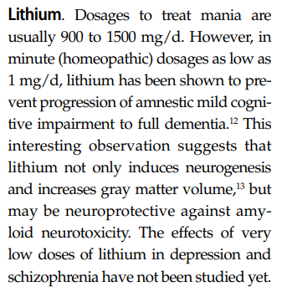
Current Psychiatry
December 2016
Forlenza OV, Diniz BS, Radanovic M, et al. Disease modifying properties of long-term lithium treatment for amnestic mild cognitive impairment: randomised controlled trial. Br J Psychiatry. 2011;198(5):351-356.

Slide 26
Current Psychiatry
December 2016
Forlenza OV, Diniz BS, Radanovic M, et al. Disease modifying properties of long-term lithium treatment for amnestic mild cognitive impairment: randomised controlled trial. Br J Psychiatry. 2011;198(5):351-356.

Slide 27
Current Psychiatry
December 2016
Forlenza OV, Diniz BS, Radanovic M, et al. Disease modifying properties of long-term lithium treatment for amnestic mild cognitive impairment: randomised controlled trial. Br J Psychiatry. 2011;198(5):351-356.

Slide 28
Current Psychiatry
December 2016
Forlenza OV, Diniz BS, Radanovic M, et al. Disease modifying properties of long-term lithium treatment for amnestic mild cognitive impairment: randomised controlled trial. Br J Psychiatry. 2011;198(5):351-356.

Slide 29
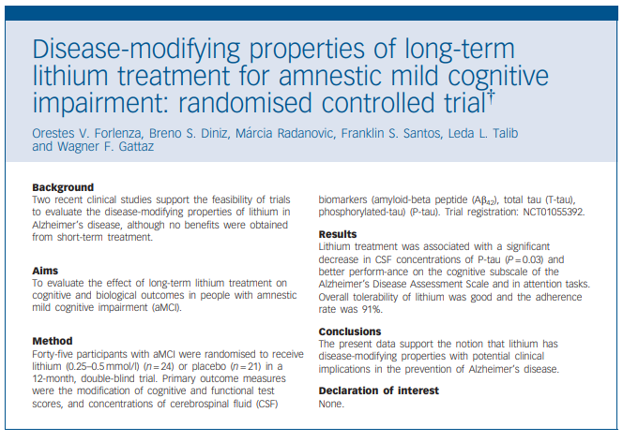
Lithium level 0.25 - 0.5
1 year
Improved cognition
Decrease in tau proteins
Forlenza OV, Diniz BS, Radanovic M, et al. Disease modifying properties of long-term lithium treatment for amnestic mild cognitive impairment: randomised controlled trial. Br J Psychiatry. 2011;198(5):351-356.
Notes:
Don’t worry, I’ll tell you about the other 9 neuroprotections…
Think about disease modifying… donepezil, and memantine don’t do this. neurofibrillary tangles composed of tau protein. 2 new antibody treatments that are disease modifying. Prevagen.

Slide 30
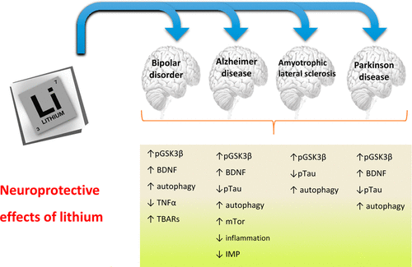
Lithium - neuroprotection
Neuroprotective Effects of Lithium: Implications for the Treatment of Alzheimer’s Disease and Related Neurodegenerative Disorders O. V. Forlenza et al. ACS Chemical Neuroscience 2014.
Notes:
Other neurodegenerative diseases. +-Overlapping mechanisms with other neuroprotectants.

Slide 31
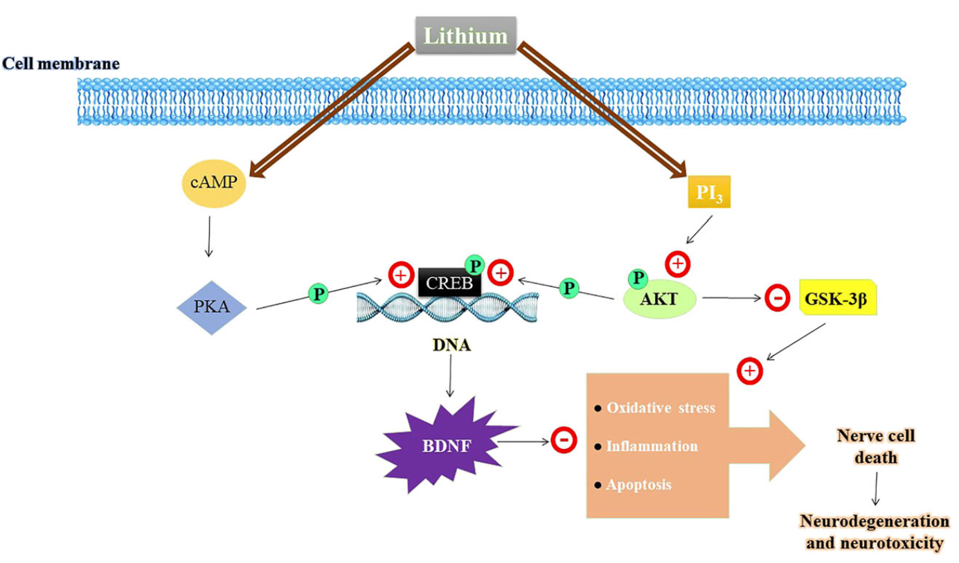
Lithium - neuroprotection
Brain-Derived Neurotrophic Factor
Jin Yan, Yuan Zhang, Lin Wang, Zhao Li, Shuang Tang, Yingwen Wang, Nina Gu, Xiaochuan Sun, Lin Li, TREM2 activation alleviates neural damage via Akt/CREB/BDNF signalling after traumatic brain injury in mice, Journal of Neuroinflammation, 10.1186/s12974-022-02651-3, 19, 1, (2022).
Notes:
Brain-Derived Neurotrophic Factor is involved

Slide 32
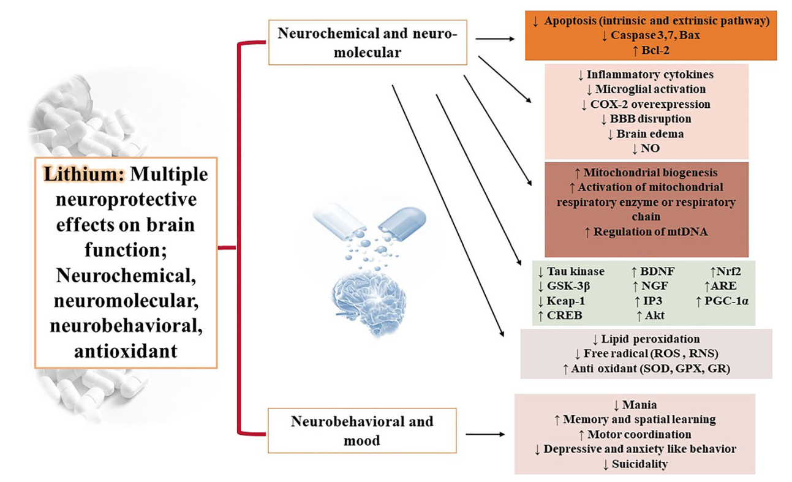
Lithium - neuroprotection
Jin Yan, Yuan Zhang, Lin Wang, Zhao Li, Shuang Tang, Yingwen Wang, Nina Gu, Xiaochuan Sun, Lin Li, TREM2 activation alleviates neural damage via Akt/CREB/BDNF signalling after traumatic brain injury in mice, Journal of Neuroinflammation, 10.1186/s12974-022-02651-3, 19, 1, (2022).
Notes:
Mitochondrial biogenesis is involved

Slide 33
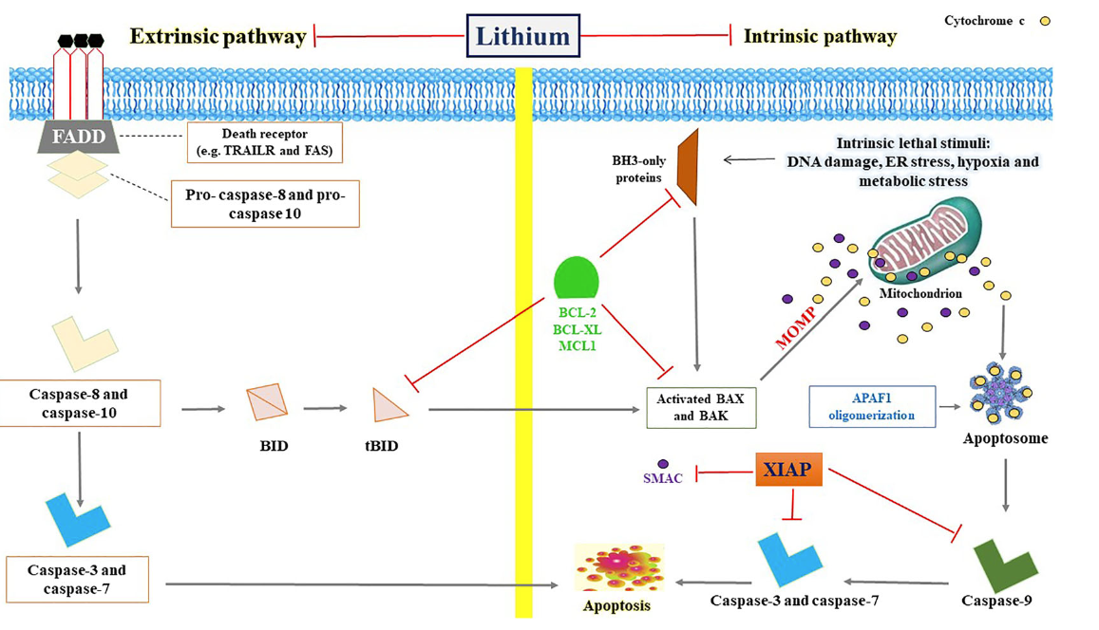
Lithium - neuroprotection
Neuroprotective Effects of Lithium: Implications for the Treatment of Alzheimer’s Disease and Related Neurodegenerative Disorders O. V. Forlenza et al. ACS Chemical Neuroscience 2014.
Notes:
Again, mitochondria, the powerhouse of the cell

Slide 34
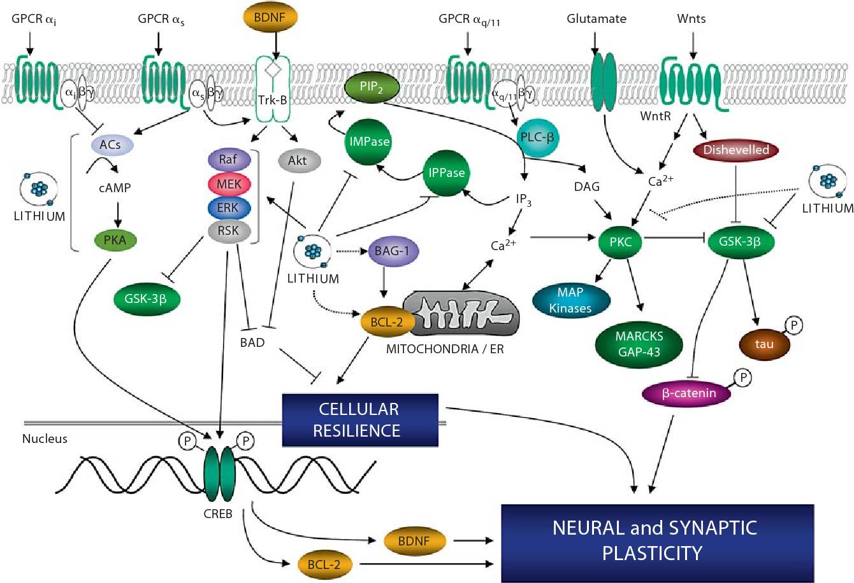
Lithium - neuroprotection
Quiroz, J.A., Machado-Vieira, R., Zarate Jr., C.A., & Manji, H.K. (2010). Novel Insights into Lithium’s Mechanism of Action: Neurotrophic and Neuroprotective Effects. Neuropsychobiology, 62, 50 - 60.
Notes:
Throughout the evolution of life, lithium has been present. It’s not surprising that it does things that no other psychotropic can.

Slide 35
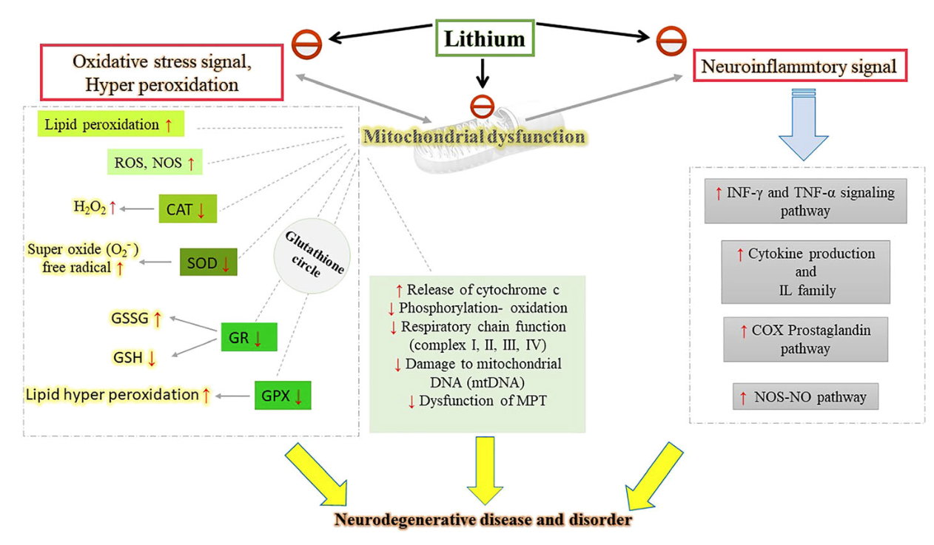
Lithium - neuroprotection
Souder, D.C., Anderson, R.M. An expanding GSK3 network: implications for aging research. GeroScience 41, 369–382 (2019). https://doi.org/10.1007/s11357-019-00085-z
Notes:
Several mechanisms to change the course of neurodegenerative diseases.

Slide 36
Lithium
The other 9:
Current Psychiatry
December 2016
Forlenza OV, Diniz BS, Radanovic M, et al. Disease modifying properties of long-term lithium treatment for amnestic mild cognitive impairment: randomised controlled trial. Br J Psychiatry. 2011;198(5):351-356.

Slide 37
Lithium
The other 9:
Nicotine
Current Psychiatry
December 2016
Forlenza OV, Diniz BS, Radanovic M, et al. Disease modifying properties of long-term lithium treatment for amnestic mild cognitive impairment: randomised controlled trial. Br J Psychiatry. 2011;198(5):351-356.

Slide 38
Lithium
The other 9:
Nicotine
Caffeine
Current Psychiatry
December 2016
Forlenza OV, Diniz BS, Radanovic M, et al. Disease modifying properties of long-term lithium treatment for amnestic mild cognitive impairment: randomised controlled trial. Br J Psychiatry. 2011;198(5):351-356.

Slide 39
Lithium
The other 9:
Nicotine
Caffeine
Melatonin
Current Psychiatry
December 2016
Forlenza OV, Diniz BS, Radanovic M, et al. Disease modifying properties of long-term lithium treatment for amnestic mild cognitive impairment: randomised controlled trial. Br J Psychiatry. 2011;198(5):351-356.

Slide 40
Lithium
The other 9:
Nicotine
Caffeine
Melatonin
Omega-3 fatty acids
Current Psychiatry
December 2016
Forlenza OV, Diniz BS, Radanovic M, et al. Disease modifying properties of long-term lithium treatment for amnestic mild cognitive impairment: randomised controlled trial. Br J Psychiatry. 2011;198(5):351-356.

Slide 41
Lithium
The other 9:
Nicotine
Caffeine
Melatonin
Omega-3 fatty acids
N-Acetylcysteine (NAC)
Current Psychiatry
December 2016
Forlenza OV, Diniz BS, Radanovic M, et al. Disease modifying properties of long-term lithium treatment for amnestic mild cognitive impairment: randomised controlled trial. Br J Psychiatry. 2011;198(5):351-356.

Slide 42
Lithium
The other 9:
Nicotine
Caffeine
Melatonin
Omega-3 fatty acids
N-Acetylcysteine (NAC)
Vitamin D
Current Psychiatry
December 2016
Forlenza OV, Diniz BS, Radanovic M, et al. Disease modifying properties of long-term lithium treatment for amnestic mild cognitive impairment: randomised controlled trial. Br J Psychiatry. 2011;198(5):351-356.

Slide 43
Lithium
The other 9:
Nicotine
Caffeine
Melatonin
Omega-3 fatty acids
N-Acetylcysteine (NAC)
Vitamin D
COX-2 inhibitors (celecoxib)
Current Psychiatry
December 2016
Forlenza OV, Diniz BS, Radanovic M, et al. Disease modifying properties of long-term lithium treatment for amnestic mild cognitive impairment: randomised controlled trial. Br J Psychiatry. 2011;198(5):351-356.

Slide 44
Lithium
The other 9:
Nicotine
Caffeine
Melatonin
Omega-3 fatty acids
N-Acetylcysteine (NAC)
Vitamin D
COX-2 inhibitors (celecoxib)
Minocycline
Current Psychiatry
December 2016
Forlenza OV, Diniz BS, Radanovic M, et al. Disease modifying properties of long-term lithium treatment for amnestic mild cognitive impairment: randomised controlled trial. Br J Psychiatry. 2011;198(5):351-356.

Slide 45
Lithium
The other 9:
Nicotine
Caffeine
Melatonin
Omega-3 fatty acids
N-Acetylcysteine (NAC)
Vitamin D
COX-2 inhibitors (celecoxib)
Minocycline
Erythropoietin
Current Psychiatry
December 2016
Forlenza OV, Diniz BS, Radanovic M, et al. Disease modifying properties of long-term lithium treatment for amnestic mild cognitive impairment: randomised controlled trial. Br J Psychiatry. 2011;198(5):351-356.

Slide 46
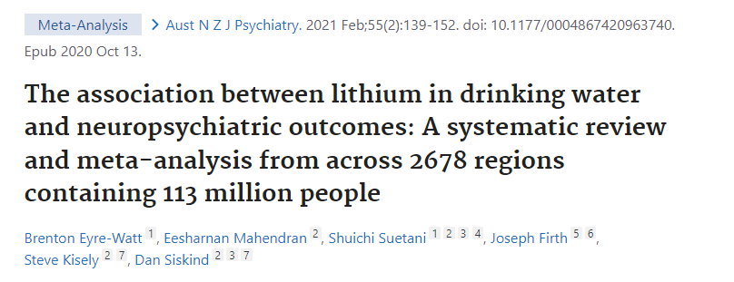
Lithium in drinking water
Higher lithium concentrations were associated with
reduced suicide rates
reduced hospital admissions.
Notes:
2021 meta-analysis - still appears to be true. Some studies showed fewer homicides.

Slide 47
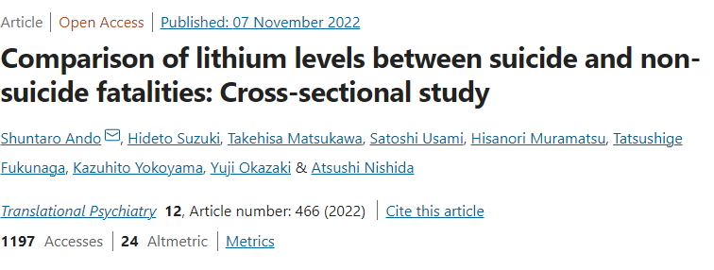
Lithium anti-suicide effects
Aqueous
humor
In Tokyo, Ando et al (2022) compared body lithium levels between suicide and non-suicide fatalities as measured in aqueous humor. This was a small study including 12 suicides and 16 non-suicides.
The aqueous humor lithium concentration was significantly lower in suicides (mean 0.50 μg/L) than in non-suicides (0.92 μg/L). The authors concluded that lower lithium concentration was associated with suicide with large effect size.

Slide 48
ddd
Lithium in drinking water
Higher long-term lithium levels in drinking water were associated with a lower incidence of dementia.
Notes:
Denmark has a robust system for measuring trace metals and other contaminants in their water supply.

Slide 49
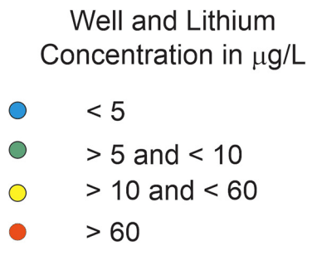
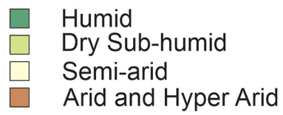
Bruce D. Lindsey, et al. Lithium in groundwater used for drinking-water supply in the United States,Science of The Total Environment,Volume 767, 2021.
Notes:
Amount of lithium in water around here is low. Many places have 10x more lithium in water, especially northern texas.

Slide 50
Lithium - anti-aging
Castillo-Quan et al., Lithium Promotes Longevity through GSK3/NRF2-Dependent Hormesis, Cell Reports (2016) http://dx.doi.org/10.1016
Notes:
Lithium may not only prevent aging of the brain, but aging throughout. It extended the lifespan and health span of yeast and fruit flies.

Slide 51
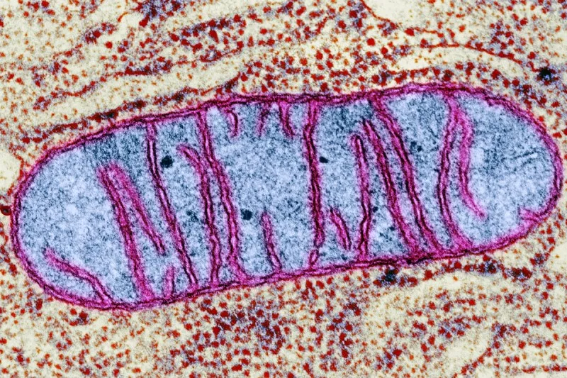
Lithium - anti-aging
Notes:
Not a simple answer but we’re learning more every year. The FDA considers aging to be a natural process, but some argue that aging is a disease because it leads to deterioration of every organ system and age-related diseases. It’s a disease everyone develops, but some people age faster than others.

Slide 52
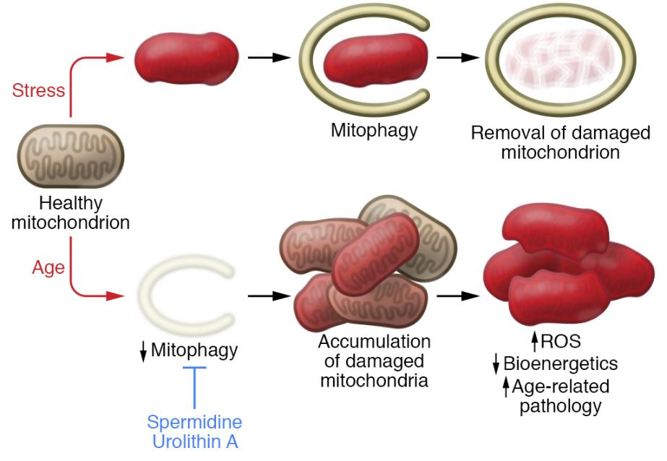
Lithium - anti-aging
Aging is in part due to mitochondrial dysfunction and decline in mitophagy.
Damaged mitochondria pile up in the aging cell.
REVIEW article
Front. Psychiatry, 29 September 2020
Sec. Mood Disorders
https://doi.org/10.3389/fpsyt.2020.586083
This article is part of the Research Topic
Neurobiological Underpinnings of Bipolar Disorder and its Treatment
View all 6 Articles
Lithium and the Interplay Between Telomeres and Mitochondria in Bipolar Disorder
Mitochondrial dysfunction and telomere shortening have been implicated in both the pathophysiology of bipolar disorder and as targets of lithium treatment. Interestingly, it has in recent years become clear that these phenomena are intimately linked, partly through reactive oxygen species signaling and the subcellular translocation and non-canonical actions of telomerase reverse transcriptase. In this review, we integrate the current understanding of mitochondrial dysfunction, oxidative stress and telomere shortening in bipolar disorder with documented effects of lithium. Moreover, we propose that lithium’s mechanism of action is intimately connected with the interdependent regulation of mitochondrial bioenergetics and telomere maintenance.
Notes:
Some things accelerate the aging process, like Type 2 diabetes, obesity, even lack of sleep. Some things slow the aging process, including calorie restriction, exercise and certain chemicals. We age because every one of our cells age. Cells age when damaged mitochondria accumulate.

Slide 53
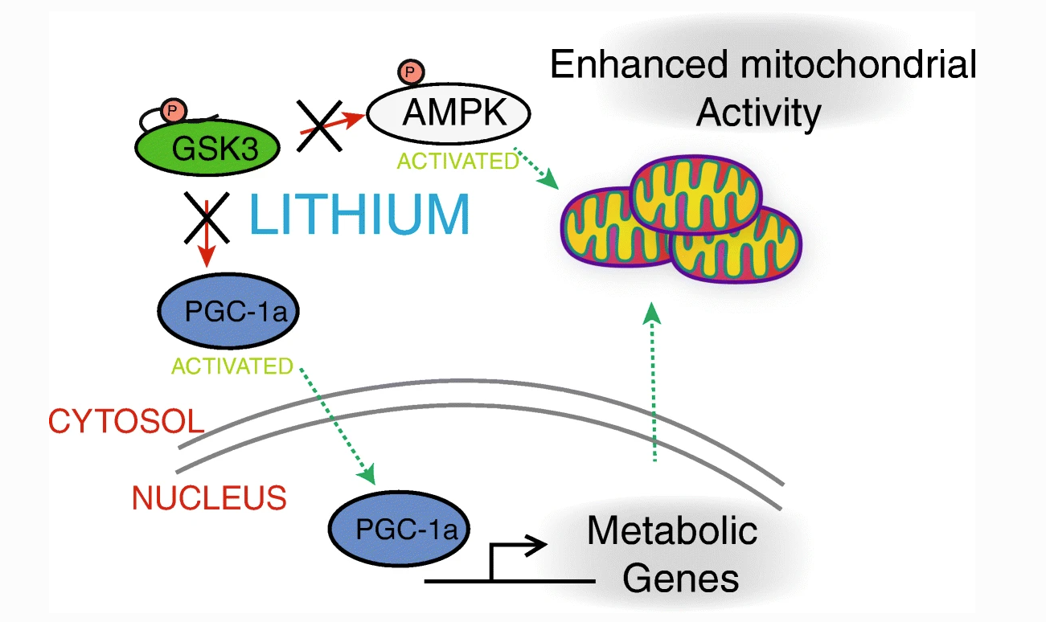
Lithium - anti-aging
Souder, D.C., Anderson, R.M. An expanding GSK3 network: implications for aging research. GeroScience 41, 369–382 (2019). https://doi.org/10.1007/s11357-019-00085-z
Notes:
Lithium improves mitochondrial dysfunction in cells throughout the body, not just in the brain.

Slide 54
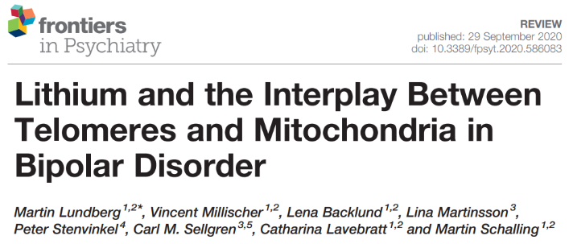
Lithium - anti-aging (bipolar)
“We propose that lithium’s mechanism of action is intimately connected with the interdependent regulation of mitochondrial bioenergetics and telomere maintenance”.
Lundberg M, Millischer V, Backlund L, Martinsson L, Stenvinkel P, Sellgren CM, Lavebratt C, Schalling M. Lithium and the Interplay Between Telomeres and Mitochondria in Bipolar Disorder. Front Psychiatry. 2020 Sep 29;11:586083.
REVIEW article
Front. Psychiatry, 29 September 2020
Sec. Mood Disorders
https://doi.org/10.3389/fpsyt.2020.586083
This article is part of the Research Topic
Neurobiological Underpinnings of Bipolar Disorder and its Treatment
View all 6 Articles
Lithium and the Interplay Between Telomeres and Mitochondria in Bipolar Disorder
Mitochondrial dysfunction and telomere shortening have been implicated in both the pathophysiology of bipolar disorder and as targets of lithium treatment. Interestingly, it has in recent years become clear that these phenomena are intimately linked, partly through reactive oxygen species signaling and the subcellular translocation and non-canonical actions of telomerase reverse transcriptase. In this review, we integrate the current understanding of mitochondrial dysfunction, oxidative stress and telomere shortening in bipolar disorder with documented effects of lithium. Moreover, we propose that lithium’s mechanism of action is intimately connected with the interdependent regulation of mitochondrial bioenergetics and telomere maintenance.
Notes:
Lithium protects mitochondria and telomeres of chromosomes in every cell in the body.

Slide 55
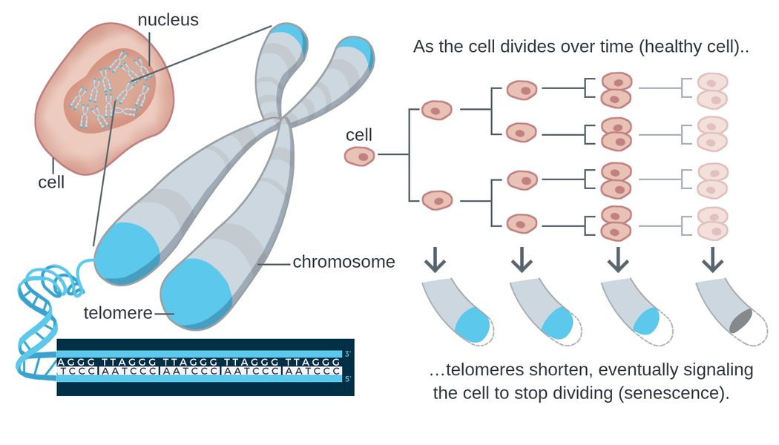
Lithium - anti-aging (bipolar)
Telomere shortening is a biomarker of aging.
https://theory.labster.com/telomere-length/
REVIEW article
Front. Psychiatry, 29 September 2020
Sec. Mood Disorders
https://doi.org/10.3389/fpsyt.2020.586083
This article is part of the Research Topic
Neurobiological Underpinnings of Bipolar Disorder and its Treatment
View all 6 Articles
Lithium and the Interplay Between Telomeres and Mitochondria in Bipolar Disorder
Mitochondrial dysfunction and telomere shortening have been implicated in both the pathophysiology of bipolar disorder and as targets of lithium treatment. Interestingly, it has in recent years become clear that these phenomena are intimately linked, partly through reactive oxygen species signaling and the subcellular translocation and non-canonical actions of telomerase reverse transcriptase. In this review, we integrate the current understanding of mitochondrial dysfunction, oxidative stress and telomere shortening in bipolar disorder with documented effects of lithium. Moreover, we propose that lithium’s mechanism of action is intimately connected with the interdependent regulation of mitochondrial bioenergetics and telomere maintenance.
Notes:
There are biomarkers that can estimate the biologic age of various organs, including the length of telomeres. Telomeres form protective caps at the ends of chromosomes.

Slide 56
Lithium - anti-aging (bipolar)
Several clinical studies indicate that lithium may attenuate telomere shortening and possibly increase telomere length.
We found that (leukocytes of) lithium-treated bipolar patients had 35% longer telomeres than controls.
Lundberg M, Millischer V, Backlund L, Martinsson L, Stenvinkel P, Sellgren CM, Lavebratt C, Schalling M. Lithium and the Interplay Between Telomeres and Mitochondria in Bipolar Disorder. Front Psychiatry. 2020 Sep 29;11:586083.
Martinsson L, Wei Y, Xu D, Melas PA, Mathé AA, Schalling M, et al. Long-term lithium treatment in bipolar disorder is associated with longer leukocyte telomeres. Transl Psychiatry (2013) 3(5):e261. 10.1038/tp.2013.37
Notes:
The telomeres of people taking lithium were found to be 35% longer, which is theorized to represent a younger biologic age. Telomeres of WBCs were tested, so this is outside of the brain.

Slide 57
Lithium - anti-aging (bipolar)
31,661 UK Biobank participants:
Longer leukocyte telomere length (LTL) is associated with:
decrease evidence of neurodegenerative disease on MRI
lower risk of all-cause dementia
(HR 0.93, 95% CI: 0.91–0.96)
Topiwala A, Nichols TE, Williams LZJ, Robinson EC, Alfaro-Almagro F, Taschler B, et al. (2023) Telomere length and brain imaging phenotypes in UK Biobank. PLoS ONE 18(3): e0282363.

Slide 58
Lithium - cardioprotection
Fractalkine (CX3CL1) is a unique chemokine associated with the pathogenesis of mood disorders and cardiovascular diseases.
Conclusion: Data from this largest sample size study of the association between lithium treatment and echocardiographic measures suggest that lithium may protect cardiac structure and function in patients with bipolar disorder.
Reduction of CX3CL1 may mediate the cardioprotective effects of lithium.
Notes:
Otherwise lithium appears to be cardioprotective, which could be a general anti-aging effect.

Slide 59
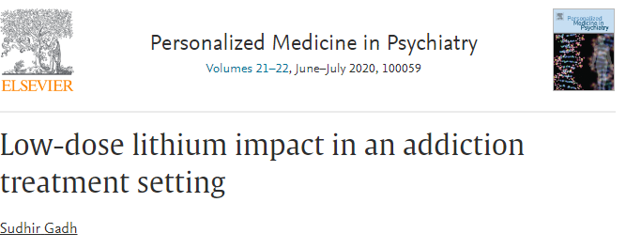
Low-dose lithium
Retrospective observational analysis
Residential addiction treatment
150 mg lithium as a substitute for or supplement to antidepressants and anxiolytics.
Program completion rate doubled
Employment rate doubled
Lithium levels not detectable with standard lab
Confounded by the comparison group consisting of patients at the treatment center prior to Dr Gadh's arrival as medical director, which brought an array of changes including deprescribing benzodiazepines.

Slide 60
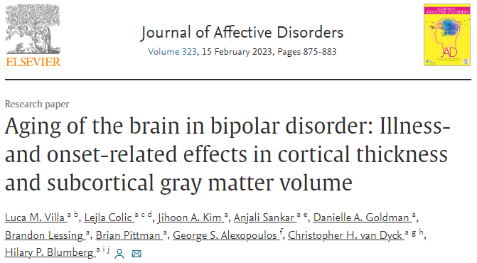
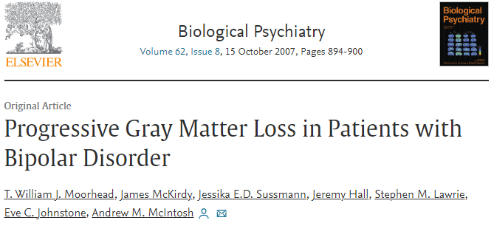
Accelerated aging in bipolar disorder
Widespread gray matter decreases in older adults with bipolar disorder
Over a 4-year period: Patients with Bipolar I Disorder lose hippocampal, fusiform and cerebellar gray matter at an accelerated rate compared with healthy control subjects.
This tissue loss is associated with deterioration in cognitive function and illness course.

Slide 61
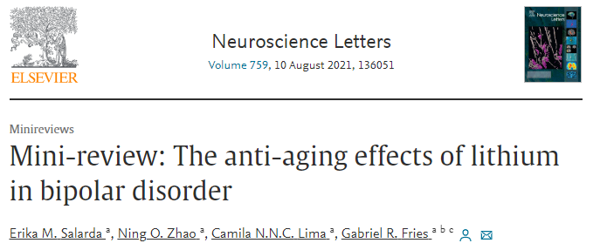
Accelerated aging in bipolar disorder
Bipolar disorder has been linked to accelerated aging mechanisms
Lithium has been shown to counteract many aging mechanisms
Lithium use can prevent telomere shortening in patients with bipolar disorder
Lithium-responders had longer telomere lengths than non-responders, with this finding later replicated.
Squassina A, Pisanu C, Corbett N, Alda M, Telomere length in bipolar disorder and lithium response, Eur. Neuropsychopharmacol.27(2017) 560–567. 10.1016/j.euroneuro.2015
Martinsson L, Wei Y, Xu D, Melas PA, Mathé AA, Schalling M, Lavebratt C, Backlund L, Long-term lithium treatment in bipolar disorder is associated with longer leukocyte telomeres, Transl. Psychiatry. 3 (2013).
Notes:
Greater urgency in giving lithium to those with bipolar to preserve brain function and overall health

Slide 62
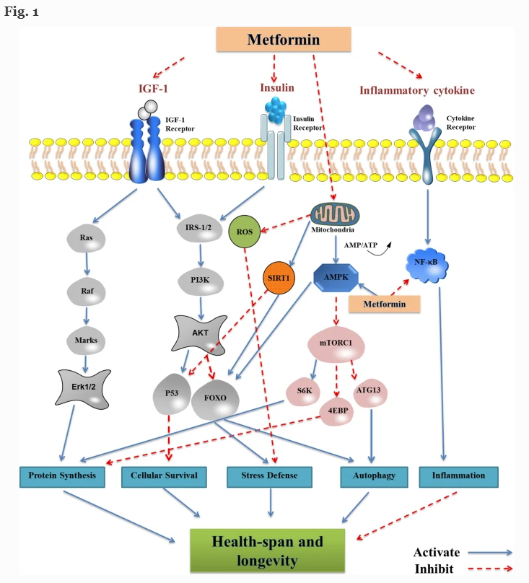
Anti-aging (Context)
Li, Z., Zhang, Z., Ren, Y. et al. Aging and age‐related diseases: from mechanisms to therapeutic strategies. Biogerontology 22, 165–187 (2021). https://doi.org/10.1007/s10522-021-09910-5
Notes:
Context: There are a handful of anti-aging drugs that longevity researchers are excited about. Metformin is in the top 3. Lithium is in the top 12- 15, likely hindered by its bad reputation. Note that effectively treating any mental illness should extend healthy lifespan, but lithium is the only psychiatric medication that appears to slow aging for mentally healthy adults.

Slide 63
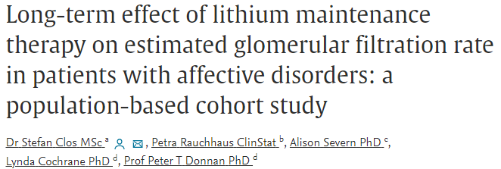
Lithium - renal risk
Our analysis suggests no effect of stable lithium maintenance therapy (lithium levels in therapeutic range) on the rate of change in eGFR over time.
Our results therefore contradict the idea that long-term lithium therapy is associated with nephrotoxicity in the absence of episodes of acute intoxication.
Stefan Clos, Petra Rauchhaus, Alison Severn, Lynda Cochrane, Peter T Donnan, Long-term effect of lithium maintenance therapy on estimated glomerular filtration rate in patients with affective disorders: a population-based cohort study, The Lancet Psychiatry, Volume 2, Issue 12, 2015.

Slide 64
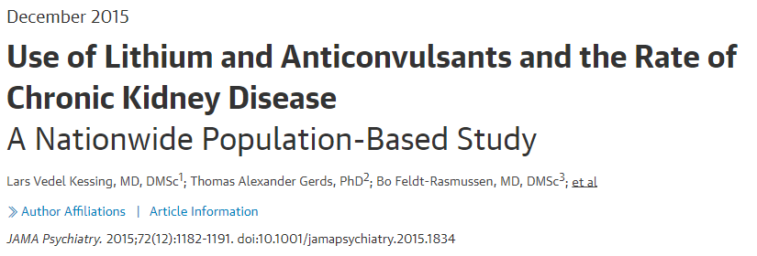
Lithium - renal risk
Maintenance treatment with lithium or anticonvulsants as practiced in modern care is associated with an increased rate of chronic kidney disease (CKD).
However, use of lithium is not associated with an increased rate of end-stage CKD.
Kessing LV, Gerds TA, Feldt-Rasmussen B, Andersen PK, Licht RW. Use of Lithium and Anticonvulsants and the Rate of Chronic Kidney Disease: A Nationwide Population-Based Study. JAMA Psychiatry. 2015;72(12):1182–1191. doi:10.1001/jamapsychiatry.2015.1834

Slide 65
Lithium - antiepileptic effects
Lithium holds a significant interest in epilepsy, where the past reports expose its non-specific proconvulsant action, followed lately by numerous studies for anticonvulsant action.
Lithium appears to be safe and effective in bipolar disorders associated with epilepsy and may have an anticonvulsant effect in some patients (Skukla et al, 1988).
Lithium does cause seizures in overdose.

Slide 66
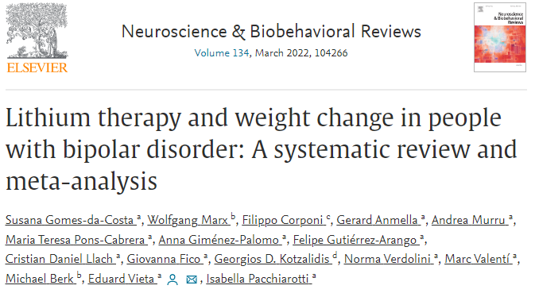
Lithium - weight gain?
Weight change with lithium was not clinically or statistically significant.
Weight change with lithium did not differ from placebo.
Gomes-da-Costa, et al. Lithium therapy and weight change in people with bipolar disorder: A systematic review and meta-analysis, Neuroscience & Biobehavioral Reviews, Volume 134, 2022.
Notes:
Batchelor, D.H. and Lowe, M.R. (1990), Reported neurotoxicity with the lithium/haloperidol combination and other neuroleptics—A literature review. Hum. Psychopharmacol. Clin. Exp., 5: 275-280. https://doi.org/10.1002/hup.470050323

Slide 67
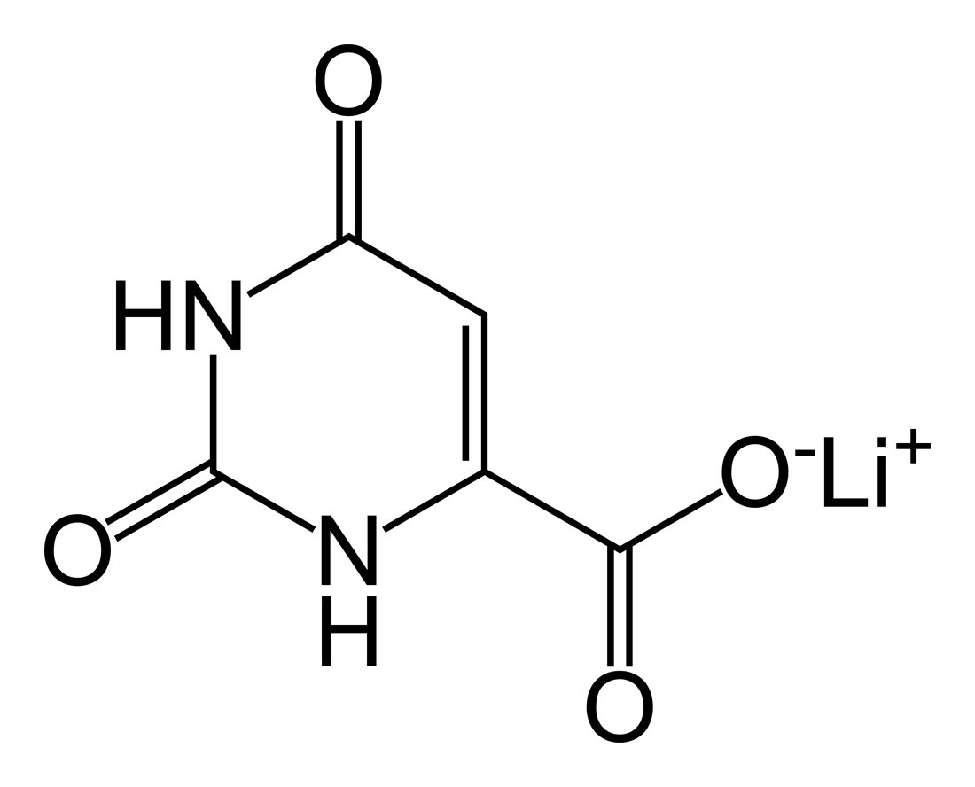
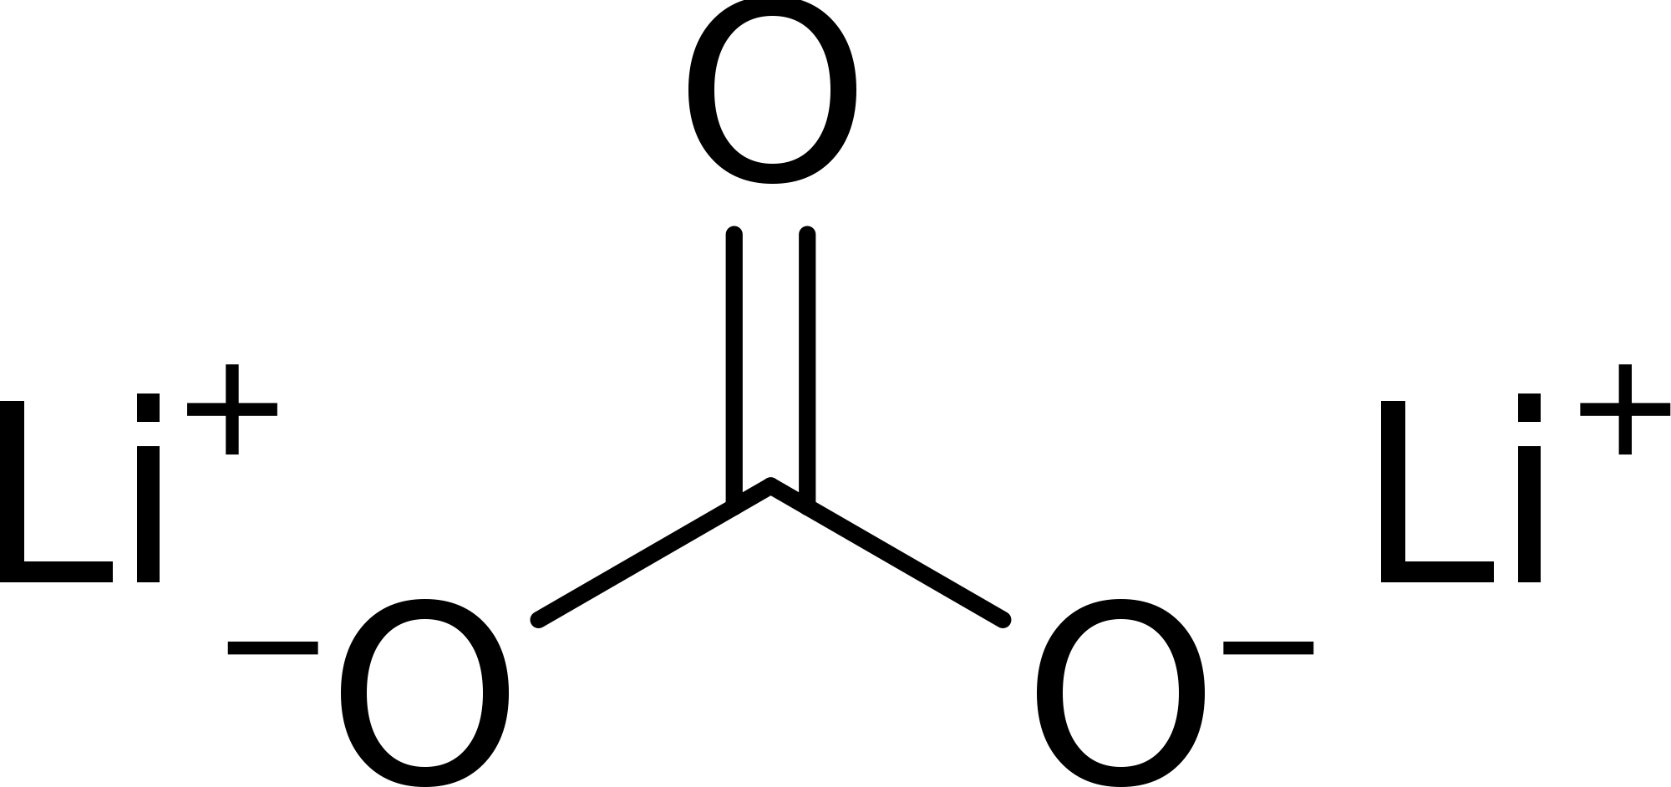
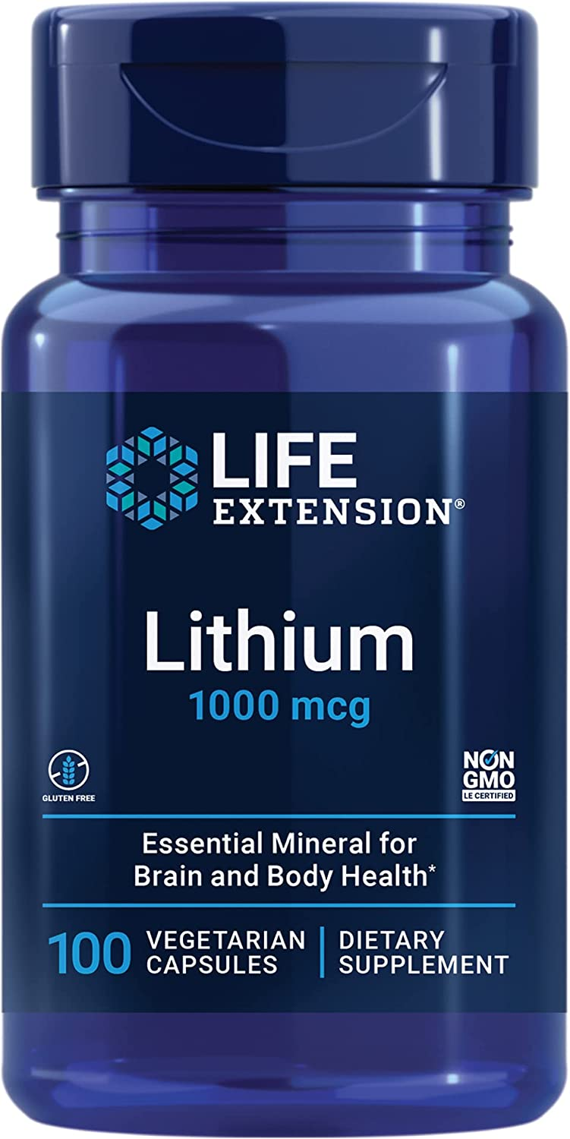
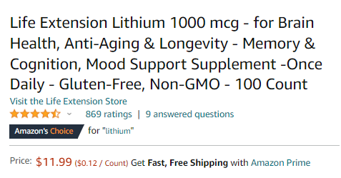
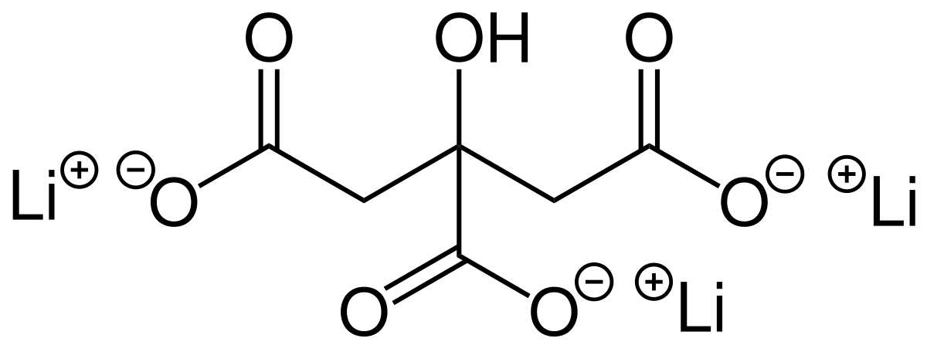
U.S. dietary intake of lithium ~ 0.6 - 3.1 mg daily (Schrauzer, 2002).
Lithium orotate pills are available on Amazon as 1, 5, 10, and 20 mg equivalents.
Lithium orotate
Lithium carbonate
Lithium citrate
Notes:
This one of 1 mg elemental lithium. 1 mg would be a reasonable dose if you conceptualize the problem as lithium deficiency. The max OTC dose is 20x stronger than this.The ideal dose has not been defined.

Slide 68
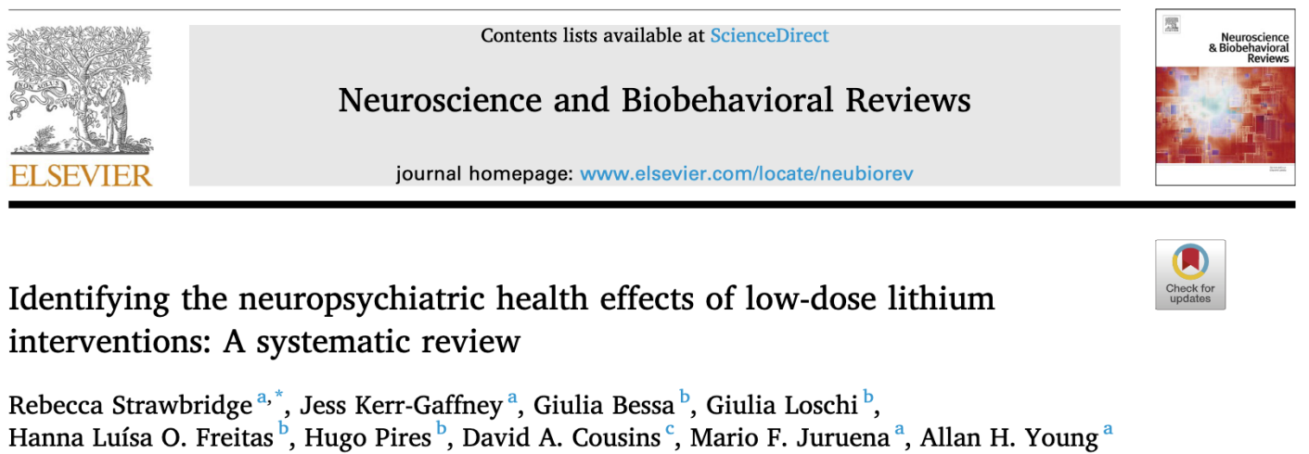
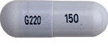
Low-dose lithium
None of the “low-dose” lithium studies identified by systematic review specifically used 150 mg.
Actual mean dose was ~ 350 - 700 mg.
2 were microdose studies using 0.3 mg and 0.4 mg.
Target blood levels ranged from 0.2 - 0.8.
lithium carbonate 150 mg is the lowest Rx strength

Slide 69
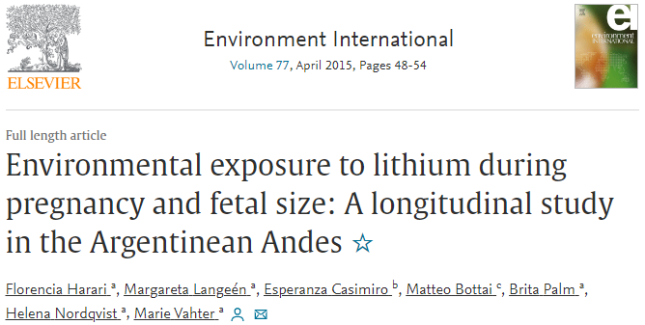
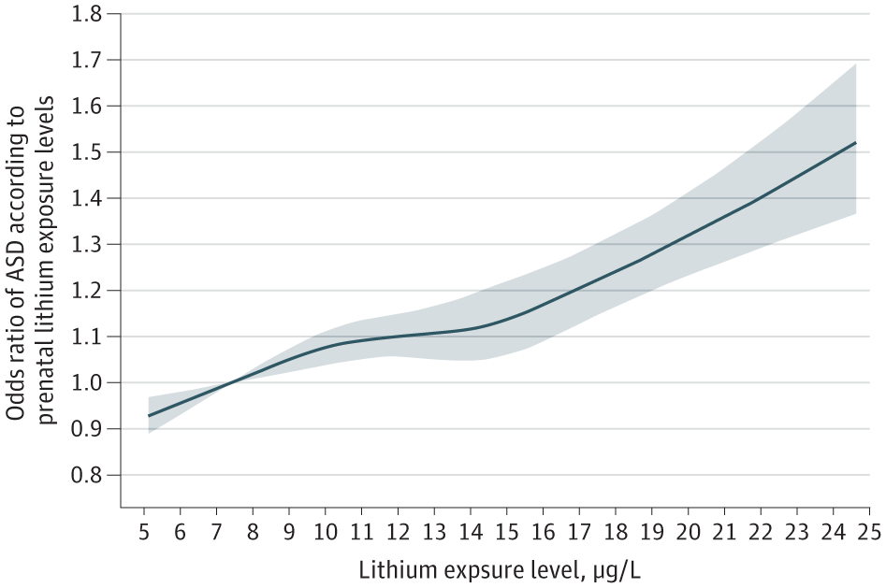
Lithium in drinking water (as teratogen)
Lithium in drinking water associated with decreased fetal size.
Lithium modulates Wnt/β-catenin signaling that is important for neurodevelopment.
Notes:
Pregnant women should not be taking low dose lithium supplements. So we probably should not be putting extra lithium in drinking water..(but we are)

Slide 70
Lithium in drinking water (as teratogen)
Lithium exposure through drinking water was associated with impaired fetal size and this seemed to be initiated in early gestation.

Slide 71
Lithium toxicity
Lithium levels increased by:
Lithium toxicity
“Tie-dyed diuretics”
The “N said” lithium toxicity
Conclusion: Educate patients that NSAIDS, blood pressure meds, and diuretics can cause lithium toxicity. For OTC pain medications, they should choose Tylenol or aspirin. Advise them to inform the prescriber if they are planning to change their caffeine intake. Excedrin is OK (combo of aspirin, acetaminophen, and caffeine). Check lithium levels frequently for patients on interacting medications. Teach the signs of lithium toxicity including tremor, nausea, diarrhea, fatigue, and drowsiness.
Notes:
INdomethacin is the worse so I should have made him indigo.

