Slide 1
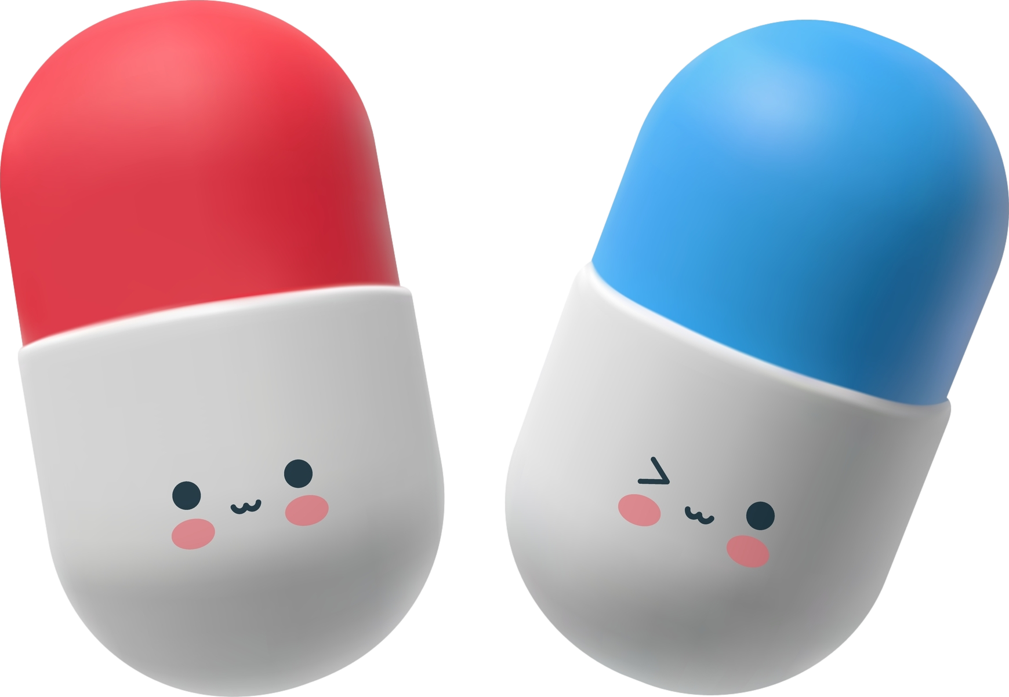
Antidepressants Jason Cafer, MD

Slide 2
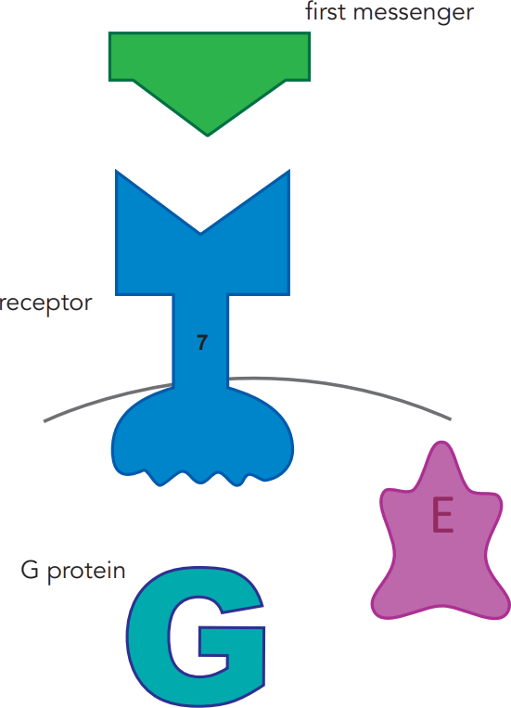
neurotransmitter
first messenger
Neurotransmission
is the foundation of psychopharmacology.
remember #7
neuron cell membrane
Enzyme
Stahl’s Essential Psychopharmacology

Slide 3
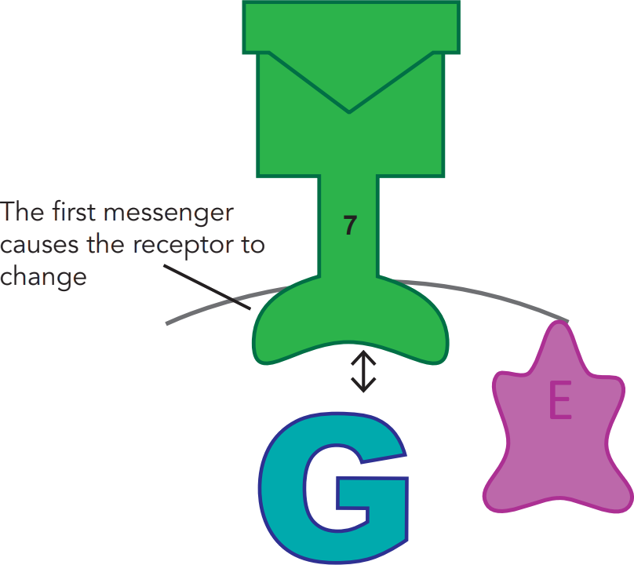
Binding can start a signal transduction cascade
e.g., serotonin
neurotransmitter
receptor
Stahl’s Essential Psychopharmacology

Slide 4
Second messenger starts signal transduction cascade
neurotransmitter
receptor
enzyme synthesizes second messenger
Stahl’s Essential Psychopharmacology

Slide 5
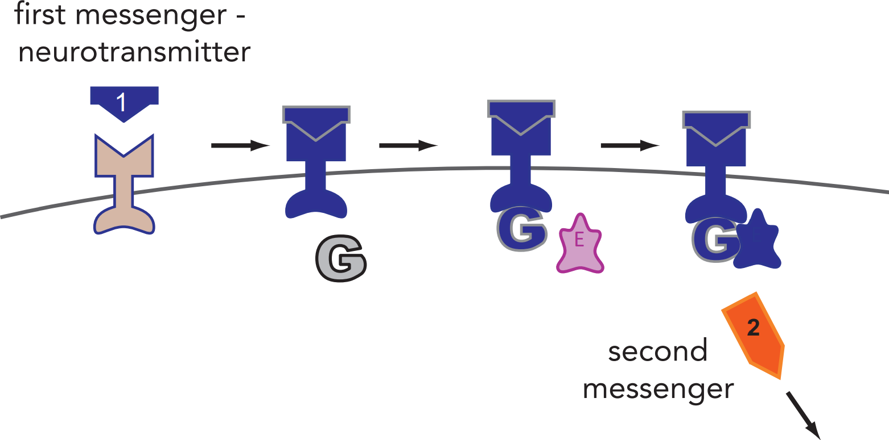
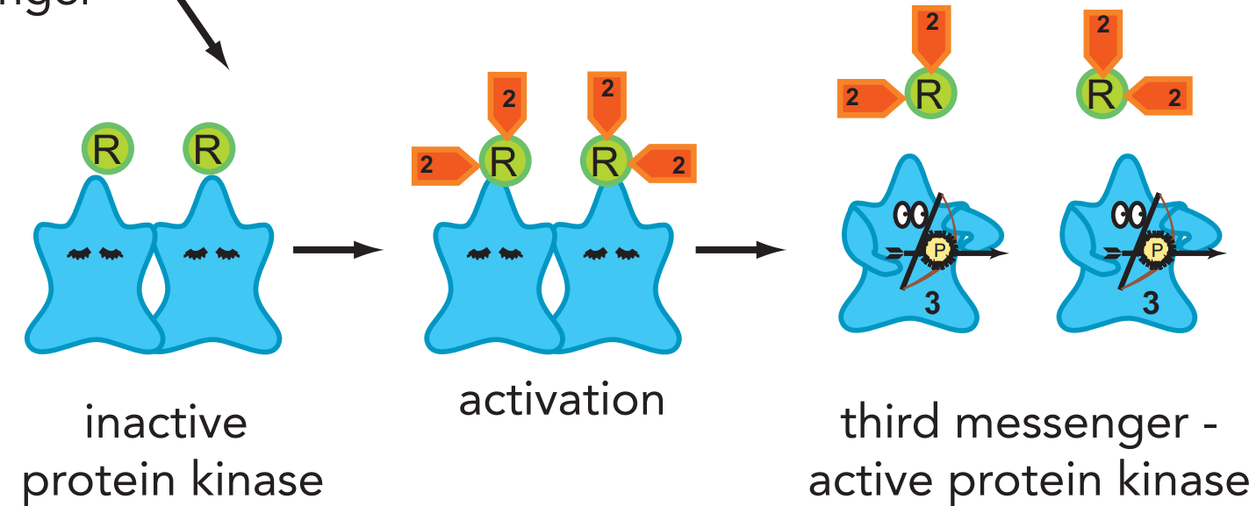
2nd messenger activates 3rd messenger
cAMP
Stahl’s Essential Psychopharmacology

Slide 6
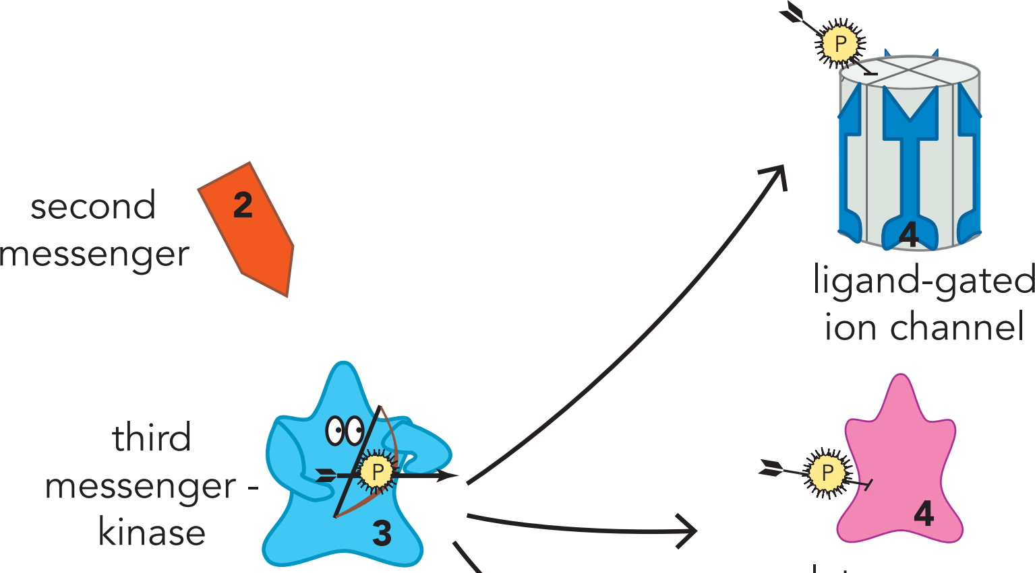
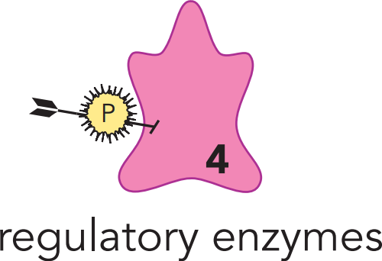
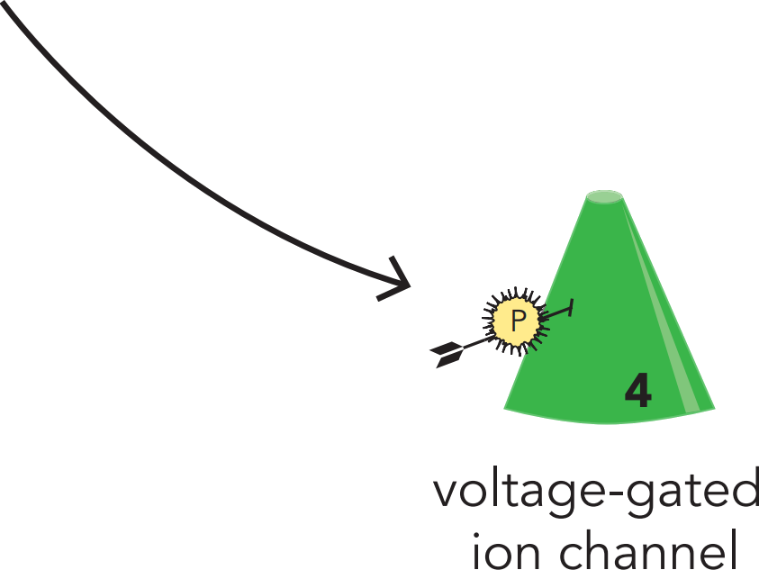
3rd messenger activates 4th messengers
Stahl’s Essential Psychopharmacology

Slide 7
A 4th messenger can be a transcription factor
Stahl’s Essential Psychopharmacology

Slide 8
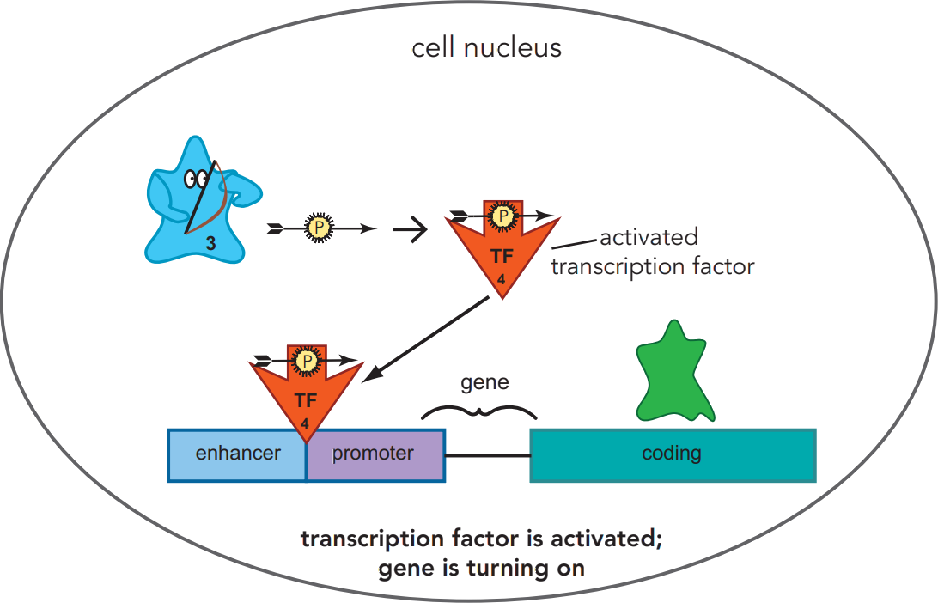
4th messenger activates a gene
Stahl’s Essential Psychopharmacology

Slide 9
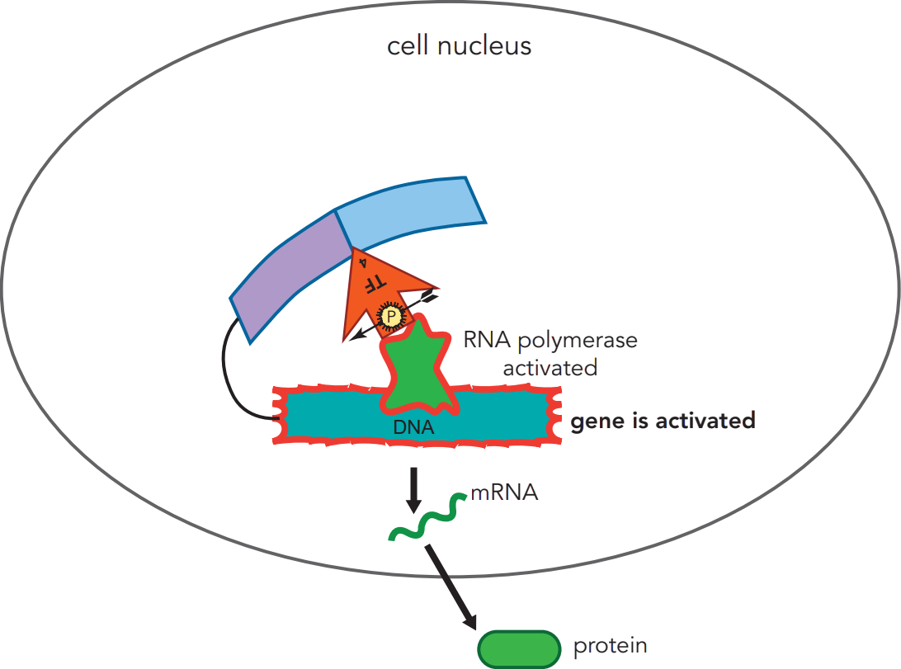
Early gene product is 5th messenger
transcription
translation
(5th messenger, early gene product)
Stahl’s Essential Psychopharmacology
5

Slide 10
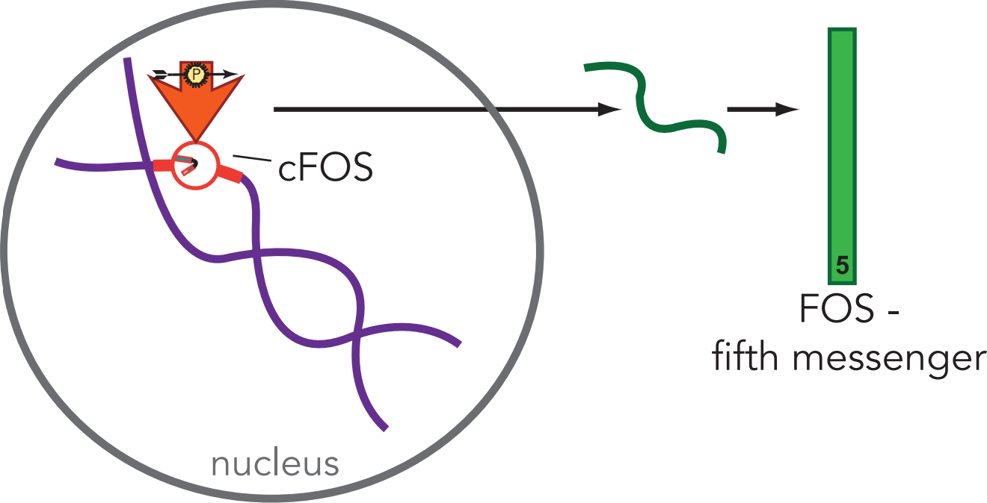
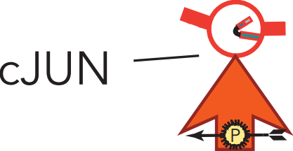
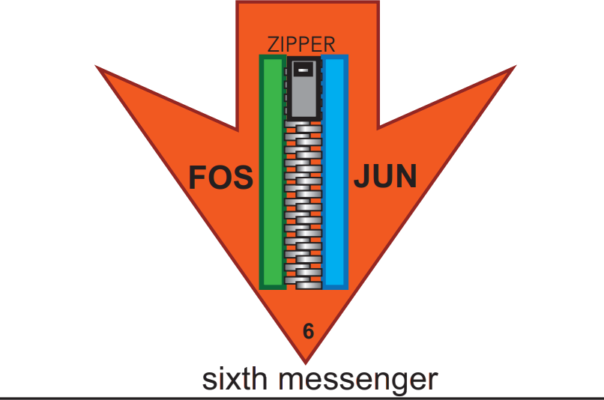
6th messenger is another transcription factor
Stahl’s Essential Psychopharmacology

Slide 11
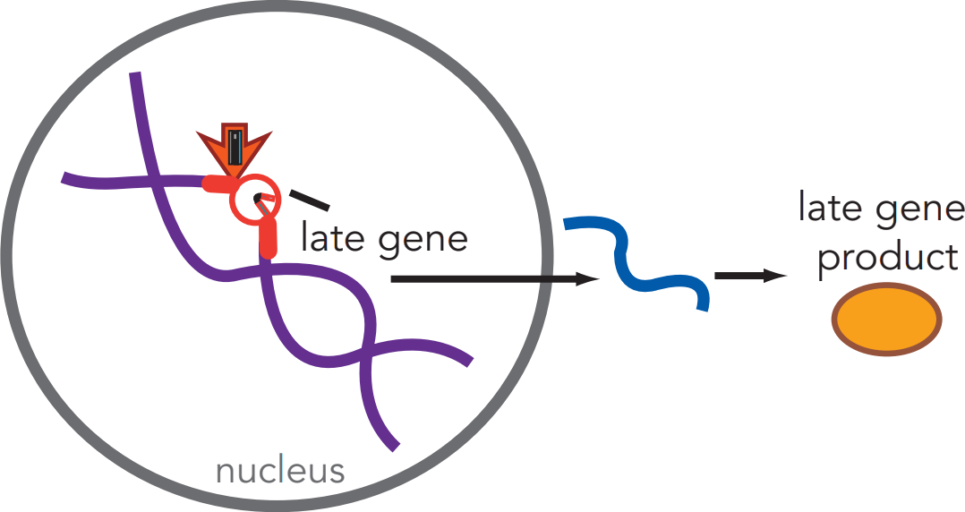
7th messenger is a late gene product
7
Stahl’s Essential Psychopharmacology

Slide 12
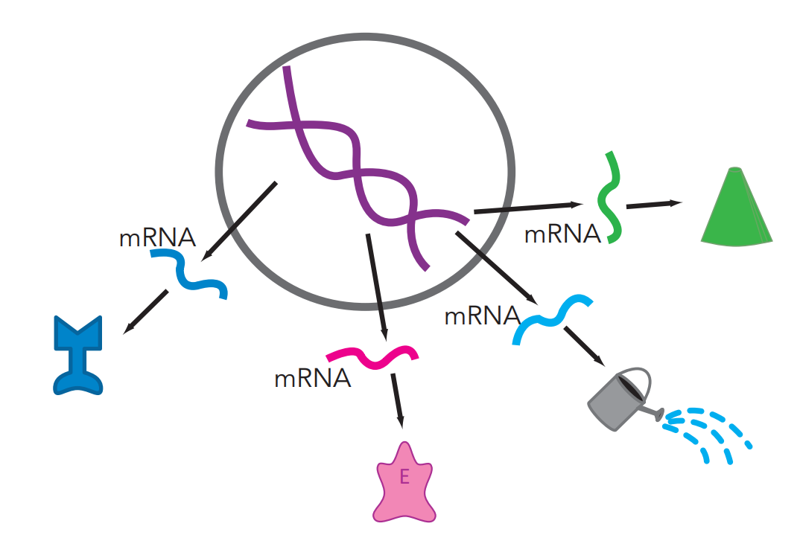
Examples of 7th messengers
7
an ion channel
7
a receptor
7
a neurotrophic growth factor
7
Stahl’s Essential Psychopharmacology
an enzyme

Slide 13
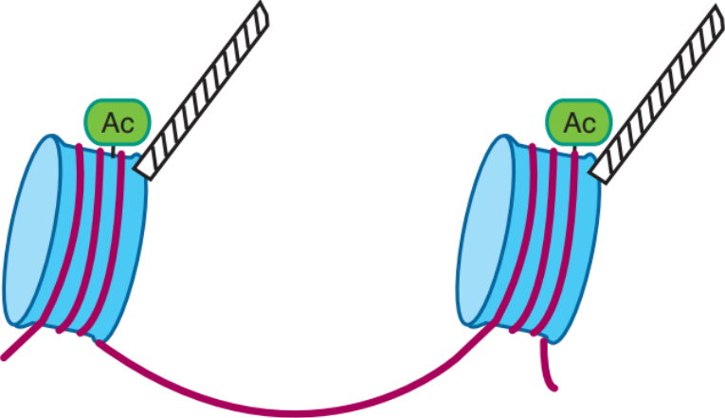
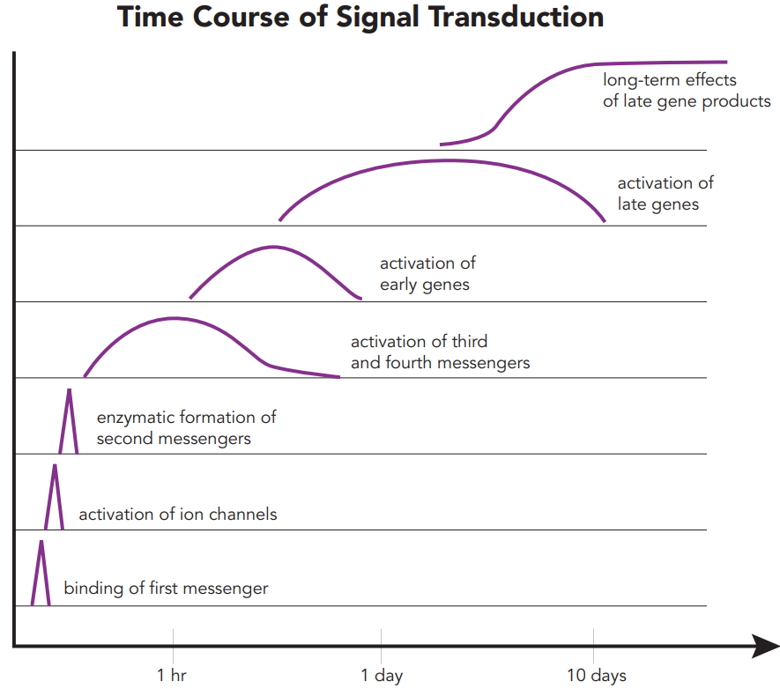
Signal transduction cascade
intracellular “downstream” effects
--> synthesis of new proteins which can alter the neuron’s functions
Downstream effects can be long-lasting, e.g.,
Synaptogenesis
Neurogenesis
Epigenetic changes

Slide 14
Chemical neurotransmission
neurotransmitter
first messenger
remember #7 = seventh messenger
(late gene product)
neuron cell membrane
Enzyme
Stahl’s Essential Psychopharmacology

Slide 15
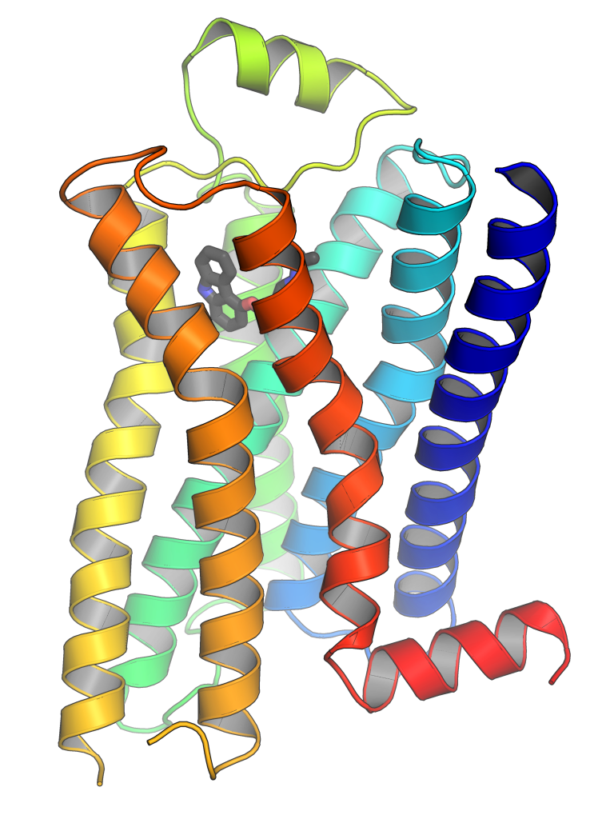
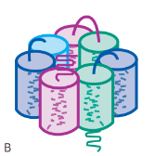
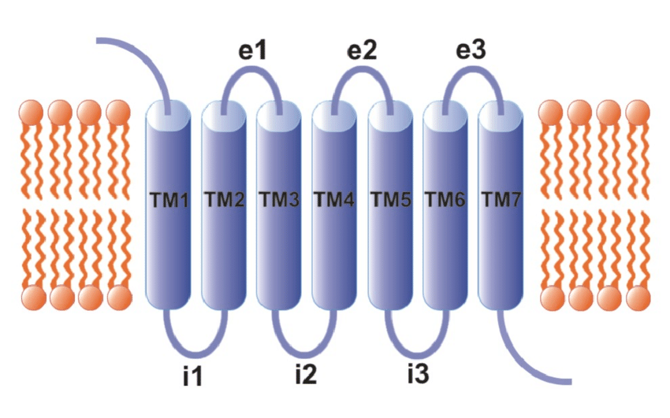
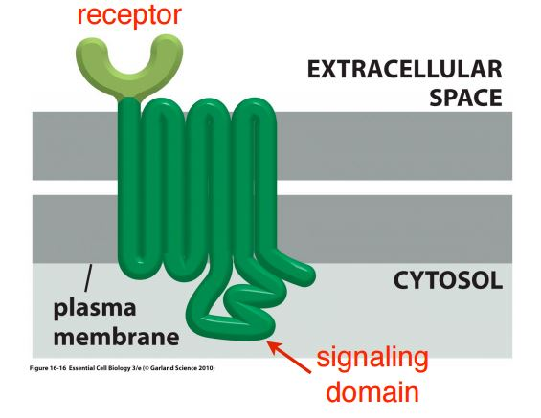
7-trans-membrane receptors
neurotransmitter
neuron cell membrane
Also 7-trans-
membrane region
Enzyme

Slide 16
Chemical neurotransmission
neurotransmitter
neuron cell membrane
Neurotransmission can alter the target neuron
in a profound and enduring manner.
The presynaptic genome is talking to the postsynaptic genome.
All treatments for depression affect gene expression in the brain.
Enzyme

Slide 17
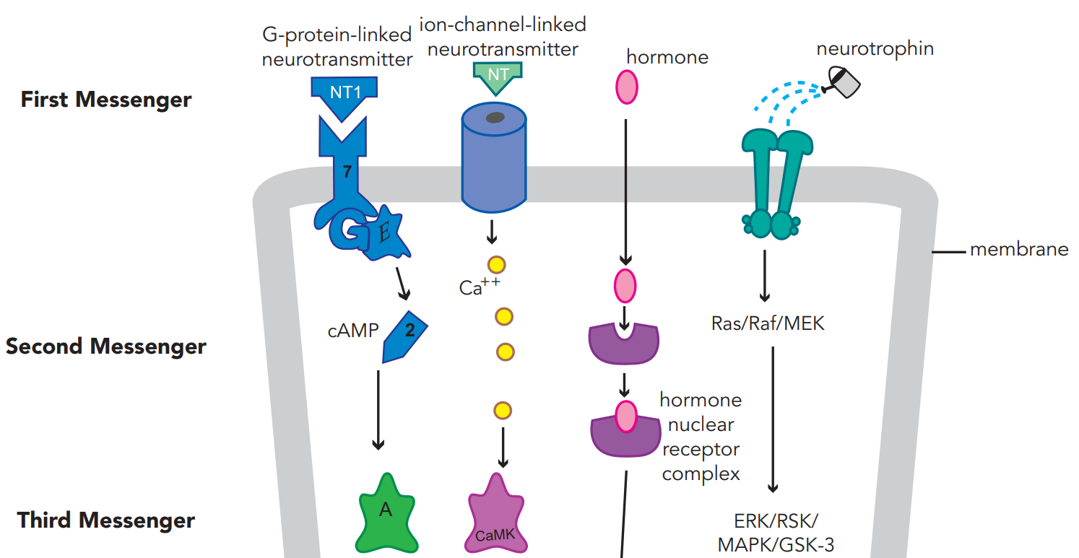
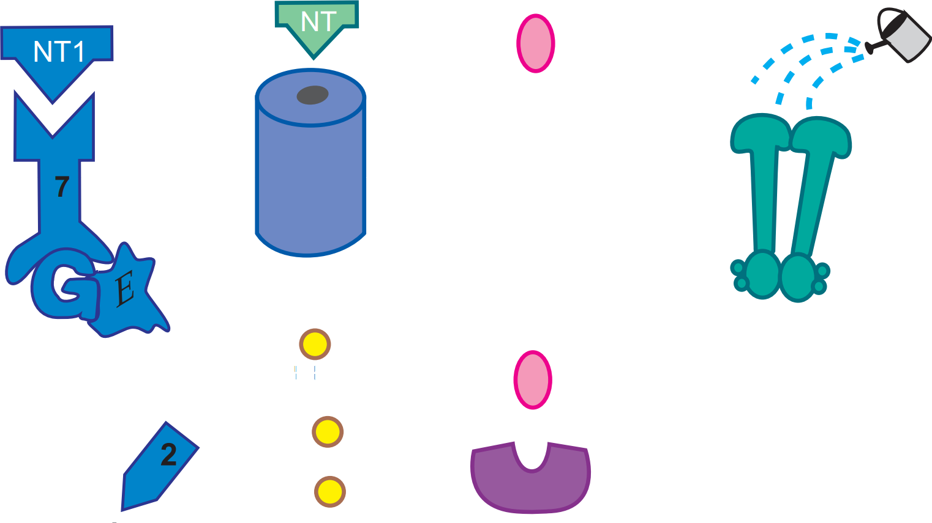
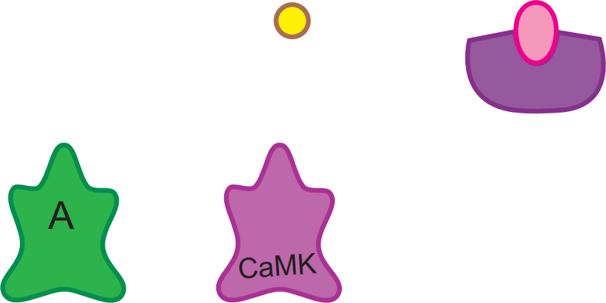
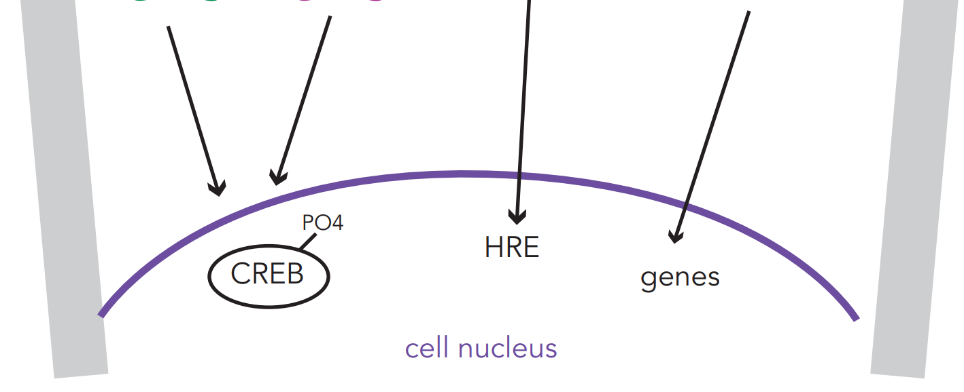
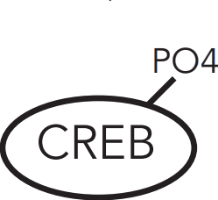
4 of the most
important signal
transduction
cascades
neurotransmitter
cAMP = cyclic adenosine monophosphate
downstream effects
A = protein kinase A
CaMK = calcium/calmodulin kinase
CREB = cAMP response element-binding protein (phosphorylated)
genes (related to synaptogenesis
and neuronal survival)
HRE = hormone-response element
gene activation
cell nucleus

Slide 18
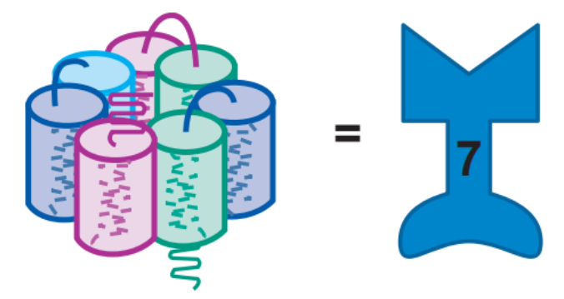
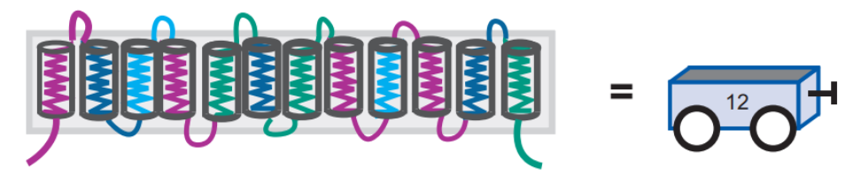
The Five Targets of Psychotropic Drugs
G-protein linked receptor
Voltage-gated ion channel
Transporter
(reuptake inhibitors)
Enzyme
Ligand-gated ion channel
Stahl’s Essential Psychopharmacology

Slide 19
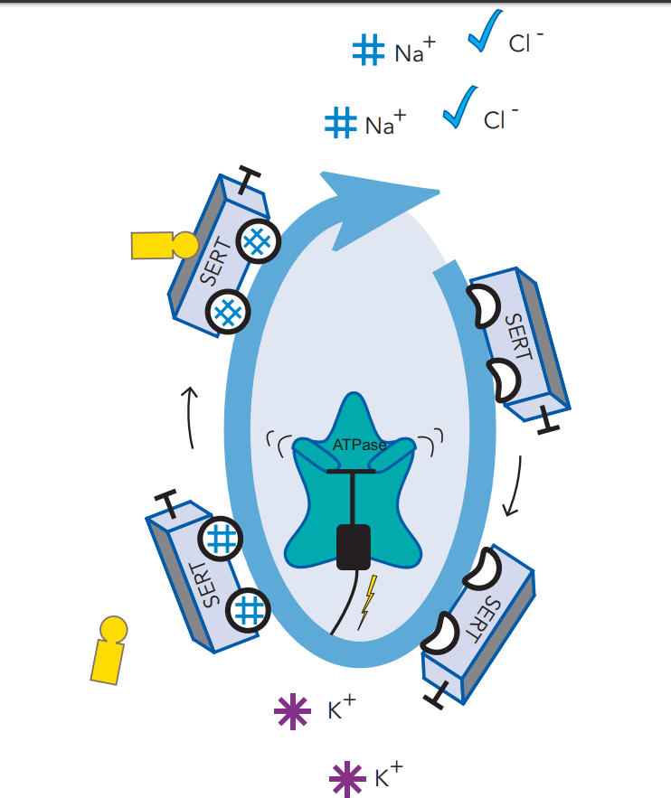
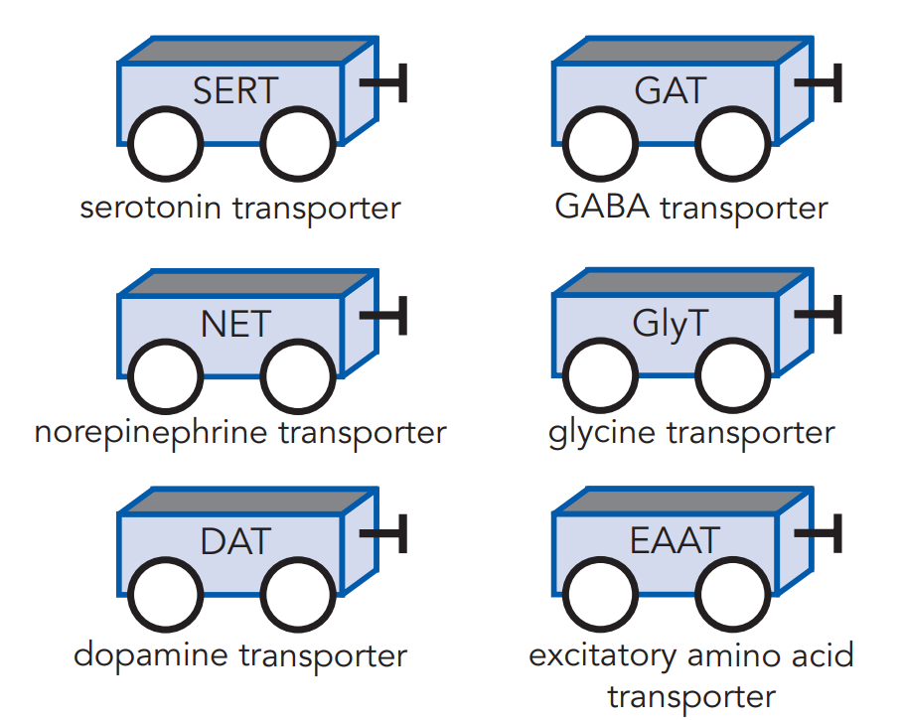
Transporters = reuptake pumps
= what’s blocked by a reuptake inhibitor

Slide 20
Serotonin transporter (SERT)
Serotonin transporter (SERT) blocker
Stahl’s Essential Psychopharmacology

Slide 21
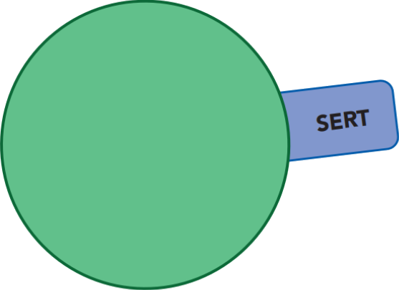
Serotonin transporter (SERT)
Serotonin reuptake inhibitor (SRI)
Stahl’s Essential Psychopharmacology

Slide 22
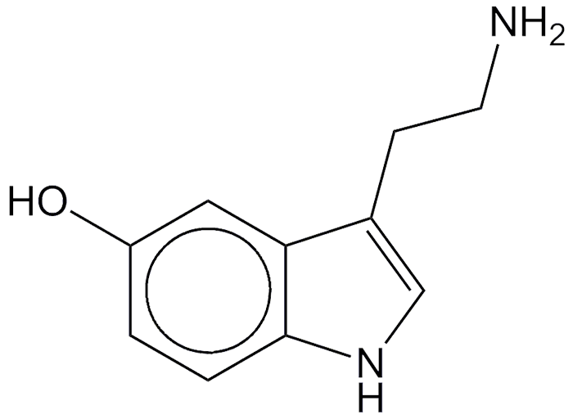
Serotonin = 5-hydroxytryptamine = 5-HT
=

Slide 23
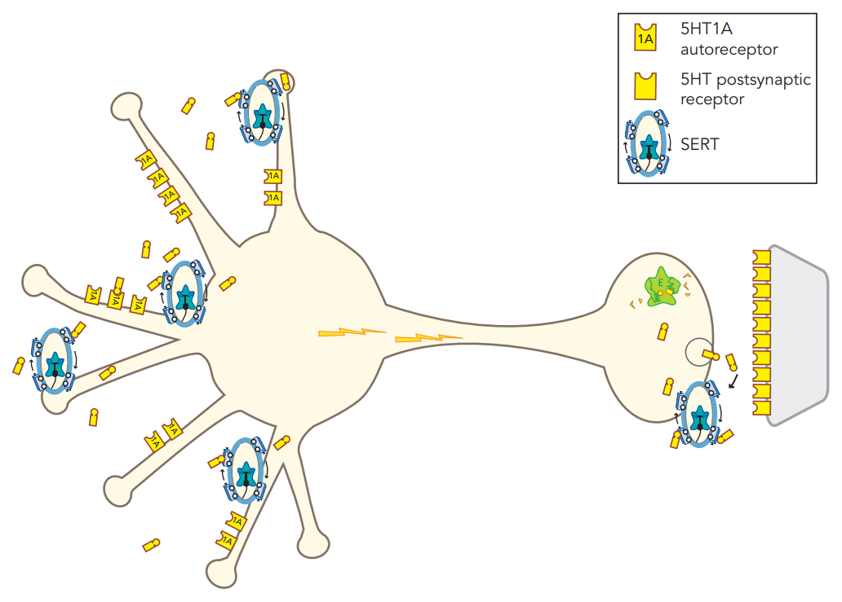
Monoamine hypothesis of depression - “low serotonin”
Low serotonin (5HT) at somatodendritic areas
5HT receptor
serotonin neuron
Low serotonin (5HT) in the synapse
serotonin transporter (SERT)
Stahl’s Essential Psychopharmacology

Slide 24
Monoamine hypothesis of depression - “low serotonin”
Low serotonin (5HT) at somatodendritic areas
5HT receptor
serotonin neuron
Low serotonin (5HT) in the synapse
serotonin transporter (SERT)

Slide 25
Neurotransmitter receptor hypothesis of depression
Upregulated presynaptic 5HT_{1A} autoreceptors
low serotonin in synapse
serotonin neuron
low number of signals

Slide 26
Neurotransmitter receptor hypothesis of depression
Upregulated presynaptic 5HT_{1A} autoreceptors
serotonin neuron
Upregulated postsynaptic 5HT receptors
low number of signals

Slide 27
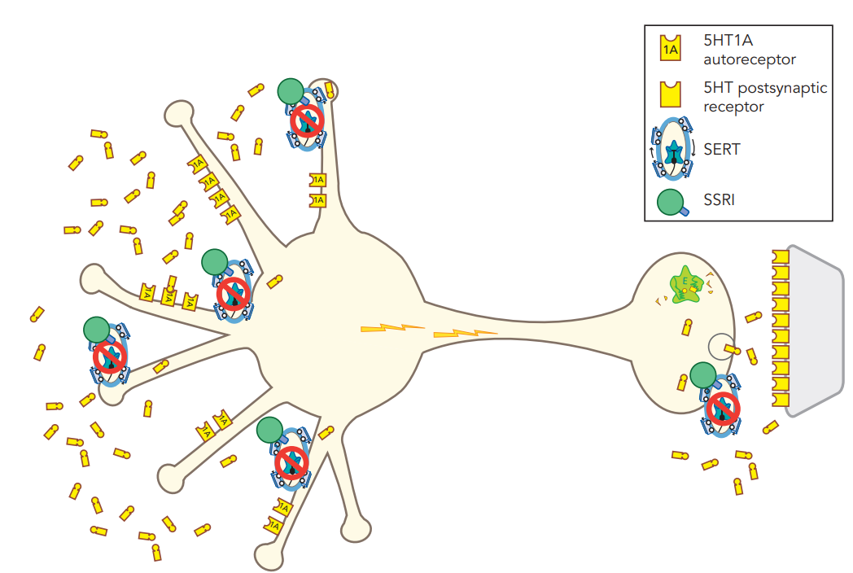
SSRI mechanism - immediate effects
SRI blocks SERT on dendrites
More 5HT in somatodendritic area.
serotonin neuron
SRI blocks SERT at axon terminal

Slide 28
SSRI mechanism - immediate effects
SRI blocks SERT on dendrites
Binding to 5HT1A autoreceptors...
serotonin neuron
SRI blocks SERT at axon terminal

Slide 29
SSRI mechanism - immediate effects
SRI blocks SERT on dendrites
Binding to 5HT1A autoreceptors...
inhibits firing
serotonin neuron
so, still low number of signals...
despite SSRI
SRI blocks SERT at axon terminal

Slide 30
SSRI mechanism - immediate effects
SRI blocks SERT on dendrites
Binding to 5HT1A autoreceptors...
inhibits firing
serotonin neuron
so, not much more 5HT in axon terminal
so, still low number of signals...
despite SSRI
SRI blocks SERT at axon terminal

Slide 31
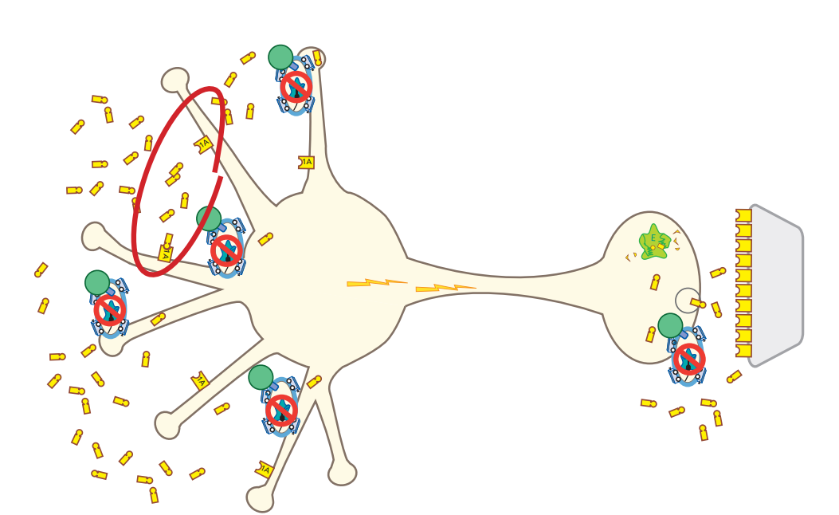
SSRI mechanism - delayed effects
5HT1A autoreceptors downregulate
(due to increased 5HT)
serotonin neuron

Slide 32
SSRI mechanism - delayed effects
5HT1A autoreceptors downregulate
(due to increased 5HT)
serotonin neuron
Increased neuronal impulse flow

Slide 33
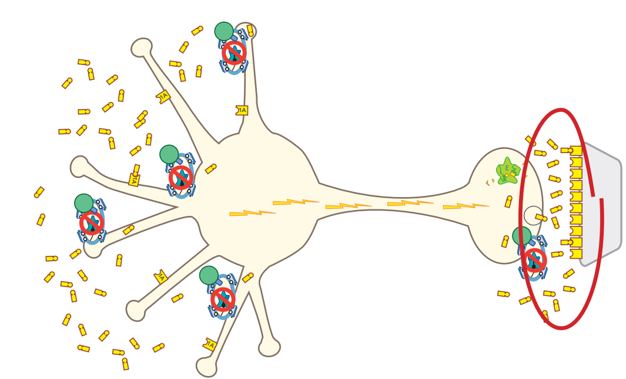
SSRI mechanism - result of delayed effects
Increased release of 5HT from axon
serotonin neuron

Slide 34
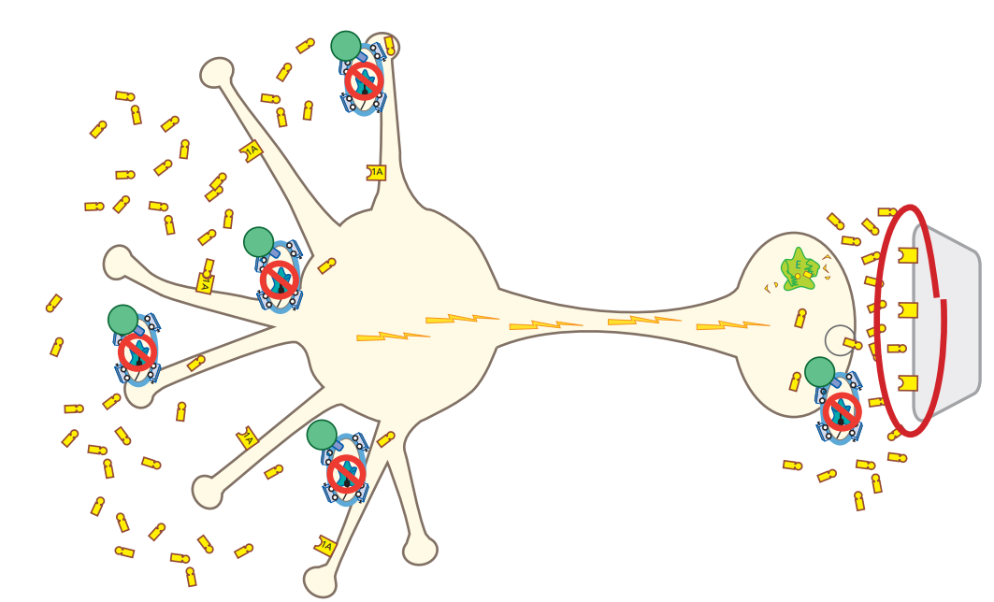
SSRI mechanism - result of delayed effects
The increase of 5HT at the axon causes postsynaptic receptors to downregulate/
desensitize
→ therapeutic effects
→ tolerance to side effects
serotonin neuron

Slide 35
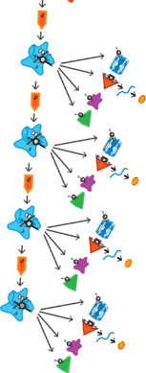
SSRI mechanism - result of delayed effects
serotonin neuron

Slide 36
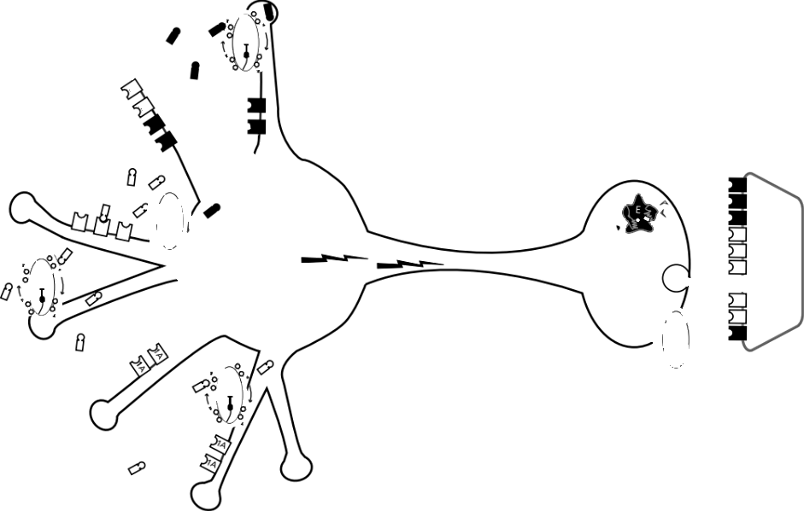
Serotonin (5HT) receptor subtypes
Note that these postsynaptic 5HT receptors are on a non-serotonin neuron (e.g., GABA interneuron)
serotonin neuron
serotonin neuron
and the post-synaptic neuron won’t have all receptor subtypes

Slide 37
Serotonin (5HT) receptor subtypes
5HT1A “negative feedback” receptors
serotonin neuron
serotonin neuron
inhibitory

Slide 38
Serotonin (5HT) receptor subtypes
Inhibitory / negative feedback receptors
serotonin neuron

Slide 39
Serotonin (5HT) receptor subtypes
“Feed-forward” / excitatory receptors
serotonin neuron

Slide 40
Serotonin (5HT) receptor subtypes
Other than 5HT3, serotonin receptors are G-protein linked
5HT3 receptors are ligand-gated ion channels
serotonin neuron
serotonin neuron

Slide 41
Serotonin (5HT) receptor subtypes
serotonin neuron
serotonin neuron
serotonin transmission regulates other neurotransmitters in downstream circuits

Slide 42
5HT1A
5HT1A Stimulation Increases Release of Norepinephrine Dopamine and Acetylcholine
serotonin transmission regulates other neurotransmitters in downstream circuits

Slide 43
5HT1A Stimulation Increases Release of Norepinephrine Dopamine and Acetylcholine
serotonin transmission regulates other neurotransmitters in downstream circuits
5HT1A receptors are on GABA interneurons

Slide 44
Those were 5HT-1A receptors...
now some examples with other serotonin receptor subtypes...
Don’t worry about the specifics.
serotonin transmission regulates other neurotransmitters in downstream circuits

Slide 45
Here’s 5HT-1B
serotonin transmission regulates other neurotransmitters in downstream circuits

Slide 46
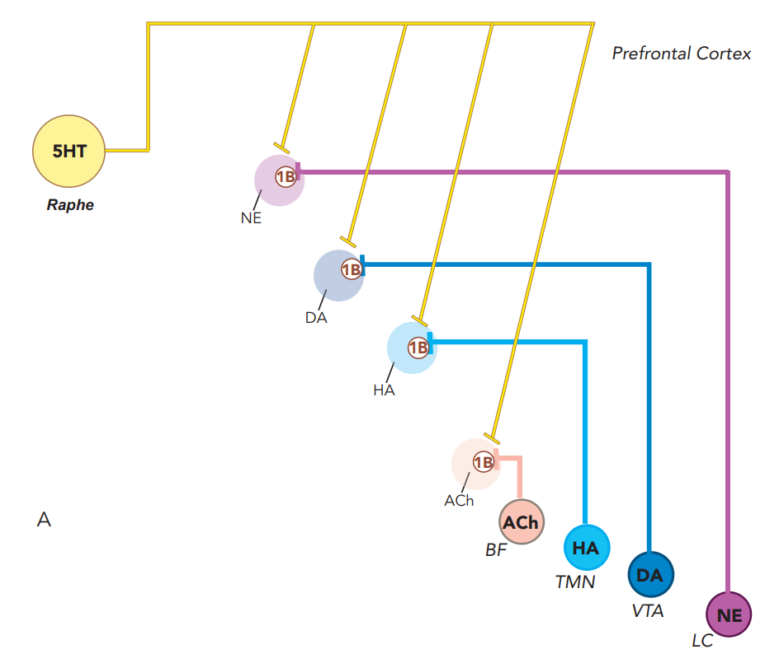
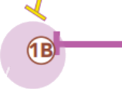
5HT1B Presynaptic Regulation of NE DA HA & Acetylcholine in the Prefrontal Cortex
serotonin transmission regulates other neurotransmitters in downstream circuits
Presynaptic

Slide 47
Here’s 5HT-2A
serotonin transmission regulates other neurotransmitters in downstream circuits

Slide 48
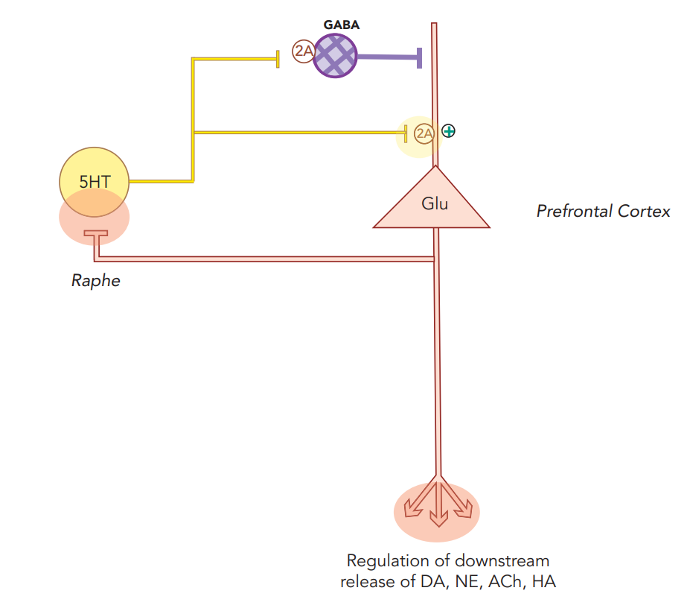
5HT2A Receptors Regulate Glutamate Release – But It’s Complicated
serotonin transmission regulates other neurotransmitters in downstream circuits

Slide 49
Here’s 5HT-2C
serotonin transmission regulates other neurotransmitters in downstream circuits

Slide 50
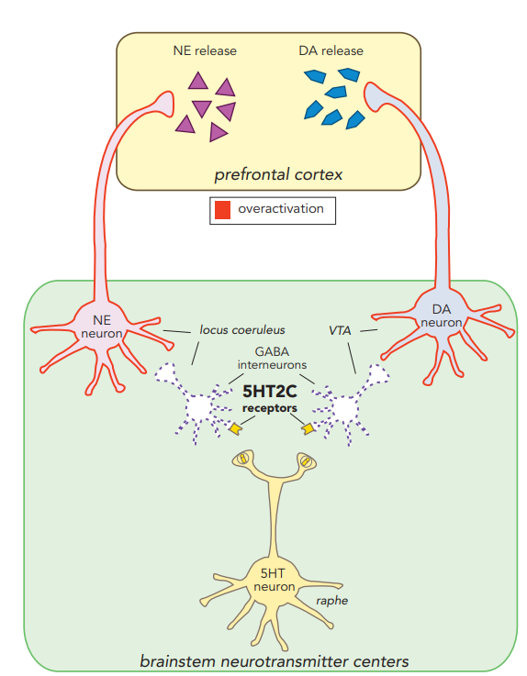
5HT-2C

Slide 51
Here’s 5HT-3
serotonin transmission regulates other neurotransmitters in downstream circuits

Slide 52
5HT3 Stimulation inhibits release of NE and acetylcholine
These 5HT3 receptors are on GABA interneurons
serotonin transmission regulates other neurotransmitters in downstream circuits
Stahl’s Essential Psychopharmacology

Slide 53
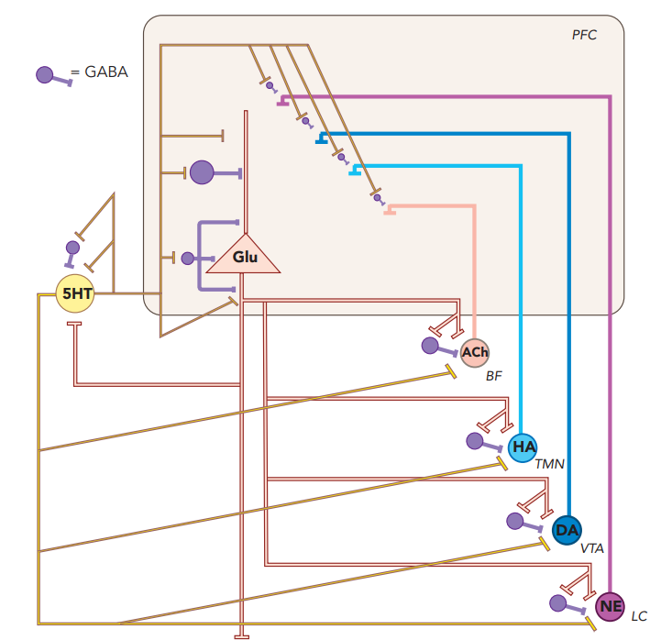
Serotonin (5HT) Interacts in a Neuronal Network to Regulate All Major Neurotransmitter Systems
serotonin transmission regulates other neurotransmitters in downstream circuits

Slide 54
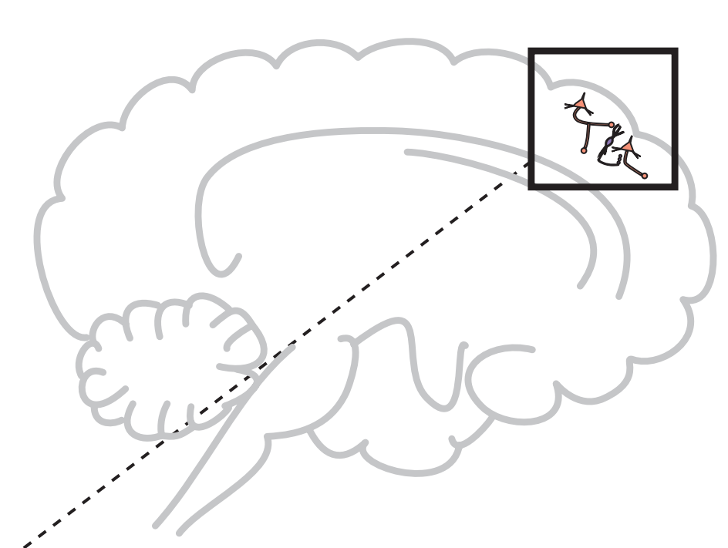
Glutamate pathways
Glutamate (pyramidal neurons)
Pyramidal neurons constitute the large majority of nerve cells in the cerebral cortex

Slide 55
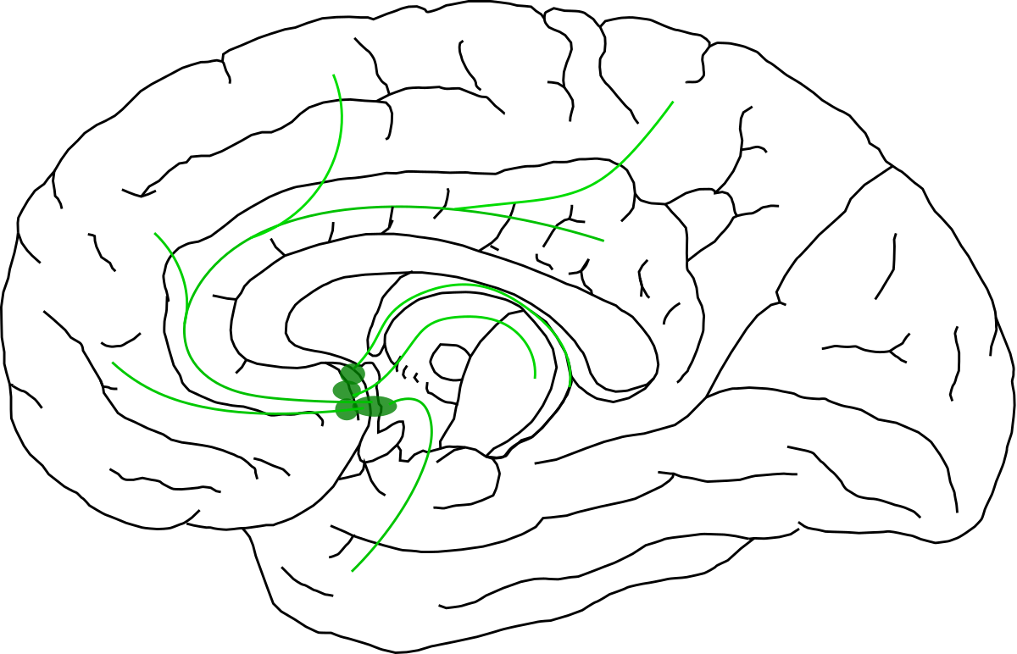
Acetylcholine pathways
acetylcholine (basal forebrain)

Slide 56
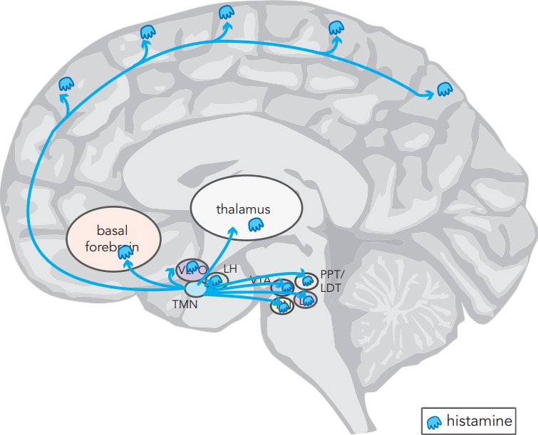
Histamine pathways
histamine
(tuberomammillary nucleus)

Slide 57
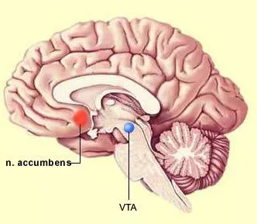
Dopamine pathways
dopamine (ventral tegmental area)

Slide 58
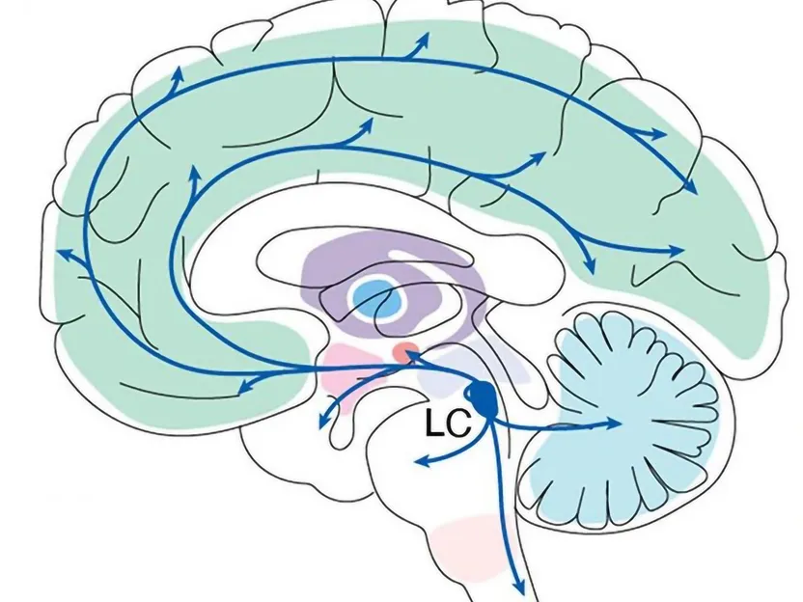
Norepinephrine pathways
norepinephrine (locus coeruleus)

Slide 59
Serotonin (5HT) Interacts in a Neuronal Network to Regulate All Major Neurotransmitter Systems
serotonin (raphe nucleus)
glutamate (pyramidal neurons)
acetylcholine (basal forebrain)
histamine
(tuberomammillary nucleus)
dopamine
(ventral tegmental area)
norepinephrine (locus coeruleus)

Slide 60
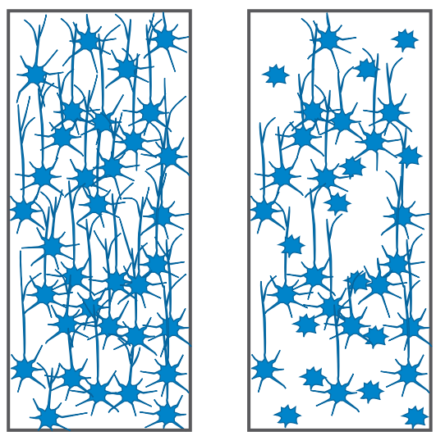
Serotonin (5HT) Interacts in a Neuronal Network to Regulate All Major Neurotransmitter Systems
Intracellular downstream effects
transcription factor
epigenetic changes
neurogenesis / synaptogenesis

Slide 61
Let’s block some serotonin (5-HT) transporters!
Stahl’s Essential Psychopharmacology

Slide 62
Escitalopram (LEXAPRO)
ess sit AL o pram / LEX a pro
“Lexus Pram”
#26
2002
$3–$98
❖ Antidepressant
❖ Selective serotonin
reuptake inhibitor (SSRI)
EXAPRO
SSRI
5
10
20
mg
“Pram” is the British word for baby carriage.

Slide 63
Escitalopram: SSRI
not a CYP inHibitor - MAJOR ADVANTAGE OVER THE OTHER SSRIs
sensitive substrate
(CYP2C19)
no off-target effects - slightly fewer side effects
escitalopram
LEXAPRO
Antidepressant and anxiolytic effects, sexual dysfunction
Serotonin reuptake inhibitor
not a CYP inDucer
(no antidepressants are)

Slide 64
Escitalopram: SSRI
Serum levels of escitalopram increased by 90%
CYP2C19
sensitive substrate
(CYP2C19)
PPI
omeprazole
PRILOSEC

Slide 65
Escitalopram (LEXAPRO)
The only pure SSRI
1st-line SSRI (or sertraline)
Does not inHibit CYP enzymes
Slightly fewer side effects
The “pure” form of citalopram (Celexa)...
sensitive substrate
(CYP2C19)
not a CYP inHibitor
no off-target effects
escitalopram
LEXAPRO
Antidepressant and anxiolytic effects, sexual dysfunction
Serotonin reuptake inhibitor
not a CYP inDucer
(no antidepressants are)

Slide 66
Citalopram (CELEXA)
si TAL o pram / SEL ex a
“Sell Lexus Pram”
#21
1998
$2–$35
❖ Antidepressant
❖ Selective serotonin
reuptake inhibitor (SSRI)
ELEXA
The right-handed enantiomer (R-citalopram) is ineffective and causes QT interval prolongation.
SSRI
QT prolongation
10
20
40
mg
QT prolongation

Slide 67
Citalopram: SSRI
50%
50%
S-citalopram
R-citalopram

Slide 68
Citalopram: SSRI
possible sedation, weight gain
Anti-
histamine
(mild)
“Bad citalopram”
May interfere with S-citaloprams ability
to inhibit SERT
S-citalopram
R-citalopram
R-citalopram
“Lexapro”
inhibitor of rapid delayed rectifier (IKr) potassium channels
QT prolongation

Slide 69
Citalopram (Celexa)
Choose escitalopram (Lexapro) instead
possible sedation, weight gain
Anti-
histamine
(mild)
“Bad citalopram”
May interfere with S-citaloprams ability
to inhibit SERT
S-citalopram
R-citalopram
R-citalopram
“Lexapro”
“Bad Lexapro”
inhibitor of rapid delayed rectifier (IKr) potassium channels
QT prolongation

Slide 70
Citalopram (Celexa)
Choose escitalopram (Lexapro) instead
If changing, go from citalopram 40 mg to escitalopram 20 mg
20 mg
20 mg
S-citalopram
R-citalopram
R-citalopram
R-citalopram
“Lexapro”
“Bad Lexapro”

Slide 71
Citalopram (Celexa)
Choose escitalopram (Lexapro) instead
If changing, go from citalopram 40 mg to escitalopram 20 mg
20 mg
20 mg
S-citalopram
“Lexapro”

Slide 72
Fluoxetine (PROZAC)
flu OX e teen / PRO zak
“Prolonged sack of the Flustered ox”
#29
1987
$2–$36
❖ Antidepressant
❖ Selective serotonin
reuptake inhibitor (SSRI)
SSRI
The “fluffers” - infamous inHibitors of CYP enzymes:
❖ Fluvoxamine (Luvox)
❖ Fluoxetine (Prozac)
❖ Fluconazole (Diflucan)
10
20
40
mg
“Prolonged” refers to Prozac’s prolonged presence in the body, with half-life of 1 week.

Slide 73
What’s the major difference between escitalopram...
escitalopram
LEXAPRO

Slide 74
What’s the major difference between escitalopram and fluoxetine?
escitalopram
LEXAPRO
fluoxetine
PROZAC

Slide 75
Stahl’s Essential Psychopharmacology

Slide 76
CYP
not
“fluffer”
inHibitor
fluoxetine
PROZAC

Slide 77
Fluoxetine: SSRI
“fluffer” inHibitor
markedly increases serum levels of other medications
CYP
5HT2C antagonist
“activating” effects (at very high doses, if at all)
Norepinephrine reuptake inhibitor
fluoxetine
PROZAC
Antidepressant and anxiolytic effects, sexual dysfunction
Serotonin reuptake inhibitor

Slide 78
Fluoxetine: SSRI
“fluffer” inHibitor
markedly increases serum levels of other medications
CYP
5HT2C antagonist
“activating” effects (at very high doses, if at all)
Norepinephrine reuptake inhibitor
about these things sticking off the Stahl balls...
fluoxetine
PROZAC
Antidepressant and anxiolytic effects, sexual dysfunction
Serotonin reuptake inhibitor

Slide 79
The agonist spectrum
e.g., no serotonin
antagonist = “blocker”
keeps the neurotransmitter (e.g., serotonin) from exerting an effect

Slide 80
The agonist spectrum
partial agonist = “stabilizer”
causes a relative increase or decrease in activity depending on how much neurotransmitter is around

Slide 81
Fluoxetine: SSRI
disinhibition of norepinephrine and dopamine
potentially “activating”

Slide 82
Fluoxetine (Prozac)
“fluffer” inHibitor
markedly increases serum levels of other medications
CYP
5HT2C antagonist
“activating” effects (at very high doses, if at all)
Norepinephrine reuptake inhibitor
potentially “activating”
disinhibition of norepinephrine and dopamine
fluoxetine
PROZAC
Anti-
depressant and anxiolytic effects, sexual dysfunction
Serotonin reuptake inhibitor

Slide 83
Fluoxetine (Prozac)
“Fluffer” inHibitor
Only start it if you know the interactions
Run an interaction check if you encounter it
Long half-life
The best at not causing serotonin withdrawal symptoms
Reputation as “activating”
“fluffer” inHibitor
markedly increases serum levels of other medications
CYP
5HT2C antagonist
“activating” effects (at very high doses, if at all)
Norepinephrine reuptake inhibitor
potentially “activating”
fluoxetine
PROZAC
Anti-
depressant and anxiolytic effects, sexual dysfunction
Serotonin reuptake inhibitor

Slide 84
Sertraline (ZOLOFT)
SER tra leen / ZOE loft
“So Soft (on the) Shirt Line”
#14
1991
$3–$49
❖ Antidepressant
❖ Selective serotonin
reuptake inhibitor (SSRI)
SSRI
25
50
100
mg
Sertraline is the preferred antidepressant for pregnancy and breastfeeding.

Slide 85
Sertraline (ZOLOFT)
Reasonable 1st-line SSRI
More GI side effects (e.g., diarrhea)
“so-soft”
may improve energy, motivation, and concentration
(in theory)
Dopamine reuptake inhibitor
Antidepressant and anxiolytic effects, sexual dysfunction
sertraline
ZOLOFT
anxiolytic actions and may be beneficial in psychotic depression
(in theory)
binds sigma-1 receptors
Serotonin reuptake inhibitor

Slide 86
Escitalopram vs Sertraline
The two first-line SSRIs
Clinically significant differences are minimal
escitalopram
LEXAPRO
sertraline
ZOLOFT

Slide 87
Paroxetine (PAXIL)
par OX e tine / PAX il
“Pear rocks a teen (Paxil Rose)”
#64
1992
IR $3–$37
ER $55–$140
❖ Antidepressant
❖ Selective serotonin reuptake
inhibitor (SSRI)
Among SSRIs, Paxil has a relatively short half-life of 21 hours.
SSRI
short
ER 12.5
25
37.5
mg
10
20
30
40
mg
Axl Rose (Guns N' Roses)

Slide 88
Paroxetine (PAXIL)
Most sexual side effects
Most teratogenicity concerns
Most anticholinergic effects
Short half-life, worse 5-HT withdrawal
“More calming” reputation is mythology
Don’t start it
CYP
inHibitor
(strong)
increases levels of CYP2D6 substrates
CYP
Norepinephrine reuptake inhibitor (weak)
anticholinergic (mild)
activating in theory (but has mythological “calming” reputation)
constipation,
dry mouth,
impaired cognition
Antidepressant and anxiolytic effects, sexual dysfunction
paroxetine
PAXIL
Inhibitor of nitric oxide synthase
Serotonin reuptake inhibitor
sexual dysfunction

Slide 89
Serotonin Discontinuation Syndrome
“withdrawal” if an antidepressant is stopped abruptly
Paroxetine (Paxil)
Paresthesias (pins-and-needles tingling)
Lightheadedness
Nausea
Fatigue
Irritability

Slide 90
Fluvoxamine (LUVOX)
flu VOX a meen / LU vox
“Glove-ox”
*
1996
$20–$120
❖ Selective serotonin
reuptake inhibitor (SSRI)
❖ OCD medication
❖ Potent CYP inHibitor
For maintenance, Luvox is dosed BID because it has the shortest half-life among SSRIs (15 hr).
SSRI
short
25
50
100
mg

Slide 91
Fluvoxamine (LUVOX)
FDA-approved for OCD, not depression
“Fluffer” inHibitor
Don’t prescribe it unless you know the interactions!!
Run an interaction check!!
Shortest half-life of SSRIs
BID dosing
5HT withdrawal
CYP
“fluffer” inHibitor
markedly increases serum levels of CYP1A2
CYP2C19
CYP3A4
substrates
Antidepressant and anxiolytic effects, sexual dysfunction
fluvoxamine
LUVOX
anxiolytic actions and theoretically beneficial in psychotic depression
binds sigma-1 receptors
Serotonin reuptake inhibitor

Slide 92
Serotonin Discontinuation Syndrome
Fluvoxamine (Luvox)
Lightheadedness
Paresthesias
Nausea
Fatigue
Irritability

Slide 93
SSRIs
CYP
CYP
escitalopram
LEXAPRO
sertraline
ZOLOFT
fluoxetine
PROZAC
CYP
CYP
citalopram
CELEXA
paroxetine
PAXIL
fluvoxamine
LUVOX

Slide 94
SSRIs
CYP
CYP
escitalopram
LEXAPRO
sertraline
ZOLOFT
fluoxetine
PROZAC
not entirely selective for serotonin
CYP
CYP
citalopram
CELEXA
paroxetine
PAXIL
fluvoxamine
LUVOX

Slide 95
SSRIs
CYP
CYP
escitalopram
LEXAPRO
sertraline
ZOLOFT
fluoxetine
PROZAC
CYP inHibitors
CYP
CYP
citalopram
CELEXA
paroxetine
PAXIL
fluvoxamine
LUVOX

Slide 96
SSRIs
CYP
CYP
escitalopram
LEXAPRO
sertraline
ZOLOFT
fluoxetine
PROZAC
No antidepressants are inDucers
CYP
CYP
citalopram
CELEXA
paroxetine
PAXIL
fluvoxamine
LUVOX

Slide 97
SSRIs
CYP
CYP
escitalopram
LEXAPRO
sertraline
ZOLOFT
fluoxetine
PROZAC
side effects
CYP
CYP
citalopram
CELEXA
paroxetine
PAXIL
fluvoxamine
LUVOX

Slide 98
SSRIs
CYP
CYP
escitalopram
LEXAPRO
sertraline
ZOLOFT
fluoxetine
PROZAC
risk of QT prolongation
CYP
CYP
citalopram
CELEXA
paroxetine
PAXIL
fluvoxamine
LUVOX

Slide 99
SSRIs
CYP
CYP
escitalopram
LEXAPRO
sertraline
ZOLOFT
fluoxetine
PROZAC
potential therapeutic effects
CYP
CYP
citalopram
CELEXA
paroxetine
PAXIL
fluvoxamine
LUVOX

Slide 100
...and these 3 are first-line for OCD
CYP
CYP
escitalopram
LEXAPRO
sertraline
ZOLOFT
fluoxetine
PROZAC
CYP
CYP
citalopram
CELEXA
paroxetine
PAXIL
fluvoxamine
LUVOX

Slide 101
Norepinephrine (NE)
CYP
CYP
escitalopram
LEXAPRO
sertraline
ZOLOFT
fluoxetine
PROZAC
CYP
CYP
citalopram
CELEXA
paroxetine
PAXIL
fluvoxamine
LUVOX

Slide 102
CYP
Norepinephrine (NE)
These 2 SSRIs could be called SNRIs.
fluoxetine
PROZAC
CYP
paroxetine
PAXIL

Slide 103
Norepinephrine (NE)

Slide 104
Serotonin and norepinephrine reuptake inhibitors (SNRIs)
SERT
SERT
SERT
NET
NET
NET
Stahl’s Essential Psychopharmacology

Slide 105
Serotonin and norepinephrine reuptake inhibitor (SNRI)
SERT
NET
5HT
NE
5HT

Slide 106
Serotonin and norepinephrine reuptake inhibitor (SNRI)
SERT
NET
5HT
NE
5HT

Slide 107
Serotonin & Norepinephrine Reuptake Inhibitors (SNRIs)
CYP
venlafaxine
EFFEXOR
duloxetine
CYMBALTA
levomilnacipran
FETZIMA
desvenlafaxine
PRISTIQ

Slide 108
Venlafaxine (EFFEXOR)
ven la FAX ine / e FEX er
“Vanilla faxing (eFax’er)”
#51
1995
$6–$105
❖ Antidepressant
❖ Serotonin-norepinephrine
reuptake inhibitor (SNRI)
❖ 5-HT > NE
I’m depressed.
Must fax for help.
80’s rapper Vanilla Ice
+
SNRI
XR
37.5
75
150
mg
possible BP elevation

Slide 109
SNRI: Venlafaxine
serotonin reuptake inhibitor
antidepressant and anxiolytic effects, sexual dysfunction
Effexor XR
EFFEXOR
37.5
mg
75
mg
150
mg
antidepressant and anxiolytic effects, potentially activating, benefits in chronic pain, ameliorates sexual dysfunction
norepinephrine reuptake inhibitor
“SSRI” “SSRI” SNRI
Venlafaxine and desvenlafaxine

Slide 110
SNRI: Venlafaxine
Venlafaxine (EFFEXOR)
1st line option for severe melancholic depression (or mirtazapine)
More likely than duloxetine to elevate blood pressure
Short half-life
Serotonin withdrawal symptoms can be problematic
Always use XL formulation
Venlafaxine IR very poorly tolerated - “Side Effexor”...
even in bariatric patients (absorption no different between IR & XR)
not a sensitive substrate
not an inHibitor
serotonin reuptake inhibitor
antidepressant and anxiolytic effects, sexual dysfunction
EFFEXOR
antidepressant and anxiolytic effects, potentially activating, benefits in chronic pain, ameliorates sexual dysfunction
norepinephrine reuptake inhibitor
not an inDucer
(no antidepressants are)
Venlafaxine and desvenlafaxine

Slide 111
Serotonin Discontinuation Syndrome
Venlafaxine (Effexor)
Paresthesias
Lightheadedness
Nausea
Fatigue
Irritability

Slide 112
Desvenlafaxine (PRISTIQ)
des ven la FAX ine / Pris TIQ
“Desk faxing Pressed steak”
#272
2007
$33–$274
❖ Antidepressant
❖ Serotonin-norepinephrine
reuptake inhibitor (SNRI)
❖ 5-HT > NE
I’m (de)pressed
You have to
press a steak
before you can
fax it.
+
SNRI
Unnecessarily
expensive desk—
generic but still more expensive than Effexor XR
25
50
100
mg

Slide 113
SNRI: Venlafaxine
2D6
EFFEXOR
PRISTIQ
Active parent drug
Active metabolite
Active metabolite
Venlafaxine and desvenlafaxine

Slide 114
Duloxetine (CYMBALTA)
du LOX e tine / cym BAL ta
“Dueling Cymbals”
#48
2004
$6–$166
❖ Antidepressant
❖ Serotonin-norepinephrine
reuptake inhibitor (SNRI)
❖ 5-HT > NE
Cymbal duel
+
SNRI
20
30
40
60
mg
Rare risk of liver damage

Slide 115
Duloxetine (CYMBALTA)
Serotonin withdrawal less of an issue than with venlafaxine
Lower incidence of BP elevation than venlafaxine
Liver toxicity is a potential rare idiosyncratic reaction
More drug-drug interactions than venlafaxine
Basically a toss-up between duloxetine and venlafaxine XR as a first-line SNRI
sensitive substrate (CYP1A2, CYP2D6)
CYP
CYP
inHibitor
(moderate)
increases levels of CYP2D6 substrates
antidepressant and anxiolytic effects, sexual dysfunction
serotonin reuptake inhibitor
duloxetine
CYMBALTA
antidepressant and anxiolytic effects, potentially activating, benefits in chronic pain, ameliorates sexual dysfunction
norepinephrine reuptake inhibitor

Slide 116
Levomilnacipran (FETZIMA)
LEE voe mil NA si pran / fet ZEE ma
“Leave Milhouse with a Zima Fetish”
2013
$394–$484
Now that’s stimulating!
❖ Antidepressant
❖ Serotonin-norepinephrine
reuptake inhibitor (SNRI)
❖ NE >> 5-HT
+
SNRI
20
40
80
120
mg
Zima was a clear malt beverage available 1993–2008.

Slide 117
SNRIs: Milnacipran & Levomilnacipran
(SAVELLA)
FETZIMA
Stronger NE inhibitor
FDA-approved for fibromyalgia
FDA-approved for depression
Milnacipran and levomilnacipran FETZIMA and SAVELLA

Slide 118
SNRIs
CYP
venlafaxine
EFFEXOR
duloxetine
CYMBALTA
levomilnacipran
FETZIMA
desvenlafaxine
PRISTIQ

Slide 119
SNRIs
CYP
venlafaxine
EFFEXOR
duloxetine
CYMBALTA
levomilnacipran
FETZIMA
desvenlafaxine
PRISTIQ

Slide 120
Bupropion (WELLBUTRIN)
bu PRO pi on / wel BYU trin
“Boop ropin’ Well booty”
#28
1985
XL $12–$109 (#30)
SR $9–$76 (#60)
❖ Antidepressant
❖ Norepinephrine-dopamine
reuptake inhibitor (NDRI)
Betty Boop is slender, and bupropion may cause weight loss.
NE
DA
SR:
100
150
200
mg
XL:
150
300
mg

Slide 121
Bupropion: Norepinephrine and dopamine reuptake inhibitor (NDRI)
CYP
inHibitor
(mod/strong)
increases levels of CYP2D6 substrates
CYP
Strategically combined with dextromethorphan (DXM) to inHibit its metabolism to “bad dextro”
dopamine reuptake
inhibitor
sensitive substrate (CYP2B6)
insignificant at usual doses
can spike DA in nucleus accumbens (i.e., get you high) at supra-therapeutic dose
weak
Bupropion
WELLBUTRIN
Antidepressant effects, improvement of ADHD symptoms, appetite suppression, improved sexual dysfunction, seizures at high dose, delayed anxiolytic effects
Norepinephrine reuptake inhibitor
indirectly increases DA in prefrontal cortex, which improves ADHD

Slide 122
Bupropion (Wellbutrin)
inHibitor --> check interactions
No serotonin so no sexual side effects
Can combine with SSRI to ameliorate sexual dysfunction
Approved for smoking cessation
Off-label for ADHD
Lowers seizure threshold at high dose
Minimal seizure risk with XL formulation
CYP
inHibitor
(mod/strong)
increases levels of CYP2D6 substrates
CYP
dopamine reuptake
inhibitor
sensitive substrate (CYP2B6)
insignificant at usual doses
weak
Bupropion
WELLBUTRIN
Norepinephrine reuptake inhibitor
Indirectly increases DA in prefrontal cortex, which improves ADHD

Slide 123
Bupropion is a NDRI that is essentially an NRI at usual doses
NRIs increase NE in prefrontal cortex (obviously)
post-
synaptic
neuron
NE
neuron
NE
DA
No DA transporters in the cerebral cortex
DA neuron

Slide 124
Bupropion is a NDRI that is essentially an NRI at usual doses
NRIs increase NE in prefrontal cortex (obviously)
DA removed from synapse by NE transporter (NET)
--> DA goes into the NE neuron
By blocking NET, the NRI increases DA in prefrontal cortex
Nucleus accumbens has DATs, so NRIs do not spike DA there
DA
No DA transporters in the cerebral cortex

Slide 125
Bupropion compared to ADHD medications
non-controlled
Schedule II
controlled substance
non-controlled
non-controlled
CYP
Indirectly increases DA in the prefrontal cortex
DIRECTLY increases DA in the nucleus accumbens
Bupropion
WELLBUTRIN
Atomoxetine
STRATTERA
Methylphenidate
RITALIN
NDRI
NRI
DNRI

Slide 126
Tricyclic Antidepressants
Amitriptyline
ELAVIL
Nortriptyline
PAMELOR
Serotonergic;
Tertiary amine
Noradrenergic; Secondary amine
metabolized to
Imipramine
TOFRANIL
Desipramine
NORPRAMIN
Serotonergic;
Tertiary amine
Noradrenergic; Secondary amine
metabolized to

Slide 127
Block 5HT2A: Amitriptyline, Nortriptyline, Amoxapine, Clomipramine, Doxepin, Maprotiline, Imipramine,
5HT2C inverse agonists: amitriptyline and nortriptyline
5HT2C antagonists: fluoxetine, mirtazapine, nefazodone, trazodone
Tricyclic antidepressants (TCAs)
*
nortriptyline
desipramine
clomipramine
doxepin
amitriptyline
imipramine
*Gillman: clomipramine and imipramine (but not other TCAs) can cause severe serotonin toxicity in combo with MAOI

Slide 128
Amitriptyline (ELAVIL)
am i TRIP ta leen / EL a vil
“Am I trippin’ (off the) Elevator?”
#88
1961
$4–$16
❖ Tricyclic Antidepressant (TCA)
❖ Serotonin and norepinephrine
reuptake inhibitor (SNRI)
❖ 5-HT₂ receptor antagonist
❖ 5-HT > NE
Amitriptyline
is highly anticholinergic
TCA
“Mad as a
hatter”
10 mg
25
50
75
100
150
Risk of falls for the elderly

Slide 129
Amitriptyline (Elavil) - TCA
weight gain, sedation
voltage-sensitive
Overdose toxicity: arrhythmia, seizure, coma
antihistamine
Orthostatic hypotension
(like prazosin)
Alpha1 adrenergic antagonist
sensitive substrate
(CYP2D6, CYP2C19)
Antidepressant effects (like 2nd-gen antipsychotics)
antagonist
most
antidepressant effects, sexual dysfunction
SRI
clomipramine
imipramine
Possible antidepressant effects, disinhibition of NE and DA
inverse agonist
amitriptyline
nortriptyline
dry mouth, blurred vision, urinary retention, constipation, cognitive impairment, delirium
stimulant effects, improvement of ADHD, amelioration of sexual side effects, BP elevation
anticholinergic
(antimuscarinic)
NE reuptake inhibitor
Some tricyclics have equal or greater potency for SERT inhibition (e.g., clomipramine); others are more selective for NET inhibition (e.g., desipramine, maprotiline, 335 STAHL’S ESSENTIAL PSYCHOPHARMACOLOGY 5HT2C 5HT2A Na+ sodium channel blocker A B C TCA SERT H1 NET α1 M1 H1 Na+ sodium channel blocker SERT H1 NET α1 M1 H1 Na+ sodium channel blocker H1 NET α1 M1 H1 Figure 7-67 Icons of tricyclic antidepressants (TCAs). All tricyclic antidepressants block reuptake of norepinephrine and are antagonists at histamine 1 (H1), α1-adrenergic, and muscarinic cholinergic receptors; they also block voltagesensitive sodium channels (A, B, and C). Some TCAs are also potent inhibitors of the serotonin reuptake pump (A, C), and some may additionally be antagonists at serotonin 2A and 2C receptors (C). nortriptyline, protriptyline) (Figure 7-67B). Most, however, block both serotonin and norepinephrine reuptake to some extent (Figure 7-67A). In addition, some TCAs have antagonist actions at 5HT2A and 5HT2C receptors, which could contribute to the therapeutic profile of those tricyclics that have such pharmacological actions (Figure 7-67C). The major limitation to the TCAs has never been their efficacy: these are quite effective agents. The problem with drugs in this class is the fact that all of them share at least four other unwanted pharmacological actions, namely, blockade of muscarinic cholinergic receptors, H1 histamine receptors, α1-adrenergic receptors, and voltagesensitive sodium channels (Figure 7-67). As already discussed, blockade of H1 receptors causes sedation and may cause weight gain (see Chapter 5 and Figure 5-13A). Blockade of muscarinic cholinergic receptors, also known as anticholinergic actions, causes dry mouth, blurred vision, urinary retention, and constipation (Figure 5-8). Blockade of α1-adrenergic receptors may be therapeutic but also causes orthostatic hypotension and dizziness (Figure 5-13B). Tricyclic antidepressants also weakly block voltage-sensitive sodium channels in the heart and brain at therapeutic doses; in overdose, this action is thought to be the cause of coma and seizures due to central nervous system actions, and cardiac arrhythmias and cardiac arrest and death due to peripheral cardiac actions (Figure 7-68). The lethal dose of a TCA is only about a 30-day supply of drug. For this reason, it has been said that each time you are giving the patient a 1-month’s prescription for a TCA, you are handing them a loaded gun. Obviously, this is often not a good idea in the treatment of a disorder associated with so much suicide; thus, TCAs have largely fallen out of favor except for patients who fail to respond to the various first-line drugs for depression discussed up to this point in this chapter. Monoamine Oxidase Inhibitors (MAOIs) The first clinically effective drugs for depression ever discovered were inhibitors of the enzyme monoamine oxidase (MAO). They were found by accident when an anti-tuberculosis drug was observed to help depression that coexisted in some of the patients who had tuberculosis. This anti-tuberculosis drug, iproniazid, was eventually found to work in depression by inhibiting the enzyme MAO. However, inhibition of MAO was unrelated to its anti-tubercular actions. Although best known as powerful drugs to treat depression, the monoamine oxidase inhibitors (MAOIs) are also highly effective therapeutic agents for certain anxiety disorders such as panic disorder and social anxiety disorder. MAOIs

Slide 130
Doxepin (SINEQUAN)
DOX e pin / SIN e qwan
“Box pin”
#239
1969
$10–$21 caps
$450–$550 tabs
❖ Tricyclic Antidepressant (TCA)
❖ NE & 5-HT reuptake inhibitor
❖ 5-HT₂ receptor antagonist
❖ Antihistamine (sedating)
TCA
10
25
50
75
100
150
3
6
mg
$$$$
$

Slide 131
Just an antihistamine at low dose

Slide 132
Pharmacokinetic interaction
Increased levels of CYP2D6
and CYP2C19 substrates
sensitive substrate
(levels increased by inHibitors of CYP2D6, CYP2C19)
“fluffer” inHibitor
CYP
Amitriptyline
ELAVIL
fluoxetine
PROZAC

Slide 133
Pharmacodynamic interaction
Looks like a lot of serotonin
therapeutic duplication
possibility for mild serotonergic toxicity (side effects)
no risk of life-threatening serotonin toxicity
that only occurs if one of the meds is a MAOI
CYP
Amitriptyline
ELAVIL
fluoxetine
PROZAC

Slide 134
Serotonin Toxicity - don’t say “serotonin syndrome”
“Twitchy frog”
Dilated pupils
5-HT
Agitation
Sweating
Hyperreflexia
Fever

Slide 135
Serotonin toxicity - don’t say “serotonin syndrome”
For life-threatening serotonin toxicity, other serotonergic effects don’t count.
It has to be
an overload
of actual
serotonin.
MDMA
azapine
Gillman, P. K. (2011). CNS toxicity involving methylene blue: the exemplar for understanding and predicting drug interactions that precipitate serotonin toxicity. Journal of psychopharmacology, 25(3), 429-436.

Slide 136
Serotonin toxicity - don’t say “serotonin syndrome”
For life-threatening serotonin toxicity, other serotonergic effects don’t count.
It has to be an overload
of actual serotonin.
MDMA
azapine
Gillman, P. K. (2011). CNS toxicity involving methylene blue: the exemplar for understanding and predicting drug interactions that precipitate serotonin toxicity. Journal of psychopharmacology, 25(3), 429-436.

Slide 137
Serotonin toxicity - don’t say “serotonin syndrome”
For life-threatening serotonin toxicity, other serotonergic effects don’t count.
It has to be an overload
of actual serotonin.
MDMA
azapine
Gillman, P. K. (2011). CNS toxicity involving methylene blue: the exemplar for understanding and predicting drug interactions that precipitate serotonin toxicity. Journal of psychopharmacology, 25(3), 429-436.

Slide 138
Serotonin toxicity - don’t say “serotonin syndrome”
For life-threatening serotonin toxicity, other serotonergic effects don’t count.
It has to be an overload
of actual serotonin.
MDMA
azapine
Gillman, P. K. (2011). CNS toxicity involving methylene blue: the exemplar for understanding and predicting drug interactions that precipitate serotonin toxicity. Journal of psychopharmacology, 25(3), 429-436.

Slide 139
Hunter criteria for serotonin toxicity:
Potent serotonergic agent plus any of the following:
5-HT
Gillman, P. K. (2011). CNS toxicity involving methylene blue: the exemplar for understanding and predicting drug interactions that precipitate serotonin toxicity. Journal of psychopharmacology, 25(3), 429-436.

Slide 140
Monoamine Oxidase Inhibitors (MAOIs)
“Chairman Mao”
❖ Antidepressants
❖ Parkinson’s disease medications
Monoamine Oxidase (MAO) is the enzyme that breaks down the monoamine neurotransmitters:
Serotonin (5-HT)
Norepinephrine (NE)
Dopamine (DA)

Slide 141
Monoamine Oxidase Inhibitors (MAOIs)
Very serious dynamic interactions with serotonergic medications and tyramine-rich foods
*

Slide 142
Isocarboxazid (MARPLAN)
eye so kar BOX a zid / MAR plan
“Ice box Mars plan”
1959
$262–$286
To Mars is the plan,
to escape depression.
❖ Monoamine Oxidase Inhibitor
– Irreversible MAOI
– MAO-A & MAO-B
– 5-HT > NE > DA
Must not eat:
aged cheese
cured meats
MAOI
The dietary restrictions are not nearly as onerous as previously believed. Half of Pizza Hut pepperoni lover’s pizza won’t cause hypertensive crisis.
fava beans
soy sauce, sauerkraut
wine
10
mg
Unpasteurized beer
(Bottled beer is usually OK,
draught beer often not OK).

Slide 143
“TIP”
The following information applies to all of
the non-selective MAO inhibitors used for
treatment of depression —”TIP”
► Tranylcypromine (PARNATE)
► Isocarboxazid (MARPLAN)
► Phenelzine (NARDIL)
Must not eat:
aged cheese
cured meats
fava beans
soy sauce, sauerkraut
wine
Unpasteurized beer
(Bottled beer is usually OK,
draught beer often not OK).
Tyramine—“tire rim”
Tyramine accumulates, causing hypertensive crisis.

Slide 144
Phenelzine (NARDIL)
FEN el zeen / NAR dil
“Gnarly Funnel”
1961
$25–$86
❖ Monoamine Oxidase Inhibitor
– Irreversible MAOI
– MAO-A & MAO-B
– 5-HT > NE > DA
How could I be depressed with this (g)narly phunnel?
MAOI
15 mg

Slide 145
How neurotransmitters are terminated
Serotonin:
Block SERT + MAOI for serotonin toxicity

Slide 146
MAOIs for depression inhibit both A & B
High 5-HT
High NE
High DA

Slide 147
MAOIs
MAO
A
MAO
B
MAO
A
MAO
B
phenelzine
NARDIL
tranylcypromine
PARNATE
escitalopram
LEXAPRO
Not true, you’d die of serotonin toxicity
MAO
A
MAO
B
MAO
B
MAO
A
isocarboxazid
MARPLAN
selegiline
EMSAM

Slide 148
MAOIs
MAO
A
MAO
B
MAO
A
MAO
B
phenelzine
NARDIL
tranylcypromine
PARNATE
Only blocks MAO-A at high dose
Sensitive CYP2B6 substrate
MAO
A
MAO
B
MAO
B
MAO
A
isocarboxazid
MARPLAN
selegiline
EMSAM
Transdermal patch

Slide 149
Mirtazapine (REMERON)
mir TAZ ah peen / rim er ON
“Mr Taz zapping (R.E.M.-a’roni)”
#128
1996
$9–$52
❖ Noradrenergic and Specific
Serotonergic Antidepressant
(NaSSA)
– Alpha-2 antagonist
– 5-HT₂ antagonist
– 5-HT₃ antagonist
Taz is too depressed to sleep or eat
NaSSA
7.5
15
30
45
mg
R.E.M.-a’roni
Eating and sleeping well on Remeron

Slide 150
Mirtazapine: Noradrenergic and specific serotonergic antidepressant (NaSSA)
First line for severe melancholic depression (or venlafaxine)
Works faster than others
Stimulates appetite
Great for sleep
Suitable for older adults
Not an SRI
Best choice for depressed patient who is not sleeping or eating well
mirtazapine
REMERON

Slide 151
Mirtazapine: Noradrenergic and specific serotonergic antidepressant (NaSSA)
not an inHibitor
antagonist
primary therapeutic action
(opposite of clonidine)
Can precipitate hypertensive crisis when added to a stable clonidine regimen.
not a susceptible substrate
antihistamine
sedation, weight gain
mirtazapine
REMERON
antidepressant effect (like SGAs)
antagonist
possible antidepressant effects
antagonist
possible antidepressant effects
antagonist
not an inDucer (no antidepressants are)

Slide 152
Trazodone (DESYREL)
TRA zo dohn / DES zi rel
“Trays o’ bone / Dizzy reel”
#24
1981
$3–$18
“Trays of bone” make you sleepy
❖ Antidepressant/sleep medication
❖ Serotonin antagonist and
reuptake inhibitor (SARI)
– 5-HT₂ antagonist
– 5-HT_{1A} agonist
*
SARI (sorry),
I fell asleep.
SARI
50
100
150
300
mg
Risk of prolonged
“boner”
Mouth “dry as
a bone”

Slide 153
trazodone
nefazodone

Slide 154
Trazodone - Serotonin antagonist/reuptake inhibitor (SARI)
antagonist
partial agonist
(like buspirone)
not an inHibitor
not a sensitive substrate
antagonist
(potent)
antidepressant effect (like SGAs)
antihistamine
Serotonin reuptake inhibitor (weak)
antagonist
Possible pro-cognitive and antidepressant actions
antagonist
Receptor affinity (K_{i}) = drug concentration required to occupy 50% of the receptor.
Lower Ki means
higher affinity.
unknown effect (like viloxazine)
antagonist
possible antidepressant effects
antagonist
possible pro-cognitive and antidepressant actions
Stahl’s Essential Psychopharmacology

Slide 155
Trazodone - Serotonin antagonist/reuptake inhibitor (SARI)
antagonist
partial agonist
(like buspirone)
not an inHibitor
not a sensitive substrate
antagonist
(potent)
antidepressant effect (like SGAs)
antihistamine
Higher Ki means lower affinity
Serotonin reuptake inhibitor (weak)
antagonist
Possible pro-cognitive and antidepressant actions
antagonist
Lower Ki means
higher affinity.
unknown effect (like viloxazine)
antagonist
possible antidepressant effects
antagonist
possible pro-cognitive and antidepressant actions
Stahl’s Essential Psychopharmacology

Slide 157
Nefazodone (SERZONE)
nef FAH zoe dohn / SARE zone
“Nefarious Sear zone”
1994
$79–$173
❖ Antidepressant
❖ Serotonin antagonist and
reuptake inhibitor (SARI)
– 5-HT₂ antagonist
– 5-HT_{1A} agonist
Rare risk of “searing” the liver
SARI
50
100
150
200
250
mg

Slide 158
Nefazodone: Serotonin antagonist/reuptake inhibitor (SARI)
CYP
CYP3A4 inHibitor
SERZONE

Slide 159
Vilazodone (VIIBRYD)
vil AZ o dohn / VY brid
“(what that) Vile lazer done
(to that) Virile hybrid”
#278
2011
$276–$343
❖ Antidepressant
❖ Serotonin Modulator
and Stimulator (SMS)
– 5-HT reuptake
inhibitor (SRI)
– 5-HT_{1A} partial
agonist
I’m depressed!
SMS
I’m just fine !
10
20
40
mg

Slide 160
Serotonin partial agonist reuptake inhibitor (SPARI)
vilazodone
5HT1A autoreceptors desensitize/ downregulate
serotonin neuron

Slide 161
Serotonin partial agonist reuptake inhibitor (SPARI)
vilazodone
downregulation of postsynaptic 5HT receptors
serotonin neuron
5HT1A partial agonism may lead to downstream enhancement of dopamine release, which may mitigate sexual dysfunction.

Slide 162
Serotonin partial agonist reuptake inhibitor (SPARI)
5HT1A receptor partial agonist
sensitive substrate (CYP3A4)
anxiolytic actions and may mitigate sexual dysfunction
(principal mechanism of buspirone)
Antidepressant and anxiolytic effects, sexual dysfunction
vilazodone
VIIBRYD
Serotonin reuptake inhibitor

Slide 163
SSRIs
escitalopram
citalopram
fluoxetine
sertraline
paroxetine
fluvoxamine
SNRIs
venlafaxine
desvenlafaxine
duloxetine
levomilnacipran
NDRI
bupropion
TCAs
MAOIs
Atypical antidepressants
mirtazapine
trazodone
nefazodone
vilazodone
vortioxetine

Slide 164
Vortioxetine (TRINTELLIX)
vor tye OX e teen / trin TELL ix
“Trent’s Vortex”
#260
2013
$357–$462
❖ Multimodal antidepressant
❖ Serotonin modulator
and stimulator (SMS)
- 5-HT reuptake inhibitor
- 5-HT_{1A} partial agonist
- 5-HT₃ antagonist
Trying to learn all of these serotonergic mechanisms
is making me nauseous!
“serotonergic vortex” of nausea
Long half-life of 3 days
SMS
Trent Reznor (Nine Inch Nails)
5
10
20
mg
Guitar
pick- shaped tablets
“Fight the fog (machine)
of depression” (cognitive benefits)

Slide 165
Vortioxetine: Serotonin modulator and stimulator (SMS)
not an inHibitor
partial agonist
(like buspirone)
weak partial agonist to antagonist
susceptible substrate (CYP2D6)
nausea
weak partial agonist to antagonist
Serotonin reuptake inhibitor
Vortioxetine
TRINTELLIX
Amelioration of nausea (same mechanism as ondansetron)
not an inDucer (no antidepressants are)
antagonist
antagonist
possible pro-cognitive and antidepressant actions

Slide 166
Block 5HT2A: Amitriptyline, Nortriptyline, Amoxapine, Clomipramine, Doxepin, Maprotiline, Imipramine,
5HT2C inverse agonists: amitriptyline and nortriptyline
5HT2C antagonists: fluoxetine, mirtazapine, nefazodone, trazodone
Tricyclic antidepressants (TCAs)
Essentially NRIs with off-target effects
Essentially atypical antidepressants with off-target effects
Essentially SNRIs with off-target effects
*
nortriptyline
desipramine
clomipramine
doxepin
amitriptyline
imipramine
*Gillman: clomipramine and imipramine (but not other TCAs) can cause severe serotonin toxicity in combo with MAOI

Slide 167
Atypical antidepressants
mirtazapine
REMERON
CYP
Vortioxetine
TRINTELLIX
vilazodone
VIIBRYD
SERZONE

Slide 168
Neuromodulators
antagonist
NMDA antagonist
Rapid antidepressant effects;
dissociation
Dextromethorphan
DXM
SPRAVATO
agonist (potent)
Rapid antidepressant effects; hallucinogenic effects (opposite mechanism of second-generation antipsychotics)
Off-target: Valvular heart disease when chronically administered (like fenfluramine)
Psilocybin
agonist

