Slide 1
Mood Stabilizers
Jason Cafer MD

Slide 2
What’s a mood stabilizer?
Arbitrary category of medications for bipolar disorder
U.S. Food and Drug Administration (FDA) does not officially recognize the term.
No consensus definition is accepted among investigators.
“Mood stabilizer” originated as a marketing term for alternatives to lithium

Slide 3
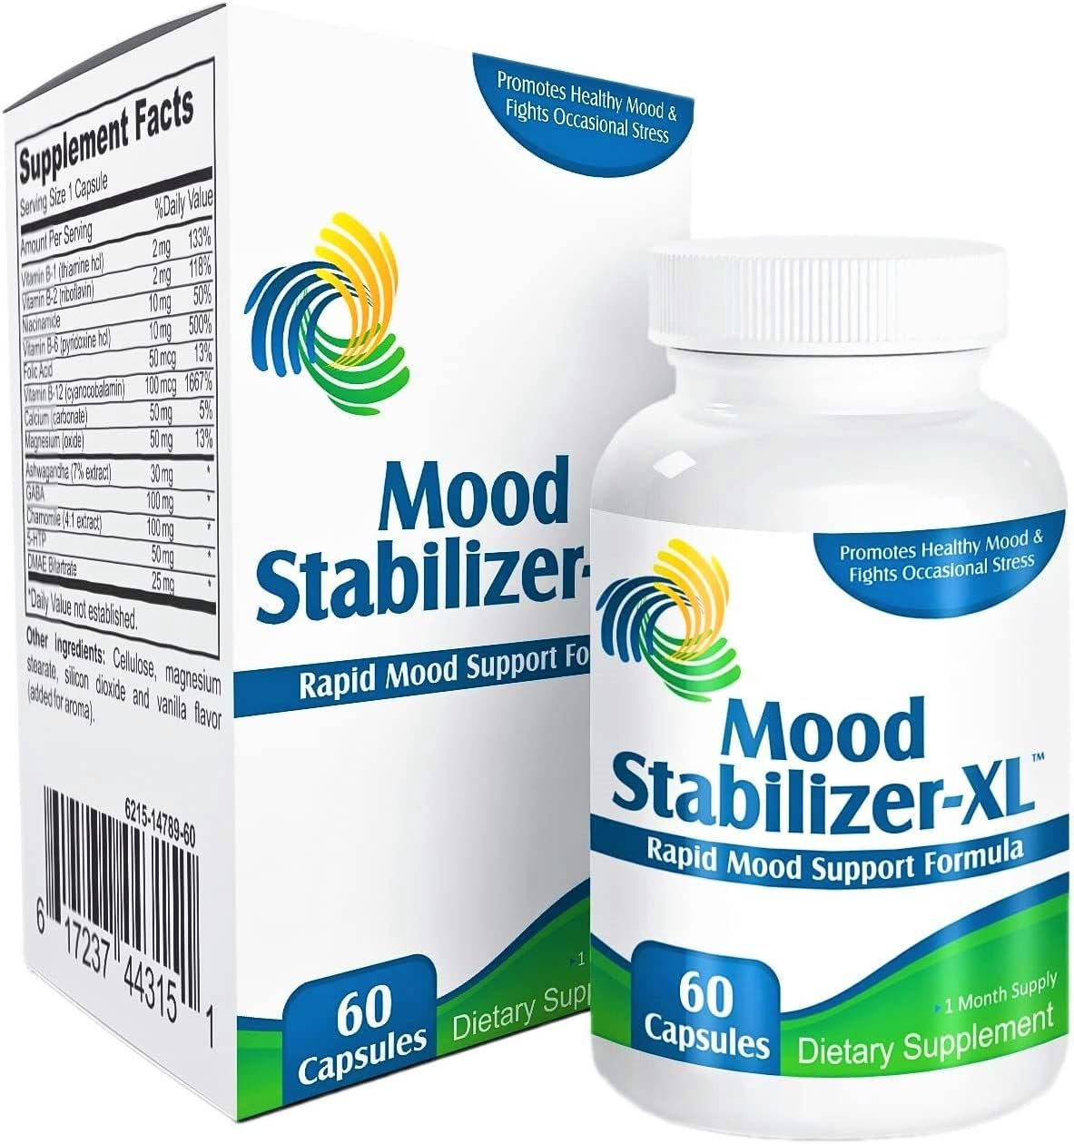
What’s a mood stabilizer?
Since there is no FDA-approved “mood stabilizer…
OTC supplements can claim to be mood stabilizers
This one contains St John’s Wort which would destabilize bipolar disorder.

Slide 4
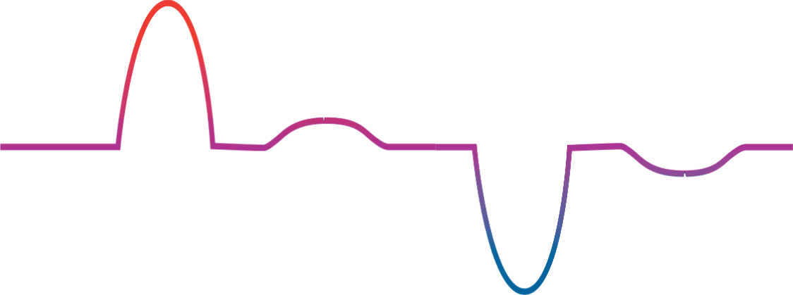
Bipolar disorder
mania
elevated mood
hypomania
Mild depression
severe
depression
depressed mood

Slide 5
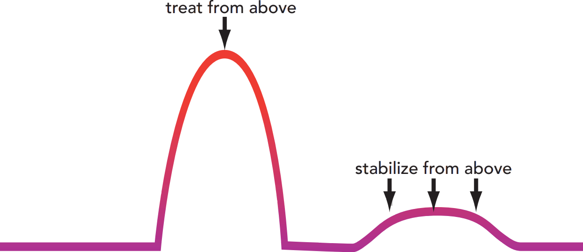
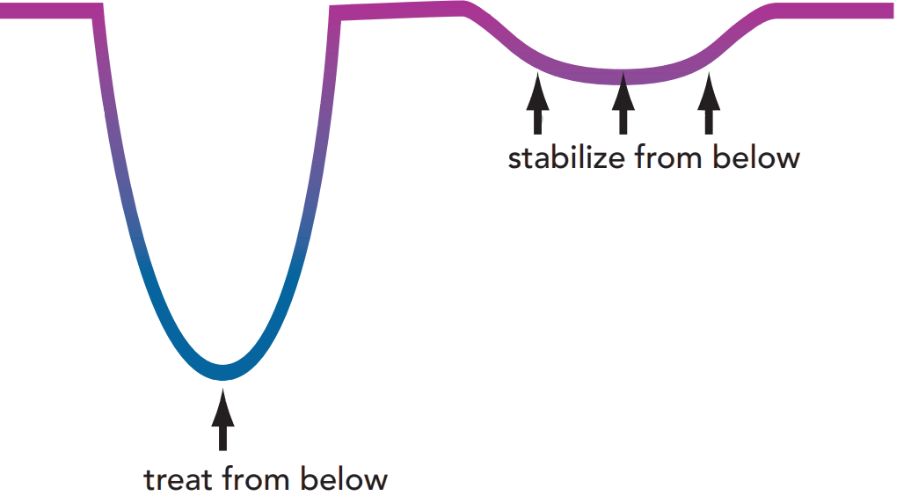
Ideally, a mood stabilizer would:
elevated mood
depressed mood

Slide 6
Lithium does all 4 (relative weakness for acute depressive episodes).
FDA-approved for bipolar mania and maintenance.
elevated mood
( )
depressed mood

Slide 7
Valproate (Depakote) is mostly antimanic.
Only FDA-approved for bipolar mania (not bipolar maintenance).
elevated mood
( )
( )
depressed mood

Slide 8
Ditto for carbamazepine (Tegretol) – mostly antimanic.
Only FDA-approved for bipolar mania.
elevated mood
( )
( )
depressed mood

Slide 9
Lamotrigine is a true “mood stabilizer” but ineffective in treatment of mania.
Only FDA-approved for bipolar maintenance.
elevated mood
depressed mood

Slide 10
Quetiapine (Seroquel) is a great mood stabilizer (and not much of an antipsychotic), but we call it an antipsychotic.
FDA-approved for bipolar depression and mania.
elevated mood
depressed mood

Slide 11
What’s a mood stabilizer?
Most psychiatrists would probably say:
Mood stabilizers = lithium and the antiepileptic drugs that stablize bipolar disorder.
The 4 FDA-approved for bipolar: lithium, valproate (Depakote), carbamazepine (Tegretol) and lamotrigine (Lamictal)…
and possibly oxcarbazepine (Trileptal) and/or eslicarbazepine (Aptiom), off-label, due to smilarilities to carbamazepine…
and possibly other antiepileptic drugs with purported mood stabilizing properties (topiramate, gabapentin, pregabalin).
Quetiapine (Seroquel) and other 2nd generation antipsychotics?
🡪 “antipsychotics that serve as mood stabilizers”

Slide 12
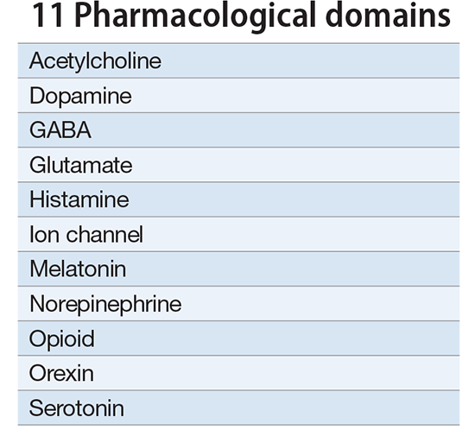
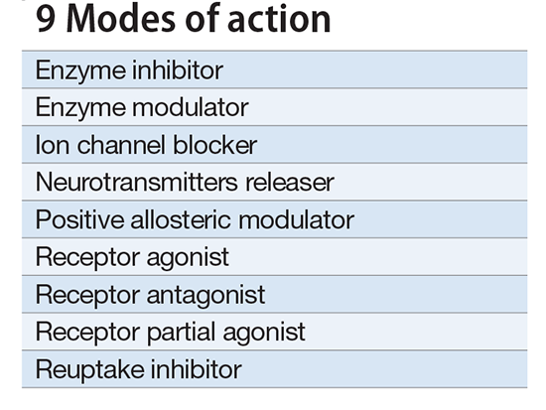
Neuroscience-based Nomenclature
lithium
antiepileptic drugs (AEDs)
the brain’s excitatory neurotransmitter
action potential

Slide 13
Antidepressants for Bipolar Disorder
Antidepressants are often “mood destabilizers” in bipolar disorder.

Slide 14
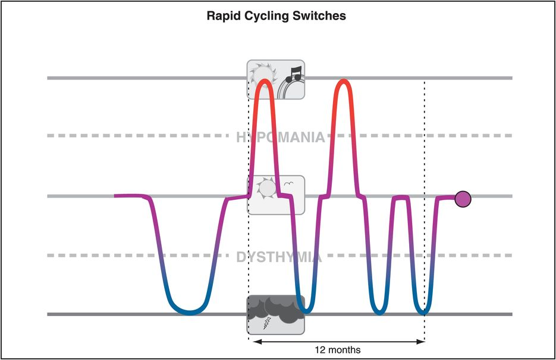
Antidepressants for Bipolar Disorder
Antidepressants are often “mood destabilizers” in bipolar disorder.
Antidepressants are ineffective in bipolar disorder, slightly inferior to placebo in large STEP-BD trial.
Despite preselection for good antidepressant response and concurrent mood stabilizer treatment, antidepressant continuation in rapid-cycling was associated with worsened maintenance outcomes, especially for depressive morbidity, versus antidepressant discontinuation.
In one-third of treatment-refractory bipolar patients, mania is likely to be antidepressant-induced and not attributable to the expected course of illness.
In STEP-BD the most important risk factor for recurrence of depression was residual subthreshold mood elevation.
For bipolar patients who are depressed, antidepressants should be tapered off.

Slide 15
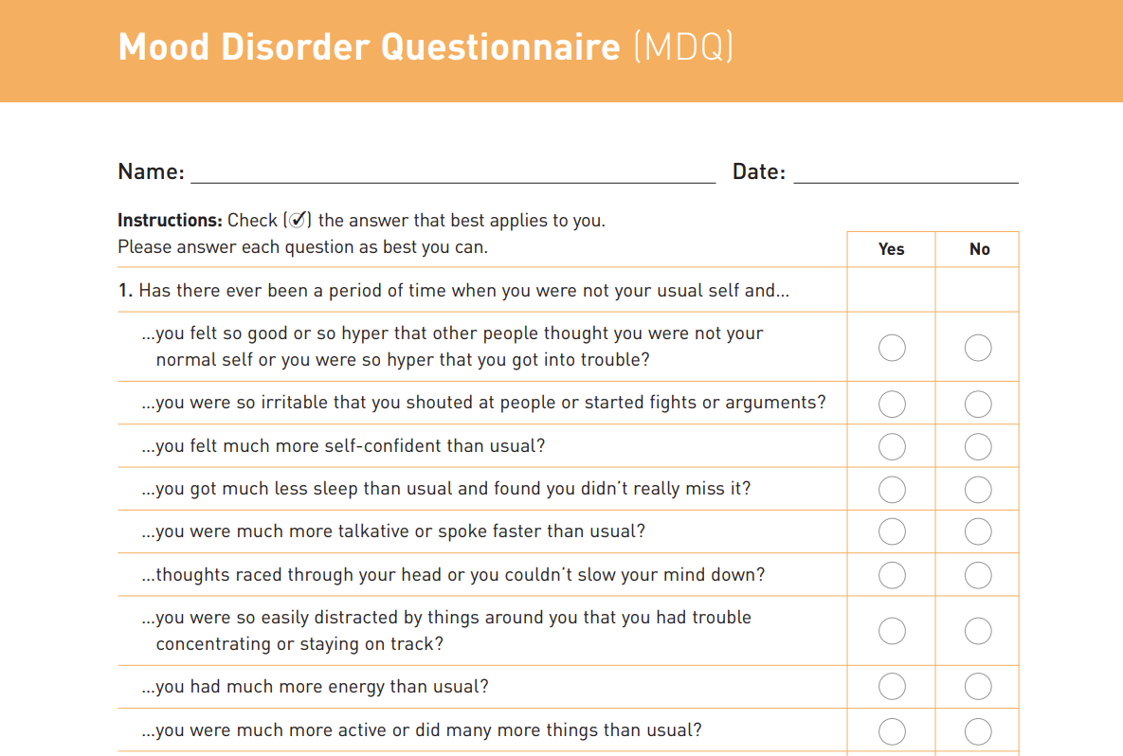
“Invincible”

Slide 16
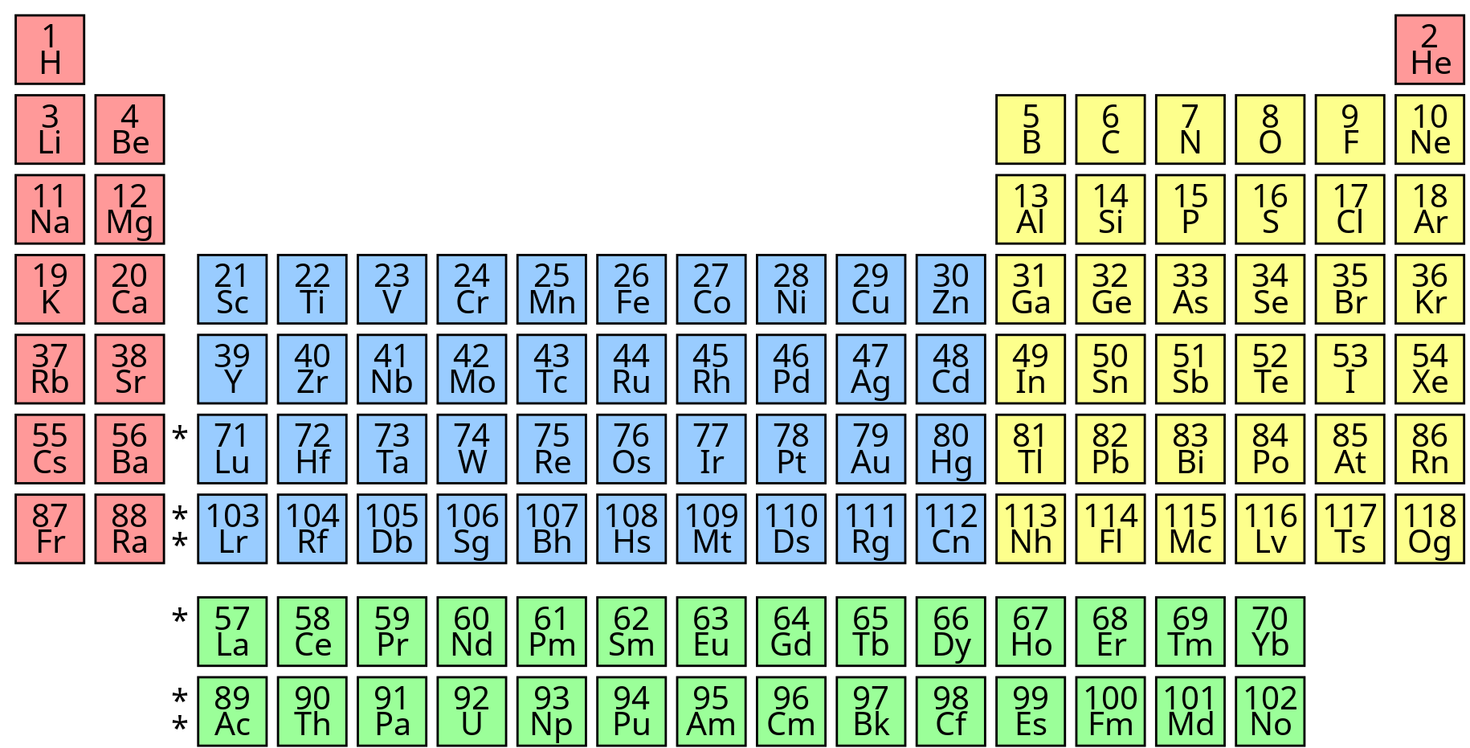
The other mood stabilizers block voltage-sensitive sodium channels.

Slide 17
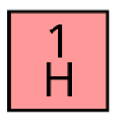
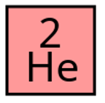
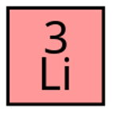
Lithium was the 3rd thing in existence

Slide 18
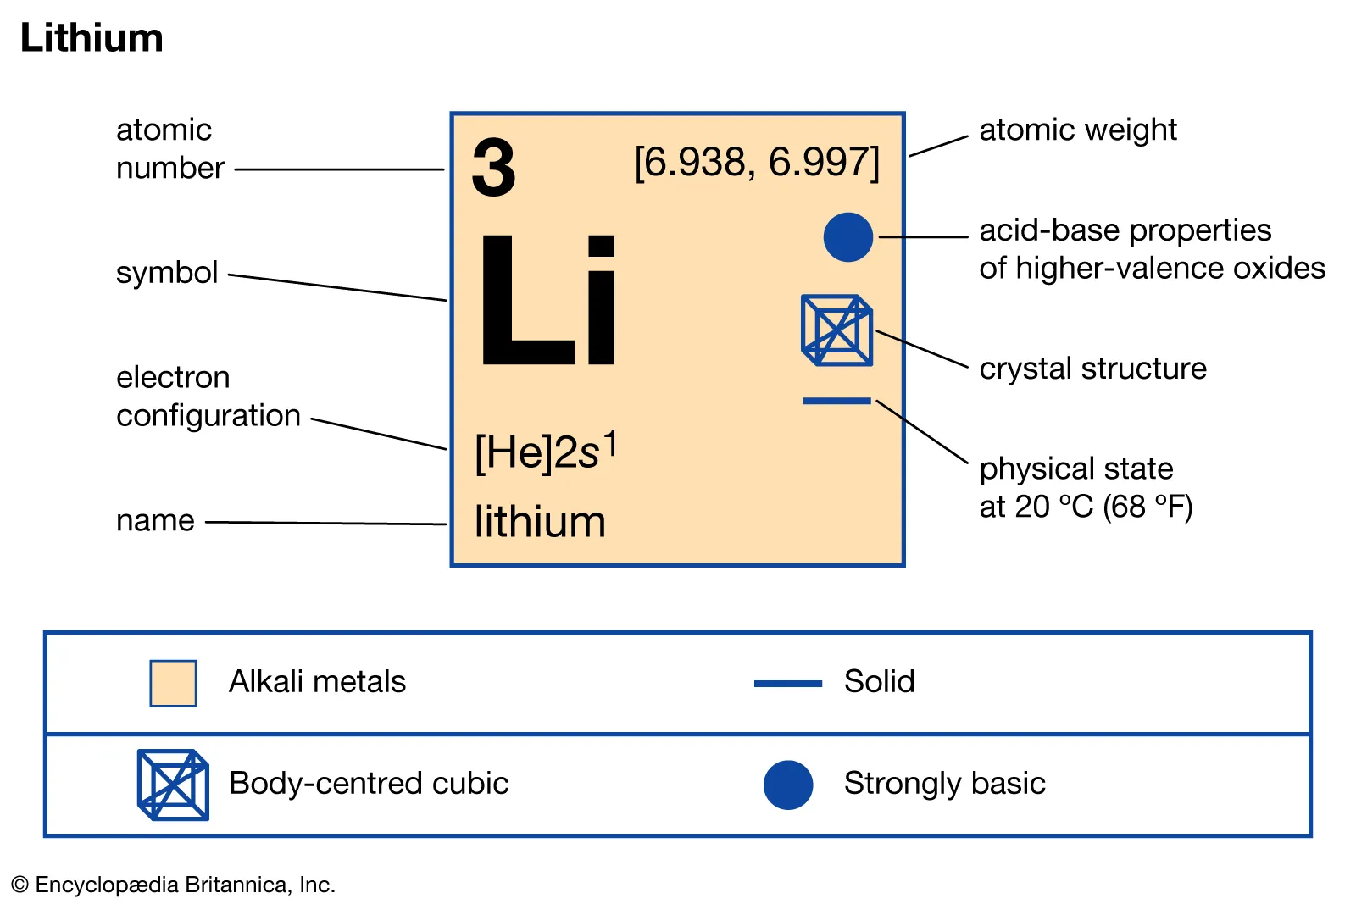
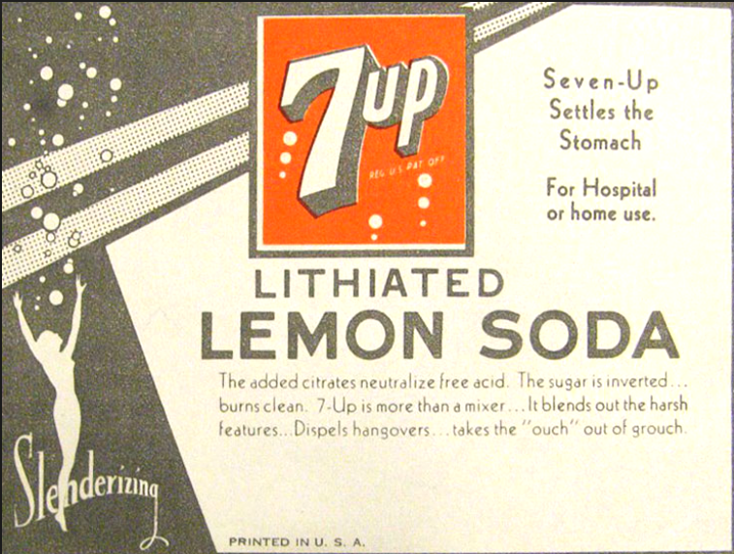
7-up contained lithium until 1950

Slide 19
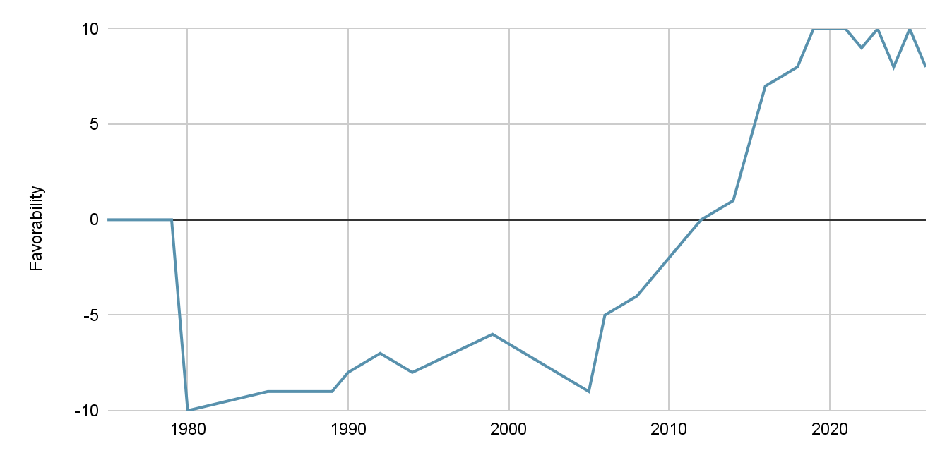
Personal perception of lithium as an ingestible
What changed my mind?

Slide 20
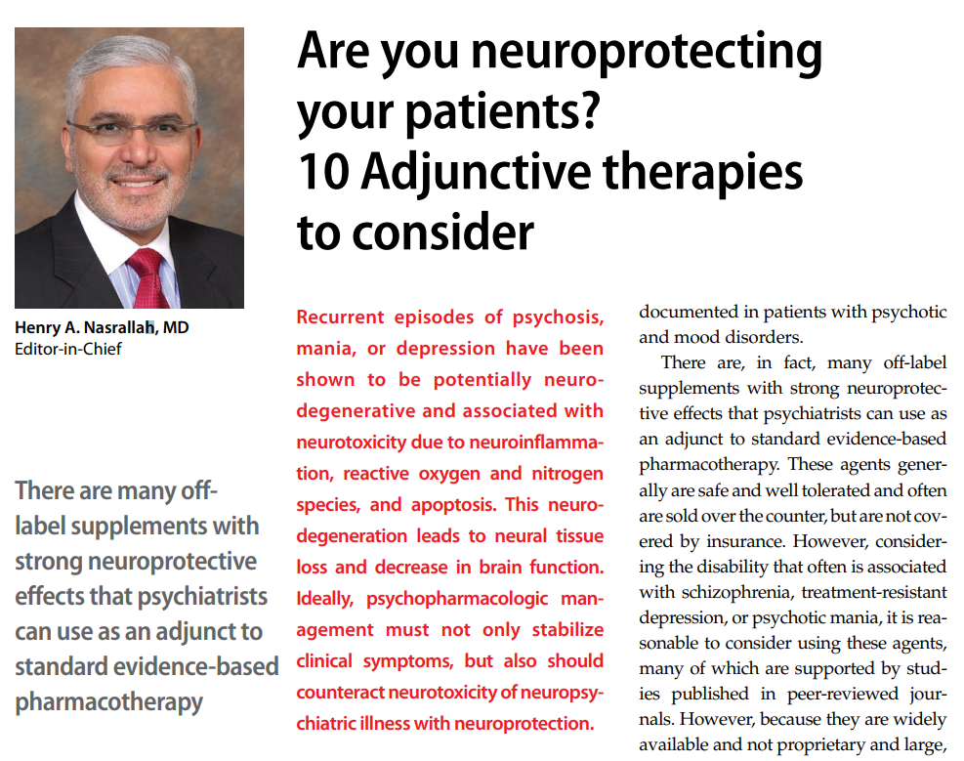
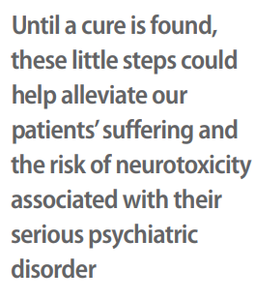
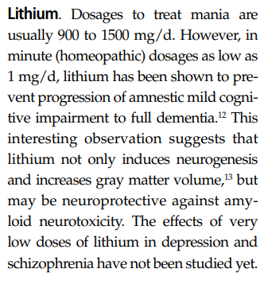
Current Psychiatry
December 2016
Forlenza OV, Diniz BS, Radanovic M, et al. Disease modifying properties of long-term lithium treatment for amnestic mild cognitive impairment: randomised controlled trial. Br J Psychiatry. 2011;198(5):351-356.

Slide 21
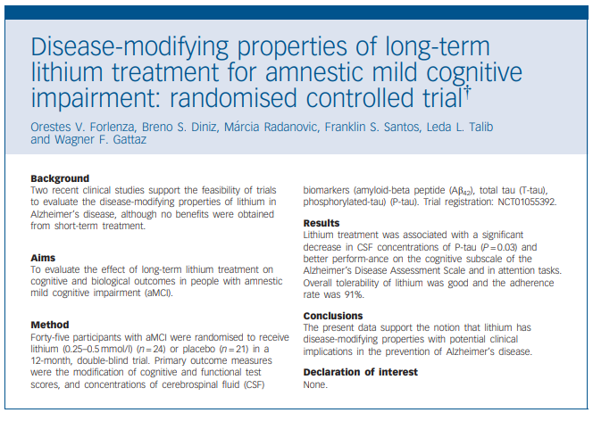
Lithium level 0.25 - 0.5
1 year
Improved cognition
Decrease in tau proteins
Forlenza OV, Diniz BS, Radanovic M, et al. Disease modifying properties of long-term lithium treatment for amnestic mild cognitive impairment: randomised controlled trial. Br J Psychiatry. 2011;198(5):351-356.

Slide 22
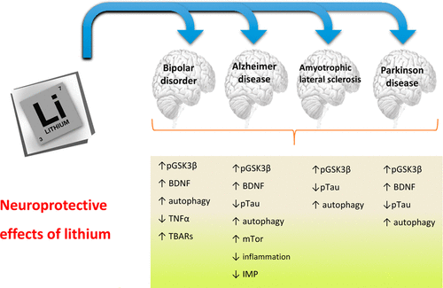
Lithium - neuroprotection
Neuroprotective Effects of Lithium: Implications for the Treatment of Alzheimer’s Disease and Related Neurodegenerative Disorders O. V. Forlenza et al. ACS Chemical Neuroscience 2014.

Slide 23
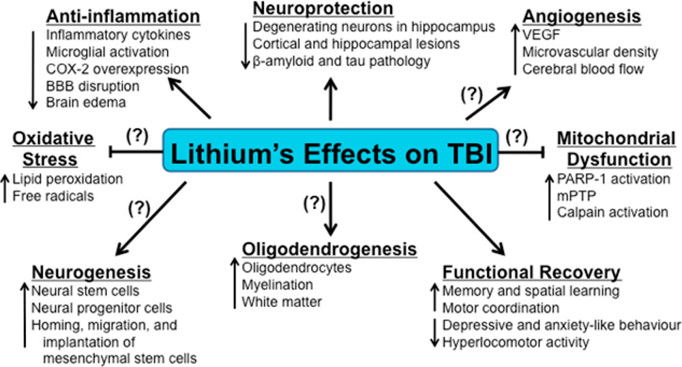
Lithium - neuroprotection post-TBI
ACS Chem. Neurosci. 2014, 5, 6, 422–433 Publication Date:April 3, 2014 https://doi.org/10.1021/cn500040g

Slide 24
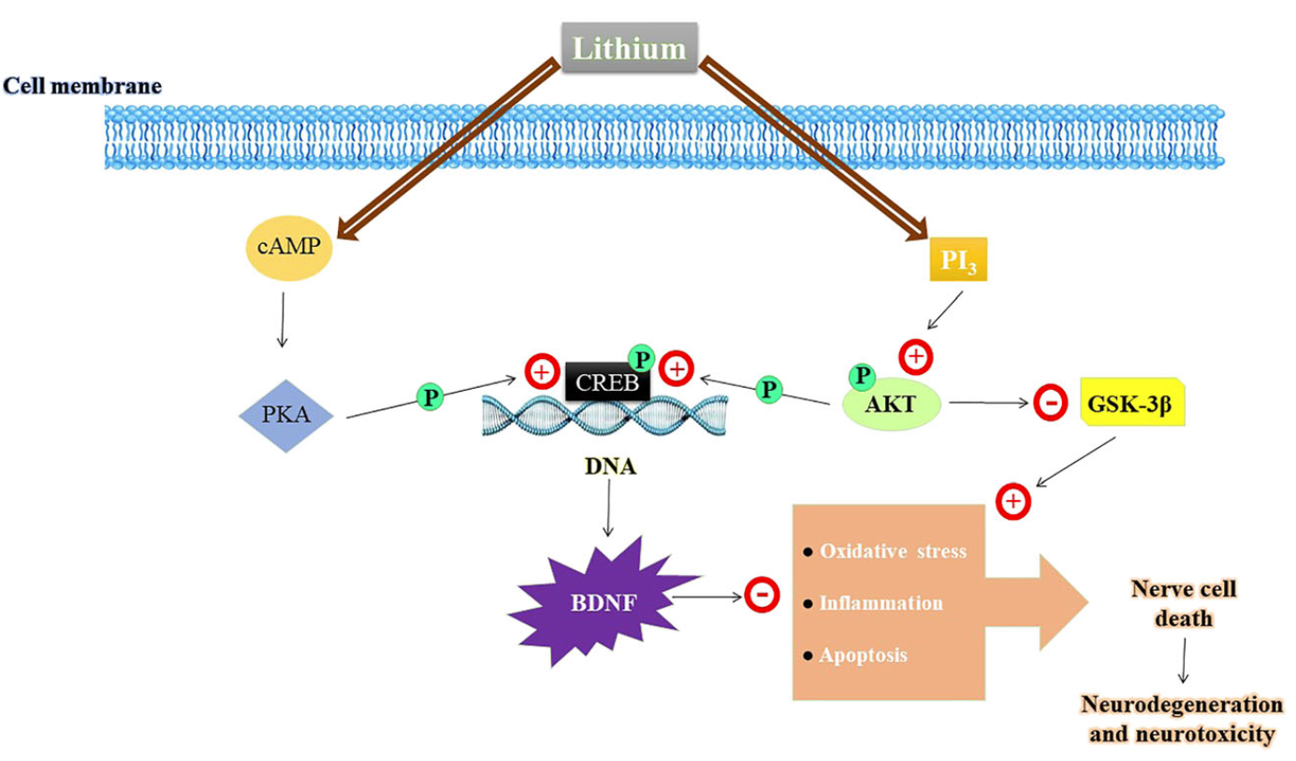
Lithium - neuroprotection
Brain-Derived Neurotrophic Factor
Jin Yan, Yuan Zhang, Lin Wang, Zhao Li, Shuang Tang, Yingwen Wang, Nina Gu, Xiaochuan Sun, Lin Li, TREM2 activation alleviates neural damage via Akt/CREB/BDNF signalling after traumatic brain injury in mice, Journal of Neuroinflammation, 10.1186/s12974-022-02651-3, 19, 1, (2022).

Slide 25
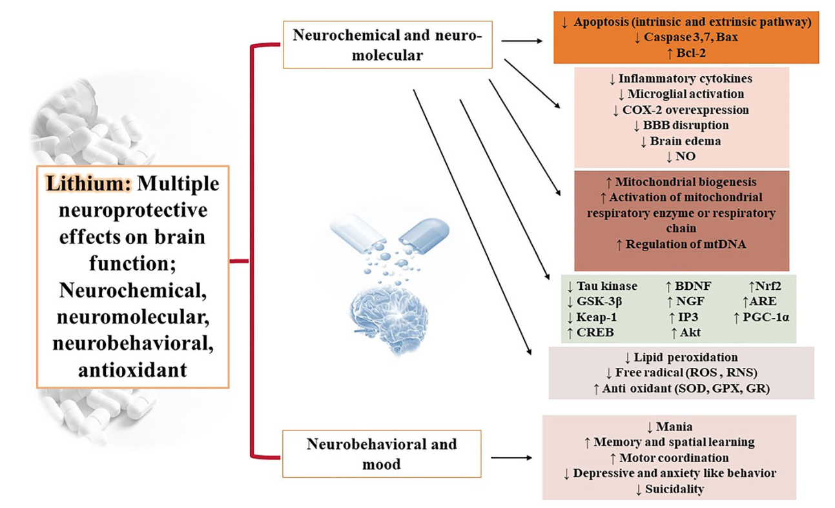
Lithium - neuroprotection
Jin Yan, Yuan Zhang, Lin Wang, Zhao Li, Shuang Tang, Yingwen Wang, Nina Gu, Xiaochuan Sun, Lin Li, TREM2 activation alleviates neural damage via Akt/CREB/BDNF signalling after traumatic brain injury in mice, Journal of Neuroinflammation, 10.1186/s12974-022-02651-3, 19, 1, (2022).

Slide 26
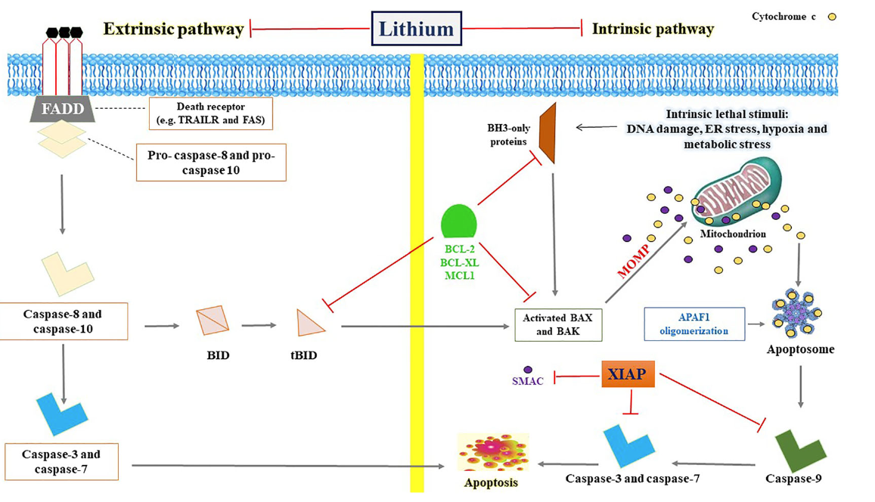
Lithium - neuroprotection
Neuroprotective Effects of Lithium: Implications for the Treatment of Alzheimer’s Disease and Related Neurodegenerative Disorders O. V. Forlenza et al. ACS Chemical Neuroscience 2014.

Slide 27
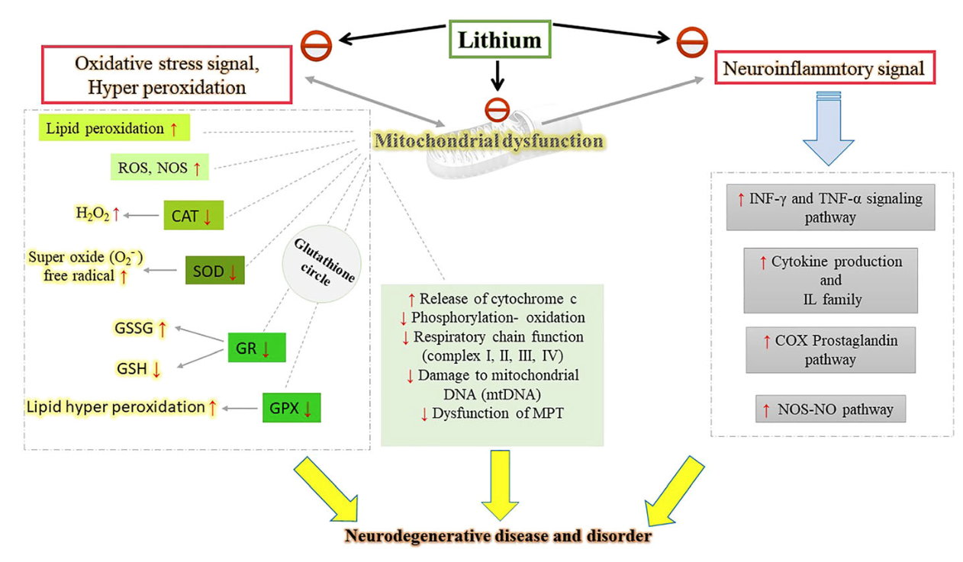
Lithium - neuroprotection
Souder, D.C., Anderson, R.M. An expanding GSK3 network: implications for aging research. GeroScience 41, 369–382 (2019). https://doi.org/10.1007/s11357-019-00085-z

Slide 28
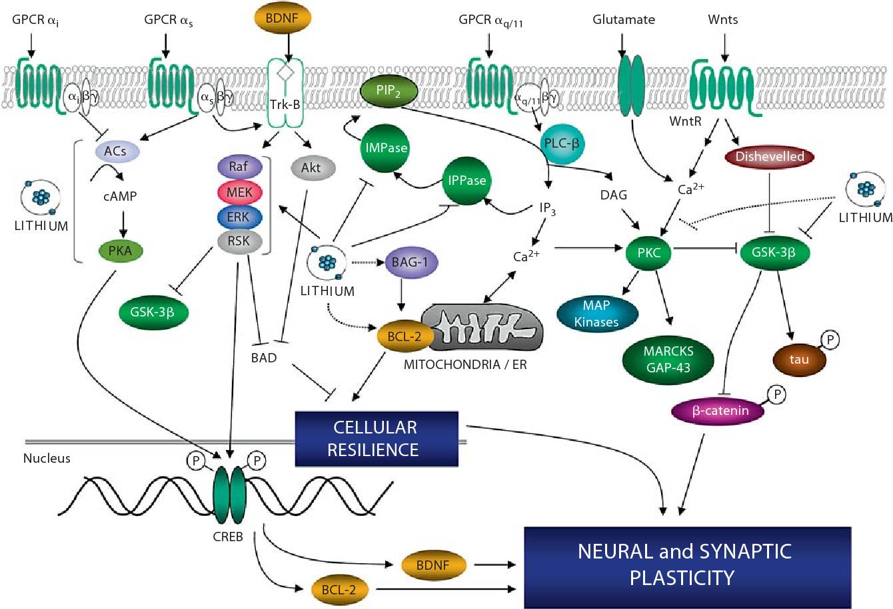
Lithium - neuroprotection
Enzyme
modulator
Quiroz, J.A., Machado-Vieira, R., Zarate Jr., C.A., & Manji, H.K. (2010). Novel Insights into Lithium’s Mechanism of Action: Neurotrophic and Neuroprotective Effects. Neuropsychobiology, 62, 50 - 60.

Slide 29
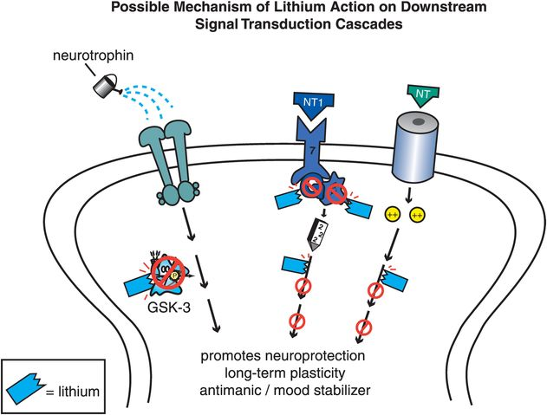
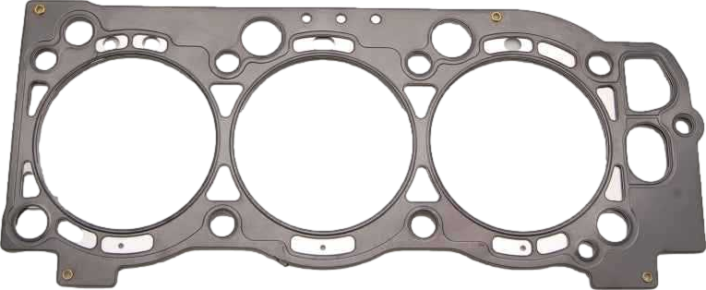
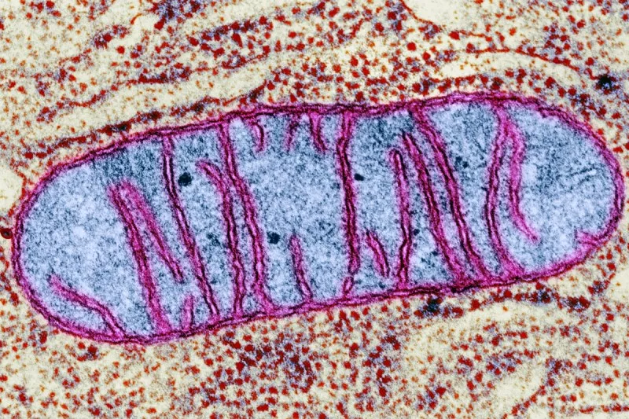
Lithium - neuroprotection
enzyme modulator
3 gaskets
Stahl’s Essential Psychopharmacology

Slide 30
Lithium
Neuroscience-based nomenclature:
enzyme modulator
Including inhibition/attenuation of:
Inositol monophosphatase
Adenylyl-cyclase
Glycogen synthase kinase (GSK-3)
Protein kinase C (PKC)
Modulator of multiple intracellular signaling cascades
Neuroprotectant
Promotes mitochondrial health
Regulator of gene expression
3 gaskets
3 gaskets

Slide 31
Lithium
The other 9:
Nicotine
Caffeine
Melatonin
Omega-3 fatty acids
N-Acetylcysteine (NAC)
Vitamin D
COX-2 inhibitors (celecoxib)
Minocycline
Erythropoietin
Current Psychiatry
December 2016
Forlenza OV, Diniz BS, Radanovic M, et al. Disease modifying properties of long-term lithium treatment for amnestic mild cognitive impairment: randomised controlled trial. Br J Psychiatry. 2011;198(5):351-356.

Slide 32
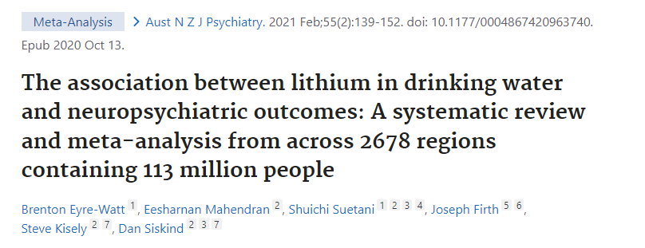
ddd
Lithium in drinking water
Higher lithium concentrations were associated with lower incidence of:
dementia
suicide
homicide
Notes:
Denmark has a robust system for measuring trace metals and other contaminants in their water supply.

Slide 33
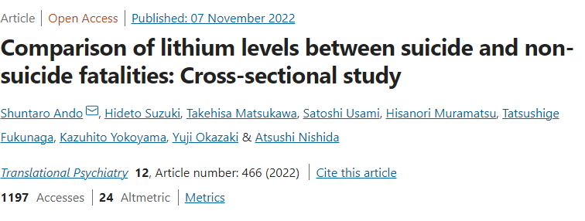
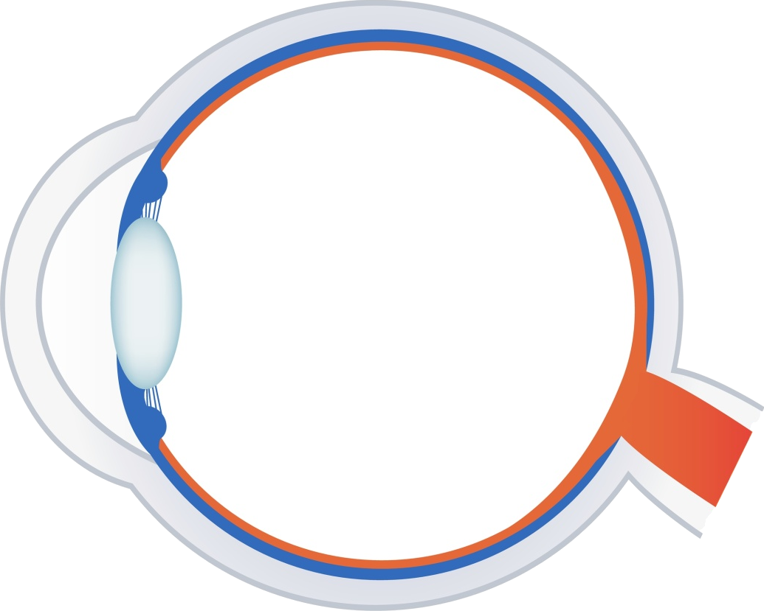
Lithium anti-suicide effects
Aqueous
humor
Suicide was associated with lower lithium concentration (aqueous humor, post-mortem) with large effect size.
In Tokyo, Ando et al (2022) compared body lithium levels between suicide and non-suicide fatalities as measured in aqueous humor. This was a small study including 12 suicides and 16 non-suicides. Subjects were all presumed to not be taking supplemental lithium.
The aqueous humor lithium concentration was significantly lower in suicides (mean 0.50 μg/L) than in non-suicides (0.92 μg/L).

Slide 34
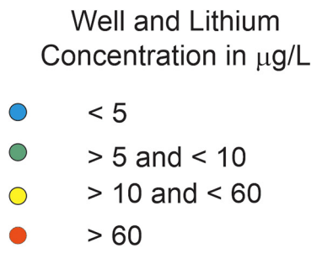
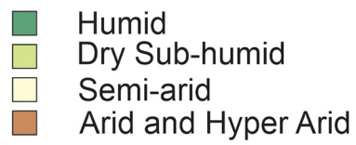
~1 mg /day
Bruce D. Lindsey, et al. Lithium in groundwater used for drinking-water supply in the United States,Science of The Total Environment,Volume 767, 2021.
Notes:
Amount of lithium in water around here is low. Many places have 10x more lithium in water, especially northern texas.

Slide 35
Lithium - anti-aging
3 gaskets
Enzyme
modulator
Castillo-Quan et al., Lithium Promotes Longevity through GSK3/NRF2-Dependent Hormesis, Cell Reports (2016) http://dx.doi.org/10.1016
Notes:
Lithium may not only prevent aging of the brain, but aging throughout. It extended the lifespan and health span of yeast and fruit flies. Mice too but less dramatically.

Slide 36
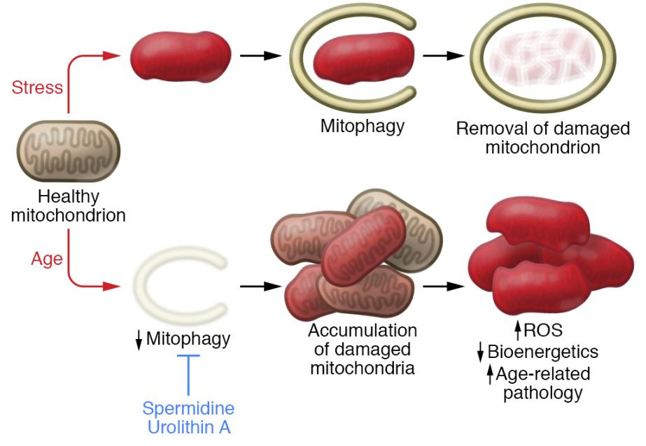
Lithium - anti-aging
Aging is in part due to mitochondrial dysfunction.
Damaged mitochondria pile up in the aging cell.
REVIEW article
Front. Psychiatry, 29 September 2020
Sec. Mood Disorders
https://doi.org/10.3389/fpsyt.2020.586083
This article is part of the Research Topic
Neurobiological Underpinnings of Bipolar Disorder and its Treatment
View all 6 Articles
Lithium and the Interplay Between Telomeres and Mitochondria in Bipolar Disorder
Mitochondrial dysfunction and telomere shortening have been implicated in both the pathophysiology of bipolar disorder and as targets of lithium treatment. Interestingly, it has in recent years become clear that these phenomena are intimately linked, partly through reactive oxygen species signaling and the subcellular translocation and non-canonical actions of telomerase reverse transcriptase. In this review, we integrate the current understanding of mitochondrial dysfunction, oxidative stress and telomere shortening in bipolar disorder with documented effects of lithium. Moreover, we propose that lithium’s mechanism of action is intimately connected with the interdependent regulation of mitochondrial bioenergetics and telomere maintenance.
Notes:
Some things accelerate the aging process, like Type 2 diabetes, obesity, even lack of sleep. Some things slow the aging process, including calorie restriction, exercise and certain chemicals. We age because every one of our cells age. Cells age when damaged mitochondria accumulate.

Slide 37
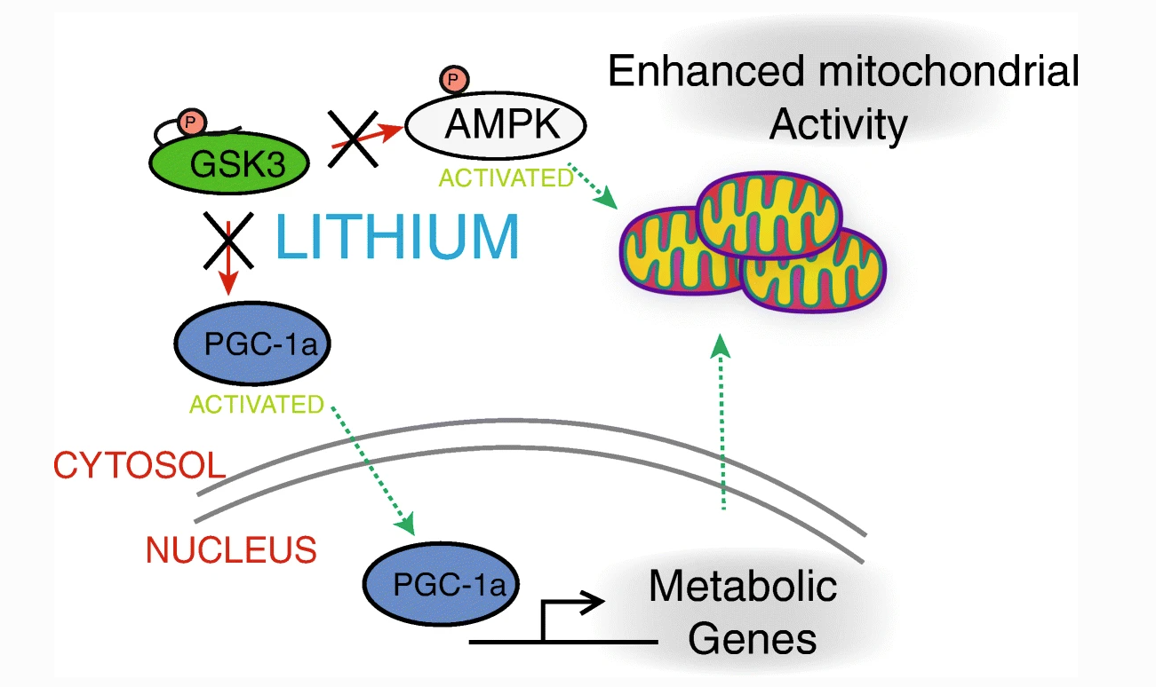
Lithium - anti-aging
3 gaskets
Enzyme
modulator
Souder, D.C., Anderson, R.M. An expanding GSK3 network: implications for aging research. GeroScience 41, 369–382 (2019). https://doi.org/10.1007/s11357-019-00085-z
Notes:
Lithium improves mitochondrial dysfunction in cells throughout the body, not just in the brain.

Slide 38
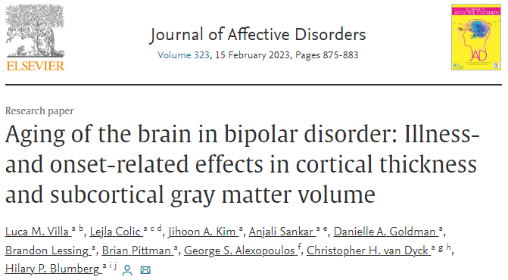
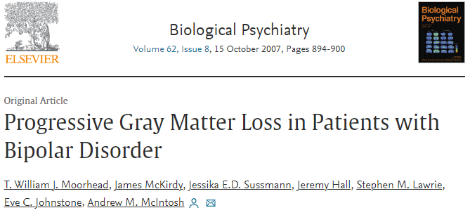
Accelerated aging in bipolar disorder
Bipolar disorder has been linked to accelerated aging mechanisms
Widespread gray matter decreases in older adults with bipolar disorder
Over a 4-year period: Patients with Bipolar I Disorder lose hippocampal, fusiform and cerebellar gray matter at an accelerated rate compared with healthy control subjects.
This tissue loss is associated with deterioration in cognitive function and illness course.

Slide 39
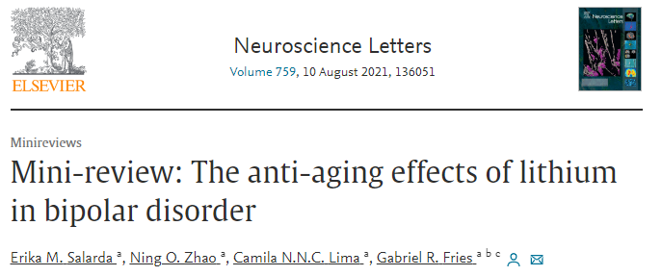
Accelerated aging in bipolar disorder
Lithium has been shown to counteract many aging mechanisms in bipolar
Lithium preserves brain volume
Squassina A, Pisanu C, Corbett N, Alda M, Telomere length in bipolar disorder and lithium response, Eur. Neuropsychopharmacol.27(2017) 560–567. 10.1016/j.euroneuro.2015
Martinsson L, Wei Y, Xu D, Melas PA, Mathé AA, Schalling M, Lavebratt C, Backlund L, Long-term lithium treatment in bipolar disorder is associated with longer leukocyte telomeres, Transl. Psychiatry. 3 (2013).
Notes:
Greater urgency in giving lithium to those with bipolar to preserve brain function and overall health

Slide 40
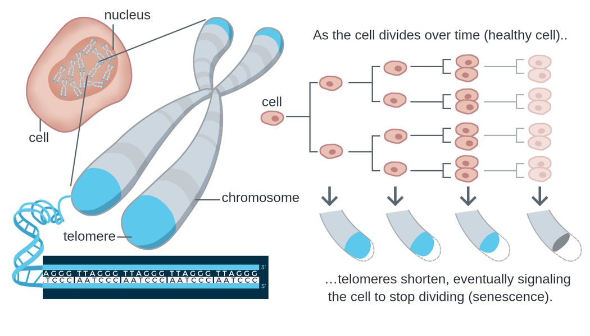
Lithium - anti-aging (bipolar)
Telomere shortening is a biomarker of aging.
https://theory.labster.com/telomere-length/
REVIEW article
Front. Psychiatry, 29 September 2020
Sec. Mood Disorders
https://doi.org/10.3389/fpsyt.2020.586083
This article is part of the Research Topic
Neurobiological Underpinnings of Bipolar Disorder and its Treatment
View all 6 Articles
Lithium and the Interplay Between Telomeres and Mitochondria in Bipolar Disorder
Mitochondrial dysfunction and telomere shortening have been implicated in both the pathophysiology of bipolar disorder and as targets of lithium treatment. Interestingly, it has in recent years become clear that these phenomena are intimately linked, partly through reactive oxygen species signaling and the subcellular translocation and non-canonical actions of telomerase reverse transcriptase. In this review, we integrate the current understanding of mitochondrial dysfunction, oxidative stress and telomere shortening in bipolar disorder with documented effects of lithium. Moreover, we propose that lithium’s mechanism of action is intimately connected with the interdependent regulation of mitochondrial bioenergetics and telomere maintenance.

Slide 41
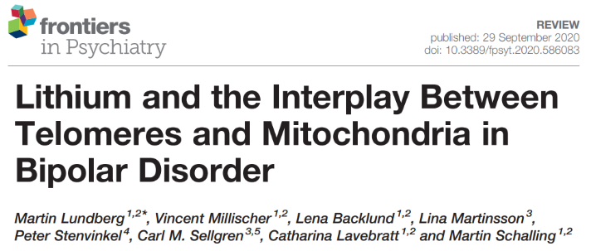
Lithium - anti-aging (bipolar)
(Leukocytes of) lithium-treated bipolar patients had 35% longer telomeres than controls.
Lundberg M, Millischer V, Backlund L, Martinsson L, Stenvinkel P, Sellgren CM, Lavebratt C, Schalling M. Lithium and the Interplay Between Telomeres and Mitochondria in Bipolar Disorder. Front Psychiatry. 2020 Sep 29;11:586083.
Martinsson L, Wei Y, Xu D, Melas PA, Mathé AA, Schalling M, et al. Long-term lithium treatment in bipolar disorder is associated with longer leukocyte telomeres. Transl Psychiatry (2013) 3(5):e261. 10.1038/tp.2013.37

Slide 42
Lithium - anti-aging (bipolar)
31,661 UK Biobank participants:
Longer leukocyte telomere length (LTL) is associated with:
decrease evidence of neurodegenerative disease on MRI
lower risk of all-cause dementia
(HR 0.93, 95% CI: 0.91–0.96)
Topiwala A, Nichols TE, Williams LZJ, Robinson EC, Alfaro-Almagro F, Taschler B, et al. (2023) Telomere length and brain imaging phenotypes in UK Biobank. PLoS ONE 18(3): e0282363.

Slide 43
Lithium - cardioprotection
Lithium may protect cardiac structure and function in patients with bipolar disorder.
Reduction of CX3CL1 (chemokine associated with the pathogenesis of mood disorders and cardiovascular diseases) may mediate the cardioprotective effects of lithium.

Slide 44
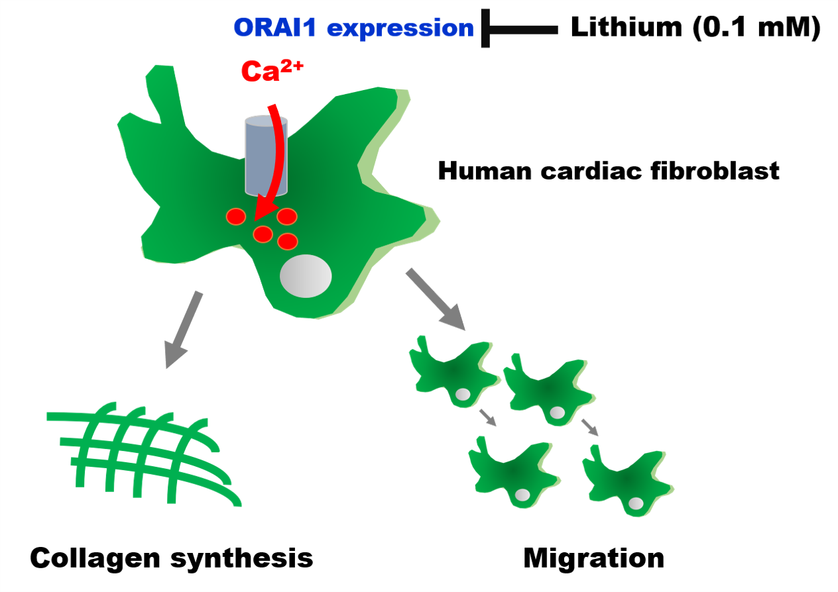
Lithium - cardioprotection
Cardiac fibrosis plays a vital role in the pathogenesis of heart failure.
Chen P-H, Chung C-C, Lin Y-F, Kao Y-H, Chen Y-J. Lithium Reduces Migration and Collagen Synthesis Activity in Human Cardiac Fibroblasts by Inhibiting Store-Operated Ca2+ Entry. International Journal of Molecular Sciences. 2021; 22(2):842.

Slide 45
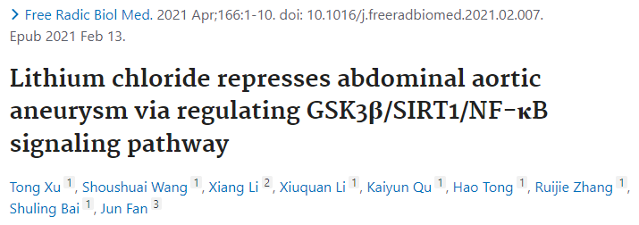
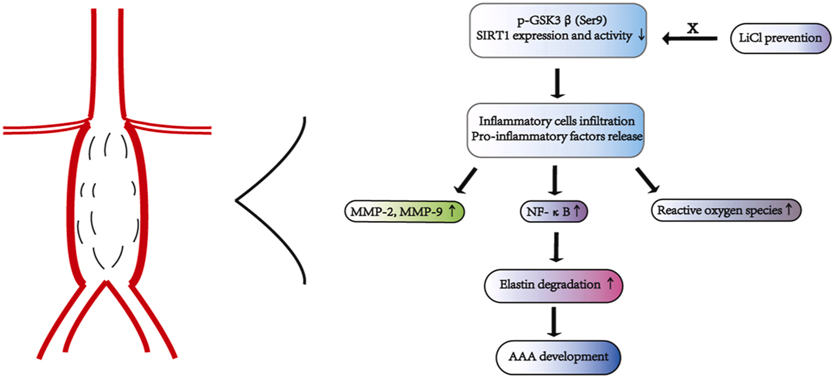
Lithium - cardioprotection
3 gaskets

Slide 46
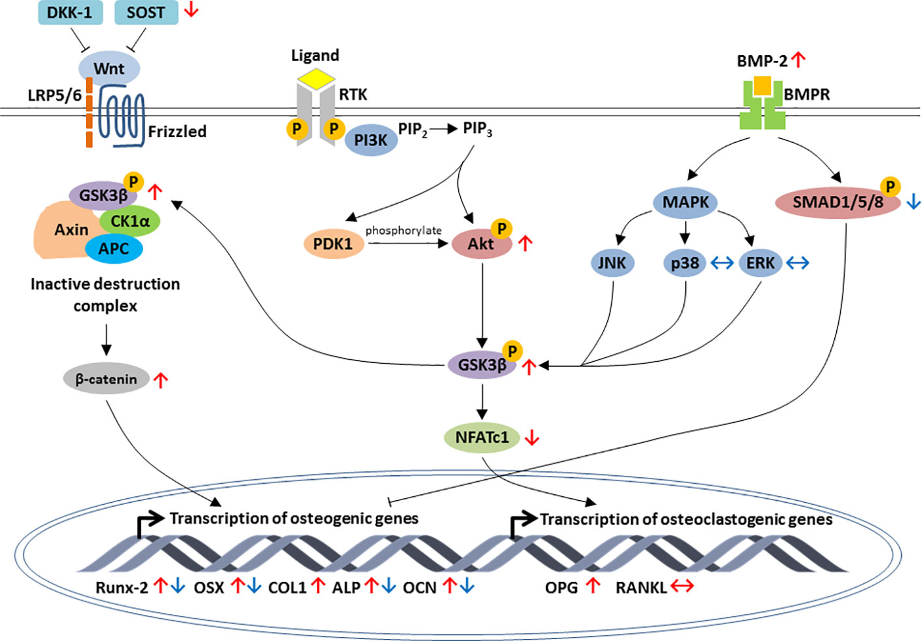
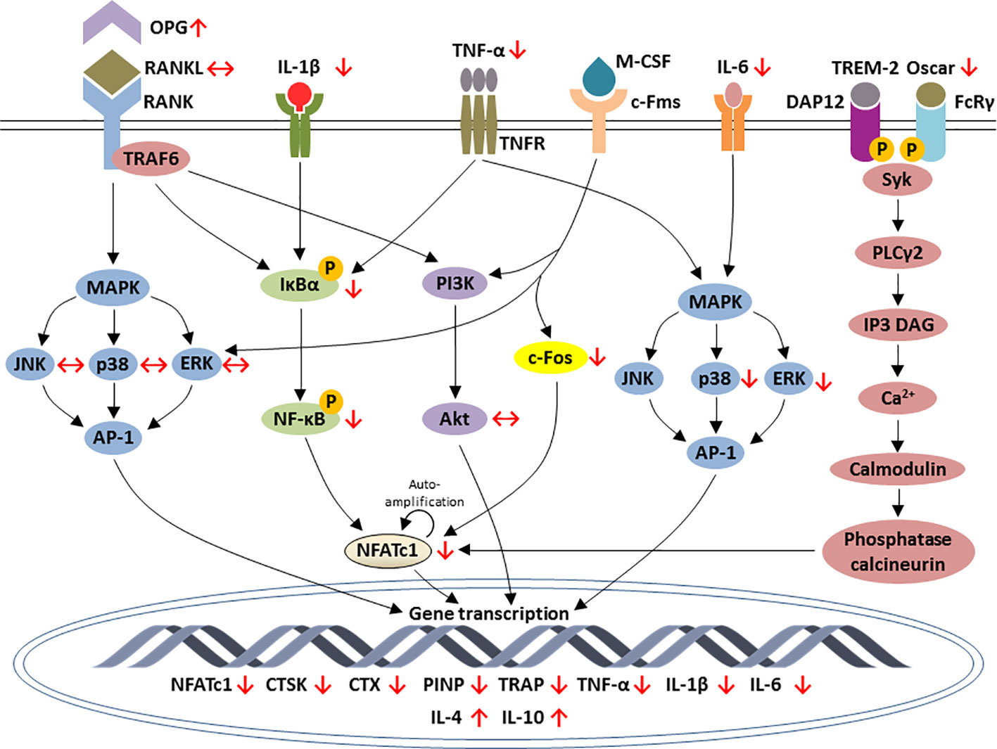
Lithium - improved bone mineral density
regulation of osteoblastic-specific genes expression by lithium
regulation of osteoclastic-specific genes expression by lithium
Wong SK, Chin K-Y and Ima-Nirwana S (2020) The Skeletal-Protecting Action and Mechanisms of Action for Mood-Stabilizing Drug Lithium Chloride: Current Evidence and Future Potential Research Areas. Front. Pharmacol. 11:430.

Slide 47
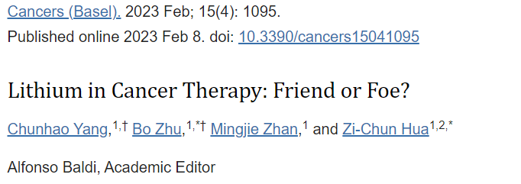
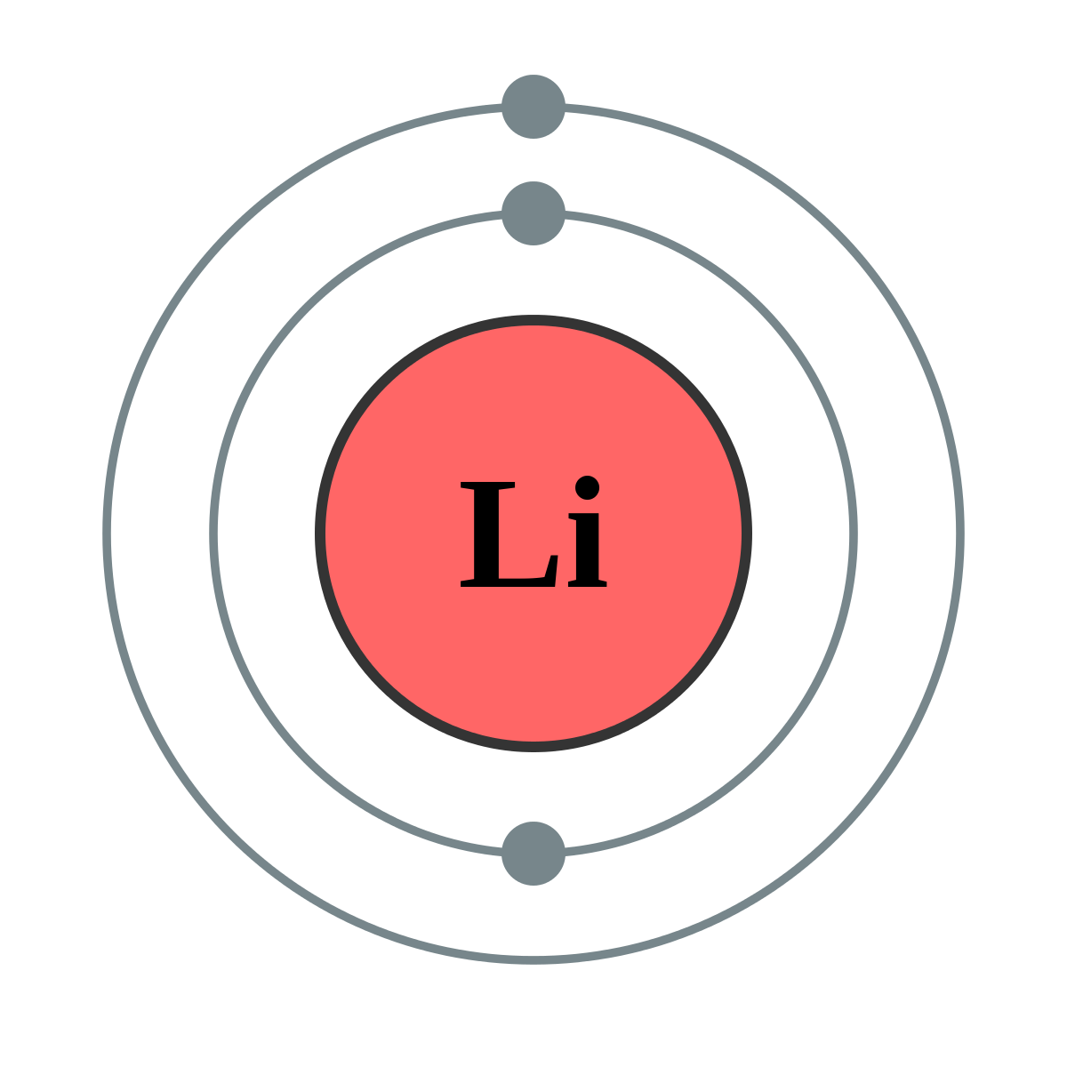
Lithium - anti-tumor effects
Much evidence shows lithium prevents the development of different cancers, including leukemia, melanoma, lung cancer, and pancreatic cancer.
Lithium prevents tumor metastasis
Lithium may increase cancer treatment efficacy while reducing side effects, suggesting that it can be used as an adjunctive therapy.
Yang C, Zhu B, Zhan M, Hua ZC. Lithium in Cancer Therapy: Friend or Foe? Cancers (Basel). 2023 Feb 8;15(4):1095.

Slide 48
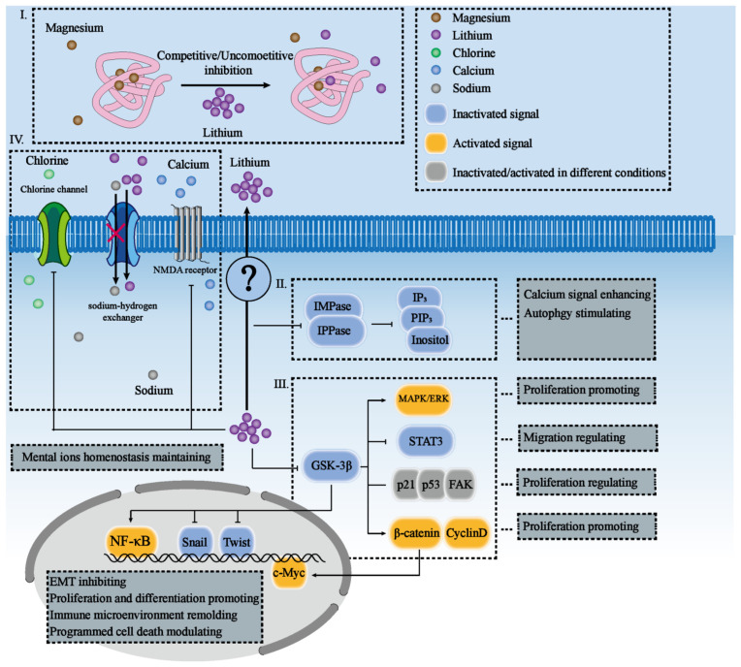
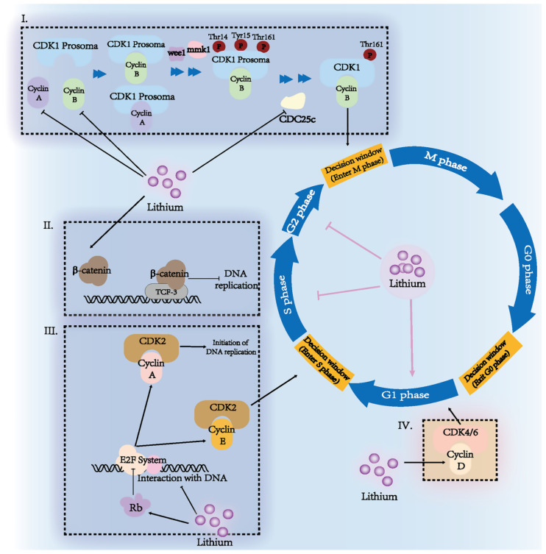
Lithium - anti-tumor effects
Yang C, Zhu B, Zhan M, Hua ZC. Lithium in Cancer Therapy: Friend or Foe? Cancers (Basel). 2023 Feb 8;15(4):1095.

Slide 49
Lithium - renal risk
Our analysis suggests no effect of stable lithium maintenance therapy (lithium levels no higher than 0.8) on the rate of change in eGFR over time.
Our results therefore contradict the idea that long-term lithium therapy is associated with nephrotoxicity in the absence of episodes of acute intoxication.
Stefan Clos, Petra Rauchhaus, Alison Severn, Lynda Cochrane, Peter T Donnan, Long-term effect of lithium maintenance therapy on estimated glomerular filtration rate in patients with affective disorders: a population-based cohort study, The Lancet Psychiatry, Volume 2, Issue 12, 2015.

Slide 50
Lithium - renal risk
Maintenance treatment with lithium or anticonvulsants as practiced in modern care is associated with an increased rate of chronic kidney disease (CKD).
However, use of lithium is not associated with an increased rate of end-stage CKD.
Kessing LV, Gerds TA, Feldt-Rasmussen B, Andersen PK, Licht RW. Use of Lithium and Anticonvulsants and the Rate of Chronic Kidney Disease: A Nationwide Population-Based Study. JAMA Psychiatry. 2015;72(12):1182–1191. doi:10.1001/jamapsychiatry.2015.1834

Slide 51
Lithium - antiepileptic effects
Lithium holds a significant interest in epilepsy, where the past reports expose its non-specific proconvulsant action, followed lately by numerous studies for anticonvulsant action.
Lithium appears to be safe and effective in bipolar disorders associated with epilepsy and may have an anticonvulsant effect in some patients (Skukla et al, 1988).
Lithium does cause seizures at toxic concentrations.

Slide 52
Lithium - weight gain?
Weight change with lithium was not clinically or statistically significant.
Weight change with lithium did not differ from placebo.
Gomes-da-Costa, et al. Lithium therapy and weight change in people with bipolar disorder: A systematic review and meta-analysis, Neuroscience & Biobehavioral Reviews, Volume 134, 2022.

Slide 53
Low-dose lithium
Retrospective observational analysis
Residential addiction treatment
150 mg lithium as a substitute for or supplement to antidepressants and anxiolytics.
Program completion rate doubled
Employment rate doubled
Lithium levels not detectable with standard lab
Confounded by the comparison group consisting of patients at the treatment center prior to Dr Gadh's arrival as medical director, which brought an array of changes including deprescribing benzodiazepines.

Slide 54
U.S. dietary intake of lithium ~ 0.6 - 3.1 mg daily (Schrauzer, 2002).
Lithium orotate pills are available on Amazon as 1, 5, 10, and 20 mg equivalents.
~1 mg /day
Lithium orotate
Lithium carbonate
Lithium citrate

Slide 55
Low-dose lithium
None of the “low-dose” lithium studies identified by systematic review specifically used 150 mg.
Actual mean dose was ~ 350 - 700 mg.
2 were microdose studies using 0.3 mg and 0.4 mg.
Target blood levels ranged from 0.2 - 0.8.
lithium carbonate 150 mg is the lowest Rx strength

Slide 56
Lithium
Gold-standard mood stabilizer
Neuroprotective
Suicide prevention
Nephrogenic diabetes insipidus
- ameliorate by giving in single daily dose
Hypothyroidism
Hyperparathyroidism (but bone strengthening)
Avoid toxic levels!
- renal damage
- encephalopathy
- potentially irreversible cerebellar damage

Slide 57
Lithium toxicity
Lithium levels increased by:
Lithium toxicity
The “N said” lithium toxicity
“Tie-dyed diuretics”
Conclusion: Educate patients that NSAIDS, blood pressure meds, and diuretics can cause lithium toxicity. For OTC pain medications, they should choose Tylenol or aspirin. Advise them to inform the prescriber if they are planning to change their caffeine intake. Excedrin is OK (combo of aspirin, acetaminophen, and caffeine). Check lithium levels frequently for patients on interacting medications. Teach the signs of lithium toxicity including tremor, nausea, diarrhea, fatigue, and drowsiness.
Notes:
Indomethacin is the worse so I should have made him indigo.

Slide 58
Lamotrigine (LAMICTAL)
“Lamb-ictal”
Lamotrigine

Slide 59
Lamotrigine is a true “mood stabilizer” but ineffective in treatment of mania.
elevated mood
depressed mood

Slide 60
Lamotrigine (LAMICTAL)
Neuroscience-based nomenclature:

Slide 61
Lamotrigine (LAMICTAL)
action potential
blocks voltage-sensitive
sodium channels
action potential
reduces glutamate release
Stahl’s Essential Psychopharmacology

Slide 62
Lamotrigine (LAMICTAL)
blocks voltage-sensitive
sodium channels
reduces glutamate release
Stahl’s Essential Psychopharmacology

Slide 63
Lamotrigine (LAMICTAL)
Minimal side effects
Minimal risks other than Stevens-Johnson syndrome
Great for bipolar maintenance
Not effective for bipolar mania
Must be titrated over 5 weeks
No lab monitoring required
Serum levels usually unnecessary
Wide therapeutic index
Wide therapeutic window
Can be used off-label for unipolar depression
Can combine with lithium for maintenance
+

Slide 64
Lamotrigine (LAMICTAL)
1 in 4,000 patients develop Stevens-Johnson rash on lamotrigine (standard titration).
1 in 10 develop benign allergic rash.
So, if a patient develops a rash on lamotrigine (standard titration), the likelihood that it’s SJS is 1 in 400
Nonetheless, for any rash occurring within 2 months, lamotrigine needs to be discontinued (because we don’t know if rash will evolve into SJS)
The risk of SJS is ~1 in 100 if lamotrigine is started at full strength without titration.
Retitration is necessary if patient stops taking lamotrigine for > 1 week.

Slide 65
Stevens-Johnson syndrome (SJS)
Stevens-Johnson syndrome (SJS) | Benign rash
❖ Usually occurs between 1–12 weeks ❖ Purpuric (non-blanching), may be tender ❖ Rapidly confluent and wide-spread ❖ Usually involves neck and above ❖ Can involve conjunctiva, mucous membranes ❖ With fever, malaise or lymphadenopathy ❖ Leukocytosis | ❖ Peaks at 10–14 days ❖ Non-tender ❖ Spotty (non-confluent) ❖ Below the neck ❖ No involvement of mucous membranes ❖ No fever, malaise or lymphadenopathy ❖ Normal CBC and CMP
Purrrrr

Slide 66
Serious or benign?
BENIGN
The exanthematous (maculopapular) drug eruption with confluent areas of morbilliform (measles-looking) erythema with small white areas of sparing.
This is the most common type of drug reaction.
https://www.contemporarypediatrics.com/view/drug-eruptions-benignand-life-threatening

Slide 67
Serious or benign?
Serious
Stevens-Johnsons Syndrome
above the neck
mucus membrane involvement
MERCK MANUAL - DR P. MARAZZI/SCIENCE PHOTO LIBRARY

Slide 68
Serious or benign?
Serious
Toxic epidermal necrolysis (TEN)
TEN = SJS covering 30%+ body surface
https://www.contemporarypediatrics.com/view/drug-eruptions-benignand-life-threatening

Slide 69
Lamotrigine interactions
Phase II metabolism, UGT1A4
Lamotrigine
UGT1A4 substrate
Ugg wool boots for UGT substrate
Jou Young Lee, PA
1 Animal, 4 boots

Slide 70
Lamotrigine interactions
18% of individuals are UGT1A4 ultrarapid metabolizers.
0% are poor metabolizers.
Phase II metabolism, UGT1A4
UGT1A4
ultrarapid
metabolizer

Slide 71
Pharmacokinetic (PK) interactions
Drug metabolism
enzyme
Substrate
“victim drug”
metabolite
Notes:
“Subs” are the “victim” drugs in PK interactions.
Subs are modified by specific enzymes
en route to being cleared from the body.

Slide 72
Enzyme inHibition
Enzyme inHibition causes increased levels of “victim” drug (substrate).
H for High and Hurried
(immediate effect)
substrate
inHibitor
Notes:
I emphasize the H in inHibition
for HIGH and HURRIED,
an immediate effect.

Slide 73
Enzyme inHibition
2-fold
increase
substrate, e.g.,
lamotrigine (Lamictal)
High and
Hurried
inHibitor, e.g.,
valproate (Depakote)
Notes:
An example: A patient is maintained on clozapine for schizophrenia.
Fluvoxamine is added for obsessiveness.
Profound sedation results because blood
levels of clozapine TRIPLE due to enzyme inHibition.

Slide 74
The 2 Actions
inHibitor
inDucer
Notes:
The 2 actions are
inHibition and inDuction
(up and down)

Slide 75
Enzyme inDuction
Enzyme inDuction causes decreased levels of “victim” drug (substrate).
D for Down and Delayed
(2–4 weeks)
inDucer
substrate
Notes:
inDuction is “Down and Delayed”,
causing a gradual decrease
of the victim drug
due to increased enzyme production.

Slide 76
Enzyme inDuction
Down and Delayed
inDucer, e.g.,
carbamazepine
Wait for liver to unregulate production of metabolic enzymes
substrate, e.g.,
quetiapine (Seroquel)
)
6-fold
decrease
Notes:
In our example, a patient is taking lurasidone.
The doctor adds carbamazepine for mood stabilization.
Nothing is noticeable for a couple of weeks, but the liver is ramping up enzyme production.
After a couple of weeks, lurasidone stops working, and the patient’s mood destabilizes.
The prescriber may have no idea why things went poorly.

Slide 77
Phase II Metabolism
Phase I
Phase II
CYP
UGT
glucuronic acid
“U Got Tagged”

Slide 78
Interaction mnemonics
UGT enzymes
“U Got Tagged”
inDuction
UGT
inDucer
Down and Delayed
UGT1A4
Substrate
“1 Animal, 4 Uggs”
Notes:
Razors decrease levels of lamb medications , such as lamotrigine (Lamictal)

Slide 79
Interaction mnemonics
UGT enzymes
“U Got Tagged”
inDuction
Carbamazepine
(Tegretol)
“Tiger tail”
Down and Delayed
50% decrease
Lamotrigine (Lamictal)
“Lamb-ictal”
Notes:
Carbamazepine is a shaver.

Slide 80
Lamotrigine (LAMICTAL)
UGT1A4
inducer
UGT1A4
substrate
inDucer
= Down and Delayed

Slide 81
Lamotrigine interactions
18% of individuals are UGT1A4 ultrarapid metabolizers.
0% are poor metabolizers.
Phase II metabolism, UGT1A4
These UGT1A4 inDucers are expected to cause a Decrease of lamotrigine blood levels by about 50%
Carbamazepine
TEGRETOL
Primidone
MYSOLINE
Phenytoin
DILANTIN
Phenobarbital
LUMINAL
estrogens or pregnancy
Rifampin
RIFADIN
30-40% decrease

Slide 82
Lamotrigine interactions
18% of individuals are UGT1A4 ultrarapid metabolizers.
0% are poor metabolizers.
Phase II metabolism, UGT1A4
inHibitor = High
increased lamotrigine level
inHibition happens
within hours = Hurried
UGT1A4 inhibitor
UGT1A4
substrate

Slide 83
Lamotrigine (LAMICTAL)
Valproate (DEPAKOTE)
UGT1A4
UGT1A4
substrate

Slide 85
SUBVENITE
starter kits
“Substitute convenient”
“UGT substrate convenience?”

Slide 86
Valproate
valproate = general term including valproic acid or divalproex (Depakote)
Depakene = valproic acid (VPA) = the active drug / what we test blood levels of
Depakote DR = regular Depakote
“When the Dr Says Depakote, she means Depakote DR”
Depakote ER = the extended release form of Depakote
Only ~85% bioavailable compared to DR
Depakote IR = does not exist. That would be Depakene.

Slide 87
Valproate (Depakote)
Valproate
Official neuroscience-based nomenclature:
“unclear”

Slide 88
Valproate (Depakote)
Valproate
But the mechanism seems to involve:
inhibitory (VPA increases)
excitatory (VPA decreases)

Slide 89
Valproate
Voltage-sensitive calcium channel blocker
Voltage-sensitive sodium channel blocker
blocks glutamate (blocks excitatory)
enhances GABA (inhibitory)
Stahl’s Essential Psychopharmacology

Slide 90
inHibition
inDuction
UGT
High &
Hurried
Down &
Delayed
valproate

Slide 91
Valproate
UGT
blocks glutamate (blocks excitatory)
enhances GABA (inhibitory)

Slide 92
Valproate
Valproate
Stahl’s Essential Psychopharmacology

Slide 93
Valproate
Stahl’s Essential Psychopharmacology

Slide 94
Valproate
UGT
valproate
DEPAKOTE
3 gaskets

Slide 95
Valproate
UGT
inHibitor
valproate
DEPAKOTE
VPA
High &
Hurried

Slide 96
UGT
lamotrigine
LAMICTAL
valproate
DEPAKOTE
UGT1A4
inHibitor
UGT1A4
substrate
Lamotrigine

Slide 97
Not GSK3 inhibitor
GSK3 inhibitor
Not PKC inhibitor
PKC inhibitor
UGT
lamotrigine
LAMICTAL
valproate
DEPAKOTE

Slide 98
sensitive substrate (UGT1A4)
UGT
lamotrigine
LAMICTAL
valproate
DEPAKOTE

Slide 99
lamotrigine
LAMICTAL
valproate
DEPAKOTE

Slide 100
lamotrigine
LAMICTAL
valproate
DEPAKOTE

Slide 101
sensitive substrate (UGT1A4)
UGT
lamotrigine
LAMICTAL
valproate
DEPAKOTE

Slide 102
UGT
lamotrigine
LAMICTAL
valproate
DEPAKOTE
UGT1A4
inHibitor
UGT1A4
substrate
Lamotrigine

Slide 103
UGT
valproate
DEPAKOTE
UGT1A4 UGT2B15
inHibitor
UGT1A4
substrate
lorazepam
UGT2B15 substrate
L-O-T benzodiazepine

Slide 104
UGT
valproate
DEPAKOTE
UGT1A4 UGT2B15
inHibitor
UGT1A4
substrate
oxazepam
UGT2B15 substrate
L-O-T benzodiazepine

Slide 105
UGT
valproate
DEPAKOTE
UGT1A4 UGT2B15
inHibitor
UGT1A4
substrate
temazepam
UGT2B15 substrate
L-O-T benzodiazepine

Slide 106
Valproate
Valproate doubles lamotrigine. So the starter pack contains ½-strength lamotrigine.

Slide 107
Valproate
Antimanic agent
Compared to lithium, lamotrigine, or carbamazepine, more:
weight gain
tremor
sedation
Need to monitor
serum VPA level
liver enzymes
Potential for hyperammonemic encephalopathy
If patient is confused, check ammonia levels
Teratogenic

Slide 108
Carbamazepine (Tegretol)

Slide 109
Carbamazepine (Tegretol)
“shredder” inDucer of UGT, CYP, and P-gp enzymes
Notes:
Most important thing to remember about carbamazepine

Slide 110
Carbamazepine (Tegretol)
carbamazepine
TEGRETOL
ATP-sensitive potassium channel blocker
enhances GABA
“shredder” inDucer of CYP, UGT and P-gp enzymes

Slide 111
UGT
sensitive substrate (UGT1A4)
valproate
DEPAKOTE
carbamazepine
TEGRETOL
lamotrigine
LAMICTAL

Slide 112
inDuction
carbamazepine
TEGRETOL
Down & Delayed
lamotrigine
LAMICTAL

Slide 113
inDuction
Down & Delayed
carbamazepine
TEGRETOL
lamotrigine
LAMICTAL

Slide 114
inDuction
Down & Delayed
carbamazepine
TEGRETOL
lamotrigine
LAMICTAL

Slide 116
carbamazepine
TEGRETOL
oxcarbazepine
TRILEPTAL
moderate inDucer of CYP3A4
“shredder” inDucer of UGT, CYP, and P-gp enzymes
Safer overall (other than hyponatremia)
But no real evidence in bipolar

Slide 117
Carbamazepine (Tegretol)
Official neuroscience-based nomenclature:

Slide 118
Carbamazepine (Tegretol)

Slide 119
Carbamazepine (TEGRETOL)
“Tiger tail (in the) Car Maze”
Notes:
This mnemonic accomplishes everything I’m going for - pairs trade name with the generic-- TIGER TAIL

Slide 120
Carbamazepine (TEGRETOL)
“Tiger tail (in the) Car Maze”

Slide 121
Carbamazine (Tegretol)
Enzyme inDucer
Always check interactions with other medications!
Antimanic
2nd line to lithium, valproate, and antipsychotics
Antiepileptic
Health risks
Effective for neuropathic pain
Monitor serum levels if used for seizures (optional for bipolar)

Slide 122
Risks of CBZ:
hyponatremia
Carbamazepine
(TEGRETOL)
“Tiger tail (in the)
Car Maze”
terato-
genicity
aplastic anemia
(rare)
Na⁺ Na⁺
decreased bone mineral density
agranulo-
cytosis (rare)
reduced levels of many medications
neural tube defects
hepatotoxicity
Notes:
most typically neural tube defects, pretty much contraindicated in women of childbearing age

Slide 123
Risks of CBZ:
hyponatremia
Carbamazepine
(TEGRETOL)
“Tiger tail (in the)
Car Maze”
terato-
genicity
aplastic anemia
(rare)
Na⁺ Na⁺
decreased bone mineral density
agranulo-
cytosis (rare)
reduced levels of many medications
hepatotoxicity

Slide 124
Risks of CBZ:
hyponatremia
Carbamazepine
(TEGRETOL)
“Tiger tail (in the)
Car Maze”
terato-
genicity
aplastic anemia
(rare)
Na⁺ Na⁺
decreased bone mineral density
agranulo-
cytosis (rare)
reduced levels of many medications
hepatotoxicity
Notes:
Shredder inducer

Slide 125
Carbamazepine (TEGRETOL)
inDuction
Autoinduction of CYP3A4
Down and Delayed
Carbamazepine “eats its own tail” inducing its own metabolism as a CYP3A4 substrate and inDucer.
Serum levels lower by one month.

Slide 126
Carbamazepine
(TEGRETOL)
FDA-approved for:
❖ Seizure disorder
❖ Trigeminal neuralgia
❖ Manic/mixed episode of
bipolar I disorder
Used off label for:
❖ Bipolar maintenance
❖ Neuropathic pain
❖ Restless legs syndrome
❖ Migraine prophylaxis
❖ Alcohol use disorder

Slide 127
Carbamazepine
(TEGRETOL)
Recommendation:
Only prescribe it if you can manage the drug-drug interactions.
Always run interaction check when you encounter it!
Not for childbearing women.
Notes:
relieve alcohol withdrawal symptoms and assist in maintaining sobriety (off-label)

Slide 128
Carbamazepine
(TEGRETOL)
Three mood stabilizers FDA-approved for bipolar mania:
❖ Lithium
❖ Valproate
❖ Carbamazepine

Slide 129
Carbamazepine
(TEGRETOL)
Advantages over valproate and lithium:
❖ No weight gain
❖ No tremor
❖ Also effective for neuropathic pain
But lithium-induced weight gain is a myth.

Slide 130
Asian patients have a 10-fold higher incidence of carbamazepine-induced SJS and TEN
FDA recommends screening Asians for the HLA-B*1502 allele, which would be a contraindication for starting CBZ.
“Hey Look, Asian Blood!
if 1502, no Tegretol for you!”

Slide 131
Carbamazepine kinetic interactions:
3A4 inDucer
(strong)
2B6 inDucer
(moderate)
1A2 inDucer
(weak)
UGT inDucer
(moderate)

Slide 132
Carbamazepine kinetic interactions:
3A4 substrate (fish)

Slide 133
Interaction mnemonics
CYP3A4
“3 A’s For
(fishing)”
inDuction
3A4
Down and Delayed
inducer
3A4
substrate
Notes:
Anvils
drop
the blood levels
of fish

Slide 134
Interaction mnemonics
CYP3A4
“3 A’s For
(fishing)”
inDuction
Down and Delayed
Carbamazepine
(Tegretol)
“Tiger tail”
3A4
substrate
Notes:
“Tiger Tail”
is
an anvil

Slide 135
Interaction mnemonics
CYP3A4
“3 A’s For
(fishing)”
inDuction
Down and Delayed
Carbamazepine
(Tegretol)
“Tiger tail”
Quetiapine (Seroquel)
“Quit typing!”
6-fold decrease!
Notes:
Which decreases
“Quit Typing, Sera!”
6-fold

Slide 136
Interaction mnemonics
CYP3A4
“3 A’s For
(fishing)”
inDuction
Down and Delayed
Carbamazepine
(Tegretol)
“Tiger tail”
Lumateperone
(Caplyta)
“‘Luminated
Cap lighter”
20-fold decrease
of a $1,800 drug!
Notes:
“Cap Lighter”
levels decrease 95%...
That’s an $1,800 drug
made useless…and many psychiatrists
are unaware of this effect.

Slide 137
P-glycoprotein (P-gp) – “Pumpers gonna pump”.
Carbamazepine inDuces P-gp.
Gatekeeper at the blood-brain barrier that pumps certain drugs out of the CNS.
Notes:
a shredder.

Slide 138
“Shredder” inDucers
barb
carbamazepine
phenobarbital / primidone (also a barbiturate)
phenytoin
rifampin
“Carb and Barb”

Slide 139
“Fluffer
inHibitors”
“Shredder” inDucers
“carb & barb”
carbamazepine (Tegretol)
phenobarbital
phenytoin
rifampin
fluvoxamine (Luvox)
fluoxetine (Prozac)
fluconazole
ketoconazole
Notes:
While Tegretal, up next, is a Shredder inducer, which is the opposite effect.

Slide 140
For patients TAKING “Shredder” inDucers: carbamazepine, phenytoin, phenobarbital, or primidone

Slide 141
How effective are anti-manic drugs?
elevated mood
mania
depressed mood

Slide 142
Cohen’s d of = 0.80 is a Large effect size
= NNT 3.53
# patients to have 1 response
that is not a placebo response
Yildiz A, et al. Efficacy of antimanic treatments: meta-analysis of randomized, controlled trials. Neuropsychopharmacology. 2011;36(2):375-389.
1335

Slide 143
Antimanic effect of Lamotrigine (N=179)
# patients to have 1 response
that is not a placebo response
Yildiz A, et al. Efficacy of antimanic treatments: meta-analysis of randomized, controlled trials. Neuropsychopharmacology. 2011;36(2):375-389.
1335

Slide 144
Antimanic effect of Topiramate (N=1074)
# patients to have 1 response
that is not a placebo response
Yildiz A, et al. Efficacy of antimanic treatments: meta-analysis of randomized, controlled trials. Neuropsychopharmacology. 2011;36(2):375-389.
1335

Slide 145
Antimanic effect of Aripiprazole (N=1662)
# patients to have 1 response
that is not a placebo response
Yildiz A, et al. Efficacy of antimanic treatments: meta-analysis of randomized, controlled trials. Neuropsychopharmacology. 2011;36(2):375-389.
1335

Slide 146
Antimanic effect of Valproate (N=1064)
# patients to have 1 response
that is not a placebo response
Yildiz A, et al. Efficacy of antimanic treatments: meta-analysis of randomized, controlled trials. Neuropsychopharmacology. 2011;36(2):375-389.
1335

Slide 147
Antimanic effect of Lithium (N=1199)
# patients to have 1 response
that is not a placebo response
Yildiz A, et al. Efficacy of antimanic treatments: meta-analysis of randomized, controlled trials. Neuropsychopharmacology. 2011;36(2):375-389.
1335

Slide 148
Antimanic effect of Quetiapine (N=1007)
# patients to have 1 response
that is not a placebo response
Yildiz A, et al. Efficacy of antimanic treatments: meta-analysis of randomized, controlled trials. Neuropsychopharmacology. 2011;36(2):375-389.
1335

Slide 149
Antimanic effect of Ziprasidone (N=663)
# patients to have 1 response
that is not a placebo response
Yildiz A, et al. Efficacy of antimanic treatments: meta-analysis of randomized, controlled trials. Neuropsychopharmacology. 2011;36(2):375-389.
1335

Slide 150
Antimanic effect of Olanzapine (N=1335)
# patients to have 1 response
that is not a placebo response
Yildiz A, et al. Efficacy of antimanic treatments: meta-analysis of randomized, controlled trials. Neuropsychopharmacology. 2011;36(2):375-389.
1335

Slide 151
Antimanic effect of Carbamazepine (N=427)
# patients to have 1 response
that is not a placebo response
Yildiz A, et al. Efficacy of antimanic treatments: meta-analysis of randomized, controlled trials. Neuropsychopharmacology. 2011;36(2):375-389.
1335

Slide 152
Antimanic effect of Risperidone (N=823)
# patients to have 1 response
that is not a placebo response
Yildiz A, et al. Efficacy of antimanic treatments: meta-analysis of randomized, controlled trials. Neuropsychopharmacology. 2011;36(2):375-389.
1335

Slide 153
No single FDA-approved medication for mania achieves a large effect size,
despite mania not being susceptible to placebo effect.
Conclusion:
For mania, it takes combination treatment.
I use:
Mood stabilizer +
Antipsychotic +
Benzodiazepine +
Blue light-blocking glasses
= large effect size
# patients to have 1 response
that is not a placebo response
Yildiz A, et al. Efficacy of antimanic treatments: meta-analysis of randomized, controlled trials. Neuropsychopharmacology. 2011;36(2):375-389.
1335

Slide 154
Antimanic effect of Blue-blocking glasses 6pm - 8am (N=23)
Beyond large
Way beyond large 1.86
# patients to have 1 response
that is not a placebo response
Henriksen et al. Blue-blocking glasses as additive treatment for mania: a randomized placebo-controlled trial. Bipolar Disord. 2016
Yildiz A, et al. Efficacy of antimanic treatments: meta-analysis of randomized, controlled trials. Neuropsychopharmacology. 2011;36(2):375-389.
Graphing tool at https://rpsychologist.com/cohend/
Notes:
Nobel prize territory if it’s real

Slide 155
Blocking blue light to treat mania
Melanopsin cells

Slide 156
Blocking blue light to treat mania
melanopsin response
Amber is the complimentary
color to block dark blue light

Slide 157
Blocking blue light to treat mania
Main innervation of SCN:
melanopsin cells
serotonin
SCN sped up by:
blue light
(increasing photoperiod)
SCN “Super Clock”
= where mania starts?
antidepressants
May explain why serotonergics are more likely to induce mania than dopaminergics (Adderall, Ritalin, etc).
SCN slowed down by:
lithium
5-HT
5-HT
melanopsin photoreceptors (retina)

Slide 158
Antimanic effect of Blue-blocking glasses 6pm - 8am (N=23)
Beyond large
Way beyond large 1.86
# patients to have 1 response
that is not a placebo response
Henriksen et al. Blue-blocking glasses as additive treatment for mania: a randomized placebo-controlled trial. Bipolar Disord. 2016
Yildiz A, et al. Efficacy of antimanic treatments: meta-analysis of randomized, controlled trials. Neuropsychopharmacology. 2011;36(2):375-389.
Graphing tool at https://rpsychologist.com/cohend/

Slide 159
Graphing tool would not accommodate 2.32
Antimanic effect of Tamoxifen (N=73)
Beyond large
Way beyond large 2.32
# patients to have 1 response
that is not a placebo response
(for effect size of 2.00)
Yildiz A, et al. Efficacy of antimanic treatments: meta-analysis of randomized, controlled trials. Neuropsychopharmacology. 2011;36(2):375-389.
Graphing tool at https://rpsychologist.com/cohend/

Slide 160
Tamoxifen (NOLVADEX)
Lithium and valproate attenuate PKC indirectly.
The only direct protein kinase C (PKC) inhibitor
Off-label mania treatment with beyond large effect size (although small studies)
“tame ox defends”
(against breast cancer)

Slide 161
Effect size in treatment of mania
tamoxifen

Slide 162
Assure sleep with a benzo
Taper off antidepressants
+
6pm - 8am
Antipsychotics
60%
40%
+
+
+/-
+
+
+
clozapine
Purrrrr
Medication Fact Book for Psychiatric Practice, Daniel Carlat, 6th Edition

Slide 163
Allopurinol (ZYLOPRIM)
xanthine oxidase inhibitor
reduces urinary and serum uric acid concentrations to prevent gout attacks
effective for bipolar mania (which seems to be associated with purinergic system dysfunction)
especially effective for severe mania
although small to moderate effect size
can cause Stevens-Johnson Syndrome
Purrrrr
podagra

Slide 164
Keto diet for mood stabilization?
It is highly effective for refractory epilepsy.
And like lithium, promotes mitochondrial health.
Mechanisms overlap with mood stabilizers:
but we know topiramate is ineffective, at least in mania
Chmiel, I. (2022). Ketogenic diet in therapy of bipolar affective disorder - case report and literature review. Psychiatria Polska, 56(6), 1345-1363. https://doi.org/10.12740/PP/OnlineFirst/136356

Slide 165
The End
Lithium toxicity
Carbamazepine =
shredder inDucer
Don’t prescribe antidepressants in bipolar
Protect your patient’s brain with lithium…
but don’t allow lithium toxicity
(no NSAIDS, thiazides)

