Slide 2
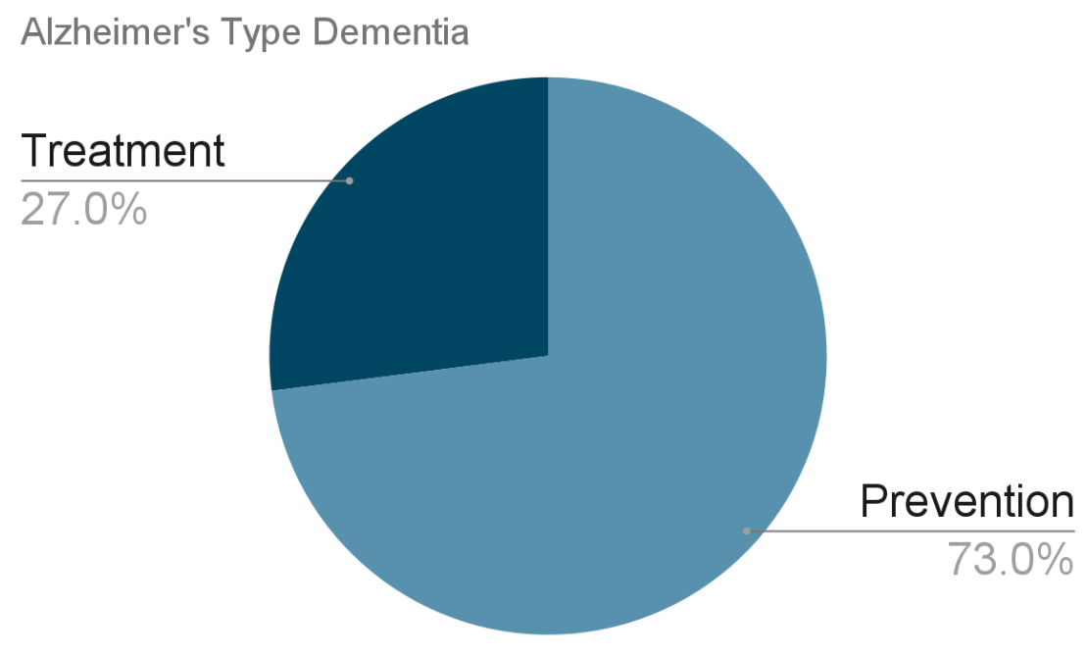

Slide 4
Not causing Alzheimer’s by
avoiding centrally-acting anticholinergics

Slide 5
cholinergics
Not causing Alzheimer’s by
avoiding centrally-acting anticholinergics

Slide 6
Nuances of DSM-5 Neurocognitive Disorder vs Alzheimer’s Dementia
cholinergics
Not causing Alzheimer’s by
avoiding centrally-acting anticholinergics

Slide 7
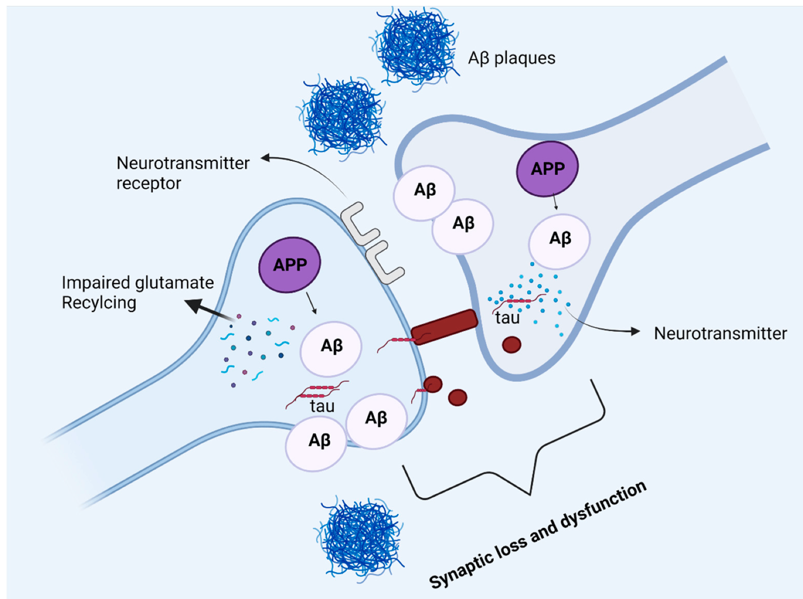
Alzheimer’s dementia is caused by plaques and tangles:
Sehar, U., Rawat, P., Reddy, A. P., Kopel, J., & Reddy, P. H. (2022). Amyloid beta in aging and Alzheimer’s disease. International journal of molecular sciences, 23(21), 12924.
Notes:
https://www.mdpi.com/1422-0067/23/21/12924
Figure 5. Amyloid beta and tau protein at the synapse. In Alzheimer’s disease, amyloid precursor protein is processed into amyloid beta peptides that accumulate inside and outside the neuronal cells and form plaques. The deposition of amyloid plaques in the vicinity of the synapse causes synaptic loss and dysfunction. Moreover, glutamate recycling is also dysregulated in the presence of pathological amyloid beta levels in neurons. The soluble, hyperphosphorylated tau protein can directly move across the plasma membrane, or by another mechanism where the formation of nanotubules helps the translocation of tau intracellularly. The synergetic pathology of Aβ and tau at synapse causes synaptic loss and dysfunction.

Slide 8
Alzheimer’s dementia is caused by plaques and tangles:
β-amyloid (Aβ) plaques
Sehar, U., Rawat, P., Reddy, A. P., Kopel, J., & Reddy, P. H. (2022). Amyloid beta in aging and Alzheimer’s disease. International journal of molecular sciences, 23(21), 12924.
Notes:
https://www.mdpi.com/1422-0067/23/21/12924
Figure 5. Amyloid beta and tau protein at the synapse. In Alzheimer’s disease, amyloid precursor protein is processed into amyloid beta peptides that accumulate inside and outside the neuronal cells and form plaques. The deposition of amyloid plaques in the vicinity of the synapse causes synaptic loss and dysfunction. Moreover, glutamate recycling is also dysregulated in the presence of pathological amyloid beta levels in neurons. The soluble, hyperphosphorylated tau protein can directly move across the plasma membrane, or by another mechanism where the formation of nanotubules helps the translocation of tau intracellularly. The synergetic pathology of Aβ and tau at synapse causes synaptic loss and dysfunction.

Slide 9
Alzheimer’s dementia is caused by plaques and tangles:
β-amyloid (Aβ) plaques
neurofibrillary tangles composed of tau protein
Sehar, U., Rawat, P., Reddy, A. P., Kopel, J., & Reddy, P. H. (2022). Amyloid beta in aging and Alzheimer’s disease. International journal of molecular sciences, 23(21), 12924.
Notes:
https://www.mdpi.com/1422-0067/23/21/12924
Figure 5. Amyloid beta and tau protein at the synapse. In Alzheimer’s disease, amyloid precursor protein is processed into amyloid beta peptides that accumulate inside and outside the neuronal cells and form plaques. The deposition of amyloid plaques in the vicinity of the synapse causes synaptic loss and dysfunction. Moreover, glutamate recycling is also dysregulated in the presence of pathological amyloid beta levels in neurons. The soluble, hyperphosphorylated tau protein can directly move across the plasma membrane, or by another mechanism where the formation of nanotubules helps the translocation of tau intracellularly. The synergetic pathology of Aβ and tau at synapse causes synaptic loss and dysfunction.

Slide 10
Alzheimer’s dementia is caused by plaques and tangles:
β-amyloid (Aβ) plaques
neurofibrillary tangles composed of tau protein
Sehar, U., Rawat, P., Reddy, A. P., Kopel, J., & Reddy, P. H. (2022). Amyloid beta in aging and Alzheimer’s disease. International journal of molecular sciences, 23(21), 12924.
Notes:
https://www.mdpi.com/1422-0067/23/21/12924
Figure 5. Amyloid beta and tau protein at the synapse. In Alzheimer’s disease, amyloid precursor protein is processed into amyloid beta peptides that accumulate inside and outside the neuronal cells and form plaques. The deposition of amyloid plaques in the vicinity of the synapse causes synaptic loss and dysfunction. Moreover, glutamate recycling is also dysregulated in the presence of pathological amyloid beta levels in neurons. The soluble, hyperphosphorylated tau protein can directly move across the plasma membrane, or by another mechanism where the formation of nanotubules helps the translocation of tau intracellularly. The synergetic pathology of Aβ and tau at synapse causes synaptic loss and dysfunction.

Slide 11
Alzheimer’s dementia is caused by plaques and tangles:
β-amyloid (Aβ) plaques
neurofibrillary tangles (NFTs) composed of tau protein
Sehar, U., Rawat, P., Reddy, A. P., Kopel, J., & Reddy, P. H. (2022). Amyloid beta in aging and Alzheimer’s disease. International journal of molecular sciences, 23(21), 12924.
Notes:
https://www.mdpi.com/1422-0067/23/21/12924
Figure 5. Amyloid beta and tau protein at the synapse. In Alzheimer’s disease, amyloid precursor protein is processed into amyloid beta peptides that accumulate inside and outside the neuronal cells and form plaques. The deposition of amyloid plaques in the vicinity of the synapse causes synaptic loss and dysfunction. Moreover, glutamate recycling is also dysregulated in the presence of pathological amyloid beta levels in neurons. The soluble, hyperphosphorylated tau protein can directly move across the plasma membrane, or by another mechanism where the formation of nanotubules helps the translocation of tau intracellularly. The synergetic pathology of Aβ and tau at synapse causes synaptic loss and dysfunction.

Slide 12
Alzheimer’s dementia is caused by plaques and tangles:
β-amyloid (Aβ) plaques
neurofibrillary tangles (NFTs) composed of tau protein
What’s
this?
Sehar, U., Rawat, P., Reddy, A. P., Kopel, J., & Reddy, P. H. (2022). Amyloid beta in aging and Alzheimer’s disease. International journal of molecular sciences, 23(21), 12924.
Notes:
https://www.mdpi.com/1422-0067/23/21/12924
Figure 5. Amyloid beta and tau protein at the synapse. In Alzheimer’s disease, amyloid precursor protein is processed into amyloid beta peptides that accumulate inside and outside the neuronal cells and form plaques. The deposition of amyloid plaques in the vicinity of the synapse causes synaptic loss and dysfunction. Moreover, glutamate recycling is also dysregulated in the presence of pathological amyloid beta levels in neurons. The soluble, hyperphosphorylated tau protein can directly move across the plasma membrane, or by another mechanism where the formation of nanotubules helps the translocation of tau intracellularly. The synergetic pathology of Aβ and tau at synapse causes synaptic loss and dysfunction.

Slide 13
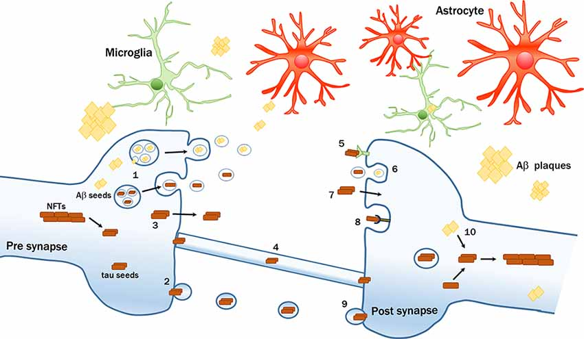
Intercellular transmission of pathological amyloid-β (Aβ) and tau proteins.
d ‘Errico, P., & Meyer-Luehmann, M. (2020). Mechanisms of pathogenic tau and Aβ protein spreading in Alzheimer’s disease. Frontiers in aging neuroscience, 12, 265.
Notes:
FIGURE 1. Intercellular transmission of pathological amyloid-β (Aβ) and tau proteins. Seeds of pathological proteins can be released at the presynaptic level: (1) in exosomes after the fusion of Multivesicular bodies (MVBs) with plasma membrane (PM); (2) in larger vesicles called ectosomes; (3) as naked protein freely crossing the PM; or (4) can be transferred via tunneling nanotubes. Mechanisms of up-take by recipient neurons include; (5) receptors-mediated endocytosis; (6) bulk-endocytosis; (7) fluid-phase translocation; (8) macropinocytosis mediated by heparan sulfate proteoglycans (HSPGs); and (9) fusion of large tau-containing large vescicles with PM. (10) Intraneuronal Aβ seeds can trigger or enhance the formation of tau pathological aggregates. The transmission process can be modulated by multiple factors, including glial cells.

Slide 14
Intercellular transmission of pathological amyloid-β (Aβ) and tau proteins.
(4) can be transferred via tunneling nanotubes.
d ‘Errico, P., & Meyer-Luehmann, M. (2020). Mechanisms of pathogenic tau and Aβ protein spreading in Alzheimer’s disease. Frontiers in aging neuroscience, 12, 265.
Notes:
FIGURE 1. Intercellular transmission of pathological amyloid-β (Aβ) and tau proteins. Seeds of pathological proteins can be released at the presynaptic level: (1) in exosomes after the fusion of Multivesicular bodies (MVBs) with plasma membrane (PM); (2) in larger vesicles called ectosomes; (3) as naked protein freely crossing the PM; or (4) can be transferred via tunneling nanotubes. Mechanisms of up-take by recipient neurons include; (5) receptors-mediated endocytosis; (6) bulk-endocytosis; (7) fluid-phase translocation; (8) macropinocytosis mediated by heparan sulfate proteoglycans (HSPGs); and (9) fusion of large tau-containing large vescicles with PM. (10) Intraneuronal Aβ seeds can trigger or enhance the formation of tau pathological aggregates. The transmission process can be modulated by multiple factors, including glial cells.

Slide 15
Intercellular transmission of pathological amyloid-β (Aβ) and tau proteins.
Alzheimer’s dementia is caused by plaques and tangles:
(4) can be transferred via tunneling nanotubes.
d ‘Errico, P., & Meyer-Luehmann, M. (2020). Mechanisms of pathogenic tau and Aβ protein spreading in Alzheimer’s disease. Frontiers in aging neuroscience, 12, 265.
Notes:
FIGURE 1. Intercellular transmission of pathological amyloid-β (Aβ) and tau proteins. Seeds of pathological proteins can be released at the presynaptic level: (1) in exosomes after the fusion of Multivesicular bodies (MVBs) with plasma membrane (PM); (2) in larger vesicles called ectosomes; (3) as naked protein freely crossing the PM; or (4) can be transferred via tunneling nanotubes. Mechanisms of up-take by recipient neurons include; (5) receptors-mediated endocytosis; (6) bulk-endocytosis; (7) fluid-phase translocation; (8) macropinocytosis mediated by heparan sulfate proteoglycans (HSPGs); and (9) fusion of large tau-containing large vescicles with PM. (10) Intraneuronal Aβ seeds can trigger or enhance the formation of tau pathological aggregates. The transmission process can be modulated by multiple factors, including glial cells.

Slide 16
Intercellular transmission of pathological amyloid-β (Aβ) and tau proteins.
Alzheimer’s dementia is caused by plaques and tangles:
β-amyloid (Aβ) plaques
neurofibrillary tangles (NFTs) composed of tau protein
(4) can be transferred via tunneling nanotubes.
d ‘Errico, P., & Meyer-Luehmann, M. (2020). Mechanisms of pathogenic tau and Aβ protein spreading in Alzheimer’s disease. Frontiers in aging neuroscience, 12, 265.
Notes:
FIGURE 1. Intercellular transmission of pathological amyloid-β (Aβ) and tau proteins. Seeds of pathological proteins can be released at the presynaptic level: (1) in exosomes after the fusion of Multivesicular bodies (MVBs) with plasma membrane (PM); (2) in larger vesicles called ectosomes; (3) as naked protein freely crossing the PM; or (4) can be transferred via tunneling nanotubes. Mechanisms of up-take by recipient neurons include; (5) receptors-mediated endocytosis; (6) bulk-endocytosis; (7) fluid-phase translocation; (8) macropinocytosis mediated by heparan sulfate proteoglycans (HSPGs); and (9) fusion of large tau-containing large vescicles with PM. (10) Intraneuronal Aβ seeds can trigger or enhance the formation of tau pathological aggregates. The transmission process can be modulated by multiple factors, including glial cells.

Slide 17
Intercellular transmission of pathological amyloid-β (Aβ) and tau proteins.
Alzheimer’s dementia is caused by plaques and tangles:
β-amyloid (Aβ) plaques
neurofibrillary tangles (NFTs) composed of tau protein
(4) can be transferred via tunneling nanotubes.
d ‘Errico, P., & Meyer-Luehmann, M. (2020). Mechanisms of pathogenic tau and Aβ protein spreading in Alzheimer’s disease. Frontiers in aging neuroscience, 12, 265.
Notes:
FIGURE 1. Intercellular transmission of pathological amyloid-β (Aβ) and tau proteins. Seeds of pathological proteins can be released at the presynaptic level: (1) in exosomes after the fusion of Multivesicular bodies (MVBs) with plasma membrane (PM); (2) in larger vesicles called ectosomes; (3) as naked protein freely crossing the PM; or (4) can be transferred via tunneling nanotubes. Mechanisms of up-take by recipient neurons include; (5) receptors-mediated endocytosis; (6) bulk-endocytosis; (7) fluid-phase translocation; (8) macropinocytosis mediated by heparan sulfate proteoglycans (HSPGs); and (9) fusion of large tau-containing large vescicles with PM. (10) Intraneuronal Aβ seeds can trigger or enhance the formation of tau pathological aggregates. The transmission process can be modulated by multiple factors, including glial cells.

Slide 18
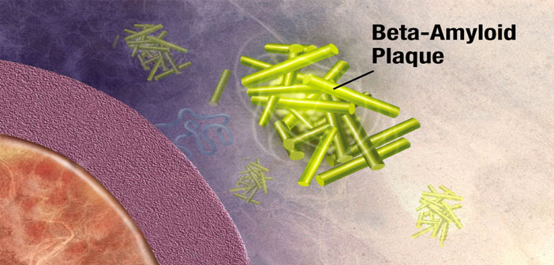
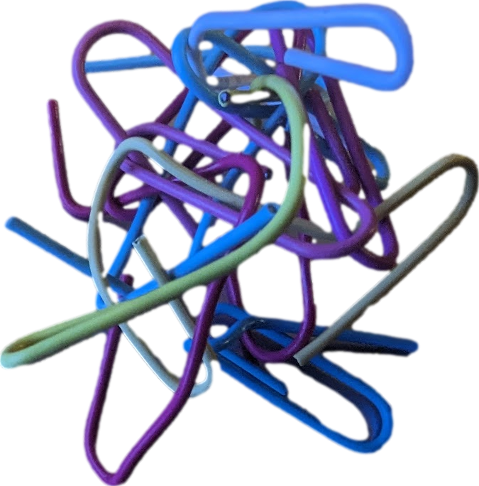

Slide 19
Amyloid =

Slide 20
Amyloid = insoluble protein that can deposit in tissues

Slide 21
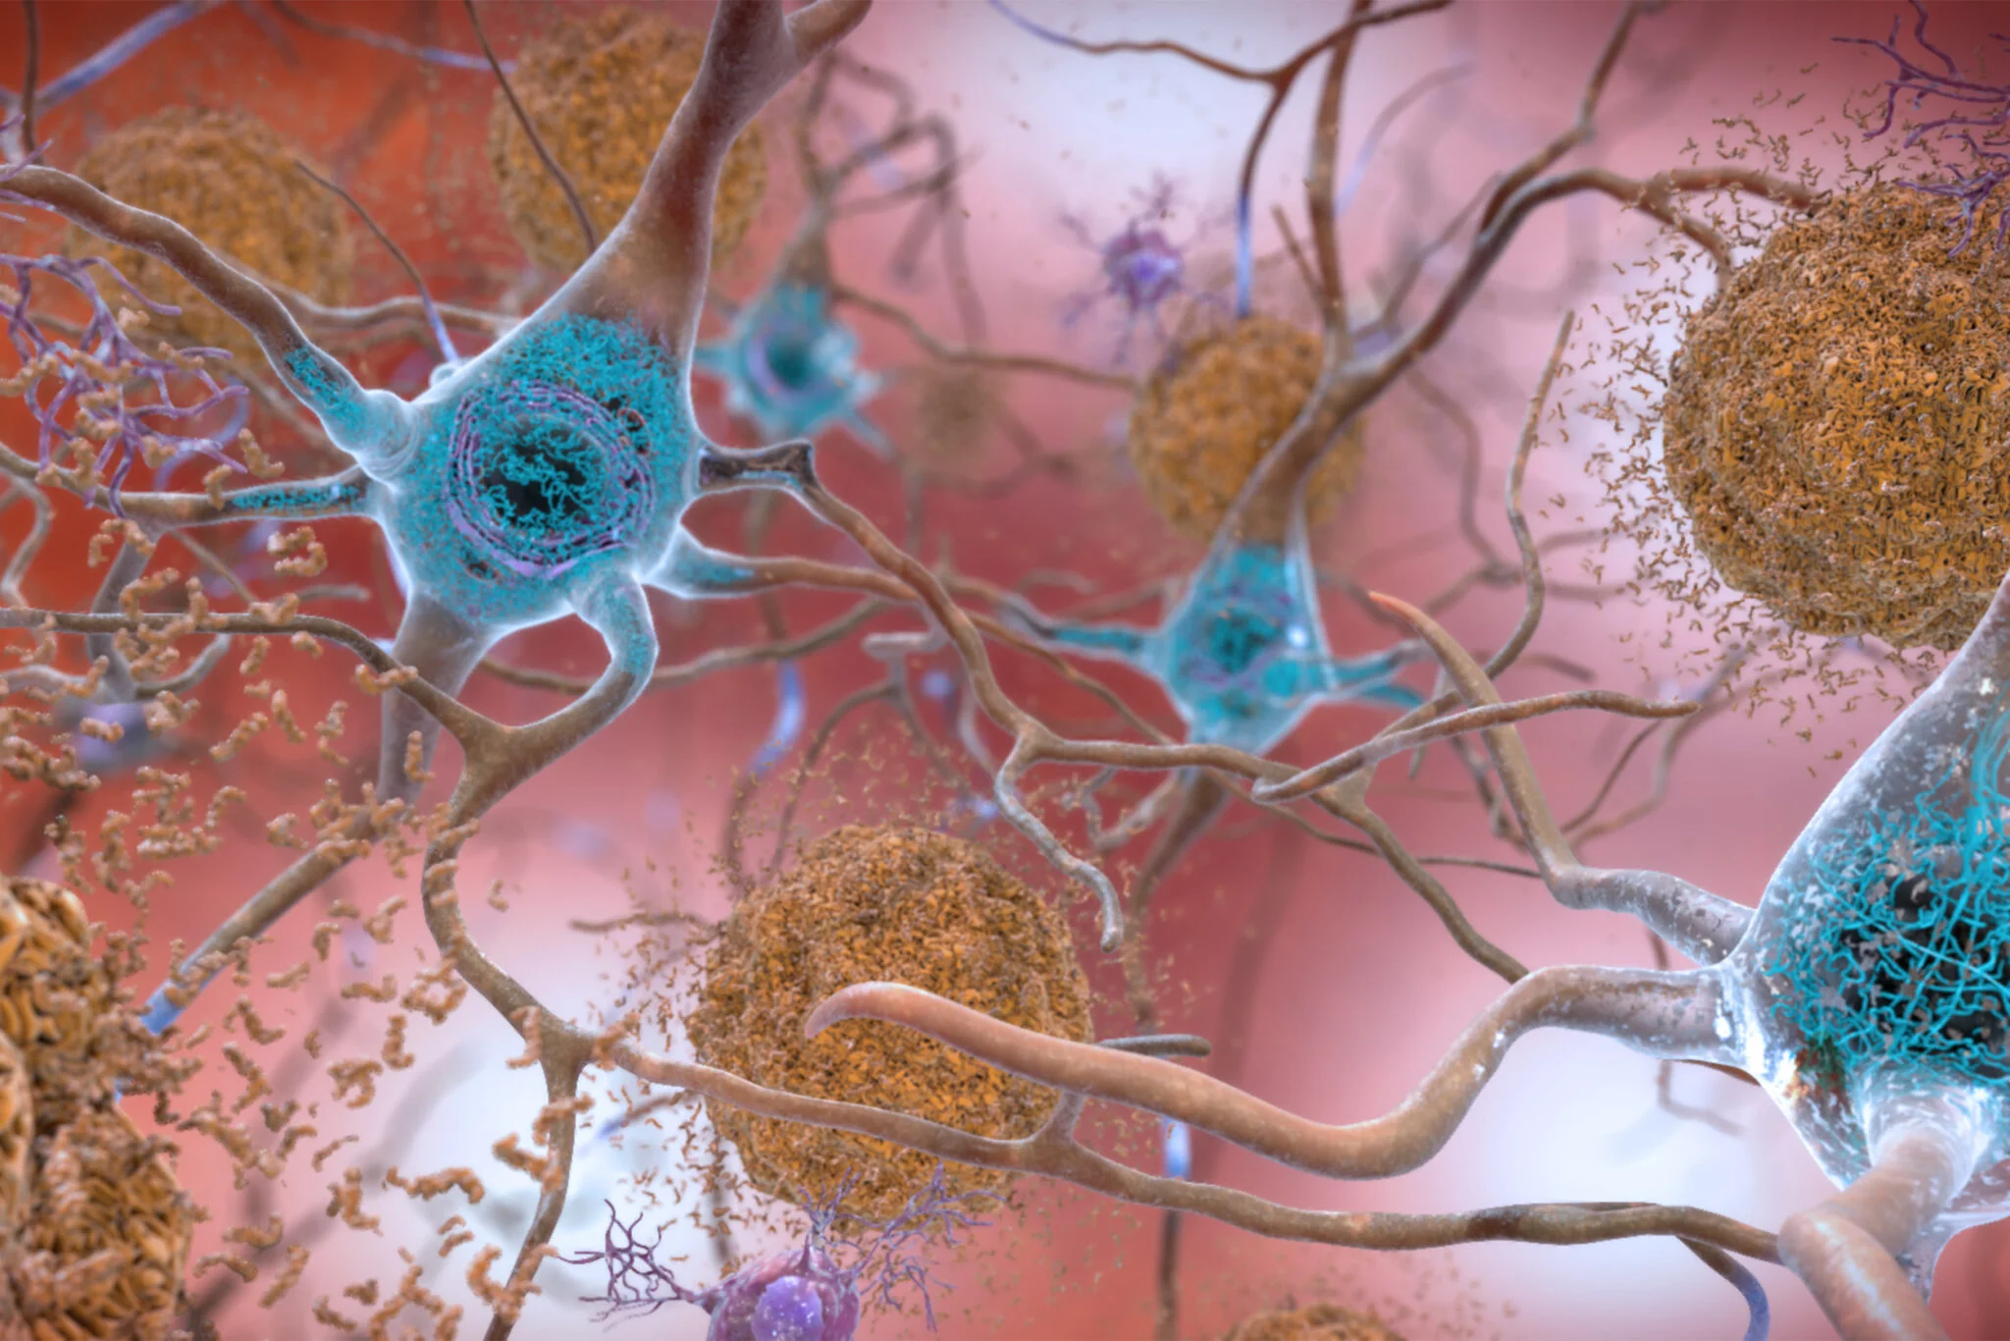
Amyloid = insoluble protein that can deposit in tissues
Amyloid β plaques
=
aggregates of misfolded proteins that form in the spaces between nerve cells

Slide 22
Amyloid = insoluble protein that can deposit in tissues
Amyloid β plaques
=
aggregates of misfolded proteins that form in the spaces between nerve cells

Slide 23
Where does amyloid β come from?

Slide 24
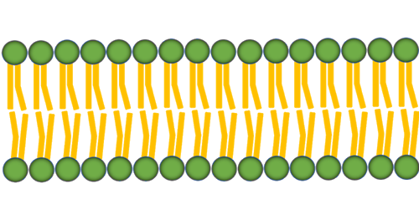
Amyloid β precursor protein (APP)
cell membrane receptor likely involved in neural stem cell development, neurite outgrowth and neurorepair.

Slide 25
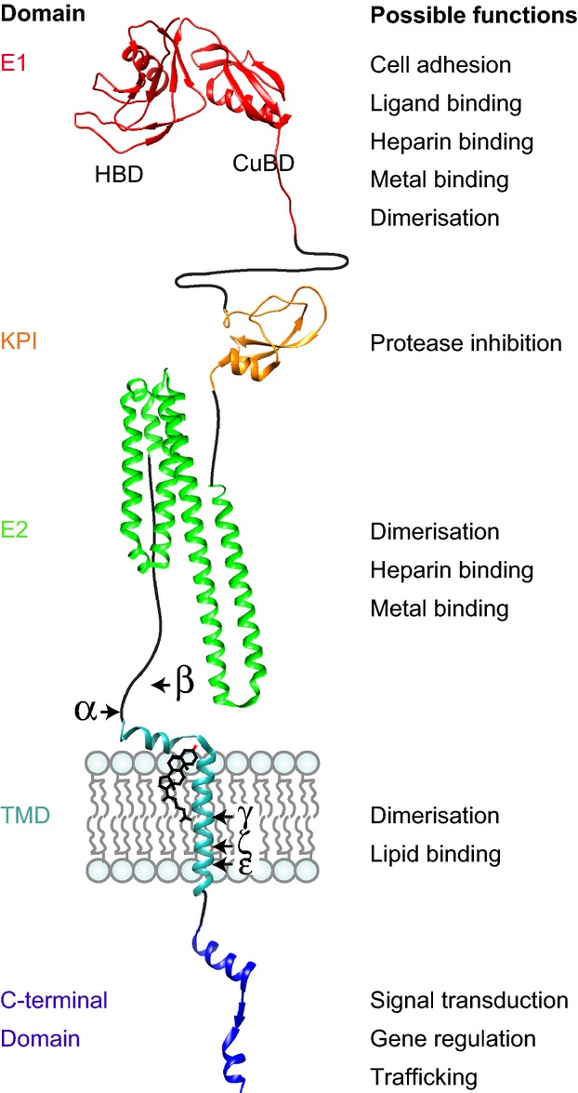
Amyloid β precursor protein (APP)
cell membrane receptor likely involved in neural stem cell development, neurite outgrowth and neurorepair.
=

Slide 26
Amyloid β precursor protein (APP)

Slide 27
What’s supposed to happen to it?
Amyloid β precursor protein (APP)

Slide 28
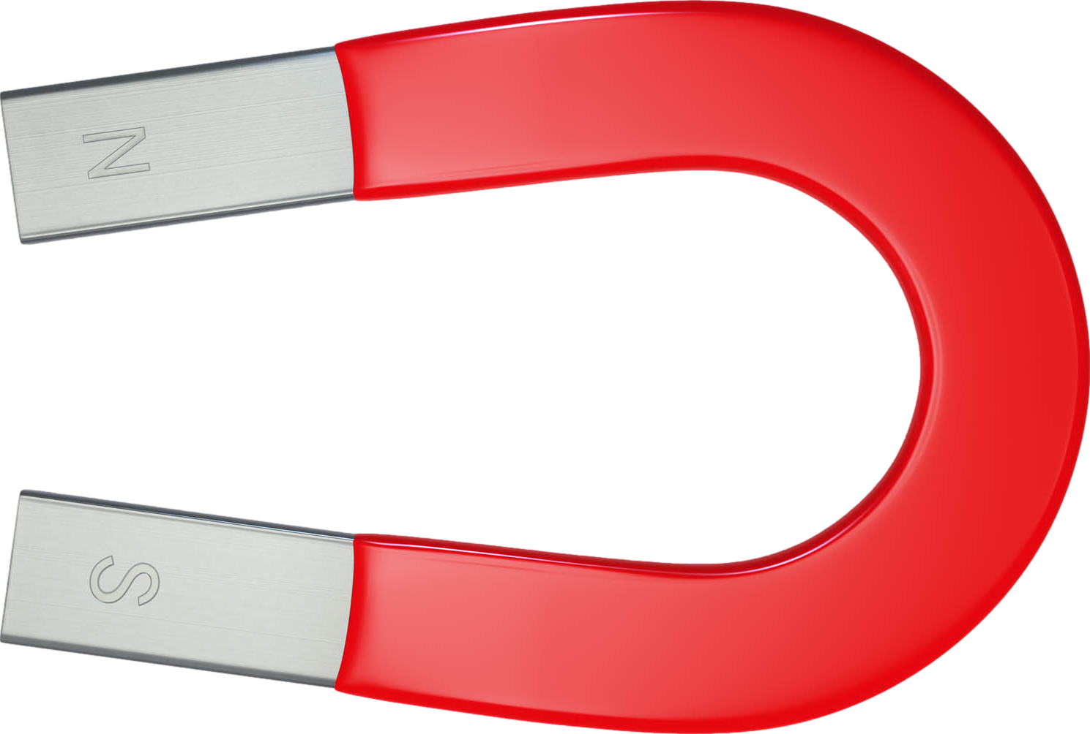
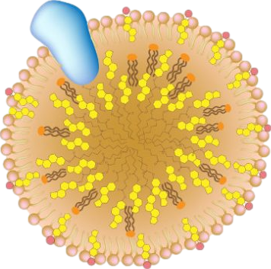
What’s supposed to happen to it?
lipoprotein
APOE = apolipoprotein E
ε2
the dominant lipid carrier in the brain, critical for Aβ catabolism
ε3
Amyloid β precursor protein (APP)

Slide 29
Apolipoprotein =
“A.P.O.”lipoprotein =
“A Part Of” a lipoprotein
What’s supposed to happen to it?
lipoprotein
APOE = apolipoprotein E
ε2
the dominant lipid carrier in the brain, critical for Aβ catabolism
ε3
Amyloid β precursor protein (APP)

Slide 30
Apolipoprotein =
“A.P.O.”lipoprotein =
“A Part Of” a lipoprotein
What’s supposed to happen to it?
lipoprotein
APOE = apolipoprotein E
ε2
the dominant lipid carrier in the brain, critical for Aβ catabolism
ε3
Amyloid β precursor protein (APP)
ε4
APOE4 = high risk gene for Alzheimer’s
ε4

Slide 31
Amyloid β precursor protein (APP)
Apolipoprotein =
“A.P.O.”lipoprotein =
“A Part Of” a lipoprotein
lipoprotein
APOE = apolipoprotein E
ε2
the dominant lipid carrier in the brain, critical for Aβ catabolism
ε3
Amyloid β plaques
ε4
APOE4 = high risk gene for Alzheimer’s
aggregates of misfolded proteins that form in the spaces between nerve cells
ε4

Slide 32
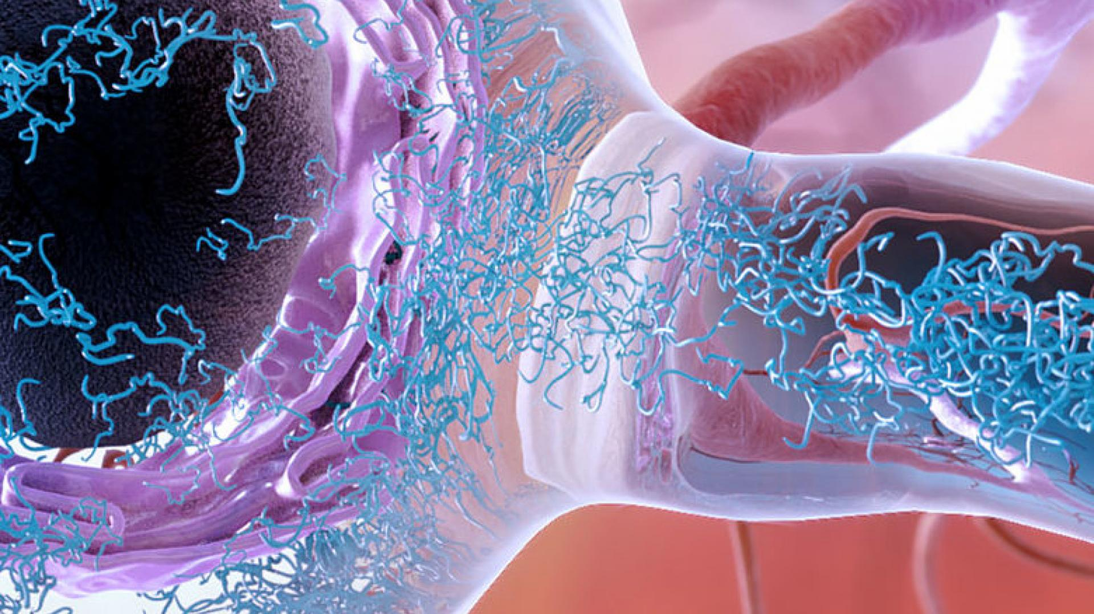
Tau protein accumulation within a neuron = neurofibrillary tangles (NFTs)
National Institute on Aging/National Institutes of Health

Slide 33
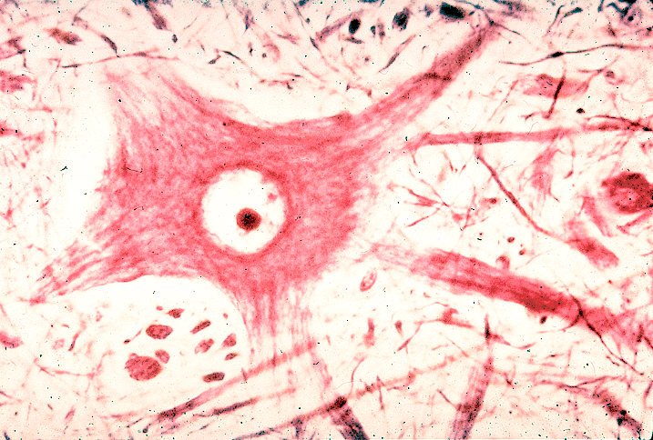
neurofibrillary tangles (NFTs) are composed of modified tau protein.
www1.udel.edu
neurofibrils not tangled
Notes:
https://www1.udel.edu/biology/Wags/histopage/colorpage/cne/cne.htm

Slide 34
neurofibrillary tangles (NFTs) are composed of modified tau protein.
www1.udel.edu
neurofibrils not tangled
neurofibrillary tangles
Notes:
https://www1.udel.edu/biology/Wags/histopage/colorpage/cne/cne.htm

Slide 35
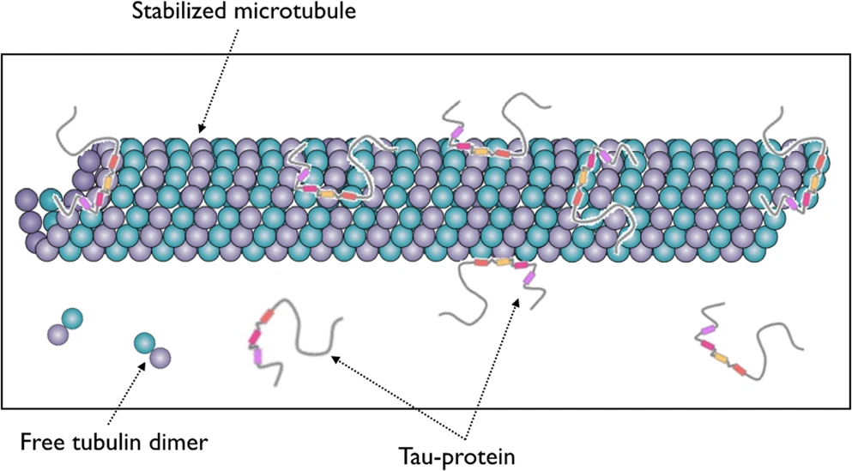
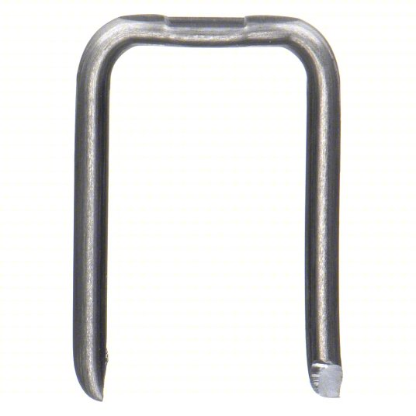
Tau's normal function is stabilizing microtubules inside of neurons
Neurofibrillary tangles
(made of tau protein)

Slide 36
Tau's normal function is stabilizing microtubules inside of neurons

Slide 37
Tau's normal function is stabilizing microtubules inside of neurons

Slide 38
Tau's normal function is stabilizing microtubules inside of neurons

Slide 39
Tau's normal function is stabilizing microtubules inside of neurons

Slide 40
Plaques and tangles
Neurofibrillary tangles
(made of tau protein)
Amyloid β plaques
→ neuronal death

Slide 41
The newest Alzheimer’s meds:

Slide 42
The newest Alzheimer’s meds:
Antibodies vs amyloid β
?

Slide 43
The newest Alzheimer’s meds:
Antibodies vs amyloid β

Slide 44
The newest Alzheimer’s meds:
Antibodies vs amyloid β
The oldest Alzheimer’s meds:

Slide 45
The newest Alzheimer’s meds:
Antibodies vs amyloid β
The oldest Alzheimer’s meds: Cholinergics
?

Slide 46
The newest Alzheimer’s meds:
Antibodies vs amyloid β
The oldest Alzheimer’s meds: Cholinergics
S L U D G E

Slide 47
The newest Alzheimer’s meds:
Antibodies vs amyloid β
The oldest Alzheimer’s meds: Cholinergics
Next topic:
S L U D G E

Slide 48
The newest Alzheimer’s meds:
Antibodies vs amyloid β
The oldest Alzheimer’s meds: Cholinergics
Next topic:
The opposite of cholinergics
S L U D G E

Slide 49
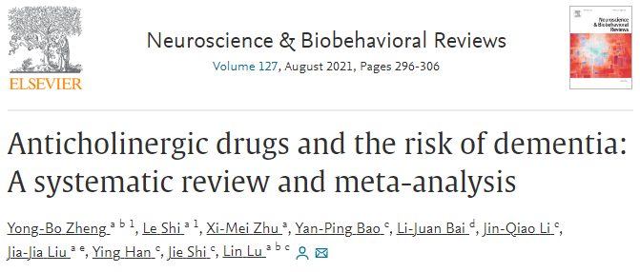
Anticholinergic drug use is an independent risk factor for all-cause dementia and Alzheimer’s disease.

Slide 50
Anticholinergic drug use is an independent risk factor for all-cause dementia and Alzheimer’s disease.
Heavier anticholinergic drug exposure is associated with a higher risk of dementia.

Slide 51
Anticholinergic drug use is an independent risk factor for all-cause dementia and Alzheimer’s disease.
Heavier anticholinergic drug exposure is associated with a higher risk of dementia.
Risk of dementia from some classes of anticholinergic drugs can be counterbalanced by therapeutic effects.

Slide 52
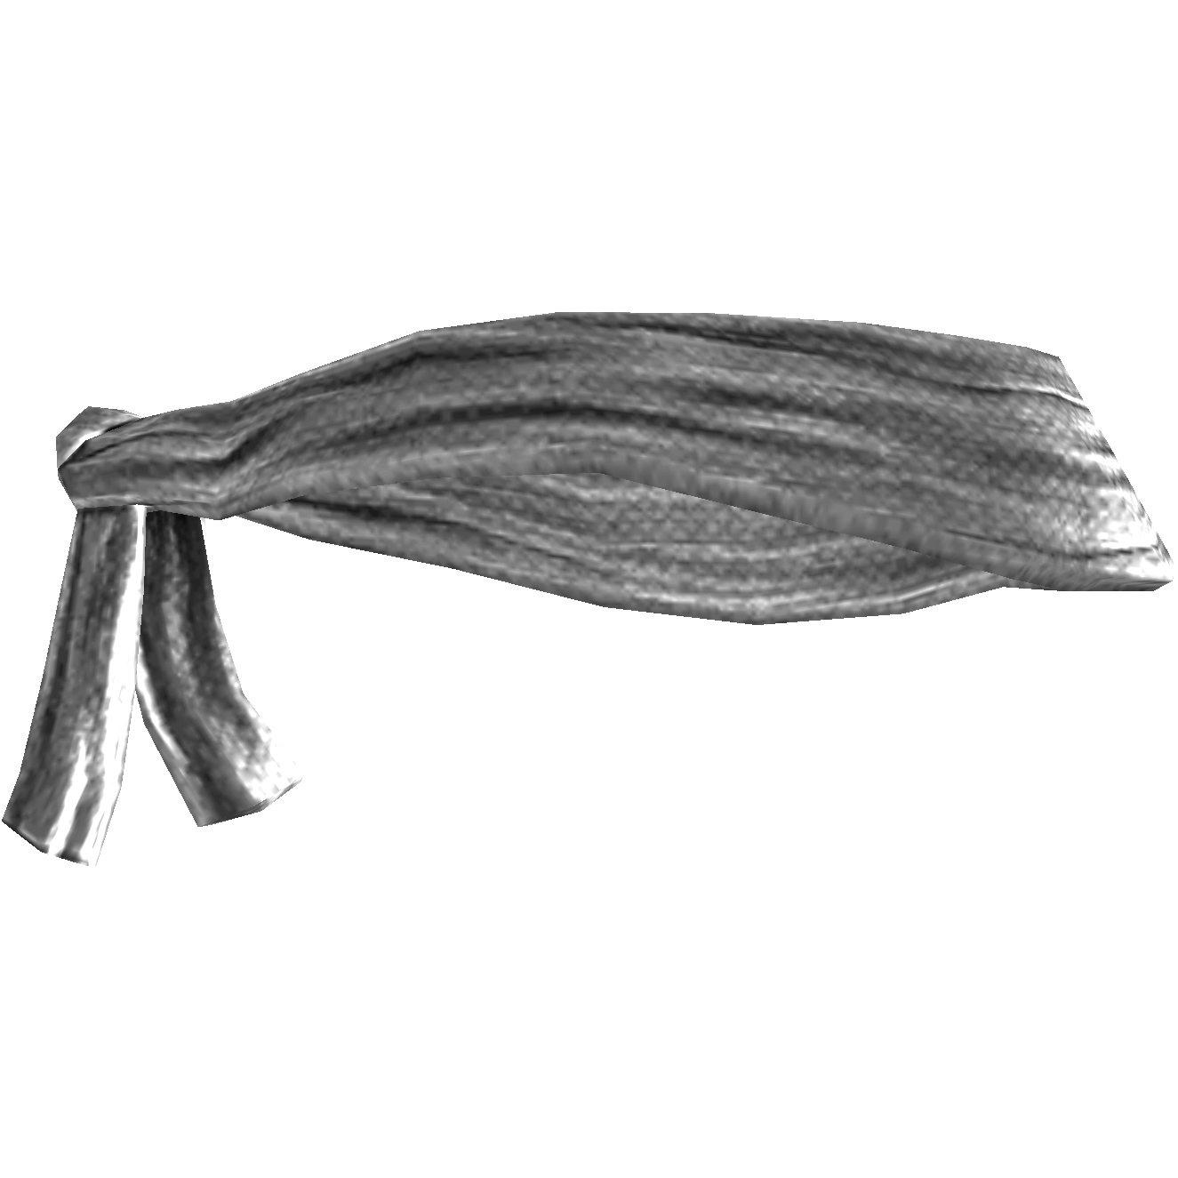
Anticholinergic (antimuscarinic) effects – everything dry
When we refer to “anticholinergic”, we actually mean antimuscarinic.
We’re talking about blocking the action of the neurotransmitter acetylcholine at muscarinic receptors, not at nicotinic receptors.
All five muscarinic receptor subtypes—M₁, M₂, M₃, M₄, and M₅—are present in various locations throughout the brain.
You’re full of crap, Auntie Choli!
“Mad as a hatter”
constipation
blind(folded)
“tacky”cardia

Slide 53
Anticholinergic (antimuscarinic) effects – everything dry
When we refer to “anticholinergic”, we actually mean antimuscarinic.
We’re talking about blocking the action of the neurotransmitter acetylcholine at muscarinic receptors, not at nicotinic receptors.
All five muscarinic receptor subtypes—M₁, M₂, M₃, M₄, and M₅—are present in various locations throughout the brain.
You’re full of crap, Auntie Choli!
“Mad as a hatter”
constipation
blind(folded)
Tacky (tachycardia) Auntie Choli is...
“tacky”cardia
“Dry as a bone”
❖ Constipation (risk of ileus, bowel rupture)
❖ Urinary retention
❖ Decreased sweating; flushing—“Red as a beet”
❖ Dry mouth (risk of sublingual adenitis)
❖ Dry nasal mucus membranes
❖ Dry eyes
❖ Inhibition of lactation

Slide 54
Anticholinergic (antimuscarinic) effects – everything dry
When we refer to “anticholinergic”, we actually mean antimuscarinic.
We’re talking about blocking the action of the neurotransmitter acetylcholine at muscarinic receptors, not at nicotinic receptors.
All five muscarinic receptor subtypes—M₁, M₂, M₃, M₄, and M₅—are present in various locations throughout the brain.
You’re full of crap, Auntie Choli!
“Mad as a hatter”
constipation
blind(folded)
Tacky (tachycardia) Auntie Choli is...
“tacky”cardia
“Dry as a bone”
❖ Constipation (risk of ileus, bowel rupture)
❖ Urinary retention
❖ Decreased sweating; flushing—“Red as a beet”
❖ Dry mouth (risk of sublingual adenitis)
❖ Dry nasal mucus membranes
❖ Dry eyes
❖ Inhibition of lactation
“Blind as a bat”
❖ Cycloplegia (loss of accommodation)
—lens cannot focus on near objects
❖ Photophobia due to mydriasis
(dilated pupils)
❖ Increased intraocular pressure;
contraindicated in angle-closure
glaucoma (unless already treated by
laser iridotomy)

Slide 55
Anticholinergic (antimuscarinic) effects – everything dry
When we refer to “anticholinergic”, we actually mean antimuscarinic.
We’re talking about blocking the action of the neurotransmitter acetylcholine at muscarinic receptors, not at nicotinic receptors.
All five muscarinic receptor subtypes—M₁, M₂, M₃, M₄, and M₅—are present in various locations throughout the brain.
You’re full of crap, Auntie Choli!
“Mad as a hatter”
constipation
blind(folded)
Tacky (tachycardia) Auntie Choli is...
“tacky”cardia
“Dry as a bone”
❖ Constipation (risk of ileus, bowel rupture)
❖ Urinary retention
❖ Decreased sweating; flushing—“Red as a beet”
❖ Dry mouth (risk of sublingual adenitis)
❖ Dry nasal mucus membranes
❖ Dry eyes
❖ Inhibition of lactation
“Blind as a bat”
❖ Cycloplegia (loss of accommodation)
—lens cannot focus on near objects
❖ Photophobia due to mydriasis
(dilated pupils)
❖ Increased intraocular pressure;
contraindicated in angle-closure
glaucoma (unless already treated by
laser iridotomy)
“Mad as a hatter”
❖ Confusion, memory problems
❖ Increased risk of developing Alzheimer’s disease
❖ Delirium with visual hallucinations

Slide 56
Anticholinergic drugs and dementia risk
positive effect
e.g., anticholinergic for Parkinson's or overactive bladder
negative effect
Risk of dementia from some classes of anticholinergic drugs can be counterbalanced by therapeutic effects.
Yong-Bo Zheng, Le Shi, Xi-Mei Zhu, Yan-Ping Bao, Li-Juan Bai, Jin-Qiao Li, Jia-Jia Liu, Ying Han, Jie Shi, Lin Lu. Anticholinergic drugs and the risk of dementia: A systematic review and meta-analysis. Neuroscience & Biobehavioral Reviews. Volume 127, 2021

Slide 57
Anticholinergic drugs and dementia risk
positive effect
e.g., anticholinergic for Parkinson's or overactive bladder
negative effect
Risk of dementia from some classes of anticholinergic drugs can be counterbalanced by therapeutic effects.
strong anticholinergic
better mood
e.g., strongly anticholinergic psychotropic
Yong-Bo Zheng, Le Shi, Xi-Mei Zhu, Yan-Ping Bao, Li-Juan Bai, Jin-Qiao Li, Jia-Jia Liu, Ying Han, Jie Shi, Lin Lu. Anticholinergic drugs and the risk of dementia: A systematic review and meta-analysis. Neuroscience & Biobehavioral Reviews. Volume 127, 2021

Slide 58
Anticholinergic drugs and dementia risk
positive effect
e.g., anticholinergic for Parkinson's or overactive bladder
negative effect
Risk of dementia from some classes of anticholinergic drugs can be counterbalanced by therapeutic effects.
strong anticholinergic
better mood
e.g., strongly anticholinergic psychotropic
weak anticholinergic
better mood
e.g., weakly anticholinergic psychotropic
Yong-Bo Zheng, Le Shi, Xi-Mei Zhu, Yan-Ping Bao, Li-Juan Bai, Jin-Qiao Li, Jia-Jia Liu, Ying Han, Jie Shi, Lin Lu. Anticholinergic drugs and the risk of dementia: A systematic review and meta-analysis. Neuroscience & Biobehavioral Reviews. Volume 127, 2021

Slide 59
Association with dementia
decreased
increased
Benztropine (Cogentin)

Slide 60
Association with dementia
decreased
increased
Benztropine (Cogentin)
-
+
++
+++
anticholinergic:

Slide 61
benztropine
oxybutynin
amitriptyline
chlorpromazine
Yong-Bo Zheng, Le Shi, Xi-Mei Zhu, Yan-Ping Bao, Li-Juan Bai, Jin-Qiao Li, Jia-Jia Liu, Ying Han, Jie Shi, Lin Lu. Anticholinergic drugs and the risk of dementia: A systematic review and meta-analysis,
Neuroscience & Biobehavioral Reviews. Volume 127, 2021

Slide 62
Association with dementia
decreased
increased
Oxybutynin (Ditropan)

Slide 63
Association with dementia
decreased
increased
Oxybutynin (Ditropan)
-
+
++
+++
anticholinergic:

Slide 64
benztropine
oxybutynin
amitriptyline
chlorpromazine
Yong-Bo Zheng, Le Shi, Xi-Mei Zhu, Yan-Ping Bao, Li-Juan Bai, Jin-Qiao Li, Jia-Jia Liu, Ying Han, Jie Shi, Lin Lu. Anticholinergic drugs and the risk of dementia: A systematic review and meta-analysis,
Neuroscience & Biobehavioral Reviews. Volume 127, 2021

Slide 65
Association with dementia
decreased
increased
Amitriptyline (Elavil)

Slide 66
Association with dementia
decreased
increased
Amitriptyline (Elavil)
-
+
++
+++
anticholinergic:

Slide 67
benztropine
oxybutynin
amitriptyline
chlorpromazine
Yong-Bo Zheng, Le Shi, Xi-Mei Zhu, Yan-Ping Bao, Li-Juan Bai, Jin-Qiao Li, Jia-Jia Liu, Ying Han, Jie Shi, Lin Lu. Anticholinergic drugs and the risk of dementia: A systematic review and meta-analysis,
Neuroscience & Biobehavioral Reviews. Volume 127, 2021

Slide 68
Association with dementia
decreased
increased
Chlorpromazine (Thorazine)

Slide 69
Association with dementia
decreased
increased
Chlorpromazine (Thorazine)
-
+
++
+++
anticholinergic:

Slide 70
benztropine
oxybutynin
amitriptyline
chlorpromazine
Yong-Bo Zheng, Le Shi, Xi-Mei Zhu, Yan-Ping Bao, Li-Juan Bai, Jin-Qiao Li, Jia-Jia Liu, Ying Han, Jie Shi, Lin Lu. Anticholinergic drugs and the risk of dementia: A systematic review and meta-analysis,
Neuroscience & Biobehavioral Reviews. Volume 127, 2021

Slide 71
Association with dementia
decreased
increased
Paroxetine (Paxil)

Slide 72
Association with dementia
decreased
increased
Paroxetine (Paxil)
weak anticholinergic
better mood
-
+
++
+++
anticholinergic:

Slide 73
Association with dementia
decreased
increased
Escitalopram (Lexapro)

Slide 74
Association with dementia
decreased
increased
Escitalopram (Lexapro)
-
+
++
+++
anticholinergic:

Slide 75
Association with dementia
decreased
increased
Quetiapine (Seroquel)

Slide 76
Association with dementia
decreased
increased
Quetiapine (Seroquel)
weak anticholinergic
Anticholinergic but potentially protective for people who need it. Non-anticholinergic antipsychotics may be safer.
better mood
-
+
++
+++
anticholinergic:

Slide 77
Association with dementia
decreased
increased
Olanzapine (Zyprexa)

Slide 78
Association with dementia
decreased
increased
Olanzapine (Zyprexa)
metabolic and anticholinergic effects
psychiatric benefits
Has not been associated with dementia, but considering olanzapine’s anticholinergic + metabolic effects, we cannot conclude it is benign.
-
+
++
+++
anticholinergic:

Slide 79
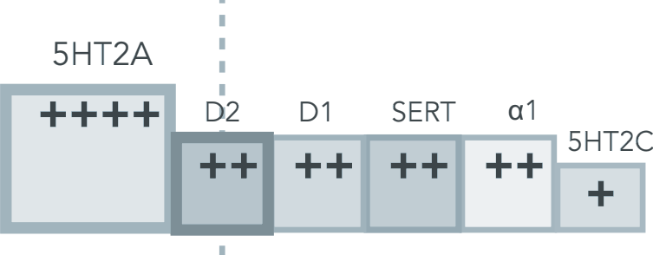
clozapine
M1-M4
“-pines”
olanzapine
quetiapine
asenapine
risperidone
paliperidone
ziprasidone
iloperidone
lurasidone
lumateperone
aripiprazole
brexpiprazole
cariprazine

Slide 80
Association with dementia
decreased
increased
Diphenhydramine (Benadryl)

Slide 81
Association with dementia
decreased
increased
Diphenhydramine (Benadryl)
-
+
++
+++
anticholinergic:

Slide 82
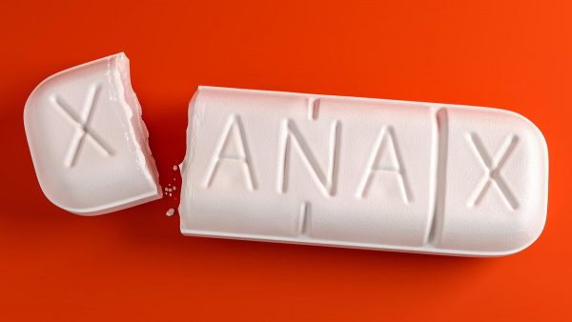
Association with dementia
decreased
increased
Benzodiazepines

Slide 83
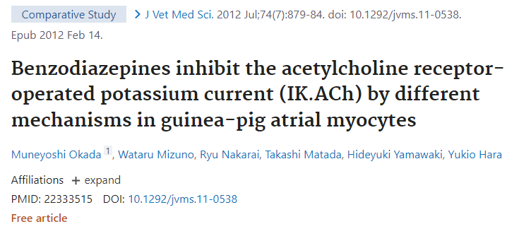
Association with dementia
decreased
increased
Benzodiazepines
There were studies showing an association of benzodiazepines and dementia, but more recent studies have cast doubt.
In a prospective follow-up study with 3434 patients, the risk of dementia actually went down as the dose exposure went up (Gray SL et al, 2016).
Another study with 616,256 patients found the same risk of dementia in people taking benzodiazepines as in those on antidepressants, suggesting that these meds are just a marker for another variable, like having a psychiatric disorder (Baek et al, 2020).
No association between benzos and dementia (n = 235,465, Osler & Jørgensen, 2020).
A systematic review of reviews suggested an association (Ferreira et al, 2021).
-
+
++
+++
anticholinergic:

Slide 84
Anticholinergic Burden Scale
 | 3 Points (worst) | 2 points | 1 point (mild) | 0 points

Slide 85
Anticholinergic Burden Scale
 | 3 Points (worst) | 2 points | 1 point (mild) | 0 points
TCA Antidepressants

Slide 86
Anticholinergic Burden Scale
 | 3 Points (worst) | 2 points | 1 point (mild) | 0 points
TCA Antidepressants | Amitriptyline Clomipramine Doxepin ≥ 50 mg Imipramine Maprotiline Protriptyline Trimipramine

Slide 87
Anticholinergic Burden Scale
 | 3 Points (worst) | 2 points | 1 point (mild) | 0 points
TCA Antidepressants | Amitriptyline Clomipramine Doxepin ≥ 50 mg Imipramine Maprotiline Protriptyline Trimipramine | Desipramine Nortriptyline

Slide 88
Anticholinergic Burden Scale
 | 3 Points (worst) | 2 points | 1 point (mild) | 0 points
TCA Antidepressants | Amitriptyline Clomipramine Doxepin ≥ 50 mg Imipramine Maprotiline Protriptyline Trimipramine | Desipramine Nortriptyline | Amoxapine

Slide 89
Anticholinergic Burden Scale
 | 3 Points (worst) | 2 points | 1 point (mild) | 0 points
TCA Antidepressants | Amitriptyline Clomipramine Doxepin ≥ 50 mg Imipramine Maprotiline Protriptyline Trimipramine | Desipramine Doxepin ≤ 25 mg Nortriptyline | Amoxapine Doxepin ≤ 10 mg | Doxepin ≤ 6 mg

Slide 90
Anticholinergic Burden Scale
 | 3 Points (worst) | 2 points | 1 point (mild) | 0 points
TCA Antidepressants | Amitriptyline Clomipramine Doxepin ≥ 50 mg Imipramine Maprotiline Protriptyline Trimipramine | Desipramine Doxepin ≤ 25 mg Nortriptyline | Amoxapine Doxepin ≤ 10 mg | Doxepin ≤ 6 mg
Other Antidepressants

Slide 91
Anticholinergic Burden Scale
 | 3 Points (worst) | 2 points | 1 point (mild) | 0 points
TCA Antidepressants | Amitriptyline Clomipramine Doxepin ≥ 50 mg Imipramine Maprotiline Protriptyline Trimipramine | Desipramine Doxepin ≤ 25 mg Nortriptyline | Amoxapine Doxepin ≤ 10 mg | Doxepin ≤ 6 mg
Other Antidepressants | N/A

Slide 92
Anticholinergic Burden Scale
 | 3 Points (worst) | 2 points | 1 point (mild) | 0 points
TCA Antidepressants | Amitriptyline Clomipramine Doxepin ≥ 50 mg Imipramine Maprotiline Protriptyline Trimipramine | Desipramine Doxepin ≤ 25 mg Nortriptyline | Amoxapine Doxepin ≤ 10 mg | Doxepin ≤ 6 mg
Other Antidepressants | N/A | Paroxetine (Paxil)

Slide 93
Anticholinergic Burden Scale
 | 3 Points (worst) | 2 points | 1 point (mild) | 0 points
TCA Antidepressants | Amitriptyline Clomipramine Doxepin ≥ 50 mg Imipramine Maprotiline Protriptyline Trimipramine | Desipramine Doxepin ≤ 25 mg Nortriptyline | Amoxapine Doxepin ≤ 10 mg | Doxepin ≤ 6 mg
Other Antidepressants | N/A | Paroxetine (Paxil) | Citalopram (Celexa) Fluoxetine (Prozac) MAOIs Mirtazapine (Remeron)

Slide 94
Anticholinergic Burden Scale
 | 3 Points (worst) | 2 points | 1 point (mild) | 0 points
TCA Antidepressants | Amitriptyline Clomipramine Doxepin ≥ 50 mg Imipramine Maprotiline Protriptyline Trimipramine | Desipramine Doxepin ≤ 25 mg Nortriptyline | Amoxapine Doxepin ≤ 10 mg | Doxepin ≤ 6 mg
Other Antidepressants | N/A | Paroxetine (Paxil) | Citalopram (Celexa) Fluoxetine (Prozac) MAOIs Mirtazapine (Remeron) | SNRIs, Other SSRIs, Bupropion (Wellbutrin), Trazodone, Nefazodone, Vilazodone (Viibryd), Vortioxetine (Trintellix)

Slide 95
Anticholinergic Burden Scale
 | 3 Points (worst) | 2 points | 1 point (mild) | 0 points
TCA Antidepressants | Amitriptyline Clomipramine Doxepin ≥ 50 mg Imipramine Maprotiline Protriptyline Trimipramine | Desipramine Doxepin ≤ 25 mg Nortriptyline | Amoxapine Doxepin ≤ 10 mg | Doxepin ≤ 6 mg
Other Antidepressants | N/A | Paroxetine (Paxil) | Citalopram (Celexa) Fluoxetine (Prozac) MAOIs Mirtazapine (Remeron) | SNRIs, Other SSRIs, Bupropion (Wellbutrin), Trazodone, Nefazodone, Vilazodone (Viibryd), Vortioxetine (Trintellix)
Antipsychotics (and other D2 blockers)

Slide 96
Anticholinergic Burden Scale
 | 3 Points (worst) | 2 points | 1 point (mild) | 0 points
TCA Antidepressants | Amitriptyline Clomipramine Doxepin ≥ 50 mg Imipramine Maprotiline Protriptyline Trimipramine | Desipramine Doxepin ≤ 25 mg Nortriptyline | Amoxapine Doxepin ≤ 10 mg | Doxepin ≤ 6 mg
Other Antidepressants | N/A | Paroxetine (Paxil) | Citalopram (Celexa) Fluoxetine (Prozac) MAOIs Mirtazapine (Remeron) | SNRIs, Other SSRIs, Bupropion (Wellbutrin), Trazodone, Nefazodone, Vilazodone (Viibryd), Vortioxetine (Trintellix)
Antipsychotics (and other D2 blockers) | Low potency FGAs:
?

Slide 97
Anticholinergic Burden Scale
 | 3 Points (worst) | 2 points | 1 point (mild) | 0 points
TCA Antidepressants | Amitriptyline Clomipramine Doxepin ≥ 50 mg Imipramine Maprotiline Protriptyline Trimipramine | Desipramine Doxepin ≤ 25 mg Nortriptyline | Amoxapine Doxepin ≤ 10 mg | Doxepin ≤ 6 mg
Other Antidepressants | N/A | Paroxetine (Paxil) | Citalopram (Celexa) Fluoxetine (Prozac) MAOIs Mirtazapine (Remeron) | SNRIs, Other SSRIs, Bupropion (Wellbutrin), Trazodone, Nefazodone, Vilazodone (Viibryd), Vortioxetine (Trintellix)
Antipsychotics (and other D2 blockers) | Low potency FGAs:

Slide 98
Anticholinergic Burden Scale
 | 3 Points (worst) | 2 points | 1 point (mild) | 0 points
TCA Antidepressants | Amitriptyline Clomipramine Doxepin ≥ 50 mg Imipramine Maprotiline Protriptyline Trimipramine | Desipramine Doxepin ≤ 25 mg Nortriptyline | Amoxapine Doxepin ≤ 10 mg | Doxepin ≤ 6 mg
Other Antidepressants | N/A | Paroxetine (Paxil) | Citalopram (Celexa) Fluoxetine (Prozac) MAOIs Mirtazapine (Remeron) | SNRIs, Other SSRIs, Bupropion (Wellbutrin), Trazodone, Nefazodone, Vilazodone (Viibryd), Vortioxetine (Trintellix)
Antipsychotics (and other D2 blockers) | Low potency FGAs: Chlorpromazine (Thorazine) Promethazine (Phenergan) Thioridazine (Mellaril)

Slide 99
Anticholinergic Burden Scale
 | 3 Points (worst) | 2 points | 1 point (mild) | 0 points
TCA Antidepressants | Amitriptyline Clomipramine Doxepin ≥ 50 mg Imipramine Maprotiline Protriptyline Trimipramine | Desipramine Doxepin ≤ 25 mg Nortriptyline | Amoxapine Doxepin ≤ 10 mg | Doxepin ≤ 6 mg
Other Antidepressants | N/A | Paroxetine (Paxil) | Citalopram (Celexa) Fluoxetine (Prozac) MAOIs Mirtazapine (Remeron) | SNRIs, Other SSRIs, Bupropion (Wellbutrin), Trazodone, Nefazodone, Vilazodone (Viibryd), Vortioxetine (Trintellix)
Antipsychotics (and other D2 blockers) | Low potency FGAs: Chlorpromazine (Thorazine) Promethazine (Phenergan) Thioridazine (Mellaril) | Intermediate potency FGAs: Loxapine (Loxitane) Molindone (Moban) Perphenazine (Trilafon) SGAs: Clozapine (Clozaril) Olanzapine (Zyprexa)

Slide 100
Anticholinergic Burden Scale
 | 3 Points (worst) | 2 points | 1 point (mild) | 0 points
TCA Antidepressants | Amitriptyline Clomipramine Doxepin ≥ 50 mg Imipramine Maprotiline Protriptyline Trimipramine | Desipramine Doxepin ≤ 25 mg Nortriptyline | Amoxapine Doxepin ≤ 10 mg | Doxepin ≤ 6 mg
Other Antidepressants | N/A | Paroxetine (Paxil) | Citalopram (Celexa) Fluoxetine (Prozac) MAOIs Mirtazapine (Remeron) | SNRIs, Other SSRIs, Bupropion (Wellbutrin), Trazodone, Nefazodone, Vilazodone (Viibryd), Vortioxetine (Trintellix)
Antipsychotics (and other D2 blockers) | Low potency FGAs: Chlorpromazine (Thorazine) Promethazine (Phenergan) Thioridazine (Mellaril) | Intermediate potency FGAs: Loxapine (Loxitane) Molindone (Moban) Perphenazine (Trilafon) SGAs: Clozapine (Clozaril) Olanzapine (Zyprexa) | High potency FGAs:
?

Slide 101
Anticholinergic Burden Scale
 | 3 Points (worst) | 2 points | 1 point (mild) | 0 points
TCA Antidepressants | Amitriptyline Clomipramine Doxepin ≥ 50 mg Imipramine Maprotiline Protriptyline Trimipramine | Desipramine Doxepin ≤ 25 mg Nortriptyline | Amoxapine Doxepin ≤ 10 mg | Doxepin ≤ 6 mg
Other Antidepressants | N/A | Paroxetine (Paxil) | Citalopram (Celexa) Fluoxetine (Prozac) MAOIs Mirtazapine (Remeron) | SNRIs, Other SSRIs, Bupropion (Wellbutrin), Trazodone, Nefazodone, Vilazodone (Viibryd), Vortioxetine (Trintellix)
Antipsychotics (and other D2 blockers) | Low potency FGAs: Chlorpromazine (Thorazine) Promethazine (Phenergan) Thioridazine (Mellaril) | Intermediate potency FGAs: Loxapine (Loxitane) Molindone (Moban) Perphenazine (Trilafon) SGAs: Clozapine (Clozaril) Olanzapine (Zyprexa) | High potency FGAs: Fluphenazine (Prolixin) Haloperidol (Haldol) Pimozide (Orap) Prochlorperazine (Compazine) Thiothixene (Navane) Trifluoperazine (Stelazine) SGAs: Pimavanserin (Nuplazid) Quetiapine (Seroquel)

Slide 102
Anticholinergic Burden Scale
 | 3 Points (worst) | 2 points | 1 point (mild) | 0 points
TCA Antidepressants | Amitriptyline Clomipramine Doxepin ≥ 50 mg Imipramine Maprotiline Protriptyline Trimipramine | Desipramine Doxepin ≤ 25 mg Nortriptyline | Amoxapine Doxepin ≤ 10 mg | Doxepin ≤ 6 mg
Other Antidepressants | N/A | Paroxetine (Paxil) | Citalopram (Celexa) Fluoxetine (Prozac) MAOIs Mirtazapine (Remeron) | SNRIs, Other SSRIs, Bupropion (Wellbutrin), Trazodone, Nefazodone, Vilazodone (Viibryd), Vortioxetine (Trintellix)
Antipsychotics (and other D2 blockers) | Low potency FGAs: Chlorpromazine (Thorazine) Promethazine (Phenergan) Thioridazine (Mellaril) | Intermediate potency FGAs: Loxapine (Loxitane) Molindone (Moban) Perphenazine (Trilafon) SGAs: Clozapine (Clozaril) Olanzapine (Zyprexa) | High potency FGAs: Fluphenazine (Prolixin) Haloperidol (Haldol) Pimozide (Orap) Prochlorperazine (Compazine) Thiothixene (Navane) Trifluoperazine (Stelazine) SGAs: Pimavanserin (Nuplazid) Quetiapine (Seroquel) | SGAs: Aripiprazole (Abilify) Asenapine (Saphris) Brexpiprazole (Rexulti) Cariprazine (Vraylar) Iloperidone (Fanapt) Lurasidone (Latuda) Paliperidone (Invega) Risperidone (Risperdal) Ziprasidone (Geodon)

Slide 103
Anticholinergic Burden Scale
 | 3 Points (worst) | 2 points | 1 point (mild) | 0 points
Antihistamines

Slide 104
Anticholinergic Burden Scale
 | 3 Points (worst) | 2 points | 1 point (mild) | 0 points
Antihistamines | Cyproheptadine (Periactin) Diphenhydramine (Benadryl) Doxylamine (Unisom) Meclizine (Antivert) Hydroxyzine (Vistaril)

Slide 105
Anticholinergic Burden Scale
 | 3 Points (worst) | 2 points | 1 point (mild) | 0 points
Antihistamines | Cyproheptadine (Periactin) Diphenhydramine (Benadryl) Doxylamine (Unisom) Meclizine (Antivert) | Hydroxyzine (Vistaril) Chlorpheniramine (Chlor-Trimeton)

Slide 106
Anticholinergic Burden Scale
 | 3 Points (worst) | 2 points | 1 point (mild) | 0 points
Antihistamines | Cyproheptadine (Periactin) Diphenhydramine (Benadryl) Doxylamine (Unisom) Meclizine (Antivert) | Hydroxyzine (Vistaril) Chlorpheniramine (Chlor-Trimeton) | Cetirizine (Zyrtec) Famotidine (Pepcid) Fexofenadine (Allegra) Loratadine (Claritin) Ranitidine (Zantac)

Slide 107
Anticholinergic Burden Scale
 | 3 Points (worst) | 2 points | 1 point (mild) | 0 points
Antihistamines | Cyproheptadine (Periactin) Diphenhydramine (Benadryl) Doxylamine (Unisom) Meclizine (Antivert) | Hydroxyzine (Vistaril) Chlorpheniramine (Chlor-Trimeton) | Cetirizine (Zyrtec) Famotidine (Pepcid) Fexofenadine (Allegra) Loratadine (Claritin) Ranitidine (Zantac) | Levocetirizine (Xyzal)

Slide 108
Anticholinergic Burden Scale
 | 3 Points (worst) | 2 points | 1 point (mild) | 0 points
Antihistamines | Cyproheptadine (Periactin) Diphenhydramine (Benadryl) Doxylamine (Unisom) Meclizine (Antivert) | Hydroxyzine (Vistaril) Chlorpheniramine (Chlor-Trimeton) | Cetirizine (Zyrtec) Famotidine (Pepcid) Fexofenadine (Allegra) Loratadine (Claritin) Ranitidine (Zantac) | Levocetirizine (Xyzal)
Anticholinergics for OAB

Slide 109
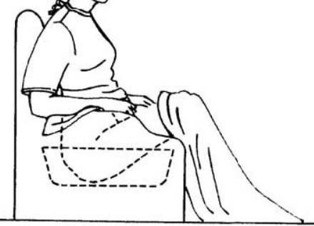
Anticholinergic Burden Scale
 | 3 Points (worst) | 2 points | 1 point (mild) | 0 points
Antihistamines | Cyproheptadine (Periactin) Diphenhydramine (Benadryl) Doxylamine (Unisom) Meclizine (Antivert) | Hydroxyzine (Vistaril) Chlorpheniramine (Chlor-Trimeton) | Cetirizine (Zyrtec) Famotidine (Pepcid) Fexofenadine (Allegra) Loratadine (Claritin) Ranitidine (Zantac) | Levocetirizine (Xyzal)
Anticholinergics for OAB | Oxybutynin (Ditropan)
DITRO
“Ox’s booty in a
(ditro)pan”

Slide 110
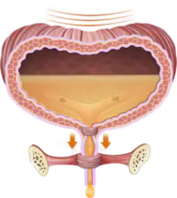
Anticholinergic Burden Scale
 | 3 Points (worst) | 2 points | 1 point (mild) | 0 points
Antihistamines | Cyproheptadine (Periactin) Diphenhydramine (Benadryl) Doxylamine (Unisom) Meclizine (Antivert) | Hydroxyzine (Vistaril) Chlorpheniramine (Chlor-Trimeton) | Cetirizine (Zyrtec) Famotidine (Pepcid) Fexofenadine (Allegra) Loratadine (Claritin) Ranitidine (Zantac) | Levocetirizine (Xyzal)
Anticholinergics for OAB | Oxybutynin (Ditropan) | Tolterodine (Detrol)
DITRO
“Total rodent
Detrusor control”
“Ox’s booty in a
(ditro)pan”

Slide 111
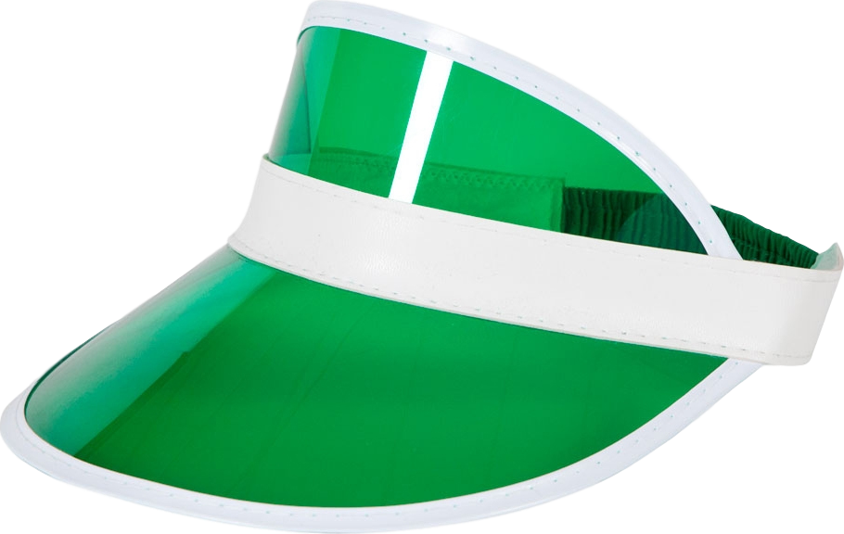
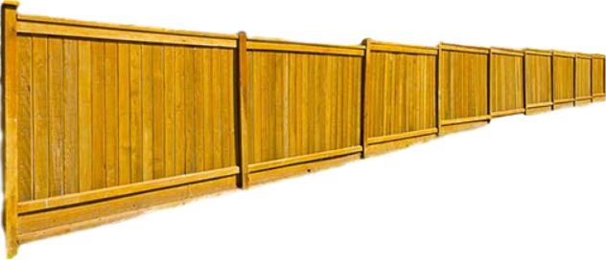
Anticholinergic Burden Scale
 | 3 Points (worst) | 2 points | 1 point (mild) | 0 points
Antihistamines | Cyproheptadine (Periactin) Diphenhydramine (Benadryl) Doxylamine (Unisom) Meclizine (Antivert) | Hydroxyzine (Vistaril) Chlorpheniramine (Chlor-Trimeton) | Cetirizine (Zyrtec) Famotidine (Pepcid) Fexofenadine (Allegra) Loratadine (Claritin) Ranitidine (Zantac) | Levocetirizine (Xyzal)
Anticholinergics for OAB | Oxybutynin (Ditropan) | Tolterodine (Detrol) | Fesoterodine (Toviaz) Solifenacin (Vesicare)
DITRO
“Total rodent
Detrusor control”
“Ox’s booty in a
(ditro)pan”

Slide 112
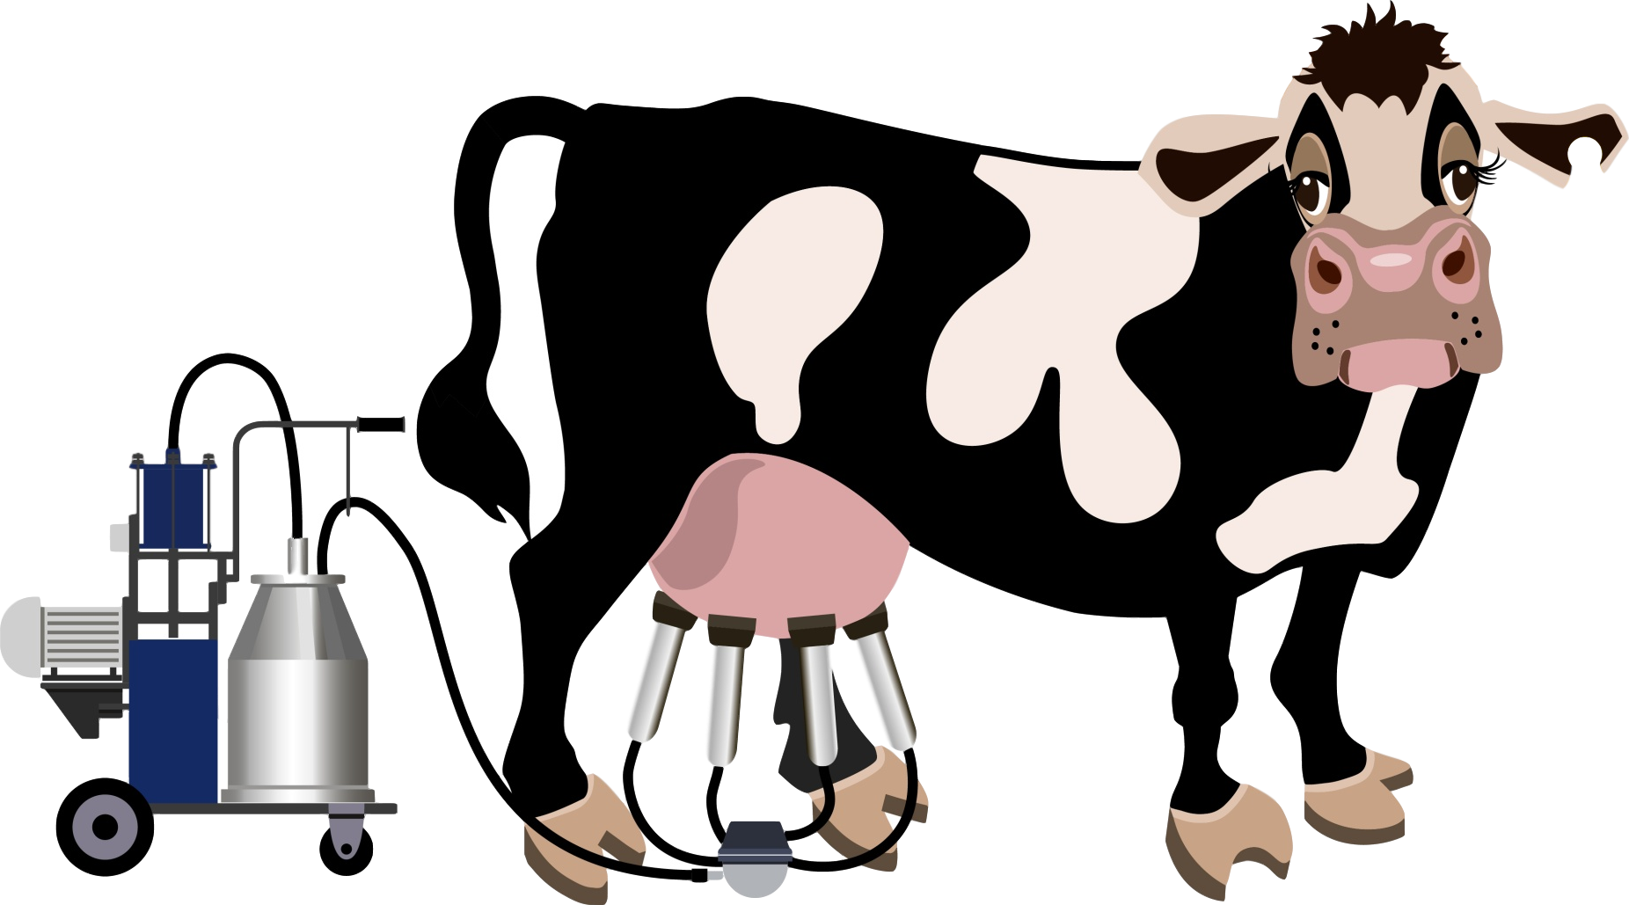
Anticholinergic Burden Scale
 | 3 Points (worst) | 2 points | 1 point (mild) | 0 points
Antihistamines | Cyproheptadine (Periactin) Diphenhydramine (Benadryl) Doxylamine (Unisom) Meclizine (Antivert) | Hydroxyzine (Vistaril) Chlorpheniramine (Chlor-Trimeton) | Cetirizine (Zyrtec) Famotidine (Pepcid) Fexofenadine (Allegra) Loratadine (Claritin) Ranitidine (Zantac) | Levocetirizine (Xyzal)
Anticholinergics for OAB | Oxybutynin (Ditropan) | Tolterodine (Detrol) | Fesoterodine (Toviaz) Solifenacin (Vesicare) | Darifenacin (Enablex) Trospium (Sanctura)
DITRO
“Total rodent
Detrusor control”
“Ox’s booty in a
(ditro)pan”

Slide 113
Anticholinergic Burden Scale
 | 3 Points (worst) | 2 points | 1 point (mild) | 0 points
Antihistamines | Cyproheptadine (Periactin) Diphenhydramine (Benadryl) Doxylamine (Unisom) Meclizine (Antivert) | Hydroxyzine (Vistaril) Chlorpheniramine (Chlor-Trimeton) | Cetirizine (Zyrtec) Famotidine (Pepcid) Fexofenadine (Allegra) Loratadine (Claritin) Ranitidine (Zantac) | Levocetirizine (Xyzal)
Anticholinergics for OAB | Oxybutynin (Ditropan) | Tolterodine (Detrol) | Fesoterodine (Toviaz) Solifenacin (Vesicare) | Darifenacin (Enablex) Trospium (Sanctura)
Other Anticholinergics

Slide 114
Anticholinergic Burden Scale
 | 3 Points (worst) | 2 points | 1 point (mild) | 0 points
Antihistamines | Cyproheptadine (Periactin) Diphenhydramine (Benadryl) Doxylamine (Unisom) Meclizine (Antivert) | Hydroxyzine (Vistaril) Chlorpheniramine (Chlor-Trimeton) | Cetirizine (Zyrtec) Famotidine (Pepcid) Fexofenadine (Allegra) Loratadine (Claritin) Ranitidine (Zantac) | Levocetirizine (Xyzal)
Anticholinergics for OAB | Oxybutynin (Ditropan) | Tolterodine (Detrol) | Fesoterodine (Toviaz) Solifenacin (Vesicare) | Darifenacin (Enablex) Trospium (Sanctura)
Other Anticholinergics | Atropine (injected) Benztropine (Cogentin) Dicyclomine (Bentyl) Hyoscyamine (Levsin) Scopolamine (Transderm Scōp) Trihexyphenidyl (Artane)

Slide 115
Anticholinergic Burden Scale
 | 3 Points (worst) | 2 points | 1 point (mild) | 0 points
Antihistamines | Cyproheptadine (Periactin) Diphenhydramine (Benadryl) Doxylamine (Unisom) Meclizine (Antivert) | Hydroxyzine (Vistaril) Chlorpheniramine (Chlor-Trimeton) | Cetirizine (Zyrtec) Famotidine (Pepcid) Fexofenadine (Allegra) Loratadine (Claritin) Ranitidine (Zantac) | Levocetirizine (Xyzal)
Anticholinergics for OAB | Oxybutynin (Ditropan) | Tolterodine (Detrol) | Fesoterodine (Toviaz) Solifenacin (Vesicare) | Darifenacin (Enablex) Trospium (Sanctura)
Other Anticholinergics | Atropine (injected) Benztropine (Cogentin) Dicyclomine (Bentyl) Hyoscyamine (Levsin) Scopolamine (Transderm Scōp) Trihexyphenidyl (Artane) | Amantadine (Symmetrel) Atropine eye drops

Slide 116
Anticholinergic Burden Scale
 | 3 Points (worst) | 2 points | 1 point (mild) | 0 points
Antihistamines | Cyproheptadine (Periactin) Diphenhydramine (Benadryl) Doxylamine (Unisom) Meclizine (Antivert) | Hydroxyzine (Vistaril) Chlorpheniramine (Chlor-Trimeton) | Cetirizine (Zyrtec) Famotidine (Pepcid) Fexofenadine (Allegra) Loratadine (Claritin) Ranitidine (Zantac) | Levocetirizine (Xyzal)
Anticholinergics for OAB | Oxybutynin (Ditropan) | Tolterodine (Detrol) | Fesoterodine (Toviaz) Solifenacin (Vesicare) | Darifenacin (Enablex) Trospium (Sanctura)
Other Anticholinergics | Atropine (injected) Benztropine (Cogentin) Dicyclomine (Bentyl) Hyoscyamine (Levsin) Scopolamine (Transderm Scōp) Trihexyphenidyl (Artane) | Amantadine (Symmetrel) Atropine eye drops | Ipratropium inhaler (Atrovent) Note that ipratropium is like an inhaled form of atropine (the strongest anticholinergic)

Slide 117
Anticholinergic Burden Scale
 | 3 Points (worst) | 2 points | 1 point (mild) | 0 points
Antihistamines | Cyproheptadine (Periactin) Diphenhydramine (Benadryl) Doxylamine (Unisom) Meclizine (Antivert) | Hydroxyzine (Vistaril) Chlorpheniramine (Chlor-Trimeton) | Cetirizine (Zyrtec) Famotidine (Pepcid) Fexofenadine (Allegra) Loratadine (Claritin) Ranitidine (Zantac) | Levocetirizine (Xyzal)
Anticholinergics for OAB | Oxybutynin (Ditropan) | Tolterodine (Detrol) | Fesoterodine (Toviaz) Solifenacin (Vesicare) | Darifenacin (Enablex) Trospium (Sanctura)
Other Anticholinergics | Atropine (injected) Benztropine (Cogentin) Dicyclomine (Bentyl) Hyoscyamine (Levsin) Scopolamine (Transderm Scōp) Trihexyphenidyl (Artane) | Amantadine (Symmetrel) Atropine eye drops | Ipratropium inhaler (Atrovent) Note that ipratropium is like an inhaled form of atropine (the strongest anticholinergic) | Glycopyrrolate (Robinul)* *Strong anticholinergic but does not cross blood-brain barrier; Therefore it causes constipation but not cognitive problems.

Slide 118
Anticholinergic Burden Scale
 | 3 Points (worst) | 2 points | 1 point (mild) | 0 points
Antihistamines | Cyproheptadine (Periactin) Diphenhydramine (Benadryl) Doxylamine (Unisom) Meclizine (Antivert) | Hydroxyzine (Vistaril) Chlorpheniramine (Chlor-Trimeton) | Cetirizine (Zyrtec) Famotidine (Pepcid) Fexofenadine (Allegra) Loratadine (Claritin) Ranitidine (Zantac) | Levocetirizine (Xyzal)
Anticholinergics for OAB | Oxybutynin (Ditropan) | Tolterodine (Detrol) | Fesoterodine (Toviaz) Solifenacin (Vesicare) | Darifenacin (Enablex) Trospium (Sanctura)
Other Anticholinergics | Atropine (injected) Benztropine (Cogentin) Dicyclomine (Bentyl) Hyoscyamine (Levsin) Scopolamine (Transderm Scōp) Trihexyphenidyl (Artane) | Amantadine (Symmetrel) Atropine eye drops | Ipratropium inhaler (Atrovent) Note that ipratropium is like an inhaled form of atropine (the strongest anticholinergic) | Glycopyrrolate (Robinul)* *Strong anticholinergic but does not cross blood-brain barrier; Therefore it causes constipation but not cognitive problems.
Muscle relaxants

Slide 119
Anticholinergic Burden Scale
 | 3 Points (worst) | 2 points | 1 point (mild) | 0 points
Antihistamines | Cyproheptadine (Periactin) Diphenhydramine (Benadryl) Doxylamine (Unisom) Meclizine (Antivert) | Hydroxyzine (Vistaril) Chlorpheniramine (Chlor-Trimeton) | Cetirizine (Zyrtec) Famotidine (Pepcid) Fexofenadine (Allegra) Loratadine (Claritin) Ranitidine (Zantac) | Levocetirizine (Xyzal)
Anticholinergics for OAB | Oxybutynin (Ditropan) | Tolterodine (Detrol) | Fesoterodine (Toviaz) Solifenacin (Vesicare) | Darifenacin (Enablex) Trospium (Sanctura)
Other Anticholinergics | Atropine (injected) Benztropine (Cogentin) Dicyclomine (Bentyl) Hyoscyamine (Levsin) Scopolamine (Transderm Scōp) Trihexyphenidyl (Artane) | Amantadine (Symmetrel) Atropine eye drops | Ipratropium inhaler (Atrovent) Note that ipratropium is like an inhaled form of atropine (the strongest anticholinergic) | Glycopyrrolate (Robinul)* *Strong anticholinergic but does not cross blood-brain barrier; Therefore it causes constipation but not cognitive problems.
Muscle relaxants | Carisoprodol (Soma) Orphenadrine (Norflex)

Slide 120
Anticholinergic Burden Scale
 | 3 Points (worst) | 2 points | 1 point (mild) | 0 points
Antihistamines | Cyproheptadine (Periactin) Diphenhydramine (Benadryl) Doxylamine (Unisom) Meclizine (Antivert) | Hydroxyzine (Vistaril) Chlorpheniramine (Chlor-Trimeton) | Cetirizine (Zyrtec) Famotidine (Pepcid) Fexofenadine (Allegra) Loratadine (Claritin) Ranitidine (Zantac) | Levocetirizine (Xyzal)
Anticholinergics for OAB | Oxybutynin (Ditropan) | Tolterodine (Detrol) | Fesoterodine (Toviaz) Solifenacin (Vesicare) | Darifenacin (Enablex) Trospium (Sanctura)
Other Anticholinergics | Atropine (injected) Benztropine (Cogentin) Dicyclomine (Bentyl) Hyoscyamine (Levsin) Scopolamine (Transderm Scōp) Trihexyphenidyl (Artane) | Amantadine (Symmetrel) Atropine eye drops | Ipratropium inhaler (Atrovent) Note that ipratropium is like an inhaled form of atropine (the strongest anticholinergic) | Glycopyrrolate (Robinul)* *Strong anticholinergic but does not cross blood-brain barrier; Therefore it causes constipation but not cognitive problems.
Muscle relaxants | Carisoprodol (Soma) Orphenadrine (Norflex) | Cyclobenzaprine (Flexeril) Baclofen (Lioresal)

Slide 121
Anticholinergic Burden Scale
 | 3 Points (worst) | 2 points | 1 point (mild) | 0 points
Antihistamines | Cyproheptadine (Periactin) Diphenhydramine (Benadryl) Doxylamine (Unisom) Meclizine (Antivert) | Hydroxyzine (Vistaril) Chlorpheniramine (Chlor-Trimeton) | Cetirizine (Zyrtec) Famotidine (Pepcid) Fexofenadine (Allegra) Loratadine (Claritin) Ranitidine (Zantac) | Levocetirizine (Xyzal)
Anticholinergics for OAB | Oxybutynin (Ditropan) | Tolterodine (Detrol) | Fesoterodine (Toviaz) Solifenacin (Vesicare) | Darifenacin (Enablex) Trospium (Sanctura)
Other Anticholinergics | Atropine (injected) Benztropine (Cogentin) Dicyclomine (Bentyl) Hyoscyamine (Levsin) Scopolamine (Transderm Scōp) Trihexyphenidyl (Artane) | Amantadine (Symmetrel) Atropine eye drops | Ipratropium inhaler (Atrovent) Note that ipratropium is like an inhaled form of atropine (the strongest anticholinergic) | Glycopyrrolate (Robinul)* *Strong anticholinergic but does not cross blood-brain barrier; Therefore it causes constipation but not cognitive problems.
Muscle relaxants | Carisoprodol (Soma) Orphenadrine (Norflex) | Cyclobenzaprine (Flexeril) Baclofen (Lioresal) | Methocarbamol (Robaxin)

Slide 122
Anticholinergic Burden Scale
 | 3 Points (worst) | 2 points | 1 point (mild) | 0 points
Antihistamines | Cyproheptadine (Periactin) Diphenhydramine (Benadryl) Doxylamine (Unisom) Meclizine (Antivert) | Hydroxyzine (Vistaril) Chlorpheniramine (Chlor-Trimeton) | Cetirizine (Zyrtec) Famotidine (Pepcid) Fexofenadine (Allegra) Loratadine (Claritin) Ranitidine (Zantac) | Levocetirizine (Xyzal)
Anticholinergics for OAB | Oxybutynin (Ditropan) | Tolterodine (Detrol) | Fesoterodine (Toviaz) Solifenacin (Vesicare) | Darifenacin (Enablex) Trospium (Sanctura)
Other Anticholinergics | Atropine (injected) Benztropine (Cogentin) Dicyclomine (Bentyl) Hyoscyamine (Levsin) Scopolamine (Transderm Scōp) Trihexyphenidyl (Artane) | Amantadine (Symmetrel) Atropine eye drops | Ipratropium inhaler (Atrovent) Note that ipratropium is like an inhaled form of atropine (the strongest anticholinergic) | Glycopyrrolate (Robinul)* *Strong anticholinergic but does not cross blood-brain barrier; Therefore it causes constipation but not cognitive problems.
Muscle relaxants | Carisoprodol (Soma) Orphenadrine (Norflex) | Cyclobenzaprine (Flexeril) Baclofen (Lioresal) | Methocarbamol (Robaxin) | Metaxalone (Skelaxin) Tizanidine (Zanaflex)

Slide 123
Anticholinergic Burden Scale
 | 3 Points (worst) | 2 points | 1 point (mild) | 0 points
Antihistamines | Cyproheptadine (Periactin) Diphenhydramine (Benadryl) Doxylamine (Unisom) Meclizine (Antivert) | Hydroxyzine (Vistaril) Chlorpheniramine (Chlor-Trimeton) | Cetirizine (Zyrtec) Famotidine (Pepcid) Fexofenadine (Allegra) Loratadine (Claritin) Ranitidine (Zantac) | Levocetirizine (Xyzal)
Anticholinergics for OAB | Oxybutynin (Ditropan) | Tolterodine (Detrol) | Fesoterodine (Toviaz) Solifenacin (Vesicare) | Darifenacin (Enablex) Trospium (Sanctura)
Other Anticholinergics | Atropine (injected) Benztropine (Cogentin) Dicyclomine (Bentyl) Hyoscyamine (Levsin) Scopolamine (Transderm Scōp) Trihexyphenidyl (Artane) | Amantadine (Symmetrel) Atropine eye drops | Ipratropium inhaler (Atrovent) Note that ipratropium is like an inhaled form of atropine (the strongest anticholinergic) | Glycopyrrolate (Robinul)* *Strong anticholinergic but does not cross blood-brain barrier; Therefore it causes constipation but not cognitive problems.
Muscle relaxants | Carisoprodol (Soma) Orphenadrine (Norflex) | Cyclobenzaprine (Flexeril) Baclofen (Lioresal) | Methocarbamol (Robaxin) | Metaxalone (Skelaxin) Tizanidine (Zanaflex)
Mood stabilizers & Antiepileptics

Slide 124
Anticholinergic Burden Scale
 | 3 Points (worst) | 2 points | 1 point (mild) | 0 points
Antihistamines | Cyproheptadine (Periactin) Diphenhydramine (Benadryl) Doxylamine (Unisom) Meclizine (Antivert) | Hydroxyzine (Vistaril) Chlorpheniramine (Chlor-Trimeton) | Cetirizine (Zyrtec) Famotidine (Pepcid) Fexofenadine (Allegra) Loratadine (Claritin) Ranitidine (Zantac) | Levocetirizine (Xyzal)
Anticholinergics for OAB | Oxybutynin (Ditropan) | Tolterodine (Detrol) | Fesoterodine (Toviaz) Solifenacin (Vesicare) | Darifenacin (Enablex) Trospium (Sanctura)
Other Anticholinergics | Atropine (injected) Benztropine (Cogentin) Dicyclomine (Bentyl) Hyoscyamine (Levsin) Scopolamine (Transderm Scōp) Trihexyphenidyl (Artane) | Amantadine (Symmetrel) Atropine eye drops | Ipratropium inhaler (Atrovent) Note that ipratropium is like an inhaled form of atropine (the strongest anticholinergic) | Glycopyrrolate (Robinul)* *Strong anticholinergic but does not cross blood-brain barrier; Therefore it causes constipation but not cognitive problems.
Muscle relaxants | Carisoprodol (Soma) Orphenadrine (Norflex) | Cyclobenzaprine (Flexeril) Baclofen (Lioresal) | Methocarbamol (Robaxin) | Metaxalone (Skelaxin) Tizanidine (Zanaflex)
Mood stabilizers & Antiepileptics | N/A

Slide 125
Anticholinergic Burden Scale
 | 3 Points (worst) | 2 points | 1 point (mild) | 0 points
Antihistamines | Cyproheptadine (Periactin) Diphenhydramine (Benadryl) Doxylamine (Unisom) Meclizine (Antivert) | Hydroxyzine (Vistaril) Chlorpheniramine (Chlor-Trimeton) | Cetirizine (Zyrtec) Famotidine (Pepcid) Fexofenadine (Allegra) Loratadine (Claritin) Ranitidine (Zantac) | Levocetirizine (Xyzal)
Anticholinergics for OAB | Oxybutynin (Ditropan) | Tolterodine (Detrol) | Fesoterodine (Toviaz) Solifenacin (Vesicare) | Darifenacin (Enablex) Trospium (Sanctura)
Other Anticholinergics | Atropine (injected) Benztropine (Cogentin) Dicyclomine (Bentyl) Hyoscyamine (Levsin) Scopolamine (Transderm Scōp) Trihexyphenidyl (Artane) | Amantadine (Symmetrel) Atropine eye drops | Ipratropium inhaler (Atrovent) Note that ipratropium is like an inhaled form of atropine (the strongest anticholinergic) | Glycopyrrolate (Robinul)* *Strong anticholinergic but does not cross blood-brain barrier; Therefore it causes constipation but not cognitive problems.
Muscle relaxants | Carisoprodol (Soma) Orphenadrine (Norflex) | Cyclobenzaprine (Flexeril) Baclofen (Lioresal) | Methocarbamol (Robaxin) | Metaxalone (Skelaxin) Tizanidine (Zanaflex)
Mood stabilizers & Antiepileptics | N/A | Carbamazepine (Tegretol)

Slide 126
Anticholinergic Burden Scale
 | 3 Points (worst) | 2 points | 1 point (mild) | 0 points
Antihistamines | Cyproheptadine (Periactin) Diphenhydramine (Benadryl) Doxylamine (Unisom) Meclizine (Antivert) | Hydroxyzine (Vistaril) Chlorpheniramine (Chlor-Trimeton) | Cetirizine (Zyrtec) Famotidine (Pepcid) Fexofenadine (Allegra) Loratadine (Claritin) Ranitidine (Zantac) | Levocetirizine (Xyzal)
Anticholinergics for OAB | Oxybutynin (Ditropan) | Tolterodine (Detrol) | Fesoterodine (Toviaz) Solifenacin (Vesicare) | Darifenacin (Enablex) Trospium (Sanctura)
Other Anticholinergics | Atropine (injected) Benztropine (Cogentin) Dicyclomine (Bentyl) Hyoscyamine (Levsin) Scopolamine (Transderm Scōp) Trihexyphenidyl (Artane) | Amantadine (Symmetrel) Atropine eye drops | Ipratropium inhaler (Atrovent) Note that ipratropium is like an inhaled form of atropine (the strongest anticholinergic) | Glycopyrrolate (Robinul)* *Strong anticholinergic but does not cross blood-brain barrier; Therefore it causes constipation but not cognitive problems.
Muscle relaxants | Carisoprodol (Soma) Orphenadrine (Norflex) | Cyclobenzaprine (Flexeril) Baclofen (Lioresal) | Methocarbamol (Robaxin) | Metaxalone (Skelaxin) Tizanidine (Zanaflex)
Mood stabilizers & Antiepileptics | N/A | Carbamazepine (Tegretol) | Oxcarbazepine (Trileptal)

Slide 127
Anticholinergic Burden Scale
 | 3 Points (worst) | 2 points | 1 point (mild) | 0 points
Antihistamines | Cyproheptadine (Periactin) Diphenhydramine (Benadryl) Doxylamine (Unisom) Meclizine (Antivert) | Hydroxyzine (Vistaril) Chlorpheniramine (Chlor-Trimeton) | Cetirizine (Zyrtec) Famotidine (Pepcid) Fexofenadine (Allegra) Loratadine (Claritin) Ranitidine (Zantac) | Levocetirizine (Xyzal)
Anticholinergics for OAB | Oxybutynin (Ditropan) | Tolterodine (Detrol) | Fesoterodine (Toviaz) Solifenacin (Vesicare) | Darifenacin (Enablex) Trospium (Sanctura)
Other Anticholinergics | Atropine (injected) Benztropine (Cogentin) Dicyclomine (Bentyl) Hyoscyamine (Levsin) Scopolamine (Transderm Scōp) Trihexyphenidyl (Artane) | Amantadine (Symmetrel) Atropine eye drops | Ipratropium inhaler (Atrovent) Note that ipratropium is like an inhaled form of atropine (the strongest anticholinergic) | Glycopyrrolate (Robinul)* *Strong anticholinergic but does not cross blood-brain barrier; Therefore it causes constipation but not cognitive problems.
Muscle relaxants | Carisoprodol (Soma) Orphenadrine (Norflex) | Cyclobenzaprine (Flexeril) Baclofen (Lioresal) | Methocarbamol (Robaxin) | Metaxalone (Skelaxin) Tizanidine (Zanaflex)
Mood stabilizers & Antiepileptics | N/A | Carbamazepine (Tegretol) | Oxcarbazepine (Trileptal) Diazepam (Valium) Temazepam (Restoril)

Slide 128
Anticholinergic Burden Scale
 | 3 Points (worst) | 2 points | 1 point (mild) | 0 points
Antihistamines | Cyproheptadine (Periactin) Diphenhydramine (Benadryl) Doxylamine (Unisom) Meclizine (Antivert) | Hydroxyzine (Vistaril) Chlorpheniramine (Chlor-Trimeton) | Cetirizine (Zyrtec) Famotidine (Pepcid) Fexofenadine (Allegra) Loratadine (Claritin) Ranitidine (Zantac) | Levocetirizine (Xyzal)
Anticholinergics for OAB | Oxybutynin (Ditropan) | Tolterodine (Detrol) | Fesoterodine (Toviaz) Solifenacin (Vesicare) | Darifenacin (Enablex) Trospium (Sanctura)
Other Anticholinergics | Atropine (injected) Benztropine (Cogentin) Dicyclomine (Bentyl) Hyoscyamine (Levsin) Scopolamine (Transderm Scōp) Trihexyphenidyl (Artane) | Amantadine (Symmetrel) Atropine eye drops | Ipratropium inhaler (Atrovent) Note that ipratropium is like an inhaled form of atropine (the strongest anticholinergic) | Glycopyrrolate (Robinul)* *Strong anticholinergic but does not cross blood-brain barrier; Therefore it causes constipation but not cognitive problems.
Muscle relaxants | Carisoprodol (Soma) Orphenadrine (Norflex) | Cyclobenzaprine (Flexeril) Baclofen (Lioresal) | Methocarbamol (Robaxin) | Metaxalone (Skelaxin) Tizanidine (Zanaflex)
Mood stabilizers & Antiepileptics | N/A | Carbamazepine (Tegretol) | Oxcarbazepine (Trileptal) Diazepam (Valium) Temazepam (Restoril) | Other anticonvulsants Other benzos Lithium

Slide 129
Anticholinergic Burden Scale
3 Points (worst) | 2 points | 1 point (mild) | 0 points
Most TCAs Chlorpromazine (Thorazine) Diphenhydramine (Benadryl) Benztropine (Cogentin) Trihexyphenidyl (Artane) | Clozapine (Clozaril) Olanzapine (Zyprexa) Paroxetine (Paxil) Hydroxyzine (Vistaril) Carbamazepine (Tegretol) | Haloperidol (Haldol) Quetiapine (Seroquel) | Most SSRIs SNRIs Newer antidepressants Bupropion (Wellbutrin) Most SGAs Most benzos Most anticonvulsants

Slide 130
The opposite of anticholinergics...

Slide 131
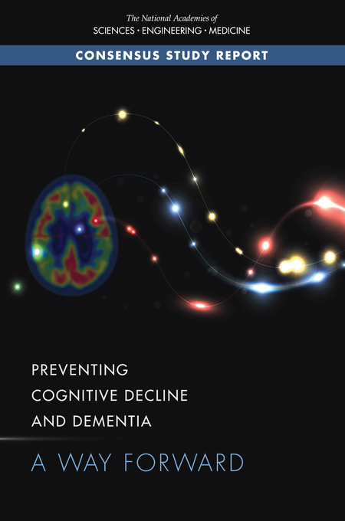
2017
Interventions once a diagnosis has been made
Cholinesterase inhibitors
have a useful, modest role in improving cognition and activities of daily living in patients with mild-to-moderate Alzheimer’s disease
National Academies of Sciences, Engineering, and Medicine; Health and Medicine Division; Board on Health Sciences Policy; Committee on Preventing Dementia and Cognitive Impairment. Preventing Cognitive Decline and Dementia: A Way Forward. Downey A, Stroud C, Landis S, Leshner AI, editors. Washington (DC): National Academies Press (US); 2017 Jun 22. PMID: 28650595.

Slide 132
2017
Interventions once a diagnosis has been made
Cholinesterase inhibitors
have a useful, modest role in improving cognition and activities of daily living in patients with mild-to-moderate Alzheimer’s disease
National Academies of Sciences, Engineering, and Medicine; Health and Medicine Division; Board on Health Sciences Policy; Committee on Preventing Dementia and Cognitive Impairment. Preventing Cognitive Decline and Dementia: A Way Forward. Downey A, Stroud C, Landis S, Leshner AI, editors. Washington (DC): National Academies Press (US); 2017 Jun 22. PMID: 28650595.

Slide 133
Cholinergics (muscarinics) - everything wet
Brady(cardia) Bunch SLUDGE buckets filled with fluids produced as cholinergic effects
Saliva
Tears
Urine
Vomitus
Sweat
Diarrhea
pro-cognitive

Slide 134
Cholinergics (muscarinics) - everything wet
Brady(cardia) Bunch SLUDGE buckets filled with fluids produced as cholinergic effects
Saliva
Tears
Urine
Vomitus
Sweat
Diarrhea
pro-cognitive
Anticholinergics (antimuscarinics) - everything dry

Slide 135
Cholinergics (muscarinics) - everything wet
Brady(cardia) Bunch SLUDGE buckets filled with fluids produced as cholinergic effects
Saliva
Tears
Urine
Vomitus
Sweat
Diarrhea
pro-cognitive
tachycardia
Anticholinergics (antimuscarinics) - everything dry

Slide 136
Cholinergics (muscarinics) - everything wet
Brady(cardia) Bunch SLUDGE buckets filled with fluids produced as cholinergic effects
Saliva
Tears
Urine
Vomitus
Sweat
Diarrhea
pro-cognitive
dry
mouth
tachycardia
Anticholinergics (antimuscarinics) - everything dry

Slide 137
Cholinergics (muscarinics) - everything wet
Brady(cardia) Bunch SLUDGE buckets filled with fluids produced as cholinergic effects
Saliva
Tears
Urine
Vomitus
Sweat
Diarrhea
pro-cognitive
dry
mouth
dry
eyes
tachycardia
Anticholinergics (antimuscarinics) - everything dry

Slide 138
Cholinergics (muscarinics) - everything wet
Brady(cardia) Bunch SLUDGE buckets filled with fluids produced as cholinergic effects
Saliva
Tears
Urine
Vomitus
Sweat
Diarrhea
pro-cognitive
dry
mouth
dry
eyes
urinary
retention
tachycardia
“dry as a bone”
Anticholinergics (antimuscarinics) - everything dry

Slide 139
Cholinergics (muscarinics) - everything wet
Brady(cardia) Bunch SLUDGE buckets filled with fluids produced as cholinergic effects
Saliva
Tears
Urine
Vomitus
Sweat
Diarrhea
pro-cognitive
dry
mouth
dry
eyes
urinary
retention
antiemetic effects
tachycardia
“dry as a bone”
Anticholinergics (antimuscarinics) - everything dry

Slide 140
Cholinergics (muscarinics) - everything wet
Brady(cardia) Bunch SLUDGE buckets filled with fluids produced as cholinergic effects
Saliva
Tears
Urine
Vomitus
Sweat
Diarrhea
pro-cognitive
dry
mouth
dry
eyes
urinary
retention
antiemetic effects
“red as a beet” / “hot as a hare”
tachycardia
“dry as a bone”
Anticholinergics (antimuscarinics) - everything dry

Slide 141
Cholinergics (muscarinics) - everything wet
Brady(cardia) Bunch SLUDGE buckets filled with fluids produced as cholinergic effects
Saliva
Tears
Urine
Vomitus
Sweat
Diarrhea
pro-cognitive
dry
mouth
dry
eyes
urinary
retention
antiemetic effects
constipation
“red as a beet” / “hot as a hare”
tachycardia
“dry as a bone”
Anticholinergics (antimuscarinics) - everything dry

Slide 142
Cholinergics (muscarinics) - everything wet
Brady(cardia) Bunch SLUDGE buckets filled with fluids produced as cholinergic effects
Saliva
Tears
Urine
Vomitus
Sweat
Diarrhea
pro-cognitive
dry
mouth
dry
eyes
urinary
retention
antiemetic effects
constipation
“mad as a hatter”
“red as a beet” / “hot as a hare”
tachycardia
“dry as a bone”
Anticholinergics (antimuscarinics) - everything dry

Slide 143
Cholinergics (muscarinics) - everything wet
Brady(cardia) Bunch SLUDGE buckets filled with fluids produced as cholinergic effects
Saliva
Tears
Urine
Vomitus
Sweat
Diarrhea
pro-cognitive
Cholinesterase
Inhibitors
cholinergic medications for Alzheimer’s

Slide 144
Cholinergics (muscarinics) - everything wet
Brady(cardia) Bunch SLUDGE buckets filled with fluids produced as cholinergic effects
Saliva
Tears
Urine
Vomitus
Sweat
Diarrhea
pro-cognitive
Cholinesterase
Inhibitors
cholinergic medications for Alzheimer’s
“Donnie Pez”
donepezil

Slide 145
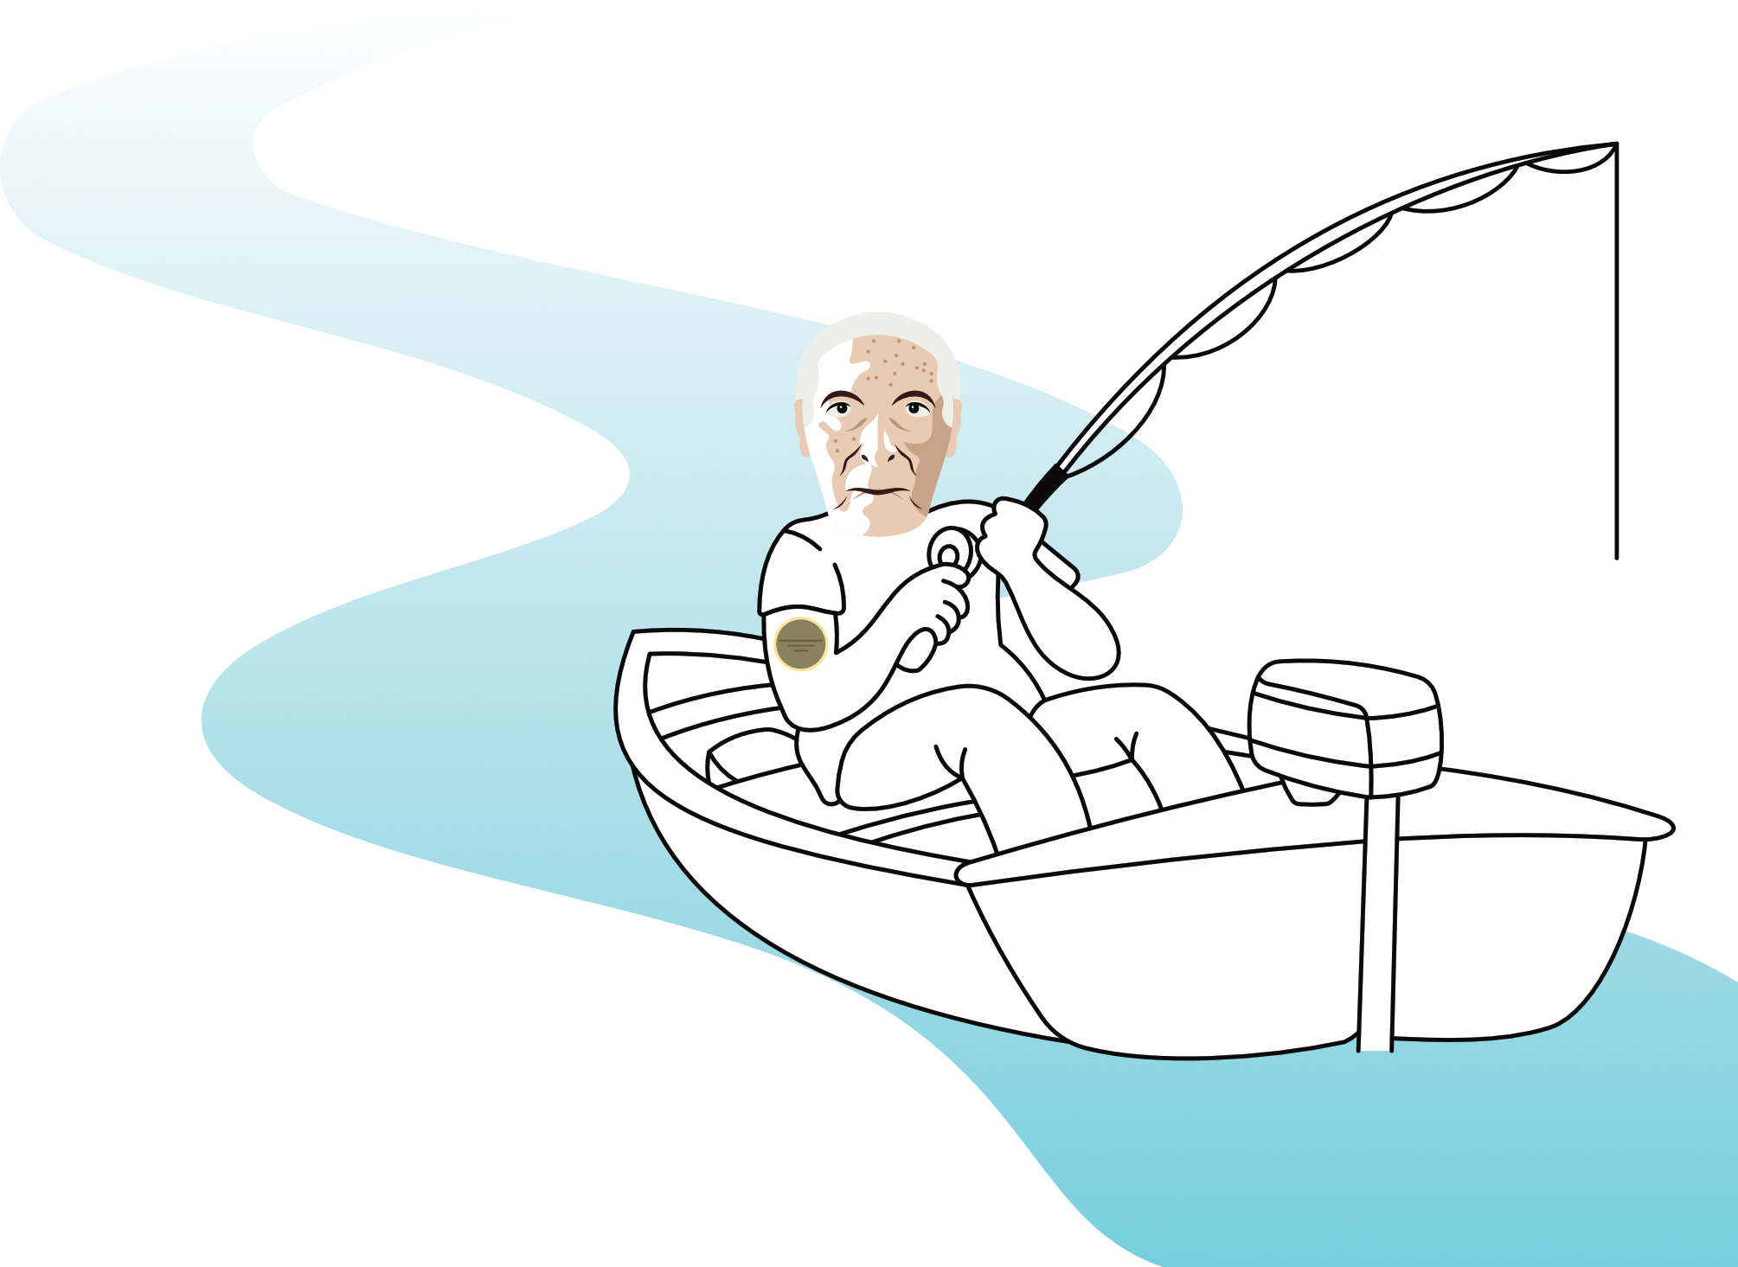
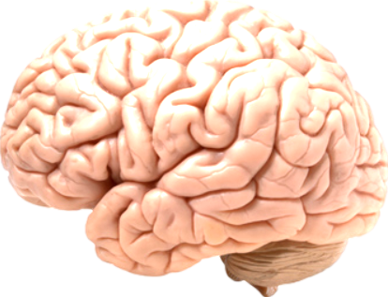
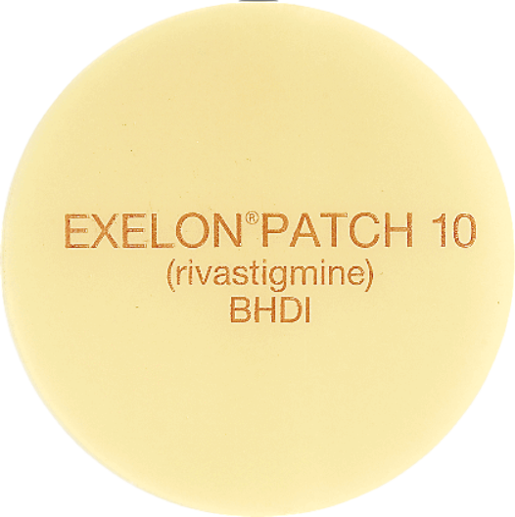
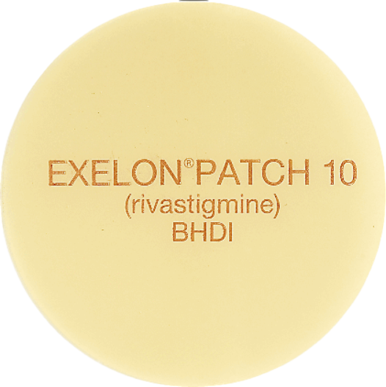
Cholinergics (muscarinics) - everything wet
Brady(cardia) Bunch SLUDGE buckets filled with fluids produced as cholinergic effects
Saliva
Tears
Urine
Vomitus
Sweat
Diarrhea
pro-cognitive
“river”stigmine
Cholinesterase
Inhibitors
cholinergic medications for Alzheimer’s
“Donnie Pez”
donepezil
rivastigmine

Slide 146
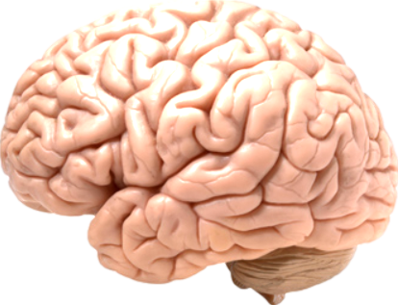
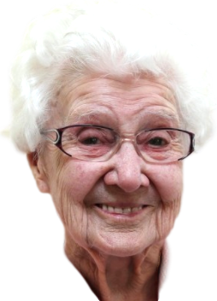
Cholinergics (muscarinics) - everything wet
Brady(cardia) Bunch SLUDGE buckets filled with fluids produced as cholinergic effects
Saliva
Tears
Urine
Vomitus
Sweat
Diarrhea
pro-cognitive
“river”stigmine
Cholinesterase
Inhibitors
cholinergic medications for Alzheimer’s
“Donnie Pez”
Go lantern!
donepezil
rivastigmine
galantamine

Slide 147
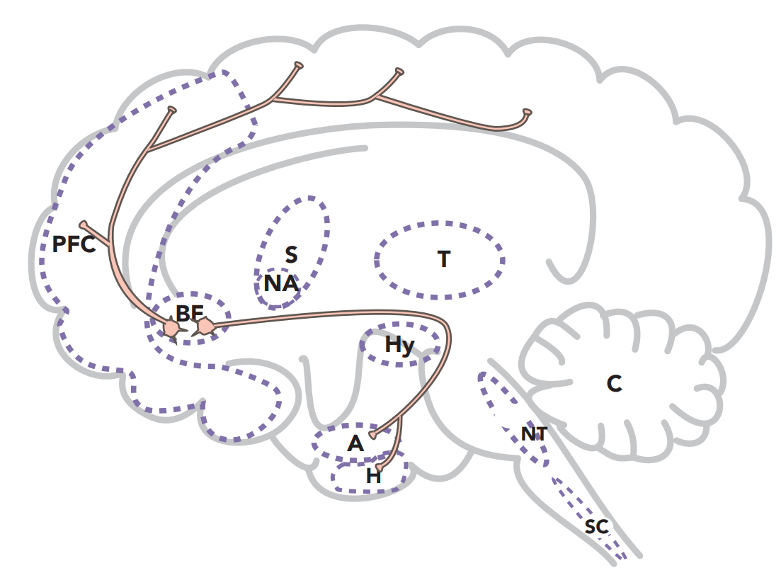
Mild cognitive impairment & early Alzheimer’s involves loss of cholinergic neurons
Cholinergic projects from the basal forebrain
Stahl’s Essential Psychopharmacology

Slide 148
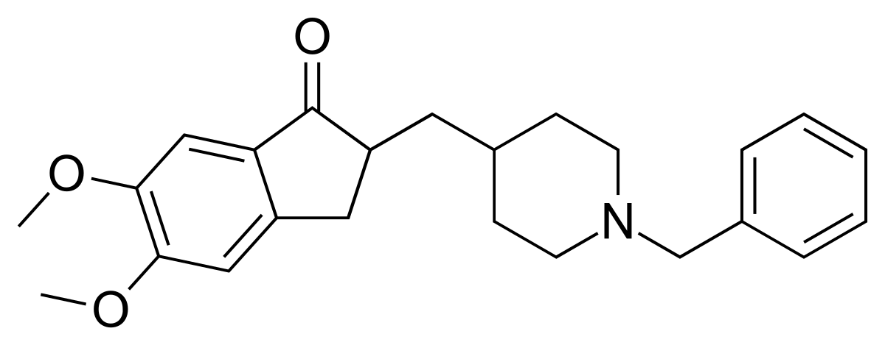
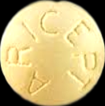
Donepezil (ARICEPT)
don ep e zil / AIR e cept
“Donnie Pez is Air except”
(for an Alzheimer’s brain)
#98
1996
$7–$158
“Air” in Alzheimer’s patient’s brain
I have one of the great memories of all time.
❖ Cholinergic drug
❖ Cholinesterase inhibitor
❖ Cognitive enhancer
FDA-approved for:
❖ Alzheimer’s dementia:
➤ mild–moderate
➤ moderate–severe
5
10
23
mg

Slide 149
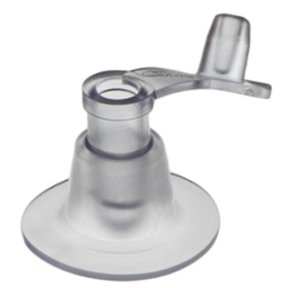
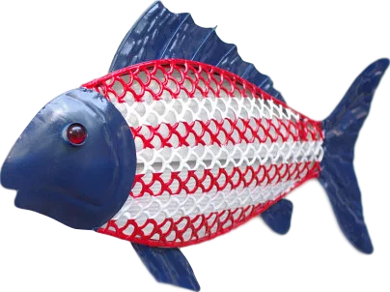
Donepezil
(ARICEPT)
Side effects (10% dropout)
cholinergic effects
❖ nausea, vomiting, diarrhea
(generally lasting ~2 weeks)
❖ bradycardia
S L U D G E
5
10
23
mg
3A4 substrate (minor)
2D6 substrate

Slide 150
Donepezil
(ARICEPT)
Side effects (10% dropout)
cholinergic effects
❖ nausea, vomiting, diarrhea
(generally lasting ~2 weeks)
❖ bradycardia
also:
❖ agitation
❖ vivid dreams
❖ weight loss (23 mg dose)
S L U D G E
5
10
23
mg
3A4 substrate (minor)
2D6 substrate

Slide 151
Donepezil
(ARICEPT)
Side effects (10% dropout)
cholinergic effects
❖ nausea, vomiting, diarrhea
(generally lasting ~2 weeks)
❖ bradycardia
also:
❖ agitation
❖ vivid dreams
❖ weight loss (23 mg dose)
_________________________________
❖ better evidence for mild Alzheimer’s
than the other cholinesterase inhibitors
S L U D G E
5
10
23
mg
3A4 substrate (minor)
2D6 substrate

Slide 152
Donepezil
(ARICEPT)
Side effects (10% dropout)
cholinergic effects
❖ nausea, vomiting, diarrhea
(generally lasting ~2 weeks)
❖ bradycardia
also:
❖ agitation
❖ vivid dreams
❖ weight loss (23 mg dose)
_________________________________
❖ better evidence for mild Alzheimer’s
than the other cholinesterase inhibitors
❖ long half-life of about 3 days.
S L U D G E
5
10
23
mg
3A4 substrate (minor)
2D6 substrate

Slide 153
Donepezil
(ARICEPT)
Side effects (10% dropout)
cholinergic effects
❖ nausea, vomiting, diarrhea
(generally lasting ~2 weeks)
❖ bradycardia
also:
❖ agitation
❖ vivid dreams
❖ weight loss (23 mg dose)
_________________________________
❖ better evidence for mild Alzheimer’s
than the other cholinesterase inhibitors
❖ long half-life of about 3 days.
❖ typically dosed at bedtime but is
non-sedating
S L U D G E
5
10
23
mg
3A4 substrate (minor)
2D6 substrate

Slide 154
Donepezil
(ARICEPT)
Side effects (10% dropout)
cholinergic effects
❖ nausea, vomiting, diarrhea
(generally lasting ~2 weeks)
❖ bradycardia
also:
❖ agitation
❖ vivid dreams
❖ weight loss (23 mg dose)
_________________________________
❖ better evidence for mild Alzheimer’s
than the other cholinesterase inhibitors
❖ long half-life of about 3 days.
❖ typically dosed at bedtime but is
non-sedating
❖ 5 mg HS x 4 weeks then 10 mg HS, which is the target dose for mild Alzheimer’s dementia.
S L U D G E
5
10
23
mg
3A4 substrate (minor)
2D6 substrate

Slide 155
Donepezil
(ARICEPT)
Side effects (10% dropout)
cholinergic effects
❖ nausea, vomiting, diarrhea
(generally lasting ~2 weeks)
❖ bradycardia
also:
❖ agitation
❖ vivid dreams
❖ weight loss (23 mg dose)
_________________________________
❖ better evidence for mild Alzheimer’s
than the other cholinesterase inhibitors
❖ long half-life of about 3 days.
❖ typically dosed at bedtime but is
non-sedating
❖ 5 mg HS x 4 weeks then 10 mg HS, which is the target dose for mild Alzheimer’s dementia.
❖ Maximum dose is 23 mg HS (intended for moderate to severe dementia), after the patient has tolerated 10 mg for 3 months.
S L U D G E
5
10
23
mg
3A4 substrate (minor)
2D6 substrate

Slide 156
Donepezil
(ARICEPT)
Side effects (10% dropout)
cholinergic effects
❖ nausea, vomiting, diarrhea
(generally lasting ~2 weeks)
❖ bradycardia
also:
❖ agitation
❖ vivid dreams
❖ weight loss (23 mg dose)
_________________________________
❖ better evidence for mild Alzheimer’s
than the other cholinesterase inhibitors
❖ long half-life of about 3 days.
❖ typically dosed at bedtime but is
non-sedating
❖ 5 mg HS x 4 weeks then 10 mg HS, which is the target dose for mild Alzheimer’s dementia.
❖ Maximum dose is 23 mg HS (intended for moderate to severe dementia), after the patient has tolerated 10 mg for 3 months.
❖ If stopped, it should be tapered over 4 weeks, but be advised that cognitive functioning may plummet, possibly irrecoverably.
S L U D G E
5
10
23
mg
3A4 substrate (minor)
2D6 substrate

Slide 157
Donepezil
(ARICEPT)
Dynamic interactions:
❖ Avoid combining with anticholinergics (with CNS effects) due to opposing mechanism of action.
2D6 substrate
5
10
23
mg
3A4 substrate (minor)

Slide 158
Donepezil
(ARICEPT)
Dynamic interactions:
❖ Avoid combining with anticholinergics (with CNS effects) due to opposing mechanism of action.
❖ Cholinergic toxicity (SLUDGE syndrome) is possible when combined with cholinergics such as bethanechol (Urecholine)
2D6 substrate
5
10
23
mg
3A4 substrate (minor)

Slide 159
Donepezil
(ARICEPT)
Dynamic interactions:
❖ Avoid combining with anticholinergics (with CNS effects) due to opposing mechanism of action.
❖ Cholinergic toxicity (SLUDGE syndrome) is possible when combined with cholinergics such as bethanechol (Urecholine)
❖ Strategic combination with a peripheral anticholinergic (without CNS effects) can ameliorate GI distress.
2D6 substrate
5
10
23
mg
3A4 substrate (minor)

Slide 160
Donepezil
(ARICEPT)
Dynamic interactions:
❖ Avoid combining with anticholinergics (with CNS effects) due to opposing mechanism of action.
❖ Cholinergic toxicity (SLUDGE syndrome) is possible when combined with cholinergics such as bethanechol (Urecholine)
❖ Strategic combination with a peripheral anticholinergic (without CNS effects) can ameliorate GI distress.
❖ Caution with beta blockers (propranolol, metoprolol, etc) due to aggregate risk of bradycardia.
2D6 substrate
5
10
23
mg
3A4 substrate (minor)

Slide 161
Donepezil
(ARICEPT)
Dynamic interactions:
❖ Avoid combining with anticholinergics (with CNS effects) due to opposing mechanism of action.
❖ Cholinergic toxicity (SLUDGE syndrome) is possible when combined with cholinergics such as bethanechol (Urecholine)
❖ Strategic combination with a peripheral anticholinergic (without CNS effects) can ameliorate GI distress.
❖ Caution with beta blockers (propranolol, metoprolol, etc) due to aggregate risk of bradycardia.
❖ Lowers seizure threshold
2D6 substrate
5
10
23
mg
3A4 substrate (minor)

Slide 162
Donepezil
(ARICEPT)
Dynamic interactions:
❖ Avoid combining with anticholinergics (with CNS effects) due to opposing mechanism of action.
❖ Cholinergic toxicity (SLUDGE syndrome) is possible when combined with cholinergics such as bethanechol (Urecholine)
❖ Strategic combination with a peripheral anticholinergic (without CNS effects) can ameliorate GI distress.
❖ Caution with beta blockers (propranolol, metoprolol, etc) due to aggregate risk of bradycardia.
❖ Lowers seizure threshold
Kinetic interactions:
❖ 2D6 substrate
❖ 3A4 substrate (minor)
2D6 substrate
5
10
23
mg
3A4 substrate (minor)

Slide 163
Donepezil
(ARICEPT)
Cytochrome P450 2D6 (CYP2D6)
“Too Darn Sexy”
These balls are
2 Darn 6’y
You’re inflating my ego!
2D6 substrate
2D6
substrate
2D6 inHibitor
5
10
23
mg
3A4 substrate (minor)
inHibition = High
& Hurried

Slide 164
Donepezil
(ARICEPT)
Cytochrome P450 2D6 (CYP2D6)
These balls are
2 Darn 6’y
You’re inflating my ego!
2D6 inHibitor
2D6
substrate
2D6 substrate
5
10
23
mg
3A4 substrate (minor)

Slide 165
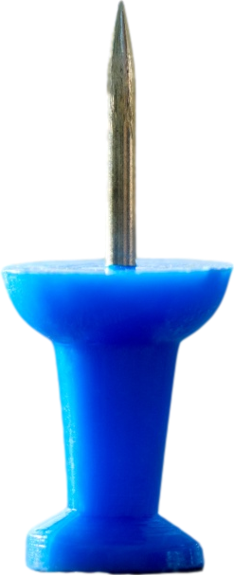
Donepezil
(ARICEPT)
Cytochrome P450 2D6 (CYP2D6)
“Too Darn Sexy”
inDuction = Down & Delayed
2D6 inHibitor
2D6 substrate
5
10
23
mg
3A4 substrate (minor)
2D6
substrate

Slide 166
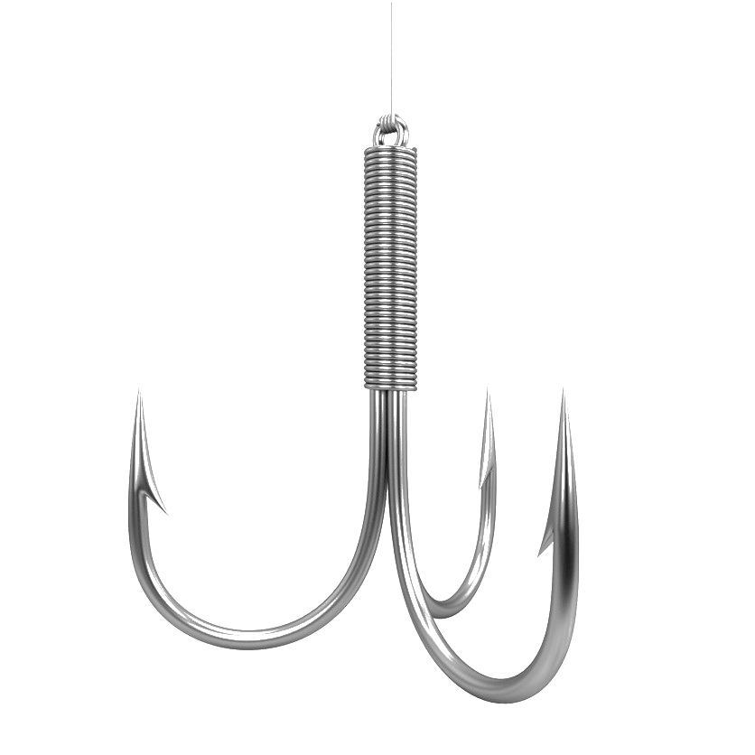
Interaction mnemonics
CYP3A4
“3 A’s For
(fishing)”
CYP3A4
“3 A’s For
(fishing)”
3A4
inhibitor
Three letter
A’s
3A4
substrate
Notes:
Here’s another CYP enzyme.

Slide 167
Interaction mnemonics
CYP3A4
“3 A’s For
(fishing)”
3A4
inhibitor
3A4
substrate
Notes:
Bobbers increase fish (PAUSE FOR GROWTH)

Slide 168
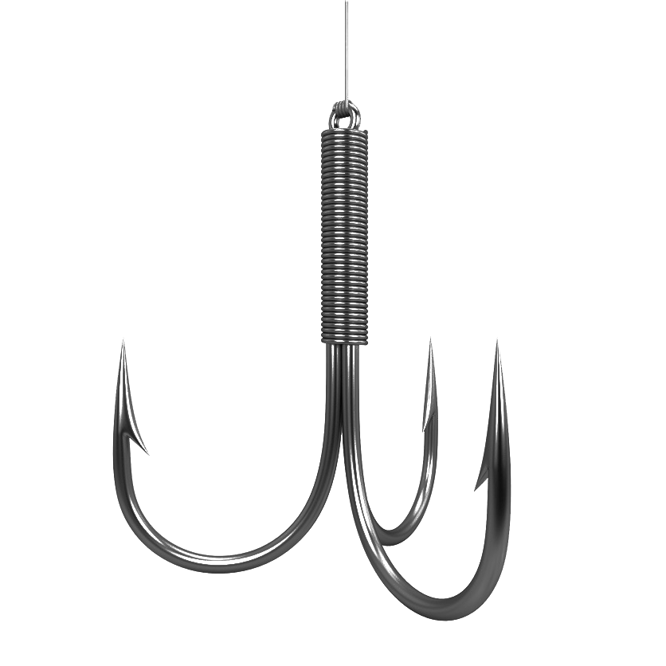
Interaction mnemonics
CYP3A4
“3 A’s For
(fishing)”
inHibition
High and
Hurried
Fluvoxamine
Luvox
“gLove-ox”
3A4
substrate
Notes:
Plug in Luvox,
an inHibitor

Slide 169
Interaction mnemonics
CYP3A4
“3 A’s For
(fishing)”
inHibition
High and
Hurried
Fluvoxamine
Luvox
“gLove-ox”
Notes:
Plug in Luvox,
an inHibitor

Slide 170
Interaction mnemonics
CYP3A4
“3 A’s For
(fishing)”
inDuction
3A4
Down and Delayed
inducer
3A4
substrate
Notes:
Anvils
drop
the blood levels
of fish

Slide 171
Interaction mnemonics
CYP3A4
“3 A’s For
(fishing)”
inDuction
Down and Delayed
Carbamazepine
(Tegretol)
“Tiger tail”
3A4
substrate
Notes:
“Tiger Tail”
is
an anvil

Slide 172
Interaction mnemonics
CYP3A4
“3 A’s For
(fishing)”
inDuction
Down and Delayed
Carbamazepine
(Tegretol)
“Tiger tail”
Notes:
“Tiger Tail”
is
an anvil

Slide 173
Donepezil
(ARICEPT)
Dynamic interactions:
❖ Avoid combining with anticholinergics (with CNS effects) due to opposing mechanism of action.
❖ Cholinergic toxicity (SLUDGE syndrome) is possible when combined with cholinergics such as bethanechol (Urecholine)
❖ Strategic combination with a peripheral anticholinergic (without CNS effects) can ameliorate GI distress.
❖ Caution with beta blockers (propranolol, metoprolol, etc) due to aggregate risk of bradycardia.
❖ Lowers seizure threshold
Kinetic interactions:
❖ 2D6 substrate
❖ 3A4 substrate (minor)
2D6 substrate
5
10
23
mg
3A4 substrate (minor)

Slide 174
Anticholinergic Burden Scale
What could we strategically combine with donepezil to ameliorate GI distress or bradycardia?

Slide 175
Anticholinergic Burden Scale
What could we combine with donepezil to ameliorate GI distress or bradycardia?
 | 3 Points (worst) | 2 points | 1 point (mild) | 0 points
Anticholinergics for OAB | Oxybutynin (Ditropan) | Tolterodine (Detrol) | Fesoterodine (Toviaz) Solifenacin (Vesicare) | Darifenacin (Enablex) Trospium (Sanctura)
Other Anticholinergics | Atropine (injected) Benztropine (Cogentin) Dicyclomine (Bentyl) Hyoscyamine (Levsin) Scopolamine (Transderm Scōp) Trihexyphenidyl (Artane) | Amantadine (Symmetrel) | Ipratropium inhaler (Atrovent) Note that ipratropium is like an inhaled form of atropine (the strongest anticholinergic) | Glycopyrrolate (Robinul)* *Strong anticholinergic but does not cross blood-brain barrier; Therefore it causes constipation but not cognitive problems.

Slide 176
Anticholinergic Burden Scale
What could we combine with donepezil to ameliorate GI distress or bradycardia?
 | 3 Points (worst) | 2 points | 1 point (mild) | 0 points
Anticholinergics for OAB | Oxybutynin (Ditropan) | Tolterodine (Detrol) | Fesoterodine (Toviaz) Solifenacin (Vesicare) | Darifenacin (Enablex) Trospium (Sanctura)
Other Anticholinergics | Atropine (injected) Benztropine (Cogentin) Dicyclomine (Bentyl) Hyoscyamine (Levsin) Scopolamine (Transderm Scōp) Trihexyphenidyl (Artane) | Amantadine (Symmetrel) | Ipratropium inhaler (Atrovent) Note that ipratropium is like an inhaled form of atropine (the strongest anticholinergic) | Glycopyrrolate (Robinul)* *Strong anticholinergic but does not cross blood-brain barrier; Therefore it causes constipation but not cognitive problems.
These may counteract peripheral cholinergic effects of donepezil, but would oppose the therapeutic effect.

Slide 177
Anticholinergic Burden Scale
What could we combine with donepezil to ameliorate GI distress or bradycardia?
 | 3 Points (worst) | 2 points | 1 point (mild) | 0 points
Anticholinergics for OAB | Oxybutynin (Ditropan) | Tolterodine (Detrol) | Fesoterodine (Toviaz) Solifenacin (Vesicare) | Darifenacin (Enablex) Trospium (Sanctura)
Other Anticholinergics | Atropine (injected) Benztropine (Cogentin) Dicyclomine (Bentyl) Hyoscyamine (Levsin) Scopolamine (Transderm Scōp) Trihexyphenidyl (Artane) | Amantadine (Symmetrel) | Ipratropium inhaler (Atrovent) Note that ipratropium is like an inhaled form of atropine (the strongest anticholinergic) | Glycopyrrolate (Robinul)* *Strong anticholinergic but does not cross blood-brain barrier; Therefore it causes constipation but not cognitive problems.
These may counteract peripheral cholinergic effects of donepezil, but would oppose the therapeutic effect.
These have been used in conjunction with donepezil to ameliorate side effects and allow a higher donepezil dose.

Slide 178
Cholinergics (muscarinics) - everything wet
Brady(cardia) Bunch SLUDGE buckets filled with fluids produced as cholinergic effects
Saliva
Tears
Urine
Vomitus
Sweat
Diarrhea
pro-cognitive
“river”stigmine
Cholinesterase
Inhibitors
cholinergic medications for Alzheimer’s
“Donnie Pez”
Go lantern!
donepezil
rivastigmine
galantamine

Slide 179
Cholinergics (muscarinics) - everything wet
Brady(cardia) Bunch SLUDGE buckets filled with fluids produced as cholinergic effects
Saliva
Tears
Urine
Vomitus
Sweat
Diarrhea
pro-cognitive
“river”stigmine
Cholinesterase
Inhibitors
cholinergic medications for Alzheimer’s
“Donnie Pez”
Go lantern!
donepezil
rivastigmine
galantamine

Slide 180
Rivastigmine (EXELON)
riv a stig meen / EX el on
“Excel on River Stigmine”
2000
$60–$500
❖ Cholinergic drug
❖ Cholinesterase inhibitor
➤ acetylcholinesterase
➤ butyrylcholinesterase
❖ Cognitive enhancer
River Stigmine
?
4.6
13.3
mg patch

Slide 181
Rivastigmine (EXELON)
riv a stig meen / EX el on
“Excel on River Stigmine”
2000
$60–$500
❖ Cholinergic drug
❖ Cholinesterase inhibitor
➤ acetylcholinesterase
➤ butyrylcholinesterase
❖ Cognitive enhancer
River Stigmine
4.6
13.3
mg patch

Slide 182
Rivastigmine (EXELON)
riv a stig meen / EX el on
“Excel on River Stigmine”
2000
$60–$500
❖ Cholinergic drug
❖ Cholinesterase inhibitor
➤ acetylcholinesterase
➤ butyrylcholinesterase
❖ Cognitive enhancer
River Stigmine
FDA-approved for:
❖ Alzheimer’s dementia,
mild–moderate
❖ Parkinson’s dementia,
mild–moderate
?
4.6
13.3
mg patch

Slide 183
Rivastigmine (EXELON)
riv a stig meen / EX el on
“Excel on River Stigmine”
2000
$60–$500
❖ Cholinergic drug
❖ Cholinesterase inhibitor
➤ acetylcholinesterase
➤ butyrylcholinesterase
❖ Cognitive enhancer
River Stigmine
FDA-approved for:
❖ Alzheimer’s dementia,
mild–moderate
❖ Parkinson’s dementia,
mild–moderate
4.6
13.3
mg patch

Slide 184
Rivastigmine (EXELON)
❖ the same side effects and
pharmacodynamic interactions
as donepezil
S L U D G E
River Stigmine
minimal clinically relevant kinetic interactions
– “in a bubble”
4.6
13.3
mg patch

Slide 185
Rivastigmine (EXELON)
❖ the same side effects and
pharmacodynamic interactions
as donepezil
❖ second-line (to donepezil)
not necessarily more effective than donepezil, but rivastigmine inhibits two types of cholinesterases
S L U D G E
River Stigmine
minimal clinically relevant kinetic interactions
– “in a bubble”
4.6
13.3
mg patch

Slide 186
Rivastigmine (EXELON)
❖ the same side effects and
pharmacodynamic interactions
as donepezil
❖ second-line (to donepezil)
not necessarily more effective than donepezil, but rivastigmine inhibits two types of cholinesterases
❖ Consider switching to the rivastigmine patch if cognitive decline continues past 6 to 9 months on donepezil.
S L U D G E
River Stigmine
minimal clinically relevant kinetic interactions
– “in a bubble”
4.6
13.3
mg patch

Slide 187
Rivastigmine (EXELON)
❖ the same side effects and
pharmacodynamic interactions
as donepezil
❖ second-line (to donepezil)
not necessarily more effective than donepezil, but rivastigmine inhibits two types of cholinesterases
❖ Consider switching to the rivastigmine patch if cognitive decline continues past 6 to 9 months on donepezil.
❖ PO formulation has excessive GI side effects
S L U D G E
River Stigmine
minimal clinically relevant kinetic interactions
– “in a bubble”
4.6
13.3
mg patch

Slide 188
Rivastigmine (EXELON)
❖ the same side effects and
pharmacodynamic interactions
as donepezil
❖ second-line (to donepezil)
not necessarily more effective than donepezil, but rivastigmine inhibits two types of cholinesterases
❖ Consider switching to the rivastigmine patch if cognitive decline continues past 6 to 9 months on donepezil.
❖ PO formulation has excessive GI side effects
❖ Patch is replaced daily
S L U D G E
River Stigmine
minimal clinically relevant kinetic interactions
– “in a bubble”
4.6
13.3
mg patch

Slide 189
Rivastigmine (EXELON)
❖ the same side effects and
pharmacodynamic interactions
as donepezil
❖ second-line (to donepezil)
not necessarily more effective than donepezil, but rivastigmine inhibits two types of cholinesterases
❖ Consider switching to the rivastigmine patch if cognitive decline continues past 6 to 9 months on donepezil.
❖ PO formulation has excessive GI side effects
❖ Patch is replaced daily
❖ There have been cases of cholinergic toxicity (SLUDGE) caused by applying new patches without removing old patches.
S L U D G E
River Stigmine
minimal clinically relevant kinetic interactions
– “in a bubble”
4.6
13.3
mg patch

Slide 190
Mechanism of rivastigmine
❖ Cholinesterase inhibitor
➤ acetylcholinesterase
➤ butyrylcholinesterase

Slide 191
Rivastigmine (EXELON)
“Excel on River Stigmine”
River Stigmine
❖ Cholinergic drug
❖ Cholinesterase inhibitor
➤ acetylcholinesterase
➤ butyrylcholinesterase
❖ Cognitive enhancer
Exelon also happens to be the name of the
largest electric company in the US.

Slide 192
Cholinergics (muscarinics) - everything wet
Brady(cardia) Bunch SLUDGE buckets filled with fluids produced as cholinergic effects
Saliva
Tears
Urine
Vomitus
Sweat
Diarrhea
pro-cognitive
“river”stigmine
Cholinesterase
Inhibitors
cholinergic medications for Alzheimer’s
“Donnie Pez”
Go lantern!
donepezil
rivastigmine
galantamine

Slide 193
Cholinergics (muscarinics) - everything wet
Brady(cardia) Bunch SLUDGE buckets filled with fluids produced as cholinergic effects
Saliva
Tears
Urine
Vomitus
Sweat
Diarrhea
pro-cognitive
“river”stigmine
Cholinesterase
Inhibitors
cholinergic medications for Alzheimer’s
“Donnie Pez”
Go lantern!
donepezil
rivastigmine
galantamine

Slide 194
“river”stigmine
Cholinesterase
Inhibitors
cholinergic medications for Alzheimer’s
“Donnie Pez”
Go lantern!
donepezil
rivastigmine
galantamine

Slide 195
Galantamine (RAZADYNE)
gah LAN tah meen / RAZ a dine
“Go lantern! Raise a dyin’ (brain)”
2001
$50–$170
❖ Cholinergic drug
❖ Cholinesterase inhibitor
❖ Cognitive enhancer
FDA-approved for:
❖ Alzheimer’s dementia,
mild–moderate
4
8
12
mg

Slide 196
Galantamine (RAZADYNE)
gah LAN tah meen / RAZ a dine
“Go lantern! Raise a dyin’ (brain)”
memory
dream recollection
lucid
dreaming
naturally occurring in Galanthus snowdrops

Slide 197
Galantamine
(RAZADYNE)
“Go lantern! Raise a dyin’ (brain)”
❖ the same side effects and
pharmacodynamic interactions
as donepezil & rivastigmine
S L U D G E
Kinetic interactions:
❖ 2D6 substrate (minor)
❖ 3A4 substrate (minor)
❖ Significant kinetic interactions unlikely – “in a box”

Slide 198
Galantamine
(RAZADYNE)
“Go lantern! Raise a dyin’ (brain)”
❖ the same side effects and
pharmacodynamic interactions
as donepezil & rivastigmine
❖ In addition to inhibiting acetylcholinesterase, galantamine is also a nicotinic cholinergic receptor modulator.
S L U D G E
Kinetic interactions:
❖ 2D6 substrate (minor)
❖ 3A4 substrate (minor)
❖ Significant kinetic interactions unlikely – “in a box”

Slide 199
Galantamine
(RAZADYNE)
“Go lantern! Raise a dyin’ (brain)”
❖ the same side effects and
pharmacodynamic interactions
as donepezil & rivastigmine
❖ In addition to inhibiting acetylcholinesterase, galantamine is also a nicotinic cholinergic receptor modulator.
❖ No more effective than donepezil
S L U D G E
Kinetic interactions:
❖ 2D6 substrate (minor)
❖ 3A4 substrate (minor)
❖ Significant kinetic interactions unlikely – “in a box”

Slide 200
Galantamine
(RAZADYNE)
“Go lantern! Raise a dyin’ (brain)”
❖ the same side effects and
pharmacodynamic interactions
as donepezil & rivastigmine
❖ In addition to inhibiting acetylcholinesterase, galantamine is also a nicotinic cholinergic receptor modulator.
❖ No more effective than donepezil
❖ Rarely prescribed
S L U D G E
Kinetic interactions:
❖ 2D6 substrate (minor)
❖ 3A4 substrate (minor)
❖ Significant kinetic interactions unlikely – “in a box”

Slide 201
Galantamine
(RAZADYNE)
“Go lantern! Raise a dyin’ (brain)”
❖ the same side effects and
pharmacodynamic interactions
as donepezil & rivastigmine
❖ In addition to inhibiting acetylcholinesterase, galantamine is also a nicotinic cholinergic receptor modulator.
❖ No more effective than donepezil
❖ Rarely prescribed
❖ It is important to maintain adequate hydration during treatment because galantamine is excreted 95% renally and may cause diarrhea.
S L U D G E
Kinetic interactions:
❖ 2D6 substrate (minor)
❖ 3A4 substrate (minor)
❖ Significant kinetic interactions unlikely – “in a box”

Slide 202
2017
Interventions once a diagnosis has been made
Cholinesterase inhibitors
have a useful, modest role in improving cognition and activities of daily living in patients with mild-to-moderate Alzheimer’s disease and
National Academies of Sciences, Engineering, and Medicine; Health and Medicine Division; Board on Health Sciences Policy; Committee on Preventing Dementia and Cognitive Impairment. Preventing Cognitive Decline and Dementia: A Way Forward. Downey A, Stroud C, Landis S, Leshner AI, editors. Washington (DC): National Academies Press (US); 2017 Jun 22. PMID: 28650595.

Slide 203
2017
Interventions once a diagnosis has been made
Cholinesterase inhibitors
have a useful, modest role in improving cognition and activities of daily living in patients with mild-to-moderate Alzheimer’s disease and
Memantine can be prescribed in combination or each drug used separately for moderate and severe Alzheimer’s disease.
National Academies of Sciences, Engineering, and Medicine; Health and Medicine Division; Board on Health Sciences Policy; Committee on Preventing Dementia and Cognitive Impairment. Preventing Cognitive Decline and Dementia: A Way Forward. Downey A, Stroud C, Landis S, Leshner AI, editors. Washington (DC): National Academies Press (US); 2017 Jun 22. PMID: 28650595.

Slide 204
2017
Interventions once a diagnosis has been made
Cholinesterase inhibitors
have a useful, modest role in improving cognition and activities of daily living in patients with mild-to-moderate Alzheimer’s disease and
Memantine can be prescribed in combination or each drug used separately for moderate and severe Alzheimer’s disease.
These drugs are no longer remunerated in France because it is felt that they offer only a small benefit while shifting clinician’s attention from other interventions.
National Academies of Sciences, Engineering, and Medicine; Health and Medicine Division; Board on Health Sciences Policy; Committee on Preventing Dementia and Cognitive Impairment. Preventing Cognitive Decline and Dementia: A Way Forward. Downey A, Stroud C, Landis S, Leshner AI, editors. Washington (DC): National Academies Press (US); 2017 Jun 22. PMID: 28650595.

Slide 205
Memantine (NAMENDA)
mem an tine / na MEN da
“Memaw’s Name reminder”
#147
2003
IR $15–$285
ER $70–$1275
❖ NMDA receptor antagonist
❖ Cognitive enhancer
FDA-approved for:
❖ Alzheimer’s dementia,
moderate–severe
?
“Alfonzo..”
“Alexa..”
“Amanda..”
“Odessa..”
“Allegra..”
“Amelia..”
“Anita..”
“Alberta..”
“Alaina..”
“Aretha..”
“Alisha..”
“Aldis..”
“Arashel..”
“Excedrin..”
“Alopecia..”
“Clarissa..”
“Alexandra..”
“Namenda…”
In a 2017 Saturday Night Live skit, Amazon partnered with AARP to present the Amazon Echo Silver, the only smart speaker device designed specifically to be used by the Greatest Generation. It's super loud and responds to any name even remotely close to Alexa.
7 ER
14 ER
21 ER
28 ER
mg
5
10
mg

Slide 206
Memantine (NAMENDA)
mem an tine / na MEN da
“Memaw’s Name reminder”
#147
2003
IR $15–$285
ER $70–$1275
❖ NMDA receptor antagonist
❖ Cognitive enhancer
FDA-approved for:
❖ Alzheimer’s dementia,
moderate–severe
“Alfonzo..”
“Alexa..”
“Amanda..”
“Odessa..”
“Allegra..”
“Amelia..”
“Arashel..”
“Excedrin..”
“Alopecia..”
“Clarissa..”
“Alexandra..”
“Namenda…”
“Anita..”
“Alberta..”
“Alaina..”
“Aretha..”
“Alisha..”
“Aldis..”
In a 2017 Saturday Night Live skit, Amazon partnered with AARP to present the Amazon Echo Silver, the only smart speaker device designed specifically to be used by the Greatest Generation. It's super loud and responds to any name even remotely close to Alexa.
7 ER
14 ER
21 ER
28 ER
mg
5
10
mg

Slide 207
Memantine
(NAMENDA)
“Memaw’s
Name reminder”
❖ Low-affinity NMDA receptor antagonist
❖ Cognitive enhancer
#147
2003
IR $15–$285
ER $70–$1275
7 ER
14 ER
21 ER
28 ER
mg
5
10
mg

Slide 208
Memantine
(NAMENDA)
“Memaw’s
Name reminder”
❖ Low-affinity NMDA receptor antagonist
❖ Cognitive enhancer
FDA-approved for:
❖ Alzheimer’s dementia, moderate–severe
#147
2003
IR $15–$285
ER $70–$1275
7 ER
14 ER
21 ER
28 ER
mg
5
10
mg

Slide 209
Memantine
(NAMENDA)
“Memaw’s
Name reminder”
❖ Low-affinity NMDA receptor antagonist
❖ Cognitive enhancer
FDA-approved for:
❖ Alzheimer’s dementia, moderate–severe
Used off-label for:
❖ Other types of dementia
#147
2003
IR $15–$285
ER $70–$1275
7 ER
14 ER
21 ER
28 ER
mg
5
10
mg

Slide 210
Memantine
(NAMENDA)
“Memaw’s
Name reminder”
❖ Low-affinity NMDA receptor antagonist
❖ Cognitive enhancer
FDA-approved for:
❖ Alzheimer’s dementia, moderate–severe
Used off-label for:
❖ Other types of dementia
❖ Substance use disorders
❖ ADHD
❖ OCD
❖ Neuropathic pain
❖ Bipolar disorder
#147
2003
IR $15–$285
ER $70–$1275
7 ER
14 ER
21 ER
28 ER
mg
5
10
mg

Slide 211
Memantine
(NAMENDA)
“Memaw’s
Name reminder”
❖ Low-affinity NMDA receptor antagonist
❖ Cognitive enhancer
FDA-approved for:
❖ Alzheimer’s dementia, moderate–severe
Used off-label for:
❖ Other types of dementia
❖ Substance use disorders
❖ ADHD
❖ OCD
❖ Neuropathic pain
❖ Bipolar disorder
❖ Augmentation of clozapine
for refractory psychosis
#147
2003
IR $15–$285
ER $70–$1275
7 ER
14 ER
21 ER
28 ER
mg
5
10
mg

Slide 212
Memantine
(NAMENDA)
“Memaw’s
Name reminder”
❖ Low-affinity NMDA receptor antagonist
❖ Cognitive enhancer
FDA-approved for:
❖ Alzheimer’s dementia, moderate–severe
Used off-label for:
❖ Other types of dementia
❖ Substance use disorders
❖ ADHD
❖ OCD
❖ Neuropathic pain
❖ Bipolar disorder
❖ Augmentation of clozapine
for refractory psychosis
“Memantine is for memory”
NaMenDA has NMDA in its name.
#147
2003
IR $15–$285
ER $70–$1275
7 ER
14 ER
21 ER
28 ER
mg
5
10
mg

Slide 213
Memantine
(NAMENDA)
“Memaw’s
Name reminder”
❖ Low-affinity NMDA receptor antagonist
❖ Cognitive enhancer
FDA-approved for:
❖ Alzheimer’s dementia, moderate–severe
Used off-label for:
❖ Other types of dementia
❖ Substance use disorders
❖ ADHD
❖ OCD
❖ Neuropathic pain
❖ Bipolar disorder
❖ Augmentation of clozapine
for refractory psychosis
“Memantine is for memory”
NaMenDA has NMDA in its name.
#147
2003
IR $15–$285
ER $70–$1275
7 ER
14 ER
21 ER
28 ER
mg
5
10
mg

Slide 214
Memantine
(NAMENDA)
“Memaw’s Name
reminder”
❖ Approved for Alzheimer’s dementia, moderate–severe
.
2003
7 ER
14 ER
21 ER
28 ER
mg
5
10
mg
❖ NMDA receptor
antagonist
Significant kinetic interactions unlikely – “in a bubble”

Slide 215
Memantine
(NAMENDA)
“Memaw’s Name
reminder”
❖ Approved for Alzheimer’s dementia, moderate–severe
❖ Slightly more effective than placebo
.
2003
7 ER
14 ER
21 ER
28 ER
mg
5
10
mg
❖ NMDA receptor
antagonist
Significant kinetic interactions unlikely – “in a bubble”

Slide 216
Memantine
(NAMENDA)
“Memaw’s Name
reminder”
❖ Approved for Alzheimer’s dementia, moderate–severe
❖ Slightly more effective than placebo
❖ Often added after donepezil is established
.
2003
7 ER
14 ER
21 ER
28 ER
mg
5
10
mg
❖ NMDA receptor
antagonist
Significant kinetic interactions unlikely – “in a bubble”

Slide 217
Memantine
(NAMENDA)
“Memaw’s Name
reminder”
❖ Approved for Alzheimer’s dementia, moderate–severe
❖ Slightly more effective than placebo
❖ Often added after donepezil is established
❖ Safe with outstanding tolerability profile
.
2003
7 ER
14 ER
21 ER
28 ER
mg
5
10
mg
❖ NMDA receptor
antagonist
Significant kinetic interactions unlikely – “in a bubble”

Slide 218
Memantine
(NAMENDA)
“Memaw’s Name
reminder”
❖ Approved for Alzheimer’s dementia, moderate–severe
❖ Slightly more effective than placebo
❖ Often added after donepezil is established
❖ Safe with outstanding tolerability profile
❖ Headache 5.7% (vs 2% for placebo)
.
2003
7 ER
14 ER
21 ER
28 ER
mg
5
10
mg
❖ NMDA receptor
antagonist
Significant kinetic interactions unlikely – “in a bubble”

Slide 219
Memantine
(NAMENDA)
“Memaw’s Name
reminder”
❖ Approved for Alzheimer’s dementia, moderate–severe
❖ Slightly more effective than placebo
❖ Often added after donepezil is established
❖ Safe with outstanding tolerability profile
❖ Headache 5.7% (vs 2% for placebo)
❖ Agitation (1.6%) was less than placebo (4.6%).
.
2003
7 ER
14 ER
21 ER
28 ER
mg
5
10
mg
❖ NMDA receptor
antagonist
Significant kinetic interactions unlikely – “in a bubble”

Slide 220
Memantine
(NAMENDA)
“Memaw’s Name
reminder”
❖ Approved for Alzheimer’s dementia, moderate–severe
❖ Slightly more effective than placebo
❖ Often added after donepezil is established
❖ Safe with outstanding tolerability profile
❖ Headache 5.7% (vs 2% for placebo)
❖ Agitation (1.6%) was less than placebo (4.6%).
❖ Does not cause weight gain, sedation, or nausea
.
2003
7 ER
14 ER
21 ER
28 ER
mg
5
10
mg
❖ NMDA receptor
antagonist
Significant kinetic interactions unlikely – “in a bubble”

Slide 221
Memantine
(NAMENDA)
“Memaw’s Name
reminder”
❖ Approved for Alzheimer’s dementia, moderate–severe
❖ Slightly more effective than placebo
❖ Often added after donepezil is established
❖ Safe with outstanding tolerability profile
❖ Headache 5.7% (vs 2% for placebo)
❖ Agitation (1.6%) was less than placebo (4.6%).
❖ Does not cause weight gain, sedation, or nausea
❖ Used as a nootropic [ noh a TROP ik ]— a brain enhancing pill— by some healthy individuals, without evidence.
.
2003
7 ER
14 ER
21 ER
28 ER
mg
5
10
mg
❖ NMDA receptor
antagonist
Significant kinetic interactions unlikely – “in a bubble”

Slide 222
Memantine
(NAMENDA)
“Memaw’s Name
reminder”
❖ Approved for Alzheimer’s dementia, moderate–severe
❖ Slightly more effective than placebo
❖ Often added after donepezil is established
❖ Safe with outstanding tolerability profile
❖ Headache 5.7% (vs 2% for placebo)
❖ Agitation (1.6%) was less than placebo (4.6%).
❖ Does not cause weight gain, sedation, or nausea
❖ Used as a nootropic [ noh a TROP ik ]— a brain enhancing pill— by some healthy individuals, without evidence.
❖ No contraindications except severe renal insufficiency or allergy to amantadine
.
2003
7 ER
14 ER
21 ER
28 ER
mg
5
10
mg
❖ NMDA receptor
antagonist
Significant kinetic interactions unlikely – “in a bubble”

Slide 223
Memantine
(NAMENDA)
“Memaw’s Name
reminder”
❖ Approved for Alzheimer’s dementia, moderate–severe
❖ Slightly more effective than placebo
❖ Often added after donepezil is established
❖ Safe with outstanding tolerability profile
❖ Headache 5.7% (vs 2% for placebo)
❖ Agitation (1.6%) was less than placebo (4.6%).
❖ Does not cause weight gain, sedation, or nausea
❖ Used as a nootropic [ noh a TROP ik ]— a brain enhancing pill— by some healthy individuals, without evidence.
❖ No contraindications except severe renal insufficiency or allergy to amantadine
❖ Start 5 mg q AM x 1 week, then 5 mg BID x 1 week, then 10 mg q AM + 5 mg q PM x 1 week, then 10 mg BID which is the target dose (also max dose).
❖ 28 mg of ER = 10 mg BID of IR
❖ Use a lower dose if renal insufficiency
.
2003
7 ER
14 ER
21 ER
28 ER
mg
5
10
mg
❖ NMDA receptor
antagonist
Significant kinetic interactions unlikely – “in a bubble”

Slide 224
Amantadine (Symmetrel)
Memantine
(Namenda)
❖ Anti-Parkinson agent
❖ NMDA antagonist
❖ Dopaminergic
❖ NMDA antagonist
❖ The 2 contraindications are severe renal insufficiency and allergy to amantadine

Slide 225
Amantadine (Symmetrel)
Memantine
(Namenda)
❖ Anti-Parkinson agent
❖ NMDA antagonist
❖ Dopaminergic
❖ Also contraindicated in severe renal insufficiency
❖ NMDA antagonist
❖ The 2 contraindications are severe renal insufficiency and allergy to amantadine

Slide 226
NMDA receptor (simplified)
binding site for:
❖ memantine
❖ amantadine
❖ ketamine
❖ DXM
❖ PCP
Because modulation of NMDA receptor activity can increase or decrease excitability of neuronal circuits, subtle differences in the mechanisms of action of NMDA receptor antagonists can strongly impact on their clinical effects.
glutamate in glutamate binding site
glycine in glycine binding site
extracellular
intracellular
Ca²⁺ channel

Slide 227
NMDA receptor (simplified)
binding site for:
❖ memantine
❖ amantadine
❖ ketamine
❖ DXM
❖ PCP
Because modulation of NMDA receptor activity can increase or decrease excitability of neuronal circuits, subtle differences in the mechanisms of action of NMDA receptor antagonists can strongly impact on their clinical effects.
glutamate in glutamate binding site
glycine in glycine binding site
extracellular
intracellular
Ca²⁺ channel
NMDA receptors are “coincidence detectors”, allowing inflow of ions if three things happen at the same time...

Slide 228
NMDA receptor (simplified)
binding site for:
❖ memantine
❖ amantadine
❖ ketamine
❖ DXM
❖ PCP
Because modulation of NMDA receptor activity can increase or decrease excitability of neuronal circuits, subtle differences in the mechanisms of action of NMDA receptor antagonists can strongly impact on their clinical effects.
glutamate in glutamate binding site
glycine in glycine binding site
extracellular
intracellular
Ca²⁺ channel
NMDA receptors are “coincidence detectors”, allowing inflow of ions if three things happen at the same time:
neuronal depolarization

Slide 229
NMDA receptor (simplified)
binding site for:
❖ memantine
❖ amantadine
❖ ketamine
❖ DXM
❖ PCP
Because modulation of NMDA receptor activity can increase or decrease excitability of neuronal circuits, subtle differences in the mechanisms of action of NMDA receptor antagonists can strongly impact on their clinical effects.
glutamate in glutamate binding site
glycine in glycine binding site
extracellular
intracellular
Ca²⁺ channel
NMDA receptors are “coincidence detectors”, allowing inflow of ions if three things happen at the same time:
neuronal depolarization
glutamate binding

Slide 230
NMDA receptor (simplified)
binding site for:
❖ memantine
❖ amantadine
❖ ketamine
❖ DXM
❖ PCP
Because modulation of NMDA receptor activity can increase or decrease excitability of neuronal circuits, subtle differences in the mechanisms of action of NMDA receptor antagonists can strongly impact on their clinical effects.
glutamate in glutamate binding site
glycine in glycine binding site
extracellular
intracellular
Ca²⁺ channel
NMDA receptors are “coincidence detectors”, allowing inflow of ions if three things happen at the same time:
neuronal depolarization
glutamate binding
cotransmitter (glycine) binding

Slide 231
Memantine
(NAMENDA)
“Memaw’s Name
reminder”
Low-affinity NMDA receptor antagonist
NMDA-receptor ion channel blocker

Slide 232
Memantine
(NAMENDA)
“Memaw’s Name
reminder”
Low-affinity NMDA receptor antagonist
Mg++
NMDA-receptor ion channel blocker

Slide 233
Memantine
(NAMENDA)
“Memaw’s Name
reminder”
Low-affinity NMDA receptor antagonist
Mg++
NMDA-receptor ion channel blocker
5-HT3 ANTAGONIST ‒ principal antiemetic effect of ondansetron and ginger. Also blocked by mirtazapine.

Slide 234
Memantine
(NAMENDA)
“Memaw’s Name
reminder”
Sigma receptor binding ‒
Fluvoxamine (Luvox) also binds σ receptors.
Low-affinity NMDA receptor antagonist
Mg++
NMDA-receptor ion channel blocker

Slide 235
Memantine
(NAMENDA)
“Memaw’s Name
reminder”
Sigma receptor binding ‒
Fluvoxamine (Luvox) also binds σ receptors.
Low-affinity NMDA receptor antagonist
Mg++
NMDA-receptor ion channel blocker
5-HT3 ANTAGONIST ‒ principal antiemetic effect of ondansetron and ginger. Also blocked by mirtazapine.

Slide 236
NMDA receptors are a subtype of glutamate receptors.
?

Slide 237
NMDA receptors are a subtype of glutamate receptors.

Slide 238
NMDA receptors are a subtype of glutamate receptors.

Slide 239
NMDA receptors are a subtype of glutamate receptors.
Subtle differences in the mechanisms of action of NMDA receptor antagonists can strongly impact on their clinical effects, e.g., memantine vs ketamine vs PCP.

Slide 240
NMDA receptors are a subtype of glutamate receptors.
Subtle differences in the mechanisms of action of NMDA receptor antagonists can strongly impact on their clinical effects, e.g., memantine vs ketamine vs PCP.
Memantine (Namenda) is a low-affinity NMDA receptor blocker.

Slide 241
NMDA receptors
Magnesium as a negative allosteric modulator

Slide 242
NMDA receptors
Magnesium as a negative allosteric modulator

Slide 243
Magnesium and memantine
as negative allosteric modulators NMDA receptors

Slide 244
Magnesium and memantine
as negative allosteric modulators NMDA receptors

Slide 245
Magnesium and memantine
as negative allosteric modulators NMDA receptors
Memantine only blocks NMDA receptors when the ion channel is open.

Slide 246
Normal glutaminergic neurotransmission
is necessary for memory
NMDA receptors are “coincidence detectors”, allowing inflow of ions if three things happen at the same time:

Slide 247
Normal glutaminergic neurotransmission
is necessary for memory
NMDA receptors are “coincidence detectors”, allowing inflow of ions if three things happen at the same time:
neuronal depolarization

Slide 248
Normal glutaminergic neurotransmission
is necessary for memory
NMDA receptors are “coincidence detectors”, allowing inflow of ions if three things happen at the same time:
neuronal depolarization
glutamate binding

Slide 249
Normal glutaminergic neurotransmission
is necessary for memory
NMDA receptors are “coincidence detectors”, allowing inflow of ions if three things happen at the same time:
neuronal depolarization
glutamate binding
cotransmitter (glycine) binding

Slide 250
Alzheimer’s
Plaques and tangles →

Slide 251
Alzheimer’s
Plaques and tangles →
Death of GABA interneurons →

Slide 252
Alzheimer’s
Plaques and tangles →
Death of GABA interneurons →
Excessive glutamate release →

Slide 253
Alzheimer’s
Plaques and tangles →
Death of GABA interneurons →
Excessive glutamate release →

Slide 254
Alzheimer’s
Plaques and tangles →
Death of GABA interneurons →
Excessive glutamate release →
Excitatory neurotoxicity

Slide 255
Alzheimer’s
Plaques and tangles →
Death of GABA interneurons →
Excessive glutamate release →
Excitatory neurotoxicity

Slide 256
Alzheimer’s
Plaques and tangles →
Death of GABA interneurons →
Excessive glutamate release →
Excitatory neurotoxicity
Memantine plugs the NMDA ion channel (with low affinity)

Slide 257
Alzheimer’s
Plaques and tangles →
Death of GABA interneurons →
Excessive glutamate release →
Excitatory neurotoxicity
Memantine plugs the NMDA ion channel (with low affinity)

Slide 258
Alzheimer’s
Plaques and tangles →
Death of GABA interneurons →
Excessive glutamate release →
Excitatory neurotoxicity
Memantine plugs the NMDA ion channel (with low affinity)

Slide 259
Alzheimer’s
Plaques and tangles →
Death of GABA interneurons →
Excessive glutamate release →
Excitatory neurotoxicity
Memantine is displaced by a phasic burst of glutamate...
Memantine plugs the NMDA ion channel (with low affinity)

Slide 260
Alzheimer’s
Plaques and tangles →
Death of GABA interneurons →
Excessive glutamate release →
Excitatory neurotoxicity
Memantine is displaced by a phasic burst of glutamate, allowing normal functioning.
Memantine plugs the NMDA ion channel (with low affinity)

Slide 261
Memantine
(NAMENDA)
“Memaw’s Name
reminder”
Memantine is commonly combined with...
Low-affinity NMDA receptor antagonist
NMDA-receptor ion channel blocker

Slide 262
Donepezil (ARICEPT)
“Donnie Pez is Air except”
(for an Alzheimer’s brain)
❖ Cholinergic drug
❖ Cholinesterase inhibitor
❖ Cognitive enhancer
FDA-approved for:
❖ Alzheimer’s dementia:
➤ mild–moderate
➤ moderate–severe
donepezil

Slide 263
Donepezil (ARICEPT)
7/10
14/10
21/10
28/10
mg

Slide 264
Memantine ER
(NAMENDA)
Donepezil (ARICEPT)
7/10
14/10
21/10
28/10
mg

Slide 265
Donepezil (ARICEPT)
Memantine ER
(NAMENDA)
7/10
14/10
21/10
28/10
mg

Slide 266
Donepezil (ARICEPT)
Memantine ER
(NAMENDA)
7/10
14/10
21/10
28/10
mg

Slide 267
Donepezil (ARICEPT)
Memantine ER
(NAMENDA)
NAMZARIC
7/10
14/10
21/10
28/10
mg

Slide 268
Donepezil (ARICEPT)
Memantine ER
(NAMENDA)
NAMZARIC
?
7/10
14/10
21/10
28/10
mg

Slide 269
Donepezil (ARICEPT)
Memantine ER
(NAMENDA)
NAMZARIC
B
7/10
14/10
21/10
28/10
mg

Slide 270
Donepezil (ARICEPT)
Memantine ER
(NAMENDA)
NAMZARIC
C
7/10
14/10
21/10
28/10
mg

Slide 271
Donepezil (ARICEPT)
Memantine ER
(NAMENDA)
NAMZARIC
D
7/10
14/10
21/10
28/10
mg

Slide 272
Donepezil (ARICEPT)
Memantine ER
(NAMENDA)
NAMZARIC
F
7/10
14/10
21/10
28/10
mg

Slide 273
Donepezil (ARICEPT)
Memantine ER
(NAMENDA)
NAMZARIC
G
7/10
14/10
21/10
28/10
mg

Slide 274
Donepezil (ARICEPT)
Memantine ER
(NAMENDA)
NAMZARIC
H
7/10
14/10
21/10
28/10
mg

Slide 275
Donepezil (ARICEPT)
Memantine ER
(NAMENDA)
NAMZARIC
J
7/10
14/10
21/10
28/10
mg

Slide 276
Donepezil (ARICEPT)
Memantine ER
(NAMENDA)
NAMZARIC
K
7/10
14/10
21/10
28/10
mg

Slide 277
Donepezil (ARICEPT)
Memantine ER
(NAMENDA)
NAMZARIC
L
7/10
14/10
21/10
28/10
mg

Slide 278
Donepezil (ARICEPT)
Memantine ER
(NAMENDA)
NAMZARIC
M
7/10
14/10
21/10
28/10
mg

Slide 279
Donepezil (ARICEPT)
Memantine ER
(NAMENDA)
NAMZARIC
?
7/10
14/10
21/10
28/10
mg

Slide 280
Donepezil (ARICEPT)
Memantine ER
(NAMENDA)
NAMZARIC
?
7/10
14/10
21/10
28/10
mg

Slide 281
Donepezil (ARICEPT)
Memantine ER
(NAMENDA)
NAMZARIC
?
My son’s NAMe’s ERIC
7/10
14/10
21/10
28/10
mg

Slide 282
Donepezil (ARICEPT)
Memantine ER
(NAMENDA)
NAMZARIC
Z
[ nam-ZAIR-ik ]
My son’s NAMe’s ERIC
7/10
14/10
21/10
28/10
mg

Slide 283
Donepezil (ARICEPT)
Memantine ER
(NAMENDA)
NAMZARIC
[ nam-ZAIR-ik ]
My son’s NAMe’s ERIC
7/10
14/10
21/10
28/10
mg
Stop donepezil and start Namzaric 7/10 mg QD x 1 week, then 14/10 mg QD x 1 week, then 21/10 mg QD x 1 week, the target maintenance dose of 28/10 mg QD

Slide 284
We now have 2 antibodies targeting amyloid β (2021, 2023)

Slide 285
2021
FDA granted Accelerated Approval for Aducanumab (ADUHELM)

Slide 286
2021
FDA granted Accelerated Approval for Aducanumab (ADUHELM)
→ everyone thought it was a bad idea and no one would pay for it

Slide 287
Aducanumab (ADUHELM)
a du CAHN ue mab / AD yew helm
“Adult helmet”
2021
$28,200 yearly
❖ Monoclonal antibody
against amyloid β
peptides
I βet I am a’ loaded with plaques!
Adult, can you maybe ADd yoUr HELMet?
FDA-approved for:
❖ Mild Alzheimer’s
disease
?
Monoclonal antibodies against
beta amyloid plaques
170
300
mg

Slide 288
Aducanumab (ADUHELM)
a du CAHN ue mab / AD yew helm
“Adult helmet”
2021
$28,200 yearly
❖ Monoclonal antibody
against amyloid β
peptides
I βet I am a’ loaded with plaques!
Adult, can you maybe ADd yoUr HELMet?
FDA-approved for:
❖ Mild Alzheimer’s
disease
Monoclonal antibodies against
beta amyloid plaques
170
300
mg

Slide 289
Aducanumab
(ADUHELM)
a du CAHN ue mab / AD yew helm
“Adult helmet”
❖ immunotherapy for mild Alzheimer’s
2021
$28,200 yearly
Adult, can you maybe ADd yoUr HELMet?
I βet I am a’ loaded with plaques!
Monoclonal antibody
against amyloid β
Monoclonal antibodies against beta amyloid plaques
Aducanumab (ADUHELM)
170
300
mg
❖ FDA-approved for:
mild Alzheimer’s

Slide 290
Aducanumab
(ADUHELM)
a du CAHN ue mab / AD yew helm
“Adult helmet”
❖ immunotherapy for mild Alzheimer’s
❖ monoclonal IgG antibody
2021
$28,200 yearly
Adult, can you maybe ADd yoUr HELMet?
I βet I am a’ loaded with plaques!
Monoclonal antibody
against amyloid β
Monoclonal antibodies against beta amyloid plaques
Aducanumab (ADUHELM)
170
300
mg
❖ FDA-approved for:
mild Alzheimer’s

Slide 291
Aducanumab
(ADUHELM)
a du CAHN ue mab / AD yew helm
“Adult helmet”
❖ immunotherapy for mild Alzheimer’s
❖ monoclonal IgG antibody
❖ stimulates the immune system to attack amyloid β (beta) peptides
2021
$28,200 yearly
Adult, can you maybe ADd yoUr HELMet?
I βet I am a’ loaded with plaques!
Monoclonal antibody
against amyloid β
Monoclonal antibodies against beta amyloid plaques
Aducanumab (ADUHELM)
170
300
mg
❖ FDA-approved for:
mild Alzheimer’s

Slide 292
Aducanumab
(ADUHELM)
a du CAHN ue mab / AD yew helm
“Adult helmet”
❖ immunotherapy for mild Alzheimer’s
❖ monoclonal IgG antibody
❖ stimulates the immune system to attack amyloid β (beta) peptides
❖ cross the blood-brain barrier
How? Receptor-mediated transcytosis?
2021
$28,200 yearly
Adult, can you maybe ADd yoUr HELMet?
I βet I am a’ loaded with plaques!
Monoclonal antibody
against amyloid β
Monoclonal antibodies against beta amyloid plaques
Aducanumab (ADUHELM)
170
300
mg
❖ FDA-approved for:
mild Alzheimer’s

Slide 293
Aducanumab
(ADUHELM)
a du CAHN ue mab / AD yew helm
“Adult helmet”
❖ immunotherapy for mild Alzheimer’s
❖ monoclonal IgG antibody
❖ stimulates the immune system to attack amyloid β (beta) peptides
❖ cross the blood-brain barrier
How? Receptor-mediated transcytosis?
❖ proven to reduce
amyloid plaques
2021
$28,200 yearly
Adult, can you maybe ADd yoUr HELMet?
I βet I am a’ loaded with plaques!
Monoclonal antibody
against amyloid β
Monoclonal antibodies against beta amyloid plaques
Aducanumab (ADUHELM)
170
300
mg
❖ FDA-approved for:
mild Alzheimer’s

Slide 294
Aducanumab
(ADUHELM)
a du CAHN ue mab / AD yew helm
“Adult helmet”
❖ immunotherapy for mild Alzheimer’s
❖ monoclonal IgG antibody
❖ stimulates the immune system to attack amyloid β (beta) peptides
❖ cross the blood-brain barrier
How? Receptor-mediated transcytosis?
❖ proven to reduce
amyloid plaques
❖ also reduces
neurofibrillary
tangles composed
of tau protein (How?)
2021
$28,200 yearly
Adult, can you maybe ADd yoUr HELMet?
I βet I am a’ loaded with plaques!
Monoclonal antibody
against amyloid β
Monoclonal antibodies against beta amyloid plaques
Aducanumab (ADUHELM)
170
300
mg
❖ FDA-approved for:
mild Alzheimer’s

Slide 295
Aducanumab
(ADUHELM)
a du CAHN ue mab / AD yew helm
“Adult helmet”
❖ immunotherapy for mild Alzheimer’s
❖ monoclonal IgG antibody
❖ stimulates the immune system to attack amyloid β (beta) peptides
❖ cross the blood-brain barrier
How? Receptor-mediated transcytosis?
❖ proven to reduce
amyloid plaques
❖ also reduces
neurofibrillary
tangles composed
of tau protein (How?)
❖ has not been proven to improve clinical outcomes
2021
$28,200 yearly
Adult, can you maybe ADd yoUr HELMet?
I βet I am a’ loaded with plaques!
Monoclonal antibody
against amyloid β
Monoclonal antibodies against beta amyloid plaques
Aducanumab (ADUHELM)
170
300
mg
❖ FDA-approved for:
mild Alzheimer’s

Slide 296
Aducanumab
(ADUHELM)
a du CAHN ue mab / AD yew helm
“Adult helmet”
❖ Has not been proven to improve clinical outcomes
2021
$28,200 yearly
Adult, can you maybe ADd yoUr HELMet?
I βet I am a’ loaded with plaques!
Monoclonal antibody
against amyloid β
Monoclonal antibodies against beta amyloid plaques
Aducanumab (ADUHELM)
170
300
mg
❖ FDA-approved for:
mild Alzheimer’s

Slide 297
Aducanumab
(ADUHELM)
a du CAHN ue mab / AD yew helm
“Adult helmet”
❖ Has not been proven to improve clinical outcomes
❖ There was considerable debate on whether aducanumab should have been approved.
2021
$28,200 yearly
Adult, can you maybe ADd yoUr HELMet?
I βet I am a’ loaded with plaques!
Monoclonal antibody
against amyloid β
Monoclonal antibodies against beta amyloid plaques
Aducanumab (ADUHELM)
170
300
mg
❖ FDA-approved for:
mild Alzheimer’s

Slide 298
Aducanumab
(ADUHELM)
a du CAHN ue mab / AD yew helm
“Adult helmet”
❖ Has not been proven to improve clinical outcomes
❖ There was considerable debate on whether aducanumab should have been approved.
❖ An independent advisory committee to the FDA rejected the medication, and several committee members resigned in protest when the FDA accepted it against their recommendations.
2021
$28,200 yearly
Adult, can you maybe ADd yoUr HELMet?
I βet I am a’ loaded with plaques!
Monoclonal antibody
against amyloid β
Monoclonal antibodies against beta amyloid plaques
Aducanumab (ADUHELM)
170
300
mg
❖ FDA-approved for:
mild Alzheimer’s

Slide 299
Aducanumab
(ADUHELM)
a du CAHN ue mab / AD yew helm
“Adult helmet”
❖ Has not been proven to improve clinical outcomes
❖ There was considerable debate on whether aducanumab should have been approved.
❖ An independent advisory committee to the FDA rejected the medication, and several committee members resigned in protest when the FDA accepted it against their recommendations.
❖ Several Alzheimer’s specialists have vowed not to prescribe it.
2021
$28,200 yearly
Adult, can you maybe ADd yoUr HELMet?
I βet I am a’ loaded with plaques!
Monoclonal antibody
against amyloid β
Monoclonal antibodies against beta amyloid plaques
Aducanumab (ADUHELM)
170
300
mg
❖ FDA-approved for:
mild Alzheimer’s

Slide 300
Aducanumab
(ADUHELM)
a du CAHN ue mab / AD yew helm
“Adult helmet”
❖ Has not been proven to improve clinical outcomes
❖ There was considerable debate on whether aducanumab should have been approved.
❖ An independent advisory committee to the FDA rejected the medication, and several committee members resigned in protest when the FDA accepted it against their recommendations.
❖ Several Alzheimer’s specialists have vowed not to prescribe it.
❖ The FDA accepted the medication through the Accelerated Approval pathway—which provides access to important therapies despite uncertainty regarding clinical benefit.
2021
$28,200 yearly
Adult, can you maybe ADd yoUr HELMet?
I βet I am a’ loaded with plaques!
Monoclonal antibody
against amyloid β
Monoclonal antibodies against beta amyloid plaques
Aducanumab (ADUHELM)
170
300
mg
❖ FDA-approved for:
mild Alzheimer’s

Slide 301
Aducanumab
(ADUHELM)
a du CAHN ue mab / AD yew helm
“Adult helmet”
❖ Has not been proven to improve clinical outcomes
❖ There was considerable debate on whether aducanumab should have been approved.
❖ An independent advisory committee to the FDA rejected the medication, and several committee members resigned in protest when the FDA accepted it against their recommendations.
❖ Several Alzheimer’s specialists have vowed not to prescribe it.
❖ The FDA accepted the medication through the Accelerated Approval pathway—which provides access to important therapies despite uncertainty regarding clinical benefit.
❖ Clinical trials only included individuals in early-stage Alzheimer’s whose brains contained high levels of amyloid via PET scanning.
2021
$28,200 yearly
Adult, can you maybe ADd yoUr HELMet?
I βet I am a’ loaded with plaques!
Monoclonal antibody
against amyloid β
Monoclonal antibodies against beta amyloid plaques
Aducanumab (ADUHELM)
170
300
mg
❖ FDA-approved for:
mild Alzheimer’s

Slide 302
Aducanumab
(ADUHELM)
a du CAHN ue mab / AD yew helm
“Adult helmet”
❖ Has not been proven to improve clinical outcomes
2021
$28,200 yearly
Adult, can you maybe ADd yoUr HELMet?
I βet I am a’ loaded with plaques!
Monoclonal antibody
against amyloid β
Monoclonal antibodies against beta amyloid plaques
Aducanumab (ADUHELM)
170
300
mg
❖ FDA-approved for:
mild Alzheimer’s

Slide 303
Aducanumab
(ADUHELM)
a du CAHN ue mab / AD yew helm
“Adult helmet”
❖ Has not been proven to improve clinical outcomes
❖ Aducanumab is associated with 35% risk of brain edema or microhemorrhage. One subject died.
2021
$28,200 yearly
Adult, can you maybe ADd yoUr HELMet?
I βet I am a’ loaded with plaques!
Monoclonal antibody
against amyloid β
Monoclonal antibodies against beta amyloid plaques
Aducanumab (ADUHELM)
170
300
mg
❖ FDA-approved for:
mild Alzheimer’s

Slide 304
Aducanumab
(ADUHELM)
a du CAHN ue mab / AD yew helm
“Adult helmet”
❖ Has not been proven to improve clinical outcomes
❖ Aducanumab is associated with 35% risk of brain edema or microhemorrhage. One subject died.
❖ 24% of patients reported side effects (versus 5% on placebo), most commonly headache.
2021
$28,200 yearly
Adult, can you maybe ADd yoUr HELMet?
I βet I am a’ loaded with plaques!
Monoclonal antibody
against amyloid β
Monoclonal antibodies against beta amyloid plaques
Aducanumab (ADUHELM)
170
300
mg
❖ FDA-approved for:
mild Alzheimer’s

Slide 305
Aducanumab
(ADUHELM)
a du CAHN ue mab / AD yew helm
“Adult helmet”
❖ Has not been proven to improve clinical outcomes
❖ Aducanumab is associated with 35% risk of brain edema or microhemorrhage. One subject died.
❖ 24% of patients reported side effects (versus 5% on placebo), most commonly headache.
❖ 8% of patients experienced confusion / delirium / disorientation / altered mental status (versus 4% with placebo).
2021
$28,200 yearly
Adult, can you maybe ADd yoUr HELMet?
I βet I am a’ loaded with plaques!
Monoclonal antibody
against amyloid β
Monoclonal antibodies against beta amyloid plaques
Aducanumab (ADUHELM)
170
300
mg
❖ FDA-approved for:
mild Alzheimer’s

Slide 306
Aducanumab
(ADUHELM)
a du CAHN ue mab / AD yew helm
“Adult helmet”
❖ Has not been proven to improve clinical outcomes
❖ Aducanumab is associated with 35% risk of brain edema or microhemorrhage. One subject died.
❖ 24% of patients reported side effects (versus 5% on placebo), most commonly headache.
❖ 8% of patients experienced confusion / delirium / disorientation / altered mental status (versus 4% with placebo).
❖ 6% percent of recipients discontinued aducanumab due to side effects.
2021
$28,200 yearly
Adult, can you maybe ADd yoUr HELMet?
I βet I am a’ loaded with plaques!
Monoclonal antibody
against amyloid β
Monoclonal antibodies against beta amyloid plaques
Aducanumab (ADUHELM)
170
300
mg
❖ FDA-approved for:
mild Alzheimer’s

Slide 307
Aducanumab
(ADUHELM)
a du CAHN ue mab / AD yew helm
“Adult helmet”
❖ Has not been proven to improve clinical outcomes
❖ Aducanumab is associated with 35% risk of brain edema or microhemorrhage. One subject died.
❖ 24% of patients reported side effects (versus 5% on placebo), most commonly headache.
❖ 8% of patients experienced confusion / delirium / disorientation / altered mental status (versus 4% with placebo).
❖ 6% percent of recipients discontinued aducanumab due to side effects.
❖ Hypersensitivity reactions including angioedema and urticaria have occurred.
2021
$28,200 yearly
Adult, can you maybe ADd yoUr HELMet?
I βet I am a’ loaded with plaques!
Monoclonal antibody
against amyloid β
Monoclonal antibodies against beta amyloid plaques
Aducanumab (ADUHELM)
170
300
mg
❖ FDA-approved for:
mild Alzheimer’s

Slide 308
Aducanumab
(ADUHELM)
a du CAHN ue mab / AD yew helm
“Adult helmet”
❖ Has not been proven to improve clinical outcomes
2021
$28,200 yearly
Adult, can you maybe ADd yoUr HELMet?
I βet I am a’ loaded with plaques!
Monoclonal antibody
against amyloid β
Monoclonal antibodies against beta amyloid plaques
Aducanumab (ADUHELM)
170
300
mg
❖ FDA-approved for:
mild Alzheimer’s

Slide 309
Aducanumab
(ADUHELM)
a du CAHN ue mab / AD yew helm
“Adult helmet”
❖ Has not been proven to improve clinical outcomes
❖ Once monthly IV dosing
2021
$28,200 yearly
Adult, can you maybe ADd yoUr HELMet?
I βet I am a’ loaded with plaques!
Monoclonal antibody
against amyloid β
Monoclonal antibodies against beta amyloid plaques
Aducanumab (ADUHELM)
170
300
mg
❖ FDA-approved for:
mild Alzheimer’s

Slide 310
Aducanumab
(ADUHELM)
a du CAHN ue mab / AD yew helm
“Adult helmet”
❖ Has not been proven to improve clinical outcomes
❖ Once monthly IV dosing
❖ Duration of the clinical trial was 1 year
2021
$28,200 yearly
Adult, can you maybe ADd yoUr HELMet?
I βet I am a’ loaded with plaques!
Monoclonal antibody
against amyloid β
Monoclonal antibodies against beta amyloid plaques
Aducanumab (ADUHELM)
170
300
mg
❖ FDA-approved for:
mild Alzheimer’s

Slide 311
Aducanumab
(ADUHELM)
a du CAHN ue mab / AD yew helm
“Adult helmet”
❖ Has not been proven to improve clinical outcomes
❖ Once monthly IV dosing
❖ Duration of the clinical trial was 1 year
❖ No contraindications
2021
$28,200 yearly
Adult, can you maybe ADd yoUr HELMet?
I βet I am a’ loaded with plaques!
Monoclonal antibody
against amyloid β
Monoclonal antibodies against beta amyloid plaques
Aducanumab (ADUHELM)
170
300
mg
❖ FDA-approved for:
mild Alzheimer’s

Slide 312
Aducanumab
(ADUHELM)
a du CAHN ue mab / AD yew helm
“Adult helmet”
❖ Has not been proven to improve clinical outcomes
❖ Once monthly IV dosing
❖ Duration of the clinical trial was 1 year
❖ No contraindications
❖ The dose must be titrated with full strength not reached until the 7th monthly infusion.
2021
$28,200 yearly
Adult, can you maybe ADd yoUr HELMet?
I βet I am a’ loaded with plaques!
Monoclonal antibody
against amyloid β
Monoclonal antibodies against beta amyloid plaques
Aducanumab (ADUHELM)
170
300
mg
❖ FDA-approved for:
mild Alzheimer’s

Slide 313
Aducanumab
(ADUHELM)
a du CAHN ue mab / AD yew helm
“Adult helmet”
❖ Has not been proven to improve clinical outcomes
2021
$28,200 yearly
Adult, can you maybe ADd yoUr HELMet?
I βet I am a’ loaded with plaques!
Monoclonal antibody
against amyloid β
Monoclonal antibodies against beta amyloid plaques
Aducanumab (ADUHELM)
170
300
mg
❖ FDA-approved for:
mild Alzheimer’s

Slide 314
Aducanumab
(ADUHELM)
a du CAHN ue mab / AD yew helm
“Adult helmet”
❖ Has not been proven to improve clinical outcomes
❖ Enhanced vigilance for symptoms of brain swelling or bleeding is necessary during the first 8 months of treatment, particularly during titration.
2021
$28,200 yearly
Adult, can you maybe ADd yoUr HELMet?
I βet I am a’ loaded with plaques!
Monoclonal antibody
against amyloid β
Monoclonal antibodies against beta amyloid plaques
Aducanumab (ADUHELM)
170
300
mg
❖ FDA-approved for:
mild Alzheimer’s

Slide 315
Aducanumab
(ADUHELM)
a du CAHN ue mab / AD yew helm
“Adult helmet”
❖ Has not been proven to improve clinical outcomes
❖ Enhanced vigilance for symptoms of brain swelling or bleeding is necessary during the first 8 months of treatment, particularly during titration.
❖ Brain MRI is required prior to the 7th and 12th infusions to check for Amyloid-Related Imaging Abnormalities due to Hemosiderin deposition (ARIA-H) which can be indicative of microhemorrhage or superficial siderosis (iron deposition).
2021
$28,200 yearly
Adult, can you maybe ADd yoUr HELMet?
I βet I am a’ loaded with plaques!
Monoclonal antibody
against amyloid β
Monoclonal antibodies against beta amyloid plaques
Aducanumab (ADUHELM)
170
300
mg
❖ FDA-approved for:
mild Alzheimer’s

Slide 316
Aducanumab
(ADUHELM)
a du CAHN ue mab / AD yew helm
“Adult helmet”
❖ Has not been proven to improve clinical outcomes
❖ Enhanced vigilance for symptoms of brain swelling or bleeding is necessary during the first 8 months of treatment, particularly during titration.
❖ Brain MRI is required prior to the 7th and 12th infusions to check for Amyloid-Related Imaging Abnormalities due to Hemosiderin deposition (ARIA-H) which can be indicative of microhemorrhage or superficial siderosis (iron deposition).
❖ If an MRI shows severe “H in the Area” (ARIA-H), treatment may be continued with caution only after a clinical evaluation and a follow-up MRI demonstrates radiographic stabilization (i.e., no increase in size or number of ARIA-H deposits).
❖ ARIA-E means an “Area” of brain Edema.
2021
$28,200 yearly
Adult, can you maybe ADd yoUr HELMet?
I βet I am a’ loaded with plaques!
Monoclonal antibody
against amyloid β
Monoclonal antibodies against beta amyloid plaques
Aducanumab (ADUHELM)
170
300
mg
❖ FDA-approved for:
mild Alzheimer’s

Slide 317
Aducanumab
(ADUHELM)
a du CAHN ue mab / AD yew helm
“Adult helmet”
Amyloid-Related Imaging Abnormalities due to Hemosiderin deposition (ARIA-H)
MRI is looking for “H in the Area” (ARIA-H)
2021
$28,200 yearly
Adult, can you maybe ADd yoUr HELMet?
I βet I am a’ loaded with plaques!
Monoclonal antibody
against amyloid β
Monoclonal antibodies against beta amyloid plaques
Aducanumab (ADUHELM)
170
300
mg
❖ FDA-approved for:
mild Alzheimer’s

Slide 318
Aducanumab
(ADUHELM)
a du CAHN ue mab / AD yew helm
“Adult helmet”
Amyloid-Related Imaging Abnormalities due to Hemosiderin deposition (ARIA-H)
MRI is looking for “H in the Area” (ARIA-H)
ARIA-E means an “Area” of brain Edema.
2021
$28,200 yearly
Adult, can you maybe ADd yoUr HELMet?
I βet I am a’ loaded with plaques!
Monoclonal antibody
against amyloid β
Monoclonal antibodies against beta amyloid plaques
Aducanumab (ADUHELM)
170
300
mg
❖ FDA-approved for:
mild Alzheimer’s

Slide 319
Aducanumab
(ADUHELM)
a du CAHN ue mab / AD yew helm
“Adult helmet”
Dynamic interactions:
❖ None significant
Kinetic interactions:
❖ None—”in a bubble”
2021
$28,200 yearly
Adult, can you maybe ADd yoUr HELMet?
I βet I am a’ loaded with plaques!
Monoclonal antibody
against amyloid β
Monoclonal antibodies against beta amyloid plaques
Aducanumab (ADUHELM)
170
300
mg
Monoclonal antibodies are not subject to pharmacokinetic interactions. They are degraded into small peptides and amino acids in the same manner as endogenous IgG antibodies.
❖ FDA-approved for:
mild Alzheimer’s

Slide 320
Aducanumab
(ADUHELM)
a du CAHN ue mab / AD yew helm
“Adult helmet”
The full name of the medication is aducanumab-avwa.
2021
$28,200 yearly
Adult, can you maybe ADd yoUr HELMet?
I βet I am a’ loaded with plaques!
Monoclonal antibody
against amyloid β
Monoclonal antibodies against beta amyloid plaques
Aducanumab (ADUHELM)
170
300
mg
❖ FDA-approved for:
mild Alzheimer’s

Slide 321
Aducanumab
(ADUHELM)
a du CAHN ue mab / AD yew helm
“Adult helmet”
The full name of the medication is aducanumab-avwa.
The four-letter suffix has no pronunciation or meaning.
Such suffixes are added to biologic drugs to distinguish reference products from their biosimilars.
2021
$28,200 yearly
Adult, can you maybe ADd yoUr HELMet?
I βet I am a’ loaded with plaques!
Monoclonal antibody
against amyloid β
Monoclonal antibodies against beta amyloid plaques
Aducanumab (ADUHELM)
170
300
mg
❖ FDA-approved for:
mild Alzheimer’s

Slide 322
Aducanumab
(ADUHELM)
a du CAHN ue mab / AD yew helm
“Adult helmet”
The full name of the medication is aducanumab-avwa.
The four-letter suffix has no pronunciation or meaning.
Such suffixes are added to biologic drugs to distinguish reference products from their biosimilars.
The suffix "-mab" is used for monoclonal antibodies.
2021
$28,200 yearly
Adult, can you maybe ADd yoUr HELMet?
I βet I am a’ loaded with plaques!
Monoclonal antibody
against amyloid β
Monoclonal antibodies against beta amyloid plaques
Aducanumab (ADUHELM)
170
300
mg
❖ FDA-approved for:
mild Alzheimer’s

Slide 323
Aducanumab
(ADUHELM)
a du CAHN ue mab / AD yew helm
“Adult helmet”
The full name of the medication is aducanumab-avwa.
The four-letter suffix has no pronunciation or meaning.
Such suffixes are added to biologic drugs to distinguish reference products from their biosimilars.
The suffix "-mab" is used for monoclonal antibodies.
More specifically “-umab” signifies that the product is a humanized antibody, i.e., an antibody made in the laboratory by combining a human antibody with a small part of a animal antibody, the Chinese hamster in this case.
2021
$28,200 yearly
Adult, can you maybe ADd yoUr HELMet?
I βet I am a’ loaded with plaques!
Monoclonal antibody
against amyloid β
Monoclonal antibodies against beta amyloid plaques
Aducanumab (ADUHELM)
170
300
mg
❖ FDA-approved for:
mild Alzheimer’s

Slide 324
Aducanumab
(ADUHELM)
a du CAHN ue mab / AD yew helm
“Adult helmet”
The full name of the medication is aducanumab-avwa.
The four-letter suffix has no pronunciation or meaning.
Such suffixes are added to biologic drugs to distinguish reference products from their biosimilars.
The suffix "-mab" is used for monoclonal antibodies.
More specifically “-umab” signifies that the product is a humanized antibody, i.e., an antibody made in the laboratory by combining a human antibody with a small part of a animal antibody, the Chinese hamster in this case.
The hamster part of the antibody binds to the target antigen, and the human part makes it less likely to be destroyed by the immune system.
2021
$28,200 yearly
Adult, can you maybe ADd yoUr HELMet?
I βet I am a’ loaded with plaques!
Monoclonal antibody
against amyloid β
Monoclonal antibodies against beta amyloid plaques
Aducanumab (ADUHELM)
170
300
mg
❖ FDA-approved for:
mild Alzheimer’s

Slide 325
2021
FDA granted Accelerated Approval for Aducanumab (ADUHELM)
→ everyone thought it was a bad idea and no one would pay for it
January 2023

Slide 326
2021
FDA granted Accelerated Approval for Aducanumab (ADUHELM)
→ everyone thought it was a bad idea and no one would pay for it
January 2023
FDA granted Accelerated Approval for Lecanemab (LEQEMBI)

Slide 327
2021
FDA granted Accelerated Approval for Aducanumab (ADUHELM)
→ everyone thought it was a bad idea and no one would pay for it
January 2023
FDA granted Accelerated Approval for Lecanemab (LEQEMBI)
→ many rejoiced because this drug showed actual clinical benefit
?

Slide 328
2021
FDA granted Accelerated Approval for Aducanumab (ADUHELM)
→ everyone thought it was a bad idea and no one would pay for it
January 2023
FDA granted Accelerated Approval for Lecanemab (LEQEMBI)
→ many rejoiced because this drug showed actual clinical benefit

Slide 329
2021
FDA granted Accelerated Approval for Aducanumab (ADUHELM)
→ everyone thought it was a bad idea and no one would pay for it
January 2023
FDA granted Accelerated Approval for Lecanemab (LEQEMBI)
→ many rejoiced because this drug showed actual clinical benefit
May 2023

Slide 330
2021
FDA granted Accelerated Approval for Aducanumab (ADUHELM)
→ everyone thought it was a bad idea and no one would pay for it
January 2023
FDA granted Accelerated Approval for Lecanemab (LEQEMBI)
→ many rejoiced because this drug showed actual clinical benefit
May 2023
FDA granted supplemental approval of Brexpiprazole (REXULTI) for the treatment of agitation associated with dementia due to Alzheimer’s disease. This is the first FDA-approved treatment option for this indication.

Slide 331
2021
FDA granted Accelerated Approval for Aducanumab (ADUHELM)
→ everyone thought it was a bad idea and no one would pay for it
January 2023
FDA granted Accelerated Approval for Lecanemab (LEQEMBI)
→ many rejoiced because this drug showed actual clinical benefit
May 2023
FDA granted supplemental approval of Brexpiprazole (REXULTI) for the treatment of agitation associated with dementia due to Alzheimer’s disease. This is the first FDA-approved treatment option for this indication.
→ not a lot of excitement

Slide 332
2021
FDA granted Accelerated Approval for Aducanumab (ADUHELM)
→ everyone thought it was a bad idea and no one would pay for it
January 2023
FDA granted Accelerated Approval for Lecanemab (LEQEMBI)
→ many rejoiced because this drug showed actual clinical benefit
May 2023
FDA granted supplemental approval of Brexpiprazole (REXULTI) for the treatment of agitation associated with dementia due to Alzheimer’s disease. This is the first FDA-approved treatment option for this indication.
→ not a lot of excitement
July 2023

Slide 333
2021
FDA granted Accelerated Approval for Aducanumab (ADUHELM)
→ everyone thought it was a bad idea and no one would pay for it
January 2023
FDA granted Accelerated Approval for Lecanemab (LEQEMBI)
→ many rejoiced because this drug showed actual clinical benefit
May 2023
FDA granted supplemental approval of Brexpiprazole (REXULTI) for the treatment of agitation associated with dementia due to Alzheimer’s disease. This is the first FDA-approved treatment option for this indication.
→ not a lot of excitement
July 2023
FDA granted Traditional Approval for Lecanemab (LEQEMBI)
→ more rejoicing!

Slide 334
Lecanemab (LEQEMBI)
le CAHN ue mab / leh KEM bee
“Lickin’ β”
2023
$26,500 yearly
❖ Monoclonal antibody
against amyloid β
peptides
Monoclonal antibody against amyloid β (beta) peptides
FDA-approved for:
❖ Mild Alzheimer’s
disease
?
“Leqembi licks beta” out of the brain
200
500
mg

Slide 335
Lecanemab (LEQEMBI)
le CAHN ue mab / leh KEM bee
“Lickin’ β”
2023
$26,500 yearly
❖ Monoclonal antibody
against amyloid β
peptides
Monoclonal antibody against amyloid β (beta) peptides
FDA-approved for:
❖ Mild Alzheimer’s
disease
“Leqembi licks beta” out of the brain
200
500
mg

Slide 336
Lecanemab (LEQEMBI)
le CAHN ue mab / leh KEM bee
“Lickin’ β”
2023
$26,500 yearly
❖ Monoclonal antibody
against amyloid β
peptides
Monoclonal antibody against amyloid β (beta) peptides
FDA-approved for:
❖ Mild Alzheimer’s
disease
(The cholinesterase inhibitors and memantine were approved for Alzheimer’s dementia).
“Leqembi licks beta” out of the brain
200
500
mg

Slide 337
Lecanemab (LEQEMBI)
le CAHN ue mab / leh KEM bee
“Lickin’ β”
❖ Slowed AD decline by 27% percent over 18 months relative to placebo
2023
$26,500 yearly
Monoclonal antibody against amyloid β (beta) peptides
“Leqembi licks beta” out of the brain
200
500
mg

Slide 338
Lecanemab (LEQEMBI)
le CAHN ue mab / leh KEM bee
“Lickin’ β”
❖ Slowed AD decline by 27% percent over 18 months relative to placebo
❖ Lecanemab appears to be much safer than aducanumab in terms of brain edema and microhemorrhage.
2023
$26,500 yearly
Monoclonal antibody against amyloid β (beta) peptides
“Leqembi licks beta” out of the brain
200
500
mg

Slide 339
Lecanemab (LEQEMBI)
le CAHN ue mab / leh KEM bee
“Lickin’ β”
❖ Slowed AD decline by 27% percent over 18 months relative to placebo
❖ Lecanemab appears to be much safer than aducanumab in terms of brain edema and microhemorrhage.
❖ Amyloid-Related Imaging Abnormalities (ARIA) were less commonly seen with lecanemab (21% vs 9% placebo) than with aducanumab (41% vs 10% placebo).
2023
$26,500 yearly
Monoclonal antibody against amyloid β (beta) peptides
“Leqembi licks beta” out of the brain
200
500
mg

Slide 340
Lecanemab (LEQEMBI)
le CAHN ue mab / leh KEM bee
“Lickin’ β”
❖ Slowed AD decline by 27% percent over 18 months relative to placebo
❖ Lecanemab appears to be much safer than aducanumab in terms of brain edema and microhemorrhage.
❖ Amyloid-Related Imaging Abnormalities (ARIA) were less commonly seen with lecanemab (21% vs 9% placebo) than with aducanumab (41% vs 10% placebo).
❖ Incidence of symptomatic ARIA with lecanemab was only 2.3%, compared to 26% with aducanumab.
2023
$26,500 yearly
Monoclonal antibody against amyloid β (beta) peptides
“Leqembi licks beta” out of the brain
200
500
mg

Slide 341
Lecanemab (LEQEMBI)
le CAHN ue mab / leh KEM bee
“Lickin’ β”
❖ 15% of subjects (vs 6% placebo) stopped lecanemab due to an adverse reaction.
2023
$26,500 yearly
Monoclonal antibody against amyloid β (beta) peptides
“Leqembi licks beta” out of the brain
200
500
mg

Slide 342
Lecanemab (LEQEMBI)
le CAHN ue mab / leh KEM bee
“Lickin’ β”
❖ 15% of subjects (vs 6% placebo) stopped lecanemab due to an adverse reaction.
❖ The most common side effect leading to discontinuation of lecanemab was infusion-related reaction.
2023
$26,500 yearly
Monoclonal antibody against amyloid β (beta) peptides
“Leqembi licks beta” out of the brain
200
500
mg

Slide 343
Lecanemab (LEQEMBI)
le CAHN ue mab / leh KEM bee
“Lickin’ β”
❖ 15% of subjects (vs 6% placebo) stopped lecanemab due to an adverse reaction.
❖ The most common side effect leading to discontinuation of lecanemab was infusion-related reaction.
❖ The overall incidence of infusion-related reactions was 20% with lecanemab (vs 3% placebo), which was much more commonly reported than with aducanumab.
2023
$26,500 yearly
Monoclonal antibody against amyloid β (beta) peptides
“Leqembi licks beta” out of the brain
200
500
mg

Slide 344
Lecanemab (LEQEMBI)
le CAHN ue mab / leh KEM bee
“Lickin’ β”
❖ 15% of subjects (vs 6% placebo) stopped lecanemab due to an adverse reaction.
❖ The most common side effect leading to discontinuation of lecanemab was infusion-related reaction.
❖ The overall incidence of infusion-related reactions was 20% with lecanemab (vs 3% placebo), which was much more commonly reported than with aducanumab.
❖ If infusion-related reactions occur with lecanemab, consider pre-medication with antihistamines, NSAIDs, or corticosteroids.
2023
$26,500 yearly
Monoclonal antibody against amyloid β (beta) peptides
“Leqembi licks beta” out of the brain
200
500
mg

Slide 345
Lecanemab (LEQEMBI)
le CAHN ue mab / leh KEM bee
“Lickin’ β”
❖ Although not directly compared, “lecanemab licked aducanumab” in most every category except for infusion-related reactions.
2023
$26,500 yearly
Monoclonal antibody against amyloid β (beta) peptides
Lecanemab licked aducanumab
“Leqembi licks beta” out of the brain
200
500
mg

Slide 346
Lecanemab (LEQEMBI)
le CAHN ue mab / leh KEM bee
“Lickin’ β”
❖ Although not directly compared, “lecanemab licked aducanumab” in most every category except for infusion-related reactions.
❖ However, three specific side effects reported with lecanemab but not with aducanumab (versus placebo) were cough 9% (vs 5%), atrial fibrillation 4% (vs 1%), and decreased lymphocyte count 4% (vs 1%).
2023
$26,500 yearly
Monoclonal antibody against amyloid β (beta) peptides
Lecanemab licked aducanumab
“Leqembi licks beta” out of the brain
200
500
mg

Slide 347
Lecanemab (LEQEMBI)
le CAHN ue mab / leh KEM bee
“Lickin’ β”
❖ High vigilance for ARIA is necessary during the first 14 weeks of treatment with lecanemab.
2023
$26,500 yearly
Amyloid-Related Imaging Abnormalities due to Hemosiderin deposition (ARIA-H)
MRI is looking for “H in the Area” (ARIA-H)
Monoclonal antibody against amyloid β (beta) peptides
“Leqembi licks beta” out of the brain
200
500
mg

Slide 348
Lecanemab (LEQEMBI)
le CAHN ue mab / leh KEM bee
“Lickin’ β”
❖ High vigilance for ARIA is necessary during the first 14 weeks of treatment with lecanemab.
❖ Risk of ARIA was increased in apolipoprotein E (APOE) ε4 homozygotes compared to heterozygotes and noncarriers.
2023
$26,500 yearly
Amyloid-Related Imaging Abnormalities due to Hemosiderin deposition (ARIA-H)
MRI is looking for “H in the Area” (ARIA-H)
Monoclonal antibody against amyloid β (beta) peptides
“Leqembi licks beta” out of the brain
200
500
mg
ε2
ε3

Slide 349
Lecanemab (LEQEMBI)
le CAHN ue mab / leh KEM bee
“Lickin’ β”
❖ High vigilance for ARIA is necessary during the first 14 weeks of treatment with lecanemab.
❖ Risk of ARIA was increased in apolipoprotein E (APOE) ε4 homozygotes compared to heterozygotes and noncarriers.
2023
$26,500 yearly
Amyloid-Related Imaging Abnormalities due to Hemosiderin deposition (ARIA-H)
MRI is looking for “H in the Area” (ARIA-H)
Monoclonal antibody against amyloid β (beta) peptides
“Leqembi licks beta” out of the brain
200
500
mg
ε4
ε4

Slide 350
Lecanemab (LEQEMBI)
le CAHN ue mab / leh KEM bee
“Lickin’ β”
❖ Lecanemab may be continued based on clinical judgement if severity of ARIA-E (E for edema) on MRI is mild and symptoms are mild, but otherwise dosing should be suspended.
2023
$26,500 yearly
Monoclonal antibody against amyloid β (beta) peptides
“Leqembi licks beta” out of the brain
200
500
mg

Slide 351
Lecanemab (LEQEMBI)
le CAHN ue mab / leh KEM bee
“Lickin’ β”
❖ Lecanemab may be continued based on clinical judgement if severity of ARIA-E (E for edema) on MRI is mild and symptoms are mild, but otherwise dosing should be suspended.
❖ Lecanemab may only be continued in ARIA-H (H for hemosiderin deposits) if mild on MRI and asymptomatic.
2023
$26,500 yearly
Monoclonal antibody against amyloid β (beta) peptides
Amyloid-Related Imaging Abnormalities due to Hemosiderin deposition (ARIA-H)
MRI is looking for “H in the Area” (ARIA-H)
“Leqembi licks beta” out of the brain
200
500
mg

Slide 352
Amyloid-Related Imaging Abnormalities due to Edema (ARIA-E)

Slide 353
Amyloid-Related Imaging Abnormalities due to Hemosiderin deposition (ARIA-H)
Actually ARIA-E with incident ARIA-H
Notes:
ARIA-E (edema) with incident ARIA-H (superficial hemosiderin deposits). Gradient recalled-echo/T2* and corresponding FLAIR sequences from the same patient, at baseline (A), week 19 (B), and week 28 (C). By week 19 (B), several regions of parenchymal edema have developed, including bifrontal regions and the right parieto-occipital lobe. On the corresponding gradient recalled-echo/T2* images, by week 19, there is concomitant development of several superficial linear areas of blood-degradation products (arrows) in the bifrontal regions (≥10 mm). By week 28, the FLAIR changes relating to ARIA-E have resolved, with blood products re-demonstrated.

Slide 354
2017
Agitation in dementia
National Academies of Sciences, Engineering, and Medicine; Health and Medicine Division; Board on Health Sciences Policy; Committee on Preventing Dementia and Cognitive Impairment. Preventing Cognitive Decline and Dementia: A Way Forward. Downey A, Stroud C, Landis S, Leshner AI, editors. Washington (DC): National Academies Press (US); 2017 Jun 22. PMID: 28650595.

Slide 355
2017
Agitation in dementia
Risperidone in low doses (0.5 mg daily) and some other antipsychotics are sometimes effective but often ineffective and have adverse effects.
National Academies of Sciences, Engineering, and Medicine; Health and Medicine Division; Board on Health Sciences Policy; Committee on Preventing Dementia and Cognitive Impairment. Preventing Cognitive Decline and Dementia: A Way Forward. Downey A, Stroud C, Landis S, Leshner AI, editors. Washington (DC): National Academies Press (US); 2017 Jun 22. PMID: 28650595.

Slide 356
2017
Agitation in dementia
Risperidone in low doses (0.5 mg daily) and some other antipsychotics are sometimes effective but often ineffective and have adverse effects.
Update: FDA recently approved brexpiprazole (Rexulti) for agitation associated with dementia due to Alzheimer’s disease
National Academies of Sciences, Engineering, and Medicine; Health and Medicine Division; Board on Health Sciences Policy; Committee on Preventing Dementia and Cognitive Impairment. Preventing Cognitive Decline and Dementia: A Way Forward. Downey A, Stroud C, Landis S, Leshner AI, editors. Washington (DC): National Academies Press (US); 2017 Jun 22. PMID: 28650595.

Slide 357
2017
Agitation in dementia
Risperidone in low doses (0.5 mg daily) and some other antipsychotics are sometimes effective but often ineffective and have adverse effects.
Update: FDA recently approved brexpiprazole (Rexulti) for agitation associated with dementia due to Alzheimer’s disease
Specific initiatives have led to a decrease in antipsychotic prescriptions for people with dementia, although often replaced with other psychotropics that lack evidence of efficacy for neuropsychiatric symptoms but show clear evidence of possible harm.
National Academies of Sciences, Engineering, and Medicine; Health and Medicine Division; Board on Health Sciences Policy; Committee on Preventing Dementia and Cognitive Impairment. Preventing Cognitive Decline and Dementia: A Way Forward. Downey A, Stroud C, Landis S, Leshner AI, editors. Washington (DC): National Academies Press (US); 2017 Jun 22. PMID: 28650595.

Slide 358
2017
Agitation in dementia
Risperidone in low doses (0.5 mg daily) and some other antipsychotics are sometimes effective but often ineffective and have adverse effects.
Update: FDA recently approved brexpiprazole (Rexulti) for agitation associated with dementia due to Alzheimer’s disease
Specific initiatives have led to a decrease in antipsychotic prescriptions for people with dementia, although often replaced with other psychotropics that lack evidence of efficacy for neuropsychiatric symptoms but show clear evidence of possible harm.
For instance, trazodone and benzodiazepines increase fall-related injuries.
National Academies of Sciences, Engineering, and Medicine; Health and Medicine Division; Board on Health Sciences Policy; Committee on Preventing Dementia and Cognitive Impairment. Preventing Cognitive Decline and Dementia: A Way Forward. Downey A, Stroud C, Landis S, Leshner AI, editors. Washington (DC): National Academies Press (US); 2017 Jun 22. PMID: 28650595.

Slide 359
2017
Psychosis in dementia
National Academies of Sciences, Engineering, and Medicine; Health and Medicine Division; Board on Health Sciences Policy; Committee on Preventing Dementia and Cognitive Impairment. Preventing Cognitive Decline and Dementia: A Way Forward. Downey A, Stroud C, Landis S, Leshner AI, editors. Washington (DC): National Academies Press (US); 2017 Jun 22. PMID: 28650595.

Slide 360
2017
Psychosis in dementia
Evidence for effectiveness of non-pharmacological interventions for psychosis is weaker than for agitation.
National Academies of Sciences, Engineering, and Medicine; Health and Medicine Division; Board on Health Sciences Policy; Committee on Preventing Dementia and Cognitive Impairment. Preventing Cognitive Decline and Dementia: A Way Forward. Downey A, Stroud C, Landis S, Leshner AI, editors. Washington (DC): National Academies Press (US); 2017 Jun 22. PMID: 28650595.

Slide 361
2017
Psychosis in dementia
Evidence for effectiveness of non-pharmacological interventions for psychosis is weaker than for agitation.
Antipsychotics for psychosis in dementia should be prescribed in as low a dose and for the shortest duration possible.
National Academies of Sciences, Engineering, and Medicine; Health and Medicine Division; Board on Health Sciences Policy; Committee on Preventing Dementia and Cognitive Impairment. Preventing Cognitive Decline and Dementia: A Way Forward. Downey A, Stroud C, Landis S, Leshner AI, editors. Washington (DC): National Academies Press (US); 2017 Jun 22. PMID: 28650595.

Slide 362
2017
Psychosis in dementia
Evidence for effectiveness of non-pharmacological interventions for psychosis is weaker than for agitation.
Antipsychotics for psychosis in dementia should be prescribed in as low a dose and for the shortest duration possible.
However, for participants with dementia who had responded to antipsychotic treatment, stopping antipsychotics was associated with symptomatic relapse.
National Academies of Sciences, Engineering, and Medicine; Health and Medicine Division; Board on Health Sciences Policy; Committee on Preventing Dementia and Cognitive Impairment. Preventing Cognitive Decline and Dementia: A Way Forward. Downey A, Stroud C, Landis S, Leshner AI, editors. Washington (DC): National Academies Press (US); 2017 Jun 22. PMID: 28650595.

Slide 363
?

Slide 365
2017
Apathy in dementia
Apathy might be conceptualised as the opposite of engagement:
reduced interest, initiative, and activity.
3 of 5 RCTs of methylphenidate versus placebo for apathy in dementia found small improvements.
?
National Academies of Sciences, Engineering, and Medicine; Health and Medicine Division; Board on Health Sciences Policy; Committee on Preventing Dementia and Cognitive Impairment. Preventing Cognitive Decline and Dementia: A Way Forward. Downey A, Stroud C, Landis S, Leshner AI, editors. Washington (DC): National Academies Press (US); 2017 Jun 22. PMID: 28650595.

Slide 366
2017
Apathy in dementia
Apathy might be conceptualised as the opposite of engagement:
reduced interest, initiative, and activity.
3 of 5 RCTs of methylphenidate versus placebo for apathy in dementia found small improvements.
National Academies of Sciences, Engineering, and Medicine; Health and Medicine Division; Board on Health Sciences Policy; Committee on Preventing Dementia and Cognitive Impairment. Preventing Cognitive Decline and Dementia: A Way Forward. Downey A, Stroud C, Landis S, Leshner AI, editors. Washington (DC): National Academies Press (US); 2017 Jun 22. PMID: 28650595.

Slide 367
2017
Sleep in dementia
There is no evidence that medication for sleep in dementia is effective, and considerable evidence for harm, i.e., earlier death, increased hospitalisation, and falls.
National Academies of Sciences, Engineering, and Medicine; Health and Medicine Division; Board on Health Sciences Policy; Committee on Preventing Dementia and Cognitive Impairment. Preventing Cognitive Decline and Dementia: A Way Forward. Downey A, Stroud C, Landis S, Leshner AI, editors. Washington (DC): National Academies Press (US); 2017 Jun 22. PMID: 28650595.

Slide 368
Off-label medications effective in treating Alzheimer’s

Slide 369
Off-label medications effective in treating Alzheimer’s
none

Slide 371
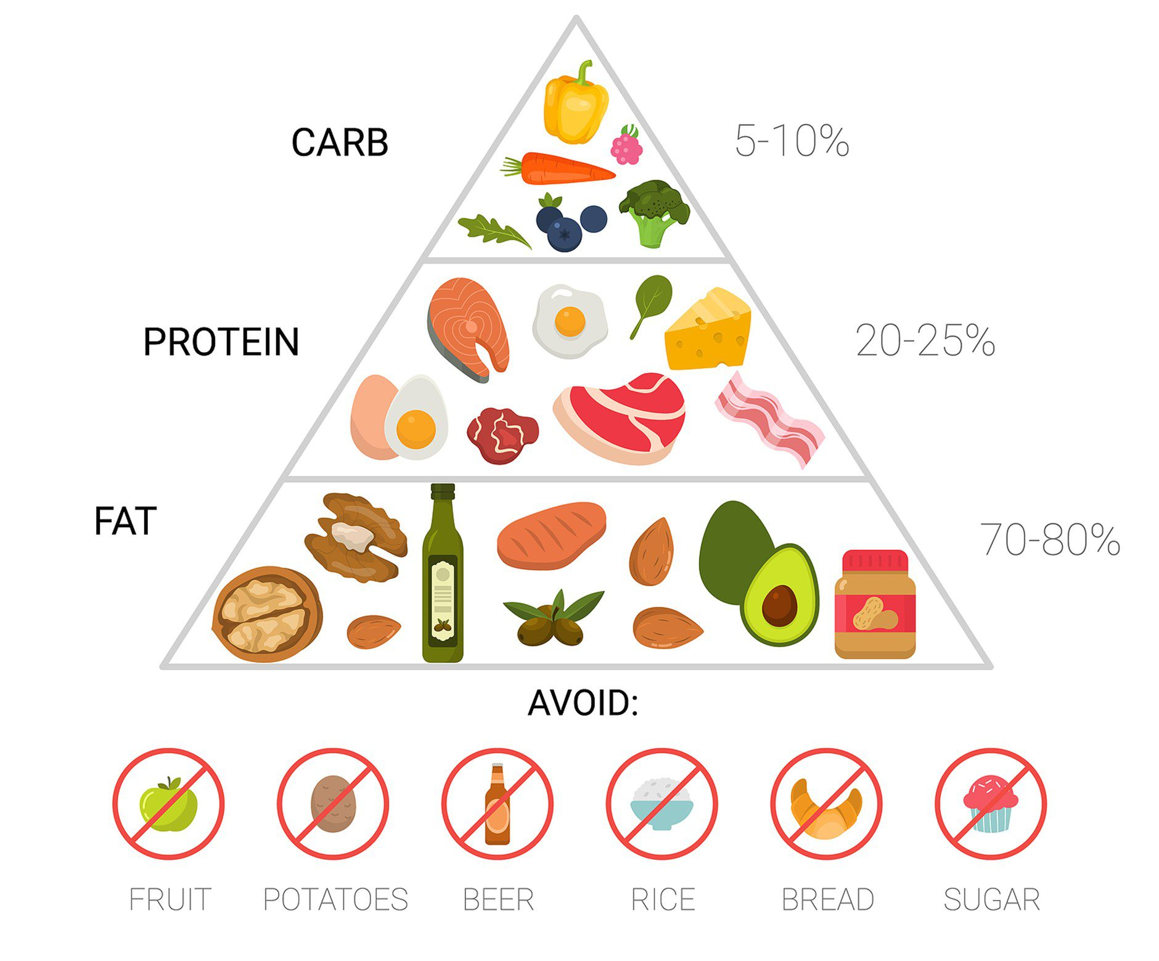
Intriguing data exists for ketogenic diet for treatment of dementia, but larger trials are needed (Beversdorf, Crosby & Shenker, 2023)
Allows brain to use ketones to switch away from obligatory processing of glucose
increased

