Slide 1
Catatonia
Todd Lucas, PharmD
PGY2 Psychiatric Pharmacy Resident
Fulton State Hospital

Slide 2
Objectives
Discuss catatonia diagnosis
01
Discuss catatonia treatment
02
Investigate a case on excited catatonia
03

Slide 3
What is Catatonia?
Catatonia
Is not recognized in the DSM-V as an independent class but recognizes
Catatonia associated with another mental disorders
Catatonic disorder due to another medical condition
Unspecified catatonia
Defined as a group of symptoms that involve a lack of movement as well as a lack of communication
Notes:
DSM-V
Edinoff AN, Kaufman SE, Hollier JW, Virgen CG, Karam CA, Malone GW, Cornett EM, Kaye AM, Kaye AD. Catatonia: Clinical overview of the diagnosis, treatment, and clinical challenges. Neurology international. 2021 Dec;13(4):570-86.

Slide 4
DSM-V Catatonia Criteria
Symptoms
Stupor
Catalepsy
Waxy flexibility
Mutism
Negativism
Posturing
Mannerism
Stereotypy
Agitation
Grimacing
Echolalia
Echopraxia
Essential feature is a marked psychomotor disturbance that may involve decreased motor activity, decreased engagement during interview or physical examination, or excessive and peculiar motor activity
3 or more symptoms
Notes:
DSM-V

Slide 5
Subtypes of Catatonia
Recent articles and continuing education materials have described three subtypes of catatonia
Stuporous Catatonia
Excited Catatonia
Malignant Catatonia
Beach SR. Psychopharmacology Institute. 2020, November 29th.
Edinoff AN. Neurology International. Dec;13(4):570-86. 5
Notes:
Psychopharmacology institute
Edinoff AN, Kaufman SE, Hollier JW, Virgen CG, Karam CA, Malone GW, Cornett EM, Kaye AM, Kaye AD. Catatonia: Clinical overview of the diagnosis, treatment, and clinical challenges. Neurology international. 2021 Dec;13(4):570-86.

Slide 6
Stuporous Catatonia
Considered the classic variant
Common symptoms
Mutism
Rigidity
Wavy flexibility

Slide 7
Excited Catatonia
Common symptoms
Psychomotor hyperactivity: restless movements, talkativeness, or frenzy

Slide 8
Malignant Catatonia – Medical Emergency
Common symptoms
Fever
Lead-pipe rigidity
Autonomic instability
Creatinine kinase

Slide 9
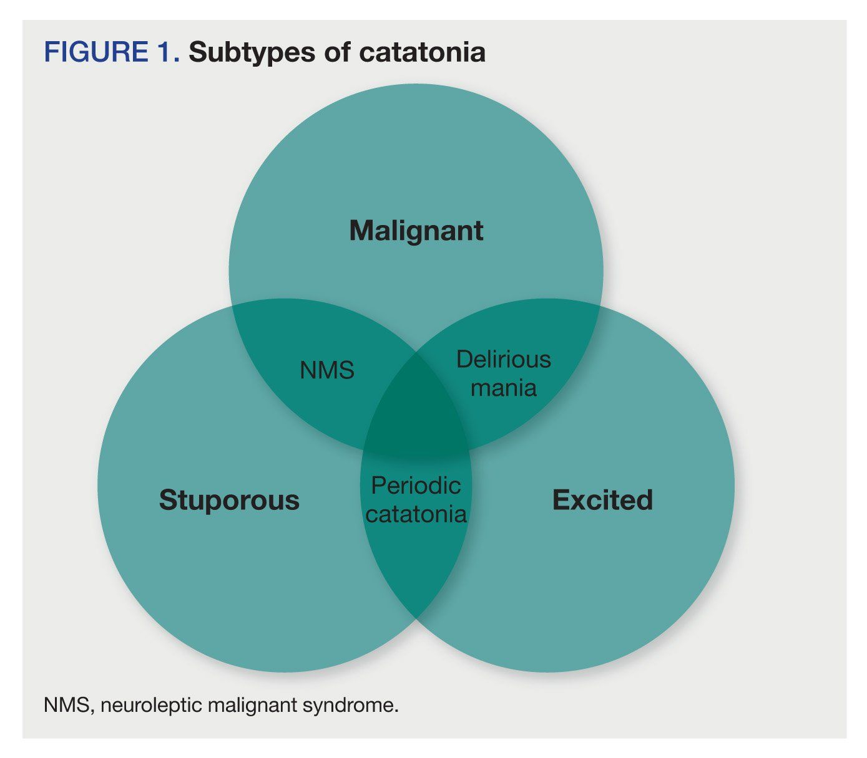
Notes:
Azzam, P. N., & Gopalan, P. (2013). Prototypes of catatonia: diagnostic and therapeutic challenges in the general hospital. Psychosomatics, 54(1), 88.
Fricchione, G., Bush, G., Fozdar, M., Francis, A., & Fink, M. (1997). Recognition and treatment of the catatonic syndrome. Journal of Intensive Care Medicine, 12(3), 135-147.
Denysenko, L., Sica, N., Penders, T. M., Philbrick, K. L., Walker, A., Shaffer, S., ... & Francis, A. (2018). Catatonia in the medically ill: Etiology, diagnosis, and treatment. The Academy of Consultation-Liaison Psychiatry Evidence-Based Medicine Subcommittee Monograph. Annals of clinical psychiatry: official journal of the American Academy of Clinical Psychiatrists, 30(2), 140-155.

Slide 10
Bush-Francis Catatonia Rating Scale (BFCRS)
23-item clinician rated scale
Screening questions
Items 1-14
If score ≥ 2 then the full scale should be completed
Additional questions
Items 15-23
Higher the score the higher the severity of the catatonia (max score 69)
Captures symptoms of excited catatonia
Notes:
ambitendency (appearance of being stuck in indecisive or hesitant movement), automatic obedience (mechanical and reproducible compliance with examiner’s request, even if dangerous), autonomic abnormality (diaphore- sis, palpitations, or abnormal temperature, blood pressure, pulse, or respiratory rate), combativeness (striking out against others with or without potential for injury), gegenhal- ten (resistance to positioning by examiner that increases proportionally to applied force), grasp reflex (strong grasp of any object in proximity of the hand or upon touch), impulsivity (patient suddenly engages in inappropriate behavior without provocation; afterwards, can give no or only a facile explanation), mitgehen (exaggerated movements in response to light pressure), perseveration (whole or partial repetition of actions or verbal content that is not goal directed), rigidity (resistance by way of increased muscle tone), staring, verbigeration (continuous, directionless repetition of words, phrases, or sentences), and withdrawal (no eye contact, refusal to take food or drink when offered, or both; turning away from examiner or social isolation)

Slide 11
Lorazepam Challenge
Most ideal: 2 mg of intravenous (IV) lorazepam
Generally, response is seen within 30 minutes
Length of action may be longer than the half-life suggests → lorazepam in the Central Nervous System (CNS) may act longer than serum concentrations
If IV is not available, then: intramuscular > sublingual (SL) > oral
Repeat intramuscular (IM) injections should be avoided
Notes:
Psychopharmacology Institute

Slide 12
Lorazepam Challenge - Dosing
2 mg should be used in most cases as this dosing provides a reliable response
< 2 mg can be used in children, adolescents, very frail elderly patients, or those at risk for respiratory compromise

Slide 13
Positive Response to Lorazepam
If the patient improves on lorazepam then scheduled lorazepam should be initiated
This includes when patients are asleep
Lorazepam 2 mg IV every 4-6 hours is an accepted starting dose, though some patients may require dose adjustments or alternative administration routes depending on symptom severity
Again, IV would be preferred but if the catatonia is mild or the patient is medically stable then IM, SL, or oral lorazepam may be considered

Slide 14
Transitioning from IV / Tapering
IV lorazepam should be continued for at least 24 hours then switching to PO lorazepam can be considered
Starting conversion: 1 mg IV lorazepam = 2 mg PO lorazepam
PO should then be continued for another day prior to any tapers
This is variable and based off of clinical improvement
Tapers should be slow with some suggestions being 1-2 mg decrease per week
Notes:
Psychopharmacology instute

Slide 15
Patient Case
30-year-old female with history of bipolar disorder brought to the emergency department (ED) for an abrupt onset of confusion and disorientation
She exhibited marked anxiety, paranoia, and auditory / visual hallucinations
She had psychomotor agitation that led to physical aggression to ED staff which lead her to get haloperidol and lorazepam
Initial lab workup was unremarkable - Urine drug screen, blood alcohol level, complete blood counts, complete metabolic panel, HIV assay, thyroid studies, urine human chorionic gonadotropin
Notes:
Almeida M, Cicolello K, Hanso A, DeCavalcante G, DeOliveira GS. Treatment of Acute Agitation Associated With Excited Catatonia Using Dexmedetomidine: Case Series and Literature Review. Prim Care Companion CNS Disord. 2021 Oct 7;23(5):20cr02899. doi: 10.4088/PCC.20cr02899. PMID: 34619813.

Slide 16
In-patient psychiatric unit
Once she was sent to the psychiatric unit she displayed manic symptoms of hypersexuality, hyper-religiosity, impulsivity, and insomnia
Maintenance medications
Started on risperidone 0.5 mg twice daily which was titrated to 2 mg twice daily
Over the next 3 days her symptoms worsened; she became loud, combative and tried to elope multiple times
Her BFCRS was 30, she responded positively to 2mg IM lorazepam
After lorazepam, her BFCRS was 3 and the team described her symptoms as excited catatonia
After she responded to lorazepam, it was recommendation to avoid antipsychotics
Valproic acid was started and high doses of lorazepam were initiated (up to 12 mg a day)
she still required some as needed medications for disruptive behavior

Slide 17
Intensive Care Unit (ICU)
Due to the profound level of behavioral dysregulation and patient suffering that was refractory to the available psychopharmacologic treatment options she was transferred to the ICU for sedation with dexmedetomidine
All antipsychotic medications were discontinued, and a comprehensive medical workup was able to be completed – which was unremarkable
Emergency order for electroconvulsive therapy (ECT) was obtained, after 3 rounds of ECT she was discharged home

Slide 18
Summary
DSM-V does not recognize catatonia as an independent diagnosis
More recent literature has a split catatonia into 3 subtypes: stuporous, excited, and malignant
If catatonia is suspected, the BFCRS assessment can be done to quantify the symptoms and determine if a lorazepam challenge should be conducted
Lorazepam challenge is generally 2 mg IV, but IM can be used if necessary
If the patient responds to the lorazepam challenge, then lorazepam should be scheduled with the goal to transition to oral formulations
Routine IM injections should be avoided

Slide 19
References
Almeida M, Cicolello K, Hanso A, DeCavalcante G, DeOliveira GS. Treatment of Acute Agitation Associated With Excited Catatonia Using Dexmedetomidine: Case Series and Literature Review. Prim Care Companion CNS Disord. 2021 Oct 7;23(5):20cr02899. doi: 10.4088/PCC.20cr02899. PMID: 34619813.
Beach SR. Treatment Strategies for Catatonia [Internet]. Lecture published 2020, November 29th. [cited 2023Apr25]. Available from: https://psychopharmacologyinstitute.com/publication/treatment-strategies-for-catatonia-2500.
Bush G, Fink M, Petrides G, Dowling F, Francis A. Catatonia. I. Rating scale and standardized examination. Acta Psychiatr Scand. 1996 Feb;93(2):129-36. doi: 10.1111/j.1600-0447.1996.tb09814.x. PMID: 8686483.
Edinoff AN, Kaufman SE, Hollier JW, Virgen CG, Karam CA, Malone GW, Cornett EM, Kaye AM, Kaye AD. Catatonia: Clinical overview of the diagnosis, treatment, and clinical challenges. Neurology international. 2021 Dec;13(4):570-86.
Notes:
Almeida M, Cicolello K, Hanso A, DeCavalcante G, DeOliveira GS. Treatment of Acute Agitation Associated With Excited Catatonia Using Dexmedetomidine: Case Series and Literature Review. Prim Care Companion CNS Disord. 2021 Oct 7;23(5):20cr02899. doi: 10.4088/PCC.20cr02899. PMID: 34619813.
Almeida M. Prim Care Companion CNS Disorder. 2021 Oct 7;23(5):20cr02899.
Beach SR. Treatment Strategies for Catatonia [Internet]. Lecture published 2020, November 29th. [cited 2023Apr25]. Available from: https://psychopharmacologyinstitute.com/publication/treatment-strategies-for-catatonia-2500.
Beach SR. Psychopharmacology Institute. 2020, November 29th.
Bush G, Fink M, Petrides G, Dowling F, Francis A. Catatonia. I. Rating scale and standardized examination. Acta Psychiatr Scand. 1996 Feb;93(2):129-36. doi: 10.1111/j.1600-0447.1996.tb09814.x. PMID: 8686483.
Bush G. Acta Psychiatr Scand. 1996 Feb;93(2):129-36.
Edinoff AN, Kaufman SE, Hollier JW, Virgen CG, Karam CA, Malone GW, Cornett EM, Kaye AM, Kaye AD. Catatonia: Clinical overview of the diagnosis, treatment, and clinical challenges. Neurology international. 2021 Dec;13(4):570-86.
Edinoff AN. Neurology International. Dec;13(4):570-86.

Slide 20
Mania Tx
Jason Cafer MD
Notes:
Stands to reason that prolonged manic episodes are more damaging to the brain that brief manic episodes. We need something to resolve mania ASAP.

Slide 21
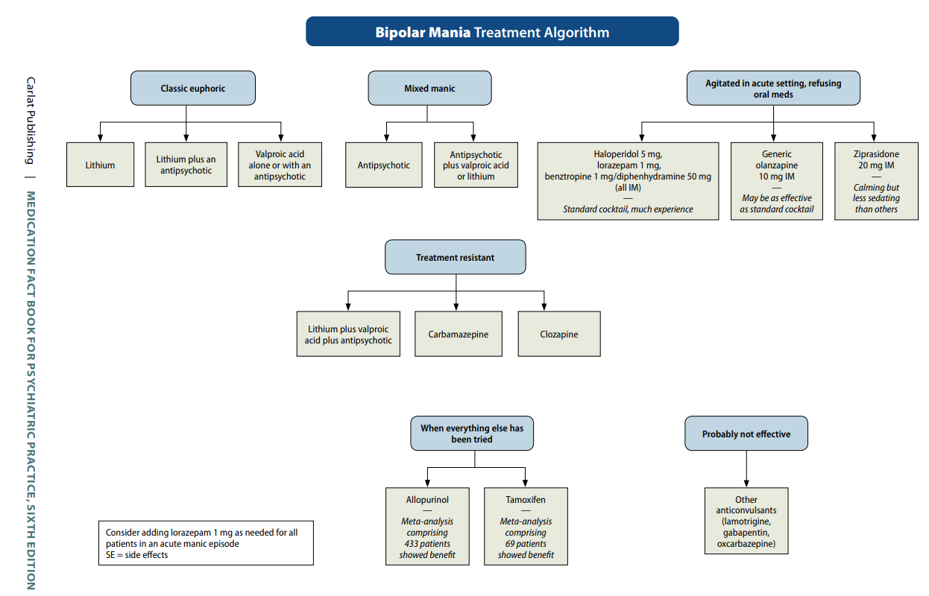
?

Slide 22
?
?

Slide 23
?

Slide 24
?
Lithium/Valproate +/- antipsychotic

Slide 25
?
Lithium/Valproate +/- antipsychotic

Slide 26
Lithium/Valproate +/- antipsychotic
antipsychotic +/- VPA/Lith

Slide 27
60%
40%
Lithium/Valproate +/- antipsychotic
antipsychotic +/- VPA/Lith

Slide 28
60%
40%
Is it possible to be severely manic without psychosis?

Slide 29
60%
40%
Which antipsychotic?

Slide 30
60%
40%
First-line antipsychotic:
quetiapine (Seroquel) per Osser

Slide 31
60%
40%
First-line antipsychotic:
quetiapine (Seroquel) per Osser
Other potential first-line antipsychotics:

Slide 32
60%
40%
First-line antipsychotic:
quetiapine (Seroquel) per Osser
Other potential first-line antipsychotics:
olanzapine (Zyprexa)

Slide 33
60%
40%
First-line antipsychotic:
quetiapine (Seroquel) per Osser
Other potential first-line antipsychotics:
olanzapine (Zyprexa)
risperidone (Risperdal)

Slide 34
60%
40%
First-line antipsychotic:
quetiapine (Seroquel) per Osser
Other potential first-line antipsychotics:
olanzapine (Zyprexa)
risperidone (Risperdal)
ziprasidone (Geodon)

Slide 35
60%
40%
First-line antipsychotic:
quetiapine (Seroquel) per Osser
Other potential first-line antipsychotics:
olanzapine (Zyprexa)
risperidone (Risperdal)
ziprasidone (Geodon)
asenapine (Saphris)

Slide 36
60%
40%
First-line antipsychotic:
quetiapine (Seroquel) per Osser
Other potential first-line antipsychotics:
olanzapine (Zyprexa)
risperidone (Risperdal)
ziprasidone (Geodon)
asenapine (Saphris)

Slide 37
60%
40%
First-line antipsychotic:
quetiapine (Seroquel) per Osser
Other potential first-line antipsychotics:
olanzapine (Zyprexa)
risperidone (Risperdal)
ziprasidone (Geodon)
asenapine (Saphris)
?

Slide 38
60%
40%
First-line antipsychotic:
quetiapine (Seroquel) per Osser
Other potential first-line antipsychotics:
olanzapine (Zyprexa)
risperidone (Risperdal)
ziprasidone (Geodon)
asenapine (Saphris)

Slide 39
60%
40%
First-line antipsychotic:
quetiapine (Seroquel) per Osser
Other potential first-line antipsychotics:
olanzapine (Zyprexa)
risperidone (Risperdal)
ziprasidone (Geodon)
asenapine (Saphris)

Slide 40
60%
40%
First-line antipsychotic:
quetiapine (Seroquel) per Osser
Other potential first-line antipsychotics:
olanzapine (Zyprexa)
risperidone (Risperdal)
ziprasidone (Geodon)
asenapine (Saphris)

Slide 41
60%
40%
First-line antipsychotic:
quetiapine (Seroquel) per Osser
Other potential first-line antipsychotics:
olanzapine (Zyprexa)
risperidone (Risperdal)
ziprasidone (Geodon)
asenapine (Saphris)
1 mg Ativan, seriously?

Slide 42
60%
40%
First-line antipsychotic:
quetiapine (Seroquel) per Osser
Other potential first-line antipsychotics:
olanzapine (Zyprexa)
risperidone (Risperdal)
ziprasidone (Geodon)
asenapine (Saphris)
1 mg Ativan, seriously?

Slide 43
60%
40%
?
First-line antipsychotic:
quetiapine (Seroquel) per Osser
Other potential first-line antipsychotics:
olanzapine (Zyprexa)
risperidone (Risperdal)
ziprasidone (Geodon)
asenapine (Saphris)

Slide 44
60%
40%
?
First-line antipsychotic:
quetiapine (Seroquel) per Osser
Other potential first-line antipsychotics:
olanzapine (Zyprexa)
risperidone (Risperdal)
ziprasidone (Geodon)
asenapine (Saphris)

Slide 45
60%
40%
?
First-line antipsychotic:
quetiapine (Seroquel) per Osser
Other potential first-line antipsychotics:
olanzapine (Zyprexa)
risperidone (Risperdal)
ziprasidone (Geodon)
asenapine (Saphris)

Slide 46
60%
40%
First-line antipsychotic:
quetiapine (Seroquel) per Osser
Other potential first-line antipsychotics:
olanzapine (Zyprexa)
risperidone (Risperdal)
ziprasidone (Geodon)
asenapine (Saphris)
?

Slide 47
60%
40%
First-line antipsychotic:
quetiapine (Seroquel) per Osser
Other potential first-line antipsychotics:
olanzapine (Zyprexa)
risperidone (Risperdal)
ziprasidone (Geodon)
asenapine (Saphris)
?

Slide 48
60%
40%
First-line antipsychotic:
quetiapine (Seroquel) per Osser
Other potential first-line antipsychotics:
olanzapine (Zyprexa)
risperidone (Risperdal)
ziprasidone (Geodon)
asenapine (Saphris)

Slide 49
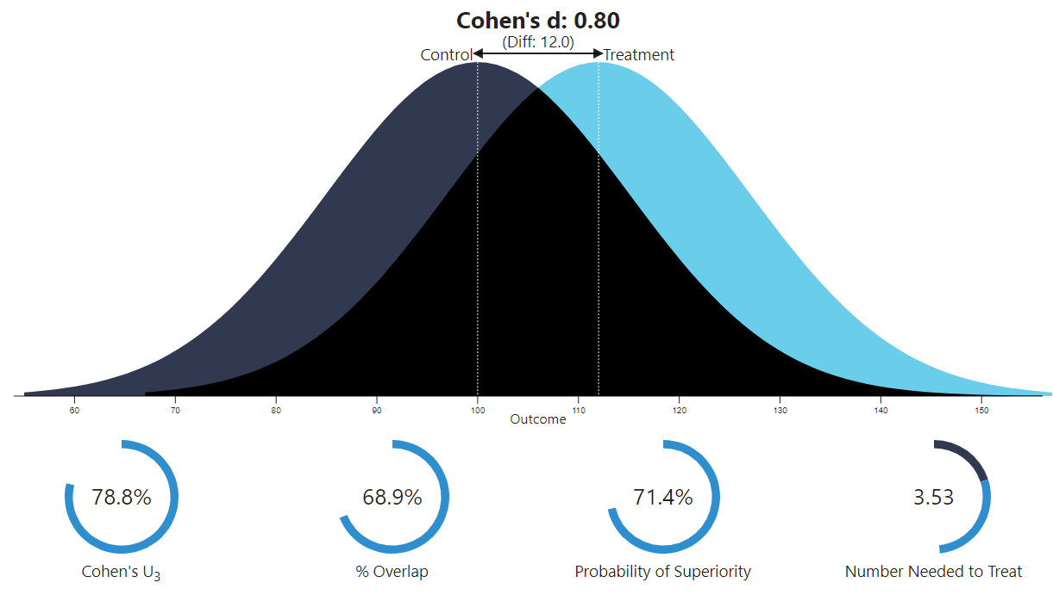
Cohen’s d of = 0.80 is a Large effect size
Yildiz A, et al. Efficacy of antimanic treatments: meta-analysis of randomized, controlled trials. Neuropsychopharmacology. 2011;36(2):375-389.
1335

Slide 50
Cohen’s d of = 0.80 is a Large effect size
= NNT 3.53
# patients to have 1 response
that is not a placebo response
Yildiz A, et al. Efficacy of antimanic treatments: meta-analysis of randomized, controlled trials. Neuropsychopharmacology. 2011;36(2):375-389.
1335

Slide 51
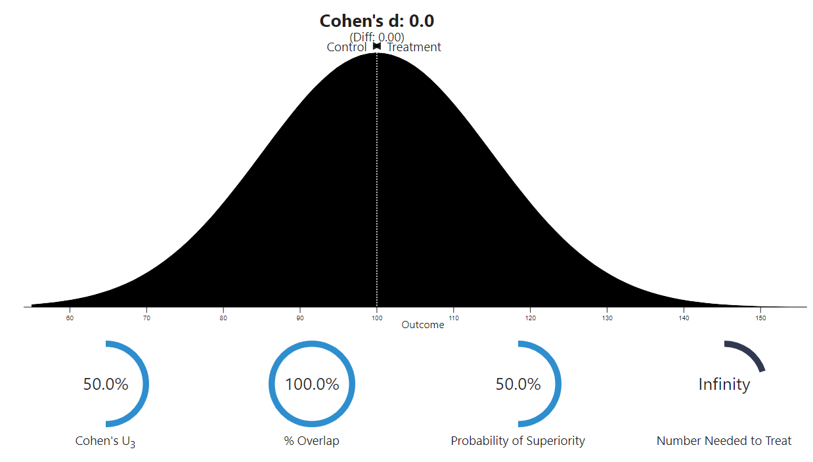
Antimanic effect of Lamotrigine (N=179)
# patients to have 1 response
that is not a placebo response
Yildiz A, et al. Efficacy of antimanic treatments: meta-analysis of randomized, controlled trials. Neuropsychopharmacology. 2011;36(2):375-389.
1335

Slide 52
Antimanic effect of Topiramate (N=1074)
# patients to have 1 response
that is not a placebo response
Yildiz A, et al. Efficacy of antimanic treatments: meta-analysis of randomized, controlled trials. Neuropsychopharmacology. 2011;36(2):375-389.
1335

Slide 53
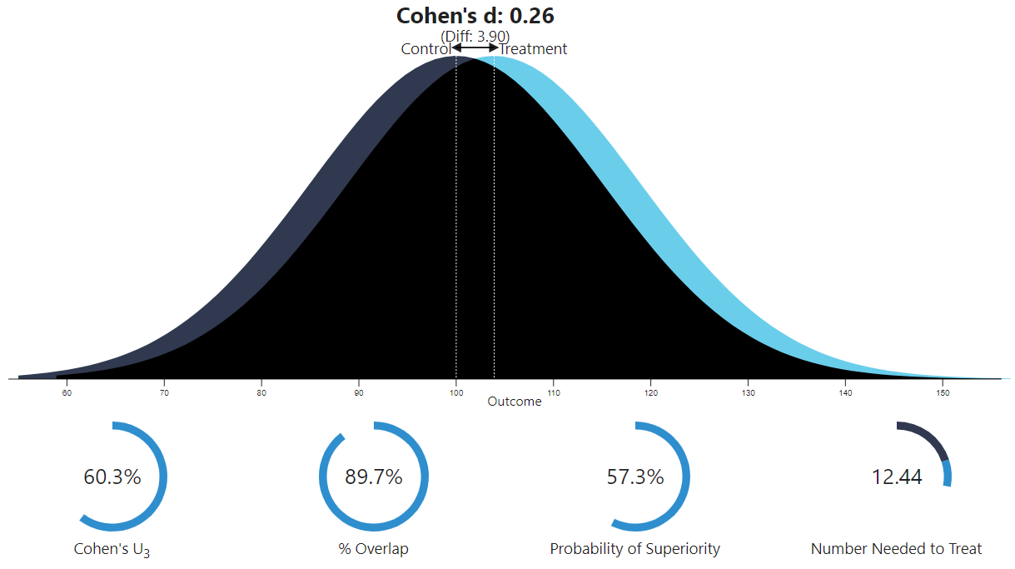
Antimanic effect of Aripiprazole (N=1662)
# patients to have 1 response
that is not a placebo response
Yildiz A, et al. Efficacy of antimanic treatments: meta-analysis of randomized, controlled trials. Neuropsychopharmacology. 2011;36(2):375-389.
1335

Slide 54
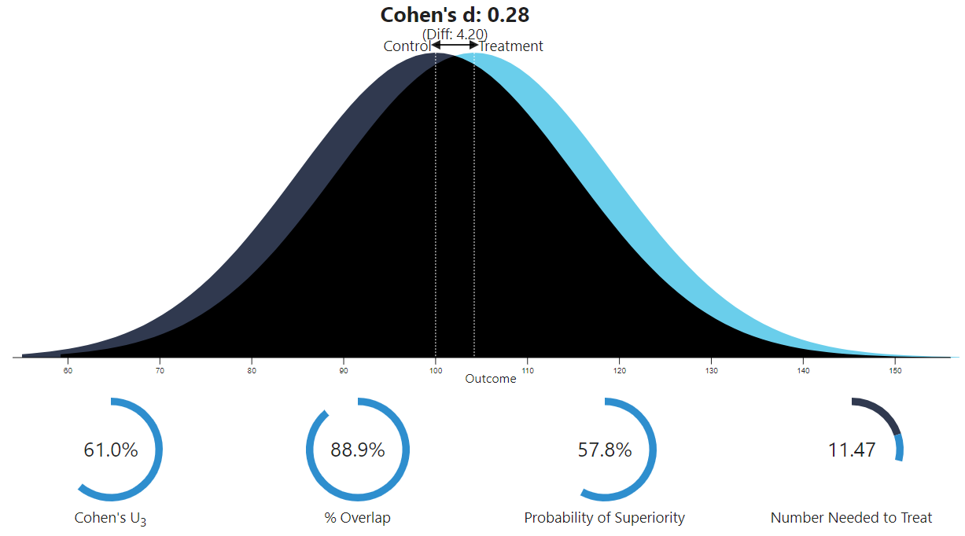
Antimanic effect of Valproate (N=1064)
So you’re gonna use VPA alone?
Yildiz A, et al. Efficacy of antimanic treatments: meta-analysis of randomized, controlled trials. Neuropsychopharmacology. 2011;36(2):375-389.
1335

Slide 55
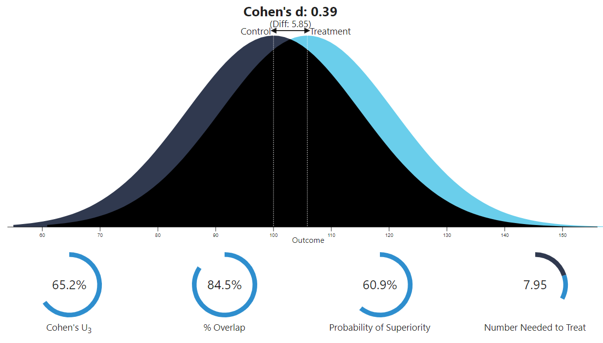
Antimanic effect of Lithium (N=1199)
Lithium monotherapy also inadequate
# patients to have 1 response
that is not a placebo response
Yildiz A, et al. Efficacy of antimanic treatments: meta-analysis of randomized, controlled trials. Neuropsychopharmacology. 2011;36(2):375-389.
1335

Slide 56
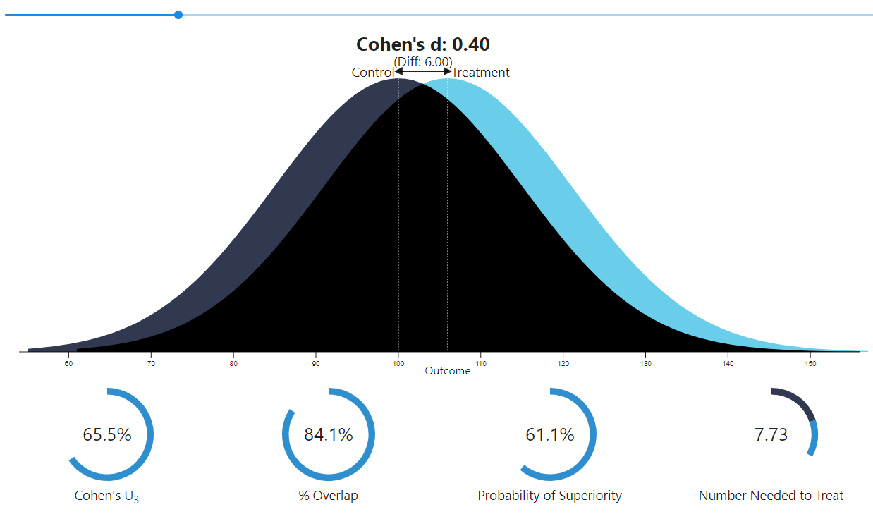
Antimanic effect of Quetiapine (N=1007)
# patients to have 1 response
that is not a placebo response
Yildiz A, et al. Efficacy of antimanic treatments: meta-analysis of randomized, controlled trials. Neuropsychopharmacology. 2011;36(2):375-389.
1335

Slide 57
Antimanic effect of Ziprasidone (N=663)
# patients to have 1 response
that is not a placebo response
Yildiz A, et al. Efficacy of antimanic treatments: meta-analysis of randomized, controlled trials. Neuropsychopharmacology. 2011;36(2):375-389.
1335

Slide 58
Antimanic effect of Olanzapine (N=1335)
# patients to have 1 response
that is not a placebo response
Yildiz A, et al. Efficacy of antimanic treatments: meta-analysis of randomized, controlled trials. Neuropsychopharmacology. 2011;36(2):375-389.
1335

Slide 59
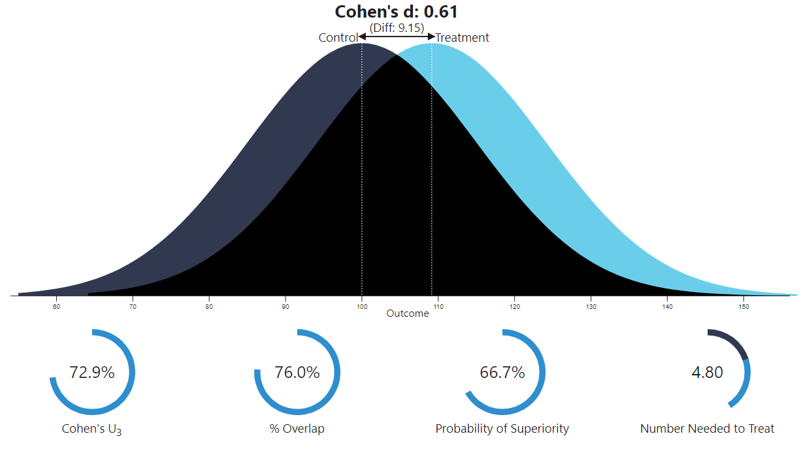
Antimanic effect of Carbamazepine (N=427)
# patients to have 1 response
that is not a placebo response
Yildiz A, et al. Efficacy of antimanic treatments: meta-analysis of randomized, controlled trials. Neuropsychopharmacology. 2011;36(2):375-389.
1335

Slide 60
Antimanic effect of Risperidone (N=823)
# patients to have 1 response
that is not a placebo response
Yildiz A, et al. Efficacy of antimanic treatments: meta-analysis of randomized, controlled trials. Neuropsychopharmacology. 2011;36(2):375-389.
1335

Slide 61
For mania, it takes more than 1 medication to achieve large effect.
# patients to have 1 response
that is not a placebo response
Yildiz A, et al. Efficacy of antimanic treatments: meta-analysis of randomized, controlled trials. Neuropsychopharmacology. 2011;36(2):375-389.
1335

Slide 62
60%
40%
First-line antipsychotic:
quetiapine (Seroquel) per Osser
Other potential first-line antipsychotics:
olanzapine (Zyprexa)
risperidone (Risperdal)
ziprasidone (Geodon)
asenapine (Saphris)
1 mg Ativan, seriously?

Slide 63
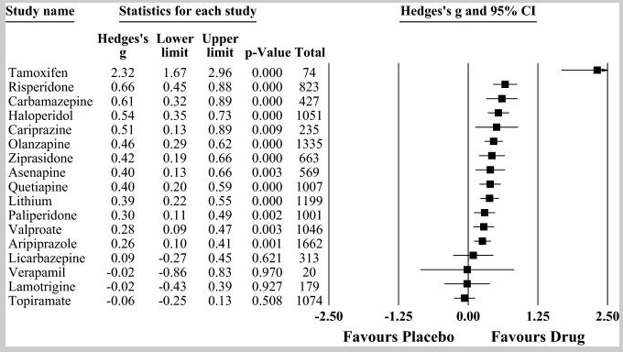
Yildiz A, et al. Efficacy of antimanic treatments: meta-analysis of randomized, controlled trials. Neuropsychopharmacology. 2011;36(2):375-389.
1335
Notes:
Nobel prize territory if it’s real

Slide 64
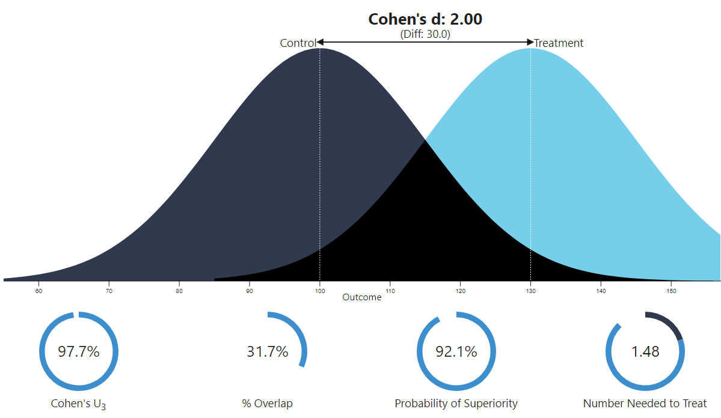
Graphing tool would not accommodate 2.32
Graphing tool would not accommodate 2.32
Antimanic effect of Tamoxifen (N=73)
Beyond large
Way beyond large 2.32
# patients to have 1 response
that is not a placebo response
(for effect size of 2.00)
Yildiz A, et al. Efficacy of antimanic treatments: meta-analysis of randomized, controlled trials. Neuropsychopharmacology. 2011;36(2):375-389.
Graphing tool at https://rpsychologist.com/cohend/
Notes:
Nobel prize territory if it’s real

Slide 65
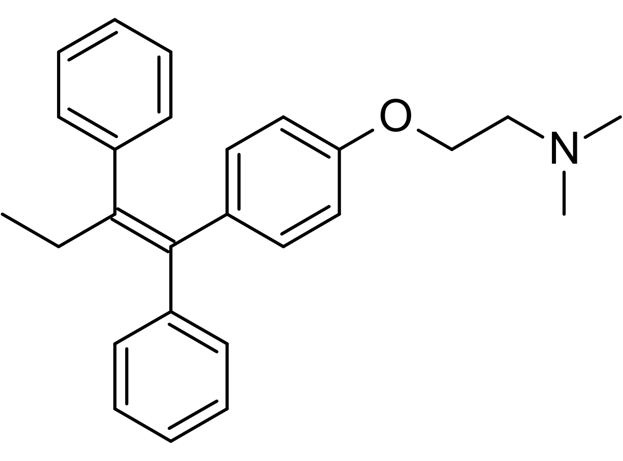
Tamoxifen (NOLVADEX)
ta MOX i fen / NOLV a dex
“Tame ox defends (against breast cancer)”
#238
1990
$20–$80
❖ Selective estrogen receptor
modulator (SERM)
❖ Protein kinase C (PKC) inhibitor
10
20
mg
Medication for breast cancer - SERMs are estrogen agonist/antagonists

Slide 66
Tamoxifen (NOLVADEX)
ta MOX i fen / NOLV a dex
“Tame ox defends (against breast cancer)”
#238
1990
$20–$80
❖ Selective estrogen receptor
modulator (SERM)
❖ Protein kinase C (PKC) inhibitor
10
20
mg
Medication for breast cancer
Good example of the prodrug concept
Some antidepressants (2D6 inHibitors) cut its effectiveness in half
Off-label for mania
For breast cancer, tamoxifen is typically taken for 5 years.
For an acute manic episode it was taken for 3 weeks.
Black box warning for risk of uterine cancer and blood clots (stroke, pulmonary embolism).
Side effects may include:
irregular periods
flushing
acne
cognitive impairment
loss of libido
hepatotoxicity

Slide 67
Tamoxifen (NOLVADEX)
ta MOX i fen / NOLV a dex
“Tame ox defends (against breast cancer)”
#238
1990
$20–$80
Tamoxifen (NOLVADEX)
ta MOX i fen / NOLV a dex
“Tame ox defends (against breast cancer)”
❖ Selective estrogen receptor
modulator (SERM)
❖ Protein kinase C (PKC) inhibitor
#238
1990
$20–$80
❖ Selective estrogen receptor
modulator (SERM)
❖ Protein kinase C (PKC) inhibitor
10
20
mg
10
20
mg
Yildiz-Yesiloglu (2006) found tamoxifen effective for acute mania with ginormous effect size.
Tamoxifen was chosen not for its antiestrogenic effect, but for its inhibition of protein kinase C (PKC) in the brain.
PKC is believed to be overactive during manic episodes of bipolar disorder.
In a 3-week study, 14 of 29 acutely manic patients showed at least 50% improvement, compared to 1 of 21 with placebo.
Side effects were minimal—flushing of face and acne.
For context, lithium and valproic acid (Depakene, Depakote) indirectly inhibit PKC, which may be involved in their mechanism of mood stabilization.
Tamoxifen is the only available direct PKC inhibitor.

Slide 68
Tamoxifen (NOLVADEX)
ta MOX i fen / NOLV a dex
“Tame ox defends (against breast cancer)”
#238
1990
$20–$80
Tamoxifen (NOLVADEX)
ta MOX i fen / NOLV a dex
“Tame ox defends (against breast cancer)”
❖ Selective estrogen receptor
modulator (SERM)
❖ Protein kinase C (PKC) inhibitor
#238
1990
$20–$80
❖ Selective estrogen receptor
modulator (SERM)
❖ Protein kinase C (PKC) inhibitor
10
20
mg
10
20
mg
Tamoxifen is a prodrug with relatively low affinity for estrogen receptors itself.
The therapeutic effects of tamoxifen are through active metabolites.
Concomitant use of 2D6-inhibiting antidepressants double the risk of recurrence of breast cancer
2D6 prodrug

Slide 69
Tamoxifen (NOLVADEX)
ta MOX i fen / NOLV a dex
“Tame ox defends (against breast cancer)”
#238
1990
$20–$80
Tamoxifen (NOLVADEX)
ta MOX i fen / NOLV a dex
“Tame ox defends (against breast cancer)”
❖ Selective estrogen receptor
modulator (SERM)
❖ Protein kinase C (PKC) inhibitor
#238
1990
$20–$80
❖ Selective estrogen receptor
modulator (SERM)
❖ Protein kinase C (PKC) inhibitor
10
20
mg
10
20
mg
Tamoxifen is a prodrug with relatively low affinity for estrogen receptors itself.
The therapeutic effects of tamoxifen are through active metabolites.
Concomitant use of 2D6-inhibiting antidepressants double the risk of recurrence of breast cancer, even
sertraline whose 2D6 inHibition(weak) is a non-factor in other contexts.
2D6 prodrug

Slide 71
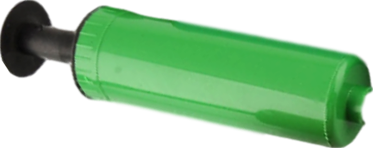
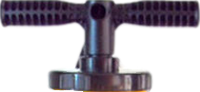
Tamoxifen (NOLVADEX)
ta MOX i fen / NOLV a dex
“Tame ox defends (against breast cancer)”
#238
1990
$20–$80
Tamoxifen (NOLVADEX)
ta MOX i fen / NOLV a dex
“Tame ox defends (against breast cancer)”
❖ Selective estrogen receptor
modulator (SERM)
❖ Protein kinase C (PKC) inhibitor
#238
1990
$20–$80
❖ Selective estrogen receptor
modulator (SERM)
❖ Protein kinase C (PKC) inhibitor
10
20
mg
10
20
mg
2D6 inHibitor antidepressants
It’s your fault I can’t roll
Aw, snap!
2D6 inhibitor
prodrug
mod/strong
Fluoxetine
PROZAC
strong
Bupropion
WELLBUTRIN
Prodrugs are substrates that are less potent than their metabolites.
Ordinary substrates (beach balls) are deactivated by 2D6.
Prodrugs (bowling balls) are activated by 2D6.
In the presence of an inhibitor prodrugs are less effective.
2D6 prodrug
strong
moderate
Paroxetine
PAXIL
Duloxetine
CYMBALTA
page
15
HORMONES
25

Slide 72
Tamoxifen (NOLVADEX)
ta MOX i fen / NOLV a dex
“Tame ox defends (against breast cancer)”
#238
1990
$20–$80
Tamoxifen (NOLVADEX)
ta MOX i fen / NOLV a dex
“Tame ox defends (against breast cancer)”
❖ Selective estrogen receptor
modulator (SERM)
❖ Protein kinase C (PKC) inhibitor
#238
1990
$20–$80
❖ Selective estrogen receptor
modulator (SERM)
❖ Protein kinase C (PKC) inhibitor
10
20
mg
10
20
mg
Tamoxifen is a prodrug with relatively low affinity for estrogen receptors itself.
The therapeutic effects of tamoxifen are through active metabolites.
Concomitant use of 2D6-inhibiting antidepressants double the risk of recurrence of breast cancer, even
sertraline whose 2D6 inHibition(weak) is a non-factor in other contexts.
It’s your fault I can’t roll
2D6 prodrug
Aw, snap!
2D6 inhibitor
prodrug

Slide 73
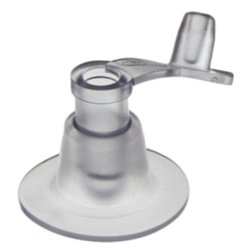
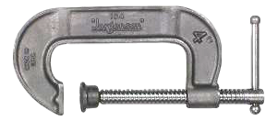
Tamoxifen (NOLVADEX)
ta MOX i fen / NOLV a dex
“Tame ox defends (against breast cancer)”
#238
1990
$20–$80
Tamoxifen (NOLVADEX)
ta MOX i fen / NOLV a dex
“Tame ox defends (against breast cancer)”
❖ Selective estrogen receptor
modulator (SERM)
❖ Protein kinase C (PKC) inhibitor
#238
1990
$20–$80
❖ Selective estrogen receptor
modulator (SERM)
❖ Protein kinase C (PKC) inhibitor
10
20
mg
10
20
mg
Tamoxifen is a prodrug with relatively low affinity for estrogen receptors itself.
The therapeutic effects of tamoxifen are through active metabolites.
Concomitant use of 2D6-inhibiting antidepressants double the risk of recurrence of breast cancer, even
sertraline whose 2D6 inHibition(weak) is a non-factor in other contexts.
Tamoxifen is less effective for individuals with 2D6 poor metabolizer (PM) genotype (5% of population)
2D6 prodrug
Poor me !
2D6 PM

Slide 74
Tamoxifen (NOLVADEX)
ta MOX i fen / NOLV a dex
“Tame ox defends (against breast cancer)”
#238
1990
$20–$80
Tamoxifen (NOLVADEX)
ta MOX i fen / NOLV a dex
“Tame ox defends (against breast cancer)”
❖ Selective estrogen receptor
modulator (SERM)
❖ Protein kinase C (PKC) inhibitor
#238
1990
$20–$80
❖ Selective estrogen receptor
modulator (SERM)
❖ Protein kinase C (PKC) inhibitor
10
20
mg
10
20
mg
How many days needed for mania?
Long half-life.
The terminal elimination half-life of tamoxifen is 5 to 7 days, while the half-life of N-desmethyltamoxifen, the primary circulating metabolite, is approximately 14 days.

Slide 75
60%
40%
First-line antipsychotic:
quetiapine (Seroquel) per Osser
Other potential first-line antipsychotics:
olanzapine (Zyprexa)
risperidone (Risperdal)
ziprasidone (Geodon)
asenapine (Saphris)

Slide 76
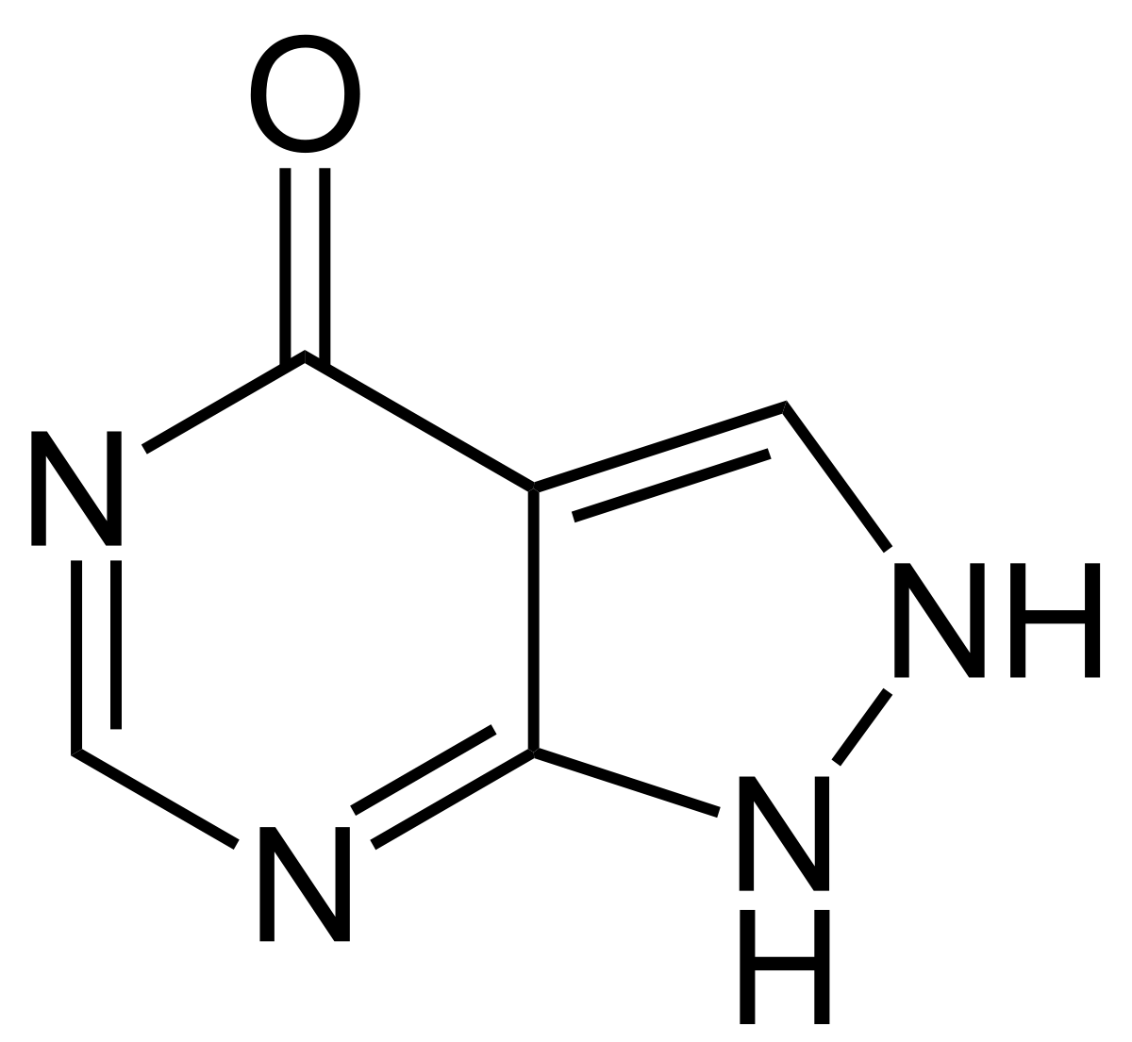
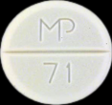
Allopurinol (Zyloprim
AL oh PURE i nol / ZY lo prim
“Alli purring”
#43
1966
$8–$20
❖ Xanthine oxidase inhibitor
100
300
mg
xanthine oxidase inhibitor
gout treatment (prevention)
reduces urinary and serum uric acid concentrations
Purrrrr
podagra

Slide 77
Allopurinol (Zyloprim
AL oh PURE i nol / ZY lo prim
“Alli purring”
#43
1966
$8–$20
❖ Xanthine oxidase inhibitor
100
300
mg
xanthine oxidase inhibitor
gout treatment (prevention)
reduces urinary and serum uric acid concentrations
can cause Stevens Johnson Syndrome
consider screening those of African American, Han Chinese, Korean, Thai, Native Hawaiian, or Pacific Islander ancestry for the HLA-B*5801 allele before starting allopurinol.
Purrrrr
podagra

Slide 78
Allopurinol (Zyloprim
AL oh PURE i nol / ZY lo prim
“Alli purring”
#43
1966
$8–$20
❖ Xanthine oxidase inhibitor
100
300
mg
xanthine oxidase inhibitor
gout treatment (prevention)
reduces urinary and serum uric acid concentrations
can cause Stevens Johnson Syndrome
consider screening those of African American, Han Chinese, Korean, Thai, Native Hawaiian, or Pacific Islander ancestry for the HLA-B*5801 allele before starting allopurinol.
Psychiatric Relevance
bipolar disorder seems to be associated with purinergic system dysfunction.
five randomized controlled trials (N=433)
effective for adjunctive treatment of bipolar mania (Bartoli et al, 2016).
allopurinol was well-tolerated
especially effective in people with severe mania
small to moderate effect size (mostly small)
(lithium’s first medical use was for gout)
Purrrrr
podagra

Slide 79
From Osser’s algorithms (with italicized additions)
From Carlat’s Medication Factbook
Mania
--Taper antidepressants.
--Ensure sleep with benzo +/- antipsychotic +/-
antihistamine (preferably not trazodone).
--Consider blue-blocking glasses.
--Preferred antipsychotic is quetiapine.
--*Alternate antipsychotics include olanzapine, risperidone, ziprasidone, asenapine.
Classic mania (60%)
Step 1: lithium (+/- antipsychotic)
Step 2: add quetiapine (or alt antipsychotic*)
Step 3: add valproate (unless childbearing)
Mixed mania (40%)
Step 1: quetiapine (or alternate antipsychotic*)
+/- valproate
Step 2: add valproate (unless childbearing)
Step 3: add lithium
Steps 4-6 for classic or mixed
Stop any ineffective medications and add:
1st tier:
carbamazepine** (unless childbearing)
olanzapine, risperidone, haloperidol
2nd tier: aripiprazole, asenapine, ziprasidone
3rd tier: clozapine
Also consider: allopurinol or tamoxifen
**Carbamazepine is a 3A4 inDucer that will reduce blood levels of quetiapine by ~85%, aripiprazole by ~65%, haloperidol by ~40%, and risperidone +metabolite by ~35% within a few weeks of starting carbamazepine. inDuction - Down and Delayed

Slide 80
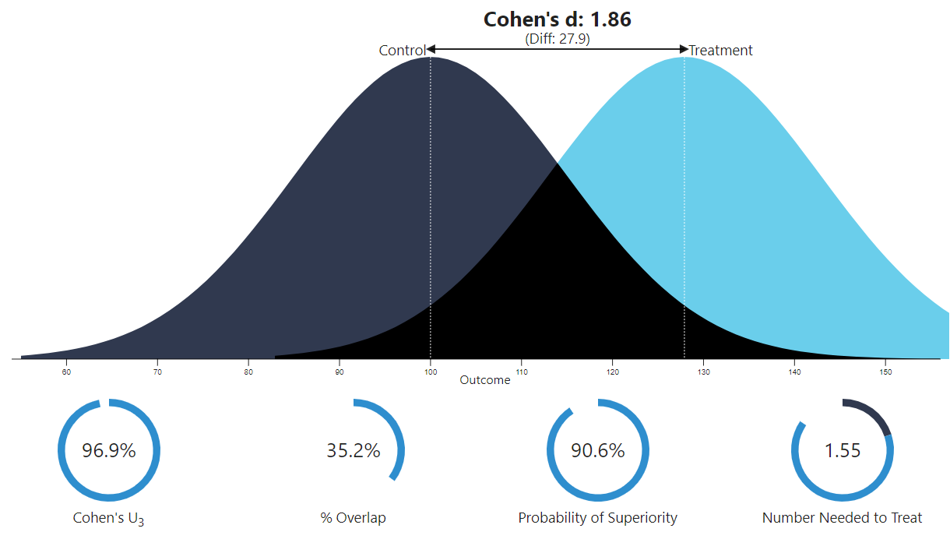
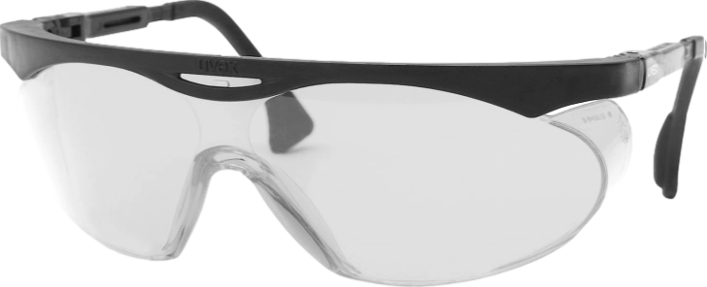
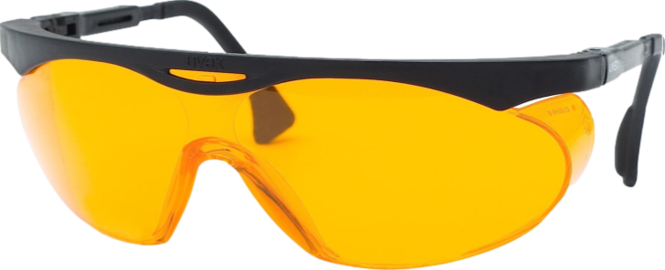
Antimanic effect of Blue-blocking glasses (N=23)
Beyond large
Way beyond large 1.86
Henriksen et al, 2016 (Norway):
100% blue-light-blocking glasses 6pm - 8am
Dramatic improvement seen within 3 days
Required substantially fewer sedating medications
Effect size similar to (actual) dark therapy
# patients to have 1 response
that is not a placebo response
Henriksen et al. Blue-blocking glasses as additive treatment for mania: a randomized placebo-controlled trial. Bipolar Disord. 2016
Yildiz A, et al. Efficacy of antimanic treatments: meta-analysis of randomized, controlled trials. Neuropsychopharmacology. 2011;36(2):375-389.
Graphing tool at https://rpsychologist.com/cohend/
Notes:
Nobel prize territory if it’s real

Slide 81
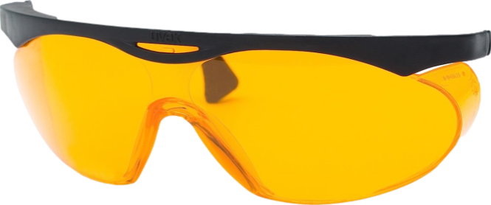
The mania treatments with large effect size
(but small sample size):
Tamoxifen x 3 weeks
Blue-blocking glasses 6pm - 8am

Slide 82
ABILIFY ASIMTUFII
Q 2 month LAI, gluteal
UZEDY
risperidone q month to q 2 month LAI, subcutaneous

