Slide 1
8 ways to not harm your patients with mood stabilizers
Jason Cafer MD

Slide 2
8 ways to harm your patients (mood stabilizers)

Slide 3
8 ways to harm your patients (mood stabilizers)
Not explaining that lithium and lamotrigine are “bipolar antidepressants”
Depriving bipolar patients of lithium treatment
Allowing acute lithium toxicity
Causing Stevens-Johnson syndrome by failure to adhere to lamotrigine dosing guidelines
Prescribing valproate to women of childbearing potential
Failure to consider drug interactions of carbamazepine
Causing Stevens-Johnson syndrome by failing to screen for HLA-B*1502 prior to giving carbamazepine to patients of Asian descent
Allowing lithium to cause gradual kidney damage

Slide 4
8 ways to harm your patients (mood stabilizers)
Not explaining that lithium and lamotrigine are “bipolar antidepressants”
Depriving bipolar patients of lithium treatment
Allowing acute lithium toxicity
Causing Stevens-Johnson syndrome by failure to adhere to lamotrigine dosing guidelines
Prescribing valproate to women of childbearing potential
Failure to consider drug interactions of carbamazepine
Causing Stevens-Johnson syndrome by failing to screen for HLA-B*1502 prior to giving carbamazepine to patients of Asian descent
Allowing lithium to cause gradual kidney damage

Slide 5
8 ways to harm your patients (mood stabilizers)
Not explaining that lithium and lamotrigine are “bipolar antidepressants”
Depriving bipolar patients of lithium treatment
Allowing acute lithium toxicity
Causing Stevens-Johnson syndrome by failure to adhere to lamotrigine dosing guidelines
Prescribing valproate to women of childbearing potential
Failure to consider drug interactions of carbamazepine
Causing Stevens-Johnson syndrome by failing to screen for HLA-B*1502 prior to giving carbamazepine to patients of Asian descent
Allowing lithium to cause gradual kidney damage

Slide 6
8 ways to harm your patients (mood stabilizers)
Not explaining that lithium and lamotrigine are “bipolar antidepressants”
Depriving bipolar patients of lithium treatment
Allowing acute lithium toxicity
Causing Stevens-Johnson syndrome by failure to adhere to lamotrigine dosing guidelines
Prescribing valproate to women of childbearing potential
Failure to consider drug interactions of carbamazepine
Causing Stevens-Johnson syndrome by failing to screen for HLA-B*1502 prior to giving carbamazepine to patients of Asian descent
Allowing lithium to cause gradual kidney damage

Slide 7
8 ways to harm your patients (mood stabilizers)
Not explaining that lithium and lamotrigine are “bipolar antidepressants”
Depriving bipolar patients of lithium treatment
Allowing acute lithium toxicity
Causing Stevens-Johnson syndrome by failure to adhere to lamotrigine dosing guidelines
Prescribing valproate to women of childbearing potential
Failure to consider drug interactions of carbamazepine
Causing Stevens-Johnson syndrome by failing to screen for HLA-B*1502 prior to giving carbamazepine to patients of Asian descent
Allowing lithium to cause gradual kidney damage

Slide 8
8 ways to harm your patients (mood stabilizers)
Not explaining that lithium and lamotrigine are “bipolar antidepressants”

Slide 9
8 ways to harm your patients (mood stabilizers)
Not explaining that lithium and lamotrigine are “bipolar antidepressants”
Mishandling bipolar disorder patient’s request
...“but I need an antidepressant”

Slide 10
8 ways to harm your patients (mood stabilizers)
Not explaining that lithium and lamotrigine are “bipolar antidepressants”
Mishandling bipolar disorder patient’s request
...“but I need an antidepressant”
Continuing to prescribe traditional antidepressants to patients who have not benefited from antidepressants

Slide 11
8 ways to harm your patients (mood stabilizers)
Not explaining that lithium and lamotrigine are “bipolar antidepressants”
Mishandling bipolar disorder patient’s request
...“but I need an antidepressant”
Continuing to prescribe traditional antidepressants to patients who have not benefited from antidepressants
Underestimating the likelihood that your unipolar MDD patient may have bipolar

Slide 12
8 ways to harm your patients (mood stabilizers)
Not explaining that lithium and lamotrigine are “bipolar antidepressants”
Mishandling bipolar disorder patient’s request
...“but I need an antidepressant”
Continuing to prescribe traditional antidepressants to patients who have not benefited from antidepressants
Underestimating the likelihood that your unipolar MDD patient may have bipolar
Thinking in black or white about medication categories and DSM-5 mood diagnoses

Slide 13
What’s a mood stabilizer?
What’s a mood stabilizer?

Slide 14
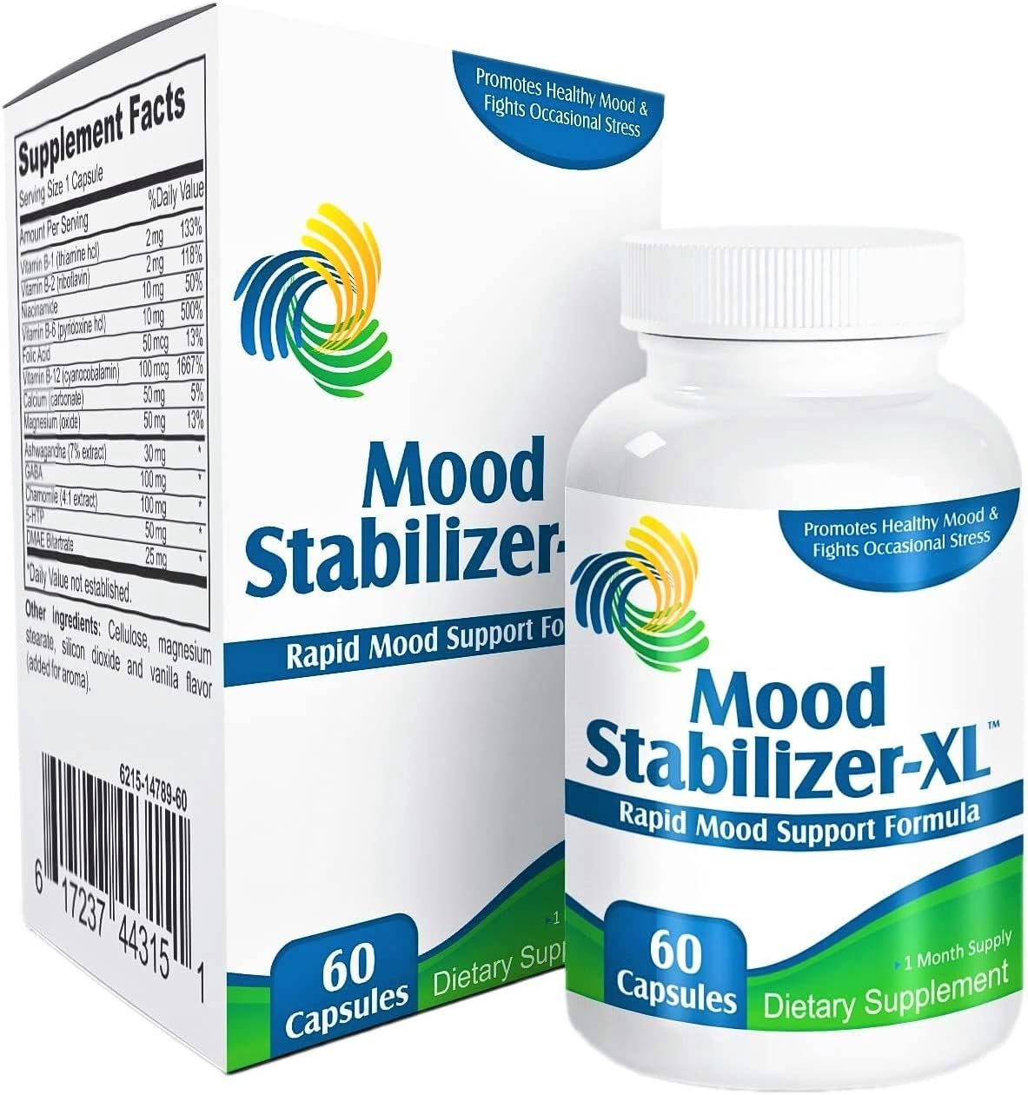
What’s a mood stabilizer?
Arbitrary category of medications for bipolar disorder

Slide 15
What’s a mood stabilizer?
Arbitrary category of medications for bipolar disorder
No consensus definition is accepted among investigators.

Slide 16
What’s a mood stabilizer?
Arbitrary category of medications for bipolar disorder
No consensus definition is accepted among investigators.
U.S. Food and Drug Administration (FDA) does not officially recognize the term.

Slide 17
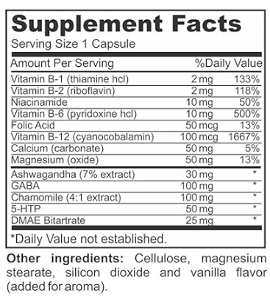
What’s a mood stabilizer?
Arbitrary category of medications for bipolar disorder
No consensus definition is accepted among investigators.
U.S. Food and Drug Administration (FDA) does not officially recognize the term.

Slide 18
The Mood Stabilizers
The
Valproate (Depakote)
Carbamazepine (Tegretol)
Lamotrigine (Lamictal)
Lithium

Slide 19
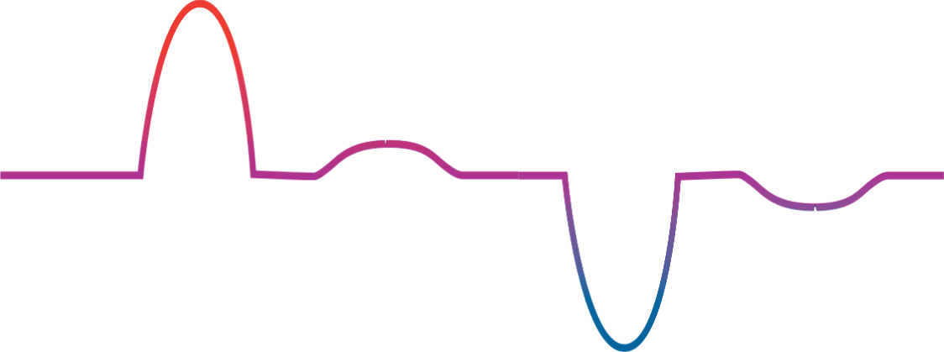
Bipolar disorder
mania
elevated mood
hypomania
Mild depression
severe
depression
depressed mood

Slide 20
Bipolar disorder
mania
elevated mood
hypomania
Mild depression
severe
depression
depressed mood

Slide 21
Bipolar disorder
mania
elevated mood
hypomania
Mild depression
severe
depression
depressed mood

Slide 22
Bipolar disorder
mania
elevated mood
hypomania
Mild depression
severe
depression
depressed mood

Slide 23
Bipolar disorder
mania
elevated mood
hypomania
Mild depression
severe
depression
depressed mood

Slide 24
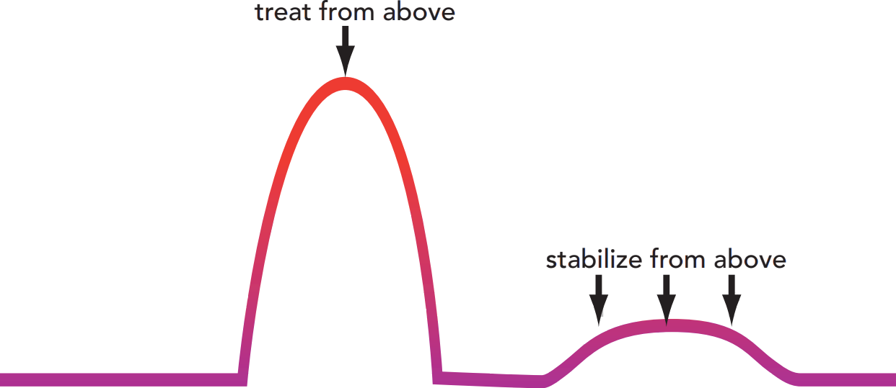
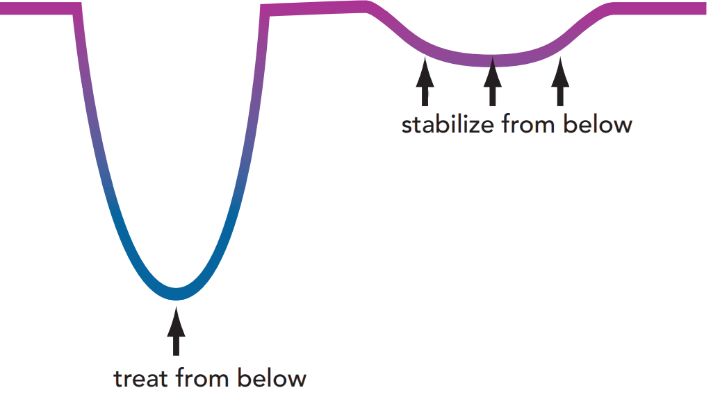
elevated mood
depressed mood

Slide 25
elevated mood
depressed mood

Slide 26
elevated mood
depressed mood

Slide 27
elevated mood
depressed mood

Slide 28
Lithium does all 4 (relative weakness for acute depressive episodes.
elevated mood
( )
depressed mood

Slide 29
Valproate (Depakote) is mostly antimanic.
elevated mood
( )
( )
depressed mood
Valproate (Depakote) is mostly antimanic.

Slide 30
Valproate (Depakote) is mostly antimanic.
elevated mood
( )
( )
depressed mood
Valproate (Depakote) is mostly antimanic.

Slide 31
elevated mood
( )
( )
depressed mood
Valproate (Depakote) is mostly antimanic.

Slide 32
elevated mood
( )
( )
nope
depressed mood
Valproate (Depakote) is mostly antimanic.

Slide 33
Valproate (Depakote) is mostly antimanic.
elevated mood
( )
( )
depressed mood

Slide 34
elevated mood
( )
( )
depressed mood
Ditto for carbamazepine (Tegretol) – mostly antimanic

Slide 35
elevated mood
( )
( )
depressed mood
Ditto for carbamazepine (Tegretol) – mostly antimanic

Slide 36
elevated mood
( )
( )
depressed mood
Ditto for carbamazepine (Tegretol) – mostly antimanic

Slide 37
elevated mood
( )
( )
nope
depressed mood
Ditto for carbamazepine (Tegretol) – mostly antimanic

Slide 38
elevated mood
depressed mood
Lamotrigine is a true “mood stabilizer” but ineffective in treatment of mania.

Slide 39
elevated mood
nope
depressed mood
Lamotrigine is a true “mood stabilizer” but ineffective in treatment of mania.

Slide 40
elevated mood
depressed mood
Lamotrigine is a true “mood stabilizer” but ineffective in treatment of mania.

Slide 41
elevated mood
depressed mood
Lamotrigine is a true “mood stabilizer” but ineffective in treatment of mania.

Slide 42
Quetiapine (Seroquel) is an effective mood stabilizer (and not much of an antipsychotic).
Not calling it a mood stabilizer is totally arbitrary.
elevated mood
depressed mood

Slide 43
Neuroscience-based Nomenclature (NbN3)

Slide 44
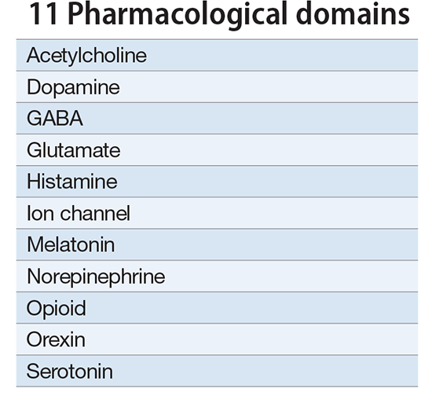
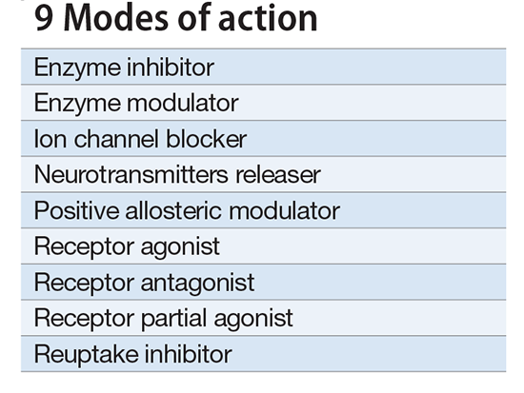
Neuroscience-based Nomenclature (NbN3)

Slide 45
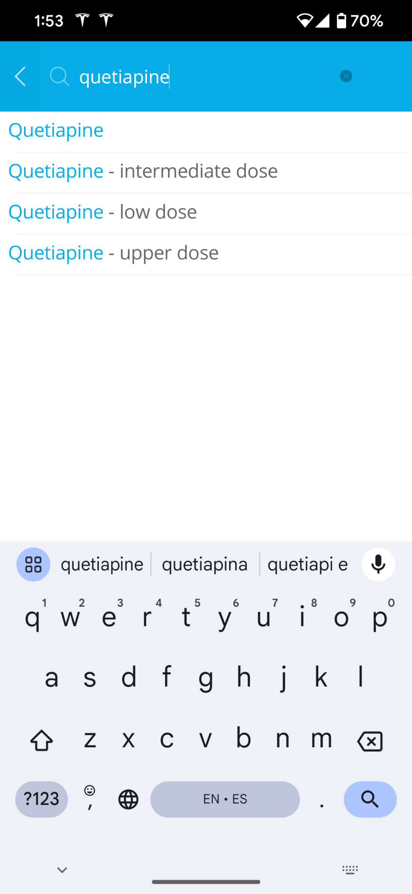
Neuroscience-based Nomenclature (NbN3)

Slide 46
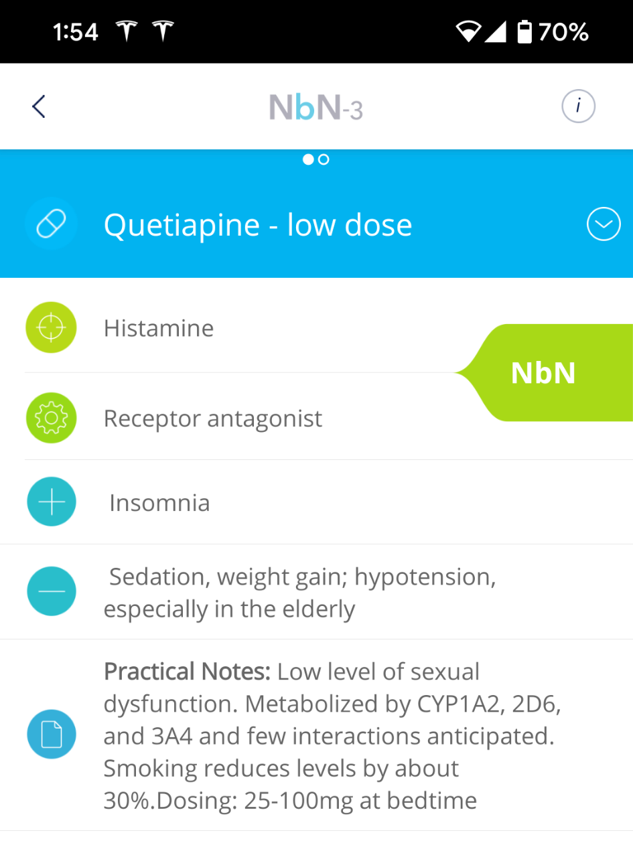
Neuroscience-based Nomenclature (NbN3)
Pharmacological domain
Mode of action
25 – 100 mg

Slide 47
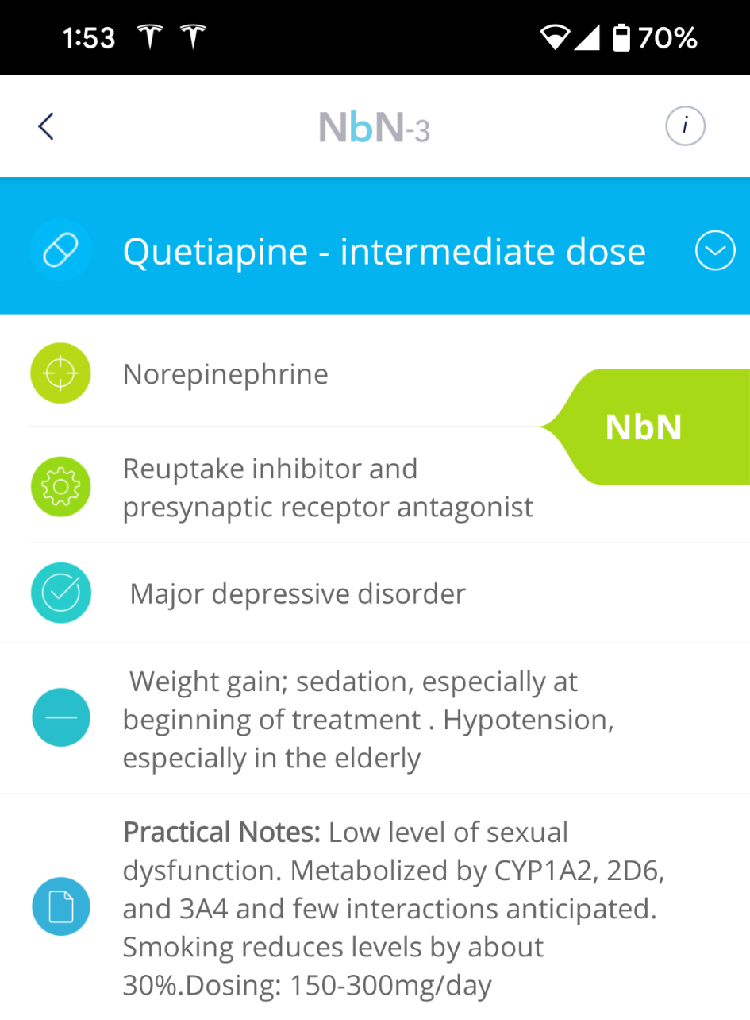
Neuroscience-based Nomenclature (NbN3)
Pharmacological domain
Mode of action
25 – 100 mg
150 – 300 mg

Slide 48
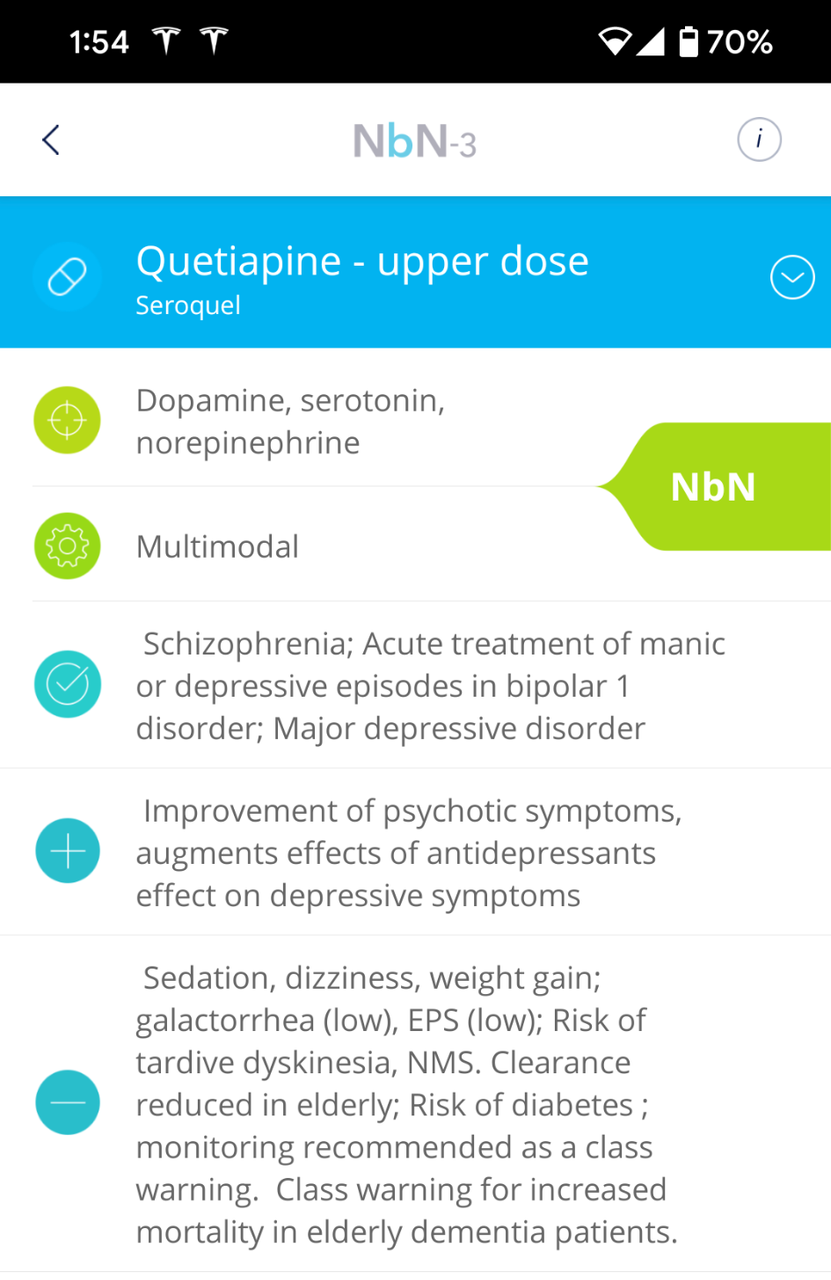
Neuroscience-based Nomenclature (NbN3)
Pharmacological domain
Mode of action
25 – 100 mg
150 – 300 mg
400+ mg antipsychotic

Slide 49
Neuroscience-based Nomenclature (NbN3)

Slide 50
Neuroscience-based Nomenclature (NbN3)

Slide 51
Neuroscience-based Nomenclature (NbN3)
the brain’s ________ neurotransmitter

Slide 52
Neuroscience-based Nomenclature (NbN3)
the brain’s excitatory neurotransmitter

Slide 53
Neuroscience-based Nomenclature (NbN3)
the brain’s inhibitory neurotransmitter
the brain’s excitatory neurotransmitter

Slide 54
Neuroscience-based Nomenclature (NbN3)
lithium
the brain’s inhibitory neurotransmitter
the brain’s excitatory neurotransmitter

Slide 55
Neuroscience-based Nomenclature (NbN3)
lithium
antiepileptic drugs (AEDs)
the brain’s inhibitory neurotransmitter
the brain’s excitatory neurotransmitter

Slide 56
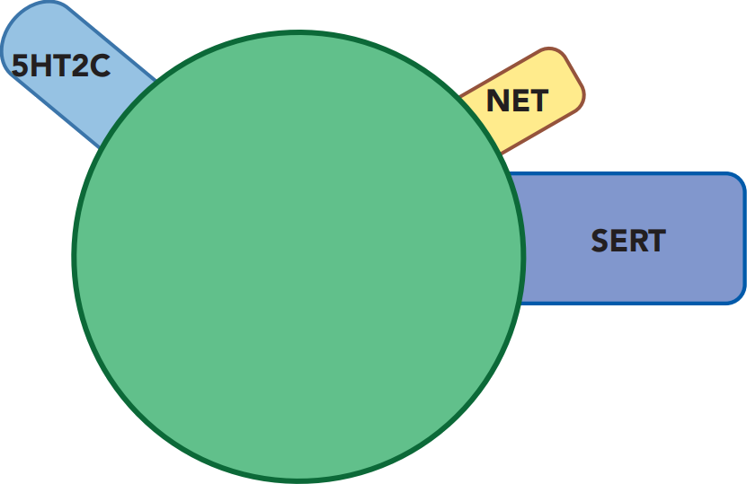
“Ballicules”
NE reuptake inhibitor
Binds 5HT receptor subtype(s)
prototypical
modern
antidepressant
5HT reuptake inhibitor
Stahl’s Essential Psychopharmacology

Slide 57
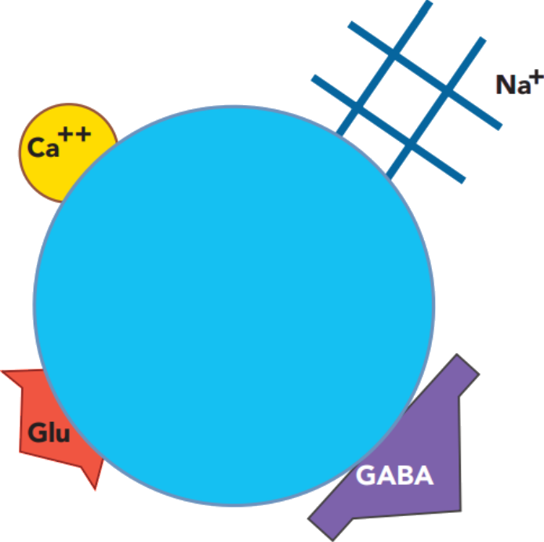
“Ballicules”
NE reuptake inhibitor
Binds 5HT receptor subtype(s)
prototypical
modern
antidepressant
prototypical
mood stabilizer
5HT reuptake inhibitor
Stahl’s Essential Psychopharmacology

Slide 58
“Ballicules”
Blocks voltage-sensitive ion channel(s)
NE reuptake inhibitor
Binds 5HT receptor subtype(s)
prototypical
modern
antidepressant
prototypical
mood stabilizer
5HT reuptake inhibitor
Stahl’s Essential Psychopharmacology

Slide 59
“Ballicules”
Blocks voltage-sensitive ion channel(s)
NE reuptake inhibitor
Binds 5HT receptor subtype(s)
prototypical
modern
antidepressant
prototypical
mood stabilizer
5HT reuptake inhibitor
inhibits
glutamate
(excitatory neurotransmitter)
Stahl’s Essential Psychopharmacology

Slide 60
“Ballicules”
Blocks voltage-sensitive ion channel(s)
NE reuptake inhibitor
Binds 5HT receptor subtype(s)
prototypical
modern
antidepressant
prototypical
mood stabilizer
5HT reuptake inhibitor
inhibits
glutamate
(excitatory neurotransmitter)
enhances GABA (inhibitory neurotransmitter)
Stahl’s Essential Psychopharmacology

Slide 61
“Ballicules”
Blocks voltage-sensitive ion channel(s)
NE reuptake inhibitor
Binds 5HT receptor subtype(s)
prototypical
modern
antidepressant
prototypical
mood stabilizer
5HT reuptake inhibitor
inhibits
glutamate
(excitatory neurotransmitter)
enhances GABA (inhibitory neurotransmitter)
Stahl’s Essential Psychopharmacology

Slide 62
“Ballicules”
Blocks voltage-sensitive ion channel(s)
NE reuptake inhibitor
Binds 5HT receptor subtype(s)
prototypical
modern
antidepressant
prototypical
mood stabilizer
5HT reuptake inhibitor
inhibits
glutamate
(excitatory neurotransmitter)
enhances GABA (inhibitory neurotransmitter)
Stahl’s Essential Psychopharmacology

Slide 63
“Ballicules”
Blocks voltage-sensitive ion channel(s)
NE reuptake inhibitor
Binds 5HT receptor subtype(s)
prototypical
modern
antidepressant
prototypical
mood stabilizer
5HT reuptake inhibitor
inhibits
glutamate
(excitatory neurotransmitter)
enhances GABA (inhibitory neurotransmitter)
Stahl’s Essential Psychopharmacology

Slide 64
“but I need an antidepressant”

Slide 65
Neuroscience-based Nomenclature (NbN3)

Slide 66
Neuroscience-based Nomenclature (NbN3)

Slide 67
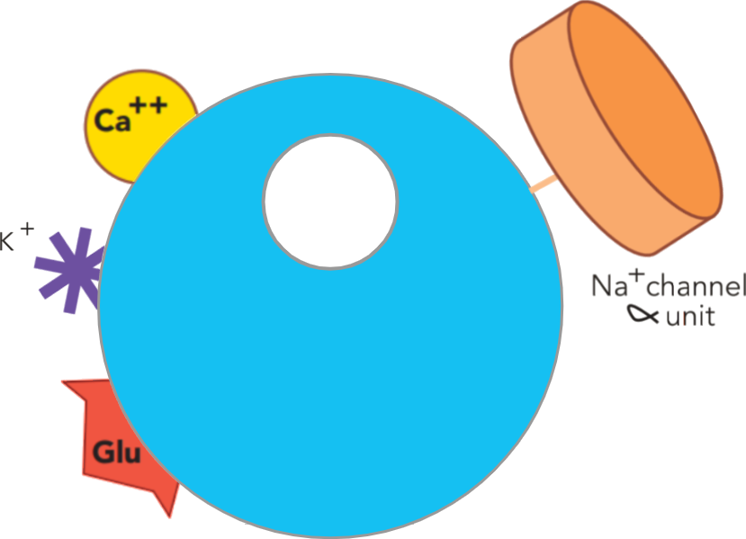
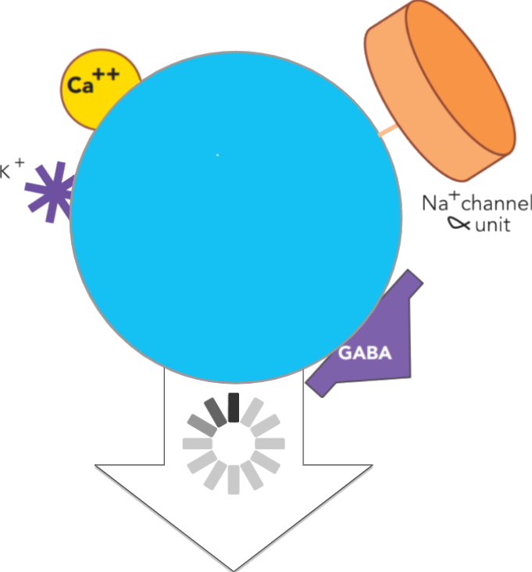
UGT
sensitive substrate (UGT1A4)
valproate
DEPAKOTE
carbamazepine
TEGRETOL
lamotrigine
LAMICTAL

Slide 68
UGT
sensitive substrate (UGT1A4)
valproate
DEPAKOTE
carbamazepine
TEGRETOL
lamotrigine
LAMICTAL

Slide 69
UGT
sensitive substrate (UGT1A4)
valproate
DEPAKOTE
carbamazepine
TEGRETOL
lamotrigine
LAMICTAL

Slide 70
UGT
sensitive substrate (UGT1A4)
valproate
DEPAKOTE
carbamazepine
TEGRETOL
lamotrigine
LAMICTAL

Slide 71
UGT
sensitive substrate (UGT1A4)
valproate
DEPAKOTE
carbamazepine
TEGRETOL
lamotrigine
LAMICTAL

Slide 72
UGT
sensitive substrate (UGT1A4)
valproate
DEPAKOTE
carbamazepine
TEGRETOL
lamotrigine
LAMICTAL

Slide 73
UGT
sensitive substrate (UGT1A4)
valproate
DEPAKOTE
carbamazepine
TEGRETOL
lamotrigine
LAMICTAL

Slide 74
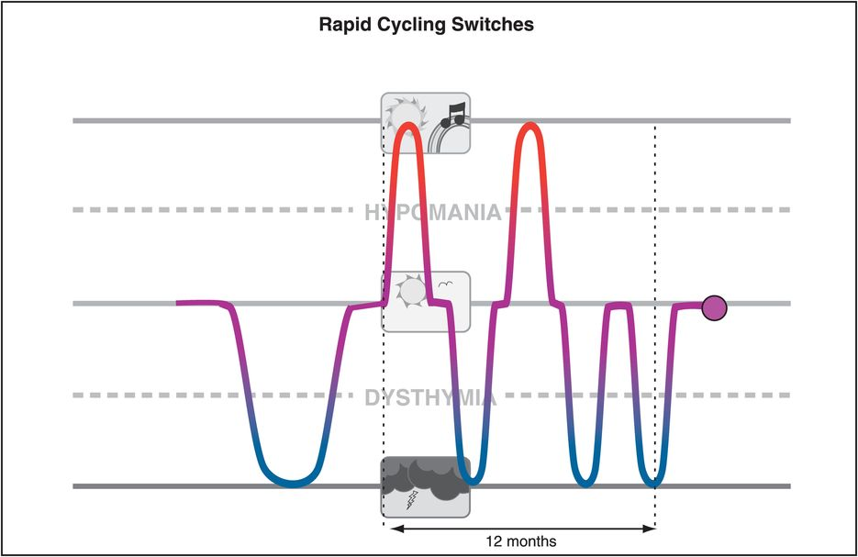
Antidepressants for Bipolar Disorder
Antidepressants are often “mood destabilizers” in bipolar disorder.

Slide 75
Antidepressants for Bipolar Disorder
Antidepressants are often “mood destabilizers” in bipolar disorder.
Antidepressants are ineffective in bipolar disorder, slightly inferior to placebo in large STEP-BD trial.

Slide 76
Antidepressants for Bipolar Disorder
Antidepressants are often “mood destabilizers” in bipolar disorder.
Antidepressants are ineffective in bipolar disorder, slightly inferior to placebo in large STEP-BD trial.
Antidepressant continuation in rapid-cycling worsened maintenance outcomes, especially for depressive morbidity, versus antidepressant discontinuation.

Slide 77
Antidepressants for Bipolar Disorder
Antidepressants are often “mood destabilizers” in bipolar disorder.
Antidepressants are ineffective in bipolar disorder, slightly inferior to placebo in large STEP-BD trial.
Antidepressant continuation in rapid-cycling worsened maintenance outcomes, especially for depressive morbidity, versus antidepressant discontinuation.
In one-third of treatment-refractory bipolar patients, mania is likely to be antidepressant-induced and not attributable to the expected course of illness.

Slide 78
Antidepressants for Bipolar Disorder
Antidepressants are often “mood destabilizers” in bipolar disorder.
Antidepressants are ineffective in bipolar disorder, slightly inferior to placebo in large STEP-BD trial.
Antidepressant continuation in rapid-cycling worsened maintenance outcomes, especially for depressive morbidity, versus antidepressant discontinuation.
In one-third of treatment-refractory bipolar patients, mania is likely to be antidepressant-induced and not attributable to the expected course of illness.
In STEP-BD the most important risk factor for recurrence of depression was residual subthreshold mood elevation.

Slide 79
Antidepressants for Bipolar Disorder
Antidepressants are often “mood destabilizers” in bipolar disorder.
Antidepressants are ineffective in bipolar disorder, slightly inferior to placebo in large STEP-BD trial.
Antidepressant continuation in rapid-cycling worsened maintenance outcomes, especially for depressive morbidity, versus antidepressant discontinuation.
In one-third of treatment-refractory bipolar patients, mania is likely to be antidepressant-induced and not attributable to the expected course of illness.
In STEP-BD the most important risk factor for recurrence of depression was residual subthreshold mood elevation.
For bipolar patients who are depressed, antidepressants should be tapered off.

Slide 80
Antidepressants for Bipolar Disorder
For bipolar patients who are depressed...

Slide 81
Antidepressants for Bipolar Disorder
For bipolar patients who are depressed, antidepressants should be tapered off.

Slide 82
Antidepressants for Bipolar Disorder
For bipolar patients who are depressed, antidepressants should be tapered off.
I would also argue that “MDD” patients who’ve failed multiple traditional antidepressants shouldn’t be given traditional antidepressants again.

Slide 83
Antidepressant nonresponders
I would also argue that “MDD” patients who’ve failed multiple traditional antidepressants shouldn’t be given traditional antidepressants again.

Slide 84
Antidepressant nonresponders
I would also argue that “MDD” patients who’ve failed multiple traditional antidepressants shouldn’t be given traditional antidepressants again.
Futility argument

Slide 85
Antidepressant nonresponders
I would also argue that “MDD” patients who’ve failed multiple traditional antidepressants shouldn’t be given traditional antidepressants again.
Futility argument
Loss of placebo benefit

Slide 86
Antidepressant nonresponders
I would also argue that “MDD” patients who’ve failed multiple traditional antidepressants shouldn’t be given traditional antidepressants again.
Futility argument
Loss of placebo benefit
If “MDD” patient is an undiagnosed or unexpressed BD patient, another antidepressant may alter course of illness

Slide 87
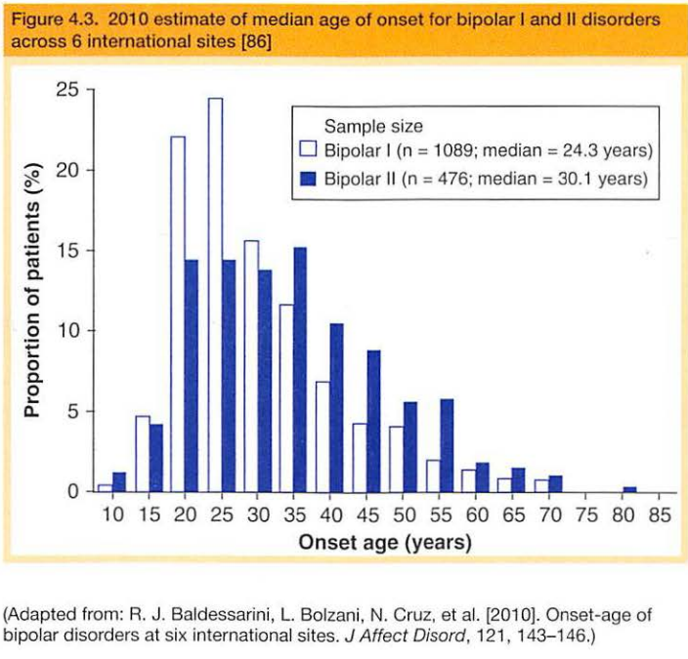
Consider your 25 year old MDD antidepressant nonresponder...

Slide 88
Consider your 25 year old MDD? antidepressant nonresponder...

Slide 89
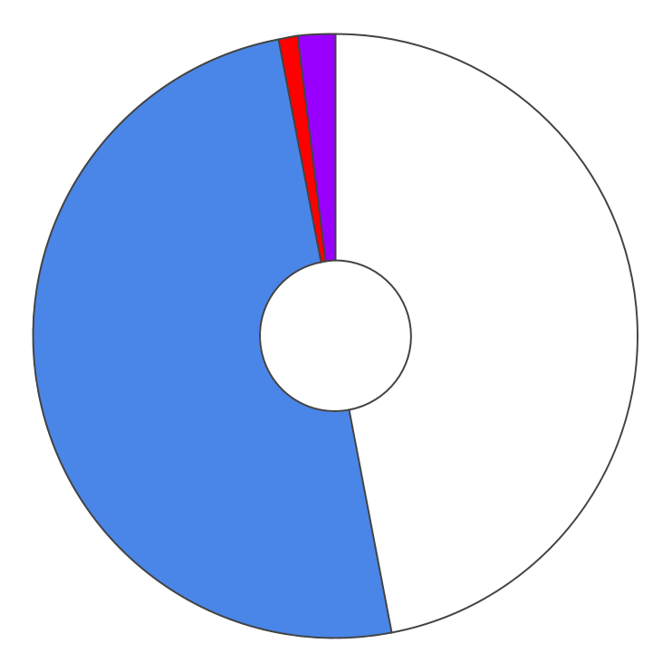
I would wager that, for every case of bipolar disorder you know about, there are two you don’t know about, and they are most likely antidepressant nonresponders.
cycling/ mixed
hypomanic
1%
2%
6%
asymptomatic
depressed
BIPOLAR
47% of weeks
II
50%
undiagnosed
unexpressed

Slide 90
8 ways to harm your patients (mood stabilizers)
Not explaining that lithium and lamotrigine are “bipolar antidepressants”

Slide 91
8 ways to harm your patients (mood stabilizers)
Not explaining that lithium and lamotrigine are “bipolar antidepressants”
mood stabilizing medications

Slide 92
8 ways to harm your patients (mood stabilizers)
Not explaining that lithium and lamotrigine are “bipolar antidepressants”
What are the evidence-based “bipolar antidepressants”?
L
L
L
L
L

Slide 93
8 ways to harm your patients (mood stabilizers)
Not explaining that lithium and lamotrigine are “bipolar antidepressants”
What are the evidence-based “bipolar antidepressants”?
Lithium (although not great as MONOtherapy for acute bipolar depression, but highly effective in preventing depression)
L
L
L
L

Slide 94
8 ways to harm your patients (mood stabilizers)
Not explaining that lithium and lamotrigine are “bipolar antidepressants”
What are the evidence-based “bipolar antidepressants”?
Lithium (although not great as MONOtherapy for acute bipolar depression, but highly effective in preventing depression)
Lamotrigine (delayed effect for titration, but traditional antidepressants have delayed benefit)
L
L
L

Slide 95
8 ways to harm your patients (mood stabilizers)
Not explaining that lithium and lamotrigine are “bipolar antidepressants”
What are the evidence-based “bipolar antidepressants”?
Lithium (although not great as MONOtherapy for acute bipolar depression, but highly effective in preventing depression)
Lamotrigine (delayed effect for titration, but traditional antidepressants have delayed benefit)
Lurasidone (Latuda)
L
L

Slide 96
8 ways to harm your patients (mood stabilizers)
Not explaining that lithium and lamotrigine are “bipolar antidepressants”
What are the evidence-based “bipolar antidepressants”?
Lithium (although not great as MONOtherapy for acute bipolar depression, but highly effective in preventing depression)
Lamotrigine (delayed effect for titration, but traditional antidepressants have delayed benefit)
Lurasidone (Latuda)
Lumateperone (Caplyta)
L

Slide 97
8 ways to harm your patients (mood stabilizers)
Not explaining that lithium and lamotrigine are “bipolar antidepressants”
What are the evidence-based “bipolar antidepressants”?
Lithium (although not great as MONOtherapy for acute bipolar depression, but highly effective in preventing depression)
Lamotrigine (delayed effect for titration, but traditional antidepressants have delayed benefit)
Lurasidone (Latuda)
Lumateperone (Caplyta)
Light therapy

Slide 98
8 ways to harm your patients (mood stabilizers)
Not explaining that lithium and lamotrigine are “bipolar antidepressants”
What are the evidence-based “bipolar antidepressants”?
Lithium (although not great as MONOtherapy for acute bipolar depression, but highly effective in preventing depression)
Lamotrigine (delayed effect for titration, but traditional antidepressants have delayed benefit)
Lurasidone (Latuda)
Lumateperone (Caplyta)
Light therapy
Quetiapine (SeroqueL)

Slide 99
8 ways to harm your patients (mood stabilizers)
Not explaining that lithium and lamotrigine are “bipolar antidepressants”
What are the evidence-based “bipolar antidepressants”?
Lithium (although not great as MONOtherapy for acute bipolar depression, but highly effective in preventing depression)
Lamotrigine (delayed effect for titration, but traditional antidepressants have delayed benefit)
Lurasidone (Latuda)
Lumateperone (Caplyta)
Light therapy
Quetiapine (SeroqueL)
Cariprazine (VrayLar)

Slide 100
8 ways to harm your patients (mood stabilizers)
Not explaining that lithium and lamotrigine are “bipolar antidepressants”
What are the evidence-based “bipolar antidepressants”?
Lithium (although not great as MONOtherapy for acute bipolar depression, but highly effective in preventing depression)
Lamotrigine (delayed effect for titration, but traditional antidepressants have delayed benefit)
Lurasidone (Latuda)
Lumateperone (Caplyta)
Light therapy
Quetiapine (SeroqueL)
Cariprazine (VrayLar)
VaLproate (adjunctive)

Slide 101
8 ways to harm your patients (mood stabilizers)
Not explaining that lithium and lamotrigine are “bipolar antidepressants”
What are the evidence-based “bipolar antidepressants”?
Lithium (although not great as MONOtherapy for acute bipolar depression, but highly effective in preventing depression)
Lamotrigine (delayed effect for titration, but traditional antidepressants have delayed benefit)
Lurasidone (Latuda)
Lumateperone (Caplyta)
Light therapy
Quetiapine (SeroqueL)
Cariprazine (VrayLar)
VaLproate (adjunctive)
Omega 3 fatty acids

Slide 102
8 ways to harm your patients (mood stabilizers)
Not explaining that lithium and lamotrigine are “bipolar antidepressants”
What are the evidence-based “bipolar antidepressants”?
Lithium (although not great as MONOtherapy for acute bipolar depression, but highly effective in preventing depression)
Lamotrigine (delayed effect for titration, but traditional antidepressants have delayed benefit)
Lurasidone (Latuda)
Lumateperone (Caplyta)
Light therapy
Quetiapine (SeroqueL)
Cariprazine (VrayLar)
VaLproate (adjunctive)
Omega 3 fatty acids
ECT

Slide 103
8 ways to harm your patients (mood stabilizers)
Not explaining that lithium and lamotrigine are “bipolar antidepressants”
What are the evidence-based “bipolar antidepressants”?
Lithium (although not great as MONOtherapy for acute bipolar depression, but highly effective in preventing depression)
Lamotrigine (delayed effect for titration, but traditional antidepressants have delayed benefit)
Lurasidone (Latuda)
Lumateperone (Caplyta)
Light therapy
Quetiapine (SeroqueL)
Cariprazine (VrayLar)
VaLproate (adjunctive)
Omega 3 fatty acids
ECT
IV ketamine

Slide 104
8 ways to harm your patients (mood stabilizers)
Not explaining that lithium and lamotrigine are “bipolar antidepressants”
What are the evidence-based “bipolar antidepressants”?
Lithium (although not great as MONOtherapy for acute bipolar depression, but highly effective in preventing depression)
Lamotrigine (delayed effect for titration, but traditional antidepressants have delayed benefit)
Lurasidone (Latuda)
Lumateperone (Caplyta)
Light therapy
Quetiapine (SeroqueL) These have evidence for unipolar depression
Cariprazine (VrayLar)
Valproate (adjunctive)
Omega 3 fatty acids
ECT
IV Ketamine

Slide 105
8 ways to harm your patients (mood stabilizers)
Not explaining that lithium and lamotrigine are “bipolar antidepressants”
Mishandling bipolar disorder patient’s request
...“but I need an antidepressant”
Continuing to prescribe traditional antidepressants to patients who have not benefited from antidepressants
Underestimating the likelihood that your unipolar MDD patient may have bipolar
Thinking in black or white about medication categories and DSM-5 mood diagnoses
Break for questions / comments

Slide 106
8 ways to harm your patients (mood stabilizers)
Not explaining that lithium and lamotrigine are “bipolar antidepressants”
Depriving bipolar patients of lithium treatment

Slide 107
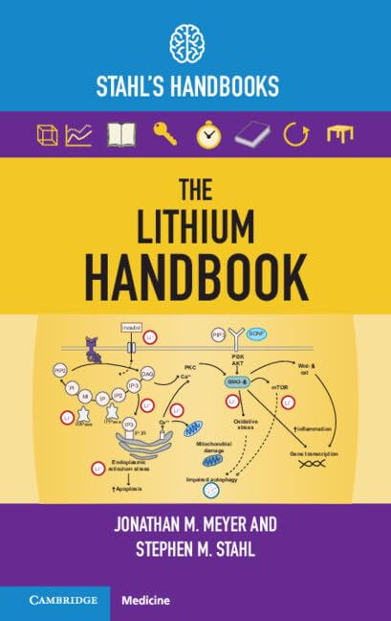
“Dissemination of new knowledge is central to dispelling outdated ideas regarding lithium and allowing patients access to its unique constellation of therapeutic properties”.

Slide 108
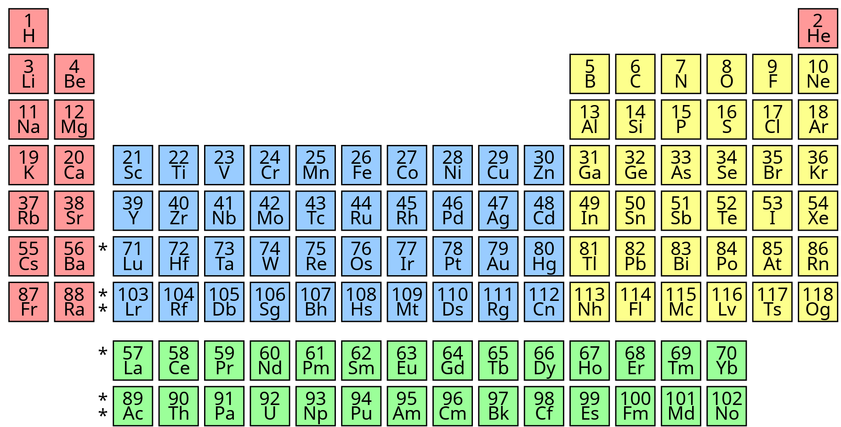
Lithium blocks voltage-sensitive sodium channels
Notes:
Lithium - third thing to exist. Hydrogen, Helium, Lithium.

Slide 109
False!
Lithium blocks voltage-sensitive sodium channels
Notes:
Lithium - third thing to exist. Hydrogen, Helium, Lithium.

Slide 110
Lithium’s NbN classification: Enzyme modulator
Lithium blocks voltage-sensitive sodium channels
Notes:
Lithium - third thing to exist. Hydrogen, Helium, Lithium.

Slide 111
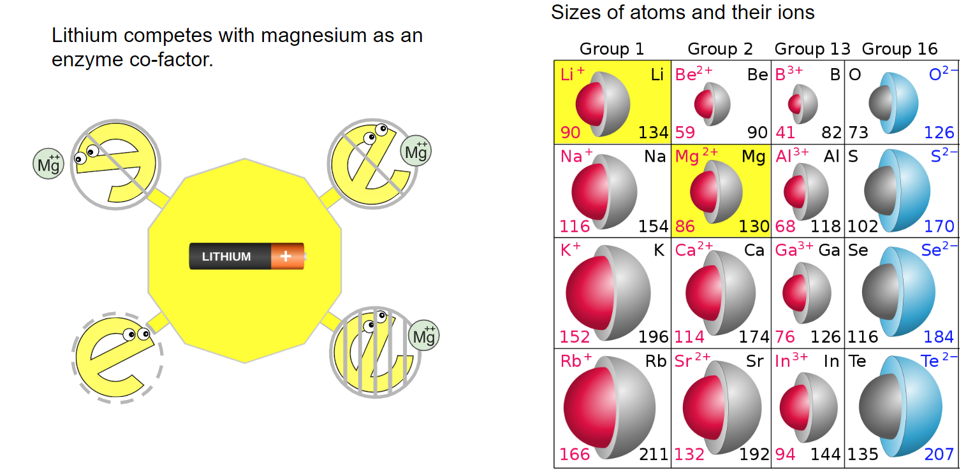
→ leading to healthy brain

Slide 112
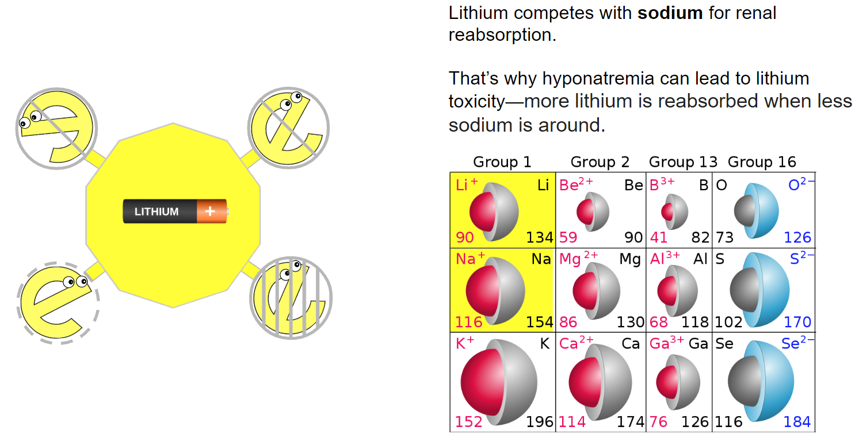

Slide 113
Lithium
Treatment guidelines and expert recommendations are substantially in agreement that lithium should be the core maintenance treatment for bipolar I individuals, and possibly bipolar II individuals (Meyer & Stahl, 2023).
Notes:
Other neurodegenerative diseases. +-Overlapping mechanisms with other neuroprotectants.

Slide 114
Lithium
Treatment guidelines and expert recommendations are substantially in agreement that lithium should be the core maintenance treatment for bipolar I individuals, and possibly bipolar II individuals (Meyer & Stahl, 2023).
Negative perception of lithium may be based on misconceptions regarding efficacy and safety that have been dispelled by newer data (Meyer & Stahl, 2023).
Notes:
Other neurodegenerative diseases. +-Overlapping mechanisms with other neuroprotectants.

Slide 115
Lithium
Treatment guidelines and expert recommendations are substantially in agreement that lithium should be the core maintenance treatment for bipolar I individuals, and possibly bipolar II individuals (Meyer & Stahl, 2023).
Negative perception of lithium may be based on misconceptions regarding efficacy and safety that have been dispelled by newer data (Meyer & Stahl, 2023).
Psychiatrists who do not prescribe lithium and clozapine are practicing below the standard of care (Malhi et al, 2020).
Notes:
Other neurodegenerative diseases. +-Overlapping mechanisms with other neuroprotectants.

Slide 116
Lithium
Treatment guidelines and expert recommendations are substantially in agreement that lithium should be the core maintenance treatment for bipolar I individuals, and possibly bipolar II individuals (Meyer & Stahl, 2023).
Negative perception of lithium may be based on misconceptions regarding efficacy and safety that have been dispelled by newer data (Meyer & Stahl, 2023).
Psychiatrists who do not prescribe lithium and clozapine are practicing below the standard of care (Malhi et al, 2020).
Failure to adequately manage bipolar disorder may itself be a disease-modifying event that portends lower long-term treatment response (Post RM, 2018). The underlying hypothesis is that failure to minimize symptom severity may result in epigenetic changes that have long-term impact.
Notes:
Other neurodegenerative diseases. +-Overlapping mechanisms with other neuroprotectants.

Slide 117
Lithium - neuroprotection
Neuroprotective Effects of Lithium: Implications for the Treatment of Alzheimer’s Disease and Related Neurodegenerative Disorders O. V. Forlenza et al. ACS Chemical Neuroscience 2014.
Notes:
Other neurodegenerative diseases. +-Overlapping mechanisms with other neuroprotectants.

Slide 118
Lithium - neuroprotection
Neuroprotective Effects of Lithium: Implications for the Treatment of Alzheimer’s Disease and Related Neurodegenerative Disorders O. V. Forlenza et al. ACS Chemical Neuroscience 2014.
Notes:
Other neurodegenerative diseases. +-Overlapping mechanisms with other neuroprotectants.

Slide 119
Lithium - neuroprotection
Neuroprotective Effects of Lithium: Implications for the Treatment of Alzheimer’s Disease and Related Neurodegenerative Disorders O. V. Forlenza et al. ACS Chemical Neuroscience 2014.
Notes:
Other neurodegenerative diseases. +-Overlapping mechanisms with other neuroprotectants.

Slide 120
Lithium - neuroprotection
Neuroprotective Effects of Lithium: Implications for the Treatment of Alzheimer’s Disease and Related Neurodegenerative Disorders O. V. Forlenza et al. ACS Chemical Neuroscience 2014.
Notes:
Other neurodegenerative diseases. +-Overlapping mechanisms with other neuroprotectants.

Slide 121
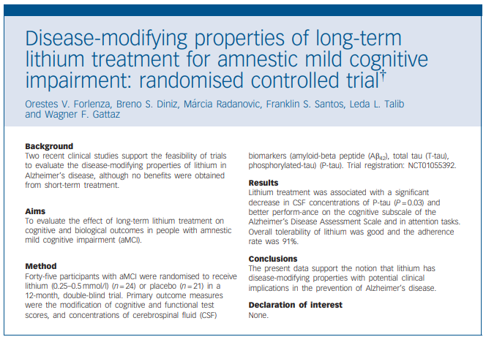
Forlenza OV, Diniz BS, Radanovic M, et al. Disease modifying properties of long-term lithium treatment for amnestic mild cognitive impairment: randomised controlled trial. Br J Psychiatry. 2011;198(5):351-356.
Notes:
Don’t worry, I’ll tell you about the other 9 neuroprotections…
Think about disease modifying… donepezil, and memantine don’t do this. neurofibrillary tangles composed of tau protein. 2 new antibody treatments that are disease modifying. Prevagen.

Slide 122
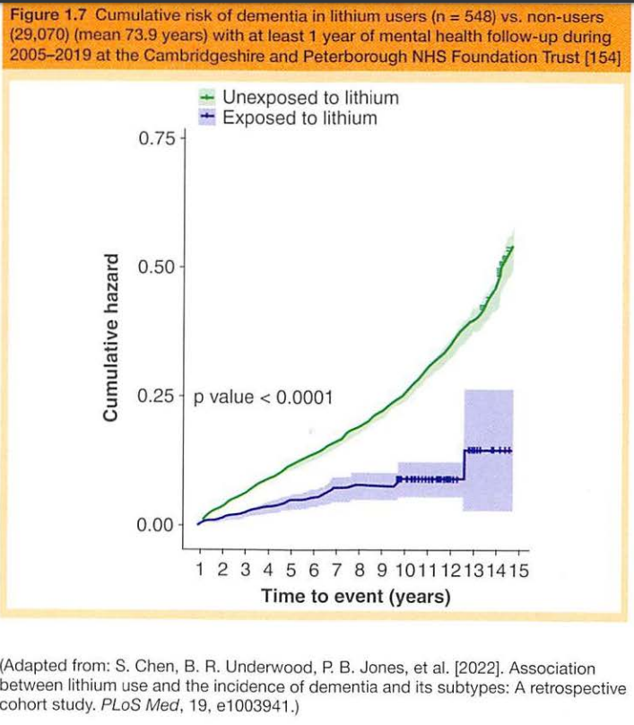
Lithium is estimated to decrease dementia by ~ 50% in bipolar patients

Slide 123
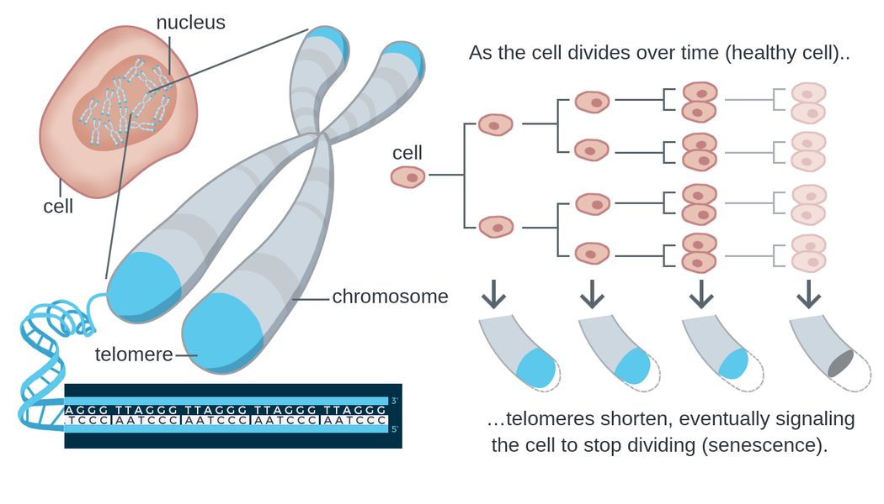
Lithium - anti-aging (bipolar)
Telomere shortening is a biomarker of aging.
https://theory.labster.com/telomere-length/
REVIEW article
Front. Psychiatry, 29 September 2020
Sec. Mood Disorders
https://doi.org/10.3389/fpsyt.2020.586083
This article is part of the Research Topic
Neurobiological Underpinnings of Bipolar Disorder and its Treatment
View all 6 Articles
Lithium and the Interplay Between Telomeres and Mitochondria in Bipolar Disorder
Mitochondrial dysfunction and telomere shortening have been implicated in both the pathophysiology of bipolar disorder and as targets of lithium treatment. Interestingly, it has in recent years become clear that these phenomena are intimately linked, partly through reactive oxygen species signaling and the subcellular translocation and non-canonical actions of telomerase reverse transcriptase. In this review, we integrate the current understanding of mitochondrial dysfunction, oxidative stress and telomere shortening in bipolar disorder with documented effects of lithium. Moreover, we propose that lithium’s mechanism of action is intimately connected with the interdependent regulation of mitochondrial bioenergetics and telomere maintenance.
Notes:
There are biomarkers that can estimate the biologic age of various organs, including the length of telomeres. Telomeres form protective caps at the ends of chromosomes.

Slide 124
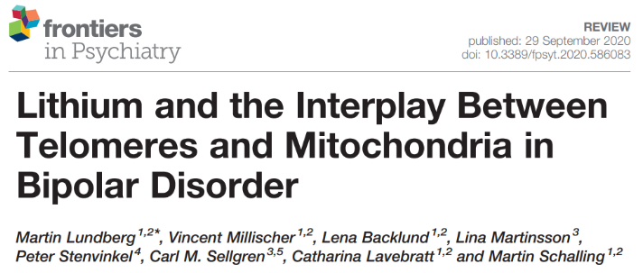
Lithium - anti-aging (bipolar)
(Leukocytes of) lithium-treated bipolar patients had 35% longer telomeres than controls.
Lundberg M, Millischer V, Backlund L, Martinsson L, Stenvinkel P, Sellgren CM, Lavebratt C, Schalling M. Lithium and the Interplay Between Telomeres and Mitochondria in Bipolar Disorder. Front Psychiatry. 2020 Sep 29;11:586083.
Martinsson L, Wei Y, Xu D, Melas PA, Mathé AA, Schalling M, et al. Long-term lithium treatment in bipolar disorder is associated with longer leukocyte telomeres. Transl Psychiatry (2013) 3(5):e261. 10.1038/tp.2013.37
Notes:
The telomeres of people taking lithium were found to be 35% longer, which is theorized to represent a younger biologic age. Telomeres of WBCs were tested, so this is outside of the brain.

Slide 125
Lithium - cardioprotection
Lithium may protect cardiac structure and function in patients with bipolar disorder
(by reduction of the chemokine CX3CL1).
Notes:
Otherwise lithium appears to be cardioprotective, which could be a general anti-aging effect.

Slide 126
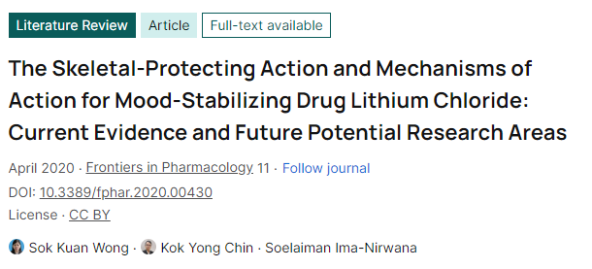
Lithium - improved bone mineral density
Improved bone density
Fewer fractures

Slide 127
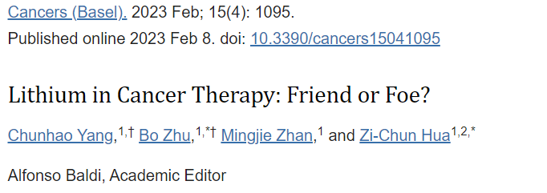
Yang C, Zhu B, Zhan M, Hua ZC. Lithium in Cancer Therapy: Friend or Foe? Cancers (Basel). 2023 Feb 8;15(4):1095.

Slide 128
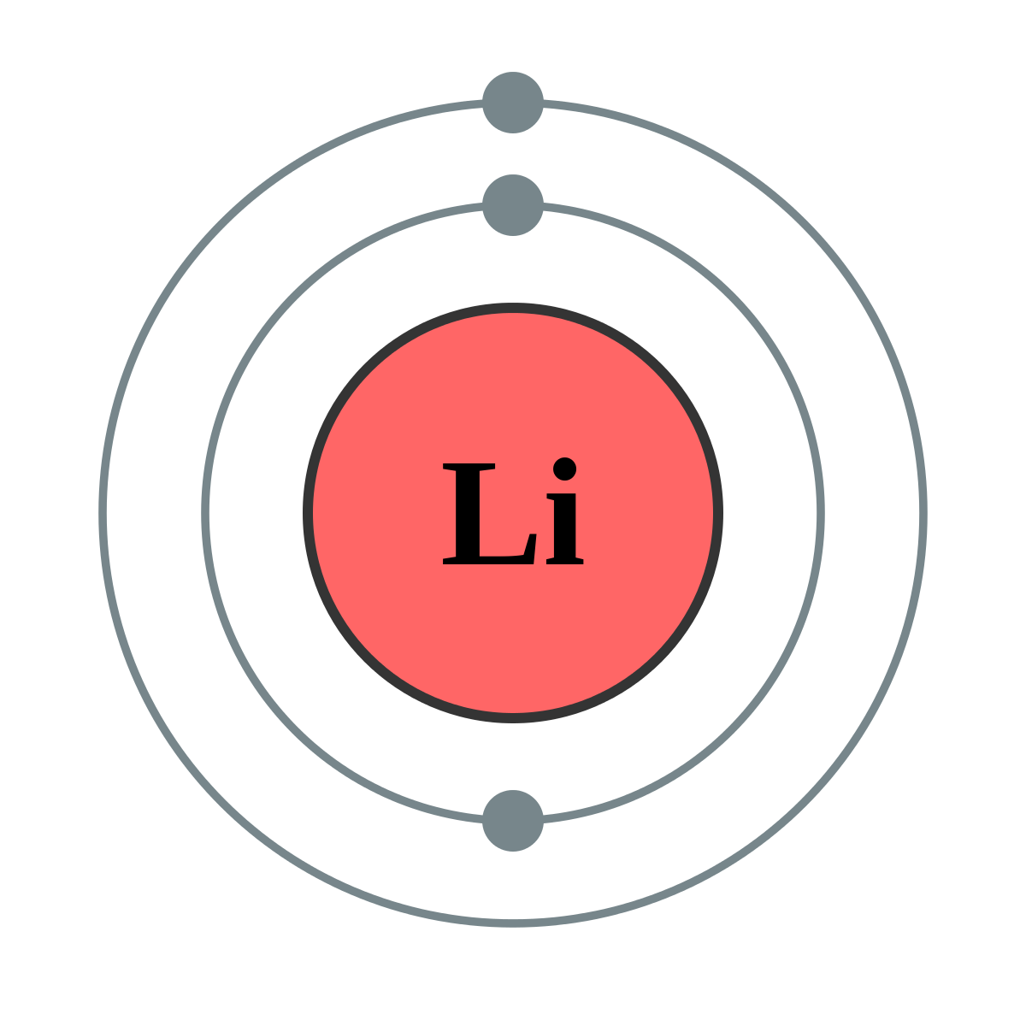
Lithium - anti-tumor effects
Much evidence shows lithium prevents the development of different cancers, including leukemia, melanoma, lung cancer, and pancreatic cancer.
Yang C, Zhu B, Zhan M, Hua ZC. Lithium in Cancer Therapy: Friend or Foe? Cancers (Basel). 2023 Feb 8;15(4):1095.

Slide 129
Lithium - anti-tumor effects
Much evidence shows lithium prevents the development of different cancers, including leukemia, melanoma, lung cancer, and pancreatic cancer.
Lithium prevents tumor metastasis
Yang C, Zhu B, Zhan M, Hua ZC. Lithium in Cancer Therapy: Friend or Foe? Cancers (Basel). 2023 Feb 8;15(4):1095.

Slide 130
Lithium - anti-tumor effects
Much evidence shows lithium prevents the development of different cancers, including leukemia, melanoma, lung cancer, and pancreatic cancer.
Lithium prevents tumor metastasis
Decreased incidence of cancer in bipolar patients in certain data sets (Meyer & Stahl)
Yang C, Zhu B, Zhan M, Hua ZC. Lithium in Cancer Therapy: Friend or Foe? Cancers (Basel). 2023 Feb 8;15(4):1095.

Slide 131
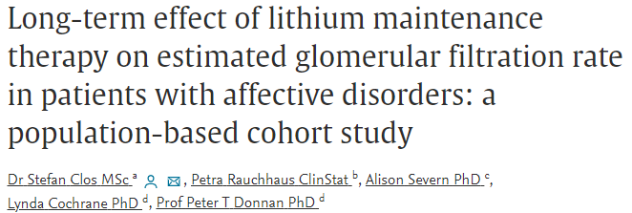
Lithium - renal risk
Stefan Clos, Petra Rauchhaus, Alison Severn, Lynda Cochrane, Peter T Donnan, Long-term effect of lithium maintenance therapy on estimated glomerular filtration rate in patients with affective disorders: a population-based cohort study, The Lancet Psychiatry, Volume 2, Issue 12, 2015.

Slide 132
Lithium - renal risk
If lithium levels do not exceeding 1.0 at 12 hr trough, eGFR does not decrease over time (beyond the normal decrease by 1 yearly with normal aging).
Stefan Clos, Petra Rauchhaus, Alison Severn, Lynda Cochrane, Peter T Donnan, Long-term effect of lithium maintenance therapy on estimated glomerular filtration rate in patients with affective disorders: a population-based cohort study, The Lancet Psychiatry, Volume 2, Issue 12, 2015.

Slide 133
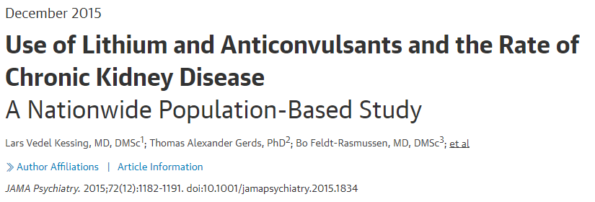
Lithium - renal risk
Lithium is not associated with end-stage CKD.
Kessing LV, Gerds TA, Feldt-Rasmussen B, Andersen PK, Licht RW. Use of Lithium and Anticonvulsants and the Rate of Chronic Kidney Disease: A Nationwide Population-Based Study. JAMA Psychiatry. 2015;72(12):1182–1191. doi:10.1001/jamapsychiatry.2015.1834

Slide 134
Lithium - antiepileptic effects
Lithium has antiepileptic effects (at therapeutic doses).

Slide 135
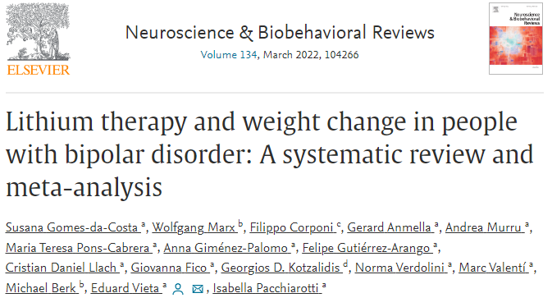
Lithium - weight gain?
Gomes-da-Costa, et al. Lithium therapy and weight change in people with bipolar disorder: A systematic review and meta-analysis, Neuroscience & Biobehavioral Reviews, Volume 134, 2022.
Notes:
Batchelor, D.H. and Lowe, M.R. (1990), Reported neurotoxicity with the lithium/haloperidol combination and other neuroleptics—A literature review. Hum. Psychopharmacol. Clin. Exp., 5: 275-280. https://doi.org/10.1002/hup.470050323

Slide 136
Lithium - weight gain?
Weight change with lithium does not differ from placebo.
Gomes-da-Costa, et al. Lithium therapy and weight change in people with bipolar disorder: A systematic review and meta-analysis, Neuroscience & Biobehavioral Reviews, Volume 134, 2022.
Notes:
Batchelor, D.H. and Lowe, M.R. (1990), Reported neurotoxicity with the lithium/haloperidol combination and other neuroleptics—A literature review. Hum. Psychopharmacol. Clin. Exp., 5: 275-280. https://doi.org/10.1002/hup.470050323

Slide 137
Lithium - suicide
Those with unipolar MDD or bipolar disorder are
75 % less likely to attempt or complete suicide on lithium
(Baldessarini et al, 2006).
?
Notes:
Batchelor, D.H. and Lowe, M.R. (1990), Reported neurotoxicity with the lithium/haloperidol combination and other neuroleptics—A literature review. Hum. Psychopharmacol. Clin. Exp., 5: 275-280. https://doi.org/10.1002/hup.470050323

Slide 138
Lithium - suicide
Those with unipolar MDD or bipolar disorder are
75 % less likely to attempt or complete suicide on lithium
(Baldessarini et al, 2006).
That’s a 4-fold decrease compared to being prescribed any other medication.
Notes:
Batchelor, D.H. and Lowe, M.R. (1990), Reported neurotoxicity with the lithium/haloperidol combination and other neuroleptics—A literature review. Hum. Psychopharmacol. Clin. Exp., 5: 275-280. https://doi.org/10.1002/hup.470050323

Slide 139
Lithium - suicide
Those with unipolar MDD or bipolar disorder are
75 % less likely to attempt or complete suicide on lithium
(Baldessarini et al, 2006).
That’s a 4-fold decrease compared to being prescribed any other medication.
but..

Slide 140
Lithium - suicide
Those with unipolar MDD or bipolar disorder are
75 % less likely to attempt or complete suicide on lithium
(Baldessarini et al, 2006).
That’s a 4-fold decrease compared to being prescribed any other medication.
The minimum duration necessary to achieve lithium's anti-suicidal effects is unknown, but 18 months or more of exposure may be required (Meyer & Stahl, 2023).
the anti-suicide effect takes at least 6 months to develop, possibly 18 months for full benefit.

Slide 141
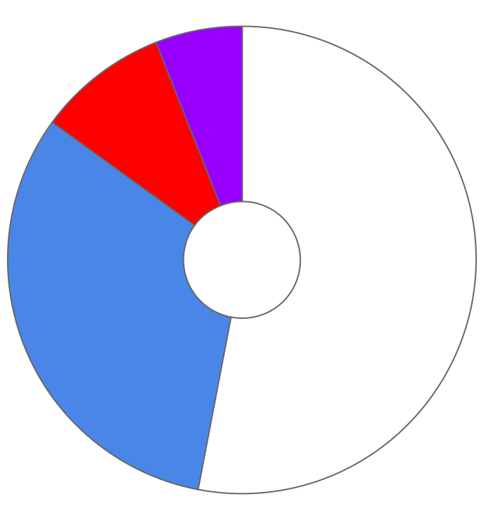
12 ways to harm your patients (mood stabilizers)
Not explaining that lithium and lamotrigine as “bipolar antidepressants”
Depriving bipolar patients of lithium treatment
cycling/ mixed
cycling/ mixed
hypomanic
manic/ hypomanic
1%
2%
6%
6%
9%
asymptomatic
asymptomatic
depressed
depressed
BIPOLAR
53% of weeks
BIPOLAR
47% of weeks
I
II
32%
50%
N=146 over 13 years
N=82 over 13 years
Judd, Akiskal, Schettler et al, 2002

Slide 142
12 ways to harm your patients (mood stabilizers)
Not explaining that lithium and lamotrigine as “bipolar antidepressants”
Depriving bipolar patients of lithium treatment

Slide 143
12 ways to harm your patients (mood stabilizers)
Not explaining that lithium and lamotrigine as “bipolar antidepressants”
Depriving bipolar patients of lithium treatment
undiagnosed or unexpressed
The accumulated data indicate that lithium is an effective adjunct to SSRIs or TCAs for unipolar MDD. There is lack of consensus on lithium’s place in the unipolar MDD treatment algorithm (Meyer & Stahl, 2023).

Slide 144
12 ways to harm your patients (mood stabilizers)
Not explaining that lithium and lamotrigine as “bipolar antidepressants”
Depriving bipolar patients of lithium treatment
undiagnosed or unexpressed
The accumulated data indicate that lithium is an effective adjunct to SSRIs or TCAs for unipolar MDD. There is lack of consensus on lithium’s place in the unipolar MDD treatment algorithm (Meyer & Stahl, 2023).
Although other options have been more extensively studied for unipolar MDD, lithium is the choice most likely to:
Reduce suicide risk 4-fold
Prevent psychiatric hospitalization
Prevent dementia (at which MDD patients are at almost 2-fold increased risk)
Prevent cancer
Extend healthy lifespan

Slide 145
12 ways to harm your patients (mood stabilizers)
Not explaining that lithium and lamotrigine as “bipolar antidepressants”
Depriving bipolar patients of lithium treatment
Break for questions / comments
undiagnosed or unexpressed
The accumulated data indicate that lithium is an effective adjunct to SSRIs or TCAs for unipolar MDD. There is lack of consensus on lithium’s place in the unipolar MDD treatment algorithm (Meyer & Stahl, 2023).
Although other options have been more extensively studied for unipolar MDD, lithium is the choice most likely to:
Reduce suicide risk 4-fold
Prevent psychiatric hospitalization
Prevent dementia (at which MDD patients are at almost 2-fold increased risk)
Prevent cancer
Extend healthy lifespan
Distribute the evidence based treatment guideline sheet

Slide 146
8 ways to harm your patients (mood stabilizers)
Not explaining that lithium and lamotrigine are “bipolar antidepressants”
Depriving bipolar patients of lithium treatment
Allowing acute lithium toxicity
Causing Stevens-Johnson syndrome by failure to adhere to lamotrigine dosing guidelines
Prescribing valproate to women of childbearing potential
Failure to consider drug interactions of carbamazepine
Causing Stevens-Johnson syndrome by failing to screen for HLA-B*1502 prior to giving carbamazepine to patients of Asian descent
Allowing lithium to cause gradual kidney damage

Slide 147
Lithium overdose
Consequences of intentional lithium overdose
renal damage

Slide 148
Lithium overdose
Consequences of intentional lithium overdose
renal damage
encephalopathy

Slide 149
Lithium overdose
Consequences of intentional lithium overdose
renal damage
encephalopathy
coma, death

Slide 150
Lithium overdose
Consequences of intentional lithium overdose
renal damage
encephalopathy
coma, death
potentially irreversible cerebellar damage

Slide 151
Lithium overdose
Consequences of intentional lithium overdose
renal damage
encephalopathy
coma, death
potentially irreversible cerebellar damage
The weight of the evidence is sufficient to consider lithium as the preferred agent for bipolar patients with a history of suicide attempts (Meyer & Stahl, 2023).
but...

Slide 152
Lithium overdose
Consequences of intentional lithium overdose
renal damage
encephalopathy
coma, death
potentially irreversible cerebellar damage
The weight of the evidence is sufficient to consider lithium as the preferred agent for bipolar patients with a history of suicide attempts (Meyer & Stahl, 2023).
but...the minimum duration necessary to achieve lithium's anti-suicidal effects is unknown, but 18 months or more of exposure may be required, so...

Slide 153
Lithium overdose
Consequences of intentional lithium overdose
renal damage
encephalopathy
coma, death
potentially irreversible cerebellar damage
The weight of the evidence is sufficient to consider lithium as the preferred agent for bipolar patients with a history of suicide attempts (Meyer & Stahl, 2023).
but...the minimum duration necessary to achieve lithium's anti-suicidal effects is unknown, but 18 months or more of exposure may be required, so...mitigate risk!

Slide 154
Preventing renal damage with lithium
Unintentional lithium toxicity

Slide 155
Preventing renal damage with lithium
Unintentional lithium toxicity
The scenarios leading to lithium toxicity...

Slide 156
Preventing renal damage with lithium
Unintentional lithium toxicity
The scenarios leading to lithium toxicity are well established, and manageable with:

Slide 157
Preventing renal damage with lithium
Unintentional lithium toxicity
The scenarios leading to lithium toxicity are well established, and manageable with:
laboratory monitoring

Slide 158
Preventing renal damage with lithium
Unintentional lithium toxicity
The scenarios leading to lithium toxicity are well established, and manageable with:
laboratory monitoring
patient education

Slide 159
Preventing renal damage with lithium
Unintentional lithium toxicity
The scenarios leading to lithium toxicity are well established, and manageable with:
laboratory monitoring
patient education
collaboration with other providers.

Slide 160
Preventing renal damage with lithium

Slide 161
Preventing renal damage with lithium
Unintentional lithium toxicity
The most common scenario leading to lithium toxicity involves
depletion of sodium stores by GI losses or excessive sweating
....and failure to...

Slide 162
Preventing renal damage with lithium
Unintentional lithium toxicity
The most common scenario leading to lithium toxicity involves
depletion of sodium stores by GI losses or excessive sweating
....and failure to...
replace electrolyte losses.

Slide 163
Preventing renal damage with lithium
Unintentional lithium toxicity
The most common scenario leading to lithium toxicity involves
depletion of sodium stores by GI losses or excessive sweating
....and failure to...
replace electrolyte losses.
Instruct the patient to drink balanced electrolytes instead of free water in these situations.

Slide 164
Preventing renal damage with lithium
Unintentional lithium toxicity
sodium depletion

Slide 165
Preventing renal damage with lithium
Lithium toxicity
Unintentional lithium toxicity
sodium depletion
interacting medications
NSAIDS
Thiazide diuretics
ACE inhibitors
ARBs
“The N said...”
“Tie-dyed diuretics”

Slide 166
Preventing renal damage with lithium
Lithium toxicity
Unintentional lithium toxicity
sodium depletion
interacting medications
NSAIDS
Thiazide diuretics
ACE inhibitors
ARBs
high altitude >3000 meters reduces lithium clearance dramatically
Hematocrit increases by 12% over 15 hours and lithium in RBCs is retained longer → up to 2-fold increase
“The N said...”
“Tie-dyed diuretics”

Slide 167
Preventing renal damage with lithium
Lithium toxicity
Unintentional lithium toxicity
sodium depletion
interacting medications
NSAIDS
Thiazide diuretics
ACE inhibitors
ARBs
high altitude >3000 meters reduces lithium clearance dramatically
Hematocrit increases by 12% over 15 hours and lithium in RBCs is retained longer → up to 2-fold increase
post-bariatric surgery
→ 2 to 5-fold increase
“The N said...”
“Tie-dyed diuretics”

Slide 168
8 ways to harm your patients (mood stabilizers)
Not explaining that lithium and lamotrigine are “bipolar antidepressants”
Depriving bipolar patients of lithium treatment
Allowing acute lithium toxicity
Causing Stevens-Johnson syndrome by failure to adhere to lamotrigine dosing guidelines
Prescribing valproate to women of childbearing potential
Failure to consider drug interactions of carbamazepine
Causing Stevens-Johnson syndrome by failing to screen for HLA-B*1502 prior to giving carbamazepine to patients of Asian descent
Allowing lithium to cause gradual kidney damage

Slide 169
Lamotrigine (LAMICTAL)
“Lamb-ictal”
Lamotrigine

Slide 170
Lamotrigine is a true “mood stabilizer” but ineffective in treatment of mania.
elevated mood
depressed mood

Slide 171
Lamotrigine (LAMICTAL)
Minimal side effects

Slide 172
Lamotrigine (LAMICTAL)
Minimal side effects
Minimal risks

Slide 173
Lamotrigine (LAMICTAL)
Minimal side effects
Minimal risks other than Stevens-Johnson syndrome

Slide 174
Lamotrigine (LAMICTAL)
Minimal side effects
Minimal risks other than Stevens-Johnson syndrome

Slide 175
Serious or benign?
https://www.contemporarypediatrics.com/view/drug-eruptions-benignand-life-threatening

Slide 176
BENIGN
The exanthematous (maculopapular) drug eruption with confluent areas of morbilliform (measles-looking) erythema with small white areas of sparing.
This is the most common type of drug reaction.

Slide 177
Serious or benign?
BENIGN
The exanthematous (maculopapular) drug eruption with confluent areas of morbilliform (measles-looking) erythema with small white areas of sparing.
This is the most common type of drug reaction.

Slide 178
Serious
Stevens-Johnsons Syndrome
above the neck
mucus membrane involvement
MERCK MANUAL - DR P. MARAZZI/SCIENCE PHOTO LIBRARY

Slide 179
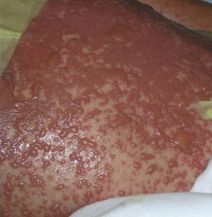
Serious or benign?
https://www.contemporarypediatrics.com/view/drug-eruptions-benignand-life-threatening

Slide 180
Toxic epidermal necrolysis (TEN)
= SJS covering 30%+ body surface
https://www.contemporarypediatrics.com/view/drug-eruptions-benignand-life-threatening

Slide 181
Lamotrigine (LAMICTAL)
Minimal side effects
Minimal risks other than Stevens-Johnson syndrome

Slide 182
Lamotrigine (LAMICTAL)
Minimal side effects
Minimal risks other than Stevens-Johnson syndrome
Great for bipolar maintenance

Slide 183
Lamotrigine (LAMICTAL)
Minimal side effects
Minimal risks other than Stevens-Johnson syndrome
Great for bipolar maintenance
Not effective for bipolar mania

Slide 184
Lamotrigine (LAMICTAL)
Minimal side effects
Minimal risks other than Stevens-Johnson syndrome
Great for bipolar maintenance
Not effective for bipolar mania
Must be titrated over 5 weeks

Slide 185
Lamotrigine (LAMICTAL)
Minimal side effects
Minimal risks other than Stevens-Johnson syndrome
Great for bipolar maintenance
Not effective for bipolar mania
Must be titrated over 5 weeks
No lab monitoring required

Slide 186
Lamotrigine (LAMICTAL)
Minimal side effects
Minimal risks other than Stevens-Johnson syndrome
Great for bipolar maintenance
Not effective for bipolar mania
Must be titrated over 5 weeks
No lab monitoring required
Serum levels usually unnecessary

Slide 187
Lamotrigine (LAMICTAL)
Minimal side effects
Minimal risks other than Stevens-Johnson syndrome
Great for bipolar maintenance
Not effective for bipolar mania
Must be titrated over 5 weeks
No lab monitoring required
Serum levels usually unnecessary
Wide therapeutic index
Wide therapeutic window

Slide 188
Lamotrigine (LAMICTAL)
Minimal side effects
Minimal risks other than Stevens-Johnson syndrome
Great for bipolar maintenance
Not effective for bipolar mania
Must be titrated over 5 weeks
No lab monitoring required
Serum levels usually unnecessary
Wide therapeutic index
Wide therapeutic window
Can be used off-label for unipolar depression
Not great evidence but many apparent success cases at SPMB.
Suitable “do no harm” option for undiagnosed or unexpressed bipolar.

Slide 189
Lamotrigine (LAMICTAL)
Minimal side effects
Minimal risks other than Stevens-Johnson syndrome
Great for bipolar maintenance
Not effective for bipolar mania
Must be titrated over 5 weeks
No lab monitoring required
Serum levels usually unnecessary
Wide therapeutic index
Wide therapeutic window
Can be used off-label for unipolar depression
Can combine with lithium for maintenance
+

Slide 190
Lamotrigine (LAMICTAL)
Although lamotrigine is one of our best medications, lithium is still the gold standard because lamotrigine does not appreciably:
Reduce suicide
Prevent psychiatric hospitalization
Prevent dementia
Prevent cancer
Extend healthy lifespan
Can combine with lithium for maintenance
+

Slide 191
Lamotrigine (LAMICTAL)
1 in 4,000 patients develop Stevens-Johnson rash on lamotrigine (standard titration).
1 in 10 develop benign allergic rash.
So, if a patient develops a rash on lamotrigine (standard titration), the likelihood that it’s SJS is 1 in 400
Nonetheless, for any rash occurring within 2 months, lamotrigine needs to be discontinued (because we don’t know if rash will evolve into SJS)
The risk of SJS is ~1 in 100 if lamotrigine is started at full strength without titration.
Retitration is necessary if patient stops taking lamotrigine for > 1 week.

Slide 192
Lamotrigine (LAMICTAL)
1 in 4,000 patients develop Stevens-Johnson rash on lamotrigine (standard titration).
1 in 10 develop benign allergic rash.
So, if a patient develops a rash on lamotrigine (standard titration), the likelihood that it’s SJS is 1 in 400
Nonetheless, for any rash occurring within 2 months, lamotrigine needs to be discontinued (because we don’t know if rash will evolve into SJS)
The risk of SJS is ~1 in 100 if lamotrigine is started at full strength without titration.
Retitration is necessary if patient stops taking lamotrigine for > 1 week.

Slide 193
Lamotrigine (LAMICTAL)
1 in 4,000 patients develop Stevens-Johnson rash on lamotrigine (standard titration).
1 in 10 develop benign allergic rash.
So, if a patient develops a rash on lamotrigine (standard titration), the likelihood that it’s SJS is 1 in 400
Nonetheless, for any rash occurring within 2 months, lamotrigine needs to be discontinued (because we don’t know if rash will evolve into SJS)
The risk of SJS is ~1 in 100 if lamotrigine is started at full strength without titration.
Retitration is necessary if patient stops taking lamotrigine for > 1 week.

Slide 194
Lamotrigine (LAMICTAL)
1 in 4,000 patients develop Stevens-Johnson rash on lamotrigine (standard titration).
1 in 10 develop benign allergic rash.
So, if a patient develops a rash on lamotrigine (standard titration), the likelihood that it’s SJS is 1 in 400
Nonetheless, for any rash occurring within 2 months, lamotrigine needs to be discontinued (because we don’t know if rash will evolve into SJS)
The risk of SJS is ~1 in 100 if lamotrigine is started at full strength without titration.
Retitration is necessary if patient stops taking lamotrigine for > 1 week.

Slide 195
Lamotrigine (LAMICTAL)
1 in 4,000 patients develop Stevens-Johnson rash on lamotrigine (standard titration).
1 in 10 develop benign allergic rash.
So, if a patient develops a rash on lamotrigine (standard titration), the likelihood that it’s SJS is 1 in 400
Nonetheless, for any rash occurring within 2-3 months, lamotrigine needs to be discontinued (because we don’t know if rash will evolve into SJS)
The risk of SJS is ~1 in 100 if lamotrigine is started at full strength
without titration.
Retitration is necessary if patient stops taking lamotrigine for > 1 week.

Slide 196
Lamotrigine (LAMICTAL)
1 in 4,000 patients develop Stevens-Johnson rash on lamotrigine (standard titration).
1 in 10 develop benign allergic rash.
So, if a patient develops a rash on lamotrigine (standard titration), the likelihood that it’s SJS is 1 in 400
Nonetheless, for any rash occurring within 2-3 months, lamotrigine needs to be discontinued (because we don’t know if rash will evolve into SJS)
The risk of SJS is ~1 in 100 if lamotrigine is started at full strength
without titration.
Retitration is necessary if patient stops taking lamotrigine for > 1 week.

Slide 197
Lamotrigine (LAMICTAL)
1 in 4,000 patients develop Stevens-Johnson rash on lamotrigine (standard titration).
1 in 10 develop benign allergic rash.
So, if a patient develops a rash on lamotrigine (standard titration), the likelihood that it’s SJS is 1 in 400
Nonetheless, for any rash occurring within 2-3 months, lamotrigine needs to be discontinued (because we don’t know if rash will evolve into SJS)
The risk of SJS is ~1 in 100 if lamotrigine is started at full strength
without titration.
Retitration is necessary if patient stops taking lamotrigine for > 1 week.

Slide 198
Lamotrigine (LAMICTAL)
1 in 4,000 patients develop Stevens-Johnson rash on lamotrigine (standard titration).
1 in 10 develop benign allergic rash.
So, if a patient develops a rash on lamotrigine (standard titration), the likelihood that it’s SJS is 1 in 400
Nonetheless, for any rash occurring within 2-3 months, lamotrigine needs to be discontinued (because we don’t know if rash will evolve into SJS)
The risk of SJS is ~1 in 100 if lamotrigine is started at full strength
without titration.
Retitration is necessary if patient stops taking lamotrigine for > 1 week.

Slide 199
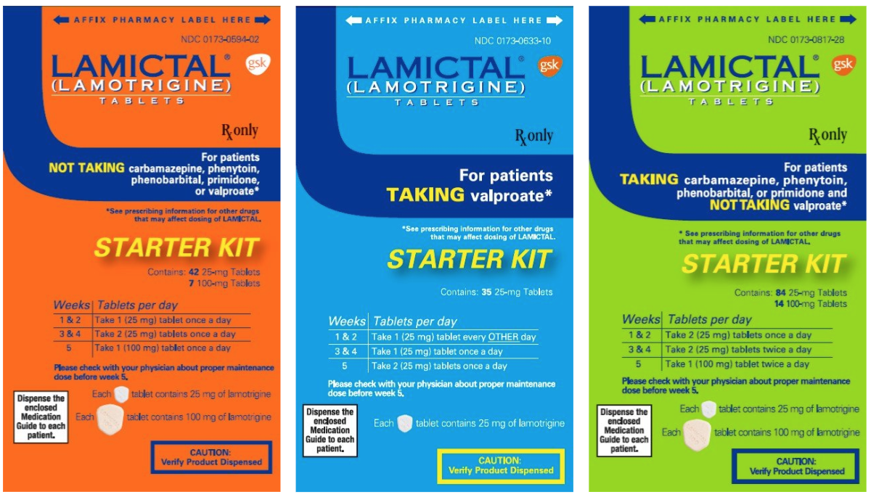

Slide 202
8 ways to harm your patients (mood stabilizers)
Not explaining that lithium and lamotrigine are “bipolar antidepressants”
Depriving bipolar patients of lithium treatment
Allowing acute lithium toxicity
Causing Stevens-Johnson syndrome by failure to adhere to lamotrigine dosing guidelines
Prescribing valproate to women of childbearing potential
Failure to consider drug interactions of carbamazepine
Causing Stevens-Johnson syndrome by failing to screen for HLA-B*1502 prior to giving carbamazepine to patients of Asian descent
Allowing lithium to cause gradual kidney damage

Slide 203
Valproate in women of childbearing potential
“Valproate is the only psychotropic contraindicated in women of childbearing potential,
although even here there can be very rare exceptions”.
British Association for Psychopharmacology, 2017

Slide 204
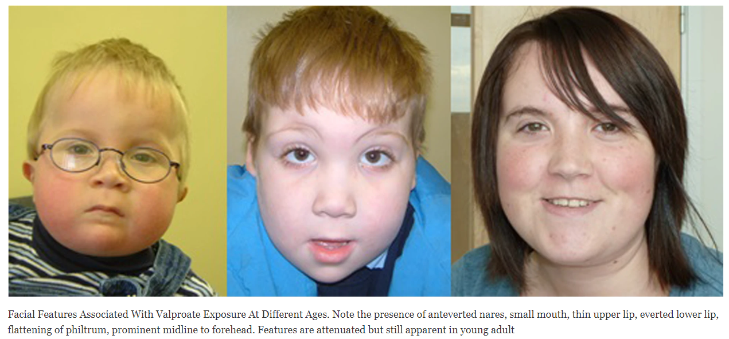
Clayton-Smith, J., Bromley, R., Dean, J. et al. Diagnosis and management of individuals with Fetal Valproate Spectrum Disorder; a consensus statement from the European Reference Network for Congenital Malformations and Intellectual Disability. Orphanet J Rare Dis 14, 180 (2019). https://doi.org/10.1186/s13023-019-1064-y

Slide 205
Clayton-Smith, J., Bromley, R., Dean, J. et al. Diagnosis and management of individuals with Fetal Valproate Spectrum Disorder; a consensus statement from the European Reference Network for Congenital Malformations and Intellectual Disability. Orphanet J Rare Dis 14, 180 (2019). https://doi.org/10.1186/s13023-019-1064-y

Slide 206
Valproate in women of childbearing potential
1st trimester VPA exposure:
Fetal valproate syndrome
3-fold of any major malformation
13-fold for spina bifida (not mitigated by folate)

Slide 207
Valproate in women of childbearing potential
Starting in 2023, the UK banned VPA in women under age 55 unless two independent consultants certified there were no other options.
?

Slide 208
Valproate in women of childbearing potential
Starting in 2023, the UK banned VPA in women under age 55 unless two independent consultants certified there were no other options.

Slide 209
Valproate in women of childbearing potential
“It is mandatory to stop VPA during pregnancy. The duration of the discontinuation/switch process depends on different clinical variables. Lithium, lamotrigine, quetiapine, olanzapine, or aripiprazole are good switch options in unplanned pregnancy”
European Medicines Agency, 2018

Slide 211
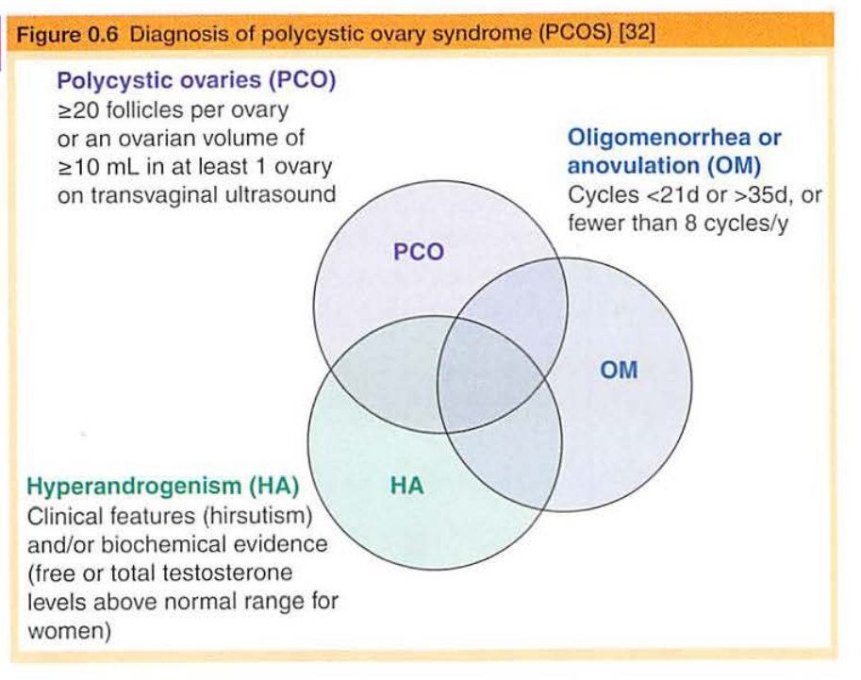
Valproate in women of childbearing potential
VPA is associated with 7-fold increase in polycystic ovary syndrome (PCOS)

Slide 212
8 ways to harm your patients (mood stabilizers)
Not explaining that lithium and lamotrigine are “bipolar antidepressants”
Depriving bipolar patients of lithium treatment
Allowing acute lithium toxicity
Causing Stevens-Johnson syndrome by failure to adhere to lamotrigine dosing guidelines
Prescribing valproate to women of childbearing potential
Failure to consider drug interactions of carbamazepine
Causing Stevens-Johnson syndrome by failing to screen for HLA-B*1502 prior to giving carbamazepine to patients of Asian descent
Allowing lithium to cause gradual kidney damage

Slide 213
Carbamazepine (TEGRETOL)
“Tiger tail (in the) Car Maze”
Notes:
This mnemonic accomplishes everything I’m going for - pairs trade name with the generic-- TIGER TAIL

Slide 214
Carbamazepine (TEGRETOL)
“Tiger tail (in the) Car Maze”

Slide 215
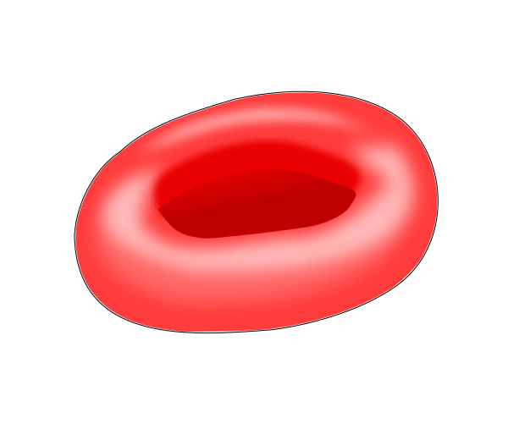
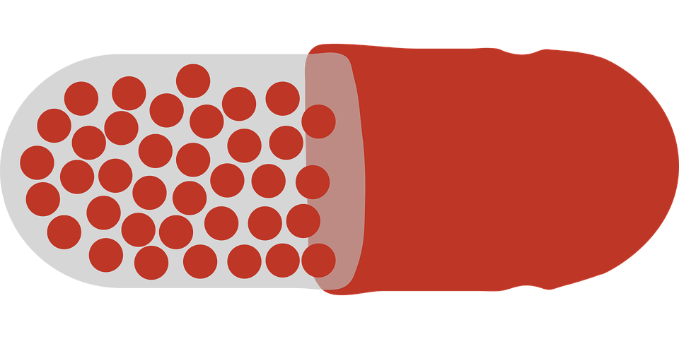
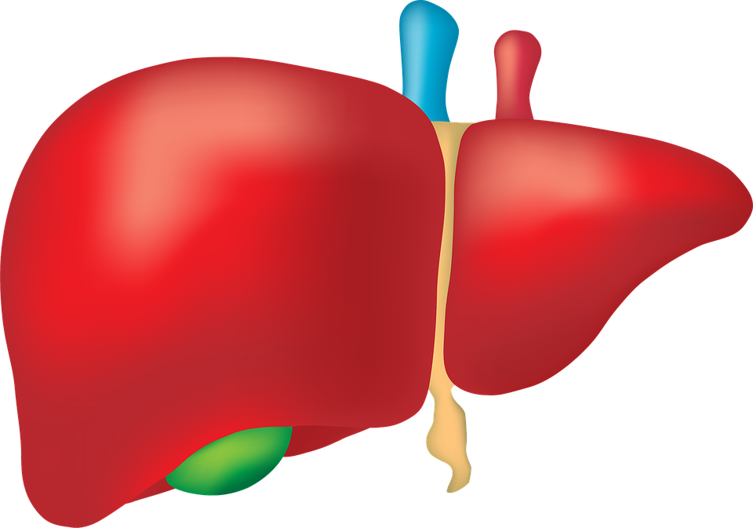
Risks of CBZ:
hyponatremia
Carbamazepine
(TEGRETOL)
“Tiger tail (in the)
Car Maze”
terato-
genicity
aplastic anemia
(rare)
Na⁺ Na⁺
decreased bone mineral density
agranulo-
cytosis (rare)
reduced levels of many medications
hepatotoxicity
Notes:
potential health risks.

Slide 216
Risks of CBZ:
hyponatremia
Carbamazepine
(TEGRETOL)
“Tiger tail (in the)
Car Maze”
terato-
genicity
aplastic anemia
(rare)
Na⁺ Na⁺
decreased bone mineral density
agranulo-
cytosis (rare)
reduced levels of many medications
neural tube defects
hepatotoxicity
Notes:
most typically neural tube defects, pretty much contraindicated in women of childbearing age

Slide 217
Risks of CBZ:
hyponatremia
Carbamazepine
(TEGRETOL)
“Tiger tail (in the)
Car Maze”
terato-
genicity
aplastic anemia
(rare)
Na⁺ Na⁺
decreased bone mineral density
agranulo-
cytosis (rare)
reduced levels of many medications
hepatotoxicity

Slide 218
Risks of CBZ:
hyponatremia
Carbamazepine
(TEGRETOL)
“Tiger tail (in the)
Car Maze”
terato-
genicity
aplastic anemia
(rare)
Na⁺ Na⁺
decreased bone mineral density
agranulo-
cytosis (rare)
reduced levels of many medications
hepatotoxicity

Slide 219
Risks of CBZ:
hyponatremia
Carbamazepine
(TEGRETOL)
“Tiger tail (in the)
Car Maze”
terato-
genicity
aplastic anemia
(rare)
Na⁺ Na⁺
decreased bone mineral density
agranulo-
cytosis (rare)
reduced levels of many medications
hepatotoxicity

Slide 220
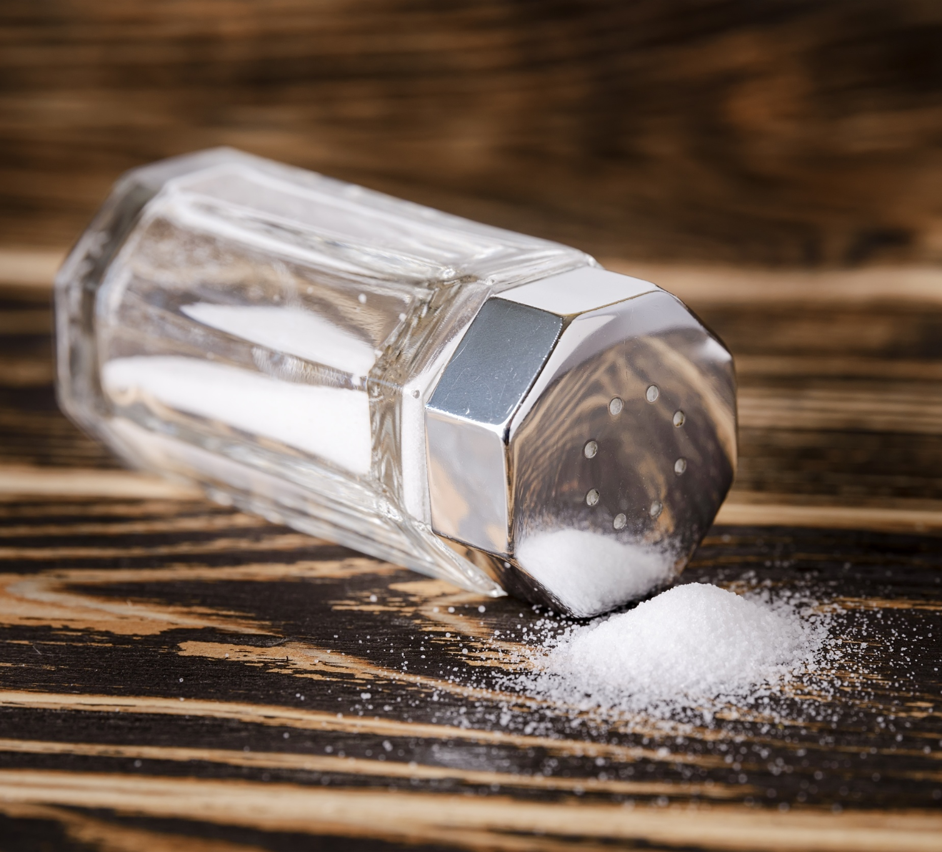
Risks of CBZ:
hyponatremia
Carbamazepine
(TEGRETOL)
“Tiger tail (in the)
Car Maze”
terato-
genicity
aplastic anemia
(rare)
Na⁺ Na⁺
decreased bone mineral density
agranulo-
cytosis (rare)
reduced levels of many medications
hepatotoxicity

Slide 221
Risks of CBZ:
hyponatremia
Carbamazepine
(TEGRETOL)
“Tiger tail (in the)
Car Maze”
terato-
genicity
aplastic anemia
(rare)
Na⁺ Na⁺
decreased bone mineral density
agranulo-
cytosis (rare)
reduced levels of many medications
hepatotoxicity

Slide 222
Risks of CBZ:
hyponatremia
Carbamazepine
(TEGRETOL)
“Tiger tail (in the)
Car Maze”
terato-
genicity
aplastic anemia
(rare)
Na⁺ Na⁺
decreased bone mineral density
agranulo-
cytosis (rare)
reduced levels of many medications
hepatotoxicity
Notes:
Shredder inducer

Slide 223
The 2 Actions
inHibitor
inDucer
Notes:
The 2 actions are
inHibition and inDuction
(up and down)

Slide 224
Carbamazepine (Tegretol)
Notes:
Most important thing

Slide 225
Carbamazepine (Tegretol)
“shredder” inDucer of UGT, CYP, and P-gp enzymes

Slide 226
#
#
Carbamazepine (TEGRETOL)
+
Lurasidone (LATUDA)

Slide 227
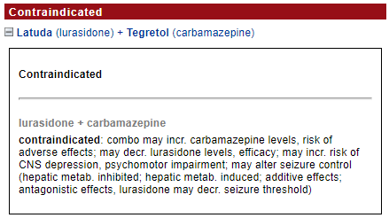
#
Carbamazepine (TEGRETOL)
3A4 inDucer
Lurasidone (LATUDA)
3A4 substrate
6-fold decrease

Slide 228
Carbamazepine (TEGRETOL)
3A4 inDucer
Lurasidone (LATUDA)
3A4 substrate
6-fold decrease
Notes:
a 6-fold decrease. The main difference is the label saying that Tegretol and Latuda are...

Slide 229
Carbamazepine (TEGRETOL)
3A4 inDucer
Lurasidone (LATUDA)
3A4 substrate
6-fold decrease
Notes:
Contraindicated in combination. I’ve seen this combo in the wild however, with the psychiatrist not knowing about this interaction and the pharmacist not catching the contraindication.

Slide 230
#
#
Carbamazepine (TEGRETOL)
+
Lumateperone (CAPLYTA)

Slide 231
#
#
Lumateperone (CAPLYTA)
“’Luminated Cap lighter”
Notes:
\

Slide 232
#
#
Lumateperone (CAPLYTA)
“’Luminated Cap lighter”

Slide 233
#
#
Lumateperone (CAPLYTA)
“’Luminated Cap lighter”

Slide 234
#
#
Lumateperone (CAPLYTA)
“’Luminated Cap lighter”
3A4 substrate

Slide 235
#
#
Lumateperone (CAPLYTA)
“’Luminated Cap lighter”
3A4 substrate
UGT substrate

Slide 236
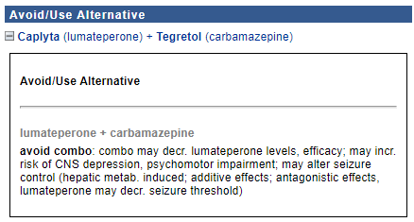
Carbamazepine (TEGRETOL)
3A4 inDucer
UGT inDucer
20-fold decrease
UGT substrate
3A4 substrate
Lumateperone (CAPLYTA)

Slide 237
#
#
Carbamazepine (TEGRETOL)
+
Methadone (DOLOPHINE)

Slide 238
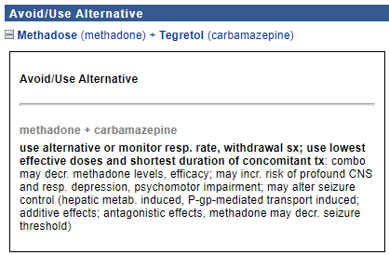
#
Carbamazepine (TEGRETOL)
3A4 inDucer
Methadone
3A4 substrate

Slide 239
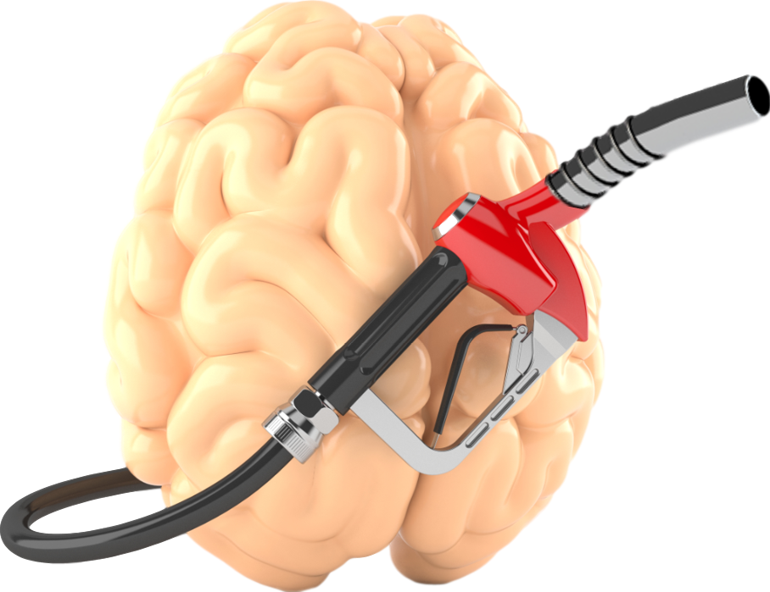
#
#
Carbamazepine (TEGRETOL)
3A4 inDucer
Methadone
3A4 substrate
P-gp
“Pumers gonna pump”
Average 60% decrease at 10 days.

Slide 240
#
#
Carbamazepine (TEGRETOL)
3A4 inDucer
Methadone
3A4 substrate
Average 60% decrease at 10 days.

Slide 241
#
While ePrescribe systems may warn the doctor when starting an interacting medication, there will be no warning when stopping a medication will result in reversal of induction / inhibition.

Slide 242
#
#
Carbamazepine (TEGRETOL)
+
Quetiapine (SEROQUEL)

Slide 243
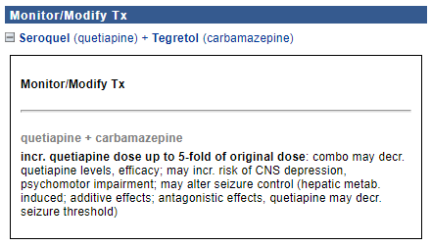
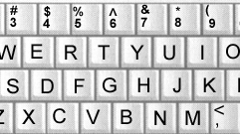
#
Carbamazepine (TEGRETOL)
3A4 inDucer
Quetiapine (SEROQUEL)
3A4 substrate

Slide 244
#
Carbamazepine (TEGRETOL)
3A4 inDucer
“Quit
typing!”
Quetiapine (SEROQUEL)
3A4 substrate

Slide 245
#
Carbamazepine (TEGRETOL)
3A4 inDucer
“Quit
typing!”
Quetiapine (SEROQUEL)
3A4 substrate
5-fold decrease

Slide 246
#
Carbamazepine (TEGRETOL)
3A4 inDucer
Quetiapine (SEROQUEL)
3A4 substrate
5-fold decrease

Slide 247
#
Carbamazepine (TEGRETOL)
3A4 inDucer
“Quit
typing!”
Quetiapine (SEROQUEL)
3A4 substrate
Know that inDuction is delayed. If quetiapine and carbamazepine are started at the same time, do not start with a high quetiapine dose because the interaction is not applicable for 2-4 weeks.
Beware of REVERSAL of inDuction. If the patient is taking a 5x dose of quetiapine and runs out of carbamazepine, serum quetiapine concentration with escalate.
5-fold decrease

Slide 248
Carbamazepine (Tegretol)
Break for questions / comments
While you select Asia on distributed blank map
“shredder” inDucer of UGT, CYP, and P-gp enzymes

Slide 249
8 ways to harm your patients (mood stabilizers)
Not explaining that lithium and lamotrigine are “bipolar antidepressants”
Depriving bipolar patients of lithium treatment
Allowing acute lithium toxicity
Causing Stevens-Johnson syndrome by failure to adhere to lamotrigine dosing guidelines
Prescribing valproate to women of childbearing potential
Failure to consider drug interactions of carbamazepine
Causing Stevens-Johnson syndrome by failing to screen for HLA-B*1502 prior to giving carbamazepine to patients of Asian descent
Allowing lithium to cause gradual kidney damage

Slide 251
Please select Asia.
“shredder” inDucer of UGT, CYP, and P-gp enzymes
HLA-B*1502 is found almost exclusively in patients with ancestry across broad areas of Asia. Patients with ancestry in genetically at-risk populations should be screened for the presence of HLA-B*1502 prior to initiating treatment with carbamazepine (Tegretol). If positive, don't, because high risk of SJS.

Slide 252
“shredder” inDucer of UGT, CYP, and P-gp enzymes

Slide 253
Russia
Papua
New Guinea
“shredder” inDucer of UGT, CYP, and P-gp enzymes
Western
New Guinea

Slide 254
Asian patients have a 10-fold higher incidence of carbamazepine-induced:
Tiger from Chinese New Year parade
Notes:
Know that Asian patients are at much higher risk of developing

Slide 255
Asian patients have a 10-fold higher incidence of carbamazepine-induced:
Stevens-Johnson syndrome (SJS)
Notes:
Stevens-Johnson syndrome

Slide 256
Asian patients have a 10-fold higher incidence of carbamazepine-induced:
Stevens-Johnson syndrome (SJS)
Toxic epidermal necrolysis (TEN)
Notes:
and toxic epidermal necrolysis (TEN) on Tegretol.

Slide 257
Asian patients have a 10-fold higher incidence of carbamazepine-induced SJS and TEN
FDA recommends screening Asians for the HLA-B*1502 allele, which would be a contraindication for starting CBZ.
Notes:
So before giving Tegretol to a patient of Asian descent, you’re gotta do a genetic screen

Slide 258
Asian patients have a 10-fold higher incidence of carbamazepine-induced SJS and TEN
FDA recommends screening Asians for the HLA-B*1502 allele, which would be a contraindication for starting CBZ.
“Hey Look, Asian Blood!
if 1502, no Tegretol for you!”
Notes:
My mnemonic for this is - Hey

Slide 259
Asian patients have a 10-fold higher incidence of carbamazepine-induced SJS and TEN
FDA recommends screening Asians for the HLA-B*1502 allele, which would be a contraindication for starting CBZ.
“Hey Look, Asian Blood!
if 1502, no Tegretol for you!”
Notes:
Look

Slide 260
Asian patients have a 10-fold higher incidence of carbamazepine-induced SJS and TEN
FDA recommends screening Asians for the HLA-B*1502 allele, which would be a contraindication for starting CBZ.
“Hey Look, Asian Blood!
if 1502, no Tegretol for you!”
Notes:
Asian

Slide 261
Asian patients have a 10-fold higher incidence of carbamazepine-induced SJS and TEN
FDA recommends screening Asians for the HLA-B*1502 allele, which would be a contraindication for starting CBZ.
“Hey Look, Asian Blood!
if 1502, no Tegretol for you!”
Notes:
Blood

Slide 262
Asian patients have a 10-fold higher incidence of carbamazepine-induced SJS and TEN
FDA recommends screening Asians for the HLA-B*1502 allele, which would be a contraindication for starting CBZ.
“Hey Look, Asian Blood!
if 1502, no Tegretol for you!”
Notes:
If 1502

Slide 263
Asian patients have a 10-fold higher incidence of carbamazepine-induced SJS and TEN
FDA recommends screening Asians for the HLA-B*1502 allele, which would be a contraindication for starting CBZ.
“Hey Look, Asian Blood!
if 1502, no Tegretol for you!”

Slide 264
8 ways to harm your patients (mood stabilizers)
Not explaining that lithium and lamotrigine are “bipolar antidepressants”
Depriving bipolar patients of lithium treatment
Allowing acute lithium toxicity
Causing Stevens-Johnson syndrome by failure to adhere to lamotrigine dosing guidelines
Prescribing valproate to women of childbearing potential
Failure to consider drug interactions of carbamazepine
Causing Stevens-Johnson syndrome by failing to screen for HLA-B*1502 prior to giving carbamazepine to patients of Asian descent
Allowing lithium to cause gradual kidney damage

Slide 265
Lithium – preventing renal damage
Myth: “Lithium ruins kidney function” (Malhi et al, 2021).
The independent effect of chronic lithium use on renal function is smaller than previously presumed (Clos et al, 2015).
It has become increasingly clear that long-term lithium treatment, overseen with modern dosing and monitoring principals, should not result in severe renal insufficiency.

Slide 266
Lithium – preventing renal damage
The risk of end-stage renal disease (ESRD) attributable to lithium has been essentially eliminated in many countries.
In Sweden, among 25,300 treatment-years of lithium exposure, there were no cases of ESRD attributable to lithium started later than 1980, the year stricter lithium monitoring guidelines were implemented (Aiff et al, 2014).

Slide 267
Lithium – preventing renal damage
Prior practices that increased risk of renal insufficiency are no longer recommended.
Historically lithium was administered in multiple daily dosing, which had more of a renal impact.
Many cases of CKD ascribed solely to lithium exposure are likely related to other risk factors that disproportionately affect bipolar patients, such as hypertension, diabetes and smoking.

Slide 268
Lithium – preventing renal damage
Duration of exposure to lithium by itself is not a significant predictor of eGFR decline (Clos et al, 2015).
Nonetheless, lithium can be associated with short-term and long-term renal adverse effects if not monitored properly.

Slide 269
Lithium – preventing renal damage
“Any patient with an evidence-based indication and eGFR >60 is a lithium candidate, including those with BD-2 or unipolar MDD”.
“For patients with a compelling indication for lithium, a baseline eGFR >45 can be considered, albeit with vigilant eGFR monitoring”.

Slide 270
Lithium – preventing renal damage
Educate the patient
Anticipate interactions
Ideally, GFR > 60 to start (> 45 if compelling reason to start)

Slide 271
Which is better to preserve kidneys?

Slide 272
Which is better to preserve kidneys?
Blue is better than green

Slide 273
Lithium – preventing renal damage
Once daily dosing of lithium reduces the risk of renal insufficiency by 20% compared to divided dosing (Castro et al, 2016).
There are no advantages to multiple daily dosing in terms of efficacy or side effects (Carter & Zolezzi et al, 2013).
The single dose should be at HS so that 12 h trough levels can be drawn in the morning.

Slide 274
Lithium – preventing renal damage
HS dosing gives the kidneys a break during the day. Another factor...
With divided doses, prescribers may underestimate total lithium exposure because the 12h trough is distorted.
To achieve the same (morning) 12h trough lithium levels, a patient taking lithium divided BID will require 28% higher total dose compared to the patient taking the entire dose at night.

Slide 275
Lithium – preventing renal damage
Educate the patient
Anticipate interactions
Ideally, GFR > 60 to start (> 45 if compelling reason to start)
Once daily dosing at HS

Slide 276
Lithium – preventing renal damage
Outpatient lithium levels should never exceed 1.2 at 12h trough (Meyer & Stahl, 2023).
The consensus that standard bipolar 1 maintenance lithium level should be 0.6–0.8 with the option to reduce it to 0.4–0.6 or increase it to 0.8–1.0 depending on response and tolerability (Nolen & Licht et al, 2019).
For BD-2 or unipolar MDD, the target range is about 0.4–0.6 mEq/L.

Slide 277
Lithium – preventing renal damage
Educate the patient
Anticipate interactions
Ideally, GFR > 60 to start (> 45 if compelling reason to start)
Once daily dosing at HS
12-hour trough levels (+/- 2 hr)
Don’t target above 1.0 (outpatient)
Don’t allow above 1.2 (12-hr trough)

Slide 278
Lithium – preventing renal damage
Individuals over 50 can have higher brain-to-serum lithium levels, so target serum levels should be reduced by about 0.2 mEq/L.

Slide 279
Lithium – preventing renal damage
Educate the patient
Anticipate interactions
Ideally, GFR > 60 to start (> 45 if compelling reason to start)
Once daily dosing at HS
12-hour trough levels (+/- 2 hr)
Don’t target above 1.0 (outpatient)
Don’t allow above 1.2 (12-hr trough)
Aim ~ 0.2 lower if >50 years old

Slide 280
Lithium – preventing renal damage
Monitor urine albumin-creatinine ratio (ACR) to detect proteinuria.
Lithium is not a major contributor to glomerular pathology, but we should monitor for glomerular damage from other causes.
The primary reason for obtaining an ACR relates to the medical comorbidity seen in serious mental illness.

Slide 281
Lithium – preventing renal damage
Educate the patient
Anticipate interactions
Ideally, GFR > 60 to start (> 45 if compelling reason to start)
Once daily dosing at HS
12-hour trough levels (+/- 2 hr)
Don’t target above 1.0 (outpatient)
Don’t allow above 1.2 (12-hr trough)
Aim ~ 0.2 lower if >50 years old
Urine albumin-creatinine ratio (ACR) to detect glomerulopathy (not related to lithium itself)

Slide 282
Lithium – preventing renal damage
Polyuria is defined as 24h urinary output > 3 liters.
20%–30% of patients on lithium will eventually develop symptomatic polyuria (Pradhan et al, 2011).
The etiology of polyuria is arginine vasopressin resistance (AVP-R), previously called nephrogenic diabetes insipidus.

Slide 283
Lithium – preventing renal damage
Polyuria should not lead to lithium discontinuation because there are well-defined monitoring tools and established treatment (Schoot et al, 2020).
$1M / ride
amiloride

Slide 284
Lithium – preventing renal damage
Early morning urine osmolality (EMUO) is
EMUO <850 means the kidneys are not adequately concentrating urine, and this is a call to clinical action.
That’s when you add amiloride.
$1M / ride
amiloride

Slide 285
Lithium – preventing renal damage
Educate the patient
Anticipate interactions
Ideally, GFR > 60 to start (> 45 if compelling reason to start)
Once daily dosing at HS
12-hour trough levels (+/- 2 hr)
Don’t target above 1.0 (outpatient)
Don’t allow above 1.2 (12-hr trough)
Aim ~ 0.2 lower if >50 years old
Urine albumin-creatinine ratio (ACR) to detect glomerulopathy (not related to lithium itself)
Early morning osmolality (EMUO)
Add amiloride if EMUO <850

Slide 286
Lithium – preventing renal damage
The potassium-sparing diuretic Amiloride (Midamor) is an effective treatment for lithium related polyuria.
Amiloride should be started (by the psychiatrist) as soon as problems with polyuria are detected.
$1M / ride
amiloride

Slide 287
Lithium – preventing renal damage
Polyuria is the earliest clinical manifestation of intracellular accumulation of lithium in collecting duct principal cells and of the ensuing process that combine with CKD risk factors to accelerate age-related eGFR decline.
Amiloride, although primarily used to ameliorate polyuria, it may prevent lithium-induced interstitial fibrosis (Kalita-De Croft, 2018).
$1M / ride
amiloride

Slide 288
Lithium – preventing renal damage
Acetazolamide (DIAMOX)
“A set of ol’ migh(ty) Dimes”
If amiloride is ineffective for polyuria, the psychiatrist should add acetazolamide (Diamox).
“Dime-ox”

Slide 289
Lithium – preventing renal damage
Baseline: CMP including eGFR, CBC, TSH, A1c, lipids, pregnancy test
Lithium level and eGFR at ~1 wk, 6 wk, 12 wk, 6 mo, then q 6 mo (or more frequently if risk factors)
24h fluid intake recollection (FIR)
Ask the patient to record their fluid intake /24h for two days and average the result. FIR below 2 liters /24h is associated with very low likelihood of polyuria. FIR > 3.5 liters very high likelihood, as the standard definition of polyuria is 24h urine volume >3 liters.
Early morning urine osmolality (EMUO)
Urine albumin-creatinine ratio (ACR)

Slide 290
Lithium – preventing renal damage
Educate the patient
Anticipate interactions
Ideally, GFR > 60 to start (> 45 if compelling reason to start)
Once daily dosing at HS
12-hour trough levels (+/- 2 hr)
Don’t target above 1.0 (outpatient)
Don’t allow above 1.2 (12-hr trough)
Aim ~ 0.2 lower if >50 years old
Urine albumin-creatinine ratio (ACR) to detect glomerulopathy (not related to lithium itself)
Early morning osmolality (EMUO)
Add amiloride if EMUO <850
Lithium level and eGFR at ~1 wk, 6 wk, 12 wk, 6 mo, then q 6 mo

Slide 291
Lithium – preventing renal damage
When to consult a nephrologist
Decline in eGFR >4 over 12 months as verified by a repeat specimen
eGFR <45 as verified by a repeat specimen
Albumin/creatinine >300 (stage A3)
Early morning urine osmolality (EMUO) <300 unresponsive to maximal doses of amiloride (10 mg BID) plus adjunctive use of acetazolamide (up to 500 mg BID) for 6 weeks
Hematuria

Slide 292
Lithium – preventing renal damage
Educate the patient
Anticipate interactions
Ideally, GFR > 60 to start (> 45 if compelling reason to start)
Once daily dosing at HS
12-hour trough levels (+/- 2 hr)
Don’t target above 1.0 (outpatient)
Don’t allow above 1.2 (12-hr trough)
Aim ~ 0.2 lower if >50 years old
Urine albumin-creatinine ratio (ACR) to detect glomerulopathy (not related to lithium itself)
Early morning osmolality (EMUO)
Add amiloride if EMUO <850
Lithium level and eGFR at ~1 wk, 6 wk, 12 wk, 6 mo, then q 6 mo
Consult nephrology if eGFR <45 or decrease >4 in 12 mo or polydipsia can not be corrected with amiloride plus acetazolamide

