Slide 2
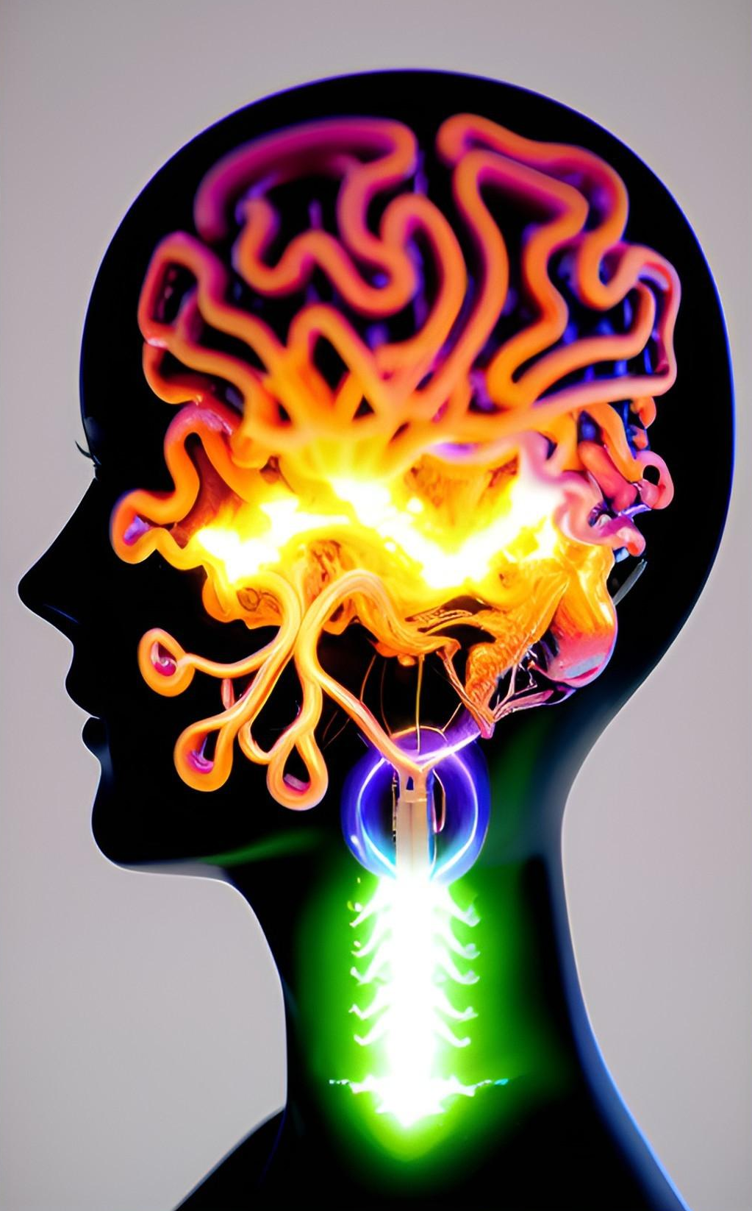
cortico-striato-thalamo-cortical loops

Slide 3
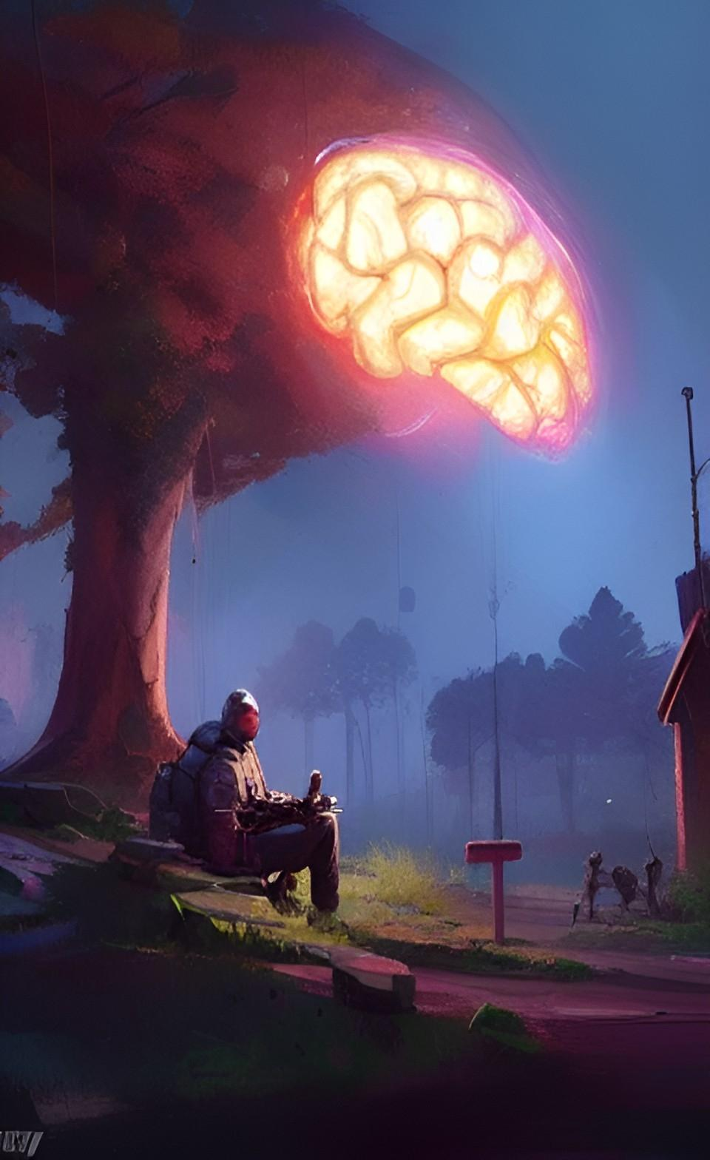
Prefrontal Cortex (PFC)
“Prefrontal cortex”

Slide 4
Prefrontal Cortex (PFC)
“Prefrontal cortex”

Slide 5
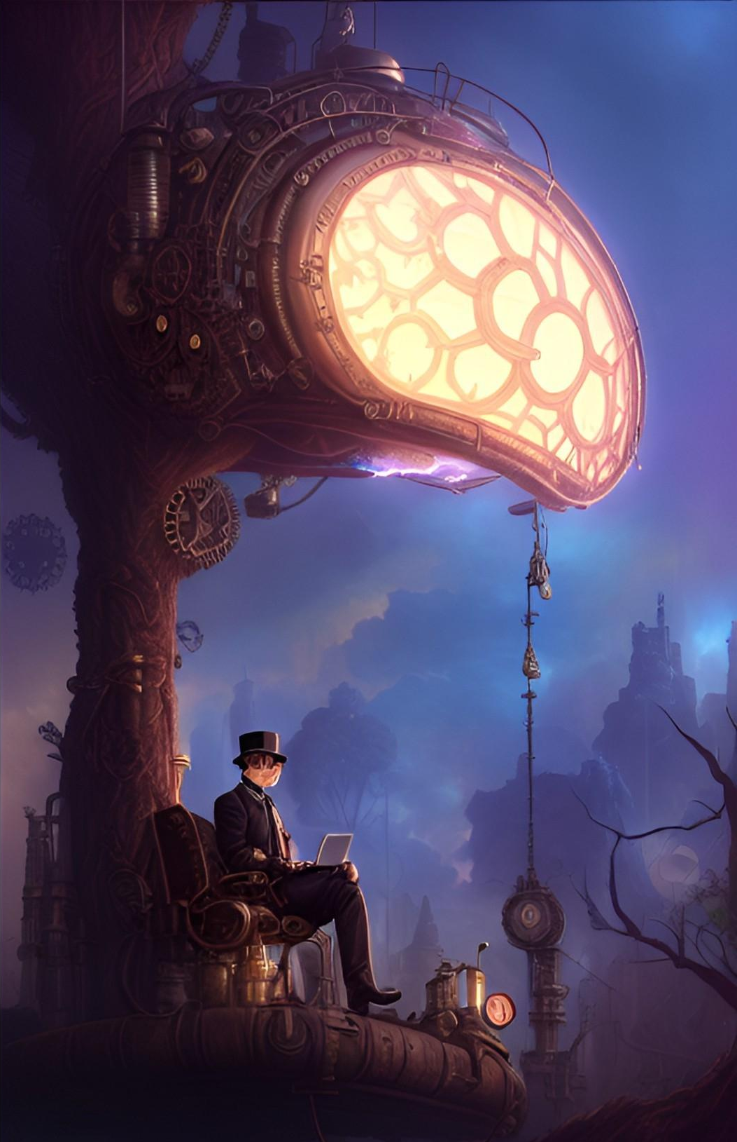
Prefrontal Cortex (PFC)
“Prefrontal cortex”

Slide 7
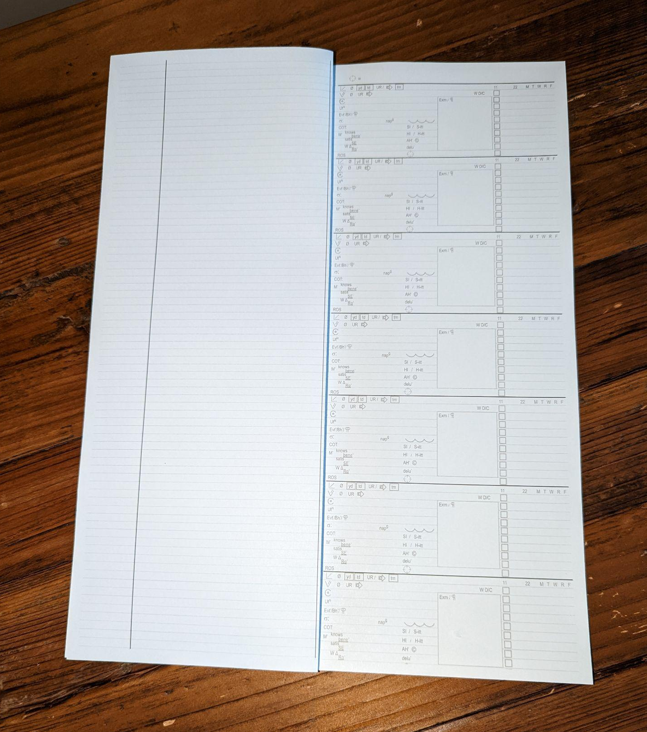

Slide 8
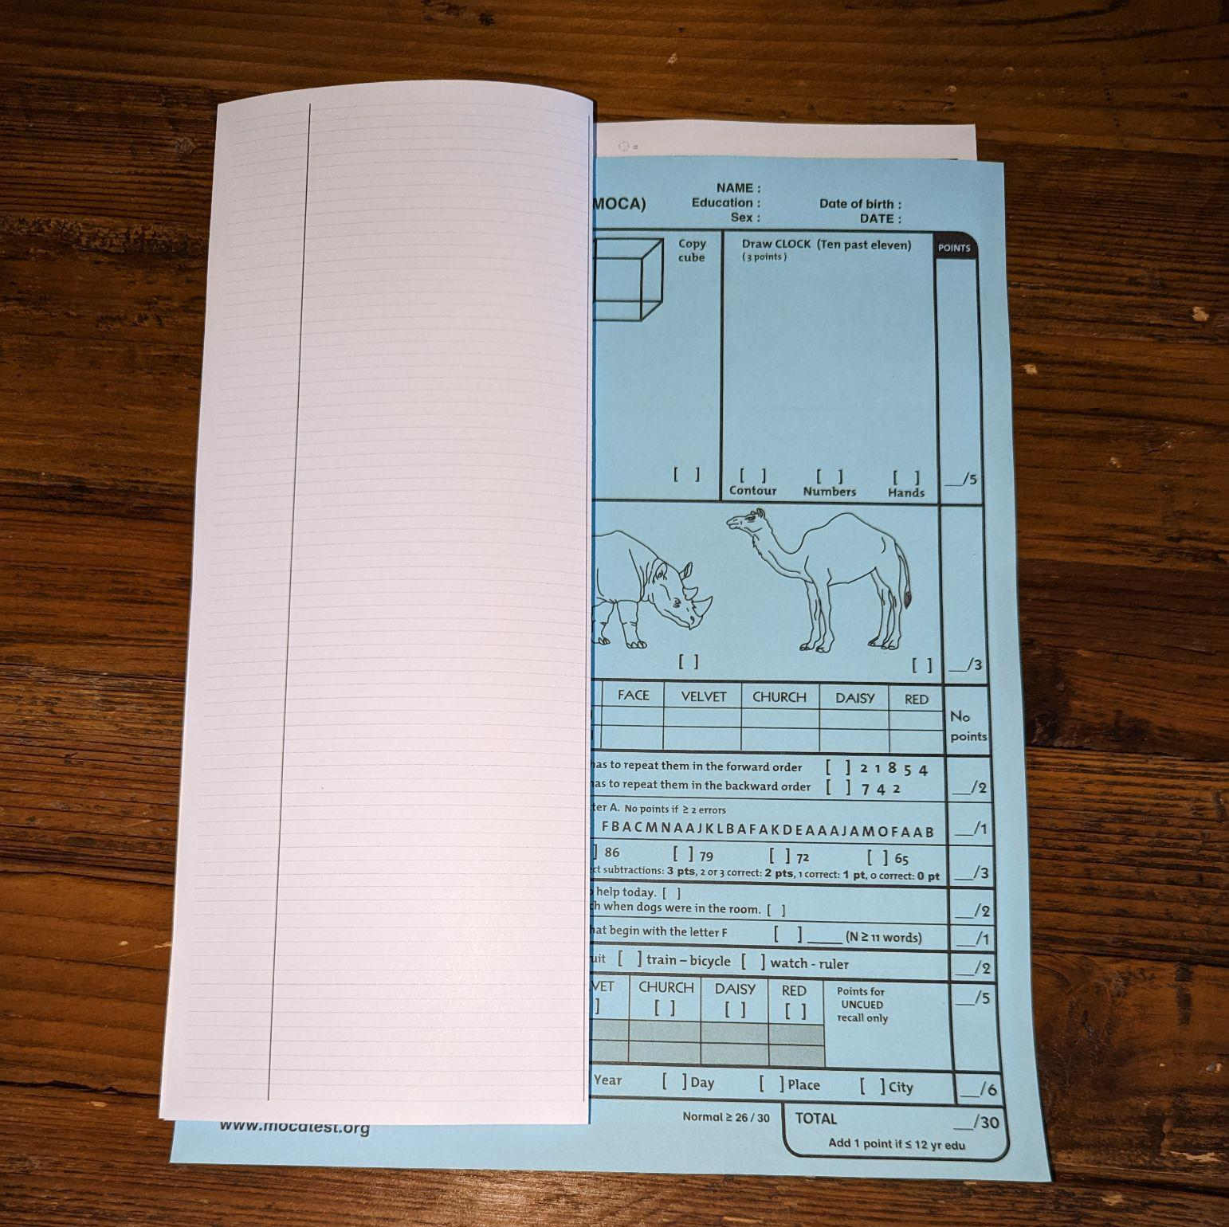

Slide 11
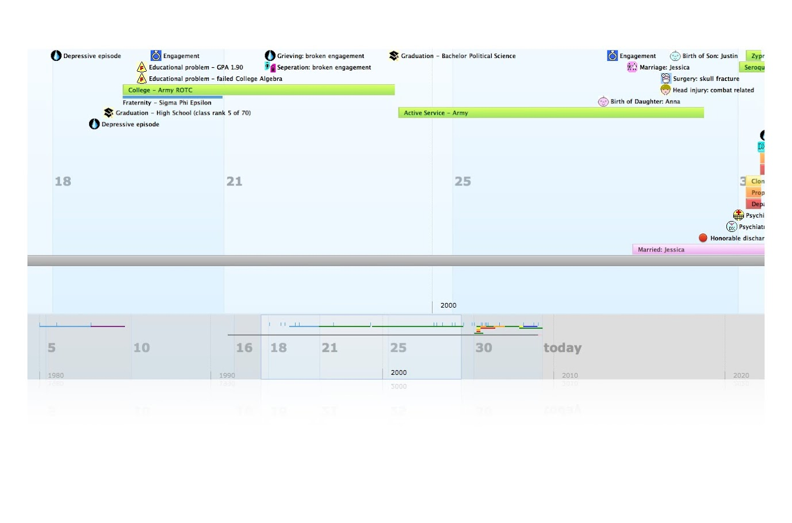

Slide 12
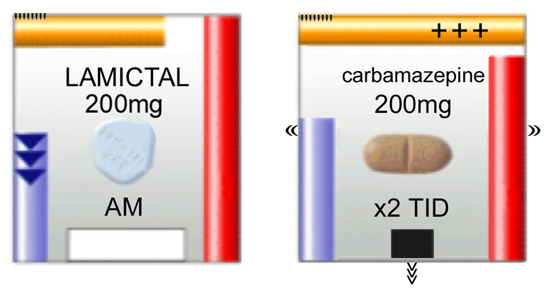
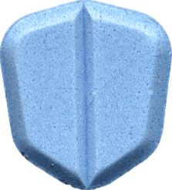
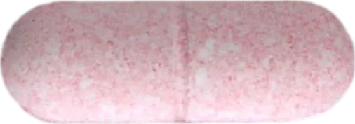

Slide 13
Medication Mascots
#
#
#
Buspirone (Buspar)
“Bus spear”
5 - H T 1 A
ANXIETY
Notes:
The objects are medications, presented as mascots.

Slide 14
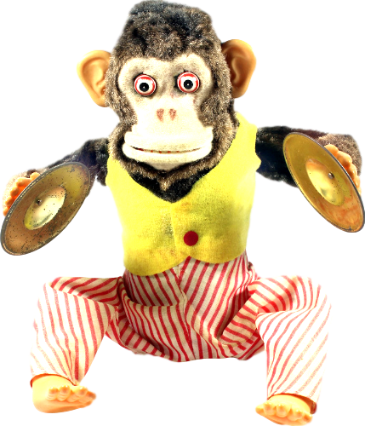
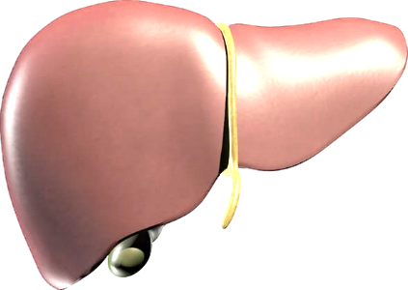
Medication Mascots
#
#
#
Duloxetine (Cymbalta)
“Dueling Cymbals”
Notes:
Each has a mnemonic phrase, including…

Slide 15
Medication Mascots
#
#
#
Lumateperone (Caplyta)
“’Luminated Cap lighter”
Notes:
The generic and trade name. Remember “Cap Lighter”, you’ll see it again.

Slide 16
Medication Mascots
#
#
#
Quetiapine (Seroquel)
“Quit typing Sera!”
manic
episode
Notes:
Sera can’t “Quit Typing” because she is manic, and quetiapine can help

Slide 17
Medication Mascots
Fluvoxamine (Luvox)
“gLove-ox”
Notes:
Remember this one. The “gLove-ox” will appear later…

Slide 18
Medication Mascots
Carbamazepine (Tegretol)
“Tiger tail”
Notes:
And we’ll see the tiger agin

Slide 19
inHibitor
inDucer
Notes:
2 actions, up and down.

Slide 20
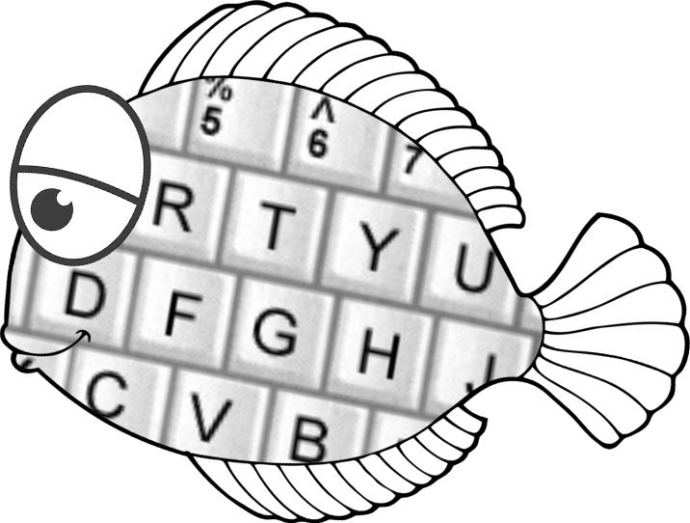
Carbamazepine & quetiapine?
encode
+
decode
Carbamazepine (CYP3A4 inducer) decreases blood levels of quetiapine (CYP3A4 substrate).
Notes:
Encode and decode medication pairings.

Slide 21
Enzyme inHibition
Enzyme inHibition causes increased levels of “victim” drug (substrate).
H for High and Hurried
(immediate effect)
substrate
inHibitor
Notes:
I emphasize the H in inHibition for HIGH and HURRIED, an immediate effect

Slide 22
Enzyme inDuction
Enzyme inDuction causes decreased levels of “victim” drug (substrate).
D for Down and Delayed
(2–4 weeks)
inDucer
substrate
Notes:
inDuction is “Down and Delayed”, causing a gradual decrease of the victim drug due to increased enzyme production.

Slide 23
Interaction mnemonics
Cytochrome P450 1A2 (CYP1A2)
“One Axe to Grind”
inDuction
Down and Delayed
1A2
Substrate
1A2 inducer
Notes:
Axes chop down trees

Slide 24
Interaction mnemonics
Cytochrome P450 1A2 (CYP1A2)
“One Axe to Grind”
inDuction
Down and Delayed
Carbamazepine
(Tegretol)
“Tiger tail”
1A2
Substrate
Notes:
Carbamazepine, remember “Tiger Tail”? Tegretol is an Axe

Slide 25
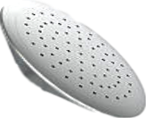
Interaction mnemonics
CYP2C19
“To See Nice Things (grow)”
inHibition
High and
Hurried
2C19 inhibitor
2C19
substrate
Notes:
Cans water flowers. High and Hurried.

Slide 26
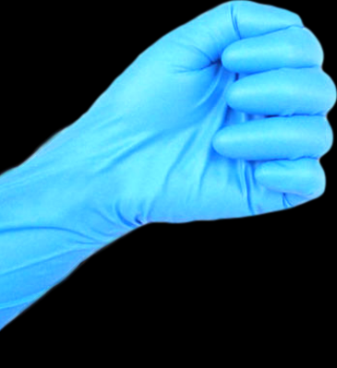
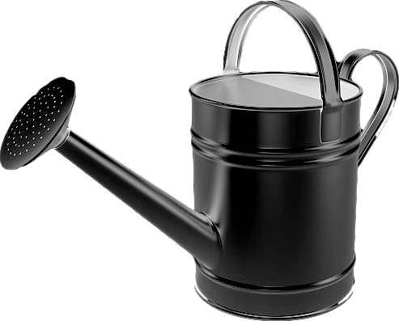
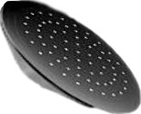
Interaction mnemonics
CYP2C19
“To See Nice Things (grow)”
inHibition
High and
Hurried
Fluvoxamine
(Luvox)
“gLove-ox”
2C19 inhibitor
2C19
substrate
Notes:
“Glove-ox” is a watering can

Slide 27
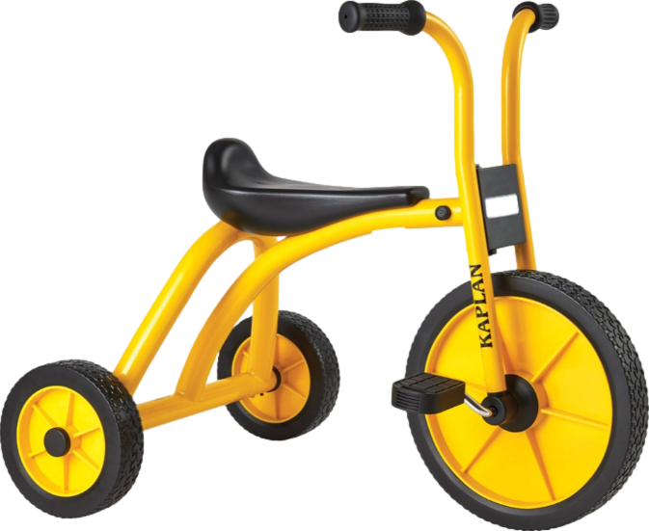
Interaction mnemonics
CYP2C19
“To See Nice Things (grow)”
inHibition
High and
Hurried
Tricyclic
antidepressants
(TCAs)
Fluvoxamine
(Luvox)
“gLove-ox”
2C19 inhibitor
2C19
substrate
Notes:
Which increases tricyclic antidepressants, potentially dangerous.

Slide 28
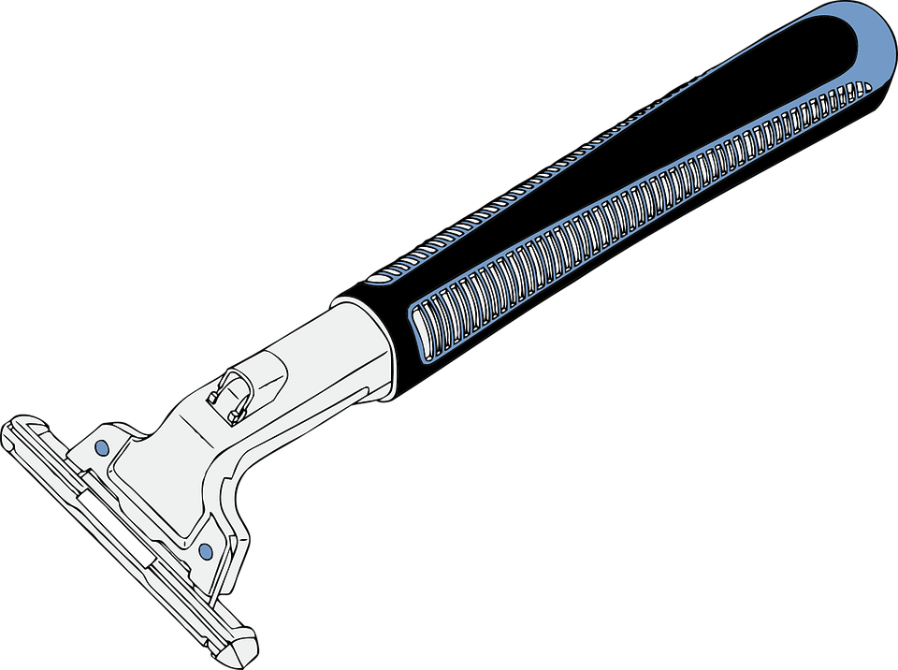
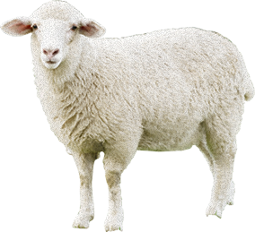
Interaction mnemonics
UGT enzymes
“U Got Tagged”
inDuction
Down and Delayed
UGT
inDucer
Lamotrigine (Lamictal)
“Lamb-ictal”
Notes:
Such as “LAMB”-ictal, or lamotrigine

Slide 29
Interaction mnemonics
UGT enzymes
“U Got Tagged”
inDuction
Down and Delayed
Carbamazepine
(Tegretol)
“Tiger tail”
50% decrease
Lamotrigine (Lamictal)
“Lamb-ictal”
Notes:
“Tiger Tail” carbamazepine is a razor

Slide 30
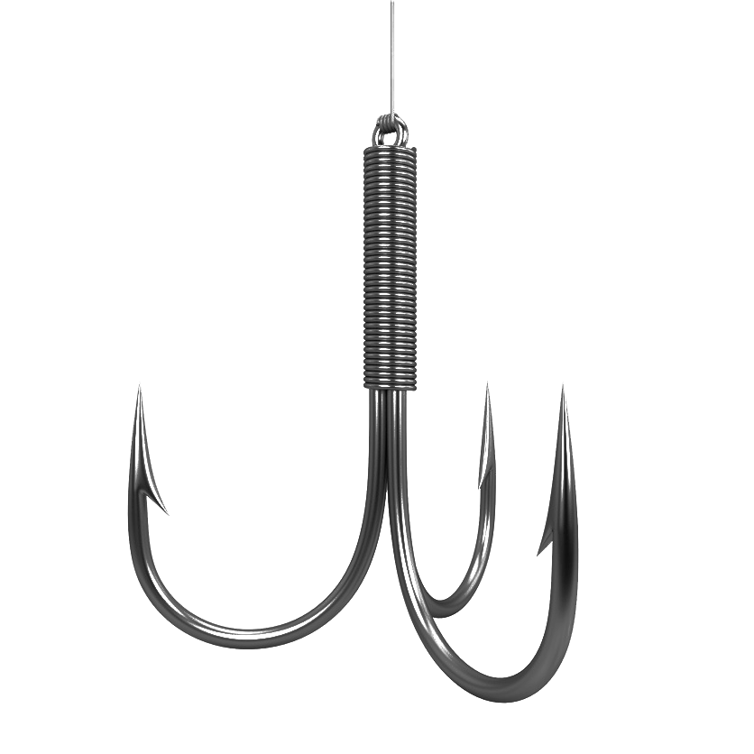
Interaction mnemonics
CYP3A4
“3 A’s For
(fishing)”
inHibition
High and
Hurried
Fluvoxamine
Luvox
“gLove-ox”
3A4
substrate

Slide 31
Interaction mnemonics
CYP3A4
“3 A’s For
(fishing)”
inHibition
High and
Hurried
Fluvoxamine
Luvox
Carbamazepine
(Tegretol)
“Tiger tail”

Slide 32
Interaction mnemonics
CYP3A4
“3 A’s For
(fishing)”
inDuction
Down and Delayed
3A4
inducer
3A4
substrate

Slide 33
Interaction mnemonics
CYP3A4
“3 A’s For
(fishing)”
inDuction
Down and Delayed
Carbamazepine
(Tegretol)
“Tiger tail”
3A4
substrate

Slide 34
Interaction mnemonics
CYP3A4
“3 A’s For
(fishing)”
inDuction
Down and Delayed
Carbamazepine
(Tegretol)
“Tiger tail”
Quetiapine (Seroquel)
“Quit typing!”
6-fold decrease!

Slide 35
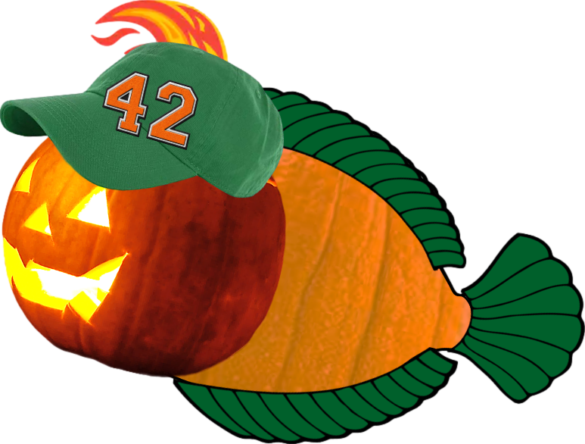
Interaction mnemonics
CYP3A4
“3 A’s For
(fishing)”
inDuction
Down and Delayed
Carbamazepine
(Tegretol)
“Tiger tail”
Lumateperone
(Caplyta)
“‘Luminated
Cap lighter”
20-fold decrease
of a $1,800 drug!
Notes:
Bobbers increase fish

Slide 36
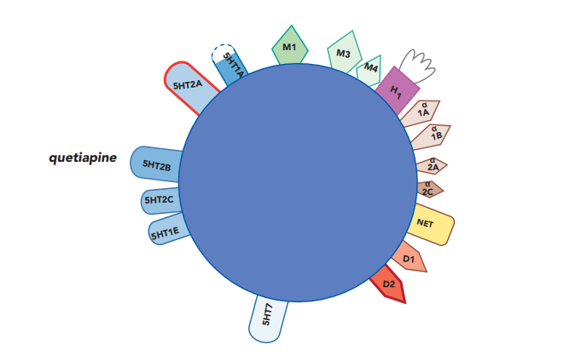

Slide 37
Neuro-
transmitter releaser
Ion channel blocker
Reuptake
inhibitor
+
Receptor agonist
Receptor antagonist
Partial
receptor antagonist
Positive
allosteric modulator
Enzyme inhibitor
Enzyme modulator
37

Slide 38
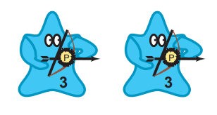
serotonin
glutamate
acetylcholine
histamine
dopamine
norepinephrine

Slide 39
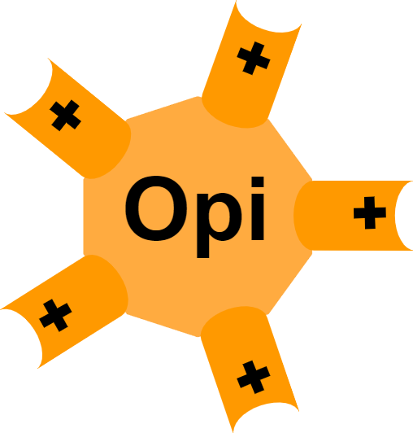
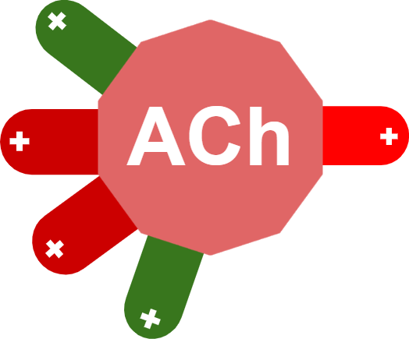
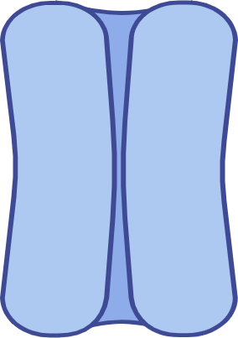
MAO-A
Norepinephrine
Melatonin
Glutamate
Opioid
Histamine
Orexin
Serotonin
Ion channel
biorender.com
39

