Slide 1
Antipsychotics
Jason Cafer, MD

Slide 2
What is a psychiatric medication?

Slide 3
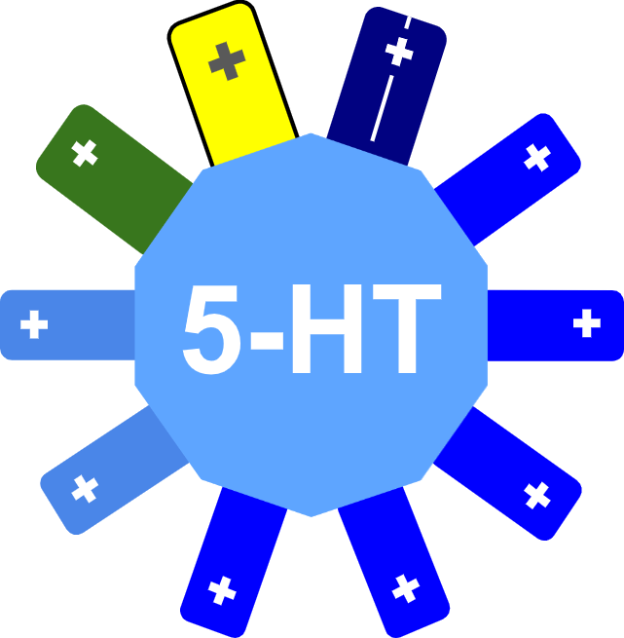

Slide 5
NE

Slide 6
NE
EPI

Slide 7
ACh
NE
EPI

Slide 8
ACh
NE
EPI

Slide 10
“Anti-
serotonin”

Slide 11
“Anti-
serotonin”

Slide 12
“Anti-
serotonin”
“Anti-
dopamine”

Slide 13
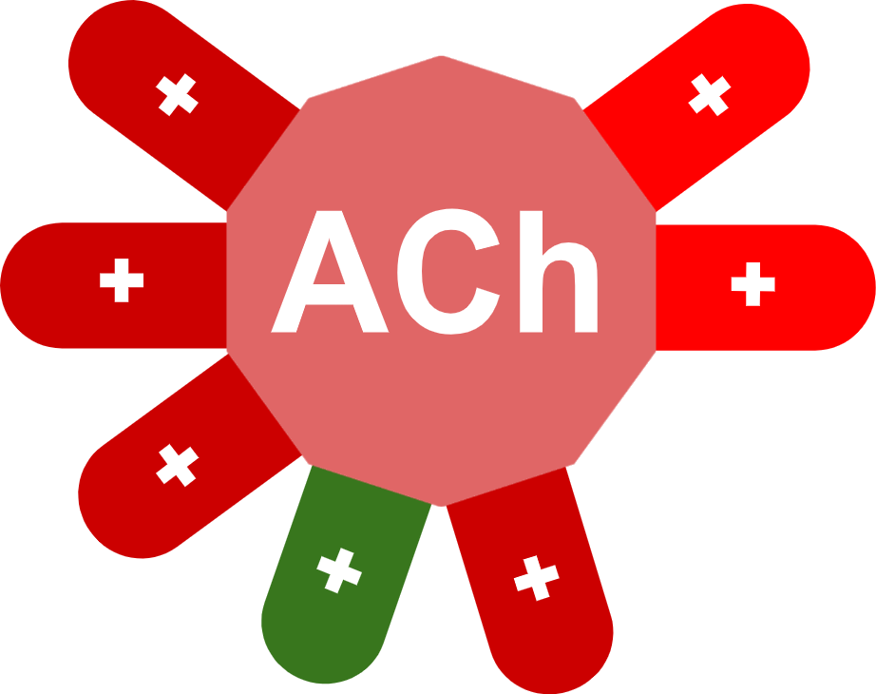
“Anti-
serotonin”
“Anti-
dopamine”

Slide 14
“Anti-
acetyl-
choline”
“Anti-
serotonin”
“Anti-
dopamine”

Slide 15
“Anti-
acetyl-
choline”
“Anti-
serotonin”
“Anti-
dopamine”

Slide 16
“Anti-
acetyl-
choline”
“Anti-
serotonin”
“Anti-
dopamine”
“Anti-
histamine”

Slide 17
“Anti-neurotransmitters”
Psychotropic drugs can be conceptualized as combinations of pieces of anti-neurotransmitters.
Our example drug would be marketed as an antipsychotic. According to NbN it would called a dopamine and serotonin receptor antagonist, with anticholinergic and antihistamine properties.

Slide 18
“Anti-neurotransmitters”
Receptor binding affinities
Psychotropic drugs can be conceptualized as combinations of pieces of anti-neurotransmitters.
Our example drug would be marketed as an antipsychotic. According to NbN it would called a dopamine and serotonin receptor antagonist, with anticholinergic and antihistamine properties.

Slide 19
“Anti-neurotransmitters”
Drug
Receptor binding affinities
Psychotropic drugs can be conceptualized as combinations of pieces of anti-neurotransmitters.
Our example drug would be marketed as an antipsychotic. According to NbN it would called a dopamine and serotonin receptor antagonist, with anticholinergic and antihistamine properties.

Slide 20
“Anti-neurotransmitters”
Drug
Receptor binding affinities
Psychotropic drugs can be conceptualized as combinations of pieces of anti-neurotransmitters.
Our example drug would be marketed as an antipsychotic. According to NbN it would called a dopamine and serotonin receptor antagonist, with anticholinergic and antihistamine properties.

Slide 21
“Anti-neurotransmitters”
Drug
D2
Receptor binding affinities
Psychotropic drugs can be conceptualized as combinations of pieces of anti-neurotransmitters.
Our example drug would be marketed as an antipsychotic. According to NbN it would called a dopamine and serotonin receptor antagonist, with anticholinergic and antihistamine properties.

Slide 22
It’s called an antipsychotic if it blocks dopamine D2 receptors
“Anti-neurotransmitters”
Drug
D2
Receptor binding affinities
Psychotropic drugs can be conceptualized as combinations of pieces of anti-neurotransmitters.
Our example drug would be marketed as an antipsychotic. According to NbN it would called a dopamine and serotonin receptor antagonist, with anticholinergic and antihistamine properties.

Slide 23
It’s called an antipsychotic if it blocks dopamine D2 receptors
“Anti-neurotransmitters”
Drug
D2
Receptor binding affinities
Psychotropic drugs can be conceptualized as combinations of pieces of anti-neurotransmitters.
Our example drug would be marketed as an antipsychotic. According to NbN it would called a dopamine and serotonin receptor antagonist, with anticholinergic and antihistamine properties.

Slide 24
It’s called an antipsychotic if it blocks dopamine D2 receptors
“Anti-neurotransmitters”
Drug
If it doesn’t block D2 receptors, it might be called…
D2
Receptor binding affinities
Psychotropic drugs can be conceptualized as combinations of pieces of anti-neurotransmitters.
Our example drug would be marketed as an antipsychotic. According to NbN it would called a dopamine and serotonin receptor antagonist, with anticholinergic and antihistamine properties.

Slide 25
It’s called an antipsychotic if it blocks dopamine D2 receptors
“Anti-neurotransmitters”
Drug
If it doesn’t block D2 receptors, it might be called…
an atypical antidepressant
D2
Receptor binding affinities
Psychotropic drugs can be conceptualized as combinations of pieces of anti-neurotransmitters.
Our example drug would be marketed as an antipsychotic. According to NbN it would called a dopamine and serotonin receptor antagonist, with anticholinergic and antihistamine properties.

Slide 26
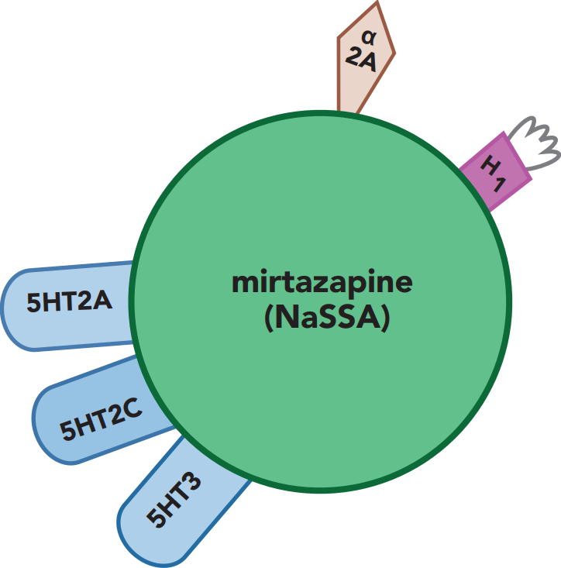
It’s called an antipsychotic if it blocks dopamine D2 receptors
“Anti-neurotransmitters”
Drug
If it doesn’t block D2 receptors, it might be called…
an atypical antidepressant
D2
Receptor binding affinities
mirtazapine
REMERON
Psychotropic drugs can be conceptualized as combinations of pieces of anti-neurotransmitters.
Our example drug would be marketed as an antipsychotic. According to NbN it would called a dopamine and serotonin receptor antagonist, with anticholinergic and antihistamine properties.

Slide 27
Blocked by antipsychotics:
Dopamine D2 receptor
Serotonin 5-HT__ receptor

Slide 28
Blocked by antipsychotics:
Dopamine D2 receptor
Serotonin 5-HT2A receptor

Slide 29
dopamine
D2 receptors
D2
Mnemonics:
“R2D2”
“D₂R (detour) from reality”.

Slide 30
serotonin
dopamine
D2 receptors
D2
5HT2A receptors
Mnemonics:
“R2D2”
“D₂R (detour) from reality”.
2A for “2nd gen Antipsychotics”
(“2 antennae?”)

Slide 31
serotonin
dopamine
D2 receptors
D2
5HT2A receptors
Mnemonics:
“R2D2”
“D₂R (detour) from reality”.
2A for “2nd gen Antipsychotics”
(“2 antennae?”)

Slide 32
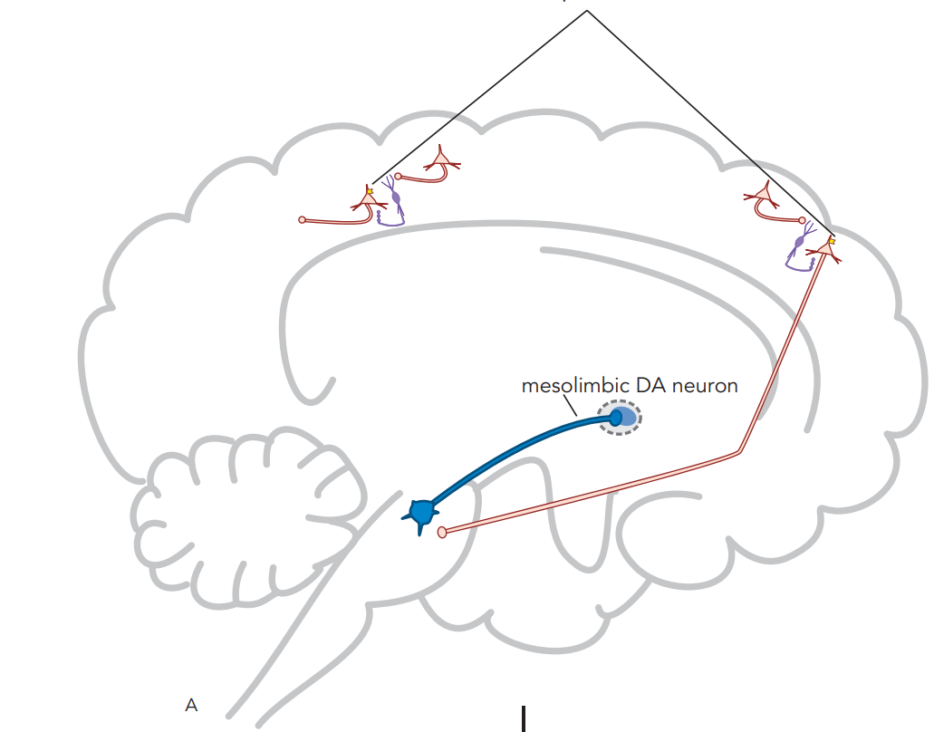
5HT2A receptors
5HT2A

Slide 33
5HT2A receptors
5HT2A
D2 receptors
D2

Slide 34
NMDA receptors
5HT2A receptors
5HT2A
D2 receptors
D2

Slide 35
NMDA receptors
5HT2A receptors
5HT2A
Glutamate
D2 receptors
D2

Slide 36
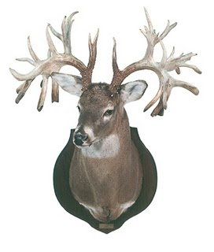
Antipsychotics
Typicals
Atypicals
First-Gen Antipsychotics
Second-Gen Antipsychotics
FGAs
SGAs
Dr Austin Campbell

Slide 37
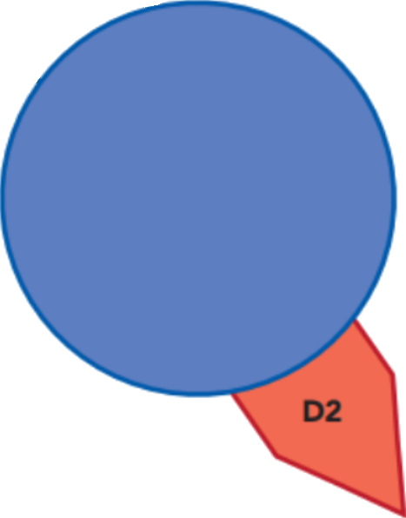
“Typicals”
First-Gen Antipsychotics
FGAs

Slide 38
“Typicals”
First-Gen Antipsychotics
FGAs
D2 receptor
blocker

Slide 39
“Typicals”
“Atypicals”
First-Gen Antipsychotics
Second-Gen Antipsychotics
FGAs
SGAs
“2 pips and a rip”
(A, B & C)
aripiprazole
brexpiprazole,
cariprazine
D2 receptor
blocker

Slide 40
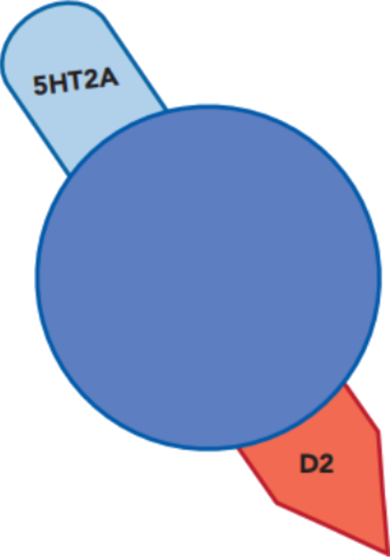
“Typicals”
“Atypicals”
First-Gen Antipsychotics
Second-Gen Antipsychotics
FGAs
SGAs
“2 pips and a rip”
(A, B & C)
aripiprazole
brexpiprazole,
cariprazine
D2 receptor
blocker

Slide 41
“Typicals”
“Atypicals”
First-Gen Antipsychotics
Second-Gen Antipsychotics
FGAs
SGAs
“2 pips and a rip”
(A, B & C)
aripiprazole
brexpiprazole,
cariprazine
D2 receptor
blocker
D2 receptor
blocker

Slide 42
“Typicals”
“Atypicals”
First-Gen Antipsychotics
Second-Gen Antipsychotics
FGAs
SGAs
5HT2A
receptor
blocker
“2 pips and a rip”
(A, B & C)
aripiprazole
brexpiprazole,
cariprazine
D2 receptor
blocker
D2 receptor
blocker

Slide 43
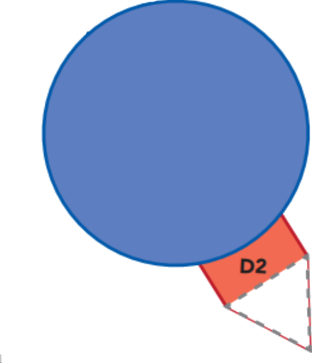
“Typicals”
“Atypicals”
First-Gen Antipsychotics
Second-Gen Antipsychotics
FGAs
SGAs
5HT2A
receptor
blocker
or
D2 receptor
blocker
D2 receptor
blocker

Slide 44
“Typicals”
“Atypicals”
First-Gen Antipsychotics
Second-Gen Antipsychotics
FGAs
SGAs
5HT2A
receptor
blocker
or
D2 receptor
blocker
D2 partial agonist
D2 receptor
blocker

Slide 45
“Typicals”
“Atypicals”
First-Gen Antipsychotics
Second-Gen Antipsychotics
FGAs
SGAs
5HT2A
receptor
blocker
“2 pips and a rip”
(A, B & C)
aripiprazole
brexpiprazole,
cariprazine
or
D2 receptor
blocker
D2 partial agonist
D2 receptor
blocker

Slide 46
“Typicals”
“Atypicals”
First-Gen Antipsychotics
Second-Gen Antipsychotics
FGAs
SGAs
5HT2A
receptor
blocker
“2 pips and a rip”
(A, B & C)
aripiprazole
brexpiprazole,
cariprazine
“-pines, -dones
and a -rone”
or
D2 receptor
blocker
D2 partial agonist
D2 receptor
blocker

Slide 47
“Typicals”
“Atypicals”
First-Gen Antipsychotics
Second-Gen Antipsychotics
FGAs
SGAs
5HT2A
receptor
blocker
potency:
low
intermediate
high
“2 pips and a rip”
(A, B & C)
aripiprazole
brexpiprazole,
cariprazine
“-pines, -dones
and a -rone”
or
D2 receptor
blocker
D2 partial agonist
D2 receptor
blocker

Slide 48
“Typicals”
“Atypicals”
First-Gen Antipsychotics
Second-Gen Antipsychotics
FGAs
SGAs
5HT2
receptor
blocker
potency:
low
intermediate
high
“2 pips and a rip”
(A, B & C)
aripiprazole
brexpiprazole,
cariprazine
or
“-pines, -dones
and a -rone”
or
D2 receptor
blocker
D2 partial agonist

Slide 49
“Typicals”
“Atypicals”
First-Gen Antipsychotics
Second-Gen Antipsychotics
FGAs
SGAs
5HT2
receptor
blocker
potency:
low
intermediate
high
“2 pips and a rip”
(A, B & C)
aripiprazole
brexpiprazole,
cariprazine
or
“-pines, -dones
and a -rone”
or
D2 receptor
blocker
D2 partial agonist

Slide 50
1st-gen antipsychotic (SGA)
D2 antagonist

Slide 51
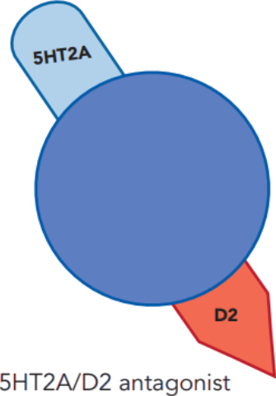
Second-generation antipsychotic (SGA)

Slide 52
Second-generation antipsychotic (SGA)
dopamine
D2
D2 receptor
“R2D2”
“D₂R (detour) from reality”

Slide 53
Second-generation antipsychotic (SGA)
dopamine
D2
D2 receptor
“R2D2”
“D₂R (detour) from reality”

Slide 54
Second-generation antipsychotic (SGA)
dopamine
D2
D2 receptor
“R2D2”
“D₂R (detour) from reality”

Slide 55
Second-generation antipsychotic (SGA)
dopamine
D2
D2 receptor
“R2D2”
“D₂R (detour) from reality”

Slide 56
Second-generation antipsychotic (SGA)
dopamine
D2
D2 receptor
“R2D2”
“D₂R (detour) from reality”

Slide 57
Second-generation antipsychotic (SGA)
dopamine
D2
D2 receptor
“R2D2”
“D₂R (detour) from reality”

Slide 58
Second-generation antipsychotic (SGA)
dopamine
D2
D2 receptor
“R2D2”
“D₂R (detour) from reality”

Slide 59
Second-generation antipsychotic (SGA)
dopamine
D2
D2 receptor
“R2D2”
“D₂R (detour) from reality”

Slide 60
Second-generation antipsychotic (SGA)
dopamine
D2
D2 receptor
“R2D2”
“D₂R (detour) from reality”

Slide 61
Second-generation antipsychotic (SGA)
dopamine
5HT2A
D2
5HT2A receptors
D2 receptor
2A for “2nd-gen Antipsychotics”
“R2D2”
“D₂R (detour) from reality”

Slide 62
Second-generation antipsychotic (SGA)
dopamine
5HT2A
D2
5HT2A receptors
D2 receptor
2A for “2nd-gen Antipsychotics”
“R2D2”
“D₂R (detour) from reality”

Slide 63
Second-generation antipsychotic (SGA)
dopamine
5HT2A
D2
5HT2A receptors
D2 receptor
2A for “2nd-gen Antipsychotics”
“R2D2”
“D₂R (detour) from reality”

Slide 64
Second-generation antipsychotic (SGA)
dopamine
5HT2A
D2
5HT2A receptors
D2 receptor
2A for “2nd-gen Antipsychotics”
“R2D2”
“D₂R (detour) from reality”

Slide 65
Second-generation antipsychotic (SGA)
dopamine
5HT2A
D2
5HT2A receptors
D2 receptor
2A for “2nd-gen Antipsychotics”
“R2D2”
“D₂R (detour) from reality”

Slide 66
Second-generation antipsychotic (SGA)
dopamine
5HT2A
D2
5HT2A receptors
D2 receptor
2A for “2nd-gen Antipsychotics”
“R2D2”
“D₂R (detour) from reality”

Slide 67
Second-generation antipsychotic (SGA)
dopamine
5HT2A
D2
5HT2A receptors
D2 receptor
2A for “2nd-gen Antipsychotics”
“R2D2”
“D₂R (detour) from reality”

Slide 68
Second-generation antipsychotic (SGA)
dopamine
5HT2A
D2
5HT2A receptors
D2 receptor
2A for “2nd-gen Antipsychotics”
“R2D2”
“D₂R (detour) from reality”

Slide 69
Second-generation antipsychotic (SGA)
dopamine
5HT2A
D2
5HT2A receptors
D2 receptor
2A for “2nd-gen Antipsychotics”
“R2D2”
“D₂R (detour) from reality”

Slide 70
Second-generation antipsychotic (SGA)
dopamine
5HT2A
D2
5HT2A receptors
D2 receptor
2A for “2nd-gen Antipsychotics”
“R2D2”
“D₂R (detour) from reality”

Slide 71
Second-generation antipsychotic (SGA)
dopamine
5HT2A
D2
5HT2A receptors
D2 receptor
2A for “2nd-gen Antipsychotics”
“R2D2”
“D₂R (detour) from reality”

Slide 72
Second-generation antipsychotic (SGA)
dopamine
5HT2A
D2
5HT2A receptors
D2 receptor
2A for “2nd-gen Antipsychotics”
“R2D2”
“D₂R (detour) from reality”

Slide 73
Second-generation antipsychotic (SGA)
dopamine
5HT2A
D2
5HT2A receptors
D2 receptor
2A for “2nd-gen Antipsychotics”
“R2D2”
“D₂R (detour) from reality”

Slide 74
Second-generation antipsychotic (SGA)
dopamine
5HT2A
D2
5HT2A receptors
D2 receptor
2A for “2nd-gen Antipsychotics”
“R2D2”
“D₂R (detour) from reality”

Slide 75
Second-generation antipsychotic (SGA)
dopamine
5HT2A
D2
5HT2A receptors
D2 receptor
2A for “2nd-gen Antipsychotics”
“R2D2”
“D₂R (detour) from reality”

Slide 76
Second-generation antipsychotic (SGA)
dopamine
5HT2A
D2
5HT2A receptors
D2 receptor
2A for “2nd-gen Antipsychotics”
“R2D2”
“D₂R (detour) from reality”

Slide 77
What Differentiates 2nd-gen (SGAs) from 1st-gen antipsychotics (FGAs)?
vs

Slide 78
What Differentiates 2nd-gen (SGAs) from 1st-gen antipsychotics (FGAs)?
SGA = marketing term for newer antipsychotics (clozapine and later).
vs

Slide 79
What Differentiates 2nd-gen (SGAs) from 1st-gen antipsychotics (FGAs)?
SGA = marketing term for newer antipsychotics (clozapine and later).
Conceptually, an SGA is an antipsychotic that (supposedly) causes less EPS at doses producing antipsychotic effects.
vs

Slide 80
What Differentiates 2nd-gen (SGAs) from 1st-gen antipsychotics (FGAs)?
SGA = marketing term for newer antipsychotics (clozapine and later).
Conceptually, an SGA is an antipsychotic that (supposedly) causes less EPS at doses producing antipsychotic effects.
Incidence of TD is lower SGA (~2.6%) FGA (~6.5%)
vs

Slide 81
What Differentiates 2nd-gen (SGAs) from 1st-gen antipsychotics (FGAs)?
SGA = marketing term for newer antipsychotics (clozapine and later).
Conceptually, an SGA is an antipsychotic that (supposedly) causes less EPS at doses producing antipsychotic effects.
Incidence of TD is lower SGA (~2.6%) FGA (~6.5%)
Mechanisms of FGAs and SGAs are similar, although receptor binding affinities are different.
vs

Slide 82
1st-gen antipsychotic (FGA)
Second-generation antipsychotic (SGA)
D2 antagonist

Slide 83
1st-gen antipsychotic (FGA)
Second-generation antipsychotic (SGA)
Most FGA’s block
5-HT2A also, but binding affinity is weaker
D2 antagonist

Slide 84
D2 antagonist

Slide 85
D2 antagonist
D2
dopamine

Slide 86
Dopamine Neural Pathways
Dopamine Pathway | Effect of D2 antagonist
Mesolimbic | ↓ DA activity - reduction of positive symptoms of schizophrenia (hallucinations, delusions).
D2 antagonist
D2
dopamine

Slide 87
Dopamine Neural Pathways
Dopamine Pathway | Effect of D2 antagonist
Mesolimbic | ↓ DA activity - reduction of positive symptoms of schizophrenia (hallucinations, delusions). Side effects of apathy and anhedonia.
Mesocortical | ↓ DA - potential worsening of negative symptoms (amotivation, anhedonia, blunting of affect, cognitive symptoms)
Nigrostriatal | ↓ DA - EPS, risk of tardive dyskinesia
Tubero- infundibular | ↓ DA - increased prolactin, risk of breast growth (gynecomastia)
D2 antagonist
D2
dopamine

Slide 88
Dopamine Neural Pathways
Dopamine Pathway | Effect of D2 antagonist
Mesolimbic | ↓ DA activity - reduction of positive symptoms of schizophrenia (hallucinations, delusions). Side effects of apathy and anhedonia.
Mesocortical | ↓ DA - potential worsening of negative symptoms (amotivation, anhedonia, blunting of affect, cognitive symptoms)
Nigrostriatal | ↓ DA - EPS, risk of tardive dyskinesia
Tubero- infundibular | ↓ DA - increased prolactin, risk of breast growth (gynecomastia)
D2 antagonist
D2
dopamine

Slide 89
Dopamine Neural Pathways
Dopamine Pathway | Effect of D2 antagonist
Mesolimbic | ↓ DA activity - reduction of positive symptoms of schizophrenia (hallucinations, delusions). Side effects of apathy and anhedonia.
Mesocortical | ↓ DA - potential worsening of negative symptoms (amotivation, anhedonia, blunting of affect, cognitive symptoms)
Nigrostriatal | ↓ DA - EPS, risk of tardive dyskinesia
Tubero- infundibular | ↓ DA - increased prolactin, risk of breast growth (gynecomastia)
D2 antagonist
D2
dopamine

Slide 90
Dopamine Neural Pathways
Dopamine Pathway | Effect of D2 antagonist
Mesolimbic | ↓ DA activity - reduction of positive symptoms of schizophrenia (hallucinations, delusions). Side effects of apathy and anhedonia.
Mesocortical | ↓ DA - potential worsening of negative symptoms (amotivation, anhedonia, blunting of affect, cognitive symptoms)
Nigrostriatal | ↓ DA - EPS, risk of tardive dyskinesia
Tubero- infundibular | ↓ DA - increased prolactin, risk of breast growth (gynecomastia)
D2 antagonist
D2
dopamine

Slide 91
Pituitary lactotroph cell
Stahl’s Essential Psychopharmacology

Slide 92
Pituitary lactotroph cell
Stahl’s Essential Psychopharmacology

Slide 93
Pituitary lactotroph cell
D2
Stahl’s Essential Psychopharmacology

Slide 94
5HT2A
Pituitary lactotroph
D2
Stahl’s Essential Psychopharmacology

Slide 95
Dopamine decreases prolactin release
Stahl’s Essential Psychopharmacology

Slide 96
Dopamine decreases prolactin release
Stahl’s Essential Psychopharmacology

Slide 97
Dopamine decreases prolactin release
Serotonin stimulates prolactin release
Stahl’s Essential Psychopharmacology

Slide 98
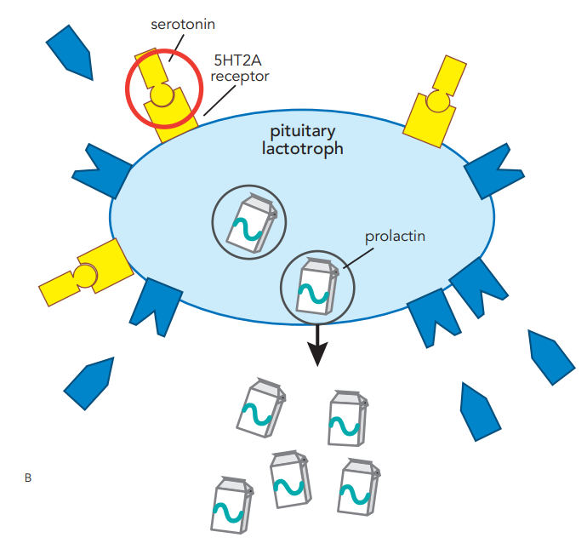
Dopamine decreases prolactin release
Serotonin stimulates prolactin release
Stahl’s Essential Psychopharmacology

Slide 99
Dopamine decreases prolactin release
Serotonin stimulates prolactin release
You can essentially use prolactin elevation as a barometer of atypicality of an antipsychotic
Stahl’s Essential Psychopharmacology

Slide 100
First-generation antipsychotic (FGA)
haloperidol
HALDOL
D2 receptor blocker
Stahl’s Essential Psychopharmacology

Slide 101
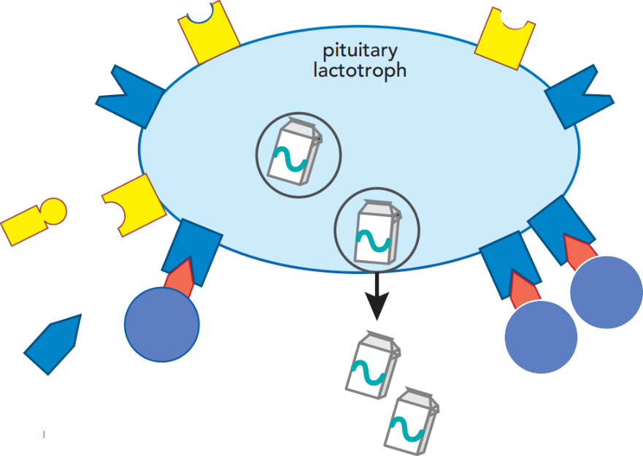
First-generation antipsychotic (FGA)
5HT2A
D2
haloperidol
HALDOL
Blocking D2 receptors increases release of prolactin
D2 receptor blocker
Stahl’s Essential Psychopharmacology

Slide 102
2nd generation antipsychotic
5HT2 receptor blocker
D2 receptor blocker
Stahl’s Essential Psychopharmacology

Slide 103
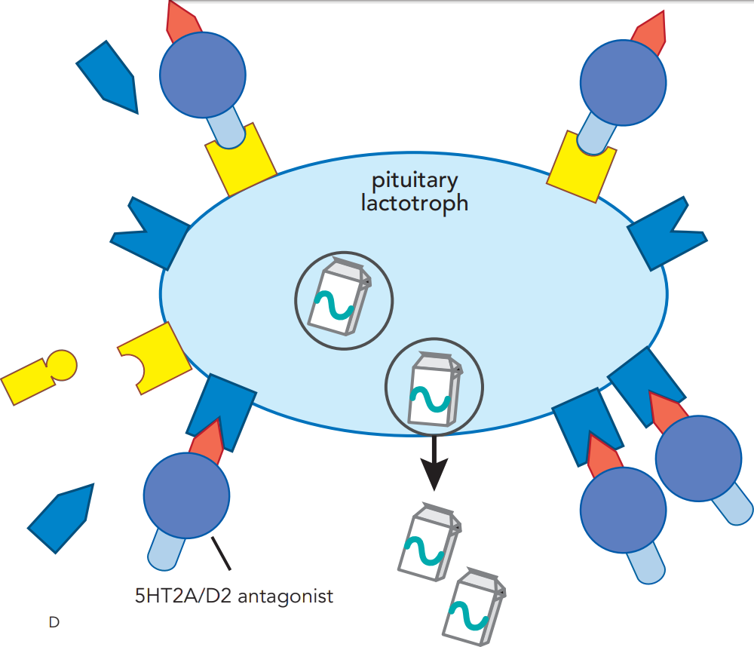
2nd generation antipsychotic
Blocking 5HT2 receptors ameliorates prolactin release caused by D2 blockade
5HT2 receptor blocker
D2 receptor blocker
Stahl’s Essential Psychopharmacology

Slide 104
“2 pips and a rip” or
“A, B, C”
aripiprazole
brexpiprazole,
cariprazine
D2 partial agonist
Stahl’s Essential Psychopharmacology

Slide 105
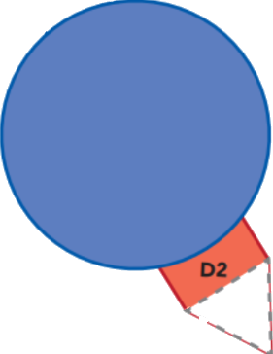
“2 pips and a rip” or
“A, B, C”
aripiprazole
brexpiprazole,
cariprazine
D2 partial agonist
Aripiprazole decreases prolactin, the opposite effect of D2 blockers.
Stahl’s Essential Psychopharmacology

Slide 106
CATIE

Slide 107
CATIE

Slide 108
CATIE

Slide 109
CATIE – 5 findings:

Slide 110
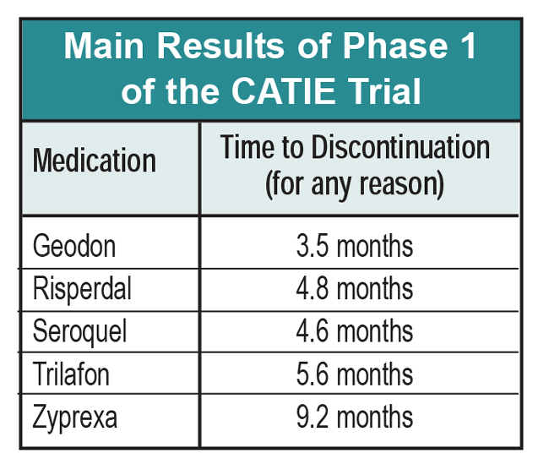
Which one was taken
the longest?

Slide 112
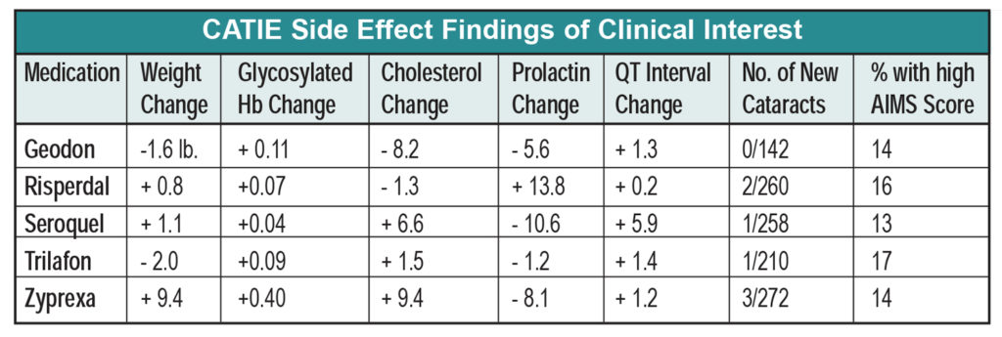
Which two were associated with weight loss?

Slide 114
Out of 5, how many caused prolactin elevation?

Slide 116
Which one prolongs QT?

Slide 120
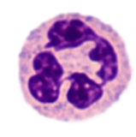
Clozapine (CLOZARIL)
KLOE za peen / KLOE za ril
“Clothes pin”
❖ Antipsychotic (SGA)
❖ D2 antagonist - ⇩ DA
❖ 5-HT_{2A} antagonist - ⇧ DA
❖ Alpha-adrenergic antagonist
Neutrophil
FDA-approved for:
❖ Treatment-resistant
schizophrenia
❖ Prevention of schizophrenia-
associated suicide

Slide 121
Clozapine (CLOZARIL)
KLOE za peen / KLOE za ril
“Clothes pin”
❖ Antipsychotic (SGA)
❖ D2 antagonist - ⇩ DA
❖ 5-HT_{2A} antagonist - ⇧ DA
❖ Alpha-adrenergic antagonist
Neutrophil
FDA-approved for:
❖ Treatment-resistant
schizophrenia
❖ Prevention of schizophrenia-
associated suicide

Slide 122
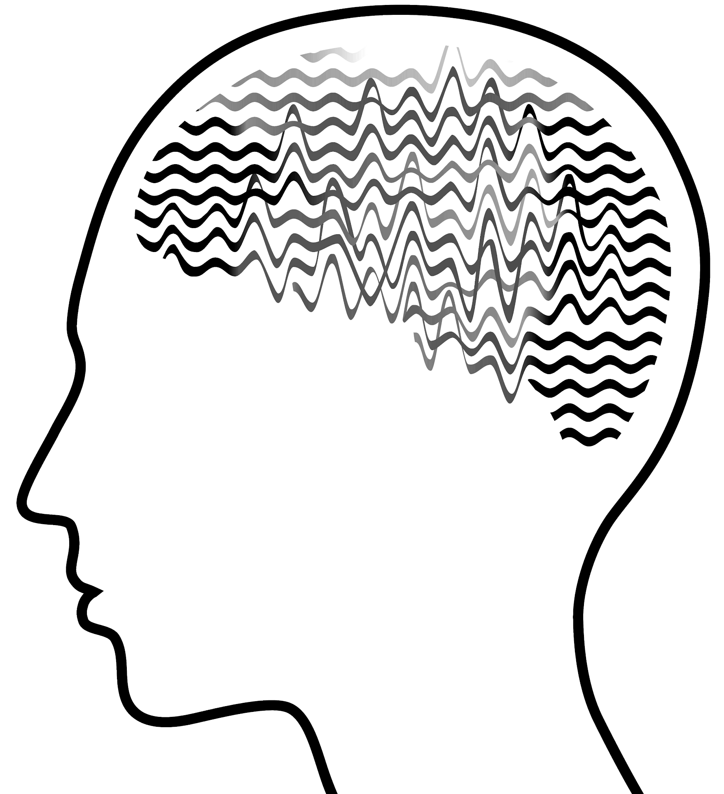
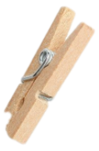
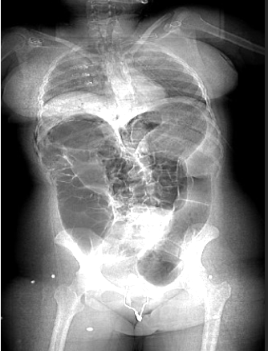
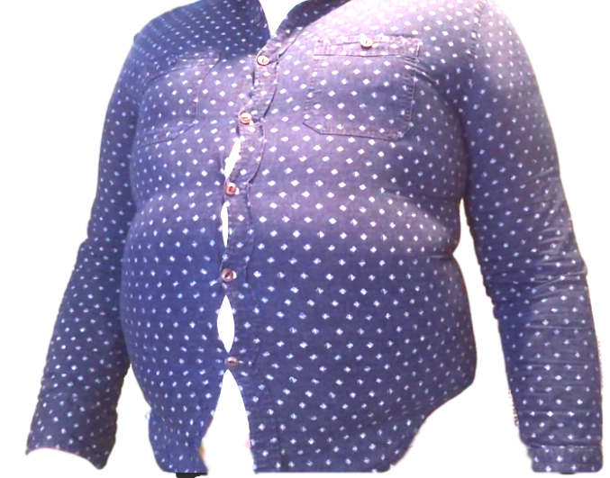
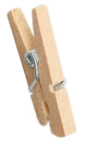
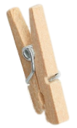
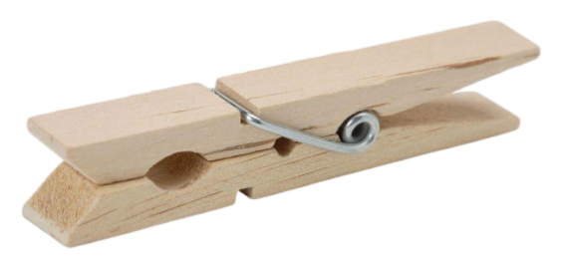
Clozapine (CLOZARIL)
KLOE za peen / KLOE za ril
“Clothes pin”
Neutrophil
Weight
gain
Severe constipation,
which can lead to toxic megacolon and bowel rupture.
Hypersalivation by cholinergic mechanism (the S in SLUDGE)
Potentially fatal myocarditis
Antipsychotics are represented
with spooky mascots.
Seizures

Slide 123
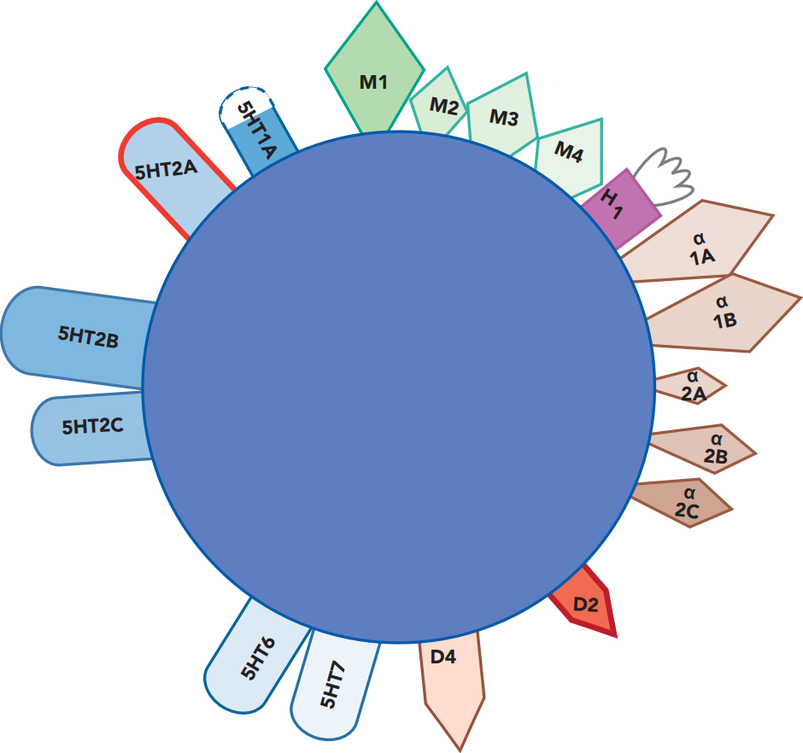
Clozapine
CLOZARIL

Slide 124
Clozapine
CLOZARIL
less EPS than placebo!

Slide 125
Clozapine
CLOZARIL
Orthostatic hypotension, which limits speed of titration
less EPS than placebo!

Slide 126
Clozapine
CLOZARIL
Potential for massive weight gain
less EPS than placebo!

Slide 127
Clozapine
CLOZARIL
very sedating
less EPS than placebo!

Slide 128
Clozapine
CLOZARIL
Highly anticholinergic, potential for severe constipation
x
less EPS than placebo!

Slide 129
Clozapine
CLOZARIL
Highly anticholinergic, potential for severe constipation
Salivation is a cholinergic effect cause by the norclozapine metabolite.
less EPS than placebo!

Slide 130
Olanzapine (ZYPREXA)
o lan za peen / zy PREX a
“Owl lands upon (cra)Zy pretzel”
❖ Antipsychotic (SGA)
❖ D2 antagonist - ⇩ DA
❖ 5-HT_{2A} antagonist - ⇧ DA
FDA-approved for:
❖ Schizophrenia
❖ Bipolar mania
❖ Bipolar maintenance
❖ Bipolar depression
(with fluoxetine)
❖ Treatment-resistant depression
(with fluoxetine)
❖ Acute agitation of mania
(IM route)

Slide 131
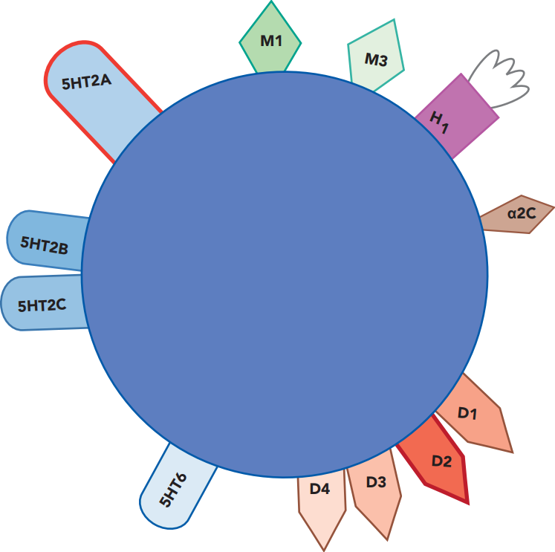
Olanzapine
ZYPREXA

Slide 132
Olanzapine
ZYPREXA
minimal EPS

Slide 133
Clozapine
CLOZARIL
Olanzapine
ZYPREXA
Hypotension is a major issue, must titrate slowly

Slide 134
Clozapine
CLOZARIL
Olanzapine
ZYPREXA
Hypotension is a major issue, must titrate slowly

Slide 135
Clozapine
CLOZARIL
Olanzapine
ZYPREXA
Hypotension is a major issue, must titrate slowly

Slide 136
Clozapine
CLOZARIL
Olanzapine
ZYPREXA
Hypotension is a major issue, must titrate slowly

Slide 137
Clozapine
CLOZARIL
Olanzapine
ZYPREXA
Hypotension is a major issue, must titrate slowly
Very high dose can be tolerated without titration

Slide 138
Clozapine
CLOZARIL
Olanzapine
ZYPREXA
Constipation is often problematic
Hypotension is a major issue, must titrate slowly
Very high dose can be tolerated without titration

Slide 139
Clozapine
CLOZARIL
Olanzapine
ZYPREXA
Constipation is often problematic
Constipation is manageable
Hypotension is a major issue, must titrate slowly
Very high dose can be tolerated without titration

Slide 140
Clozapine
CLOZARIL
Olanzapine
ZYPREXA
Constipation is often problematic
Constipation is manageable
Hypotension is a major issue, must titrate slowly
Very high dose can be tolerated without titration
Potential for massive weight gain

Slide 141
Clozapine
CLOZARIL
Olanzapine
ZYPREXA
Constipation is often problematic
Constipation is manageable
Hypotension is a major issue, must titrate slowly
Very high dose can be tolerated without titration
Potential for massive weight gain
Equal potential for massive weight gain

Slide 142
Clozapine
CLOZARIL
Olanzapine
ZYPREXA
Constipation is often problematic
Constipation is manageable
very sedating
Hypotension is a major issue, must titrate slowly
Very high dose can be tolerated without titration
Potential for massive weight gain
Equal potential for massive weight gain

Slide 143
Clozapine
CLOZARIL
Olanzapine
ZYPREXA
Constipation is often problematic
Constipation is manageable
Stronger antihistamine but overall less sedating
very sedating
Hypotension is a major issue, must titrate slowly
Very high dose can be tolerated without titration
Potential for massive weight gain
Equal potential for massive weight gain

Slide 144
Quetiapine (SEROQUEL)
kwe TYE a peen / SEH ruh kwil
“Sera, Quit typing!”
❖ Antipsychotic (SGA)
❖ D2 antagonist (weak) - ⇩ DA
❖ 5-HT_{2A} antagonist - ⇧ DA
❖ NE reuptake inhibitor (metabolite)
Sera! Quit typing (and get some sleep)!
FDA-approved for:
❖ Schizophrenia
❖ Bipolar, manic episode
❖ Bipolar, depressive episode
– XR formulation
❖ Depression (adjunct)
mania

Slide 145
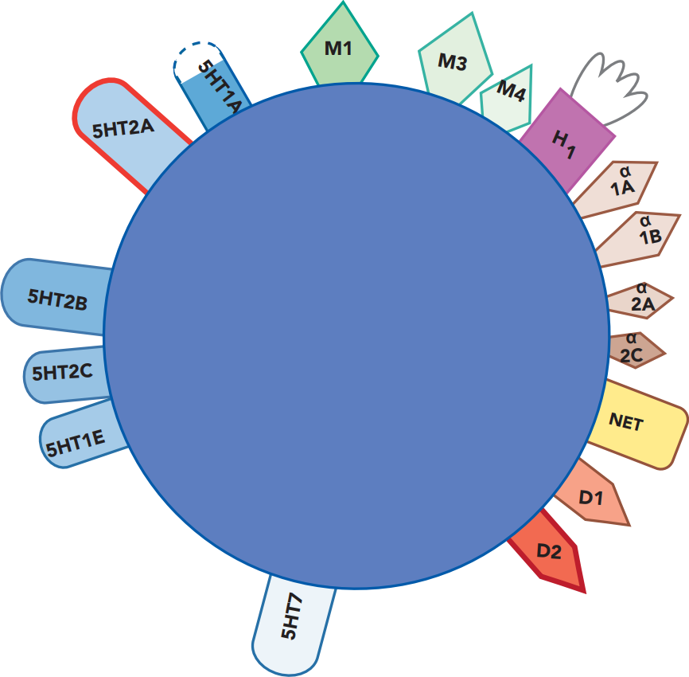
Quetiapine
SEROQUEL

Slide 146
Quetiapine
SEROQUEL
minimal EPS

Slide 147
Quetiapine
SEROQUEL
weak antipsychotic
minimal EPS

Slide 148
Quetiapine
SEROQUEL
weight gain (less extreme than olanzapine)
weak antipsychotic
minimal EPS

Slide 149
Quetiapine
SEROQUEL
antidepressant effects
antidepressant effects
x
weight gain and metabolic syndrome
weak antipsychotic
minimal EPS

Slide 150
Quetiapine
SEROQUEL
antidepressant effects
antidepressant effects
shared mechanism with bupropion (Wellbutrin)
x
weight gain and metabolic syndrome
weak antipsychotic
minimal EPS

Slide 151
Quetiapine
SEROQUEL
antidepressant effects
antidepressant effects
shared mechanism with mirtazapine (Remeron)
shared mechanism with bupropion (Wellbutrin)
x
weight gain and metabolic syndrome
weak antipsychotic
minimal EPS

Slide 152
Quetiapine
SEROQUEL
shared mechanism with buspirone (Buspar)
antidepressant effects
shared mechanism with mirtazapine (Remeron)
shared mechanism with bupropion (Wellbutrin)
x
weight gain and metabolic syndrome
weak antipsychotic
minimal EPS

Slide 153
Quetiapine
SEROQUEL
shared mechanism with buspirone (Buspar)
antidepressant effects
shared mechanism with mirtazapine (Remeron)
fluoxetine (Prozac) and mirtazapine (Remeron) also block 5HT2C receptors
shared mechanism with bupropion (Wellbutrin)
x
weight gain and metabolic syndrome
weak antipsychotic
minimal EPS

Slide 154
Quetiapine
SEROQUEL
shared mechanism with buspirone (Buspar)
very sedating
antidepressant effects
shared mechanism with mirtazapine (Remeron)
fluoxetine (Prozac) and mirtazapine (Remeron) also block 5HT2C receptors
shared mechanism with bupropion (Wellbutrin)
x
weight gain and metabolic syndrome
weak antipsychotic
minimal EPS

Slide 155
Quetiapine
SEROQUEL
shared mechanism with buspirone (Buspar)
very sedating
antidepressant effects
hypotension limits rate of titration
shared mechanism with mirtazapine (Remeron)
fluoxetine (Prozac) and mirtazapine (Remeron) also block 5HT2C receptors
shared mechanism with bupropion (Wellbutrin)
x
weight gain and metabolic syndrome
weak antipsychotic
minimal EPS

Slide 156
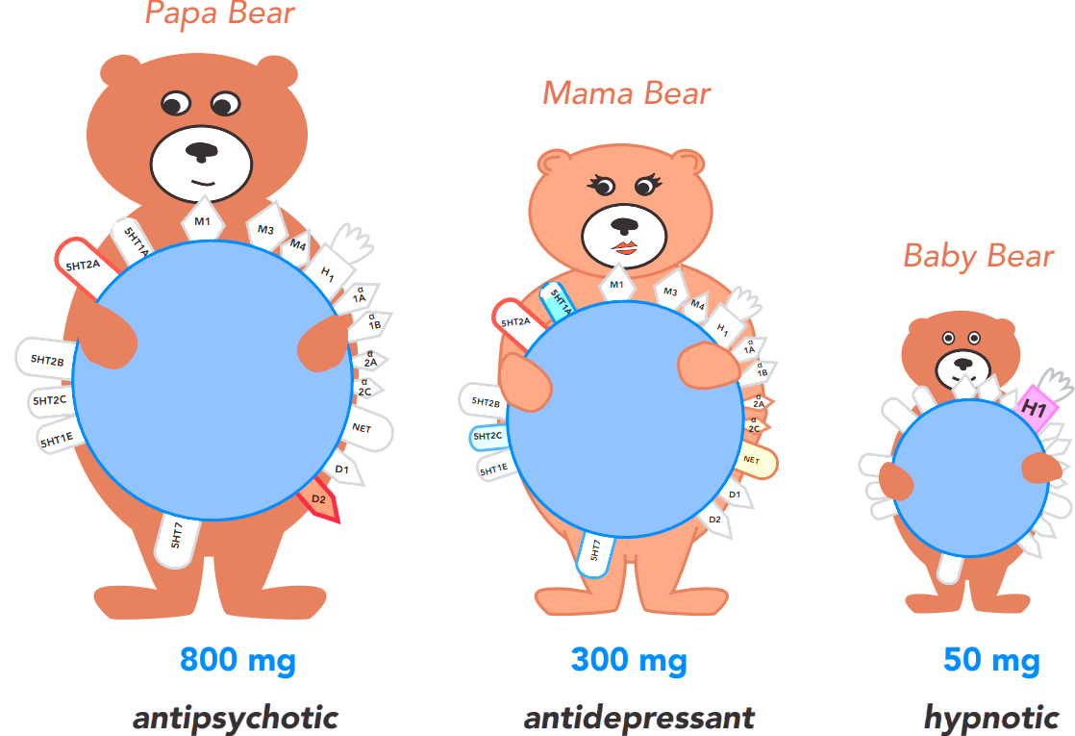
Quetiapine
SEROQUEL

Slide 157
Quetiapine
SEROQUEL

Slide 158
Quetiapine
SEROQUEL

Slide 159
quetiapine
SEROQUEL
50 mg

Slide 160
diphenhydramine
BENADRYL
50 mg
quetiapine
SEROQUEL
50 mg

Slide 161
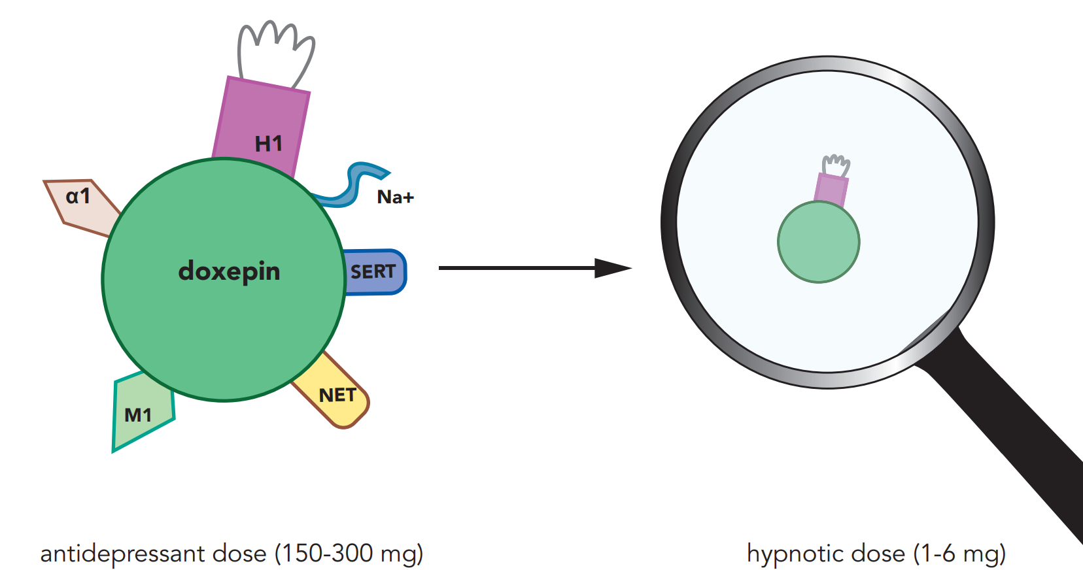
TCA
diphenhydramine
BENADRYL
50 mg
quetiapine
SEROQUEL
50 mg

Slide 162
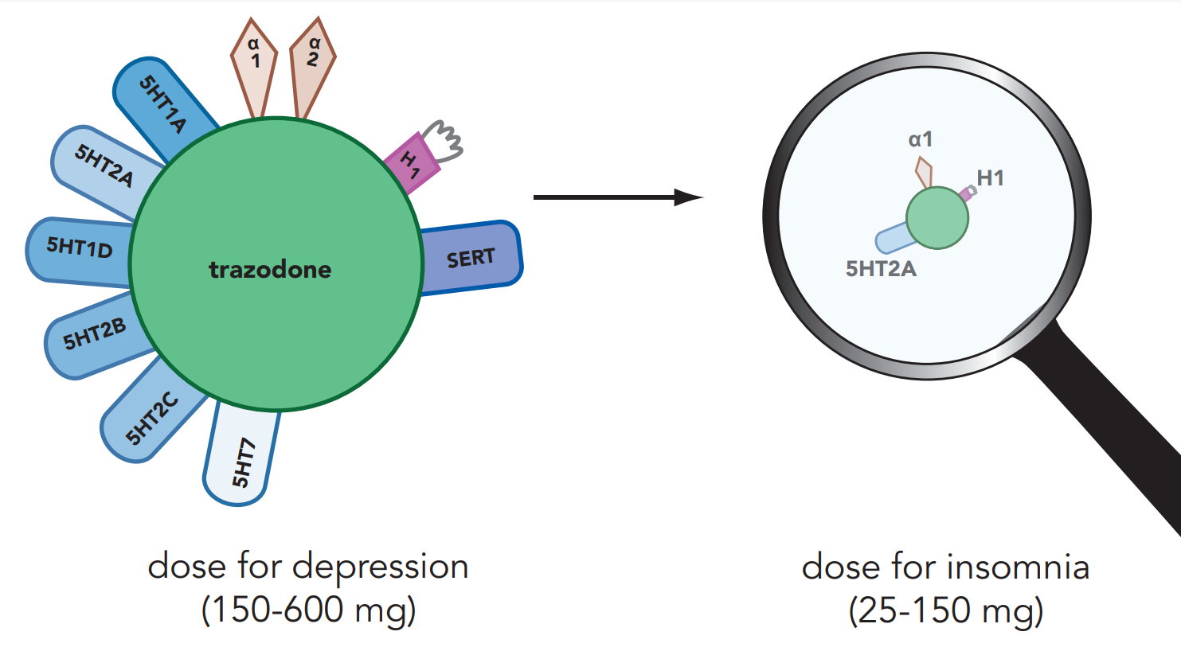
TCA
diphenhydramine
BENADRYL
50 mg
quetiapine
SEROQUEL
50 mg

Slide 163
Risperidone (RISPERDAL)
ris PER i dohn / RIS per dal
“Breast-perdal”
❖ Antipsychotic (SGA)
❖ D2 antagonist - ⇩ DA
❖ 5-HT_{2A} antagonist - ⇧ DA
❖ Alpha-adrenergic antagonist
FDA-approved for:
❖ Schizophrenia > 13 years old
❖ Bipolar > 10 years old
❖ Irritability of autism > 5 years old
gyneco-
mastia

Slide 164
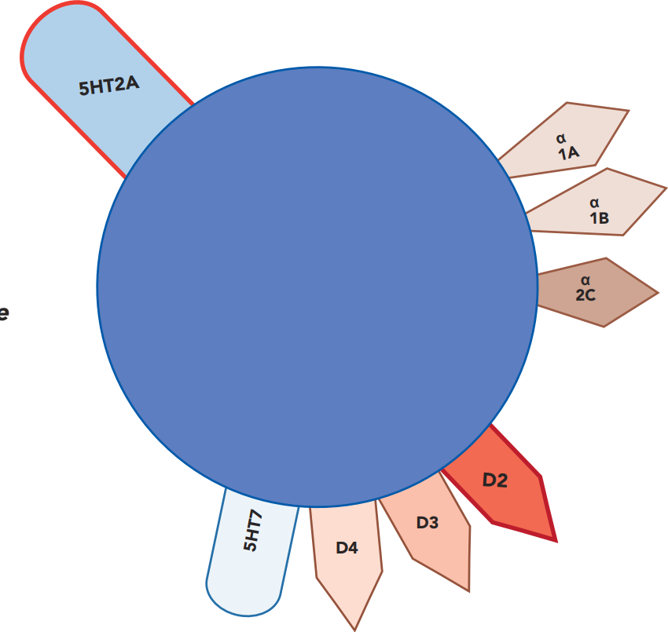
Risperidone
RISPERDAL

Slide 165
Risperidone
RISPERDAL
The 2nd atypical antipsychotic, following clozapine.

Slide 166
Risperidone
RISPERDAL
The 2nd atypical antipsychotic, following clozapine.
Marketing genius!

Slide 167
Risperidone
RISPERDAL
The 2nd atypical antipsychotic, following clozapine.
Marketing genius!
It’s barely atypical, because 5HT2A blocking ~= D2 blocking.

Slide 168
Risperidone
RISPERDAL
The 2nd atypical antipsychotic, following clozapine.
Marketing genius!
It’s barely atypical, because 5HT2A blocking ~= D2 blocking.
An SGA is supposed to block 5HT2A >> D2.

Slide 169
Risperidone
RISPERDAL
The 2nd atypical antipsychotic, following clozapine.
Marketing genius!
It’s barely atypical, because 5HT2A blocking ~= D2 blocking.
An SGA is supposed to block 5HT2A >> D2.
large prolactin elevation

Slide 170
Risperidone
RISPERDAL
The 2nd atypical antipsychotic, following clozapine.
Marketing genius!
It’s barely atypical, because 5HT2A blocking ~= D2 blocking.
An SGA is supposed to block 5HT2A >> D2.
large prolactin elevation
EPS unless low dose

Slide 171
Risperidone
RISPERDAL
The 2nd atypical antipsychotic, following clozapine.
Marketing genius!
It’s barely atypical, because 5HT2A blocking ~= D2 blocking.
An SGA is supposed to block 5HT2A >> D2.
No built-in antimuscarinic activity, so may need to add benztropine.
large prolactin elevation
EPS unless low dose

Slide 172
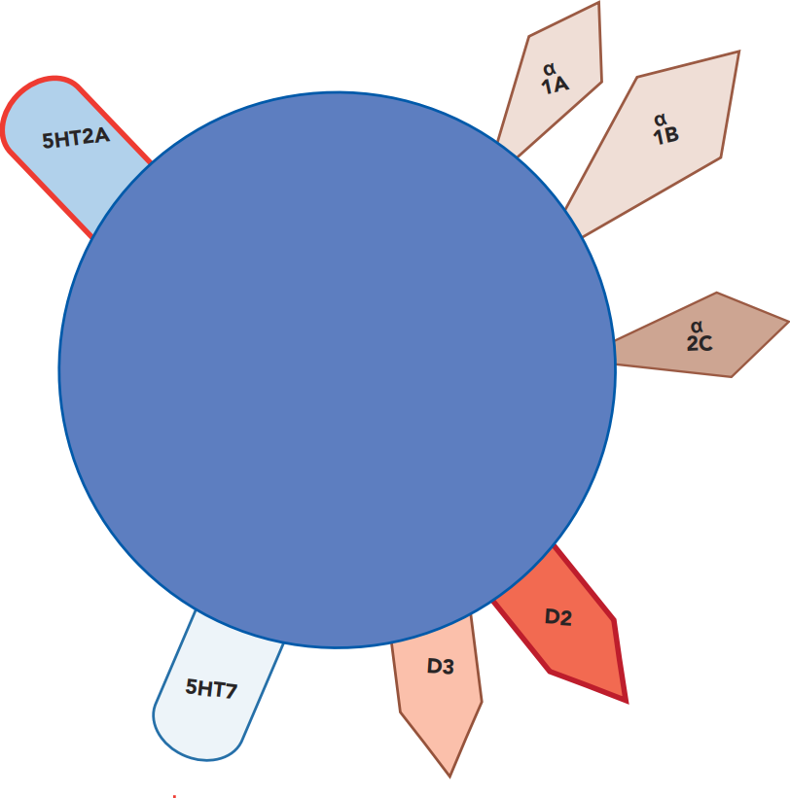
Risperidone
RISPERDAL
Paliperidone
INVEGA
Metabolized to

Slide 173
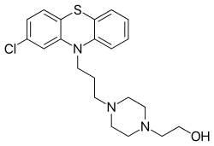
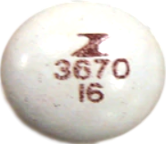
Perphenazine (TRILAFON)
per FEN uh zeen / TRIL uh fon
“Perple Trial phone”
1957
$31–$115
TRIAL PHONE
❖ Antipsychotic
❖ Medium potency FGA
❖ D2 antagonist
❖ Phenothiazine
FDA-approved for:
❖ Schizophrenia
❖ Nausea/vomiting
Phenothiazine
structure
Intermediate potency FGAs are relatively low in EPS, similar to SGAs
2
4
8
16
mg

Slide 174
Perphenazine (TRILAFON)
per FEN uh zeen / TRIL uh fon
“Perple Trial phone”
The first generation antipsychotic (FGA) included in the CATIE schizophrenia trial.
1957
$31–$115
TRIAL PHONE
Phenothiazine
structure
Perphenazine showed comparable effectiveness and caused no more EPS than the SGAs.
Perphenazine was no less effective in improving cognitive performance than the SGAs.
Although these four SGAs are now affordable, they were much more expensive when the CATIE trial was conducted. Perphenazine is now the more expensive one.
When choosing a medium potency FGA, the author prefers loxapine (Loxitane) over perphenazine because loxapine has fewer relevant kinetic interactions. Perphenazine PLACEHOLDER
2
4
8
16
mg

Slide 175
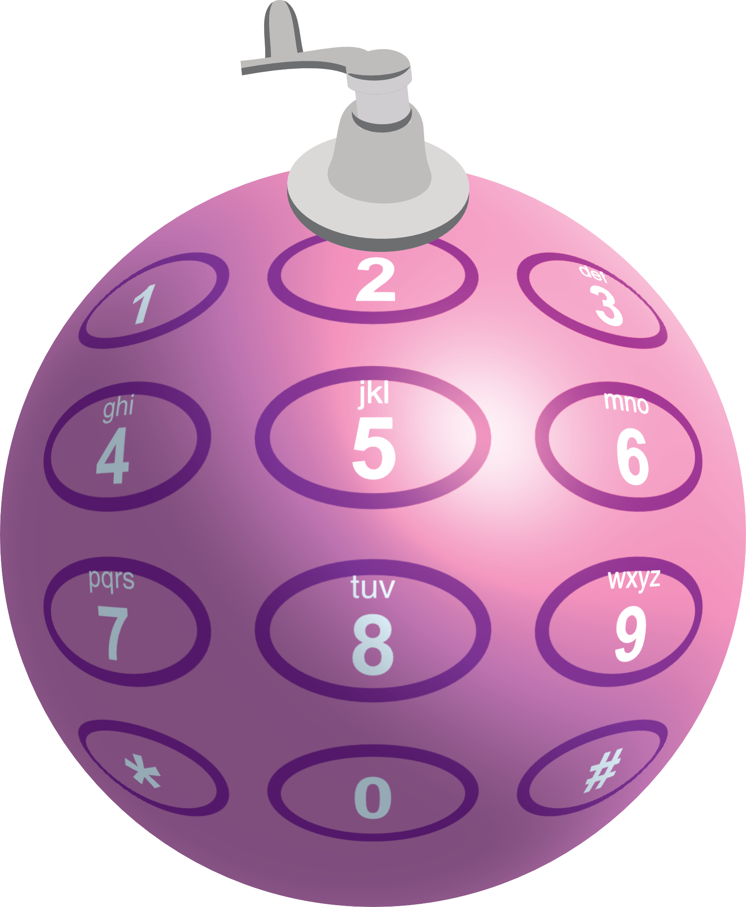
Perphenazine (TRILAFON)
per FEN uh zeen / TRIL uh fon
“Perple Trial phone”
1957
$31–$115
TRIAL PHONE
When choosing a medium potency FGA, the author prefers loxapine (Loxitane) over perphenazine because loxapine has fewer relevant kinetic interactions.
Phenothiazine
structure
When choosing a medium potency FGA, the author prefers loxapine (Loxitane) over perphenazine because loxapine has fewer relevant kinetic interactions.
Perphenazine is such a sensitive 2D6 substrate that the FDA recommends 2D6 genotype testing before it is started, because levels will be increased 3-fold for 2D6 poor metabolizers.
2
4
8
16
mg

Slide 176
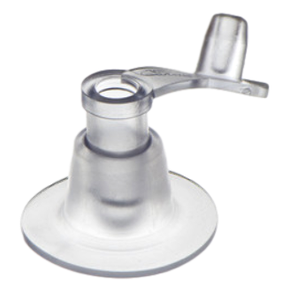
For 2D6 “POOR ME”tabolizers (PM), air accumulates, resulting in unexpectedly long half-lives for 2D6 substrates. These individuals are more likely to report side effects.
Poor me!
PM
Perphenazine is such a sensitive 2D6 substrate that the FDA recommends 2D6 genotype testing before it is started, because levels will be increased 3-fold for 2D6 poor metabolizers.

Slide 177
Perphenazine (TRILAFON)
per FEN uh zeen / TRIL uh fon
“Perple Trial phone”
1957
$31–$115
TRIAL PHONE
Even though perphenazine's half-life is about 10 hours, maintenance dosing can be once daily. For antipsychotics in general, continuous dopamine D2 receptor blockade is not necessary to sustain antipsychotic response (Takeuchi et al, 2014).
Phenothiazine
structure
2
4
8
16
mg

Slide 178
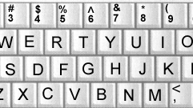
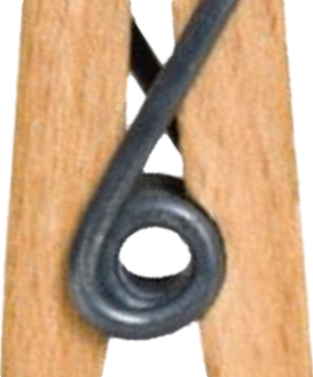
SGAs are substrates (victims) in kinetic drug-drug interactions
(not clinically significant inDucers or inHibitors)
1A2 substrates
“-pine” trees
Olanzapine
ZYPREXA
3A4 substrates (fish)
Cariprazine
VRAYLAR
Clozapine
CLOZARIL
Lumateperone
CAPLYTA
Lurasidone
LATUDA
Quetiapine
SEROQUEL
Asenapine
SAPHRIS
Pimavanserin
NUPLAZID
Aripiprazole
ABILIFY
Brexpiprazole REXULTI
Iloperidone
FANAPT
Risperidone
RISPERDAL
“Boxes” - few relevant kinetic interactions
Ziprasidone
GEODON
Paliperidone
INVEGA
2D6 substrates (beach balls)

Slide 179
Vs Haloperidol
53
3,666
377
12
10,000
0.7
0.2
5-9
1800
3

Slide 180
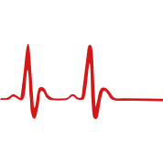
Ziprasidone (GEODON)
zi PRAY si dohn / GEE o don
“Geode Don’s Zipper”
geode
2001
$32–$292
❖ Antipsychotic (SGA)
❖ D2 antagonist - ⇩ DA
❖ 5-HT_{2A} antagonist - ⇧ DA
FDA-approved for:
❖ Schizophrenia
❖ Bipolar mania
❖ Schizophrenia-associated
agitation (IM)
Used off-label for:
❖ Bipolar maintenance
❖ Impulse control disorders
❖ Delirium
❖ Agitation of any type (IM)
QT
prolong-
ation
“In a box” – few relevant kinetic interactions
DRESS syndrome
20
40
60
80
mg

Slide 181
Ziprasidone
GEODON

Slide 182
Ziprasidone
GEODON
no anticholinergic effects

Slide 183
Ziprasidone
GEODON
no anticholinergic effects
Weak NE and 5-HT reuptake inhibitor

Slide 184
SGAs are substrates (victims) in kinetic drug-drug interactions
(not clinically significant inDucers or inHibitors)
1A2 substrates
“-pine” trees
Olanzapine
ZYPREXA
3A4 substrates (fish)
Cariprazine
VRAYLAR
Clozapine
CLOZARIL
Lumateperone
CAPLYTA
Lurasidone
LATUDA
Quetiapine
SEROQUEL
Asenapine
SAPHRIS
Pimavanserin
NUPLAZID
Aripiprazole
ABILIFY
Brexpiprazole REXULTI
Iloperidone
FANAPT
Risperidone
RISPERDAL
“Boxes” - few relevant kinetic interactions
Ziprasidone
GEODON
Paliperidone
INVEGA
2D6 substrates (beach balls)

Slide 185
clozapine
SGAs
D2
“-pines”
olanzapine
olanzapine
quetiapine
quetiapine
asenapine
“-dones and a -rone”
risperidone
risperidone
paliperidone
ziprasidone
ziprasidone
iloperidone
iloperidone
lurasidone
lurasidone
D2
lumateperone
lumateperone
“2 -pips & a rip”
aripiprazole
brexpiprazole
brexpiprazole
cariprazine
cariprazine

Slide 186
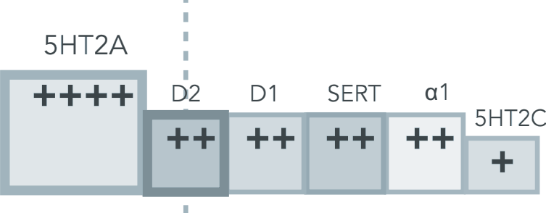
SGAs
D2
clozapine
“-pines”
olanzapine
quetiapine
asenapine
“-dones and a -rone”
risperidone
paliperidone
ziprasidone
iloperidone
lurasidone
D2
lumateperone
“2 -pips & a rip”
aripiprazole
brexpiprazole
cariprazine

Slide 187
clozapine
5HT2A
“-pines”
olanzapine
quetiapine
asenapine
“-dones and a -rone”
risperidone
paliperidone
ziprasidone
ziprasidone
iloperidone
iloperidone
lurasidone
lurasidone
5HT2A
lumateperone
lumateperone
“2 -pips & a rip”
aripiprazole
brexpiprazole
brexpiprazole
cariprazine
cariprazine

Slide 188
clozapine
5HT2A
“-pines”
olanzapine
quetiapine
asenapine
“-dones and a -rone”
risperidone
paliperidone
ziprasidone
ziprasidone
iloperidone
iloperidone
lurasidone
lurasidone
5HT2A
lumateperone
lumateperone
“2 -pips & a rip”
Are “atypical” antipsychotics by virtue of D2 receptor partial agonism.
aripiprazole
brexpiprazole
brexpiprazole
cariprazine
cariprazine

