Slide 1
Mood Stabilizers
Jason Cafer MD

Slide 2
What’s a mood stabilizer?
What’s a mood stabilizer?

Slide 3
What’s a mood stabilizer?
Arbitrary category of medications for bipolar disorder

Slide 4
What’s a mood stabilizer?
Arbitrary category of medications for bipolar disorder
U.S. Food and Drug Administration (FDA) does not officially recognize the term.

Slide 5
What’s a mood stabilizer?
Arbitrary category of medications for bipolar disorder
U.S. Food and Drug Administration (FDA) does not officially recognize the term.
No consensus definition is accepted among investigators.

Slide 6
What’s a mood stabilizer?
Arbitrary category of medications for bipolar disorder
U.S. Food and Drug Administration (FDA) does not officially recognize the term.
No consensus definition is accepted among investigators.
“Mood stabilizer” was a marketing term for valproate (Depakote) as a comparison to lithium

Slide 7
What’s a mood stabilizer?
Since there is no FDA-approved “mood stabilizer…

Slide 8
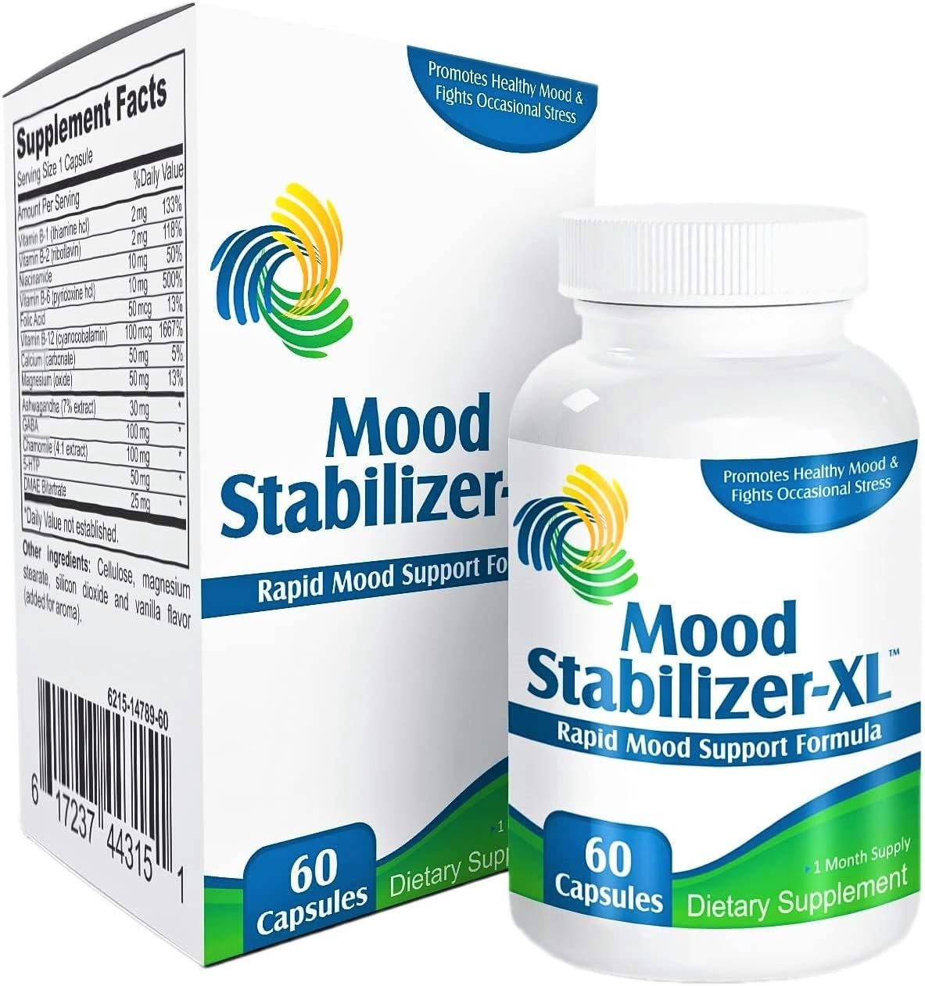
What’s a mood stabilizer?
Since there is no FDA-approved “mood stabilizer…
OTC supplements can claim to be mood stabilizers

Slide 9
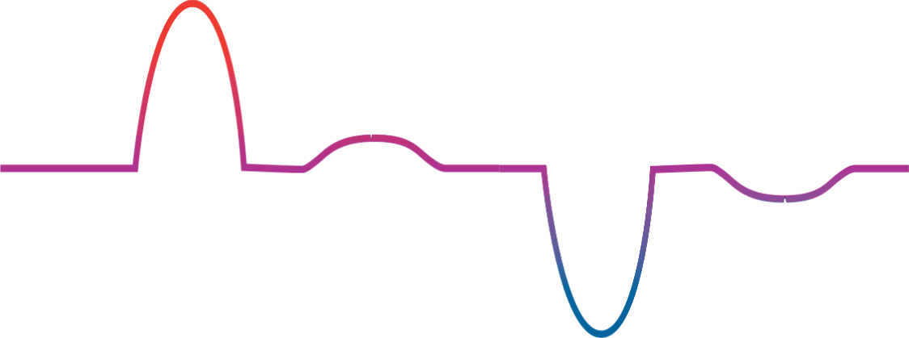
Bipolar disorder
mania
elevated mood
hypomania
Mild depression
severe
depression
depressed mood

Slide 10
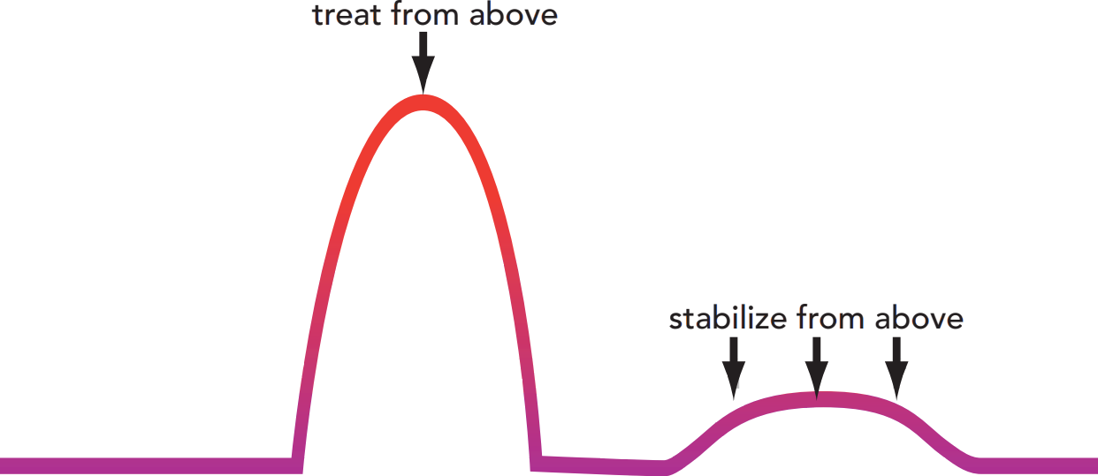
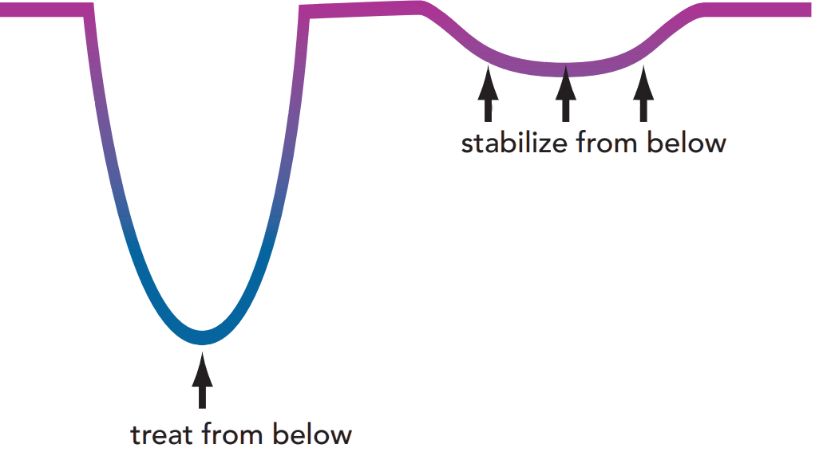
elevated mood
depressed mood

Slide 11
Lithium does all 4 (relative weakness for acute depressive episodes.
elevated mood
( )
depressed mood

Slide 12
Valproate (Depakote) is mostly antimanic.
elevated mood
( )
( )
depressed mood

Slide 13
Ditto for carbamazepine (Tegretol) – mostly antimanic
elevated mood
( )
( )
depressed mood

Slide 14
Lamotrigine is a true “mood stabilizer” but ineffective in treatment of mania.
elevated mood
depressed mood

Slide 15
Quetiapine (Seroquel) is a great mood stabilizer (and not much of an antipsychotic), but we call it an antipsychotic.
elevated mood
depressed mood

Slide 16
What’s a mood stabilizer?
Most psychiatrists consider these to be mood stabilizers:

Slide 17
What’s a mood stabilizer?
Most psychiatrists consider these to be mood stabilizers:
Lithium

Slide 18
What’s a mood stabilizer?
Most psychiatrists consider these to be mood stabilizers:
Lithium
Valproate (Depakote)

Slide 19
What’s a mood stabilizer?
Most psychiatrists consider these to be mood stabilizers:
Lithium
Valproate (Depakote)
Carbamazepine (Tegretol)

Slide 20
What’s a mood stabilizer?
Most psychiatrists consider these to be mood stabilizers:
Lithium
Valproate (Depakote)
Carbamazepine (Tegretol)
Lamotrigine (Lamictal)

Slide 21
What’s a mood stabilizer?
Most psychiatrists consider these to be mood stabilizers:
Lithium
Valproate (Depakote)
Carbamazepine (Tegretol)
Lamotrigine (Lamictal)
And possibly oxcarbazepine (Trileptal), off-label.

Slide 22
What’s a mood stabilizer?
Most psychiatrists consider these to be mood stabilizers:
Lithium
Valproate (Depakote)
Carbamazepine (Tegretol)
Lamotrigine (Lamictal)
And possibly oxcarbazepine (Trileptal), off-label.
And possibly other antiepileptic drugs with mood stabilizing properties (topiramate, gabapentin, pregabalin, eslicarbazepine).

Slide 23
What’s a mood stabilizer?
Most psychiatrists consider these to be mood stabilizers:
Lithium
Valproate (Depakote)
Carbamazepine (Tegretol)
Lamotrigine (Lamictal)
And possibly oxcarbazepine (Trileptal), off-label.
And possibly other antiepileptic drugs with mood stabilizing properties.
Most psychiatrists disqualify antipsychotics, e.g., quetiapine (Seroquel), even if they are effective in stabilizing bipolar disorder.

Slide 24
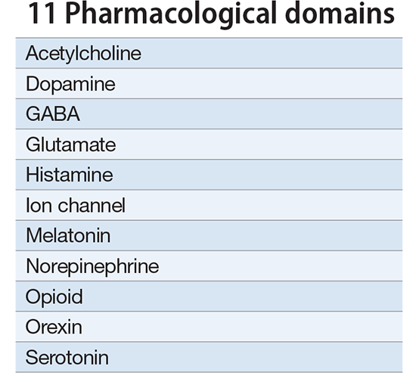
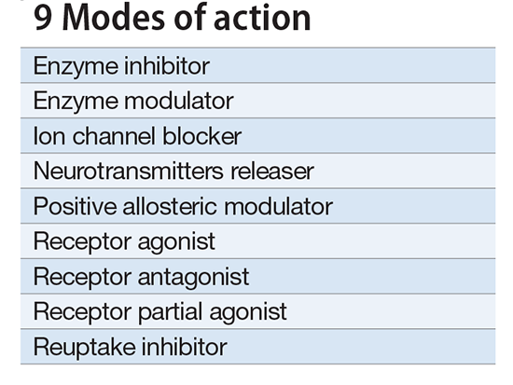
Neuroscience-based Nomenclature

Slide 25
Neuroscience-based Nomenclature

Slide 26
Neuroscience-based Nomenclature
the brain’s ________ neurotransmitter

Slide 27
Neuroscience-based Nomenclature
the brain’s excitatory neurotransmitter

Slide 28
Neuroscience-based Nomenclature
lithium
the brain’s excitatory neurotransmitter

Slide 29
Neuroscience-based Nomenclature
lithium
antiepileptic drugs (AEDs)
the brain’s excitatory neurotransmitter

Slide 30
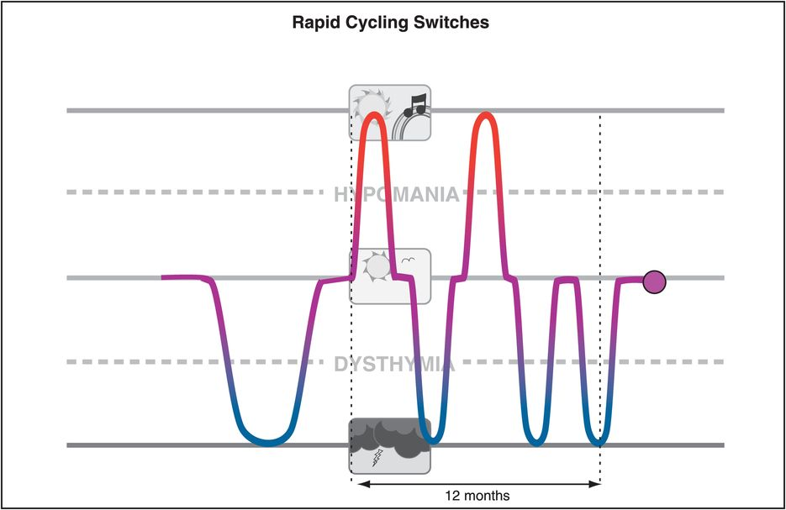
Antidepressants for Bipolar Disorder
Antidepressants are often “mood destabilizers” in bipolar disorder.

Slide 31
Antidepressants for Bipolar Disorder
Antidepressants are often “mood destabilizers” in bipolar disorder.
Antidepressants are ineffective in bipolar disorder, slightly inferior to placebo in large STEP-BD trial.

Slide 32
Antidepressants for Bipolar Disorder
Antidepressants are often “mood destabilizers” in bipolar disorder.
Antidepressants are ineffective in bipolar disorder, slightly inferior to placebo in large STEP-BD trial.
Despite preselection for good antidepressant response and concurrent mood stabilizer treatment, antidepressant continuation in rapid-cycling was associated with worsened maintenance outcomes, especially for depressive morbidity, versus antidepressant discontinuation.

Slide 33
Antidepressants for Bipolar Disorder
Antidepressants are often “mood destabilizers” in bipolar disorder.
Antidepressants are ineffective in bipolar disorder, slightly inferior to placebo in large STEP-BD trial.
Despite preselection for good antidepressant response and concurrent mood stabilizer treatment, antidepressant continuation in rapid-cycling was associated with worsened maintenance outcomes, especially for depressive morbidity, versus antidepressant discontinuation.
In one-third of treatment-refractory bipolar patients, mania is likely to be antidepressant-induced and not attributable to the expected course of illness.

Slide 34
Antidepressants for Bipolar Disorder
Antidepressants are often “mood destabilizers” in bipolar disorder.
Antidepressants are ineffective in bipolar disorder, slightly inferior to placebo in large STEP-BD trial.
Despite preselection for good antidepressant response and concurrent mood stabilizer treatment, antidepressant continuation in rapid-cycling was associated with worsened maintenance outcomes, especially for depressive morbidity, versus antidepressant discontinuation.
In one-third of treatment-refractory bipolar patients, mania is likely to be antidepressant-induced and not attributable to the expected course of illness.
In STEP-BD the most important risk factor for recurrence of depression was residual subthreshold mood elevation.

Slide 35
Antidepressants for Bipolar Disorder
Antidepressants are often “mood destabilizers” in bipolar disorder.
Antidepressants are ineffective in bipolar disorder, slightly inferior to placebo in large STEP-BD trial.
Despite preselection for good antidepressant response and concurrent mood stabilizer treatment, antidepressant continuation in rapid-cycling was associated with worsened maintenance outcomes, especially for depressive morbidity, versus antidepressant discontinuation.
In one-third of treatment-refractory bipolar patients, mania is likely to be antidepressant-induced and not attributable to the expected course of illness.
In STEP-BD the most important risk factor for recurrence of depression was residual subthreshold mood elevation.
For bipolar patients who are depressed, antidepressants should be tapered off.

Slide 36
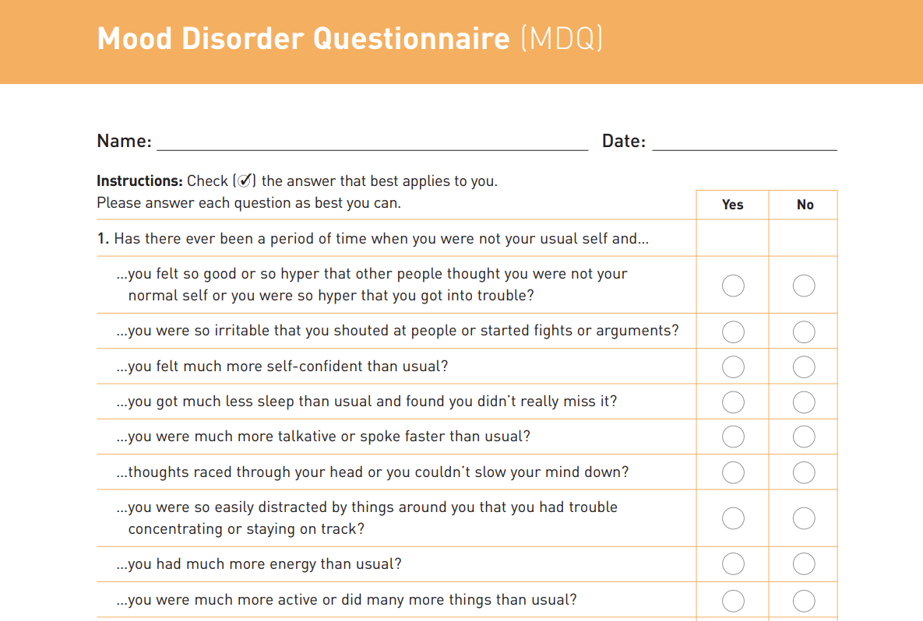
“Invincible”

Slide 37
Notes:
Lithium - third thing to exist. Hydrogen, Helium, Lithium.

Slide 38
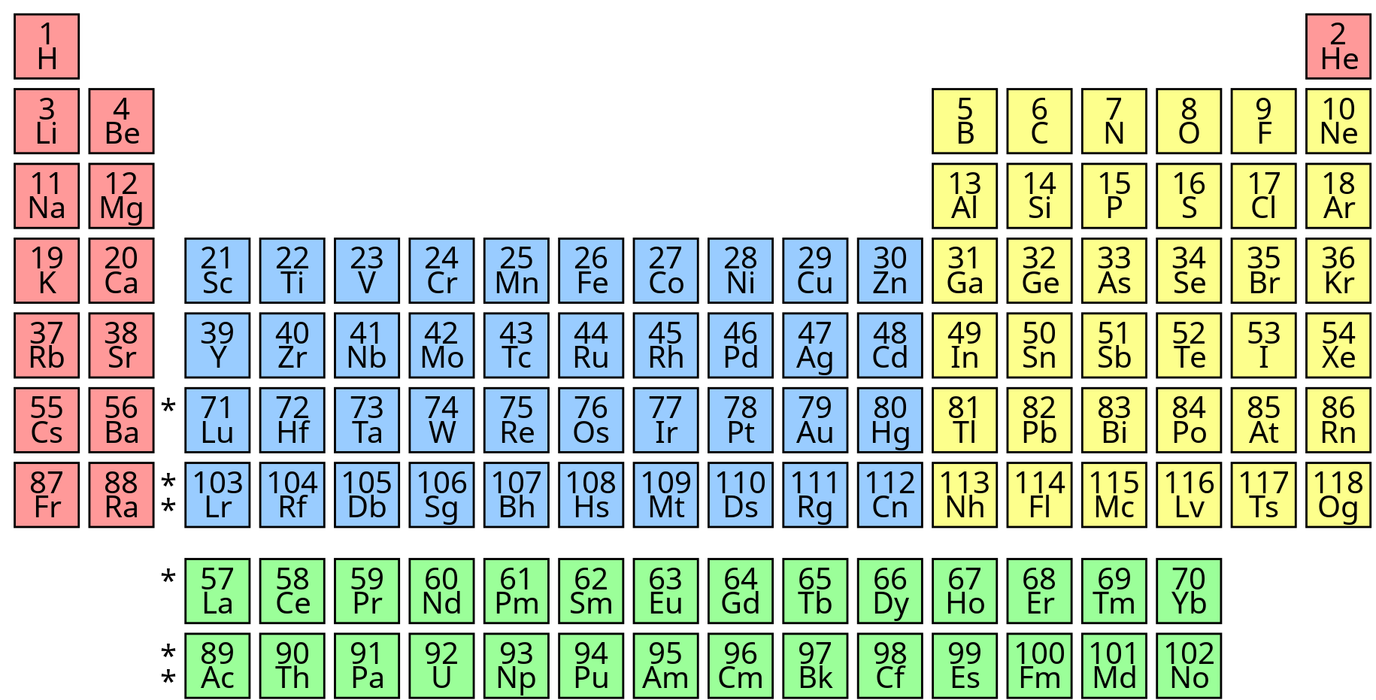
Notes:
Lithium - third thing to exist. Hydrogen, Helium, Lithium.

Slide 39
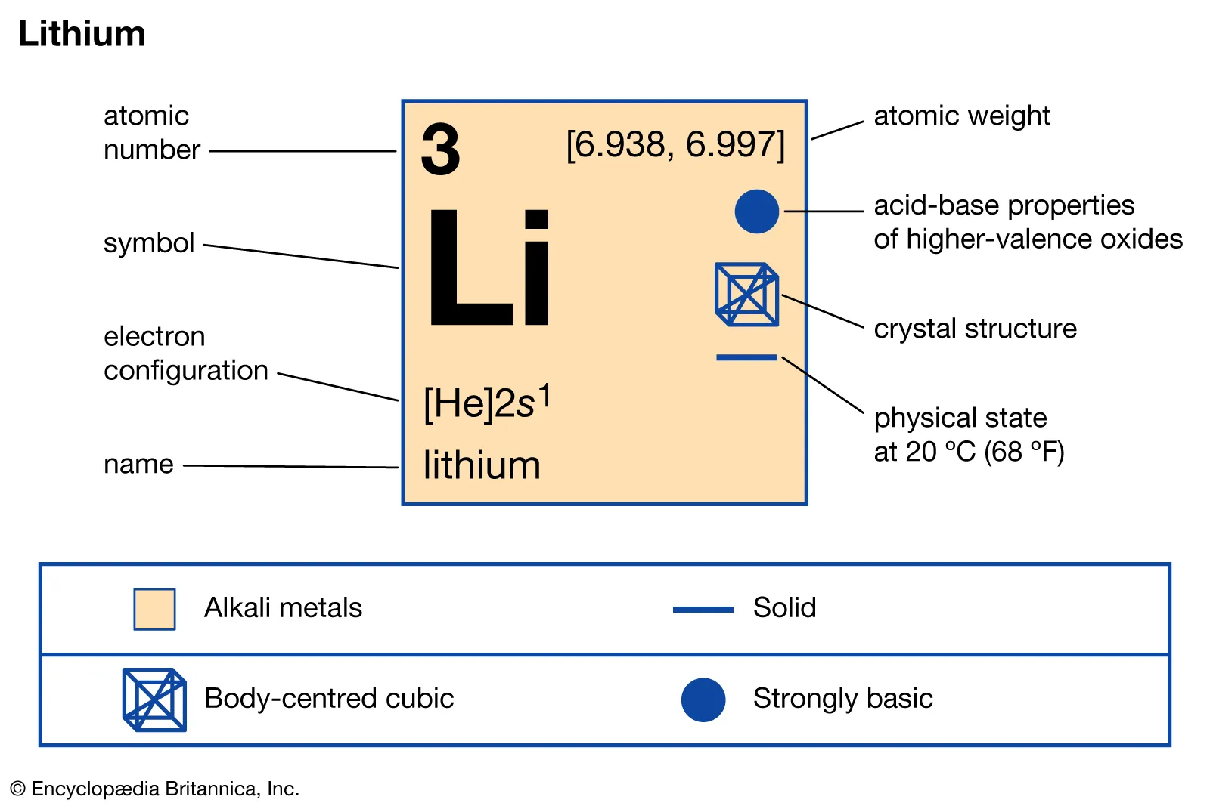
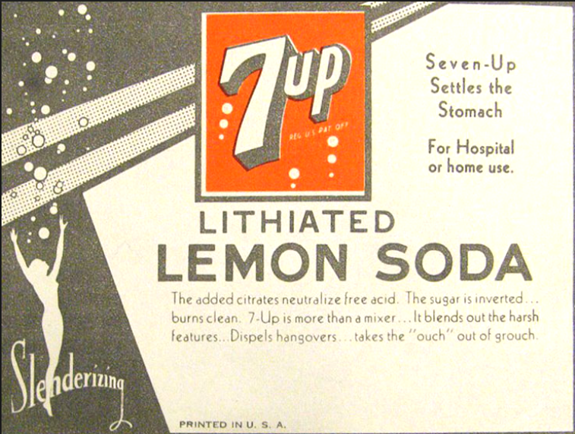
7-up contained lithium until 1950

Slide 40
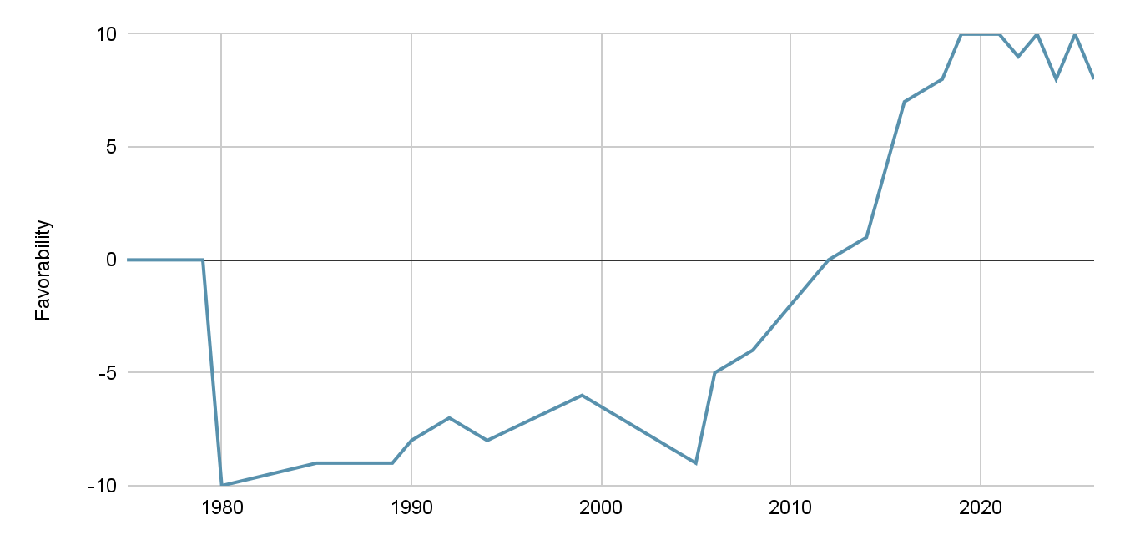
Personal perception of lithium as an ingestible
Lithium is in batteries

Slide 41
Personal perception of lithium as an ingestible
What changed my mind?

Slide 42
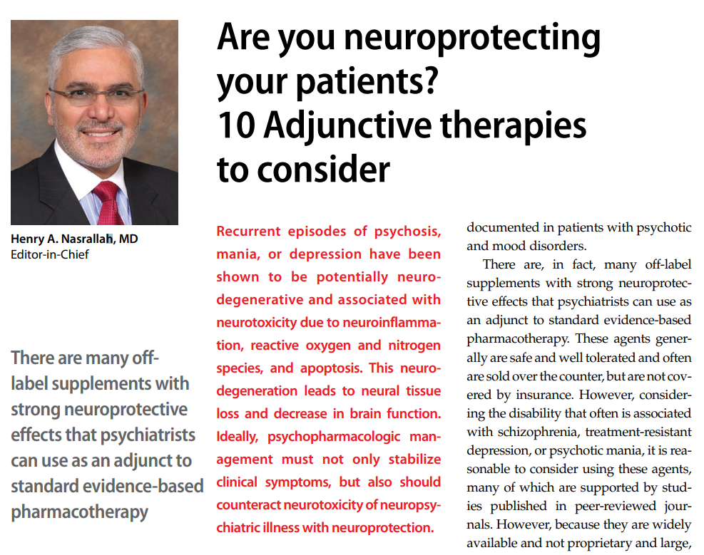
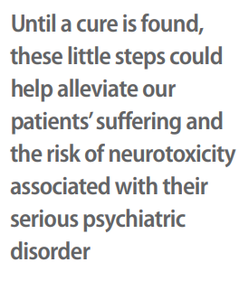
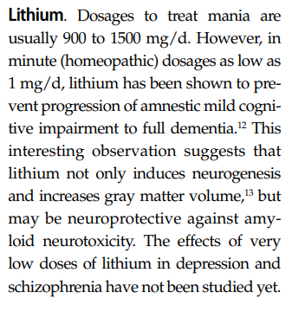
Current Psychiatry
December 2016
Forlenza OV, Diniz BS, Radanovic M, et al. Disease modifying properties of long-term lithium treatment for amnestic mild cognitive impairment: randomised controlled trial. Br J Psychiatry. 2011;198(5):351-356.

Slide 43
Current Psychiatry
December 2016
Forlenza OV, Diniz BS, Radanovic M, et al. Disease modifying properties of long-term lithium treatment for amnestic mild cognitive impairment: randomised controlled trial. Br J Psychiatry. 2011;198(5):351-356.

Slide 44
Current Psychiatry
December 2016
Forlenza OV, Diniz BS, Radanovic M, et al. Disease modifying properties of long-term lithium treatment for amnestic mild cognitive impairment: randomised controlled trial. Br J Psychiatry. 2011;198(5):351-356.

Slide 45
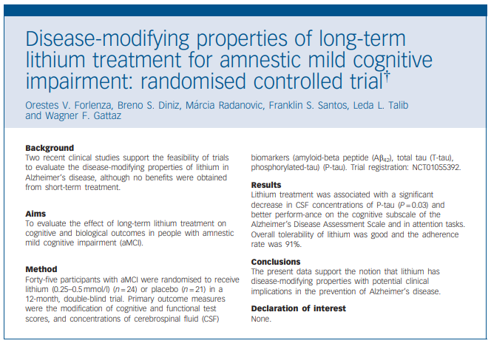
Lithium level 0.25 - 0.5
1 year
Improved cognition
Decrease in tau proteins
Forlenza OV, Diniz BS, Radanovic M, et al. Disease modifying properties of long-term lithium treatment for amnestic mild cognitive impairment: randomised controlled trial. Br J Psychiatry. 2011;198(5):351-356.
Notes:
Don’t worry, I’ll tell you about the other 9 neuroprotections…
Think about disease modifying… donepezil, and memantine don’t do this. neurofibrillary tangles composed of tau protein. 2 new antibody treatments that are disease modifying. Prevagen.

Slide 46
Lithium - neuroprotection
Neuroprotective Effects of Lithium: Implications for the Treatment of Alzheimer’s Disease and Related Neurodegenerative Disorders O. V. Forlenza et al. ACS Chemical Neuroscience 2014.
Notes:
Other neurodegenerative diseases. +-Overlapping mechanisms with other neuroprotectants.

Slide 47
Lithium - neuroprotection
Neuroprotective Effects of Lithium: Implications for the Treatment of Alzheimer’s Disease and Related Neurodegenerative Disorders O. V. Forlenza et al. ACS Chemical Neuroscience 2014.
Notes:
Other neurodegenerative diseases. +-Overlapping mechanisms with other neuroprotectants.

Slide 48
Lithium - neuroprotection
Neuroprotective Effects of Lithium: Implications for the Treatment of Alzheimer’s Disease and Related Neurodegenerative Disorders O. V. Forlenza et al. ACS Chemical Neuroscience 2014.
Notes:
Other neurodegenerative diseases. +-Overlapping mechanisms with other neuroprotectants.

Slide 49
Lithium - neuroprotection
Neuroprotective Effects of Lithium: Implications for the Treatment of Alzheimer’s Disease and Related Neurodegenerative Disorders O. V. Forlenza et al. ACS Chemical Neuroscience 2014.
Notes:
Other neurodegenerative diseases. +-Overlapping mechanisms with other neuroprotectants.

Slide 50
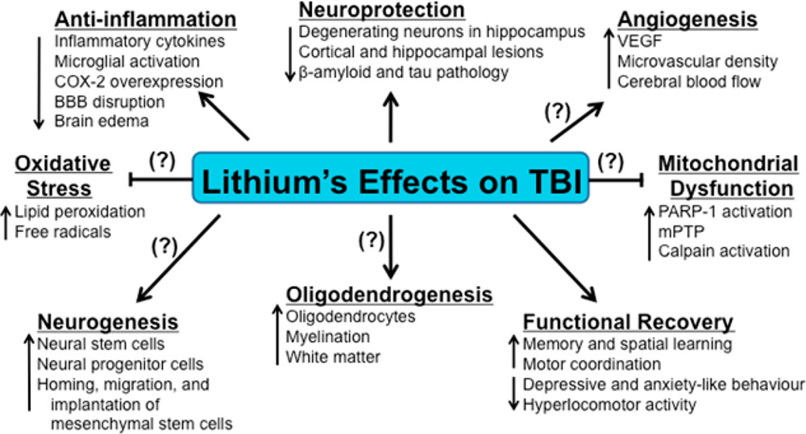
Lithium - neuroprotection post-TBI
ACS Chem. Neurosci. 2014, 5, 6, 422–433 Publication Date:April 3, 2014 https://doi.org/10.1021/cn500040g

Slide 51
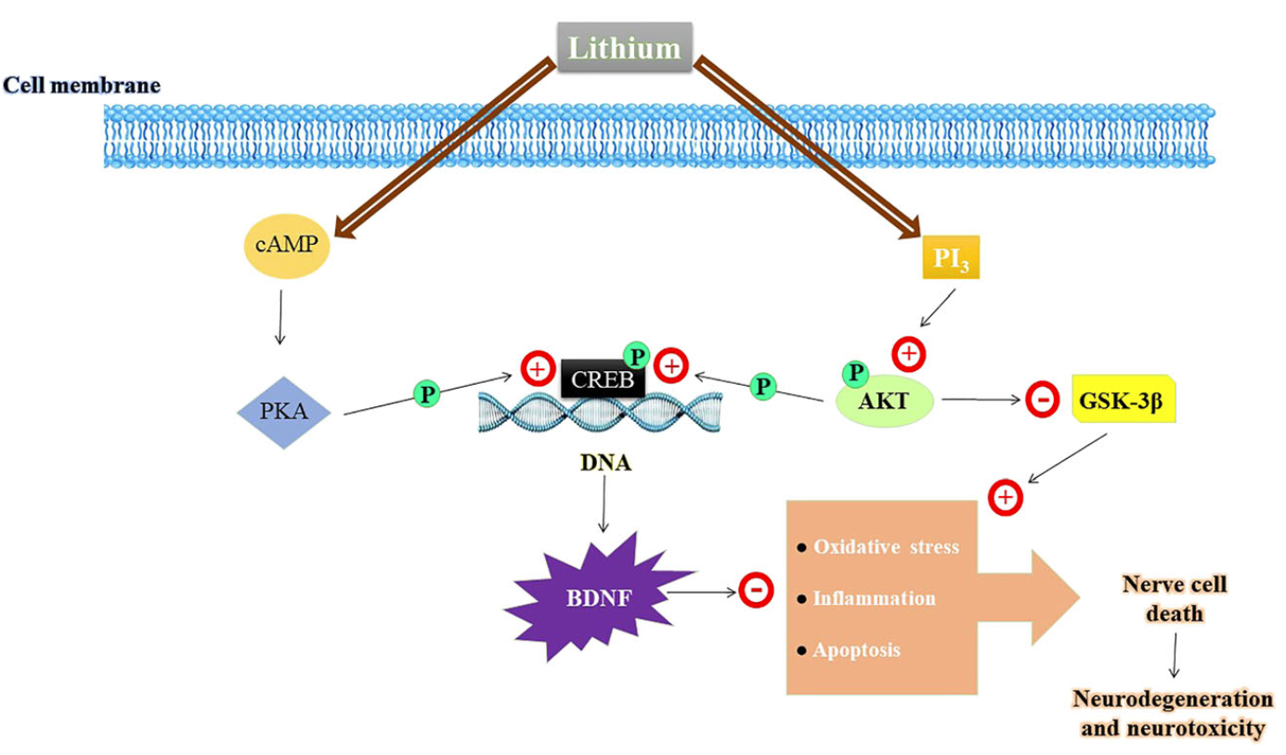
Lithium - neuroprotection
Brain-Derived Neurotrophic Factor
Jin Yan, Yuan Zhang, Lin Wang, Zhao Li, Shuang Tang, Yingwen Wang, Nina Gu, Xiaochuan Sun, Lin Li, TREM2 activation alleviates neural damage via Akt/CREB/BDNF signalling after traumatic brain injury in mice, Journal of Neuroinflammation, 10.1186/s12974-022-02651-3, 19, 1, (2022).
Notes:
Brain-Derived Neurotrophic Factor is involved

Slide 52
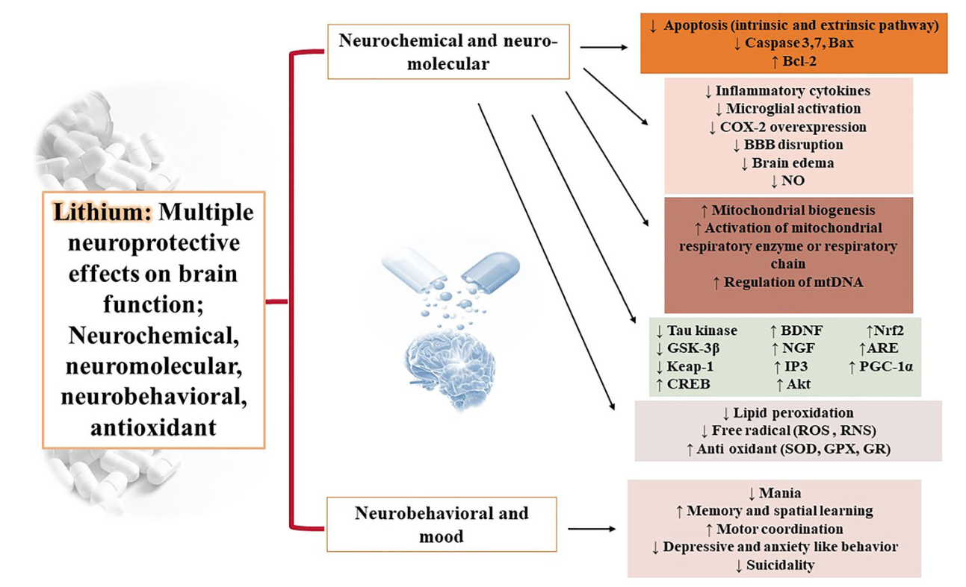
Lithium - neuroprotection
Jin Yan, Yuan Zhang, Lin Wang, Zhao Li, Shuang Tang, Yingwen Wang, Nina Gu, Xiaochuan Sun, Lin Li, TREM2 activation alleviates neural damage via Akt/CREB/BDNF signalling after traumatic brain injury in mice, Journal of Neuroinflammation, 10.1186/s12974-022-02651-3, 19, 1, (2022).
Notes:
Mitochondrial biogenesis is involved

Slide 53
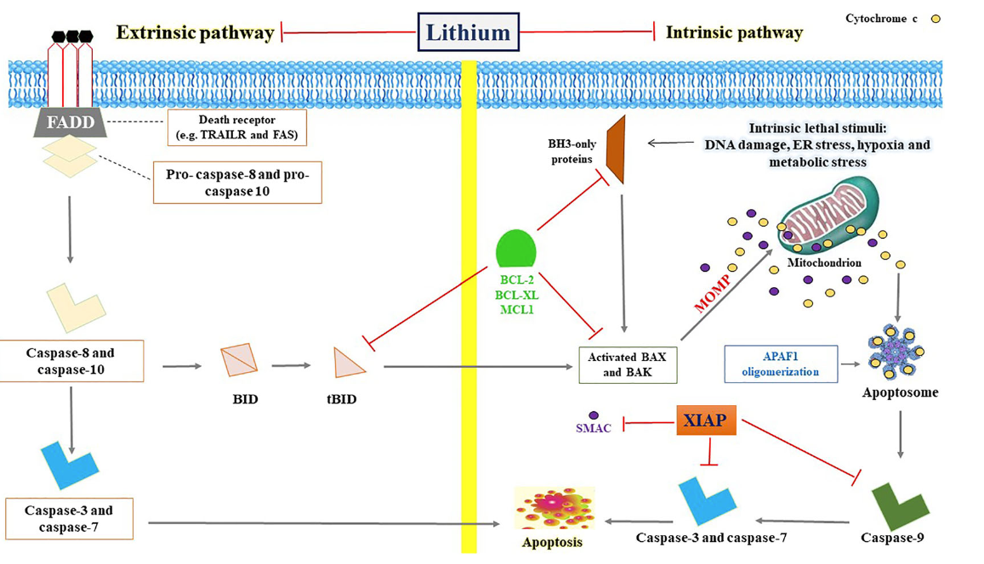
Lithium - neuroprotection
Neuroprotective Effects of Lithium: Implications for the Treatment of Alzheimer’s Disease and Related Neurodegenerative Disorders O. V. Forlenza et al. ACS Chemical Neuroscience 2014.
Notes:
Again, mitochondria, the powerhouse of the cell

Slide 54
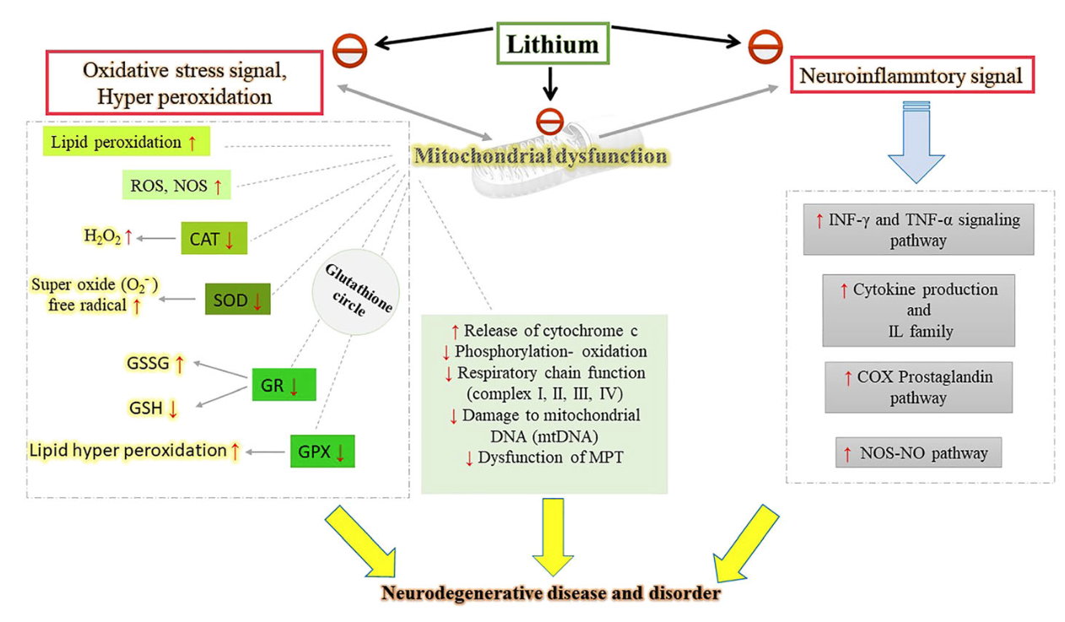
Lithium - neuroprotection
Souder, D.C., Anderson, R.M. An expanding GSK3 network: implications for aging research. GeroScience 41, 369–382 (2019). https://doi.org/10.1007/s11357-019-00085-z
Notes:
Several mechanisms to change the course of neurodegenerative diseases.

Slide 55
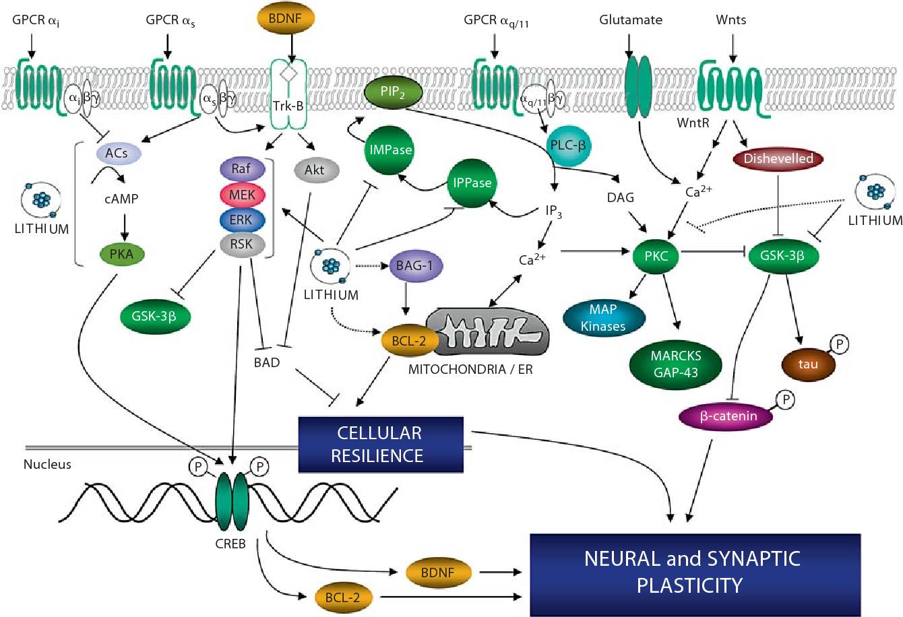
Lithium - neuroprotection
Quiroz, J.A., Machado-Vieira, R., Zarate Jr., C.A., & Manji, H.K. (2010). Novel Insights into Lithium’s Mechanism of Action: Neurotrophic and Neuroprotective Effects. Neuropsychobiology, 62, 50 - 60.
Notes:
Throughout the evolution of life, lithium has been present. It’s not surprising that it does things that no other psychotropic can.

Slide 56
Lithium - neuroprotection
Enzyme
modulator
Quiroz, J.A., Machado-Vieira, R., Zarate Jr., C.A., & Manji, H.K. (2010). Novel Insights into Lithium’s Mechanism of Action: Neurotrophic and Neuroprotective Effects. Neuropsychobiology, 62, 50 - 60.
Notes:
Throughout the evolution of life, lithium has been present. It’s not surprising that it does things that no other psychotropic can.

Slide 57
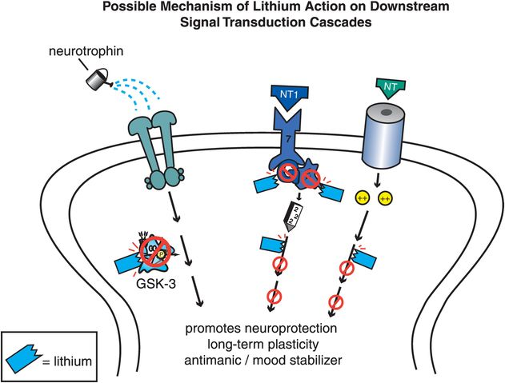
Lithium - neuroprotection
Stahl’s Essential Psychopharmacology

Slide 58
Lithium - neuroprotection
Enzyme
modulator
Stahl’s Essential Psychopharmacology

Slide 59
Lithium - neuroprotection
Stahl’s Essential Psychopharmacology

Slide 60
Lithium - neuroprotection
enzyme modulator
Stahl’s Essential Psychopharmacology

Slide 61
Lithium - neuroprotection
enzyme modulator
Stahl’s Essential Psychopharmacology
Notes:
Here’s the best explanation of lithium’s mechanism of action

Slide 62
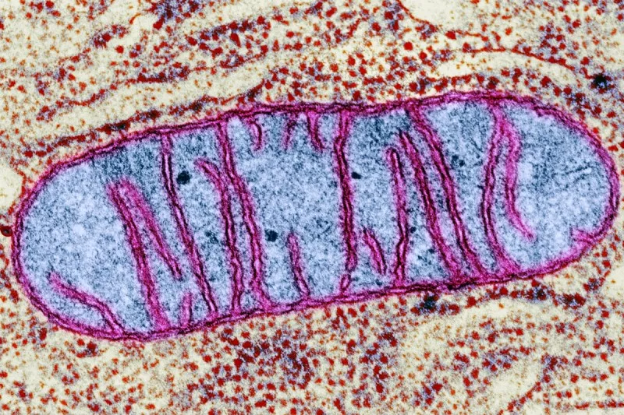
Lithium - neuroprotection
enzyme modulator
Stahl’s Essential Psychopharmacology
Notes:
Here’s the best explanation of lithium’s mechanism of action

Slide 63
Lithium
Neuroscience-based nomenclature:
enzyme modulator
Including inhibition of:
Inositol monophosphatase
Adenylyl-cyclase
Glycogen synthase kinase (GSK-3)
Protein kinase C (PKC)
Modulator of multiple intracellular signaling cascades
Neuroprotectant
Promotes mitochondrial health
Regulator of gene expression

Slide 64
Lithium
The other 9:
Current Psychiatry
December 2016
Forlenza OV, Diniz BS, Radanovic M, et al. Disease modifying properties of long-term lithium treatment for amnestic mild cognitive impairment: randomised controlled trial. Br J Psychiatry. 2011;198(5):351-356.

Slide 65
Lithium
The other 9:
Nicotine
Current Psychiatry
December 2016
Forlenza OV, Diniz BS, Radanovic M, et al. Disease modifying properties of long-term lithium treatment for amnestic mild cognitive impairment: randomised controlled trial. Br J Psychiatry. 2011;198(5):351-356.

Slide 66
Lithium
The other 9:
Nicotine
Caffeine
Current Psychiatry
December 2016
Forlenza OV, Diniz BS, Radanovic M, et al. Disease modifying properties of long-term lithium treatment for amnestic mild cognitive impairment: randomised controlled trial. Br J Psychiatry. 2011;198(5):351-356.

Slide 67
Lithium
The other 9:
Nicotine
Caffeine
Melatonin
Current Psychiatry
December 2016
Forlenza OV, Diniz BS, Radanovic M, et al. Disease modifying properties of long-term lithium treatment for amnestic mild cognitive impairment: randomised controlled trial. Br J Psychiatry. 2011;198(5):351-356.

Slide 68
Lithium
The other 9:
Nicotine
Caffeine
Melatonin
Omega-3 fatty acids
Current Psychiatry
December 2016
Forlenza OV, Diniz BS, Radanovic M, et al. Disease modifying properties of long-term lithium treatment for amnestic mild cognitive impairment: randomised controlled trial. Br J Psychiatry. 2011;198(5):351-356.

Slide 69
Lithium
The other 9:
Nicotine
Caffeine
Melatonin
Omega-3 fatty acids
N-Acetylcysteine (NAC)
Current Psychiatry
December 2016
Forlenza OV, Diniz BS, Radanovic M, et al. Disease modifying properties of long-term lithium treatment for amnestic mild cognitive impairment: randomised controlled trial. Br J Psychiatry. 2011;198(5):351-356.

Slide 70
Lithium
The other 9:
Nicotine
Caffeine
Melatonin
Omega-3 fatty acids
N-Acetylcysteine (NAC)
Vitamin D
Current Psychiatry
December 2016
Forlenza OV, Diniz BS, Radanovic M, et al. Disease modifying properties of long-term lithium treatment for amnestic mild cognitive impairment: randomised controlled trial. Br J Psychiatry. 2011;198(5):351-356.

Slide 71
Lithium
The other 9:
Nicotine
Caffeine
Melatonin
Omega-3 fatty acids
N-Acetylcysteine (NAC)
Vitamin D
COX-2 inhibitors (celecoxib)
Current Psychiatry
December 2016
Forlenza OV, Diniz BS, Radanovic M, et al. Disease modifying properties of long-term lithium treatment for amnestic mild cognitive impairment: randomised controlled trial. Br J Psychiatry. 2011;198(5):351-356.

Slide 72
Lithium
The other 9:
Nicotine
Caffeine
Melatonin
Omega-3 fatty acids
N-Acetylcysteine (NAC)
Vitamin D
COX-2 inhibitors (celecoxib)
Minocycline
Current Psychiatry
December 2016
Forlenza OV, Diniz BS, Radanovic M, et al. Disease modifying properties of long-term lithium treatment for amnestic mild cognitive impairment: randomised controlled trial. Br J Psychiatry. 2011;198(5):351-356.

Slide 73
Lithium
The other 9:
Nicotine
Caffeine
Melatonin
Omega-3 fatty acids
N-Acetylcysteine (NAC)
Vitamin D
COX-2 inhibitors (celecoxib)
Minocycline
Erythropoietin
Current Psychiatry
December 2016
Forlenza OV, Diniz BS, Radanovic M, et al. Disease modifying properties of long-term lithium treatment for amnestic mild cognitive impairment: randomised controlled trial. Br J Psychiatry. 2011;198(5):351-356.

Slide 74
ddd
Lithium in drinking water
Higher long-term lithium levels in drinking water were associated with a lower incidence of dementia.
Notes:
Denmark has a robust system for measuring trace metals and other contaminants in their water supply.

Slide 75
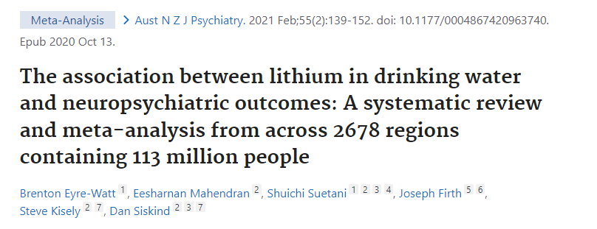
Lithium in drinking water
Higher lithium concentrations were associated with
Notes:
2021 meta-analysis - still appears to be true. Some studies showed fewer homicides.

Slide 76
Lithium in drinking water
Higher lithium concentrations were associated with
reduced suicide rates
Notes:
2021 meta-analysis - still appears to be true. Some studies showed fewer homicides.

Slide 77
Lithium in drinking water
Higher lithium concentrations were associated with
reduced suicide rates
reduced hospital admissions
Notes:
2021 meta-analysis - still appears to be true. Some studies showed fewer homicides.

Slide 78
Lithium in drinking water
Higher lithium concentrations were associated with
reduced suicide rates
reduced hospital admissions
reduced homicide rates
Notes:
2021 meta-analysis - still appears to be true. Some studies showed fewer homicides.

Slide 79
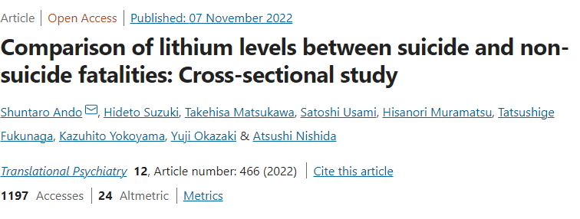
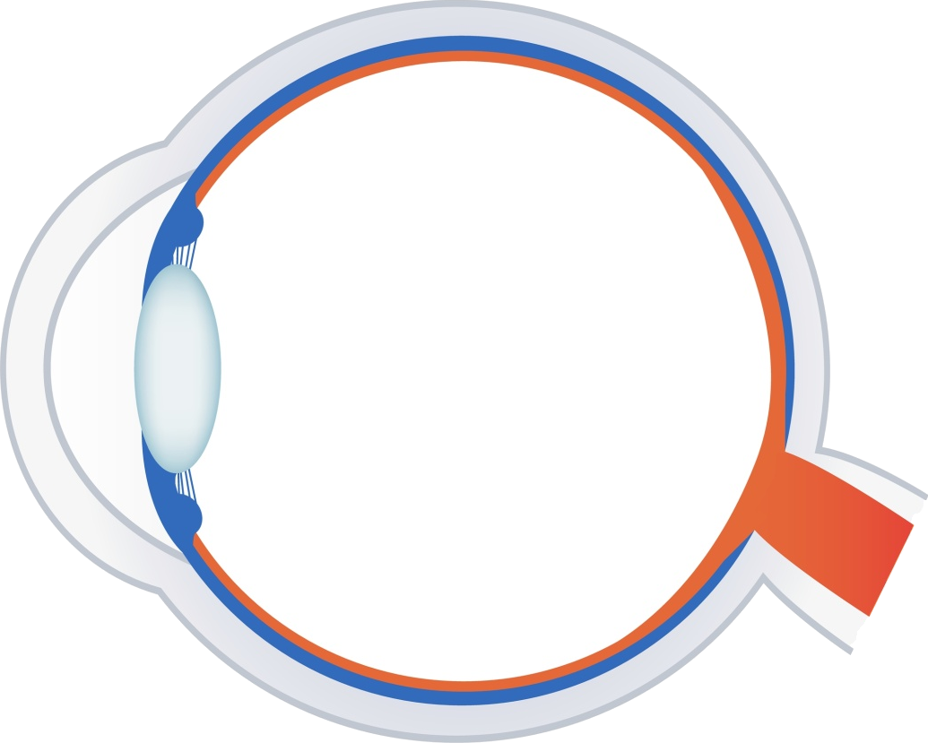
Lithium anti-suicide effects
Aqueous
humor
In Tokyo, Ando et al (2022) compared body lithium levels between suicide and non-suicide fatalities as measured in aqueous humor. This was a small study including 12 suicides and 16 non-suicides.
The aqueous humor lithium concentration was significantly lower in suicides (mean 0.50 μg/L) than in non-suicides (0.92 μg/L). The authors concluded that lower lithium concentration was associated with suicide with large effect size.

Slide 80
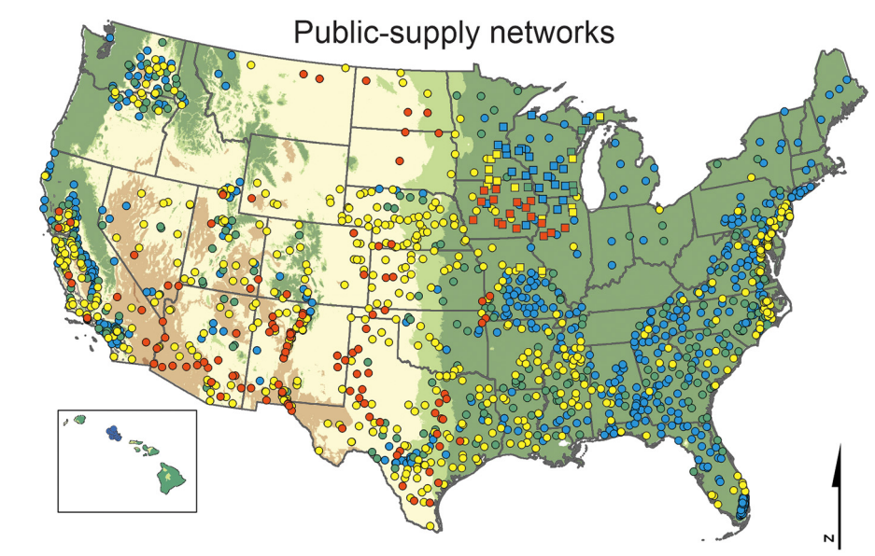
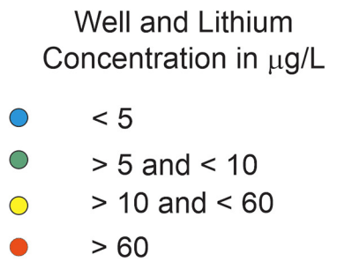
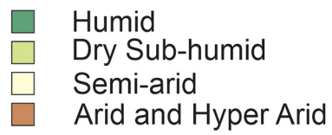
Bruce D. Lindsey, et al. Lithium in groundwater used for drinking-water supply in the United States,Science of The Total Environment,Volume 767, 2021.
Notes:
Amount of lithium in water around here is low. Many places have 10x more lithium in water, especially northern texas.

Slide 81
Lithium - anti-aging
Castillo-Quan et al., Lithium Promotes Longevity through GSK3/NRF2-Dependent Hormesis, Cell Reports (2016) http://dx.doi.org/10.1016
Notes:
Lithium may not only prevent aging of the brain, but aging throughout. It extended the lifespan and health span of yeast and fruit flies.

Slide 82
Lithium - anti-aging
Enzyme
modulator
Castillo-Quan et al., Lithium Promotes Longevity through GSK3/NRF2-Dependent Hormesis, Cell Reports (2016) http://dx.doi.org/10.1016
Notes:
Lithium may not only prevent aging of the brain, but aging throughout. It extended the lifespan and health span of yeast and fruit flies. Mice too but less dramatically.

Slide 83
Lithium - anti-aging
Enzyme
modulator
Castillo-Quan et al., Lithium Promotes Longevity through GSK3/NRF2-Dependent Hormesis, Cell Reports (2016) http://dx.doi.org/10.1016
Notes:
Lithium may not only prevent aging of the brain, but aging throughout. It extended the lifespan and health span of yeast and fruit flies. Mice too but less dramatically.

Slide 84
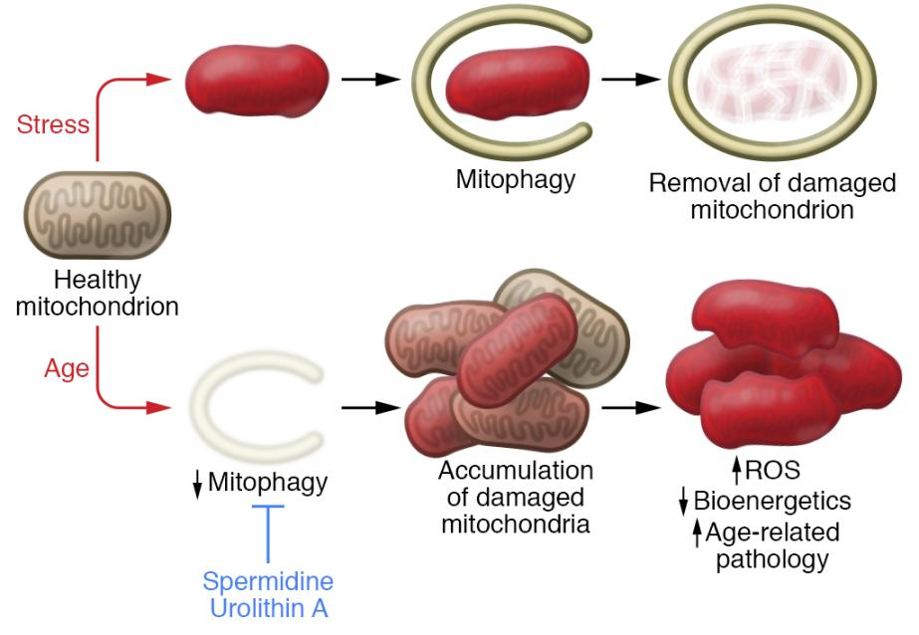
Lithium - anti-aging
Aging is in part due to mitochondrial dysfunction.
Damaged mitochondria pile up in the aging cell.
REVIEW article
Front. Psychiatry, 29 September 2020
Sec. Mood Disorders
https://doi.org/10.3389/fpsyt.2020.586083
This article is part of the Research Topic
Neurobiological Underpinnings of Bipolar Disorder and its Treatment
View all 6 Articles
Lithium and the Interplay Between Telomeres and Mitochondria in Bipolar Disorder
Mitochondrial dysfunction and telomere shortening have been implicated in both the pathophysiology of bipolar disorder and as targets of lithium treatment. Interestingly, it has in recent years become clear that these phenomena are intimately linked, partly through reactive oxygen species signaling and the subcellular translocation and non-canonical actions of telomerase reverse transcriptase. In this review, we integrate the current understanding of mitochondrial dysfunction, oxidative stress and telomere shortening in bipolar disorder with documented effects of lithium. Moreover, we propose that lithium’s mechanism of action is intimately connected with the interdependent regulation of mitochondrial bioenergetics and telomere maintenance.
Notes:
Some things accelerate the aging process, like Type 2 diabetes, obesity, even lack of sleep. Some things slow the aging process, including calorie restriction, exercise and certain chemicals. We age because every one of our cells age. Cells age when damaged mitochondria accumulate.

Slide 85
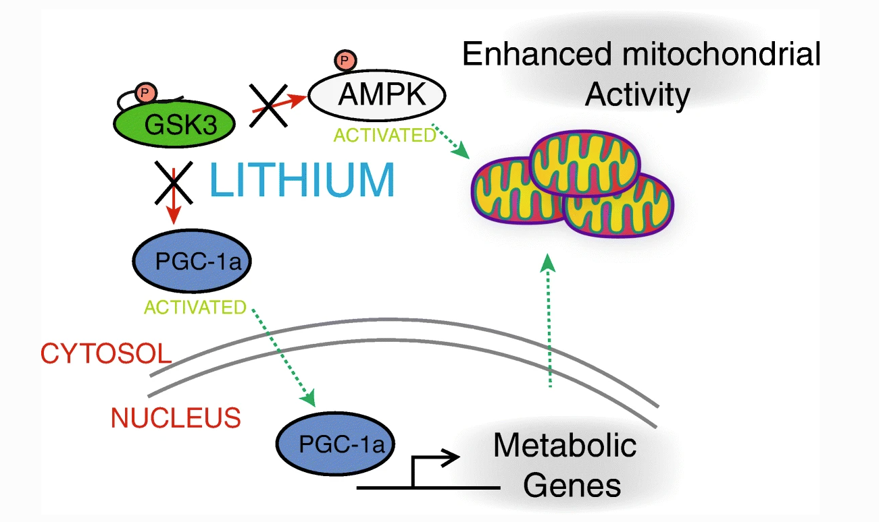
Lithium - anti-aging
Enzyme
modulator
Souder, D.C., Anderson, R.M. An expanding GSK3 network: implications for aging research. GeroScience 41, 369–382 (2019). https://doi.org/10.1007/s11357-019-00085-z
Notes:
Lithium improves mitochondrial dysfunction in cells throughout the body, not just in the brain.

Slide 86
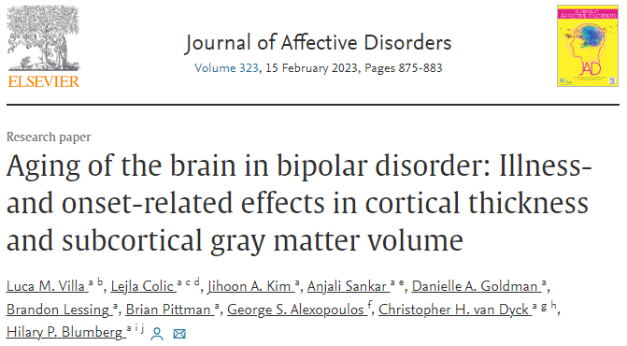
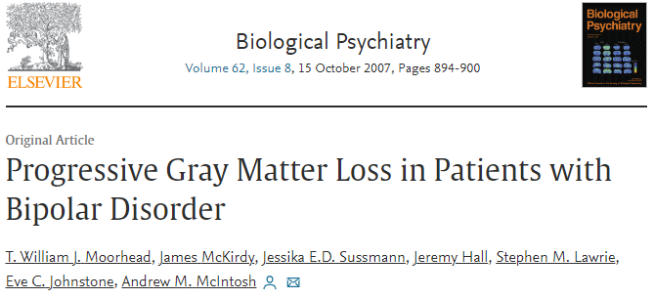
Accelerated aging in bipolar disorder
Bipolar disorder has been linked to accelerated aging mechanisms
Widespread gray matter decreases in older adults with bipolar disorder
Over a 4-year period: Patients with Bipolar I Disorder lose hippocampal, fusiform and cerebellar gray matter at an accelerated rate compared with healthy control subjects.
This tissue loss is associated with deterioration in cognitive function and illness course.

Slide 87
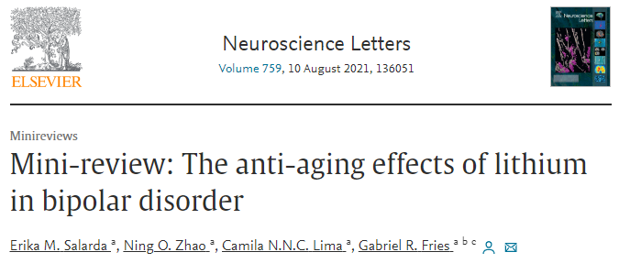
Accelerated aging in bipolar disorder
Lithium has been shown to counteract many aging mechanisms in bipolar
Squassina A, Pisanu C, Corbett N, Alda M, Telomere length in bipolar disorder and lithium response, Eur. Neuropsychopharmacol.27(2017) 560–567. 10.1016/j.euroneuro.2015
Martinsson L, Wei Y, Xu D, Melas PA, Mathé AA, Schalling M, Lavebratt C, Backlund L, Long-term lithium treatment in bipolar disorder is associated with longer leukocyte telomeres, Transl. Psychiatry. 3 (2013).
Notes:
Greater urgency in giving lithium to those with bipolar to preserve brain function and overall health

Slide 88
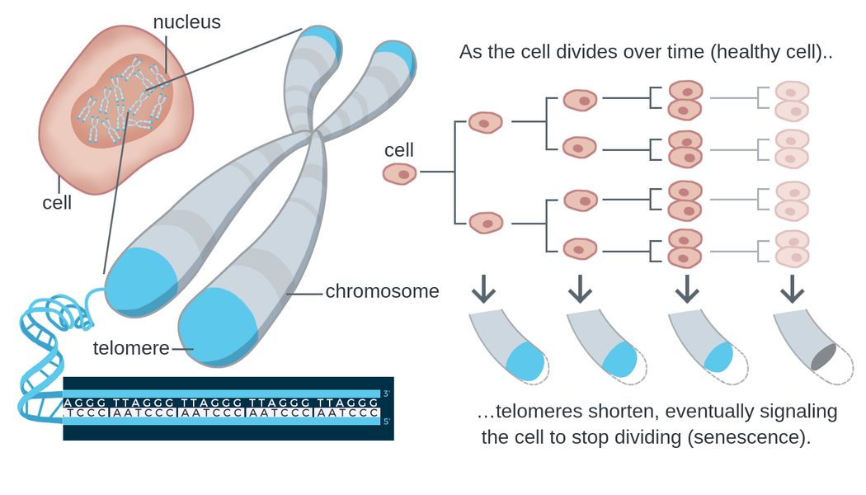
Lithium - anti-aging (bipolar)
Telomere shortening is a biomarker of aging.
https://theory.labster.com/telomere-length/
REVIEW article
Front. Psychiatry, 29 September 2020
Sec. Mood Disorders
https://doi.org/10.3389/fpsyt.2020.586083
This article is part of the Research Topic
Neurobiological Underpinnings of Bipolar Disorder and its Treatment
View all 6 Articles
Lithium and the Interplay Between Telomeres and Mitochondria in Bipolar Disorder
Mitochondrial dysfunction and telomere shortening have been implicated in both the pathophysiology of bipolar disorder and as targets of lithium treatment. Interestingly, it has in recent years become clear that these phenomena are intimately linked, partly through reactive oxygen species signaling and the subcellular translocation and non-canonical actions of telomerase reverse transcriptase. In this review, we integrate the current understanding of mitochondrial dysfunction, oxidative stress and telomere shortening in bipolar disorder with documented effects of lithium. Moreover, we propose that lithium’s mechanism of action is intimately connected with the interdependent regulation of mitochondrial bioenergetics and telomere maintenance.
Notes:
There are biomarkers that can estimate the biologic age of various organs, including the length of telomeres. Telomeres form protective caps at the ends of chromosomes.

Slide 89
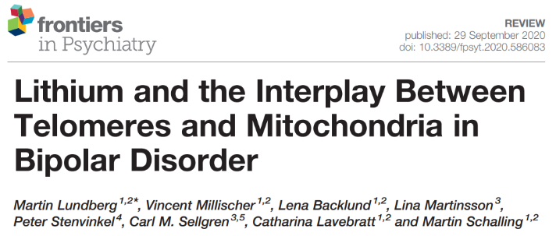
Lithium - anti-aging (bipolar)
(Leukocytes of) lithium-treated bipolar patients had 35% longer telomeres than controls.
Lundberg M, Millischer V, Backlund L, Martinsson L, Stenvinkel P, Sellgren CM, Lavebratt C, Schalling M. Lithium and the Interplay Between Telomeres and Mitochondria in Bipolar Disorder. Front Psychiatry. 2020 Sep 29;11:586083.
Martinsson L, Wei Y, Xu D, Melas PA, Mathé AA, Schalling M, et al. Long-term lithium treatment in bipolar disorder is associated with longer leukocyte telomeres. Transl Psychiatry (2013) 3(5):e261. 10.1038/tp.2013.37
Notes:
The telomeres of people taking lithium were found to be 35% longer, which is theorized to represent a younger biologic age. Telomeres of WBCs were tested, so this is outside of the brain.

Slide 90
Lithium - anti-aging (bipolar)
31,661 UK Biobank participants:
Longer leukocyte telomere length (LTL) is associated with:
decrease evidence of neurodegenerative disease on MRI
lower risk of all-cause dementia
(HR 0.93, 95% CI: 0.91–0.96)
Topiwala A, Nichols TE, Williams LZJ, Robinson EC, Alfaro-Almagro F, Taschler B, et al. (2023) Telomere length and brain imaging phenotypes in UK Biobank. PLoS ONE 18(3): e0282363.

Slide 91
Lithium - cardioprotection
Lithium may protect cardiac structure and function in patients with bipolar disorder.
Reduction of CX3CL1 (chemokine associated with the pathogenesis of mood disorders and cardiovascular diseases) may mediate the cardioprotective effects of lithium.
Notes:
Otherwise lithium appears to be cardioprotective, which could be a general anti-aging effect.

Slide 92
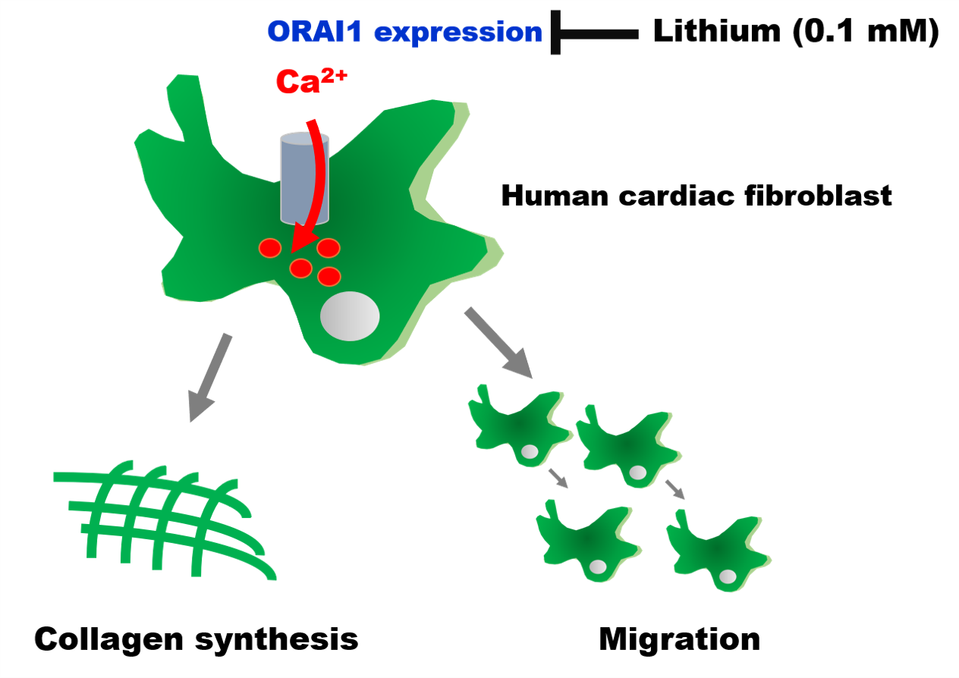
Lithium - cardioprotection
Cardiac fibrosis plays a vital role in the pathogenesis of heart failure.
Chen P-H, Chung C-C, Lin Y-F, Kao Y-H, Chen Y-J. Lithium Reduces Migration and Collagen Synthesis Activity in Human Cardiac Fibroblasts by Inhibiting Store-Operated Ca2+ Entry. International Journal of Molecular Sciences. 2021; 22(2):842.

Slide 93
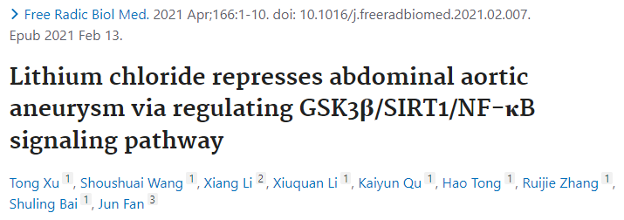
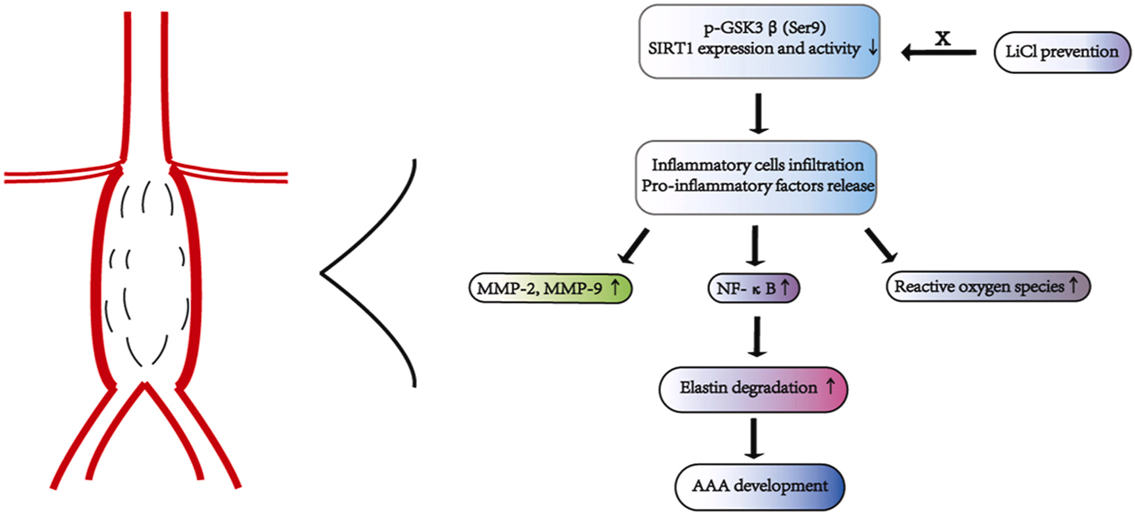
Lithium - cardioprotection

Slide 94
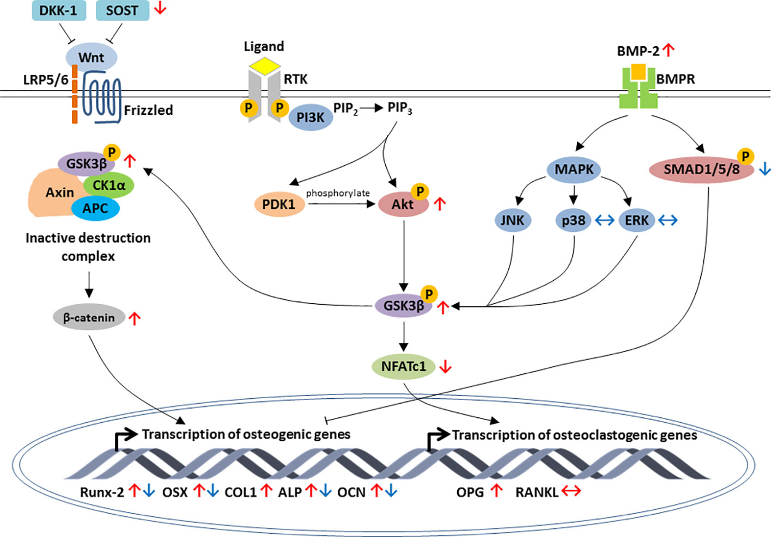
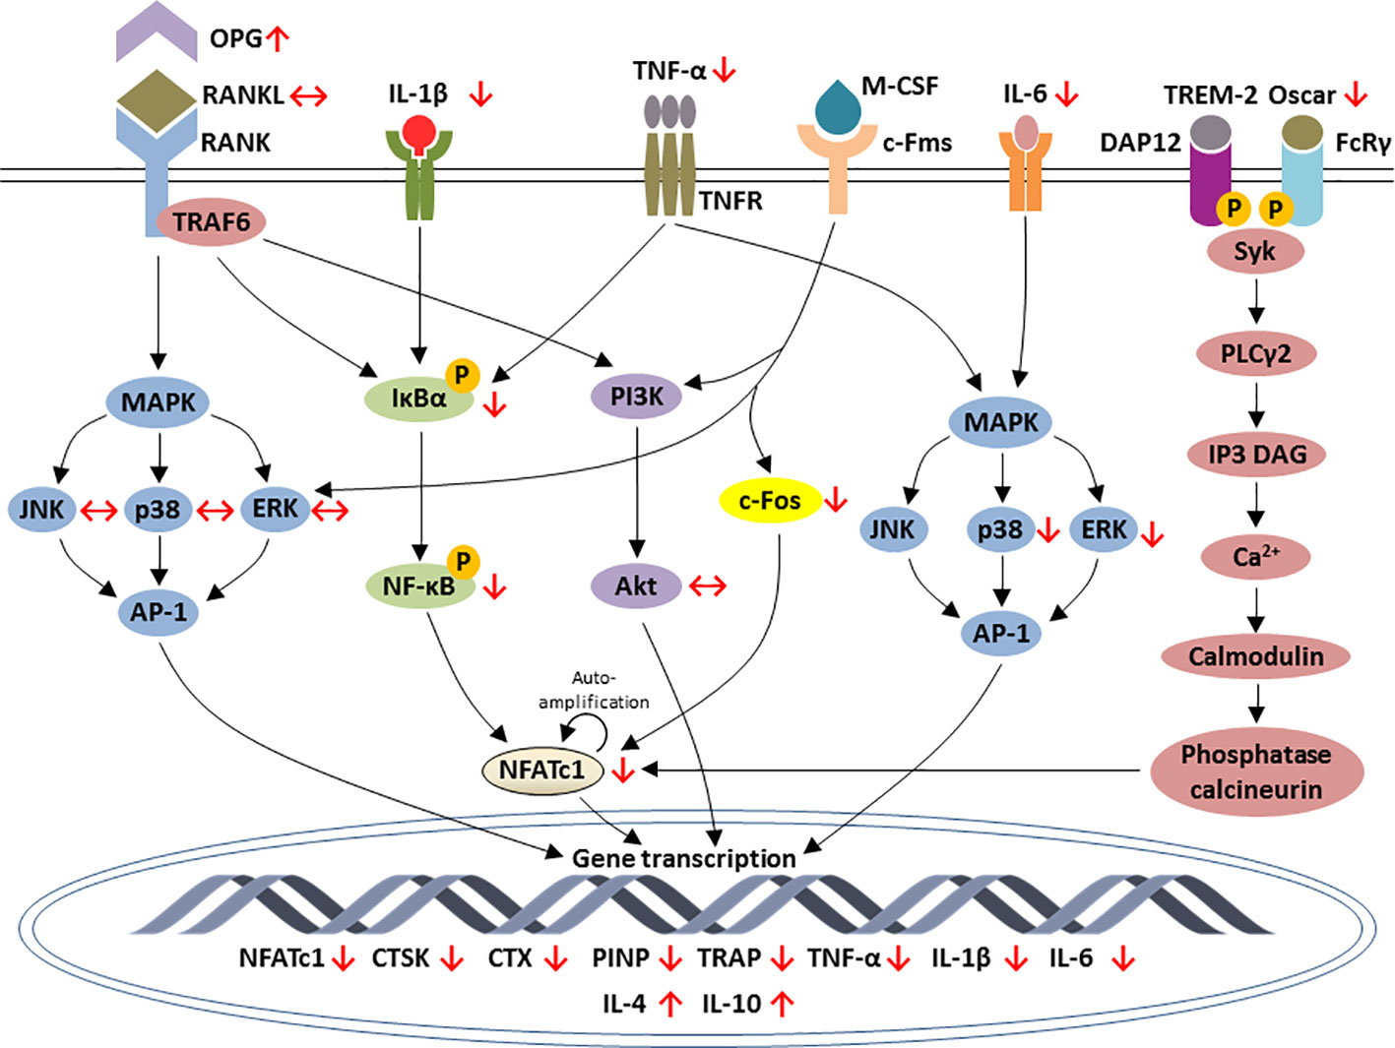
Lithium - improved bone mineral density
regulation of osteoblastic-specific genes expression by lithium
regulation of osteoclastic-specific genes expression by lithium
Wong SK, Chin K-Y and Ima-Nirwana S (2020) The Skeletal-Protecting Action and Mechanisms of Action for Mood-Stabilizing Drug Lithium Chloride: Current Evidence and Future Potential Research Areas. Front. Pharmacol. 11:430.

Slide 95
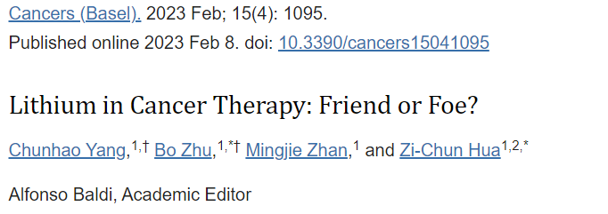
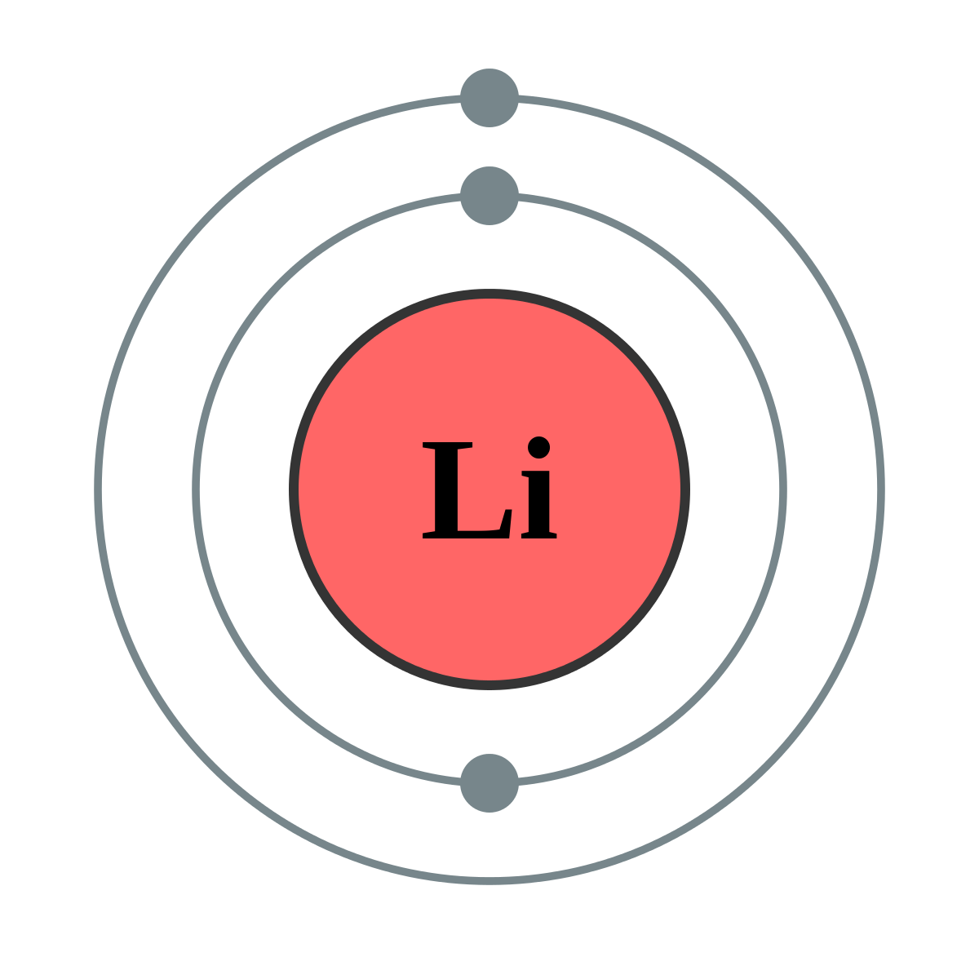
Lithium - anti-tumor effects
Much evidence shows lithium prevents the development of different cancers, including leukemia, melanoma, lung cancer, and pancreatic cancer.
Lithium prevents tumor metastasis
Lithium may increase cancer treatment efficacy while reducing side effects, suggesting that it can be used as an adjunctive therapy.
Yang C, Zhu B, Zhan M, Hua ZC. Lithium in Cancer Therapy: Friend or Foe? Cancers (Basel). 2023 Feb 8;15(4):1095.

Slide 96
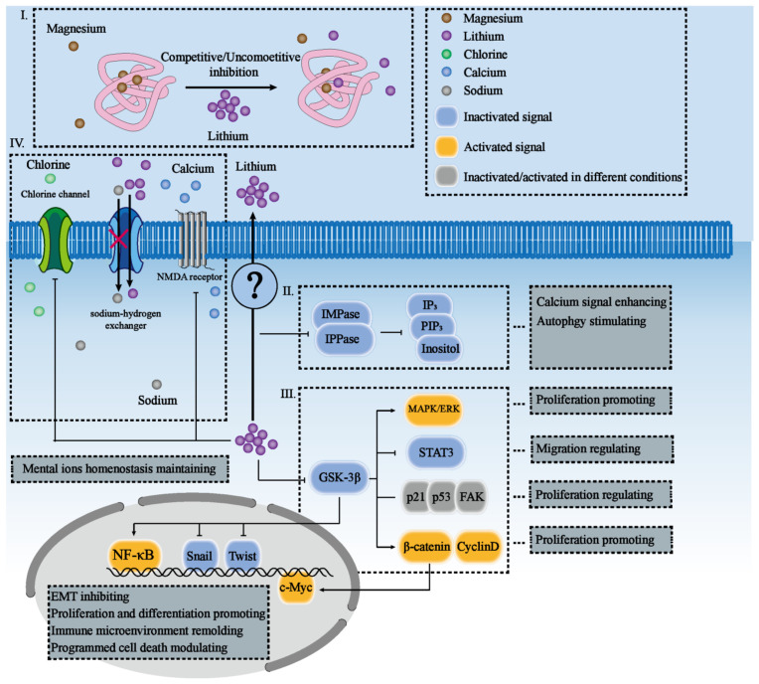
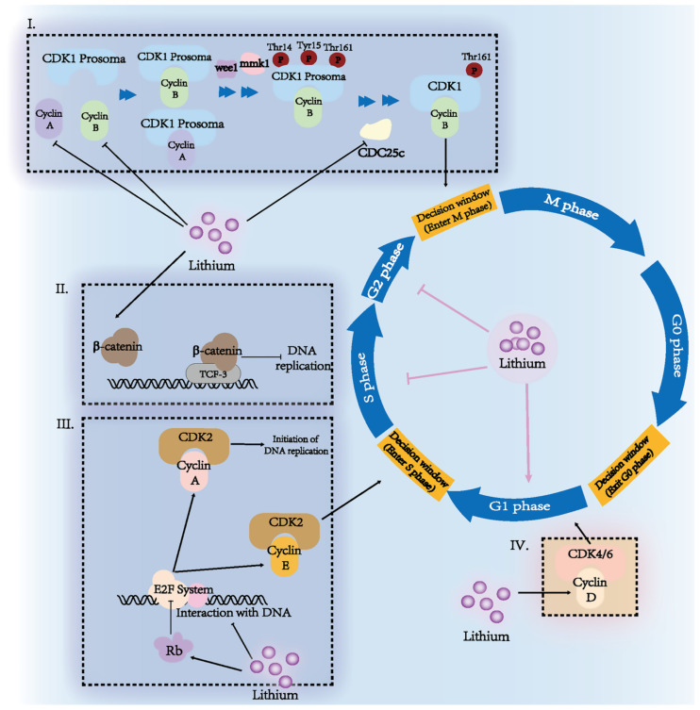
Lithium - anti-tumor effects
Yang C, Zhu B, Zhan M, Hua ZC. Lithium in Cancer Therapy: Friend or Foe? Cancers (Basel). 2023 Feb 8;15(4):1095.

Slide 97
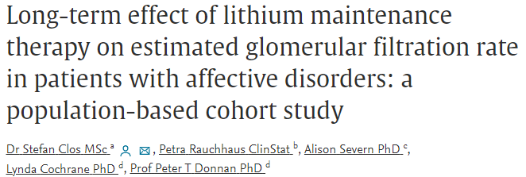
Lithium - renal risk
Our analysis suggests no effect of stable lithium maintenance therapy (lithium levels in therapeutic range) on the rate of change in eGFR over time.
Our results therefore contradict the idea that long-term lithium therapy is associated with nephrotoxicity in the absence of episodes of acute intoxication.
Stefan Clos, Petra Rauchhaus, Alison Severn, Lynda Cochrane, Peter T Donnan, Long-term effect of lithium maintenance therapy on estimated glomerular filtration rate in patients with affective disorders: a population-based cohort study, The Lancet Psychiatry, Volume 2, Issue 12, 2015.

Slide 98
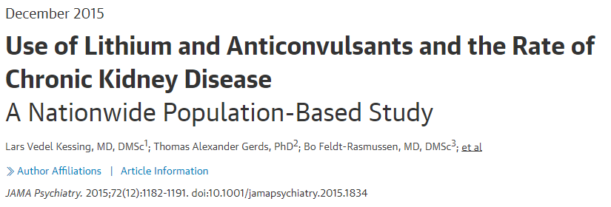
Lithium - renal risk
Maintenance treatment with lithium or anticonvulsants as practiced in modern care is associated with an increased rate of chronic kidney disease (CKD).
However, use of lithium is not associated with an increased rate of end-stage CKD.
Kessing LV, Gerds TA, Feldt-Rasmussen B, Andersen PK, Licht RW. Use of Lithium and Anticonvulsants and the Rate of Chronic Kidney Disease: A Nationwide Population-Based Study. JAMA Psychiatry. 2015;72(12):1182–1191. doi:10.1001/jamapsychiatry.2015.1834

Slide 99
Lithium - antiepileptic effects
Lithium holds a significant interest in epilepsy, where the past reports expose its non-specific proconvulsant action, followed lately by numerous studies for anticonvulsant action.
Lithium appears to be safe and effective in bipolar disorders associated with epilepsy and may have an anticonvulsant effect in some patients (Skukla et al, 1988).
Lithium does cause seizures in overdose.

Slide 100
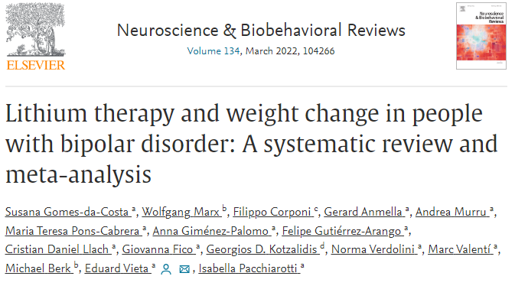
Lithium - weight gain?
Weight change with lithium was not clinically or statistically significant.
Weight change with lithium did not differ from placebo.
Gomes-da-Costa, et al. Lithium therapy and weight change in people with bipolar disorder: A systematic review and meta-analysis, Neuroscience & Biobehavioral Reviews, Volume 134, 2022.
Notes:
Batchelor, D.H. and Lowe, M.R. (1990), Reported neurotoxicity with the lithium/haloperidol combination and other neuroleptics—A literature review. Hum. Psychopharmacol. Clin. Exp., 5: 275-280. https://doi.org/10.1002/hup.470050323

Slide 101
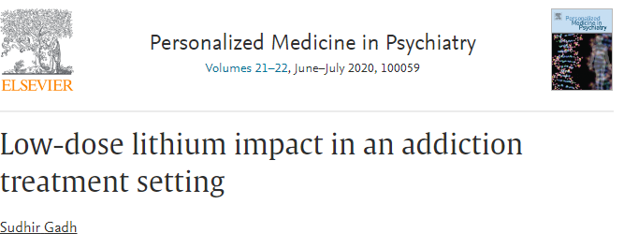
Low-dose lithium
Retrospective observational analysis
Residential addiction treatment
150 mg lithium as a substitute for or supplement to antidepressants and anxiolytics.
Program completion rate doubled
Employment rate doubled
Lithium levels not detectable with standard lab
Confounded by the comparison group consisting of patients at the treatment center prior to Dr Gadh's arrival as medical director, which brought an array of changes including deprescribing benzodiazepines.

Slide 102
U.S. dietary intake of lithium ~ 0.6 - 3.1 mg daily (Schrauzer, 2002).
Lithium orotate pills are available on Amazon as 1, 5, 10, and 20 mg equivalents.
Lithium orotate
Lithium carbonate
Lithium citrate
Notes:
This one of 1 mg elemental lithium. 1 mg would be a reasonable dose if you conceptualize the problem as lithium deficiency. The max OTC dose is 20x stronger than this.The ideal dose has not been defined.

Slide 103
Low-dose lithium
None of the “low-dose” lithium studies identified by systematic review specifically used 150 mg.
Actual mean dose was ~ 350 - 700 mg.
2 were microdose studies using 0.3 mg and 0.4 mg.
Target blood levels ranged from 0.2 - 0.8.
lithium carbonate 150 mg is the lowest Rx strength

Slide 104
Lithium
Gold-standard mood stabilizer

Slide 105
Lithium
Gold-standard mood stabilizer
Neuroprotective

Slide 106
Lithium
Gold-standard mood stabilizer
Neuroprotective
Suicide prevention

Slide 107
Lithium
Gold-standard mood stabilizer
Neuroprotective
Suicide prevention
Nephrogenic diabetes insipidus

Slide 108
Lithium
Gold-standard mood stabilizer
Neuroprotective
Suicide prevention
Nephrogenic diabetes insipidus
- ameliorate by giving in single daily dose

Slide 109
Lithium
Gold-standard mood stabilizer
Neuroprotective
Suicide prevention
Nephrogenic diabetes insipidus
- ameliorate by giving in single daily dose
Hypothyroidism

Slide 110
Lithium
Gold-standard mood stabilizer
Neuroprotective
Suicide prevention
Nephrogenic diabetes insipidus
- ameliorate by giving in single daily dose
Hypothyroidism
Hyperparathyroidism (but bone strengthening)

Slide 111
Lithium
Gold-standard mood stabilizer
Neuroprotective
Suicide prevention
Nephrogenic diabetes insipidus
- ameliorate by giving in single daily dose
Hypothyroidism
Hyperparathyroidism (but bone strengthening)
Avoid toxic levels!

Slide 112
Lithium
Gold-standard mood stabilizer
Neuroprotective
Suicide prevention
Nephrogenic diabetes insipidus
- ameliorate by giving in single daily dose
Hypothyroidism
Hyperparathyroidism (but bone strengthening)
Avoid toxic levels!
- renal damage

Slide 113
Lithium
Gold-standard mood stabilizer
Neuroprotective
Suicide prevention
Nephrogenic diabetes insipidus
- ameliorate by giving in single daily dose
Hypothyroidism
Hyperparathyroidism (but bone strengthening)
Avoid toxic levels!
- renal damage
- encephalopathy

Slide 114
Lithium
Gold-standard mood stabilizer
Neuroprotective
Suicide prevention
Nephrogenic diabetes insipidus
- ameliorate by giving in single daily dose
Hypothyroidism
Hyperparathyroidism (but bone strengthening)
Avoid toxic levels!
- renal damage
- encephalopathy
- potentially irreversible cerebellar damage

Slide 115
Lithium toxicity
Lithium levels increased by:
Lithium toxicity
The “N said” lithium toxicity
Conclusion: Educate patients that NSAIDS, blood pressure meds, and diuretics can cause lithium toxicity. For OTC pain medications, they should choose Tylenol or aspirin. Advise them to inform the prescriber if they are planning to change their caffeine intake. Excedrin is OK (combo of aspirin, acetaminophen, and caffeine). Check lithium levels frequently for patients on interacting medications. Teach the signs of lithium toxicity including tremor, nausea, diarrhea, fatigue, and drowsiness.
Notes:
INdomethacin is the worse so I should have made him indigo.

Slide 116
Lithium toxicity
Lithium levels increased by:
Lithium toxicity
The “N said” lithium toxicity
“Tie-dyed diuretics”
Conclusion: Educate patients that NSAIDS, blood pressure meds, and diuretics can cause lithium toxicity. For OTC pain medications, they should choose Tylenol or aspirin. Advise them to inform the prescriber if they are planning to change their caffeine intake. Excedrin is OK (combo of aspirin, acetaminophen, and caffeine). Check lithium levels frequently for patients on interacting medications. Teach the signs of lithium toxicity including tremor, nausea, diarrhea, fatigue, and drowsiness.
Notes:
INdomethacin is the worse so I should have made him indigo.

Slide 117
Lamotrigine (LAMICTAL)
“Lamb-ictal”
Lamotrigine

Slide 118
Lamotrigine is a true “mood stabilizer” but ineffective in treatment of mania.
elevated mood
depressed mood

Slide 119
Lamotrigine (LAMICTAL)
Neuroscience-based nomenclature:

Slide 120
Lamotrigine (LAMICTAL)
“May have actions at other ion channels”
blocks voltage-sensitive
sodium channels
reduces glutamate release
Stahl’s Essential Psychopharmacology

Slide 121
Lamotrigine (LAMICTAL)
blocks voltage-sensitive
sodium channels
reduces glutamate release
Stahl’s Essential Psychopharmacology

Slide 122
Lamotrigine (LAMICTAL)
Minimal side effects

Slide 123
Lamotrigine (LAMICTAL)
Minimal side effects
Minimal risks

Slide 124
Lamotrigine (LAMICTAL)
Minimal side effects
Minimal risks other than Stevens-Johnson syndrome

Slide 125
Lamotrigine (LAMICTAL)
Minimal side effects
Minimal risks other than Stevens-Johnson syndrome

Slide 126
Lamotrigine (LAMICTAL)
Minimal side effects
Minimal risks other than Stevens-Johnson syndrome
Great for bipolar maintenance

Slide 127
Lamotrigine (LAMICTAL)
Minimal side effects
Minimal risks other than Stevens-Johnson syndrome
Great for bipolar maintenance
Not effective for bipolar mania

Slide 128
Lamotrigine (LAMICTAL)
Minimal side effects
Minimal risks other than Stevens-Johnson syndrome
Great for bipolar maintenance
Not effective for bipolar mania
Must be titrated over 5 weeks

Slide 129
Lamotrigine (LAMICTAL)
Minimal side effects
Minimal risks other than Stevens-Johnson syndrome
Great for bipolar maintenance
Not effective for bipolar mania
Must be titrated over 5 weeks
No lab monitoring required

Slide 130
Lamotrigine (LAMICTAL)
Minimal side effects
Minimal risks other than Stevens-Johnson syndrome
Great for bipolar maintenance
Not effective for bipolar mania
Must be titrated over 5 weeks
No lab monitoring required
Serum levels usually unnecessary

Slide 131
Lamotrigine (LAMICTAL)
Minimal side effects
Minimal risks other than Stevens-Johnson syndrome
Great for bipolar maintenance
Not effective for bipolar mania
Must be titrated over 5 weeks
No lab monitoring required
Serum levels usually unnecessary
Wide therapeutic index
Wide therapeutic window

Slide 132
Lamotrigine (LAMICTAL)
Minimal side effects
Minimal risks other than Stevens-Johnson syndrome
Great for bipolar maintenance
Not effective for bipolar mania
Must be titrated over 5 weeks
No lab monitoring required
Serum levels usually unnecessary
Wide therapeutic index
Wide therapeutic window
Can be used off-label for unipolar depression

Slide 133
Lamotrigine (LAMICTAL)
Minimal side effects
Minimal risks other than Stevens-Johnson syndrome
Great for bipolar maintenance
Not effective for bipolar mania
Must be titrated over 5 weeks
No lab monitoring required
Serum levels usually unnecessary
Wide therapeutic index
Wide therapeutic window
Can be used off-label for unipolar depression
Can combine with lithium for maintenance
+

Slide 134
Lamotrigine (LAMICTAL)
1 in 4,000 patients develop Stevens-Johnson rash on lamotrigine (standard titration).
1 in 10 develop benign allergic rash.
So, if a patient develops a rash on lamotrigine (standard titration), the likelihood that it’s SJS is 1 in 400
Nonetheless, for any rash occurring within 2 months, lamotrigine needs to be discontinued (because we don’t know if rash will evolve into SJS)
The risk of SJS is ~1 in 100 if lamotrigine is started at full strength without titration.
Retitration is necessary if patient stops taking lamotrigine for > 1 week.

Slide 135
Lamotrigine (LAMICTAL)
1 in 4,000 patients develop Stevens-Johnson rash on lamotrigine (standard titration).
1 in 10 develop benign allergic rash.
So, if a patient develops a rash on lamotrigine (standard titration), the likelihood that it’s SJS is 1 in 400
Nonetheless, for any rash occurring within 2 months, lamotrigine needs to be discontinued (because we don’t know if rash will evolve into SJS)
The risk of SJS is ~1 in 100 if lamotrigine is started at full strength without titration.
Retitration is necessary if patient stops taking lamotrigine for > 1 week.

Slide 136
Lamotrigine (LAMICTAL)
1 in 4,000 patients develop Stevens-Johnson rash on lamotrigine (standard titration).
1 in 10 develop benign allergic rash.
So, if a patient develops a rash on lamotrigine (standard titration), the likelihood that it’s SJS is 1 in 400
Nonetheless, for any rash occurring within 2 months, lamotrigine needs to be discontinued (because we don’t know if rash will evolve into SJS)
The risk of SJS is ~1 in 100 if lamotrigine is started at full strength without titration.
Retitration is necessary if patient stops taking lamotrigine for > 1 week.

Slide 137
Lamotrigine (LAMICTAL)
1 in 4,000 patients develop Stevens-Johnson rash on lamotrigine (standard titration).
1 in 10 develop benign allergic rash.
So, if a patient develops a rash on lamotrigine (standard titration), the likelihood that it’s SJS is 1 in 400
Nonetheless, for any rash occurring within 2 months, lamotrigine needs to be discontinued (because we don’t know if rash will evolve into SJS)
The risk of SJS is ~1 in 100 if lamotrigine is started at full strength without titration.
Retitration is necessary if patient stops taking lamotrigine for > 1 week.

Slide 138
Lamotrigine (LAMICTAL)
1 in 4,000 patients develop Stevens-Johnson rash on lamotrigine (standard titration).
1 in 10 develop benign allergic rash.
So, if a patient develops a rash on lamotrigine (standard titration), the likelihood that it’s SJS is 1 in 400
Nonetheless, for any rash occurring within 2 months, lamotrigine needs to be discontinued (because we don’t know if rash will evolve into SJS)
The risk of SJS is ~1 in 100 if lamotrigine is started at full strength without titration.
Retitration is necessary if patient stops taking lamotrigine for > 1 week.

Slide 139
Lamotrigine (LAMICTAL)
1 in 4,000 patients develop Stevens-Johnson rash on lamotrigine (standard titration).
1 in 10 develop benign allergic rash.
So, if a patient develops a rash on lamotrigine (standard titration), the likelihood that it’s SJS is 1 in 400
Nonetheless, for any rash occurring within 2 months, lamotrigine needs to be discontinued (because we don’t know if rash will evolve into SJS)
The risk of SJS is ~1 in 100 if lamotrigine is started at full strength without titration.
Retitration is necessary if patient stops taking lamotrigine for > 1 week.

Slide 140
Lamotrigine (LAMICTAL)
1 in 4,000 patients develop Stevens-Johnson rash on lamotrigine (standard titration).
1 in 10 develop benign allergic rash.
So, if a patient develops a rash on lamotrigine (standard titration), the likelihood that it’s SJS is 1 in 400
Nonetheless, for any rash occurring within 2 months, lamotrigine needs to be discontinued (because we don’t know if rash will evolve into SJS)
The risk of SJS is ~1 in 100 if lamotrigine is started at full strength without titration.
Retitration is necessary if patient stops taking lamotrigine for > 1 week.

Slide 141
Stevens-Johnson syndrome (SJS)
Stevens-Johnson syndrome (SJS) | Benign rash
❖ ❖ ❖ ❖ ❖ ❖ ❖ | ❖ ❖ ❖ ❖ ❖ ❖ ❖

Slide 142
Stevens-Johnson syndrome (SJS)
Stevens-Johnson syndrome (SJS) | Benign rash
❖ ❖ ❖ ❖ ❖ ❖ ❖ | ❖ ❖ ❖ ❖ ❖ ❖ ❖

Slide 143
Stevens-Johnson syndrome (SJS)
Stevens-Johnson syndrome (SJS) | Benign rash
❖ ❖ ❖ ❖ ❖ ❖ ❖ | ❖ ❖ ❖ ❖ ❖ ❖ ❖
Purrrrr

Slide 144
Stevens-Johnson syndrome (SJS)
Stevens-Johnson syndrome (SJS) | Benign rash
❖ Usually occurs between 1–12 weeks ❖ ❖ ❖ ❖ ❖ ❖ | ❖ ❖ ❖ ❖ ❖ ❖ ❖
Purrrrr

Slide 145
Stevens-Johnson syndrome (SJS)
Stevens-Johnson syndrome (SJS) | Benign rash
❖ Usually occurs between 1–12 weeks ❖ ❖ ❖ ❖ ❖ ❖ | ❖ ❖ ❖ ❖ ❖ ❖ ❖
Purrrrr

Slide 146
Stevens-Johnson syndrome (SJS)
Stevens-Johnson syndrome (SJS) | Benign rash
❖ Usually occurs between 1–12 weeks ❖ ❖ ❖ ❖ ❖ ❖ | ❖ Peaks at 10–14 days ❖ ❖ ❖ ❖ ❖ ❖
Purrrrr

Slide 147
Stevens-Johnson syndrome (SJS)
Stevens-Johnson syndrome (SJS) | Benign rash
❖ Usually occurs between 1–12 weeks ❖ Purpuric (non-blanching), may be tender ❖ ❖ ❖ ❖ ❖ | ❖ Peaks at 10–14 days ❖ ❖ ❖ ❖ ❖ ❖
Purrrrr

Slide 148
Stevens-Johnson syndrome (SJS)
Stevens-Johnson syndrome (SJS) | Benign rash
❖ Usually occurs between 1–12 weeks ❖ Purpuric (non-blanching), may be tender ❖ ❖ ❖ ❖ ❖ | ❖ Peaks at 10–14 days ❖ Non-tender ❖ ❖ ❖ ❖ ❖
Purrrrr

Slide 149
Stevens-Johnson syndrome (SJS)
Stevens-Johnson syndrome (SJS) | Benign rash
❖ Usually occurs between 1–12 weeks ❖ Purpuric (non-blanching), may be tender ❖ Rapidly confluent and wide-spread ❖ ❖ ❖ ❖ | ❖ Peaks at 10–14 days ❖ Non-tender ❖ ❖ ❖ ❖ ❖
Purrrrr

Slide 150
Stevens-Johnson syndrome (SJS)
Stevens-Johnson syndrome (SJS) | Benign rash
❖ Usually occurs between 1–12 weeks ❖ Purpuric (non-blanching), may be tender ❖ Rapidly confluent and wide-spread ❖ ❖ ❖ ❖ | ❖ Peaks at 10–14 days ❖ Non-tender ❖ Spotty (non-confluent) ❖ ❖ ❖ ❖
Purrrrr

Slide 151
Stevens-Johnson syndrome (SJS)
Stevens-Johnson syndrome (SJS) | Benign rash
❖ Usually occurs between 1–12 weeks ❖ Purpuric (non-blanching), may be tender ❖ Rapidly confluent and wide-spread ❖ Usually involves neck and above ❖ ❖ ❖ | ❖ Peaks at 10–14 days ❖ Non-tender ❖ Spotty (non-confluent) ❖ ❖ ❖ ❖
Purrrrr

Slide 152
Stevens-Johnson syndrome (SJS)
Stevens-Johnson syndrome (SJS) | Benign rash
❖ Usually occurs between 1–12 weeks ❖ Purpuric (non-blanching), may be tender ❖ Rapidly confluent and wide-spread ❖ Usually involves neck and above ❖ ❖ ❖ | ❖ Peaks at 10–14 days ❖ Non-tender ❖ Spotty (non-confluent) ❖ Below the neck ❖ ❖ ❖
Purrrrr

Slide 153
Stevens-Johnson syndrome (SJS)
Stevens-Johnson syndrome (SJS) | Benign rash
❖ Usually occurs between 1–12 weeks ❖ Purpuric (non-blanching), may be tender ❖ Rapidly confluent and wide-spread ❖ Usually involves neck and above ❖ Can involve conjunctiva, mucous membranes ❖ ❖ | ❖ Peaks at 10–14 days ❖ Non-tender ❖ Spotty (non-confluent) ❖ Below the neck ❖ ❖ ❖
Purrrrr

Slide 154
Stevens-Johnson syndrome (SJS)
Stevens-Johnson syndrome (SJS) | Benign rash
❖ Usually occurs between 1–12 weeks ❖ Purpuric (non-blanching), may be tender ❖ Rapidly confluent and wide-spread ❖ Usually involves neck and above ❖ Can involve conjunctiva, mucous membranes ❖ ❖ | ❖ Peaks at 10–14 days ❖ Non-tender ❖ Spotty (non-confluent) ❖ Below the neck ❖ No involvement of mucous membranes ❖ ❖
Purrrrr

Slide 155
Stevens-Johnson syndrome (SJS)
Stevens-Johnson syndrome (SJS) | Benign rash
❖ Usually occurs between 1–12 weeks ❖ Purpuric (non-blanching), may be tender ❖ Rapidly confluent and wide-spread ❖ Usually involves neck and above ❖ Can involve conjunctiva, mucous membranes ❖ With fever, malaise or lymphadenopathy ❖ | ❖ Peaks at 10–14 days ❖ Non-tender ❖ Spotty (non-confluent) ❖ Below the neck ❖ No involvement of mucous membranes ❖ ❖
Purrrrr

Slide 156
Stevens-Johnson syndrome (SJS)
Stevens-Johnson syndrome (SJS) | Benign rash
❖ Usually occurs between 1–12 weeks ❖ Purpuric (non-blanching), may be tender ❖ Rapidly confluent and wide-spread ❖ Usually involves neck and above ❖ Can involve conjunctiva, mucous membranes ❖ With fever, malaise or lymphadenopathy ❖ | ❖ Peaks at 10–14 days ❖ Non-tender ❖ Spotty (non-confluent) ❖ Below the neck ❖ No involvement of mucous membranes ❖ No fever, malaise or lymphadenopathy ❖
Purrrrr

Slide 157
Stevens-Johnson syndrome (SJS)
Stevens-Johnson syndrome (SJS) | Benign rash
❖ Usually occurs between 1–12 weeks ❖ Purpuric (non-blanching), may be tender ❖ Rapidly confluent and wide-spread ❖ Usually involves neck and above ❖ Can involve conjunctiva, mucous membranes ❖ With fever, malaise or lymphadenopathy ❖ Leukocytosis | ❖ Peaks at 10–14 days ❖ Non-tender ❖ Spotty (non-confluent) ❖ Below the neck ❖ No involvement of mucous membranes ❖ No fever, malaise or lymphadenopathy ❖
Purrrrr

Slide 158
Stevens-Johnson syndrome (SJS)
Stevens-Johnson syndrome (SJS) | Benign rash
❖ Usually occurs between 1–12 weeks ❖ Purpuric (non-blanching), may be tender ❖ Rapidly confluent and wide-spread ❖ Usually involves neck and above ❖ Can involve conjunctiva, mucous membranes ❖ With fever, malaise or lymphadenopathy ❖ Leukocytosis | ❖ Peaks at 10–14 days ❖ Non-tender ❖ Spotty (non-confluent) ❖ Below the neck ❖ No involvement of mucous membranes ❖ No fever, malaise or lymphadenopathy ❖ Normal CBC and CMP
Purrrrr

Slide 159
Serious or benign?
https://www.contemporarypediatrics.com/view/drug-eruptions-benignand-life-threatening

Slide 160
Serious or benign?
BENIGN
The exanthematous (maculopapular) drug eruption with confluent areas of morbilliform (measles-looking) erythema with small white areas of sparing.
This is the most common type of drug reaction.
https://www.contemporarypediatrics.com/view/drug-eruptions-benignand-life-threatening

Slide 161
Serious or benign?
MERCK MANUAL - DR P. MARAZZI/SCIENCE PHOTO LIBRARY

Slide 162
Serious or benign?
Serious
Stevens-Johnsons Syndrome
MERCK MANUAL - DR P. MARAZZI/SCIENCE PHOTO LIBRARY

Slide 163
Serious or benign?
Serious
Stevens-Johnsons Syndrome
above the neck
MERCK MANUAL - DR P. MARAZZI/SCIENCE PHOTO LIBRARY

Slide 164
Serious or benign?
Serious
Stevens-Johnsons Syndrome
above the neck
mucus membrane involvement
MERCK MANUAL - DR P. MARAZZI/SCIENCE PHOTO LIBRARY

Slide 165
Serious or benign?
https://www.contemporarypediatrics.com/view/drug-eruptions-benignand-life-threatening

Slide 166
Serious or benign?
Serious
Toxic epidermal necrolysis (TEN)
TEN =
https://www.contemporarypediatrics.com/view/drug-eruptions-benignand-life-threatening

Slide 167
Serious or benign?
Serious
Toxic epidermal necrolysis (TEN)
TEN = SJS covering 30%+ body surface
https://www.contemporarypediatrics.com/view/drug-eruptions-benignand-life-threatening

Slide 168
Lamotrigine interactions
18% of individuals are UGT1A4 ultrarapid metabolizers.
0% are poor metabolizers.
Phase II metabolism, UGT1A4
Lamotrigine
UGT1A4 substrate
Ugg wool boots for UGT substrate
Jou Young Lee, PA
1 Animal, 4 boots

Slide 169
Lamotrigine interactions
18% of individuals are UGT1A4 ultrarapid metabolizers.
0% are poor metabolizers.
Phase II metabolism, UGT1A4
UGT1A4
ultrarapid
metabolizer

Slide 170
Pharmacokinetic (PK) interactions
Drug metabolism
enzyme
Substrate
“victim drug”
metabolite
Notes:
“Subs” are the “victim” drugs in PK interactions.
Subs are modified by specific enzymes
en route to being cleared from the body.

Slide 171
Enzyme inHibition
Enzyme inHibition causes increased levels of “victim” drug (substrate).
H for High and Hurried
(immediate effect)
substrate
inHibitor
Notes:
I emphasize the H in inHibition
for HIGH and HURRIED,
an immediate effect.

Slide 172
Enzyme inHibition
2-fold
increase
substrate, e.g.,
lamotrigine (Lamictal)
High and
Hurried
inHibitor, e.g.,
valproate (Depakote)
Notes:
An example: A patient is maintained on clozapine for schizophrenia.
Fluvoxamine is added for obsessiveness.
Profound sedation results because blood
levels of clozapine TRIPLE due to enzyme inHibition.

Slide 173
The 2 Actions
inHibitor
inDucer
Notes:
The 2 actions are
inHibition and inDuction
(up and down)

Slide 174
Enzyme inDuction
Enzyme inDuction causes decreased levels of “victim” drug (substrate).
D for Down and Delayed
(2–4 weeks)
inDucer
substrate
Notes:
inDuction is “Down and Delayed”,
causing a gradual decrease
of the victim drug
due to increased enzyme production.

Slide 175
Enzyme inDuction
Down and Delayed
inDucer, e.g.,
carbamazepine
Wait for liver to unregulate production of metabolic enzymes
substrate, e.g.,
quetiapine (Seroquel)
)
6-fold
decrease
Notes:
In our example, a patient is taking lurasidone.
The doctor adds carbamazepine for mood stabilization.
Nothing is noticeable for a couple of weeks, but the liver is ramping up enzyme production.
After a couple of weeks, lurasidone stops working, and the patient’s mood destabilizes.
The prescriber may have no idea why things went poorly.

Slide 176
The Actions
inHibitor
inDucer
Notes:
2 actions,
up and down.

Slide 177
Phase II Metabolism
Phase I
Phase II
CYP
UGT
glucuronic acid
“U Got Tagged”
Notes:
We have Phase 2 interactions

Slide 178
Interaction mnemonics
UGT enzymes
“U Got Tagged”
inDuction
UGT
inDucer
Down and Delayed
UGT1A4
Substrate
“1 Animal, 4 Uggs”
UGT1A4
Substrate
“1 Animal, 4 Uggs”
Notes:
Including this one. \
Razors decrease levels of lamb medications
Such as “LAMB” ***CLICK****-ictal, or lamotrigine

Slide 179
Interaction mnemonics
UGT enzymes
“U Got Tagged”
inDuction
Carbamazepine
(Tegretol)
“Tiger tail”
Down and Delayed
50% decrease
Lamotrigine (Lamictal)
“Lamb-ictal”
Notes:
Carbamazepine is a shaver . (period, wait for animation)

Slide 180
Lamotrigine (LAMICTAL)
UGT1A4
inducer
UGT1A4
substrate

Slide 181
Lamotrigine (LAMICTAL)
UGT1A4
inducer
UGT1A4
substrate

Slide 182
Lamotrigine (LAMICTAL)
UGT1A4
inducer
UGT1A4
substrate
inDucer
= Down and Delayed

Slide 183
Lamotrigine (LAMICTAL)
Carbamazepine (Tegretol)
UGT1A4
substrate
inDucer
= Down and Delayed

Slide 184
Lamotrigine interactions
18% of individuals are UGT1A4 ultrarapid metabolizers.
0% are poor metabolizers.
Phase II metabolism, UGT1A4
These UGT1A4 inDucers are expected to cause a Decrease of lamotrigine blood levels by about 50%
Carbamazepine
TEGRETOL
Primidone
MYSOLINE
Phenytoin
DILANTIN
Phenobarbital
LUMINAL
estrogens or pregnancy
Rifampin
RIFADIN
30-40% decrease

Slide 185
Lamotrigine interactions
18% of individuals are UGT1A4 ultrarapid metabolizers.
0% are poor metabolizers.
Phase II metabolism, UGT1A4
inHibitor = High
increased lamotrigine level
inHibition happens
within hours = Hurried
UGT1A4 inhibitor
UGT1A4
substrate

Slide 186
Lamotrigine (LAMICTAL)
inHibitor
UGT1A4
UGT1A4
substrate

Slide 187
Lamotrigine (LAMICTAL)
inHibitor
UGT1A4
UGT1A4
substrate

Slide 188
Lamotrigine (LAMICTAL)
inHibitor
UGT1A4
UGT1A4
substrate

Slide 189
Lamotrigine (LAMICTAL)
Valproate (DEPAKOTE)
UGT1A4
UGT1A4
substrate

Slide 193
SUBVENITE
starter kits
“Substitute convenient”
“UGT substrate convenience?”

Slide 195
Valproate
valproate = general term including valproic acid or divalproex (Depakote)

Slide 196
Valproate
valproate = general term including valproic acid or divalproex (Depakote)
Depakene = valproic acid (VPA) = the active drug / what we test blood levels of

Slide 197
Valproate
valproate = general term including valproic acid or divalproex (Depakote)
Depakene = valproic acid (VPA) = the active drug / what we test blood levels of
Depakote DR = regular Depakote
“When the Dr Says Depakote, she means Depakote DR”

Slide 198
Valproate
valproate = general term including valproic acid or divalproex (Depakote)
Depakene = valproic acid (VPA) = the active drug / what we test blood levels of
Depakote DR = regular Depakote
“When the Dr Says Depakote, she means Depakote DR”
Depakote ER = the extended release form of Depakote
Only ~85% bioavailable compared to DR

Slide 199
Valproate
valproate = general term including valproic acid or divalproex (Depakote)
Depakene = valproic acid (VPA) = the active drug / what we test blood levels of
Depakote DR = regular Depakote
“When the Dr Says Depakote, she means Depakote DR”
Depakote ER = the extended release form of Depakote
Only ~85% bioavailable compared to DR
Depakote IR = does not exist. That would be Depakene.

Slide 200
Valproate (Depakote)
Valproate
Official neuroscience-based nomenclature:
“unclear”

Slide 201
Valproate (Depakote)
Valproate
But the mechanism seems to involve:
“unclear”
inhibitory (VPA increases)
excitatory (VPA decreases)

Slide 202
Valproate
Voltage-sensitive calcium channel blocker
Voltage-sensitive sodium channel blocker
blocks glutamate (blocks excitatory)
enhances GABA (inhibitory)
Stahl’s Essential Psychopharmacology

Slide 203
inHibition
inDuction
High &
Hurried
Down &
Delayed
valproate

Slide 204
inHibition
inDuction
UGT
High &
Hurried
Down &
Delayed
valproate

Slide 205
Valproate
UGT
Voltage-sensitive calcium channel blocker
Voltage-sensitive sodium channel blocker
blocks glutamate (blocks excitatory)
enhances GABA (inhibitory)

Slide 206
Valproate
Valproate
Stahl’s Essential Psychopharmacology

Slide 207
Valproate
Stahl’s Essential Psychopharmacology

Slide 208
Valproate
Possible mechanisms
Calming excitable neurons by
inhibiting voltage-sensitive ion channels
enhancing GABA and blocking glutamate
Regulating downstream signal transduction cascades
UGT

Slide 209
Valproate
UGT
inHibitor
valproate
DEPAKOTE
VPA
High &
Hurried

Slide 210
UGT
lamotrigine
LAMICTAL
valproate
DEPAKOTE
UGT1A4
inHibitor
UGT1A4
substrate
Lamotrigine

Slide 211
UGT
lamotrigine
LAMICTAL
valproate
DEPAKOTE

Slide 212
UGT
lamotrigine
LAMICTAL
valproate
DEPAKOTE

Slide 213
UGT
lamotrigine
LAMICTAL
valproate
DEPAKOTE

Slide 214
sensitive substrate (UGT1A4)
UGT
lamotrigine
LAMICTAL
valproate
DEPAKOTE

Slide 215
lamotrigine
LAMICTAL
valproate
DEPAKOTE

Slide 216
lamotrigine
LAMICTAL
valproate
DEPAKOTE

Slide 217
sensitive substrate (UGT1A4)
UGT
lamotrigine
LAMICTAL
valproate
DEPAKOTE

Slide 218
UGT
lamotrigine
LAMICTAL
valproate
DEPAKOTE
UGT1A4
inHibitor
UGT1A4
substrate
Lamotrigine

Slide 219
UGT
valproate
DEPAKOTE
UGT1A4 UGT2B15
inHibitor
UGT1A4
substrate
lorazepam
UGT2B15 substrate
L-O-T benzodiazepine

Slide 220
UGT
valproate
DEPAKOTE
UGT1A4 UGT2B15
inHibitor
UGT1A4
substrate
oxazepam
UGT2B15 substrate
L-O-T benzodiazepine

Slide 221
UGT
valproate
DEPAKOTE
UGT1A4 UGT2B15
inHibitor
UGT1A4
substrate
temazepam
UGT2B15 substrate
L-O-T benzodiazepine

Slide 222
Valproate
Valproate doubles lithium. If used concomitantly with lamotrigine, give ½ strength lamotrigine.

Slide 223
Valproate
Antimanic agent

Slide 224
Valproate
Antimanic agent
Compared to lithium, lamotrigine, or carbamazepine, more:

Slide 225
Valproate
Antimanic agent
Compared to lithium, lamotrigine, or carbamazepine, more:
weight gain

Slide 226
Valproate
Antimanic agent
Compared to lithium, lamotrigine, or carbamazepine, more:
weight gain
tremor

Slide 227
Valproate
Antimanic agent
Compared to lithium, lamotrigine, or carbamazepine, more:
weight gain
tremor
sedation

Slide 228
Valproate
Antimanic agent
Compared to lithium, lamotrigine, or carbamazepine, more:
weight gain
tremor
sedation
Need to monitor:

Slide 229
Valproate
Antimanic agent
Compared to lithium, lamotrigine, or carbamazepine, more:
weight gain
tremor
sedation
Need to monitor
serum VPA level

Slide 230
Valproate
Antimanic agent
Compared to lithium, lamotrigine, or carbamazepine, more:
weight gain
tremor
sedation
Need to monitor
serum VPA level
liver enzymes

Slide 231
Valproate
Antimanic agent
Compared to lithium, lamotrigine, or carbamazepine, more:
weight gain
tremor
sedation
Need to monitor
serum VPA level
liver enzymes
Potential for hyperammonemic encephalopathy

Slide 232
Valproate
Antimanic agent
Compared to lithium, lamotrigine, or carbamazepine, more:
weight gain
tremor
sedation
Need to monitor
serum VPA level
liver enzymes
Potential for hyperammonemic encephalopathy
If patient is confused, check ammonia levels

Slide 233
Valproate
Antimanic agent
Compared to lithium, lamotrigine, or carbamazepine, more:
weight gain
tremor
sedation
Need to monitor
serum VPA level
liver enzymes
Potential for hyperammonemic encephalopathy
If patient is confused, check ammonia levels

Slide 234
Valproate
Antimanic agent
Compared to lithium, lamotrigine, or carbamazepine, more:
weight gain
tremor
sedation
Need to monitor
serum VPA level
liver enzymes
Potential for hyperammonemic encephalopathy
If patient is confused, check ammonia levels
Teratogenic

Slide 235
Carbamazepine (Tegretol)
Notes:
Most important thing

Slide 236
Carbamazepine (Tegretol)
“shredder” inDucer of UGT, CYP, and P-gp enzymes
Notes:
Most important thing

Slide 237
Carbamazepine (Tegretol)
voltage-sensitive calcium channel blocker
voltage-sensitive sodium channel blocker
ATP-sensitive potassium channel blocker
carbamazepine
TEGRETOL
enhances GABA
“shredder” inDucer of CYP, UGT and P-gp enzymes

Slide 238
UGT
sensitive substrate (UGT1A4)
valproate
DEPAKOTE
carbamazepine
TEGRETOL
lamotrigine
LAMICTAL

Slide 239
UGT
sensitive substrate (UGT1A4)
valproate
DEPAKOTE
carbamazepine
TEGRETOL
lamotrigine
LAMICTAL

Slide 240
UGT
sensitive substrate (UGT1A4)
valproate
DEPAKOTE
carbamazepine
TEGRETOL
lamotrigine
LAMICTAL

Slide 241
UGT
sensitive substrate (UGT1A4)
valproate
DEPAKOTE
carbamazepine
TEGRETOL
lamotrigine
LAMICTAL

Slide 242
UGT
sensitive substrate (UGT1A4)
valproate
DEPAKOTE
carbamazepine
TEGRETOL
lamotrigine
LAMICTAL

Slide 243
UGT
sensitive substrate (UGT1A4)
valproate
DEPAKOTE
carbamazepine
TEGRETOL
lamotrigine
LAMICTAL

Slide 244
UGT
sensitive substrate (UGT1A4)
valproate
DEPAKOTE
carbamazepine
TEGRETOL
lamotrigine
LAMICTAL

Slide 245
inDuction
carbamazepine
TEGRETOL
Down & Delayed
lamotrigine
LAMICTAL

Slide 246
inDuction
Down & Delayed
carbamazepine
TEGRETOL
lamotrigine
LAMICTAL

Slide 247
inDuction
Down & Delayed
carbamazepine
TEGRETOL
lamotrigine
LAMICTAL

Slide 248
carbamazepine
TEGRETOL
oxcarbazepine
TRILEPTAL

Slide 249
carbamazepine
TEGRETOL
oxcarbazepine
TRILEPTAL
moderate inDucer of CYP3A4
“shredder” inDucer of UGT, CYP, and P-gp enzymes

Slide 250
carbamazepine
TEGRETOL
oxcarbazepine
TRILEPTAL
moderate inDucer of CYP3A4
“shredder” inDucer of UGT, CYP, and P-gp enzymes
Safer overall (other than hyponatremia)

Slide 251
carbamazepine
TEGRETOL
oxcarbazepine
TRILEPTAL
moderate inDucer of CYP3A4
“shredder” inDucer of UGT, CYP, and P-gp enzymes
Safer overall (other than hyponatremia)
But no real evidence in bipolar

Slide 252
“Fluffer
inHibitors”
“Shredder” inDucers
“carb & barb”
carbamazepine (Tegretol)
phenobarbital
phenytoin
rifampin
fluvoxamine (Luvox)
fluoxetine (Prozac)
fluconazole
ketoconazole
Notes:
While Tegretal, up next, is a Shredder inducer, which is the opposite effect.

Slide 253
Carbamazepine (Tegretol)
Official neuroscience-based nomenclature:

Slide 254
Carbamazepine (Tegretol)

Slide 255
Carbamazepine (TEGRETOL)
“Tiger tail (in the) Car Maze”
Notes:
This mnemonic accomplishes everything I’m going for - pairs trade name with the generic-- TIGER TAIL

Slide 256
Carbamazepine (TEGRETOL)
“Tiger tail (in the) Car Maze”

Slide 257
Carbamazine (Tegretol)
Enzyme inDucer
Always check interactions with other medications!
Notes:
Carbamazepine ***OPEN PIC***

Slide 258
Carbamazine (Tegretol)
Enzyme inDucer
Always check interactions with other medications!
Antimanic
2nd line to lithium, valproate, and antipsychotics
Notes:
Carbamazepine ***OPEN PIC***

Slide 259
Carbamazine (Tegretol)
Enzyme inDucer
Always check interactions with other medications!
Antimanic
2nd line to lithium, valproate, and antipsychotics
Antiepileptic
Notes:
Carbamazepine ***OPEN PIC***

Slide 260
Carbamazine (Tegretol)
Enzyme inDucer
Always check interactions with other medications!
Antimanic
2nd line to lithium, valproate, and antipsychotics
Antiepileptic
Health risks
Notes:
Carbamazepine ***OPEN PIC***

Slide 261
Carbamazine (Tegretol)
Enzyme inDucer
Always check interactions with other medications!
Antimanic
2nd line to lithium, valproate, and antipsychotics
Antiepileptic
Health risks
Effective for neuropathic pain
Notes:
Carbamazepine ***OPEN PIC***

Slide 262
Carbamazine (Tegretol)
Enzyme inDucer
Always check interactions with other medications!
Antimanic
2nd line to lithium, valproate, and antipsychotics
Antiepileptic
Health risks
Effective for neuropathic pain
Monitor serum levels if used for seizures (optional for bipolar)
Notes:
Carbamazepine ***OPEN PIC***

Slide 263
Risks of CBZ:
hyponatremia
Carbamazepine
(TEGRETOL)
“Tiger tail (in the)
Car Maze”
terato-
genicity
aplastic anemia
(rare)
Na⁺ Na⁺
decreased bone mineral density
agranulo-
cytosis (rare)
reduced levels of many medications
hepatotoxicity
Notes:
potential health risks.

Slide 264
Risks of CBZ:
hyponatremia
Carbamazepine
(TEGRETOL)
“Tiger tail (in the)
Car Maze”
terato-
genicity
aplastic anemia
(rare)
Na⁺ Na⁺
decreased bone mineral density
agranulo-
cytosis (rare)
reduced levels of many medications
neural tube defects
hepatotoxicity
Notes:
most typically neural tube defects, pretty much contraindicated in women of childbearing age

Slide 265
Risks of CBZ:
hyponatremia
Carbamazepine
(TEGRETOL)
“Tiger tail (in the)
Car Maze”
terato-
genicity
aplastic anemia
(rare)
Na⁺ Na⁺
decreased bone mineral density
agranulo-
cytosis (rare)
reduced levels of many medications
hepatotoxicity

Slide 266
Risks of CBZ:
hyponatremia
Carbamazepine
(TEGRETOL)
“Tiger tail (in the)
Car Maze”
terato-
genicity
aplastic anemia
(rare)
Na⁺ Na⁺
decreased bone mineral density
agranulo-
cytosis (rare)
reduced levels of many medications
hepatotoxicity

Slide 267
Risks of CBZ:
hyponatremia
Carbamazepine
(TEGRETOL)
“Tiger tail (in the)
Car Maze”
terato-
genicity
aplastic anemia
(rare)
Na⁺ Na⁺
decreased bone mineral density
agranulo-
cytosis (rare)
reduced levels of many medications
hepatotoxicity

Slide 268
Risks of CBZ:
hyponatremia
Carbamazepine
(TEGRETOL)
“Tiger tail (in the)
Car Maze”
terato-
genicity
aplastic anemia
(rare)
Na⁺ Na⁺
decreased bone mineral density
agranulo-
cytosis (rare)
reduced levels of many medications
hepatotoxicity

Slide 269
Risks of CBZ:
hyponatremia
Carbamazepine
(TEGRETOL)
“Tiger tail (in the)
Car Maze”
terato-
genicity
aplastic anemia
(rare)
Na⁺ Na⁺
decreased bone mineral density
agranulo-
cytosis (rare)
reduced levels of many medications
hepatotoxicity

Slide 270
Risks of CBZ:
hyponatremia
Carbamazepine
(TEGRETOL)
“Tiger tail (in the)
Car Maze”
terato-
genicity
aplastic anemia
(rare)
Na⁺ Na⁺
decreased bone mineral density
agranulo-
cytosis (rare)
reduced levels of many medications
hepatotoxicity
Notes:
Shredder inducer

Slide 271
Carbamazepine (TEGRETOL)
inDuction
Down and Delayed
Carbamazepine “eats its own tail”

Slide 272
Carbamazepine (TEGRETOL)
inDuction
Autoinduction of CYP3A4
Down and Delayed
Carbamazepine “eats its own tail”
inducing its own metabolism
Notes:
By stimulating production of 3A4 enzymes that metabolize it

Slide 273
Carbamazepine (TEGRETOL)
inDuction
Autoinduction of CYP3A4
Down and Delayed
Carbamazepine “eats its own tail” inducing its own metabolism as a CYP3A4 substrate and inDucer
Notes:
So blood levels at 3-4 weeks will be lower than at week 1 of starting it

Slide 274
Carbamazepine (TEGRETOL)
inDuction
Autoinduction of CYP3A4
Down and Delayed
Carbamazepine “eats its own tail” inducing its own metabolism as a CYP3A4 substrate and inDucer.
Serum levels lower by one month.
Notes:
Initially carbamazepine has a half-life of 35 hr

Slide 275
Carbamazepine
(TEGRETOL)
FDA-approved for:
Notes:
Various formulations

Slide 276
Carbamazepine
(TEGRETOL)
FDA-approved for:
❖ Seizure disorder

Slide 277
Carbamazepine
(TEGRETOL)
FDA-approved for:
❖ Seizure disorder
❖ Trigeminal neuralgia

Slide 278
Carbamazepine
(TEGRETOL)
FDA-approved for:
❖ Seizure disorder
❖ Trigeminal neuralgia
❖ Bipolar

Slide 279
Carbamazepine
(TEGRETOL)
FDA-approved for:
❖ Seizure disorder
❖ Trigeminal neuralgia
❖ Manic/mixed episode of
bipolar I disorder
Notes:
Although we use generic IR

Slide 280
Carbamazepine
(TEGRETOL)
FDA-approved for:
❖ Seizure disorder
❖ Trigeminal neuralgia
❖ Manic/mixed episode of
bipolar I disorder
Used off label for:

Slide 281
Carbamazepine
(TEGRETOL)
FDA-approved for:
❖ Seizure disorder
❖ Trigeminal neuralgia
❖ Manic/mixed episode of
bipolar I disorder
Used off label for:
❖ Bipolar maintenance

Slide 282
Carbamazepine
(TEGRETOL)
FDA-approved for:
❖ Seizure disorder
❖ Trigeminal neuralgia
❖ Manic/mixed episode of
bipolar I disorder
Used off label for:
❖ Bipolar maintenance
❖ Neuropathic pain
❖ Restless legs syndrome
❖ Migraine prophylaxis
Notes:
Several neurologic conditions

Slide 283
Carbamazepine
(TEGRETOL)
FDA-approved for:
❖ Seizure disorder
❖ Trigeminal neuralgia
❖ Manic/mixed episode of
bipolar I disorder
Used off label for:
❖ Bipolar maintenance
❖ Neuropathic pain
❖ Restless legs syndrome
❖ Migraine prophylaxis
❖ Alcohol use disorder
Notes:
relieve alcohol withdrawal symptoms and assist in maintaining sobriety

Slide 284
Carbamazepine
(TEGRETOL)
Recommendation:
Notes:
relieve alcohol withdrawal symptoms and assist in maintaining sobriety

Slide 285
Carbamazepine
(TEGRETOL)
Recommendation:
Only prescribe it if you can manage the drug-drug interactions.
Notes:
relieve alcohol withdrawal symptoms and assist in maintaining sobriety

Slide 286
Carbamazepine
(TEGRETOL)
Recommendation:
Only prescribe it if you can manage the drug-drug interactions.
Always run interaction check when you encounter it!
Notes:
relieve alcohol withdrawal symptoms and assist in maintaining sobriety

Slide 287
Carbamazepine
(TEGRETOL)
Recommendation:
Only prescribe it if you can manage the drug-drug interactions.
Always run interaction check when you encounter it!
Not for childbearing women.
Notes:
relieve alcohol withdrawal symptoms and assist in maintaining sobriety

Slide 288
Carbamazepine
(TEGRETOL)
Three mood stabilizers FDA-approved for bipolar mania:

Slide 289
Carbamazepine
(TEGRETOL)
Three mood stabilizers FDA-approved for bipolar mania:
❖ Lithium

Slide 290
Carbamazepine
(TEGRETOL)
Three mood stabilizers FDA-approved for bipolar mania:
❖ Lithium
❖ Valproate

Slide 291
Carbamazepine
(TEGRETOL)
Three mood stabilizers FDA-approved for bipolar mania:
❖ Lithium
❖ Valproate
❖ Carbamazepine

Slide 292
Carbamazepine
(TEGRETOL)
Advantages over valproate and lithium:

Slide 293
Carbamazepine
(TEGRETOL)
Advantages over valproate and lithium:
❖ No weight gain
Notes:
WEIGHT NEUTRAL

Slide 294
Carbamazepine
(TEGRETOL)
Advantages over valproate and lithium:
❖ No weight gain
❖ No tremor

Slide 295
Carbamazepine
(TEGRETOL)
Advantages over valproate and lithium:
❖ No weight gain
❖ No tremor
❖ Also effective for neuropathic pain

Slide 296
Carbamazepine
(TEGRETOL)
Advantages over valproate and lithium:
❖ No weight gain
❖ No tremor
❖ Also effective for neuropathic pain
But lithium-induced weight gain is a myth.

Slide 297
Asian patients have a 10-fold higher incidence of carbamazepine-induced:
Notes:
Once you’ve defined a mascot you can tack a lot of info onto it.

Slide 298
Asian patients have a 10-fold higher incidence of carbamazepine-induced:
Stevens-Johnson syndrome (SJS) / Toxic epidermal necrolysis (TEN)

Slide 299
Asian patients have a 10-fold higher incidence of carbamazepine-induced SJS and TEN
FDA recommends screening Asians for the HLA-B*1502 allele, which would be a contraindication for starting CBZ.

Slide 300
Asian patients have a 10-fold higher incidence of carbamazepine-induced SJS and TEN
FDA recommends screening Asians for the HLA-B*1502 allele, which would be a contraindication for starting CBZ.
“Hey Look, Asian Blood!
if 1502, no Tegretol for you!”
Notes:
My mnemonic for this

Slide 301
Asian patients have a 10-fold higher incidence of carbamazepine-induced SJS and TEN
FDA recommends screening Asians for the HLA-B*1502 allele, which would be a contraindication for starting CBZ.
“Hey Look, Asian Blood!
if 1502, no Tegretol for you!”

Slide 302
Asian patients have a 10-fold higher incidence of carbamazepine-induced SJS and TEN
FDA recommends screening Asians for the HLA-B*1502 allele, which would be a contraindication for starting CBZ.
“Hey Look, Asian Blood!
if 1502, no Tegretol for you!”

Slide 303
Asian patients have a 10-fold higher incidence of carbamazepine-induced SJS and TEN
FDA recommends screening Asians for the HLA-B*1502 allele, which would be a contraindication for starting CBZ.
“Hey Look, Asian Blood!
if 1502, no Tegretol for you!”

Slide 304
Asian patients have a 10-fold higher incidence of carbamazepine-induced SJS and TEN
FDA recommends screening Asians for the HLA-B*1502 allele, which would be a contraindication for starting CBZ.
“Hey Look, Asian Blood!
if 1502, no Tegretol for you!”

Slide 305
Asian patients have a 10-fold higher incidence of carbamazepine-induced SJS and TEN
FDA recommends screening Asians for the HLA-B*1502 allele, which would be a contraindication for starting CBZ.
“Hey Look, Asian Blood!
if 1502, no Tegretol for you!”
Notes:
HLA-B*1502 allele, is a contraindication

Slide 306
Carbamazepine kinetic interactions:
3A4 inDucer
2B6 inDucer
1A2 inDucer
UGT inDucer
Notes:
interaction mnemonics - MOST MEDICATIONS HAVE 1 or 2 interaction mnemonics

Slide 307
Carbamazepine kinetic interactions:
3A4 inDucer
(strong)
2B6 inDucer
1A2 inDucer
UGT inDucer
Notes:
More specific down arrows only more specific

Slide 308
Carbamazepine kinetic interactions:
3A4 inDucer
(strong)
2B6 inDucer
(moderate)
1A2 inDucer
UGT inDucer

Slide 309
Carbamazepine kinetic interactions:
3A4 inDucer
(strong)
2B6 inDucer
(moderate)
1A2 inDucer
(weak)
UGT inDucer

Slide 310
Carbamazepine kinetic interactions:
3A4 inDucer
(strong)
2B6 inDucer
(moderate)
1A2 inDucer
(weak)
UGT inDucer
(moderate)

Slide 311
Carbamazepine kinetic interactions:
3A4 substrate (fish)

Slide 312
Interaction mnemonics
CYP3A4
“3 A’s For
(fishing)”
inDuction
3A4
Down and Delayed
inducer
3A4
substrate
Notes:
Anvils
drop
the blood levels
of fish

Slide 313
Interaction mnemonics
CYP3A4
“3 A’s For
(fishing)”
inDuction
Down and Delayed
Carbamazepine
(Tegretol)
“Tiger tail”
3A4
substrate
Notes:
“Tiger Tail”
is
an anvil

Slide 314
Interaction mnemonics
CYP3A4
“3 A’s For
(fishing)”
inDuction
Down and Delayed
Carbamazepine
(Tegretol)
“Tiger tail”
Quetiapine (Seroquel)
“Quit typing!”
6-fold decrease!
Notes:
Which decreases
“Quit Typing, Sera!”
6-fold

Slide 315
Interaction mnemonics
CYP3A4
“3 A’s For
(fishing)”
inDuction
Down and Delayed
Carbamazepine
(Tegretol)
“Tiger tail”
Lumateperone
(Caplyta)
“‘Luminated
Cap lighter”
20-fold decrease
of a $1,800 drug!
Notes:
“Cap Lighter”
levels decrease 95%...
That’s an $1,800 drug
made useless…and many psychiatrists
are unaware of this effect.

Slide 316
P-glycoprotein (P-gp) – “Pumpers gonna pump”.
Carbamazepine inDuces P-gp.
Gatekeeper at the blood-brain barrier that pumps certain drugs out of the CNS.
Notes:
Tegretol

Slide 317
P-glycoprotein (P-gp) – “Pumpers gonna pump”.
Carbamazepine inDuces P-gp.
Gatekeeper at the blood-brain barrier that pumps certain drugs out of the CNS.
Notes:
induces

Slide 318
P-glycoprotein (P-gp) – “Pumpers gonna pump”.
Carbamazepine inDuces P-gp.
Gatekeeper at the blood-brain barrier that pumps certain drugs out of the CNS.
Notes:
production

Slide 319
P-glycoprotein (P-gp) – “Pumpers gonna pump”.
Carbamazepine inDuces P-gp.
Gatekeeper at the blood-brain barrier that pumps certain drugs out of the CNS.
Notes:
of

Slide 320
P-glycoprotein (P-gp) – “Pumpers gonna pump”.
Carbamazepine inDuces P-gp.
Gatekeeper at the blood-brain barrier that pumps certain drugs out of the CNS.
Notes:
P-

Slide 321
P-glycoprotein (P-gp) – “Pumpers gonna pump”.
Carbamazepine inDuces P-gp.
Gatekeeper at the blood-brain barrier that pumps certain drugs out of the CNS.
Notes:
-glycoprotein,

Slide 322
P-glycoprotein (P-gp) – “Pumpers gonna pump”.
Carbamazepine inDuces P-gp.
Gatekeeper at the blood-brain barrier that pumps certain drugs out of the CNS.
Notes:
Just

Slide 323
P-glycoprotein (P-gp) – “Pumpers gonna pump”.
Carbamazepine inDuces P-gp.
Gatekeeper at the blood-brain barrier that pumps certain drugs out of the CNS.
Notes:
like

Slide 324
P-glycoprotein (P-gp) – “Pumpers gonna pump”.
Carbamazepine inDuces P-gp.
Gatekeeper at the blood-brain barrier that pumps certain drugs out of the CNS.
Notes:
It

Slide 325
P-glycoprotein (P-gp) – “Pumpers gonna pump”.
Carbamazepine inDuces P-gp.
Gatekeeper at the blood-brain barrier that pumps certain drugs out of the CNS.
Notes:
induces

Slide 326
P-glycoprotein (P-gp) – “Pumpers gonna pump”.
Carbamazepine inDuces P-gp.
Gatekeeper at the blood-brain barrier that pumps certain drugs out of the CNS.
Notes:
everything

Slide 327
P-glycoprotein (P-gp) – “Pumpers gonna pump”.
Carbamazepine inDuces P-gp.
Gatekeeper at the blood-brain barrier that pumps certain drugs out of the CNS.
Notes:
else.

Slide 328
P-glycoprotein (P-gp) – “Pumpers gonna pump”.
Carbamazepine inDuces P-gp.
Gatekeeper at the blood-brain barrier that pumps certain drugs out of the CNS.
Notes:
It’s

Slide 329
P-glycoprotein (P-gp) – “Pumpers gonna pump”.
Carbamazepine inDuces P-gp.
Gatekeeper at the blood-brain barrier that pumps certain drugs out of the CNS.
Notes:
a shredder.

Slide 330
P-glycoprotein (P-gp) – “Pumpers gonna pump”.
Carbamazepine inDuces P-gp.
Gatekeeper at the blood-brain barrier that pumps certain drugs out of the CNS.
Notes:
The effect

Slide 331
P-glycoprotein (P-gp) – “Pumpers gonna pump”.
Carbamazepine inDuces P-gp.
Gatekeeper at the blood-brain barrier that pumps certain drugs out of the CNS.
Notes:
is Down

Slide 332
P-glycoprotein (P-gp) – “Pumpers gonna pump”.
Carbamazepine inDuces P-gp.
Gatekeeper at the blood-brain barrier that pumps certain drugs out of the CNS.
Notes:
and

Slide 333
P-glycoprotein (P-gp) – “Pumpers gonna pump”.
Carbamazepine inDuces P-gp.
Gatekeeper at the blood-brain barrier that pumps certain drugs out of the CNS.
Notes:
delayed.

Slide 334
P-glycoprotein (P-gp) – “Pumpers gonna pump”.
Carbamazepine inDuces P-gp.
Gatekeeper at the blood-brain barrier that pumps certain drugs out of the CNS.
Notes:
Down as in

Slide 335
P-glycoprotein (P-gp) – “Pumpers gonna pump”.
Carbamazepine inDuces P-gp.
Gatekeeper at the blood-brain barrier that pumps certain drugs out of the CNS.
Notes:
decreased

Slide 336
P-glycoprotein (P-gp) – “Pumpers gonna pump”.
Carbamazepine inDuces P-gp.
Gatekeeper at the blood-brain barrier that pumps certain drugs out of the CNS.
Notes:
gut

Slide 337
P-glycoprotein (P-gp) – “Pumpers gonna pump”.
Carbamazepine inDuces P-gp.
Gatekeeper at the blood-brain barrier that pumps certain drugs out of the CNS.
Notes:
absorption

Slide 338
P-glycoprotein (P-gp) – “Pumpers gonna pump”.
Carbamazepine inDuces P-gp.
Gatekeeper at the blood-brain barrier that pumps certain drugs out of the CNS.
Notes:
and

Slide 339
P-glycoprotein (P-gp) – “Pumpers gonna pump”.
Carbamazepine inDuces P-gp.
Gatekeeper at the blood-brain barrier that pumps certain drugs out of the CNS.
Notes:
Brain penetrance

Slide 340
P-glycoprotein (P-gp) – “Pumpers gonna pump”.
Carbamazepine inDuces P-gp.
Gatekeeper at the blood-brain barrier that pumps certain drugs out of the CNS.
Notes:
of victim substrates. Get outta the brain

Slide 341
“Shredder” inDucers
carbamazepine
phenobarbital
phenytoin
rifampin

Slide 342
“Shredder” inDucers
barb
carbamazepine
phenobarbital / primidone (also a barbiturate)
phenytoin
rifampin
“Carb and Barb”

Slide 343
For patients TAKING carbamazepine, phenytoin, phenobarbital, or primidone and NOT TAKING valproate

Slide 344
How effective are anti-manic drugs?

Slide 345
Cohen’s d of = 0.80 is a Large effect size
Yildiz A, et al. Efficacy of antimanic treatments: meta-analysis of randomized, controlled trials. Neuropsychopharmacology. 2011;36(2):375-389.
1335

Slide 346
Cohen’s d of = 0.80 is a Large effect size
Yildiz A, et al. Efficacy of antimanic treatments: meta-analysis of randomized, controlled trials. Neuropsychopharmacology. 2011;36(2):375-389.
1335

Slide 347
Cohen’s d of = 0.80 is a Large effect size
= NNT 3.53
# patients to have 1 response
that is not a placebo response
Yildiz A, et al. Efficacy of antimanic treatments: meta-analysis of randomized, controlled trials. Neuropsychopharmacology. 2011;36(2):375-389.
1335

Slide 348
Antimanic effect of Lamotrigine (N=179)
# patients to have 1 response
that is not a placebo response
Yildiz A, et al. Efficacy of antimanic treatments: meta-analysis of randomized, controlled trials. Neuropsychopharmacology. 2011;36(2):375-389.
1335

Slide 349
Antimanic effect of Topiramate (N=1074)
# patients to have 1 response
that is not a placebo response
Yildiz A, et al. Efficacy of antimanic treatments: meta-analysis of randomized, controlled trials. Neuropsychopharmacology. 2011;36(2):375-389.
1335

Slide 350
Antimanic effect of Aripiprazole (N=1662)
# patients to have 1 response
that is not a placebo response
Yildiz A, et al. Efficacy of antimanic treatments: meta-analysis of randomized, controlled trials. Neuropsychopharmacology. 2011;36(2):375-389.
1335

Slide 351
Antimanic effect of Valproate (N=1064)
# patients to have 1 response
that is not a placebo response
Yildiz A, et al. Efficacy of antimanic treatments: meta-analysis of randomized, controlled trials. Neuropsychopharmacology. 2011;36(2):375-389.
1335

Slide 352
Antimanic effect of Lithium (N=1199)
# patients to have 1 response
that is not a placebo response
Yildiz A, et al. Efficacy of antimanic treatments: meta-analysis of randomized, controlled trials. Neuropsychopharmacology. 2011;36(2):375-389.
1335

Slide 353
Antimanic effect of Quetiapine (N=1007)
# patients to have 1 response
that is not a placebo response
Yildiz A, et al. Efficacy of antimanic treatments: meta-analysis of randomized, controlled trials. Neuropsychopharmacology. 2011;36(2):375-389.
1335

Slide 354
Antimanic effect of Ziprasidone (N=663)
# patients to have 1 response
that is not a placebo response
Yildiz A, et al. Efficacy of antimanic treatments: meta-analysis of randomized, controlled trials. Neuropsychopharmacology. 2011;36(2):375-389.
1335

Slide 355
Antimanic effect of Olanzapine (N=1335)
# patients to have 1 response
that is not a placebo response
Yildiz A, et al. Efficacy of antimanic treatments: meta-analysis of randomized, controlled trials. Neuropsychopharmacology. 2011;36(2):375-389.
1335

Slide 356
Antimanic effect of Carbamazepine (N=427)
# patients to have 1 response
that is not a placebo response
Yildiz A, et al. Efficacy of antimanic treatments: meta-analysis of randomized, controlled trials. Neuropsychopharmacology. 2011;36(2):375-389.
1335

Slide 357
Antimanic effect of Risperidone (N=823)
# patients to have 1 response
that is not a placebo response
Yildiz A, et al. Efficacy of antimanic treatments: meta-analysis of randomized, controlled trials. Neuropsychopharmacology. 2011;36(2):375-389.
1335

Slide 358
No single FDA-approved medication for mania achieves a large effect size,
= large effect size
# patients to have 1 response
that is not a placebo response
Yildiz A, et al. Efficacy of antimanic treatments: meta-analysis of randomized, controlled trials. Neuropsychopharmacology. 2011;36(2):375-389.
1335

Slide 359
No single FDA-approved medication for mania achieves a large effect size,
despite mania not being susceptible to placebo effect.
= large effect size
# patients to have 1 response
that is not a placebo response
Yildiz A, et al. Efficacy of antimanic treatments: meta-analysis of randomized, controlled trials. Neuropsychopharmacology. 2011;36(2):375-389.
1335

Slide 360
No single FDA-approved medication for mania achieves a large effect size,
despite mania not being susceptible to placebo effect.
Conclusion:
= large effect size
# patients to have 1 response
that is not a placebo response
Yildiz A, et al. Efficacy of antimanic treatments: meta-analysis of randomized, controlled trials. Neuropsychopharmacology. 2011;36(2):375-389.
1335

Slide 361
No single FDA-approved medication for mania achieves a large effect size,
despite mania not being susceptible to placebo effect.
Conclusion:
For mania, it takes combination treatment.
= large effect size
# patients to have 1 response
that is not a placebo response
Yildiz A, et al. Efficacy of antimanic treatments: meta-analysis of randomized, controlled trials. Neuropsychopharmacology. 2011;36(2):375-389.
1335

Slide 362
No single FDA-approved medication for mania achieves a large effect size,
despite mania not being susceptible to placebo effect.
Conclusion:
For mania, it takes combination treatment.
I use:
= large effect size
# patients to have 1 response
that is not a placebo response
Yildiz A, et al. Efficacy of antimanic treatments: meta-analysis of randomized, controlled trials. Neuropsychopharmacology. 2011;36(2):375-389.
1335

Slide 363
No single FDA-approved medication for mania achieves a large effect size,
despite mania not being susceptible to placebo effect.
Conclusion:
For mania, it takes combination treatment.
I use:
Mood stabilizer +
= large effect size
# patients to have 1 response
that is not a placebo response
Yildiz A, et al. Efficacy of antimanic treatments: meta-analysis of randomized, controlled trials. Neuropsychopharmacology. 2011;36(2):375-389.
1335

Slide 364
No single FDA-approved medication for mania achieves a large effect size,
despite mania not being susceptible to placebo effect.
Conclusion:
For mania, it takes combination treatment.
I use:
Mood stabilizer +
Antipsychotic +
= large effect size
# patients to have 1 response
that is not a placebo response
Yildiz A, et al. Efficacy of antimanic treatments: meta-analysis of randomized, controlled trials. Neuropsychopharmacology. 2011;36(2):375-389.
1335

Slide 365
No single FDA-approved medication for mania achieves a large effect size,
despite mania not being susceptible to placebo effect.
Conclusion:
For mania, it takes combination treatment.
I use:
Mood stabilizer +
Antipsychotic +
Benzodiazepine +
= large effect size
# patients to have 1 response
that is not a placebo response
Yildiz A, et al. Efficacy of antimanic treatments: meta-analysis of randomized, controlled trials. Neuropsychopharmacology. 2011;36(2):375-389.
1335

Slide 366
No single FDA-approved medication for mania achieves a large effect size,
despite mania not being susceptible to placebo effect.
Conclusion:
For mania, it takes combination treatment.
I use:
Mood stabilizer +
Antipsychotic +
Benzodiazepine +
Blue light-blocking glasses
= large effect size
# patients to have 1 response
that is not a placebo response
Yildiz A, et al. Efficacy of antimanic treatments: meta-analysis of randomized, controlled trials. Neuropsychopharmacology. 2011;36(2):375-389.
1335

Slide 367
Antimanic effect of Blue-blocking glasses 6pm - 8am (N=23)
Beyond large
Way beyond large 1.86
# patients to have 1 response
that is not a placebo response
Henriksen et al. Blue-blocking glasses as additive treatment for mania: a randomized placebo-controlled trial. Bipolar Disord. 2016
Yildiz A, et al. Efficacy of antimanic treatments: meta-analysis of randomized, controlled trials. Neuropsychopharmacology. 2011;36(2):375-389.
Graphing tool at https://rpsychologist.com/cohend/
Notes:
Nobel prize territory if it’s real

Slide 368
Blocking blue light to treat mania
Melanopsin cells

Slide 369
Blocking blue light to treat mania
Melanopsin cells
melanopsin response

Slide 370
Blocking blue light to treat mania
Melanopsin cells
melanopsin response
Amber is the complimentary
color to block dark blue light

Slide 371
Blocking blue light to treat mania
melanopsin response
Amber is the complimentary
color to block dark blue light

Slide 372
Blocking blue light to treat mania
SCN “Super Clock”
= where mania starts?
melanopsin photoreceptors (retina)

Slide 373
Blocking blue light to treat mania
Main innervation of SCN:
SCN “Super Clock”
= where mania starts?
5-HT
5-HT
melanopsin photoreceptors (retina)

Slide 374
Blocking blue light to treat mania
Main innervation of SCN:
melanopsin cells
SCN “Super Clock”
= where mania starts?
5-HT
5-HT
melanopsin photoreceptors (retina)

Slide 375
Blocking blue light to treat mania
Main innervation of SCN:
melanopsin cells
serotonin
SCN “Super Clock”
= where mania starts?
5-HT
5-HT
melanopsin photoreceptors (retina)

Slide 376
Blocking blue light to treat mania
Main innervation of SCN:
melanopsin cells
serotonin
SCN sped up by:
SCN “Super Clock”
= where mania starts?
5-HT
5-HT
melanopsin photoreceptors (retina)

Slide 377
Blocking blue light to treat mania
Main innervation of SCN:
melanopsin cells
serotonin
SCN sped up by:
blue light
(increasing photoperiod)
SCN “Super Clock”
= where mania starts?
5-HT
5-HT
melanopsin photoreceptors (retina)

Slide 378
Blocking blue light to treat mania
Main innervation of SCN:
melanopsin cells
serotonin
SCN sped up by:
blue light
(increasing photoperiod)
SCN “Super Clock”
= where mania starts?
antidepressants
5-HT
5-HT
melanopsin photoreceptors (retina)

Slide 379
Blocking blue light to treat mania
Main innervation of SCN:
melanopsin cells
serotonin
SCN sped up by:
blue light
(increasing photoperiod)
SCN “Super Clock”
= where mania starts?
antidepressants
May explain why serotonergics are more likely to induce mania than dopaminergics (Adderall, Ritalin, etc).
5-HT
5-HT
melanopsin photoreceptors (retina)

Slide 380
Blocking blue light to treat mania
Main innervation of SCN:
melanopsin cells
serotonin
SCN sped up by:
blue light
(increasing photoperiod)
SCN “Super Clock”
= where mania starts?
antidepressants
May explain why serotonergics are more likely to induce mania than dopaminergics (Adderall, Ritalin, etc).
SCN slowed down by:
5-HT
5-HT
melanopsin photoreceptors (retina)

Slide 381
Blocking blue light to treat mania
Main innervation of SCN:
melanopsin cells
serotonin
SCN sped up by:
blue light
(increasing photoperiod)
SCN “Super Clock”
= where mania starts?
antidepressants
May explain why serotonergics are more likely to induce mania than dopaminergics (Adderall, Ritalin, etc).
SCN slowed down by:
lithium
5-HT
5-HT
melanopsin photoreceptors (retina)

Slide 382
Antimanic effect of Blue-blocking glasses 6pm - 8am (N=23)
Beyond large
Way beyond large 1.86
# patients to have 1 response
that is not a placebo response
Henriksen et al. Blue-blocking glasses as additive treatment for mania: a randomized placebo-controlled trial. Bipolar Disord. 2016
Yildiz A, et al. Efficacy of antimanic treatments: meta-analysis of randomized, controlled trials. Neuropsychopharmacology. 2011;36(2):375-389.
Graphing tool at https://rpsychologist.com/cohend/
Notes:
Nobel prize territory if it’s real

Slide 383
Antimanic effect of Tamoxifen (N=73)
Beyond large
Way beyond large 2.32
# patients to have 1 response
that is not a placebo response
(for effect size of 2.00)
Yildiz A, et al. Efficacy of antimanic treatments: meta-analysis of randomized, controlled trials. Neuropsychopharmacology. 2011;36(2):375-389.
Graphing tool at https://rpsychologist.com/cohend/
Notes:
Nobel prize territory if it’s real

Slide 384
Graphing tool would not accommodate 2.32
Antimanic effect of Tamoxifen (N=73)
Beyond large
Way beyond large 2.32
# patients to have 1 response
that is not a placebo response
(for effect size of 2.00)
Yildiz A, et al. Efficacy of antimanic treatments: meta-analysis of randomized, controlled trials. Neuropsychopharmacology. 2011;36(2):375-389.
Graphing tool at https://rpsychologist.com/cohend/
Notes:
Nobel prize territory if it’s real

Slide 385
Tamoxifen (NOLVADEX)
The only direct protein kinase C (PKC) inhibitor
Off-label mania treatment with beyond large effect size (although small studies)
“tame ox defends”
(against breast cancer)

Slide 386
Tamoxifen (NOLVADEX)
Lithium attenuates PKC indirectly.
The only direct protein kinase C (PKC) inhibitor
Off-label mania treatment with beyond large effect size (although small studies)
“tame ox defends”
(against breast cancer)

Slide 387
Effect size in treatment of mania
tamoxifen

Slide 388
Effect size in treatment of mania
tamoxifen

Slide 389
Effect size in treatment of mania
tamoxifen

Slide 390
Medication Fact Book for Psychiatric Practice, Daniel Carlat, 6th Edition

Slide 391
Medication Fact Book for Psychiatric Practice, Daniel Carlat, 6th Edition

Slide 392
60%
Medication Fact Book for Psychiatric Practice, Daniel Carlat, 6th Edition

Slide 393
60%
Medication Fact Book for Psychiatric Practice, Daniel Carlat, 6th Edition

Slide 394
60%
+
Medication Fact Book for Psychiatric Practice, Daniel Carlat, 6th Edition

Slide 395
60%
+
+/-
Medication Fact Book for Psychiatric Practice, Daniel Carlat, 6th Edition

Slide 396
60%
+
+/-
Medication Fact Book for Psychiatric Practice, Daniel Carlat, 6th Edition

Slide 397
60%
+
+/-
Medication Fact Book for Psychiatric Practice, Daniel Carlat, 6th Edition

Slide 398
60%
40%
+
+/-
Medication Fact Book for Psychiatric Practice, Daniel Carlat, 6th Edition

Slide 399
60%
40%
+
+/-
Medication Fact Book for Psychiatric Practice, Daniel Carlat, 6th Edition

Slide 400
60%
40%
+
+
+/-
Medication Fact Book for Psychiatric Practice, Daniel Carlat, 6th Edition

Slide 401
60%
40%
+
+
+/-
+
Medication Fact Book for Psychiatric Practice, Daniel Carlat, 6th Edition

Slide 402
Antipsychotics
60%
40%
+
+
+/-
+
Medication Fact Book for Psychiatric Practice, Daniel Carlat, 6th Edition

Slide 403
Taper off antidepressants
Antipsychotics
60%
40%
+
+
+/-
+
Medication Fact Book for Psychiatric Practice, Daniel Carlat, 6th Edition

Slide 404
Assure sleep with a benzo
Taper off antidepressants
Antipsychotics
60%
40%
+
+
+/-
+
Medication Fact Book for Psychiatric Practice, Daniel Carlat, 6th Edition

Slide 405
Assure sleep with a benzo
Taper off antidepressants
+
6pm - 8am
Antipsychotics
60%
40%
+
+
+/-
+
Medication Fact Book for Psychiatric Practice, Daniel Carlat, 6th Edition

Slide 406
6pm - 8am
+
6pm - 8am
Assure sleep with a benzo
Taper off antidepressants
+
Taper off antidepressants
Antipsychotics
Antipsychotics
60%
40%
40%
+
+
+/-
+
Medication Fact Book for Psychiatric Practice, Daniel Carlat, 6th Edition

Slide 407
Assure sleep with a benzo
Taper off antidepressants
+
6pm - 8am
Antipsychotics
60%
40%
+
+
+/-
+
+
+
Medication Fact Book for Psychiatric Practice, Daniel Carlat, 6th Edition

Slide 408
Assure sleep with a benzo
Taper off antidepressants
+
6pm - 8am
Antipsychotics
60%
40%
+
+
+/-
+
+
+
Medication Fact Book for Psychiatric Practice, Daniel Carlat, 6th Edition

Slide 409
Assure sleep with a benzo
Taper off antidepressants
+
6pm - 8am
Antipsychotics
60%
40%
+
+
+/-
+
+
+
clozapine
Medication Fact Book for Psychiatric Practice, Daniel Carlat, 6th Edition

Slide 410
Assure sleep with a benzo
Taper off antidepressants
+
6pm - 8am
Antipsychotics
60%
40%
+
+
+/-
+
+
+
clozapine
Medication Fact Book for Psychiatric Practice, Daniel Carlat, 6th Edition

Slide 411
Assure sleep with a benzo
Taper off antidepressants
+
6pm - 8am
Antipsychotics
60%
40%
+
+
+/-
+
+
+
clozapine
Medication Fact Book for Psychiatric Practice, Daniel Carlat, 6th Edition

Slide 412
Assure sleep with a benzo
Taper off antidepressants
+
6pm - 8am
Antipsychotics
60%
40%
+
+
+/-
+
+
+
clozapine
Purrrrr
Medication Fact Book for Psychiatric Practice, Daniel Carlat, 6th Edition

Slide 413
Allopurinol (ZYLOPRIM)
xanthine oxidase inhibitor
Purrrrr
podagra

Slide 414
Allopurinol (ZYLOPRIM)
xanthine oxidase inhibitor
reduces urinary and serum uric acid concentrations to prevent gout attacks
Purrrrr
podagra

Slide 415
Allopurinol (ZYLOPRIM)
xanthine oxidase inhibitor
reduces urinary and serum uric acid concentrations to prevent gout attacks
effective for bipolar mania (which seems to be associated with purinergic system dysfunction)
Purrrrr
podagra

Slide 416
Allopurinol (ZYLOPRIM)
xanthine oxidase inhibitor
reduces urinary and serum uric acid concentrations to prevent gout attacks
effective for bipolar mania (which seems to be associated with purinergic system dysfunction)
especially effective for severe mania
Purrrrr
podagra

Slide 417
Allopurinol (ZYLOPRIM)
xanthine oxidase inhibitor
reduces urinary and serum uric acid concentrations to prevent gout attacks
effective for bipolar mania (which seems to be associated with purinergic system dysfunction)
especially effective for severe mania
although small to moderate effect size
Purrrrr
podagra

Slide 418
Allopurinol (ZYLOPRIM)
xanthine oxidase inhibitor
reduces urinary and serum uric acid concentrations to prevent gout attacks
effective for bipolar mania (which seems to be associated with purinergic system dysfunction)
especially effective for severe mania
although small to moderate effect size
can cause Stevens-Johnson Syndrome
Purrrrr
podagra

Slide 419
One final topic worthy of future research:

Slide 420
One final topic worthy of future research:
Anything effective for seizure disorders should be investigated as a mood stabilizer…

Slide 421
One final topic worthy of future research:
Anything effective for seizure disorders should be investigated as a mood stabilizer…
Ketogenic diet is highly effective for refractory epilepsy.

Slide 422
Keto diet for mood stabilization?
It is highly effective for refractory epilepsy.
And like lithium, promotes mitochondrial health.
Mechanisms overlap with mood stabilizers:
Chmiel, I. (2022). Ketogenic diet in therapy of bipolar affective disorder - case report and literature review. Psychiatria Polska, 56(6), 1345-1363. https://doi.org/10.12740/PP/OnlineFirst/136356

Slide 423
Keto diet for mood stabilization?
It is highly effective for refractory epilepsy.
And like lithium, promotes mitochondrial health.
Mechanisms overlap with mood stabilizers:
Chmiel, I. (2022). Ketogenic diet in therapy of bipolar affective disorder - case report and literature review. Psychiatria Polska, 56(6), 1345-1363. https://doi.org/10.12740/PP/OnlineFirst/136356

Slide 424
Keto diet for mood stabilization?
It is highly effective for refractory epilepsy.
And like lithium, promotes mitochondrial health.
Mechanisms overlap with mood stabilizers:
Chmiel, I. (2022). Ketogenic diet in therapy of bipolar affective disorder - case report and literature review. Psychiatria Polska, 56(6), 1345-1363. https://doi.org/10.12740/PP/OnlineFirst/136356

Slide 425
Keto diet for mood stabilization?
It is highly effective for refractory epilepsy.
And like lithium, promotes mitochondrial health.
Mechanisms overlap with mood stabilizers:
Chmiel, I. (2022). Ketogenic diet in therapy of bipolar affective disorder - case report and literature review. Psychiatria Polska, 56(6), 1345-1363. https://doi.org/10.12740/PP/OnlineFirst/136356

Slide 426
Keto diet for mood stabilization?
It is highly effective for refractory epilepsy.
And like lithium, promotes mitochondrial health.
Mechanisms overlap with mood stabilizers:
Chmiel, I. (2022). Ketogenic diet in therapy of bipolar affective disorder - case report and literature review. Psychiatria Polska, 56(6), 1345-1363. https://doi.org/10.12740/PP/OnlineFirst/136356

Slide 427
Keto diet for mood stabilization?
It is highly effective for refractory epilepsy.
And like lithium, promotes mitochondrial health.
Mechanisms overlap with mood stabilizers:
but we know topiramate is ineffective, at least in mania
Chmiel, I. (2022). Ketogenic diet in therapy of bipolar affective disorder - case report and literature review. Psychiatria Polska, 56(6), 1345-1363. https://doi.org/10.12740/PP/OnlineFirst/136356

Slide 428
Mood Stabilizers
Jason Cafer MD

