Slide 1
Mood Stabilizers
Jason Cafer MD

Slide 2
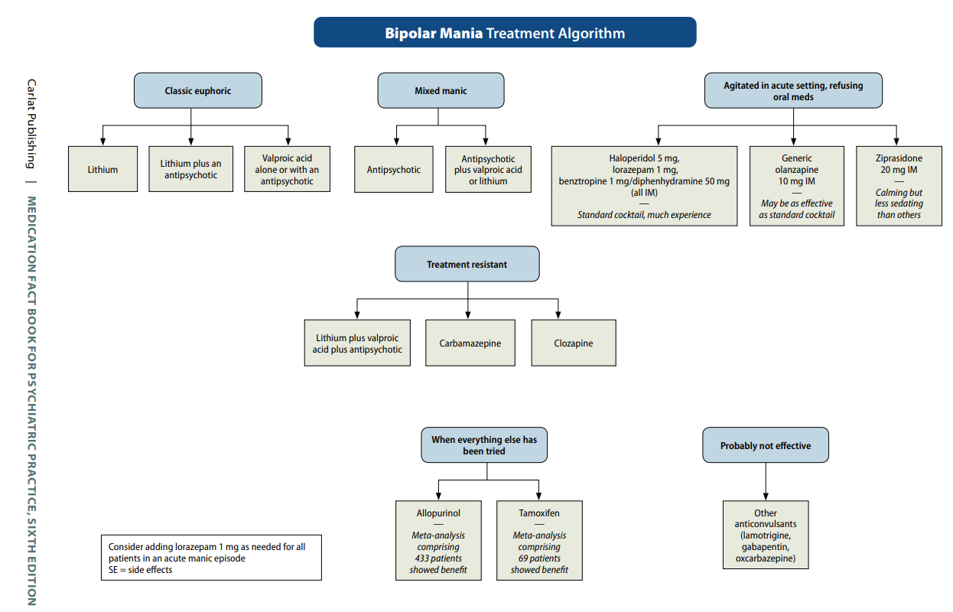
?

Slide 3
?
?

Slide 4
?

Slide 5
?

Slide 7
60%
40%

Slide 8
60%
40%
Which antipsychotic?

Slide 9
60%
40%
First-line antipsychotic:
quetiapine (Seroquel) per Osser
Other potential first-line antipsychotics:

Slide 10
60%
40%
First-line antipsychotic:
quetiapine (Seroquel) per Osser
Other potential first-line antipsychotics:
olanzapine (Zyprexa)

Slide 11
60%
40%
First-line antipsychotic:
quetiapine (Seroquel) per Osser
Other potential first-line antipsychotics:
olanzapine (Zyprexa)
risperidone (Risperdal)

Slide 12
60%
40%
First-line antipsychotic:
quetiapine (Seroquel) per Osser
Other potential first-line antipsychotics:
olanzapine (Zyprexa)
risperidone (Risperdal)
ziprasidone (Geodon)

Slide 13
60%
40%
First-line antipsychotic:
quetiapine (Seroquel) per Osser
Other potential first-line antipsychotics:
olanzapine (Zyprexa)
risperidone (Risperdal)
ziprasidone (Geodon)
asenapine (Saphris)

Slide 14
60%
40%
First-line antipsychotic:
quetiapine (Seroquel) per Osser
Other potential first-line antipsychotics:
olanzapine (Zyprexa)
risperidone (Risperdal)
ziprasidone (Geodon)
asenapine (Saphris)

Slide 15
60%
40%
First-line antipsychotic:
quetiapine (Seroquel) per Osser
Other potential first-line antipsychotics:
olanzapine (Zyprexa)
risperidone (Risperdal)
ziprasidone (Geodon)
asenapine (Saphris)
?

Slide 16
60%
40%
First-line antipsychotic:
quetiapine (Seroquel) per Osser
Other potential first-line antipsychotics:
olanzapine (Zyprexa)
risperidone (Risperdal)
ziprasidone (Geodon)
asenapine (Saphris)

Slide 17
60%
40%
First-line antipsychotic:
quetiapine (Seroquel) per Osser
Other potential first-line antipsychotics:
olanzapine (Zyprexa)
risperidone (Risperdal)
ziprasidone (Geodon)
asenapine (Saphris)

Slide 18
60%
40%
First-line antipsychotic:
quetiapine (Seroquel) per Osser
Other potential first-line antipsychotics:
olanzapine (Zyprexa)
risperidone (Risperdal)
ziprasidone (Geodon)
asenapine (Saphris)

Slide 19
60%
40%
First-line antipsychotic:
quetiapine (Seroquel) per Osser
Other potential first-line antipsychotics:
olanzapine (Zyprexa)
risperidone (Risperdal)
ziprasidone (Geodon)
asenapine (Saphris)

Slide 20
60%
40%
?
First-line antipsychotic:
quetiapine (Seroquel) per Osser
Other potential first-line antipsychotics:
olanzapine (Zyprexa)
risperidone (Risperdal)
ziprasidone (Geodon)
asenapine (Saphris)

Slide 21
60%
40%
?
First-line antipsychotic:
quetiapine (Seroquel) per Osser
Other potential first-line antipsychotics:
olanzapine (Zyprexa)
risperidone (Risperdal)
ziprasidone (Geodon)
asenapine (Saphris)

Slide 22
60%
40%
?
First-line antipsychotic:
quetiapine (Seroquel) per Osser
Other potential first-line antipsychotics:
olanzapine (Zyprexa)
risperidone (Risperdal)
ziprasidone (Geodon)
asenapine (Saphris)

Slide 23
60%
40%
First-line antipsychotic:
quetiapine (Seroquel) per Osser
Other potential first-line antipsychotics:
olanzapine (Zyprexa)
risperidone (Risperdal)
ziprasidone (Geodon)
asenapine (Saphris)
?

Slide 24
60%
40%
First-line antipsychotic:
quetiapine (Seroquel) per Osser
Other potential first-line antipsychotics:
olanzapine (Zyprexa)
risperidone (Risperdal)
ziprasidone (Geodon)
asenapine (Saphris)
?

Slide 25
60%
40%
First-line antipsychotic:
quetiapine (Seroquel) per Osser
Other potential first-line antipsychotics:
olanzapine (Zyprexa)
risperidone (Risperdal)
ziprasidone (Geodon)
asenapine (Saphris)

Slide 26
60%
40%
First-line antipsychotic:
quetiapine (Seroquel) per Osser
Other potential first-line antipsychotics:
olanzapine (Zyprexa)
risperidone (Risperdal)
ziprasidone (Geodon)
asenapine (Saphris)

Slide 27
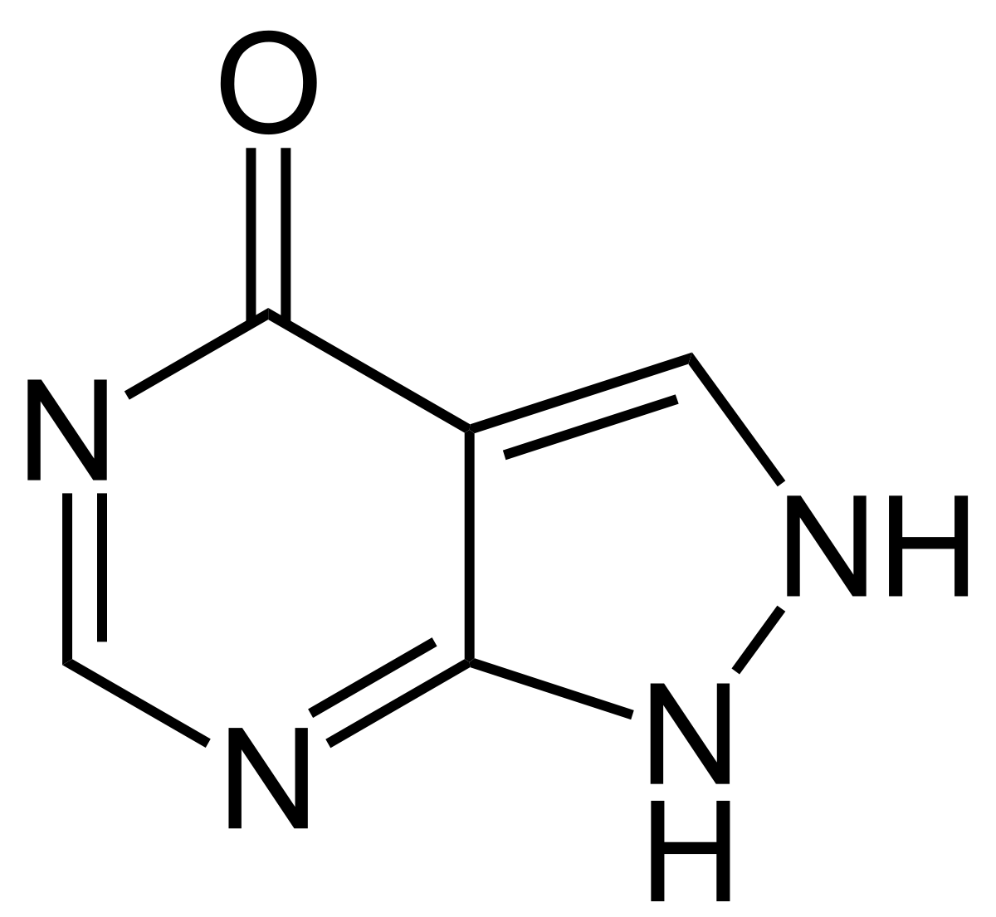
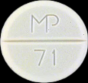
Allopurinol (Zyloprim
AL oh PURE i nol / ZY lo prim
“Alli purring”
#43
1966
$8–$20
❖ Xanthine oxidase inhibitor
100
300
mg
xanthine oxidase inhibitor
gout treatment (prevention)
reduces urinary and serum uric acid concentrations
can cause Stevens Johnson Syndrome
consider screening those of African American, Han Chinese, Korean, Thai, Native Hawaiian, or Pacific Islander ancestry for the HLA-B*5801 allele before starting allopurinol.
Purrrrr
podagra

Slide 28
Allopurinol (Zyloprim
AL oh PURE i nol / ZY lo prim
“Alli purring”
#43
1966
$8–$20
❖ Xanthine oxidase inhibitor
100
300
mg
xanthine oxidase inhibitor
gout treatment (prevention)
reduces urinary and serum uric acid concentrations
can cause Stevens Johnson Syndrome
consider screening those of African American, Han Chinese, Korean, Thai, Native Hawaiian, or Pacific Islander ancestry for the HLA-B*5801 allele before starting allopurinol.
Psychiatric Relevance
bipolar disorder seems to be associated with purinergic system dysfunction.
five randomized controlled trials (N=433)
effective for adjunctive treatment of bipolar mania (Bartoli et al, 2016).
allopurinol was well-tolerated
especially effective in people with severe mania
small to moderate effect side.
Purrrrr
podagra

Slide 29
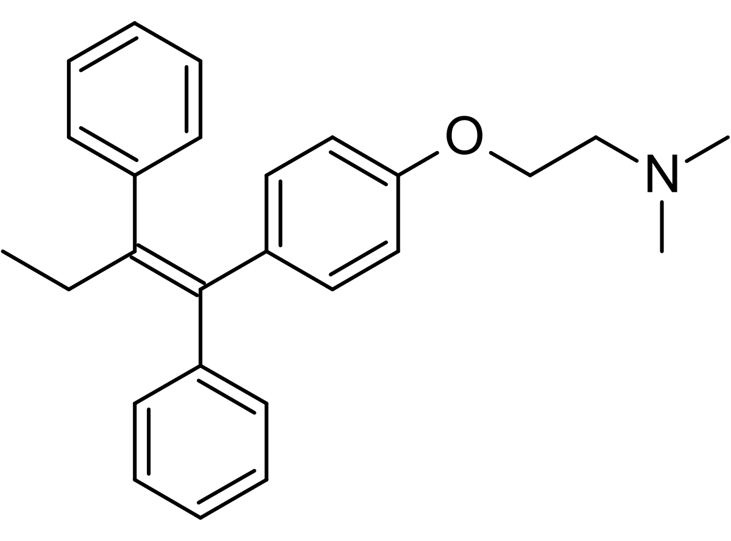
Tamoxifen (NOLVADEX)
ta MOX i fen / NOLV a dex
“Tame ox defends (against breast cancer)”
#238
1990
$20–$80
❖ Selective estrogen receptor
modulator (SERM)
❖ Protein kinase C (PKC) inhibitor
10
20
mg
Medication for breast cancer - SERMs are estrogen agonist/antagonists
Experimental for manic episode treatment

Slide 30
Tamoxifen (NOLVADEX)
ta MOX i fen / NOLV a dex
“Tame ox defends (against breast cancer)”
#238
1990
$20–$80
❖ Selective estrogen receptor
modulator (SERM)
❖ Protein kinase C (PKC) inhibitor
10
20
mg
Medication for breast cancer
Experimental for manic episode treatment
I included it in my book because:
good example of the prodrug concept
some antidepressants (2D6 inHibitors) cut its effectiveness in half
It appears to be effective for the treatment of acute mania
For breast cancer, tamoxifen is typically taken for 5 years.
For an acute manic episode it was taken for 3 weeks.
Black box warning for risk of uterine cancer and blood clots (stroke, pulmonary embolism).
Side effects may include:
irregular periods
flushing
acne
cognitive impairment
loss of libido
hepatotoxicity

Slide 31
Tamoxifen (NOLVADEX)
ta MOX i fen / NOLV a dex
“Tame ox defends (against breast cancer)”
#238
1990
$20–$80
Tamoxifen (NOLVADEX)
ta MOX i fen / NOLV a dex
“Tame ox defends (against breast cancer)”
❖ Selective estrogen receptor
modulator (SERM)
❖ Protein kinase C (PKC) inhibitor
#238
1990
$20–$80
❖ Selective estrogen receptor
modulator (SERM)
❖ Protein kinase C (PKC) inhibitor
10
20
mg
10
20
mg
Yildiz-Yesiloglu (2006) found tamoxifen effective for acute mania.
Tamoxifen was chosen not for its antiestrogenic effect, but for its inhibition of protein kinase C (PKC) in the brain.
PKC is believed to be overactive during manic episodes of bipolar disorder.
In a 3-week study, 14 of 29 acutely manic patients showed at least 50% improvement, compared to 1 of 21 with placebo.
Side effects were minimal—flushing of face and acne.
For context, lithium and valproic acid (Depakene, Depakote) indirectly inhibit PKC, which may be involved in their mechanism of mood stabilization.
Tamoxifen is the only available direct PKC inhibitor.

Slide 32
Tamoxifen (NOLVADEX)
ta MOX i fen / NOLV a dex
“Tame ox defends (against breast cancer)”
#238
1990
$20–$80
Tamoxifen (NOLVADEX)
ta MOX i fen / NOLV a dex
“Tame ox defends (against breast cancer)”
❖ Selective estrogen receptor
modulator (SERM)
❖ Protein kinase C (PKC) inhibitor
#238
1990
$20–$80
❖ Selective estrogen receptor
modulator (SERM)
❖ Protein kinase C (PKC) inhibitor
10
20
mg
10
20
mg
Tamoxifen is a prodrug with relatively low affinity for estrogen receptors itself.
The therapeutic effects of tamoxifen are through active metabolites.
Concomitant use of 2D6-inhibiting antidepressants double the risk of recurrence of breast cancer
How do you pronounce this word?
2D6 prodrug

Slide 33
Tamoxifen (NOLVADEX)
ta MOX i fen / NOLV a dex
“Tame ox defends (against breast cancer)”
#238
1990
$20–$80
Tamoxifen (NOLVADEX)
ta MOX i fen / NOLV a dex
“Tame ox defends (against breast cancer)”
❖ Selective estrogen receptor
modulator (SERM)
❖ Protein kinase C (PKC) inhibitor
#238
1990
$20–$80
❖ Selective estrogen receptor
modulator (SERM)
❖ Protein kinase C (PKC) inhibitor
10
20
mg
10
20
mg
Tamoxifen is a prodrug with relatively low affinity for estrogen receptors itself.
The therapeutic effects of tamoxifen are through active metabolites.
Concomitant use of 2D6-inhibiting antidepressants double the risk of recurrence of breast cancer, even
sertraline whose 2D6 inHibition(weak) is a non-factor in other contexts.
❖ Tamoxifen is less effective for individuals with 2D6 poor metabolizer (PM) genotype (5% of population)
2D6 prodrug

Slide 34
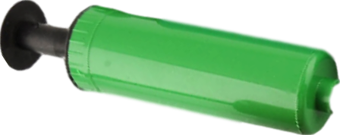
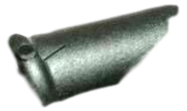
Tamoxifen (NOLVADEX)
ta MOX i fen / NOLV a dex
“Tame ox defends (against breast cancer)”
#238
1990
$20–$80
Tamoxifen (NOLVADEX)
ta MOX i fen / NOLV a dex
“Tame ox defends (against breast cancer)”
❖ Selective estrogen receptor
modulator (SERM)
❖ Protein kinase C (PKC) inhibitor
#238
1990
$20–$80
❖ Selective estrogen receptor
modulator (SERM)
❖ Protein kinase C (PKC) inhibitor
10
20
mg
10
20
mg
Tamoxifen is a prodrug with relatively low affinity for estrogen receptors itself.
The therapeutic effects of tamoxifen are through active metabolites.
Concomitant use of 2D6-inhibiting antidepressants double the risk of recurrence of breast cancer, even
sertraline whose 2D6 inHibition(weak) is a non-factor in other contexts.
It’s your fault I can’t roll
2D6 prodrug
Aw, snap!
2D6 inhibitor
prodrug

Slide 35
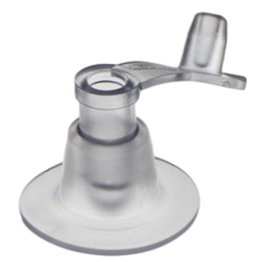
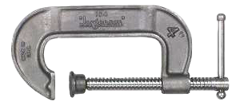
Tamoxifen (NOLVADEX)
ta MOX i fen / NOLV a dex
“Tame ox defends (against breast cancer)”
#238
1990
$20–$80
Tamoxifen (NOLVADEX)
ta MOX i fen / NOLV a dex
“Tame ox defends (against breast cancer)”
❖ Selective estrogen receptor
modulator (SERM)
❖ Protein kinase C (PKC) inhibitor
#238
1990
$20–$80
❖ Selective estrogen receptor
modulator (SERM)
❖ Protein kinase C (PKC) inhibitor
10
20
mg
10
20
mg
Tamoxifen is a prodrug with relatively low affinity for estrogen receptors itself.
The therapeutic effects of tamoxifen are through active metabolites.
Concomitant use of 2D6-inhibiting antidepressants double the risk of recurrence of breast cancer, even
sertraline whose 2D6 inHibition(weak) is a non-factor in other contexts.
Tamoxifen is less effective for individuals with 2D6 poor metabolizer (PM) genotype (5% of population)
2D6 prodrug
Poor me !
2D6 PM

Slide 36
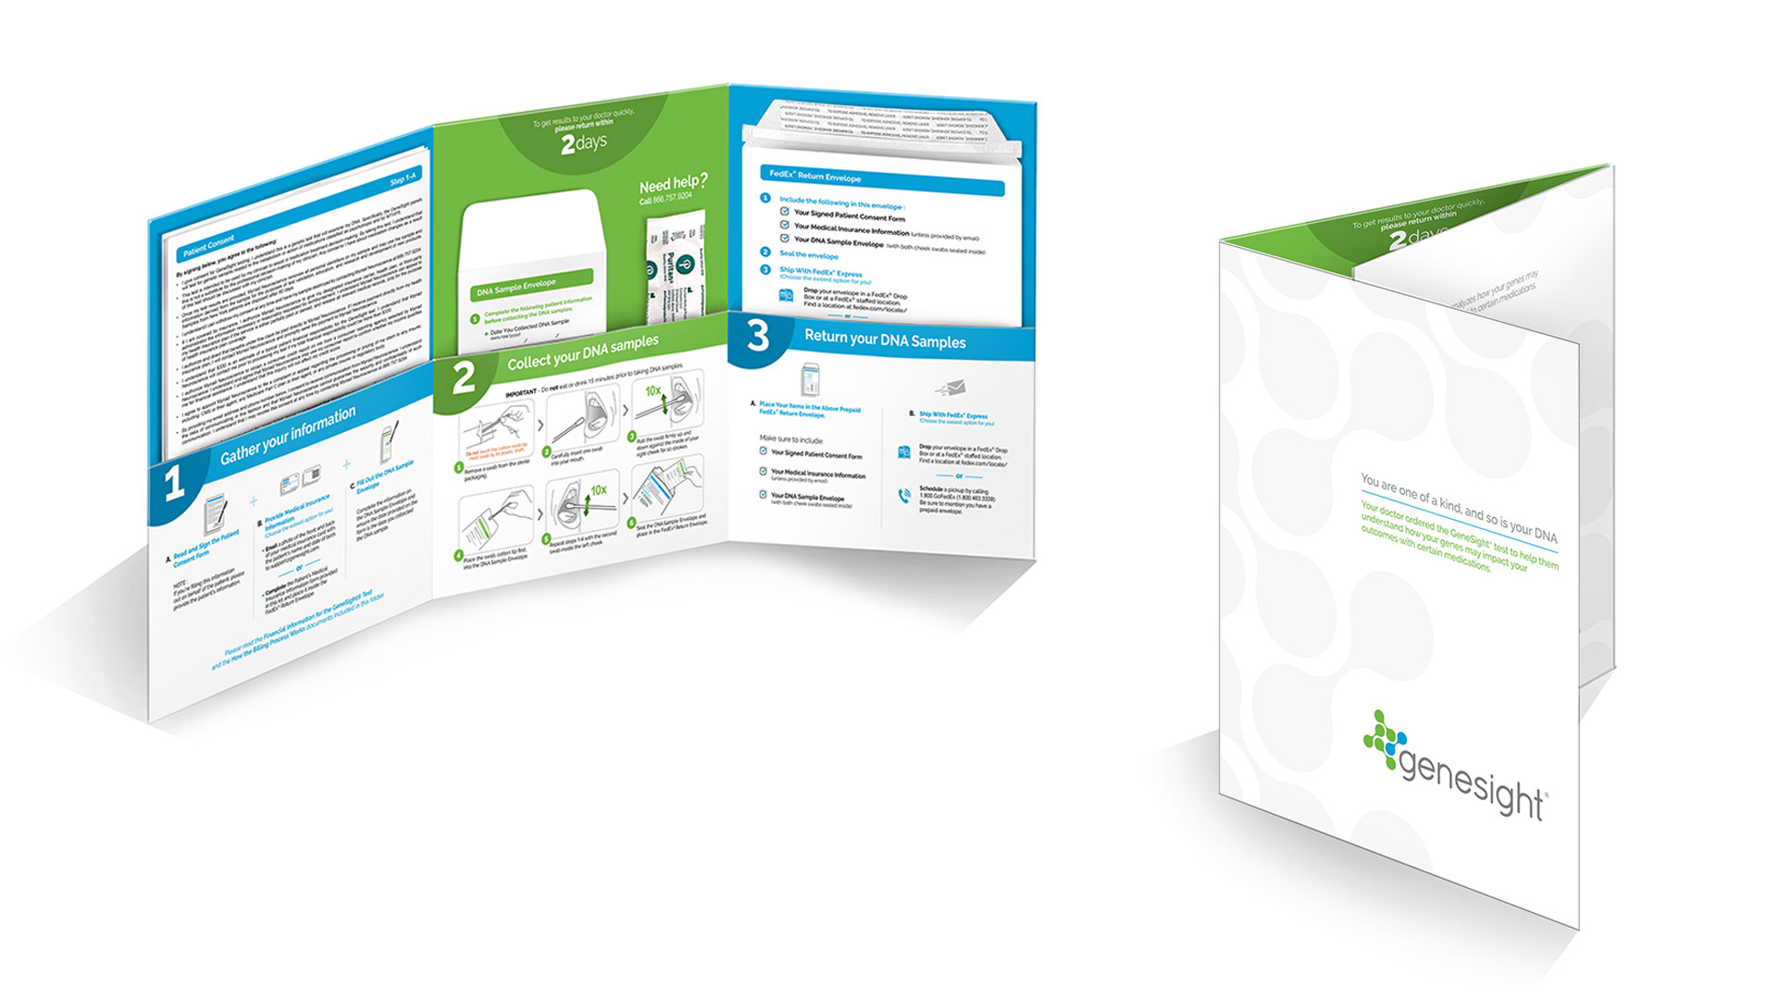
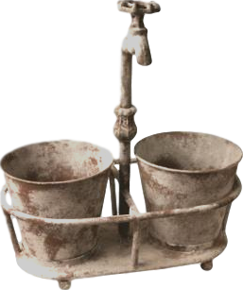
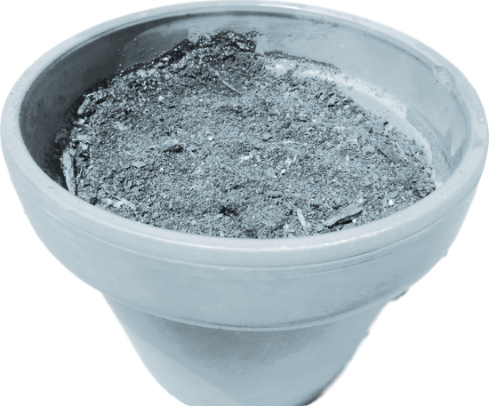
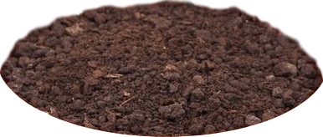
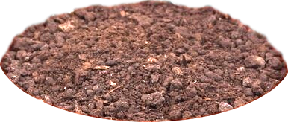
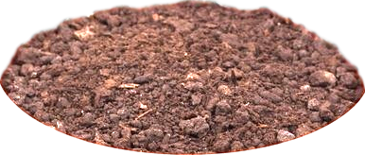
Genetic test results I have pictures for:
HLA-B*1502
UGT1A4
UM
Poor me!
Poor me!
2D6 UM
2D6 PM
Poor me !
2C19 PM
2C19 UM

Slide 37
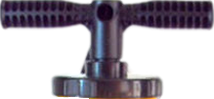
Tamoxifen (NOLVADEX)
ta MOX i fen / NOLV a dex
“Tame ox defends (against breast cancer)”
#238
1990
$20–$80
Tamoxifen (NOLVADEX)
ta MOX i fen / NOLV a dex
“Tame ox defends (against breast cancer)”
❖ Selective estrogen receptor
modulator (SERM)
❖ Protein kinase C (PKC) inhibitor
#238
1990
$20–$80
❖ Selective estrogen receptor
modulator (SERM)
❖ Protein kinase C (PKC) inhibitor
10
20
mg
10
20
mg
2D6 inHibitor antidepressants
It’s your fault I can’t roll
Aw, snap!
2D6 inhibitor
prodrug
mod/strong
Fluoxetine
PROZAC
strong
Bupropion
WELLBUTRIN
Prodrugs are substrates that are less potent than their metabolites.
Ordinary substrates (beach balls) are deactivated by 2D6.
Prodrugs (bowling balls) are activated by 2D6.
In the presence of an inhibitor prodrugs are less effective.
2D6 prodrug
strong
moderate
Paroxetine
PAXIL
Duloxetine
CYMBALTA
page
15
HORMONES
25

Slide 38
What drug are we talking about?

Slide 40
60%
40%
First-line antipsychotic:
quetiapine (Seroquel) per Osser
Other potential first-line antipsychotics:
olanzapine (Zyprexa)
risperidone (Risperdal)
ziprasidone (Geodon)
asenapine (Saphris)

Slide 41
From Osser’s algorithms (with italicized additions)
From Carlat’s Medication Factbook
Mania
--Taper antidepressants.
--Ensure sleep with benzo +/- antipsychotic +/-
antihistamine (preferably not trazodone).
--Consider blue-blocking glasses.
--Preferred antipsychotic is quetiapine.
--*Alternate antipsychotics include olanzapine, risperidone, ziprasidone, asenapine.
Classic mania (60%)
Step 1: lithium (+/- antipsychotic)
Step 2: add quetiapine (or alt antipsychotic*)
Step 3: add valproate (unless childbearing)
Mixed mania (40%)
Step 1: quetiapine (or alternate antipsychotic*)
+/- valproate
Step 2: add valproate (unless childbearing)
Step 3: add lithium
Steps 4-6 for classic or mixed
Stop any ineffective medications and add:
1st tier:
carbamazepine** (unless childbearing)
olanzapine, risperidone, haloperidol
2nd tier: aripiprazole, asenapine, ziprasidone
3rd tier: clozapine
Also consider: allopurinol or tamoxifen
**Carbamazepine is a 3A4 inDucer that will reduce blood levels of quetiapine by ~85%, aripiprazole by ~65%, haloperidol by ~40%, and risperidone +metabolite by ~35% within a few weeks of starting carbamazepine. inDuction - Down and Delayed

Slide 42
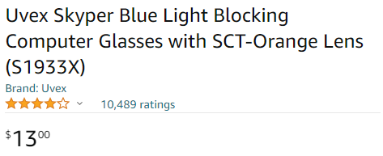
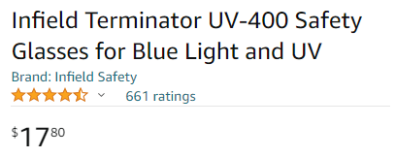
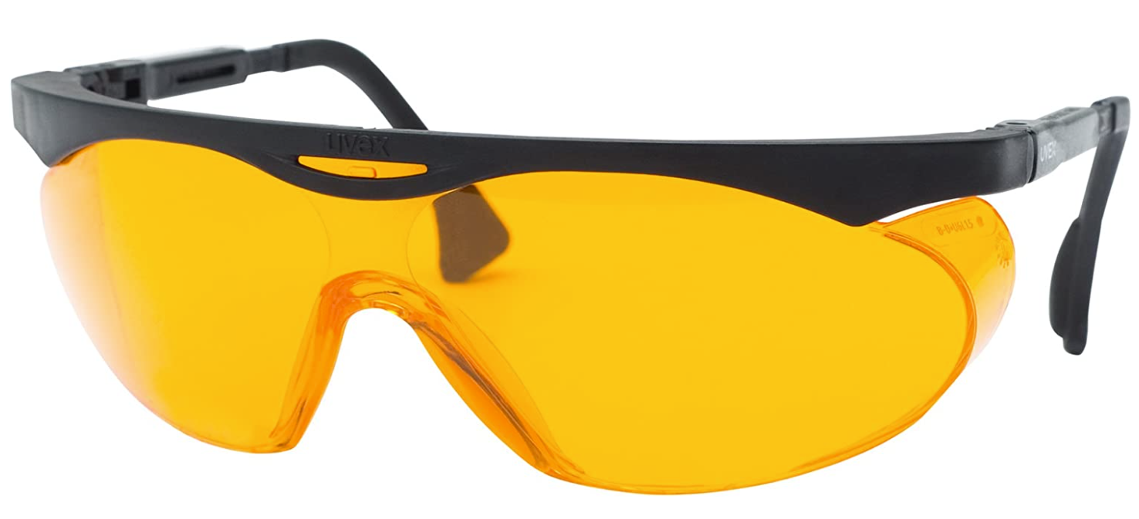
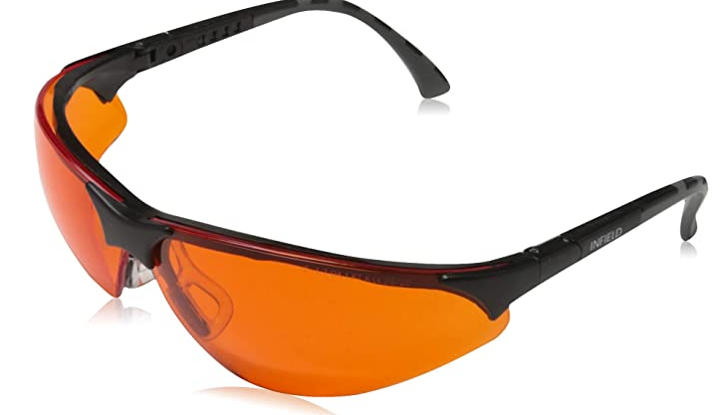
Blue light blocking glasses for elevated mood
need 100% blue light blocking, heavy orange tint
wear from 6pm - 8am if experiencing symptoms of mania, e.g., racing thoughts (unnecessary when eyes closed)
The $30 listing is for a 3-pack

Slide 43
“Fluffer
inHibitors”
“Shredder” inDucers
carbamazepine (Tegretol)
phenobarbital
phenytoin
rifampin
fluvoxamine (Luvox)
fluoxetine (Prozac)
fluconazole
ketoconazole
Notes:
Luvox is a “Fluffer” inHibitor

Slide 44
“Fluffer
inHibitors”
“Shredder” inDucers
carbamazepine (Tegretol)
phenobarbital
phenytoin
rifampin
fluvoxamine (Luvox)
fluoxetine (Prozac)
fluconazole
ketoconazole
Notes:
While Tegretal, up next, is a Shredder inducer, which is the opposite effect.

Slide 45
Carbamazine (Tegretol)
Notes:
Carbamazepine ***OPEN PIC***

Slide 46
Carbamazine (Tegretol)
Enzyme inDucer
Notes:
Carbamazepine ***OPEN PIC***

Slide 47
Carbamazine (Tegretol)
Enzyme inDucer
Antiepileptic drug / mood stabilizer
Notes:
Carbamazepine ***OPEN PIC***

Slide 48
Carbamazine (Tegretol)
Enzyme inDucer
Antiepileptic drug / mood stabilizer
Neuropathic pain med
Notes:
Carbamazepine ***OPEN PIC***

Slide 49
Carbamazine (Tegretol)
Enzyme inDucer
Antiepileptic drug / mood stabilizer
Neuropathic pain med
Teratogen
Notes:
Carbamazepine ***OPEN PIC***

Slide 50
Carbamazine (Tegretol)
Notes:
Carbamazepine ***OPEN PIC***

Slide 51
Carbamazine (Tegretol)
Notes:
Most important thing

Slide 52
Carbamazepine
TEGretol
TEGretol-XR
Carbatrol
Equetro
Epitol

Slide 53
Carbamazepine
TEGretol
TEGretol-XR
Carbatrol
Equetro – FDA-approved for bipolar
Epitol
Notes:
ER

Slide 54
Carbamazepine
TEGretol
TEGretol-XR
Carbatrol
Equetro – FDA-approved for bipolar I disorder
Epitol
Notes:
More specifically

Slide 55
Carbamazepine
TEGretol
TEGretol-XR
Carbatrol
Equetro - FDA-approved for bipolar I disorder
Epitol
manic episodes of

Slide 56
Carbamazepine
TEGretol
TEGretol-XR
Carbatrol
Equetro - FDA-approved for bipolar I disorder
Epitol
manic or mixed episodes of

Slide 57
Carbamazepine
TEGretol
TEGretol-XR
Carbatrol
Equetro - FDA-approved for Acute Manic or Mixed
Episodes associated with Bipolar I Disorder
Epitol
Notes:
The official verbiage

Slide 58
Carbamazepine
TEGretol
TEGretol-XR
Carbatrol
Equetro - FDA-approved for Acute Manic or Mixed
Episodes associated with Bipolar I Disorder
Epitol
Notes:
Identical

Slide 59
Carbamazepine (TEGRETOL)
“Tiger tail (in the) Car Maze”
Notes:
This mnemonic accomplishes everything I’m going for - pairs trade name with the generic-- TIGER TAIL

Slide 60
Carbamazepine (TEGRETOL)
“Tiger tail (in the) Car Maze”

Slide 61
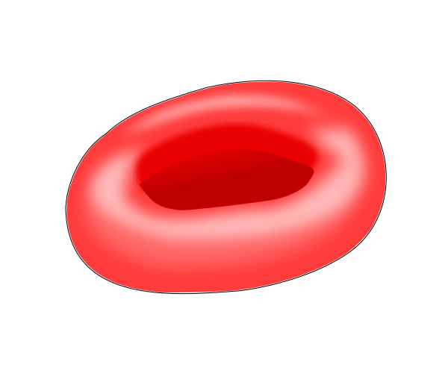
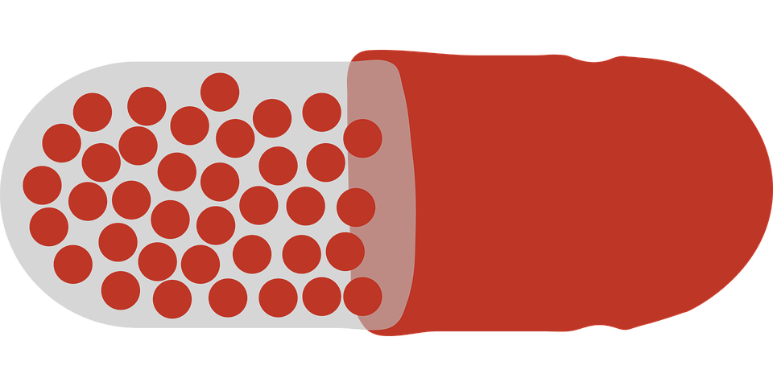
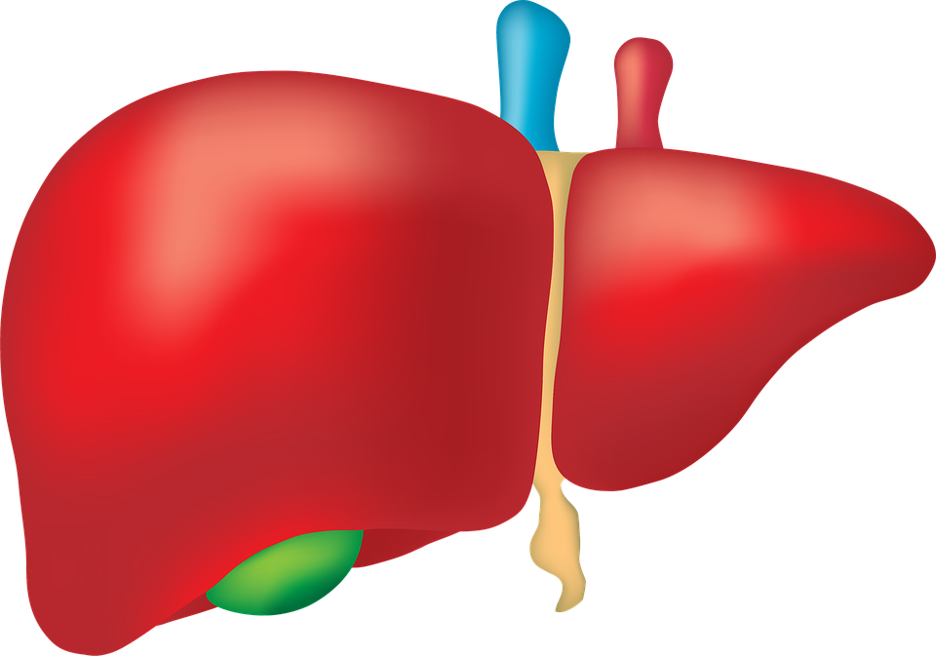
Risks of CBZ:
hyponatremia
Carbamazepine
(TEGRETOL)
“Tiger tail (in the)
Car Maze”
terato-
genicity
aplastic anemia
(rare)
Na⁺ Na⁺
decreased bone mineral density
agranulo-
cytosis (rare)
reduced levels of many medications
hepatotoxicity
Notes:
potential health risks.

Slide 62
Risks of CBZ:
hyponatremia
Carbamazepine
(TEGRETOL)
“Tiger tail (in the)
Car Maze”
terato-
genicity
aplastic anemia
(rare)
Na⁺ Na⁺
decreased bone mineral density
agranulo-
cytosis (rare)
reduced levels of many medications
neural tube defects
hepatotoxicity
Notes:
most typically neural tube defects, pretty much contraindicated in women of childbearing age

Slide 63
Risks of CBZ:
hyponatremia
Carbamazepine
(TEGRETOL)
“Tiger tail (in the)
Car Maze”
terato-
genicity
aplastic anemia
(rare)
Na⁺ Na⁺
decreased bone mineral density
agranulo-
cytosis (rare)
reduced levels of many medications
hepatotoxicity

Slide 64
Risks of CBZ:
hyponatremia
Carbamazepine
(TEGRETOL)
“Tiger tail (in the)
Car Maze”
terato-
genicity
aplastic anemia
(rare)
Na⁺ Na⁺
decreased bone mineral density
agranulo-
cytosis (rare)
reduced levels of many medications
hepatotoxicity

Slide 65
Risks of CBZ:
hyponatremia
Carbamazepine
(TEGRETOL)
“Tiger tail (in the)
Car Maze”
terato-
genicity
aplastic anemia
(rare)
Na⁺ Na⁺
decreased bone mineral density
agranulo-
cytosis (rare)
reduced levels of many medications
hepatotoxicity

Slide 66
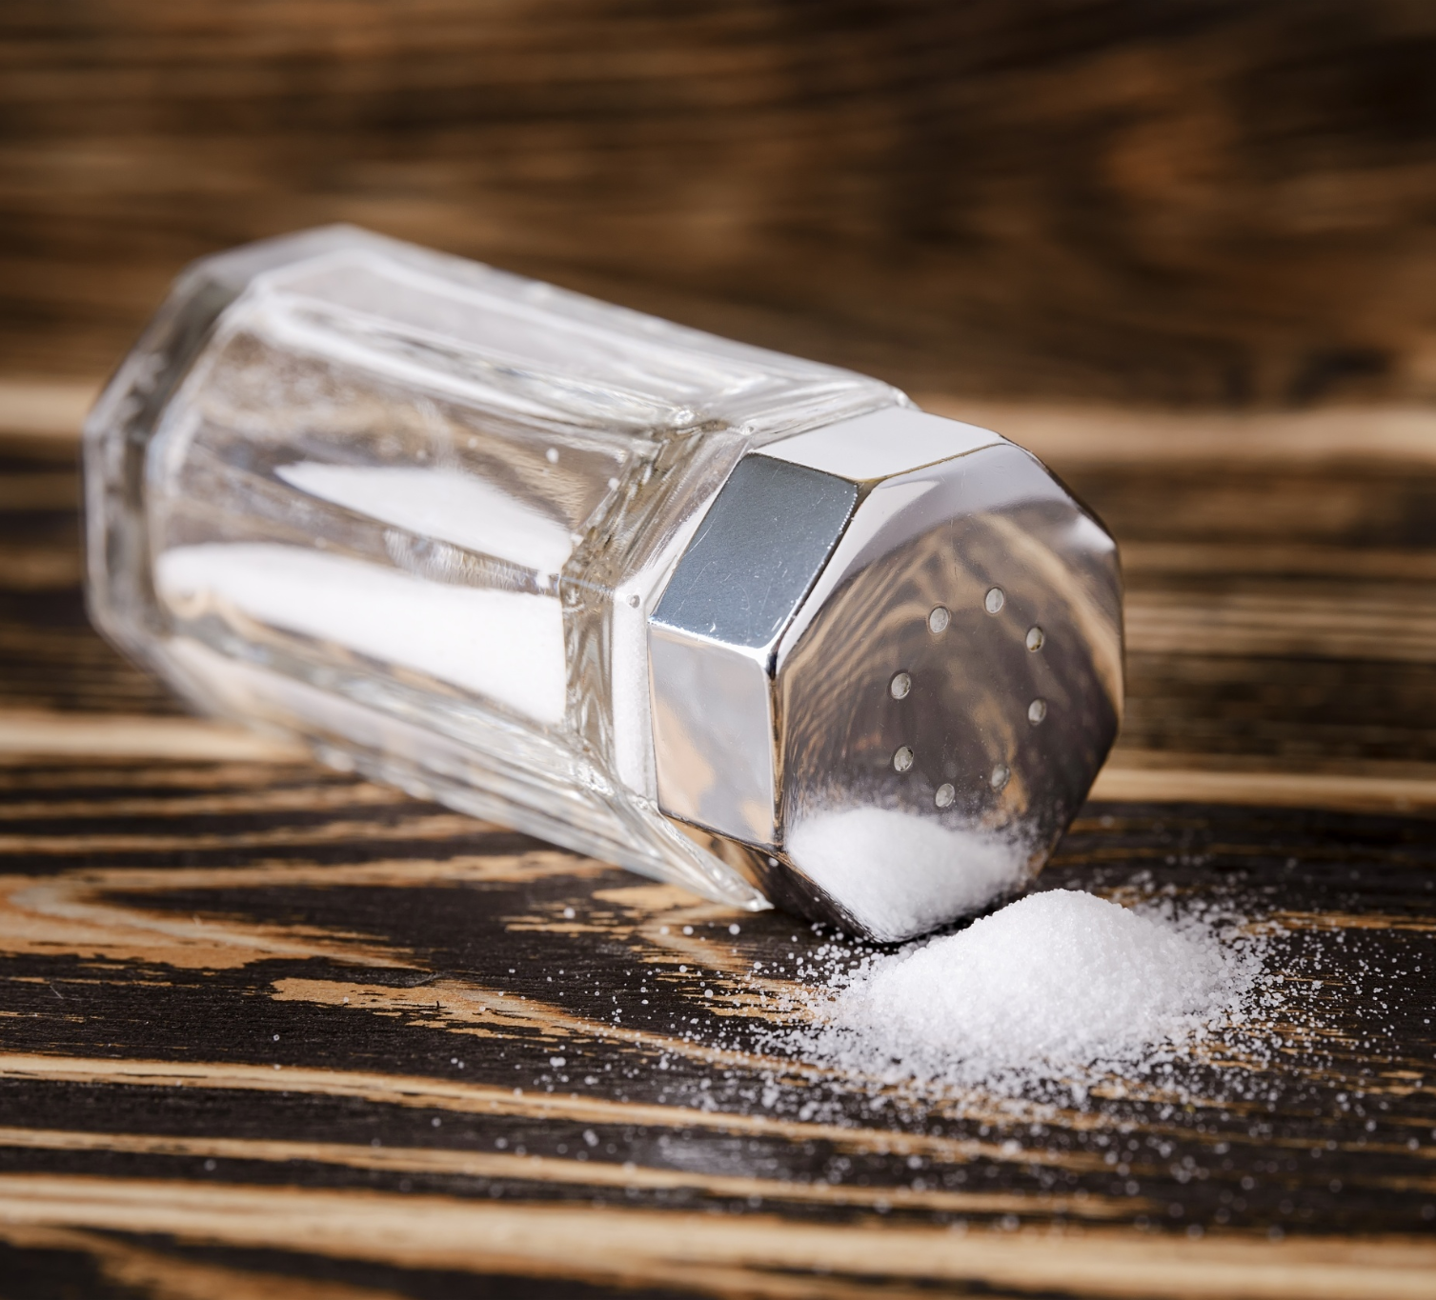
Risks of CBZ:
hyponatremia
Carbamazepine
(TEGRETOL)
“Tiger tail (in the)
Car Maze”
terato-
genicity
aplastic anemia
(rare)
Na⁺ Na⁺
decreased bone mineral density
agranulo-
cytosis (rare)
reduced levels of many medications
hepatotoxicity

Slide 67
Risks of CBZ:
hyponatremia
Carbamazepine
(TEGRETOL)
“Tiger tail (in the)
Car Maze”
terato-
genicity
aplastic anemia
(rare)
Na⁺ Na⁺
decreased bone mineral density
agranulo-
cytosis (rare)
reduced levels of many medications
hepatotoxicity

Slide 68
Risks of CBZ:
hyponatremia
Carbamazepine
(TEGRETOL)
“Tiger tail (in the)
Car Maze”
terato-
genicity
aplastic anemia
(rare)
Na⁺ Na⁺
decreased bone mineral density
agranulo-
cytosis (rare)
reduced levels of many medications
hepatotoxicity
Notes:
Shredder inducer

Slide 69
Carbamazepine (TEGRETOL)
inDuction
Down and Delayed
Carbamazepine “eats its own tail”

Slide 70
Carbamazepine (TEGRETOL)
inDuction
Autoinduction of CYP3A4
Down and Delayed
Carbamazepine “eats its own tail”
inducing its own metabolism
Notes:
By stimulating production of 3A4 enzymes that metabolize it

Slide 71
Carbamazepine (TEGRETOL)
inDuction
Autoinduction of CYP3A4
Down and Delayed
Carbamazepine “eats its own tail” inducing its own metabolism as a CYP3A4 substrate and inDucer
Notes:
So blood levels at 3-4 weeks will be lower than at week 1 of starting it

Slide 72
Carbamazepine (TEGRETOL)
inDuction
Autoinduction of CYP3A4
Down and Delayed
Carbamazepine “eats its own tail” inducing its own metabolism as a CYP3A4 substrate and inDucer.
Half-life drops from 35 hr to 15 hr.
Notes:
Initially carbamazepine has a half-life of 35 hr

Slide 73
Carbamazepine
(TEGRETOL)
Mechanism of action:

Slide 74
Carbamazepine
(TEGRETOL)
Mechanism of action:
❖ Antiepileptic
Notes:
My answer would be “seizure medication”.

Slide 75
Carbamazepine
(TEGRETOL)
Mechanism of action:
❖ Antiepileptic
❖ Voltage-gated sodium
channel blocker
Notes:
Other than lithium, all mood stabilizers are antiepileptics.

Slide 76
Carbamazepine
(TEGRETOL)
Mechanism of action:
❖ Antiepileptic
❖ Voltage-gated sodium
channel blocker - salt can get your
car out of snow
Notes:
The specific antiepileptic mechanism is blocking voltage-gated sodium channels on neurons in the brain. For a mnemonic, you can keep a bag of salt in your car in case it gets stuck in the snow. Valproate and phenytoin do the same. ***CLOSE PIC***

Slide 77
Carbamazepine
(TEGRETOL)
Mechanism of action:
❖ Antiepileptic
❖ Voltage-gated sodium
channel blocker - salt can get your
car out of snow
Some other AEDs are voltage-gated calcium channel blockers.
Notes:
As opposed to some antiepileptic drugs that block voltage-gated calcium channels, such as Gabapentin. Lamotrigine blocks both voltage-gated sodium and calcium channels. Knowing the mechanism isn’t that important...

Slide 78
Carbamazepine
(TEGRETOL)
Mechanism of action:
❖ Antiepileptic
❖ Voltage-gated sodium
channel blocker - salt can get your
car out of snow
Can decrease serum sodium, causing hyponatremia
Notes:
In this case can help you remember (by different mech)

Slide 79
Carbamazepine
(TEGRETOL)
Mechanism of action:
❖ Antiepileptic
❖ Voltage-gated sodium
channel blocker - salt can get your
car out of snow
Can decrease serum sodium, causing hyponatremia (increased ADH secretion)
Notes:
Although the mechanism is different

Slide 80
Carbamazepine
(TEGRETOL)
Mechanism of action:
❖ Antiepileptic
❖ Voltage-gated sodium
channel blocker
❖ Glutamate ⇩
decreases release of glutamate, the brain’s principal excitatory neurotransmitter
Notes:
Other AEDs do this too

Slide 81
Carbamazepine
(TEGRETOL)
FDA-approved for:
Notes:
Various formulations

Slide 82
Carbamazepine
(TEGRETOL)
FDA-approved for:
❖ Seizure disorder

Slide 83
Carbamazepine
(TEGRETOL)
FDA-approved for:
❖ Seizure disorder
❖ Trigeminal neuralgia

Slide 84
Carbamazepine
(TEGRETOL)
FDA-approved for:
❖ Seizure disorder
❖ Trigeminal neuralgia
❖ Bipolar

Slide 85
Carbamazepine
(TEGRETOL)
FDA-approved for:
❖ Seizure disorder
❖ Trigeminal neuralgia
❖ Acute manic/mixed episode of
bipolar I disorder (ER formulation)
Notes:
Although we use generic IR

Slide 86
Carbamazepine
(TEGRETOL)
FDA-approved for:
❖ Seizure disorder
❖ Trigeminal neuralgia
❖ Acute manic/mixed episode of
bipolar I disorder (ER formulation)
Used off label for:

Slide 87
Carbamazepine
(TEGRETOL)
FDA-approved for:
❖ Seizure disorder
❖ Trigeminal neuralgia
❖ Acute manic/mixed episode of
bipolar I disorder (ER formulation)
Used off label for:
❖ Bipolar maintenance

Slide 88
Carbamazepine
(TEGRETOL)
FDA-approved for:
❖ Seizure disorder
❖ Trigeminal neuralgia
❖ Acute manic/mixed episode of
bipolar I disorder (ER formulation)
Used off label for:
❖ Bipolar maintenance
❖ Neuropathic pain
❖ Restless legs syndrome
❖ Migraine prophylaxis
Notes:
Several neurologic conditions

Slide 89
Carbamazepine
(TEGRETOL)
FDA-approved for:
❖ Seizure disorder
❖ Trigeminal neuralgia
❖ Acute manic/mixed episode of
bipolar I disorder (ER formulation)
Used off label for:
❖ Bipolar maintenance
❖ Neuropathic pain
❖ Restless legs syndrome
❖ Migraine prophylaxis
❖ Alcohol use disorder
Notes:
relieve alcohol withdrawal symptoms and assist in maintaining sobriety

Slide 90
Carbamazepine
(TEGRETOL)
Recommendation:
Generally avoid prescribing it.
Notes:
relieve alcohol withdrawal symptoms and assist in maintaining sobriety

Slide 91
Carbamazepine
(TEGRETOL)
Recommendation:
Generally avoid prescribing it.
But does it have advantages over alternative meds?
Notes:
relieve alcohol withdrawal symptoms and assist in maintaining sobriety

Slide 92
Carbamazepine
(TEGRETOL)
Three mood stabilizers FDA-approved for bipolar mania:

Slide 93
Carbamazepine
(TEGRETOL)
Three mood stabilizers FDA-approved for bipolar mania:
❖ Lithium

Slide 94
Carbamazepine
(TEGRETOL)
Three mood stabilizers FDA-approved for bipolar mania:
❖ Lithium
❖ Valproate

Slide 95
Carbamazepine
(TEGRETOL)
Three mood stabilizers FDA-approved for bipolar mania:
❖ Lithium
❖ Valproate
❖ Carbamazepine

Slide 96
Carbamazepine
(TEGRETOL)
Advantages over valproate and lithium:

Slide 97
Carbamazepine
(TEGRETOL)
Advantages over valproate and lithium:
❖ No weight gain
Notes:
WEIGHT NEUTRAL

Slide 98
Carbamazepine
(TEGRETOL)
Advantages over valproate and lithium:
❖ No weight gain
❖ No tremor

Slide 99
Carbamazepine
(TEGRETOL)
Advantages over valproate and lithium:
❖ No weight gain
❖ No tremor
❖ Also effective for neuropathic pain

Slide 100
Carbamazepine
(TEGRETOL)
Three AEDs that are highly effective
for neuropathic pain:
Notes:
for context

Slide 101
Carbamazepine
(TEGRETOL)
Three AEDs that are highly effective
for neuropathic pain:
❖ Gabapentin (Neurontin)

Slide 102
Carbamazepine
(TEGRETOL)
Three AEDs that are highly effective
for neuropathic pain:
❖ Gabapentin (Neurontin)
❖ Pregabalin (Lyrica)

Slide 103
Carbamazepine
(TEGRETOL)
Three AEDs that are highly effective
for neuropathic pain:
❖ Gabapentin (Neurontin)
❖ Pregabalin (Lyrica)
❖ Carbamazepine

Slide 104
Carbamazepine
(TEGRETOL)
Three AEDs that are highly effective
for neuropathic pain:
❖ Gabapentin (Neurontin)
❖ Pregabalin (Lyrica)
❖ Carbamazepine
Notes:
One of these things is not like the other.

Slide 105
Carbamazepine
(TEGRETOL)
Three AEDs that are highly effective
for neuropathic pain:
❖ Gabapentin (Neurontin)
❖ Pregabalin (Lyrica)
❖ Carbamazepine
The gabapentinoids can cause weight gain.

Slide 106
Carbamazepine
(TEGRETOL)
But does it have advantages over alternative meds?
Notes:
relieve alcohol withdrawal symptoms and assist in maintaining sobriety

Slide 107
Carbamazepine
(TEGRETOL)
But does it have advantages over alternative meds?
weight-neutral
Notes:
relieve alcohol withdrawal symptoms and assist in maintaining sobriety

Slide 108
Carbamazepine
(TEGRETOL)
But does it have advantages over alternative meds?
weight-neutral
no tremor
Notes:
relieve alcohol withdrawal symptoms and assist in maintaining sobriety

Slide 109
Asian patients have a 10-fold higher incidence of carbamazepine-induced:
Notes:
Once you’ve defined a mascot you can tack a lot of info onto it.

Slide 110
Asian patients have a 10-fold higher incidence of carbamazepine-induced:
Stevens-Johnson syndrome (SJS)

Slide 111
Asian patients have a 10-fold higher incidence of carbamazepine-induced:
Stevens-Johnson syndrome (SJS)
Toxic epidermal necrolysis (TEN)

Slide 112
Asian patients have a 10-fold higher incidence of carbamazepine-induced SJS and TEN
FDA recommends screening Asians for the HLA-B*1502 allele, which would be a contraindication for starting CBZ.

Slide 113
Asian patients have a 10-fold higher incidence of carbamazepine-induced SJS and TEN
FDA recommends screening Asians for the HLA-B*1502 allele, which would be a contraindication for starting CBZ.
“Hey Look, Asian Blood!
if 1502, no Tegretol for you!”
Notes:
My mnemonic for this

Slide 114
Asian patients have a 10-fold higher incidence of carbamazepine-induced SJS and TEN
FDA recommends screening Asians for the HLA-B*1502 allele, which would be a contraindication for starting CBZ.
“Hey Look, Asian Blood!
if 1502, no Tegretol for you!”

Slide 115
Asian patients have a 10-fold higher incidence of carbamazepine-induced SJS and TEN
FDA recommends screening Asians for the HLA-B*1502 allele, which would be a contraindication for starting CBZ.
“Hey Look, Asian Blood!
if 1502, no Tegretol for you!”

Slide 116
Asian patients have a 10-fold higher incidence of carbamazepine-induced SJS and TEN
FDA recommends screening Asians for the HLA-B*1502 allele, which would be a contraindication for starting CBZ.
“Hey Look, Asian Blood!
if 1502, no Tegretol for you!”

Slide 117
Asian patients have a 10-fold higher incidence of carbamazepine-induced SJS and TEN
FDA recommends screening Asians for the HLA-B*1502 allele, which would be a contraindication for starting CBZ.
“Hey Look, Asian Blood!
if 1502, no Tegretol for you!”

Slide 118
Asian patients have a 10-fold higher incidence of carbamazepine-induced SJS and TEN
FDA recommends screening Asians for the HLA-B*1502 allele, which would be a contraindication for starting CBZ.
“Hey Look, Asian Blood!
if 1502, no Tegretol for you!”
Notes:
HLA-B*1502 allele, is a contraindication

Slide 119
“Shredder” inDucers
carbamazepine
phenobarbital
phenytoin
rifampin

Slide 120
“Shredder” inDucers
barb
carbamazepine
phenobarbital / primidone (also a barbiturate)
phenytoin
rifampin

Slide 121
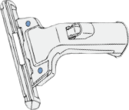
Carbamazepine kinetic interactions:
3A4 inDucer
2B6 inDucer
1A2 inDucer
UGT inDucer
Notes:
interaction mnemonics - MOST MEDICATIONS HAVE 1 or 2 interaction mnemonics

Slide 122
Carbamazepine kinetic interactions:
3A4 inDucer
(strong)
2B6 inDucer
1A2 inDucer
UGT inDucer
Notes:
More specific down arrows only more specific

Slide 123
Carbamazepine kinetic interactions:
3A4 inDucer
(strong)
2B6 inDucer
(moderate)
1A2 inDucer
UGT inDucer

Slide 124
Carbamazepine kinetic interactions:
3A4 inDucer
(strong)
2B6 inDucer
(moderate)
1A2 inDucer
(weak)
UGT inDucer

Slide 125
Carbamazepine kinetic interactions:
3A4 inDucer
(strong)
2B6 inDucer
(moderate)
1A2 inDucer
(weak)
UGT inDucer
(moderate)

Slide 126
Carbamazepine kinetic interactions:
3A4 substrate

Slide 127
Carbamazepine kinetic interactions:
3A4 substrate
Notes:
Fish is a more specific submarine

Slide 128
inDucer
inHibitor
Notes:
Substrates are victims of PK interactions

Slide 129
inDucer
inHibitor
“High and Hurried”
“Down and Delayed”

Slide 130
P-glycoprotein
interactions
Notes:
More mysterious than CYP interactions, probably applicable to more medications than have been discovered

Slide 131
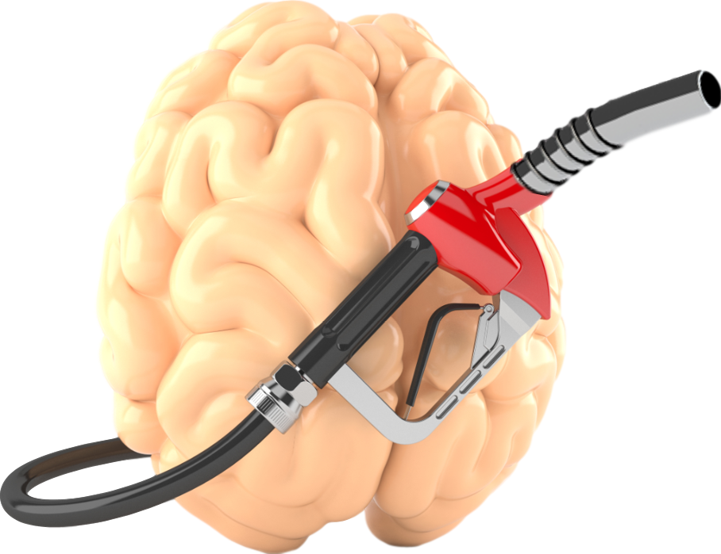
P-glycoprotein (P-gp) – “Pumpers gonna pump”.
Gatekeeper at the blood-brain barrier that pumps certain drugs out of the CNS.

Slide 132
P-glycoprotein (P-gp) – “Pumpers gonna pump”.
Gatekeeper at the blood-brain barrier that pumps certain drugs out of the CNS.
Notes:
Can

Slide 133
P-glycoprotein (P-gp) – “Pumpers gonna pump”.
Gatekeeper at the blood-brain barrier that pumps certain drugs out of the CNS.
Notes:
make

Slide 134
P-glycoprotein (P-gp) – “Pumpers gonna pump”.
Gatekeeper at the blood-brain barrier that pumps certain drugs out of the CNS.
Notes:
psychotropic

Slide 135
P-glycoprotein (P-gp) – “Pumpers gonna pump”.
Gatekeeper at the blood-brain barrier that pumps certain drugs out of the CNS.
Notes:
drugs

Slide 136
P-glycoprotein (P-gp) – “Pumpers gonna pump”.
Gatekeeper at the blood-brain barrier that pumps certain drugs out of the CNS.
Notes:
less

Slide 137
P-glycoprotein (P-gp) – “Pumpers gonna pump”.
Gatekeeper at the blood-brain barrier that pumps certain drugs out of the CNS.
Notes:
effective

Slide 138
P-glycoprotein (P-gp) – “Pumpers gonna pump”.
Gatekeeper at the blood-brain barrier that pumps certain drugs out of the CNS.
Notes:
P-glycoprotein

Slide 139
P-glycoprotein (P-gp) – “Pumpers gonna pump”.
Gatekeeper at the blood-brain barrier that pumps certain drugs out of the CNS.
Notes:
“Pumpers

Slide 140
P-glycoprotein (P-gp) – “Pumpers gonna pump”.
Gatekeeper at the blood-brain barrier that pumps certain drugs out of the CNS.
Notes:
Gonna

Slide 141
P-glycoprotein (P-gp) – “Pumpers gonna pump”.
Gatekeeper at the blood-brain barrier that pumps certain drugs out of the CNS.
Notes:
Pump...

Slide 142
P-glycoprotein (P-gp) – “Pumpers gonna pump”.
Gatekeeper at the blood-brain barrier that pumps certain drugs out of the CNS.
Notes:
P-gp is a

Slide 143
P-glycoprotein (P-gp) – “Pumpers gonna pump”.
Gatekeeper at the blood-brain barrier that pumps certain drugs out of the CNS.
Notes:
gatekeeper

Slide 144
P-glycoprotein (P-gp) – “Pumpers gonna pump”.
Gatekeeper at the blood-brain barrier that pumps certain drugs out of the CNS.
Notes:
at the

Slide 145
P-glycoprotein (P-gp) – “Pumpers gonna pump”.
Gatekeeper at the blood-brain barrier that pumps certain drugs out of the CNS.
Notes:
gut lumen

Slide 146
P-glycoprotein (P-gp) – “Pumpers gonna pump”.
Gatekeeper at the blood-brain barrier that pumps certain drugs out of the CNS.
Notes:
where

Slide 147
P-glycoprotein (P-gp) – “Pumpers gonna pump”.
Gatekeeper at the blood-brain barrier that pumps certain drugs out of the CNS.
Notes:
drugs

Slide 148
P-glycoprotein (P-gp) – “Pumpers gonna pump”.
Gatekeeper at the blood-brain barrier that pumps certain drugs out of the CNS.
Notes:
are

Slide 149
P-glycoprotein (P-gp) – “Pumpers gonna pump”.
Gatekeeper at the blood-brain barrier that pumps certain drugs out of the CNS.
Notes:
absorbed.

Slide 150
P-glycoprotein (P-gp) – “Pumpers gonna pump”.
Gatekeeper at the blood-brain barrier that pumps certain drugs out of the CNS.
Notes:
At

Slide 151
P-glycoprotein (P-gp) – “Pumpers gonna pump”.
Gatekeeper at the blood-brain barrier that pumps certain drugs out of the CNS.
Notes:
the blood-

Slide 152
P-glycoprotein (P-gp) – “Pumpers gonna pump”.
Gatekeeper at the blood-brain barrier that pumps certain drugs out of the CNS.
Notes:
brain

Slide 153
P-glycoprotein (P-gp) – “Pumpers gonna pump”.
Gatekeeper at the blood-brain barrier that pumps certain drugs out of the CNS.
Notes:
Barrier

Slide 154
P-glycoprotein (P-gp) – “Pumpers gonna pump”.
Gatekeeper at the blood-brain barrier that pumps certain drugs out of the CNS.
Notes:
...

Slide 155
P-glycoprotein (P-gp) – “Pumpers gonna pump”.
Gatekeeper at the blood-brain barrier that pumps certain drugs out of the CNS.
Notes:
...

Slide 156
P-glycoprotein (P-gp) – “Pumpers gonna pump”.
Gatekeeper at the blood-brain barrier that pumps certain drugs out of the CNS.
Notes:
P-gp

Slide 157
P-glycoprotein (P-gp) – “Pumpers gonna pump”.
Gatekeeper at the blood-brain barrier that pumps certain drugs out of the CNS.
Notes:
pumps

Slide 158
P-glycoprotein (P-gp) – “Pumpers gonna pump”.
Gatekeeper at the blood-brain barrier that pumps certain drugs out of the CNS.
Notes:
substrates

Slide 159
P-glycoprotein (P-gp) – “Pumpers gonna pump”.
Gatekeeper at the blood-brain barrier that pumps certain drugs out of the CNS.
Notes:
outta

Slide 160
P-glycoprotein (P-gp) – “Pumpers gonna pump”.
Gatekeeper at the blood-brain barrier that pumps certain drugs out of the CNS.
Notes:
the brain

Slide 161
P-glycoprotein (P-gp) – “Pumpers gonna pump”.
Gatekeeper at the blood-brain barrier that pumps certain drugs out of the CNS.
Notes:
“Pumpers

Slide 162
P-glycoprotein (P-gp) – “Pumpers gonna pump”.
Gatekeeper at the blood-brain barrier that pumps certain drugs out of the CNS.
Notes:
gonna

Slide 163
P-glycoprotein (P-gp) – “Pumpers gonna pump”.
Gatekeeper at the blood-brain barrier that pumps certain drugs out of the CNS.
Notes:
pump”

Slide 164
P-glycoprotein (P-gp) – “Pumpers gonna pump”.
Gatekeeper at the blood-brain barrier that pumps certain drugs out of the CNS.
Notes:
SHORT PAUSE

Slide 165
P-glycoprotein (P-gp) – “Pumpers gonna pump”.
Gatekeeper at the blood-brain barrier that pumps certain drugs out of the CNS.
Notes:
As you might have guessed...

Slide 166
P-glycoprotein (P-gp) – “Pumpers gonna pump”.
Carbamazepine inDuces P-gp.
Gatekeeper at the blood-brain barrier that pumps certain drugs out of the CNS.
Notes:
Tegretol

Slide 167
P-glycoprotein (P-gp) – “Pumpers gonna pump”.
Carbamazepine inDuces P-gp.
Gatekeeper at the blood-brain barrier that pumps certain drugs out of the CNS.
Notes:
induces

Slide 168
P-glycoprotein (P-gp) – “Pumpers gonna pump”.
Carbamazepine inDuces P-gp.
Gatekeeper at the blood-brain barrier that pumps certain drugs out of the CNS.
Notes:
production

Slide 169
P-glycoprotein (P-gp) – “Pumpers gonna pump”.
Carbamazepine inDuces P-gp.
Gatekeeper at the blood-brain barrier that pumps certain drugs out of the CNS.
Notes:
of

Slide 170
P-glycoprotein (P-gp) – “Pumpers gonna pump”.
Carbamazepine inDuces P-gp.
Gatekeeper at the blood-brain barrier that pumps certain drugs out of the CNS.
Notes:
P-

Slide 171
P-glycoprotein (P-gp) – “Pumpers gonna pump”.
Carbamazepine inDuces P-gp.
Gatekeeper at the blood-brain barrier that pumps certain drugs out of the CNS.
Notes:
-glycoprotein,

Slide 172
P-glycoprotein (P-gp) – “Pumpers gonna pump”.
Carbamazepine inDuces P-gp.
Gatekeeper at the blood-brain barrier that pumps certain drugs out of the CNS.
Notes:
Just

Slide 173
P-glycoprotein (P-gp) – “Pumpers gonna pump”.
Carbamazepine inDuces P-gp.
Gatekeeper at the blood-brain barrier that pumps certain drugs out of the CNS.
Notes:
like

Slide 174
P-glycoprotein (P-gp) – “Pumpers gonna pump”.
Carbamazepine inDuces P-gp.
Gatekeeper at the blood-brain barrier that pumps certain drugs out of the CNS.
Notes:
It

Slide 175
P-glycoprotein (P-gp) – “Pumpers gonna pump”.
Carbamazepine inDuces P-gp.
Gatekeeper at the blood-brain barrier that pumps certain drugs out of the CNS.
Notes:
induces

Slide 176
P-glycoprotein (P-gp) – “Pumpers gonna pump”.
Carbamazepine inDuces P-gp.
Gatekeeper at the blood-brain barrier that pumps certain drugs out of the CNS.
Notes:
everything

Slide 177
P-glycoprotein (P-gp) – “Pumpers gonna pump”.
Carbamazepine inDuces P-gp.
Gatekeeper at the blood-brain barrier that pumps certain drugs out of the CNS.
Notes:
else.

Slide 178
P-glycoprotein (P-gp) – “Pumpers gonna pump”.
Carbamazepine inDuces P-gp.
Gatekeeper at the blood-brain barrier that pumps certain drugs out of the CNS.
Notes:
It’s

Slide 179
P-glycoprotein (P-gp) – “Pumpers gonna pump”.
Carbamazepine inDuces P-gp.
Gatekeeper at the blood-brain barrier that pumps certain drugs out of the CNS.
Notes:
a shredder.

Slide 180
P-glycoprotein (P-gp) – “Pumpers gonna pump”.
Carbamazepine inDuces P-gp.
Gatekeeper at the blood-brain barrier that pumps certain drugs out of the CNS.
Notes:
The effect

Slide 181
P-glycoprotein (P-gp) – “Pumpers gonna pump”.
Carbamazepine inDuces P-gp.
Gatekeeper at the blood-brain barrier that pumps certain drugs out of the CNS.
Notes:
is Down

Slide 182
P-glycoprotein (P-gp) – “Pumpers gonna pump”.
Carbamazepine inDuces P-gp.
Gatekeeper at the blood-brain barrier that pumps certain drugs out of the CNS.
Notes:
and

Slide 183
P-glycoprotein (P-gp) – “Pumpers gonna pump”.
Carbamazepine inDuces P-gp.
Gatekeeper at the blood-brain barrier that pumps certain drugs out of the CNS.
Notes:
delayed.

Slide 184
P-glycoprotein (P-gp) – “Pumpers gonna pump”.
Carbamazepine inDuces P-gp.
Gatekeeper at the blood-brain barrier that pumps certain drugs out of the CNS.
Notes:
Down as in

Slide 185
P-glycoprotein (P-gp) – “Pumpers gonna pump”.
Carbamazepine inDuces P-gp.
Gatekeeper at the blood-brain barrier that pumps certain drugs out of the CNS.
Notes:
decreased

Slide 186
P-glycoprotein (P-gp) – “Pumpers gonna pump”.
Carbamazepine inDuces P-gp.
Gatekeeper at the blood-brain barrier that pumps certain drugs out of the CNS.
Notes:
gut

Slide 187
P-glycoprotein (P-gp) – “Pumpers gonna pump”.
Carbamazepine inDuces P-gp.
Gatekeeper at the blood-brain barrier that pumps certain drugs out of the CNS.
Notes:
absorption

Slide 188
P-glycoprotein (P-gp) – “Pumpers gonna pump”.
Carbamazepine inDuces P-gp.
Gatekeeper at the blood-brain barrier that pumps certain drugs out of the CNS.
Notes:
and

Slide 189
P-glycoprotein (P-gp) – “Pumpers gonna pump”.
Carbamazepine inDuces P-gp.
Gatekeeper at the blood-brain barrier that pumps certain drugs out of the CNS.
Notes:
Brain penetrance

Slide 190
P-glycoprotein (P-gp) – “Pumpers gonna pump”.
Carbamazepine inDuces P-gp.
Gatekeeper at the blood-brain barrier that pumps certain drugs out of the CNS.
Notes:
of victim substrates. Get outta the brain

