Slide 1
Obsessive-Compulsive Personality Disorder
Jason Cafer MD

Slide 2
Obsessive-Compulsive Personality Disorder?
Does Jason Cafer MD have

Slide 3
A Systematic Approach to Psychiatric Medication Management
Jason Cafer MD
Notes:
Begs the question - why?

Slide 4
Visual?
A Systematic Approach to Psychiatric Medication Management
Jason Cafer MD

Slide 5
Topics
Obsessive-compulsive personality disorder (OCPD)
Case study of obsessive-compulsive personality +/- disorder
Pharmacotherapy of OCPD (one slide)
5 examples of visualization of drug-drug interactions
Example of an information management technique related to prescribing decisions
Discussion of “paper brain” as a teaching tool
Examples of shorthand

Slide 6
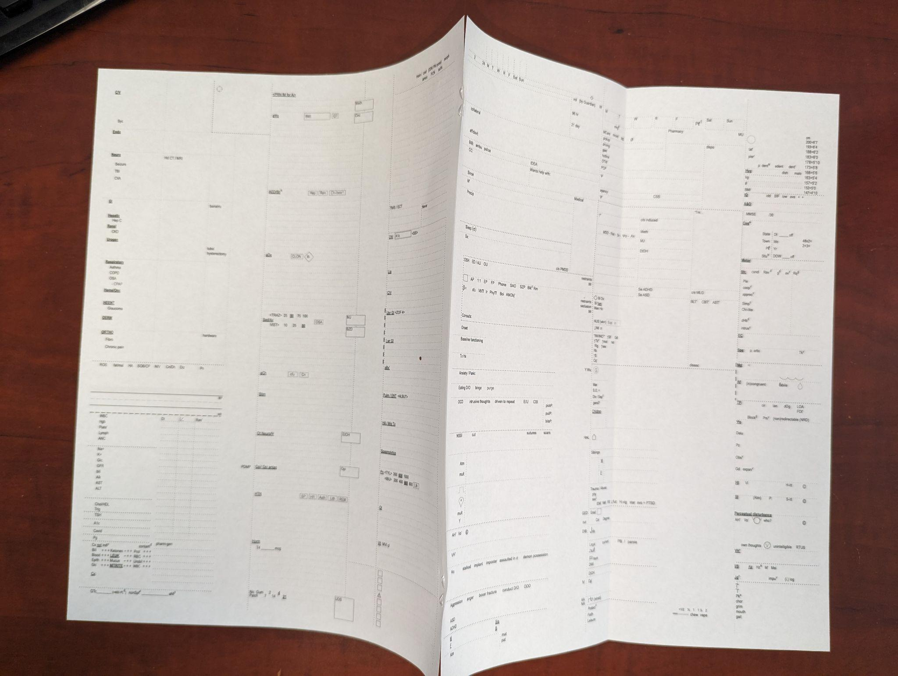
Notes:
What do I call this? Paper brain?

Slide 7
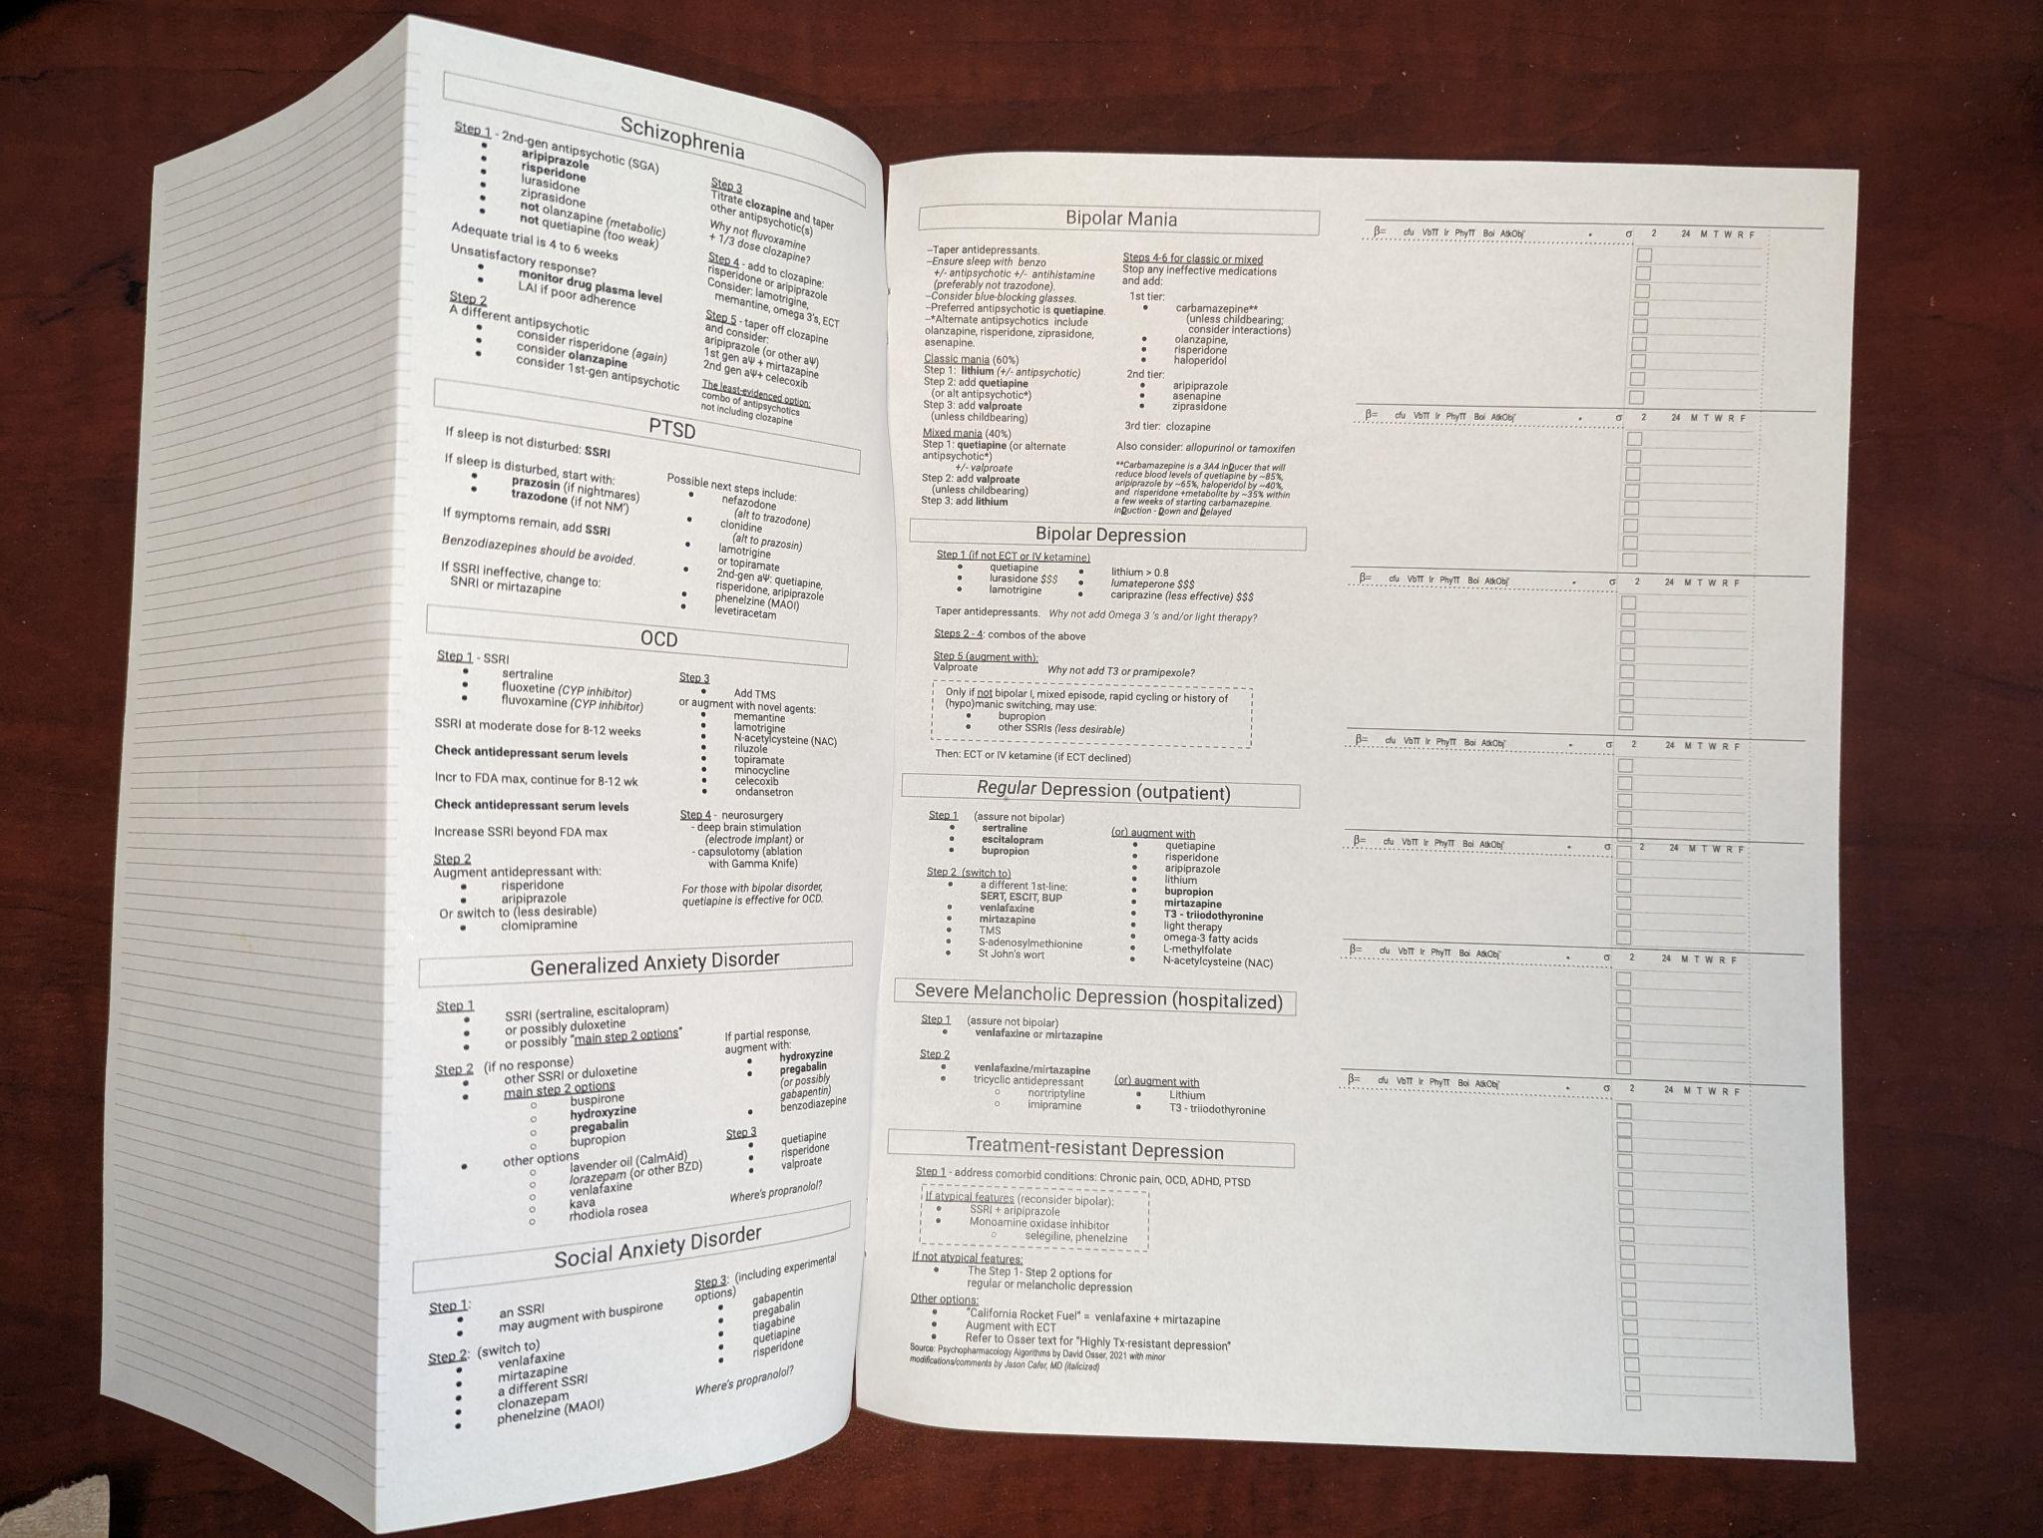
Notes:
What do I call this? Paper brain?

Slide 8
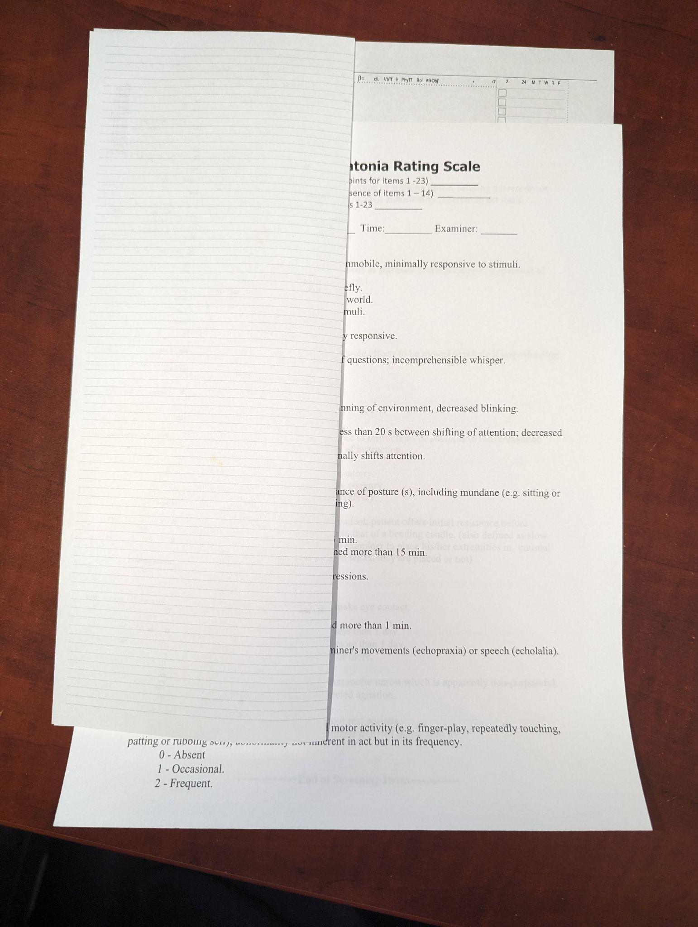
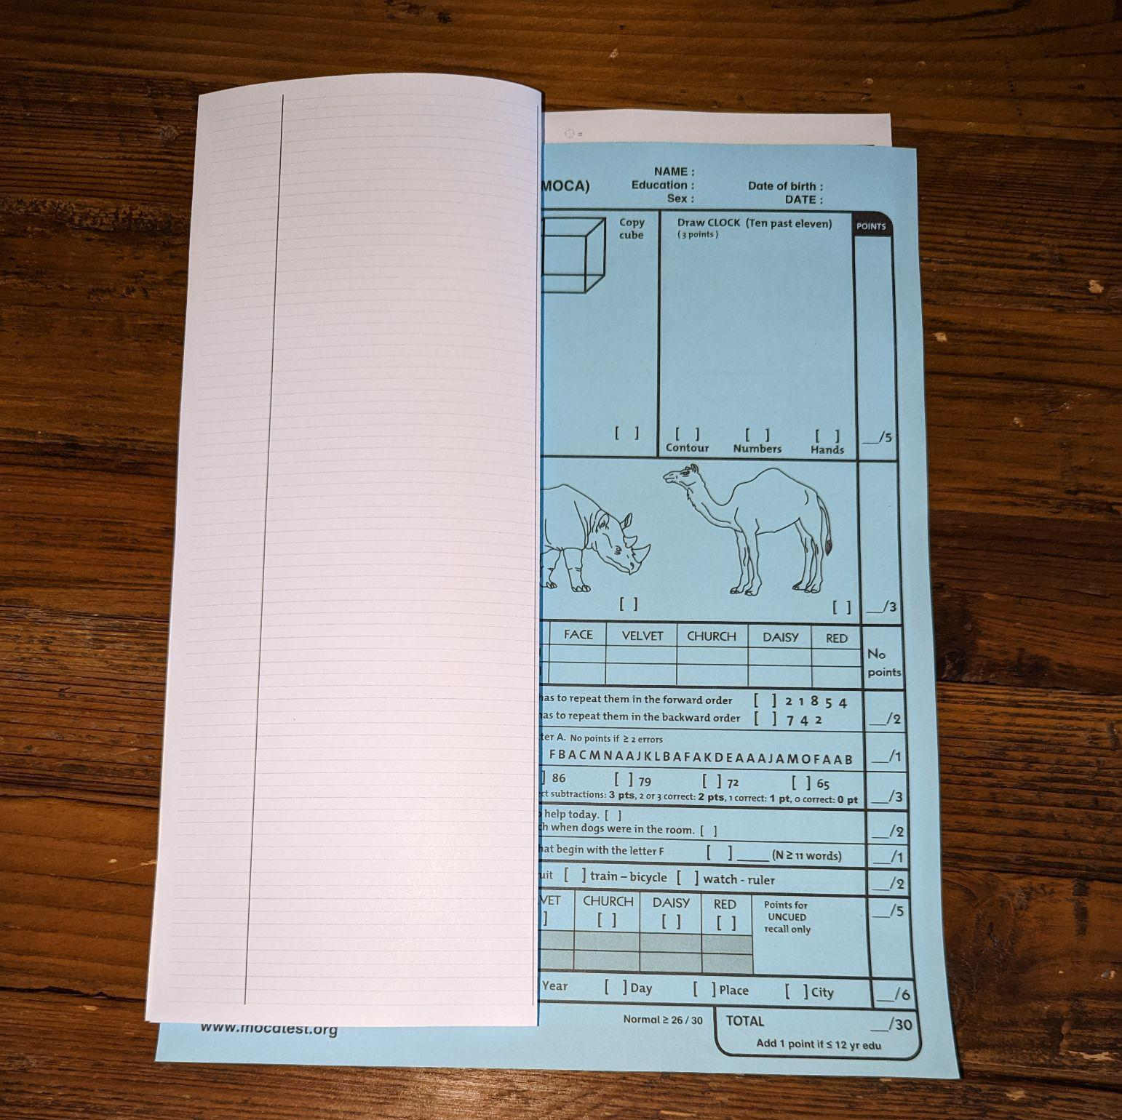

Slide 9
Intrusive Thought
Disorder
Perfectionistic
Disorder

Slide 10
Intrusive Thought
Disorder
Perfectionistic
Disorder
Can someone have both OCD and OCPD?

Slide 11
Obsessive-Compulsive Personality Disorder
23% – 32% of individuals with OCD also have OCP.

Slide 12
Obsessive-Compulsive Personality Disorder
~27% of individuals with OCD also have OCP.

Slide 13
~ 27 % of individuals with OCD also have OCPD
OCD
~1%
OCPD
~5%

Slide 14
~ 27 % of individuals with OCD also have OCPD
OCD
~1%
OCPD
~5%

Slide 15
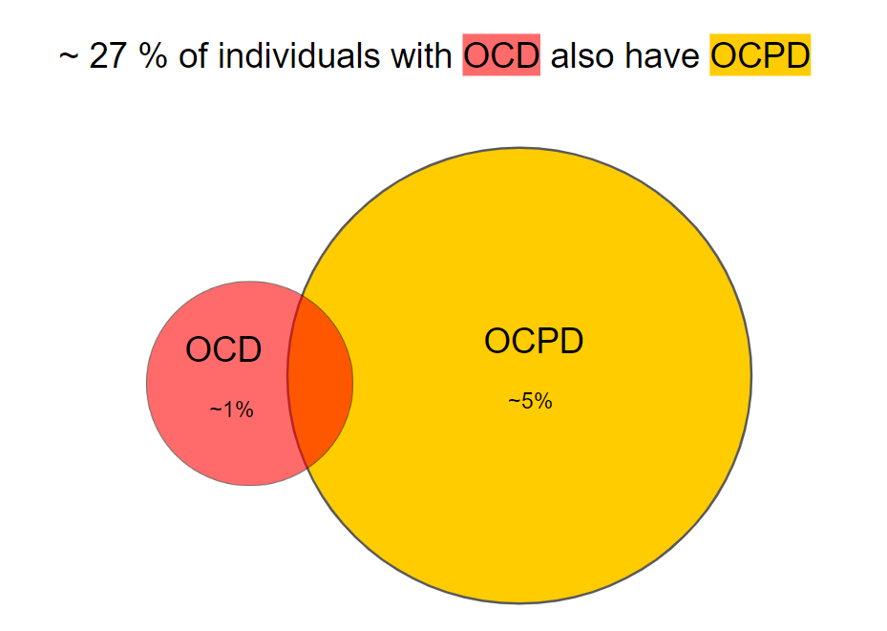
This color coding is...

Slide 16
This color coding is...
Good educational design?

Slide 17
This color coding is...
Good educational design?
Suggestive of OCD?

Slide 18
This color coding is...
Good educational design?
Suggestive of OCD?
Suggestive of OCPD?

Slide 19
To find the answer...

Slide 20
To find the answer...
cafermed.com/november

Slide 21
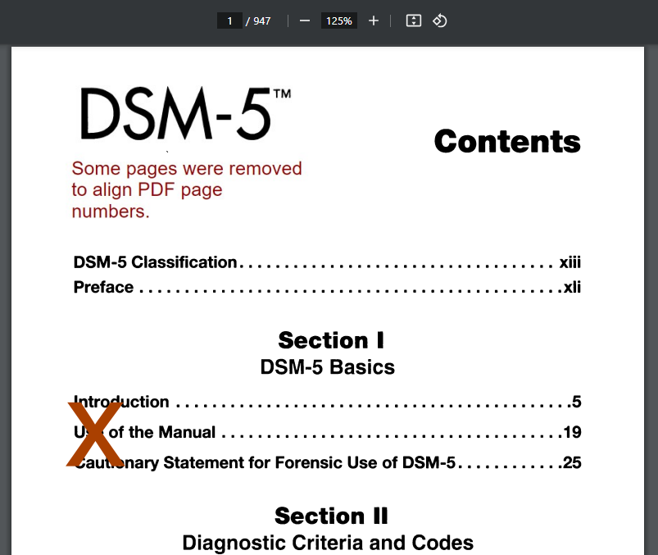
To find the answer...
cafermed.com/november

Slide 22
Obsessive-Compulsive Disorder
Acts that the individual feels driven to perform in response to an obsession or according to rules that must be applied rigidly

Slide 23
Obsessive-Compulsive Disorder
Acts that the individual feels driven to perform in response to an obsession or according to rules that must be applied rigidly
Obsessive-Compulsive Personality Disorder
Preoccupation with orderliness and perfectionism

Slide 24
Obsessive-Compulsive Disorder
Acts that the individual feels driven to perform in response to an obsession or according to rules that must be applied rigidly
Tries to suppress (ego dystonic)
Obsessive-Compulsive Personality Disorder
Preoccupation with orderliness and perfectionism
Ego syntonic

Slide 25
Obsessive-Compulsive Personality Disorder
Obsessive-Compulsive Personality Disorder
A pervasive pattern of preoccupation with orderliness, perfectionism, and mental and interpersonal control, at the expense of flexibility, openness, and efficiency, beginning by early adulthood and present in a variety of contexts, as indicated by four (or more) of the following:

Slide 26
Obsessive-Compulsive Personality Disorder
Obsessive-Compulsive Personality Disorder
Pervasive Pattern of Preoccupation
Orderliness
Control
mental and interpersonal
Perfectionism
?
?

Slide 27
Obsessive-Compulsive Personality Disorder
Obsessive-Compulsive Personality Disorder
Pervasive Pattern of Preoccupation
Orderliness
Control
mental and interpersonal
Perfectionism
?

Slide 28
Obsessive-Compulsive Personality Disorder
Obsessive-Compulsive Personality Disorder
Pervasive Pattern of Preoccupation
Orderliness
Control
mental and interpersonal
Perfectionism
Notes:
Had to rearrange items

Slide 29
Obsessive-Compulsive Personality Disorder
Obsessive-Compulsive Personality Disorder
Pervasive Pattern of Preoccupation
Orderliness
Control
mental and interpersonal
Perfectionism
It’s expensive

Slide 30
Obsessive-Compulsive Personality Disorder
Obsessive-Compulsive Personality Disorder
Pervasive Pattern of Preoccupation
Orderliness
Control
mental and interpersonal
Perfectionism
at the expense of

Slide 31
Obsessive-Compulsive Personality Disorder
Obsessive-Compulsive Personality Disorder
Pervasive Pattern of Preoccupation
Orderliness
Control
mental and interpersonal
Perfectionism
at the expense of
flexibility
openness
efficiency
?

Slide 32
Obsessive-Compulsive Personality Disorder
Obsessive-Compulsive Personality Disorder
Pervasive Pattern of Preoccupation
Orderliness
Control
mental and interpersonal
Perfectionism
at the expense of
flexibility
openness
efficiency

Slide 33
Obsessive-Compulsive Personality Disorder
Obsessive-Compulsive Personality Disorder
Pervasive Pattern of Preoccupation
Orderliness
Control
mental and interpersonal
Perfectionism
at the expense of
flexibility
openness
efficiency
by early adulthood / variety of contexts

Slide 34
Obsessive-Compulsive Personality Disorder
Obsessive-Compulsive Personality Disorder
Pervasive Pattern of Preoccupation
Orderliness
Control
mental and interpersonal
Perfectionism
at the expense of
flexibility
openness
efficiency
by early adulthood / variety of contexts

Slide 35
Obsessive-Compulsive Personality Disorder
Obsessive-Compulsive Personality Disorder
Pervasive Pattern of Preoccupation
Orderliness
Control
mental and interpersonal
Perfectionism
at the expense of
flexibility
openness
efficiency
by early adulthood / variety of contexts
4+ of 8 criteria...

Slide 36
Obsessive-Compulsive Personality Disorder
Obsessive-Compulsive Personality Disorder
4+ of
Is preoccupied with details, rules, lists, order, organization, or schedules to the extent that the major point of the activity is lost.
Shows perfectionism that interferes with task completion.
Is excessively devoted to work and productivity to the exclusion of leisure activities and friendships.
Is overconscientious, scrupulous, and inflexible about matters of morality, ethics, or values.
Is unable to discard worn-out or worthless objects even when no sentimental value.
Is reluctant to delegate tasks or to work with others unless they submit to exactly his or her way of doing things.
Adopts a miserly spending style; money is viewed as something to be hoarded for future catastrophes.
Shows rigidity and stubbornness.

Slide 37
Obsessive-Compulsive Personality Disorder
Obsessive-Compulsive Personality Disorder
4+ of
Is preoccupied with details, rules, lists, order, organization, or schedules
A Systematic Approach to Psychiatric Medication Management
Jason Cafer MD

Slide 38
Obsessive-Compulsive Personality Disorder
4+ of
Is preoccupied with details, rules, lists, order, organization, or schedules to the extent that the major point of the activity is lost.

Slide 39
Obsessive-Compulsive Personality Disorder
Obsessive-Compulsive Personality Disorder
4+ of
Is preoccupied with details, rules, lists, order, organization, or schedules to the extent that the major point of the activity is lost.
preoccupation – the state of being worried about or thinking about something most of the time

Slide 40
Obsessive-Compulsive Personality Disorder
Obsessive-Compulsive Personality Disorder
4+ of
Is preoccupied with details, rules, lists, order, organization, or schedules to the extent that the major point of the activity is lost.
preoccupation – the state of being worried about or thinking about something most of the time
vs
ASD criterion: Highly restricted, fixated interests that are abnormal in intensity or focus (e.g., excessively circumscribed or perseverative interests).

Slide 41
Fixated Interest – Visualization of Drug Interactions
(If the patient were a UGT1A4 poor metabolizer there would be up arrows.)
Notes:
1 of 5 visualizations of drug interactions

Slide 43
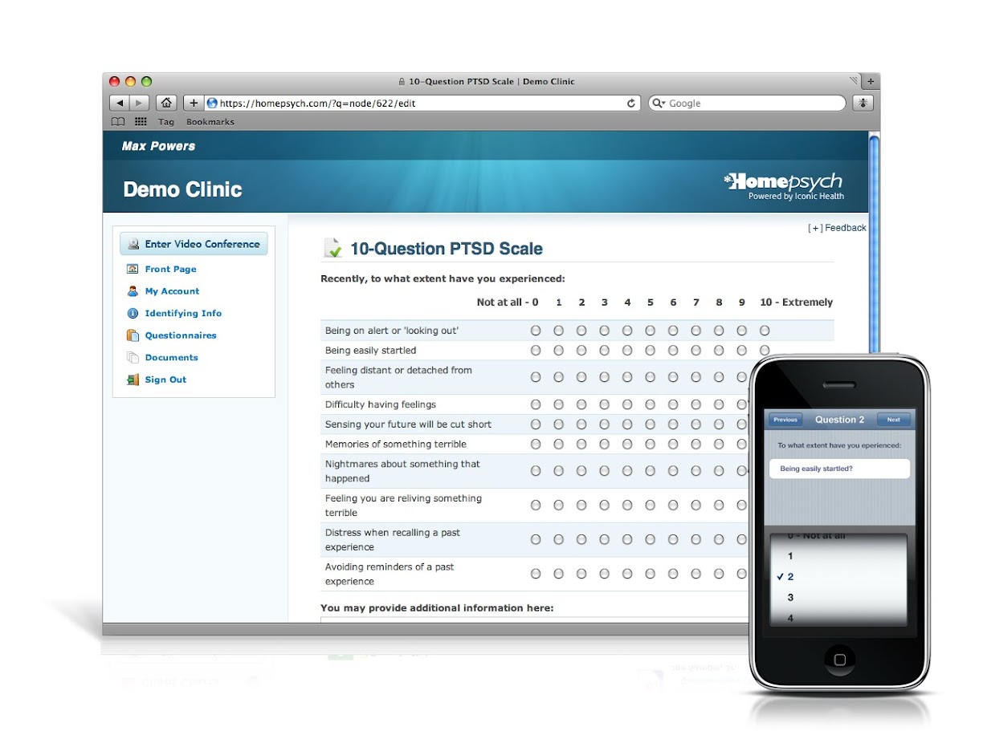

Slide 44
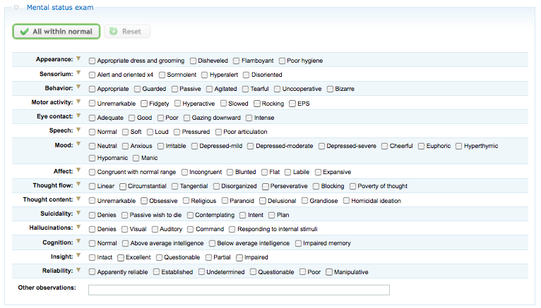

Slide 45
Fixated Interest – Visualization of Drug Interactions
inHibitor
inDucer
High & Hurried
Down & Delayed

Slide 46
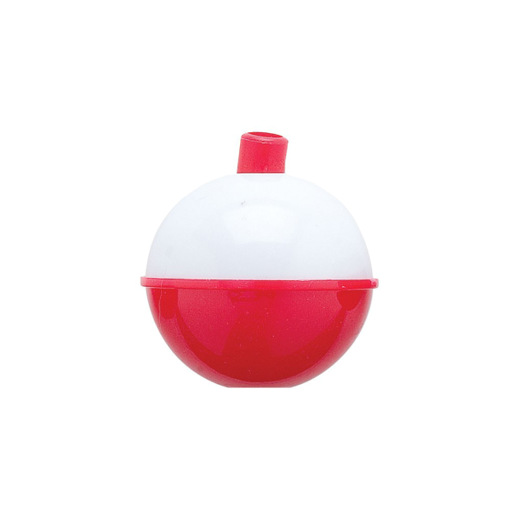
Fixated Interest – Visualization of Drug Interactions
“3 A’s 4 fishing”
inHibition
Fluvoxamine
Lumateperone
CYP3A4 inHibitor
CYP3A4 substrate
High &
Hurried
Notes:
2 of 5

Slide 47
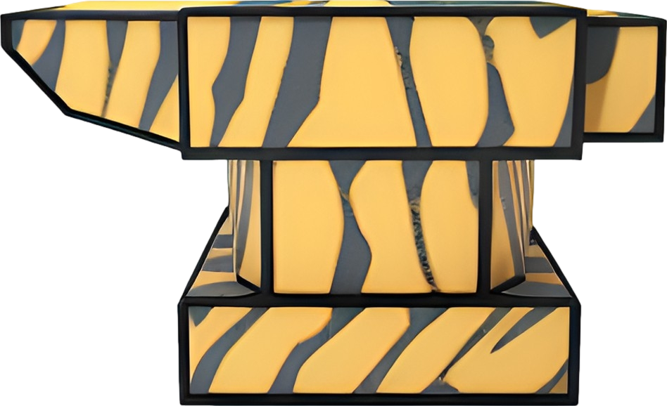
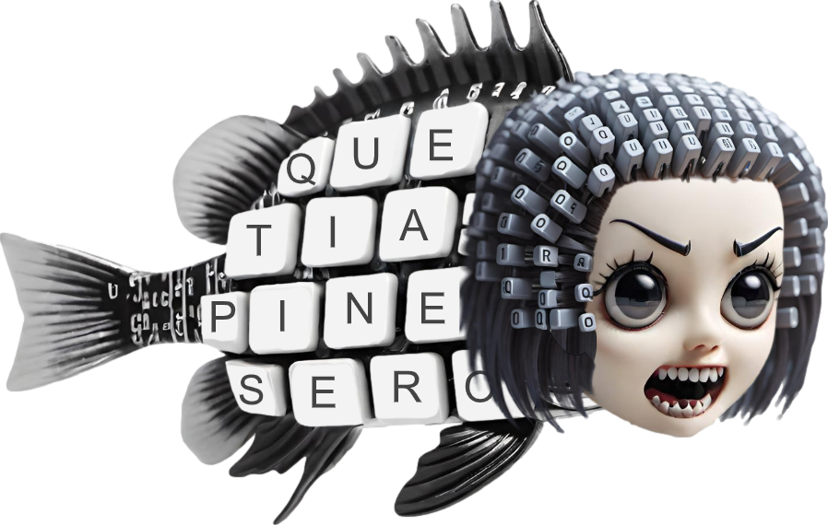
Fixated Interest – Visualization of Drug Interactions
“3 A’s 4 fishing”
inDuction
Carbamazepine
Quetiapine
CYP3A4 inDucer
CYP3A4 substrate
Down &
Delayed
6-fold decrease

Slide 48
Ballicules
Fixated Interest – Visualization of Drug Interactions
inDucer
inHibitor
Notes:
3 of 5

Slide 49
Ballicules
Fixated Interest – Visualization of Drug Interactions
“High and Hurried”
inDucer
inHibitor

Slide 50
Ballicules
Fixated Interest – Visualization of Drug Interactions
“High and Hurried”
inDucer
inHibitor
“Down and Delayed”

Slide 51
Ballicules
Fixated Interest – Visualization of Drug Interactions
“High and Hurried”
inDucer
inHibitor
sensitive substrate
“Down and Delayed”

Slide 52
Ballicules
Fixated Interest – Visualization of Drug Interactions
substrate
inHibitor

Slide 53
Ballicules
Fixated Interest – Visualization of Drug Interactions
substrate
inHibitor

Slide 54
Ballicules
Fixated Interest – Visualization of Drug Interactions
substrate
inHibitor

Slide 55
Ballicules
Fixated Interest – Visualization of Drug Interactions
substrate
inHibitor

Slide 56
Ballicules
Fixated Interest – Visualization of Drug Interactions
substrate
inHibitor

Slide 57
Ballicules
Fixated Interest – Visualization of Drug Interactions
substrate
inHibitor

Slide 58
Ballicules
Fixated Interest – Visualization of Drug Interactions
substrate
inHibitor

Slide 59
Ballicules
Fixated Interest – Visualization of Drug Interactions
“High and Hurried”
substrate
inHibitor

Slide 60
Fixated Interest – Visualization of Drug Interactions
inDucer
substrate

Slide 61
Ballicules
Fixated Interest – Visualization of Drug Interactions
inDucer
substrate

Slide 62
Ballicules
Fixated Interest – Visualization of Drug Interactions
inDucer
substrate

Slide 63
Ballicules
Fixated Interest – Visualization of Drug Interactions
inDucer
substrate
“Down and Delayed”

Slide 64
Ballicules
Fixated Interest – Visualization of Drug Interactions
“High and Hurried”
inDucer
not an inHibitor
sensitive substrate
not an inDucer
inHibitor
“Down and Delayed”
not a sensitive substrate

Slide 65
Obsessive-Compulsive Personality Disorder
Obsessive-Compulsive Personality Disorder
4+ of
Is preoccupied with details, rules, lists, order, organization, or schedules to the extent that the major point of the activity is lost.
Shows perfectionism that interferes with task completion.

Slide 66
Obsessive-Compulsive Personality Disorder
Obsessive-Compulsive Personality Disorder
4+ of
Is preoccupied with details, rules, lists, order, organization, or schedules to the extent that the major point of the activity is lost.
Shows perfectionism that interferes with task completion.
“Rigid perfectionism” trait in DSM Personality Inventory:
rigid insistence on everything being flawless, perfect, and without errors or faults, including one’s own and others’ performance

Slide 67
Obsessive-Compulsive Personality Disorder
Obsessive-Compulsive Personality Disorder
4+ of
Is preoccupied with details, rules, lists, order, organization, or schedules to the extent that the major point of the activity is lost.
Shows perfectionism that interferes with task completion.
“Rigid perfectionism” trait in DSM Personality Inventory:
rigid insistence on everything being flawless, perfect, and without errors or faults, including one’s own and others’ performance

Slide 68
Obsessive-Compulsive Personality Disorder
Obsessive-Compulsive Personality Disorder
4+ of
Is preoccupied with details, rules, lists, order, organization, or schedules to the extent that the major point of the activity is lost.
Shows perfectionism that interferes with task completion.
Is excessively devoted to work and productivity to the exclusion of leisure activities and friendships.

Slide 69
Obsessive-Compulsive Personality Disorder
Obsessive-Compulsive Personality Disorder
4+ of
Is preoccupied with details, rules, lists, order, organization, or schedules to the extent that the major point of the activity is lost.
Shows perfectionism that interferes with task completion.
Is excessively devoted to work and productivity to the exclusion of leisure activities and friendships.
Pervasive Pattern of Preoccupation with Perfectionism and Productivity

Slide 70
Obsessive-Compulsive Personality Disorder
Obsessive-Compulsive Personality Disorder
4+ of
Is preoccupied with details, rules, lists, order, organization, or schedules to the extent that the major point of the activity is lost.
Shows perfectionism that interferes with task completion.
Is excessively devoted to work and productivity to the exclusion of leisure activities and friendships.
Pervasive Pattern of Preoccupation with Perfectionism and Productivity

Slide 71
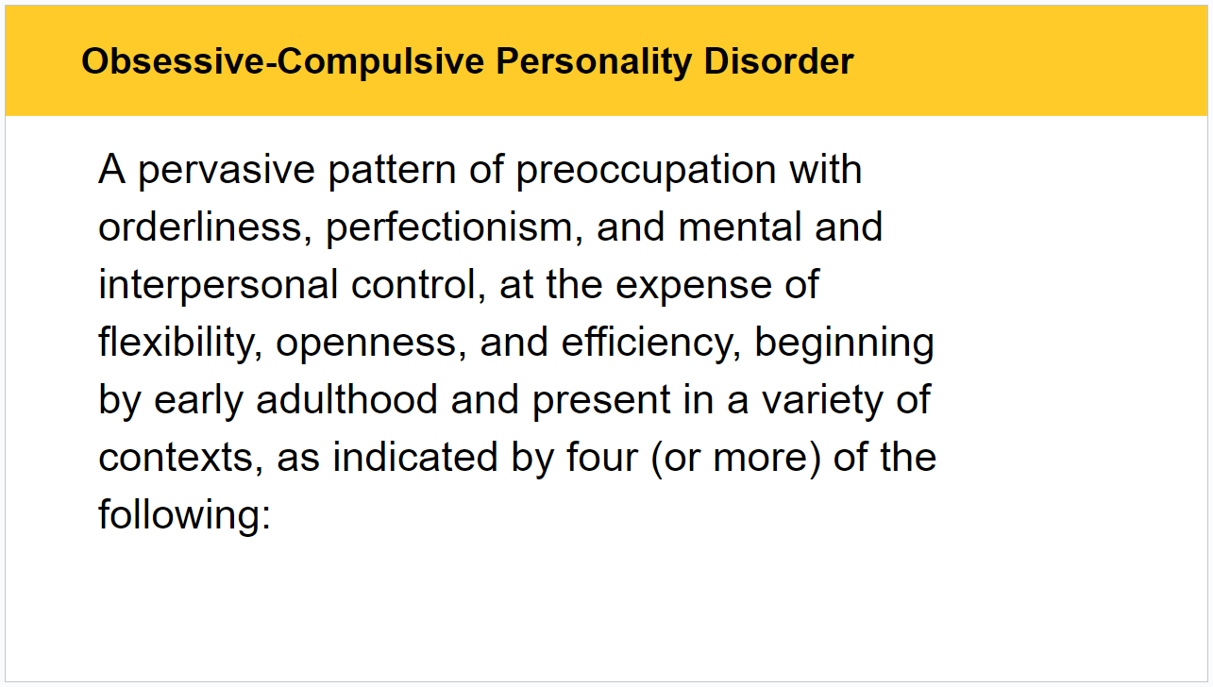
Obsessive-Compulsive Personality Disorder

Slide 72
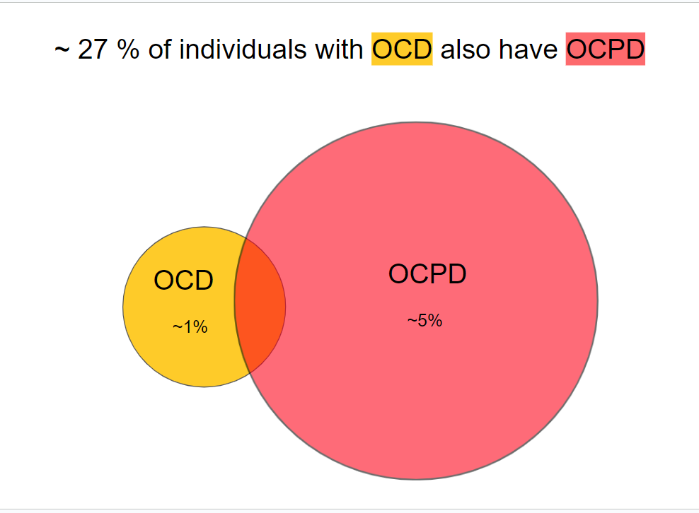
Obsessive-Compulsive Personality Disorder

Slide 73
Obsessive-Compulsive Personality Disorder
Obsessive-Compulsive Personality Disorder
4+ of
Is preoccupied with details, rules, lists, order, organization, or schedules to the extent that the major point of the activity is lost.
Shows perfectionism that interferes with task completion.
Is excessively devoted to work and productivity to the exclusion of leisure activities and friendships.
Is overconscientious, scrupulous, and inflexible about matters of morality, ethics, or values.

Slide 74
Obsessive-Compulsive Personality Disorder
Obsessive-Compulsive Personality Disorder
4+ of
Is overconscientious, scrupulous, and inflexible about matters of morality, ethics, or values.
ego-syntonic

Slide 75
Obsessive-Compulsive Personality Disorder
Obsessive-Compulsive Personality Disorder
4+ of
Is overconscientious, scrupulous, and inflexible about matters of morality, ethics, or values.
Values?
ego-syntonic
Notes:
Decided I’d list the first 5 things that came to mind and not edit revise them.

Slide 76
Obsessive-Compulsive Personality Disorder
Obsessive-Compulsive Personality Disorder
4+ of
Is overconscientious, scrupulous, and inflexible about matters of morality, ethics, or values.
Values?
Usability – no extra clicks
Notes:
Sounds shallow but it’s the first thing that came to mind

Slide 77
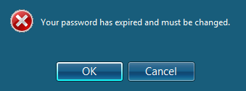
Obsessive-Compulsive Personality Disorder
Obsessive-Compulsive Personality Disorder
4+ of
Is overconscientious, scrupulous, and inflexible about matters of morality, ethics, or values.
Values?
Usability – no extra clicks
Chiasson, S., van Oorschot, P.C. Quantifying the security advantage of password expiration policies. Des. Codes Cryptogr. 77, 401–408 (2015). https://doi.org/10.1007/s10623-015-0071-9

Slide 78
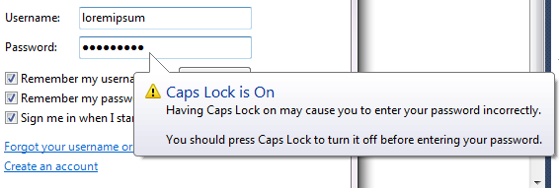
Obsessive-Compulsive Personality Disorder
Obsessive-Compulsive Personality Disorder
4+ of
Is overconscientious, scrupulous, and inflexible about matters of morality, ethics, or values.
Values?
Usability – no extra clicks
Chiasson, S., van Oorschot, P.C. Quantifying the security advantage of password expiration policies. Des. Codes Cryptogr. 77, 401–408 (2015). https://doi.org/10.1007/s10623-015-0071-9

Slide 79
Obsessive-Compulsive Personality Disorder
Obsessive-Compulsive Personality Disorder
4+ of
Is overconscientious, scrupulous, and inflexible about matters of morality, ethics, or values.
Values?
Usability – no extra clicks
Efficiency – no extra words

Slide 80
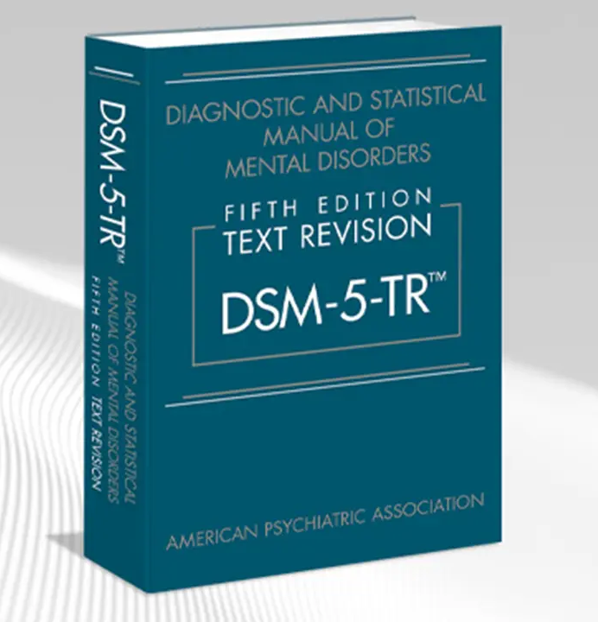
Obsessive-Compulsive Personality Disorder
Obsessive-Compulsive Personality Disorder
4+ of
Is overconscientious, scrupulous, and inflexible about matters of morality, ethics, or values.
Values?
Usability – no extra clicks
Efficiency – no extra words
Notes:
C’mon guys – Everybody uses SIGECAPS and DIGFAST...why not put diagnostic criteria in that order??

Slide 81
Obsessive-Compulsive Personality Disorder
Obsessive-Compulsive Personality Disorder
4+ of
Is overconscientious, scrupulous, and inflexible about matters of morality, ethics, or values.
Values?
Usability – no extra clicks
Efficiency – no extra words
Nonmaleficence – don’t hurt people

Slide 82
Obsessive-Compulsive Personality Disorder
Obsessive-Compulsive Personality Disorder
4+ of
Is overconscientious, scrupulous, and inflexible about matters of morality, ethics, or values.
Values?
Usability – no extra clicks
Efficiency – no extra words
Nonmaleficence – don’t hurt people
Jones, S. M., Castaing, G. I., Teets, E. L., Wells, J. J., & Guttmann, R. P. (2021). The price of predatory marketing on older adults: A perspective on Prevagen potency. Inquiries Journal, 13(09).
Notes:
Again, first example. There are worse. This is a scam and the harm done is to people worried about developing dementia not looking into neuroprotectants that actually work.

Slide 83
Obsessive-Compulsive Personality Disorder
Obsessive-Compulsive Personality Disorder
4+ of
Is overconscientious, scrupulous, and inflexible about matters of morality, ethics, or values.
Values?
Usability – no extra clicks
Efficiency – no extra words
Nonmaleficence – don’t hurt people
Jones, S. M., Castaing, G. I., Teets, E. L., Wells, J. J., & Guttmann, R. P. (2021). The price of predatory marketing on older adults: A perspective on Prevagen potency. Inquiries Journal, 13(09).
Notes:
Again, first example. There are worse. This is a scam and the harm done is to people worried about developing dementia not looking into neuroprotectants that actually work.

Slide 84
Obsessive-Compulsive Personality Disorder
Obsessive-Compulsive Personality Disorder
4+ of
Is overconscientious, scrupulous, and inflexible about matters of morality, ethics, or values.
Values?
Usability – no extra clicks
Efficiency – no extra words
Nonmaleficence – don’t hurt people
Competency – avoiding mistakes that could hurt people

Slide 85
Obsessive-Compulsive Personality Disorder
Obsessive-Compulsive Personality Disorder
4+ of
Is overconscientious, scrupulous, and inflexible about matters of morality, ethics, or values.
Values?
Usability – no extra clicks
Efficiency – no extra words
Nonmaleficence – don’t hurt people
Competency – avoiding mistakes that could hurt people

Slide 86
Obsessive-Compulsive Personality Disorder
Obsessive-Compulsive Personality Disorder
4+ of
Is overconscientious, scrupulous, and inflexible about matters of morality, ethics, or values.
Values?
Usability – no extra clicks
Efficiency – no extra words
Nonmaleficence – don’t hurt people
Competency – avoiding mistakes that could hurt people
Consideration – don’t waste people's time

Slide 87
Obsessive-Compulsive Personality Disorder
Obsessive-Compulsive Personality Disorder
4+ of
Is overconscientious, scrupulous, and inflexible about matters of morality, ethics, or values.
Values?
Usability – no extra clicks
Efficiency – no extra words
Nonmaleficence – don’t hurt people
Competency – avoiding mistakes that could hurt people
Consideration – don’t waste people's time

Slide 88
Obsessive-Compulsive Personality Disorder
Obsessive-Compulsive Personality Disorder
4+ of
Is overconscientious, scrupulous, and inflexible about matters of morality, ethics, or values.
Values?
Usability – no extra clicks
Efficiency – no extra words
Nonmaleficence – don’t hurt people
Competency – avoiding mistakes that could hurt people
Consideration – don’t waste people's time
and others’ performance

Slide 89
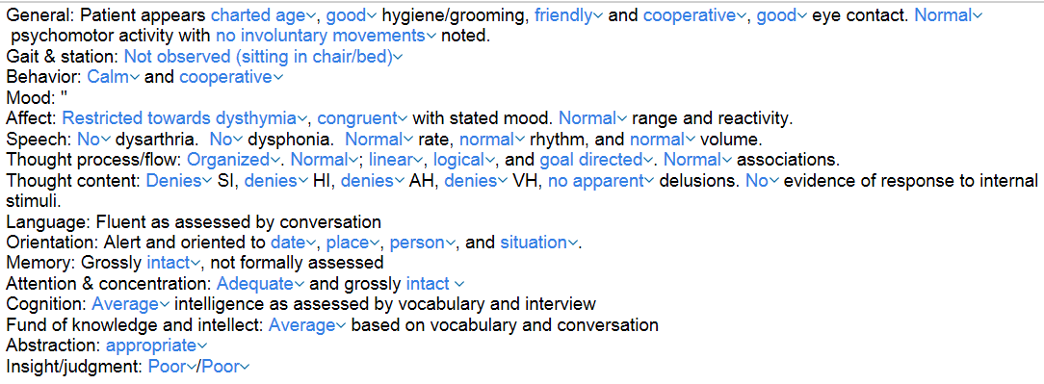
Obsessive-Compulsive Personality Disorder
and others’ performance
43-item MSE

Slide 90
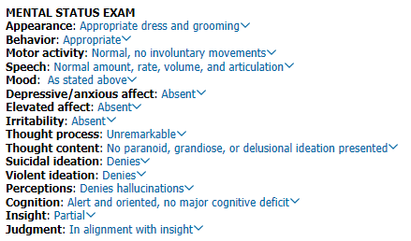
Obsessive-Compulsive Personality Disorder
..mse-cafer

Slide 91
Obsessive-Compulsive Personality Disorder
..mse-cafer
Narcissist Personality Disorder criterion: Requires excessive admiration

Slide 92
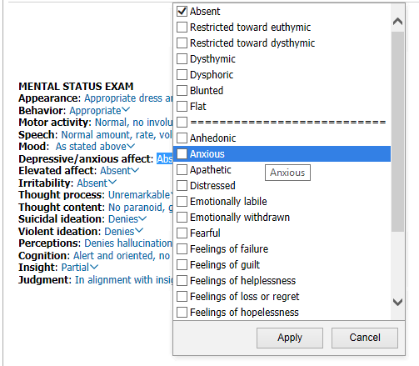
Obsessive-Compulsive Personality Disorder
..mse-cafer

Slide 93
Is unable to discard worn-out or worthless objects even when no sentimental value.
is a criterion for
Obsessive-Compulsive Personality Disorder
or
Obsessive-Compulsive Disorder
?

Slide 94
Obsessive-Compulsive Personality Disorder
Obsessive-Compulsive Personality Disorder
4+ of
Is preoccupied with details, rules, lists, order, organization, or schedules to the extent that the major point of the activity is lost.
Shows perfectionism that interferes with task completion.
Is excessively devoted to work and productivity to the exclusion of leisure activities and friendships.
Is overconscientious, scrupulous, and inflexible about matters of morality, ethics, or values.
Is unable to discard worn-out or worthless objects even when no sentimental value.

Slide 95
Obsessive-Compulsive Personality Disorder
Obsessive-Compulsive Personality Disorder
4+ of
Is preoccupied with details, rules, lists, order, organization, or schedules to the extent that the major point of the activity is lost.
Shows perfectionism that interferes with task completion.
Is excessively devoted to work and productivity to the exclusion of leisure activities and friendships.
Is overconscientious, scrupulous, and inflexible about matters of morality, ethics, or values.
Is unable to discard worn-out or worthless objects even when no sentimental value.
Not an OCD criterion, but can specify OCD as “with hoarding symptoms”

Slide 96
Hoarding Disorder
Difficulty discarding possessions due to a perceived need to save them and to distress associated with discarding them
Obsessive-Compulsive Disorder
Pathological collecting to attain sense of completeness
Obsessive-Compulsive Personality Disorder
Inability to discard worn-out or worthless objects. DSM-5 says it’s the same criteria as hoarding disorder, and if severe the diagnosis of hoarding disorder so be given also.

Slide 97
Obsessive-Compulsive Personality Disorder
Obsessive-Compulsive Personality Disorder
4+ of
Is preoccupied with details, rules, lists, order, organization, or schedules to the extent that the major point of the activity is lost.
Shows perfectionism that interferes with task completion.
Is excessively devoted to work and productivity to the exclusion of leisure activities and friendships.
Is overconscientious, scrupulous, and inflexible about matters of morality, ethics, or values.
Is unable to discard worn-out or worthless objects even when no sentimental value.
= a pinch of hoarding disorder

Slide 98
Obsessive-Compulsive Personality Disorder
Obsessive-Compulsive Personality Disorder
4+ of
Is preoccupied with details, rules, lists, order, organization, or schedules to the extent that the major point of the activity is lost.
Shows perfectionism that interferes with task completion.
Is excessively devoted to work and productivity to the exclusion of leisure activities and friendships.
Is overconscientious, scrupulous, and inflexible about matters of morality, ethics, or values.
Is unable to discard worn-out or worthless objects even when no sentimental value.
Is reluctant to delegate tasks or to work with others unless they submit to exactly his or her way of doing things.

Slide 99
Obsessive-Compulsive Personality Disorder
Obsessive-Compulsive Personality Disorder
4+ of
Is preoccupied with details, rules, lists, order, organization, or schedules to the extent that the major point of the activity is lost.
Shows perfectionism that interferes with task completion.
Is excessively devoted to work and productivity to the exclusion of leisure activities and friendships.
Is overconscientious, scrupulous, and inflexible about matters of morality, ethics, or values.
Is unable to discard worn-out or worthless objects even when no sentimental value.
Is reluctant to delegate tasks or to work with others unless they submit to exactly his or her way of doing things.
Adopts a miserly spending style; money is viewed as something to be hoarded for future catastrophes.
~ hoarding disorder but with money

Slide 100
Obsessive-Compulsive Personality Disorder
Obsessive-Compulsive Personality Disorder
4+ of
Is preoccupied with details, rules, lists, order, organization, or schedules to the extent that the major point of the activity is lost.
Shows perfectionism that interferes with task completion.
Is excessively devoted to work and productivity to the exclusion of leisure activities and friendships.
Is overconscientious, scrupulous, and inflexible about matters of morality, ethics, or values.
Is unable to discard worn-out or worthless objects even when no sentimental value.
Is reluctant to delegate tasks or to work with others unless they submit to exactly his or her way of doing things.
Adopts a miserly spending style; money is viewed as something to be hoarded for future catastrophes.
Shows rigidity and stubbornness.

Slide 101
Obsessive-Compulsive Personality Disorder
Obsessive-Compulsive Personality Disorder
4+ of
Is preoccupied with details, rules, lists, order, organization, or schedules to the extent that the major point of the activity is lost.
Shows perfectionism that interferes with task completion.
Is excessively devoted to work and productivity to the exclusion of leisure activities and friendships.
Is overconscientious, scrupulous, and inflexible about matters of morality, ethics, or values.
Is unable to discard worn-out or worthless objects even when no sentimental value.
Is reluctant to delegate tasks or to work with others unless they submit to exactly his or her way of doing things.
Adopts a miserly spending style; money is viewed as something to be hoarded for future catastrophes.
Shows rigidity and stubbornness.
Ego syntonic

Slide 102
Prevalence of OCPD in Medical Students
508 medical students
University of Jordan
Questionnaire
40% met DSM-5 criteria for OCPD
51% if you include those with moderate+ expression of rigid perfectionism
per Personality Inventory for the DSM-5 (PID-5)
?
?
Al-Na’she, M., Massad, A. ., Al Khraisat, L., Al Rafai, M. ., Albashtawi, Y. ., Almohtasib, S. ., Alhayek, A. ., Elheet, A. ., Alaqtash, R. ., & Jaber, R. . (2024).
Prevalence of Obsessive-Compulsive Personality Disorder in Medical Students . Jordan Medical Journal, 58(1). https://doi.org/10.35516/jmj.v58i1.2397

Slide 103
Prevalence of OCPD in Medical Students
508 medical students
University of Jordan
Questionnaire
40% met DSM-5 criteria for OCPD
51% if you include those with moderate+ expression of rigid perfectionism
per Personality Inventory for the DSM-5 (PID-5)
?
Al-Na’she, M., Massad, A. ., Al Khraisat, L., Al Rafai, M. ., Albashtawi, Y. ., Almohtasib, S. ., Alhayek, A. ., Elheet, A. ., Alaqtash, R. ., & Jaber, R. . (2024).
Prevalence of Obsessive-Compulsive Personality Disorder in Medical Students . Jordan Medical Journal, 58(1). https://doi.org/10.35516/jmj.v58i1.2397

Slide 104
Prevalence of OCPD in Medical Students
508 medical students
University of Jordan
Questionnaire
40% met DSM-5 criteria for OCPD
51% if you include those with moderate+ expression of rigid perfectionism
per Personality Inventory for the DSM-5 (PID-5)
Al-Na’she, M., Massad, A. ., Al Khraisat, L., Al Rafai, M. ., Albashtawi, Y. ., Almohtasib, S. ., Alhayek, A. ., Elheet, A. ., Alaqtash, R. ., & Jaber, R. . (2024).
Prevalence of Obsessive-Compulsive Personality Disorder in Medical Students . Jordan Medical Journal, 58(1). https://doi.org/10.35516/jmj.v58i1.2397

Slide 105
Prevalence of OCPD in Medical Students
508 medical students
University of Jordan
Questionnaire
40% met DSM-5 criteria for OCPD
51% if you include those with moderate+ expression of rigid perfectionism
per Personality Inventory for the DSM-5 (PID-5)
Of those meeting OCPD criteria:
Al-Na’she, M., Massad, A. ., Al Khraisat, L., Al Rafai, M. ., Albashtawi, Y. ., Almohtasib, S. ., Alhayek, A. ., Elheet, A. ., Alaqtash, R. ., & Jaber, R. . (2024).
Prevalence of Obsessive-Compulsive Personality Disorder in Medical Students . Jordan Medical Journal, 58(1). https://doi.org/10.35516/jmj.v58i1.2397

Slide 106
Prevalence of OCPD in Medical Students
508 medical students
University of Jordan
Questionnaire
40% met DSM-5 criteria for OCPD
51% if you include those with moderate+ expression of rigid perfectionism
per Personality Inventory for the DSM-5 (PID-5)
Of those meeting OCPD criteria:
More than ⅔ overwhelmed with anxiety and stress at times of exams
Al-Na’she, M., Massad, A. ., Al Khraisat, L., Al Rafai, M. ., Albashtawi, Y. ., Almohtasib, S. ., Alhayek, A. ., Elheet, A. ., Alaqtash, R. ., & Jaber, R. . (2024).
Prevalence of Obsessive-Compulsive Personality Disorder in Medical Students . Jordan Medical Journal, 58(1). https://doi.org/10.35516/jmj.v58i1.2397

Slide 107
Prevalence of OCPD in Medical Students
508 medical students
University of Jordan
Questionnaire
40% met DSM-5 criteria for OCPD
51% if you include those with moderate+ expression of rigid perfectionism
per Personality Inventory for the DSM-5 (PID-5)
Of those meeting OCPD criteria:
More than ⅔ overwhelmed with anxiety and stress at times of exams
No association between OCPD and academic performance
Did they have better grades?
Al-Na’she, M., Massad, A. ., Al Khraisat, L., Al Rafai, M. ., Albashtawi, Y. ., Almohtasib, S. ., Alhayek, A. ., Elheet, A. ., Alaqtash, R. ., & Jaber, R. . (2024).
Prevalence of Obsessive-Compulsive Personality Disorder in Medical Students . Jordan Medical Journal, 58(1). https://doi.org/10.35516/jmj.v58i1.2397

Slide 108
Prevalence of OCPD in Medical Students
508 medical students
University of Jordan
Questionnaire
40% met DSM-5 criteria for OCPD
51% if you include those with moderate+ expression of rigid perfectionism
per Personality Inventory for the DSM-5 (PID-5)
Of those meeting OCPD criteria:
More than ⅔ overwhelmed with anxiety and stress at times of exams
No association between OCPD and academic performance
Al-Na’she, M., Massad, A. ., Al Khraisat, L., Al Rafai, M. ., Albashtawi, Y. ., Almohtasib, S. ., Alhayek, A. ., Elheet, A. ., Alaqtash, R. ., & Jaber, R. . (2024).
Prevalence of Obsessive-Compulsive Personality Disorder in Medical Students . Jordan Medical Journal, 58(1). https://doi.org/10.35516/jmj.v58i1.2397

Slide 109
Prevalence of OCPD in Medical Students
508 medical students
University of Jordan
Questionnaire
40% met DSM-5 criteria for OCPD
51% if you include those with moderate+ expression of rigid perfectionism
per Personality Inventory for the DSM-5 (PID-5)
Of those meeting OCPD criteria:
More than ⅔ overwhelmed with anxiety and stress at times of exams
No association between OCPD and academic performance
53% of OCPD "happy studying medicine" vs 47% non-OCPD (not statistically significant)
Were they less likely to be “happy studying medicine”?
Al-Na’she, M., Massad, A. ., Al Khraisat, L., Al Rafai, M. ., Albashtawi, Y. ., Almohtasib, S. ., Alhayek, A. ., Elheet, A. ., Alaqtash, R. ., & Jaber, R. . (2024).
Prevalence of Obsessive-Compulsive Personality Disorder in Medical Students . Jordan Medical Journal, 58(1). https://doi.org/10.35516/jmj.v58i1.2397

Slide 110
Prevalence of OCPD in Medical Students
508 medical students
University of Jordan
Questionnaire
40% met DSM-5 criteria for OCPD
51% if you include those with moderate+ expression of rigid perfectionism
per Personality Inventory for the DSM-5 (PID-5)
Of those meeting OCPD criteria:
More than ⅔ overwhelmed with anxiety and stress at times of exams
No association between OCPD and academic performance
53% of OCPD "happy studying medicine" vs 47% non-OCPD (not statistically significant)
Al-Na’she, M., Massad, A. ., Al Khraisat, L., Al Rafai, M. ., Albashtawi, Y. ., Almohtasib, S. ., Alhayek, A. ., Elheet, A. ., Alaqtash, R. ., & Jaber, R. . (2024).
Prevalence of Obsessive-Compulsive Personality Disorder in Medical Students . Jordan Medical Journal, 58(1). https://doi.org/10.35516/jmj.v58i1.2397

Slide 111
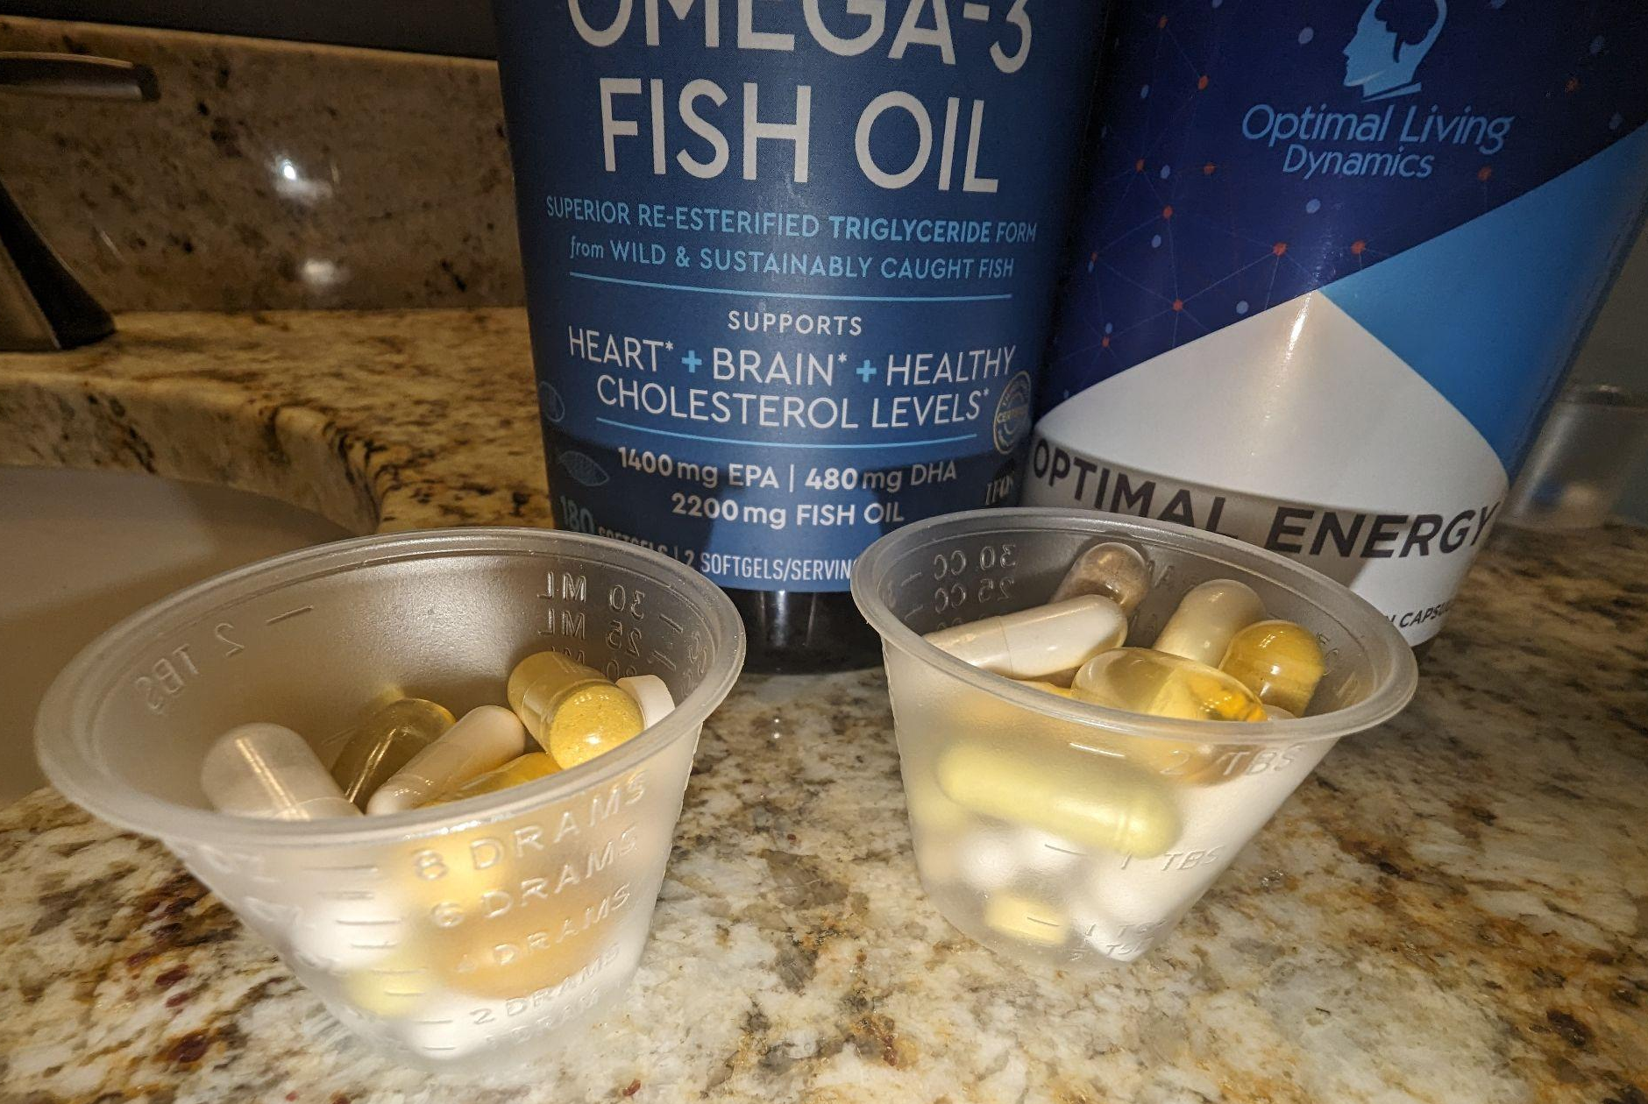
Pharmacotherapy for OCPD
Pervasive
Pattern of
Preoccupation
Orderliness
Control
mental
interpersonal
Perfectionism

Slide 112
Pharmacotherapy for OCPD
Pervasive
Pattern of
Preoccupation
Orderliness
Control
mental
interpersonal
Perfectionism

Slide 113
Pharmacotherapy for OCPD
Only 2 small randomized controlled trials
Julija Gecaite-Stonciene, Taryn Williams, Christine Lochner, Jacob Hoffman & Dan J. Stein (2022) Efficacy and tolerability of pharmacotherapy for obsessive-compulsive personality disorder: a systematic review of randomized controlled trials, Expert Opinion on Pharmacotherapy, 23:11, 1351-1358, DOI: 10.1080/14656566.2022.2100695

Slide 114
Pharmacotherapy for OCPD
Only 2 small randomized controlled trials
MDD + OCPD
Citalopram was more effective than sertraline with fewer dropouts
Julija Gecaite-Stonciene, Taryn Williams, Christine Lochner, Jacob Hoffman & Dan J. Stein (2022) Efficacy and tolerability of pharmacotherapy for obsessive-compulsive personality disorder: a systematic review of randomized controlled trials, Expert Opinion on Pharmacotherapy, 23:11, 1351-1358, DOI: 10.1080/14656566.2022.2100695

Slide 115
Pharmacotherapy for OCPD
Only 2 small randomized controlled trials
MDD + OCPD
Citalopram was more effective than sertraline with fewer dropouts
OCPD
Fluvoxamine was more effective than placebo
Julija Gecaite-Stonciene, Taryn Williams, Christine Lochner, Jacob Hoffman & Dan J. Stein (2022) Efficacy and tolerability of pharmacotherapy for obsessive-compulsive personality disorder: a systematic review of randomized controlled trials, Expert Opinion on Pharmacotherapy, 23:11, 1351-1358, DOI: 10.1080/14656566.2022.2100695

Slide 116
Fixated Interest – Neuroprotection
Since nothing is evidence-based for OCPD, why not use neuroprotectants that could help any mental illness by “healthy brain” mechanism?

Slide 117
Fixated Interest – Neuroprotection
Since nothing is evidence-based for OCPD, why not use neuroprotectants that could help any mental illness by “healthy brain” mechanism?
Omega 3’s
N-acetylcysteine (NAC)
Low dose lithium

Slide 118
Obsessive-Compulsive Personality Disorder
4+ of
Is preoccupied with details, rules, lists, order, organization, or schedules to the extent that the major point of the activity is lost.
A Systematic Approach to Psychiatric Medication Management
Jason Cafer MD
Notes:
My argument to you, and to myself, is that, in doing this thing I do—to an extreme extent —does not lose the major point of the activity.

Slide 119
Notes:
What do I call this? Paper brain?

Slide 120
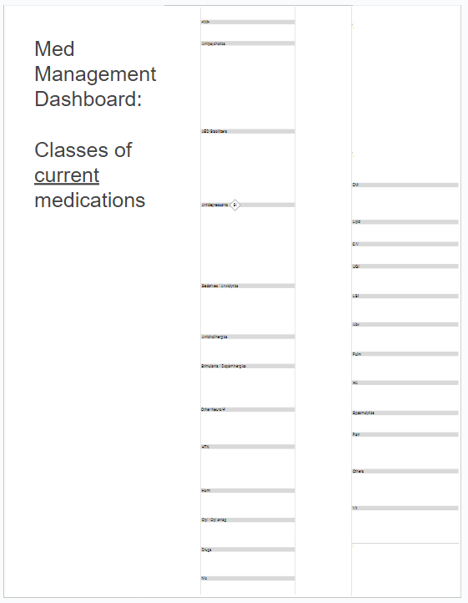

Slide 121
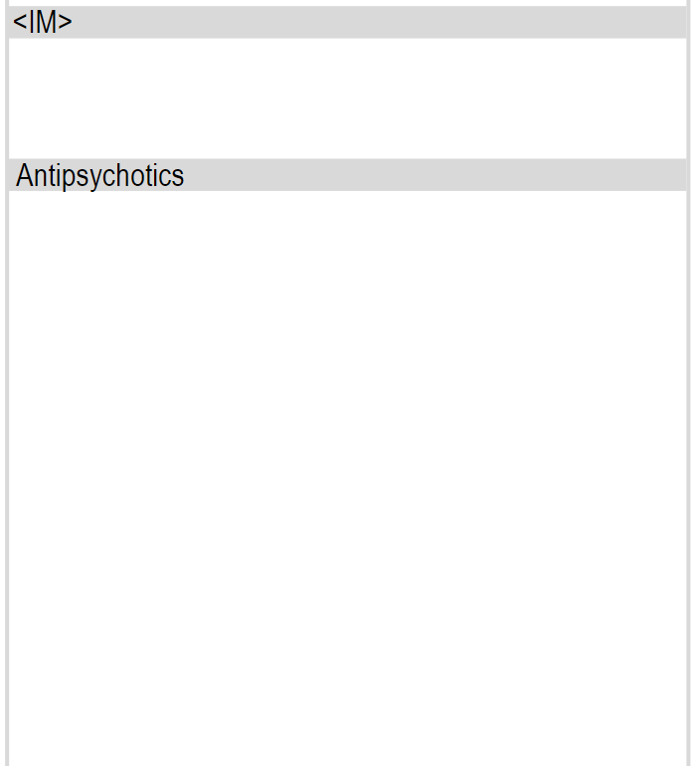

Slide 122
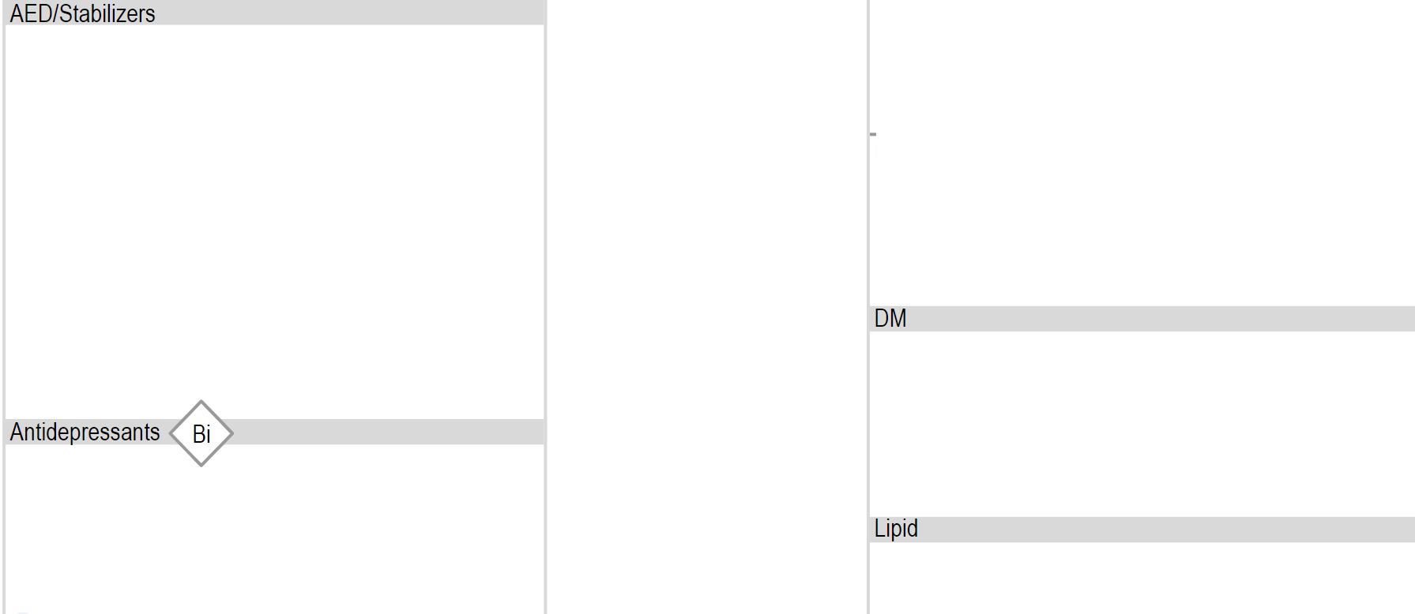

Slide 123
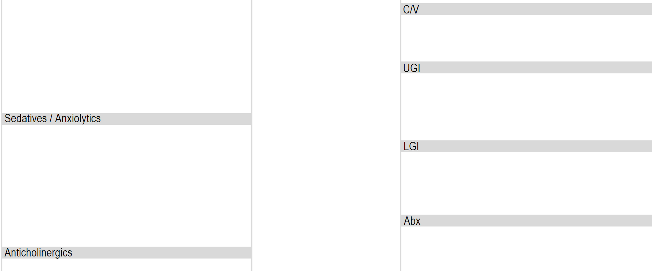

Slide 124
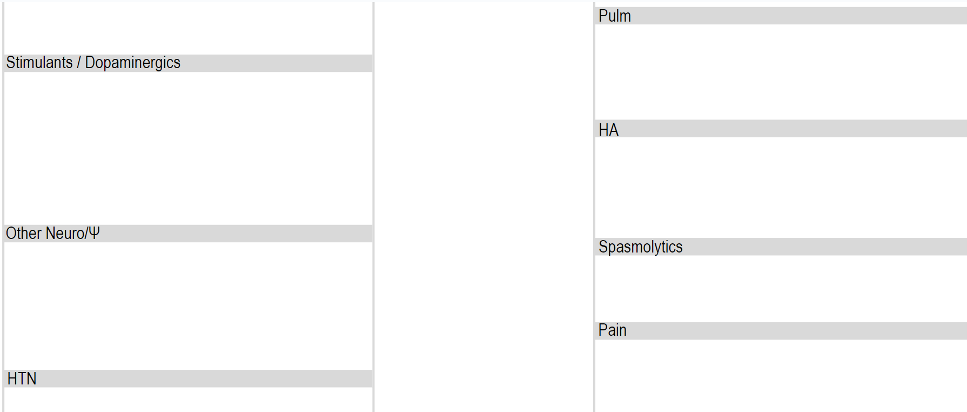

Slide 125
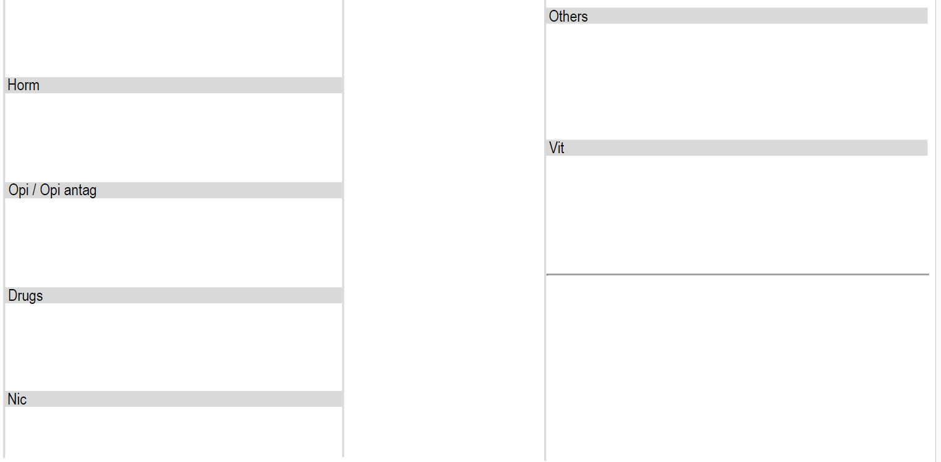

Slide 126
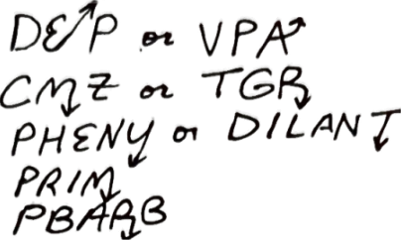
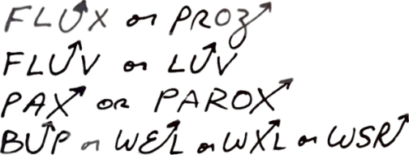

Slide 127
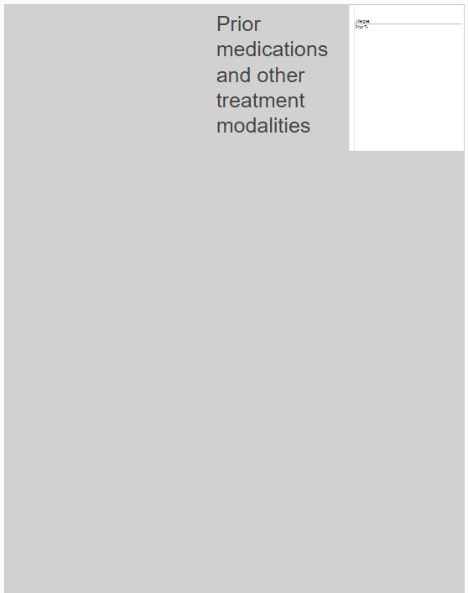

Slide 129
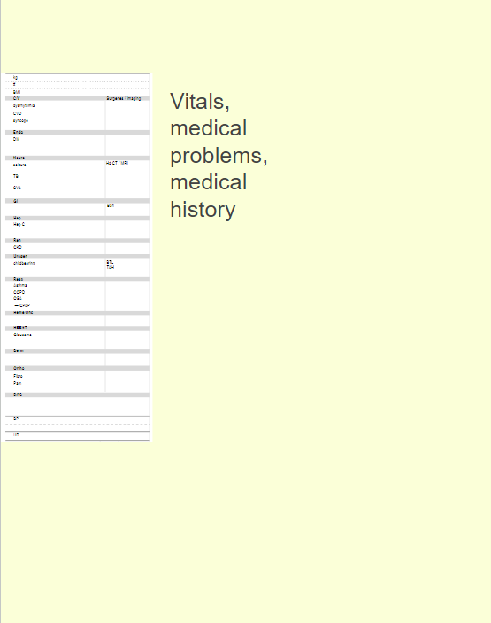

Slide 130
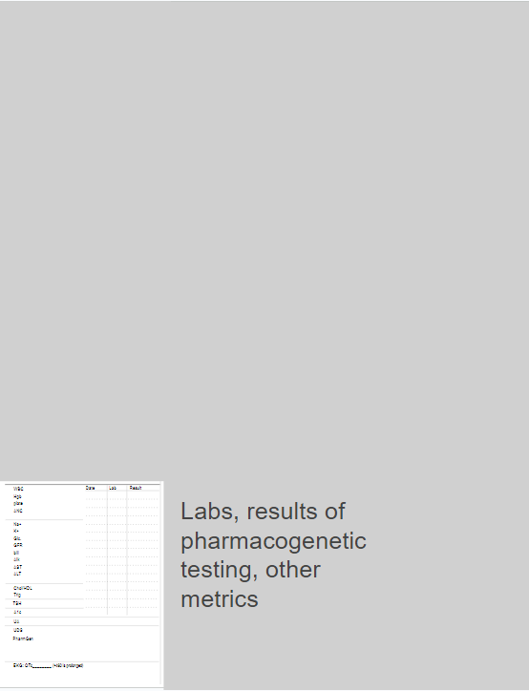

Slide 131
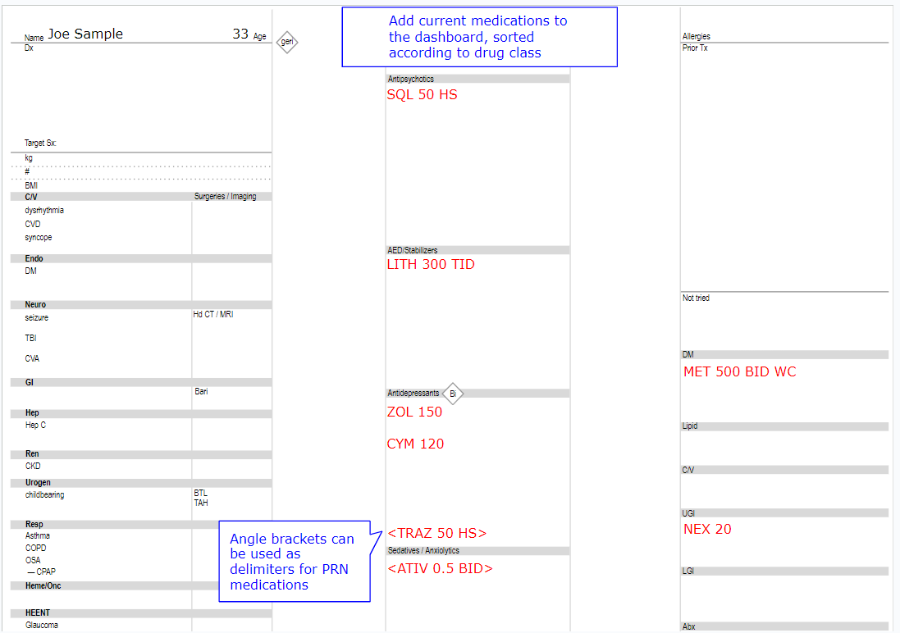

Slide 132
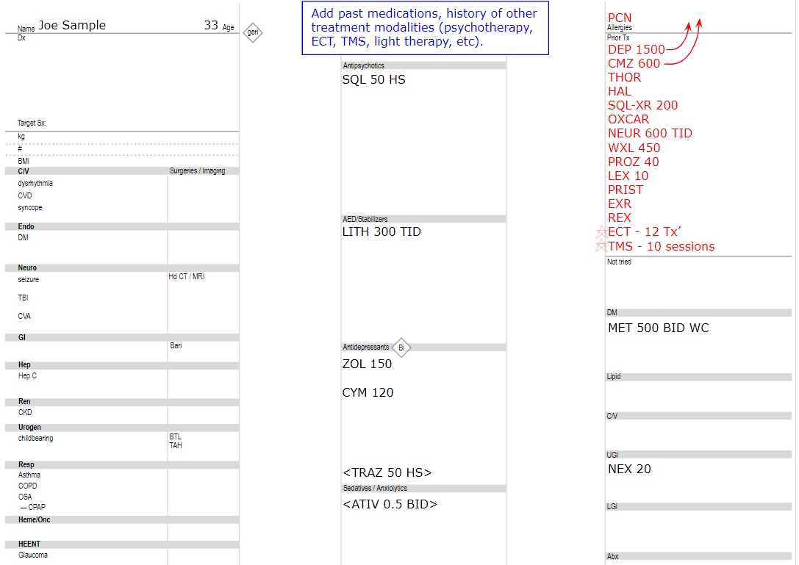

Slide 134
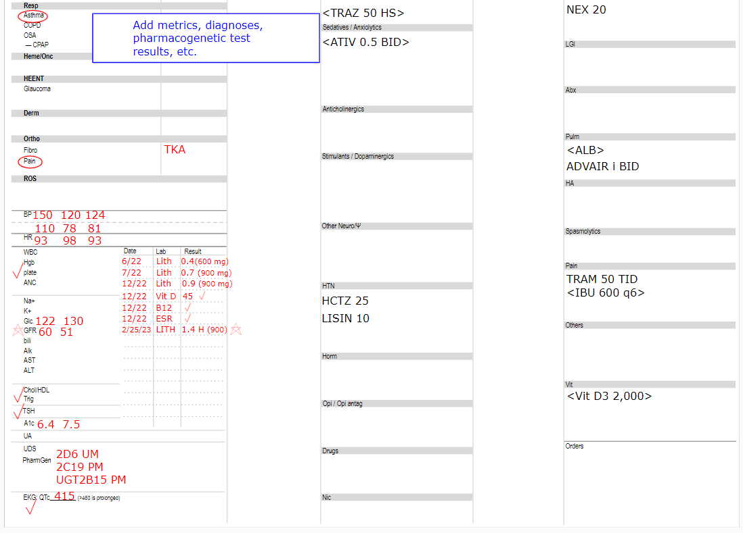

Slide 135
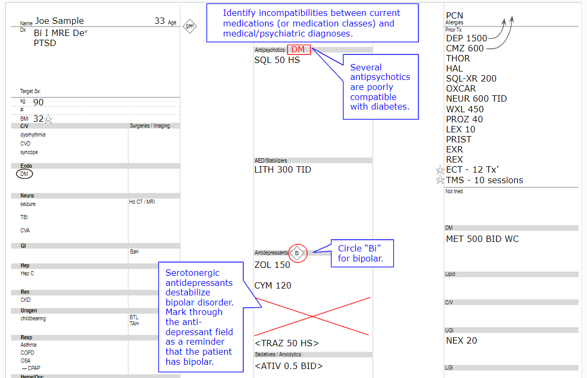

Slide 136
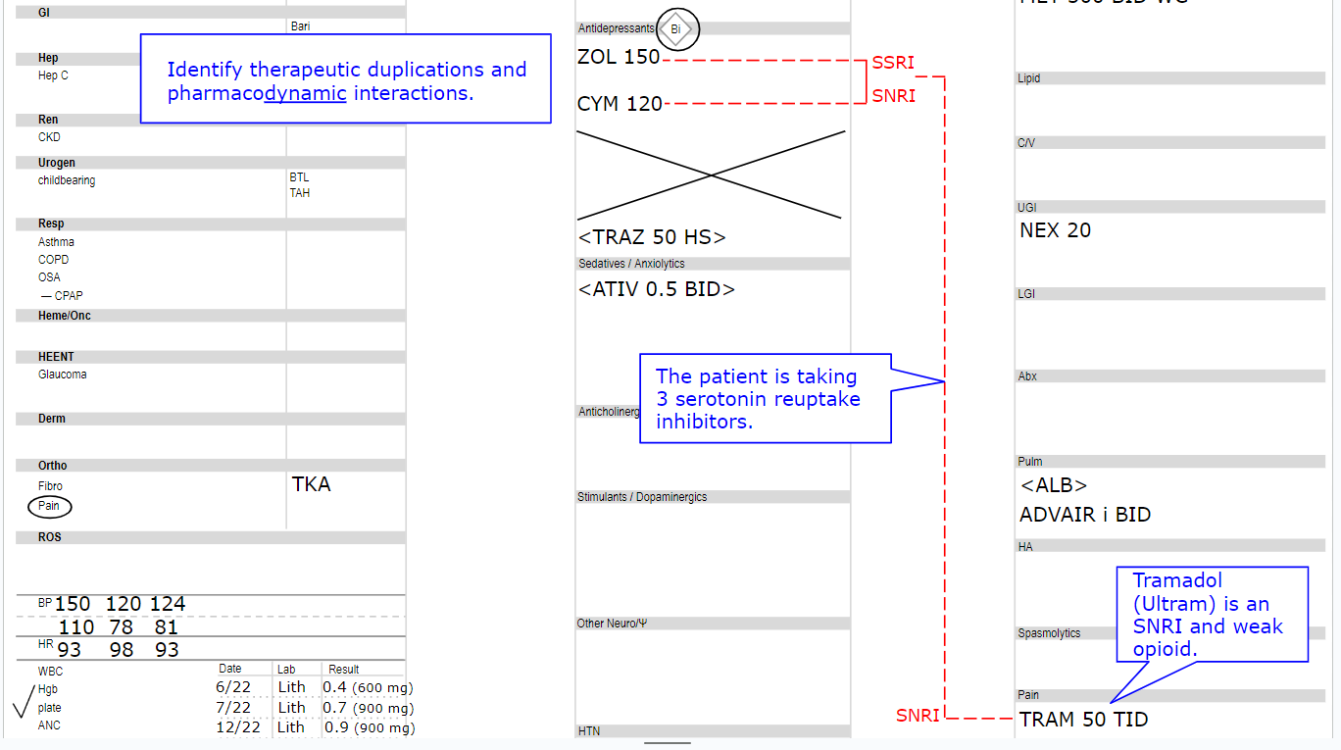

Slide 137
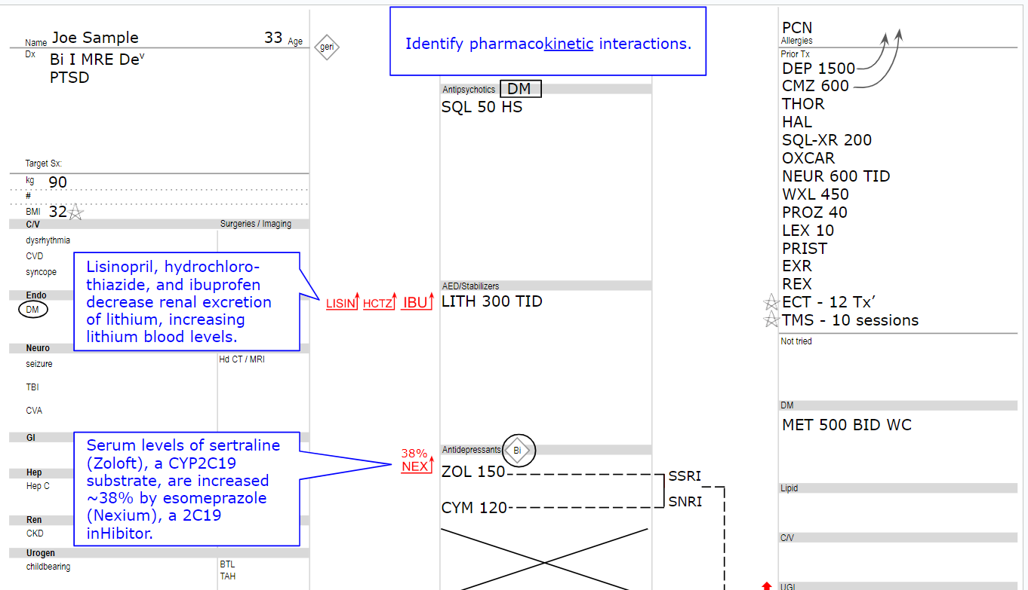

Slide 138
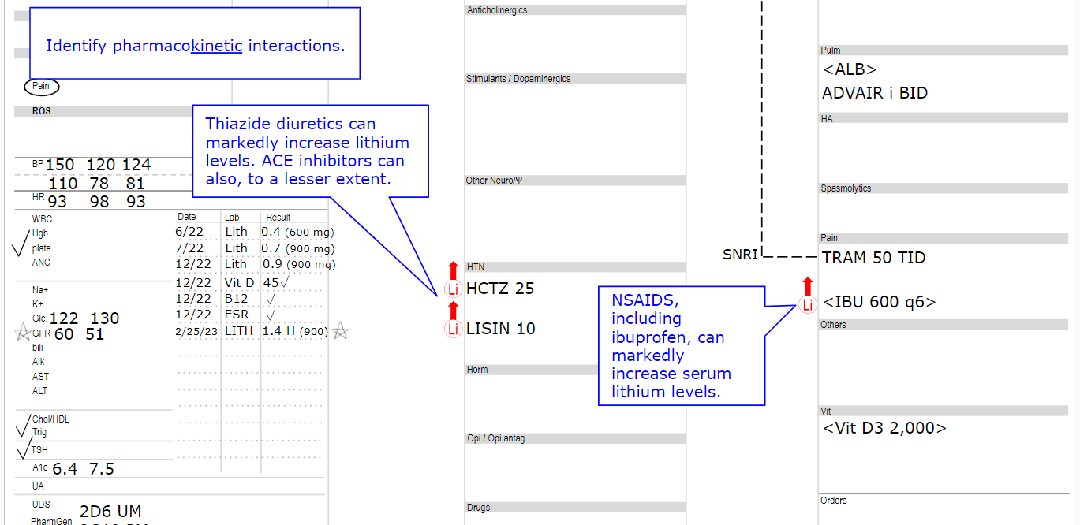

Slide 139
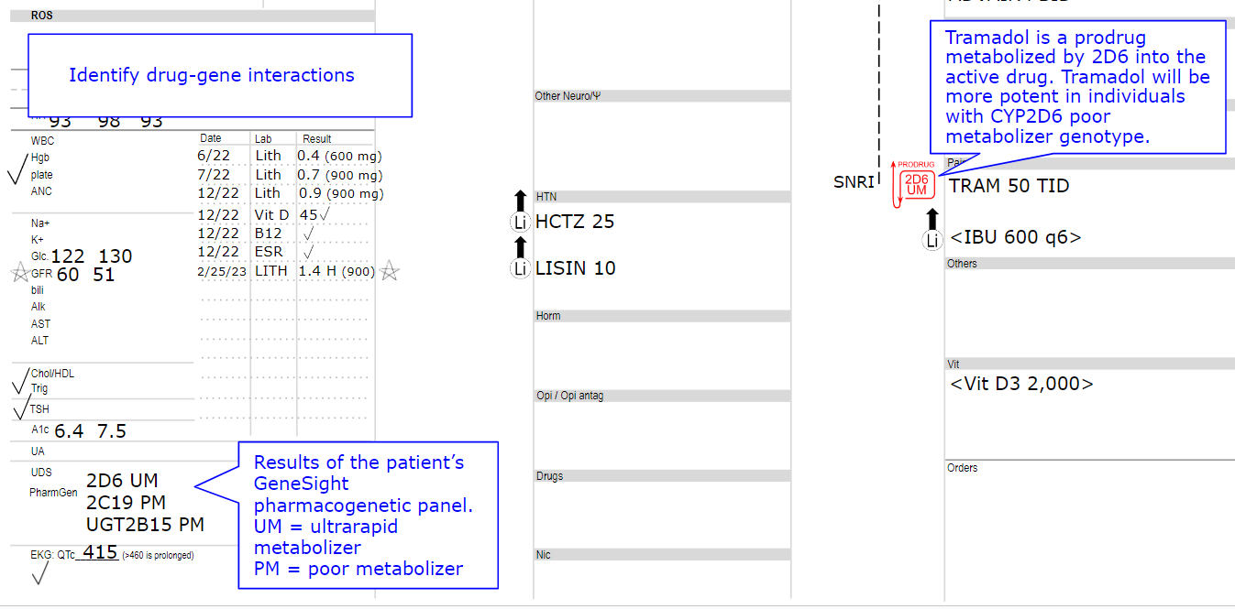

Slide 140
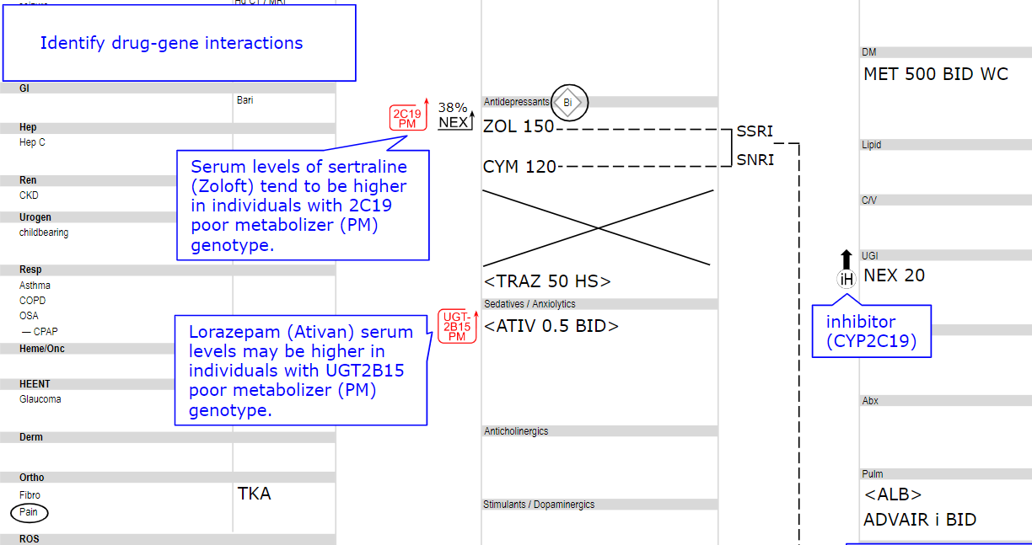

Slide 141
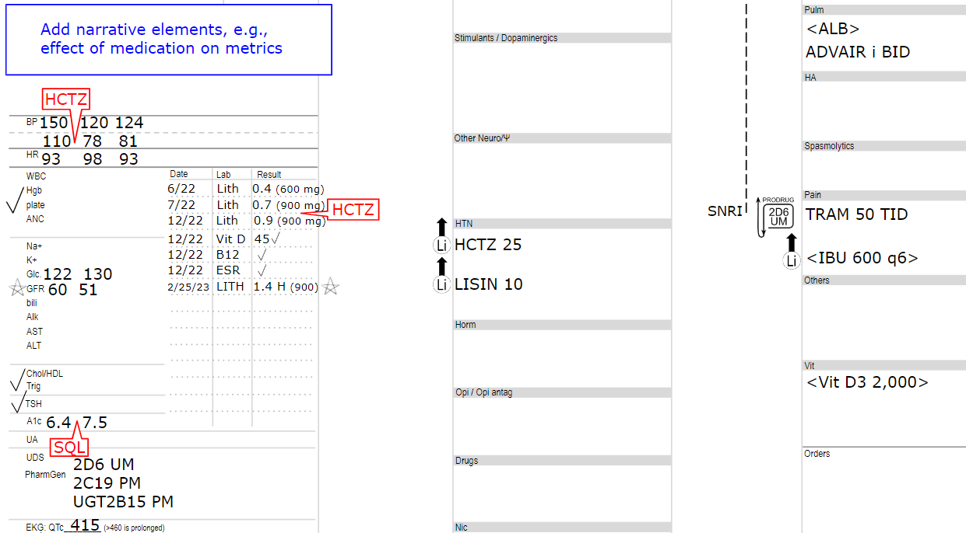

Slide 142
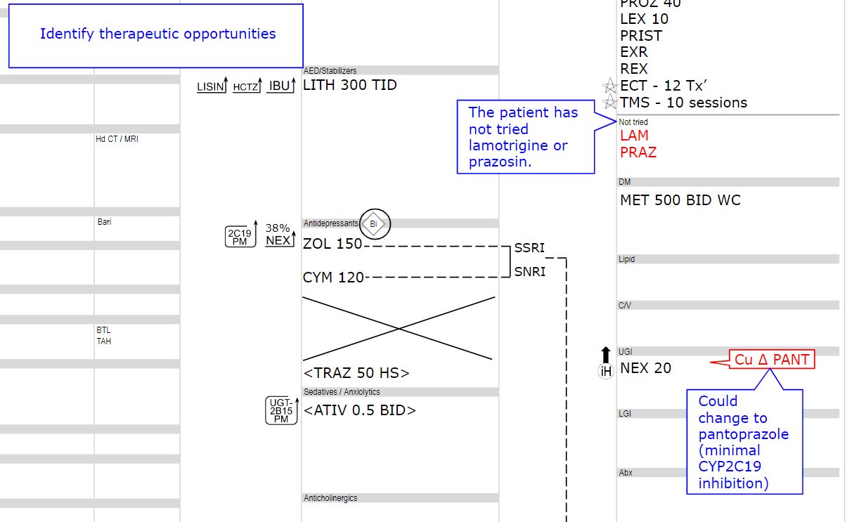

Slide 143
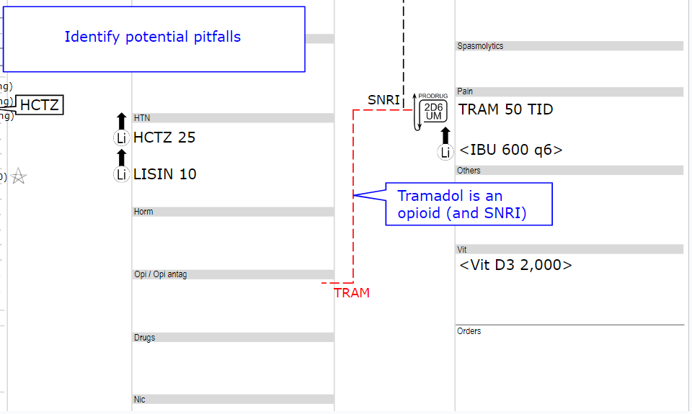

Slide 144
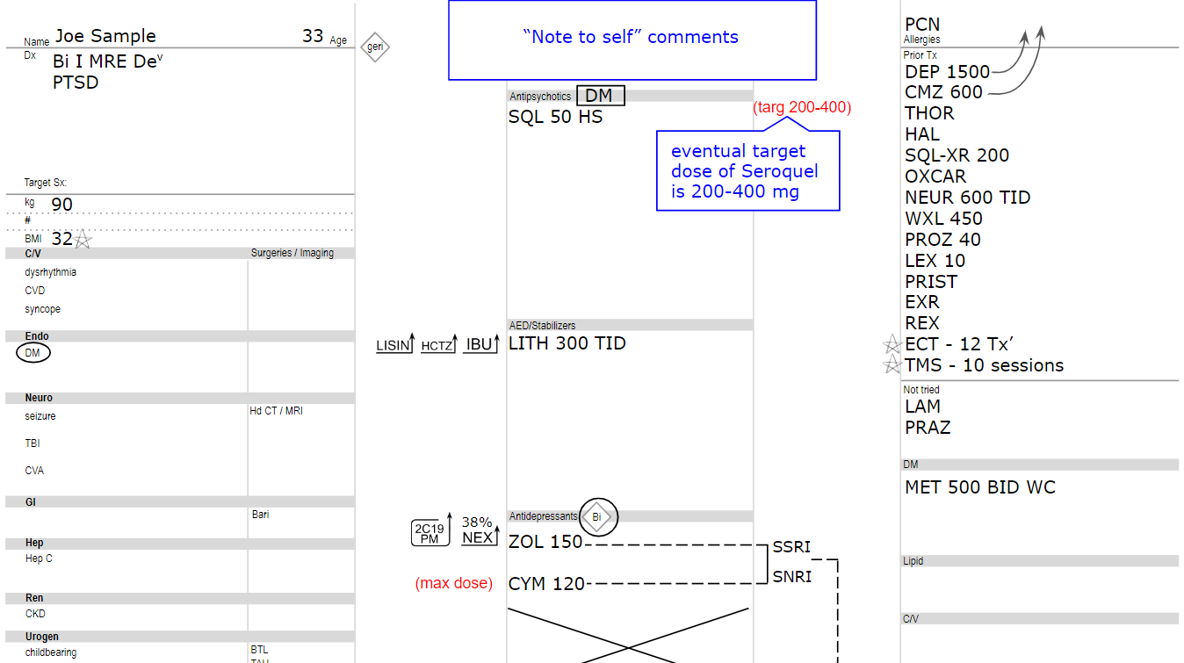

Slide 145
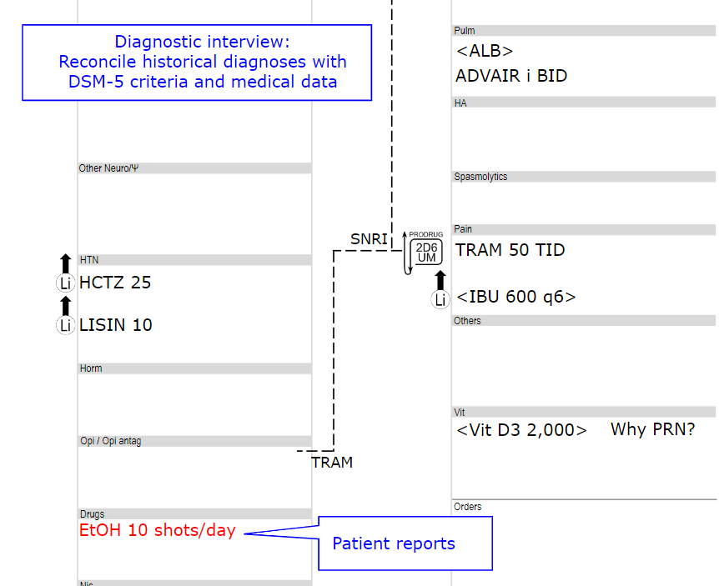

Slide 146
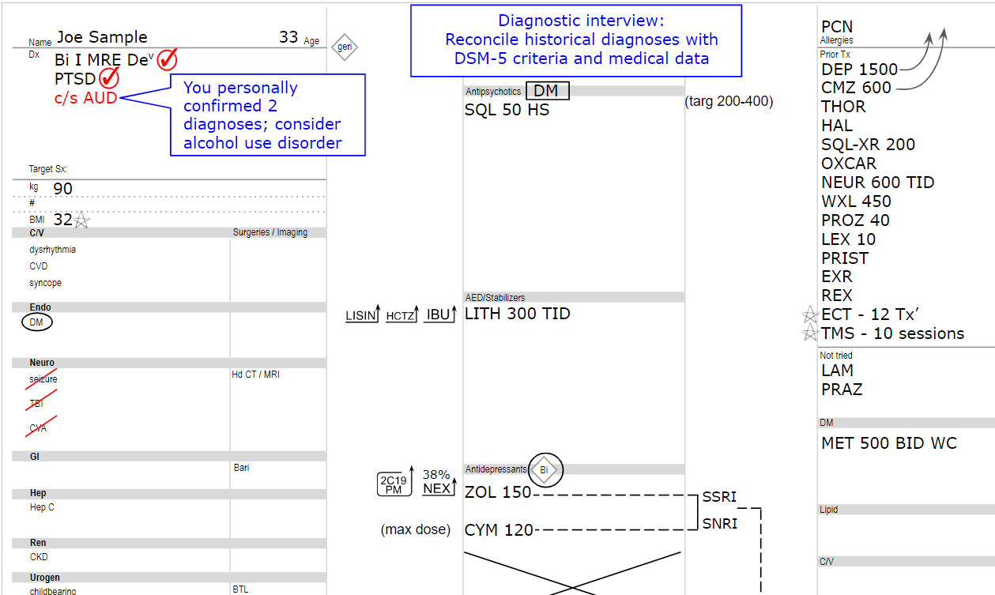

Slide 147
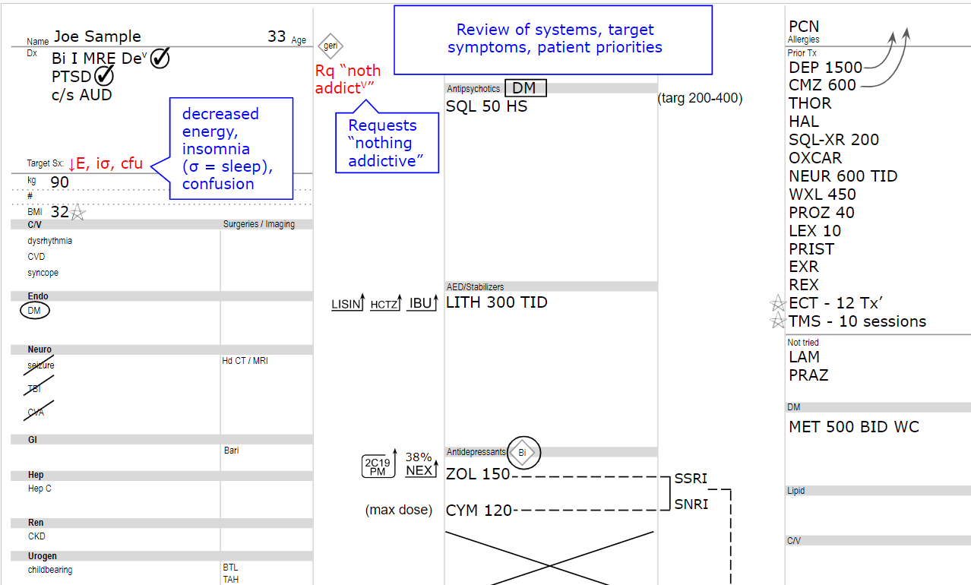

Slide 148
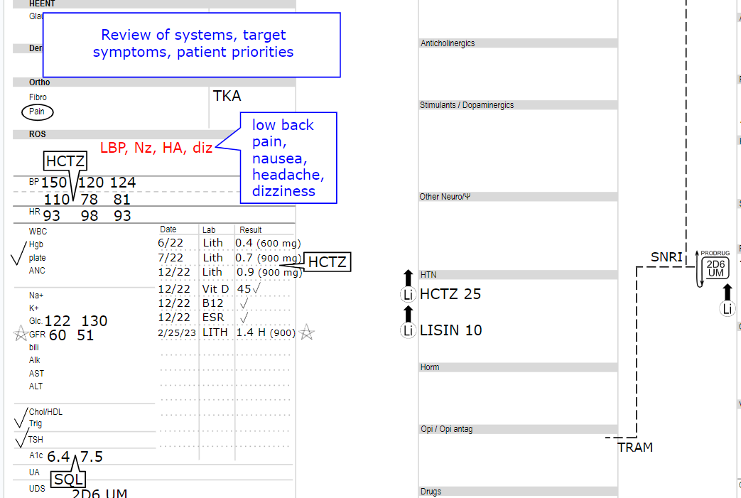

Slide 149
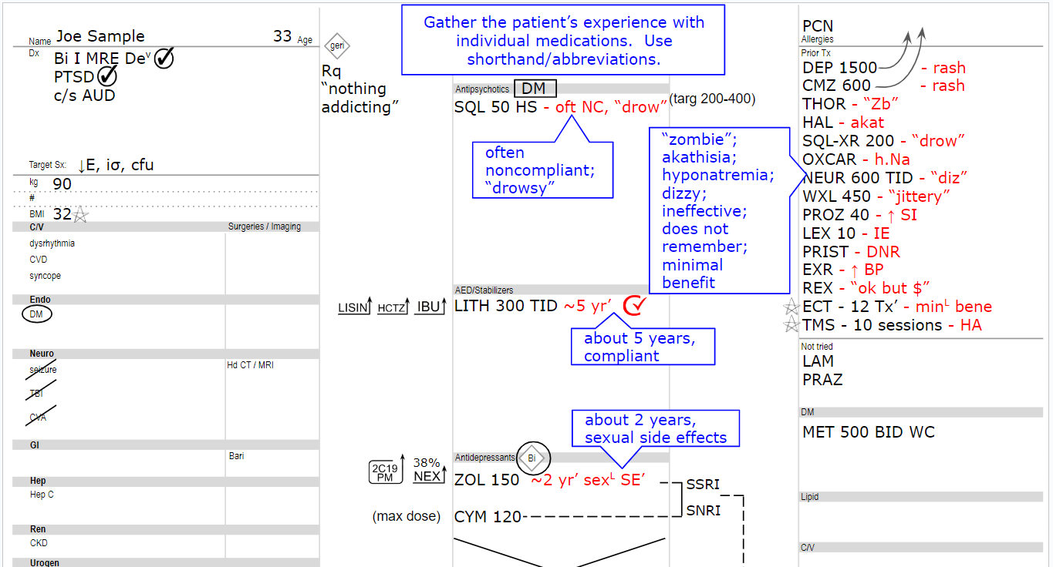

Slide 150
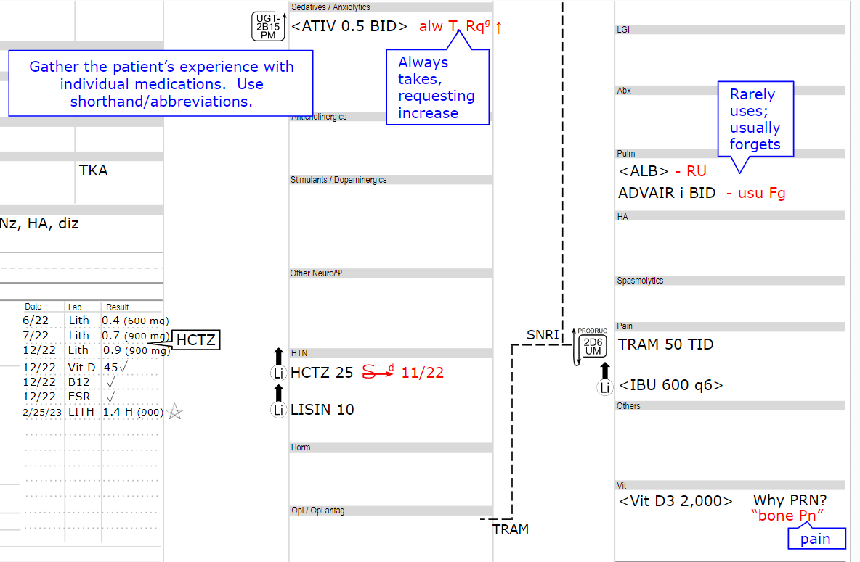

Slide 157
cafermed.com/november

Slide 164
IE = ineffective
Ef^{V} = effective
Ey = early
T = take / took
T^{g} = taking
NT = not taking
DNL = does not like
t = try
t^{g} = trying
M = medication
M’ = medications
b. = bad
g. = good
v. = very
Ψo = psychosis
aΨ = antipsychotic
Ψ = psychiatrist
Ψ = psychotherapist
W = want(s)
W^{g} = wanting
W^{d} = wanted
Y = you (the prescriber)
M = mother
GF = grandfather
D = daughter
yd = yesterday
td = today
tm = tomorrow
2da = 2 days ago
1wa = one week ago
7da’ = 7 days ago
1wa = 1 week ago
2wa’ = 2 weeks ago
fda’ = few days ago
fwa’ = few weeks ago
fma’ = few months ago
ya’ = years ago
LTA = long time ago
Nv = never

Slide 165
IE = ineffective
Ef^{V} = effective
Ey = early
T = take / took
T^{g} = taking
NT = not taking
DNL = does not like
t = try
t^{g} = trying
M = medication
M’ = medications
b. = bad
g. = good
v. = very
Ψo = psychosis
aΨ = antipsychotic
Ψ = psychiatrist
Ψ = psychotherapist
W = want(s)
W^{g} = wanting
W^{d} = wanted
Y = you (the prescriber)
M = mother
GF = grandfather
D = daughter
yd = yesterday
td = today
tm = tomorrow
2da = 2 days ago
1wa = one week ago
7da’ = 7 days ago
1wa = 1 week ago
2wa’ = 2 weeks ago
fda’ = few days ago
fwa’ = few weeks ago
fma’ = few months ago
ya’ = years ago
LTA = long time ago
Nv = never

Slide 166
IE = ineffective
Ef^{V} = effective
Ey = early
T = take / took
T^{g} = taking
NT = not taking
DNL = does not like
t = try
t^{g} = trying
M = medication
M’ = medications
b. = bad
g. = good
v. = very
Ψo = psychosis
aΨ = antipsychotic
Ψ = psychiatrist
Ψ = psychotherapist
W = want(s)
W^{g} = wanting
W^{d} = wanted
Y = you (the prescriber)
M = mother
GF = grandfather
D = daughter
yd = yesterday
td = today
tm = tomorrow
2da = 2 days ago
1wa = one week ago
7da’ = 7 days ago
1wa = 1 week ago
2wa’ = 2 weeks ago
fda’ = few days ago
fwa’ = few weeks ago
fma’ = few months ago
ya’ = years ago
LTA = long time ago
Nv = never

Slide 167
IE = ineffective
Ef^{V} = effective
Ey = early
T = take / took
T^{g} = taking
NT = not taking
DNL = does not like
t = try
t^{g} = trying
M = medication
M’ = medications
b. = bad
g. = good
v. = very
Ψo = psychosis
aΨ = antipsychotic
Ψ = psychiatrist
Ψ = psychotherapist
W = want(s)
W^{g} = wanting
W^{d} = wanted
Y = you (the prescriber)
M = mother
GF = grandfather
D = daughter
yd = yesterday
td = today
tm = tomorrow
2da = 2 days ago
1wa = one week ago
7da’ = 7 days ago
1wa = 1 week ago
2wa’ = 2 weeks ago
fda’ = few days ago
fwa’ = few weeks ago
fma’ = few months ago
ya’ = years ago
LTA = long time ago
Nv = never

Slide 168
IE = ineffective
Ef^{V} = effective
Ey = early
T = take / took
T^{g} = taking
NT = not taking
DNL = does not like
t = try
t^{g} = trying
M = medication
M’ = medications
b. = bad
g. = good
v. = very
Ψo = psychosis
aΨ = antipsychotic
Ψ = psychiatrist
Ψ = psychotherapist
W = want(s)
W^{g} = wanting
W^{d} = wanted
Y = you (the prescriber)
M = mother
GF = grandfather
D = daughter
yd = yesterday
td = today
tm = tomorrow
2da = 2 days ago
1wa = one week ago
7da’ = 7 days ago
1wa = 1 week ago
2wa’ = 2 weeks ago
fda’ = few days ago
fwa’ = few weeks ago
fma’ = few months ago
ya’ = years ago
LTA = long time ago
Nv = never

Slide 169
seen
dead
resolved
start
appropriate
C
claim
inappropriate
compliance
i
started
little
some
compliant
last
C
call
G
guardian
=

Slide 170
seen
dead
resolved
start
appropriate
C
claim
inappropriate
compliance
i
started
little
some
compliant
last
C
call
G
guardian
=

Slide 171
seen
dead
resolved
start
appropriate
C
claim
inappropriate
compliance
i
started
little
some
compliant
last
C
call
G
guardian
=

Slide 172
seen
dead
resolved
start
appropriate
C
claim
inappropriate
compliance
i
started
little
some
compliant
last
C
call
G
guardian
=

Slide 180
The Dirty Dozen – 8 inHibitors and 4 inDucers

