Slide 2
Carlat podcast
Commandment #1

Slide 3
Carlat podcast
Commandment #1
Do not worsen mental illness with psychiatric medications

Slide 4
Carlat podcast
Commandment #1
Do not worsen mental illness with psychiatric medications
Do not start an antidepressant during mania

Slide 5
Carlat podcast
Commandment #1
Do not worsen mental illness with psychiatric medications
Do not start an antidepressant during mania
Do not start stimulants during psychosis

Slide 6
Carlat podcast
Commandment #1
Do not worsen mental illness with psychiatric medications
Do not start an antidepressant during mania
Do not start stimulants during psychosis
(No antidepressant monotherapy in bipolar I)

Slide 7
Carlat podcast
Commandment #1
Do not worsen mental illness with psychiatric medications
Do not start an antidepressant during mania
Do not start stimulants during psychosis
(No antidepressant monotherapy in bipolar I)
(No stimulants in schizophrenia)

Slide 8
Carlat podcast
Commandment #1
Do not worsen mental illness with psychiatric medications
Do not start an antidepressant during mania
Do not start stimulants during psychosis
(No antidepressant monotherapy in bipolar I)
(No stimulants in schizophrenia)
(Don’t start a serotonergic antidepressant in bipolar)

Slide 9
Carlat podcast
Commandment #1
Do not worsen mental illness with psychiatric medications
Do not start an antidepressant during mania
Do not start stimulants during psychosis
(No antidepressant monotherapy in bipolar I)
(No stimulants in schizophrenia)
(Don’t start a serotonergic antidepressant in bipolar)
Commandment #2
(In general) Don’t stop psych meds abruptly

Slide 10
Carlat podcast
Commandment #1
Do not worsen mental illness with psychiatric medications
Do not start an antidepressant during mania
Do not start stimulants during psychosis
(No antidepressant monotherapy in bipolar I)
(No stimulants in schizophrenia)
(Don’t start a serotonergic antidepressant in bipolar)
Commandment #2
(In general) Don’t stop psych meds abruptly
Serotonin discontinuation

Slide 11
Carlat podcast
Commandment #1
Do not worsen mental illness with psychiatric medications
Do not start an antidepressant during mania
Do not start stimulants during psychosis
(No antidepressant monotherapy in bipolar I)
(No stimulants in schizophrenia)
(Don’t start a serotonergic antidepressant in bipolar)
Commandment #2
(In general) Don’t stop psych meds abruptly
Serotonin discontinuation
Rebound seizures

Slide 12
Carlat podcast
Commandment #1
Do not worsen mental illness with psychiatric medications
Do not start an antidepressant during mania
Do not start stimulants during psychosis
(No antidepressant monotherapy in bipolar I)
(No stimulants in schizophrenia)
(Don’t start a serotonergic antidepressant in bipolar)
Commandment #2
(In general) Don’t stop psych meds abruptly
Serotonin discontinuation
Rebound seizures
Rebound suicidality (lithium)

Slide 13
Carlat podcast
Commandment #1
Do not worsen mental illness with psychiatric medications
Do not start an antidepressant during mania
Do not start stimulants during psychosis
(No antidepressant monotherapy in bipolar I)
(No stimulants in schizophrenia)
(Don’t start a serotonergic antidepressant in bipolar)
Commandment #2
(In general) Don’t stop psych meds abruptly
Serotonin discontinuation
Rebound seizures
Rebound suicidality (lithium)
Rebound psychosis

Slide 14
Carlat podcast
Commandment #1
Do not worsen mental illness with psychiatric medications
Do not start an antidepressant during mania
Do not start stimulants during psychosis
(No antidepressant monotherapy in bipolar I)
(No stimulants in schizophrenia)
(Don’t start a serotonergic antidepressant in bipolar)
Commandment #2
(In general) Don’t stop psych meds abruptly
Serotonin discontinuation
Rebound seizures
Rebound suicidality (lithium)
Rebound psychosis
Rebound anxiety

Slide 15
Carlat podcast
Commandment #1
Do not worsen mental illness with psychiatric medications
Do not start an antidepressant during mania
Do not start stimulants during psychosis
(No antidepressant monotherapy in bipolar I)
(No stimulants in schizophrenia)
(Don’t start a serotonergic antidepressant in bipolar)
Commandment #2
(In general) Don’t stop psych meds abruptly
Commandment #3
Prevent lithium toxicity by keeping tabs on:

Slide 16
Carlat podcast
Commandment #1
Do not worsen mental illness with psychiatric medications
Do not start an antidepressant during mania
Do not start stimulants during psychosis
(No antidepressant monotherapy in bipolar I)
(No stimulants in schizophrenia)
(Don’t start a serotonergic antidepressant in bipolar)
Commandment #2
(In general) Don’t stop psych meds abruptly
Commandment #3
Prevent lithium toxicity by keeping tabs on:
drug interactions

Slide 17
Carlat podcast
Commandment #1
Do not worsen mental illness with psychiatric medications
Do not start an antidepressant during mania
Do not start stimulants during psychosis
(No antidepressant monotherapy in bipolar I)
(No stimulants in schizophrenia)
(Don’t start a serotonergic antidepressant in bipolar)
Commandment #2
(In general) Don’t stop psych meds abruptly
Commandment #3
Prevent lithium toxicity by keeping tabs on:
drug interactions
especially thiazides and NSAIDS

Slide 18
Carlat podcast
Commandment #1
Do not worsen mental illness with psychiatric medications
Do not start an antidepressant during mania
Do not start stimulants during psychosis
(No antidepressant monotherapy in bipolar I)
(No stimulants in schizophrenia)
(Don’t start a serotonergic antidepressant in bipolar)
Commandment #2
(In general) Don’t stop psych meds abruptly
Commandment #3
Prevent lithium toxicity by keeping tabs on:
drug interactions
especially thiazides and NSAIDS
patient’s age

Slide 19
Carlat podcast
Commandment #1
Do not worsen mental illness with psychiatric medications
Do not start an antidepressant during mania
Do not start stimulants during psychosis
(No antidepressant monotherapy in bipolar I)
(No stimulants in schizophrenia)
(Don’t start a serotonergic antidepressant in bipolar)
Commandment #2
(In general) Don’t stop psych meds abruptly
Commandment #3
Prevent lithium toxicity by keeping tabs on:
drug interactions
especially thiazides and NSAIDS
patient’s age
renal function

Slide 20
Carlat podcast
Commandment #1
Do not worsen mental illness with psychiatric medications
Do not start an antidepressant during mania
Do not start stimulants during psychosis
(No antidepressant monotherapy in bipolar I)
(No stimulants in schizophrenia)
(Don’t start a serotonergic antidepressant in bipolar)
Commandment #2
(In general) Don’t stop psych meds abruptly
Commandment #3
Prevent lithium toxicity by keeping tabs on drug interactions, your patient’s age, and their renal function
Commandment #4

Slide 21
Carlat podcast
Commandment #1
Do not worsen mental illness with psychiatric medications
Do not start an antidepressant during mania
Do not start stimulants during psychosis
(No antidepressant monotherapy in bipolar I)
(No stimulants in schizophrenia)
(Don’t start a serotonergic antidepressant in bipolar)
Commandment #2
(In general) Don’t stop psych meds abruptly
Commandment #3
Prevent lithium toxicity by keeping tabs on drug interactions, your patient’s age, and their renal function
Commandment #4
Never accelerate the standard lamotrigine titration schedule.

Slide 22
Carlat podcast
Commandment #1
Do not worsen mental illness with psychiatric medications
Do not start an antidepressant during mania
Do not start stimulants during psychosis
(No antidepressant monotherapy in bipolar I)
(No stimulants in schizophrenia)
(Don’t start a serotonergic antidepressant in bipolar)
Commandment #2
(In general) Don’t stop psych meds abruptly
Commandment #3
Prevent lithium toxicity by keeping tabs on drug interactions, your patient’s age, and their renal function
Commandment #4
Never accelerate the standard lamotrigine titration schedule.
Always stop lamotrigine after an initial rash.

Slide 23
Carlat podcast
Commandment #1
Do not worsen mental illness with psychiatric medications
Do not start an antidepressant during mania
Do not start stimulants during psychosis
(No antidepressant monotherapy in bipolar I)
(No stimulants in schizophrenia)
(Don’t start a serotonergic antidepressant in bipolar)
Commandment #2
(In general) Don’t stop psych meds abruptly
Commandment #3
Prevent lithium toxicity by keeping tabs on drug interactions, your patient’s age, and their renal function
Commandment #4
Never accelerate the standard lamotrigine titration schedule.
Always stop lamotrigine after an initial rash
within 3 months

Slide 24
Carlat podcast
Commandment #1
Do not worsen mental illness with psychiatric medications
Do not start an antidepressant during mania
Do not start stimulants during psychosis
(No antidepressant monotherapy in bipolar I)
(No stimulants in schizophrenia)
(Don’t start a serotonergic antidepressant in bipolar)
Commandment #2
(In general) Don’t stop psych meds abruptly
Commandment #3
Prevent lithium toxicity by keeping tabs on drug interactions, your patient’s age, and their renal function
Commandment #4
Never accelerate the standard lamotrigine titration schedule.
Always stop lamotrigine after an initial rash.
within 3 months
Commandment #5
Don’t mix benzos with opioids in high-risk patients

Slide 25
Carlat podcast
Commandment #6
Honor thy MAOI interactions

Slide 26
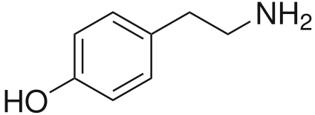
Carlat podcast
Monoamine Oxidase Inhibitors
High in efficacy
Well-tolerated
Less weight gain
Less fatigue
Less sexual dysfunction
Serotonin syndrome
Hypertensive crisis with tyramine-rich foods

Slide 27
Carlat podcast
Monoamine Oxidase Inhibitors
High in efficacy
Well-tolerated
Less weight gain
Less fatigue
Less sexual dysfunction
Serotonin syndrome
Hypertensive crisis with tyramine-rich foods
“tire rim”

Slide 28
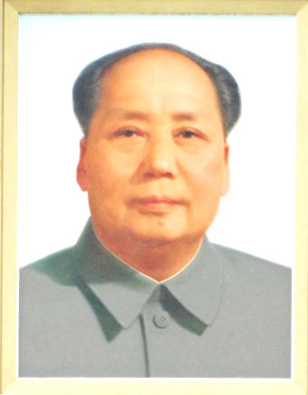
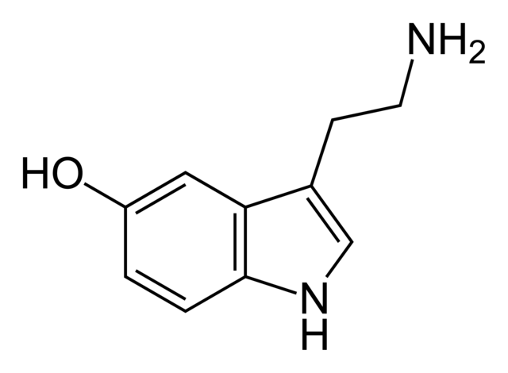
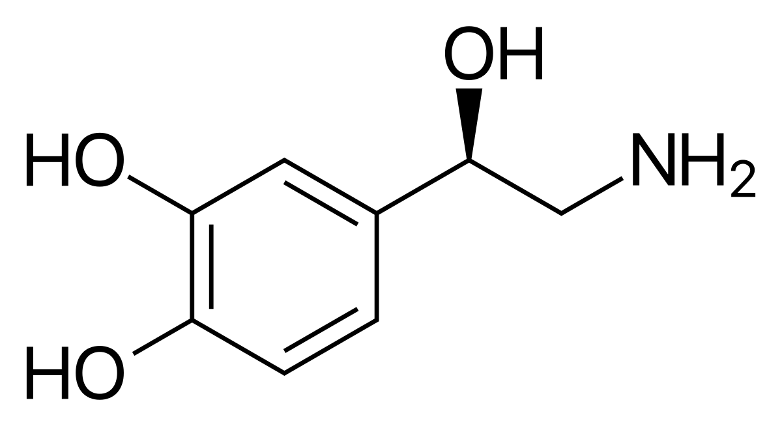
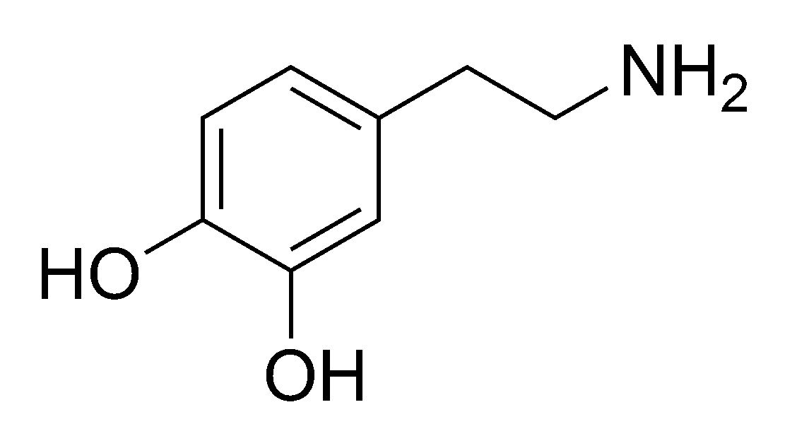
Monoamine Oxidase Inhibitors (MAOIs)
“Chairman Mao”
❖ Antidepressants
❖ Medications for Parkinson’s disease
Monoamine Oxidase (MAO) is the enzyme that breaks down the monoamine neurotransmitters:
Serotonin (5-HT)
Norepinephrine (NE)
Dopamine (DA)

Slide 29
Monoamine Oxidase Inhibitors (MAOIs)
“Chairman Mao”
❖ Antidepressants
❖ Medications for Parkinson’s disease
Monoamine Oxidase (MAO) is the enzyme that breaks down the monoamine neurotransmitters:
Serotonin (5-HT)
Norepinephrine (NE)
Dopamine (DA)

Slide 30
Monoamine Oxidase Inhibitors (MAOIs)
Very serious dynamic interactions with tyramine-rich foods and serotonergic medications
*

Slide 31
Monoamine Oxidase Inhibitors (MAOIs)
Very serious dynamic interactions with tyramine-rich foods and serotonergic medications
*

Slide 33
Monoamine Oxidase Inhibitors (MAOIs)
5-HT – serotonergic
NE – noradrenergic
DA – dopaminergic
*Selectivity is dose dependent. Above recommended doses, selective MAO-B inhibitors can also inhibit MAO-A.
MAOI | Use | Year | Cost/mo | 5-HT | NE | DA | MAO select- ivity | Dietary tyramine risk | Wt gain | Sed- ation | Anti- cholin ergic | Rever- sible?
Tranylcypromine (PARNATE) | MDD | 1961 | $240 | +++ | +++ | +++ | A & B | ++++ | - | low | low | no
Isocarboxazid (MARPLAN) | MDD | 1959 | $780 | +++ | +++ | +++ | A & B | ++++ | - | low | low | no
Phenelzine (NARDIL) | MDD | 1961 | $43 | +++ | +++ | +++ | A & B | ++++ | ++ | low | low | no
Selegiline transdermal (EMSAM) | MDD | 2006 | $1650 | ++ | ++ | +++ | (A) & B | ++ | loss | low | low | no
Selegiline PO (ELDEPRYL) | Parkinson’s | 1989 | $26 | ++ | ++ | +++ | B | + | loss | low | low | no
Rasagiline (AZILECT) | Parkinson’s | 2006 | $270 | ++ | ++ | +++ | B | + | loss | low | low | no
Safinamide (XADAGO) | Parkinson’s | 2017 | $780 | + | + | +++ | B | +/- | - | low | low | yes
*

Slide 34
Monoamine Oxidase Inhibitors (MAOIs)
5-HT – serotonergic
NE – noradrenergic
DA – dopaminergic
*Selectivity is dose dependent. Above recommended doses, selective MAO-B inhibitors can also inhibit MAO-A.
MAOI | Use | Year | Cost/mo | 5-HT | NE | DA | MAO select- ivity | Dietary tyramine risk | Wt gain | Sed- ation | Anti- cholin ergic | Rever- sible?
Tranylcypromine (PARNATE) | MDD | 1961 | $240 | +++ | +++ | +++ | A & B | ++++ | - | low | low | no
Isocarboxazid (MARPLAN) | MDD | 1959 | $780 | +++ | +++ | +++ | A & B | ++++ | - | low | low | no
Phenelzine (NARDIL) | MDD | 1961 | $43 | +++ | +++ | +++ | A & B | ++++ | ++ | low | low | no
Selegiline transdermal (EMSAM) | MDD | 2006 | $1650 | ++ | ++ | +++ | (A) & B | ++ | loss | low | low | no
Selegiline PO (ELDEPRYL) | Parkinson’s | 1989 | $26 | ++ | ++ | +++ | B | + | loss | low | low | no
Rasagiline (AZILECT) | Parkinson’s | 2006 | $270 | ++ | ++ | +++ | B | + | loss | low | low | no
Safinamide (XADAGO) | Parkinson’s | 2017 | $780 | + | + | +++ | B | +/- | - | low | low | yes
*

Slide 35
Monoamine Oxidase Inhibitors (MAOIs)
5-HT – serotonergic
NE – noradrenergic
DA – dopaminergic
*Selectivity is dose dependent. Above recommended doses, selective MAO-B inhibitors can also inhibit MAO-A.
MAOI | Use | Year | Cost/mo | 5-HT | NE | DA | MAO select- ivity | Dietary tyramine risk | Wt gain | Sed- ation | Anti- cholin ergic | Rever- sible?
Tranylcypromine (PARNATE) | MDD | 1961 | $240 | +++ | +++ | +++ | A & B | ++++ | - | low | low | no
Isocarboxazid (MARPLAN) | MDD | 1959 | $780 | +++ | +++ | +++ | A & B | ++++ | - | low | low | no
Phenelzine (NARDIL) | MDD | 1961 | $43 | +++ | +++ | +++ | A & B | ++++ | ++ | low | low | no
Selegiline transdermal (EMSAM) | MDD | 2006 | $1650 | ++ | ++ | +++ | (A) & B | ++ | loss | low | low | no
Selegiline PO (ELDEPRYL) | Parkinson’s | 1989 | $26 | ++ | ++ | +++ | B | + | loss | low | low | no
Rasagiline (AZILECT) | Parkinson’s | 2006 | $270 | ++ | ++ | +++ | B | + | loss | low | low | no
Safinamide (XADAGO) | Parkinson’s | 2017 | $780 | + | + | +++ | B | +/- | - | low | low | yes
*

Slide 36
Monoamine Oxidase Inhibitors (MAOIs)
5-HT – serotonergic
NE – noradrenergic
DA – dopaminergic
*Selectivity is dose dependent. Above recommended doses, selective MAO-B inhibitors can also inhibit MAO-A.
MAOI | Use | Year | Cost/mo | 5-HT | NE | DA | MAO select- ivity | Dietary tyramine risk | Wt gain | Sed- ation | Anti- cholin ergic | Rever- sible?
Tranylcypromine (PARNATE) | MDD | 1961 | $240 | +++ | +++ | +++ | A & B | ++++ | - | low | low | no
Isocarboxazid (MARPLAN) | MDD | 1959 | $780 | +++ | +++ | +++ | A & B | ++++ | - | low | low | no
Phenelzine (NARDIL) | MDD | 1961 | $43 | +++ | +++ | +++ | A & B | ++++ | ++ | low | low | no
Selegiline transdermal (EMSAM) | MDD | 2006 | $1650 | ++ | ++ | +++ | (A) & B | ++ | loss | low | low | no
Selegiline PO (ELDEPRYL) | Parkinson’s | 1989 | $26 | ++ | ++ | +++ | B | + | loss | low | low | no
Rasagiline (AZILECT) | Parkinson’s | 2006 | $270 | ++ | ++ | +++ | B | + | loss | low | low | no
Safinamide (XADAGO) | Parkinson’s | 2017 | $780 | + | + | +++ | B | +/- | - | low | low | yes
*

Slide 37
Monoamine Oxidase Inhibitors (MAOIs)
5-HT – serotonergic
NE – noradrenergic
DA – dopaminergic
*Selectivity is dose dependent. Above recommended doses, selective MAO-B inhibitors can also inhibit MAO-A.
MAOI | Use | Year | Cost/mo | 5-HT | NE | DA | MAO select- ivity | Dietary tyramine risk | Wt gain | Sed- ation | Anti- cholin ergic | Rever- sible?
Tranylcypromine (PARNATE) | MDD | 1961 | $240 | +++ | +++ | +++ | A & B | ++++ | - | low | low | no
Isocarboxazid (MARPLAN) | MDD | 1959 | $780 | +++ | +++ | +++ | A & B | ++++ | - | low | low | no
Phenelzine (NARDIL) | MDD | 1961 | $43 | +++ | +++ | +++ | A & B | ++++ | ++ | low | low | no
Selegiline transdermal (EMSAM) | MDD | 2006 | $1650 | ++ | ++ | +++ | (A) & B | ++ | loss | low | low | no
Selegiline PO (ELDEPRYL) | Parkinson’s | 1989 | $26 | ++ | ++ | +++ | B | + | loss | low | low | no
Rasagiline (AZILECT) | Parkinson’s | 2006 | $270 | ++ | ++ | +++ | B | + | loss | low | low | no
Safinamide (XADAGO) | Parkinson’s | 2017 | $780 | + | + | +++ | B | +/- | - | low | low | yes
*

Slide 38
Monoamine Oxidase Inhibitors (MAOIs)
5-HT – serotonergic
NE – noradrenergic
DA – dopaminergic
*Selectivity is dose dependent. Above recommended doses, selective MAO-B inhibitors can also inhibit MAO-A.
MAOI | Use | Year | Cost/mo | 5-HT | NE | DA | MAO select- ivity | Dietary tyramine risk | Wt gain | Sed- ation | Anti- cholin ergic | Rever- sible?
Tranylcypromine (PARNATE) | MDD | 1961 | $240 | +++ | +++ | +++ | A & B | ++++ | - | low | low | no
Isocarboxazid (MARPLAN) | MDD | 1959 | $780 | +++ | +++ | +++ | A & B | ++++ | - | low | low | no
Phenelzine (NARDIL) | MDD | 1961 | $43 | +++ | +++ | +++ | A & B | ++++ | ++ | low | low | no
Selegiline transdermal (EMSAM) | MDD | 2006 | $1650 | ++ | ++ | +++ | (A) & B | ++ | loss | low | low | no
Selegiline PO (ELDEPRYL) | Parkinson’s | 1989 | $26 | ++ | ++ | +++ | B | + | loss | low | low | no
Rasagiline (AZILECT) | Parkinson’s | 2006 | $270 | ++ | ++ | +++ | B | + | loss | low | low | no
Safinamide (XADAGO) | Parkinson’s | 2017 | $780 | + | + | +++ | B | +/- | - | low | low | yes
*

Slide 39
Monoamine Oxidase Inhibitors (MAOIs)
5-HT – serotonergic
NE – noradrenergic
DA – dopaminergic
*Selectivity is dose dependent. Above recommended doses, selective MAO-B inhibitors can also inhibit MAO-A.
MAOI | Use | Year | Cost/mo | 5-HT | NE | DA | MAO select- ivity | Dietary tyramine risk | Wt gain | Sed- ation | Anti- cholin ergic | Rever- sible?
Tranylcypromine (PARNATE) | MDD | 1961 | $240 | +++ | +++ | +++ | A & B | ++++ | - | low | low | no
Isocarboxazid (MARPLAN) | MDD | 1959 | $780 | +++ | +++ | +++ | A & B | ++++ | - | low | low | no
Phenelzine (NARDIL) | MDD | 1961 | $43 | +++ | +++ | +++ | A & B | ++++ | ++ | low | low | no
Selegiline transdermal (EMSAM) | MDD | 2006 | $1650 | ++ | ++ | +++ | (A) & B | ++ | loss | low | low | no
Selegiline PO (ELDEPRYL) | Parkinson’s | 1989 | $26 | ++ | ++ | +++ | B | + | loss | low | low | no
Rasagiline (AZILECT) | Parkinson’s | 2006 | $270 | ++ | ++ | +++ | B | + | loss | low | low | no
Safinamide (XADAGO) | Parkinson’s | 2017 | $780 | + | + | +++ | B | +/- | - | low | low | yes
*

Slide 40
Monoamine Oxidase Inhibitors (MAOIs)
5-HT – serotonergic
NE – noradrenergic
DA – dopaminergic
*Selectivity is dose dependent. Above recommended doses, selective MAO-B inhibitors can also inhibit MAO-A.
MAOI | Use | Year | Cost/mo | 5-HT | NE | DA | MAO select- ivity | Dietary tyramine risk | Wt gain | Sed- ation | Anti- cholin ergic | Rever- sible?
Tranylcypromine (PARNATE) | MDD | 1961 | $240 | +++ | +++ | +++ | A & B | ++++ | - | low | low | no
Isocarboxazid (MARPLAN) | MDD | 1959 | $780 | +++ | +++ | +++ | A & B | ++++ | - | low | low | no
Phenelzine (NARDIL) | MDD | 1961 | $43 | +++ | +++ | +++ | A & B | ++++ | ++ | low | low | no
Selegiline transdermal (EMSAM) | MDD | 2006 | $1650 | ++ | ++ | +++ | (A) & B | ++ | loss | low | low | no
Selegiline PO (ELDEPRYL) | Parkinson’s | 1989 | $26 | ++ | ++ | +++ | B | + | loss | low | low | no
Rasagiline (AZILECT) | Parkinson’s | 2006 | $270 | ++ | ++ | +++ | B | + | loss | low | low | no
Safinamide (XADAGO) | Parkinson’s | 2017 | $780 | + | + | +++ | B | +/- | - | low | low | yes
*

Slide 41
Monoamine Oxidase Inhibitors (MAOIs)
5-HT – serotonergic
NE – noradrenergic
DA – dopaminergic
*Selectivity is dose dependent. Above recommended doses, selective MAO-B inhibitors can also inhibit MAO-A.
MAOI | Use | Year | Cost/mo | 5-HT | NE | DA | MAO select- ivity | Dietary tyramine risk | Wt gain | Sed- ation | Anti- cholin ergic | Rever- sible?
Tranylcypromine (PARNATE) | MDD | 1961 | $240 | +++ | +++ | +++ | A & B | ++++ | - | low | low | no
Isocarboxazid (MARPLAN) | MDD | 1959 | $780 | +++ | +++ | +++ | A & B | ++++ | - | low | low | no
Phenelzine (NARDIL) | MDD | 1961 | $43 | +++ | +++ | +++ | A & B | ++++ | ++ | low | low | no
Selegiline transdermal (EMSAM) | MDD | 2006 | $1650 | ++ | ++ | +++ | (A) & B | ++ | loss | low | low | no
Selegiline PO (ELDEPRYL) | Parkinson’s | 1989 | $26 | ++ | ++ | +++ | B | + | loss | low | low | no
Rasagiline (AZILECT) | Parkinson’s | 2006 | $270 | ++ | ++ | +++ | B | + | loss | low | low | no
Safinamide (XADAGO) | Parkinson’s | 2017 | $780 | + | + | +++ | B | +/- | - | low | low | yes
*

Slide 42
Monoamine Oxidase Inhibitors (MAOIs)
5-HT – serotonergic
NE – noradrenergic
DA – dopaminergic
*Selectivity is dose dependent. Above recommended doses, selective MAO-B inhibitors can also inhibit MAO-A.
MAOI | Use | Year | Cost/mo | 5-HT | NE | DA | MAO select- ivity | Dietary tyramine risk | Wt gain | Sed- ation | Anti- cholin ergic | Rever- sible?
Tranylcypromine (PARNATE) | MDD | 1961 | $240 | +++ | +++ | +++ | A & B | ++++ | - | low | low | no
Isocarboxazid (MARPLAN) | MDD | 1959 | $780 | +++ | +++ | +++ | A & B | ++++ | - | low | low | no
Phenelzine (NARDIL) | MDD | 1961 | $43 | +++ | +++ | +++ | A & B | ++++ | ++ | low | low | no
Selegiline transdermal (EMSAM) | MDD | 2006 | $1650 | ++ | ++ | +++ | (A) & B | ++ | loss | low | low | no
Selegiline PO (ELDEPRYL) | Parkinson’s | 1989 | $26 | ++ | ++ | +++ | B | + | loss | low | low | no
Rasagiline (AZILECT) | Parkinson’s | 2006 | $270 | ++ | ++ | +++ | B | + | loss | low | low | no
Safinamide (XADAGO) | Parkinson’s | 2017 | $780 | + | + | +++ | B | +/- | - | low | low | yes
*

Slide 43
Monoamine Oxidase Inhibitors (MAOIs)
5-HT – serotonergic
NE – noradrenergic
DA – dopaminergic
*Selectivity is dose dependent. Above recommended doses, selective MAO-B inhibitors can also inhibit MAO-A.
MAOI | Use | Year | Cost/mo | 5-HT | NE | DA | MAO select- ivity | Dietary tyramine risk | Wt gain | Sed- ation | Anti- cholin ergic | Rever- sible?
Tranylcypromine (PARNATE) | MDD | 1961 | $240 | +++ | +++ | +++ | A & B | ++++ | - | low | low | no
Isocarboxazid (MARPLAN) | MDD | 1959 | $780 | +++ | +++ | +++ | A & B | ++++ | - | low | low | no
Phenelzine (NARDIL) | MDD | 1961 | $43 | +++ | +++ | +++ | A & B | ++++ | ++ | low | low | no
Selegiline transdermal (EMSAM) | MDD | 2006 | $1650 | ++ | ++ | +++ | (A) & B | ++ | loss | low | low | no
Selegiline PO (ELDEPRYL) | Parkinson’s | 1989 | $26 | ++ | ++ | +++ | B | + | loss | low | low | no
Rasagiline (AZILECT) | Parkinson’s | 2006 | $270 | ++ | ++ | +++ | B | + | loss | low | low | no
Safinamide (XADAGO) | Parkinson’s | 2017 | $780 | + | + | +++ | B | +/- | - | low | low | yes
*
Are they triple reuptake inhibitors?
SNDRI’s?

Slide 44
Monoamine Oxidase Inhibitors (MAOIs)
5-HT – serotonergic
NE – noradrenergic
DA – dopaminergic
*Selectivity is dose dependent. Above recommended doses, selective MAO-B inhibitors can also inhibit MAO-A.
MAOI | Use | Year | Cost/mo | 5-HT | NE | DA | MAO select- ivity | Dietary tyramine risk | Wt gain | Sed- ation | Anti- cholin ergic | Rever- sible?
Tranylcypromine (PARNATE) | MDD | 1961 | $240 | +++ | +++ | +++ | A & B | ++++ | - | low | low | no
Isocarboxazid (MARPLAN) | MDD | 1959 | $780 | +++ | +++ | +++ | A & B | ++++ | - | low | low | no
Phenelzine (NARDIL) | MDD | 1961 | $43 | +++ | +++ | +++ | A & B | ++++ | ++ | low | low | no
Selegiline transdermal (EMSAM) | MDD | 2006 | $1650 | ++ | ++ | +++ | (A) & B | ++ | loss | low | low | no
Selegiline PO (ELDEPRYL) | Parkinson’s | 1989 | $26 | ++ | ++ | +++ | B | + | loss | low | low | no
Rasagiline (AZILECT) | Parkinson’s | 2006 | $270 | ++ | ++ | +++ | B | + | loss | low | low | no
Safinamide (XADAGO) | Parkinson’s | 2017 | $780 | + | + | +++ | B | +/- | - | low | low | yes
*
Are they triple reuptake inhibitors?
SNDRI’s?
No but similar effect to a would-be “holy grail” SNDRI

Slide 45
Monoamine Oxidase Inhibitors (MAOIs)
5-HT – serotonergic
NE – noradrenergic
DA – dopaminergic
*Selectivity is dose dependent. Above recommended doses, selective MAO-B inhibitors can also inhibit MAO-A.
MAOI | Use | Year | Cost/mo | 5-HT | NE | DA | MAO select- ivity | Dietary tyramine risk | Wt gain | Sed- ation | Anti- cholin ergic | Rever- sible?
Tranylcypromine (PARNATE) | MDD | 1961 | $240 | +++ | +++ | +++ | A & B | ++++ | - | low | low | no
Isocarboxazid (MARPLAN) | MDD | 1959 | $780 | +++ | +++ | +++ | A & B | ++++ | - | low | low | no
Phenelzine (NARDIL) | MDD | 1961 | $43 | +++ | +++ | +++ | A & B | ++++ | ++ | low | low | no
Selegiline transdermal (EMSAM) | MDD | 2006 | $1650 | ++ | ++ | +++ | (A) & B | ++ | loss | low | low | no
Selegiline PO (ELDEPRYL) | Parkinson’s | 1989 | $26 | ++ | ++ | +++ | B | + | loss | low | low | no
Rasagiline (AZILECT) | Parkinson’s | 2006 | $270 | ++ | ++ | +++ | B | + | loss | low | low | no
Safinamide (XADAGO) | Parkinson’s | 2017 | $780 | + | + | +++ | B | +/- | - | low | low | yes
*
Are they triple reuptake inhibitors?
SNDRI’s?
No but similar effect to a would-be “holy grail” SNDRI

Slide 46
Monoamine Oxidase Inhibitors (MAOIs)
5-HT – serotonergic
NE – noradrenergic
DA – dopaminergic
*Selectivity is dose dependent. Above recommended doses, selective MAO-B inhibitors can also inhibit MAO-A.
MAOI | Use | Year | Cost/mo | 5-HT | NE | DA | MAO select- ivity | Dietary tyramine risk | Wt gain | Sed- ation | Anti- cholin ergic | Rever- sible?
Tranylcypromine (PARNATE) | MDD | 1961 | $240 | +++ | +++ | +++ | A & B | ++++ | - | low | low | no
Isocarboxazid (MARPLAN) | MDD | 1959 | $780 | +++ | +++ | +++ | A & B | ++++ | - | low | low | no
Phenelzine (NARDIL) | MDD | 1961 | $43 | +++ | +++ | +++ | A & B | ++++ | ++ | low | low | no
Selegiline transdermal (EMSAM) | MDD | 2006 | $1650 | ++ | ++ | +++ | (A) & B | ++ | loss | low | low | no
Selegiline PO (ELDEPRYL) | Parkinson’s | 1989 | $26 | ++ | ++ | +++ | B | + | loss | low | low | no
Rasagiline (AZILECT) | Parkinson’s | 2006 | $270 | ++ | ++ | +++ | B | + | loss | low | low | no
Safinamide (XADAGO) | Parkinson’s | 2017 | $780 | + | + | +++ | B | +/- | - | low | low | yes
*

Slide 47
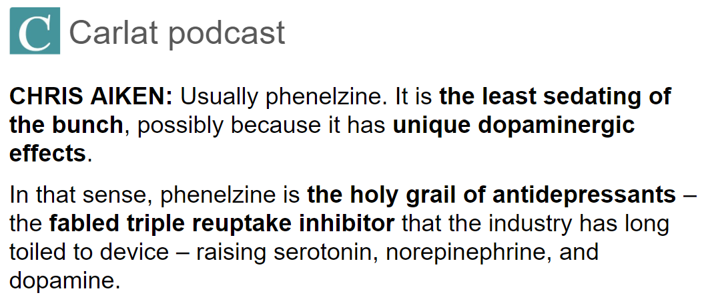
Monoamine Oxidase Inhibitors (MAOIs)
5-HT – serotonergic
NE – noradrenergic
DA – dopaminergic
*Selectivity is dose dependent. Above recommended doses, selective MAO-B inhibitors can also inhibit MAO-A.
MAOI | Use | Year | Cost/mo | 5-HT | NE | DA | MAO select- ivity | Dietary tyramine risk | Wt gain | Sed- ation | Anti- cholin ergic | Rever- sible?
Tranylcypromine (PARNATE) | MDD | 1961 | $240 | +++ | +++ | +++ | A & B | ++++ | - | low | low | no
Isocarboxazid (MARPLAN) | MDD | 1959 | $780 | +++ | +++ | +++ | A & B | ++++ | - | low | low | no
Phenelzine (NARDIL) | MDD | 1961 | $43 | +++ | +++ | +++ | A & B | ++++ | ++ | low | low | no
Selegiline transdermal (EMSAM) | MDD | 2006 | $1650 | ++ | ++ | +++ | (A) & B | ++ | loss | low | low | no
Selegiline PO (ELDEPRYL) | Parkinson’s | 1989 | $26 | ++ | ++ | +++ | B | + | loss | low | low | no
Rasagiline (AZILECT) | Parkinson’s | 2006 | $270 | ++ | ++ | +++ | B | + | loss | low | low | no
Safinamide (XADAGO) | Parkinson’s | 2017 | $780 | + | + | +++ | B | +/- | - | low | low | yes
*

Slide 48
Monoamine Oxidase Inhibitors (MAOIs)
5-HT – serotonergic
NE – noradrenergic
DA – dopaminergic
*Selectivity is dose dependent. Above recommended doses, selective MAO-B inhibitors can also inhibit MAO-A.
MAOI | Use | Year | Cost/mo | 5-HT | NE | DA | MAO select- ivity | Dietary tyramine risk | Wt gain | Sed- ation | Anti- cholin ergic | Rever- sible?
Tranylcypromine (PARNATE) | MDD | 1961 | $240 | +++ | +++ | +++ | A & B | ++++ | - | low | low | no
Isocarboxazid (MARPLAN) | MDD | 1959 | $780 | +++ | +++ | +++ | A & B | ++++ | - | low | low | no
Phenelzine (NARDIL) | MDD | 1961 | $43 | +++ | +++ | +++ | A & B | ++++ | ++ | low | low | no
Selegiline transdermal (EMSAM) | MDD | 2006 | $1650 | ++ | ++ | +++ | (A) & B | ++ | loss | low | low | no
Selegiline PO (ELDEPRYL) | Parkinson’s | 1989 | $26 | ++ | ++ | +++ | B | + | loss | low | low | no
Rasagiline (AZILECT) | Parkinson’s | 2006 | $270 | ++ | ++ | +++ | B | + | loss | low | low | no
Safinamide (XADAGO) | Parkinson’s | 2017 | $780 | + | + | +++ | B | +/- | - | low | low | yes
*

Slide 49
Monoamine Oxidase Inhibitors (MAOIs)
5-HT – serotonergic
NE – noradrenergic
DA – dopaminergic
*Selectivity is dose dependent. Above recommended doses, selective MAO-B inhibitors can also inhibit MAO-A.
MAOI | Use | Year | Cost/mo | 5-HT | NE | DA | MAO select- ivity | Dietary tyramine risk | Wt gain | Sed- ation | Anti- cholin ergic | Rever- sible?
Tranylcypromine (PARNATE) | MDD | 1961 | $240 | +++ | +++ | +++ | A & B | ++++ | - | low | low | no
Isocarboxazid (MARPLAN) | MDD | 1959 | $780 | +++ | +++ | +++ | A & B | ++++ | - | low | low | no
Phenelzine (NARDIL) | MDD | 1961 | $43 | +++ | +++ | +++ | A & B | ++++ | ++ | low | low | no
Selegiline transdermal (EMSAM) | MDD | 2006 | $1650 | ++ | ++ | +++ | (A) & B | ++ | loss | low | low | no
Selegiline PO (ELDEPRYL) | Parkinson’s | 1989 | $26 | ++ | ++ | +++ | B | + | loss | low | low | no
Rasagiline (AZILECT) | Parkinson’s | 2006 | $270 | ++ | ++ | +++ | B | + | loss | low | low | no
Safinamide (XADAGO) | Parkinson’s | 2017 | $780 | + | + | +++ | B | +/- | - | low | low | yes
*

Slide 50
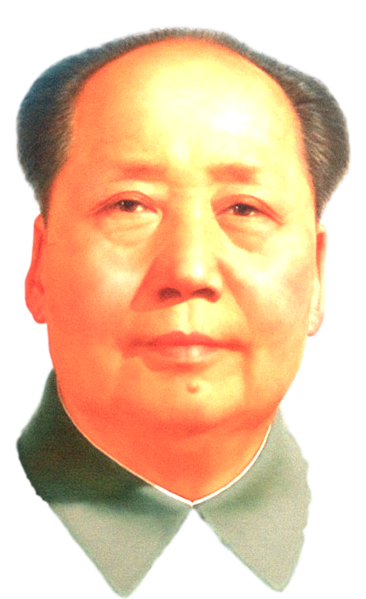
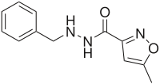
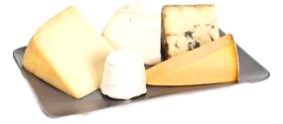
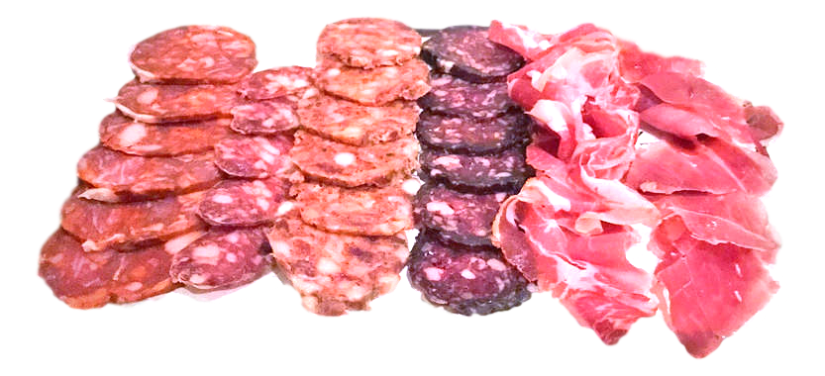
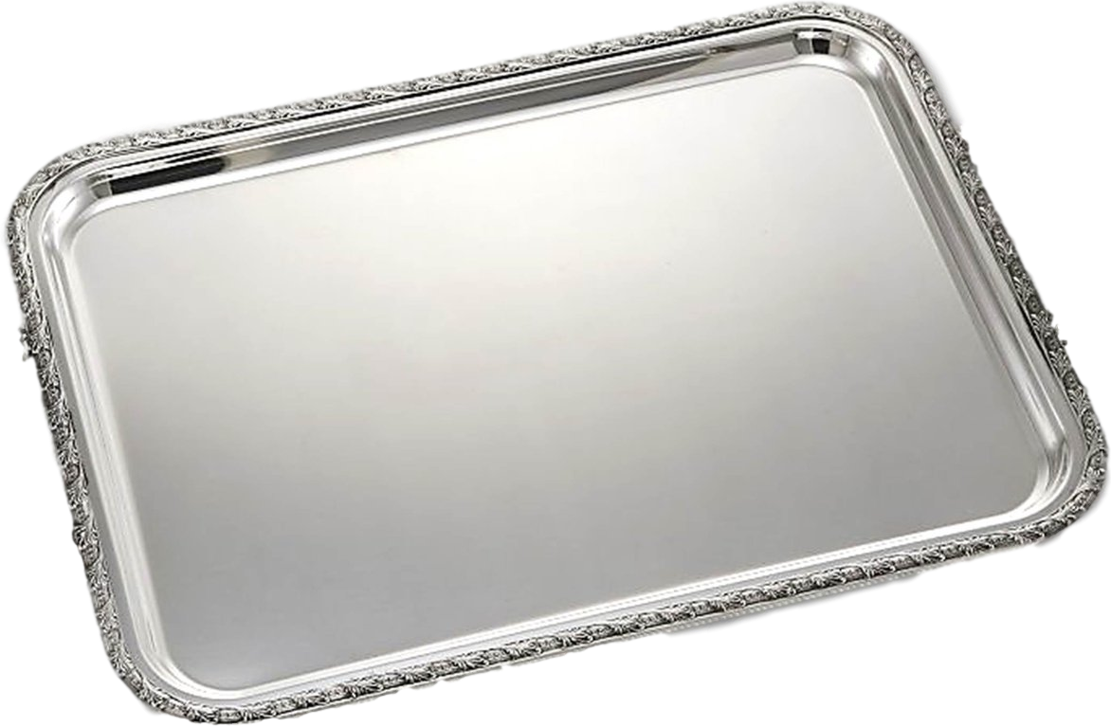
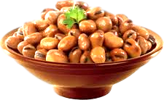
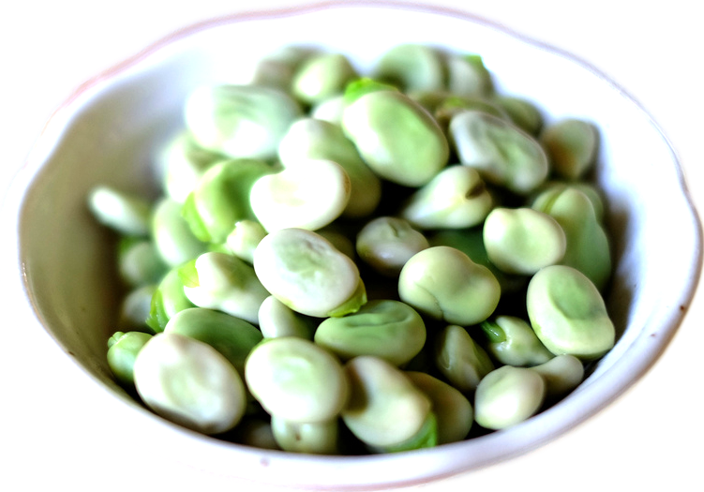
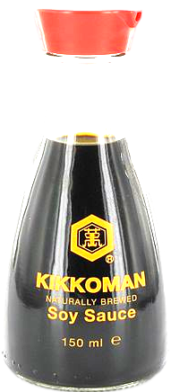
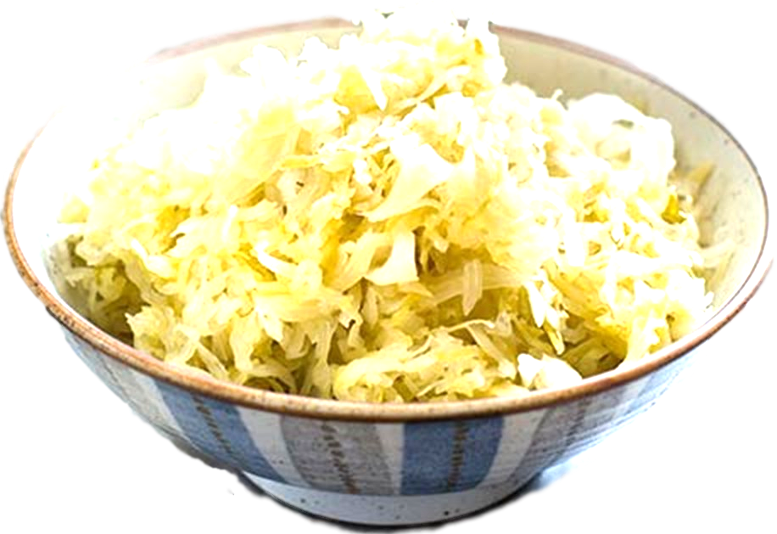
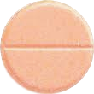
Isocarboxazid (MARPLAN)
eye so kar BOX a zid / MAR plan
“Ice box Mars plan”
1959
$262–$286
To Mars is the plan,
to escape depression.
❖ Monoamine Oxidase Inhibitor
– Irreversible MAOI
– MAO-A & MAO-B
– 5-HT > NE > DA
Must not eat:
aged cheese
cured meats
MAOI
fava beans
soy sauce, sauerkraut
wine
10
mg
Unpasteurized beer
(Bottled beer is usually OK,
draught beer often not OK).

Slide 51
Must not eat:
aged cheese
cured meats
fava beans
soy sauce, sauerkraut
wine
Unpasteurized beer
(Bottled beer is usually OK,
draught beer often not OK).
Tyramine—“tire rim”
Tyramine accumulates, causing hypertensive crisis.

Slide 52
Must not eat:
aged cheese
cured meats
fava beans
soy sauce, sauerkraut
wine
Unpasteurized beer
(Bottled beer is usually OK,
draught beer often not OK).
Tyramine—“tire rim”
Tyramine accumulates, causing hypertensive crisis.

Slide 53
“TIP”
The following information applies to all of
the non-selective MAO inhibitors used for
treatment of depression —”TIP”
► Tranylcypromine (PARNATE)
► Isocarboxazid (MARPLAN)
► Phenelzine (NARDIL)
Must not eat:
aged cheese
cured meats
fava beans
soy sauce, sauerkraut
wine
Unpasteurized beer
(Bottled beer is usually OK,
draught beer often not OK).
Tyramine—“tire rim”
Tyramine accumulates, causing hypertensive crisis.

Slide 54
Isocarboxazid
(MARPLAN)
The first MAOI
The least-prescribed of all available antidepressants.
FDA-approved for:
❖ Depression

Slide 55
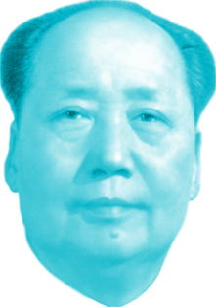
Isocarboxazid
(MARPLAN)
Dynamic interactions
❖ Serotonergic (strong) – contraindicated
with other serotonergics
❖ Blocks tyramine breakdown
(food interaction)
❖ Anticholinergic (mild)
❖ Hypertensive effects
Kinetic interactions
❖ None significant—“in a bubble”
FDA-approved for:
❖ Depression

Slide 56
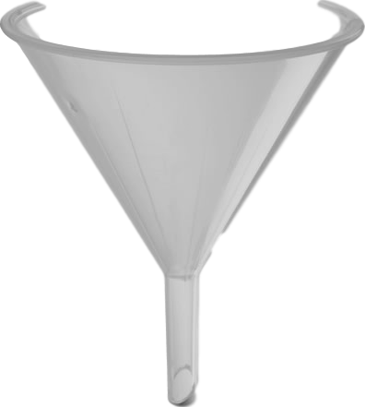
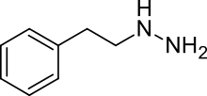
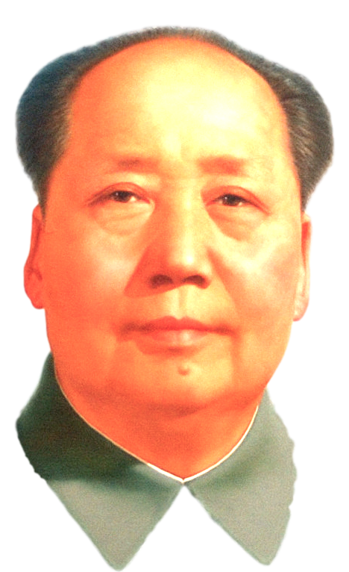
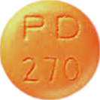
Phenelzine (NARDIL)
FEN el zeen / NAR dil
“Gnarly Funnel”
1961
$25–$86
❖ Monoamine Oxidase Inhibitor
– Irreversible MAOI
– MAO-A & MAO-B
– 5-HT > NE > DA
How could I be depressed with this (g)narly phunnel?
MAOI
15 mg

Slide 57
Phenelzine (NARDIL)
FEN el zeen / NAR dil
“Gnarly Funnel”
1961
$25–$86
❖ Monoamine Oxidase Inhibitor
– Irreversible MAOI
– MAO-A & MAO-B
– 5-HT > NE > DA
How could I be depressed with this (g)narly phunnel?
MAOI
15 mg

Slide 58
Phenelzine (NARDIL)
FEN el zeen / NAR dil
“Gnarly Funnel”
The MAOI with some weight gain
❖ Monoamine Oxidase Inhibitor
– Irreversible MAOI
– MAO-A & MAO-B
– 5-HT > NE > DA
Do I look phat?
How could I be depressed with this (g)narly phunnel?

Slide 59
Phenelzine (NARDIL)
FEN el zeen / NAR dil
“Gnarly Funnel”
The MAOI with some weight gain
Risk of mortality in single-drug overdose with MAOIs is similar to that of tricyclics.
❖ Monoamine Oxidase Inhibitor
– Irreversible MAOI
– MAO-A & MAO-B
– 5-HT > NE > DA
Do I look phat?
How could I be depressed with this (g)narly phunnel?

Slide 60
Phenelzine (NARDIL)
FEN el zeen / NAR dil
“Gnarly Funnel”
The MAOI with
some weight
gain
Of 392 single-drug exposures to phenelzine reported to Poison Control, there were 2 deaths (Nelson & Spyker, 2017).
❖ Monoamine Oxidase Inhibitor
– Irreversible MAOI
– MAO-A & MAO-B
– 5-HT > NE > DA
Do I look phat?
How could I be depressed with this (g)narly phunnel?

Slide 61
Phenelzine (NARDIL)
FEN el zeen / NAR dil
“Gnarly Funnel”
Dynamic interactions
❖ Serotonergic (strong) –
Contraindicated with
other serotonergics
❖ Blocks tyramine
breakdown
(food interaction)
❖ Anticholinergic (mild)
❖ Hypertensive effects
Kinetic interactions
❖ None significant
– “in a bubble”
❖ Monoamine Oxidase Inhibitor
– Irreversible MAOI
– MAO-A & MAO-B
– 5-HT > NE > DA
How could I be depressed with this (g)narly phunnel?

Slide 62
Phenelzine (NARDIL)
FEN el zeen / NAR dil
“Gnarly Funnel”
15 mg
❖ Monoamine Oxidase Inhibitor
– Irreversible MAOI
– MAO-A & MAO-B
– 5-HT > NE > DA
Dosing: Start 15 mg TID and rapidly increase to 30 mg TID (which is the maximum dose of 90 mg/day) then decrease slowly over several weeks to the lowest effective dose. Use lower dose with elderly patients. Taper slowly to stop.
How could I be depressed with this (g)narly phunnel?

Slide 63
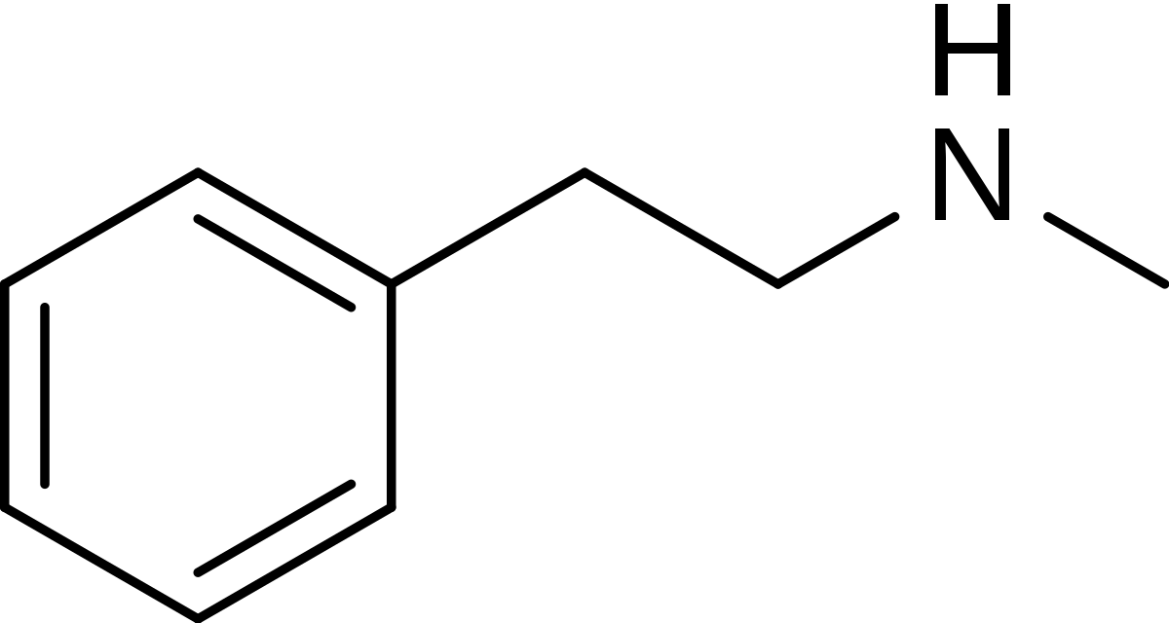
Phenelzine (NARDIL)
“Gnarly Funnel”
phenelzine
metabolized to
phenylethylamine
(produces effects similar to a short-acting methamphetamine)
methamphetamine

Slide 64
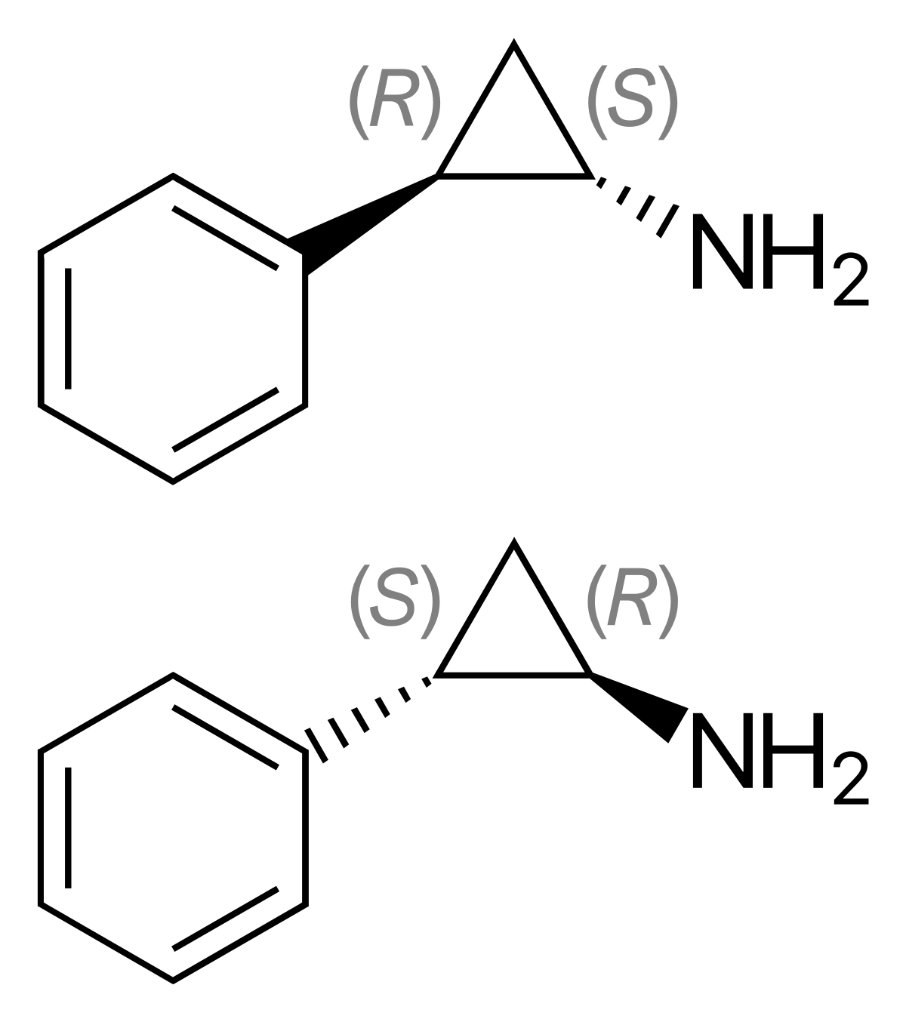
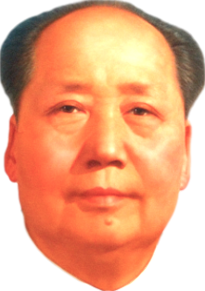
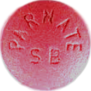
Tranylcypromine (PARNATE)
tran yl CY pro meen / PAR nate
“(Mao’s) Trans prom Partner”
1961
$187–$588
❖ Monoamine Oxidase Inhibitor
– Irreversible MAOI
– MAO-A & MAO-B
– DA & NE releaser
– 5-HT > NE > DA
It don’t matter that you’re short.
Short half-life (2.5 hr) but this is irrelevant because inhibition of MAO is irreversible
racemic mix
MAOI
10
mg

Slide 65
Tranylcypromine (PARNATE)
tran yl CY pro meen / PAR nate
“(Mao’s) Trans prom Partner”
Risk of serious outcome from a single-drug overdose of tranylcypromine is about 40%, which is one of the highest morbidity rate among antidepressants.
❖ Monoamine Oxidase Inhibitor
– Irreversible MAOI
– MAO-A & MAO-B
– DA & NE releaser
– 5-HT > NE > DA
It don’t matter that you’re short.
Short
Half-life
(2.5 hr)
but this is irrelevant because inhibition of MAO is irreversible

Slide 66
Tranylcypromine (PARNATE)
tran yl CY pro meen / PAR nate
“(Mao’s) Trans prom Partner”
Risk of serious outcome from a single-drug overdose of tranylcypromine is about 40%, which is one of the highest morbidity rate among antidepressants.
There were 1 deaths out of 330 single-drug overdoses (Nelson & Spyker, 2017).
❖ Monoamine Oxidase Inhibitor
– Irreversible MAOI
– MAO-A & MAO-B
– DA & NE releaser
– 5-HT > NE > DA
It don’t matter that you’re short.
Short
Half-life
(2.5 hr)
but this is irrelevant because inhibition of MAO is irreversible

Slide 67
Tranylcypromine (PARNATE)
tran yl CY pro meen / PAR nate
“(Mao’s) Trans prom Partner”
Risk of serious outcome from a single-drug overdose of tranylcypromine is about 40%, which is one of the highest morbidity rate among antidepressants.
There was 1
death out of 330 single-drug overdoses (Nelson & Spyker, 2017).
❖ Monoamine Oxidase Inhibitor
– Irreversible MAOI
– MAO-A & MAO-B
– DA & NE releaser
– 5-HT > NE > DA
It don’t matter that you’re short.
Short
Half-life
(2.5 hr)
but this is irrelevant because inhibition of MAO is irreversible

Slide 68
Tranylcypromine (PARNATE)
tran yl CY pro meen / PAR nate
“(Mao’s) Trans prom Partner”
Dynamic interactions
❖ Serotonergic (strong) –
Contraindicated with
other serotonergics
❖ Blocks tyramine
breakdown
(food interaction)
❖ Anticholinergic (mild)
❖ Hypertensive effects
Kinetic interactions
❖ None significant
– “in a bubble”
❖ Monoamine Oxidase Inhibitor
– Irreversible MAOI
– MAO-A & MAO-B
– DA & NE releaser
– 5-HT > NE > DA
It don’t matter that you’re short.
Short
Half-life
(2.5 hr)
but this is irrelevant because inhibition of MAO is irreversible

Slide 69
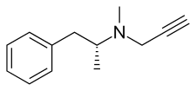
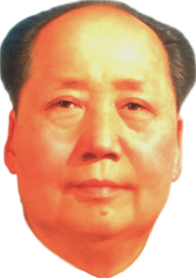
Selegiline (ELDEPRYL)
se LE ji leen / ELD e pril
“Elderly Seal’s gills”
1989
$41–$150
❖ Monoamine Oxidase Inhibitor
– MAO-B > MAO-A
– DA > NE > 5-HT
for Parkinson’s disease
Oral selegiline does not
inhibit MAO-A to the extent needed for antidepressant effect.
gills
MAOI
6
9
12
mg

Slide 70
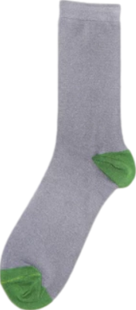
Selegiline (ELDEPRYL)
se LE ji leen / ELD e pril
“Elderly Seal’s gills”
Dynamic interactions
❖ Serotonergic (strong) –
Contraindicated with
other serotonergics
❖ Blocks tyramine
breakdown
(food interaction)
❖ Anticholinergic (mild)
❖ Hypertensive effects
Kinetic interactions
❖ 2B6 substrate (sock)
❖ Monoamine Oxidase Inhibitor
– MAO-B > MAO-A
– DA > NE > 5-HT
for Parkinson’s disease
Oral selegiline does not
inhibit MAO-A to the extent needed for antidepressant effect.
gills

Slide 71
Selegiline (ELDEPRYL)
se LE ji leen / ELD e pril
“Elderly Seal’s gills”
Dynamic interactions
❖ Serotonergic (strong) –
Contraindicated with
other serotonergics
❖ Blocks tyramine
breakdown
(food interaction)
❖ Anticholinergic (mild)
❖ Hypertensive effects
Kinetic interactions
❖ 2B6 substrate (sock)
❖ Monoamine Oxidase Inhibitor
– MAO-B > MAO-A
– DA > NE > 5-HT
for Parkinson’s disease
Oral selegiline does not
inhibit MAO-A to the extent needed for antidepressant effect.
gills

Slide 72
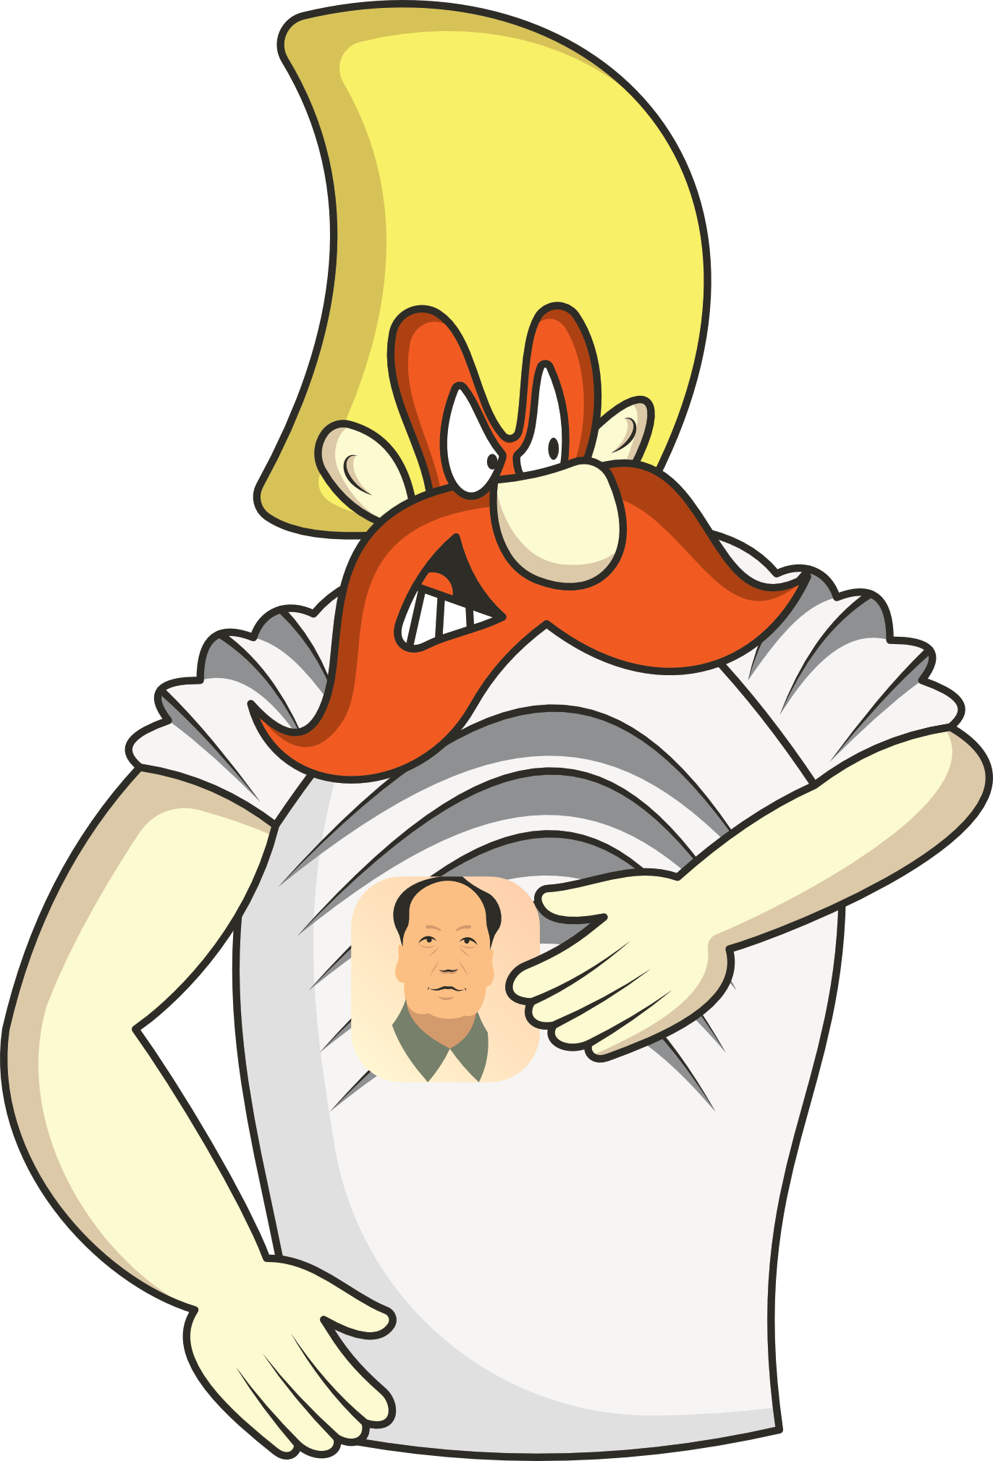
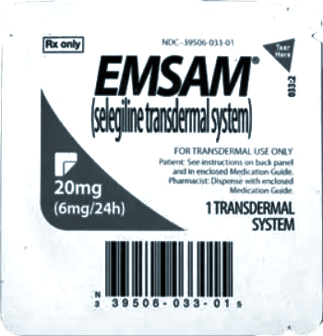
Selegiline transdermal (EMSAM)
se LE ji leen / EM sam
“YosEmite Sam Seals gills”
2006
$1,631–$1,925
❖ Monoamine Oxidase Inhibitor
– MAO-B > MAO-A
– DA > NE > 5-HT
MAOI
6
9
12
mg
Chairman Mao patch being used to seal his gills

Slide 73
Selegiline transdermal (EMSAM)
se LE ji leen / EM sam
“YosEmite Sam Seals gills”
2006
$1,631–$1,925
SAME
molecule as Eldepryl
❖ Monoamine Oxidase Inhibitor
– MAO-B > MAO-A
– DA > NE > 5-HT
=
MAOI
6
9
12
mg
Chairman Mao patch being used to seal his gills

Slide 74
selegiline
metabolized to
H
methamphetamine
(tiny amount)

Slide 75
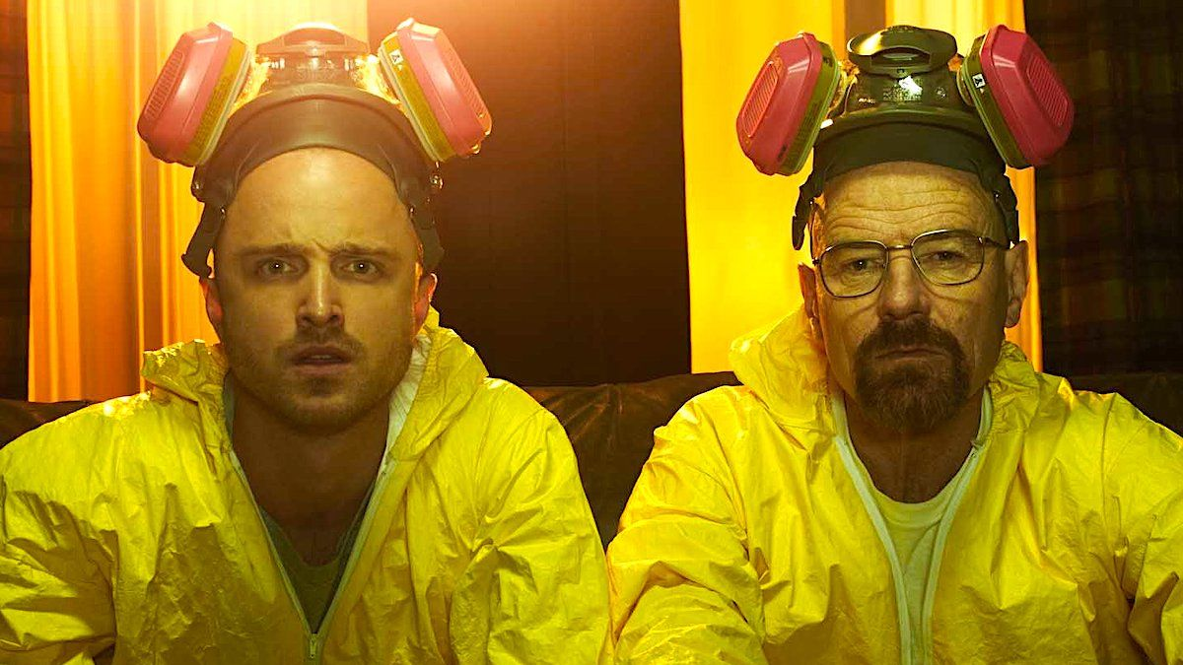
selegiline
metabolized to
methamphetamine
(tiny amount)
H
methamphetamine

Slide 76
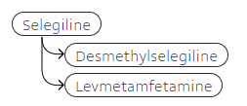
L-methamphetamine is a vasoconstrictor that is the active ingredient in some OTC nasal decongestants. Crosses BBB with some noradrenergic effects.
selegiline
metabolized to
methamphetamine
(tiny amount)
H
methamphetamine

Slide 77
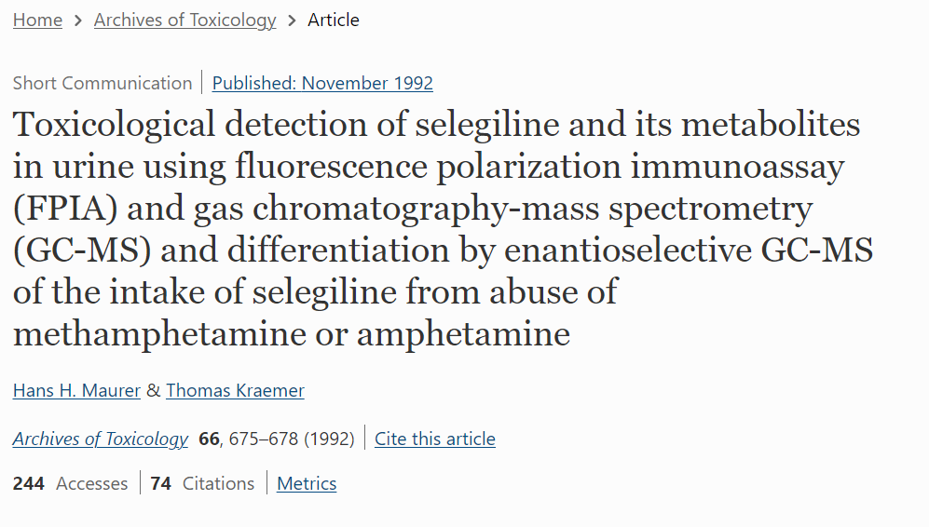
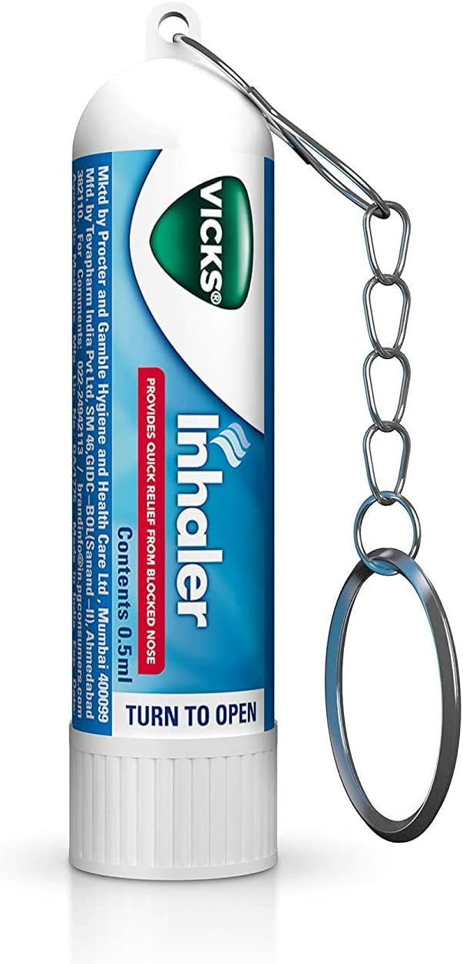
Selegiline and Vicks Vicks VapoInhaler may result in false positive meth tests.
Need enantioselective confirmatory test to distinguish.

Slide 78
Selegiline transdermal
(EMSAM)
Dynamic interactions
❖ Serotonergic (strong)
– contraindicated with other serotonergics
❖ Blocks tyramine breakdown (food interaction)
❖ Anticholinergic (mild)
❖ Hypertensive effects
Kinetic interactions
❖ 2B6 substrate (sock)
FDA-approved for:
❖ Depression
2B6 substrate

Slide 79
Cytochrome P450 2B6 (CYP2B6)
“Tube Socks”
inDucer
= Down
Decreased substrate levels
Induction onsets and reverses slowly = Delayed
-
2B6 substrate
2B6 inducer

Slide 80
-
CYP2B6
“Tube Socks”
inHibitor = High
Increased substrate levels
InHibition happens within Hours = Hurried and reverses as soon as the inhibitor is cleared from the body (five half-lives of the inhibitor)
stretched sock
increased substrate levels
2B6 inhibitor
2B6 substrate

Slide 81
2B6 inDucers
Phenobarbital
LUMINAL
Carbamazepine
TEGRETOL
Rifampin
RIFADIN
Phenytoin
DILANTIN
Nevirapine
VIRAMUNE

Slide 82
2B6 inHibitors
moderate
inhibitor
weak
inhibitor
Orphenadrine
NORFLEX
Clopidogrel
PLAVIX
spasmolytic
antiplatelet

Slide 83
2B6 Substrates
Antidepressants
SSRI
NDRI
MAOI
Bupropion
WELLBUTRIN
Selegiline
ELDEPRYL, EMSAM
Zoloft
SERTRALINE

Slide 84
2B6 Substrates
Ketamine
KETALAR
Methadone
DOLOPHINE
NMDA antagonist
(parenteral anaesthetic)
opioid
Esketamine
SPRAVATO
Propofol
DIPRIVAN
NMDA antagonist
(intranasal for depression)
anaesthetic

Slide 85
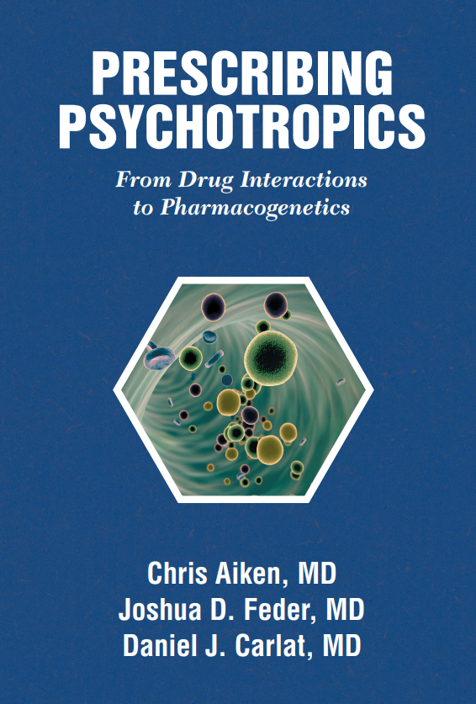
EMSAM: A Safer MAOI?
MAO-B is not involved in depression, so oral selegiline’s antidepressant effects don’t kick in until the dose gets high enough for its inhibitor effects to spread to MAO-A (around 30 mg/day of oral selegiline).
At that dose, it also inhibits MAO-A in the gut and requires the same dietary precautions as traditional MAOIs.

Slide 86
EMSAM: A Safer MAOI?
The medication passes directly into the bloodstream through the skin,
bypassing the liver and GI tract.
This, in turn, yields two metabolic benefits.
First, because transdermal selegiline’s concentration in the GI tract is much lower than the oral version, there is less inhibition of dietary tyramine’s metabolism, and so less concern about dietary restrictions.

Slide 87
EMSAM: A Safer MAOI?
Second, because there is no first-pass effect through the liver, a relatively low amount of selegiline can provide therapeutic concentrations in the brain, minimizing systemic side effects
(9 mg/day of transdermal selegiline equates to 30 mg/day of oral selegiline).

Slide 88
EMSAM: A Safer MAOI?
What all this means is that EMSAM does not require any dietary restric- tions, but only at the starting dose of 6 mg/day.
At the higher doses of 9 and 12 mg/day, all the usual restrictions apply, because at these doses enough of the medication gets into the gut to inhibit the metabolism of tyramine.

Slide 89
EMSAM: A Safer MAOI?
However…

Slide 90
EMSAM: A Safer MAOI?
However, if you take a look at the raw data used by the FDA to make these crucial dosing decisions, you come away with the sense that they were extremely cautious…

Slide 91
EMSAM: A Safer MAOI?
However, if you take a look at the raw data used by the FDA to make these crucial dosing decisions, you come away with the sense that they were extremely cautious, and that in fact the 9 mg dose is likely to be quite safe without dietary restrictions.

Slide 92
EMSAM: A Safer MAOI?
However, if you take a look at the raw data used by the FDA to make these crucial dosing decisions, you come away with the sense that they were extremely cautious, and that in fact the 9 mg dose is likely to be quite safe without dietary restrictions.
In clinical practice, this means you can be somewhat less insistent that patients follow their MAOI diet when they are on EMSAM 9 mg than if they are on the highest dose, 12 mg.

Slide 93
EMSAM: A Safer MAOI?
To increase the confusion, the entire discussion above applies only to
MAOI food interactions and not MAOI drug interactions.

Slide 94
EMSAM: A Safer MAOI?
To increase the confusion, the entire discussion above applies only to
MAOI food interactions and not MAOI drug interactions.
EMSAM is considered dangerous to combine with serotonergic drugs at all doses, including the 6 mg dose.

Slide 95
EMSAM: A Safer MAOI?
To increase the confusion, the entire discussion above applies only to
MAOI food interactions and not MAOI drug interactions.
EMSAM is considered dangerous to combine with serotonergic drugs at all doses, including the 6 mg dose.
This is because these drug interactions have nothing to do with tyramine and generally involve excessive serotonin.

Slide 96
EMSAM: A Safer MAOI?
However…

Slide 97
EMSAM: A Safer MAOI?
However, since EMSAM was released, there have been many cases of patients taking supposedly forbidden medications…

Slide 98
EMSAM: A Safer MAOI?
However, since EMSAM was released, there have been many cases of patients taking supposedly forbidden medications without suffering serotonin syndrome.
So, is EMSAM a safer MAOI?

Slide 99
EMSAM: A Safer MAOI?
However, since EMSAM was released, there have been many cases of patients taking supposedly forbidden medications without suffering serotonin syndrome.
So, is EMSAM a safer MAOI? Probably so, and as we gain more experience using it, we’ll all likely become more comfortable with it.

Slide 100
Carlat podcast
Hypertensive crisis with MAOIs
Risk of cardiovascular death, e.g., stroke
Signs:

Slide 101
Carlat podcast
Hypertensive crisis with MAOIs
Risk of cardiovascular death, e.g., stroke
Signs:
headache
blurry vision
chest pain

Slide 102
Hypertensive crisis with MAOIs, in perspective…

Slide 103
Hypertensive crisis with MAOIs
In the first few years after MAOIs were introduced, nobody knew of their dietary interactions.

Slide 104
Hypertensive crisis with MAOIs
In the first few years after MAOIs were introduced, nobody knew of their dietary interactions.
Then in 1961, a case report was published in The Lancet of a woman who died of a subarachnoid hemorrhage while taking tranylcypromine (Parnate), but clinicians were slow to blame tranylcypromine.

Slide 105
Hypertensive crisis with MAOIs
In the first few years after MAOIs were introduced, nobody knew of their dietary interactions.
Then in 1961, a case report was published in The Lancet of a woman who died of a subarachnoid hemorrhage while taking tranylcypromine (Parnate), but clinicians were slow to blame tranylcypromine.
couple
Parnate was released in 1961.
The first MAOI, isocarboxazid, released in 1959.

Slide 106
Hypertensive crisis with MAOIs
In the first few years after MAOIs were introduced, nobody knew of their dietary interactions.
Then in 1961, a case report was published in The Lancet of a woman who died of a subarachnoid hemorrhage while taking tranylcypromine (Parnate), but clinicians were slow to blame tranylcypromine.
It took a psychiatric resident to save the day...

Slide 107
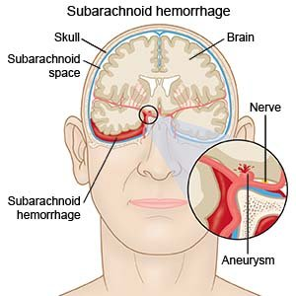
Hypertensive crisis with MAOIs
Barry Blackwell, who was training at the Maudsley Hospital in London at the time, began reading
about sporadic cases of high blood pressure, headache, and subarachnoid hemorrhage in patients taking MAOIs.

Slide 108
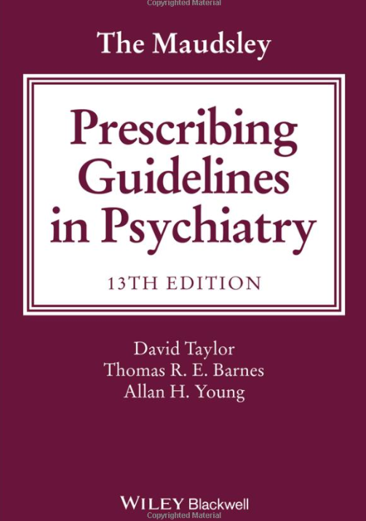
Hypertensive crisis with MAOIs
Barry Blackwell, who was training at the Maudsley Hospital in London at the time, began reading
about sporadic cases of high blood pressure, headache, and subarachnoid hemorrhage in patients taking MAOIs.

Slide 109
Hypertensive crisis with MAOIs
A pharmacist told Blackwell that the
pharmacist’s wife, who was taking an MAOI, had developed two episodes of hypertension and headache after eating cheese. Intrigued, Blackwell
and a colleague experimented on themselves. They took tranylcypromine for a week, then gorged on cheese…

Slide 110
Hypertensive crisis with MAOIs
…They felt perfectly fine. Nonetheless, Blackwell consulted on several cases where patients taking MAOIs developed hypertensive headaches after eating cheese sandwiches.

Slide 111
Hypertensive crisis with MAOIs
…They felt perfectly fine. Nonetheless, Blackwell consulted on several cases where patients taking MAOIs developed hypertensive headaches after eating cheese sandwiches.
He published his suspicions in Lancet in 1963, but it still took some time before a skeptical medical community took this MAOI-cheese connection
seriously, partly because there was no known mechanism to explain it.
Parnate was released in 1961.
The first MAOI, isocarboxazid, released in 1959.

Slide 112
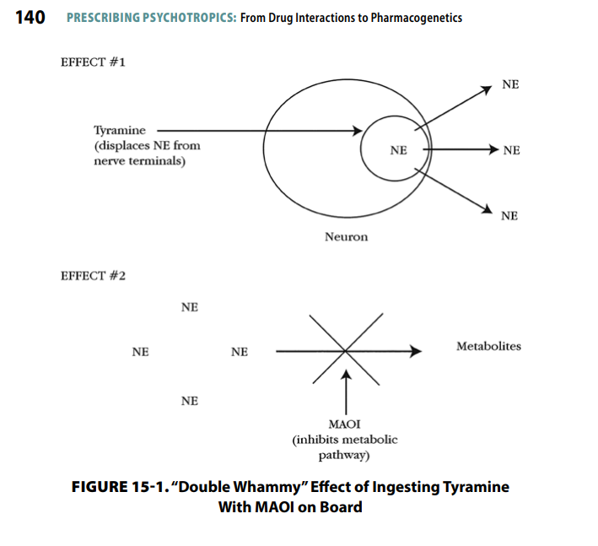
tyramine, acting as an independent false neurotransmitter, displaces norepinephrine from nerve terminals

Slide 113
Hypertensive crisis with MAOIs
This story affords some perspective on the dangers of MAOI interactions.

Slide 114
Hypertensive crisis with MAOIs
This story affords some perspective on the dangers of MAOI interactions.
MAOIs were prescribed frequently for several years…

Slide 115
Hypertensive crisis with MAOIs
This story affords some perspective on the dangers of MAOI interactions.
MAOIs were prescribed frequently for several years by physicians who had no knowledge of their possible drug or food interactions…

Slide 116
Hypertensive crisis with MAOIs
This story affords some perspective on the dangers of MAOI interactions.
MAOIs were prescribed frequently for several years by physicians who had no knowledge of their possible drug or food interactions, and yet the rate of fatal reactions was extremely low.

Slide 117
MAOI side effects are generally fairly tolerable: insomnia or sedation, orthostatic dizziness, lowered libido, and occasional weight gain.
What variety of depression?

Slide 118
MAOI side effects are generally fairly tolerable: insomnia or sedation, orthostatic dizziness, lowered libido, and occasional weight gain.
When no dangerous interactions enter the equation, MAOIs are tolerated better than tricyclic antidepressants

Slide 119
MAOI side effects are generally fairly tolerable: insomnia or sedation, orthostatic dizziness, lowered libido, and occasional weight gain.
When no dangerous interactions enter the equation, MAOIs are tolerated better than tricyclic antidepressants and a bit worse than selective serotonin reuptake inhibitors (SSRIs),

Slide 120
MAOI side effects are generally fairly tolerable: insomnia or sedation, orthostatic dizziness, lowered libido, and occasional weight gain.
When no dangerous interactions enter the equation, MAOIs are tolerated better than tricyclic antidepressants and a bit worse than selective serotonin reuptake inhibitors (SSRIs), and they are considered by some authorities to be more effective than either tricyclics or SSRIs for…
depression with atypical features (overeating, oversleeping, and leaden paralysis).
What variety of depression?

Slide 121
MAOI side effects are generally fairly tolerable: insomnia or sedation, orthostatic dizziness, lowered libido, and occasional weight gain.
When no dangerous interactions enter the equation, MAOIs are tolerated better than tricyclic antidepressants and a bit worse than selective serotonin reuptake inhibitors (SSRIs), and they are considered by some authorities to be more effective than either tricyclics or SSRIs for…
depression with atypical features (overeating, oversleeping, and leaden paralysis).

Slide 122
MAOI side effects are generally fairly tolerable: insomnia or sedation, orthostatic dizziness, lowered libido, and occasional weight gain.
When no dangerous interactions enter the equation, MAOIs are tolerated better than tricyclic antidepressants and a bit worse than selective serotonin reuptake inhibitors (SSRIs), and they are considered by some authorities to be more effective than either tricyclics or SSRIs for…
depression with atypical features (overeating, oversleeping, and leaden paralysis).

Slide 123
MAOI side effects are generally fairly tolerable: insomnia or sedation, orthostatic dizziness, lowered libido, and occasional weight gain.
When no dangerous interactions enter the equation, MAOIs are tolerated better than tricyclic antidepressants and a bit worse than selective serotonin reuptake inhibitors (SSRIs), and they are considered by some authorities to be more effective than either tricyclics or SSRIs for…
depression with atypical features (overeating, oversleeping, and leaden paralysis).

Slide 124
MAOI side effects are generally fairly tolerable: insomnia or sedation, orthostatic dizziness, lowered libido, and occasional weight gain.
When no dangerous interactions enter the equation, MAOIs are tolerated better than tricyclic antidepressants and a bit worse than selective serotonin reuptake inhibitors (SSRIs), and they are considered by some authorities to be more effective than either tricyclics or SSRIs for…
depression with atypical features (overeating, oversleeping, and leaden paralysis).

Slide 125
ATYPICAL DEPRESSION
“Leaden paralysis”

Slide 126
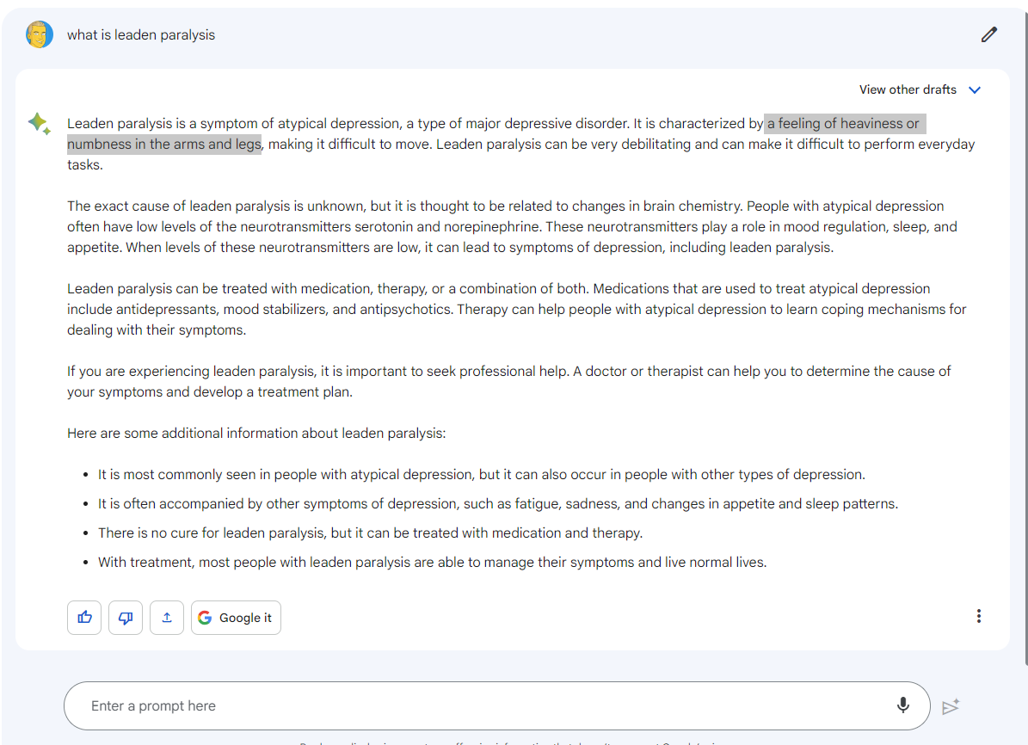

Slide 127
but not so heavy to stop you from overeating

Slide 128
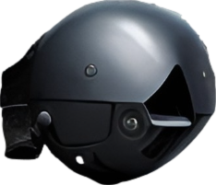
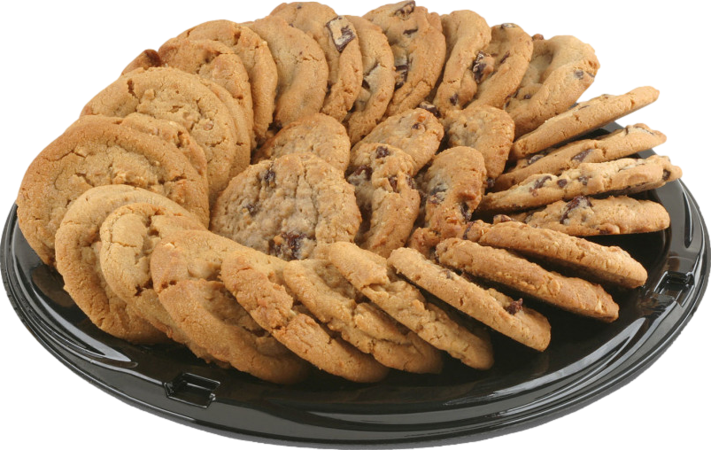
ATYPICAL DEPRESSION
“Leaden paralysis”
Overeating & oversleeping

Slide 129
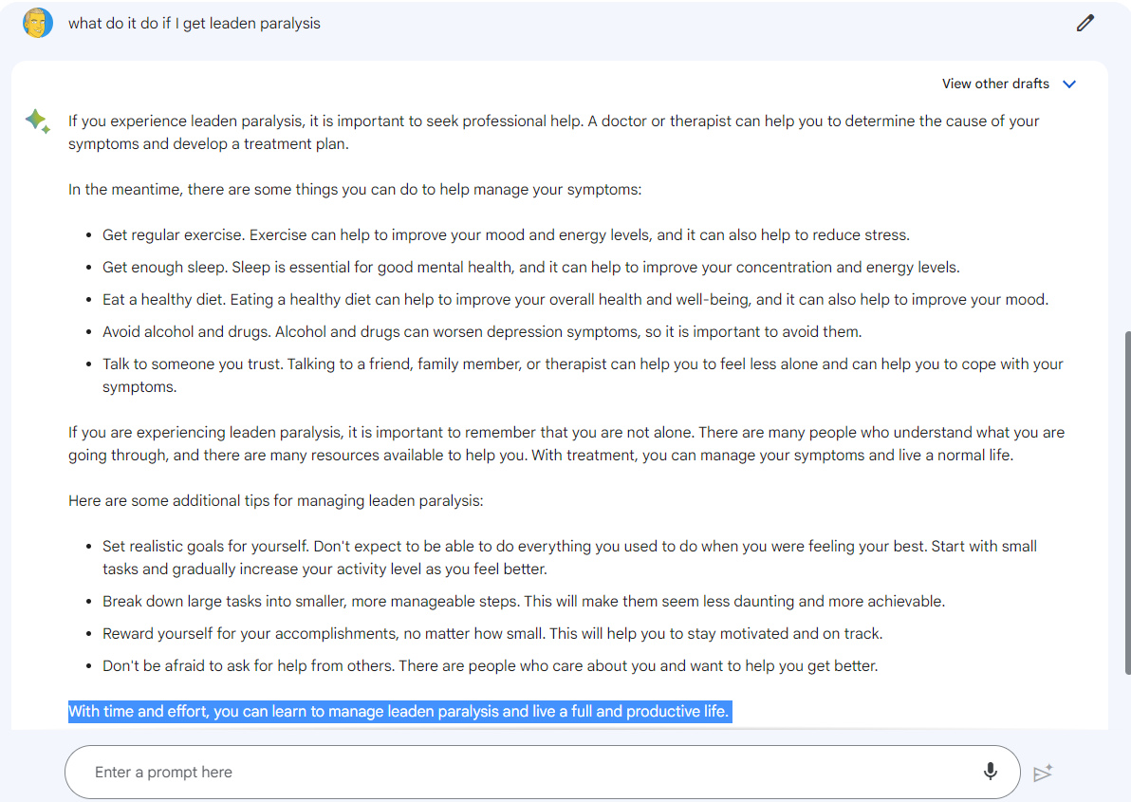
ask your doctor for an MAOI

Slide 130
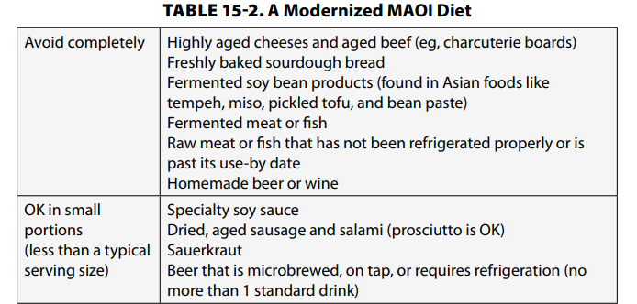

Slide 135
“TIP”
Must not eat:
aged cheese
cured meats
fava beans
soy sauce, sauerkraut
wine
Unpasteurized beer
(Bottled beer is usually OK,
draught beer often not OK).
Tyramine accumulates, causing hypertensive crisis.

Slide 136
“TIP”
Must not eat:
aged cheese
cured meats
fava beans
soy sauce, sauerkraut
wine
Unpasteurized beer
(Bottled beer is usually OK,
draught beer often not OK).
Tyramine accumulates, causing hypertensive crisis.

Slide 137
Carlat podcast
Serotonin Syndrome
“Shaking, Sweaty, and Confused”
tremor, restless, twitching
fever and sweats
delirious, unresponsive

Slide 138
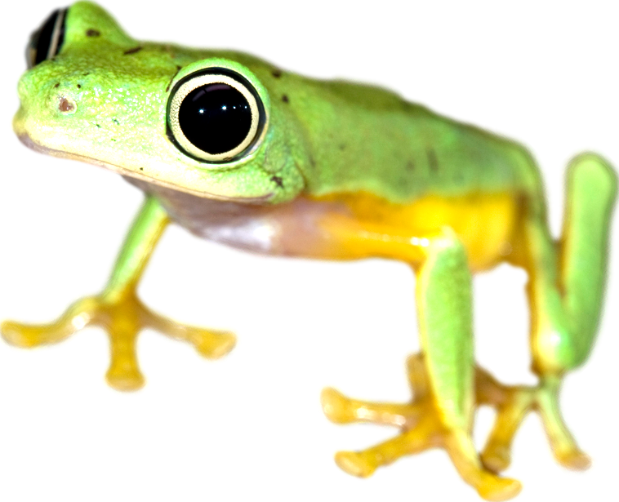
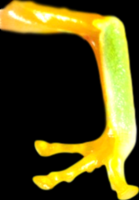
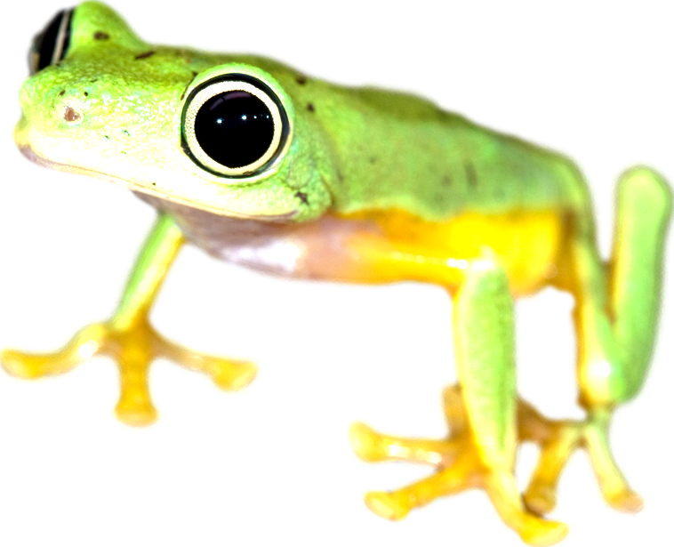
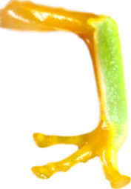
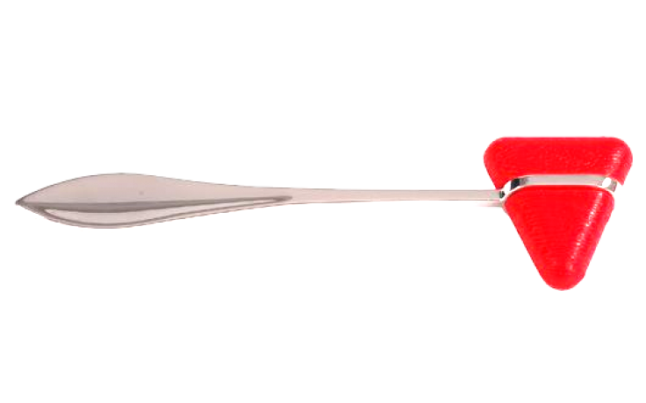
Serotonin Syndrome (5-HT Toxicity)
“Twitchy frog”
Dilated pupils 30%
5-HT
Agitation
Sweating
Hyperreflexia
Fever
45%

Slide 139
Carlat podcast
Dr Aiken:
Google MAOI drug interactions and it can seem like nearly every medication causes problems.

Slide 140
Carlat podcast
Dr Aiken:
Google MAOI drug interactions and it can seem like nearly every medication causes problems.
But some of those warnings may be unwarranted. Some meds got warnings early on, based on theoretical risks, meds like carbamazepine – whose resembles a tricyclic antidepressant - and the triptans for migraines.

Slide 141
Carlat podcast
Dr Aiken:
Google MAOI drug interactions and it can seem like nearly every medication causes problems.
But some of those warnings may be unwarranted. Some meds got warnings early on, based on theoretical risks, meds like carbamazepine – whose resembles a tricyclic antidepressant - and the triptans for migraines.
The triptans are serotonergic but do not act on the serotonin receptors involved in serotonin syndrome.

Slide 142
Carlat podcast
Dr Aiken:
Google MAOI drug interactions and it can seem like nearly every medication causes problems.
But some of those warnings may be unwarranted. Some meds got warnings early on, based on theoretical risks, meds like carbamazepine – whose resembles a tricyclic antidepressant - and the triptans for migraines.
The triptans are serotonergic but do not act on the serotonin receptors involved in serotonin syndrome.
Large epidemiologic studies have not found increased rates of serotonin syndrome with these combinations.

Slide 143
Carlat podcast
Dr Aiken:
For our book Prescribing Psychotropics we gathered an up-to-date list of meds to avoid with MAOIs.

Slide 144
Carlat podcast
Dr Aiken:
For our book Prescribing Psychotropics we gathered an up-to-date list of meds to avoid with MAOIs.
It includes all the SSRIs and SNRIs, the MAOIs, vortioxetine, vilazodone, the tricyclics – mainly clomipramine and imipramine; possibly trazodone and nefazodone; ketamine, esketamine, and possibly lithium and buspirone.

Slide 145
Carlat podcast
KELLIE NEWSOME:
We have to say “possibly” on some of these because clinical studies are not exactly possible to conduct here.
The list also includes an antipsychotic – ziprasidone – which is a serotonin 1A agonist with a track record for triggering serotonin syndrome in case reports.

Slide 146
Carlat podcast
KELLIE NEWSOME:
We have to say “possibly” on some of these because clinical studies are not exactly possible to conduct here.
The list also includes an antipsychotic – ziprasidone – which is a serotonin 1A agonist with a track record for triggering serotonin syndrome in case reports.

Slide 147
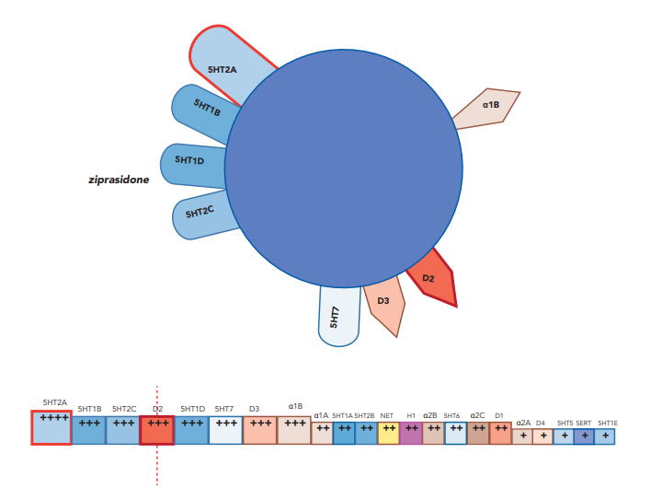
“5HT1A agonist”
Stahl’s Essential Psychopharmacology, 5th Edition, Page 224 ziprasidone

Slide 148
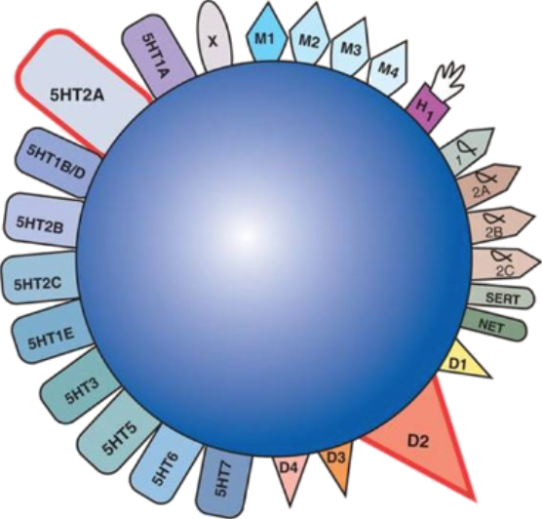
“5HT1A agonist”
Stahl’s Essential Psychopharmacology, 5th Edition, Page 224 ziprasidone

Slide 149
“5HT1A agonist”
Stahl’s Essential Psychopharmacology, 5th Edition, Page 224 ziprasidone

Slide 150
“5HT1A agonist”
Stahl’s Essential Psychopharmacology, 5th Edition, Page 224 ziprasidone

Slide 151
“5HT1A agonist”
Stahl’s Essential Psychopharmacology, 5th Edition, Page 224 ziprasidone

Slide 152
“5HT1A agonist”
Stahl’s Essential Psychopharmacology, 5th Edition, Page 224 ziprasidone

Slide 153
“5HT1A agonist”
Stahl’s Essential Psychopharmacology, 5th Edition, Page 224 ziprasidone

Slide 154
“5HT1A agonist”
Stahl’s Essential Psychopharmacology, 5th Edition, Page 224 ziprasidone

Slide 155
“5HT1A agonist”
Stahl’s Essential Psychopharmacology, 5th Edition, Page 224 ziprasidone

Slide 156
“5HT1A agonist”
Stahl’s Essential Psychopharmacology, 5th Edition, Page 224 ziprasidone

Slide 157
“5HT1A agonist”
Stahl’s Essential Psychopharmacology, 5th Edition, Page 224 ziprasidone

Slide 158
“5HT1A agonist”
Stahl: "As with all agents discussed, binding properties vary greatly with technique and from one laboratory to another; they are constantly being revised and updated".
Stahl’s Essential Psychopharmacology, 5th Edition, Page 224 ziprasidone

Slide 159
“5HT1A agonist”

Slide 160
Vilazodone (Viibryd)
5HT1A partial agonist
?
Buspirone
BUSPAR
Notes:
MOVING ON to VENLAFAXINE, which is more likely to be effective for severe depression -- Effexor is INDEED effective.

Slide 161
Vilazodone (Viibryd)
5HT1A partial agonist
Buspirone
BUSPAR
Notes:
MOVING ON to VENLAFAXINE, which is more likely to be effective for severe depression -- Effexor is INDEED effective.

Slide 162
Vilazodone (Viibryd)
5HT1A partial agonist
SSRI
?
Buspirone
BUSPAR
LEXAPRO
Notes:
MOVING ON to VENLAFAXINE, which is more likely to be effective for severe depression -- Effexor is INDEED effective.

Slide 163
Vilazodone (Viibryd)
5HT1A partial agonist
SSRI
Buspirone
BUSPAR
LEXAPRO
Notes:
MOVING ON to VENLAFAXINE, which is more likely to be effective for severe depression -- Effexor is INDEED effective.

Slide 164
Vilazodone (Viibryd)
5HT1A partial agonist
SSRI
+
=
Buspirone
BUSPAR
LEXAPRO
Notes:
MOVING ON to VENLAFAXINE, which is more likely to be effective for severe depression -- Effexor is INDEED effective.

Slide 165
Vilazodone (Viibryd)
5HT1A partial agonist
SSRI
+
=
?
Buspirone
BUSPAR
LEXAPRO
Vilazodone
VIIBRYD
Notes:
MOVING ON to VENLAFAXINE, which is more likely to be effective for severe depression -- Effexor is INDEED effective.

Slide 166
Vilazodone (Viibryd)
5HT1A partial agonist
SSRI
Serotonin Modulator & Stimulator (SMS)
+
=
?
Buspirone
BUSPAR
LEXAPRO
Vilazodone
VIIBRYD
Notes:
MOVING ON to VENLAFAXINE, which is more likely to be effective for severe depression -- Effexor is INDEED effective.

Slide 167
Vilazodone (Viibryd)
5HT1A partial agonist
SSRI
Serotonin Modulator & Stimulator (SMS)
+
=
Buspirone
BUSPAR
LEXAPRO
Vilazodone
VIIBRYD
“hybrid”
Notes:
MOVING ON to VENLAFAXINE, which is more likely to be effective for severe depression -- Effexor is INDEED effective.

Slide 168
“5HT1A agonist”
Stahl’s Essential Psychopharmacology, 5th Edition, Page 224 ziprasidone

Slide 169
“5HT1A agonist”
D2 antagonist
Stahl’s Essential Psychopharmacology, 5th Edition, Page 224 ziprasidone

Slide 170
2nd gen Antipsychotic
5HT2A antagonist
“5HT1A agonist”
D2 antagonist
Stahl’s Essential Psychopharmacology, 5th Edition, Page 224 ziprasidone

Slide 171
2nd gen Antipsychotic
5HT2A antagonist
5HT2A antagonist
“5HT1A agonist”
D2 antagonist
Stahl’s Essential Psychopharmacology, 5th Edition, Page 224 ziprasidone

Slide 172
5HT2A antagonist
D2 antagonist

Slide 173
5HT2A antagonist
D2 antagonist
Stahl’s Essential Psychopharmacology, 5th Edition, Page 217 clozapine

Slide 174
5HT2A antagonist
D2 antagonist
Stahl’s Essential Psychopharmacology, 5th Edition, Page 218 olanzapine

Slide 175
5HT2A antagonist
D2 antagonist
Stahl’s Essential Psychopharmacology, 5th Edition, Pages 219-220 quetiapine

Slide 176
5HT2A antagonist
D2 antagonist
Stahl’s Essential Psychopharmacology, 5th Edition, Page 220 asenapine

Slide 177
5HT2A antagonist
D2 antagonist
Stahl’s Essential Psychopharmacology, 5th Edition, Page 222 risperidone

Slide 178
5HT2A antagonist
D2 antagonist
Stahl’s Essential Psychopharmacology, 5th Edition, Page 223 paliperidone

Slide 179
5HT2A antagonist
D2 antagonist
Stahl’s Essential Psychopharmacology, 5th Edition, Page 226 lurasidone

Slide 180
5HT2A antagonist
D2 antagonist
Stahl’s Essential Psychopharmacology, 5th Edition, Page 227 lumateperone

Slide 181
5HT2A antagonist
D2 partial agonist
Stahl’s Essential Psychopharmacology, 5th Edition, Page 229 aripiprazole

Slide 182
5HT2A antagonist
D2 partial agonist
Stahl’s Essential Psychopharmacology, 5th Edition, Page 230 brexpiprazole

Slide 183
5HT2A antagonist
D2 partial agonist
Stahl’s Essential Psychopharmacology, 5th Edition, Page 231 cariprazine

Slide 184
I think this is a typo. Should be 5HT2A?
D2 antagonist
no 5HT2A here
Stahl’s Essential Psychopharmacology, 5th Edition, Page 225 iloperidone

Slide 185
no D2 here
Stahl’s Essential Psychopharmacology, 5th Edition, Page 231 pimavanserin

Slide 186
5HT2A antagonist
“5HT1A agonist”
D2 antagonist
Stahl’s Essential Psychopharmacology, 5th Edition, Page 224 ziprasidone

Slide 187
5HT2A antagonist
“5HT1A agonist”
D2 antagonist
Stahl’s Essential Psychopharmacology, 5th Edition, Page 224 ziprasidone

Slide 188
5HT1A partial agonist
Stahl’s Essential Psychopharmacology, 5th Edition, Page 229 aripiprazole

Slide 189
5HT1A partial agonist
Stahl’s Essential Psychopharmacology, 5th Edition, Page 230 brexpiprazole

Slide 190
5HT1A partial agonist
Stahl’s Essential Psychopharmacology, 5th Edition, Page 231 cariprazine

Slide 191
5HT1A partial agonist
D2 antagonist
Stahl’s Essential Psychopharmacology, 5th Edition, Page 217 clozapine

Slide 192
5HT1A agonist
From Stahl’s visuals, you would think lurasidone is more concerning for serotonin syndrome than ziprasidone.
Stahl’s Essential Psychopharmacology, 5th Edition, Page 226 lurasidone

Slide 193
The one case of serotonin syndrome I saw implicated quetiapine (Seroquel)
Stahl’s Essential Psychopharmacology, 5th Edition, Pages 219-220 quetiapine

Slide 197
Carlat podcast
CHRIS AIKEN:
Stimulants are included – these meds not only raise serotonin but like cheese can also cause a hypertensive crisis.

Slide 198
Carlat podcast
CHRIS AIKEN:
Stimulants are included – these meds not only raise serotonin but like cheese can also cause a hypertensive crisis.
Then there are some opioids with serotonergic effects, a few odds and ends like fenfluramine, and other-the-counter meds like L-tryptophan, SAMe, St. John’s wort, and decongestants containing phenylephrine, pseudoephedrine, dextromethorphan, or chlorpheniramine;

Slide 199
Carlat podcast
CHRIS AIKEN:
Stimulants are included – these meds not only raise serotonin but like cheese can also cause a hypertensive crisis.
Then there are some opioids with serotonergic effects, a few odds and ends like fenfluramine, and other-the-counter meds like L-tryptophan, SAMe, St. John’s wort, and decongestants containing phenylephrine, pseudoephedrine, dextromethorphan, or chlorpheniramine; as well as recreational drugs like cocaine, amphetamines, LSD, MDMA, ecstasy, and bath salts.

Slide 200
Carlat podcast
KELLIE NEWSOME:
The bulk of those medicines are antidepressants, which presents a challenge when starting MAOIs cause you have to get them off their old antidepressant first to avoid these drug interactions.
Technically, it takes 5 half-lives for a med to clear the system, but just because it’s out of the blood stream doesn’t mean it’s pharmacodynamic effects in the brain have settled down.
So add a little buffer. For most meds, 5 half lives is 5 days, so we’d wait at least 7 days after stopping it before starting the MAOI.

Slide 201
Carlat podcast
KELLIE NEWSOME:
The bulk of those medicines are antidepressants, which presents a challenge when starting MAOIs cause you have to get them off their old antidepressant first to avoid these drug interactions.
Technically, it takes 5 half-lives for a med to clear the system, but just because it’s out of the blood stream doesn’t mean it’s pharmacodynamic effects in the brain have settled down.
So add a little buffer. For most meds, 5 half lives is 5 days, so we’d wait at least 7 days after stopping it before starting the MAOI..

Slide 202
Carlat podcast
KELLIE NEWSOME:
The bulk of those medicines are antidepressants, which presents a challenge when starting MAOIs cause you have to get them off their old antidepressant first to avoid these drug interactions.
Technically, it takes 5 half-lives for a med to clear the system, but just because it’s out of the blood stream doesn’t mean it’s pharmacodynamic effects in the brain have settled down.
So add a little buffer. For most meds, 5 half lives is 5 days, so we’d wait at least 7 days after stopping it before starting the MAOI.

Slide 203
Carlat podcast
KELLIE NEWSOME:
The bulk of those medicines are antidepressants, which presents a challenge when starting MAOIs cause you have to get them off their old antidepressant first to avoid these drug interactions.
Technically, it takes 5 half-lives for a med to clear the system, but just because it’s out of the blood stream doesn’t mean it’s pharmacodynamic effects in the brain have settled down.
So add a little buffer. For most meds, 5 half lives is 5 days, so we’d wait at least 7 days after stopping it before starting the MAOI.

Slide 204
Carlat podcast
KELLIE NEWSOME:
The two with longer half lives are fluoxetine (Prozac) and vortioxetine (Trintellix).

Slide 205
Carlat podcast
KELLIE NEWSOME:
The two with longer half lives are fluoxetine (Prozac) and vortioxetine (Trintellix).

Slide 206
Carlat podcast
KELLIE NEWSOME:
The two with longer half lives are fluoxetine (Prozac) and vortioxetine (Trintellix).
For fluoxetine the wait is 4–5 weeks, and for vortioxetine it’s 2–3 weeks.

Slide 207
Carlat podcast
KELLIE NEWSOME:
The two with longer half lives are fluoxetine (Prozac) and vortioxetine (Trintellix).
For fluoxetine the wait is 4–5 weeks, and for vortioxetine it’s 2–3 weeks.

Slide 208
Carlat podcast
KELLIE NEWSOME:
The two with longer half lives are fluoxetine (Prozac) and vortioxetine (Trintellix).
For fluoxetine the wait is 4–5 weeks, and for vortioxetine it’s 2–3 weeks.

Slide 209
Vortioxetine (TRINTELLIX)
vor tye OX e teen / trin TELL ix
“Trent’s Vortex”
#260
2013
$357–$462
❖ Multimodal antidepressant
❖ Serotonin modulator
and stimulator (SMS)
- 5-HT reuptake inhibitor
- 5-HT_{1A} partial agonist
- 5-HT₃ antagonist
Trying to learn all of these serotonergic mechanisms
is making me nauseous!
“serotonergic vortex” of nausea
Long half-life of 3 days
SMS
Trent Reznor (Nine Inch Nails)
5
10
20
mg
Guitar
pick- shaped tablets
“Fight the fog (machine)
of depression” (cognitive benefits)

Slide 210
Fluoxetine (PROZAC)
flu OX e teen / PRO zak
“Prolonged sack of the Flustered ox”
#29
1987
$2–$36
❖ Antidepressant
❖ Selective serotonin
reuptake inhibitor (SSRI)
SSRI
The “fluffers” - infamous inHibitors of CYP enzymes:
❖ Fluvoxamine (Luvox)
❖ Fluoxetine (Prozac)
❖ Fluconazole (Diflucan)
Fluoxetine is a less potent enzyme inhibitor than the other two.
10
20
40
mg
“Prolonged” refers to Prozac’s prolonged presence in the body, with half-life of 1 week.

Slide 211
Carlat podcast
KELLIE NEWSOME:
For fluoxetine the wait is 4–5 weeks, and for vortioxetine it’s 2–3 weeks.

Slide 212
Serotonin Syndrome (5-HT Toxicity)
“Twitchy frog”
Dilated pupils 30%
5-HT
Agitation
Sweating
Hyperreflexia
Fever
45%

Slide 213
1 of 7
 | Serotonin Syndrome
Mechanism | Serotonin (5-HT) overload in the brain stem
Usual onset | Within 24 hours of combining antidepressants (or other serotonergics)
Cardinal features | Myoclonic jerks > 50% Hyperreflexia > 50% Mental status changes > 50% Shivering > 50%
Fever | 45%
Autonomic instability | 35% tachycardia 35% HTN 15% hypotension
Mental status change | 51% confusion 50% restlessness/hyperactivity/agitation 29% unresponsiveness (may evolve to coma)

Slide 214
1 of 7
 | Serotonin Syndrome
Mechanism | Serotonin (5-HT) overload in the brain stem
Usual onset | Within 24 hours of combining antidepressants (or other serotonergics)
Cardinal features | Myoclonic jerks > 50% Hyperreflexia > 50% Mental status changes > 50% Shivering > 50%
Fever | 45%
Autonomic instability | 35% tachycardia 35% HTN 15% hypotension
Mental status change | 51% confusion 50% restlessness/hyperactivity/agitation 29% unresponsiveness (may evolve to coma)

Slide 215
1 of 7
 | Serotonin Syndrome
Mechanism | Serotonin (5-HT) overload in the brain stem
Usual onset | Within 24 hours of combining antidepressants (or other serotonergics)
Cardinal features | Myoclonic jerks > 50% Hyperreflexia > 50% Mental status changes > 50% Shivering > 50%
Fever | 45%
Autonomic instability | 35% tachycardia 35% HTN 15% hypotension
Mental status change | 51% confusion 50% restlessness/hyperactivity/agitation 29% unresponsiveness (may evolve to coma)

Slide 216
1 of 7
 | Serotonin Syndrome
Mechanism | Serotonin (5-HT) overload in the brain stem
Usual onset | Within 24 hours of combining antidepressants (or other serotonergics)
Cardinal features | Myoclonic jerks > 50% Hyperreflexia > 50% Mental status changes > 50% Shivering > 50%
Fever | 45%
Autonomic instability | 35% tachycardia 35% HTN 15% hypotension
Mental status change | 51% confusion 50% restlessness/hyperactivity/agitation 29% unresponsiveness (may evolve to coma)

Slide 217
2 of 7
 | Serotonin Syndrome
Muscle rigidity | 51% and less severe than with NMS
Motor activity | Hyperkinesia (restlessness/hyperactivity)
Hyperreflexia | 52%
Clonus | 23% - Examine for repetitive dorsiflexion of the ankle in response to one forcible dorsiflexion.
Tremor | 43%
Ataxia | 40%
Shivering | > 50%
...with chattering teeth or bruxism | 15%
Sweating (diaphoresis) | Common
Sialorrhea (hypersalivation) | Often prominent
Eyes | 30% dilated pupils ; 20% unreactive pupils; Ocular clonus is possible.
You could clone us (clonus)

Slide 218
2 of 7
 | Serotonin Syndrome
Muscle rigidity | 51% and less severe than with NMS
Motor activity | Hyperkinesia (restlessness/hyperactivity)
Hyperreflexia | 52%
Clonus | 23% - Examine for repetitive dorsiflexion of the ankle in response to one forcible dorsiflexion.
Tremor | 43%
Ataxia | 40%
Shivering | > 50%
...with chattering teeth or bruxism | 15%
Sweating (diaphoresis) | Common
Sialorrhea (hypersalivation) | Often prominent
Eyes | 30% dilated pupils ; 20% unreactive pupils; Ocular clonus is possible.
You could clone us (clonus)

Slide 219
2 of 7
 | Serotonin Syndrome
Muscle rigidity | 51% and less severe than with NMS
Motor activity | Hyperkinesia (restlessness/hyperactivity)
Hyperreflexia | 52%
Clonus | 23% - Examine for repetitive dorsiflexion of the ankle in response to one forcible dorsiflexion.
Tremor | 43%
Ataxia | 40%
Shivering | > 50%
...with chattering teeth or bruxism | 15%
Sweating (diaphoresis) | Common
Sialorrhea (hypersalivation) | Often prominent
Eyes | 30% dilated pupils ; 20% unreactive pupils; Ocular clonus is possible.
You could clone us (clonus)

Slide 220
2 of 7
 | Serotonin Syndrome
Muscle rigidity | 51% and less severe than with NMS
Motor activity | Hyperkinesia (restlessness/hyperactivity)
Hyperreflexia | 52%
Clonus | 23% - Examine for repetitive dorsiflexion of the ankle in response to one forcible dorsiflexion.
Tremor | 43%
Ataxia | 40%
Shivering | > 50%
...with chattering teeth or bruxism | 15%
Sweating (diaphoresis) | Common
Sialorrhea (hypersalivation) | Often prominent
Eyes | 30% dilated pupils ; 20% unreactive pupils; Ocular clonus is possible.
You could clone us (clonus)

Slide 221
2 of 7
 | Serotonin Syndrome
Muscle rigidity | 51% and less severe than with NMS
Motor activity | Hyperkinesia (restlessness/hyperactivity)
Hyperreflexia | 52%
Clonus | 23% - Examine for repetitive dorsiflexion of the ankle in response to one forcible dorsiflexion.
Tremor | 43%
Ataxia | 40%
Shivering | > 50%
...with chattering teeth or bruxism | 15%
Sweating (diaphoresis) | Common
Sialorrhea (hypersalivation) | Often prominent
Eyes | 30% dilated pupils; 20% nonreactive pupils; Ocular clonus is possible.
You could clone us (clonus)

Slide 222
3 of 7
 | Serotonin Syndrome
Nature of syndrome | Can be referred to as serotonin toxicity because it is a true toxidrome, caused by excess serotonin in a concentration-dependent way
Typical evolution | Rapid onset; May have prodrome of nausea and diarrhea; Serotonin toxicity may be mild to severe.
Mortality | 1% mortality if treated; When fatal, it is usually due to extreme fever, leading to the same complications as seen with NMS.
Resolution | 70% of cases completely resolve within 24 hours.

Slide 223
3 of 7
 | Serotonin Syndrome
Nature of syndrome | Can be referred to as serotonin toxicity because it is a true toxidrome, caused by excess serotonin in a concentration-dependent way
Typical evolution | Rapid onset; May have prodrome of nausea and diarrhea; Serotonin toxicity may be mild to severe.
Mortality | 1% mortality if treated; When fatal, it is usually due to extreme fever, leading to the same complications as seen with NMS.
Resolution | 70% of cases completely resolve within 24 hours.

Slide 224
3 of 7
 | Serotonin Syndrome
Nature of syndrome | Can be referred to as serotonin toxicity because it is a true toxidrome, caused by excess serotonin in a concentration-dependent way
Typical evolution | Rapid onset; May have prodrome of nausea and diarrhea; Serotonin toxicity may be mild to severe.
Mortality | 1% mortality if treated; When fatal, it is usually due to extreme fever, leading to the same complications as seen with NMS.
Resolution | 70% of cases completely resolve within 24 hours.

Slide 225
3 of 7
 | Serotonin Syndrome
Nature of syndrome | Can be referred to as serotonin toxicity because it is a true toxidrome, caused by excess serotonin in a concentration-dependent way
Typical evolution | Rapid onset; May have prodrome of nausea and diarrhea; Serotonin toxicity may be mild to severe.
Mortality | 1% mortality if treated; When fatal, it is usually due to extreme fever, leading to the same complications as seen with NMS.
Resolution | 70% of cases completely resolve within 24 hours. So 30% don’t fully resolve within 24 hr (delirium)

Slide 226
4 of 7
 | Serotonin Syndrome
Most likely culprits | 15% of SSRI overdoses lead to 5-HT toxicity; 50% incidence when overdosing on combo SSRI + MAOI
Non- antidepressant culprits | • LSD (“Acid”) • MDMA (Ecstasy) • Dextromethorphan (DXM) • L-Tryptophan • Metaxalone (Skelaxin) • Linezolid (Zyvox) • Methylene blue (Urelle) • Lithium | • St. John’s Wort • Tramadol (Ultram) • Meperidin (Demerol) • Fentanyl (Duragesic) • Methadone (Dolophine) • Ziprasidone (Geodon) • Buspirone (Buspar) – unlikely NOT triptans (Imitrex, Maxalt, etc)
? ANTIPSYCHOTIC ?

Slide 227
4 of 7
 | Serotonin Syndrome
Most likely culprits | 15% of SSRI overdoses lead to 5-HT toxicity; 50% incidence when overdosing on combo SSRI + MAOI
Non- antidepressant culprits | • LSD (“Acid”) • MDMA (Ecstasy) • Dextromethorphan (DXM) • L-Tryptophan • Metaxalone (Skelaxin) • Linezolid (Zyvox) • Methylene blue (Urelle) • Lithium | • St. John’s Wort • Tramadol (Ultram) • Meperidin (Demerol) • Fentanyl (Duragesic) • Methadone (Dolophine) • Ziprasidone (Geodon) • Buspirone (Buspar) – unlikely NOT triptans (Imitrex, Maxalt, etc)
? ANTIPSYCHOTIC ?

Slide 228
4 of 7
 | Serotonin Syndrome
Most likely culprits | 15% of SSRI overdoses lead to 5-HT toxicity; 50% incidence when overdosing on combo SSRI + MAOI
Non- antidepressant culprits | • LSD (“Acid”) • MDMA (Ecstasy) • Dextromethorphan (DXM) • L-Tryptophan • Metaxalone (Skelaxin) • Linezolid (Zyvox) • Methylene blue (Urelle) • Lithium | • St. John’s Wort • Tramadol (Ultram) • Meperidin (Demerol) • Fentanyl (Duragesic) • Methadone (Dolophine) • Ziprasidone (Geodon) • Buspirone (Buspar) – unlikely NOT triptans (Imitrex, Maxalt, etc)
? ANTIPSYCHOTIC ?

Slide 229
4 of 7
 | Serotonin Syndrome
Most likely culprits | 15% of SSRI overdoses lead to 5-HT toxicity; 50% incidence when overdosing on combo SSRI + MAOI
Geodon was singled out by Carlat Podcast, but if Geodon can contribute to serotonin syndrome, other SGAs can too, e.g., lurasidone, quetiapine.
Non- antidepressant culprits | • LSD (“Acid”) • MDMA (Ecstasy) • Dextromethorphan (DXM) • L-Tryptophan • Metaxalone (Skelaxin) • Linezolid (Zyvox) • Methylene blue (Urelle) • Lithium | • St. John’s Wort • Tramadol (Ultram) • Meperidin (Demerol) • Fentanyl (Duragesic) • Methadone (Dolophine) • Ziprasidone (Geodon) • Buspirone (Buspar) – unlikely NOT triptans (Imitrex, Maxalt, etc)

Slide 230
5 of 7
 | Serotonin Syndrome
Relatively low risk medications | Rarely caused by a lone antidepressant. Unlikely to be caused by mirtazapine trazodone
Not caused by | Triptans (Imitrex, Maxalt, etc) bupropion non-serotonergic TCAs:

Slide 231
Carlat podcast
CHRIS AIKEN:
This next part is for the highly skilled pharmacologist, who can gauge with adept precision the risk-benefit of every decision. In other words, don’t try this unless you’re real experienced and your patient has failed ECT.
Some antidepressants may be safe to combine with MAOIs – specifically those with no serotonergic effects. That is, bupropion and (certain TCAs).

Slide 232
Tricyclic Antidepressants (TCAs)
Rx | TCA | Anticholinergic | NE | 5-HT
#1 | Amitriptyline (ELAVIL) | +++ | ++ | +++
#2 | Nortriptyline (PAMELOR) | + | ++++ | -
#3 | Doxepin (SILENOR) | +++ | ++ | +++
#4 | Imipramine (TOFRANIL) | ++ | ++ | +++
#5 | Clomipramine (ANAFRANIL) | +++ | - | ++++
#6 | Desipramine (NORPRAMIN) | + | ++++ | -
#7 | Protriptyline (VIVACTIL) | +++ | ++++ | +/-
#8 | Maprotiline (LUDIOMIL) | + | ++++ | -
#9 | Amoxapine (ASENDIN) | +/- | +++ | ++
#10 | Trimipramine (SURMONTIL) | ++ | - | -
metabolized to
metabolized to

Slide 233
Tricyclic Antidepressants (TCAs)
Rx | TCA | Anticholinergic | NE | 5-HT
#1 | Amitriptyline (ELAVIL) | +++ | ++ | +++
#2 | Nortriptyline (PAMELOR) | + | ++++ | -
#3 | Doxepin (SILENOR) | +++ | ++ | +++
#4 | Imipramine (TOFRANIL) | ++ | ++ | +++
#5 | Clomipramine (ANAFRANIL) | +++ | - | ++++
#6 | Desipramine (NORPRAMIN) | + | ++++ | -
#7 | Protriptyline (VIVACTIL) | +++ | ++++ | +/-
#8 | Maprotiline (LUDIOMIL) | + | ++++ | -
#9 | Amoxapine (ASENDIN) | +/- | +++ | ++
#10 | Trimipramine (SURMONTIL) | ++ | - | -
metabolized to
metabolized to

Slide 235
nortriptyline
desipramine
maprotiline
protriptyline
clomipramine
Some TCAs may additionally be antagonists at serotonin 2A and 2C receptors

Slide 236
Tricyclic Antidepressants (TCAs)
Rx | TCA | Anticholinergic | NE | 5-HT
#1 | Amitriptyline (ELAVIL) | +++ | ++ | +++
#2 | Nortriptyline (PAMELOR) | + | ++++ | -
#3 | Doxepin (SILENOR) | +++ | ++ | +++
#4 | Imipramine (TOFRANIL) | ++ | ++ | +++
#5 | Clomipramine (ANAFRANIL) | +++ | - | ++++
#6 | Desipramine (NORPRAMIN) | + | ++++ | -
#7 | Protriptyline (VIVACTIL) | +++ | ++++ | +/-
#8 | Maprotiline (LUDIOMIL) | + | ++++ | -
#9 | Amoxapine (ASENDIN) | +/- | +++ | ++
#10 | Trimipramine (SURMONTIL) | ++ | - | -
metabolized to
metabolized to

Slide 237
Stahl:
(trimipramine monograph, doxepin monograph and elsewhere)
“For the expert only:
Although generally prohibited, a heroic but potentially dangerous treatment for severely treatment resistant patients is for an expert to give a TCA other than clomipramine simultaneously with an MAOI for patients who fail to respond to numerous other antidepressants”.
clomipramine

Slide 238
Tricyclic Antidepressants (TCAs)
Rx | TCA | Anticholinergic | NE | 5-HT
#1 | Amitriptyline (ELAVIL) | +++ | ++ | +++
#2 | Nortriptyline (PAMELOR) | + | ++++ | -
#3 | Doxepin (SILENOR) | +++ | ++ | +++
#4 | Imipramine (TOFRANIL) | ++ | ++ | +++
#5 | Clomipramine (ANAFRANIL) | +++ | - | ++++
#6 | Desipramine (NORPRAMIN) | + | ++++ | -
#7 | Protriptyline (VIVACTIL) | +++ | ++++ | +/-
#8 | Maprotiline (LUDIOMIL) | + | ++++ | -
#9 | Amoxapine (ASENDIN) | +/- | +++ | ++
#10 | Trimipramine (SURMONTIL) | ++ | - | -
metabolized to
metabolized to

Slide 239
Carlat podcast
CHRIS AIKEN:
These TCAs have been successfully combined with MAOIs in case series, but that doesn’t mean they are safe – we’d need a lot more published data and real-world experience to back that up.
And you also have to wonder if it’s even effective. It’s difficult – after all – to show much additive benefit when two antidepressants are combined together.
Rather than combining meds, I’d recommend maximizing the MAOI dose – there is evidence of a dose response relationship with MAOIs.

Slide 240
6 of 7
 | Serotonin Syndrome
Leukocytosis | Less prominent than with NMS
Creatinine kinase (CK) elevation | Less prominent than with NMS
Management | Discontinue the contributing medication(s). Aim to normalize vital signs.
Potentially helpful meds | Benzodiazepines for agitation Cyproheptadine (anti-serotonergic antihistamine) Methysergide (anti-serotonergic migraine medication)

Slide 241
7 of 7
 | Serotonin Syndrome
Risk factors | Use of street drugs
Sequelae | None, although delirium may persist for a few days
Formal diagnosis | Hunter criteria, which focuses on clonus (spontaneous or inducible), ocular clonus, and hyperreflexia https://www.cafermed.com/clonus

Slide 242
Meperidine (DEMEROL)
me PER i deen / DEM er ol
“Meeper Demoralized”
1942
$17–$41
You are toxic and sedating. You should not be used at all.
❖ Opioid
❖ Serotonergic
❖ Schedule II controlled
Not an antidepressant
Included because it can certainly contribute to
serotonin syndrome.
Opioid

Slide 243
Meperidine (DEMEROL)
Meperidine is also known as pethidine.
You’re PETHetic!

Slide 244
-
Methadone (DOLOPHINE)
METH a dohn / DOLE o fene
“Dolphin’s Method (to be) done” (using heroin)
1947
$12 - $41
❖ Long-acting opioid
❖ Serotonergic
❖ Schedule II controlled
Not an antidepressant
Opioid
Included because it is weakly serotonergic and could
contribute to serotonin syndrome.
10
mg/ml
5
10
40 mg

Slide 245
Fentanyl (DURAGESIC)
FEN ta nil / dur a GEES ik
“Fountain eel’s Durable analgesic”
1984
$41 - $151
Opioids constrict
pupils
❖ Potent opioid
❖ Schedule II controlled
Not an antidepressant
Fentanyl is weakly serotonergic. There are case studies of it causing serotonin syndrome when combined with an antidepressant.
Opioid
Used patches are to be flushed down the toilet

Slide 246
Tramadol (ULTRAM)
TRAM a dol / UL tram
“Ultra ram Trauma doll”
#39
1995
IR: $7 - $41
ER: $32 - $123
Pain medication
❖ Weak opioid
❖ SNRI
❖ Schedule IV controlled
Ouch!
Not an antidepressant
Racemic mix
+
SNRI &
Opioid
Included due to SNRI mechanism of action.
Tramadol can contribute to serotonin syndrome.
Opioids constrict pupils
50 mg

Slide 247
Lysergic acid
diethylamide (LSD)
“Lucy’s Serotonergic Drug”
1943
❖ Hallucinogen
❖ DEA Schedule I (illegal)
❖ 5-HT_{2A} agonist
LSD can cause serotonin syndrome.
5-
HT

Slide 248
Lysergic acid
diethylamide (LSD)
“Lucy’s Serotonergic Drug”
LSD is the opposite of pimavanserin (Nuplazid), Parkinson’s psychosis med
❖ Hallucinogen
❖ DEA Schedule I (illegal)
❖ 5-HT_{2A} agonist
LSD can cause serotonin syndrome.

Slide 249
Dextromethorphan (DXM)
dex troe meth OR fan
“Dexter the Thor fan”
1953
$7–$11
❖ Cough suppressant
❖ Dissociative
❖ NMDA antagonist
❖ Sigma-1 agonist
❖ Serotonin reuptake inhibitor
DXM
DXM can contribute to serotonin syndrome.
cough

Slide 250
DXM with bupropion (AUVELITY)
au VEL i tee
“A velvety Dexter”
2022
$1,200
❖ Tx for depression
❖ DXM plus 2D6 inhibitor
❖ NMDA antagonist
❖ Sigma-1 agonist
❖ Serotonin reuptake inhibitor
❖ Dissociative
Hi, bro!
45/105 mg
dextro-
methorphan hydrobromide
2D6
substrate
DXM
2D6 inHibitor

Slide 251
Metaxalone (SKELAXIN)
me TAX a lone / ska LAX in
“Skeletor Relaxin’ (with a) Meat ax, alone”
1962
$40–$144
❖ Antispasmodic
❖ CNS depressant
❖ Serotonergic
Not an antidepressant
Included due to serotonergic mechanism of action.
It can contribute to serotonin syndrome.
muscle
(relaxant)
400
800
mg
Our spooky mascots are generally reserved for
antipsychotics, with Skelaxin as an exception.

Slide 252
Sumatriptan (IMITREX)
SOO ma TRIP tan / EM i trex
“Sumo tripped (in my tracks)”
#115
1992
$6–$112
❖ Triptan for acute migraine
❖ 5-HT_{1B} receptor agonist
❖ 5-HT_{1D} receptor agonist
Not an antidepressant
Included due to serotonergic mechanism of action.
Triptans do not appear to cause serotonin syndrome.
25
50
100
mg

Slide 253
Rizatriptan (MAXALT)
RYE za TRIP tan / MAX alt
“RZA tripped (on) Max altitude”
#232
1998
$15–$186
❖ Triptan for acute migraine
❖ 5-HT_{1B} receptor agonist
❖ 5-HT_{1D} receptor agonist
Not an antidepressant
Included due to serotonergic mechanism of action.
Triptans do not appear to cause serotonin syndrome.
5
10
mg
RZA of the Wu-Tang Clan, pronounced "rizza“, while the medication is spelled “Riza” and pronounced [ RYE-za ]

Slide 254
Cyproheptadine (PERIACTIN)
si pro HEP tuh deen / pear e ACT in
“Perry actin’…help to dine”
1961
$14–$30
Possible treatment for serotonin syndrome
❖ 1st Generation antihistamine
❖ Anticholinergic
❖ 5-HT₂ serotonin receptor
antagonist
“help to dine” —used as an appetite
stimulant
Anticholinergic with CNS effects—“mad as a hatter”
Perry
4 mg
Perry Actin’—In the cartoon Phineas and Ferb, Perry the Platypus is a crime-fighting spy, but is often undercover actin' like a docile pet. For Perry to act like a pet, it would help to dine on pet food.

Slide 257
Carlat podcast
KELLIE NEWSOME: And which MAOI do you start with Dr. Aiken?
CHRIS AIKEN: Usually phenelzine.

Slide 258
Carlat podcast
KELLIE NEWSOME: And which MAOI do you start with Dr. Aiken?
CHRIS AIKEN: Usually phenelzine.

Slide 259
Phenelzine (NARDIL)
FEN el zeen / NAR dil
“Gnarly Funnel”
1961
$25–$86
❖ Monoamine Oxidase Inhibitor
– Irreversible MAOI
– MAO-A & MAO-B
– 5-HT > NE > DA
How could I be depressed with this (g)narly phunnel?
MAOI
15 mg

Slide 260
Carlat podcast
CHRIS AIKEN: Usually phenelzine. It is the least sedating of the bunch, possibly because it has unique dopaminergic effects.

Slide 261
Carlat podcast
CHRIS AIKEN: Usually phenelzine. It is the least sedating of the bunch, possibly because it has unique dopaminergic effects.
In that sense, phenelzine is the holy grail of antidepressants – the fabled triple reuptake inhibitor that the industry has long toiled to device – raising serotonin, norepinephrine, and dopamine.

Slide 262
Carlat podcast
CHRIS AIKEN:
You know, we talk about using MAOIs in treatment resistant depression and atypical depression, but they also work really well in anxiety disorders.

Slide 263
Carlat podcast
CHRIS AIKEN:
You know, we talk about using MAOIs in treatment resistant depression and atypical depression, but they also work really well in anxiety disorders.
Phenelzine had a large effect size – much larger than SSRIs - in several trials of social anxiety, some of them large,

Slide 264
Carlat podcast
CHRIS AIKEN:
You know, we talk about using MAOIs in treatment resistant depression and atypical depression, but they also work really well in anxiety disorders.
Phenelzine had a large effect size – much larger than SSRIs - in several trials of social anxiety, some of them large,
For social anxiety disorder, phenelzine has an unrivaled effect size that’s double that of other medications.

Slide 265
Carlat podcast
CHRIS AIKEN:
You know, we talk about using MAOIs in treatment resistant depression and atypical depression, but they also work really well in anxiety disorders.
Phenelzine had a large effect size – much larger than SSRIs - in several trials of social anxiety, some of them large,
For social anxiety disorder, phenelzine has an unrivaled effect size that’s double that of other medications.
and Tranylcypromine has trials in panic disorder.

Slide 266
Carlat podcast
CHRIS AIKEN:
70% of psych meds are prescribed in primary care, which means the pool of SSRI and bupropion responders is likely dried up by the time the patients get to us.

Slide 267
Carlat podcast
CHRIS AIKEN:
70% of psych meds are prescribed in primary care, which means the pool of SSRI and bupropion responders is likely dried up by the time the patients get to us.
We are secondary and tertiary care, so ought to be well versed in using MAOIs, not to mention clozapine, lithium, and ECT.

Slide 268
Carlat podcast
CHRIS AIKEN:
70% of psych meds are prescribed in primary care, which means the pool of SSRI and bupropion responders is likely dried up by the time the patients get to us.
We are secondary and tertiary care, so ought to be well versed in using MAOIs, not to mention clozapine, lithium, and ECT.
Yet I’ve sat in conferences where the audience is asked who is prescribing MAOIs and very few hands go up.

Slide 269
Carlat podcast
CHRIS AIKEN:
70% of psych meds are prescribed in primary care, which means the pool of SSRI and bupropion responders is likely dried up by the time the patients get to us.
We are secondary and tertiary care, so ought to be well versed in using MAOIs, not to mention clozapine, lithium, and ECT.
Yet I’ve sat in conferences where the audience is asked who is prescribing MAOIs and very few hands go up.
Let’s change that – think of how many patients you see with treatment resistant depression, panic or social anxiety disorder. Try an MAOI.

Slide 270
Carlat podcast
KELLIE NEWSOME:
And I doubt it’s the drug interactions that scare people away. Those are easy; just avoid them.

Slide 271
Carlat podcast
KELLIE NEWSOME:
And I doubt it’s the drug interactions that scare people away. Those are easy; just avoid them.
It’s the food interactions where things get dicey, because we’re depending on the patient not to eat that pepperoni pizza.

Slide 272
Carlat podcast
KELLIE NEWSOME:
And I doubt it’s the drug interactions that scare people away. Those are easy; just avoid them.
It’s the food interactions where things get dicey, because we’re depending on the patient not to eat that pepperoni pizza.
And here’s where we have an update that will make it easier for you.
The internet is awash with warnings about tyramine-rich foods to avoid on MAOIs, but you can cast most of that aside.

Slide 273
Carlat podcast
We really didn’t have the technology to measure tyramine in foods until around the millennium.
Since then, the dietary restrictions have relaxed a bit….

Slide 274
In 1999, researchers at the University of Toronto measured the tyramine content in pizzas from popular chains like Pizza Hut and Dominos. They didn’t hold back, ordering double cheese and double pepperoni and considering half of a medium pizza as a single serving. All were safe.

Slide 275
Carlat podcast
CHRIS AIKEN: The foods you have to worry about are those that are aged or fermented, like aged cheese or meat – charcuterie board stuff; sauerkraut, fermented tofu, homemade beer or wine.
These foods have bacteria in them that convert proteins into tyramine, and it’s that tyramine that causes the dreaded hypertensive crisis.
Sourdough bread and specialty soy sauces also count.

Slide 276
Carlat podcast
But most commercialized, processed products are usually OK – all those preservatives keep the bacteria and the tyramine down.
Most grocery stores keep the inexpensive cheese in the dairy section – wrapped in plastic with a Kraft logo – and the expensive, aged cheese somewhere else, with an artisanal display.

Slide 277
Carlat podcast
KELLIE NEWSOME:
Bananas, avocados, commercially produced beer and wine and kimchi, even a Vegemite sandwich if you come from down under are all safe in normal portions.
Microbrewed beer or beer on tap is safe in small portions, like one standard drink.
And some foods have no restrictions: yogurt, pepperoni, prosciutto, smoked fish, and soft cheese: mozzarella, American, ricotta, cottage cheese, and cream cheese.

