Slide 1
Antipsychotics
Jason Cafer, MD

Slide 2
3 interconnected pathways linked to hallucinations and delusions:
serotonin
glutamate
dopamine

Slide 3
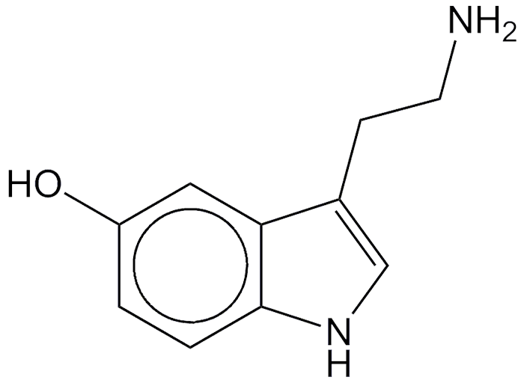
Serotonin = 5-hydroxytryptamine = 5-HT
=

Slide 4
serotonin
dopamine
D2 receptors
D2
5HT2A receptors
Mnemonics:
“R2D2”
“D₂R (detour) from reality”.
2A for “2nd gen Antipsychotics”
(“2 antennae?”)

Slide 5
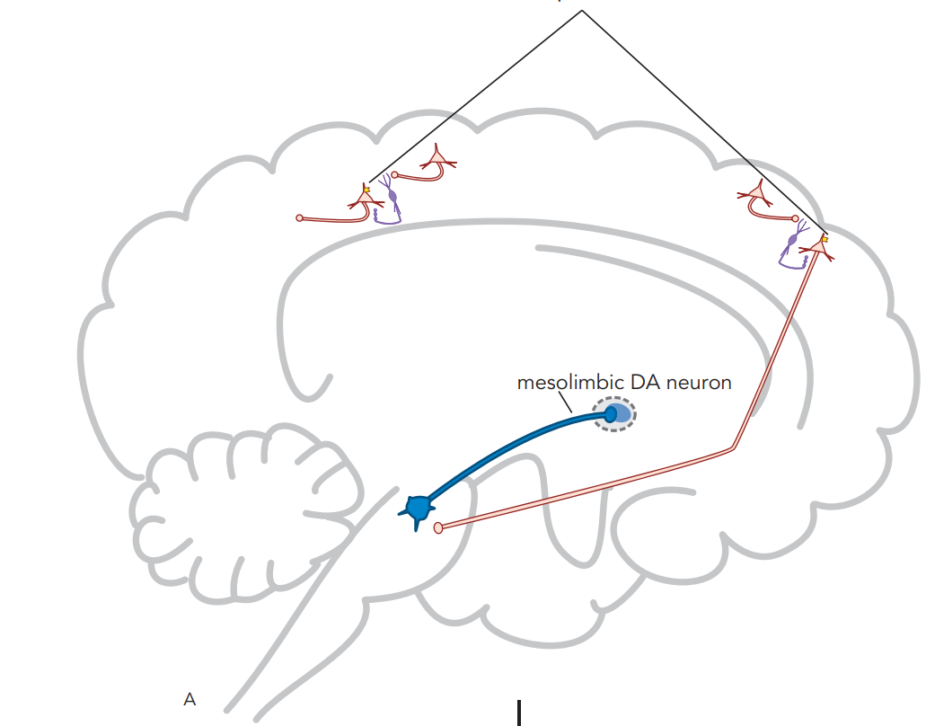
NMDA receptors
5HT2A receptors
5HT2A
D2 receptors
D2

Slide 6
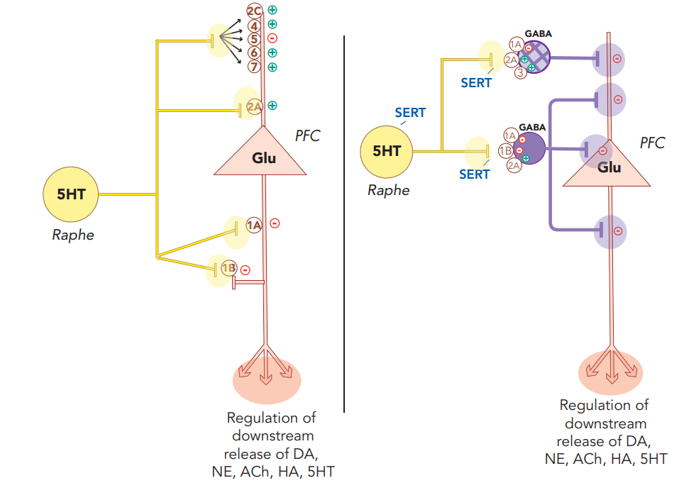
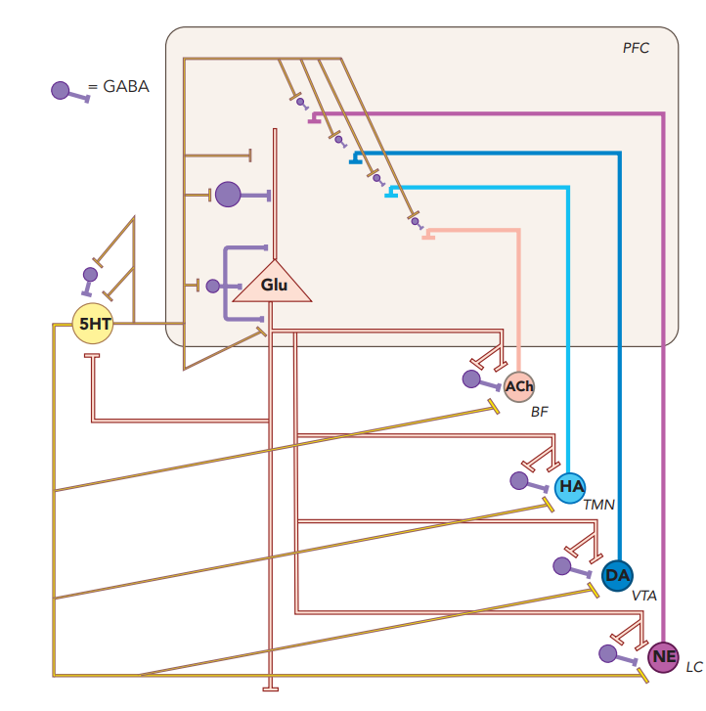
5HT Receptors Regulate Glutamate Release
Stahl’s Essential Psychopharmacology

Slide 7
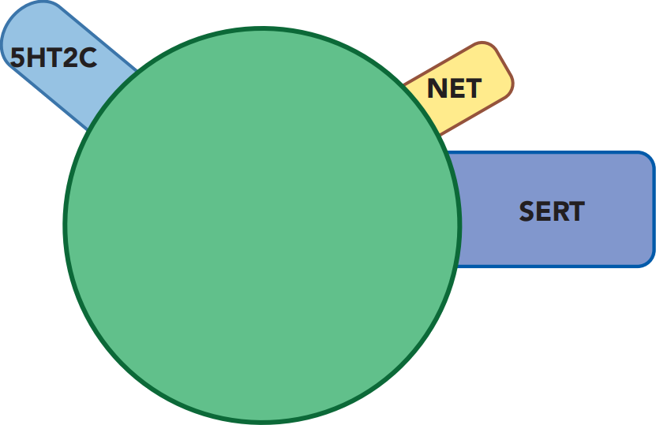
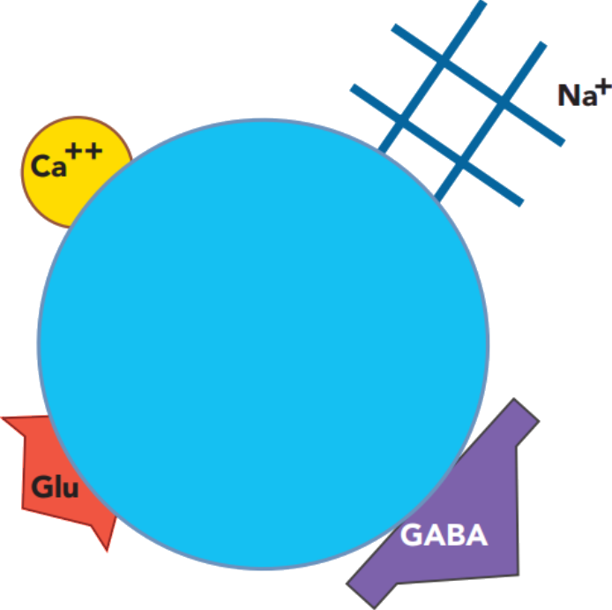
anticholinergic
CYP inHibitor
5HT2A receptor blocker
antihistaminic
CYP
Binds other 5HT receptor subtypes
NE reuptake inhibitor
Binds 5HT receptor subtype(s)
prototypical
modern
antidepressant
Blocks voltage-sensitive ion channel(s)
prototypical
antipsychotic
alpha
noradrenergic blocking
5HT reuptake inhibitor
x
No antidepressants are inDucers
mystery receptor blocker
D2 receptor blocker
prototypical
mood stabilizer
inhibits
glutamate
(excitatory neurotransmitter)
none are CYP inHibitors or inDucers
most are sensitive CYP substrates
enhances GABA (inhibitory neurotransmitter)
Stahl’s Essential Psychopharmacology
CYP inDucer

Slide 8
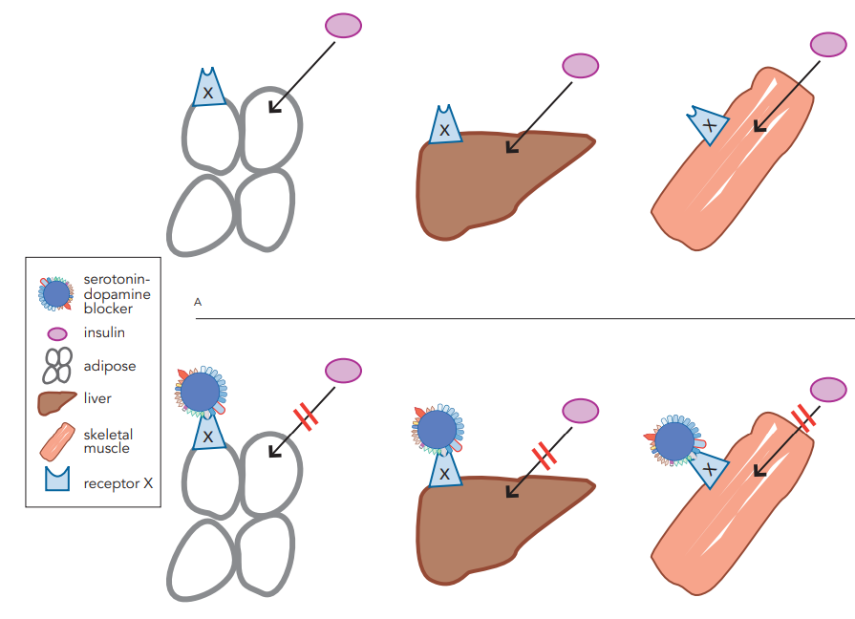
Metabolic side effects caused by blocking a mystery “receptor X”?
Stahl’s Essential Psychopharmacology

Slide 9
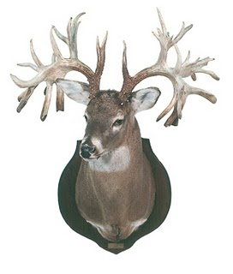
Antipsychotics
Typicals
Atypicals
First-Gen Antipsychotics
Second-Gen Antipsychotics
FGAs
SGAs
Dr Austin Campbell

Slide 10
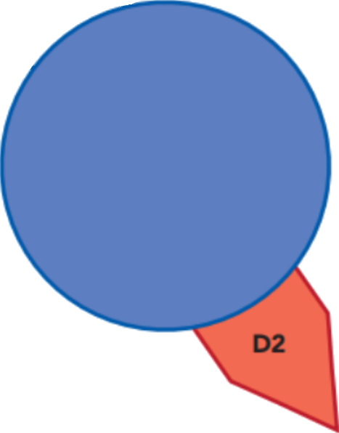
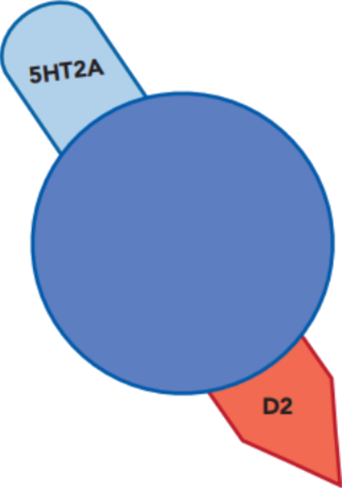
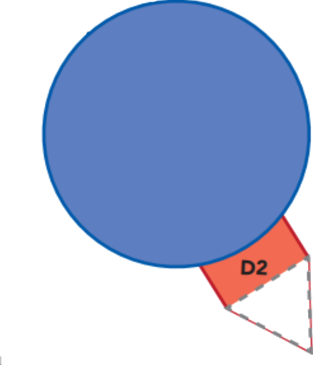
“Typicals”
“Atypicals”
First-Gen Antipsychotics
Second-Gen Antipsychotics
FGAs
SGAs
5HT2
receptor
blocker
“2 pips and a rip”
(A, B & C)
aripiprazole
brexpiprazole,
cariprazine
or
D2 receptor
blocker
D2 partial agonist
D2 receptor
blocker

Slide 11
“Typicals”
“Atypicals”
First-Gen Antipsychotics
Second-Gen Antipsychotics
FGAs
SGAs
5HT2
receptor
blocker
potency:
low
intermediate
high
“2 pips and a rip”
(A, B & C)
aripiprazole
brexpiprazole,
cariprazine
or
“-pines, -dones
and a -rone”
or
D2 receptor
blocker
x
D2 partial agonist
mystery receptor blocker

Slide 12
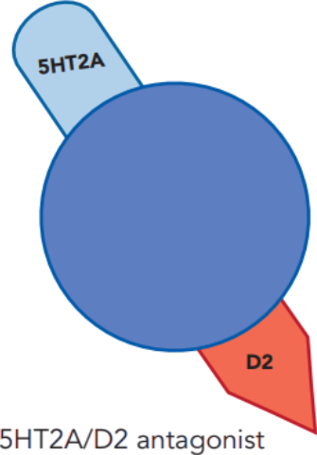
Second-generation antipsychotic (SGA)
dopamine
5HT2A
D2
5HT2A receptors
D2 receptor
2A for “2nd-gen Antipsychotics”
“R2D2”
“D₂R (detour) from reality”

Slide 13
What Differentiates 2nd-gen (SGAs) from 1st-gen antipsychotics (FGAs)?
SGA = marketing term for newer antipsychotics (clozapine and later).
Conceptually, an SGA is an antipsychotic that (supposedly) causes less EPS at doses producing antipsychotic effects.
There is not much difference between SGAs and intermediate potency FGAs.
Incidence of TD is lower SGA (~2.6%) FGA (~6.5%)
Mechanisms of FGAs and SGAs are similar, although receptor binding affinities are different.

Slide 14
Extrapyramidal Side Effects (EPS)
Type of EPS | Usual onset | Description | Reversible? | Treatment
Dystonia | Quickly | Muscle contraction | Yes | Anticholinergics: Benztropine Diphenhydramine
Akathisia | Acute akathisia - quickly; Tardive akathisia - after several months | Uncomfortable feeling of internal motor restlessness with difficulty sitting still | Yes | Propranolol Benzodiazepines Anticholinergics (less effective)
Pseudo- parkinsonism | Months–years | Pill-rolling Parkinsonian tremor; Bradykinesia (e.g., “Thorazine shuffle”). | Does not progress to Parkinson’s disease. | Amantadine Benzodiazepines
Tardive Dyskinesia | 6 months–year(s) | Movement disorder that is often irreversible, characterized by tongue movements, lip smacking, excessive blinking, grimacing or raising of eyebrows; irregular finger movements as if playing an invisible piano or air guitar; chorea of extremities in severe cases. Often the patient is unaware of the movements. Older adults are at higher risk. | Usually not | Valbenazine (Ingrezza) Deutetrabenazine (Austedo) Benzodiazepines Amantadine

Slide 15
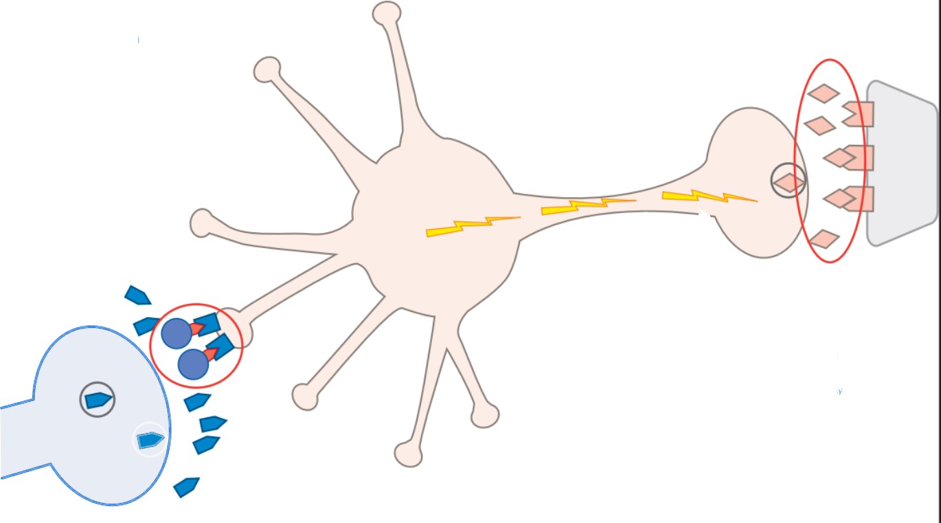
Extrapyramidal Side Effects (EPS)
The likelihood that an antipsychotic will cause EPS is proportional to its efficacy in blocking D2 receptors.
Dystonia is caused by a relative deficiency of dopamine and an excess of acetylcholine in the nigrostriatal pathway.
Partial D2 agonists have low risk of dystonia/TD but high incidence of akathisia.
“2 pips and a rip”
(A, B & C)
aripiprazole
brexpiprazole
cariprazine

Slide 16
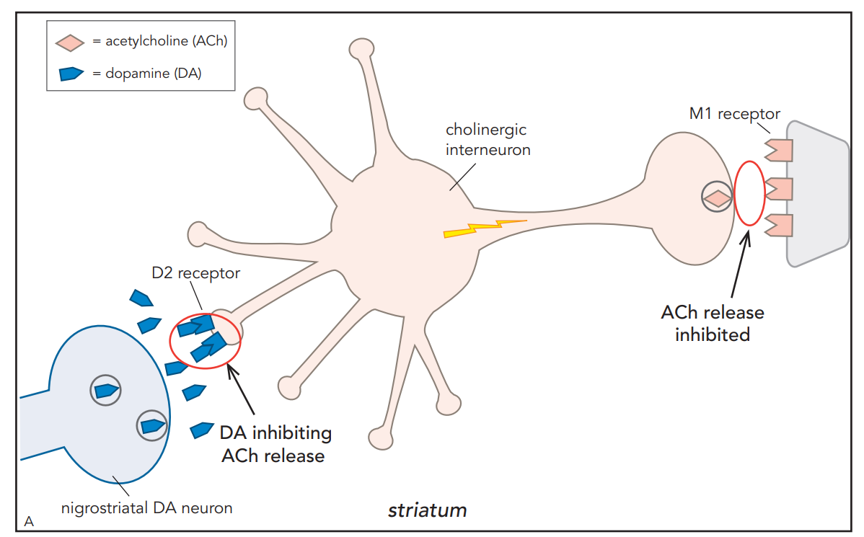
Binding of DA to D2 receptors inhibits acetylcholine release

Slide 17
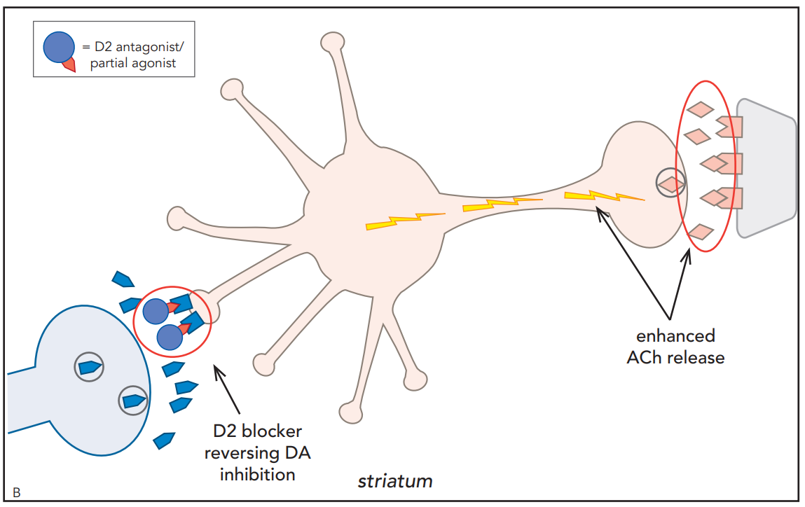
Blocking D2 increases release of acetylcholine

Slide 18
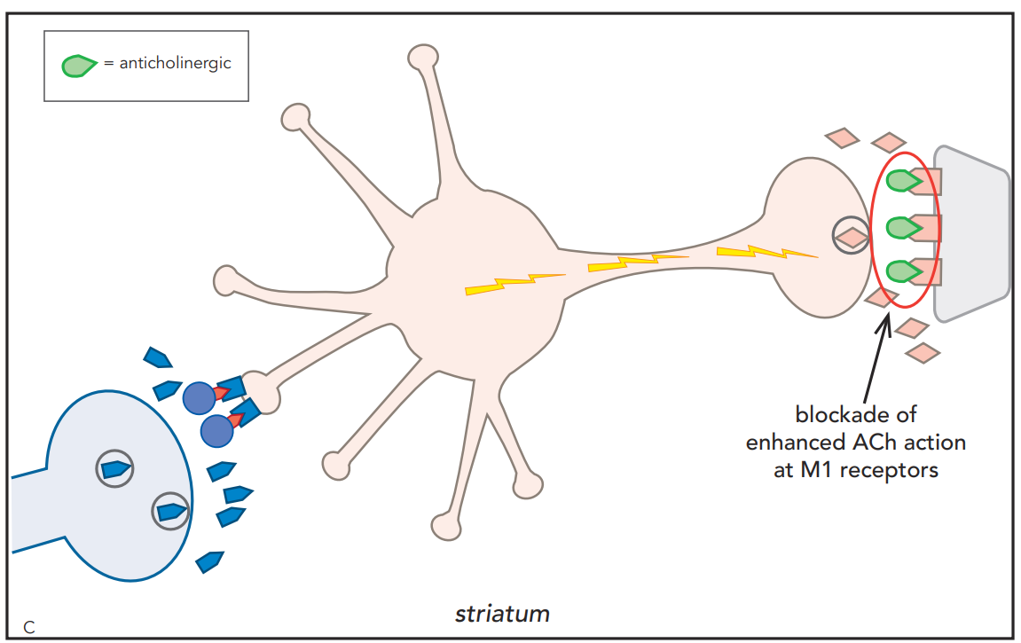
Anticholinergics can ameliorate EPS
benztropine
diphenhydramine

Slide 19
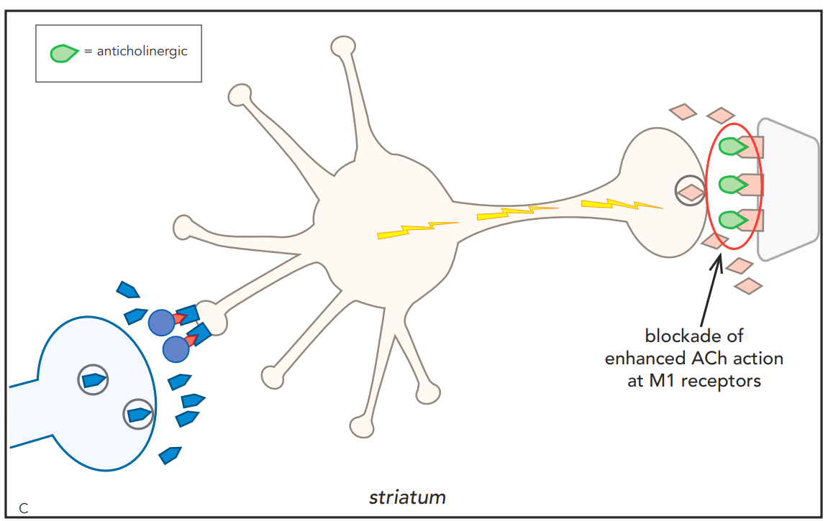
Anticholinergics can ameliorate EPS
Antipsychotics with “built-in” anticholinergic effects are less likely to cause dystonia

Slide 20
Dopamine Neural Pathways
Dopamine Pathway | Effect of D2 antagonist
Mesolimbic | ↓ DA activity - reduction of positive symptoms of schizophrenia (hallucinations, delusions).
D2 antagonist
D2
dopamine

Slide 21
Dopamine Neural Pathways
Dopamine Pathway | Effect of D2 antagonist
Mesolimbic | ↓ DA activity - reduction of positive symptoms of schizophrenia (hallucinations, delusions). Side effects of apathy and anhedonia.
Mesocortical | ↓ DA - potential worsening of negative symptoms (amotivation, anhedonia, blunting of affect, cognitive symptoms)
Nigrostriatal | ↓ DA - EPS, risk of tardive dyskinesia
Tubero- infundibular | ↓ DA - increased prolactin, risk of breast growth (gynecomastia)
D2 antagonist
D2
dopamine

Slide 22
Dopamine Neural Pathways
Dopamine Pathway | Effect of D2 antagonist
Mesolimbic | ↓ DA activity - reduction of positive symptoms of schizophrenia (hallucinations, delusions). Side effects of apathy and anhedonia.
Mesocortical | ↓ DA - potential worsening of negative symptoms (amotivation, anhedonia, blunting of affect, cognitive symptoms)
Nigrostriatal | ↓ DA - EPS, risk of tardive dyskinesia
Tubero- infundibular | ↓ DA - increased prolactin, risk of breast growth (gynecomastia)
D2 antagonist
D2
dopamine

Slide 23
Dopamine Neural Pathways
Dopamine Pathway | Effect of D2 antagonist
Mesolimbic | ↓ DA activity - reduction of positive symptoms of schizophrenia (hallucinations, delusions). Side effects of apathy and anhedonia.
Mesocortical | ↓ DA - potential worsening of negative symptoms (amotivation, anhedonia, blunting of affect, cognitive symptoms)
Nigrostriatal | ↓ DA - EPS, risk of tardive dyskinesia
Tubero- infundibular | ↓ DA - increased prolactin, risk of breast growth (gynecomastia)
D2 antagonist
D2
dopamine

Slide 24
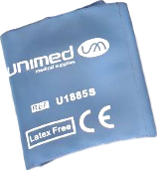
Neuroleptic Malignant Syndrome (NMS)
“can’t Bend(er)”
NMS
Mental status changes
Lead pipe rigidity
- can’t bend ‘er limbs
Autonomic
instability
Nigrostriatal
pathway
Hypothalamus
High fever
Sweating
Hypothalamus

Slide 25
Neurotransmitter pathways
glutamate
serotonin
downstream effects
downstream effects
dopamine
downstream effects

Slide 26
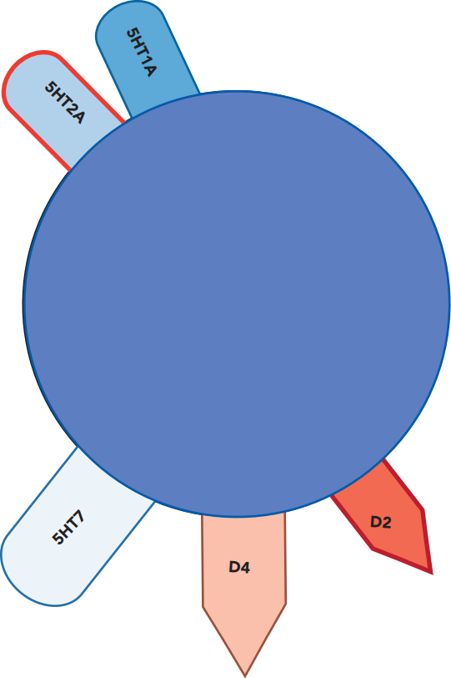
Adding a 2nd gen antipsychotic
5HT1A
decreased release
partial agonist
increased release
lurasidone
LATUDA
lurasidone
LATUDA
glutamate
dopamine
increased release
decreased release
5HT2A

Slide 27
Adding a 2nd gen antipsychotic
5HT1A
decreased release
increased release
glutamate
lurasidone
LATUDA
dopamine
increased release
decreased release
brexpiprazole
REXULTI
antagonist
5HT2A

Slide 28
Adding a 2nd gen antipsychotic
5HT1A
serotonin
decreased release
increased release
lurasidone
LATUDA
partial agonist
lurasidone
LATUDA
glutamate
Antipsychotics don’t interact with glutamate receptors directly.
antagonist
increased release
D2
lurasidone
LATUDA
antagonist
dopamine
NMDA
receptor
5HT2A

Slide 29
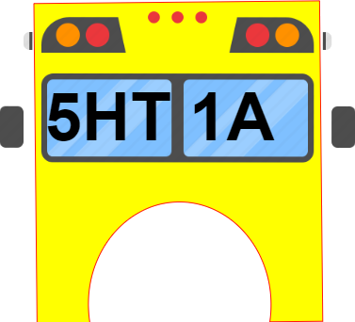
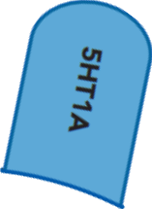
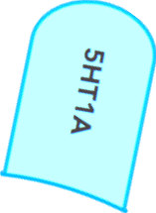
5-HT_{2A} serotonin receptor antagonists
5-HT_{1A}
partial
agonists
buspirone

Slide 30
5-HT_{1A}
partial
agonists
5-HT_{2A} serotonin receptor antagonists
SGAs:
❖ Aripiprazole
❖ Asenapine
❖ Brexpiprazole
❖ Cariprazine
❖ Clozapine
❖ Lurasidone
❖ Quetiapine
❖ Ziprasidone
Antidepressants:
❖ Mirtazapine – NaSSA
❖ Amitriptyline – TCA
❖ Doxepin – TCA
❖ Amoxapine – TCA
❖ Trimipramine – TCA
2nd gen antipsychotics (SGAs):
❖ Olanzapine
❖ Paliperidone
❖ Pimavanserin
❖ Risperidone
FGAs:
❖ Chlorpromazine
❖ Loxapine
❖ Thioridazine
❖ Trifluoperazine
Anxiolytic:
❖ Buspirone
Antidepressants:
❖ Vilazodone
❖ Vortioxetine

Slide 31
D2 blockers
Antipsychotics
Antidepressants
all other antipsychotics
pimavanserin
(NUPLAZID)
all other
antidepressants
amoxapine
(TCA)

Slide 32
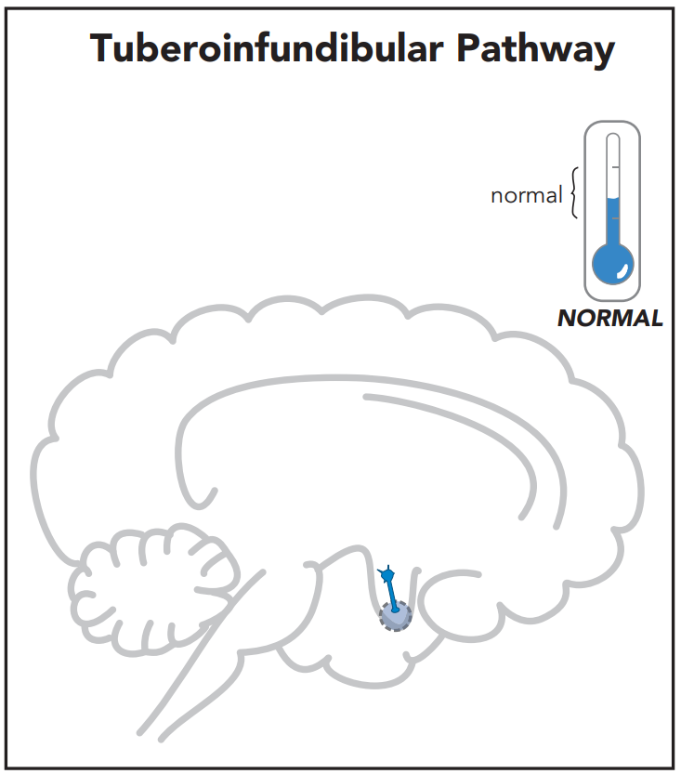
Dopamine Neural Pathways
Dopamine inhibits prolactin secretion.
Dopamine Pathway | Effect of D2 antagonist
Mesolimbic | ↓ DA activity - reduction of positive symptoms of schizophrenia (hallucinations, delusions)
Mesocortical | ↓ DA - potential worsening of negative symptoms (amotivation, anhedonia, blunting of affect)
Nigrostriatal | ↓ DA - EPS, risk of tardive dyskinesia
Tubero- infundibular | ↓ DA - increased prolactin, risk of breast growth (gynecomastia)
Stahl’s Essential Psychopharmacology

Slide 33
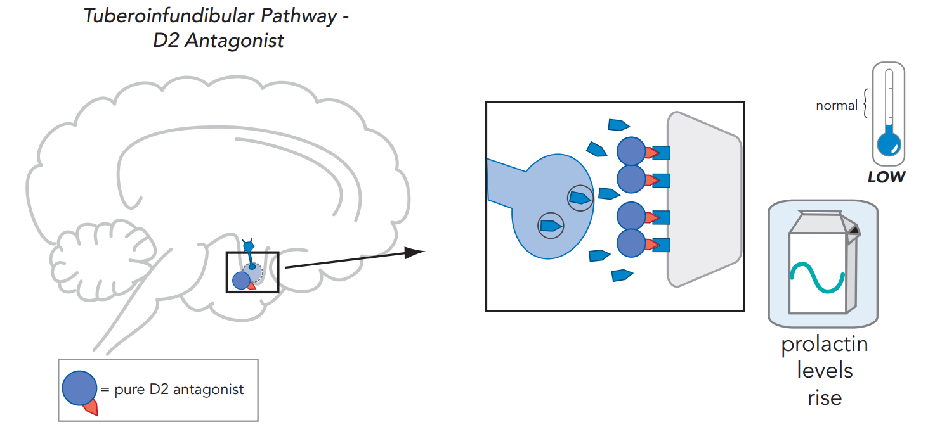
Stahl’s Essential Psychopharmacology

Slide 34
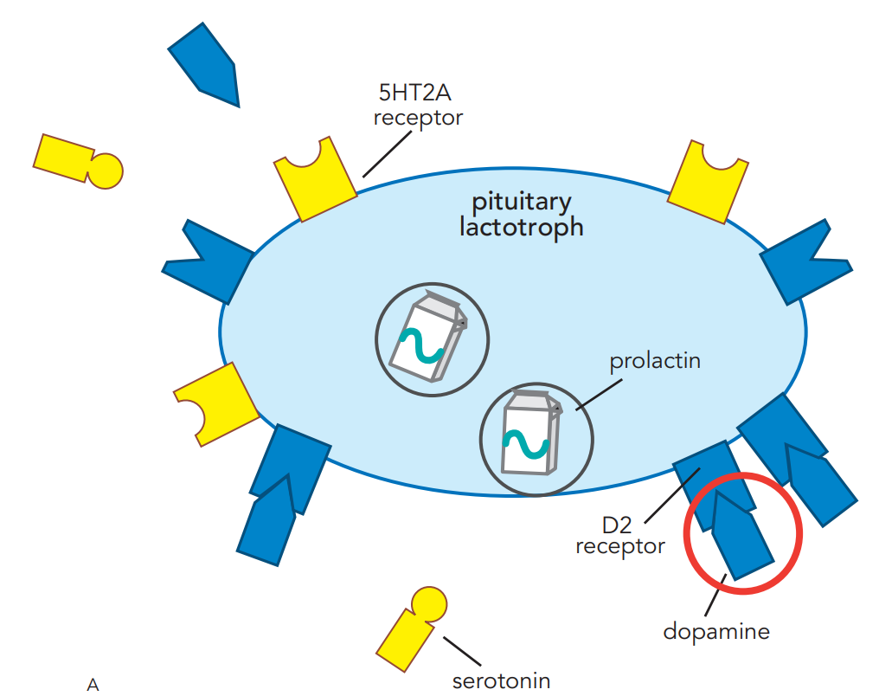
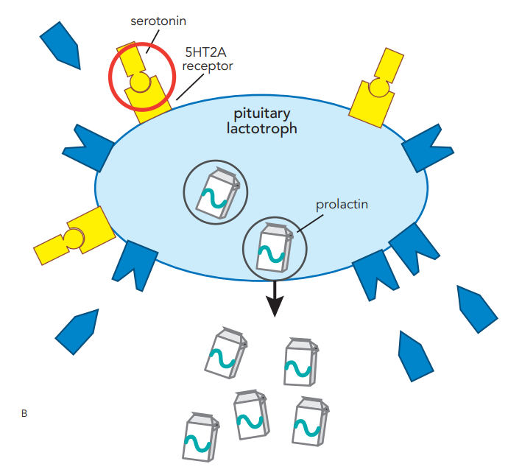
Dopamine decreases prolactin release
Serotonin stimulates prolactin release
5HT2A
D2
Stahl’s Essential Psychopharmacology

Slide 35
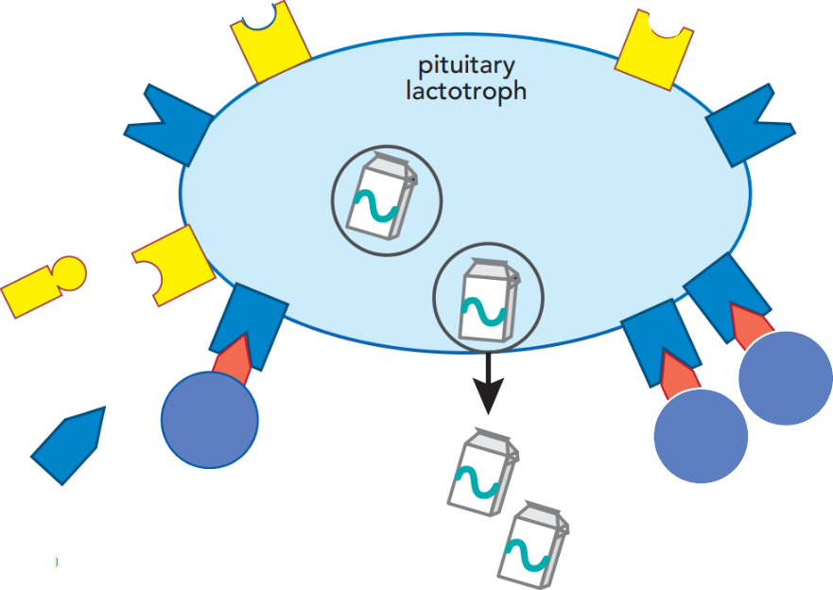
First-generation antipsychotic (FGA)
5HT2A
D2
haloperidol
HALDOL
Blocking D2 receptors increases release of prolactin
D2 receptor blocker
Stahl’s Essential Psychopharmacology

Slide 36
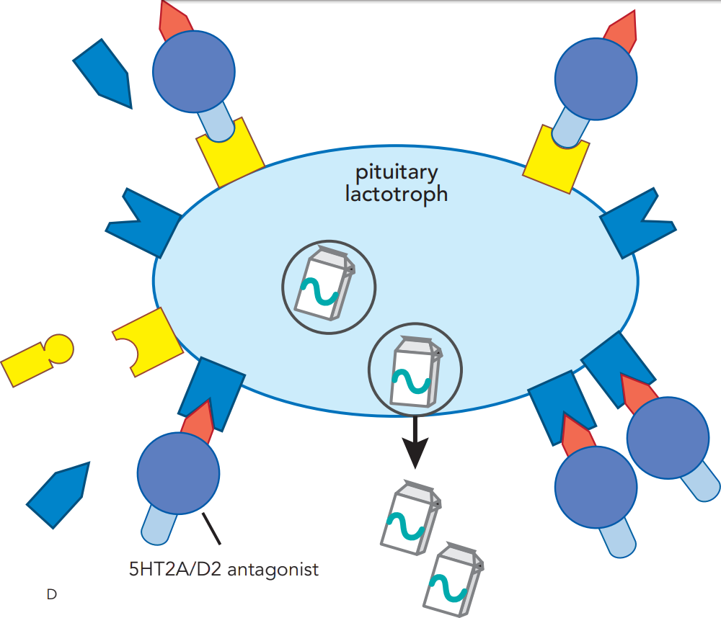
2nd generation antipsychotic
Blocking 5HT2 receptors ameliorates prolactin release caused by D2 blockade
5HT2 receptor blocker
D2 receptor blocker
Stahl’s Essential Psychopharmacology

Slide 37
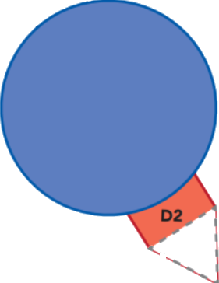
“2 pips and a rip” or
“A, B, C”
aripiprazole
brexpiprazole,
cariprazine
D2 partial agonist
Aripiprazole decreases prolactin, the opposite effect of D2 blockers.
Stahl’s Essential Psychopharmacology

Slide 38
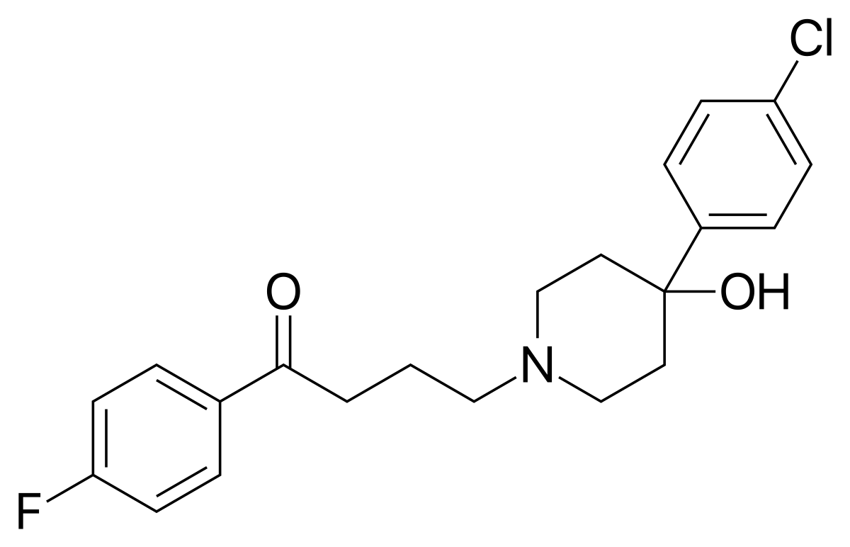
Haloperidol (HALDOL)
hal oh PER i dawl / HAL dawl
“Halo doll”
#243
1967
$12–$32
❖ Antipsychotic
❖ High potency FGA
❖ D2 antagonist
FDA-approved for:
❖ Psychosis
❖ Tourette’s disorder
Used off-label for:
❖ Agitation/aggression
❖ Delirium
❖ Mania
❖ Gastroparesis
0.5
1
2
5
10
20 mg

Slide 39
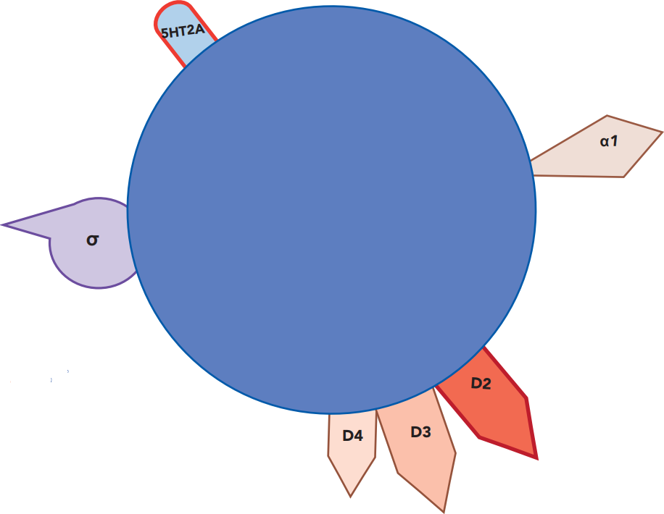
Haloperidol
HALDOL
D2
Receptor binding affinities:

Slide 40
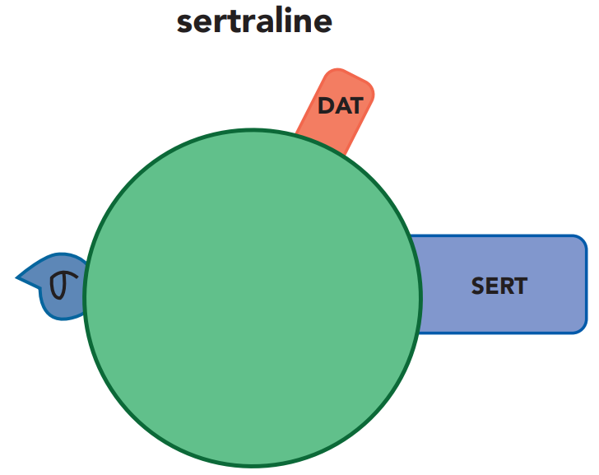
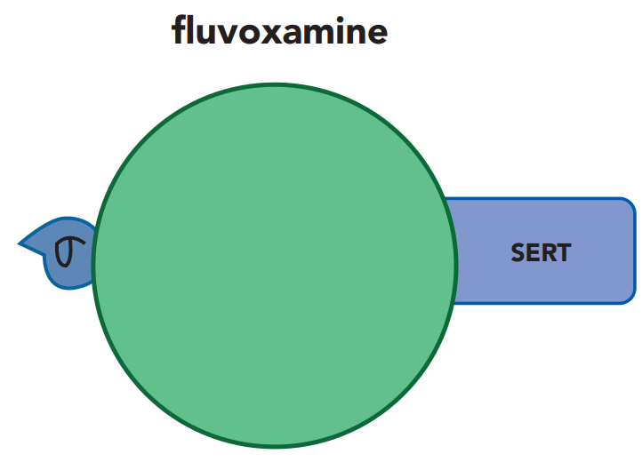
Haloperidol
HALDOL
sigma
anxiolytic?

Slide 41
Haloperidol
HALDOL
D3
Receptor binding affinities:
This droid is R6-D3

Slide 42
Haloperidol
HALDOL
Lowers blood pressure,
same mechanism as prazosin
(minimal BP drop compared to other antipsychotics)
Receptor binding affinities:

Slide 43
Haloperidol
HALDOL
Receptor binding affinities:
D4
This droid is R5-D4

Slide 44
Haloperidol
HALDOL

Slide 45
Haloperidol
HALDOL
5HT2A blocking is too weak to ameliorate EPS or hyperprolactinemia
D2 >> 5HT2A makes a “typical” antipsychotic
antipsychotic efficacy
EPS
prolactin elevation

Slide 46
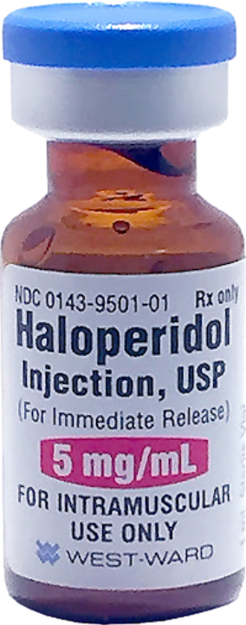
5&2
Haloperidol IM

Slide 47
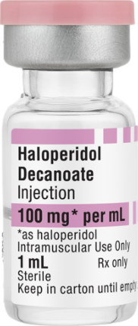
Haloperidol decanoate
HALDOL-D

Slide 48
This is a comparison to chlorpromazine (Thorazine), which causes
orthostatic hypotension
photosensitivity
corneal edema
1972

Slide 49
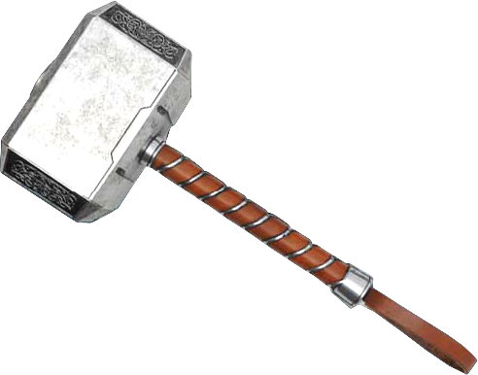
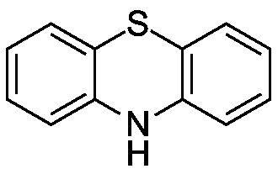
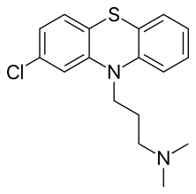
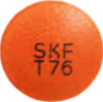
Chlorpromazine (THORAZINE)
klawr PRO muh zeen / THOR a zeen
“Thor’s Color promising” (to change)
1954
$62–$157
My color is
promising to change.
Discoloration of skin and eye at high dose.
❖ Antipsychotic
❖ Low potency FGA
❖ D2 antagonist
❖ 5-HT2 antagonist
❖ Phenothiazine
FDA-approved for:
❖ Psychosis
❖ Nausea/Vomiting
❖ Intractable hiccups
❖ Adjunct treatment of tetanus (IM)
❖ Acute intermittent porphyria (IM)
Used off-label for:
❖ Behavioral disturbance (IM or PO)
❖ Impulse control disorders
❖ Serotonin Syndrome, adjunct (IM)
❖ Anxiety (low dose)
❖ Insomnia (low dose)
Thor’s hammer
phenothiazine
structure
10
25
50
100
200
mg

Slide 50
Chlorpromazine (THORAZINE)
Corneal epithelial keratopathy
caused by high dose thorazine.
cornea verticillata pattern in corneal epithelium
benign and reversible.

Slide 51
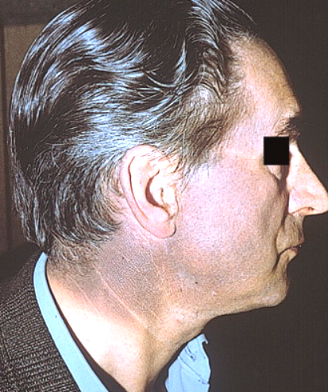
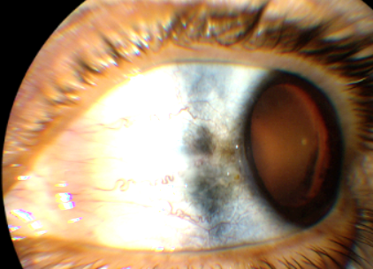
Chlorpromazine (THORAZINE)
Chlorpromazine (THORAZINE)
“Thor’s Color promising” (to change)
Skin discoloration
With high-dose chlorpromazine
Progressive blue-gray or purple discoloration
Sun-exposed areas of the skin
Sparing of facial wrinkles
Reversible

Slide 52
Chlorpromazine (THORAZINE)
klawr PRO muh zeen / THOR a zeen
“Thor’s Color promising” (to change)
My color is
promising to change.
Discoloration of skin and eye at high dose.
Also risk of:
► Corneal edema (with possible irreversible vision loss)
Thor’s hammer

Slide 53
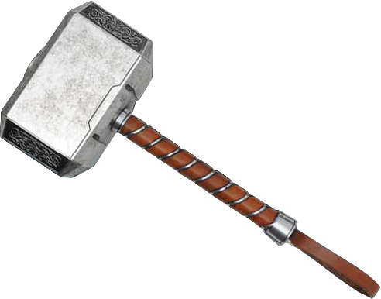
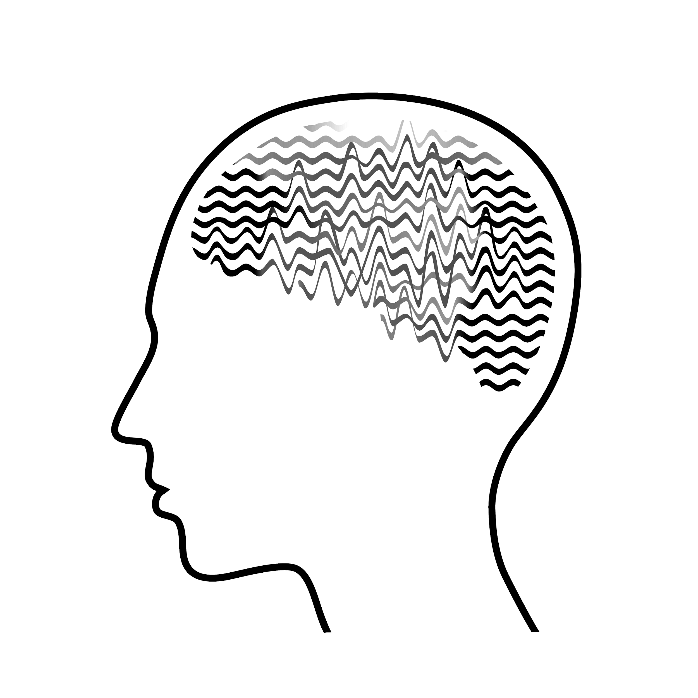
Chlorpromazine (THORAZINE)
The only FGA that significantly lowers seizure threshold.
Seizure risk among
antipsychotics (dose-dependent):
#1 Clozapine (Clozaril) up to 10x risk
#2 Olanzapine (Zyprexa) 3x
#3 Quetiapine (Seroquel) 2x
#4 Chlorpromazine (Thorazine) 2x

Slide 54
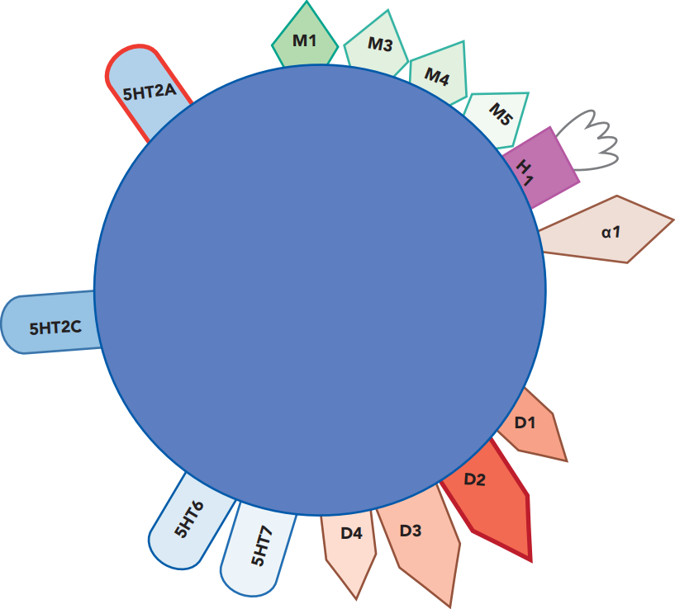
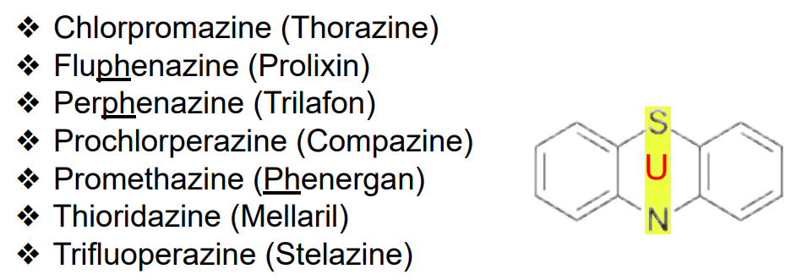
Chlorpromazine
THORAZINE
Anticholinergic - side effects (but could reduce EPS)
D2 > 5HT2A makes a “typical” (1st-gen) antipsychotic
very sedating
less EPS
Orthostatic hypotension,
same mechanism as prazosin
Photosensitivity (phenothiazine class)
This is the only mention of D5 with any of the antipsychotics

Slide 55
Fluphenazine (PROLIXIN)
flu FEN uh zeen / pro LIK sin
“Prolix Floppy hen”
1960
$21–$233
❖ Antipsychotic
❖ High potency FGA
❖ D2 antagonist
❖ Phenothiazine
FDA-approved for:
❖ Psychosis
Phenothiazine
structure
1
2.5
5
10
mg
Prolix Hen

Slide 56
Fluphenazine
PROLIXIN
High-potency FGA, similar to haloperidol

Slide 57
No built-in anticholinergic effects, so you will likely need to add benztropine (Cogentin)
Haloperidol
HALDOL
Fluphenazine
PROLIXIN
high EPS
high EPS
Very similar clinically

Slide 58
Prolixin Decanoate
PROLIXIN-D
❖ Long-acting injectable FGA

Slide 59
Loxapine (LOXITANE)
LOX a peen / LOX i tane
“Lots a’ ping, Lots o’ Tang”
1975
$21–$48
❖ Antipsychotic
❖ Medium potency FGA
❖ D2 antagonist - ⇩ DA
❖ 5-HT2A antagonist - ⇧ DA
FDA-approved for:
❖ Psychosis
Intermediate potency FGAs are relatively low in EPS, similar to SGAs
5
10
25
50
mg

Slide 60
ADASUVE (loxapine inhalation powder)
AD uh soov / LOX a peen
“Ada(boy)! soothe”
How soothing!
FDA-approved for:
❖ Agitation associated with schizophrenia or bipolar I disorder
Adaboy!

Slide 61
D2-blocking antiemetics
Nausea results from the brain stem thinking it is being poisoned by any of these neurotransmitters.
Serotonergic and muscarinic (cholinergic) medications are likely to cause nausea.
Antiserotonergics, antimuscarinics (anticholinergics), antihistamines, and antidopaminergics reduce nausea.
Serotonin
Dopamine
Vomiting
center
Histamine
Acetylcholine
D2-blocking antiemetic | Potency of D2 blockade | Antipsychotic? | High risk of tardive dyskinesia
Prochlorperazine (Compazine) | High | Yes | Yes
Metoclopramide (Reglan) | High | No | Yes
Droperidol (Inapsine) | High | Yes | Yes
Amisulpride (Barhemsys) | Medium | Yes | No
Promethazine (Phenergan) | Low | No | No
Trimethobenzamide (Tigan) | Low | No | No
mostly works as an antihistamine

Slide 62
IMPORTANT!

Slide 63
D2-blocking antiemetics
Nausea results from the brain stem thinking it is being poisoned by any of these neurotransmitters.
Serotonergic and muscarinic (cholinergic) medications are likely to cause nausea.
Antiserotonergics, antimuscarinics (anticholinergics), antihistamines, and antidopaminergics reduce nausea.
Serotonin
Dopamine
Vomiting
center
Histamine
Acetylcholine
D2-blocking antiemetic | Potency of D2 blockade | Antipsychotic? | High risk of tardive dyskinesia
Prochlorperazine (Compazine) | High | Yes | Yes
Metoclopramide (Reglan) | High | No | Yes
Droperidol (Inapsine) | High | Yes | Yes
Amisulpride (Barhemsys) | Medium | Yes | No
Promethazine (Phenergan) | Low | No | No
Trimethobenzamide (Tigan) | Low | No | No

Slide 64
Metoclopramide (REGLAN)
met o KLOH pra mide / REG lan
“Ronald Reglan Met a clopper”
1979
$4–$11
BLACK BOX WARNING not to exceed 12 weeks of treatment due to risk of tardive dyskinesia
❖
Not an antipsychotic
Howdy Clopper, I’m Ronald Reglan.
❖ Antiemetic
❖ High potency D2
antagonist
DA-approved for:
❖ GERD
❖ Diabetic
gastroparesis
❖ Nausea/vomiting
prevention
❖ Small bowel
intubation
❖ Radiologic exam
Nice to have met you.
5
10
mg

Slide 65
clozapine
SGAs
D2
“-pines”
olanzapine
olanzapine
quetiapine
quetiapine
asenapine
“-dones and a -rone”
risperidone
risperidone
paliperidone
ziprasidone
ziprasidone
iloperidone
iloperidone
lurasidone
lurasidone
D2
lumateperone
lumateperone
“2 -pips & a rip”
aripiprazole
brexpiprazole
brexpiprazole
cariprazine
cariprazine

Slide 66
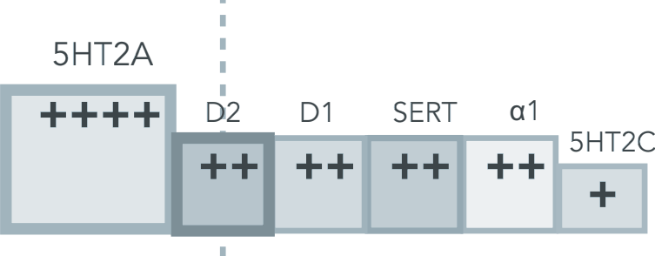
clozapine
5HT2A
“-pines”
olanzapine
quetiapine
asenapine
“-dones and a -rone”
risperidone
paliperidone
ziprasidone
ziprasidone
iloperidone
iloperidone
lurasidone
lurasidone
5HT2A
lumateperone
lumateperone
“2 -pips & a rip”
Are “atypical” antipsychotics by virtue of D2 receptor partial agonism.
aripiprazole
brexpiprazole
brexpiprazole
cariprazine
cariprazine

Slide 67
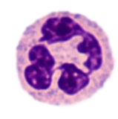
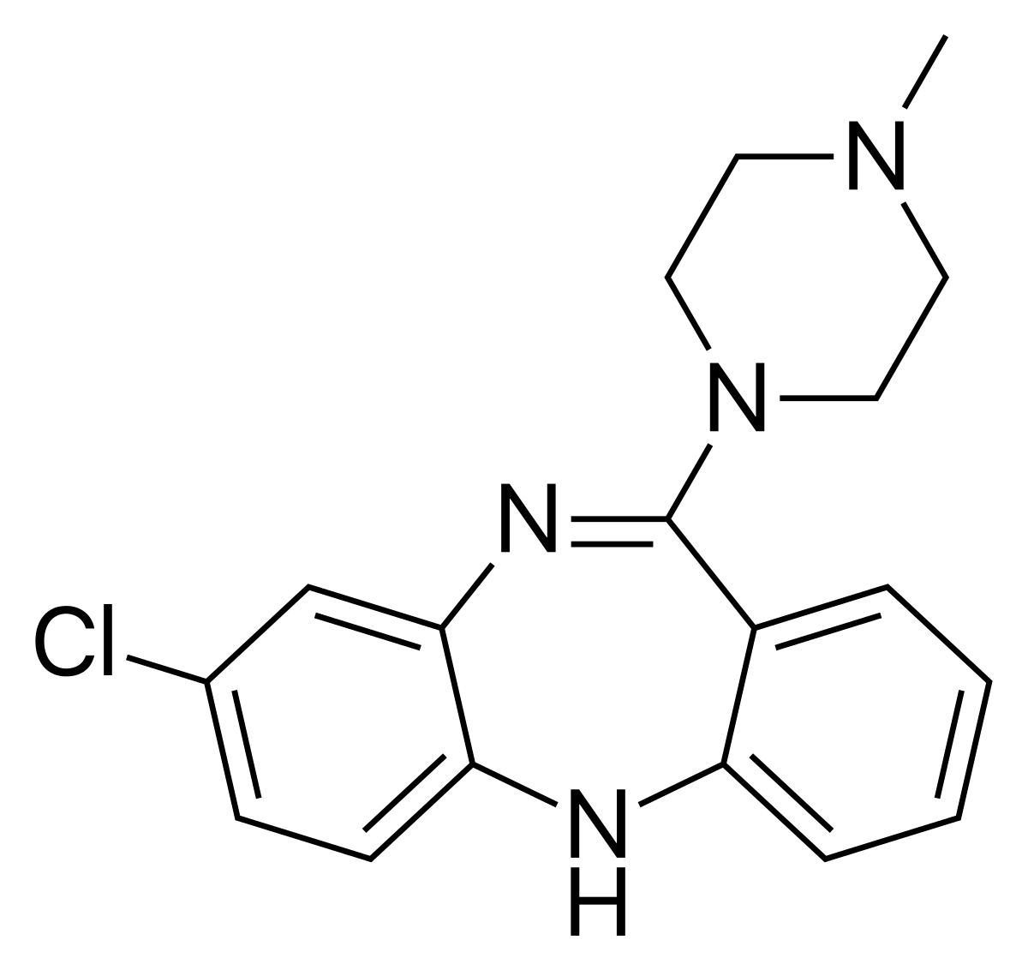
Clozapine (CLOZARIL)
KLOE za peen / KLOE za ril
“Clothes pin”
1990
$42–$184
+ labs
❖ Antipsychotic (SGA)
❖ D2 antagonist - ⇩ DA
❖ 5-HT_{2A} antagonist - ⇧ DA
❖ Alpha-adrenergic antagonist
Neutrophil
FDA-approved for:
❖ Treatment-resistant
schizophrenia
❖ Prevention of schizophrenia-
associated suicide
25
50
100
200
mg
Used off-label for:
❖ Treatment-resistant aggression
❖ Treatment-resistant mania
❖ Psychosis with tardive dyskinesia
❖ Psychosis with Parkinson’s disease

Slide 68
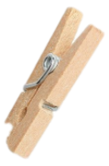
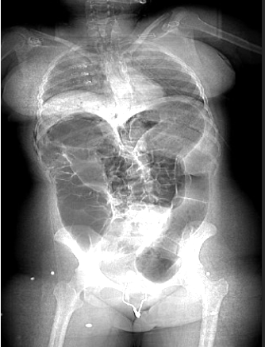
Clozapine (CLOZARIL)
KLOE za peen / KLOE za ril
“Clothes pin”
Neutrophil
Weight
gain
Severe constipation,
which can lead to toxic megacolon and bowel rupture.
Hypersalivation by cholinergic mechanism (the S in SLUDGE)
Potentially fatal myocarditis
Antipsychotics are represented
with spooky mascots.
Seizures

Slide 69
Clozapine
CLOZARIL
Highly anticholinergic, potential for severe constipation
very sedating
Potential for massive weight gain
Orthostatic hypotension,
same mechanism as prazosin
Salivation is a cholinergic effect cause by the norclozapine metabolite.
x
less EPS than placebo!

Slide 70
Clozapine Initiation
Weight: + 60 kg
~2 Years
BMI Δ: + 110%
~2 Years
Dr Austin Campbell

Slide 71
Olanzapine (ZYPREXA)
o lan za peen / zy PREX a
“Owl lands upon (cra)Zy pretzel”
#225
1996
$5–$400
❖ Antipsychotic (SGA)
❖ D2 antagonist - ⇩ DA
❖ 5-HT_{2A} antagonist - ⇧ DA
FDA-approved for:
❖ Schizophrenia
❖ Bipolar mania
❖ Bipolar maintenance
❖ Bipolar depression
(with fluoxetine)
❖ Treatment-resistant depression
(with fluoxetine)
❖ Acute agitation of mania
(IM route)
Used off-label for:
❖ Behavioral disturbance
❖ Nausea/vomiting
❖ Anorexia nervosa
2.5
5
7.5
10
15
20 mg

Slide 72
Olanzapine
ZYPREXA
minimal EPS

Slide 73
Clozapine
CLOZARIL
Olanzapine
ZYPREXA
Constipation is often problematic
Constipation is manageable
Stronger antihistamine but overall less sedating
very sedating
Hypotension is a major issue, must titrate slowly
Very high dose can be tolerated without titration
Potential for massive weight gain
x
x
Equal potential for massive weight gain

Slide 74
LYBALVI (olanzapine + samidorphan)
sam” i dor’ fan (“Semi orphan”) / lee BAWL vee
“Light bulby”
2021
$1,512–
$1,769
❖ 2nd generation antipsychotic plus μ-opioid receptor (MOR) antagonist
5/10
10/10
15/10
20/10
mg

Slide 75
SYMBYAX (olanzapine + fluoxetine)
SIM bee ax / o lan za peen + flu OX e teen
“Symbiotic ox”
2003
$350–$520
❖ SGA + SSRI
FDA-approved for:
❖ Bipolar depression
❖ Treatment-resistant depression
3/25
6/25
6/50
12/50
mg

Slide 76
Quetiapine (SEROQUEL)
kwe TYE a peen / SEH ruh kwil
“Sera, Quit typing!”
#86
1997
$3–$124
❖ Antipsychotic (SGA)
❖ D2 antagonist (weak) - ⇩ DA
❖ 5-HT_{2A} antagonist - ⇧ DA
❖ NE reuptake inhibitor (metabolite)
Sera! Quit typing (and get some sleep)!
FDA-approved for:
❖ Schizophrenia
❖ Bipolar, manic episode
❖ Bipolar, depressive episode
– XR formulation
❖ Depression (adjunct)
mania
25
50
100
200
300
400
mg
Used off-label for
❖ “Racing thoughts”
❖ Anxiety
❖ Insomnia
❖ Behavioral disturbance
❖ Coming down from meth binge

Slide 77
Quetiapine
SEROQUEL
minimal EPS

Slide 78
Quetiapine
SEROQUEL
shared mechanism with buspirone (Buspar)
very sedating
antidepressant effects
hypotension limits rate of titration
shared mechanism with mirtazapine (Remeron)
fluoxetine (Prozac) and mirtazapine (Remeron) also block 5HT2C receptors
shared mechanism with bupropion (Wellbutrin)
x
weight gain and metabolic syndrome
weak antipsychotic
minimal EPS

Slide 79
Quetiapine
SEROQUEL

Slide 80
TCA
diphenhydramine
BENADRYL
50 mg
quetiapine
SEROQUEL
50 mg

Slide 81
Chlorpromazine
THORAZINE
Quetiapine
SEROQUEL
Low potency FGA
Weak SGA
Weight gain
anticholinergic
Weight gain
anticholinergic
very sedating
very sedating
hypo-
tension
hypotension

Slide 82
Asenapine (SAPHRIS)
a SEN a peen / SAFF ris
“Sapphire (for an) Ass in a pine”
2009
$599–$728
❖ Antipsychotic (SGA)
❖ D2 antagonist - ⇩ DA
❖ 5-HT_{2A} antagonist - ⇧ DA
❖ Alpha-adrenergic antagonist
FDA-approved for:
❖ Schizophrenia
❖ Bipolar disorder
- acute manic/mixed
episode
- maintenance
Used off-label for:
❖ Acute agitation
❖ Refractory insomnia
Put this Sapphire
under your tongue
sublingual
2.5
5
10
mg

Slide 83
Asenapine
SAPHRIS
very sedating

Slide 84
Asenapine
SAPHRIS
very sedating

Slide 85
Asenapine transdermal (SECUADO)
a SEN a peen / seh kue A doe
“See (the) caudal (end of an) Ass”
2019
$1,192
3.8
5.7 7.6
/24 hr
3.8 mg/24 hours

Slide 86
Risperidone (RISPERDAL)
ris PER i dohn / RIS per dal
“Breast-perdal”
#159
1993
$4–$66
❖ Antipsychotic (SGA)
❖ D2 antagonist - ⇩ DA
❖ 5-HT_{2A} antagonist - ⇧ DA
❖ Alpha-adrenergic antagonist
FDA-approved for:
❖ Schizophrenia > 13 years old
❖ Bipolar > 10 years old
❖ Irritability of autism > 5 years old
gyneco-
mastia
Used off-label for:
❖ Depression (adjunct)
❖ Tourette’s disorder
❖ Aggression
❖ Agitation of dementia
❖ PTSD
0.25
0.5
1
2
3
4
mg

Slide 87
Risperidone
RISPERDAL
The 2nd atypical antipsychotic, following clozapine.
Marketing genius!
It’s barely atypical, because 5HT2A blocking ~= D2 blocking.
An SGA is supposed to block 5HT2A >> D2.
No built-in antimuscarinic activity, so may need to add benztropine.
large prolactin elevation
EPS unless low dose

Slide 88
Course of illness in schizophrenia
This is the time for a long-acting injectable (LAI) antipsychotic
Stahl’s Essential Psychopharmacology

Slide 89
Course of illness in schizophrenia
If 2nd episode despite compliance, it’s time for clozapine
Stahl’s Essential Psychopharmacology

Slide 90
Risperidone long-acting injectables
PERSERIS
“Purse heiress”
RISPERDAL CONSTA
Risperdal “Consta”ntly (q 2 wk)
Deltoid or gluteal
RYKINDO
“Reich
Kindle”
UZEDY
CHOOSE, EDDIE!
CHOOSE, EDDIE!
q 8 wk
SC upper arm
-or-
-or-
q 4 wk
new brand of Risperdal Consta
SC abdomen

Slide 91
Paliperidone (INVEGA)
pal e PER i dohn / in VAY guh
“Pale lips done In Vegas”
2006
$224–$804
❖ Antipsychotic (SGA)
❖ D2 antagonist - ⇩ DA
❖ 5-HT_{2A} antagonist - ⇧ DA
❖ NE alpha-2 antagonist
FDA-approved for:
❖ Schizophrenia
❖ Schizoaffective disorder
Used off-label for:
❖ Bipolar disorder
❖ Aggression
gyneco-
mastia
1.5
3
6
9
mg

Slide 92
Paliperidone
INVEGA

Slide 93
Risperidone
RISPERDAL
Paliperidone
INVEGA
Metabolized to
Looks more atypical
but EPS and prolactin elevation is no better

Slide 94
Paliperidone palmitate long-acting injectables
INVEGA HAFYERA
(q 6 month)
“Half year In Vegas”
INVEGA SUSTENNA
(q 1 month)
“Sus tanner in Vegas”
INVEGA TRINZA
(q 3 month)
“Trending in Vegas”
MAR
FEB
JAN

Slide 95
Ziprasidone (GEODON)
zi PRAY si dohn / GEE o don
“Geode Don’s Zipper”
2001
$32–$292
❖ Antipsychotic (SGA)
❖ D2 antagonist - ⇩ DA
❖ 5-HT_{2A} antagonist - ⇧ DA
geode
FDA-approved for:
❖ Schizophrenia
❖ Bipolar mania
❖ Schizophrenia-associated
agitation (IM)
Used off-label for:
❖ Bipolar maintenance
❖ Impulse control disorders
❖ Delirium
❖ Agitation of any type (IM)
QT
prolong-
ation
20
40
60
80
mg
DRESS syndrome

Slide 96
Ziprasidone
GEODON
no anticholinergic effects
Weak NE and 5-HT reuptake inhibitor

Slide 97
Iloperidone (FANAPT)
eye loe PER i dohn / fan APT
“Fan Napped (with) Eye Opener”
2009
$1,027–$1,116
❖ Antipsychotic (SGA)
❖ D2 antagonist - ⇩ DA
❖ 5-HT2A antagonist - ⇧ DA
FDA-approved for:
❖ Schizophrenia
1
2
4
6
8
10
12
mg
The fan is napping (unplugged)
so it is not restless from akathisia.

Slide 98
Iloperidone
FANAPT
hypotension
counters akathisia
Extremely high affinity for α-1 adrenergic receptors, approximately 50 times higher than its affinity for D2 and 5HT2A receptors

Slide 99
Lurasidone (LATUDA)
loo RAS i dohn / la TUDE a
“Lured (to the) Latitude”
#227
2010
$1,212–$1,490
❖ Antipsychotic (SGA)
❖ D2 antagonist - ⇩ DA
❖ 5-HT_{2A} antagonist - ⇧ DA
FDA-approved for:
❖ Schizophrenia
❖ Bipolar I depressive episode - monotherapy
❖ Bipolar depression as adjunct to lithium or
valproate (Depakote, Depakene)—but
contraindicated with carbamazepine (Tegretol)
Used off-label for:
❖ Bipolar maintenance
20
40
60
80
120
mg

Slide 100
lurasidone
LATUDA
No anticholinergic effects
No weight gain
EPS, risk of TD
EPS, risk of TD
Where’s the atypicality?
5HT2A blocking is supposed to > D2 blocking in an SGA.

Slide 101
lurasidone
LATUDA
Ziprasidone
GEODON
No weight gain
Take with food for full absorption
No weight gain
Take with food for full absorption
More EPS
blockage of 5HT2A > D2 like an SGA should

Slide 102
The 3 psychotropic medications that must be taken with food for adequate absorption—the DONE-nuts.
❖ Ziprasidone (GEODON) - antipsychotic
❖ Lurasidone (LATUDA) - antipsychotic
❖ Vilazodone (VIIBRYD) - antidepressant
Without food, absorption is only 50%.
Not applicable with:
risperidone
paliperidone
iloperidone

Slide 103
Lumateperone (CAPLYTA)
LOO ma TE per one / kah PLY tah
“’Luminated Cap lighter”
2020
$1300
❖ Antipsychotic (SGA)
❖ D2 antagonist - ⇩ DA
❖ 5-HT_{2A} antagonist - ⇧ DA
❖ Glutamate modulator
FDA-approved for:
❖ Schizophrenia
❖ Bipolar depression
10.5
21
42
mg

Slide 104
lumateperone
CAPLYTA
“’Luminated Cap lighter”
sedation
Overall great side effect profile and TD risk should be minimal.
Serotonin reuptake inhibitor
contraindicated with MAOI
less ideal for bipolar maintenance? (it’s approved for bipolar depression)
Nice spread!
A bona fide SGA!

Slide 105
clozapine
NET & SERT
olanzapine
quetiapine
asenapine
risperidone
paliperidone
ziprasidone
iloperidone
lurasidone
lumateperone
aripiprazole
brexpiprazole
cariprazine

Slide 106
“Typicals”
“Atypicals”
First-Gen Antipsychotics
Second-Gen Antipsychotics
FGAs
SGAs
5HT2
receptor
blocker
“2 pips and a rip”
(A, B & C)
aripiprazole
brexpiprazole,
cariprazine
or
D2 receptor
blocker
D2 partial agonist
D2 receptor
blocker

Slide 107
Dopamine receptor output
“2 pips and a rip”
(A, B & C)
aripiprazole
brexpiprazole,
cariprazine
= constitutive activity
(same as no agonist bound)
More than constitutive, less than from dopamine
D2 partial agonist

Slide 108
Dopamine Neural Pathways
Dopamine Pathway | Effect of D2 antagonist | Effect of D2 partial agonist
Mesolimbic | ↓ DA activity - reduction of positive symptoms of schizophrenia (hallucinations, delusions) | ↓ DA activity
Mesocortical | ↓ DA - potential worsening of negative symptoms (amotivation, anhedonia, blunting of affect) | ↑ DA - potential improvement of negative symptoms; Possibility of hypersexuality or pathologic gambling
Nigrostriatal | ↓ DA - EPS, risk of tardive dyskinesia | Akathisia is common, but low risk of tardive dyskinesia
Tuberoinfundibular | ↓ DA - increased prolactin, risk of breast growth (gynecomastia) | ↑ DA - decreased prolactin, no risk of gynecomastia

Slide 109
Aripiprazole (ABILIFY)
ar i PIP ra zole / a BIL e fy
“A ripped peep (is) Able to fly”
#131
2002
$21–$755
❖ Antipsychotic (SGA)
❖ D2 partial agonist - ⇔ DA
❖ 5-HT_{1A} partial agonist - ⇔ DA
❖ 5-HT_{2A} antagonist - ⇧ DA
FDA-approved for:
❖ Schizophrenia
❖ Bipolar mania
❖ Depression (adjunct)
❖ Irritability in autism
❖ Tourette’s disorder
Used off-label for:
❖ Bipolar depression (ineffective)
❖ Adjunct to olanzapine (Zyprexa)
to minimize weight gain
❖ Adjunct to risperidone or paliperidone
to normalize prolactin levels
generally non-sedating
aripiprazole
treatment
no
gyneco-
mastia
2
5
10
15
20
30
mg
“weight neutral” for most adults
(children/adolescents more likely to gain)

Slide 110
aripiprazole
ABILIFY
May be slightly more sedating than brexpiprazole and cariprazine
Line crosses but that’s ok
partial agonist

Slide 111
Aripiprazole long-acting injectables
ARISTADA
“Airy stadium”
Abilify MAINTENA
“Man-tenna”
ABILIFY ASIMTUFII
Asymptify!
ARISTADA INITIO
“Innie show”
Innie
show(in’)

Slide 112
Abilify MyCite
aripiprazole
tablets with sensor
“Eyesight”
2018
$1,700 / mo
tablet with
IEM sensor
We have detected your pill
Bluetooth®
radio

Slide 113
Brexpiprazole (REXULTI)
brex PIP ra zole / rex UL tee
“Bee-Rex (Rex-salty)”
2015
$1,300–$1,500
Take some Rex-salty, you young whippersnapper.
❖ Antipsychotic (SGA)
❖ D2 partial agonist - ⇔ DA
❖ 5-HT_{1A} partial agonist - ⇔ DA
❖ 5-HT_{2A} antagonist - ⇧ DA
❖ α_{1B} & α_{2C} antagonist
depressed Bee-Rex
FDA-approved for:
❖ Schizophrenia
❖ Depression (adjunct)
❖ Agitation associated
with Alzheimer’s dementia
anti-
depressant
0.25
0.5
1
2
3
4 mg
AGITATED elderly Bee-Rex

Slide 114
brexpiprazole
REXULTI
Less akathisia than aripiprazole and vraylar
Line crosses but that’s ok
partial agonist

Slide 115
activating, not sedating
Cariprazine (VRAYLAR)
kar IP ra zeen / va RAY lar
“Car ripper seen (going) Vroom!”
2016
$1,500
❖ Antipsychotic (SGA)
❖ D2 partial agonist - ⇔ DA
❖ D3 partial agonist - ⇔ DA
❖ 5-HT_{1A} partial agonist - ⇔ DA
❖ 5-HT_{2A} antagonist - ⇧ DA
FDA-approved for
❖ Schizophrenia
❖ Bipolar I Disorder,
manic/mixed episode
❖ Bipolar I Disorder, depressive
episode
❖ Depression (adjunct)
engine running (akathisia)
jaw clenched (dystonia)
V-Rays
bright headlights: possibly sharpened cognition
1.5
3
4.5
6
mg
Longest half-life of all antipsychotics, about 14 days for the main active metabolite

Slide 116
cariprazine
VRAYLAR
More akathisia than any other medication

Slide 117
Pimavanserin (NUPLAZID)
PIM a VAN ser in / Nu PLAHZ id
“Pima van (New plaster)”
2017
$2,741–$3,097
❖ Novel antipsychotic
❖ Nondopaminergic
❖ 5-HT_{2A} inverse agonist
FDA-approved for:
❖ Psychosis associated with
Parkinson’s disease
❖
Haunted PARKING(son’s) Lot
Pima Indian
10 tab
17 tab
34 cap
mg

Slide 119
Pimavanserin
NUPLAZID
5HT2A inverse agonist

Slide 120
Pimavanserin
NUPLAZID
5HT2A inverse agonist
Does not block DA receptors

Slide 121
How to cause hallucinations with serotonin
psilocybin
psilocybin
agonist
5HT2A receptors
2A for “2nd-gen Antipsychotics”

Slide 122
Hallucinogen psychosis

Slide 123
opposites
agonist
(POTENT)
inverse agonist
5HT2A
pimavanserin
NUPLAZID
Psilocybin
agonist
antagonist

Slide 124
SGAs are substrates (victims) in kinetic drug-drug interactions
(not clinically significant inDucers or inHibitors)
1A2 substrates
“-pine” trees
Olanzapine
ZYPREXA
3A4 substrates (fish)
Cariprazine
VRAYLAR
Clozapine
CLOZARIL
Lumateperone
CAPLYTA
Lurasidone
LATUDA
Quetiapine
SEROQUEL
Asenapine
SAPHRIS
Pimavanserin
NUPLAZID
Aripiprazole
ABILIFY
Brexpiprazole REXULTI
Iloperidone
FANAPT
Risperidone
RISPERDAL
“Boxes” - few relevant kinetic interactions
Ziprasidone
GEODON
Paliperidone
INVEGA
2D6 substrates (beach balls)

